Slide 1
Ice measurement plans using the SpiceCore hole
Mike DuVernois
University of Wisconsin-Madison
For the IceCube & ARA collaborations

Slide 2
Background
February 2013: South Pole Ice Core workshop, expressed interest in radio measurements from deep hole to ARA stations
Since then two years of drilling and the SPIceCore hole is down to 1751m in depth, and remains open, filled with Estisol-140
Our interest in UV optical measurements has increased with some Gen2 IceCube optical designs having significant UV acceptance
Aim to be good citizens and use the deep hole resource carefully
This has been formalized this summer somewhat with the SPIceCore collaboration, the IDDO engineering, and the NSF Polar Programs

Slide 3
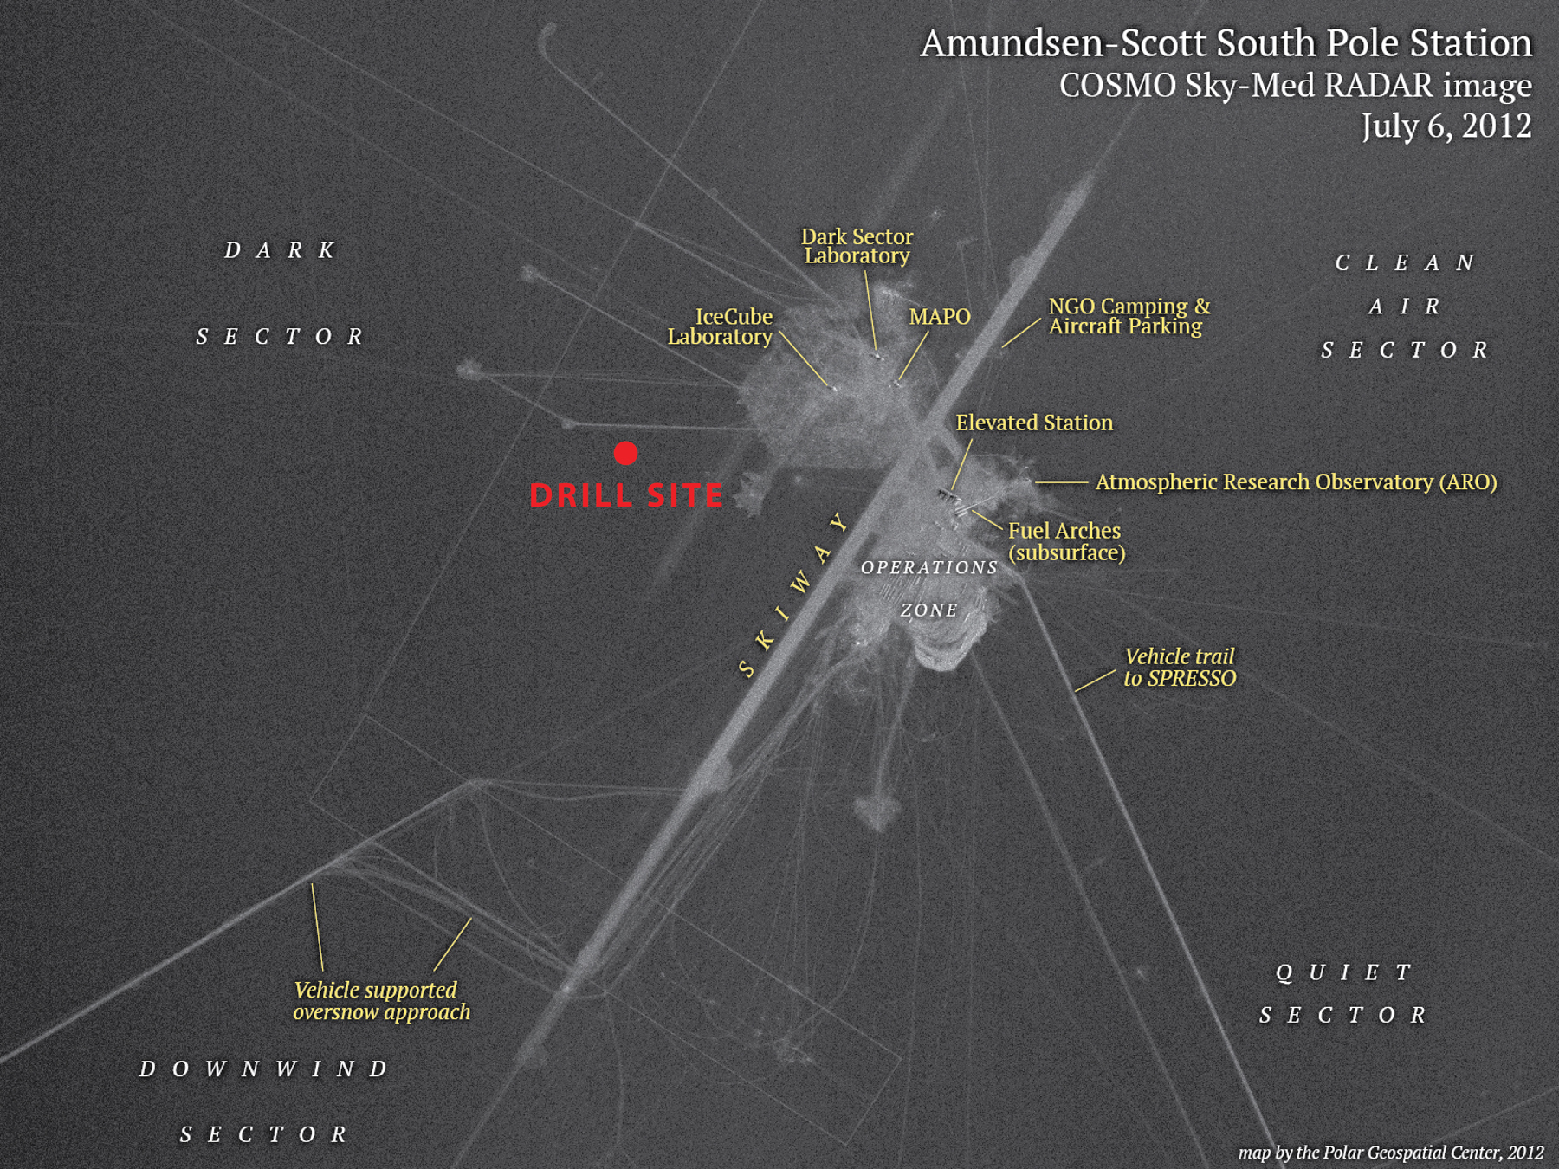

Slide 4
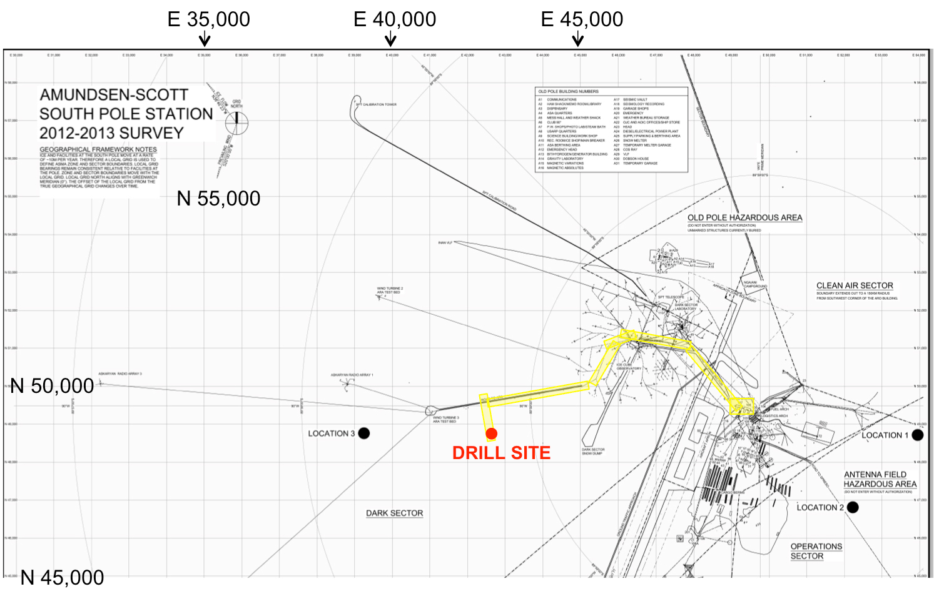

Slide 5
Resources committed
Last year the hole was logged with Ryan Bay’s dust logger
This season the IDDO intermediate depth winch returns to Pole, with an IceCube-purchased longer cable, and with multiple people (3 ARA drillers/scientists & 1 IceCube scientist/engineer) trained by IDDO in the use of the logger
Plan to have the winch back at Pole next season for additional measurements (see later slides) and possible reuses of the current downhole packages
The downhole packages (described next slide) are mostly still in development, so this season should probably be treated as a trial run in most cases

Slide 6
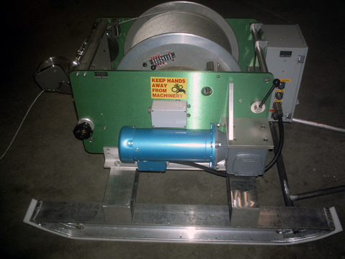

Slide 7
2017 season downhole packages
DESY-built UV absorption and scattering LIDAR
Kansas University-built piezoelectric radio frequency pulser
Sungkyunkwan University-built camera system
University of Wisconsin RF signal generator
UW/KU solid state pulser with selectable antennas
UCSD commercial pressure-depth logger
(Dust logger to below 1500m if timing works out)
(Passive radar retro-reflector for surface back to surface reflection study)

Slide 8
2017 season downhole packages
DESY-built UV absorption and scattering LIDAR Under construction, parts here
Kansas University-built piezoelectric radio frequency pulser Ditto. Oct. test
Sungkyunkwan University-built camera system Under construction.
University of Wisconsin RF signal generator Housings shipped. Final assembly.
UW/KU solid state pulser with selectable antennas Shipped to Pole
UCSD commercial pressure-depth logger To be delivered to UW in few weeks
(Dust logger to below 1500m if timing works out) Equipment at McMurdo
(Passive radar retro-reflector for surface back to surface reflection study) Simple hardware (shipped), but only draft of a plan for making measurements

Slide 9
Super-quick version of the plan
Early RF pulser run in support of ARIANNA (1 day)
Late season deployments of the RF pulser (1 day), RF signal generator (1 day), and secondary pulser (1 day) to overlap with new ARA stations
After data evaluation, option to run any (1-2) of the packages an additional time with config changes
Final effort with passive retro-reflector as time allows
Plan two deployments of each of the optical packages with data evaluation between runs (2 days + 2 days)
Density package will be deployed early in the season for practice (lightweight, easy handling) with on-the-spot data evaluation (1 day)
Hold open option of the dust logger if time is available
Looking to be able to do all of the initial data quality locally

Slide 10
Optical measurements science (1/2)

Slide 11
Optical measurements science (2/2)
Depth-independent anisotropy in light propagation

Slide 12
DESY UV logger system
Nautilus housing w/Ti caps

Slide 13
SKKU camera system

Slide 14
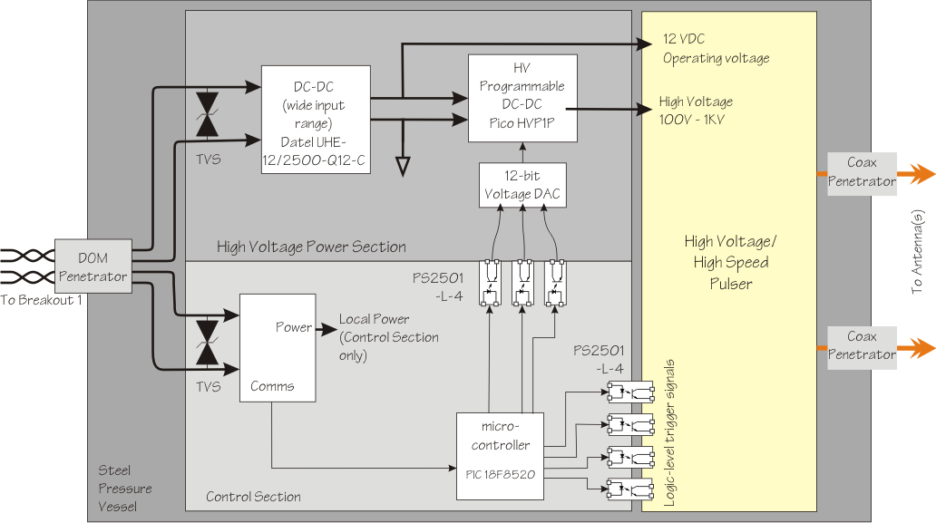
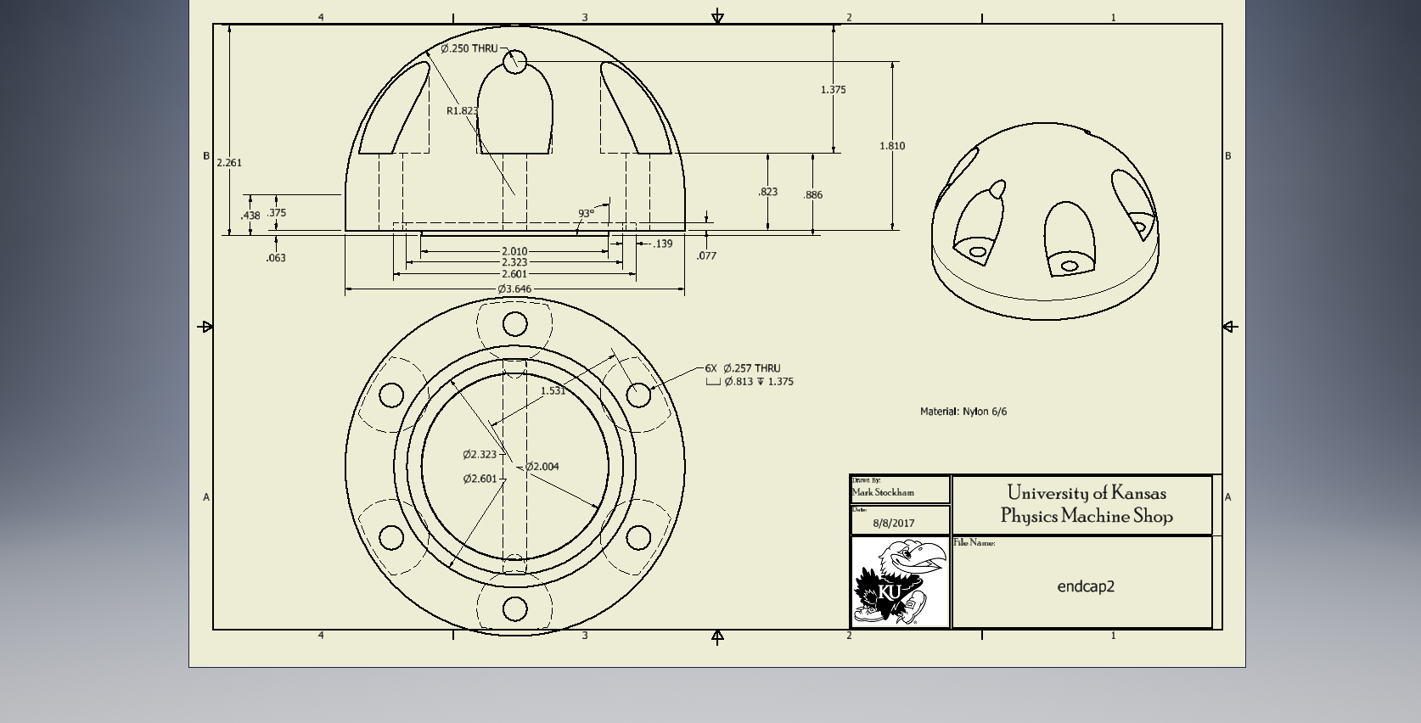
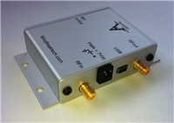
Radio transmitters/pulsers
KU pulser: custom houseing with
piezoelectric pulser launching mixed
polarization directly from the unit
Signal generator: COTS SynthNV unit +
Beagle Bone Black SBC + MiniCircuits amp
+ existing pressure housing + software
Connected to external antenna

Slide 15
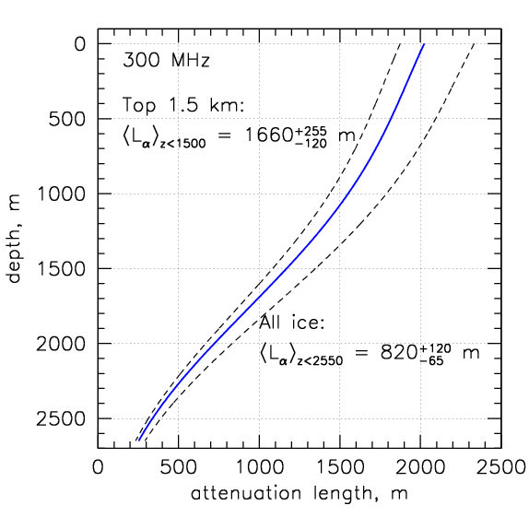
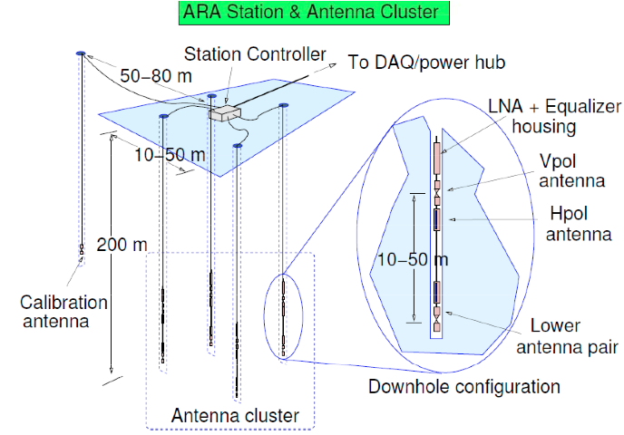
RF science (see Dave Seckel’s talk…)

Slide 16
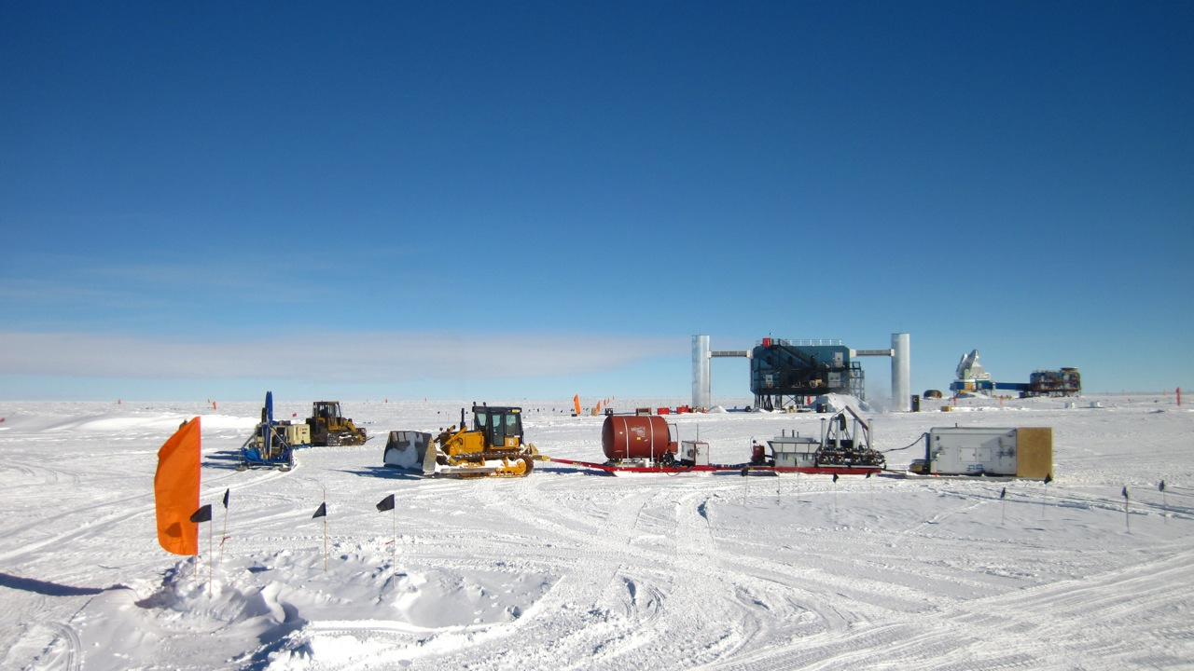
2017-18 season on the ice
ARA drilling: late November+
ARIANNA station: late November
ARA in-ice deployments: mid-December+
ARA stations full operation: early January
SPIceCore people at Pole:
Myself
IceCube student, Yee “Elim” Cheung
IDDO (ARA) driller, Chris Gibson
Winch trained ARA drillers, Thomas Meures & Uzair Latif

Slide 17
Conclusions
Good opportunities here, potentially a lot of work to do on the ice this season if all of the payloads come together
Two additional payload ideas for next year:
Luminescence logger: radioactive source, look at light output
Neutron tagger: measure in situ neutron capture lifetime
With this two year program, we’ll understand the physics detector properties of the South Pole ice better
Need to work with the glaciology folks more towards this end

Slide 18
Backup slides

Slide 24
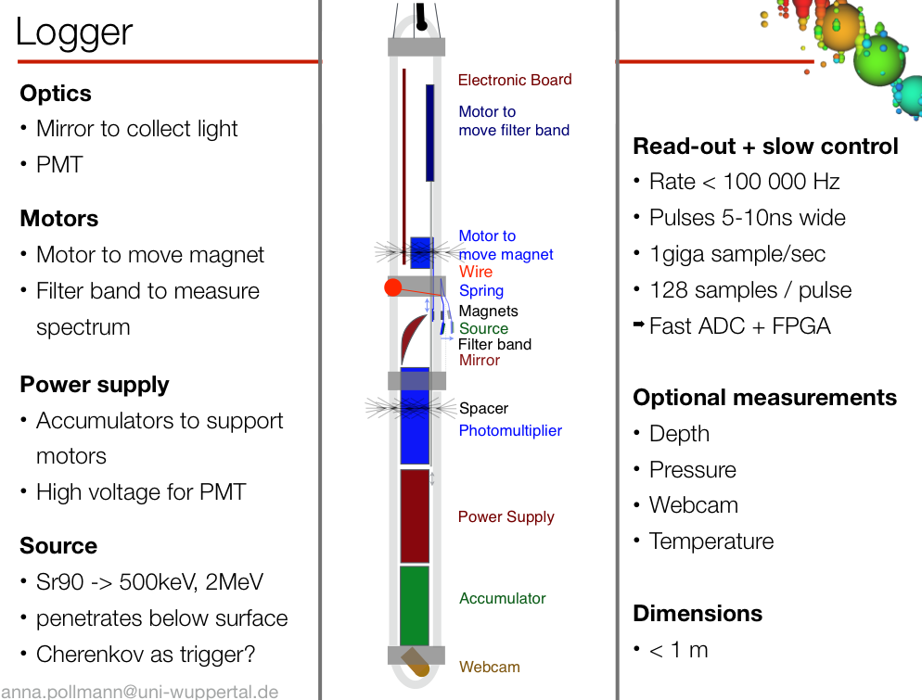

Slide 25
