Slide 1
Tank Design
Lessons Learned from HAWC
Brenda Dingus, Michael Schneider
and the rest of the HAWC collaboration
12 December 2017

Slide 2
Design Drivers
NO commercial product is light tight.
Shipping is expensive and limits the size of preconstructed tanks to ~ < 3.5 m largest dimension.
Different sites will require different designs.
Local scientists are essential – especially with logistics, site work, and infrastructure.

Slide 3
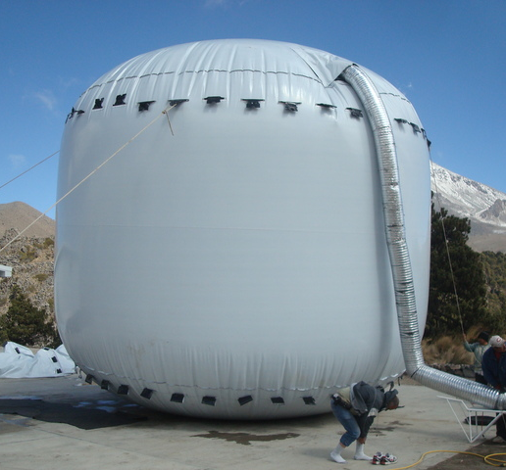
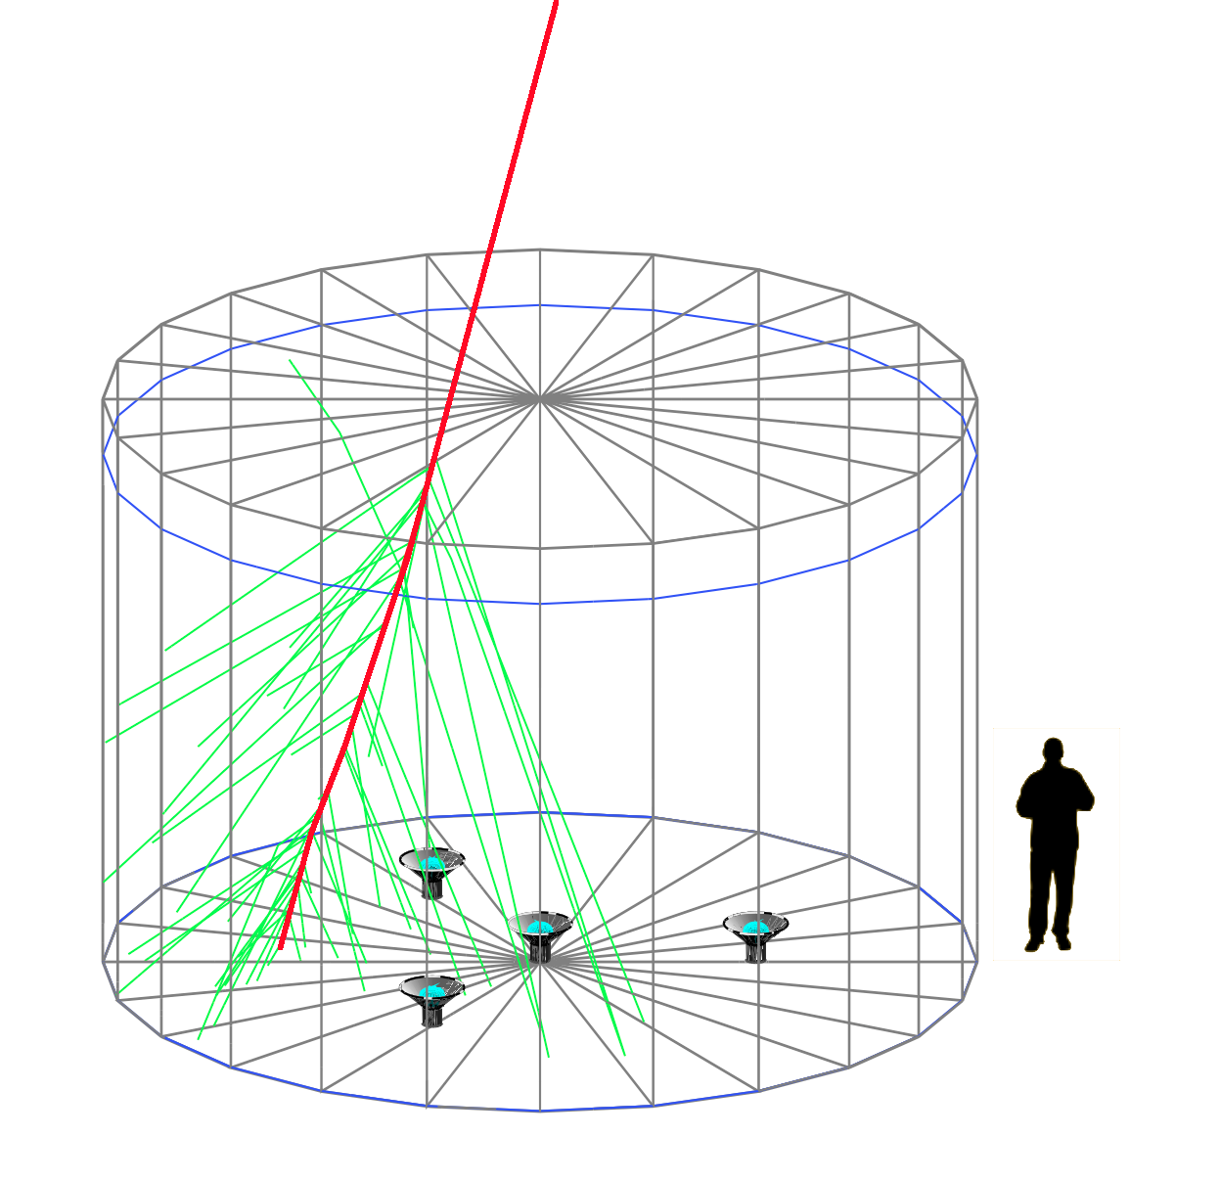
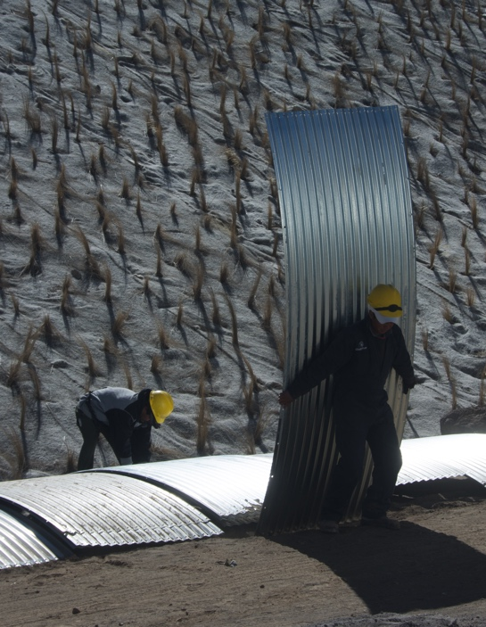
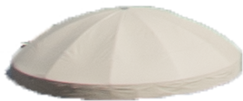
Water Cherenkov Detector (WCD) Design
3 8-inch PMTs
(reused from Milagro)
10-inch
high QE
PMT

Slide 4
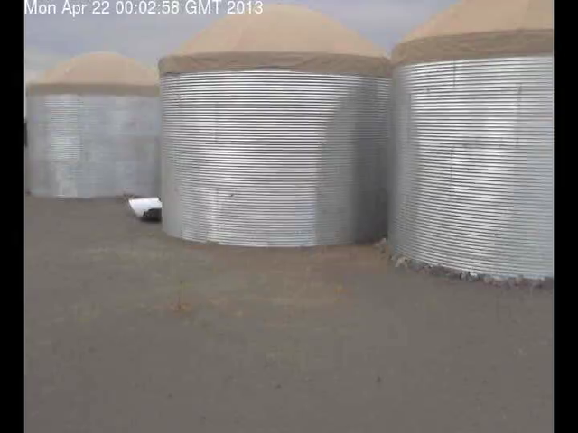
Tank Construction

Slide 5
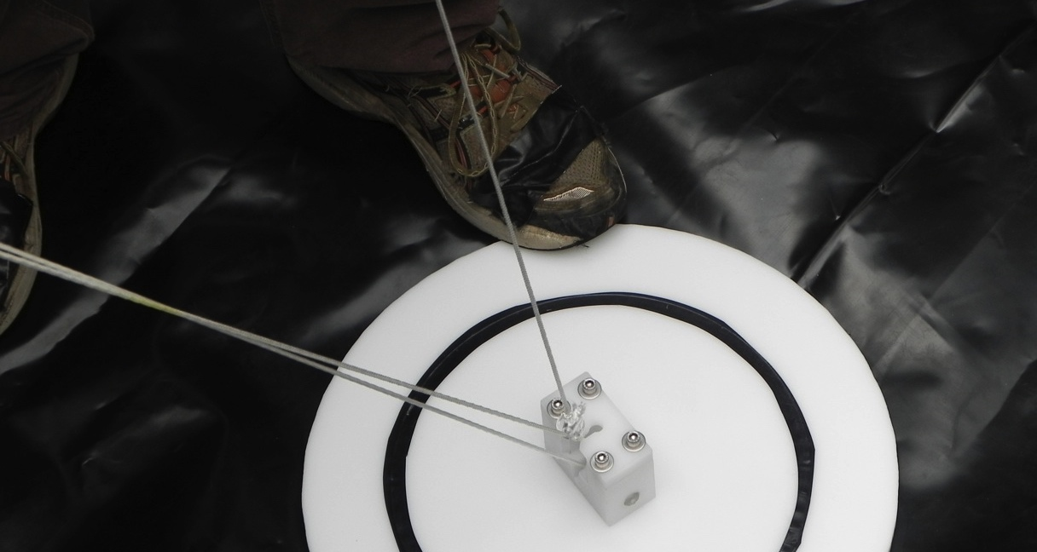
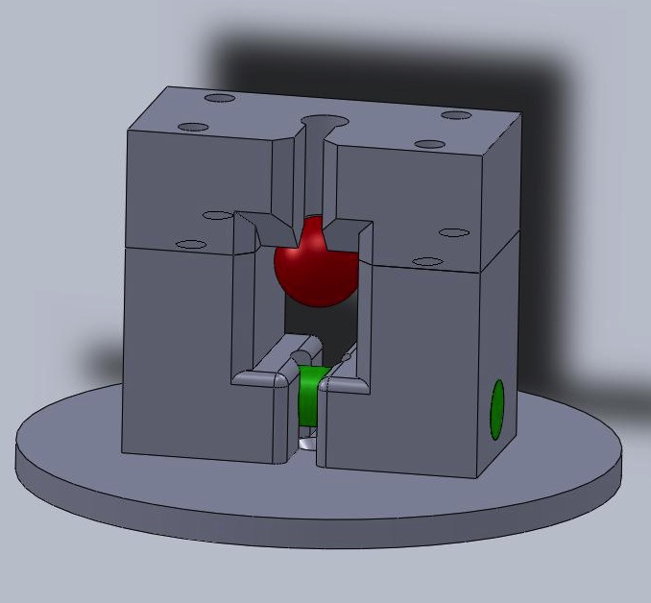
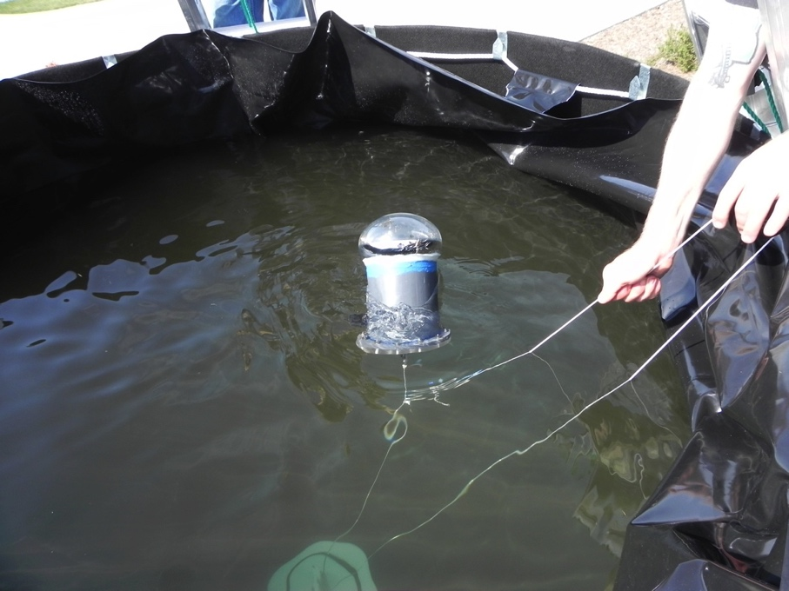
Safe PMT Deployment and Recovery

Slide 6
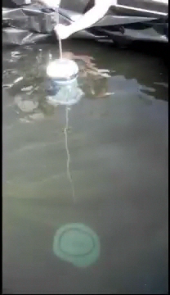
Safe PMT Deployment and Recovery

Slide 7
HAWC Tanks
4.5 m high x 7.3 m diameter containing 188,000 liters of water.
Bolted together corrugated steel consisting of 40 panels with thicker guage at the bottom.
  Considered spiral rolled steel construction but cost was nearly double mostly due to same thickness of steel throughout. Would have required different construction schedule with tanks produced at site in two batches of ~ one month each.
  Considered Mexican manufacturer. No cost savings. Quality sufficiently worse (anodized bolts and misaligned holes).
Installed on dirt (i.e. no concrete) with the bottom panel buried 0.6m in order to provide stability to earthquakes.
Special installation procedures and equipment were designed by HAWC scientists, but manual labor was done by hired crew. Required crew of 8-10 for 1.5-2 days.

Slide 8
HAWC Bladders
Custom light tight bladder of special film made for HAWC.
Considered several other types of material and visited several manufacturers, but light tightness and outgassing were issues. Required long term testing with UV laser.
HAWC designed attachment points for the 4 PMTs which insert into custom stakes that were surveyed prior to tank installation.
Geotextile between bladder and steel protects bladder from punctures.

Slide 9
HAWC Roofs
Initially thought might not be needed, but rain water pooling on top of the bladder caused steel tank to bend. Also pooling was influenced by wind and not uniform.
Roof design was customized with interaction between manufacturer and HAWC.
First roof manufacturer was bought out by another company and then the price more than doubled.
Another supplier was eventually found (separate for roof material and roof structure) but multiple companies were asked and two provided prototypes of which only one was successful.

Slide 10
First Considered Pond like Milagro
Larger area is difficult (can’t support fabric cover, like Milagro)
Repairing single PMT strategy with cover is difficult.
Can’t start operating with small fraction of the array.
LANL engineering study of a pond covered by a building showed this option is expensive and would probably not be light tight. Also humidity and temperature swings were concerns.
Mexican construction company estimated high cost of a pond with cover or building. They required considerable concrete which was not allowed by the Mexican National Park in which HAWC is located.

Slide 11
Also considered rotomolded tanks
Shipping from US prohibitively expensive because only 1-2 per truck load.
Brazilian and Mexican company asked to install rotomolding machine near HAWC (i.e. Serdan). Cost more than twice HAWC tanks per PMT.
Light tight possible with special
construction techniques (i.e.
thick walls and extra carbon
black); however, sealing
around hatch is difficult.
Smaller size (diameter and
height) required by shipping
constraints implies only one
PMT per tank.
Larger number of tanks plus
shipping made this more
expensive than selected
option. (Note cost of assembly
of HAWC tanks was low due to
labor costs in Mexico).
Milagro outrigger

Slide 12
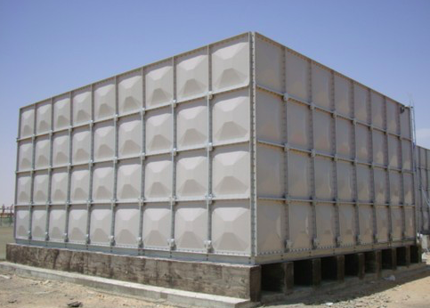
Other types of tanks considered
Fiberglass: light leaks follow fibers, expensive to make, outgassing concerns, expensive to ship => no advantage over roto-molded
Square steel or fiberglass that bolts together: light leaks at seams, required internal support beams for 4 m depth, very expensive at >20 x the cost of HAWC tanks. Also shipping was costly due to weight and size. One one HAWC size tank per shipping container compared to 10 HAWC tanks per flat-bed semi truck.

Slide 13
HAWC budget & Optimistic SGSO budget (USD)
Item | HAWC cost per PMT | SGSO cost per PMT | SGSO cost for 5000 PMTs
Light Tight Tank with water (WCD) | 4,500 | 2,000 | 10,000,000
Electronics, Cables, Cal.,Comp. | 4,000 | 1,000 | 5,000,000
Site Buildings, Infrastructure, Leveling | 2,000 | 1,000 | 5,000,000
8" R5912 Hamamatsu PMTs | 0 | 1,000 | 5,000,000
contingency |  | 1,000 | 5,000,000
TOTAL |  |  | 30,000,000
Need to reduce price of WCD and electronics

Slide 14
Reducing HAWC WCD cost
Steel enclosure 6K/WCD (including shipping and labor to construct in MX)
Bladder 4K/WCD (including engineering and labor to construct in US)
Roof 2K/WCD
Water 1.5K/ WCD (13 trucks ~20 km per WCD)
Reduce cost by eliminating steel enclosure and roof
Place bags with attached PMT in pond and fill with clean water. Inflate tubing along edges to hold shape. Anchor to bottom and cabling to hold in position. Keep submerged by ~10 cm to reduce effects of ice, weather, and sun degradation.
Large volume of water reduces freezing effects.
Need to construct a pond or find a natural one. Don’t need a building.
Service PMTs with rafts or floating docks. Nearly 100% fill factor if we want.

Slide 15
Reducing HAWC electronics cost to 1K/PMT
HAWC HV & signal cable and optical fiber for laser calibration were nearly 2K/PMT which was half the budget for electronics, because they are 500’ long.
Calibrate with air showers?
Put electronics and HV on base?
Get Chinese from LHASSO to provide White Rabbit like timing solution for each PMT?

Slide 16
30 M USD for 5000 PMT SGSO
300m x 300m gives 4.2 m separation between PMTs.
Tank depth of 4m (like HAWC) matches Cherenkov angle nicely with this separation.
~ 4 x HAWC area (but >7 x area of HAWC tanks) plus if 1000 m higher then sensitivity will be ~10x HAWC
All we need is 5-6 countries providing 6M each!
  Note takes more money with more funding sources. Each funding source likely comes with its own constraints. Need creative management to make it all balance.

