Slide 1


Cosmic Ray Anisotropy from Local Turbulence and Heliospheric Effects
Vanessa López Barquero
University of Wisconsin-Madison
P. Desiati, A. Lazarian, S. Xu. (UW Madison) N. Pogorelov (Univ. of Alabama in Huntsville)
CRA2017

Slide 2
Outline
Cosmic Ray Anisotropy from Local Turbulence and Heliospheric Effects‏
Observational Motivation.
Theoretical Framework.
Local Turbulent Magnetic Fields.
Heliospheric Effects.
Cosmic Ray Trajectories.
Forward Propagation
Conclusions.
Vanessa López-Barquero CRA2017

Slide 3
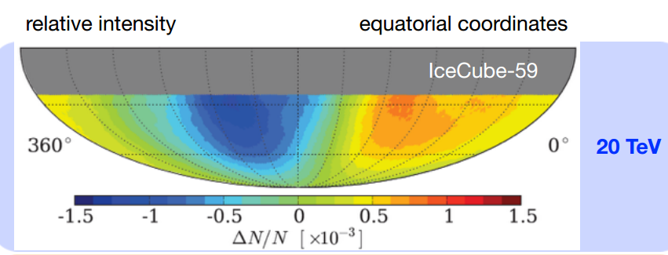
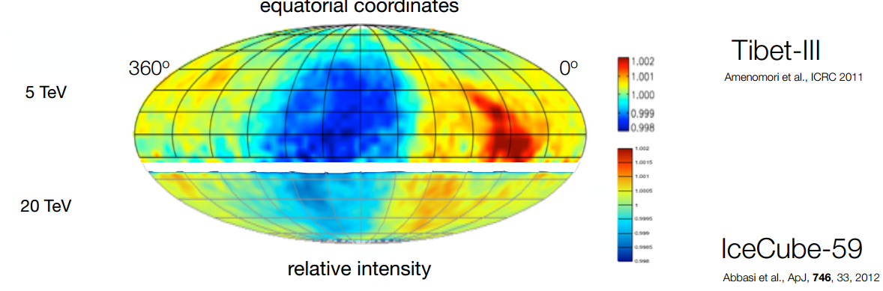
Observational Motivation
Cosmic Ray Anisotropy from Local Turbulence and Heliospheric Effects‏
Cosmic Ray Anisotropy at ~10 TeV
Possible Causes:
Distribution of Sources.
LISM
Heliosphere
Giacinti & Sigl (2012)
López-Barquero et al. ApJ (2016)
P. Desiati & A. Lazarian, ApJ (2013)
López-Barquero et al. ApJ (2017)
Vanessa López-Barquero CRA2017
Notes:
from TeV to 100s of TeV
The arrival distribution of cosmic rays at Earth is the convolution of the distribution of their sources and of the effects of geometry and properties of the magnetic field through which particles propagate.

Slide 4
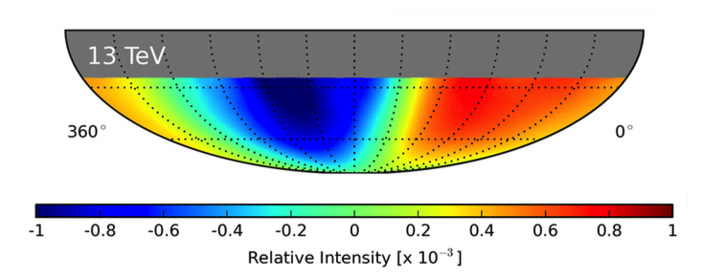
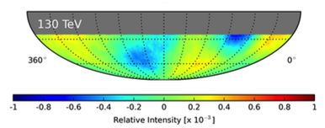
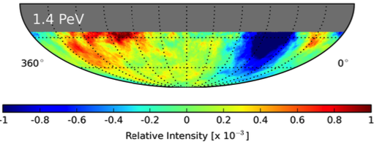
Observational Motivation
Cosmic Ray Anisotropy from Local Turbulence and Heliospheric Effects‏
IceCube Data. Aartsen et al. 2015
Vanessa López-Barquero CRA2017
Notes:
Change from TeV to 100s of TeV

Slide 5
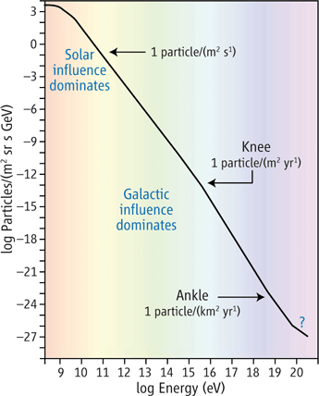
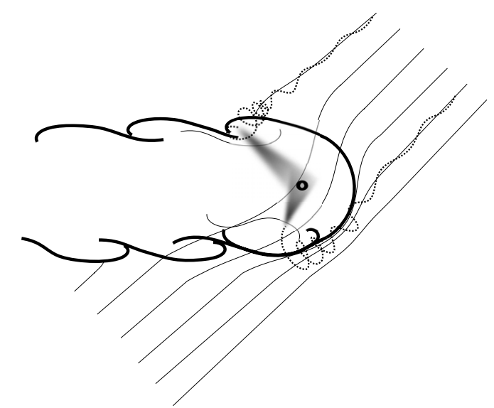
Theoretical Framework
Cosmic Ray Anisotropy from Local Turbulence and Heliospheric Effects‏
Desiati & Lazarian (2013)
Heliospheric Effects:
Schwadron et al., Science (2014)
Zhang, Zuo, Pogorelov, ApJ (2014)
Interstellar Turbulence propagation:
Yan & Lazarian, ApJ (2008)
Duldig (2006)
P. Desiati and A. Lazarian, Astrophys. J. 762, 44 (2013)
Vanessa López-Barquero CRA2017
Notes:
Mean free paths in two different phases of ISM: halo (solid line) and WIM (dashed line).
http://iopscience.iop.org/article/10.1086/524771/pdf
Figure 9
Particle propagation within the mean free path in the local interstellar medium might
have a major role in determining the properties of galactic cosmic rays, such as their arrival distribution. In particular,
scattering on perturbations induced in the local interstellar magnetic ﬁeld by the heliosphere wake may cause a
re-distribution of anisotropic cosmic rays below about 100 TeV toward the direction of the elongated heliotail and
of the local interstellar magnetic ﬁeld in the outer heliosphere. Such scattering processes are considered responsible
for the observed TeV cosmic-ray global anisotropy and its ﬁne angular structure.

Slide 6
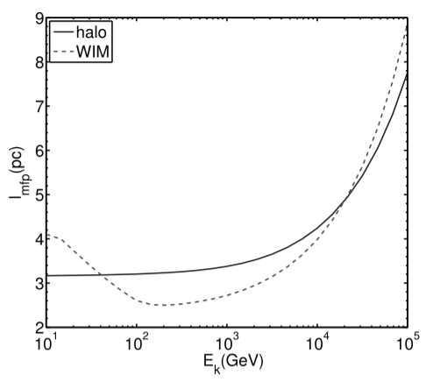
Theoretical Framework
Cosmic Ray Anisotropy from Local Turbulence and Heliospheric Effects‏
Mean Free Path
H. Yan, A. Lazarian (2008)
Duldig (2006)
Vanessa López-Barquero CRA2017
Notes:
###
Mean free paths in two different phases of ISM: halo (solid line) and WIM (dashed line).
http://iopscience.iop.org/article/10.1086/524771/pdf
Figure 9
At lower energies (P100 GeV), the different dependence in WIM is owing to the viscous damping (see Fig. 5 and text).
Galactic influence on knee region
Turbulence in astrophysical plasmas has significant effects on particle propagation, in that the stochastic nature of magnetic field lines is transmitted to the particles’ trajectories.
On scales smaller than the injection scale, particles are characterized by super-diffusion in the perpendicular direction of the mean magnetic field. This behavior is described by the so-called Richardson diffusion, where particle separation grows as (time)3 2 (Lazarian & Yan 2014).

Slide 7
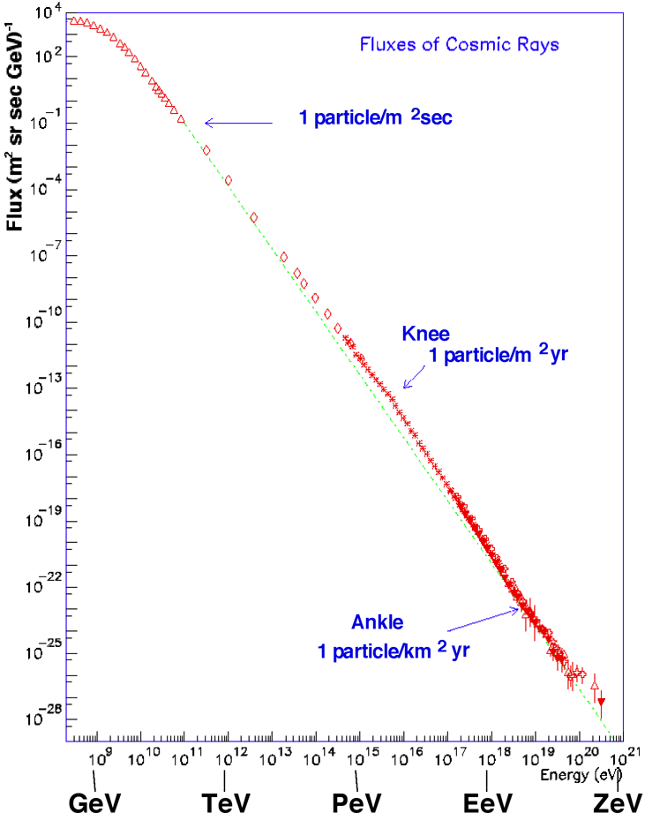

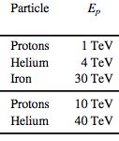
Cosmic Ray Anisotropy from Local Turbulence and Heliospheric Effects‏
Energy of Particles Studied
Local Turbulence Studies:
Heliosphere Studies:
Vanessa López-Barquero CRA2017
Notes:
ADD the range of energies that we are working
And parameters used.
Add the areas where we expect for the helio to influence, or the IS
Fixed “Shape”
---last slide of intro----

Slide 8
Cosmic Ray Anisotropy from Local Turbulent Magnetic Fields
Part I:
Local Turbulent Magnetic Field Effects
Vanessa López-Barquero CRA2017
Notes:
ADD the range of energies that we are working
And parameters used.
Add the areas where we expect for the helio to influence, or the IS
Fixed “Shape”
---last slide of intro----

Slide 9

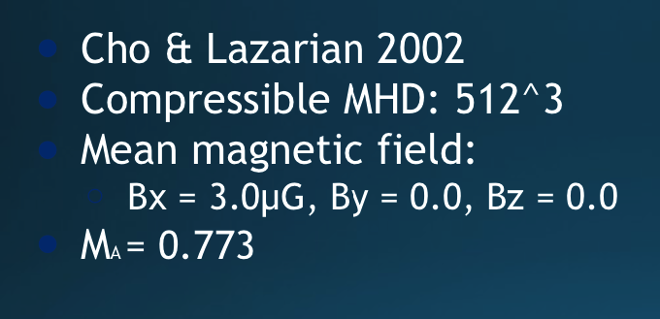
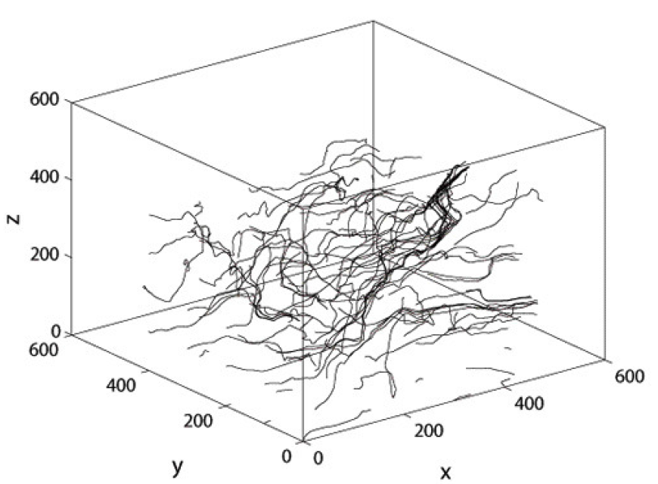
Cosmic Ray Anisotropy from Local Turbulent Magnetic Fields
Vanessa López-Barquero CRA2017

Slide 10
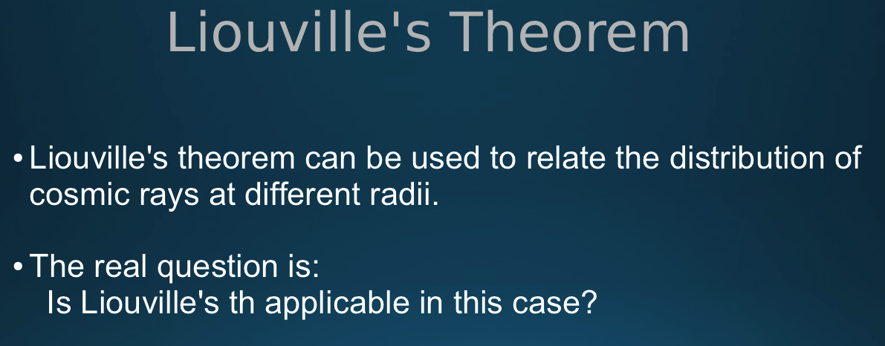

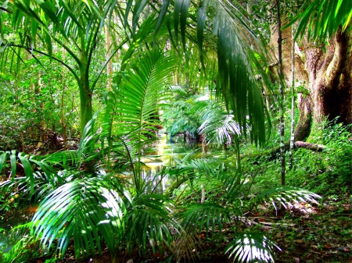
Cosmic Ray Anisotropy from Local Turbulent Magnetic Fields
Vanessa López-Barquero CRA2017

Slide 11

Cosmic Ray Anisotropy from Local Turbulent Magnetic Fields
Vanessa López-Barquero CRA2017

Slide 12

Cosmic Ray Anisotropy from Local Turbulent Magnetic Fields
Conservation of particles.
Conservative and differentiable forces
No collisions
Region where the magnetic field varies abruptly.
Adiabatic change?
Vanessa López-Barquero CRA2017

Slide 13
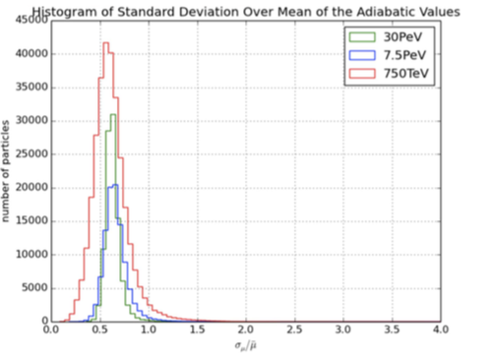
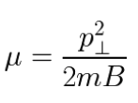
Cosmic Ray Anisotropy from Local Turbulent Magnetic Fields
Conservation of the 1st Adiabatic Invariant → application of Liouville's th.
Vanessa López-Barquero CRA2017
Notes:
Its conservation -> the application of
Liouville’s Theorem
Backtrack particles
to make sky maps
Here, mention Helio– not always the case that it will fulfill this requirement

Slide 14

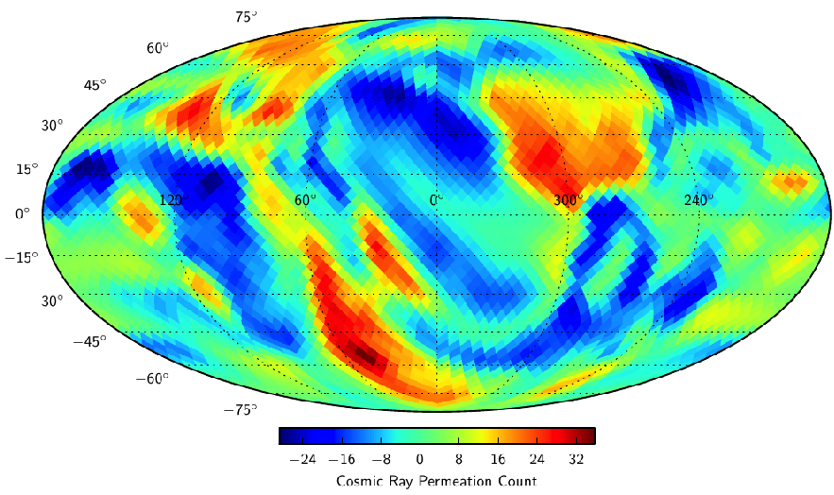
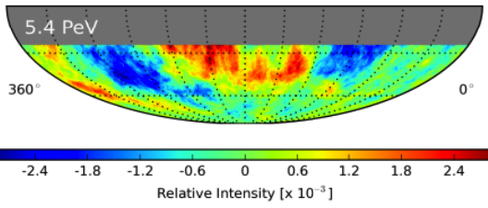
Cosmic Ray Anisotropy from Local Turbulent Magnetic Fields
Simulations
López-Barquero et al. 2016
IceCube Data. Aartsen et al. 2015
Vanessa López-Barquero CRA2017
MMFW 2016 Vanessa Lopez-Barquero

Slide 15
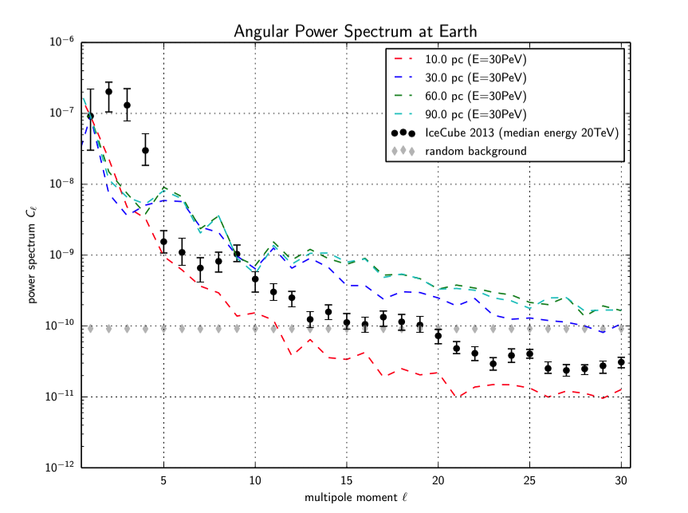
Cosmic Ray Anisotropy from Local Turbulent Magnetic Fields
Angular Power Spectrum & MFP
Mean Free Path Calculation
30 PeV Protons:
60 pc
0.6 Linj
Vanessa López-Barquero CRA2017

Slide 16
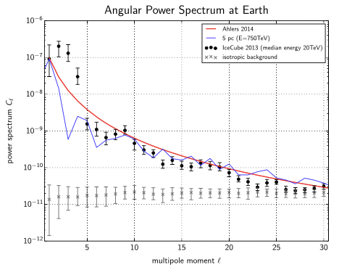
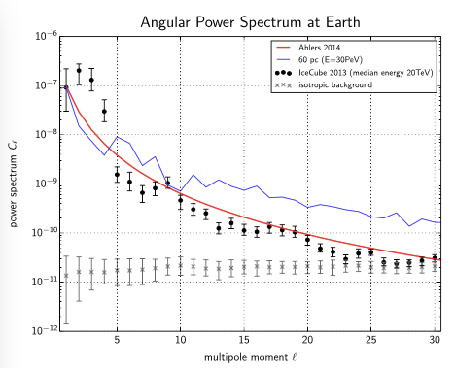
Cosmic Ray Anisotropy from Local Turbulent Magnetic Fields
Angular Power Spectrum
Vanessa López-Barquero CRA2017

Slide 17
Cosmic Ray Anisotropy from Local Turbulent Magnetic Fields
Conclusions: Part 1
Local turbulent effects are crucial for the arrival of CR to the Earth.
Conservation of the 1st adiabatic invariant points that Liouville’s Th is applicable in this specific case.
Our results show anisotropy that arises from the interaction of CRs with the local turbulent magnetic field.
Future:
Higher energy observations.
Longer inertial range.
Vanessa López-Barquero CRA2017

Slide 18
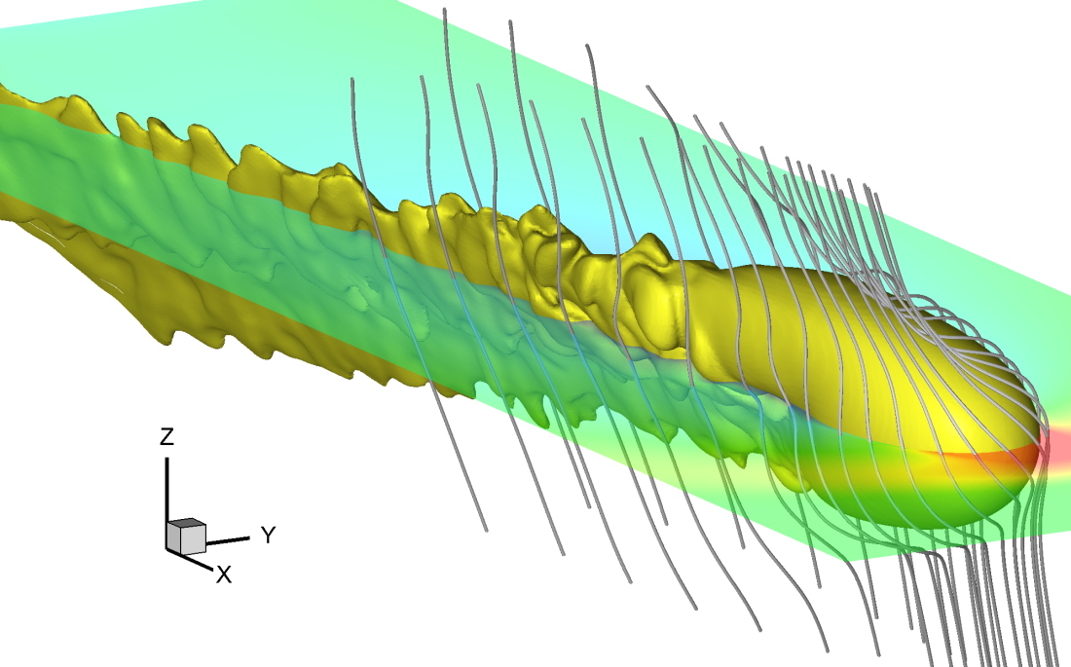
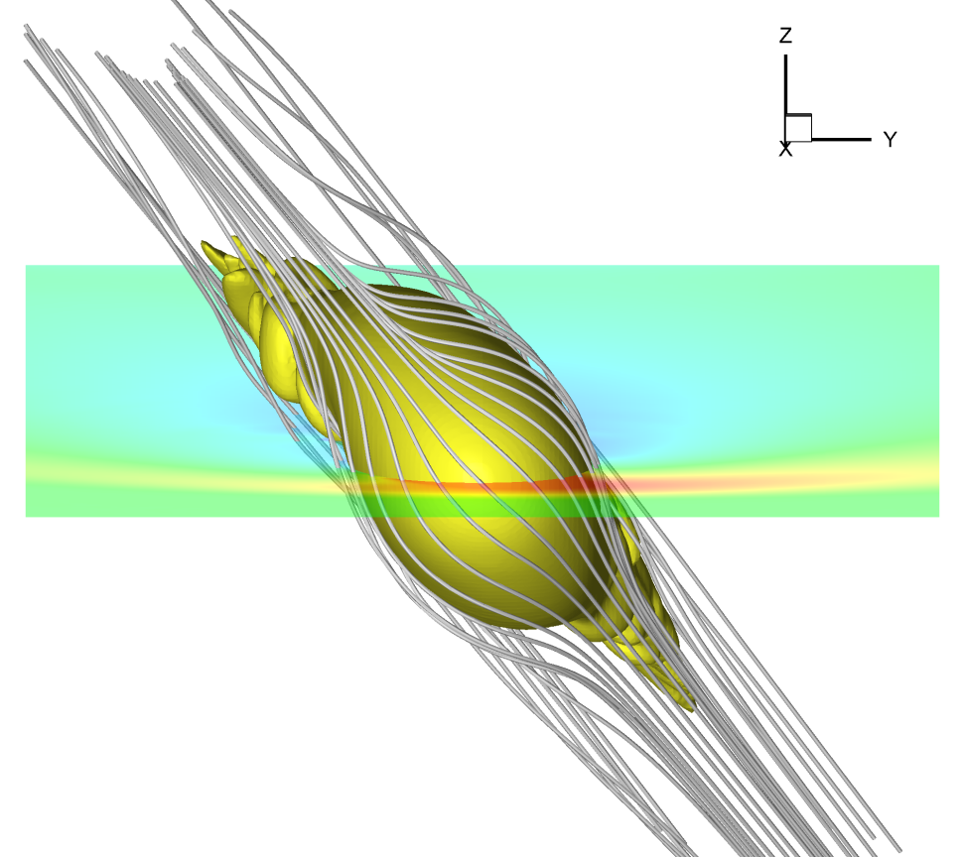
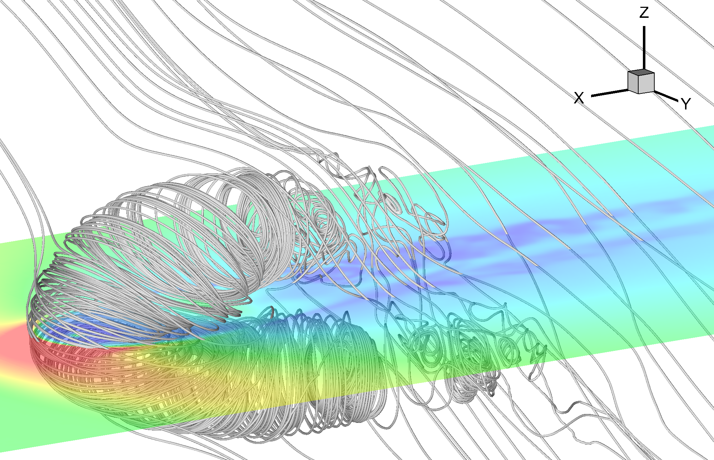
Part II:
Heliospheric Magnetic Field Effects
Borovikov, Pogorelov, Heerikhuisen 2013
Vanessa López-Barquero CRA2017
Notes:
ADD the range of energies that we are working
And parameters used.
Add the areas where we expect for the helio to influence, or the IS
Fixed “Shape”
---last slide of intro----

Slide 19
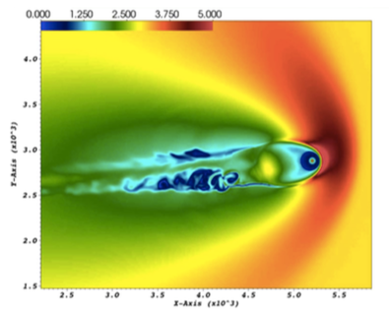

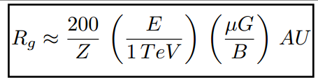
Heliospheric Effects
TeV Cosmic Ray Anisotropy from Heliospheric Magnetic Field‏
Scale (Energy) Dependent problem
P. Desiati and A. Lazarian, Astrophys. J. 762, 44 (2013)
Computational region is 6000³ AU
Tail size is 5000 AU
Vanessa López-Barquero CRA2017
Notes:
Size of the Heliotail very important!
Problem setup:
Computational region is 6000³ AU
(3000 AU in east, west, south and north directions)
Tail size is 5000 AU
Numerical resolution is 5 AU everywhere in the heliosheath.
Number of particles for kinetic modeling is 15 billions.
It gets turbulent after 1000AU -- BACKSC

Slide 20
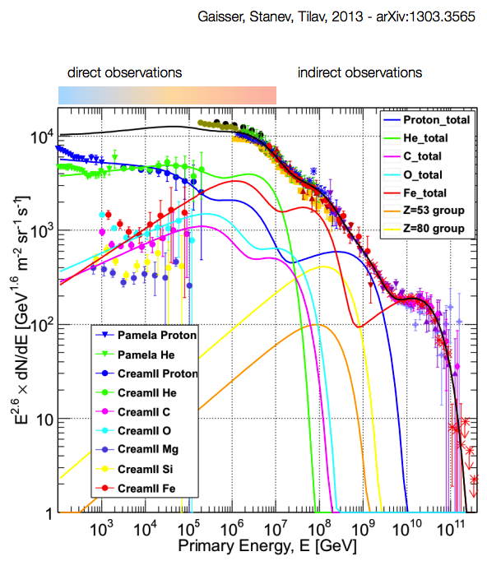
CR Spectrum
TeV Cosmic Ray Anisotropy from Heliospheric Magnetic Field‏
Vanessa López-Barquero CRA2017

Slide 21
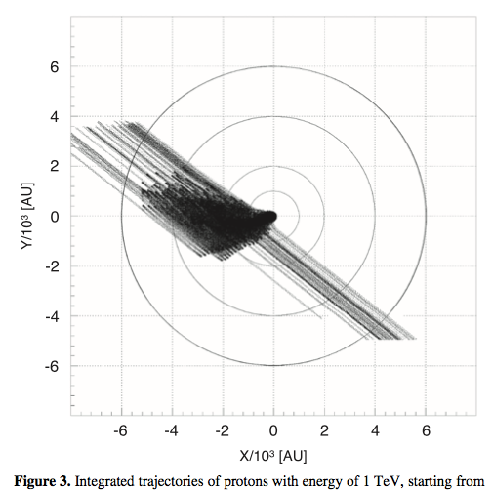
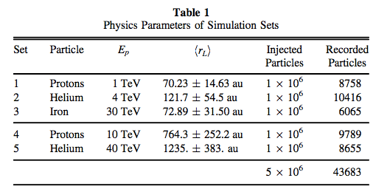
Trajectories – Scattering
TeV Cosmic Ray Anisotropy from Heliospheric Magnetic Field‏
Vanessa López-Barquero CRA2017

Slide 22
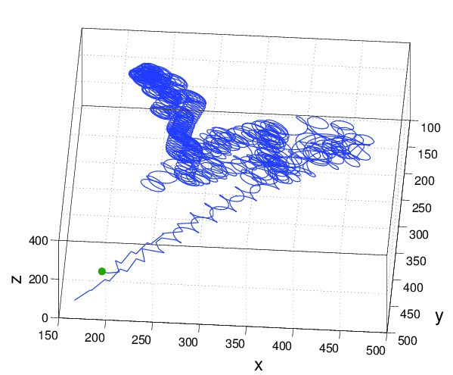
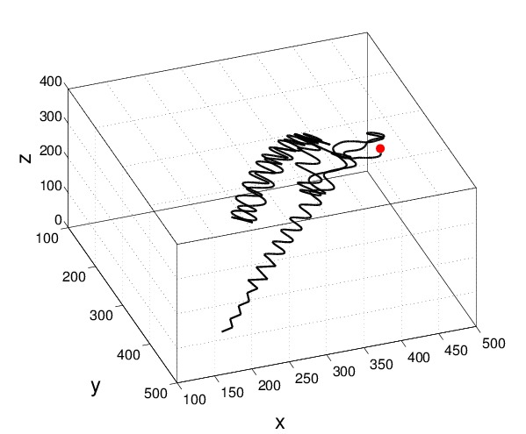
Trajectories – Scattering
TeV Cosmic Ray Anisotropy from Heliospheric Magnetic Field‏
Vanessa López-Barquero CRA2017

Slide 23
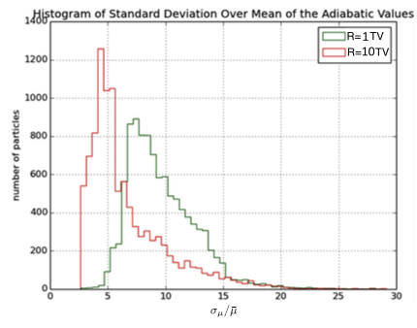
First Adiabatic Invariant
TeV Cosmic Ray Anisotropy from Heliospheric Magnetic Field‏
Heliospheric case:
For comparison, propagation in Turbulent Magnetic Field case:
López-Barquero et al. ApJ (2017)
Vanessa López-Barquero CRA2017

Slide 24
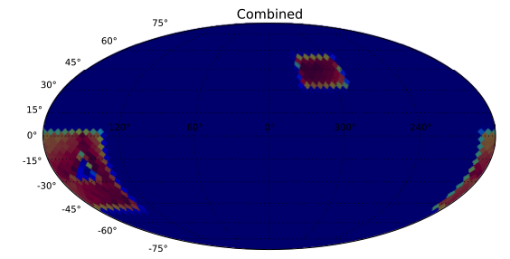
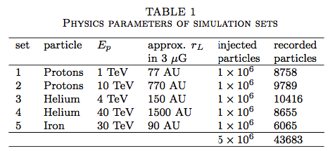
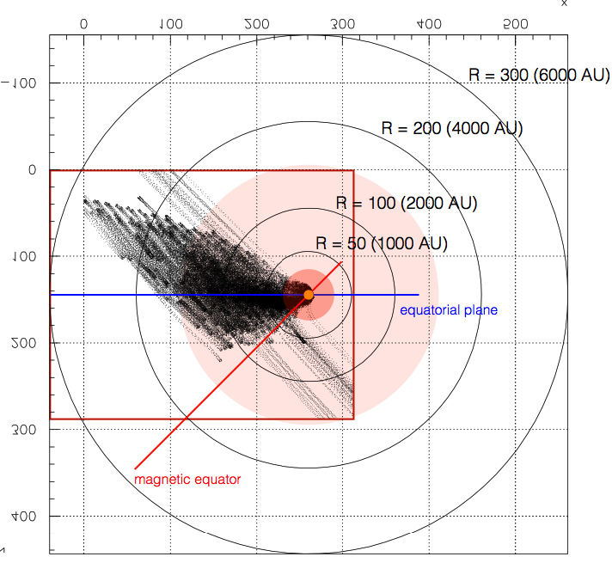
Forward Propagation
TeV Cosmic Ray Anisotropy from Heliospheric Magnetic Field‏
Vanessa López-Barquero CRA2017
Notes:
Backtracking to trace Angular distribution
Insert a better bloody map
We can’t do backtracking, so we need to do fwd tracking, but since it is a quite inefficient way, we proceed to do this.
We inject particles at the center, “Earth”

Slide 25
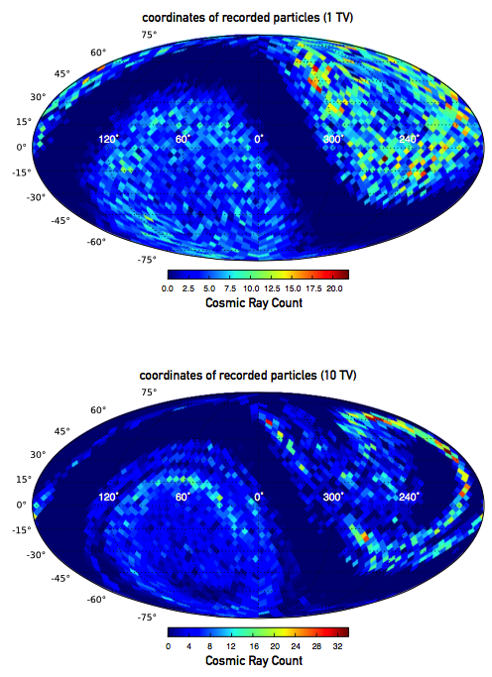
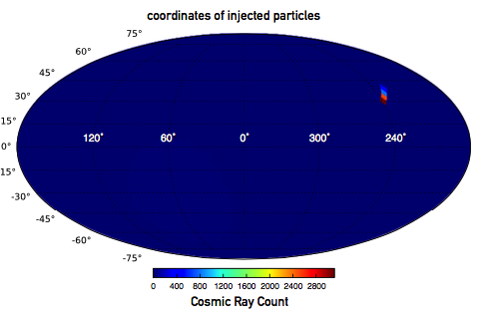
Anisotropy at Earth
TeV Cosmic Ray Anisotropy from Heliospheric Magnetic Field‏
Interaction with heliosphere
Strong Redistribution
López-Barquero et al. ApJ (2017)
Vanessa López-Barquero MMFW2017
Vanessa López-Barquero CRA2017
Notes:
Assuming a preexisting dipole, along the B field.
Schwadron et al Science (2014)

Slide 26
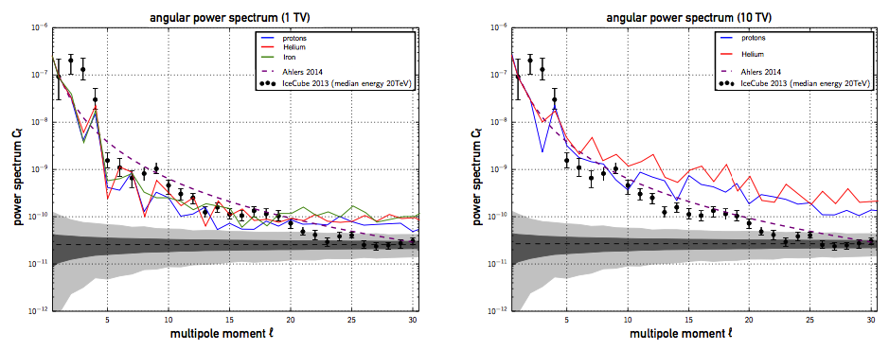
Angular Power Spectrum
TeV Cosmic Ray Anisotropy from Heliospheric Magnetic Field‏
López-Barquero et al. ApJ (2017)
Vanessa López-Barquero MMFW2017
Vanessa López-Barquero CRA2017

Slide 27
Conclusions Part II
TeV Cosmic Ray Anisotropy from Heliospheric Magnetic Field‏
Heliospheric effects are crucial for the arrival distribution of 1-10TV CR at the Earth.
Our results show anisotropy that arises from the interaction of TV CRs with the heliospheric magnetic field.
Future work:
Heliospheric model: Longer tail, solar cycles.
Exact impact of instabilities present at the heliosphere.
Thanks
Vanessa López-Barquero CRA2017
Notes:
Heliospheric model
1ST Adiabatic invariant
Simulate a lot, prelim results

Slide 29
end

Slide 30
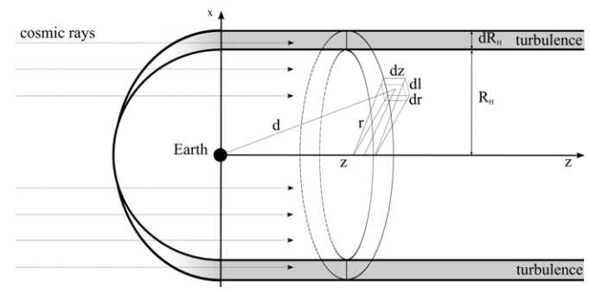
Theoretical Framework
TeV Cosmic Ray Anisotropy from Heliospheric Magnetic Field‏
Desiati & Lazarian (2013)
P. Desiati and A. Lazarian, Astrophys. J. 762, 44 (2013)
Vanessa López Barquero MMFW2017
Notes:
Particle propagation within the mean free path in the local interstellar medium might
have a major role in determining the properties of galactic cosmic rays, such as their arrival distribution. In particular,
scattering on perturbations induced in the local interstellar magnetic ﬁeld by the heliosphere wake may cause a
re-distribution of anisotropic cosmic rays below about 100 TeV toward the direction of the elongated heliotail and
of the local interstellar magnetic ﬁeld in the outer heliosphere. Such scattering processes are considered responsible
for the observed TeV cosmic-ray global anisotropy and its ﬁne angular structure.

Slide 31
Heliosphere
TeV Cosmic Ray Anisotropy from Heliospheric Magnetic Field‏
Borovikov, Pogorelov, Heerikhuisen 2013
State-of-the-art heliosphere simulations
Computational region is 6000³ AU
Tail size is 5000 AU
Vanessa López Barquero MMFW2017
Notes:
Size of the Heliotail very important!
Problem setup:
Computational region is 6000³ AU
(3000 AU in east, west, south and north directions)
Tail size is 5000 AU
Numerical resolution is 5 AU everywhere in the heliosheath.
Number of particles for kinetic modeling is 15 billions.
It gets turbulent after 1000AU -- BACKSC

Slide 32
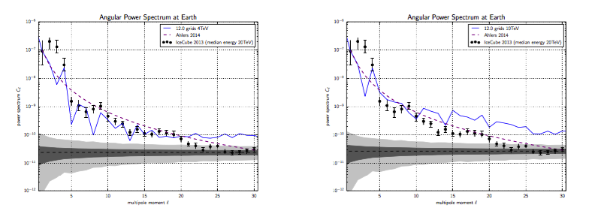
Angular Power Spectrum
Helium 1 TeV and He 10TeV

Slide 33
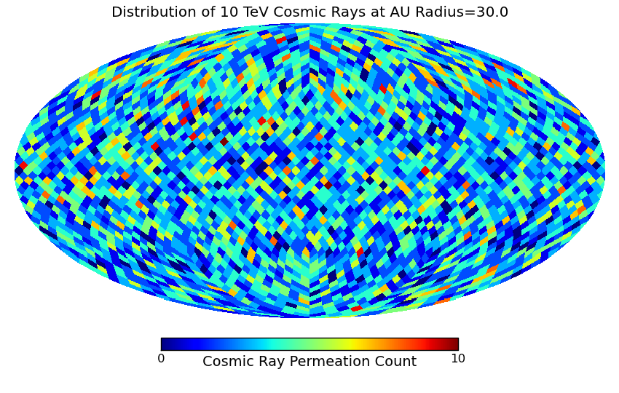
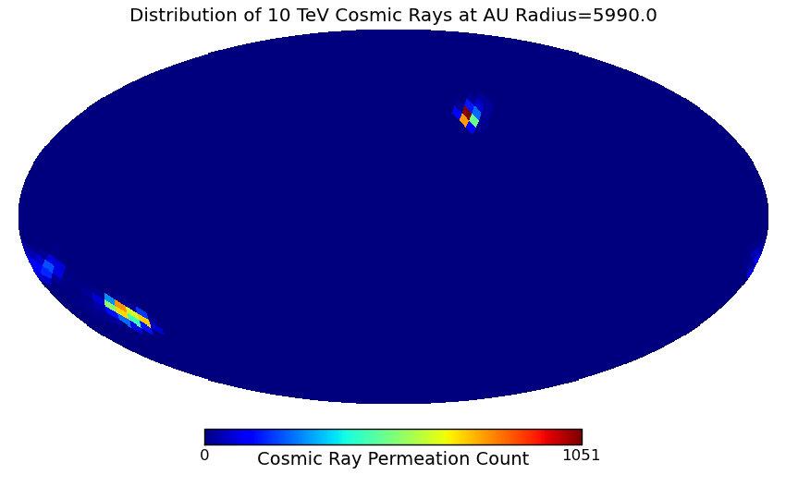
One possible method
Backtracking
Liouville’s theorem

Slide 34
Conclusions
TeV Cosmic Ray Anisotropy from Heliospheric Magnetic Field‏
Heliospheric effects are crucial for the arrival of 1-10TV CR at the Earth.
Violation of the conservation of the 1ST Adiabatic invariant renders back-tracking impossible to use.
Our results show anisotropy that arises from the interaction of TeV CRs with the heliospheric magnetic field.
We need to propagate more particles (1e8) to obtain a clearer view of the distribution of CR at Earth.
Thanks
Vanessa López Barquero MMFW2017
Notes:
Heliospheric model
1ST Adiabatic invariant
Simulate a lot, prelim results

Slide 35
MMFW 2017 Vanessa Lopez-Barquero

Slide 36
Conservation of particles.
P-divergence free force
Magnetic Forces
Conservative and differentiable forces
No collisions
Region where the magnetic field varies abruptly.
Adiabatic change?
MMFW 2017 Vanessa Lopez-Barquero

Slide 37
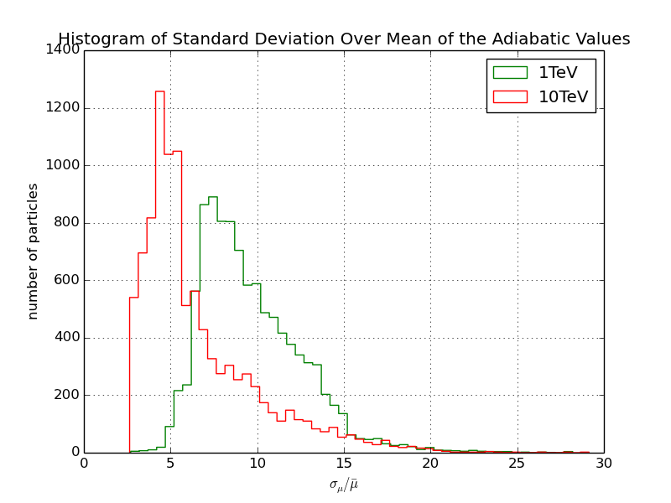
Non-Conservation of the 1st Adiabatic Invariant
Liouville’s Theorem can not be applied
MMFW 2017 Vanessa Lopez-Barquero
Notes:
Its conservation allows the application of
Liouville’s Theorem
Backtrack particles
to make sky maps
Here, mention Helio– not always the case that it will fulfill this requirement

Slide 38
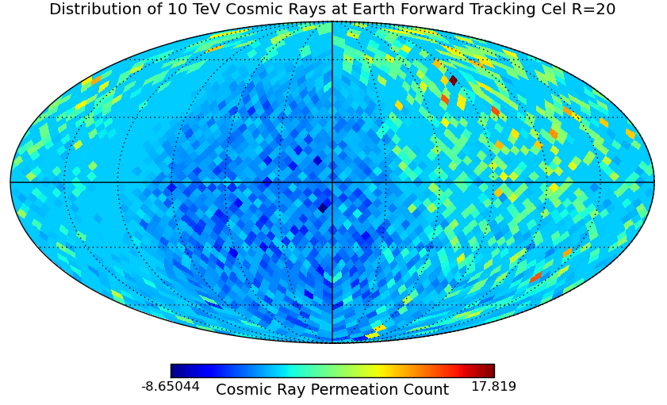
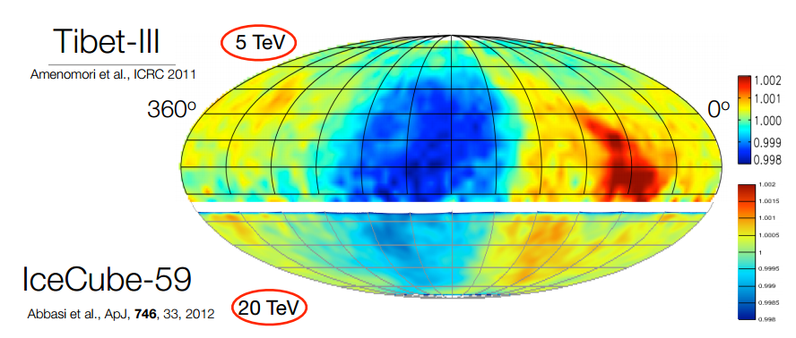
Anisotropy at Earth
TeV Cosmic Ray Anisotropy from Heliospheric Magnetic Field‏
Assumption of Dipole Distribution: Schwadron et al., Science (2014)
April 29 Vanessa López Barquero MMFW2014
Notes:
Assuming a preexisting dipole, along the B field.
Schwadron et al Science (2014)

Slide 39
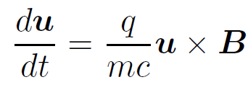

Cosmic Ray Trajectories
TeV Cosmic Ray Anisotropy from Heliospheric Magnetic Field‏
Lorentz Force
Frequency of particle’s gyromotion
Vanessa López Barquero MMFW2016
Notes:
Siyao’s description:
We propagate relativictiv particles
We integrate numerically
We use the Bulirsh-Stoer method (Press et al. 1986) to trace the trajectories
of test particles. The algorithm uses an adaptive time-step
method and the particle energy is conserved to a high degree
during the simulation.
In each time step, the magnetic fields defined on grid points
are interpolated to the position of a test particle using a cubic
spline routine. Given the local magnetic field B, the trajectory
can be computed by integrating the Lorentz force on each
particle,

Slide 40
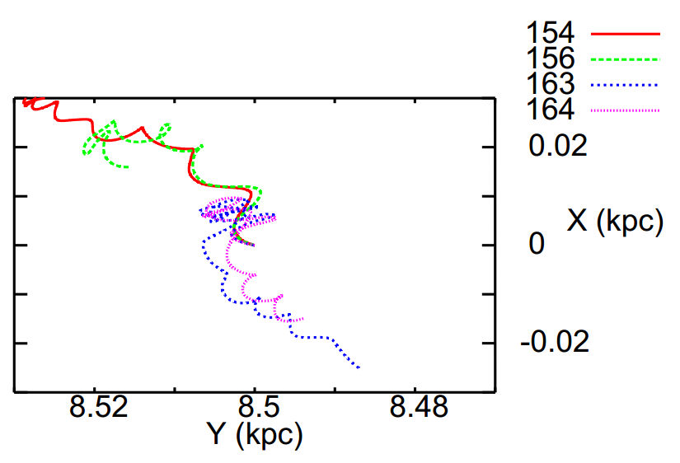
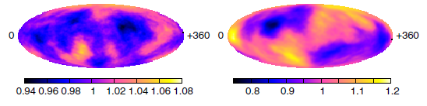
Previous Works
TeV Cosmic Ray Anisotropy from Heliospheric Magnetic Field‏
Nevertheless, in our work ,the heliospheric effects are crucial in the arrival of TeV Cosmic Rays.
Giacinti&Sigl(2012)
April 29 Vanessa López Barquero MMFW2014
Notes:
Better to call this Backtracking
http://arxiv.org/pdf/1111.2536v2.pdf
Lio-mfp-ISM

Slide 41
Trajectories – Scattering
TeV Cosmic Ray Anisotropy from Heliospheric Magnetic Field‏
April 29 Vanessa López Barquero MMFW2014

Slide 42
Main References
TeV Cosmic Ray Anisotropy from Heliospheric Magnetic Field‏
P. Desiati and A. Lazarian, Astrophys. J. 762, 44 (2013)
April 29 Vanessa López Barquero MMFW2014

Slide 43
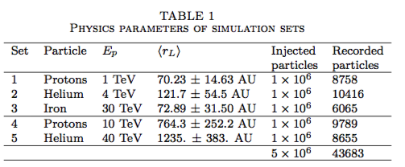
TeV Cosmic Ray Anisotropy from Heliospheric Magnetic Field‏

Slide 44

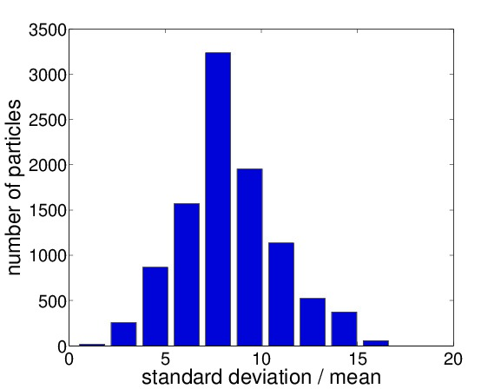
Previous Works
TeV Cosmic Ray Anisotropy from Heliospheric Magnetic Field‏
Non-Applicability of Liouville’s Theorem
Nevertheless, in our work ,the heliospheric effects are crucial in the arrival of TeV Cosmic Rays.
Giacinti&Sigl(2012)
April 29 Vanessa López Barquero MMFW2014
Notes:
Better to call this Backtracking
http://arxiv.org/pdf/1111.2536v2.pdf
Lio-mfp-ISM

Slide 45
Direct Propagation
TeV Cosmic Ray Anisotropy from Heliospheric Magnetic Field‏
Input from the center – efficient way!
Angular Distribution – Higher Probability to reach the Earth.
April 29 Vanessa López Barquero MMFW2014
Notes:
Backtracking to trace Angular distribution
Insert a better bloody map
We can’t do backtracking, so we need to do fwd tracking, but since it is a quite inefficient way, we proceed to do this.
We inject particles at the center, “Earth”

Slide 46



Extra Slides
TeV Cosmic Ray Anisotropy from Heliospheric Magnetic Field‏
Particles Trajectories
April 29 Vanessa López Barquero MMFW2014

Slide 47

Extra Slides

Slide 48

Dipole Distribution
TeV Cosmic Ray Anisotropy from Heliospheric Magnetic Field‏
April 29 Vanessa López Barquero MMFW2014
Notes:
Insert a pic of the Heliosphere and explain the direction of the dipole taken

Slide 49



Slide 50


Slide 51
Spectrum

Slide 52
Anisotropy at Earth
TeV Cosmic Ray Anisotropy from Heliospheric Magnetic Field‏
Assumption of Dipole Distribution: Schwadron et al., Science (2014)
April 29 Vanessa López Barquero MMFW2014
Notes:
Assuming a preexisting dipole, along the B field.
Schwadron et al Science (2014)

Slide 53

Cosmic Ray Anisotropy from Local Turbulent Magnetic Fields
Simulations with parameters:
L_{inj} = 100 pc; 30 PeV protons
3e5 protons propagated
L_{inj} = 10 pc for
the spiral arms,
100 pc for
the interarm regions
Haverkorn et al. (2008)
MMFW 2016 Vanessa Lopez-Barquero

Slide 54
Trajectories – Scattering
TeV Cosmic Ray Anisotropy from Heliospheric Magnetic Field‏
April 29 Vanessa López Barquero MMFW2014

Slide 55
Trajectories – Scattering
TeV Cosmic Ray Anisotropy from Heliospheric Magnetic Field‏
April 29 Vanessa López Barquero MMFW2014

Slide 56

Theoretical Framework
Cosmic Ray Anisotropy from Local Turbulence and Heliospheric Effects‏
Duldig (2006)
Vanessa López-Barquero CRA2017
Notes:
###Cut description http://iopscience.iop.org/article/10.1088/0004-637X/784/1/38/pdf
Galactic influence on knee region
Turbulence in astrophysical plasmas has significant effects on particle propagation, in that the stochastic nature of magnetic field lines is transmitted to the particles’ trajectories.
On scales smaller than the injection scale, particles are characterized by super-diffusion in the perpendicular direction of the mean magnetic field. This behavior is described by the so-called Richardson diffusion, where particle separation grows as (time)3 2 (Lazarian & Yan 2014).

