Slide 1


Compact imaging air Cherenkov telescopes as an additional component for large astroparticle detectors like
IceCube and HAWC by
Jan Auffenberg,
Thomas Bretz, Christopher Wiebusch, et al

Slide 2
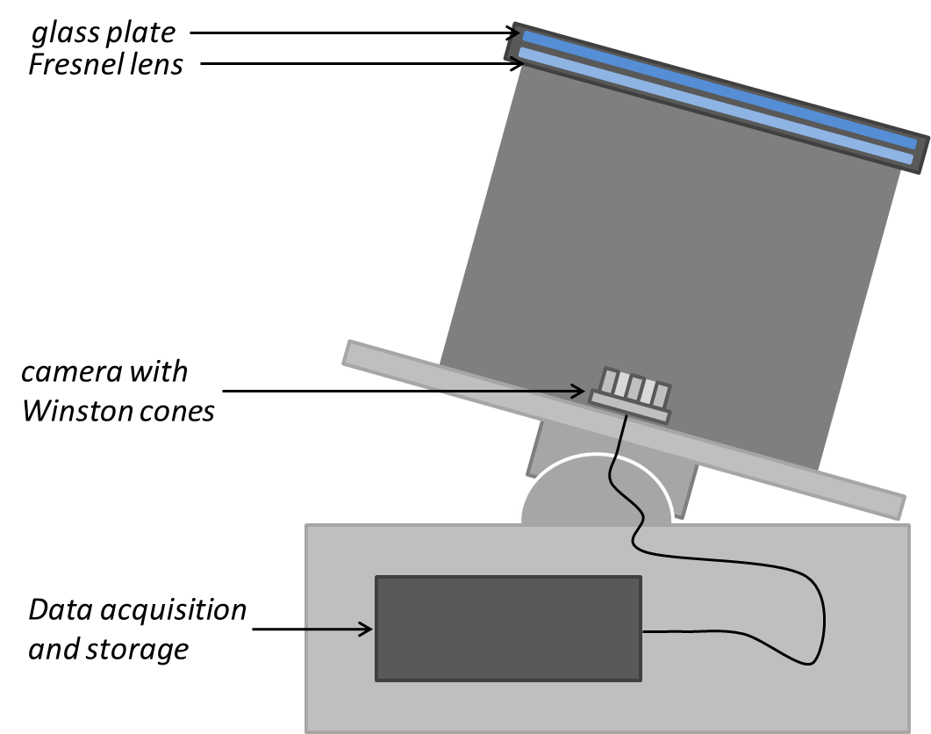
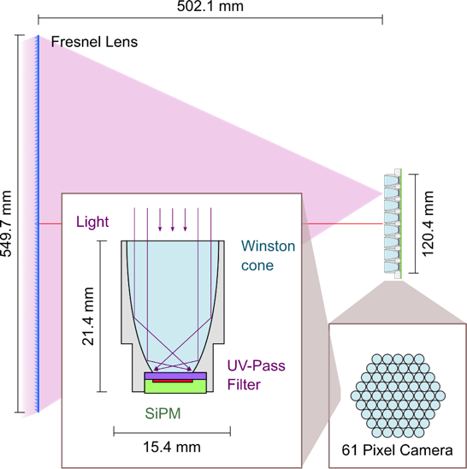
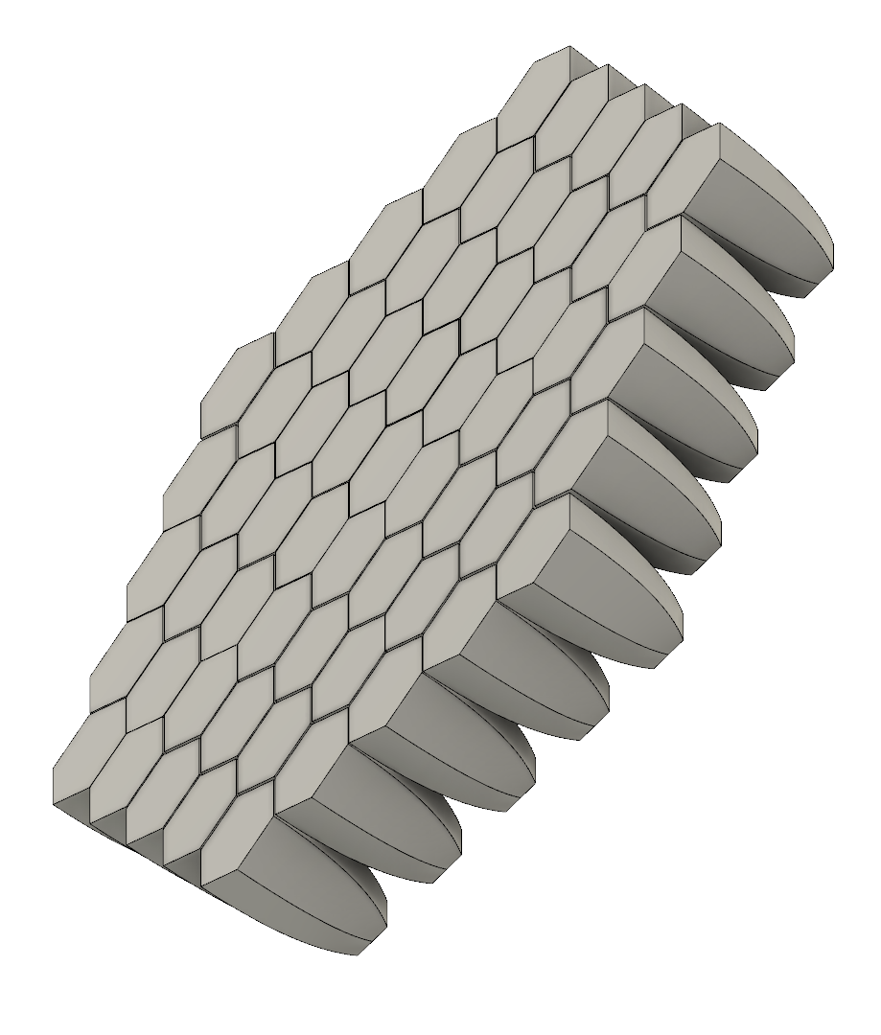
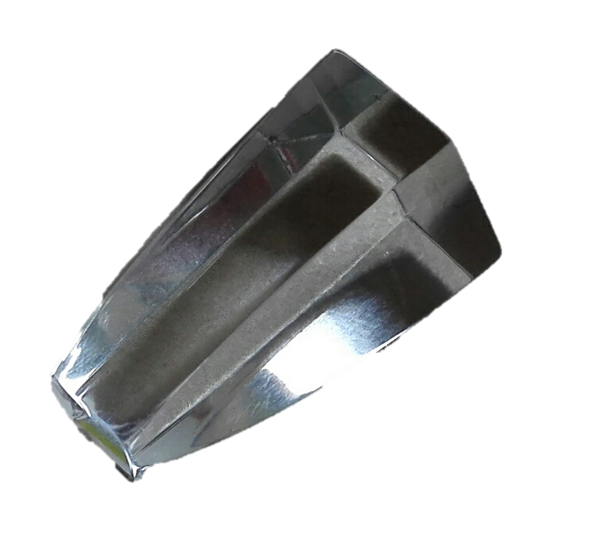
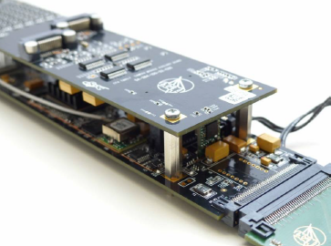
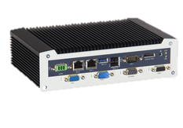
IceAct/FAMOUS Mechanical Concept
549.7 mm
23.5 mm
solid PMMA
120.4 mm
61 pixel
camera
120.4 mm
502.1 mm
0.034sr solid angle
12° Field of view
(~1.5° per pixel)

Slide 3
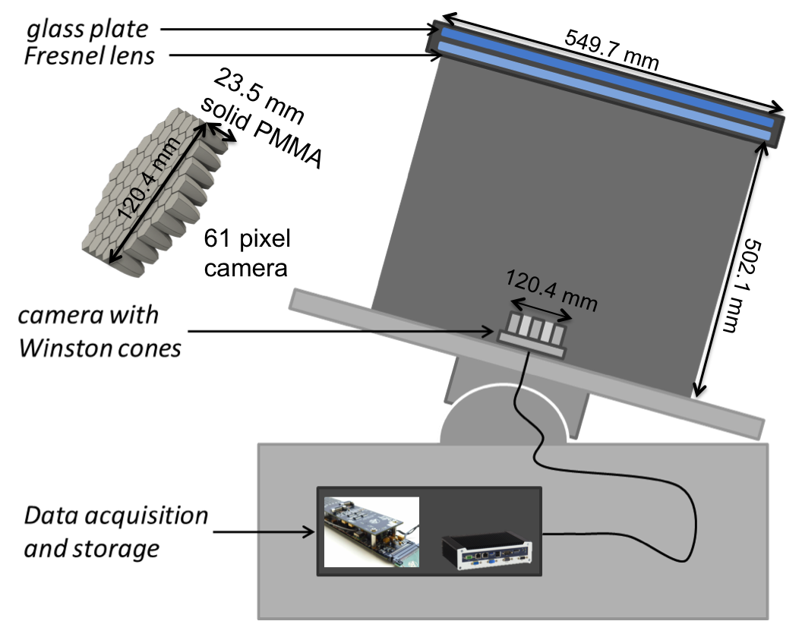
Famous/IceAct
Small Imaging Air Cherenkov Telescopes with wide field of view
Florescence Air-Shower Detection
for the Pierre Auger Observatory
Hybrid EAS detection
  Composition
  measurements
Cherenkov light Telescope for IceCube
Air shower veto for astrophysical neutrino detection
Hybrid detector component for composition studies
Cherenkov light Telescopes for HAWC
Small telescope for education
air shower physics
air-Cherenkov detectors
improving gamma ray detection
  energy resolution
  background separation

Slide 4
Famous/IceAct
Small Imaging Air Cherenkov Telescopes with wide field of view
Florescence Air-Shower Detection
for the Pierre Auger Observatory
Hybrid EAS detection
  Composition
  measurements
Cherenkov light Telescope for IceCube
Air shower Veto for astrophysical neutrino detection
Hybrid detector component for composition studies
Cherenkov light Telescopes for HAWC
Small telescope for education
air shower physics
air-Cherenkov detectors
More on applications for HAWC
improving gamma ray detection
  energy resolution
  background separation

Slide 5
Famous/IceAct
Small Imaging Air Cherenkov Telescopes with wide field of view
Florescence Air-Shower Detection
for the Pierre Auger Observatory
Hybrid EAS detection
  Composition
  measurements
Cherenkov light Telescope for IceCube
Air shower Veto for astrophysical neutrino detection
Hybrid detector component for composition studies
A bit about the
telescope technology
Cherenkov light Telescopes for HAWC
Small telescope for education
air shower physics
air-Cherenkov detectors
improving gamma ray detection
  energy resolution
  background separation

Slide 6
Famous/IceAct
Small Imaging Air Cherenkov Telescopes with wide field of view
Florescence Air-Shower Detection
for the Pierre Auger Observatory
Hybrid EAS detection
  Composition
  measurements
Cherenkov light Telescope for IceCube
Air shower Veto for astrophysical neutrino detection
Hybrid detector component for composition studies
About IceCube applications
Cherenkov light Telescopes for HAWC
Small telescope for education
air shower physics
air-Cherenkov detectors
improving gamma ray detection
  energy resolution
  background separation

Slide 7
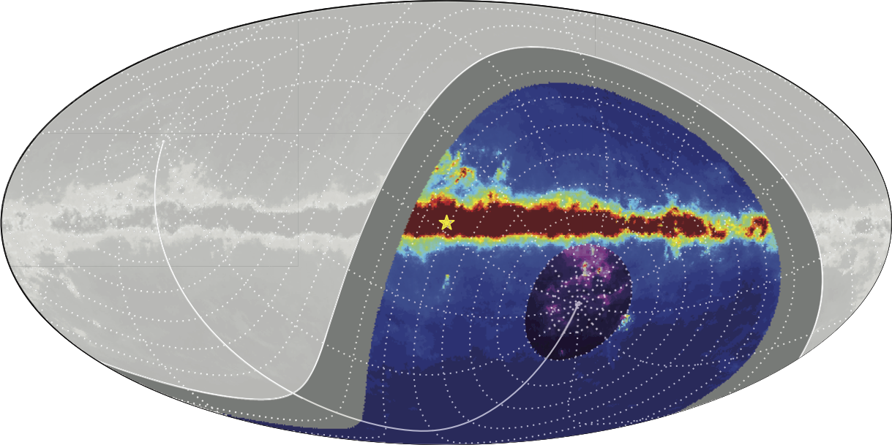
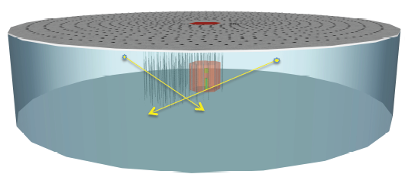
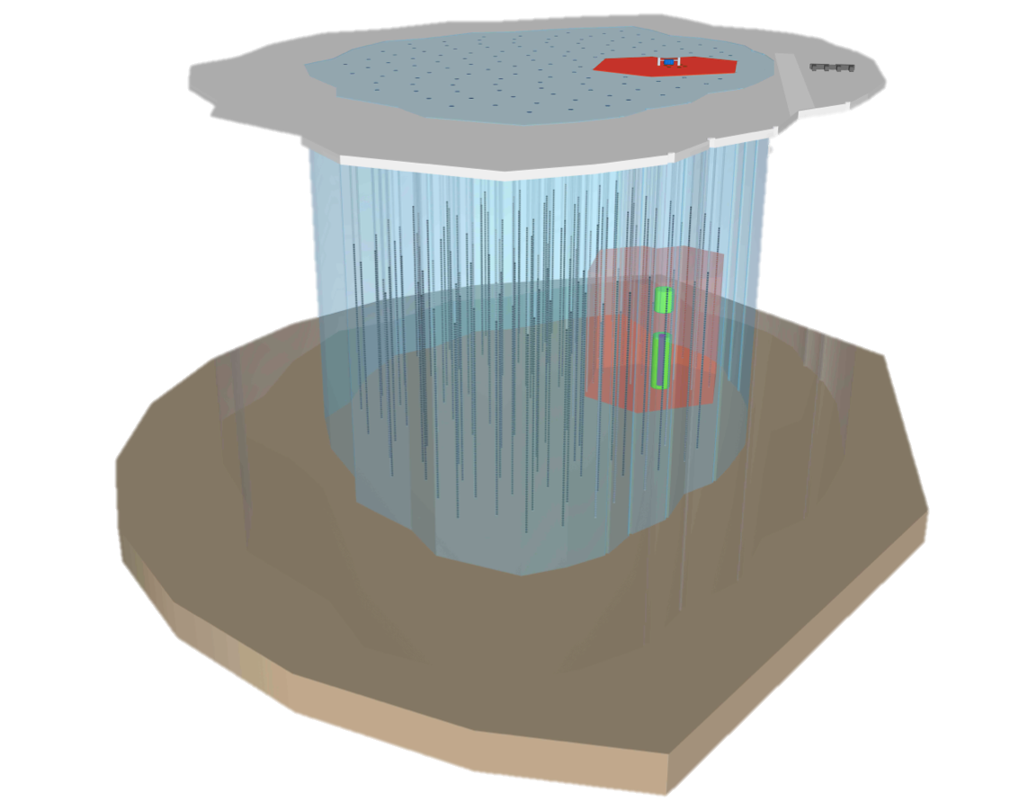
IceCube Extensions
IceCube-Gen2 plans:
The low Energy extension “Phase1” in the core of Deep Core
to increase energy and directional resolution at low energies
Extensions to increase sensitivity at high neutrino energies

Slide 8
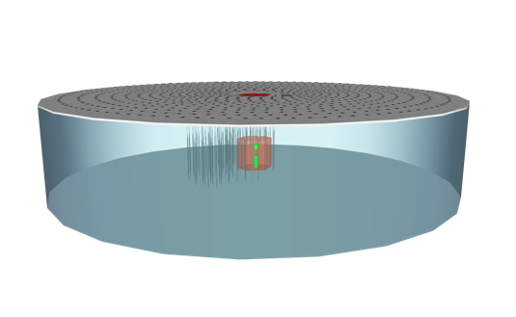
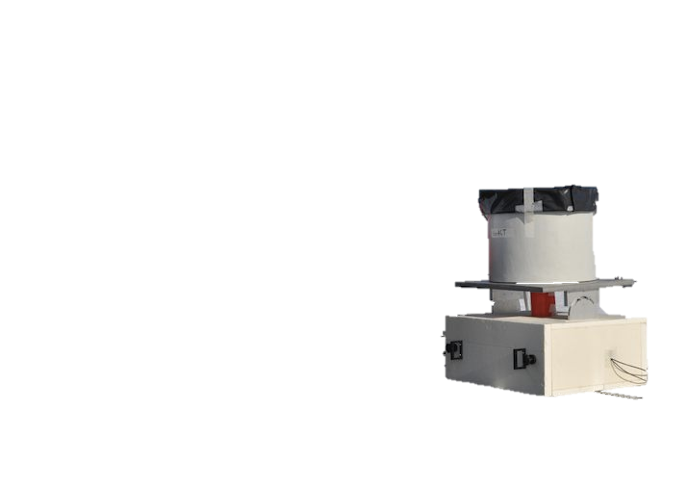
Veto CRs to measure astrophysical neutrinos
Requirements for a surface veto:
extremely good detection efficiency for CR
-high duty cycle
-low energy threshold
One solution: many surface stations to detect particles on the surface.
requires a high instrumentation density to reach sufficient detection efficiency at high energies
This idea: take atmosphere as active volume
and measure the air-Cherenkov light of the air shower.
Lower duty cycle but low energy threshold.
(see ICRC2015 PoS(ICRC2015)1156, PoS(ICRC2015)568,
PoS(ICRC2015)649, PoS(ICRC2015)605, and PoS(ICRC2015)1047)
Of course the systems can be combined!

Slide 9
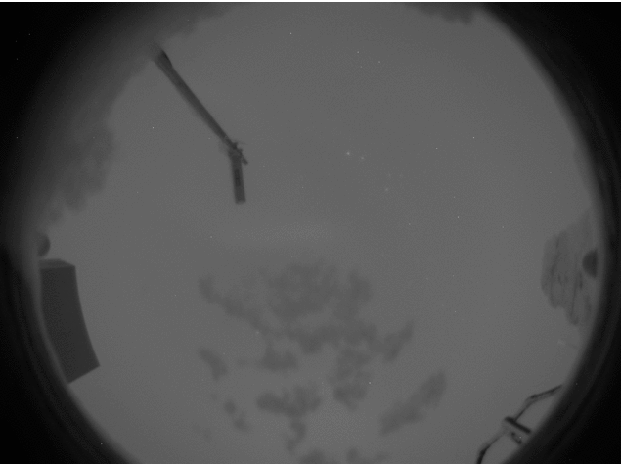
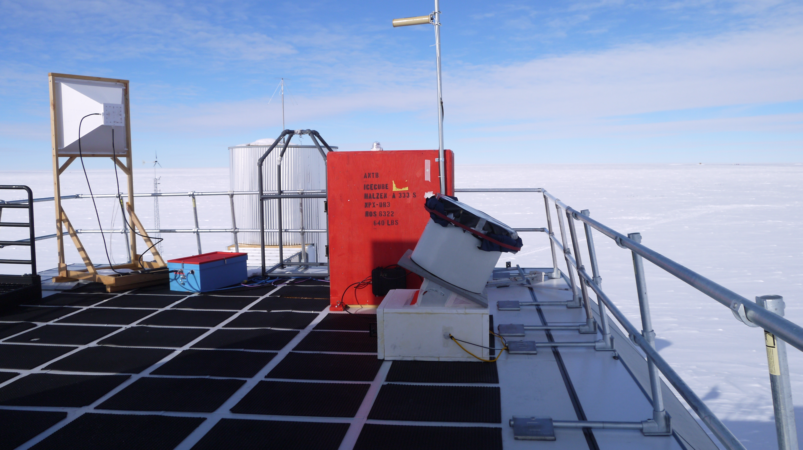
Cloud monitoring is about to improve
April 27th
IceAct demonstrator

Slide 10

IACT at South Pole Duty Cycle
Acceptable Weather
Nice Weather
IceCube Preliminary
Done by Jan Adam
Overall annual duty cycle at the South Pole is indeed in the order of ~25% or better!
TU Dortmund will keep working on this building on experience from FACT

Slide 11
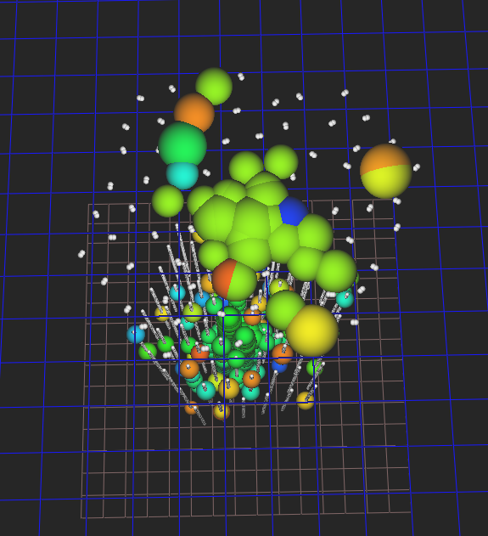
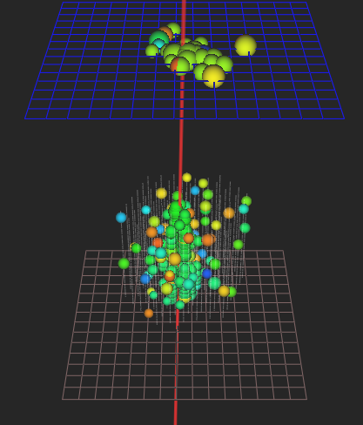
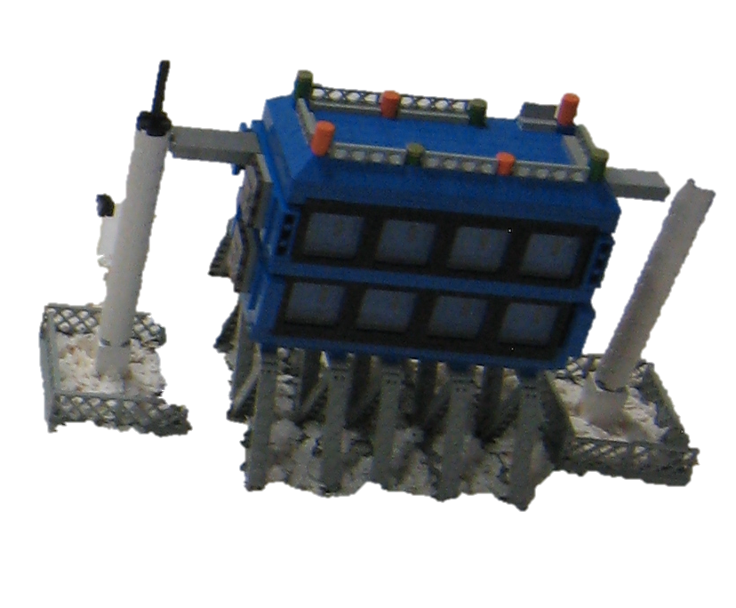
A first glance in coincident data
IceAct: 7567 Run: 128252 ID: 9282208
IceAct: 10564 Run: 128252 ID: 28837670
More coming soon!

Slide 12
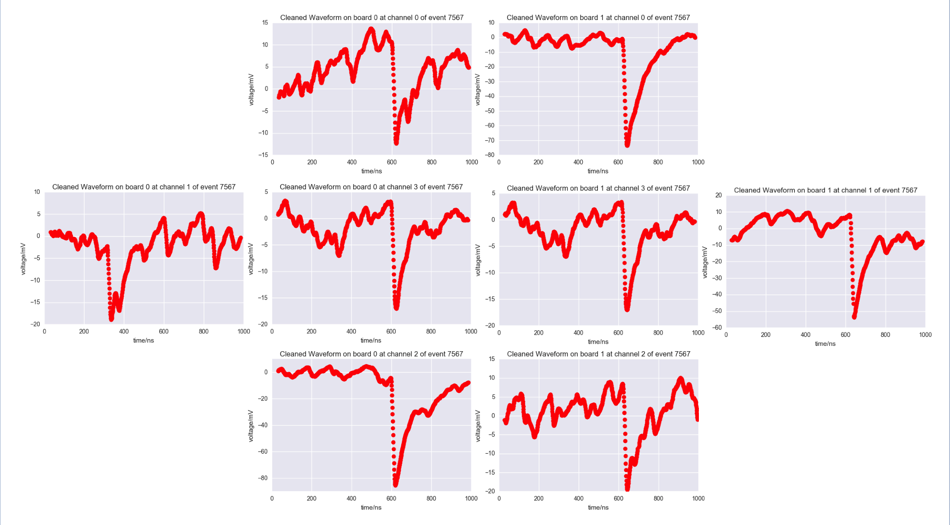
A first glance in coincident data
IceAct: 7567 Run: 128252 ID: 9282208
IceAct: 10564 Run: 128252 ID: 28837670

Slide 13
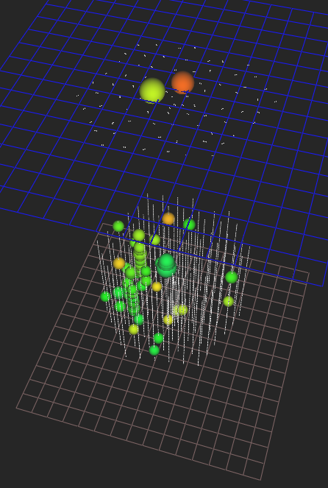
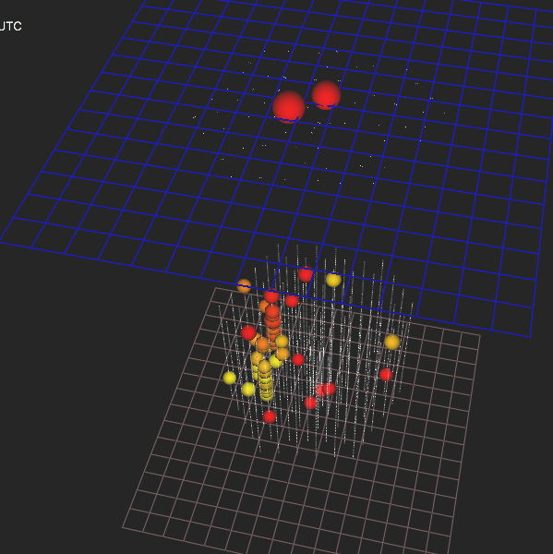
Another Event
IceAct: 6168 Run: 128252 ID: 286064

Slide 14
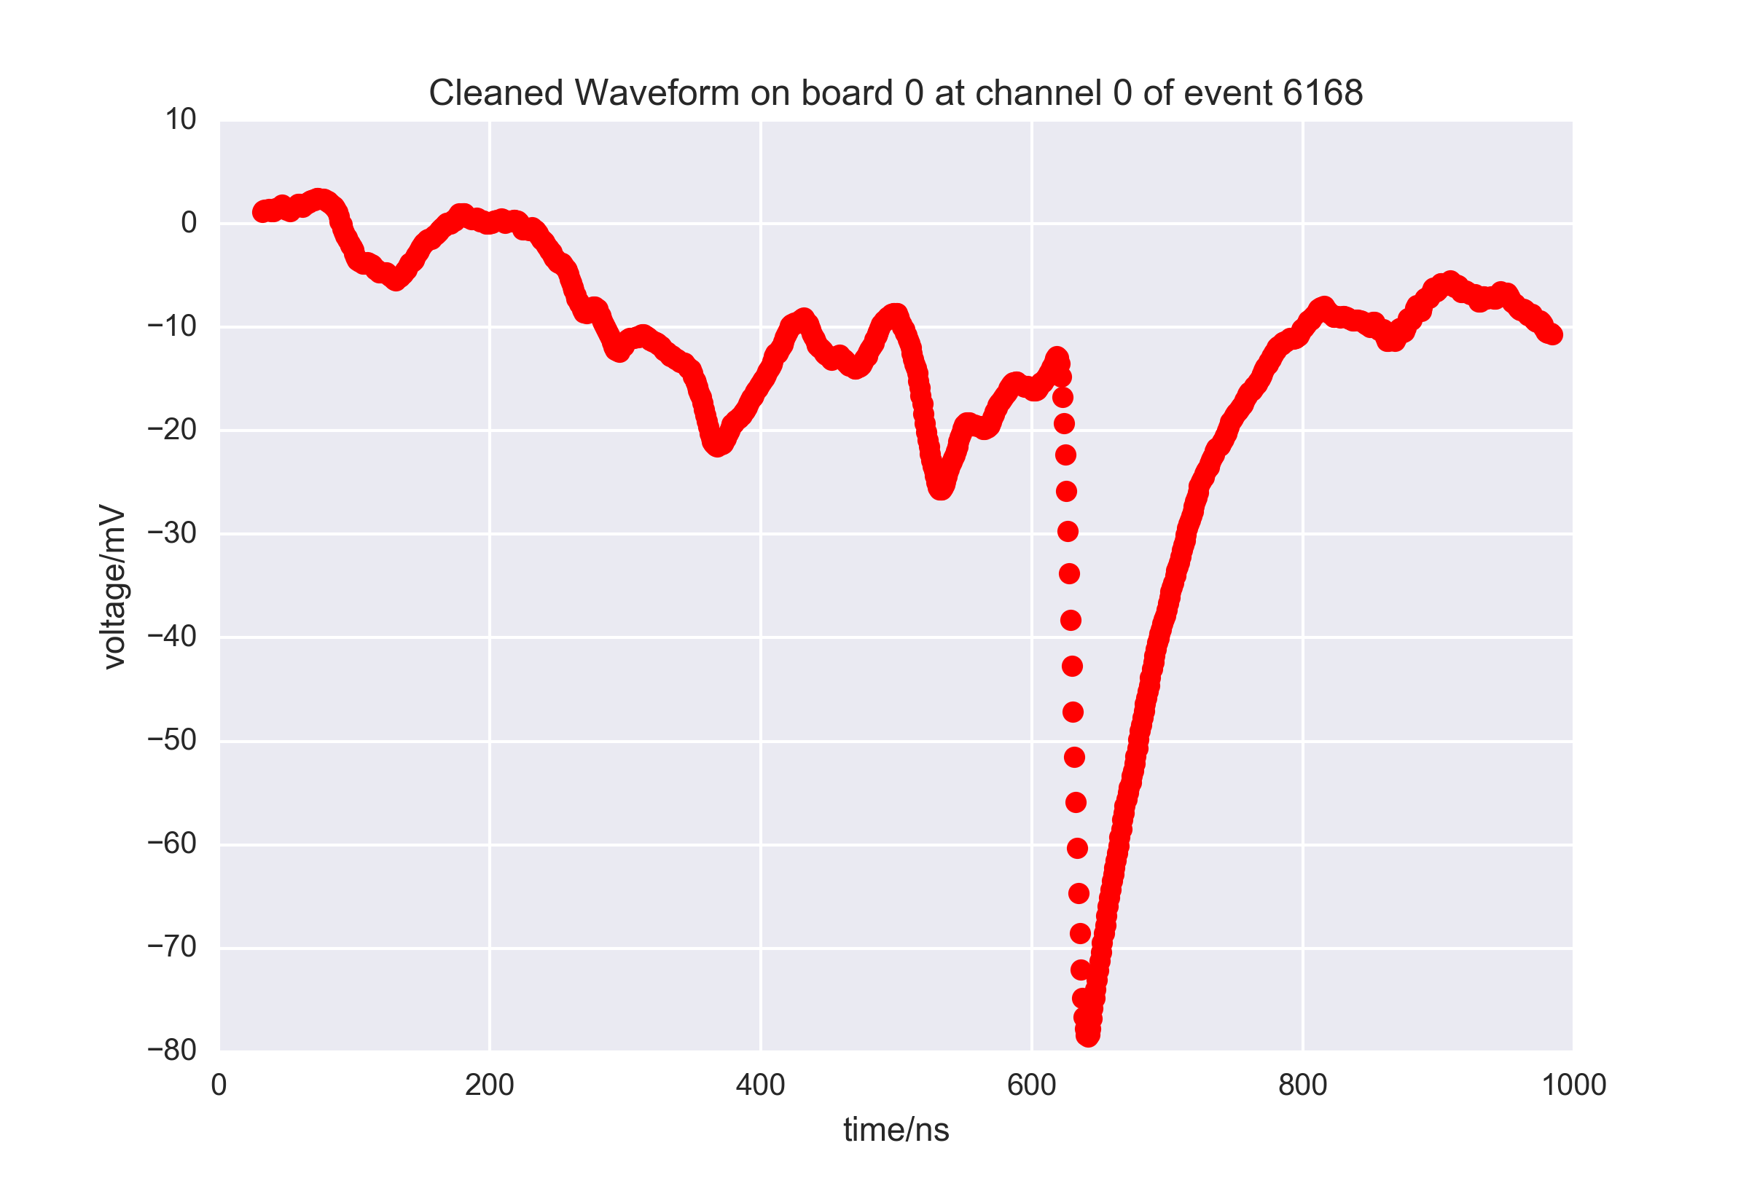
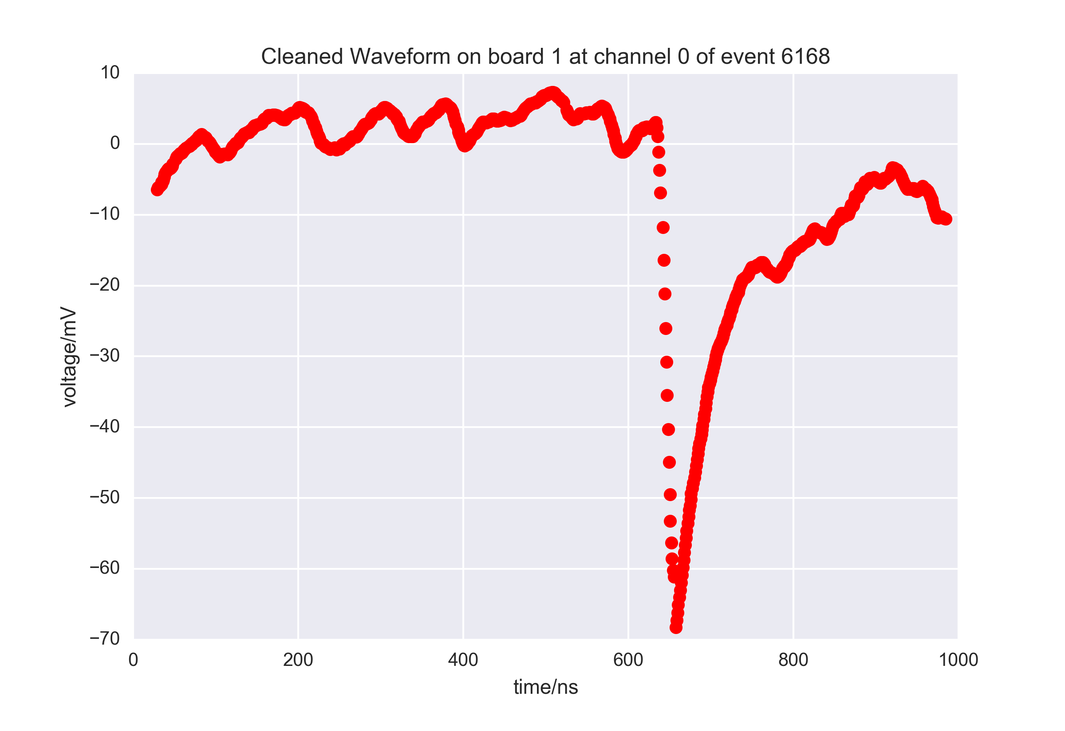
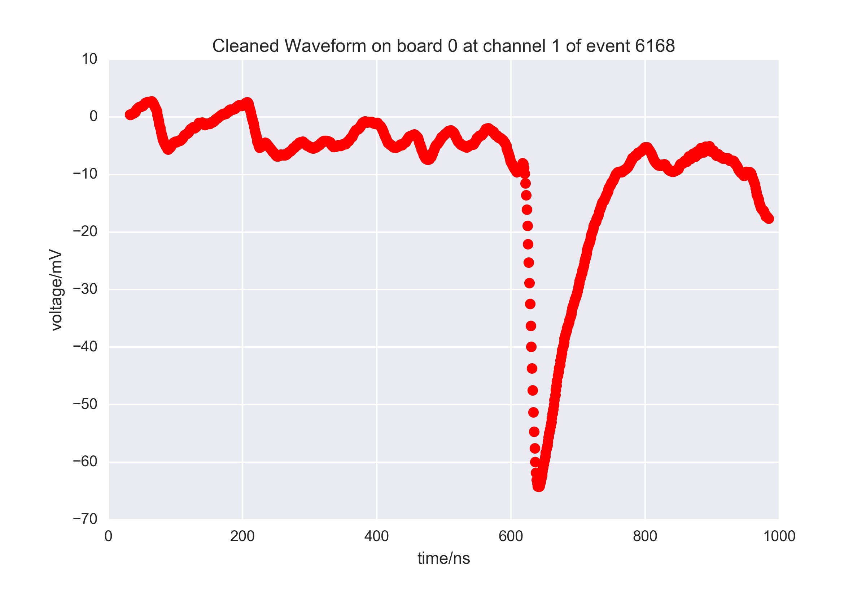
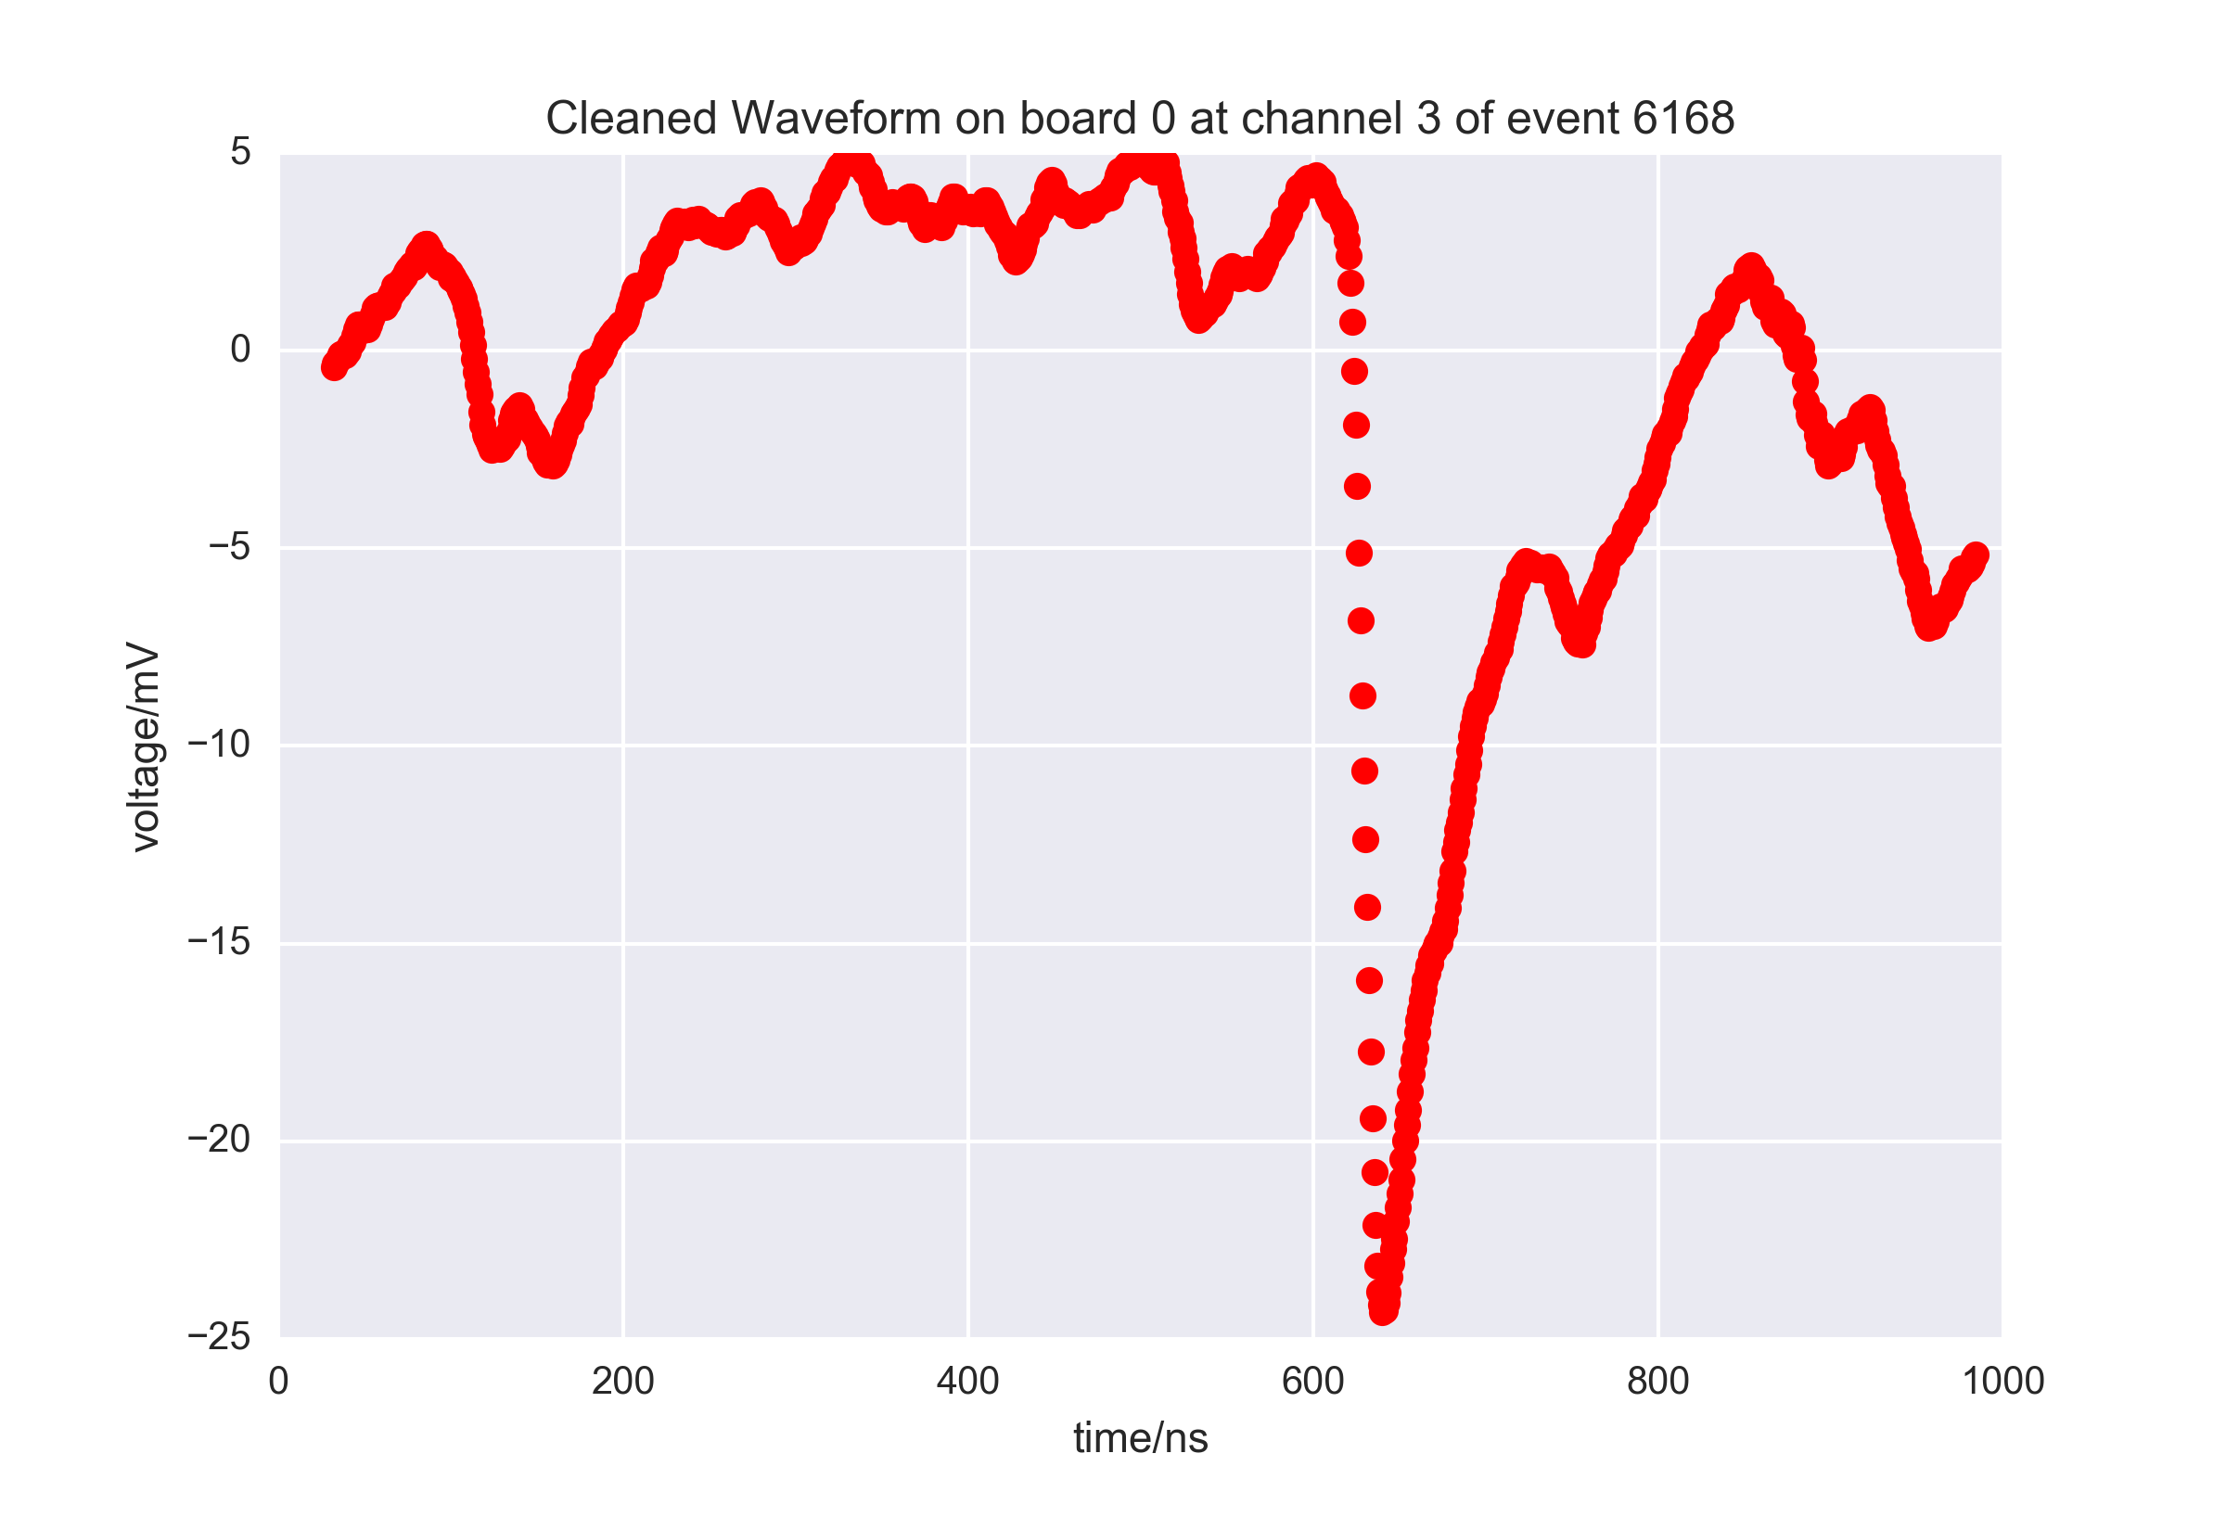
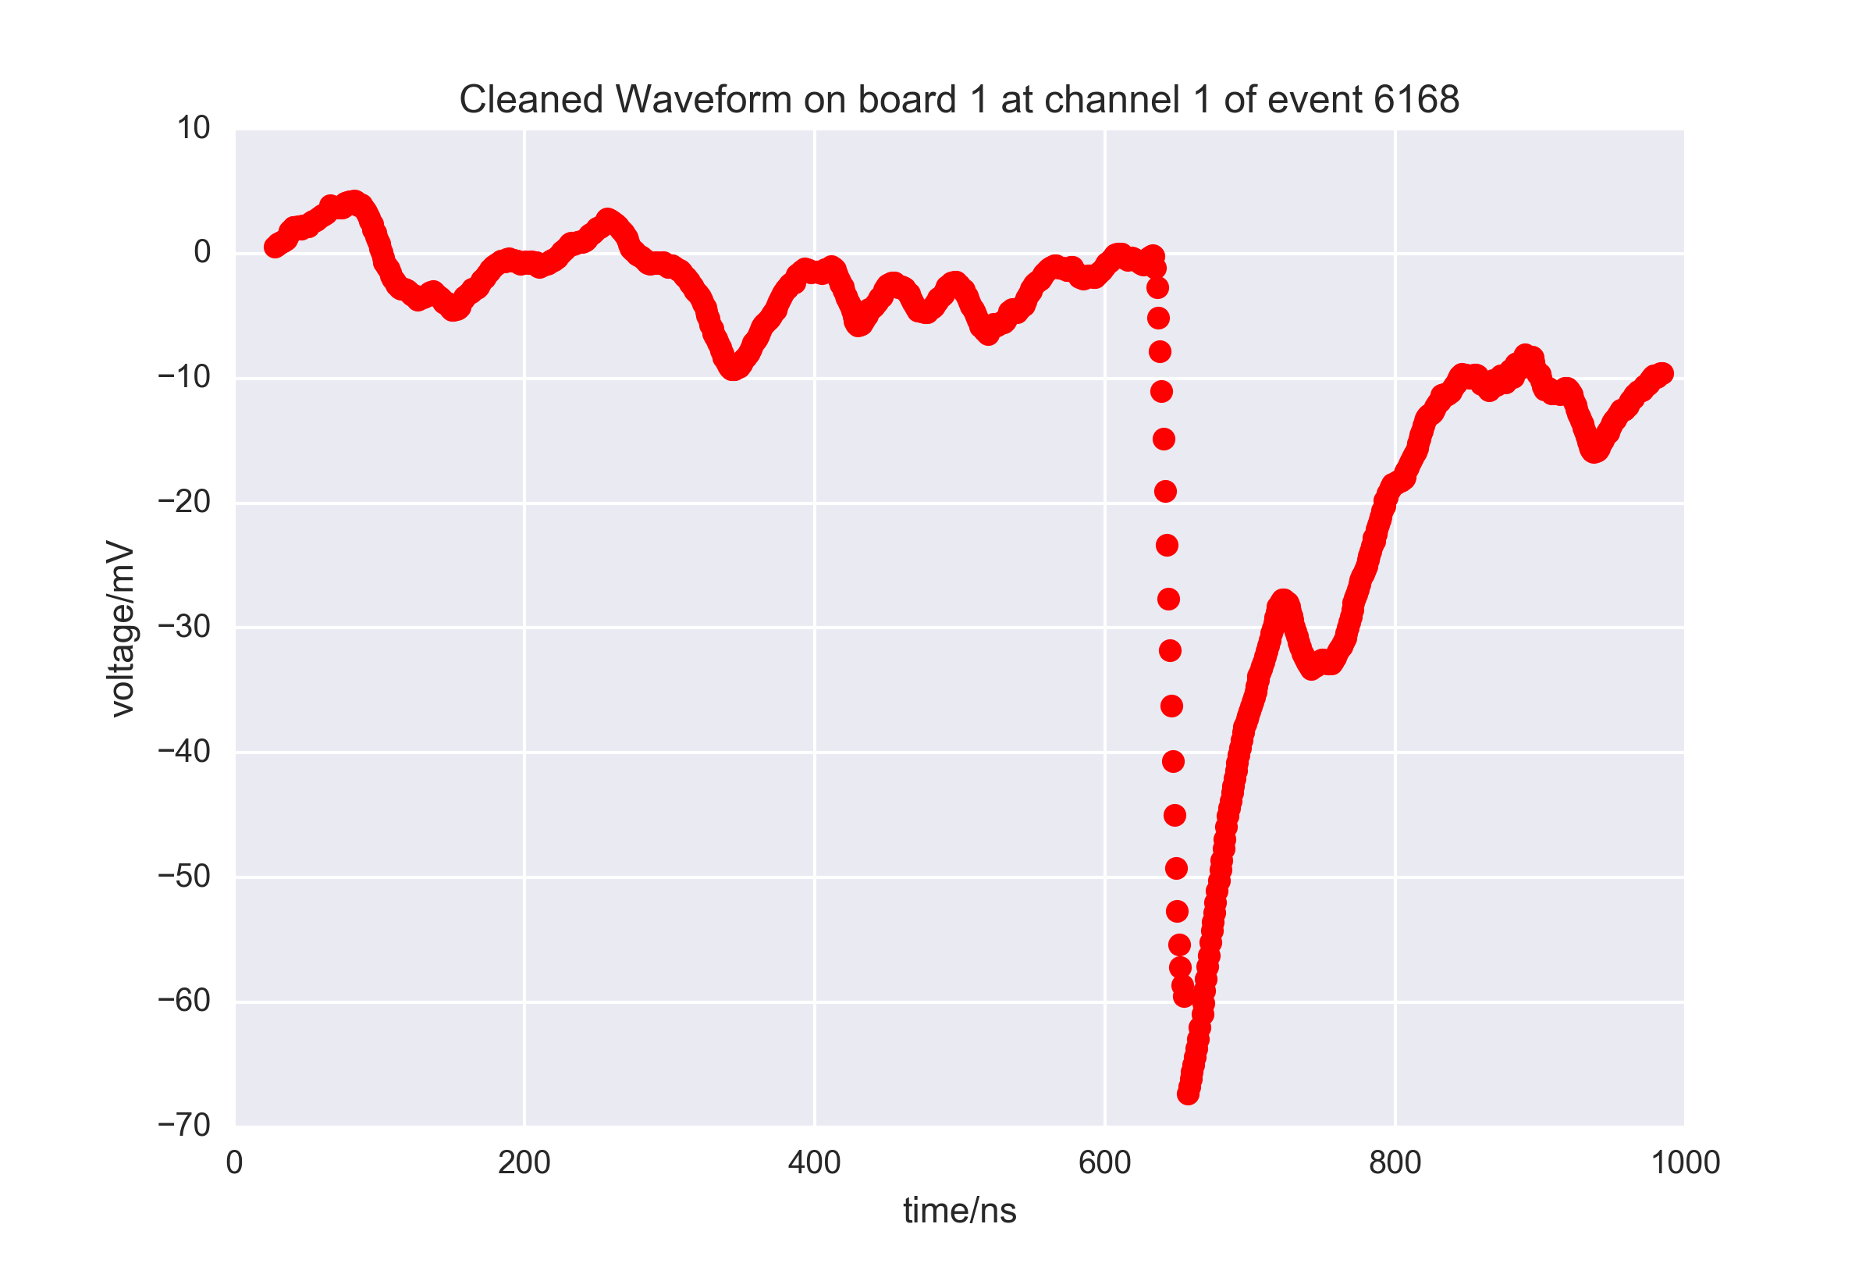
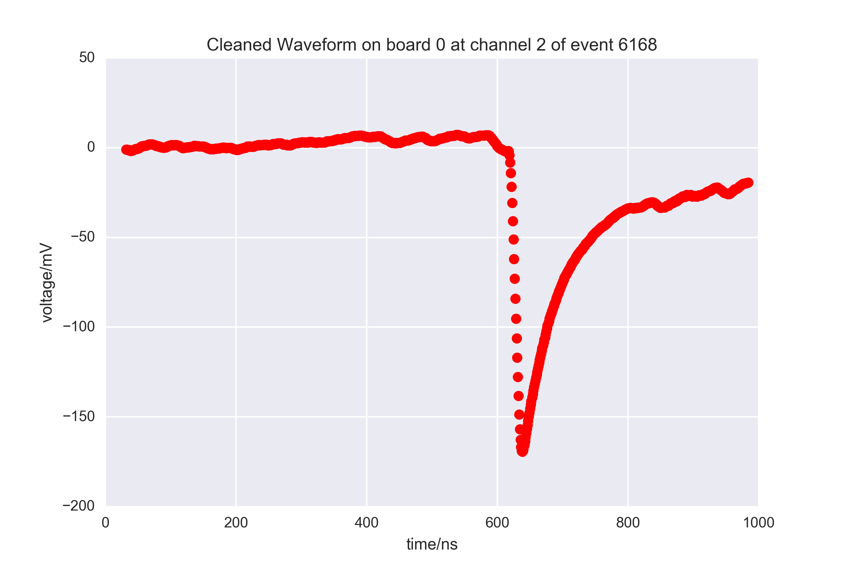
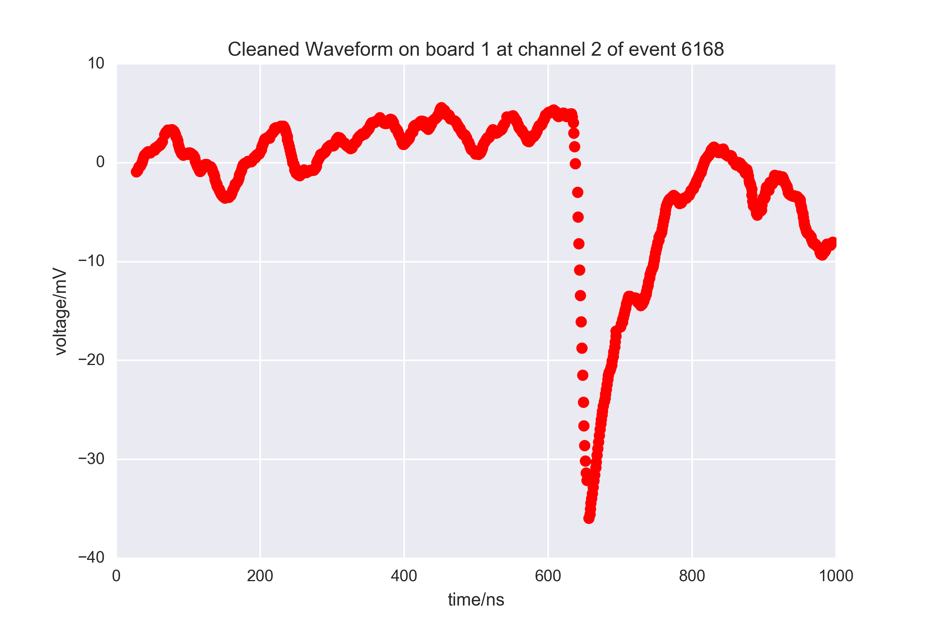
Another Event
More coming soon!
IceAct: 6168 Run: 128252 ID: 286064

Slide 15
Motivation for IceAct Veto
Hypothetical surface veto detector @ 60° declination
(Galactic Center) @ South Pole
Uptime is pessimistic
Energy threshold 20 TeV
not unrealistic
Could act as a
low energy in-fill
for the surface Veto
Needs more careful
investigation!
IACT based veto
E^{-2.6}
Particle detector based veto
E^{-2.0}

Slide 16
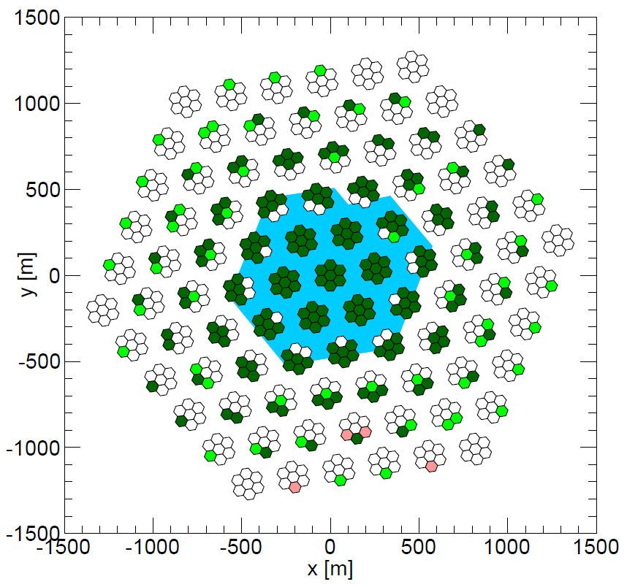
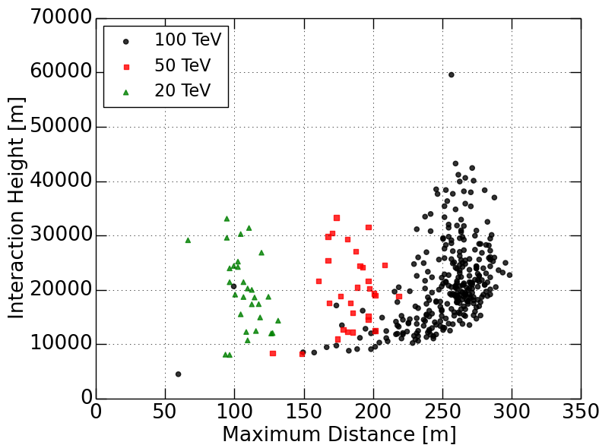
First simulation studies
threshold @ 50 TeV CR energy (about 20 TeV neutrino primary energy) for telescopes @ 150m distance
to cover IceTop (20° inclination) about 250 telescopes might be needed
AIP Conference Proceedings 1792, 060007 (2017)
See the talk by Ty DeYoung
for more details!

Slide 17
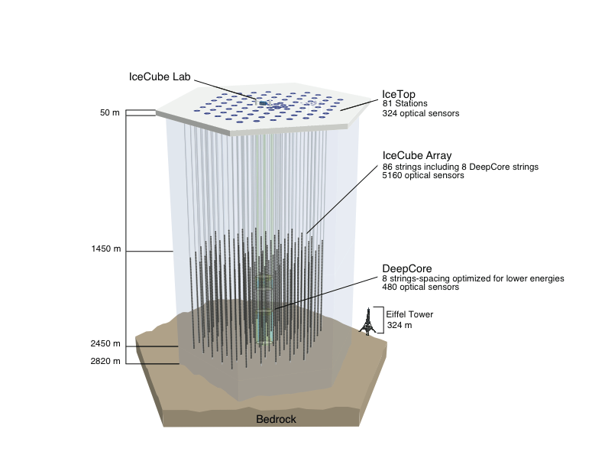
CR Physics with IceAct and IceTop
Detector Strength:
IceTop:
Energy
Direction
Particle density on ground
IceCube:
high energy muon density
IceAct:
shower evolution along the
shower axis
Ground particle detector:
IceTop or Scintillators
Might enable us to very precisely measure the particle ID!

Slide 18
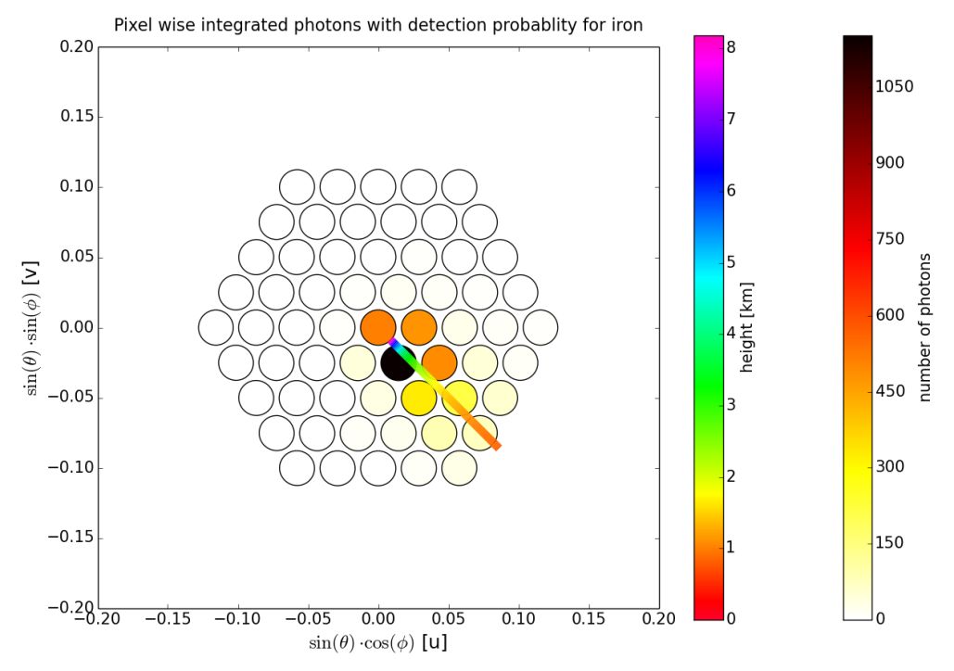
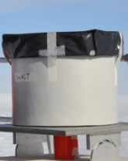
Projection relative to the average Photon Height
Iron Primary
Length 1
number of photons
sin(θ)sin(ϕ) [v]
height [km]
Length 2
Shower Axis
sin(θ)cos(ϕ) [u]
Aatif Waza

Slide 19
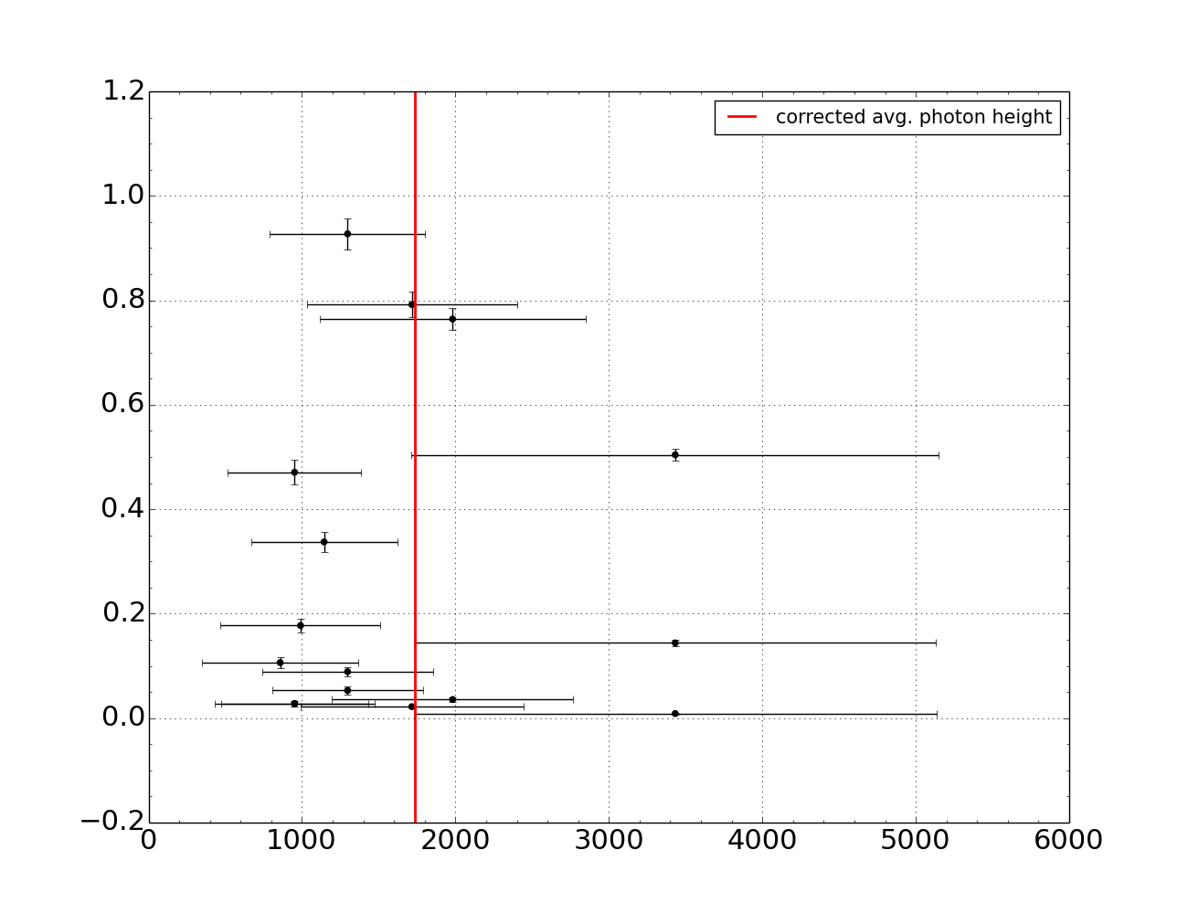
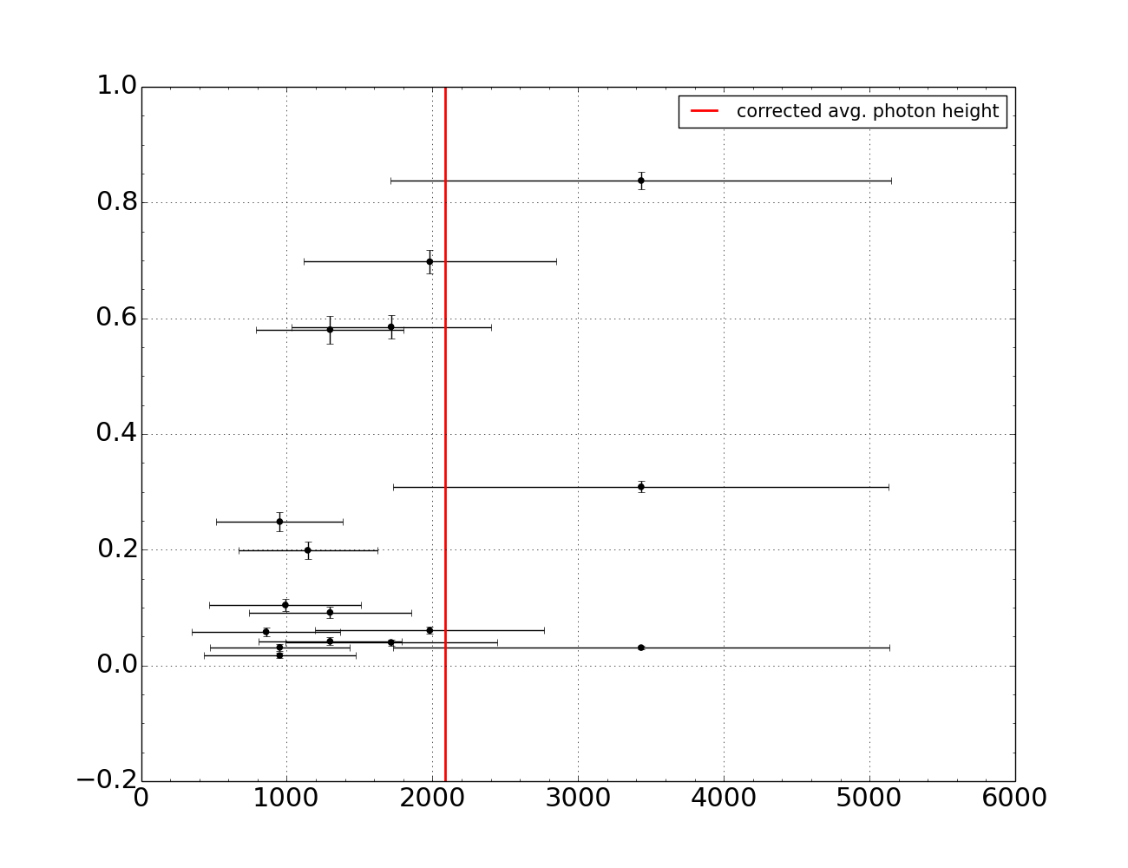
Photon projection on Shower Axis
5 PeV Proton
5 PeV Iron
photons per unit atmospheric length
height (m)
photons per unit atmospheric length
height (m)
Shower Axis
Length = Height Acceptance Range of Pixel (Central 68%)

Slide 20
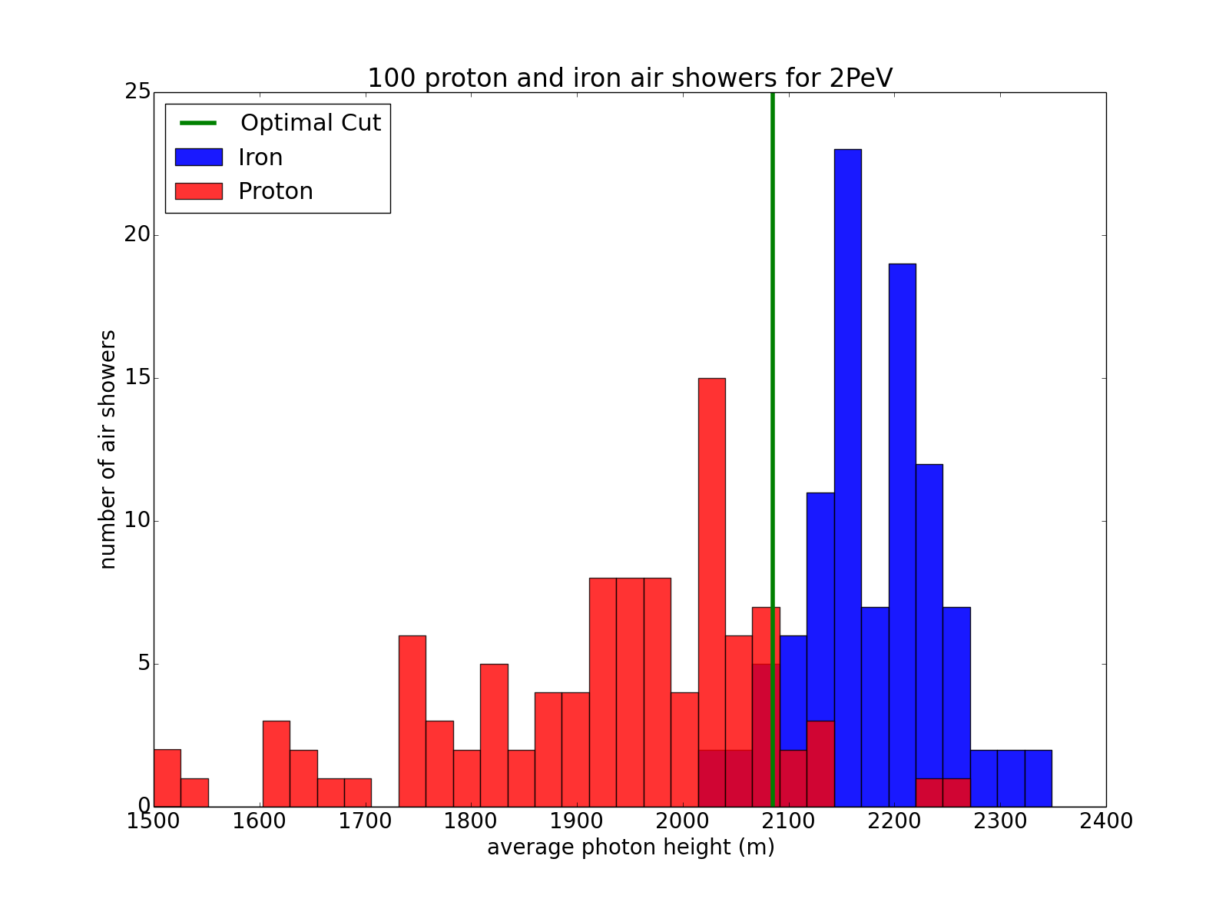
Proton/Iron 2 PeV primary energy
100 proton and iron air showers at 2 PeV
Number of Air-showers
Shower Axis
average photon height

Slide 21
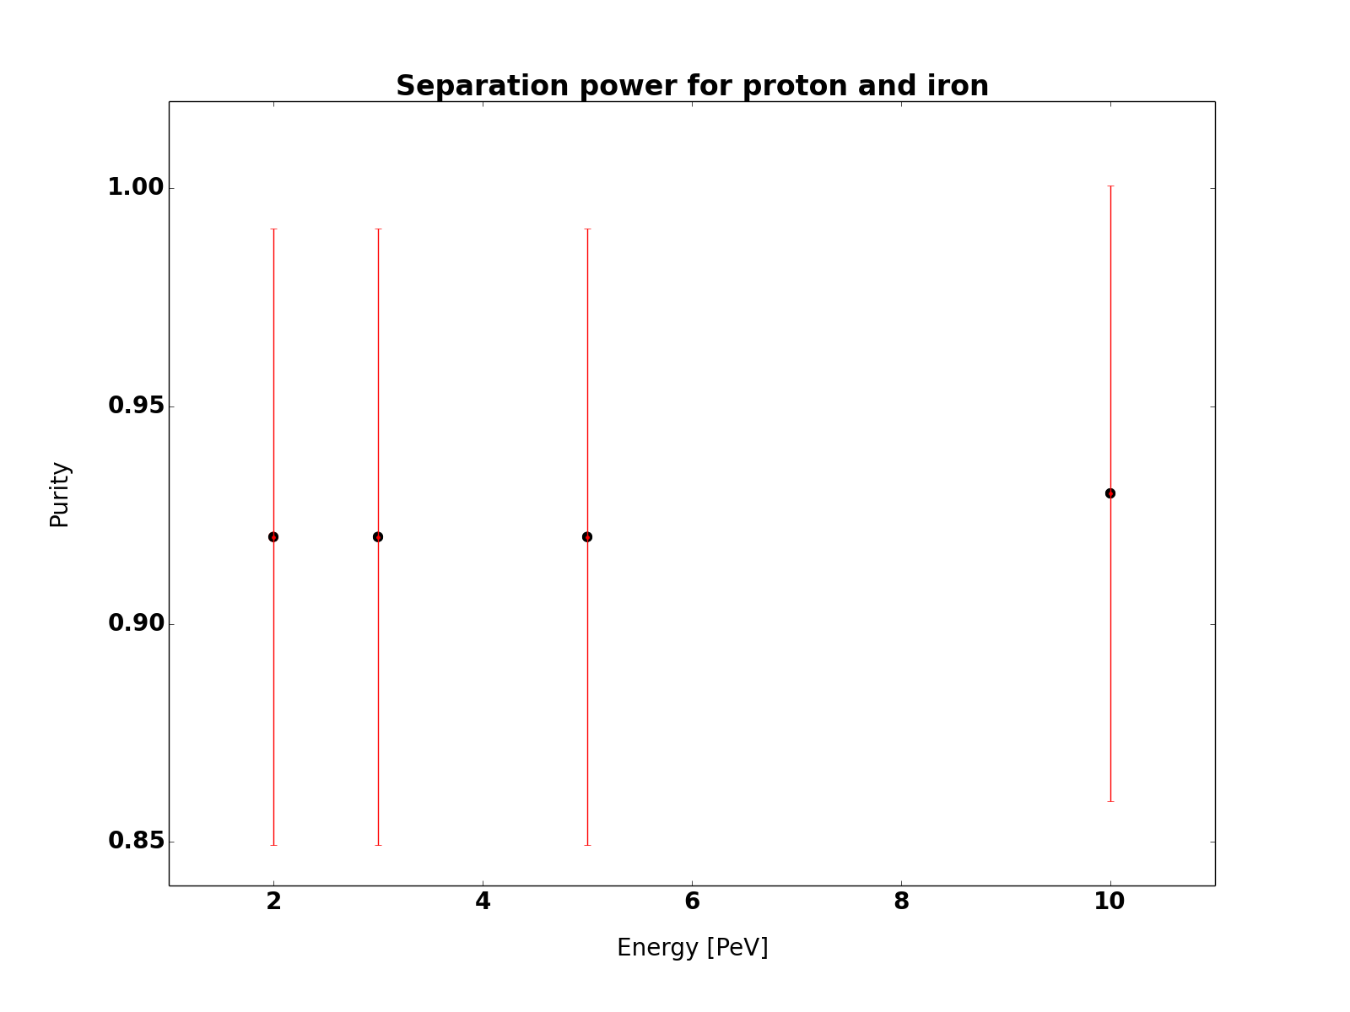
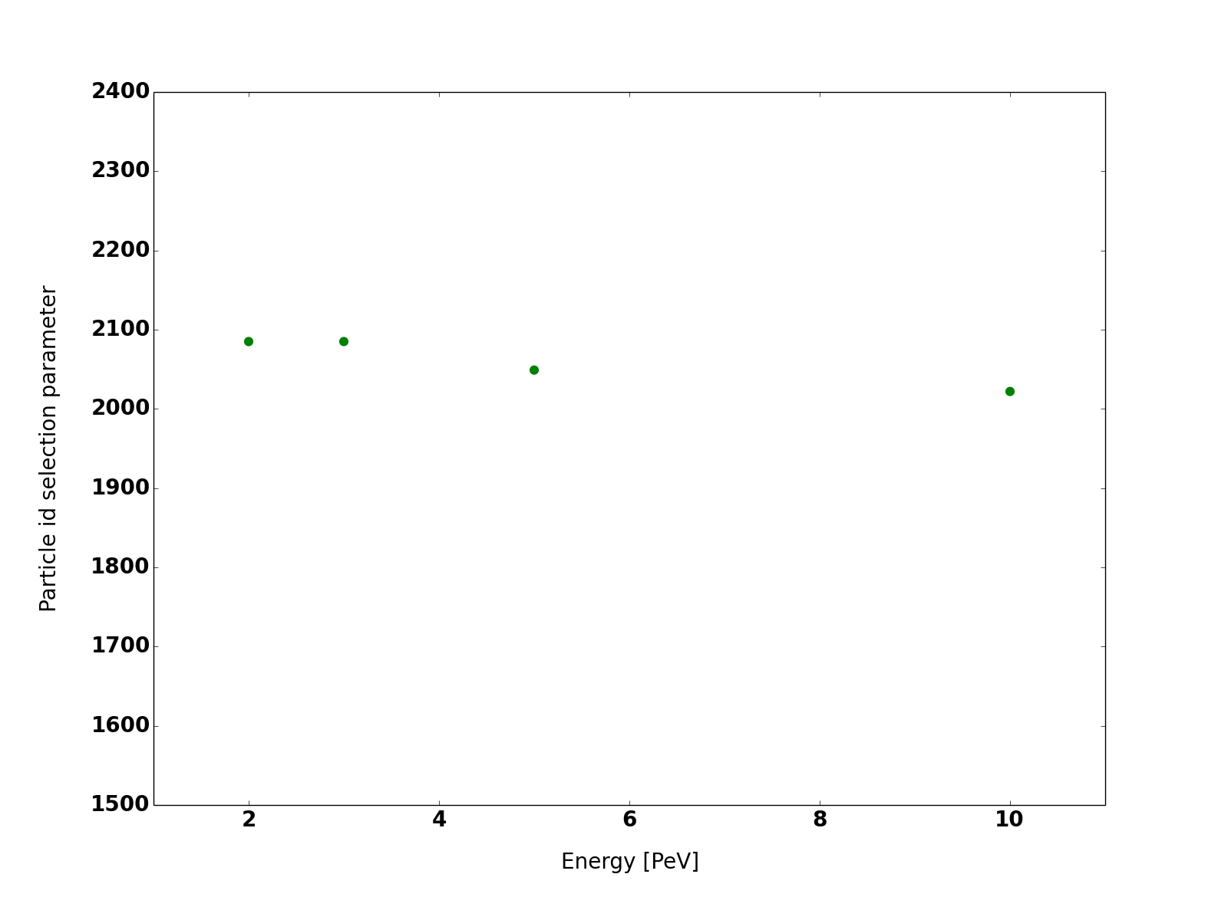
Particle separation Power
Aatif Waza
Separation power for Proton and Iron
Selection parameter value
Purity
Particle id selection parameter
2
4
6
8
10
2
4
6
8
10
Energy [PeV]
Energy [PeV]
Energy [PeV]
Purity and selection parameter are marginally changing with energy
The particle identification has low energy dependence!
Needs further investigation...

Slide 22
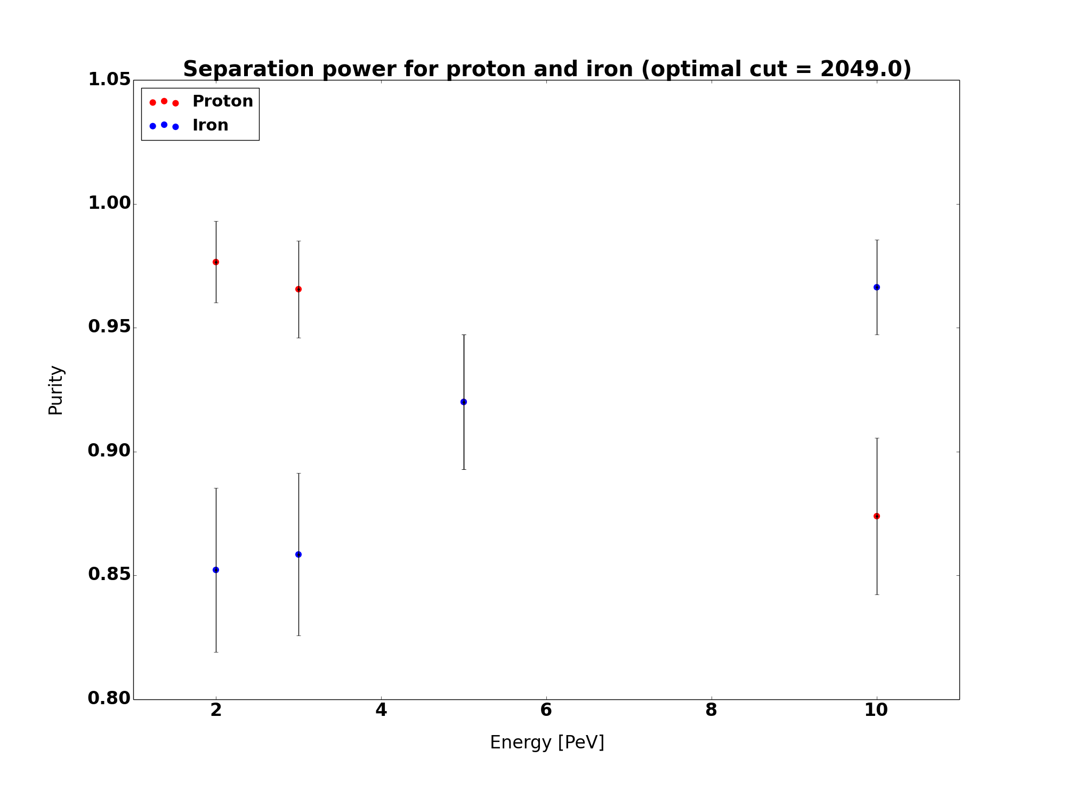
Particle separation Power
Separation power for Proton and Iron
Aatif Waza
Separation power for proton an Iron
Selection parameter value
Purity
Particle id selection parameter
2
4
6
8
10
2
4
6
8
10
Energy [PeV]
Energy [PeV]
Energy [PeV]
Energy [PeV]
Purity and selection parameter are marginally changing with energy
The particle identification has low energy dependence!
Needs further investigation...

Slide 23
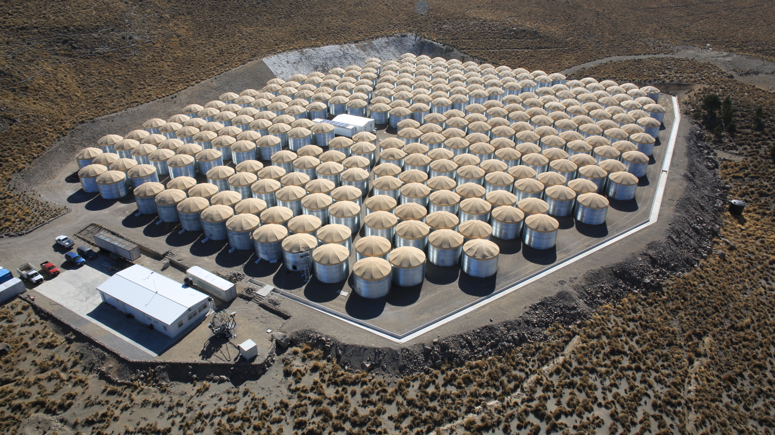


Applications for HAWC

Slide 24
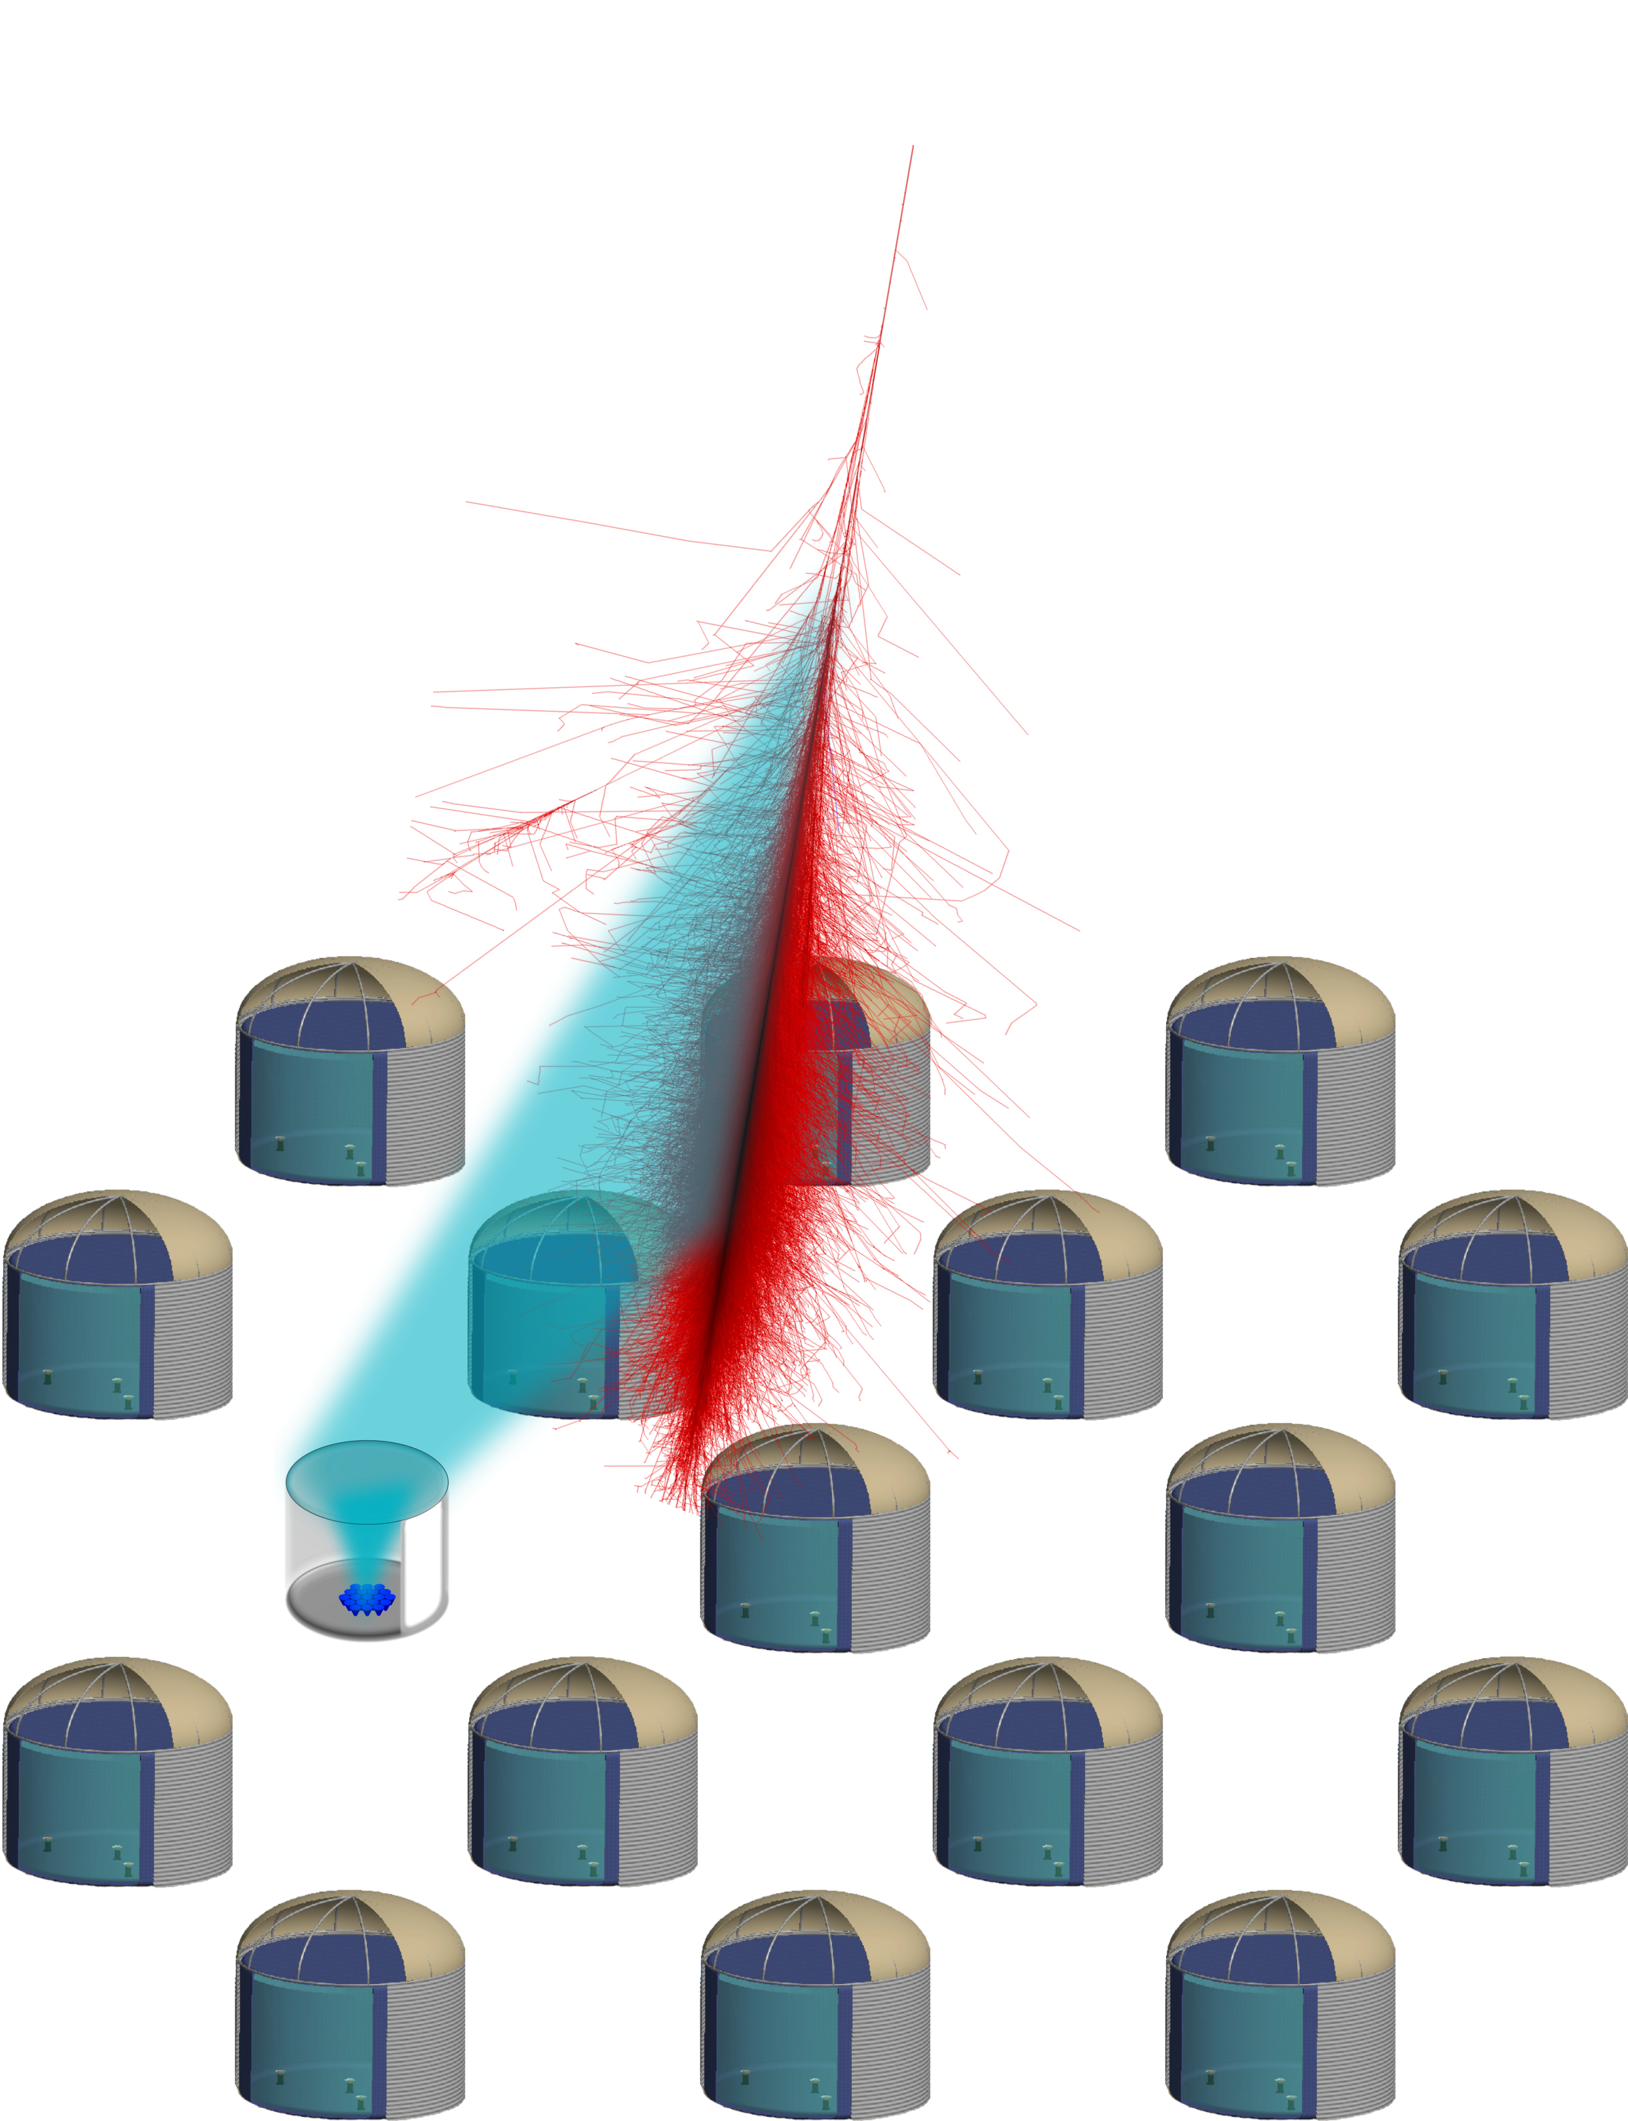

Array and air-Cherenkov hybrid detection:
Array (HAWC):
Ionizing particles:
  Inclination angle
  Shower core
  (y/Hadr. sep.)
IceAct/FAMOUS:
Cherenkov light:
  Primary Energy
  (y/Hadr. sep.)
Notes:
No XMAX,
No energy for HAWC
-at ground
Center of gravity → shower core
Title hybrid

Slide 25
Applications for HAWC
IceAct prototype telescope

Slide 26
Possible Applications for HAWC
Cut: Distance 40-50 m + shower contained
Shower contained: Less than 30 photons in the outer pixel ring.
Cut:
Distance 40-50 m
and shower contained
Done by Merlin Schaufel

Slide 27
IceAct/Famous is a candidate component for IceCube extensions.
- As a surface veto component
- For CR composition measurements
Prototype continuously running at South Pole.
- First coincident data with IceCube was shown
This year a fully equipped 61 pixel telescope will be deployed at the South Pole!
- can be used for IceTop calibration studies
IceAct/FAMOUS has the potential to improve the energy resolution of HAWC.
- Will be tested soon!
- Other applications like background separation might also be possible.
IceAct/FAMOUS summary

Slide 28
Thank you!

Slide 29
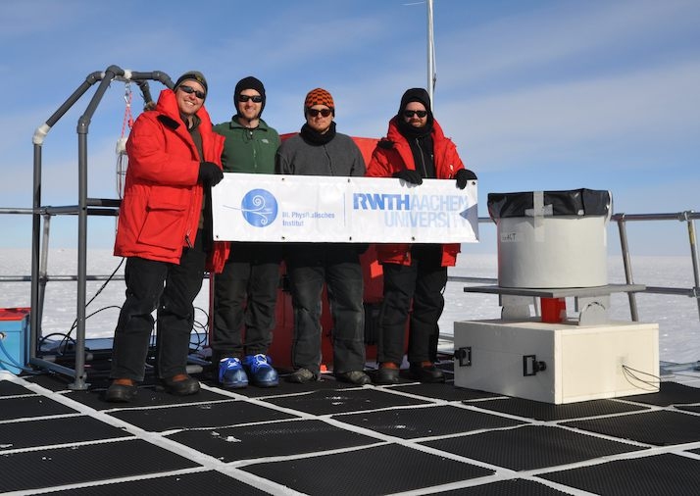
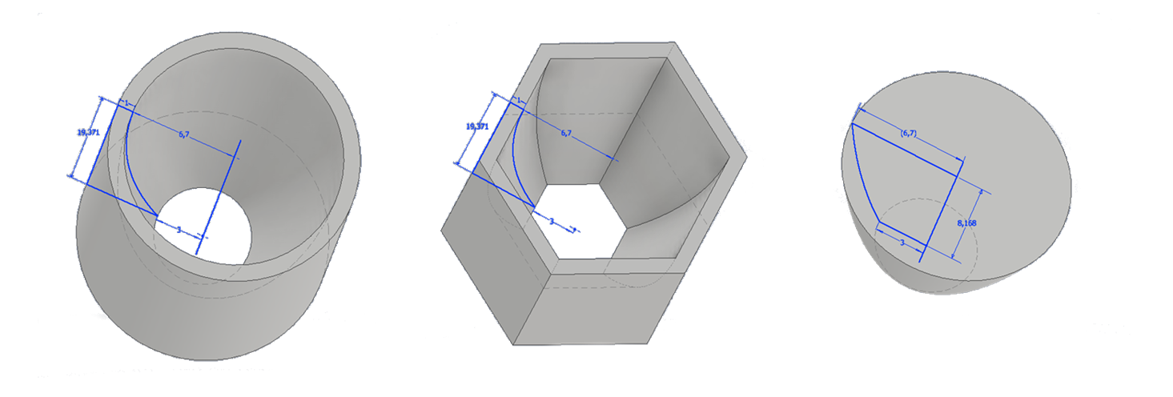
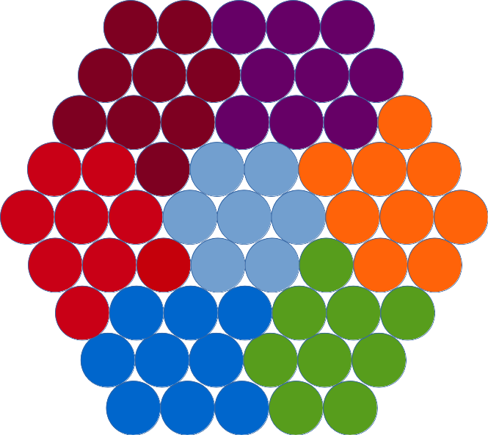
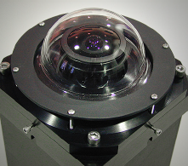
Let us know if you are interested
Let us know if you want to contribute to
Hardware R&D
  mechanics
  optics
  electronics
software development
  slow control
  daq
  monitoring
Simulation
  corsika for veto
  optical components
  array configuration for CR study
Data analysis
  IceAct as veto
  IceAct for composition studies
  IceAct energy reconstruction
  IceAct uptime study
  Skcam data analysis
  Lidar data analysis
…

Slide 30
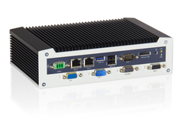
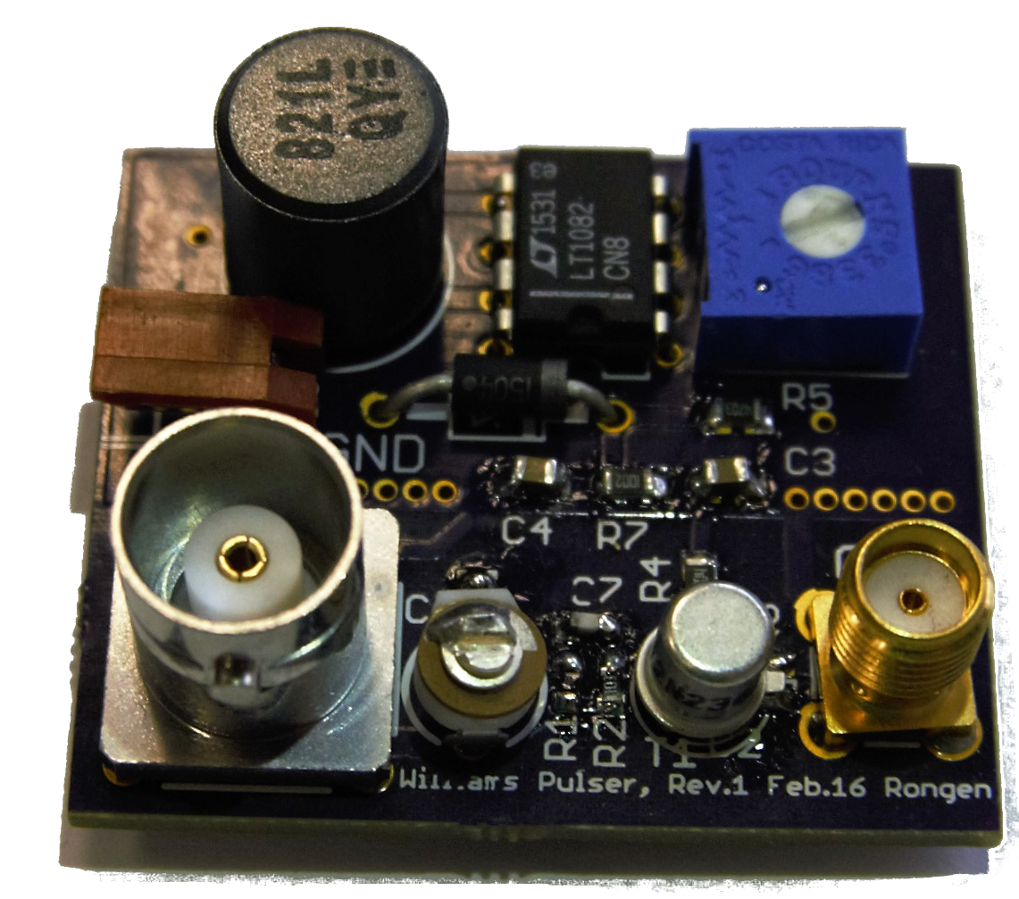
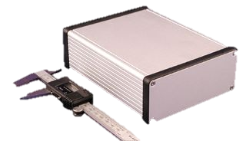
IceAct 16/17 (hardware)
Pixel wise calibration
of 7 pixel camera
removing the UG11 filter
New DAQ
adding a flasher LED
adding another heating system
New DAQ
Martin Rongen

Slide 31







Structure of the IceAct project
Bochum (Julia Tjus et al.)
– Physics motivation for ACT Veto
Dortmund (Wolfgang Rohde et al.)
– simulation
– environmental condition analysis
Canterbury (Jenni Adams)
  IceAct snow model development and construction
Erlangen (Stefan Funk, Adrian Zink, et al.)
– Traget7/C DAQ evaluation and implemtation assistance
MSU (Ty De Young et al.)
– IceAct veto array simulation
RWTH Aachen (Christopher Wiebusch, Jan Auffenberg, et al.)
– Prototype data analyses
– Prototype development (IceCube integration, mechanical and electronics development, calibration, …)
UW Madison (Kael, Albrecht, John, et al.)
  South Pole support (Mike D, John K. and many others)

Slide 32
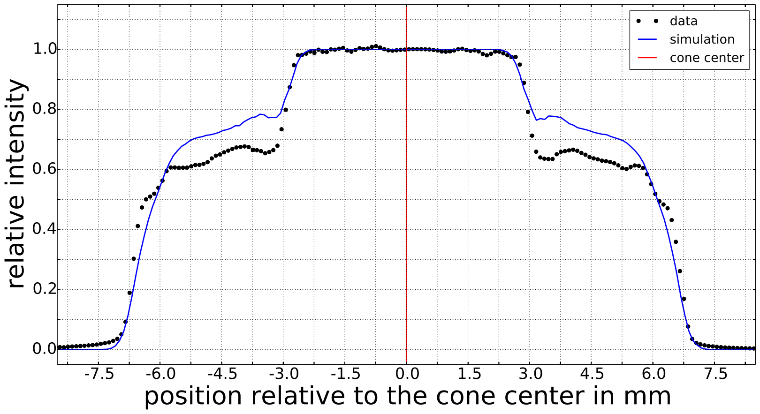
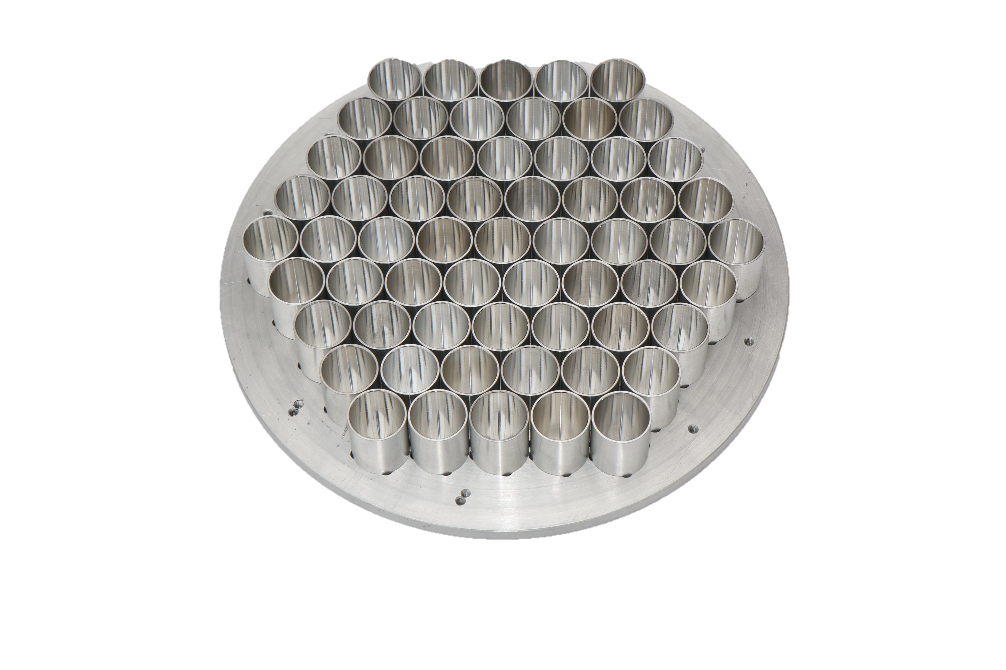
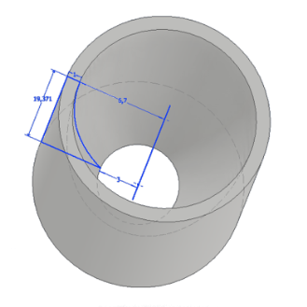

IceAct 17/18 (hardware)
61 pixel camera + DAQ
Jan Audehm
32

Slide 33
Summary
IceAct is a candidate technology for surface veto arrays
IceAct might be used for composition studies in the knee region already with about 4-6 telescopes.
The annual duty cycle seems to be ~20-25% to Veto CR with a threshold of ~20 TeV neutrino energy. A new skycam will measure this value to higher accuracy.
So far we did not evaluate the potential for gamma-ray detection
A first IceAct prototype was successfully taking data throughout the Polar winter.
We are interested in more people to join the IceAct effort!

Slide 34
Backup

Slide 35
iACT at South Pole Duty Cycle
The South Pole skycam data analyses summary:
  Observation between 16th-March-2015 and 27th-August-2015 (133 days)
  on average 40 stars (mag >2.7) where continuously monitored to estimate the cloudiness (limited by the quality of the camera)
  ~60% of the sky (57.4%) was clear. This corresponds to an annual duty cycle of 20-25%
  (This will increase with a better sky cam)
  Very good weather is in 43% of the dark period
  (less than 30% clouds)
  And acceptable weather (less than 60% clouds) is found in 73% of the time.
35

Slide 36







IceAct 17/18 (hardware)
Eff: 0.779
Eff: 0.918
Eff: 0.845
36

Slide 37



Statistics @ 1PeV
125*125*pi m^2 and 0.03 sr * 0.3 duty cycle * 1 CR/m2/year/sr (at PeV) * 3 (6 Telescopes in one direction each) = 1350 events. Without stereo requirement up to ~3800.
250m
150m

Slide 38


Precise CR Composition measurements in the knee region with IceTop and IceAct
Energy reconstruction comes mainly from IceTop
Directional reconstruction comes from IceTop
high of x-Max comes from IceAct telescope array

Slide 39



IceCube-Gen2 in gamma rays
Markus Ackermann
modified by
Jan Auffenberg
With IceAct ?
IceCube-Gen2 (10y, δ = -30°)
Without IceAct
Needs careful investigation
Improving the energy threshold down to 30 TeV might bring us into the game!

Slide 40
The future extension: IceVeto
We need more high energy tracks e.g. from the southern sky!
Open the southern sky for E < 100 TeV Neutrino induced muon tracks by vetoing signals with coincident air showers
40

Slide 41
Another Event
IceAct: 6168 Run: 128252 ID: 286064
41

Slide 42

Time calibration IceAct/IceTop
The pattern of the two fixed rate DRS4 boards
has to be found in the random coincidence data
with IceCube
For more information see talk by Maurice Günder

Slide 43

Time calibration IceAct/IceTop
43

Slide 44

Time calibration IceAct/IceTop
Physics
Triggers
Triggers
Board 1
Triggers
Board 2
44

Slide 45

Weather conditions for the ACT
http://mplnet.gsfc.nasa.gov/data?s=South_Pole&v=V3
45

Slide 46
Weather conditions for the ACT
3.5
3.3
3.1
3.0
2.9
km
It is going to be interesting!
46

Slide 47

Prototype at the South Pole
Power Supply
110 DC
7 Pixel Camera
DRS4 Board
Ethernet
USB (Signal)
NUC
110 DC
USB (Signal)
Ethernet
DOM mainboard
SensL
SiPMs
Coax
DRS4 Board
Trigger
IN/OUT
IceCube network
Serial
IT filterbank 22 + ithub08
SPADE

Slide 48
Small ACT for harsh environments
At South Pole since 2015
One more in 2017!
Learning from IceCube, FACT and CTA:
Very efficient CR detection (veto) to open the
southern sky for high energy neutrino detection
with IceCube.
Third detector component for IceCube and IceTop
to precisely measure the composition of CR above 2 PeV.
Possible second component for HAWC improving
the Energy reconstruction (1 will tested in Mexico in May).
Applications for CTA are under investigation.
IceAct &
IceCube
South Pole
First time that SiPMs are taking stable data at the South Pole!
Trailblazer in Germany: Aachen, Bochum, Dortmund, Essen

Slide 49





IACT at South Pole Duty Cycle
Cloudy Day
Recorded Aurora
Nice Day
Aurora has no
strong influence

Slide 50


Cloud monitoring is about to improve
sensor:
Kodak KAI-340 CCD
(640 x 480 pixels)
Lens:
Fujinon's FE185C046HA-1,
1.4 mm focal length, F/1.4
https://www.sbig.com/products/cameras/specialty/the-allsky-340-camera/
Installed this Season!

