Slide 1


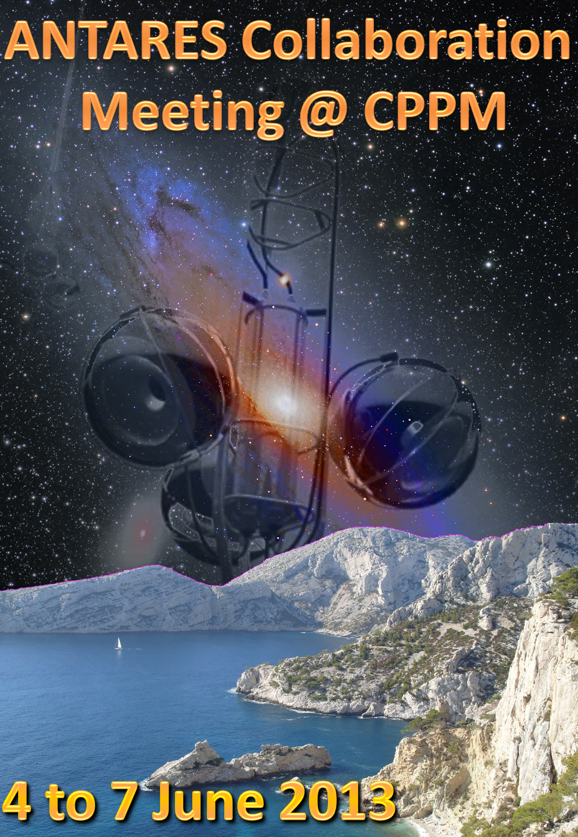
Recent Results from ANTARES
Largest underwater neutrino telescope running since 2007
Excellent view of galactic center region with high angular resolution
→ Interesting constraints on the origin of the IceCube signal
Antoine Kouchner
Université Paris 7 Diderot
AstroParticle and Cosmology APC
IceCube Symposium, Madison, Wi, USA May, 2017

Slide 2
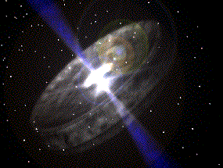
Science scope
2
2
Low Energy
> 10 GeV
Medium Energy
10 GeV < E_{ν} < 1 TeV
High Energy
E_{ν} > 1 TeV
ν Oscillations
Dark matter search
→Tonnis’ presentation
from extra-terrestrial sources
Origin and production mechanism of HE CR
+ Exotic searches
ANTARES = multi-disciplinary observatory
Main focus in this talk
Earth and Sea Sciences: oceanography, biology, geology, climate monitoring …

Slide 3
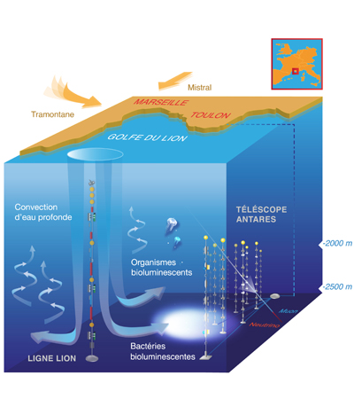
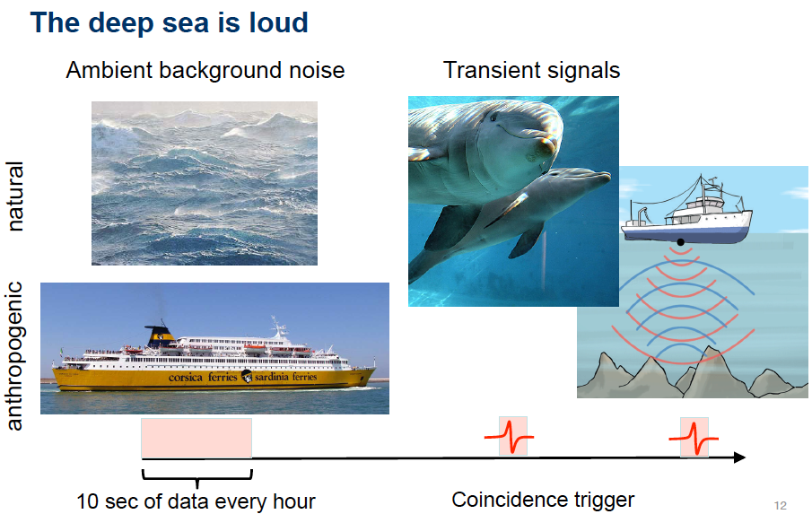
Connections to Earth and Sea sciences
3
Publications associées
   PLoS ONE 8 (7) 2013
  Deep-sea bioluminescence blooms after dense water formation at the ocean surface
  Journal of Geophysical Research: Oceans, Vol 122, 3, 2017
  Deep sediment resuspension and thick nepheloid layer
  generation by open-ocean convection
  Deep-Sea Research I 58 (2011) 875–884
  Acoustic and optical variations during rapid downward motion episodes in the deep North Western Mediterranean
  Sci. Rep. 7 (2017) 45517
  Sperm whale diel behaviour revealed by ANTARES, a deep-sea neutrino telescope
  Ocean Dynamics, April 2014, 64, 4, 507-517
  High-frequency internal wave motions at the ANTARES site in the deep Western Mediterranean

Slide 4
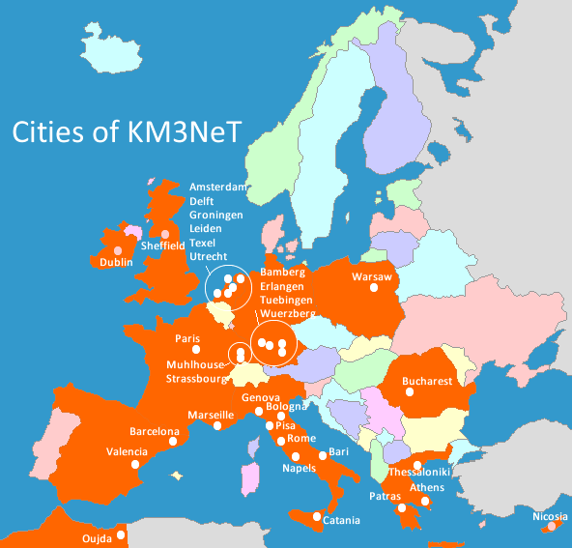



The ANTARES Collaboration
4
ANTARES
KM3NeT
and ANTARES
*
Moscow
*
Münster
*
*
*
Connection nodes of
+ Since April 2017:
CIRA Perth Australia
as observer
*
*
*
*
*
*
Saclay
*
Nantes
Strasbourg
Mulhouse
*
*
Clermont
*
*
*
*
*
*
*
*
*
Granada
ANTARES
ORCA
*
Deployment sites
Marrakech
*
*
*
Rabat
*
ARCA
*

Slide 5
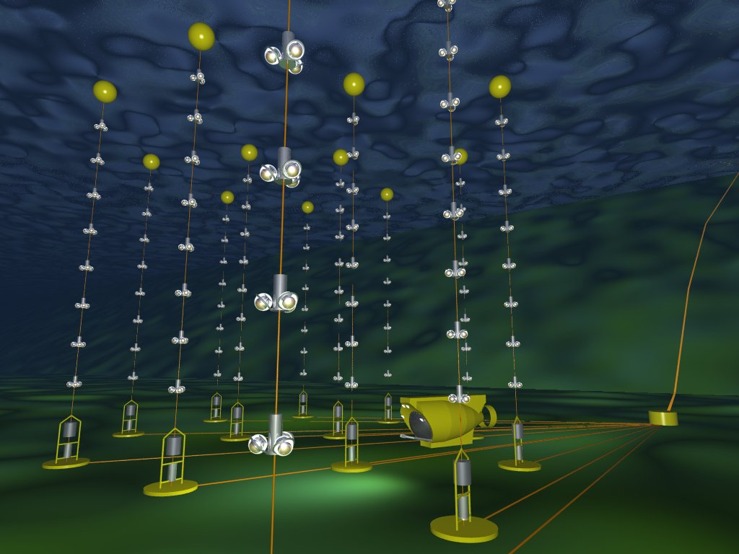
The ANTARES Neutrino Telescope
5
NIM A 656 (2011) 11-38
2500 m depth
25 storeys / line
3 PMTs / storey
885 PMTs
350 m
Deployed
in 2001
14.5 m
40 km
100 m
Junction box
(since 2002)
~70 m
Anchor/line socket
Interlink cables
©Montanet

Slide 6
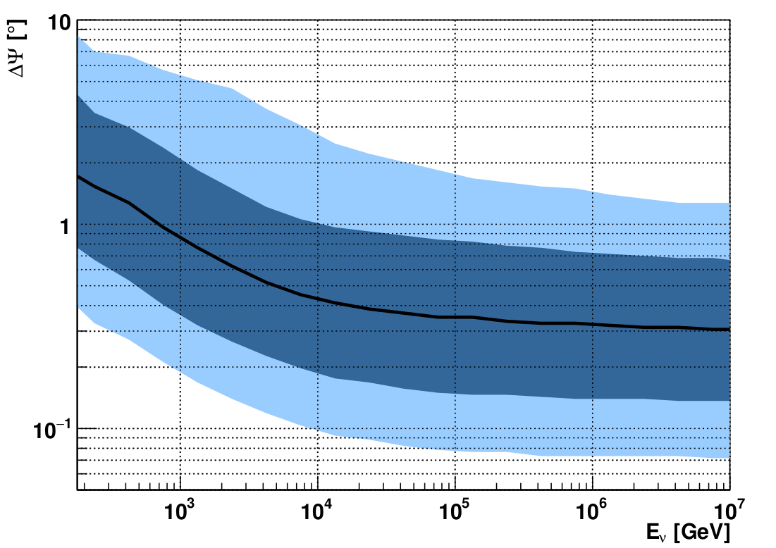
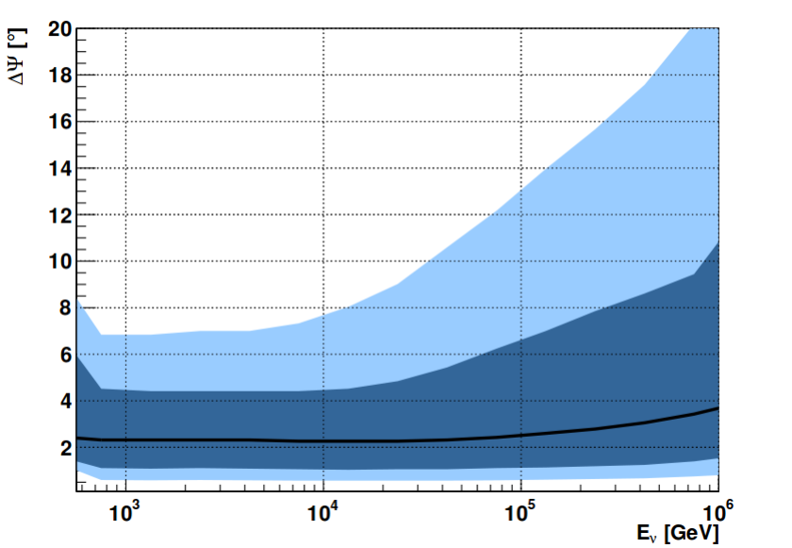
Reconstruction performances
6
tracks
Upgoing track events (ν_{μ}CC)
Angular resolution <0.4° for E_{ν}>10 TeV
90% purity
angular resolution (°)
median resolution
Upgoing cascade events (ν_{e/}ν_{t} CC, NC)
Angular resolution < 3°
Energy resolution for ν_{e}CC better than 10%
cascades
angular resolution (°)

Slide 7
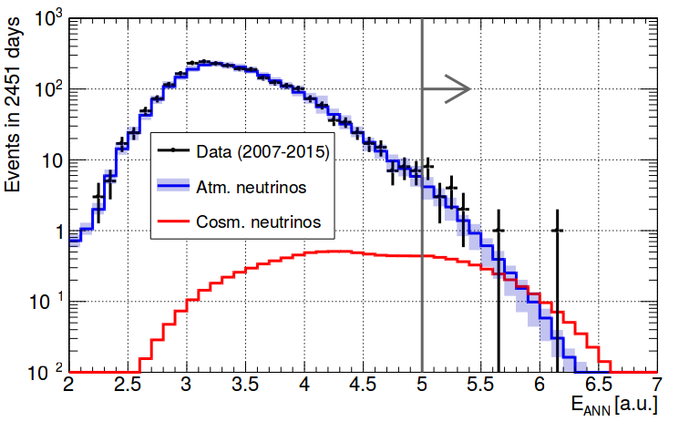
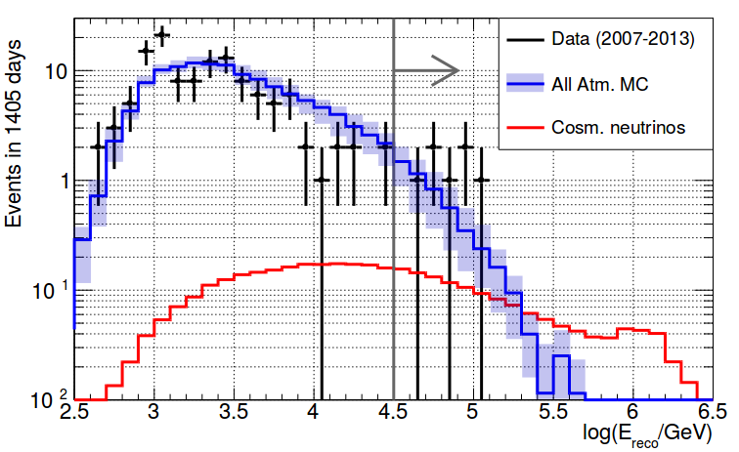
Diffuse flux (all flavors) PRELIMINARY
7
Tracks
Data: 2007-2015 (2451 livedays)
Above E_{cut}: Bkg: 13.5 ± 3 evts, IC-like signal: 3 evts
Observed: 19 evts
Cascades
Data: 2007-2013 (1405 livedays)
Above E_{cut}: Bkg: 5 ± 2 evts, IC-like signal: 1.5 evts
Observed: 7 evts
Energy Estimator
Reconstructed Energy
Compatible with
both bkg and IC
expectations
To be updated
@ ICRC17
PRELIMINARY

Slide 8
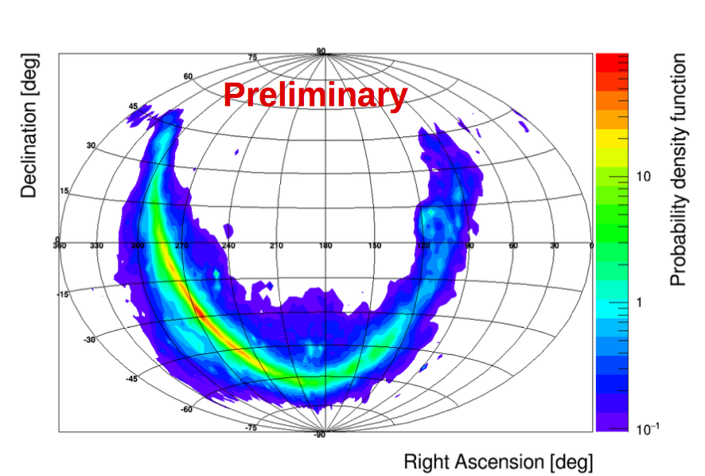
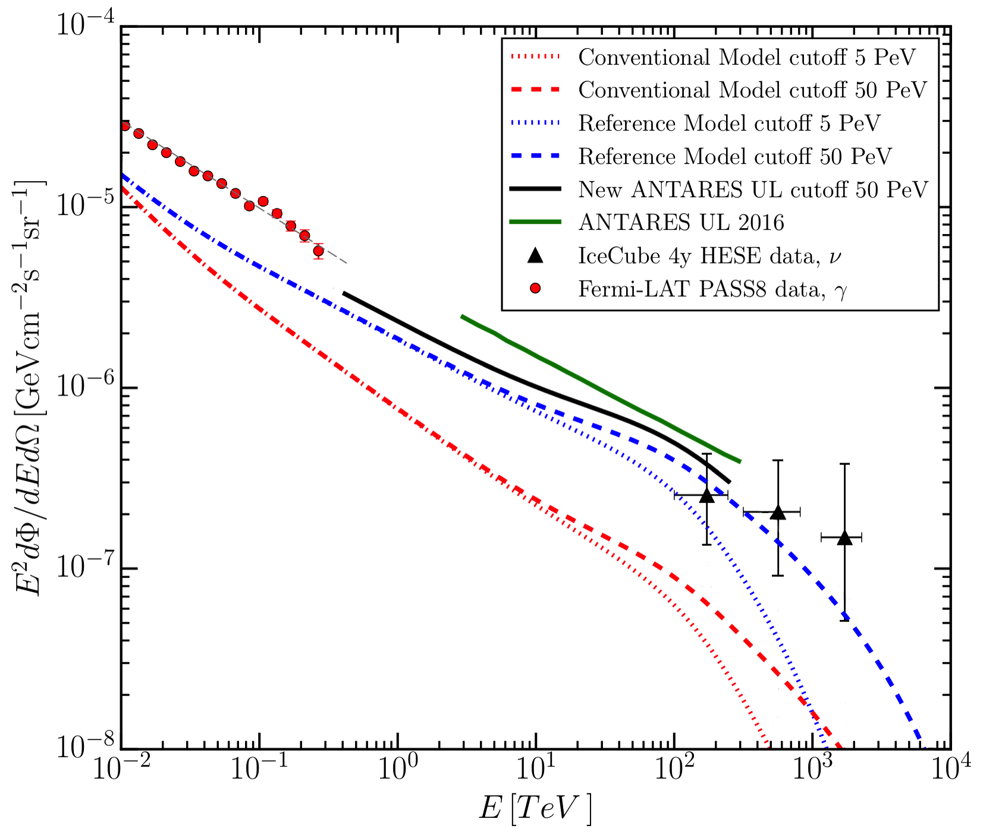
Search for diffuse flux from Galactic ridge
8
PDF for track events according to KRAγ model
Previously: Signal/off-zone analysis
2007-2013 data, track events
no excess found
 PLB 760, 143 (2016)
New all-flavour analysis
2007-2015 data, track & cascade events
Likelihood approach probing KRAγ model
Limit at 1.25 x KRAγ model
|l| < 40◦ and |b| < 3◦
At most 19% of HESE dataset can originate
from CR diffusion.
⬄ 5.6 out of the 30 HESE with E>60TeV
Combination with IC ongoing
PRELIMINARY
arXiv1705.00497

Slide 9
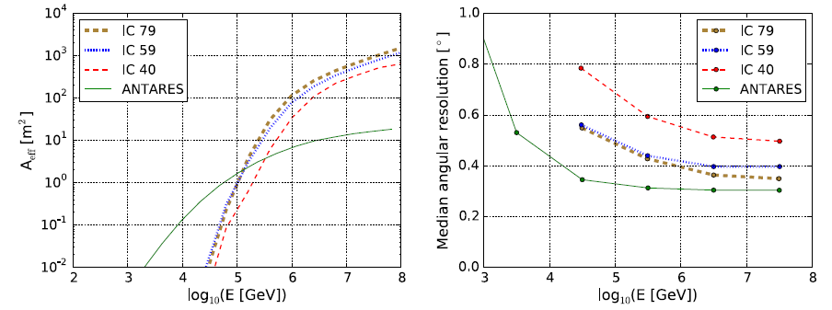
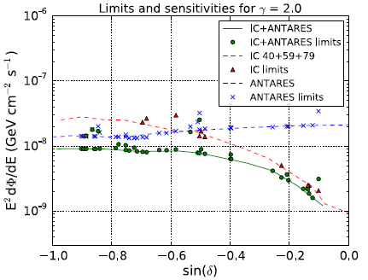
Combined ANTARES-IceCube PS search
9
ANTARES 2007-2012 and the IC40, IC59, and IC79 samples for the Southern Hemisphere
ApJ‐L.786:L5 (2014) → Public Sample @ http://antares.in2p3.fr
for δ = -30°
Effective areas
Angular resolution
Combined sensitivities (green line) and
90% CL limits (points) for E⁻² spectrum.
Blue (Red) curves/points indicate ANTARES (IceCube) sensitivities/limits
 ApJ 823 (2016) no.1, 65

Slide 10
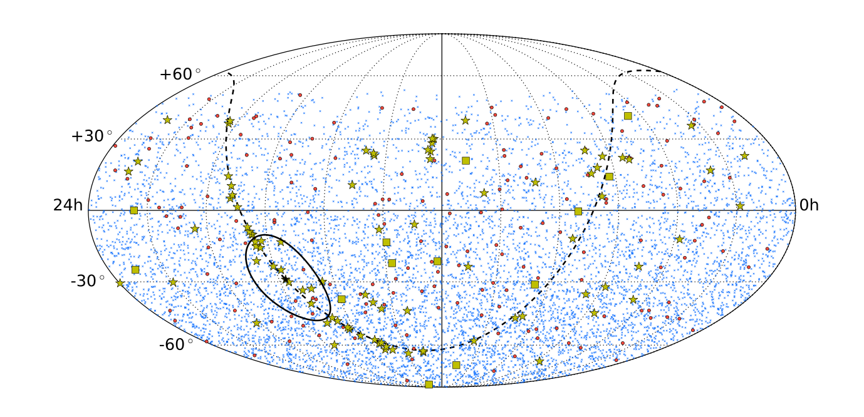
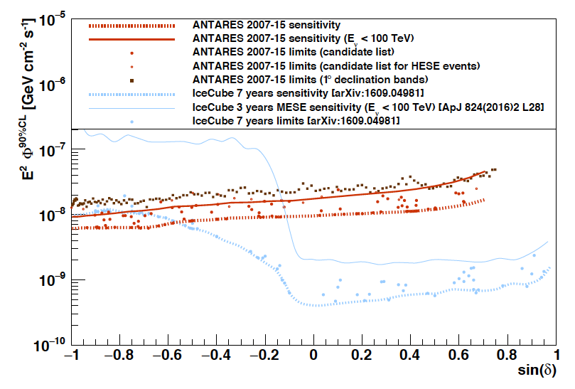
All flavor point source search
10
Candidate
Sources
IC HESE tracks
Blue: Tracks
Red: Cascades
2007-2015 (2424 days):
7629 tracks, 180 cascades
Unbinned all-sky search
103 Candidate sources
including 13 IceCube HESE tracks
and HAWC sources
GC region
No significant excess
Best limits for part of Southern Hemisphere
Excellent sensitivity for E_{ν} <100 TeV
Results to be combined with latest
IC search
PRELIMINARY
Open circles:
IC HESE tracks

Slide 11
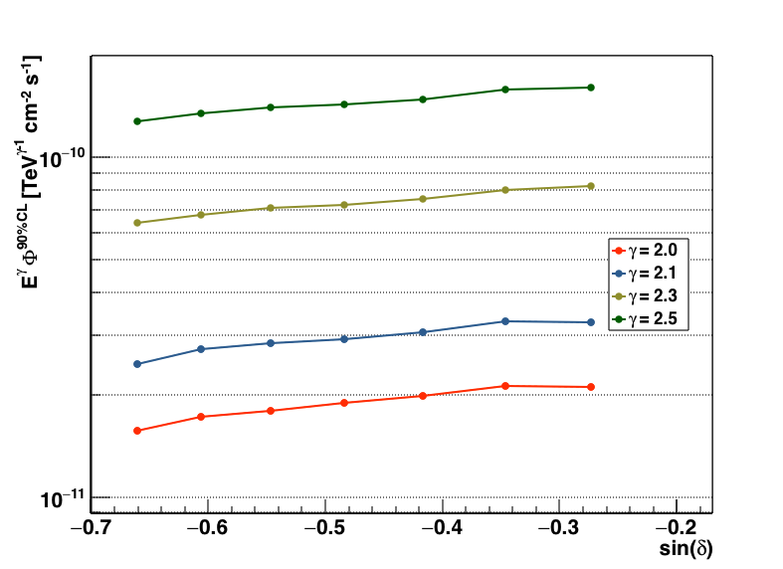
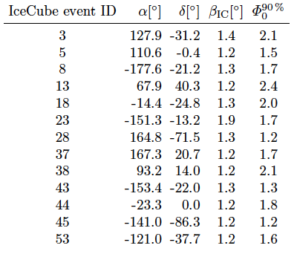
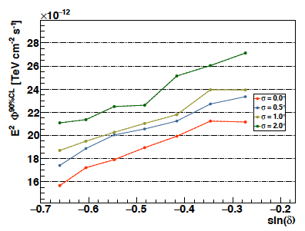
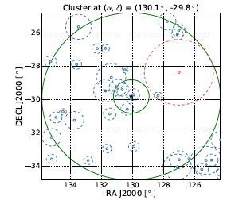
Special focuses
11
IceCube HESE muon tracks
Limits (10⁻⁸ GeV cm⁻² s⁻¹)
Dedicated Search in GC region
PRELIMINARY
Spectral
index
PRELIMINARY
E⁻²
Extension
5.3 sig. events
1.2 σ

Slide 12
The multi-messenger program
12
1st approach:
Time dependent searches
GRB
Microquasar
Gamma-ray binaries
Blazars
Supernovae Ib,c
Fast Radio Bursts

Slide 13
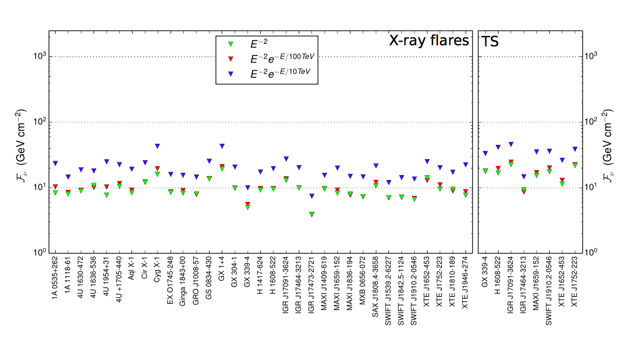
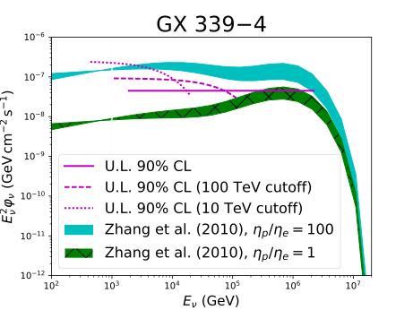
13
Constraints on neutrino emission by flaring X ray Binaries
Use light curves and assume
neutrino emission coincident
in time with electromagnetic
outburst
90% CL upper limit for the flaring periods
Using track events 2008-2012
 JCAP 04 (2017) 019
Start constraining some hadronic microquasar emission models
High baryonic loading disfavored
To be updated @ ICRC17

Slide 14
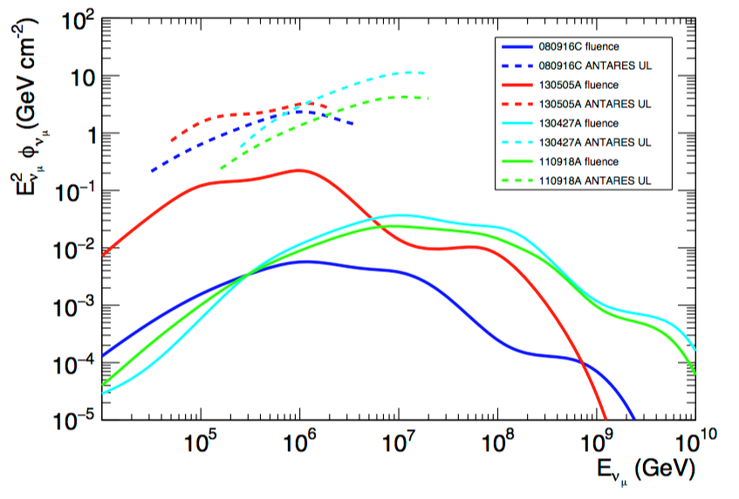
Gamma-ray bursts
14
Search for muon neutrinos for 4 bright GRB observed between 2008 and 2013
Two scenarios are investigated:
  internal shocks
  photospheric models
  → use of unfiltered data + special algorithm
 arXiv:1612.08589, MNRAS in press
ɣ-rays+ν
Stacked search for time shifted neutrinos (during 5 years of ANTARES data): probes wider time windows up to 40 days: no significant detection
 Eur.Phys.J. C77 (2017)
Solid: model
Dashed: 90% CL

Slide 15
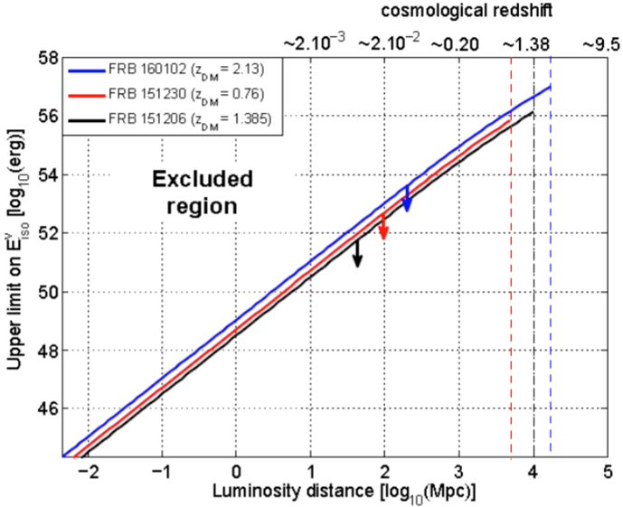
Fast Radio Bursts
15
MoU signed in 2015 between the SUPERB project (FRB discovery) at the Parkes
SUPERB team → send the FRB trigger alerts to the ANTARES alert pipeline
ANTARES coll.→ fast search for neutrino counterpart in the online neutrino data stream
7 FRBs analyses by ANTARES so far
No events within [TFRB-250s;TFRB+750s] in RoI=2°, Compatible with background
⇒ 90% C.L. upper limit on the total energy emitted in neutrinos for E⁻² & E⁻¹
1.4 x 10⁵⁵ erg (E⁻²)
3.1 x 10⁵⁶ erg (E⁻¹)
Preliminary
 MNRAS, in press

Slide 16
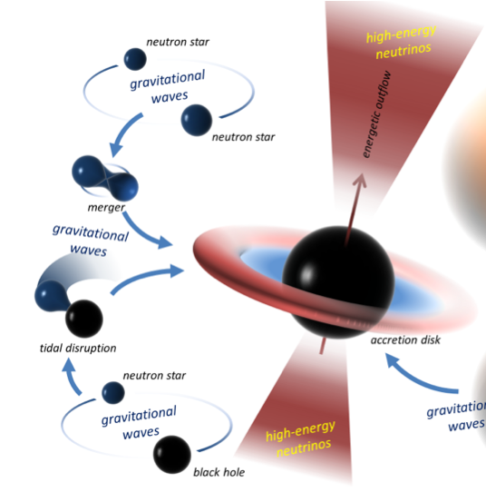
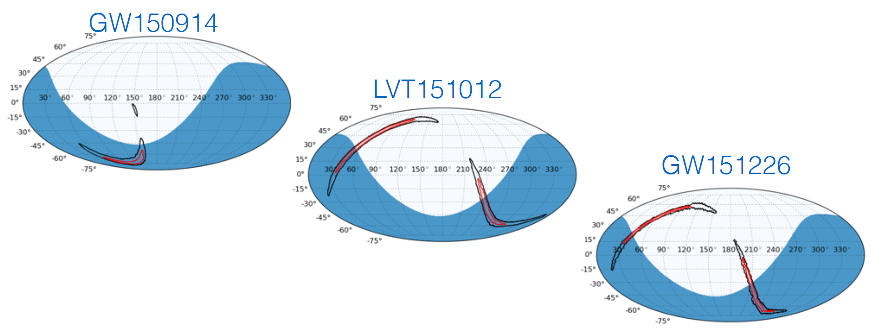
16
Search for Coincidences with Gravitational Waves
Mostly for BH/NS or NS/NS systems :
Gravitational waves
+ electromagnetic
+ neutrino emission (if baryonic ejecta)
No counterpart observed so far
Limits from ANTARES dominate Eν < 100 TeV wrt IC
Limit on total energy radiated in neutrinos: <10% GW
 PRD 93, 2016
Now real time follow-up
of ongoing science run
 arXiv:1703.06298

Slide 17
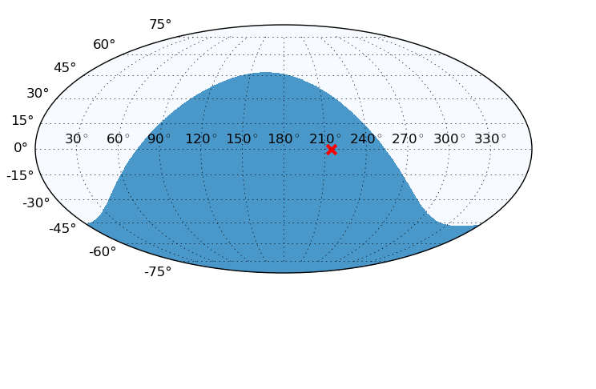
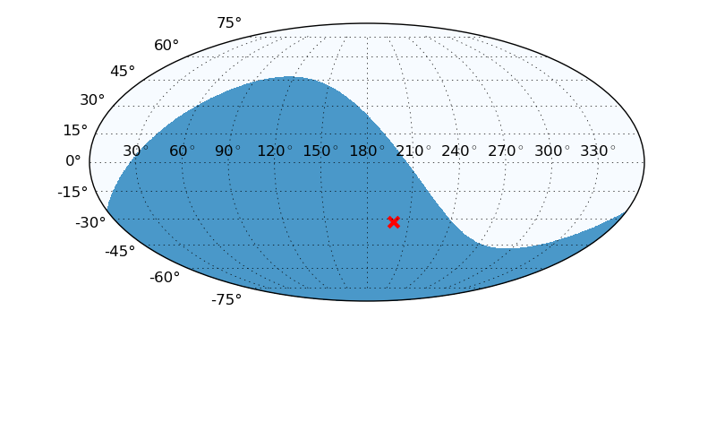
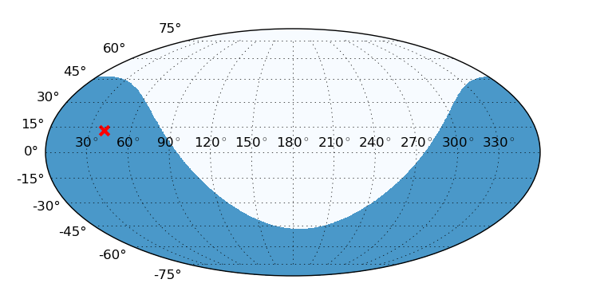
Icecube ALERTs
17
Search for counterpart to IceCube events
ICecube HE events
IceCube High Energy Starting Events and Extremely High Energy (>1 PeV) events.
IC160731
IC160814
IC161103
No event found in coincidence (ROI=2°),
± 500 s ; ± 1h
Upper limit on the radiant neutrino fluence
for E⁻² and E^{-2.5} spectra:
~15 GeV/cm2 in [2.8 TeV, 3.3 PeV] for E⁻²
~30 GeV/cm2 in [0.4 TeV, 280 TeV] for E^{-2.5}

Slide 18
The multi-messenger program: TATOO
18
Telescope-Antares Target of Opportunity
2nd approach:
Alert
triggering
Real-time analysis
+ …
- Time to send an alert: ~5 s
- First optical image <20 s
- Median angular resolution: ~0.3°
- Triggers: single HE, preferred direction,
multiplets

Slide 19
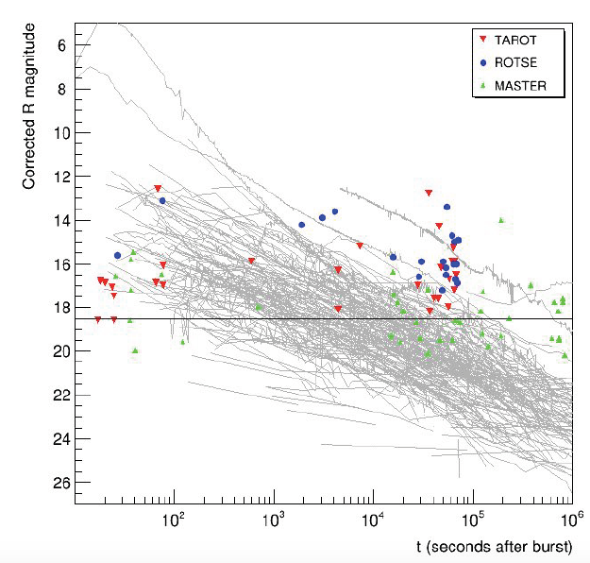
TATOO and the GRBs
19
Radio
Optical
X-ray
GeV ɣ-rays
TeV ɣ-rays
MWA
(12/yr)
TAROT
ZADKO
MASTER
(GWAC)
(30/yr)
Swift
(6/yr)
Fermi
(offline)
HESS
(2/yr)
HAWC
(offline)
93 alerts with early (<24h) follow-up (01/2010- 01/2015)
13 follow-ups with delay < 1min (best 17s)
13 X-ray Swift follow-up (5-6hr delay)
No transient candidate associated to neutrinos
GRB origin unlikely
 JCAP 02:062, 2016

Slide 20

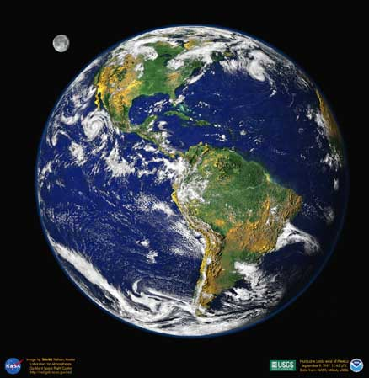
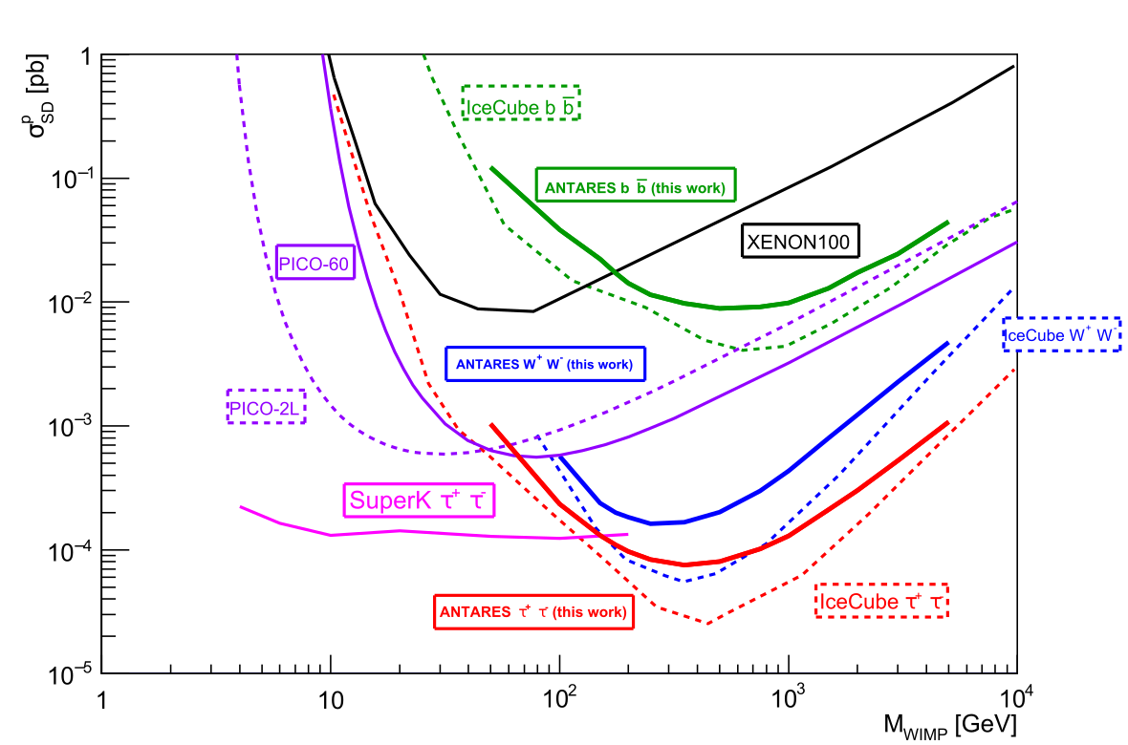
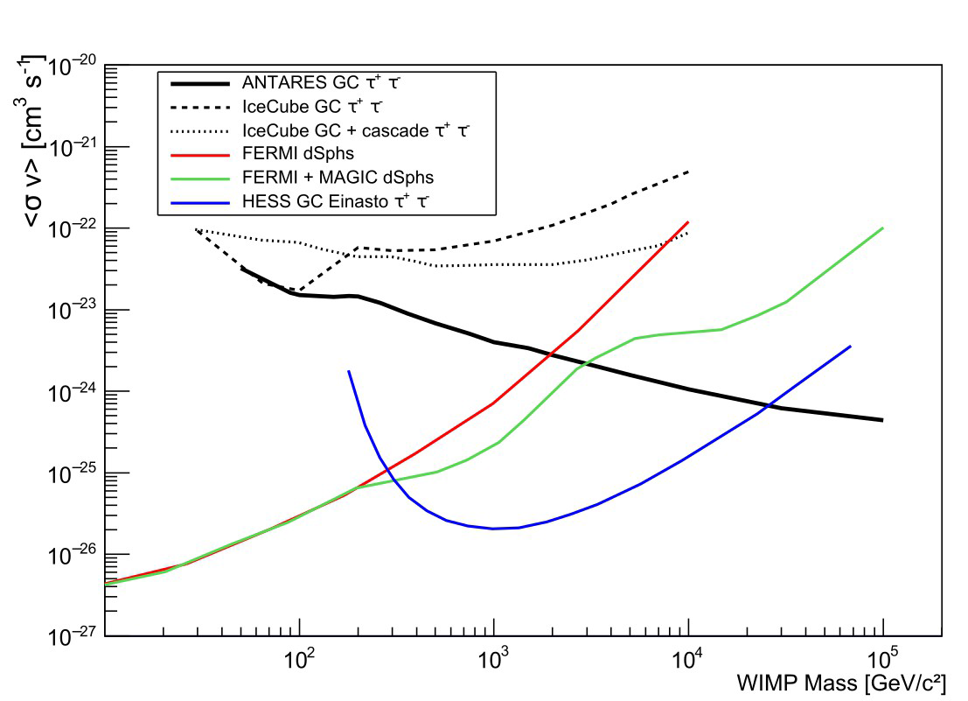
Indirect Search for Dark Matter
20
Relic WIMPs gravitationally bound / elastic collisions
(Sun, Earth, Galactic Center)
χ
Earth
χ
χ
χ
ν
χ
<E_{ν}> ~ M_{χ}/3
ANTARES
 Phys.Lett. B759 (2016) 69-74
Track channel only
 Phys. Let. B 769 (2017) 249
2007 - 2015
2007 - 2012
M_{WIMP}(GeV)
M_{WIMP}(GeV)
Also DM from the Center of the Earth :  Physics of the Dark Universe, 16 (2017) 41–48

Slide 21
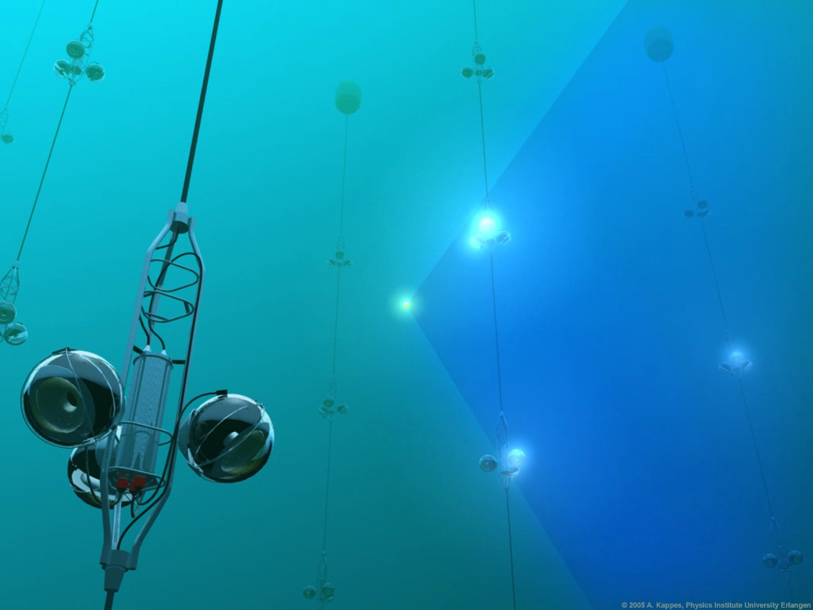
Summary
ANTARES is the largest NT in the Northern hemisphere.
A multi disciplinary observatory (associated sciences).
Competitive physics results.
Constraints on neutrinos as seen by IceCube.
Includes cascade-like events various analyses
  Good pointing power
Extensive multi-messenger program.
Although technologically challenging ANTARES
is working according to specifications.
Proves the feasibility of a deep sea Neutrino Telescope.
→ KM3NeT
Thanks for your attention

Slide 22
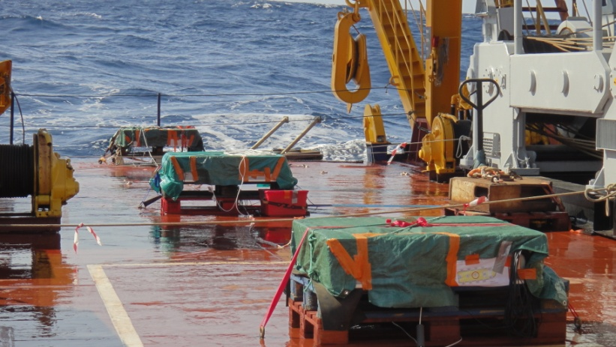
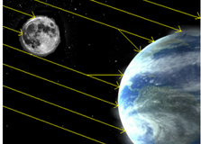
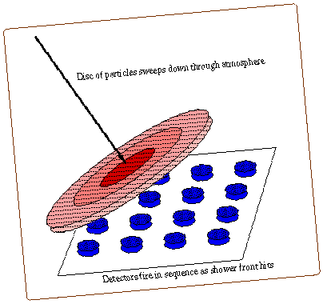
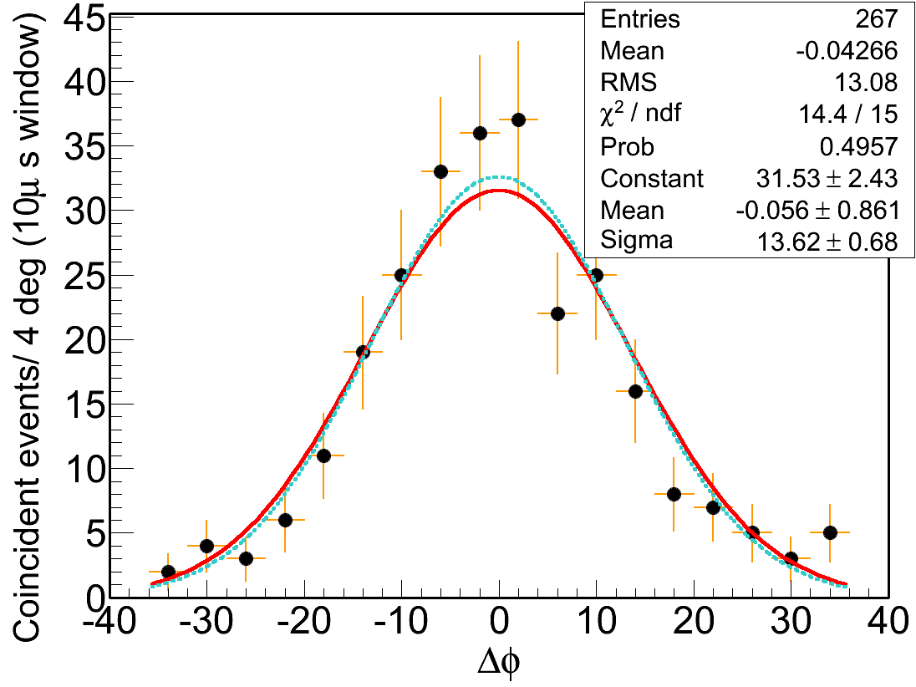
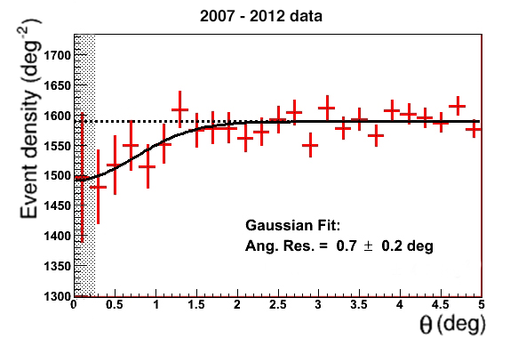
Absolute Pointing
22
Atmospheric shower
Array of 15 scintillator units
(0.8 m² each)
Moon shadow
as seen
by ANTARES
(3 σ)
180 m
Reconstructed track
350 m
100 m
To be updated @ ICRC17
Constraints:
-0.056±0.861°
Preliminary
2 sea compains
22

Slide 23
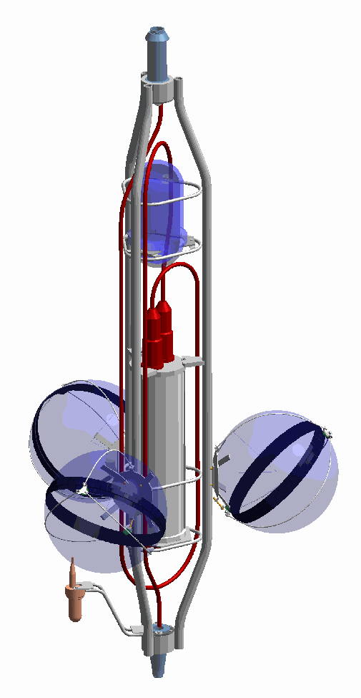
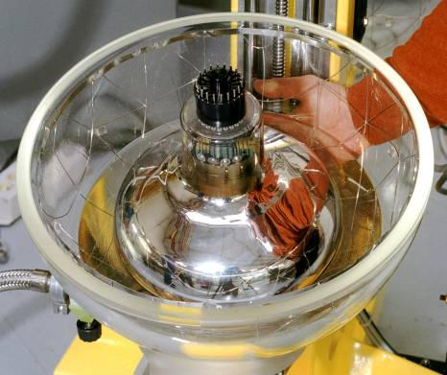
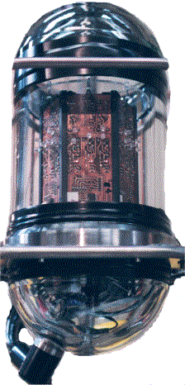
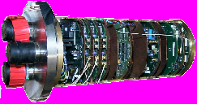
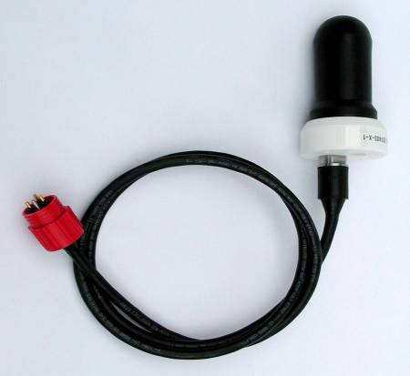
Basic neutrino detector element: storey
23
Titanium frame: support structure
Optical Beacon
with blue LEDs:
timing calibration
 NIM A578 (2007) 498
Optical Module:
10” Hamamatsu PMT in
17” glass sphere
photon detection
NIM A484 (2002) 369
NIM A555 (2005) 132
Local Control Module (Ti):
Front-end ASIC, DAQ/SC, DWDM,
Clock, tilt/compass, power distribution…
 NIMA 622 (2010) 59-73
Hydrophone:
acoustic positioning
 JINST 7 T08002

Slide 24
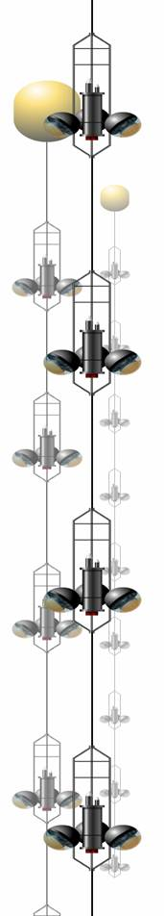
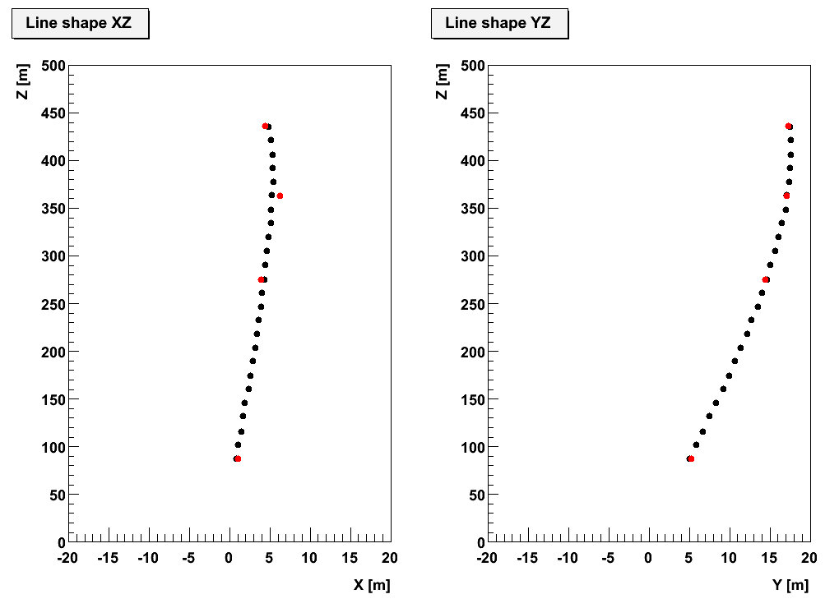
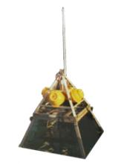
Detector Calibration
24
Hydrophone
Led/laser beacons
Intense light:
PMT TTS negligible
hydrophones
Timing resolution
of electronics
~ 0.5 ns
storey positions fit
Positioning resolution
< 10 cm
Autonomous
Transponder

Slide 25
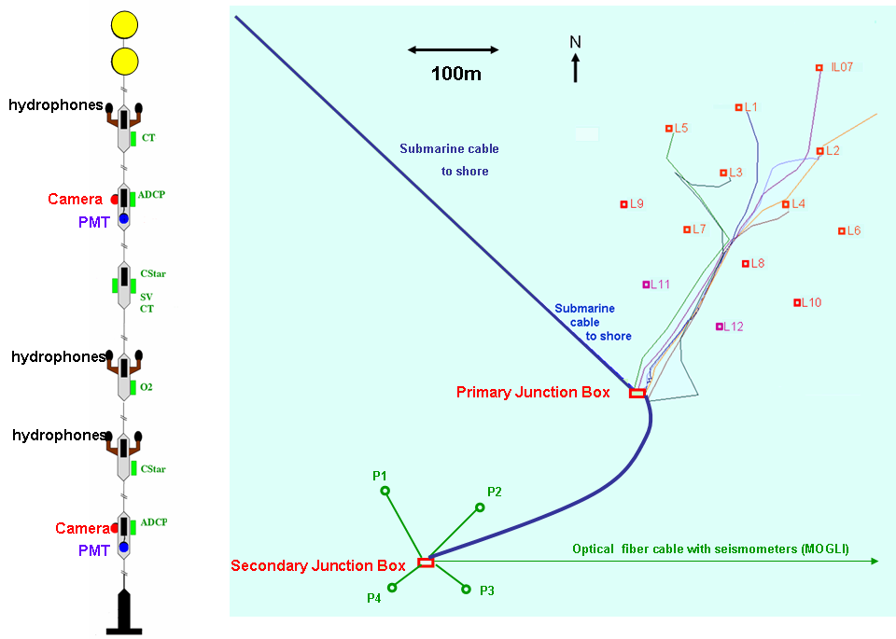
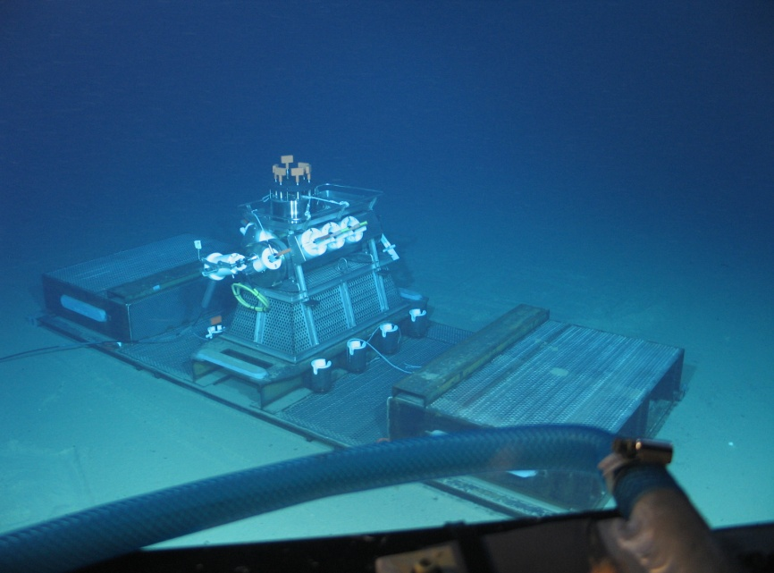
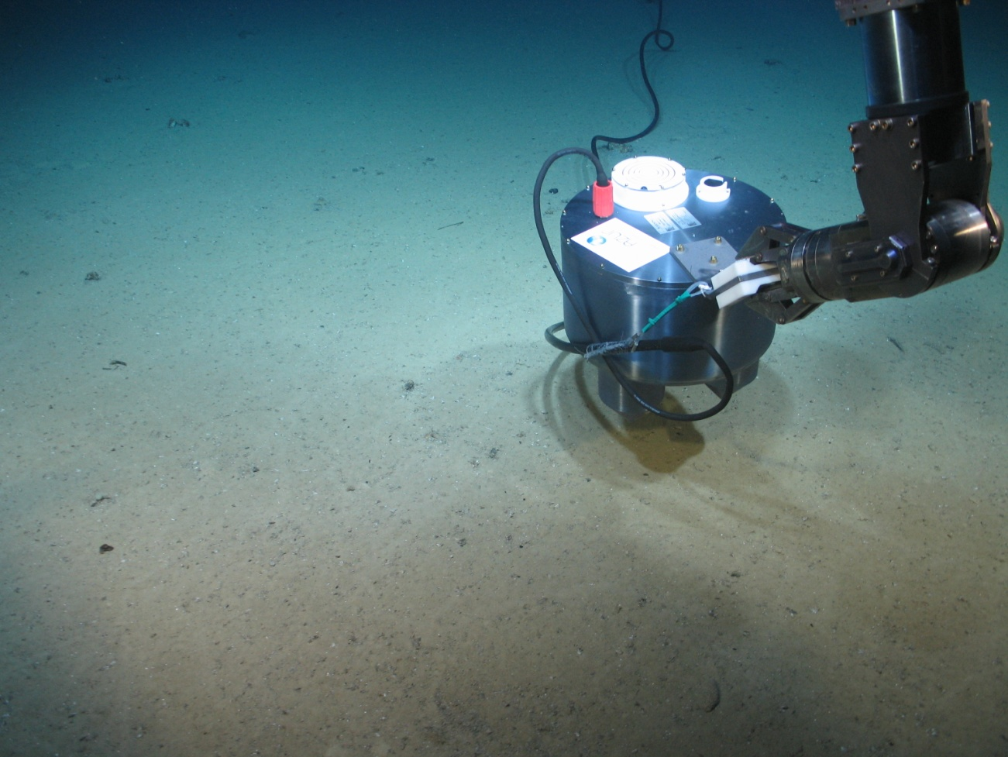
The ANTARES Infrastructure
25
Junction box 2001
Main cable 2002
Line 1, 2 2006
Line 3, 4, 5 01 / 2007
Line 6, 7, 8, 9, 10 12 / 2007
Line 11, 12 05 / 2008
IL13
Reconnected in
April 2013 with KM3NeT OM.
Houses together with L12 the sensors of the AMADEUS acoustic neutrino detection test system.
Connected
30 Oct 2010
DeepSeaNeT: optical fibre cable with seismographs

Slide 26




Search for diffuse flux from Galactic ridge
26
E^{-2.6} spectrum usually expected
Search with muon neutrinos only

Slide 27


Slide 28

Search for diffuse flux from Galactic ridge
28

Slide 29



Probing neutrinos from the Fermi Bubbles
29
Visibility signal and off-zones
New analysis 2008-2015
- only tracks
- energy threshold
- no significant excess
- ongoing work to include cascades
To be updated @ ICRC17

Slide 30







The multi-messenger program
30
GeV-TeV γ-rays
UHECR
Fermi, HESS, HAWC
Auger, TA
HE neutrinos
Radio-Visible-X
IC
Grav. Waves
MWA, SUPERB
TAROT, ZADKO, MASTER,
Swift
LIGO-VIRGO-EGO
Neutrino telescopes suited for transient sources: continuous monitoring >2π sr
Background reduction + increase of statistical significance

