Slide 1
Recent NOvA Experiment Results
Leon Mualem
For the NOvA Collaboration
Caltech
May 8, 2017

Slide 2
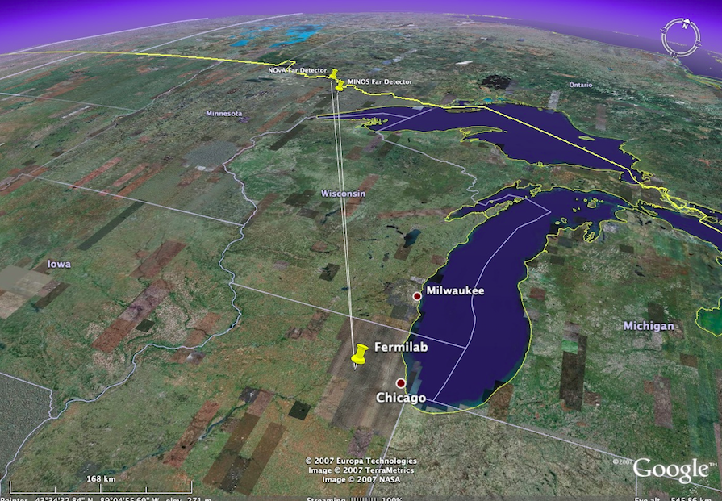
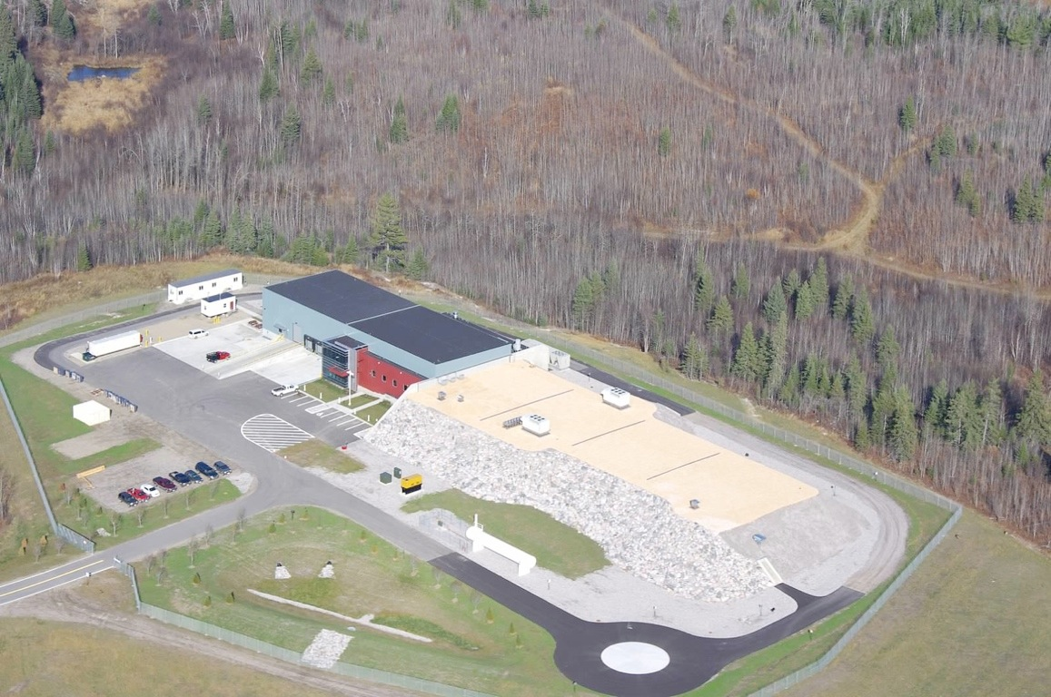
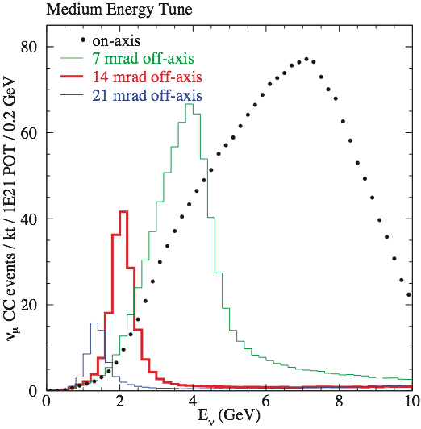
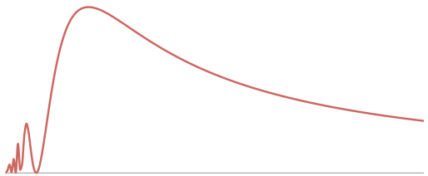
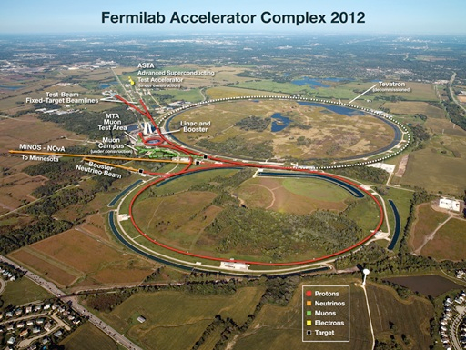
NO𝜈A Experiment
Far detector on the surface and slightly off the beam axis
Ash River, MN
810 km from Fermilab
Madison
NuMI beam at up to 700 kW and
Near detector 100 m underground
Fermilab

Slide 3
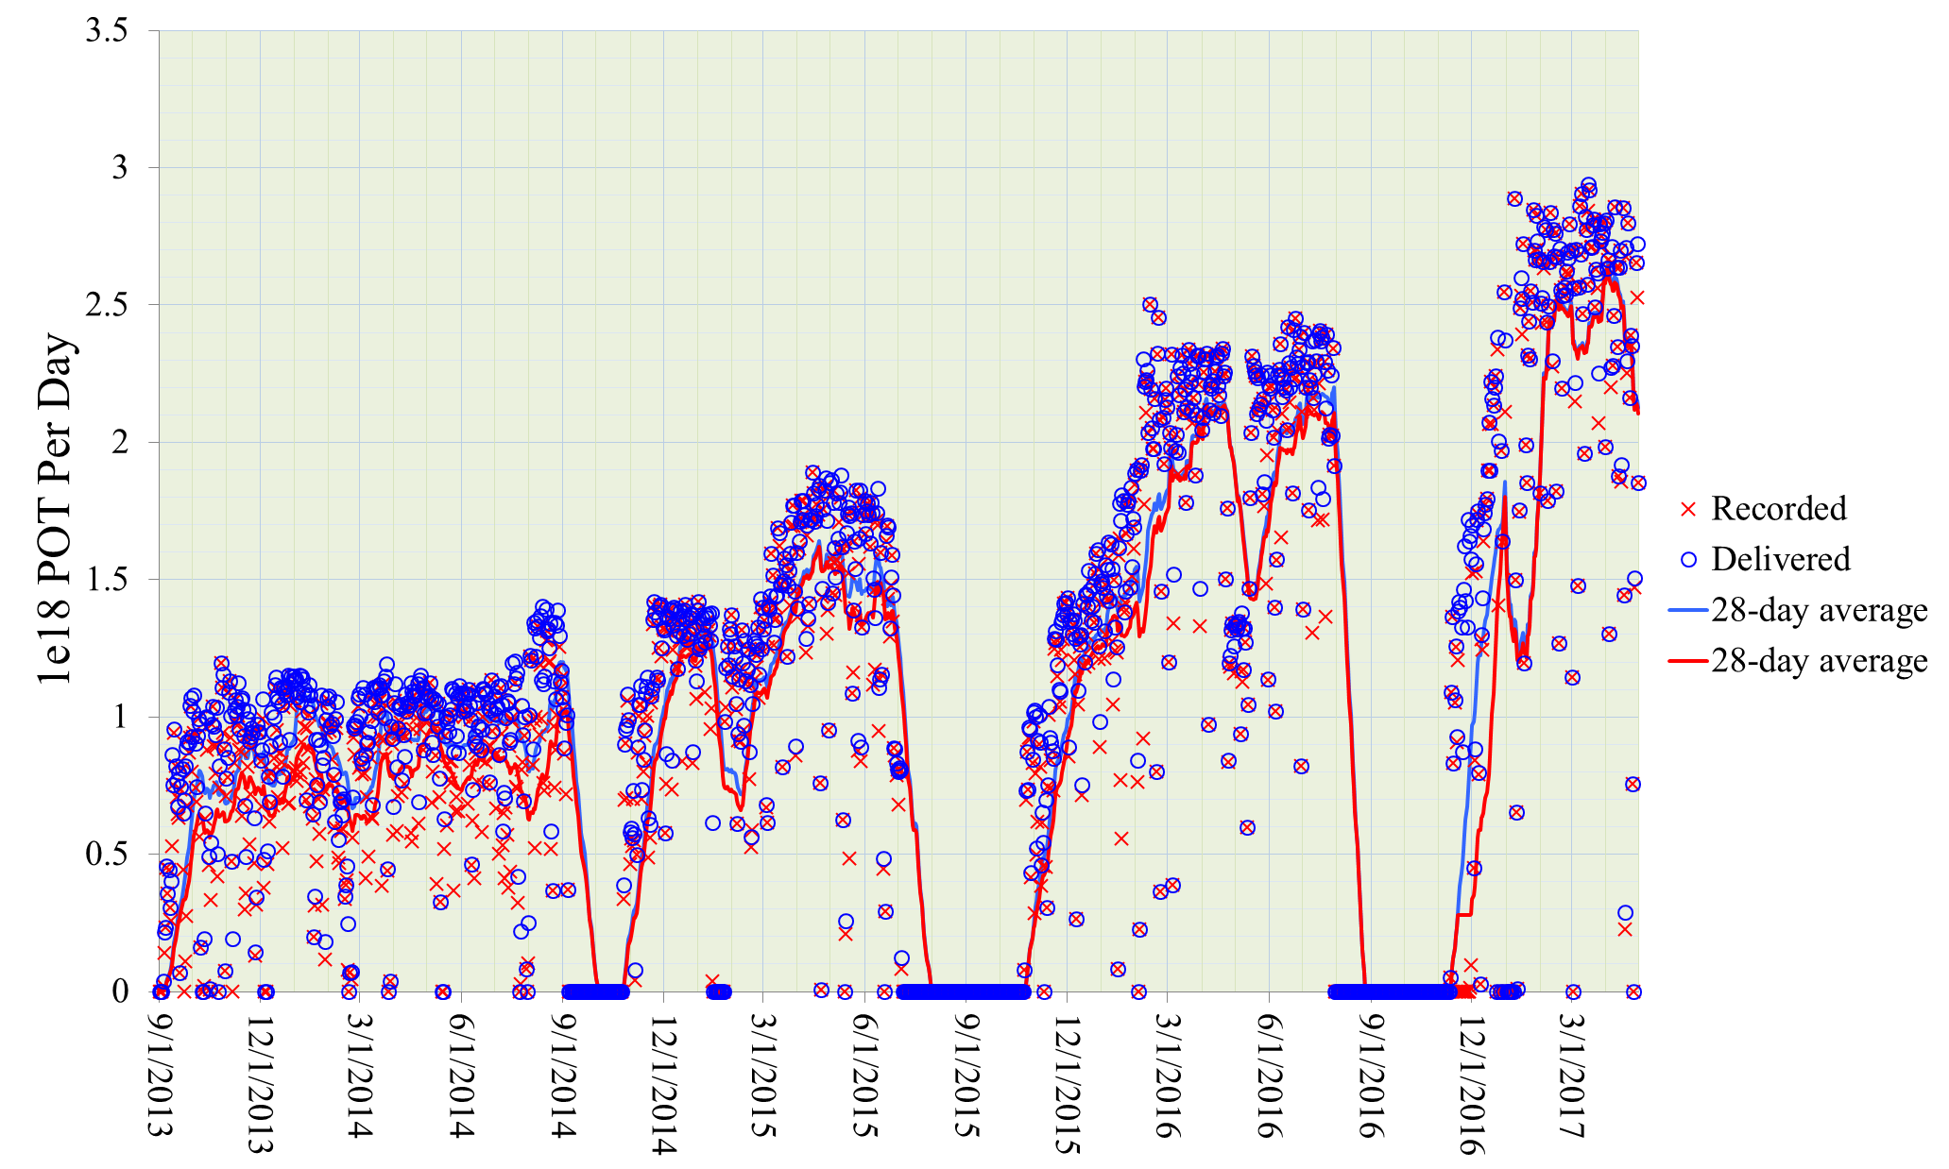
Beam Performance and plan
700kW running achieved routinely in FY17
Antineutrino running
  ~July 2016 for tuning
  Feb 20, 2017 until ~summer shutdown planned for 6/24/2017

Slide 4
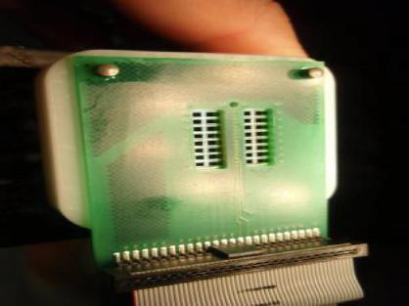
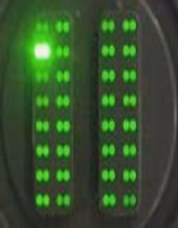

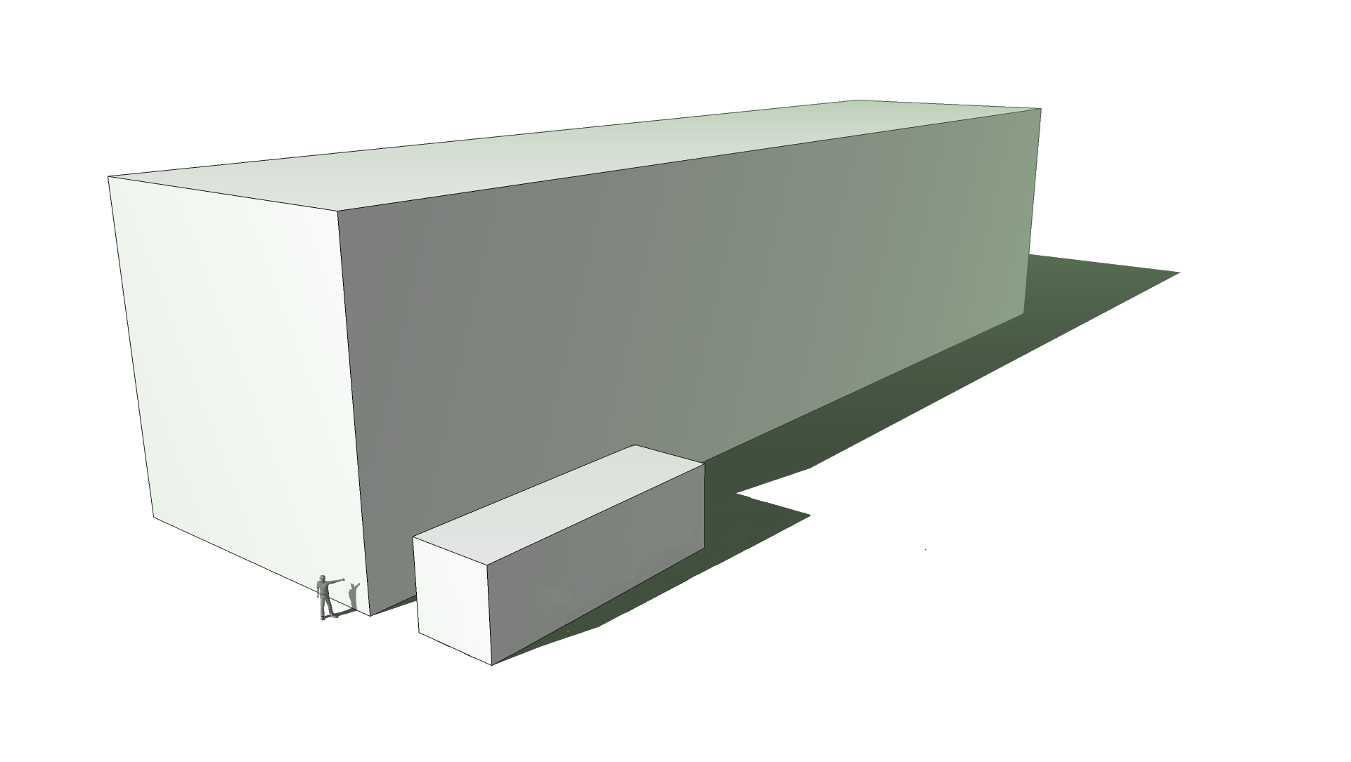
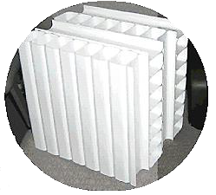
NO𝜈A Detectors:
Fine-grained, low-Z, highly-active tracking calorimeters
11 M liters of scintillator
𝜆-shifting fiber and APDs
32-pixel APD
Fiber pairs from 32 cells
~60 m
Far Detector
14 kton, 896 layers,
344,000 Channels
15.6 m
Alternating planes
(x view and y view)
Near Detector
0.3 kton, 206 layers,
18,000 Channels
4.1 m

Slide 5
Event Topologies
Muon Neutrino Charged Current
Electron Neutrino Charged Current
Neutrino Neutral Current

Slide 6
Muon Neutrino Disappearance
Spectrum predicted in absence of oscillations has 473 events
Observed spectrum has 78 events

Slide 7
Muon Neutrino Disappearance
Energy spectrum of 78 selected events
Small background determined by extrapolation from near detector data

Slide 8
Muon Neutrino Disappearance
Background subtracted ratio to unoscillated prediction

Slide 9
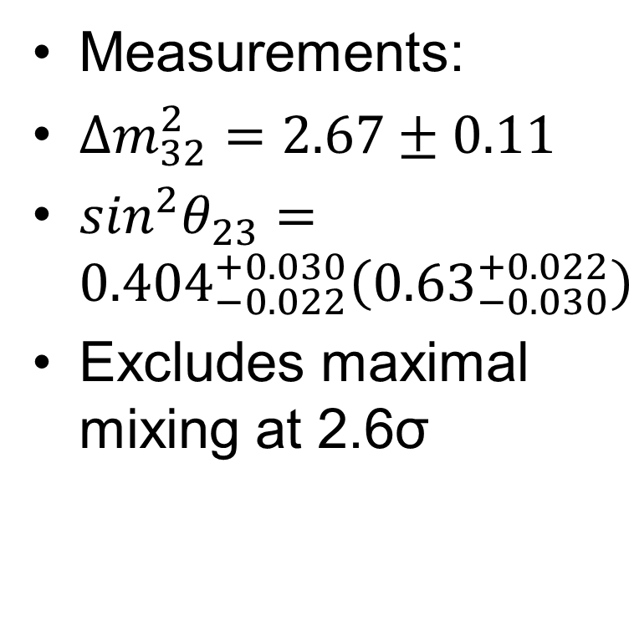
Mixing parameter measurements
Measurements:
$∆m_{32}^{2}=2.67±0.11$
$\sin^{2}θ_{23}={0.404}_{−0.022}^{+0.030}\left({0.63}_{−0.030}^{+0.022}\right)$
Excludes maximal mixing at 2.6σ

Slide 10
Newly developed CVN classifier for electron neutrino events
Machine learning technique used to select electron neutrino events and predict background
Deeper description
  A. Aurisano and A. Radovic and D. Rocco et al.
  JINST 11 P09001 (2016)
Results arXiv:1703.03328v1

Slide 11
CVN Classifier
Use CVN classifier with near detector data to measure and extrapolate backgrounds expected at the far detector.
Also use to predict oscillated electron neutrino signal
Increases sensitivity compared to previous selection techniques

Slide 12
Electron Neutrino Appearance
New Results using CVN technique found 33 events in 6.05E20 Protons on Target in the NuMI beamline
Background of 8.2+-0.8

Slide 13
Combined fit results
Combined fit with muon disappearance measurements disfavoring inverted mass ordering

Slide 14
Conclusions
Detectors are running well
Data taking very efficient, 99%+ typical beam weeks
Beam running well, hitting new records
  Routinely over 700kW to NOvA
New results have been interesting
Anti-Neutrino data coming in now until the Summer Shutdown
  Ready for this after 1 month of Anti-Neutrino running in FY16
Additional analyses and improvements are actively being developed for the interesting times ahead

Slide 15
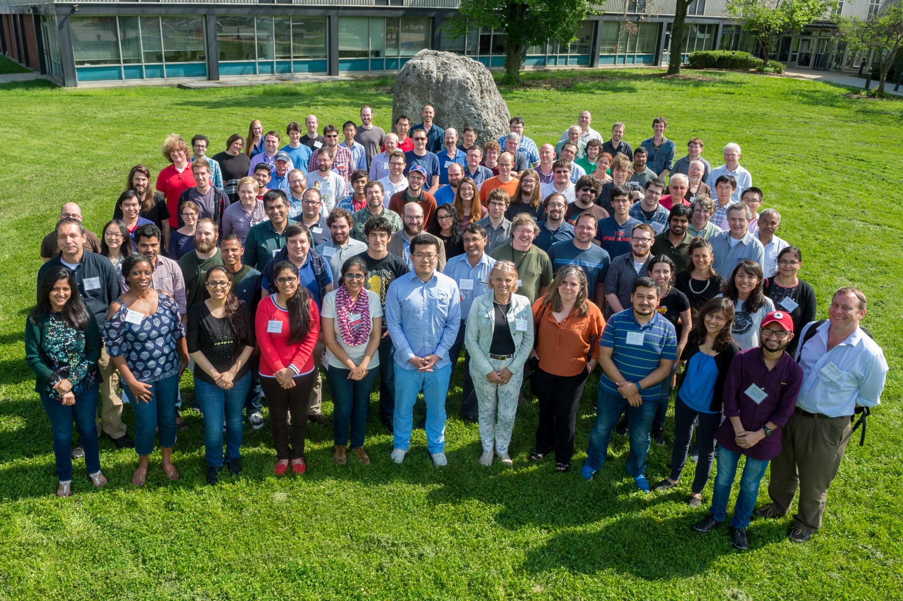
NOvA Collaboration

Slide 17
Backup: Max mixing comparison

