Slide 1
DarkSide: A Background-Free Search for WIMP Dark Matter
Andrew Renshaw
University of Houston
IceCube Particle Astrophysics Symposium
WIPAC Madison, Wisconsin
May 8th, 2017

Slide 2
The DarkSide Program
Direct detection search for WIMP dark matter
Two-phase liquid argon time projection chamber (TPC) technology
Design philosophy based on having very low background levels that can be further reduced through active suppression, for background-free operation
Multi-stage program at Gran Sasso National Laboratory
DarkSide-10
  10 kg full prototype
DarkSide-50
  First physics detector: 50 kg, physics goal ~ 10⁻⁴⁵ cm² for 100 GeV WIMP
  O(.01 tonne year) exposure
DarkSide-20k
  20 tonne fiducial volume, scalable detector: physics goal < 10⁻⁴⁷ cm² for 100 GeV WIMP (approved by INFN in April 2017)
Multi-hundred tonne detector to reach the neutrino floor
  Will also observe and provide further insight to solar neutrinos

Slide 3
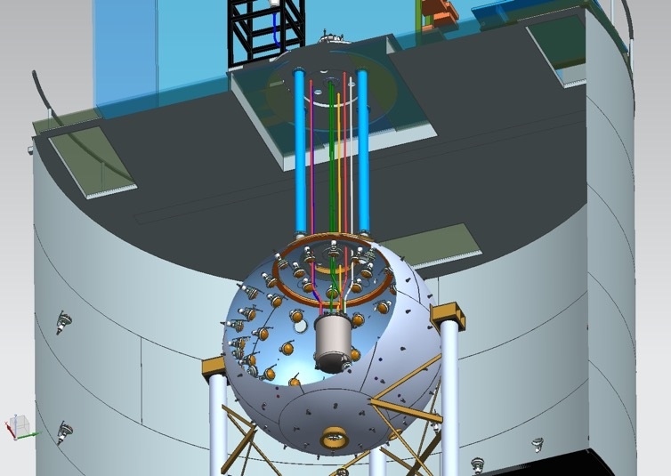
The Darkside-50 Detectors
Rn-free clean room
(10-15 mBq/m³ in 110 m³)
Water Cherenkov muon veto:
1 kton H₂O
10 m
Boron-loaded liquid scintillator
~30 ton (50% TMB + 50% PC)
4 m
Two-Phase LAr TPC
50 kg active volume
11 m

Slide 4
Why Liquid Argon (LAr)
Efficient Scintillator
  40 photons/keV_{ee} @ 128 nm
  Transparent to own scintillation light
High ionization yield
  W ~ 10-20 eV with a high electron mobility
  Further background discrimination with S2/S1 (factor of ~10²)
Powerful PSD in the scintillation signal
  Separate ER background from the WIMP induced NR signal
  Rejection factor of >10⁹
Simple cryogenic and gas handling with inline filter
  Easily purified to achieve long electron drift lengths

Slide 5
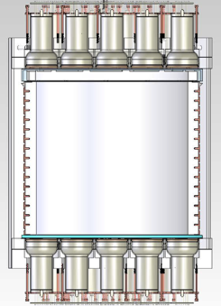
Darkside-50 TPC
PTFE Cylinder
  h=36 cm, d=36 cm, 46 kg (44 kg fiducial), inner surface is coated with TPB
38 3” Hamamatsu PMTs:
  R11065: 19(top) + 19(bottom)
  Cold amplifier (low PMT HV)
Cathode and anode windows:
  Fused silica w/ ITO transparent layers (15 nm) & TPB
Field shaping copper rings:
  Uniform electric field: E_{drift}=220 V/cm E_{gas}= 2.8kV/cm
Fused silica diving bell
  Gas pocket holding for S2 signal
LAr active volume
E field

Slide 6
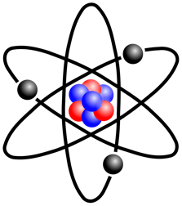
S1 Signal
e,γ
χ,n

Slide 7
S1 Signal
Field shaping rings keep uniform 200 V/cm drift field
Ionization: e⁻
Scinitllation: S1
S1
S1:
6ns & 1.6μs

Slide 8
S2 Signal
S2
Extraction Field = ~3 kV/cm
Electro-luminescence: S2
Ionization: e⁻
Scinitllation: S1
S1

Slide 9
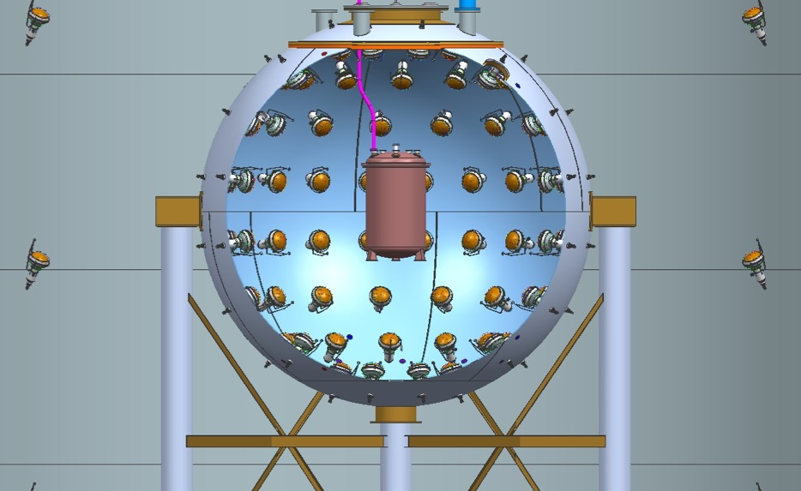

Backgrounds
Internal radioactivity
Gamma Rays
Cosmic muons
Radiogenic neutrons
Fast neutrons
μ
n
γ
α,β
n, p, γ
n

Slide 10
Background Mitigation Strategy
LNGS: Deep underground site to shield cosmic rays
Screening and selection of detector materials
Two-phase Ar TPC: 3D-TPC fiducialization; S1 PSD, S2/S1 cut
Active boron-loaded liquid scintillator neutron veto
Water Cherenkov veto for muon detection and shielding
Underground argon (UAr) with reduced ³⁹Ar

Slide 11
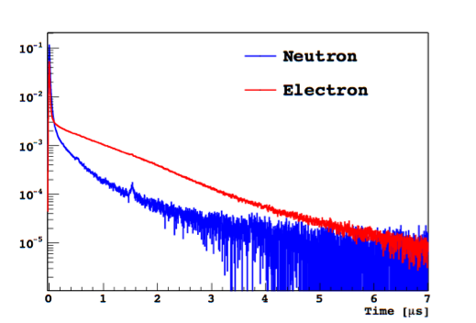
Pulse Shape Discrimination with S1
Singlet and triplet fraction difference
gives >10⁹ rejection between NR and ER

Slide 12
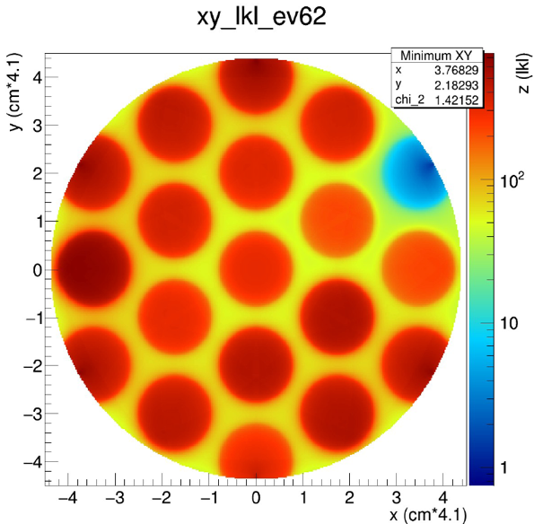
2-Phase TPC
Top ArrayPMT light fractions for S2 give x,y location
S2
The drift time gives the z-position with mm precision
S1

Slide 13
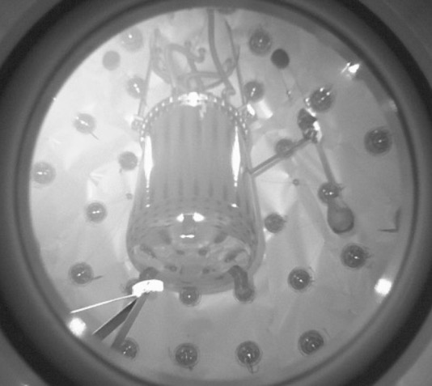
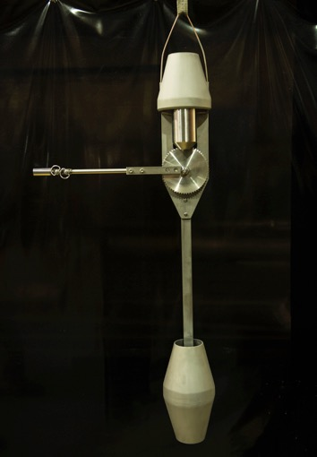
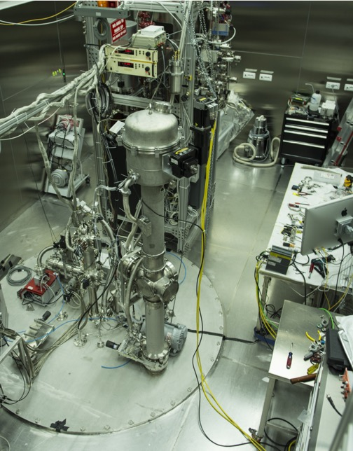
Calibration System

Slide 14
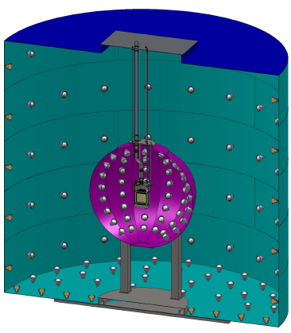
Veto Detectors
Water Cherenkov Veto
  Muon flux reduced by 10⁶ (>99% efficient)
  80 PMTs, 11 m diameter x 10 m high
  Detect the Cerenkov light produced by the muons and other showering particles
  Provides passive gamma and neutron shielding
Liquid Scintillator Veto
  4 m boron-loaded liquid scintillator (PC:TMB)
  110 8” PMTs
  Efficiently detect escaping neutrons and veto any associated nuclear recoil backgrounds
    >99% efficiency for neutrons
  Provide in situ measurement of the neutron background rate

Slide 15
Underground Argon (UAr)
⁴⁰Ar(n,2n)³⁹Ar occurs in the atmosphere
Argon that has remained underground can therefore have extremely low levels of ³⁹Ar
DS-50 UAr fill measured the ³⁹Ar reduction factor: >10³!!

Slide 16
1422 kg day AAr exposure
50-days of data

Slide 17
2616 kg day UAr exposure
70-days of data

Slide 18
2616 kg day UAr exposure
70-days of data
With S2 cuts applied

Slide 19
Summary of Darkside-50
In operation with atmospheric argon since Oct 2013, underground argon since April 2015
Cryogenics and gas handling system very stable
TPC HV system stable for years
LY @ null field ~8 pe/keV_{ee}
1422 kg-days AAr + 2616 kg-days UAr
No remaining background in WIMP search region!!!
Blind analysis now ongoing → Results expected this summer

Slide 20
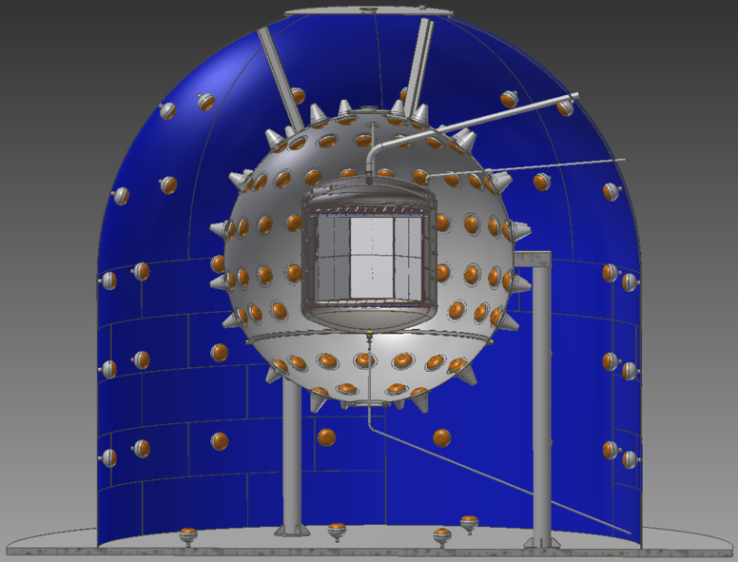
Darkside-20k: A United Front
Brings together all existing LAr dark collaborations
  DarkSide-50
  DEAP-3600
  ArDM
  miniCLEAN
20 tonne fiducial volume
Underground argon
Silicon photomulitipliers

Slide 21
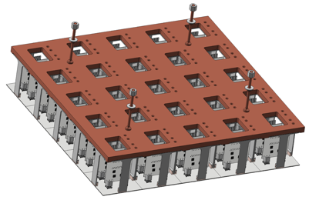
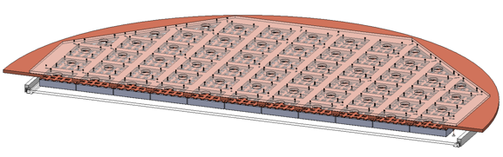
Darkside-20k: Large Area SiPMs
SiPMs for improved performance
  45% PDE requirement met
  0.1 Hz/mm2 requirement met and surpassed
SiPM tiles assembled into photodetector modules
  5 cm x 5 cm tiles tested and meet specifications
~14 m² of SiPMs total

Slide 22
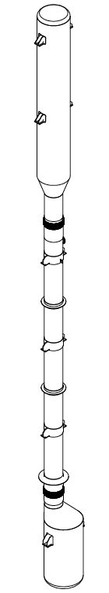

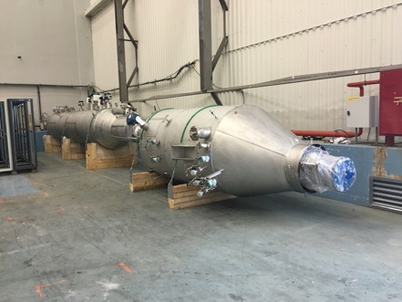
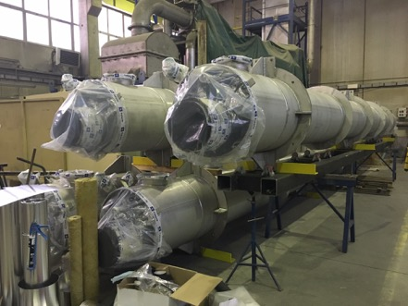
DarkSide-20k: UAr
The Urania project will procure 50 tonnes of UAr from same Colorado source as for DS-50
Will extract 100 kg/day, with 99.9% purity
UAr will be transported to Sardinia for final chemical purification at Aria
The Aria project will make the final chemical purification of the UAr
Can process O(1 tonne/day) with 10³ reduction of all chemical impurities
Ultimate goal is to isotopically separate ³⁹Ar from ⁴⁰Ar

Slide 23
Projected Sensitivities

Slide 24
Thank You!

