Slide 1

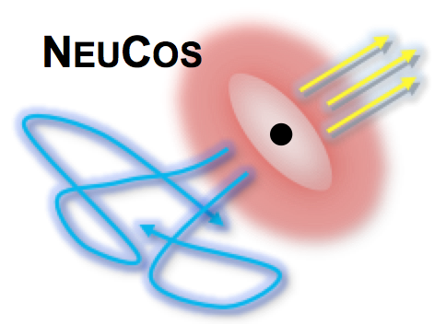

Multi-messenger particle astrophysics
Walter Winter
DESY, Zeuthen, Germany
IPA 2017
Madison, WI, USA
May 8-10, 2017
TexPoint fonts used in EMF: AAA

Slide 2
Contents
Introduction
Generic multi-messenger relationships
Different UHECR paradigms; cosmogenic neutrinos
The future of multi-messenger particle astrophysics:
What if Auger is right? Challenges and methods
Conclusions

Slide 3
Definition of “multi-messenger astrophysics” (this talk)
Talks: Barish/Franckowiak
^{GW}
^{γ}
Photon observations can be often described without cosmic rays
Exception
Multi-messenger relationships involve baryonic loading
^{DM}
Exception
Require baryon acceleration in sources
n
(yet undetected)
^{ν}
CR
e±
Most of these of extragalactic origin
Extragalactic origin?
- Beyond ankle: Yes
- Beyond 10¹⁸ eV: Probably
- Between knee and ankle: Maybe
Focus on extragalactic, baryonically loaded sources at extremest energies

Slide 4

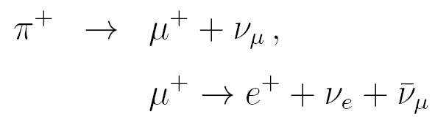
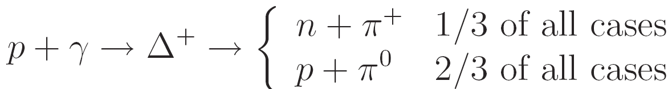
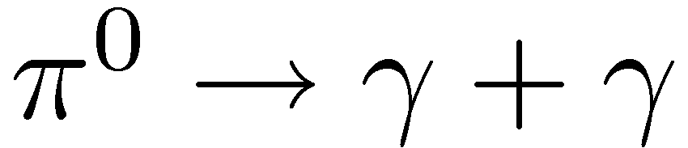
A simple multi-messenger toy model for the source
If neutrons can escape:
Source of cosmic rays
Neutrinos produced in
ratio (ν_{e}:ν_{μ}:ν_{τ})=(1:2:0)
Cosmic messengers
Δ-resonance approximation:
2) Interactions in known environments (e.g. CMB)
1) Generic relationships
among secondaries
Levels of technical “sophistication”
(no of parameters)
3) Interactions in guesstimated densities (e.g. in sources)
High energetic gamma-rays;
typically cascade down to lower E

Slide 5
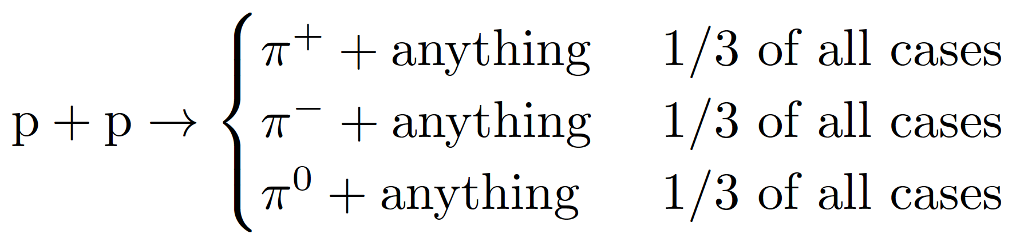
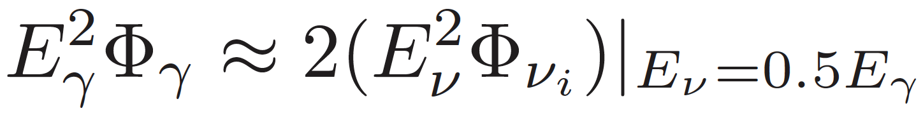
Generic relationships: pp versus pγ interactions
pp interactions
Generic relationship (if γ-rays can escape from source)
pγ interactions: more sophisticated, as relativistic target
Generic multi-messenger relationships more challenging
(e.g. Ahlers, Gonzalez-Garcia, Halzen, Astropart. Phys. 35 (2011) 87; Murase, Guetta, Ahlers, PRL 116 (2016) 071101; ...)
Spectrum:
E^{-α}
non-rel.
E^{-α}
(Branchings actually not exactly 1/3;
see JCAP 1701 (2017) 033)
E^{-α}
E^{-β}
E^{-α+β−1}
E^{-α} only if β=1! Often “ad hoc” implied assumption. Not for AGN!

Slide 6
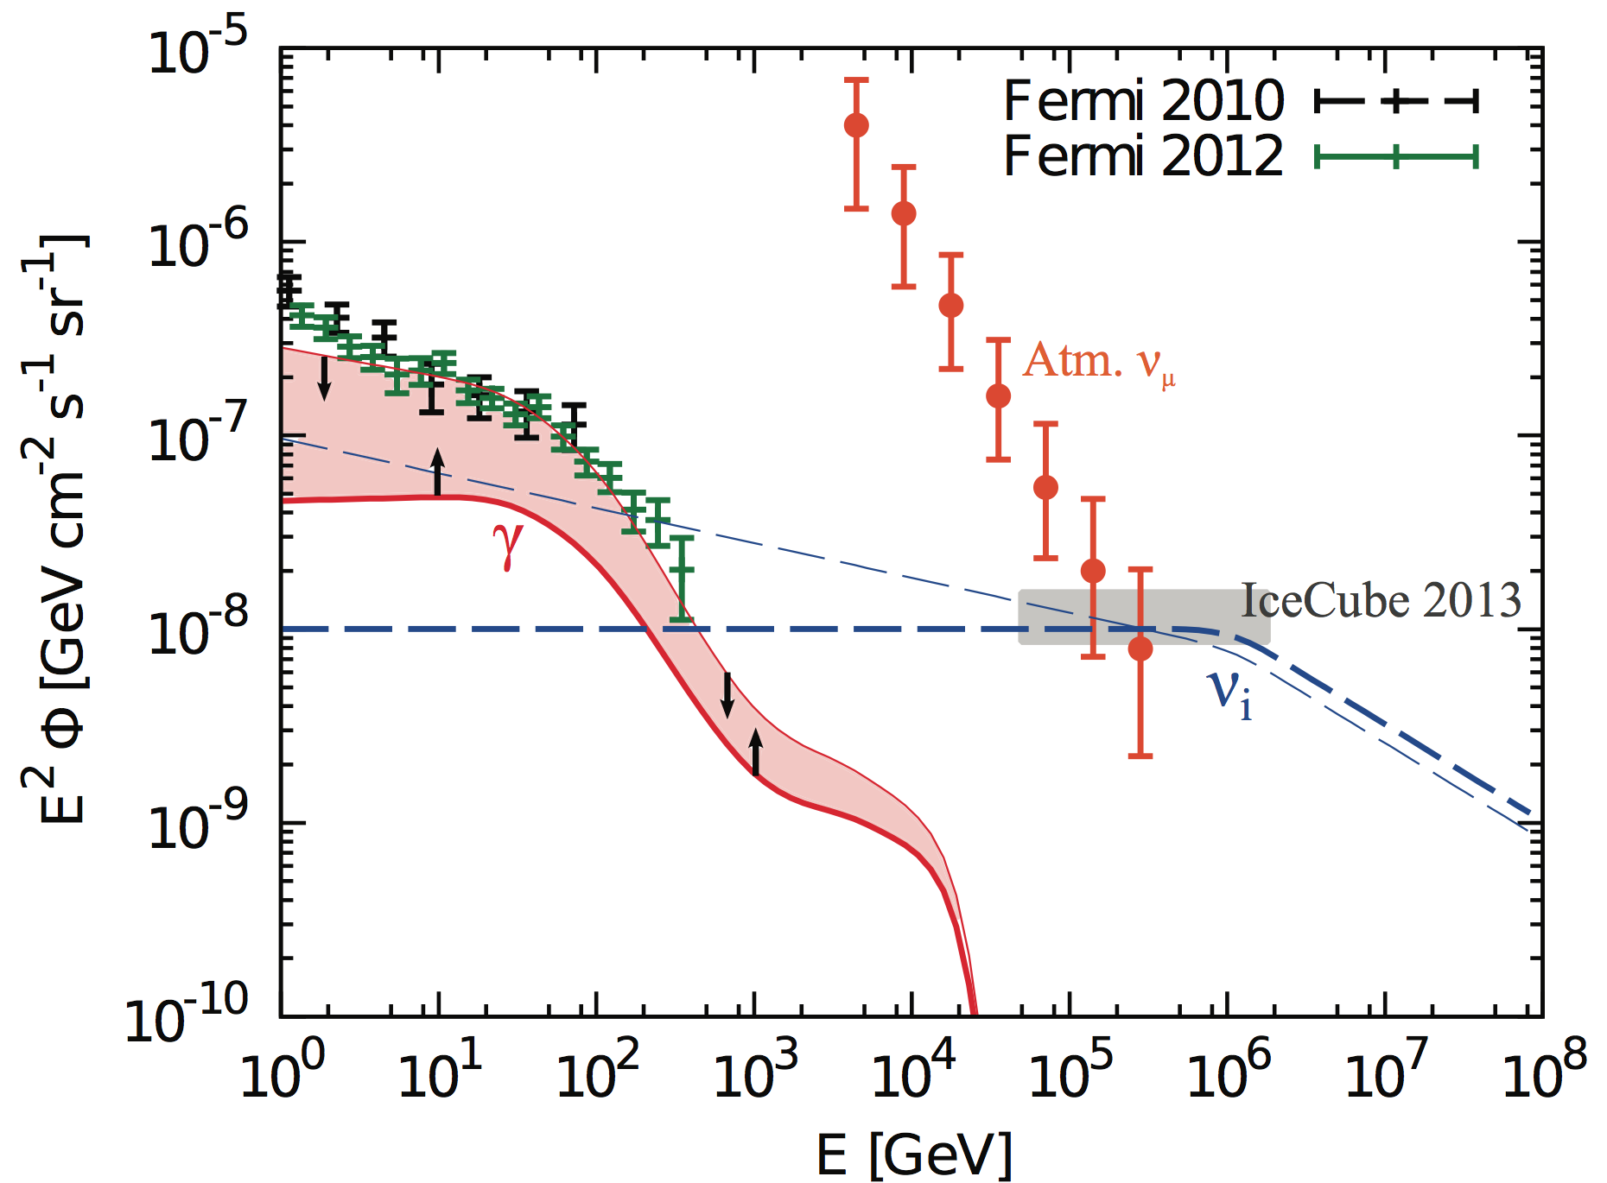
Example: Constraints from diffuse γ-ray background
Limits any pp source class with a neutrino spectrum much softer than ~ E⁻²
The constraints may be even stronger if the non-blazar contribution to the extragalactic γ-ray background is small
Murase, Ahlers, Lacki, 2013
EM cascade on photon BGs
Bechtol, Ahlers, di Mauro, Ajello, Vandenbroucke, 2017;
see also talks by M. Ajello, Z. Li

Slide 7
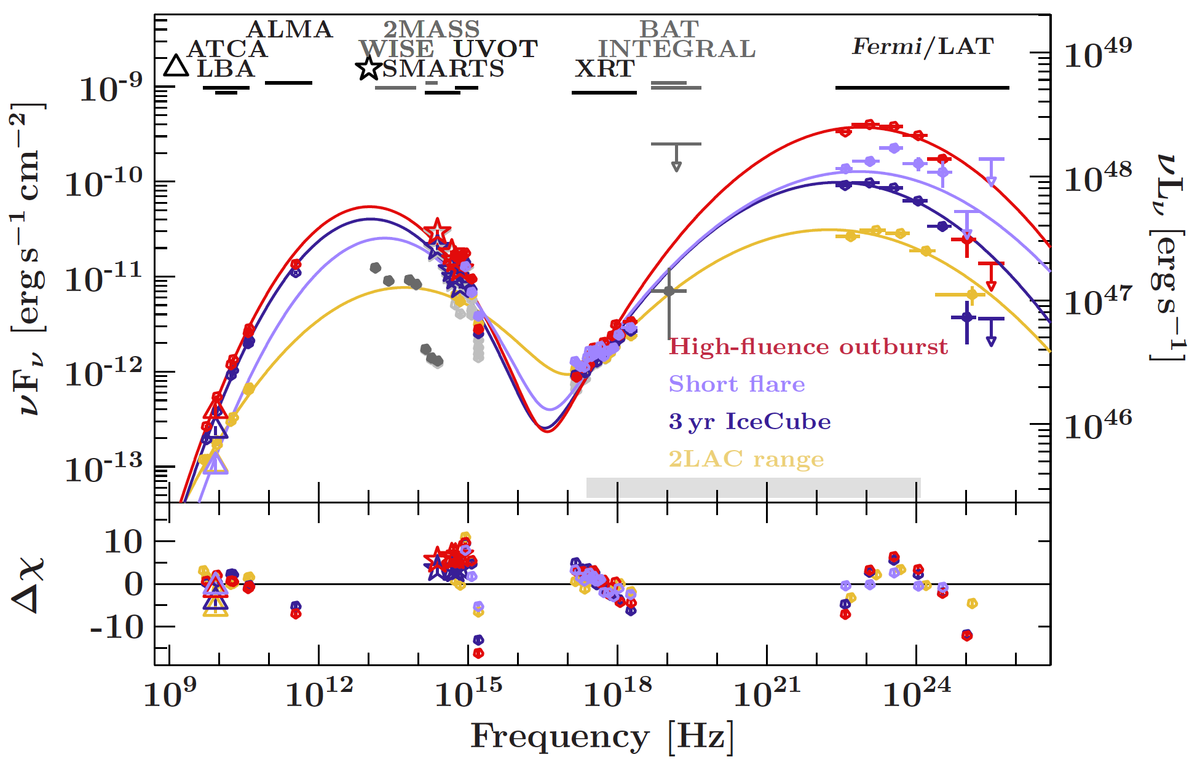
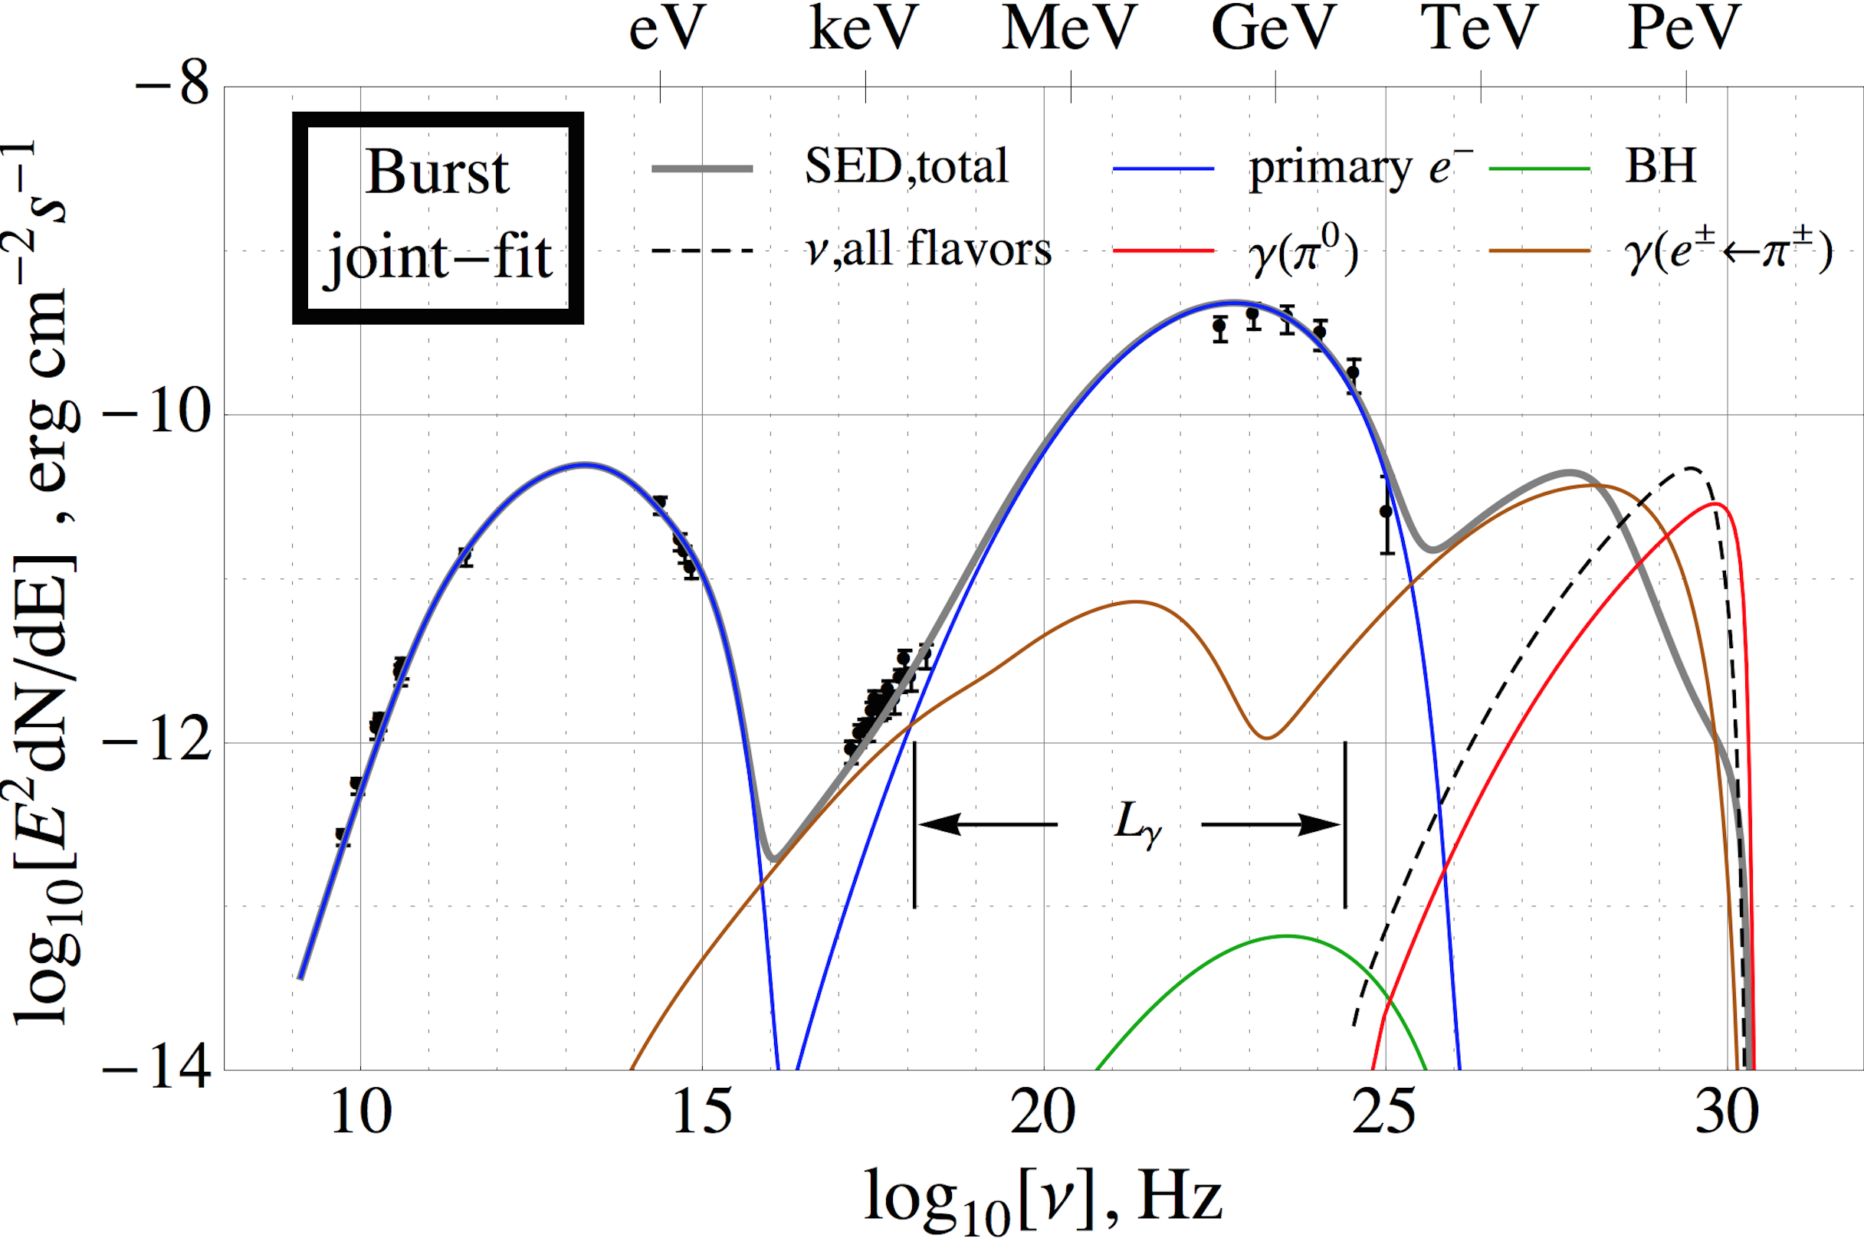
Example: Neutrino production in AGN blazar flares
Assume that 2nd peak
from hadronic γ-rays
One neutrino event from blazar
PKS B1424-418?
Limitation: hadronic processes are sub-dominant in 2nd peak in SED for this object (self-consist. rad. model):
?
Kadler et al,
arXiv:1602.02012,
Nature Physics
~0.1 events
Multi-messenger –
multi-wavelength models
Blue:
leptonic origin
Red/brown: hadronic origin
Gao, Pohl, Winter, 2017

Slide 8
Different UHECR paradigms; cosmogenic neutrinos
^{ν}
CR

Slide 9
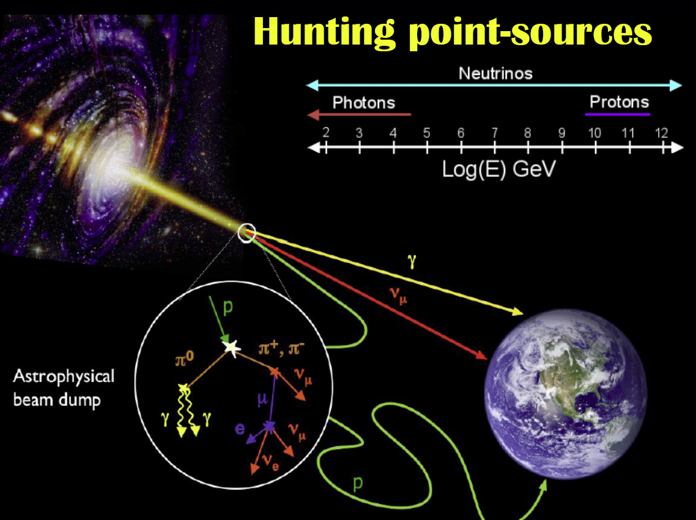
Ultra-high energy cosmic rays: Propagation models
Typical ingredients:
Power law injection spectrum from sources γ
Maximal energy E_{max}
Source distribution, e.g. (1+z)^{k}
Composition (if nuclei);
rigidity-dep. E_{max} (“Peters cycle”)?
Jet
model
Accel. model
Radiation
model
Propagation models
CRPropa,
SimProp,
HERMES,
TransportCR,
PriNCE,
proprietary codes,
…
Source-propagation models
Propaga-tion effects
(magn.
field
effects)
CMB

Slide 10
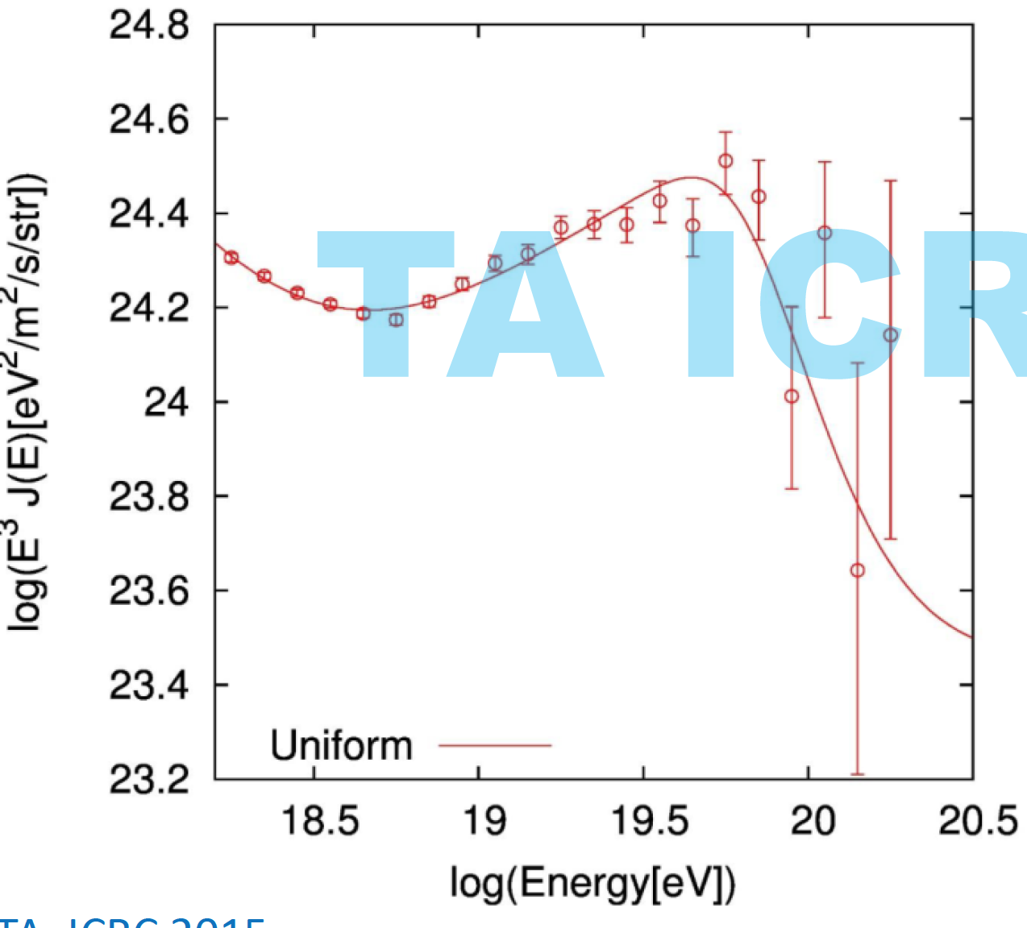
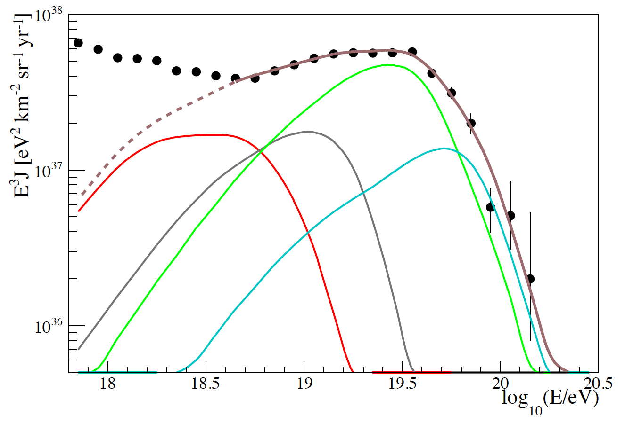
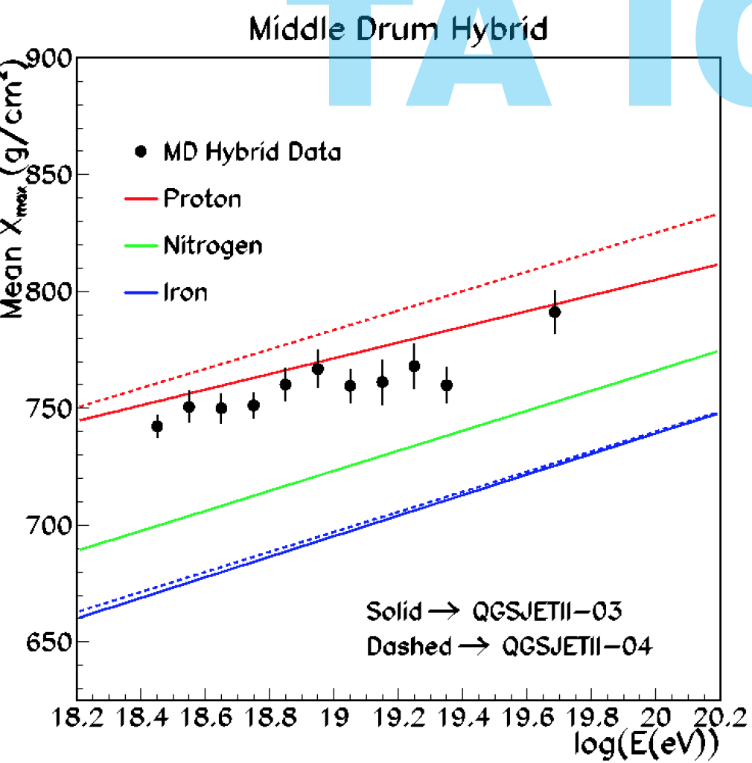
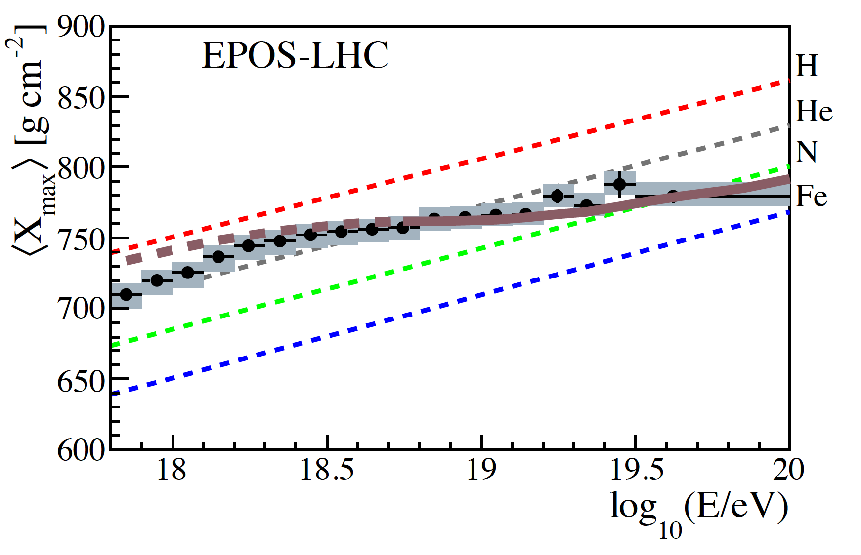
Current theoretical paradigms (from propagation models)
TA (Telescope Array)
vs.
Auger
Pair
prod.
dip
GZK
cutoff
(p + γ_{CMB})
Auger global fit, 1612.07155
Jui @ ICRC 2015; talk by D. Ivanov
Soft spectra from sources.
Possibly hydrogen only.
Proton dip model?
Berezinsky, Gazizov,
Grigorieva, 2005
Hard spectra from
sources γ~1 (best-fit).
Elements up to
silicon from sources
What can neutrinos
and γ-rays tell us?

Slide 11
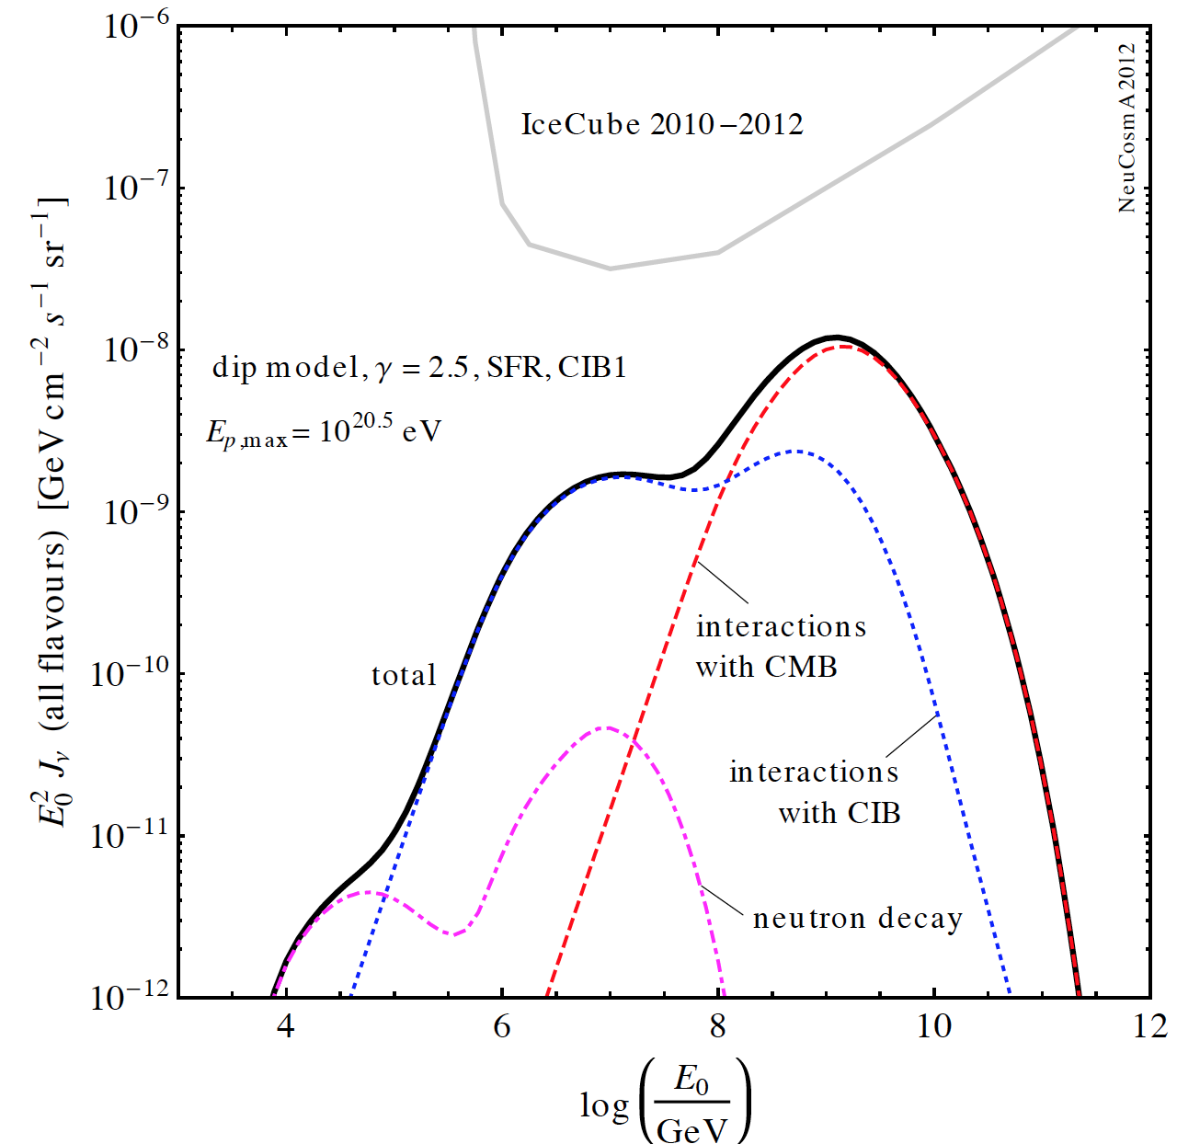
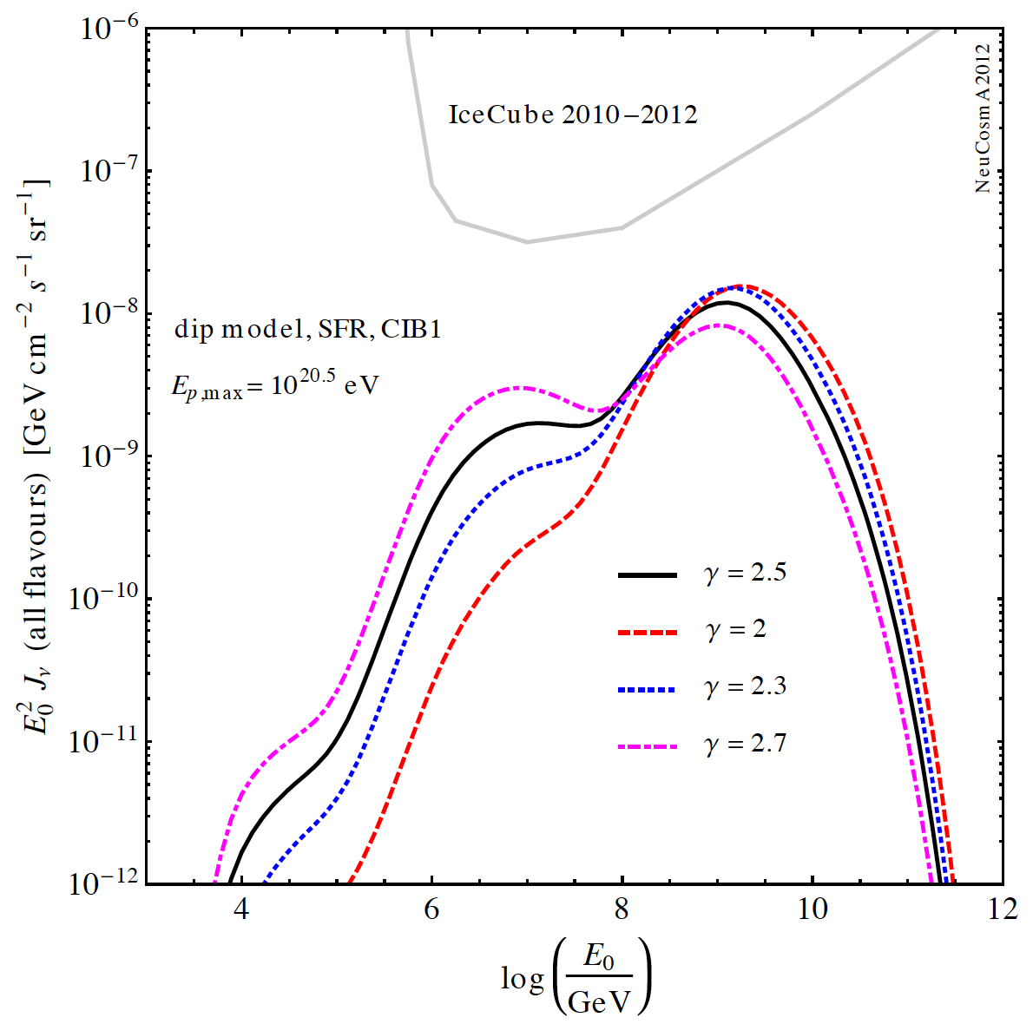
Testing the TA paradigm:
Cosmogenic neutrinos from proton primaries
Propagation in known environment (CMB [well known]+CIB [roughly known])
p injected
Kotera et al 2010; Ahlers+ 2010; Ahlers, Halzen, 2012; Heinze et a, 2016; many others;
Figures: arXiv:1401.1820/Bustamante

Slide 12
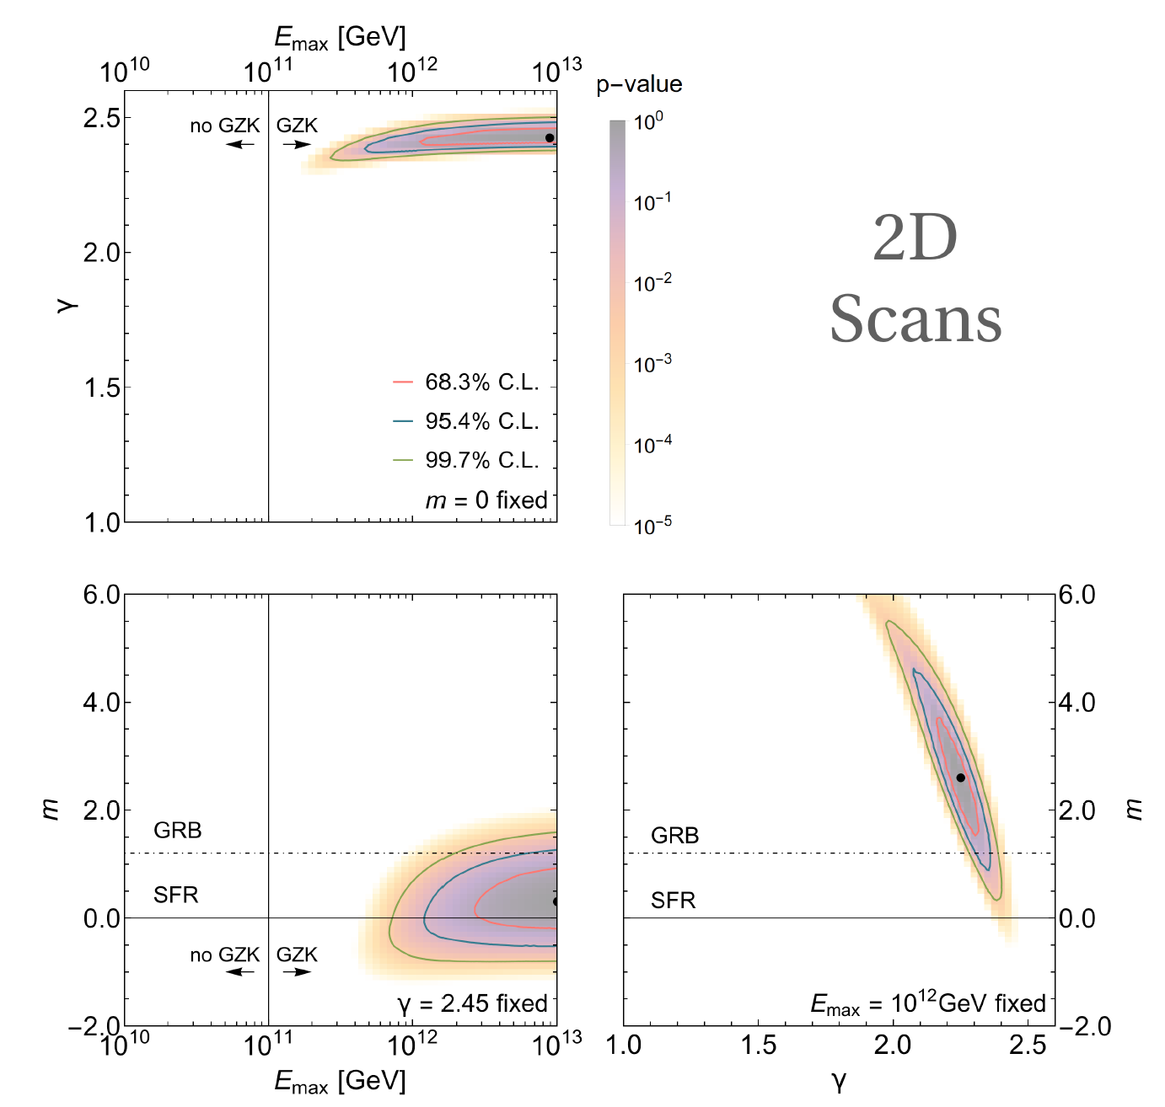
Describing TA data – from predictions to postdictions
Fit of 7-year TA data. Systematics: free normalization,
20% energy scale
Model parameters:
γ, E_{max}, m.
Injection (comoving):
Evolution:
(1+z)^{m} x SFR evol.
[Neutrinos are sensitive to sources at z>1!]
(fit for E>10⁹ GeV)
Heinze, Boncioli, Bustamante, Winter, Astrophys. J. 825 (2016) 122

Slide 13
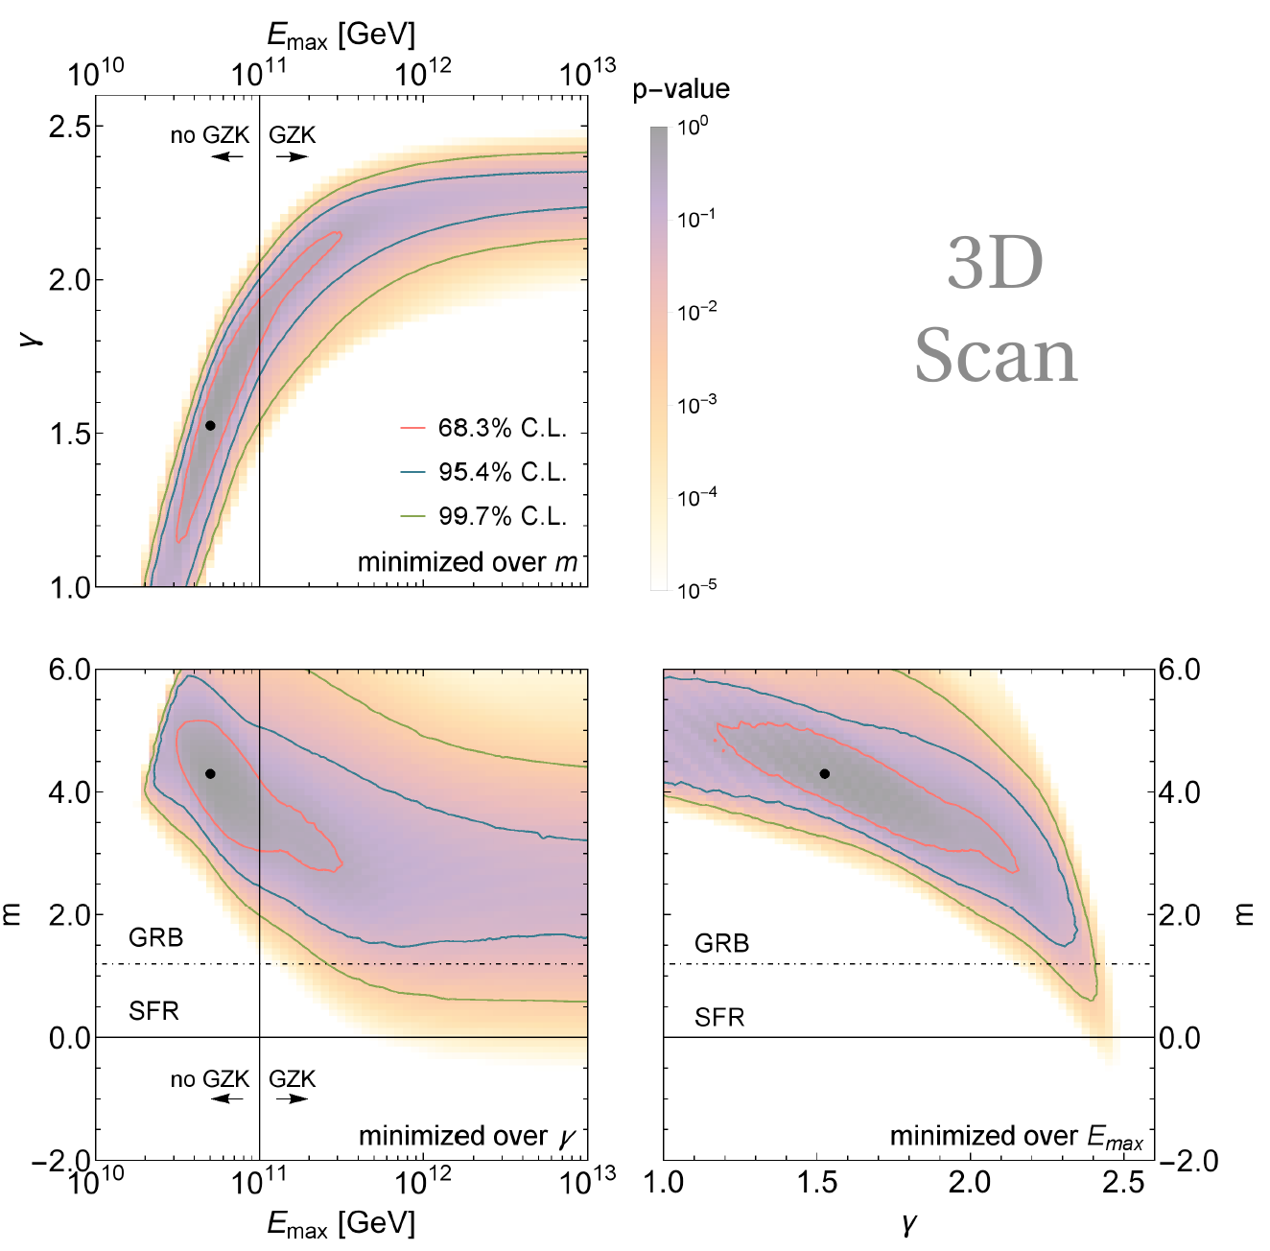
Describing TA data – from predictions to postdictions
Fit of 7-year TA data. Systematics: free normalization,
20% energy scale
Model parameters:
γ, E_{max}, m.
Injection (comoving):
Evolution:
(1+z)^{m} x SFR evol.
[Neutrinos are sensitive to sources at z>1!]
Parameter space changes if 3D marginalization taken
into account
(fit for E>10⁹ GeV)
Heinze, Boncioli, Bustamante, Winter, Astrophys. J. 825 (2016) 122

Slide 14
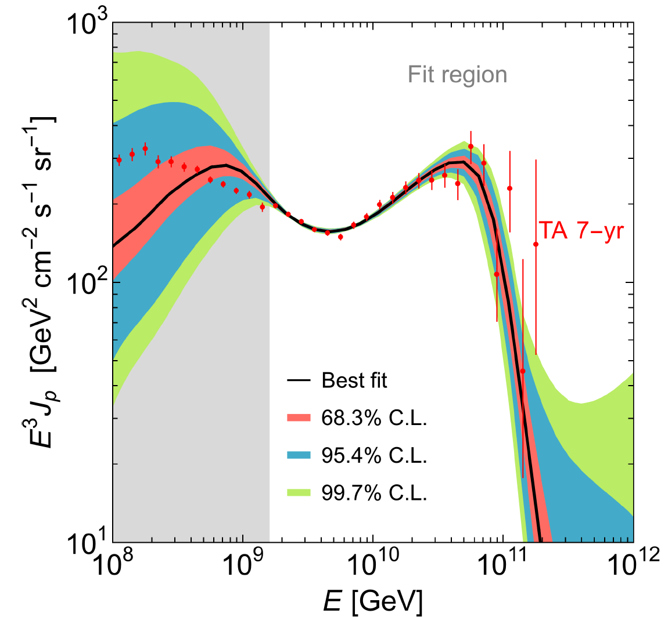
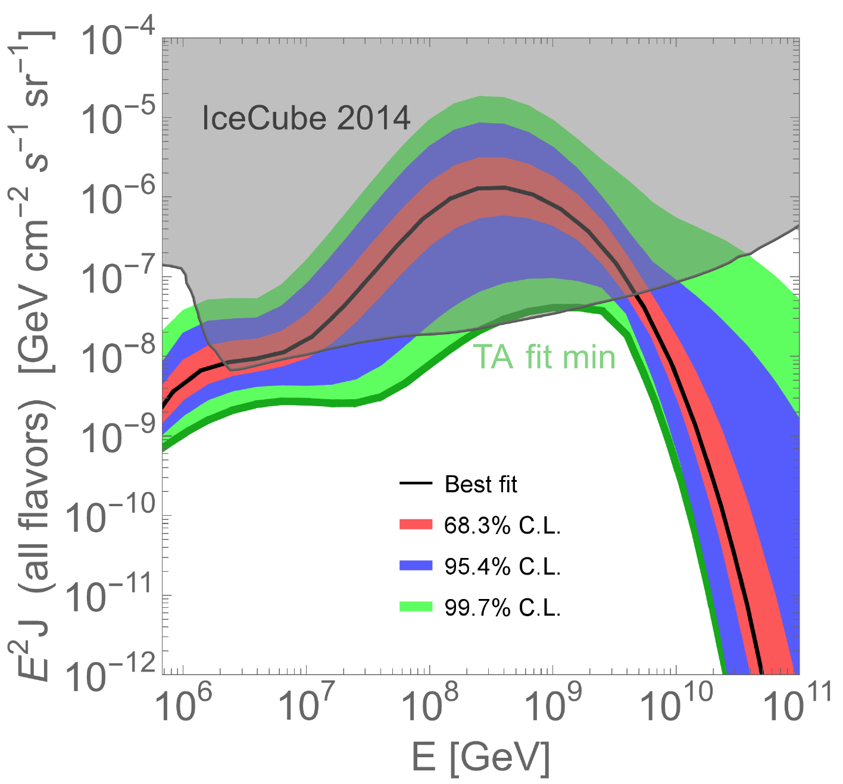
Cosmogenic neutrinos challenge the proton dip model
3D fit with fully marginalized parameters: TA 7-year meets IceCube 2014
Heinze, Boncioli, Bustamante, Winter, Astrophysical Journal 825 (2016) 122
Possible interpretations:
  The composition is not dominated by protons at the highest energies
  Transition between populations occurs at ankle, not below it (less constraining)
  There is a sharp injection cutoff at z ~ 1 (but: note that negative values of m tested!)
Similar arguments from γ-rays e. g. Supanitsky, 2016
4.9 events
95% CL
excluded

Slide 15
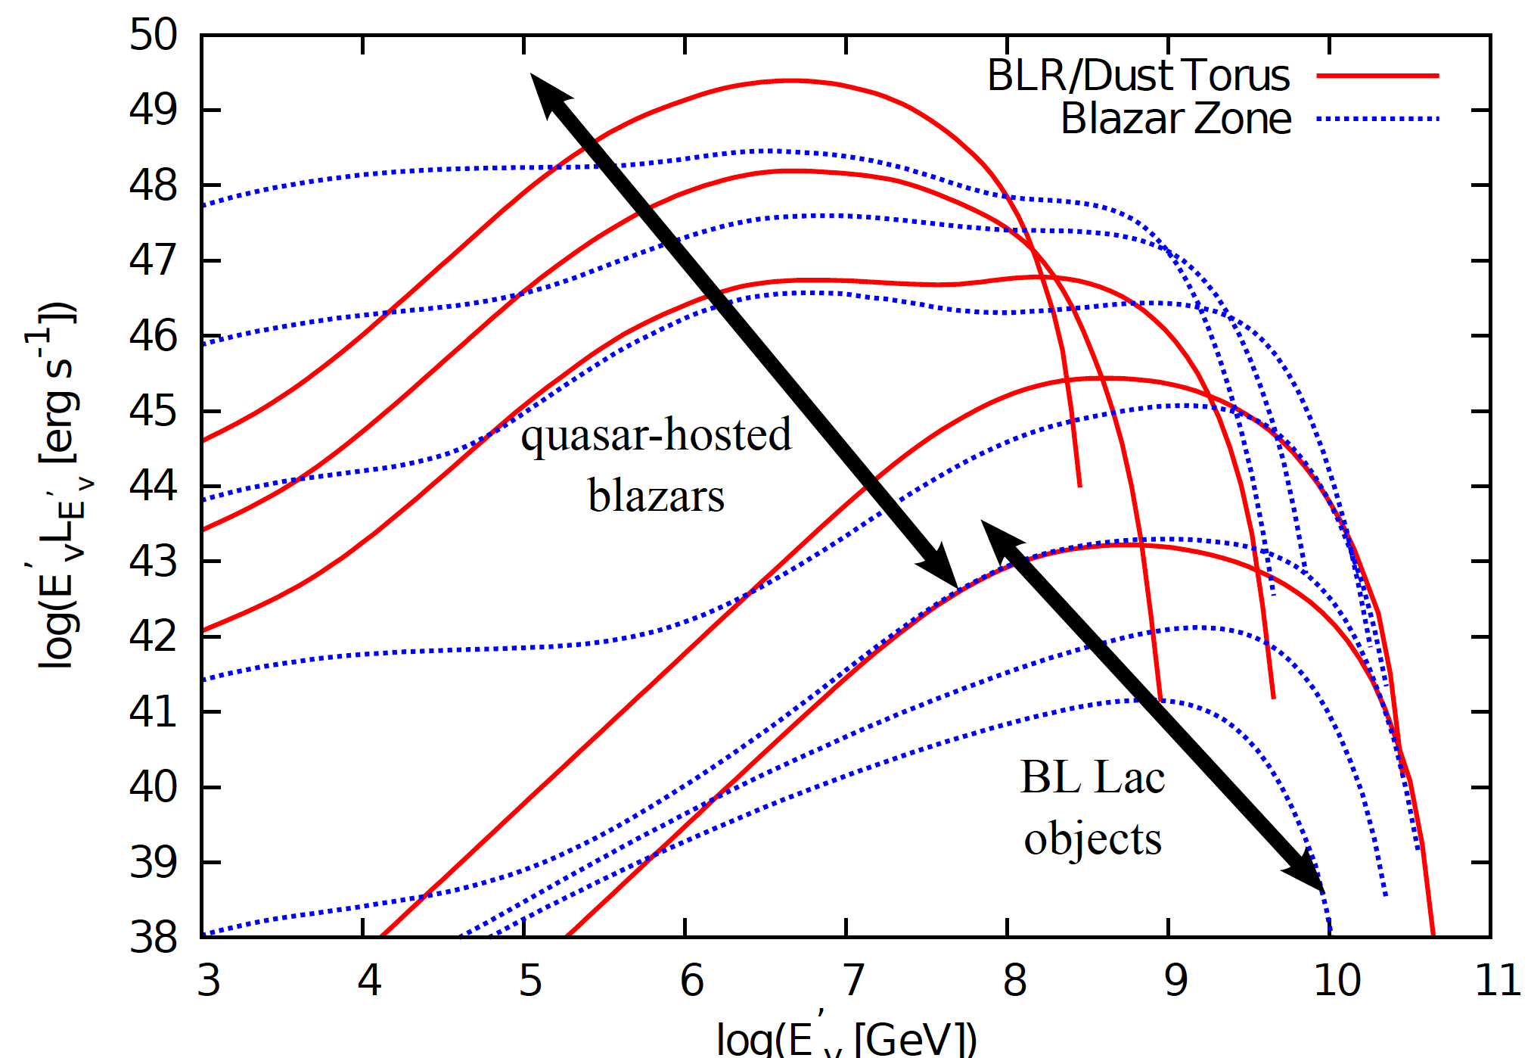
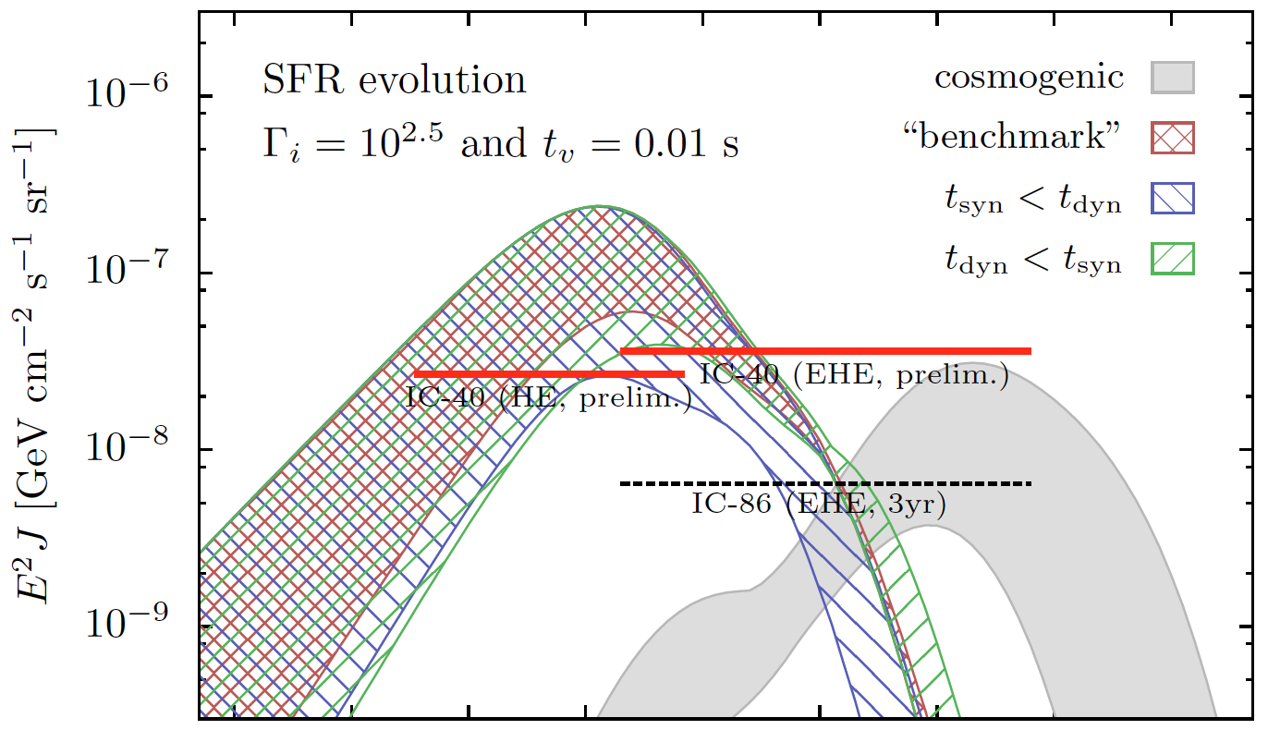
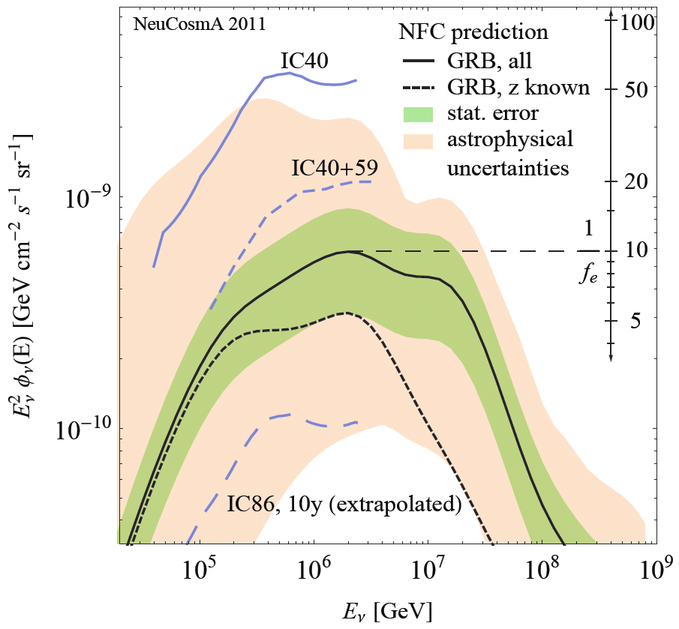
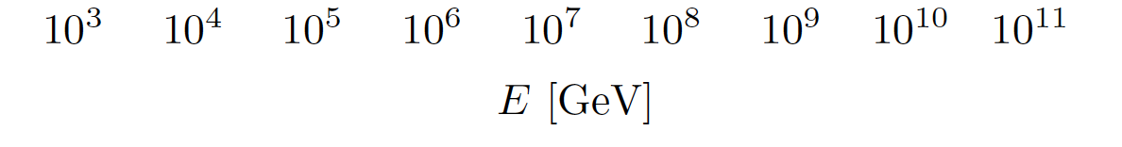
Consequences of a heavier composition for ν searches
Virtually almost all neutrino flux predictions rely on proton primaries
What if Auger is right? The UHECR compositon may be one of the central challenges in multi-messenger particle astrophysics
How to interpret neutrino observations in that case?
What can we learn about the origin of the UHECRs?
GRBs, from: Hümmer, Baerwald,
Winter, 2012
AGNs, from: Murase,
Inoue, Dermer, 2014
GRBs, from Ahlers,
Gonzalez-Garcia, Halzen, 2011

Slide 16
Future challenges and methods for
UHECR-nuclei loaded sources
(source and source-propagation models)

Slide 17
Challenges for multi-messenger models
Key challenge 2:
How do cosmic rays
escape from the source?
Key challenge 3:
Secondary production
very sensitive to
geometry estimators
Radiation
model
Key challenge 4:
Baryonic
loading
Key challenge 1:
Composition
Idea:
Determine by fit to UHECR data?
Propaga-tion effects

Slide 18
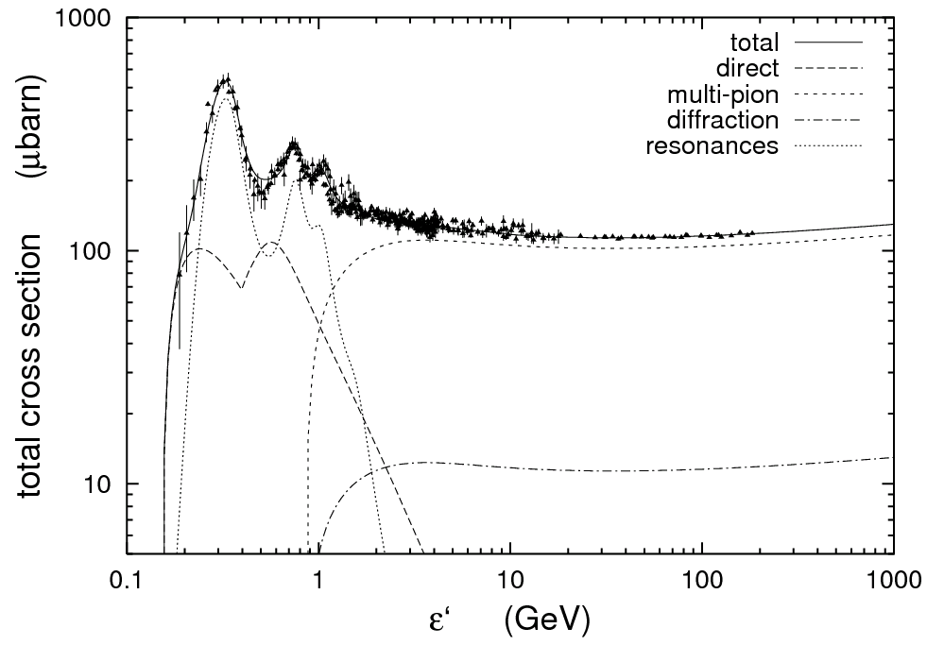
Secondary production: Particle physics 101
Beam dump picture (particle physics)
Interaction rate Γ ~ c N [cm⁻³] σ [cm²]
Target density (e.g. N_{γ})
critical for production!
Astrophysical challenge:
  Feedback between beam and target (e.g. photons from π⁰ decays); need self-consistent description called radiation model
  What you see is, in general, not what you get in the source
Δ-res.
Beam of p, A, …
Target
(p, γ, A, …)
(Mücke, Rachen, Engel,
Protheroe, Stanev, 2008;
SOPHIA)
➔Key challenge 3:
N ~ E / Volume
(Photon energy in nucleon rest frame)
Q_{ν,out}
Radiation zone:
N_{p}, N_{γ}
Interactions
Q_{p,in}
Q_{p,out}
Q_{γ,out}

Slide 19
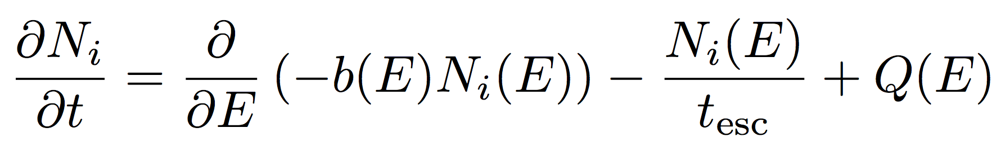
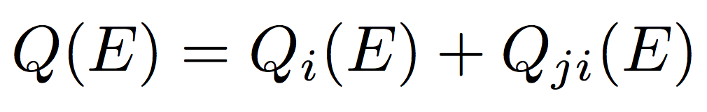
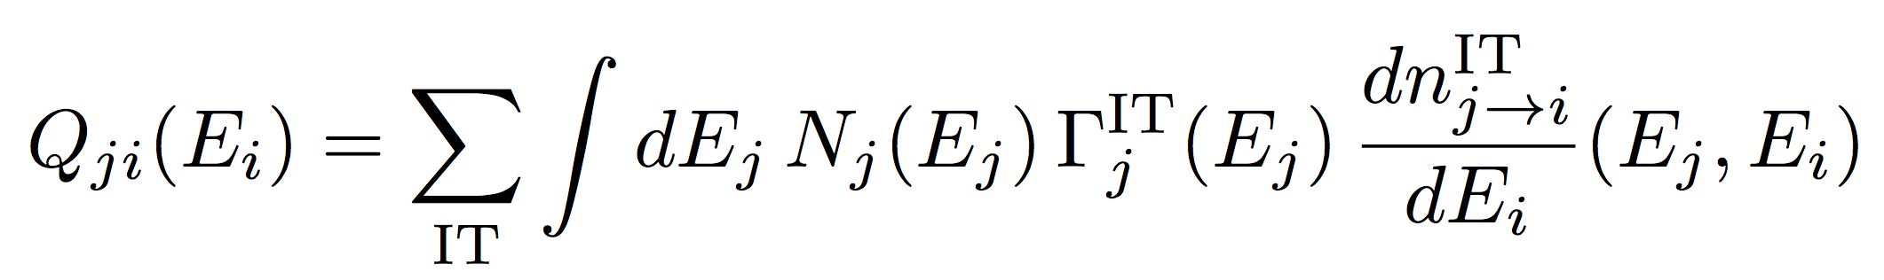
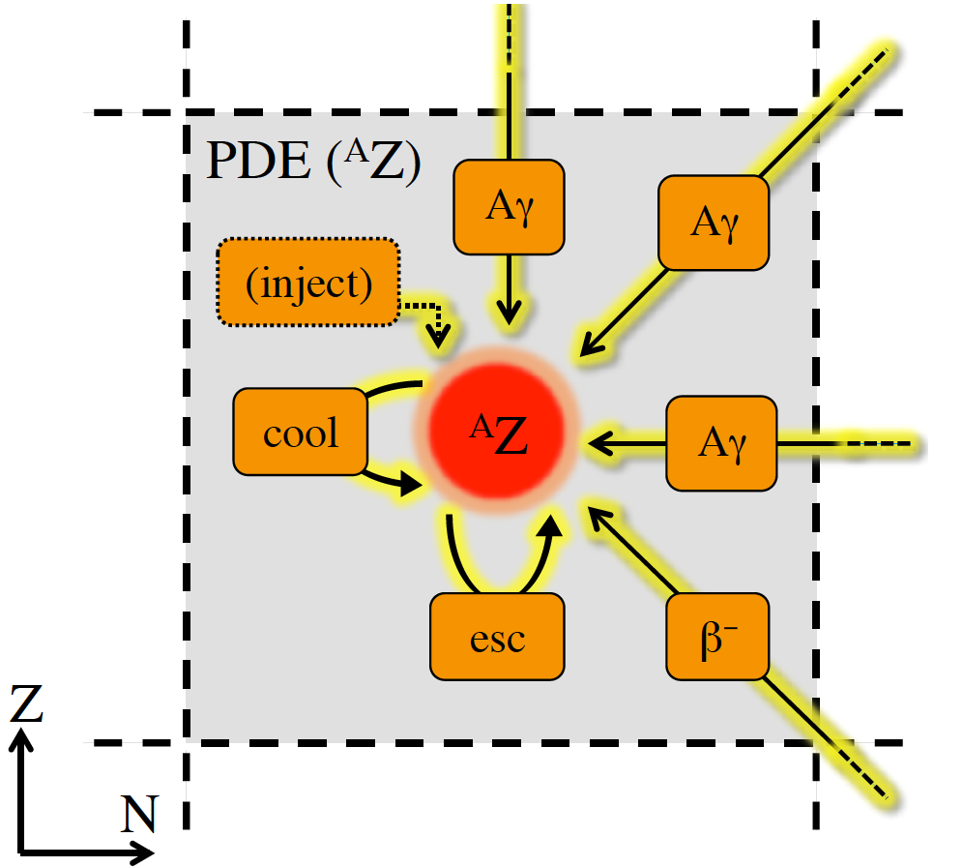
Global radiation models
(the standard tool in multi-messenger and multi-wavelength astrophysics)
Time-dependent PDE system, one PDE per particle species i
b(E)=-E t⁻¹_{loss}
Q(E,t) [GeV⁻¹ cm⁻³ s⁻¹]
N(E,t) [GeV⁻¹ cm⁻³] particle spectrum including spectral effects
Injection: species i from acceleration zone, and from other species j:
Cooling/acceleration
Escape
Injection
“radiation processes”
Density other species
Inter-action rate
Re-distribution function +secondary multiplicity

Slide 20
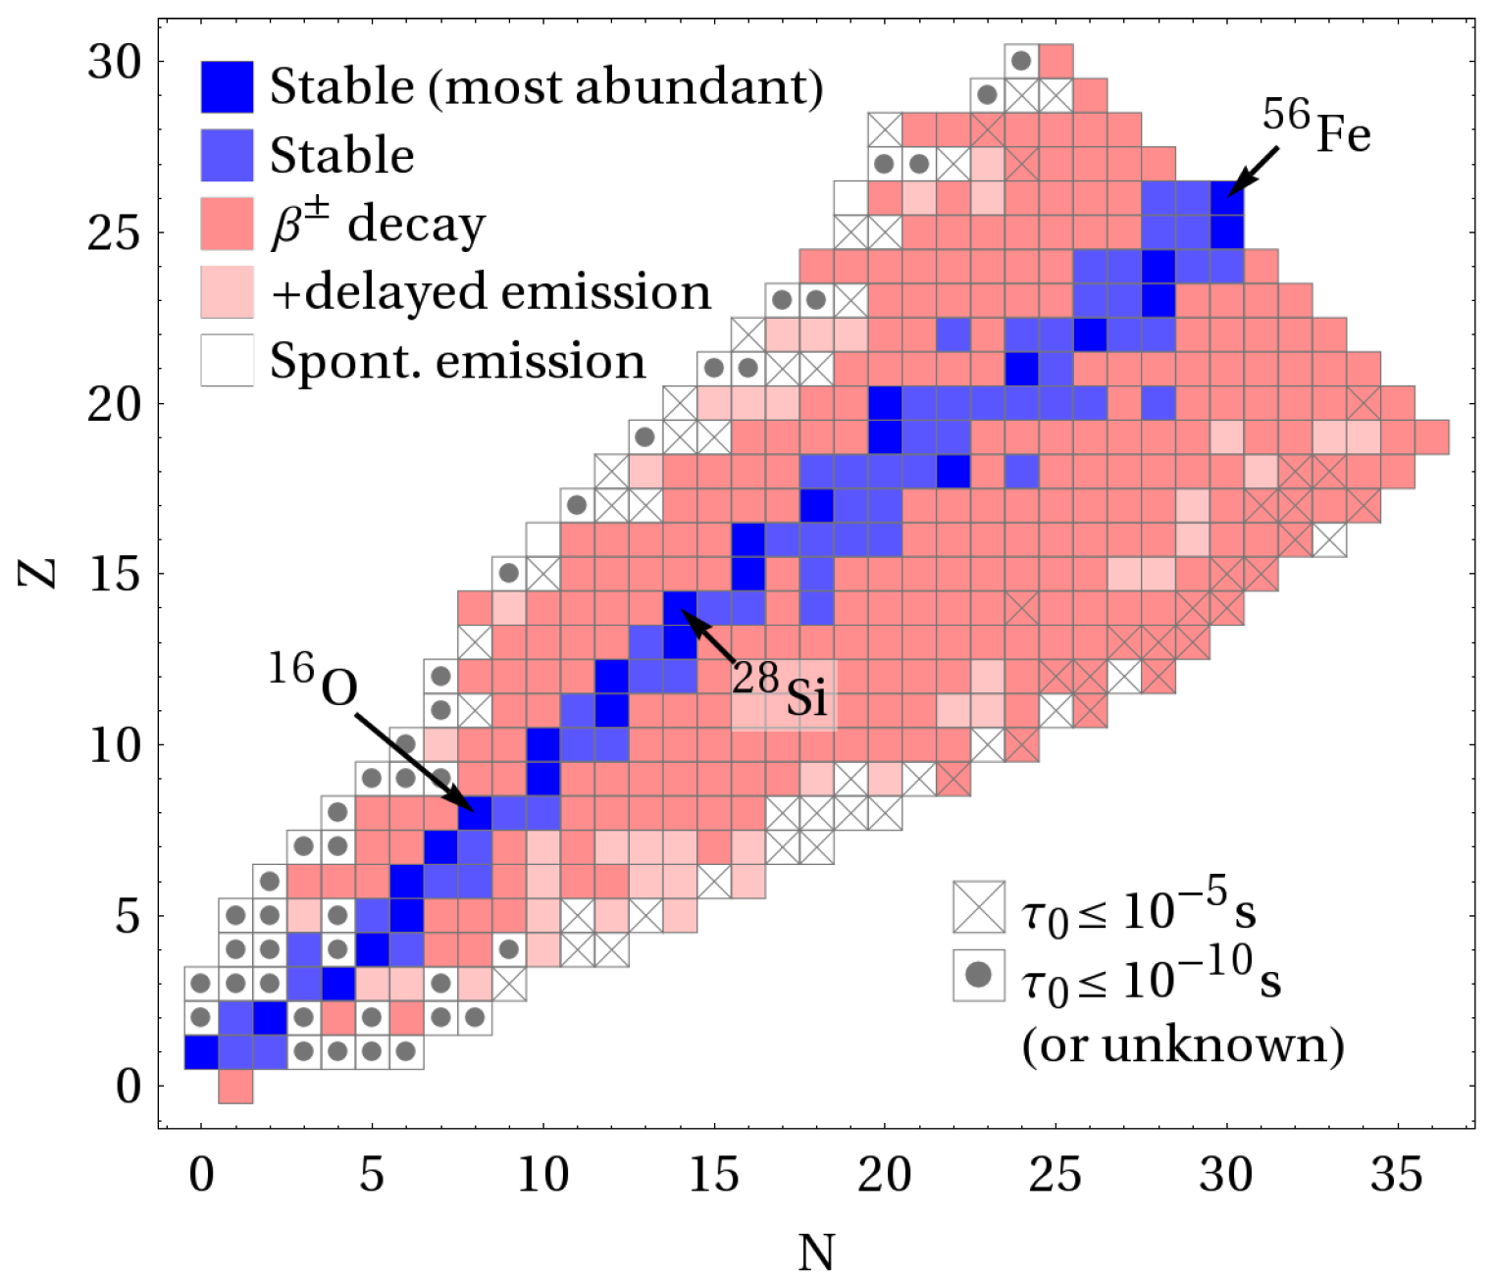
Typical radiation processes of nucleons and nuclei
Nucleons (protons, neutrons)
  Photo-meson production, e.g.
  pγ ➔ pe⁺e⁻ pair production
  pp collisions
  Beta decay (neutrons)
Heavy nuclei
  Photo-disintegration (produces unstable isotopes)
  Photo-meson production
  Aγ ➔ Ae⁺e⁻ pair production
  Beta decay, spontaneous emission of nucleons
  Ap collisions
Color coding:
lifetime
(red: unknown
dark blue: stable
white: very fast decay)
Biehl, Boncioli, Fedynitch, WW, to appear

Slide 21
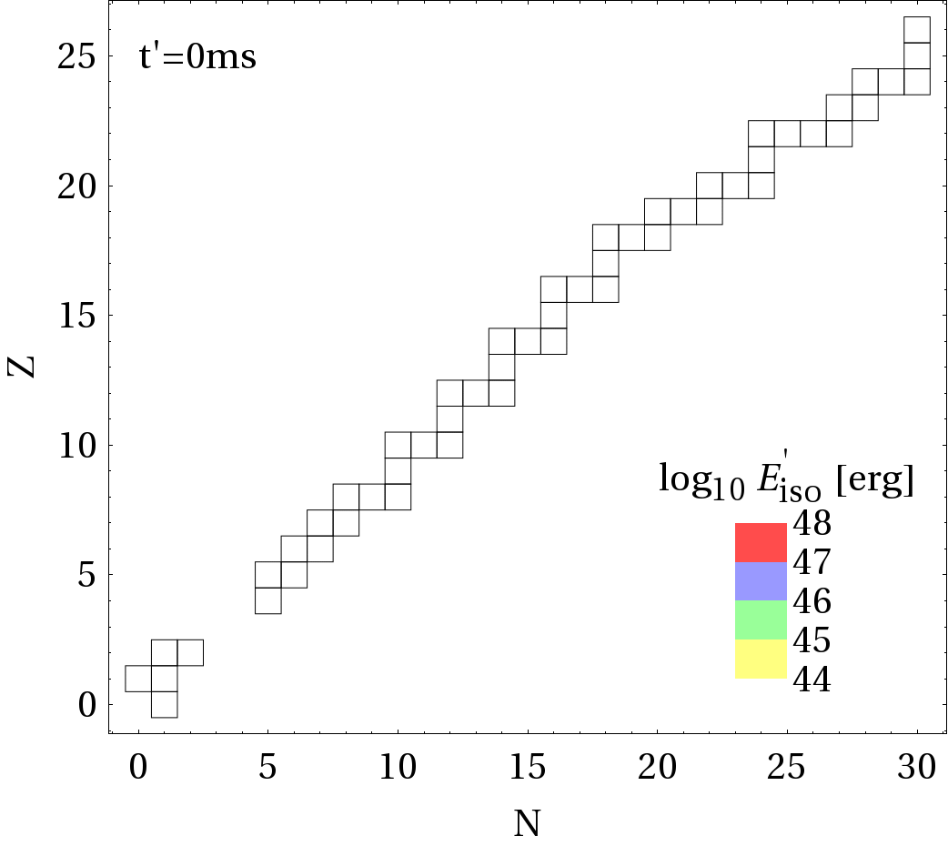
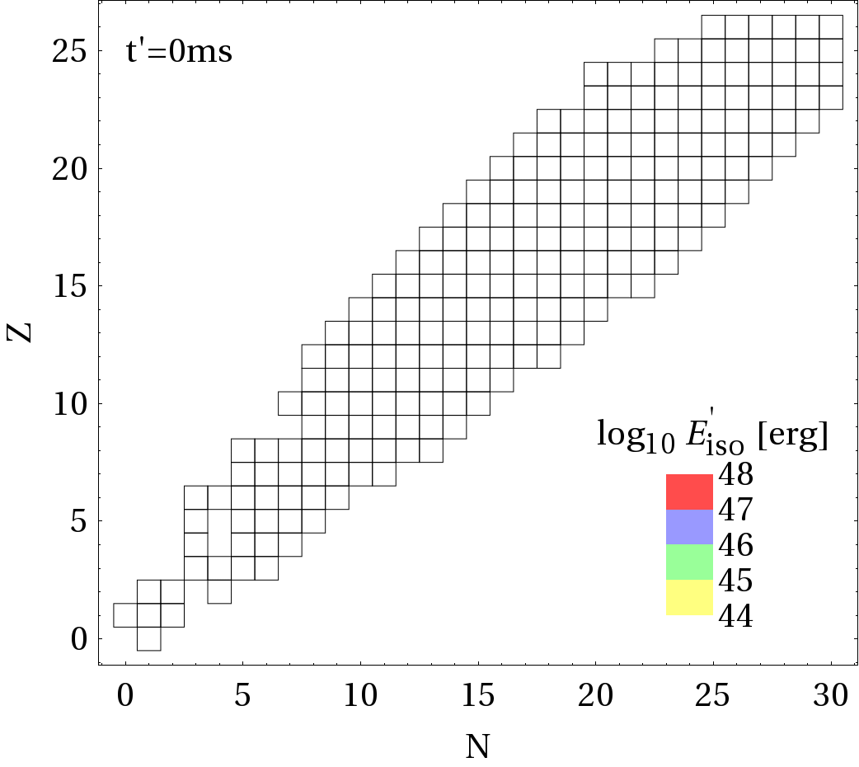
Development of nuclear cascade: model dependence
Example: disintegration of ⁵⁶Fe within a GRB shell (L_{γ}=10⁵² erg/s)
From: Boncioli, Fedynitch, Winter, 2017; arXiv:1607.07989
Puget, Stecker, Bredekamp, 1976; Khan et al, 2005
TALYS 1.8, CRPropa 2 (low mass isotopes)

Slide 22
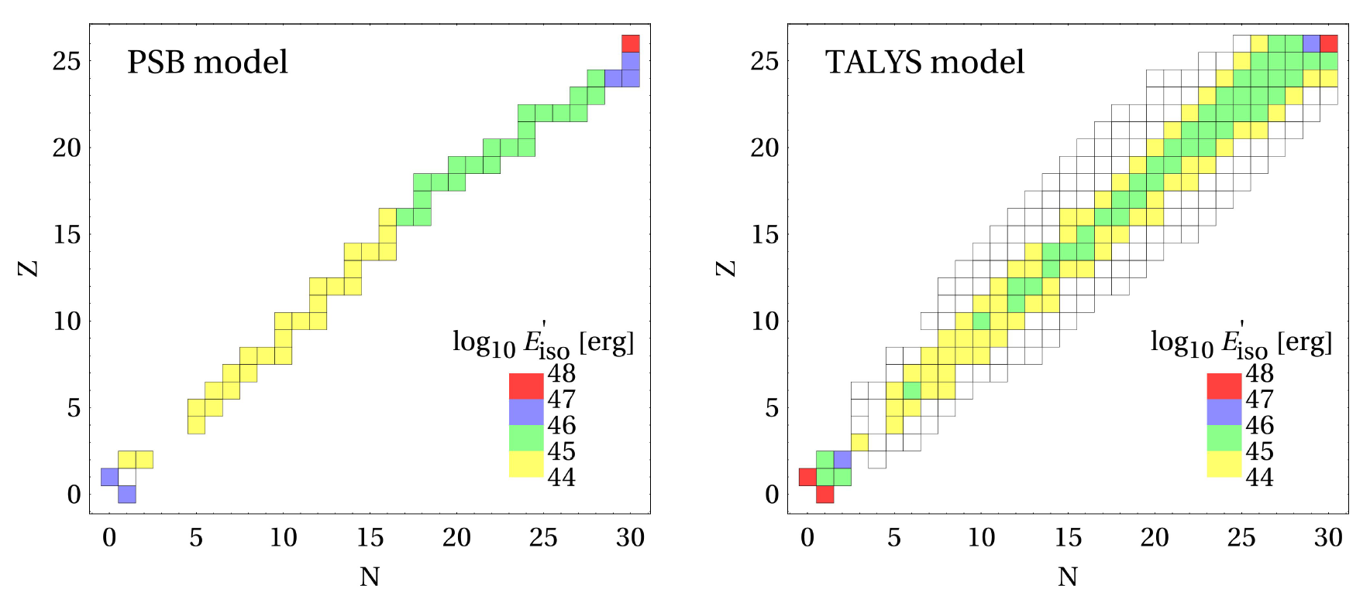
Development of nuclear cascade: model dependence
Example: disintegration of ⁵⁶Fe within a GRB shell (L_{γ}=10⁵² erg/s)
Underestimation of intermediate and light nuclei in PSB (consequences for UHECR composition, neutrinos)
From: Boncioli, Fedynitch, Winter, 2017; arXiv:1607.07989
Puget, Stecker, Bredekamp, 1976; Khan et al, 2005
TALYS 1.8, CRPropa 2 (low mass isotopes)

Slide 23
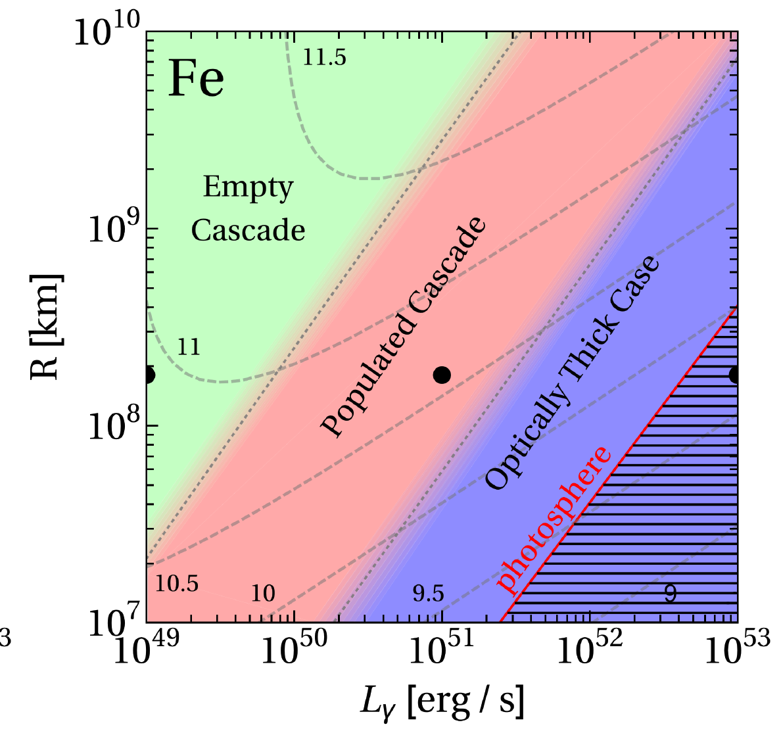
When does the nuclear cascade develop (GRB)?
Example: Pure iron (⁵⁶Fe) composition injected into a GRB shell
Empty cascade
- Nuclear cascade
cannot develop
- Primaries (here Fe)
dominate UHECRs;
Peters cycle!
- Neutrino
production by
primaries (iron)
dominates; X-sec?
Log₁₀ E_{max}
Γ=300, internal shock model
Optically thick to all nuclei and nucleons
- Nuclear cascade
“dumped” into
nucleons, primaries
cannot escape
- Efficient neutrino
production
dominated by split-
off nucleons
Populated cascade
- Nuclear cascade
populated
- Neutrino production
by secondaries
produced in
disintegration chain
- No Peters cycle!
Biehl, Boncioli, Fedynitch, WW, to appear

Slide 24
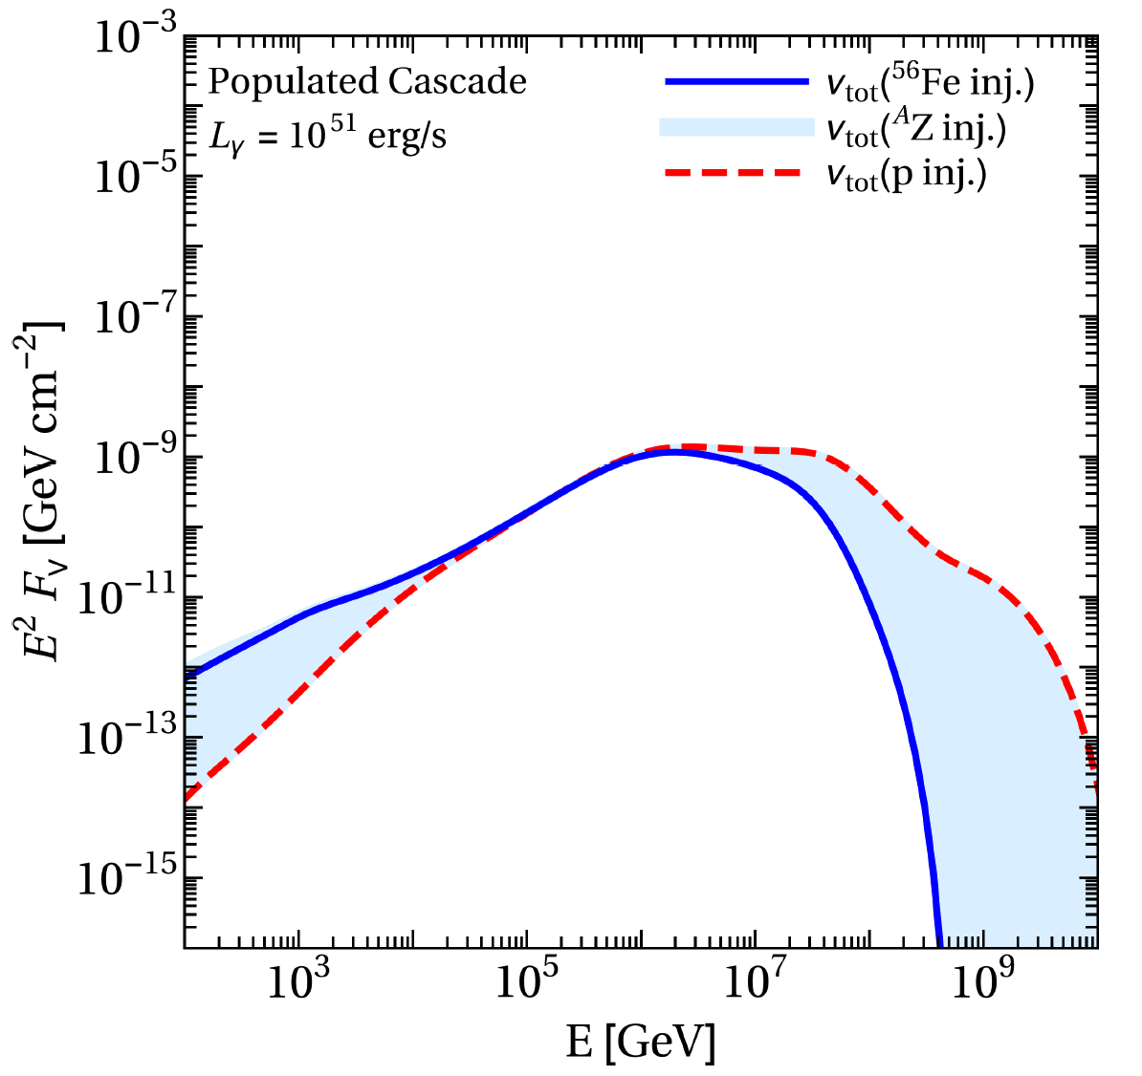
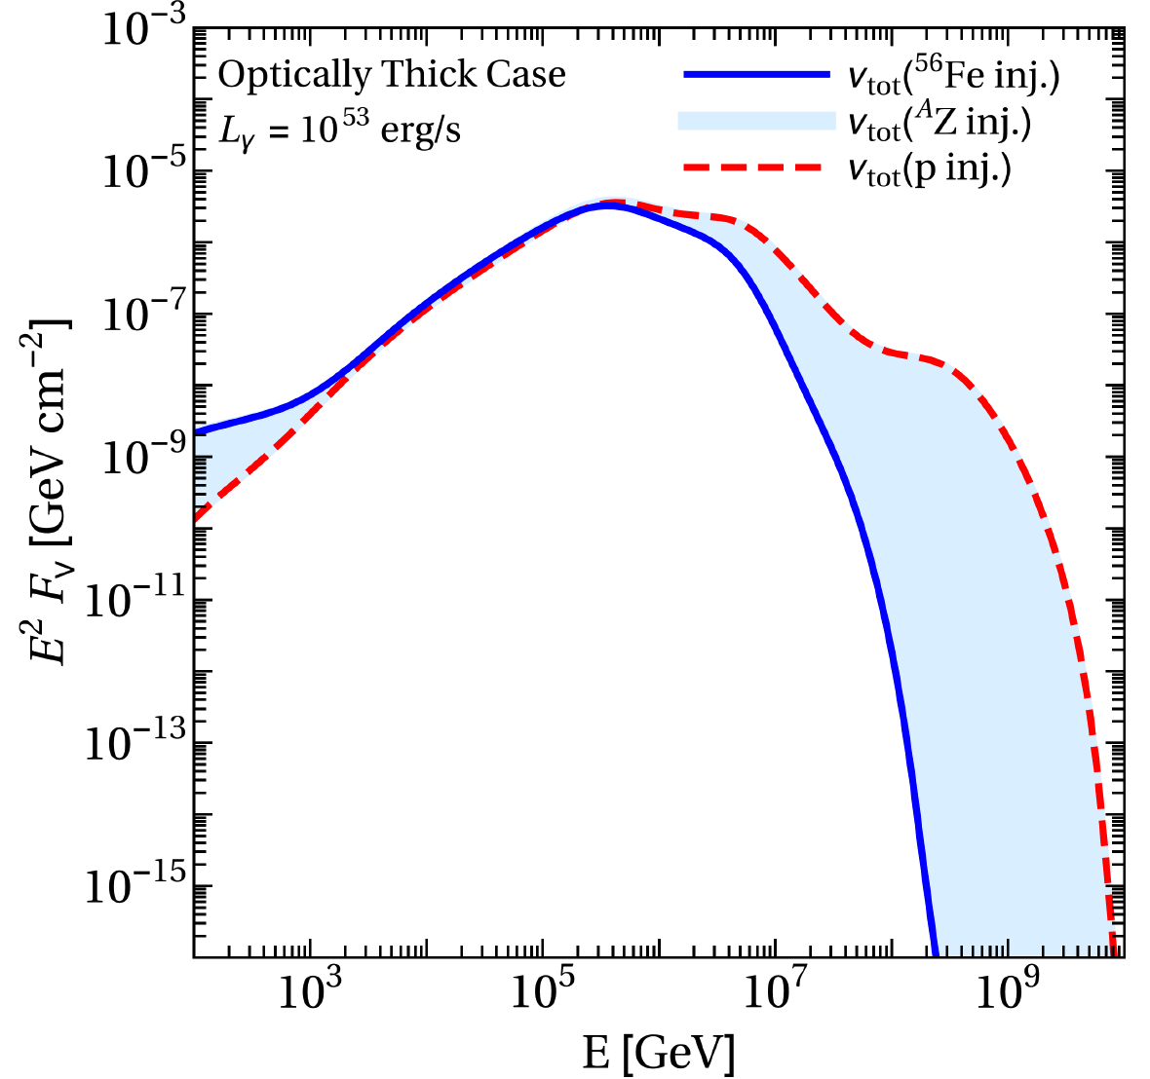
Composition dependence of neutrino fluence from GRBs
The neutrino fluence (per shell) hardly depends on the injection composition
[Consequence of E⁻² injection, conserved energy per nucleon in the disintegration chain, magnetic field effects on secondaries, and interaction rate flat in energy above threshold]
The neutrino bounds on GRBs will roughly apply if UHECRs are nuclei
Biehl, Boncioli, Fedynitch, WW, to appear

Slide 25
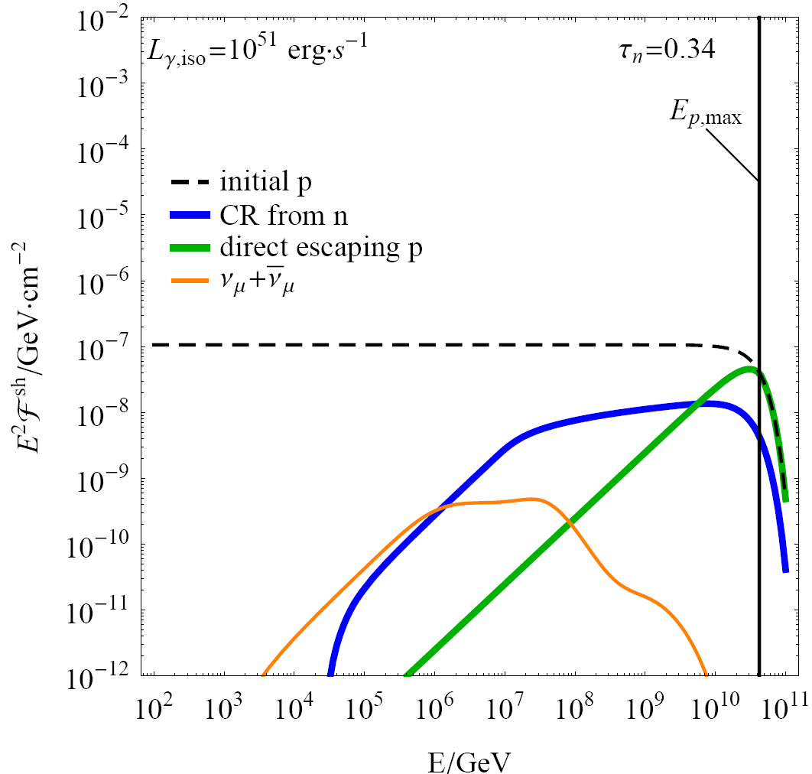
How do cosmic rays escape from the source?
Key challenge 2
Neutron model
Only neutrons can escape
Direct escape (aka “high pass filter”, “leakage”, …)
Charged cosmic rays can efficiently escape
if Larmor radius reaches size of region
(conservative escape contribution, green curve, hard)
(from: Baerwald et al, ApJ 768 (2013) 186;
similar assumptions in Globus et al, 2014)
All escape, advective/free-streaming escape
(most aggressive scenario, dashed curve, ~ E⁻²)
Diffusive escape: e. g. Escape rate ~ (R_{L})^{α}
(compromise, but highly assumption dependent)
e.g. Unger et al, 2015; Kachelrieß et al, 2017; Fang, Murase, 2017; ...
Current Auger best-fit supports
direct escape hypothesis
(requires E⁻¹ from sources);
possibly neutrons below ankle?
(e. g. Unger, Farrar, Anchordoqui, 2015)
E⁻²
softer
hard
Talk by K. Fang
(GRB, protons, without propagation effects)
Auger

Slide 26
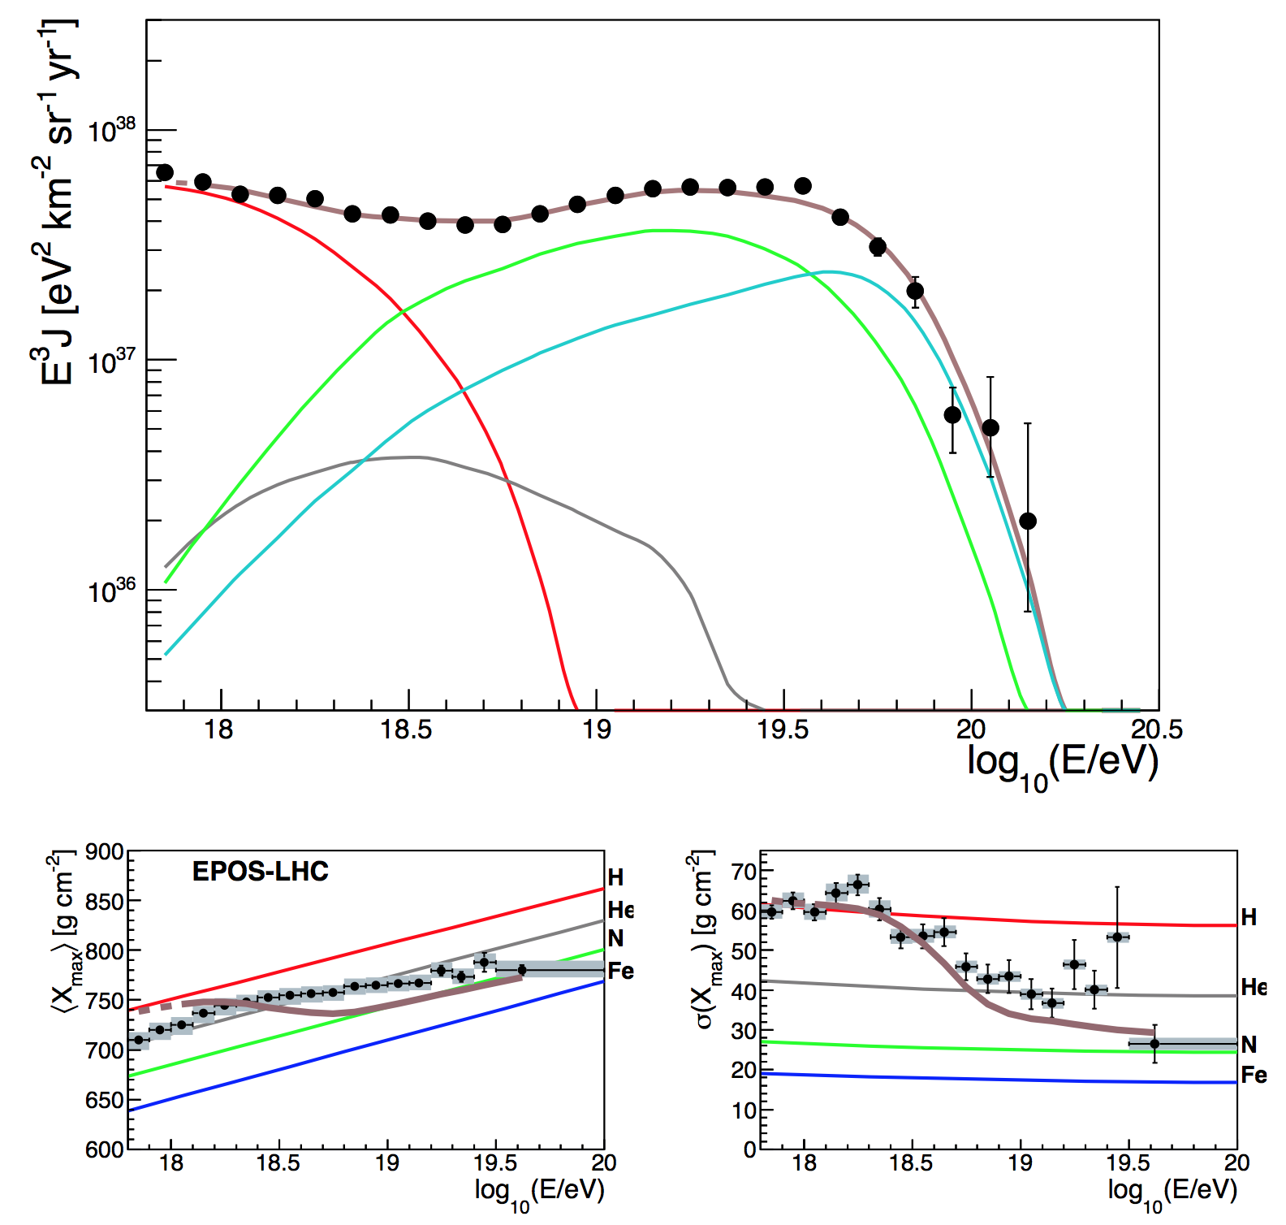
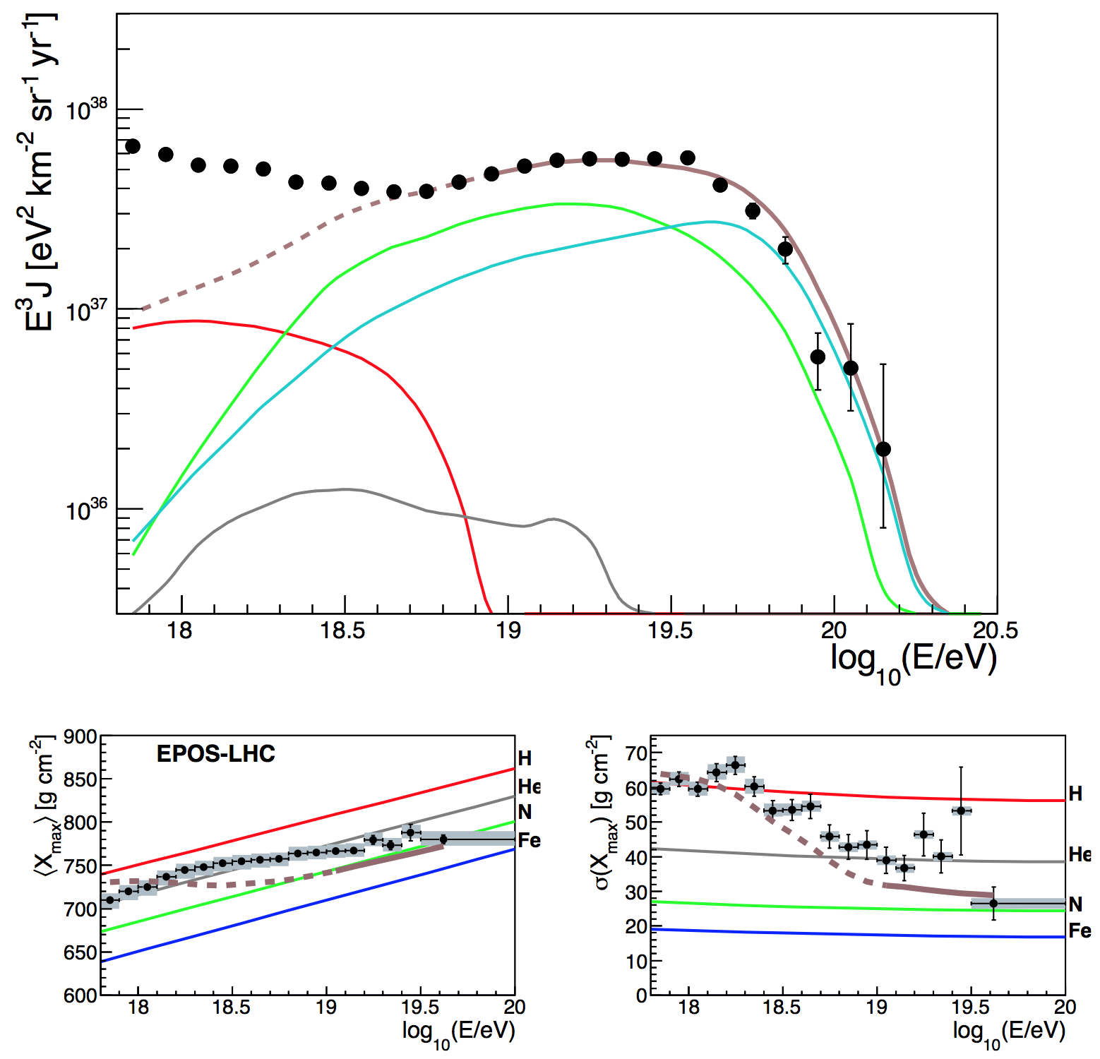
Combined source-propagation model (best-fit):
Description of Auger data with ²⁸Si injection into GRB only
Mixed composition dip model
Mixed composition ankle model
Fit range
Fit range
PRELIMINARY
Baryonic loading is a consequence of the fit!
(no free parameter anymore)
Biehl, Boncioli, Fedynitch, WW, to appear

Slide 27
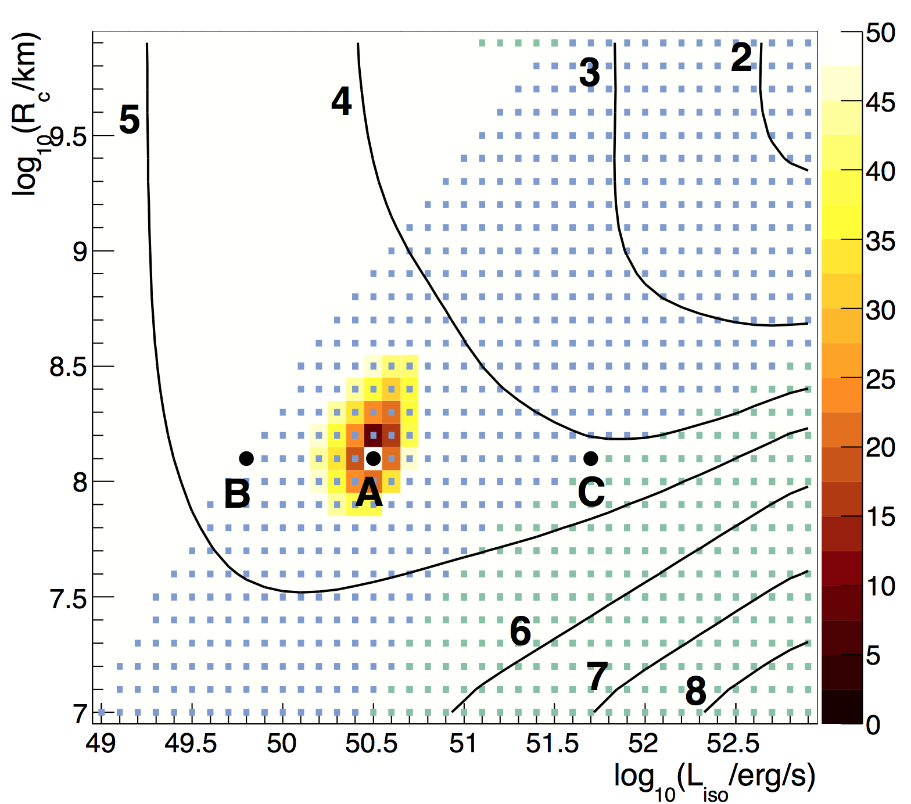
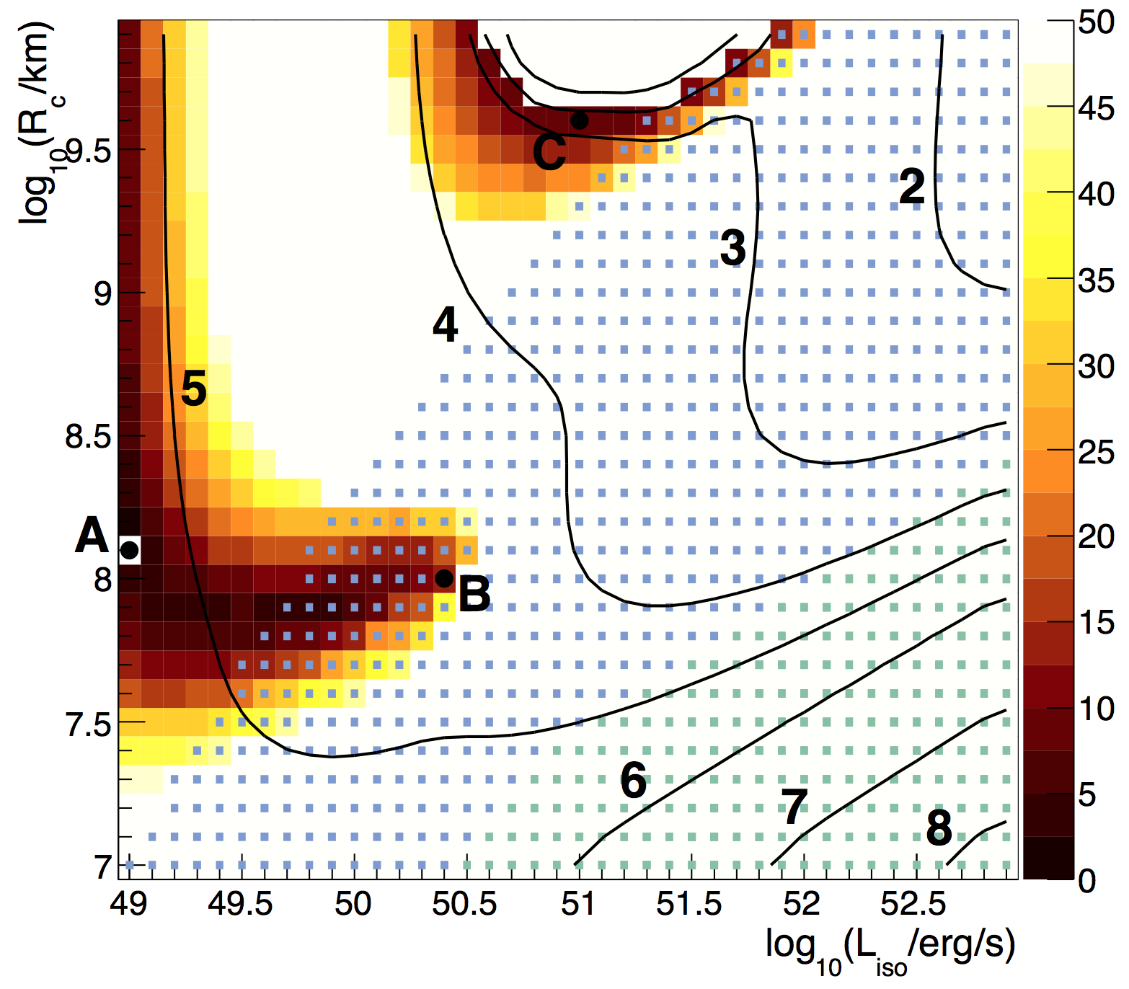
The exclusion power of prompt GRB searches
Mixed composition dip model
Mixed composition ankle model
GRB
“standard”
params?
(from γ-rays!)
IceCube 2017 prompt bound;
1702.06868
IceCube 2014 cosmogenic
PRELIMINARY
Log₁₀ f_{B} (baryonic loading)
From: Biehl, Boncioli, Fedynitch, WW, to appear;
see also Baerwald, Bustamante, Winter, Astropart. Phys. 62 (2015) 66 for proton injection

Slide 28
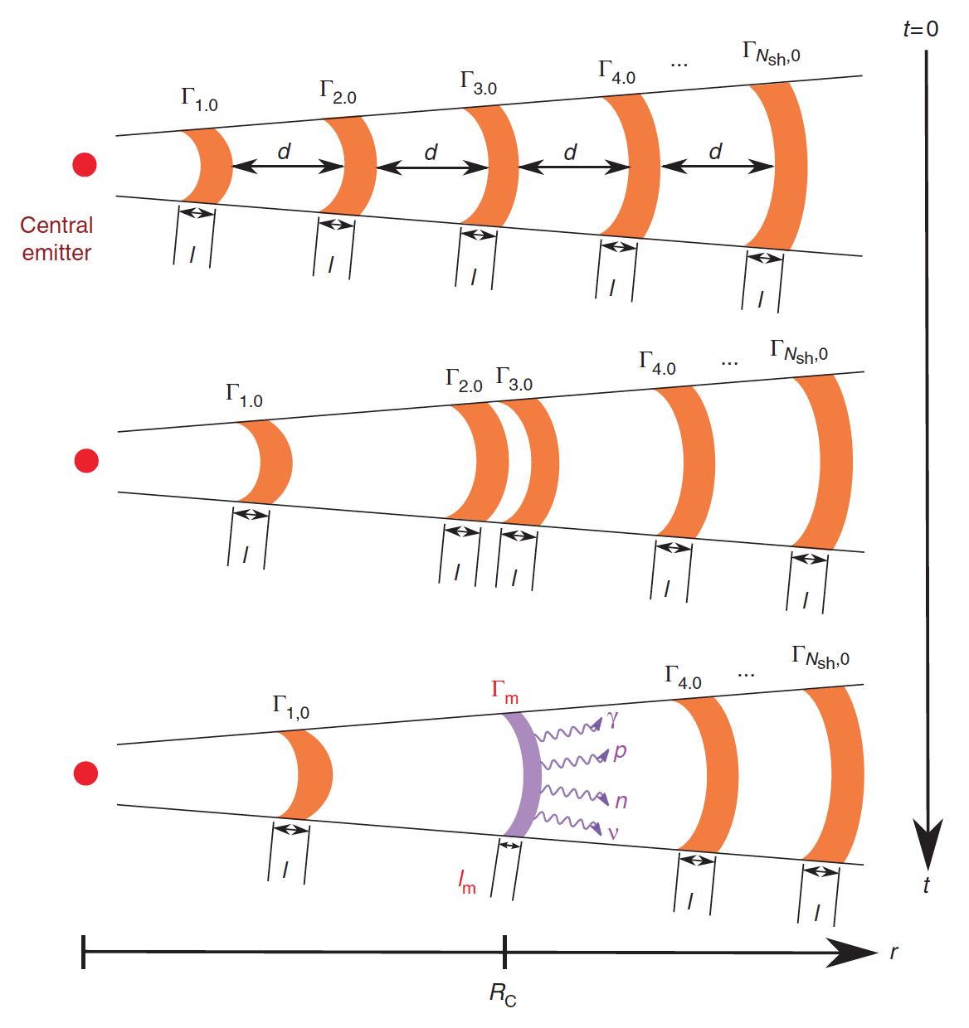
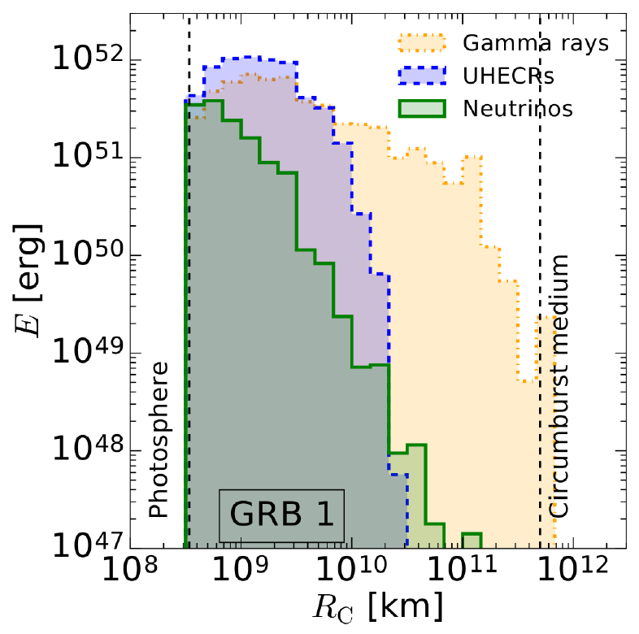
Caveat: The GRB emission comes from multiple zones
Better handle on
Key challenge 3?
(geometry estimators)
Bustamante, Baerwald, Heinze, Murase, Winter,
Nature Commun. 6, 6783 (2015) +
ApJ 837 (2017) 33;
see also Globus et al, 2014+2015
The different messengers originate from different regimes
of the GRB where the photon densities are very different
Neutrino flux is dominated by a few collisions with high densities
Fundamental problem? Quantities (e.g. geometry estimators) inferred from γ-ray observations not representative for neutrinos and UHECRs?
Talk by M. Bustamante

Slide 29
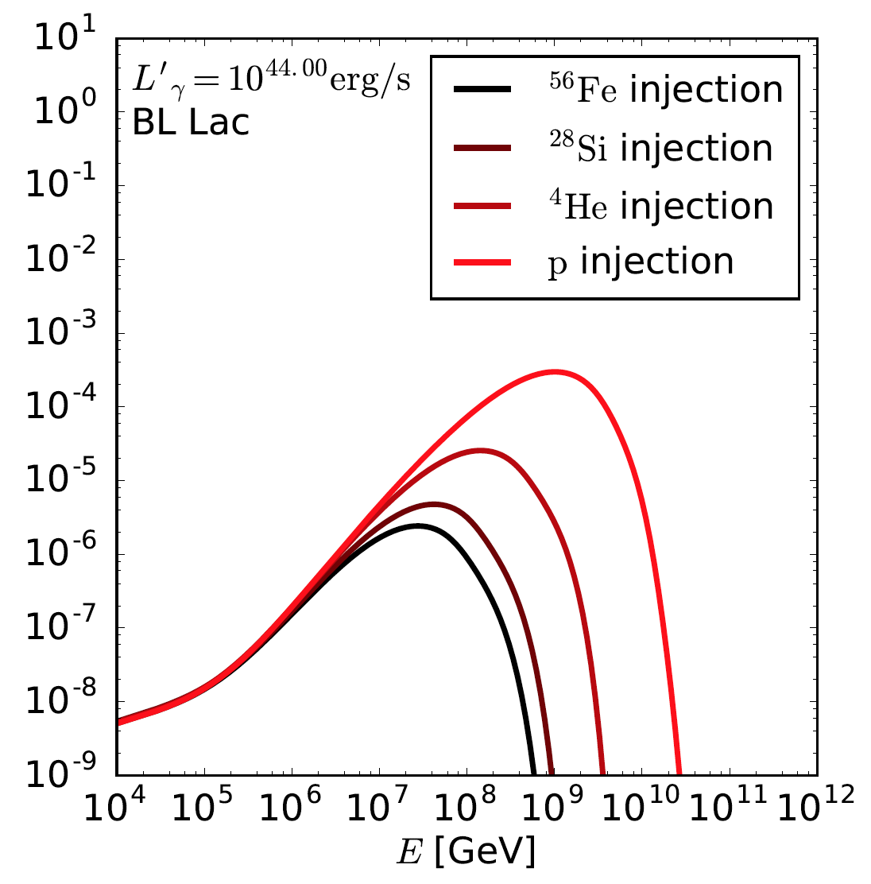
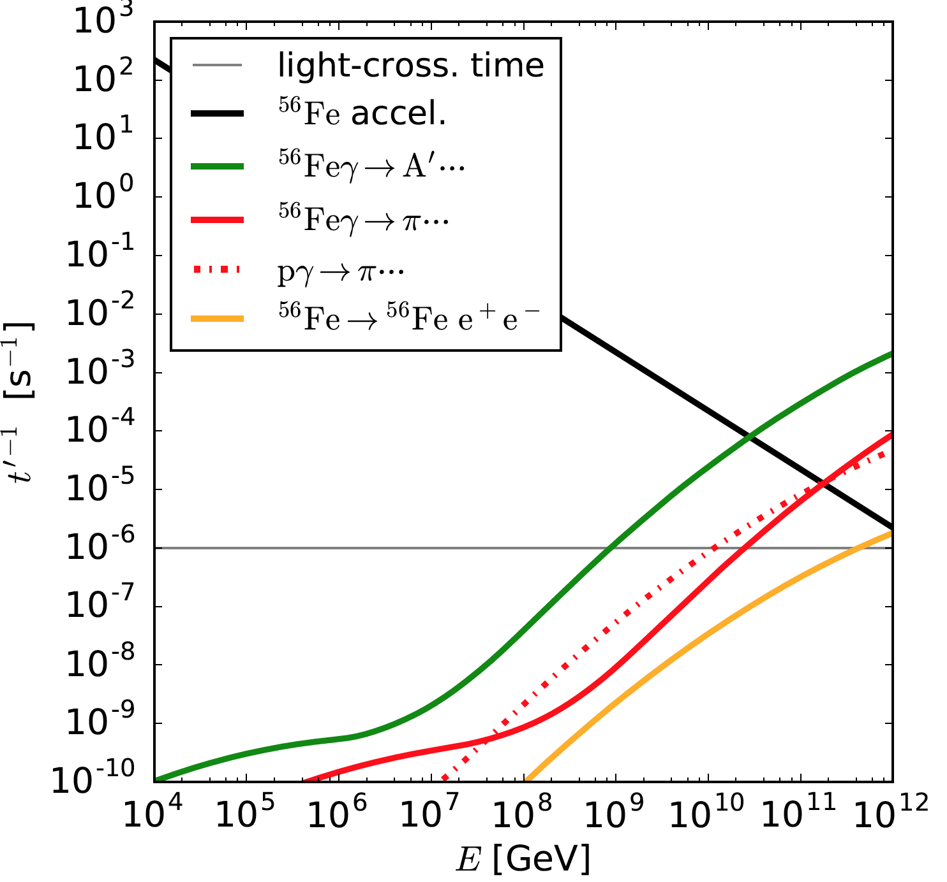

How about neutrinos from AGN blazars?
Interaction rates increase strongly
with energy:
Peaked neutrino spectra with maximal energy following the primary
Neutrino fluence depends on composition
PRELIMINARY
Rodrigues, Fedynitch, Boncioli, Gao, WW, in prep.;
AGN model similar to
Murase, Inoue, Dermer, 2014

Slide 30
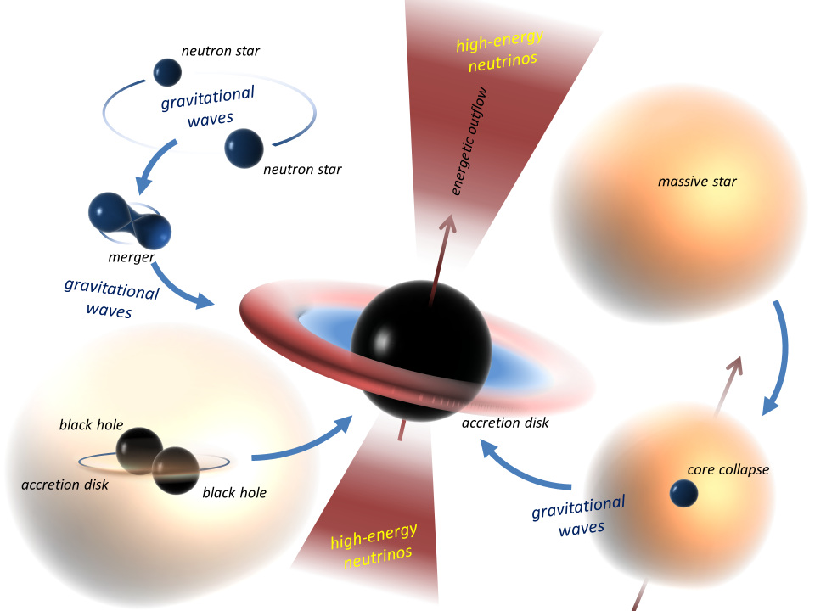
Theoretical paradigms for multi-messenger astrophysics with gravitational waves?
?
Observer
?
?
Bartos+ 2016; see e.g. arXiv:1602.06961, arXiv:1602.06938, arXiv:1609.09832 for theory papers

Slide 31
Summary: Key challenges
Can be used to learn about source. Reduced uncertainty in multi-zone models or generic relation-ships
Often (hidden?) assumption;
Auger global fit favors “direct escape” hypothesis; escape
requires further study
Key challenge 2:
How do cosmic rays
escape from the source?
Key challenge 3:
Secondary production
very sensitive to
geometry estimators
Key challenge 1:
Composition
Key challenge 4:
Baryonic
loading
Condensing evidence for nuclei; need to take this into account in multi-messenger models
Can be obtained from UHECR fit
(under the assumption that unique source class of UHECRs)

Slide 32
BACKUP

Slide 33
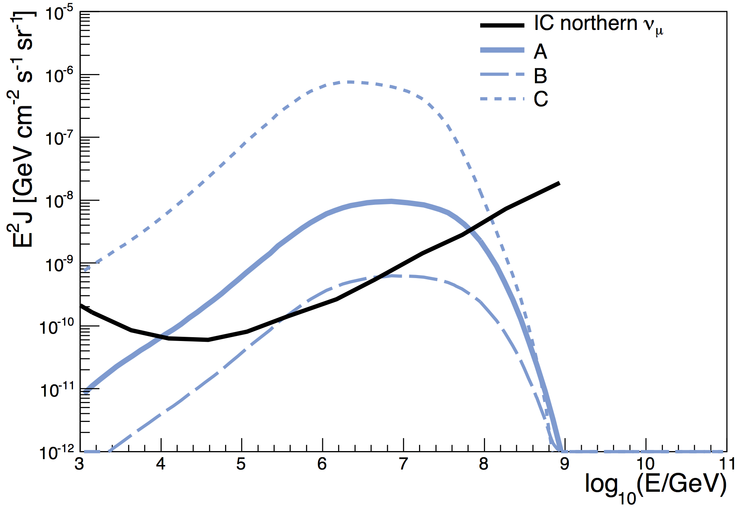
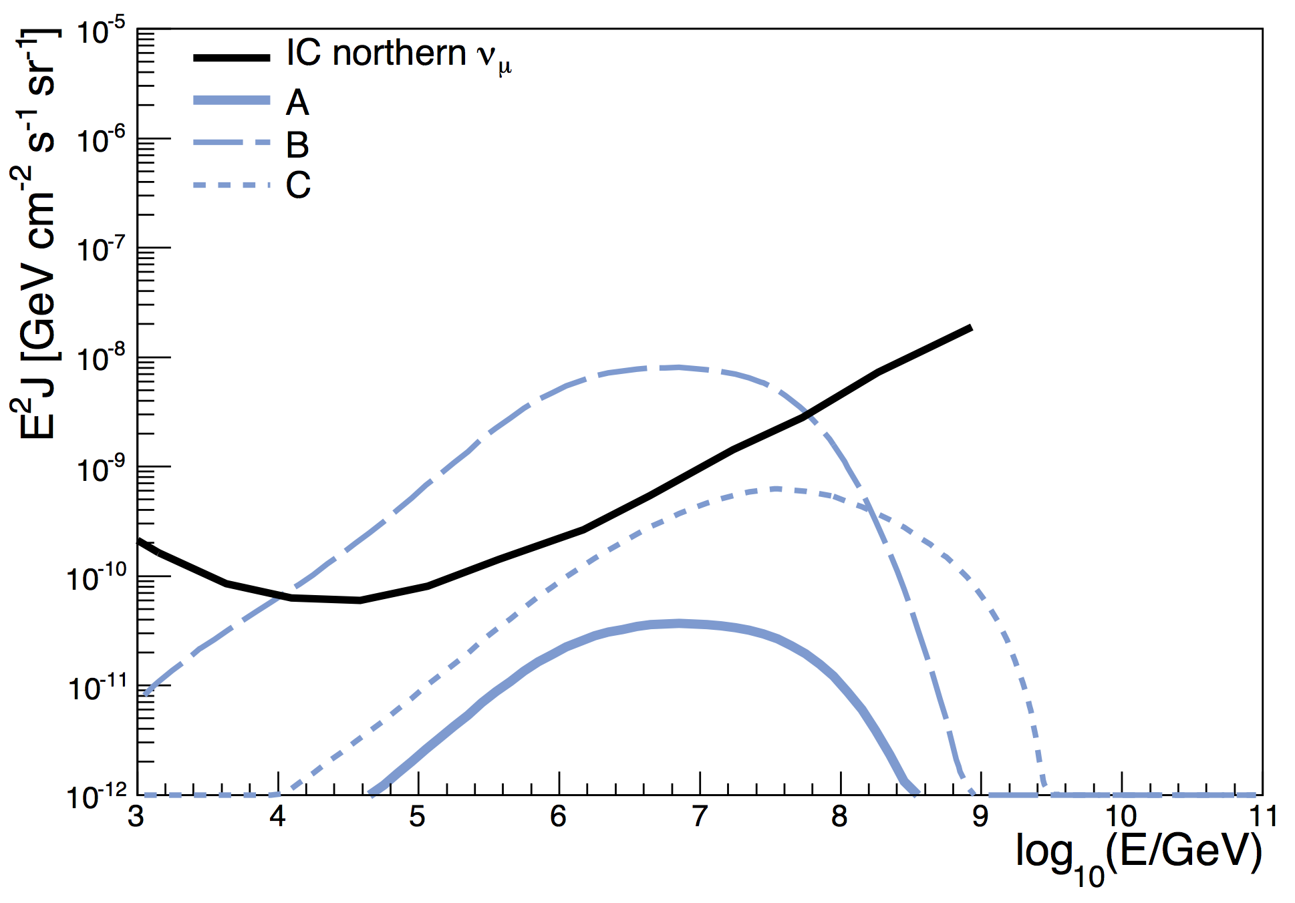
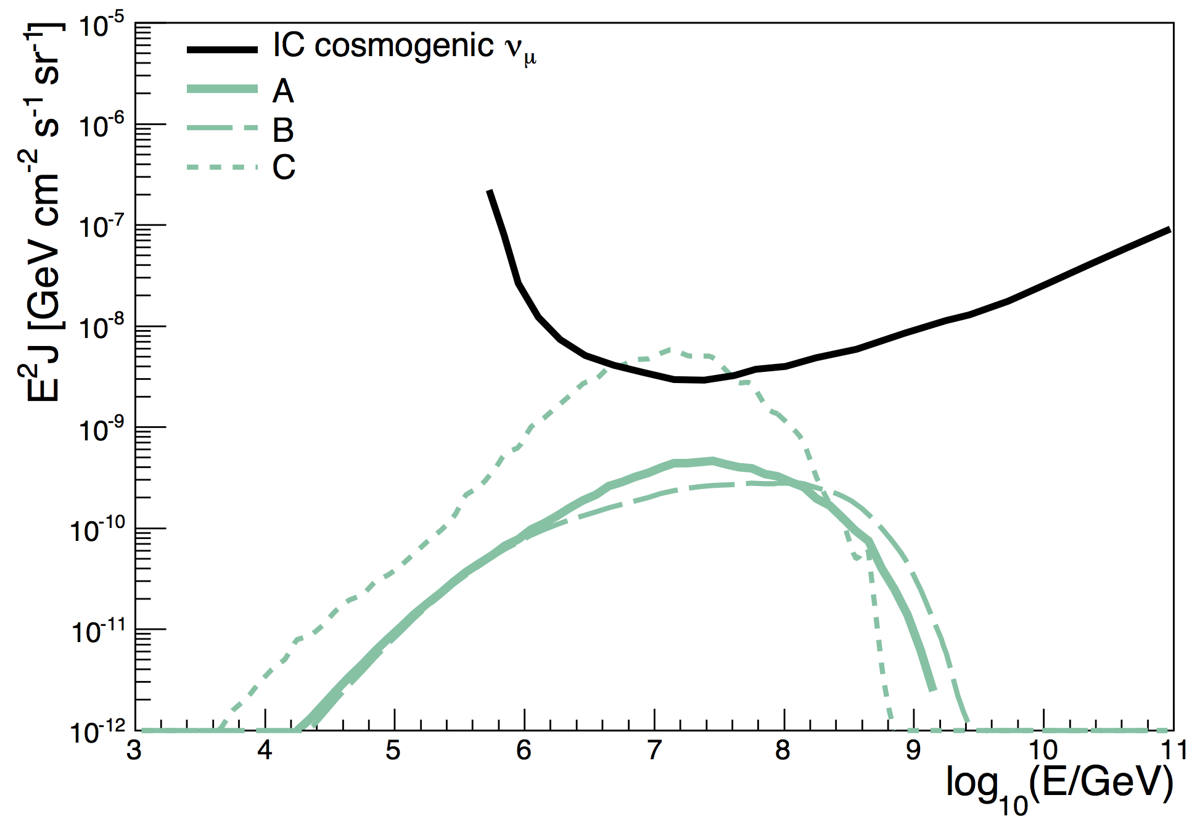
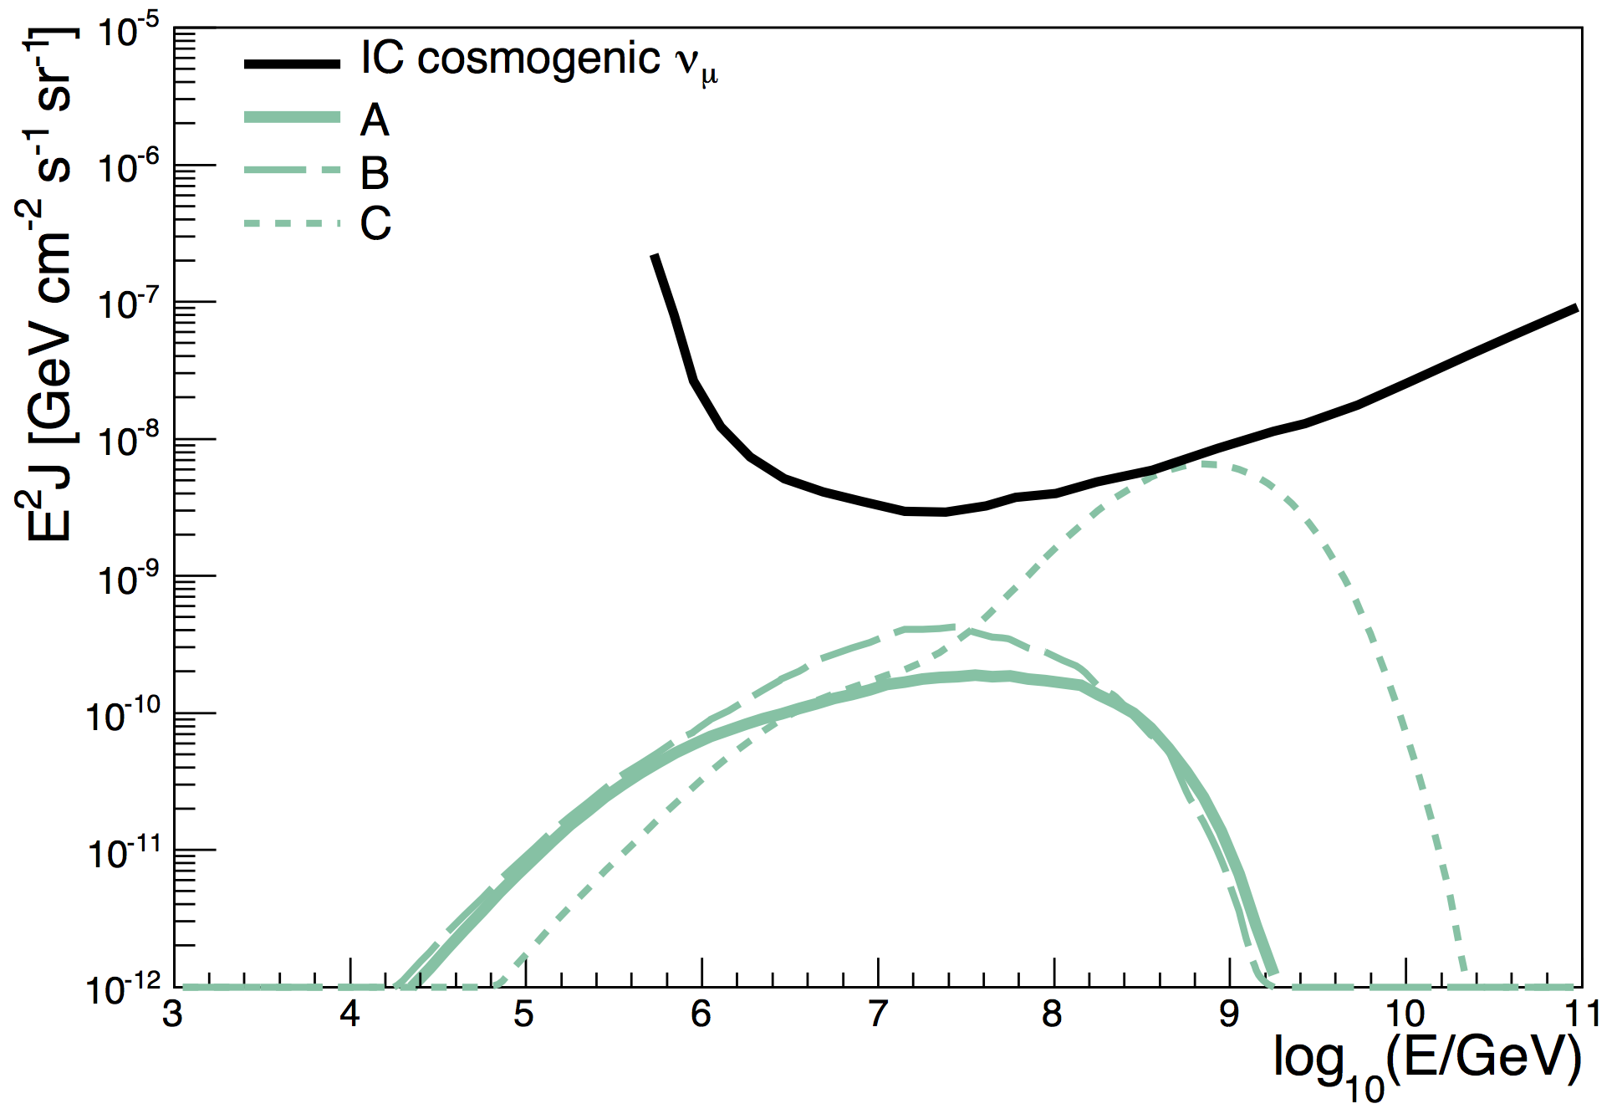
Test point neutrino plots
Mixed composition dip model
Mixed composition ankle model
PRELIMINARY
Biehl, Boncioli, Fedynitch, Winter, to appear

Slide 34

Nuclear cascade: Astrophysical model-dependence
Dependence
on Γ, t_{v} mild
Γ=300, t_{v}=0.01s
Biehl,
Boncioli,
Fedynitch,
Winter,
to appear

