Slide 1



New Physics with ORCA/PINGU
João Coelho
1st October 2016

Slide 2
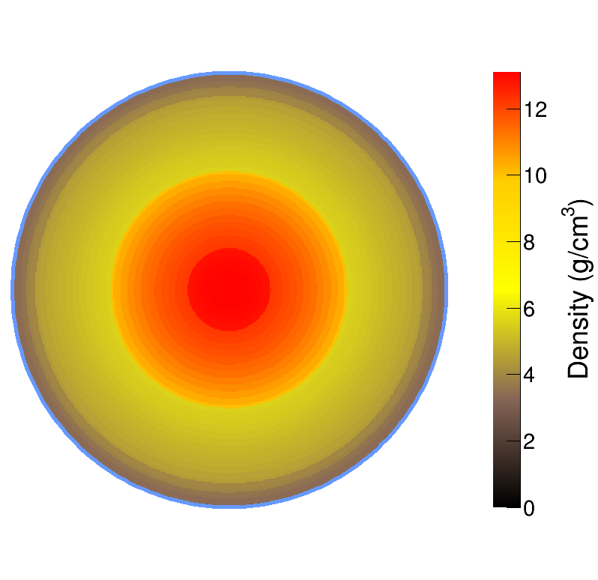

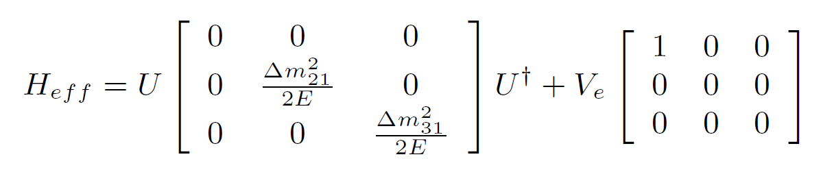
Matter Effects
Interplay between these two terms

Slide 3
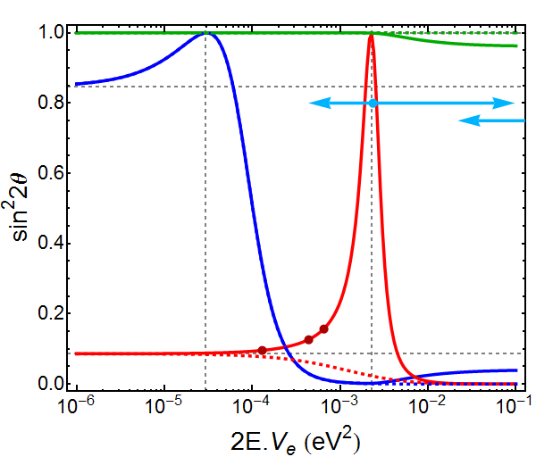
Resonances
θ₂₃
NH
θ₁₂
θ₁₃
IH

Slide 4
Resonances
θ₂₃
θ₁₂
Δm²₂₁ cos2θ₁₂
Δm²₃₁ cos2θ₁₃
θ₁₃

Slide 5
Resonances
θ₂₃
ORCA/PINGU
θ₁₂
ARCA/IceCube
DUNE
θ₁₃
NOvA
T2K

Slide 6
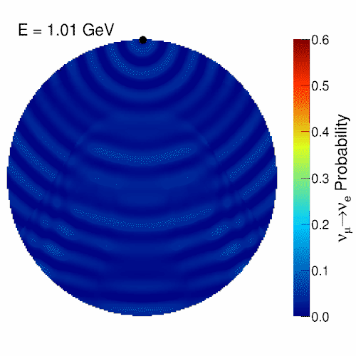
Effect on Oscillation

Slide 7
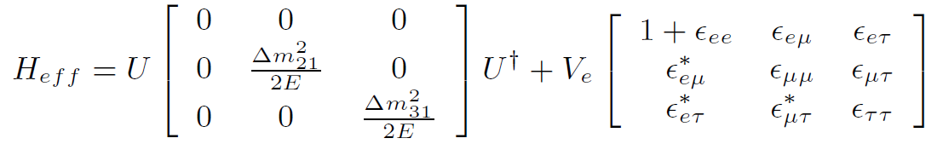
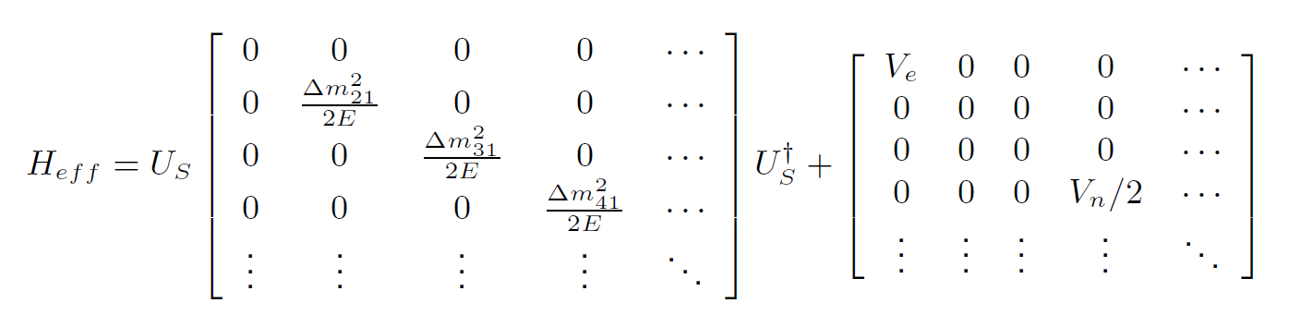
Extended Models
Arbitrary
Perturbation
Non-Standard Interactions (NSI)
Sterile Neutrinos (3+N Flavours)
NC Contribution

Slide 8
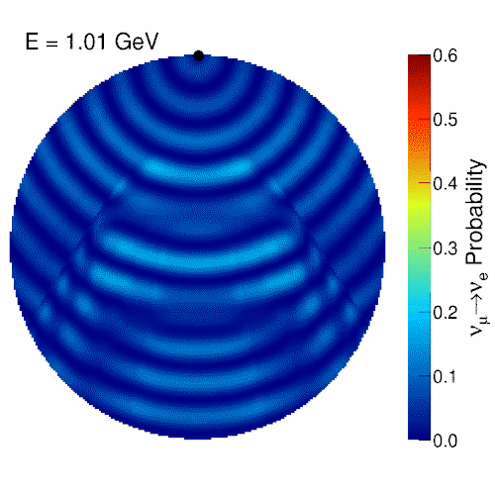
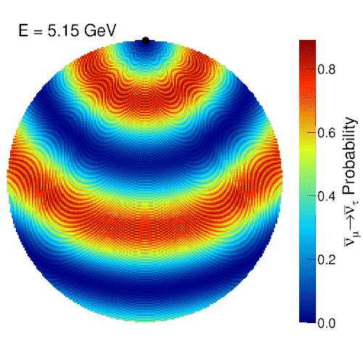
Enhanced Matter Effects
NSI (ε_{eτ} = 0.2)
Steriles (“Curr.” Limits)
Visit https://goo.gl/CJyFoK for more

Slide 9
Non-Standard Interactions

Slide 10
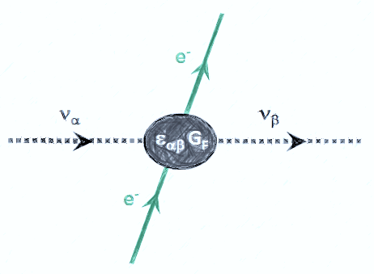
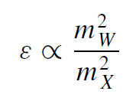

NSI Motivation
Arbitrary
Perturbation
Non-Standard Interactions (NSI)
Dimension-6
+ Naturalness
TeV Scale
~ 10⁻²

Slide 11
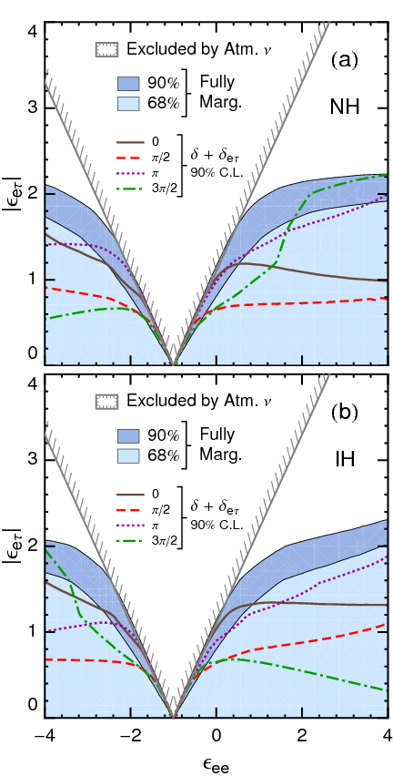

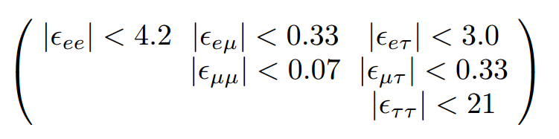
Non-Standard Interactions
Direct limits are very weak on 3 of the 6 possible new couplings
Rich phenomenology, i.e. complicated analysis with many free parameters
Still need to study the ideal approach for ORCA
Often correlated:
J. Coelho et al., Phys. Rev. D86, 113015 (2012)
Direct Bounds
See T. Ohlsson, Rep. Prog. Phys. 76, 044201 (2013) for a review

Slide 12
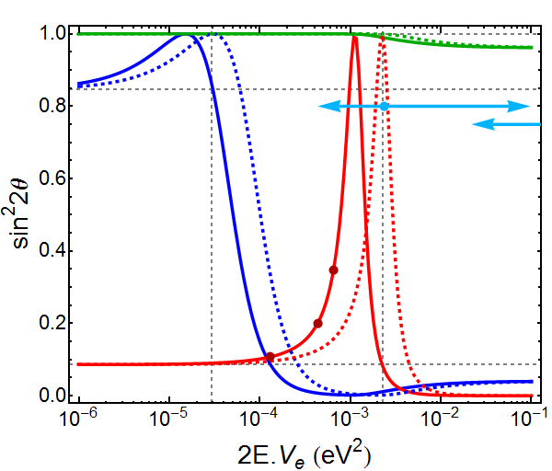
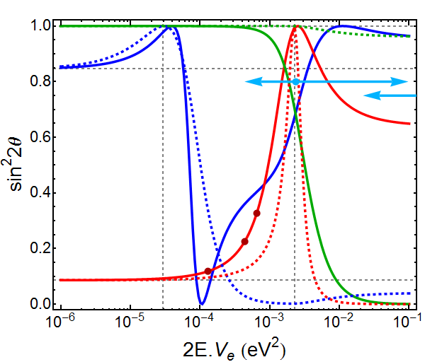
Resonances w/ NSI
ε_{ee} = 1
ε_{eτ} = 0.5, ε_{ττ} = 0.25
θ₂₃
θ₂₃
θ₁₂
θ₁₂
θ₁₃
θ₁₃

Slide 13
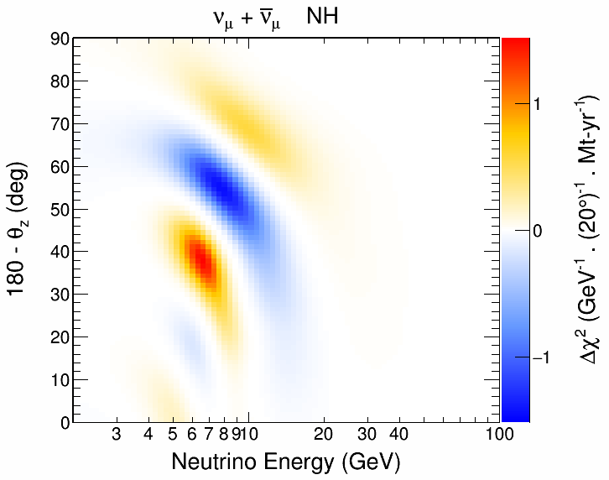
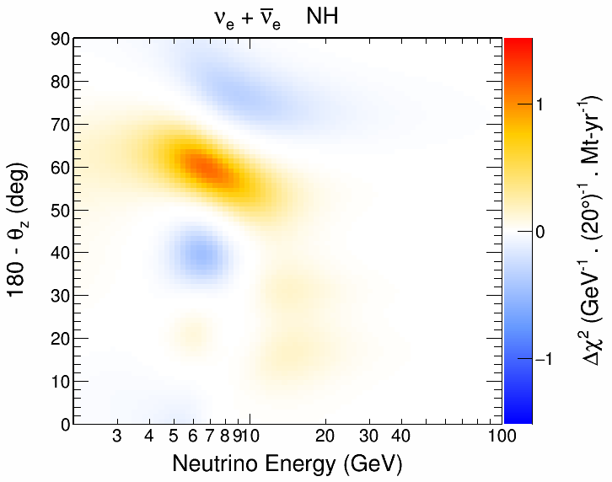
NSI Phase Space
Very different from MH for nue
Sensitivity in both channels, but numu is correlated with MH
Still under unrealistic assumptions:
  Perfect flavour selection
  No systematics or nuisance pars.
ε_{eτ} = 0.2, ε_{ττ} = 0.04

Slide 14
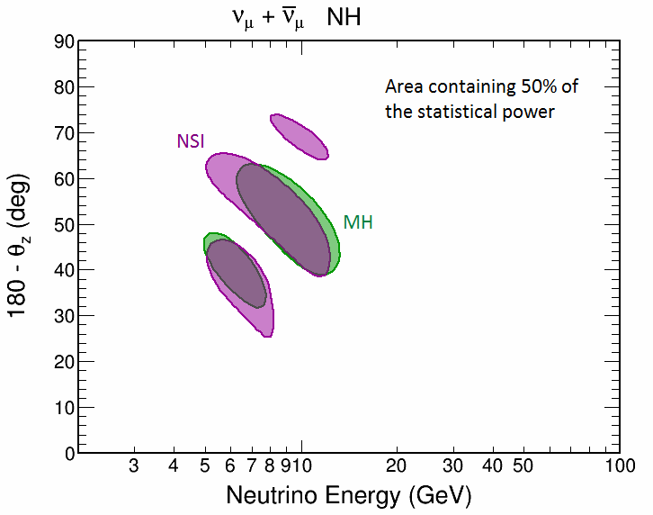
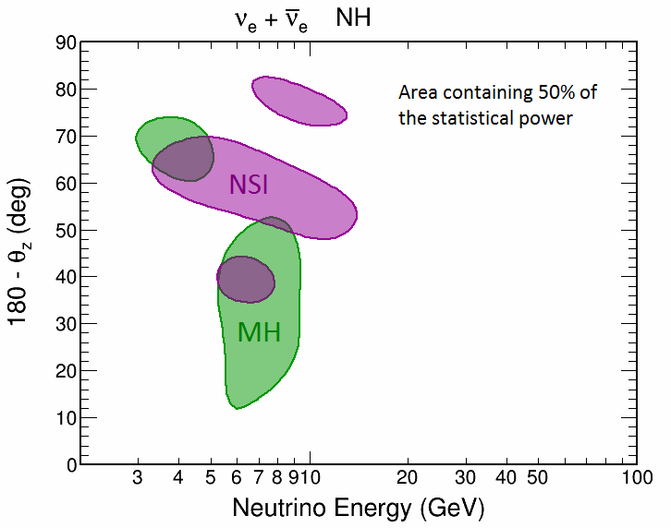
NSI Phase Space
Very different from MH for nue
Sensitivity in both channels, but numu is correlated with MH
Still under unrealistic assumptions:
  Perfect flavour selection
  No systematics or nuisance pars.
ε_{eτ} = 0.2, ε_{ττ} = 0.04

Slide 15
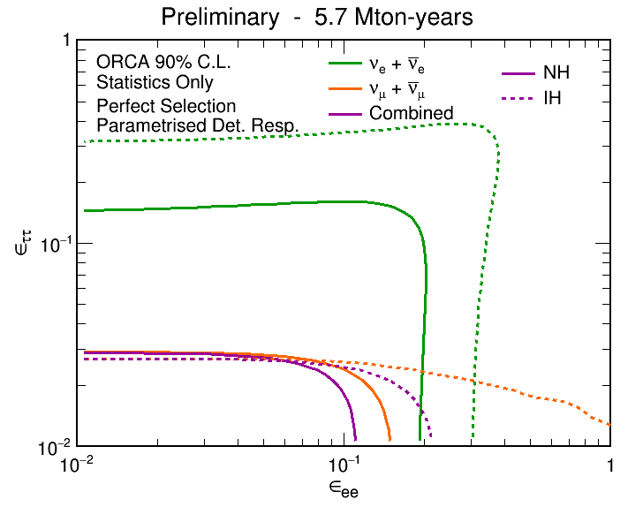
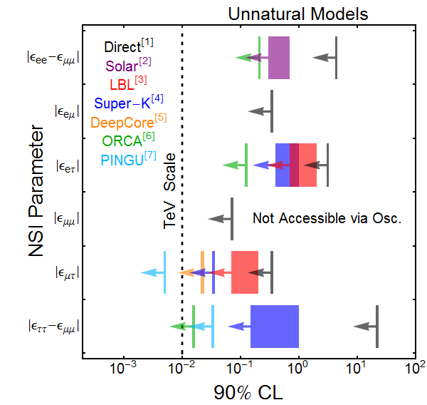
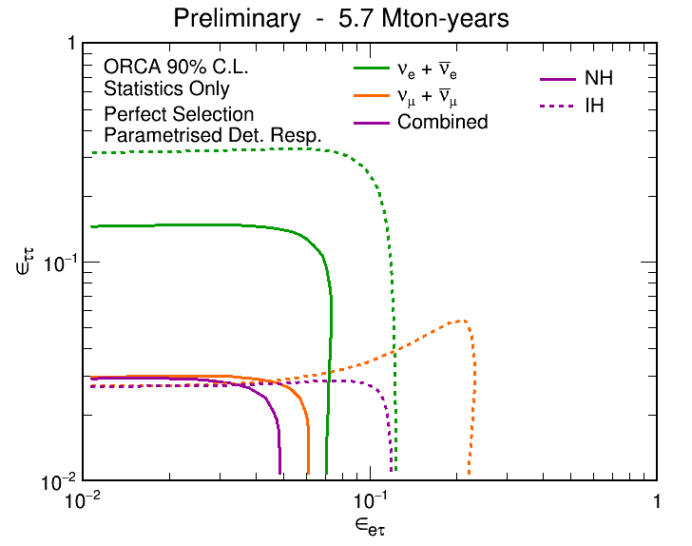
ORCA et al.
[1] JHEP 0908:090 (2009)
[2] Phys. Lett. B594:347 (2004)
[3] PRD 86, 113015 (2012); PRD 88, 072011 (2013)
[4] Phys. Rev. D 84, 113008 (2011)
[5] M. Day and A. Karle, P3.093 Neutrino 2016
[6] Joao Coelho, P2.026 Neutrino 2016
[7] Phys. Lett. B739:357 (2014)

Slide 16
Sterile Neutrinos

Slide 17
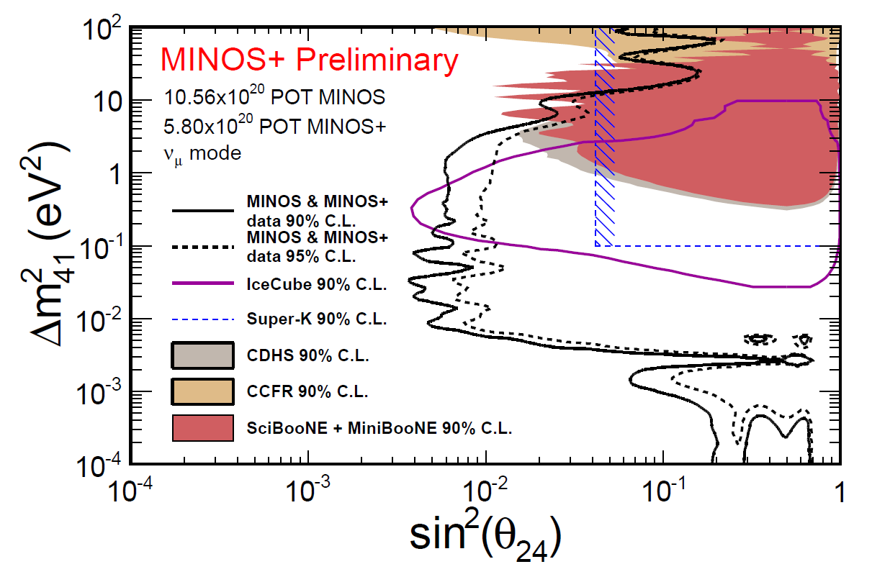
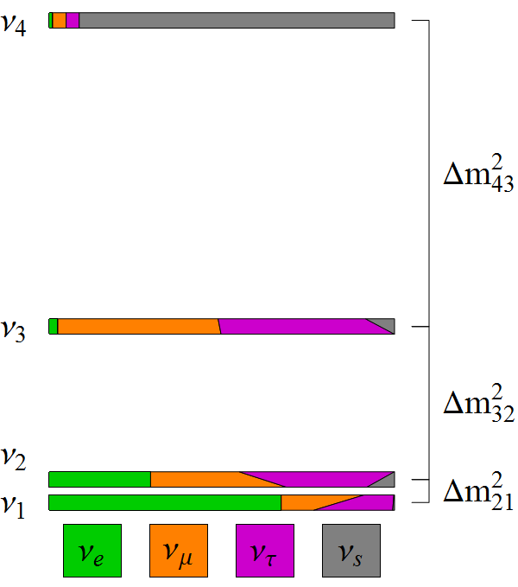
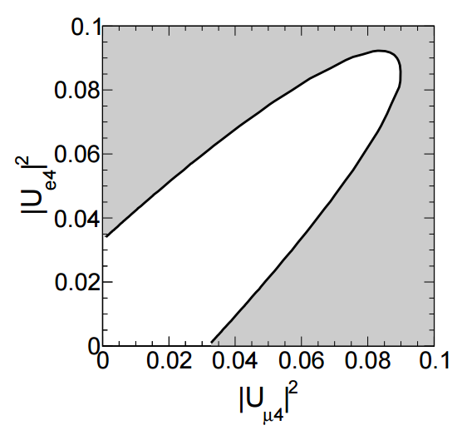
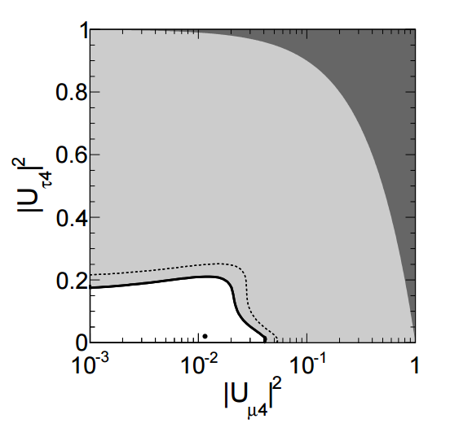
Sterile Neutrinos (3+1)
|U_{τ4}|²
|U_{e4}|²
|U_{μ4}|²
App. Hints
Super-K
Super-K
MINOS+
MINOS+
IceCube
Solar+Reactors
Super-Kamiokande: Phys. Rev. D 91, 052019 (2015)
IceCube: Phys. Rev. Lett. 117, 071801 (2016)
MINOS+: Justin Evans, Neutrino 2016
Solar+Reactors: Mod. Phys. Lett. A 28, 1330004 (2013)
MINOS
IceCube

Slide 18
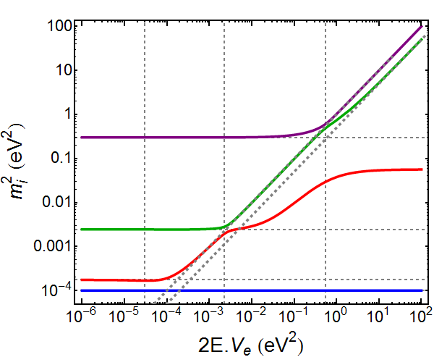
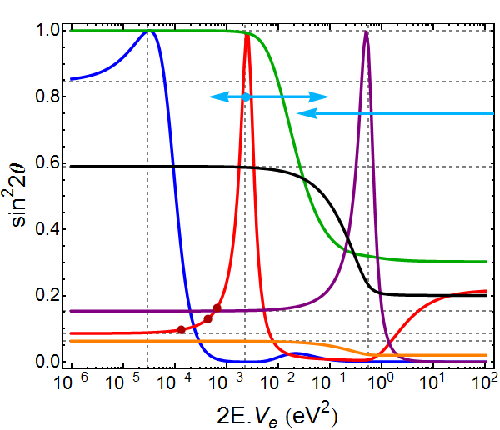
Resonances w/ Steriles
New resonant peak due to Δm²₄₁
Some intermediate behaviour between θ₁₃ and θ₁₄ resonances
θ₂₃ suppression seems to be fairly independent of Δm²₄₁
Δm²₄₁ = 0.3 eV²
θ₂₃ Suppression
θ₁₂
θ₂₃
θ₁₄
V_{e}
V_{n}
m₄²
θ₃₄
m₂²
θ₁₃
m₃²
m₁²
θ₂₄

Slide 19
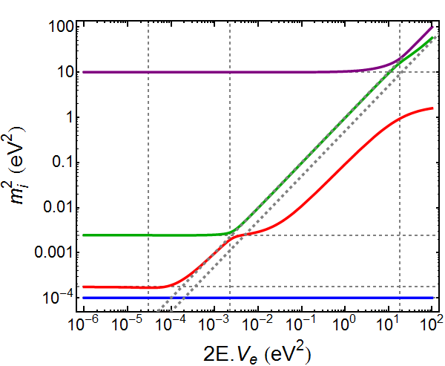
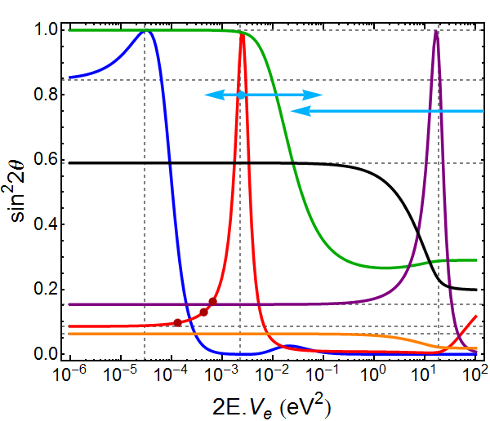
Resonances w/ Steriles
New resonant peak due to Δm²₄₁
Some intermediate behaviour between θ₁₃ and θ₁₄ resonances
θ₂₃ suppression seems to be fairly independent of Δm²₄₁
Δm²₄₁ = 10 eV²
θ₂₃ Suppression
θ₁₂
θ₂₃
θ₁₄
V_{e}
V_{n}
m₄²
θ₃₄
m₂²
θ₁₃
m₃²
m₁²
θ₂₄

Slide 20
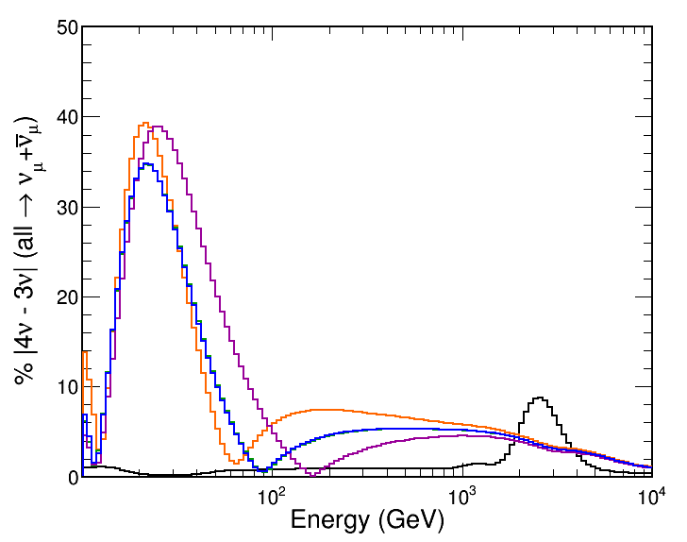
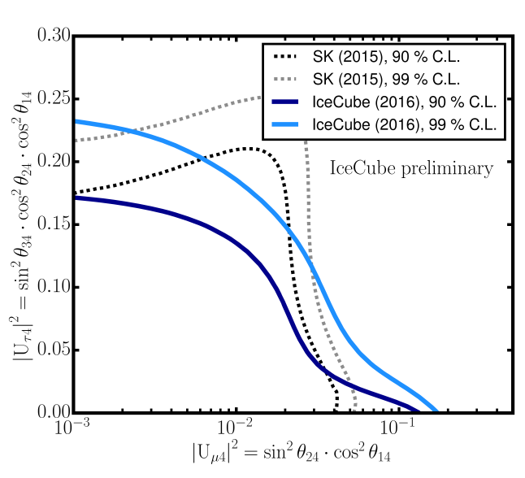
Tau Coupling
DeepCore
ORCA/PINGU
Super-K and DeepCore probed low-E with similar sensitivity
cosθ_{z} < -0.9
|U_{μ4}|² at IC limit
|U_{τ4}|² = 0.18
Probability Difference
δ₂₄ = {0, π/2, π, 3π/2}
IceCube Analysis
Region
U_{τ4} = 0
A. Terliuk, P2.024 Neutrino 2016
ORCA/PINGU can probe the U_{τ4} coupling at low energies
At high energies, effect is related to U_{μ4}
New constraints on U_{μ4} impact sensitivity at low energy too

Slide 21
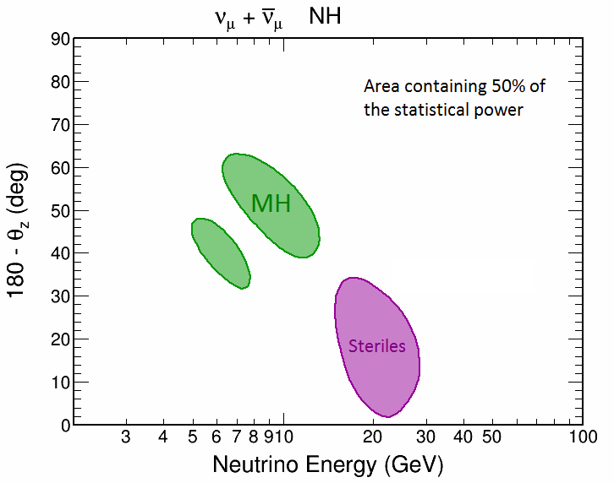
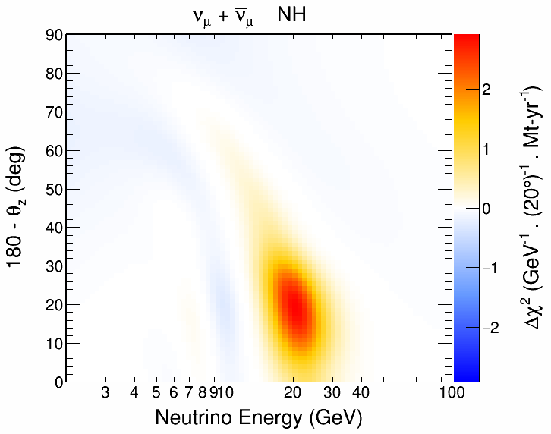
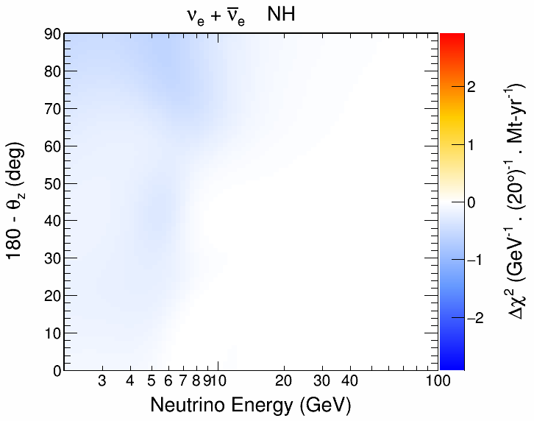
ORCA Studies
Strong sensitivity with ν_{μ} channel
Very different from 3ν resonance
Still under unrealistic assumptions:
  Perfect flavour selection
  No systematics or nuisance pars.

Slide 22
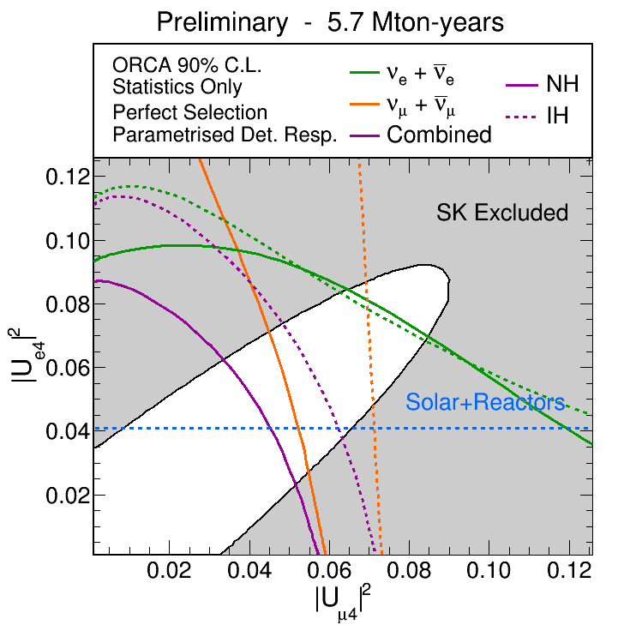
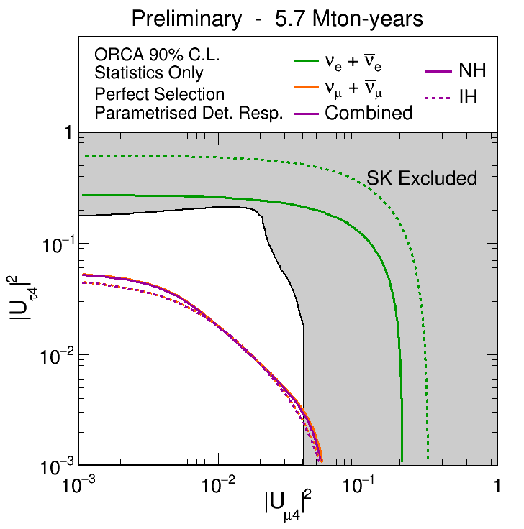
Preliminary Sensitivities
Promising sensitivity in U_{τ4} mixing
Consider only 1-year of data (statistics dominated)

Slide 23
Summary
ORCA and PINGU were designed to look for matter effects
The full structure of the MSW potential is poorly known
We should take advantage of that to look for new physics
Sterile neutrinos and NSI are good examples in that direction
Promising results so far from preliminary studies

Slide 24
Backup Slides

Slide 25
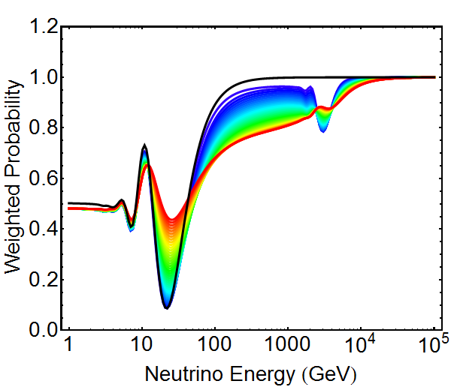
“ν_{μ}” “Probability”
20% energy resolution
Weighted according to neutrino flux
ν_{μ} at the detector
cosθ_{Z} = -0.9
ρ = 8 g/cm³
Std. Osc.
U_{τ4} = 0.2
TeV Resonance
Why the suppression?
U_{τ4} = 0

Slide 26
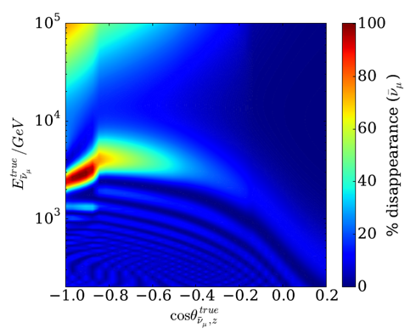
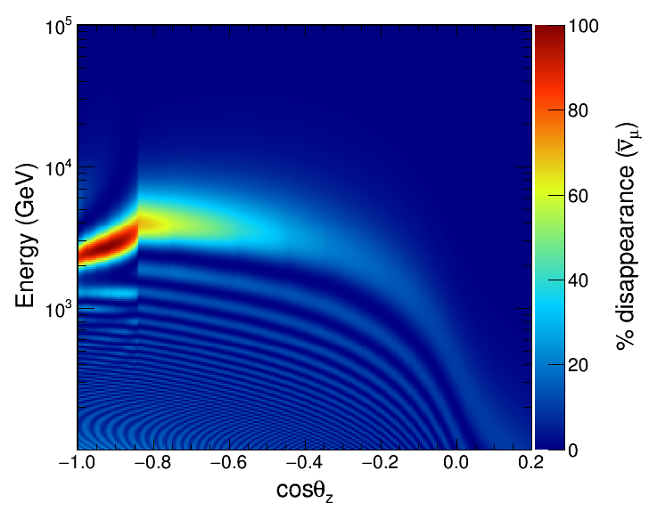
New IceCube Paper
IceCube arXiv:1605.01990 (2016)
My reproduction
Nu Absorption
IceCube
Analysis Region
Simplified model with U_{e4} = U_{τ4} = 0
Most sensitive to few TeV resonance

Slide 27
Reality Check
My reproduction
Nu Absorption
IceCube
Analysis Region
Starting point: Reproduce plot

Slide 28
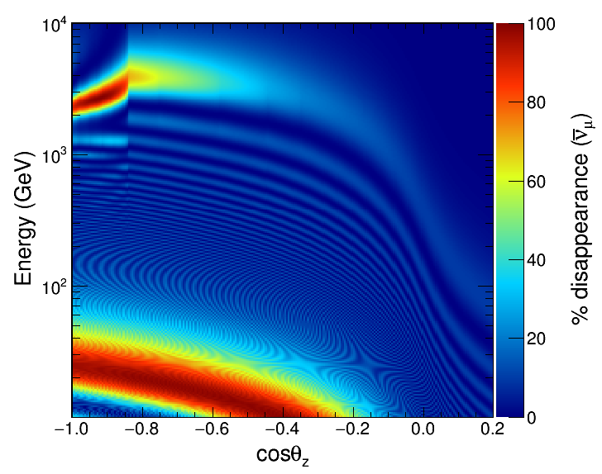
Reality Check
IceCube
Analysis Region
Std. Osc.
Step 1: Look at lower energies

Slide 29
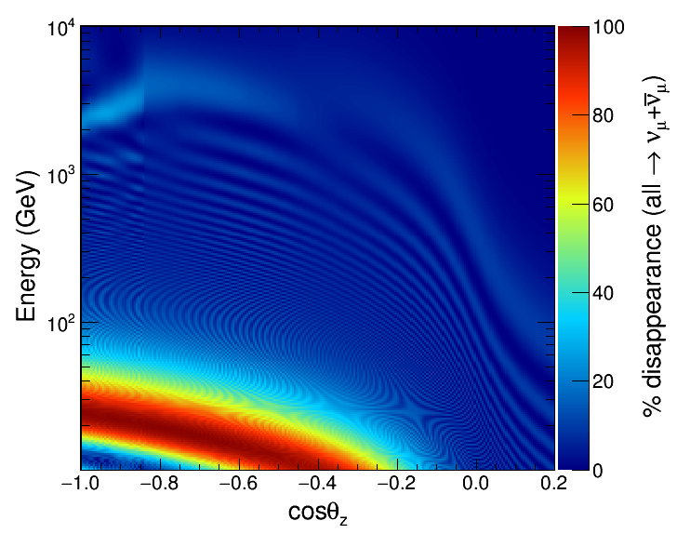
Reality Check
IceCube
Analysis Region
Std. Osc.
Step 2: Account for mixed flavour content from flux

Slide 30
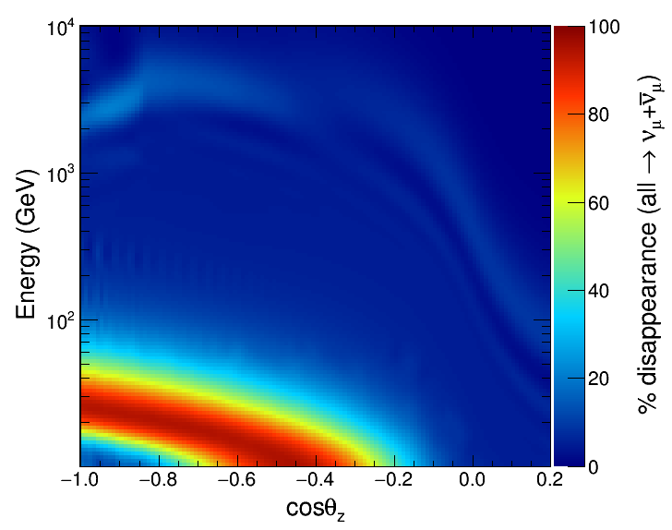
Reality Check
IceCube
Analysis Region
Std. Osc.
Step 3: Add some finite resolution (20% in Energy)

Slide 31
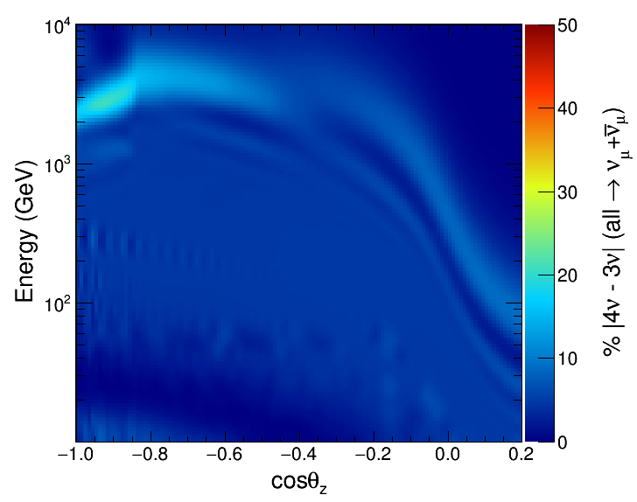
Residuals
IceCube
Analysis Region
Std. Osc.
We can look at deviations from the Std. Osc.
Roughly a 20% effect with sin²2θ₂₄ = 0.1

Slide 32
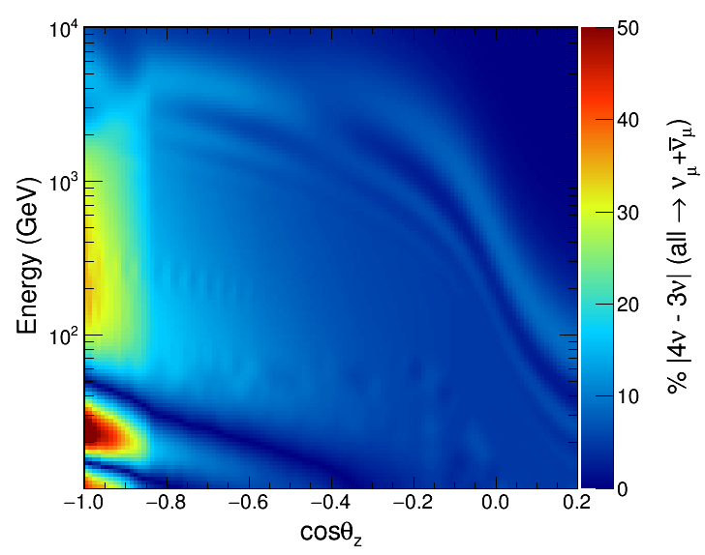
Residuals
IceCube
Analysis Region
U_{τ4} effect
δ₂₄ = 0
Std. Osc.
Much larger effect at current U_{τ4} limit (|U_{τ4}|² = 0.18)
Extra sensitivity from few 100 GeV region
Large effect in the Std. Osc. Region (Super-K)

Slide 33
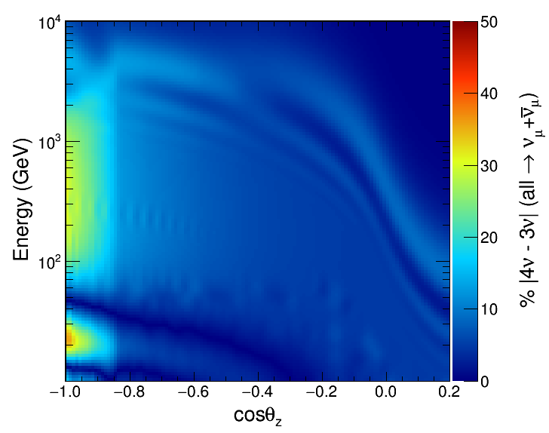
Residuals
IceCube
Analysis Region
U_{τ4} effect
δ₂₄ = π/2
Std. Osc.
Much larger effect at current U_{τ4} limit (|U_{τ4}|² = 0.18)
Extra sensitivity from few 100 GeV region
Very dependent on new CP phase at low energy

Slide 34
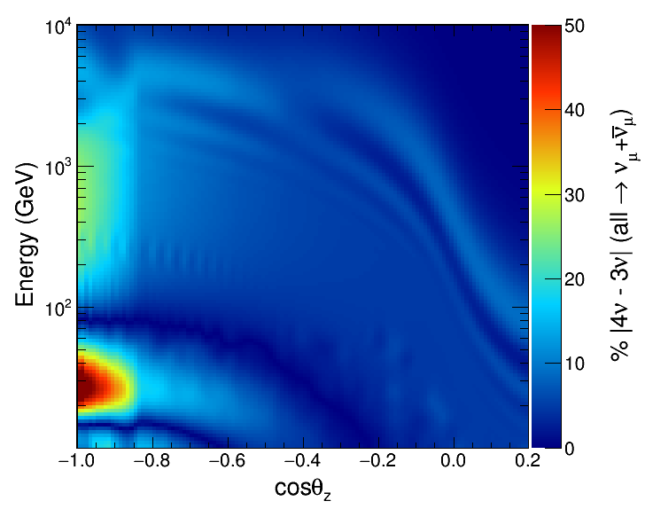
Residuals
IceCube
Analysis Region
U_{τ4} effect
δ₂₄ = π
Std. Osc.
Much larger effect at current U_{τ4} limit (|U_{τ4}|² = 0.18)
Extra sensitivity from few 100 GeV region
Very dependent on new CP phase at low energy

Slide 35
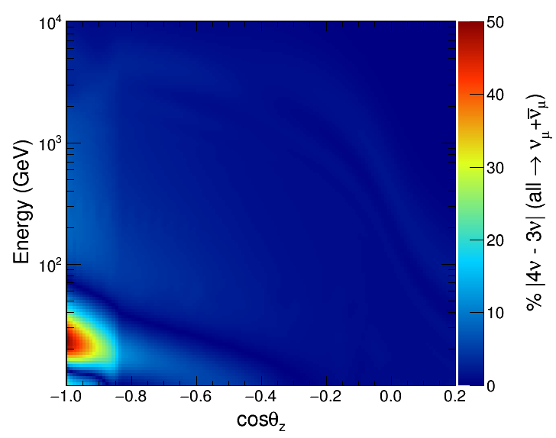
Reality Check 2
IceCube
Analysis Region
|U_{μ4}|² at IC limit
U_{τ4} effect
δ₂₄ = 0
Std. Osc.
At high energies, effect is very linked to U_{μ4}
Constraints from IceCube are very strong already

