Slide 1
Daniel Ferenc,
Physics Department, UC Davis,
and
PhotonLab, Inc.
* Patent Awarded in 2015, Other patent pending
  ABALONE PHOTOSENSOR TECHNOLOGY*
Crucial contributions to our project by
late Eckart Lorenz, MPI Munich and UC Davis, and Tom Ypsilantis, CERN and EP Paris

Slide 2
In my Keynote lecture:
"The vision of photon counting in the next decade: vacuum and gaseous sensors,“ at the ASPERA Technology Forum, 21-22 October 2010, Munich (https://indico.cern.ch/event/97302/contributions/1288309/)
I predicted that:
- PMTs will become obsolete.
- But HPDs and some similar ideas will prove impractical.
- And promised that the ABALONE technology will be proven.
Today, I am reporting on:
  The proof of concept of the ABALONE photosensor technology
  Unique ABALONE photosensor performance
  The suitability for next-generation astroparticle projects
  The collaboration with Uni-Mainz on the development of new prototypes for IceCube2.

Slide 4
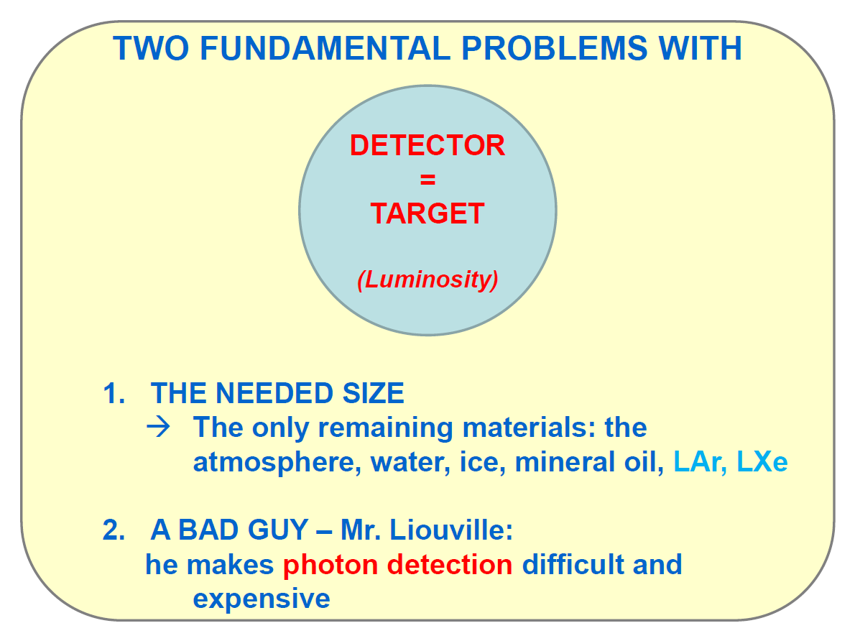

Slide 6
PMTs – an 80-year Old Manufacture

Slide 7
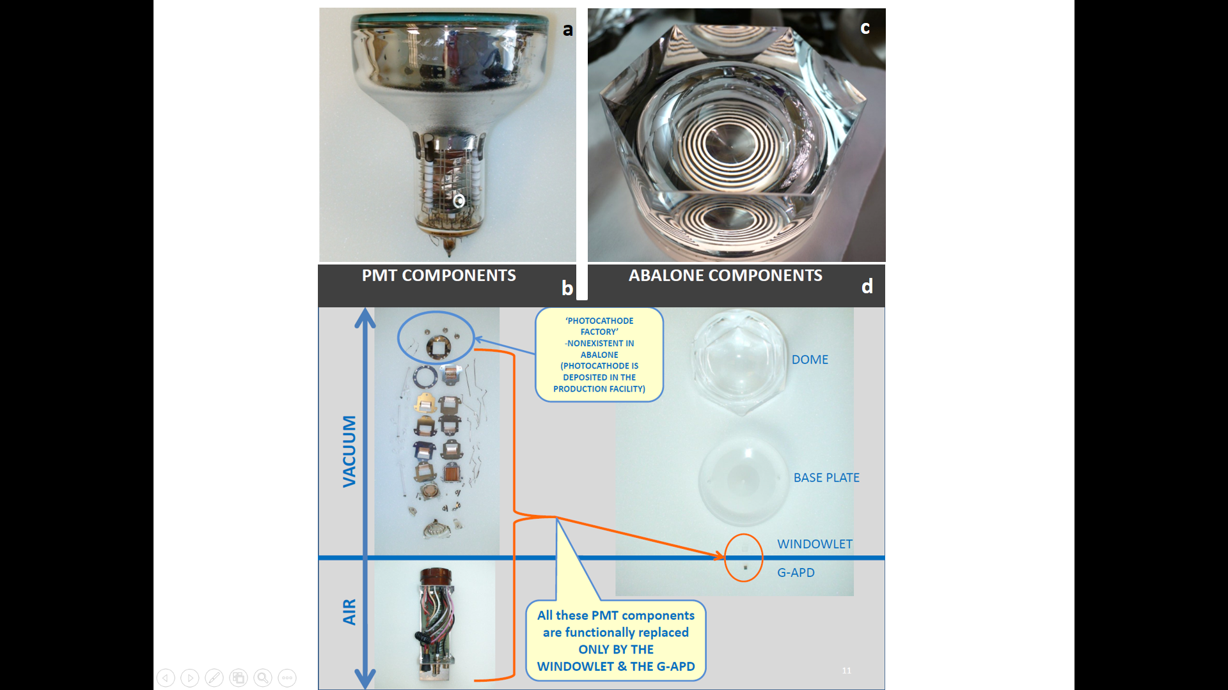
ANATOMIC DISPLAY of a PMT (only of its vacuum part)
> 180 components
> 400 spot-welds
HAND-MADE
PHOTOCATHODE ‘FACTORY’

Slide 8
CRUCIAL:
GLASS ONLY !
NO METALS
NO CERAMICS
NO APDs
NO MCPs
NO ELECTRODES
NO FEEDTHROUGHS
10,000 X CONCENTRATION
SMALL GAPD:
→ CHEAP
→ FAST

Slide 9
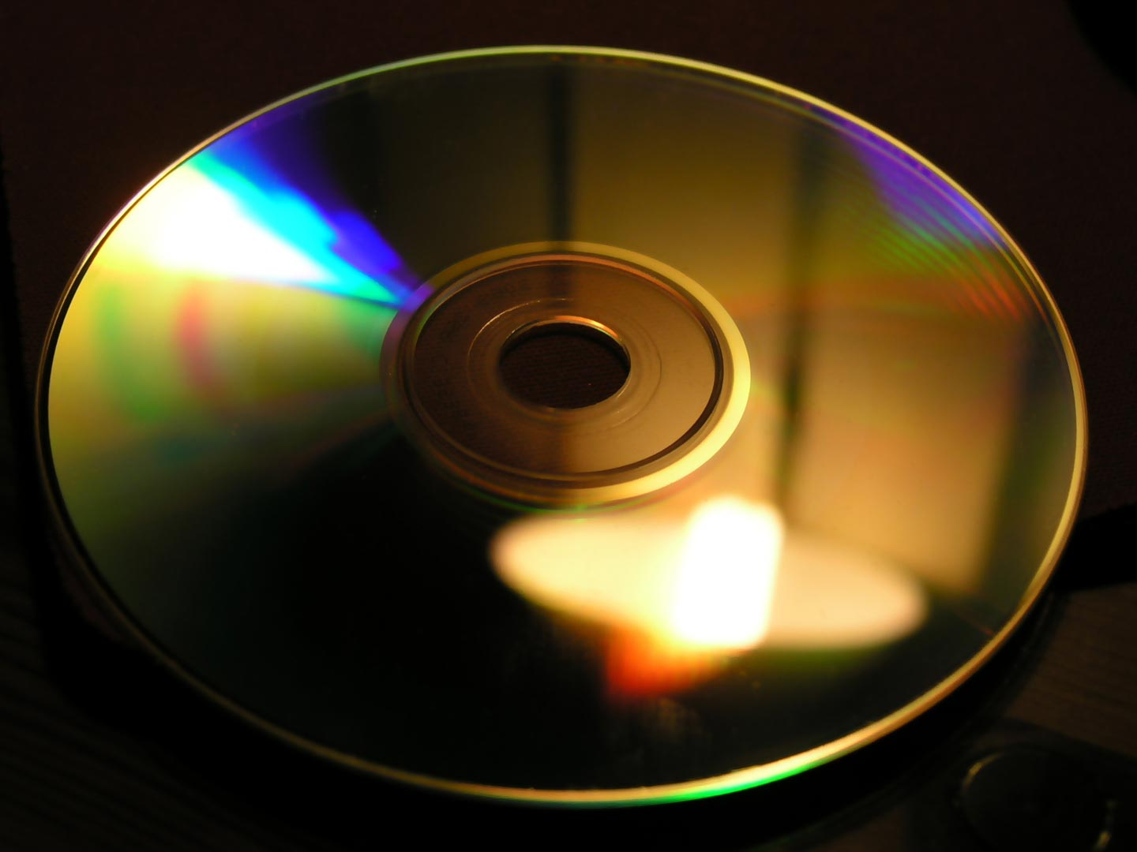
THE GOAL
OF THE ABALONE PHOTOSENSOR TECHNOLOGY
MASS-PRODUCTION USING THE SAME BASIC TECHNIQUE LIKE THE ONE APPLIED IN THE PRODUCTION OF COMPACT DISCS (CDs)
(Thin-film deposition on dielectric substrates)

Slide 10
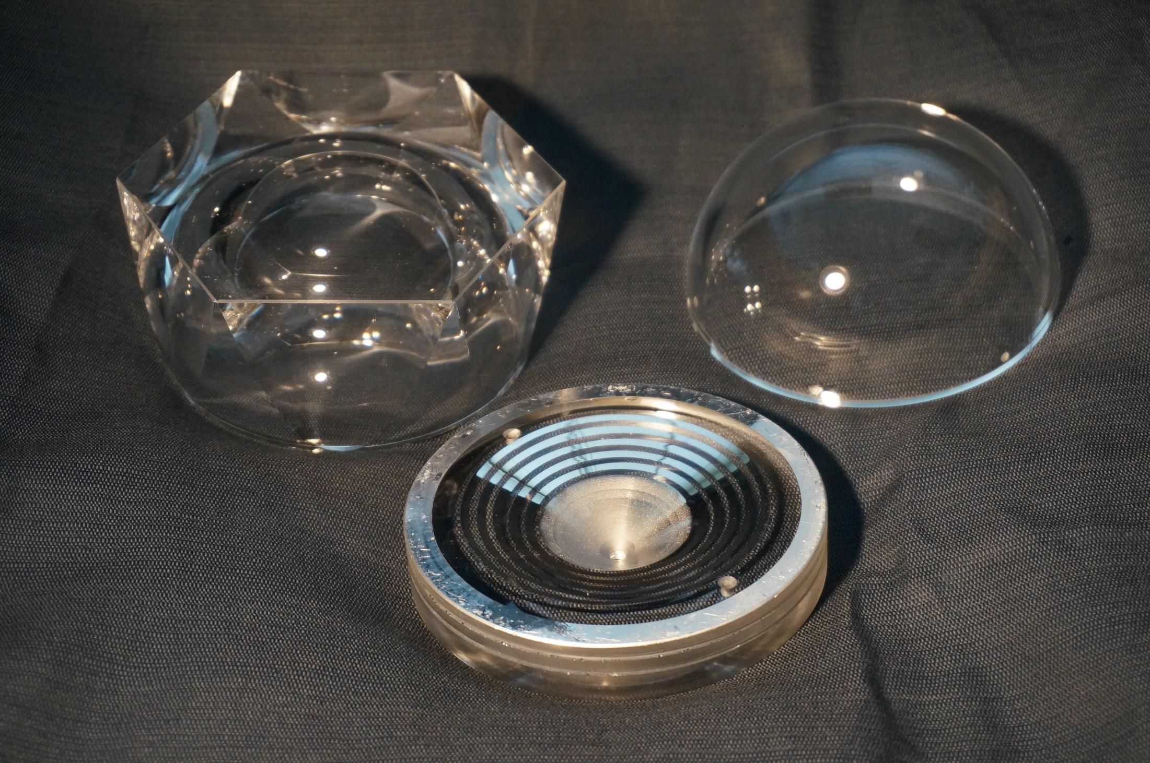

Slide 11
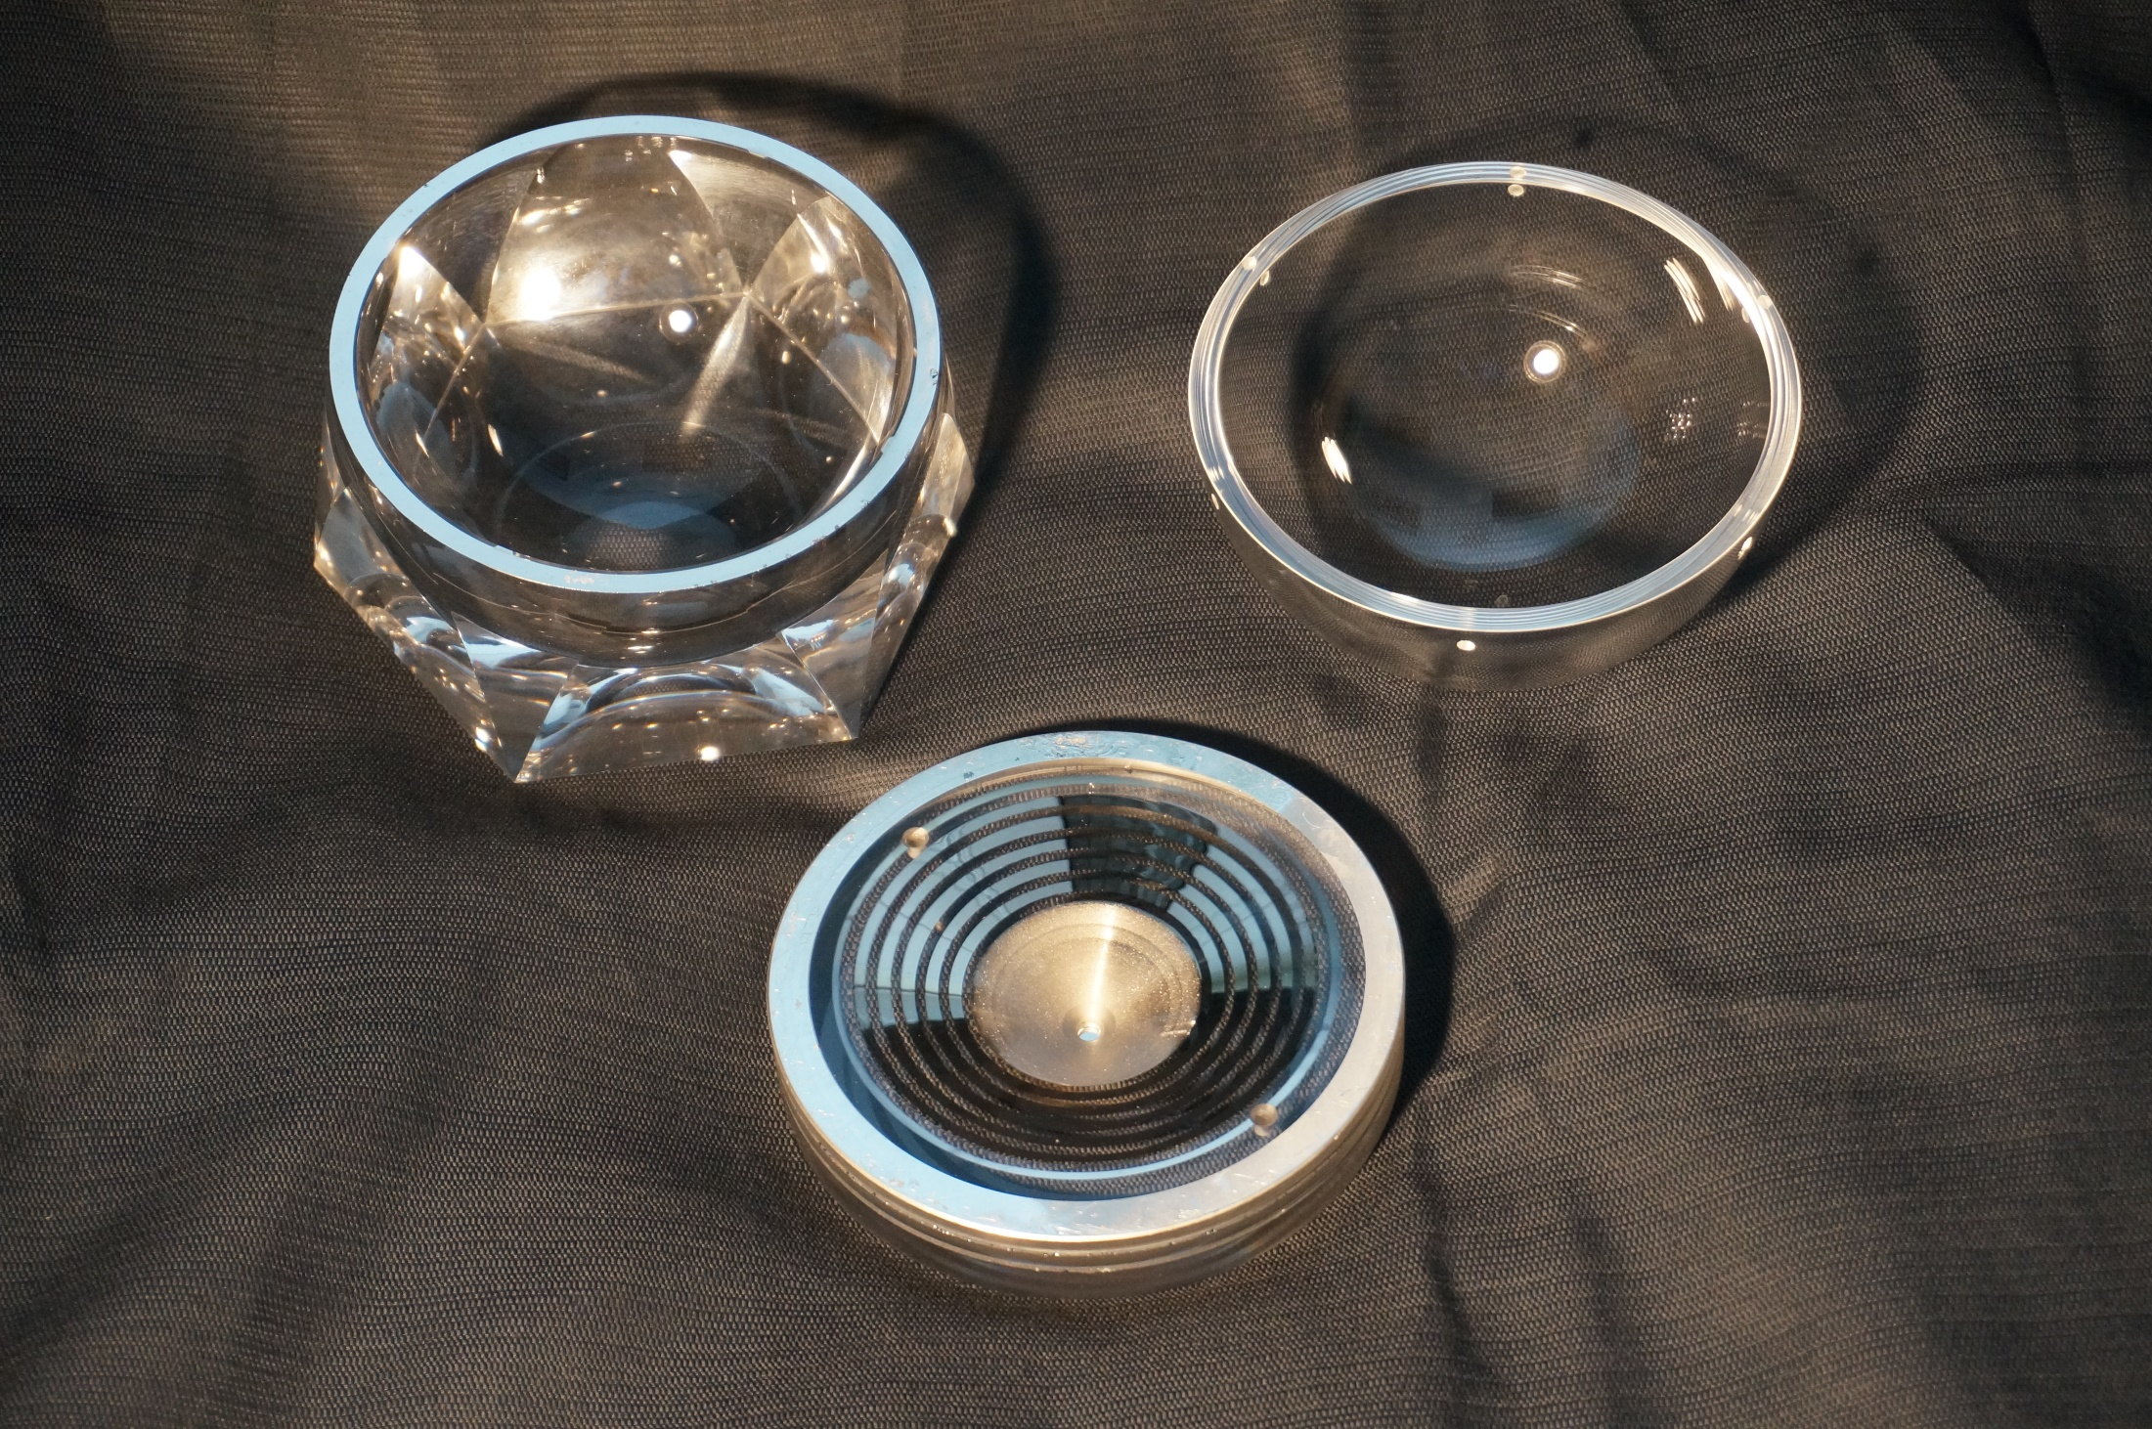

Slide 12
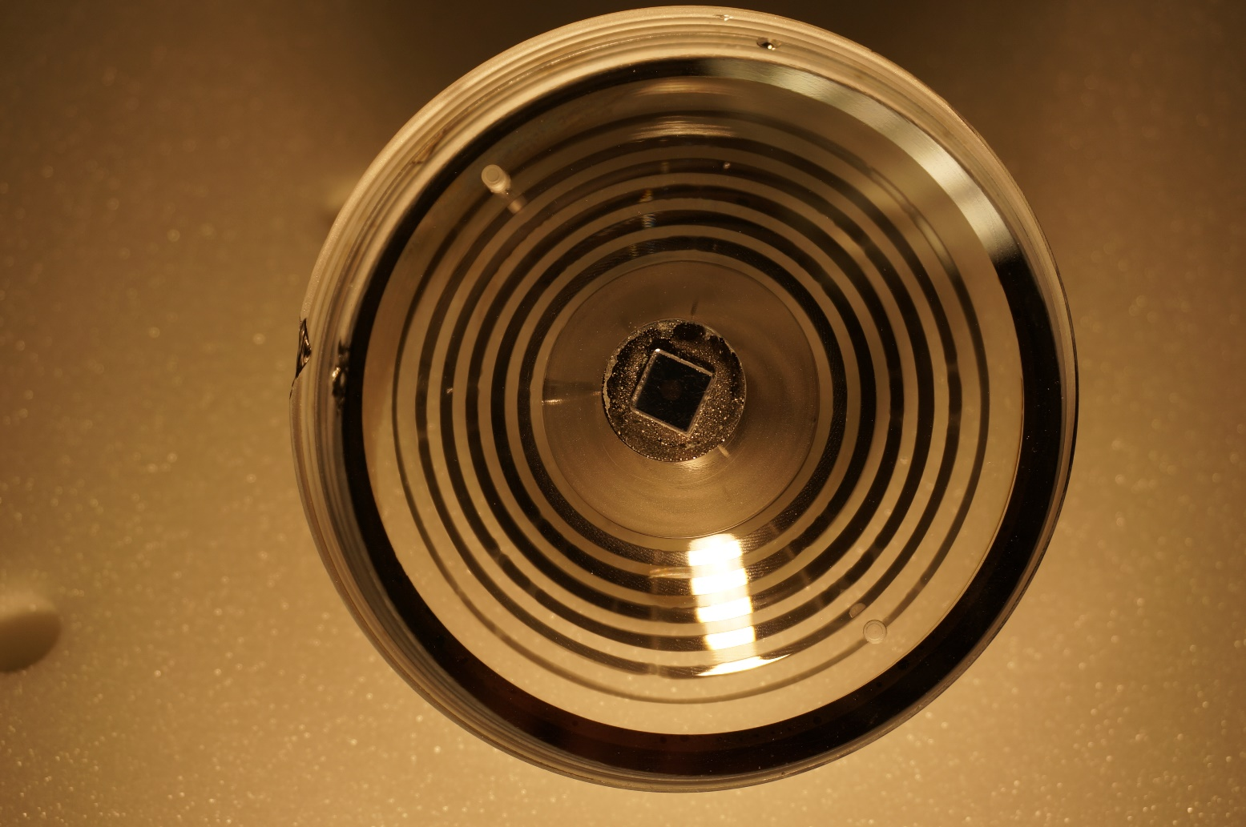
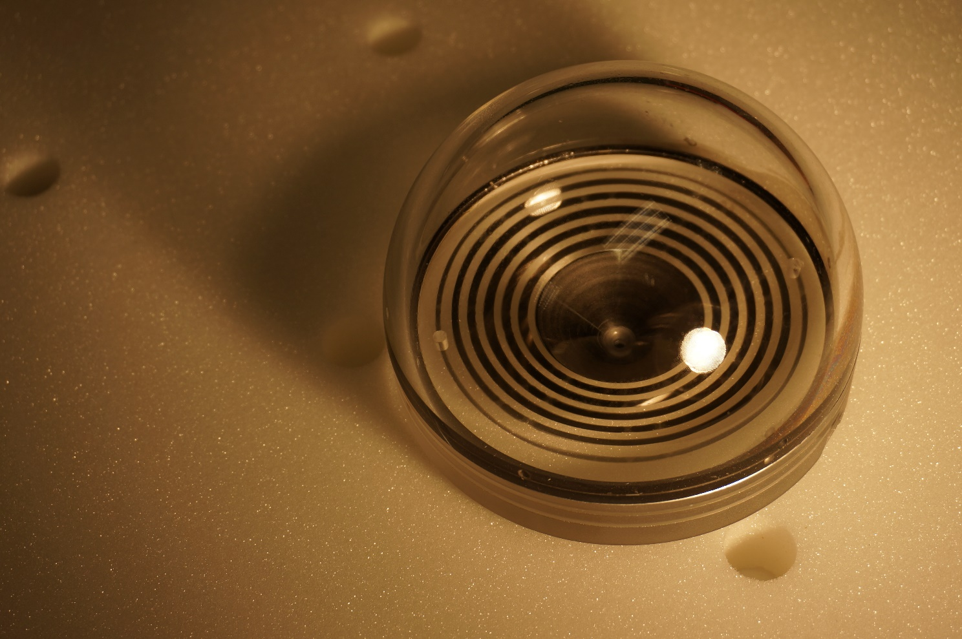
The First IceCube ABALONE “Pre-Prototype”
Collaboration:
UC Davis
Uni-Mainz
PhotonLab, Inc.

Slide 13
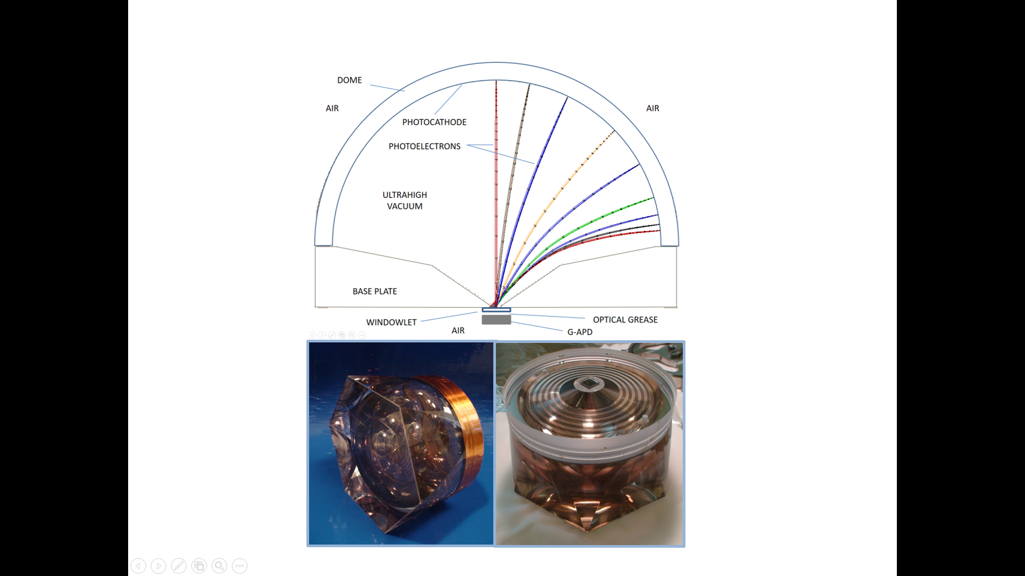

Slide 14
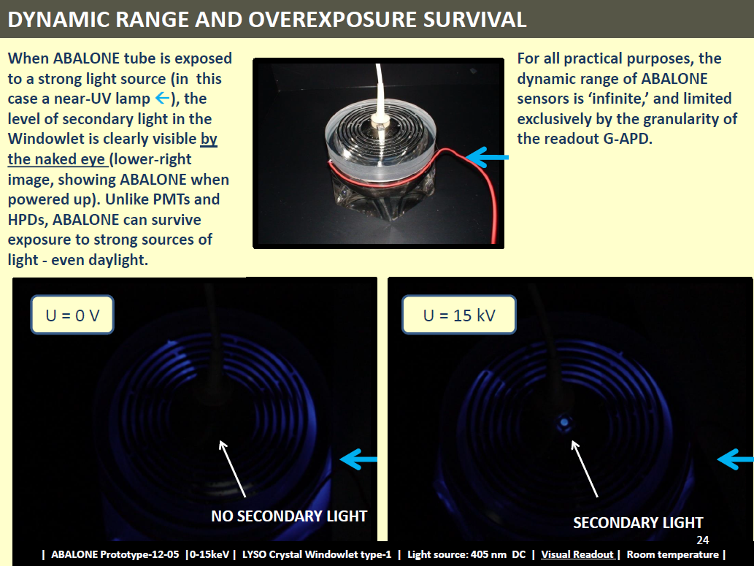
Patent No. 9,064,678

Slide 15
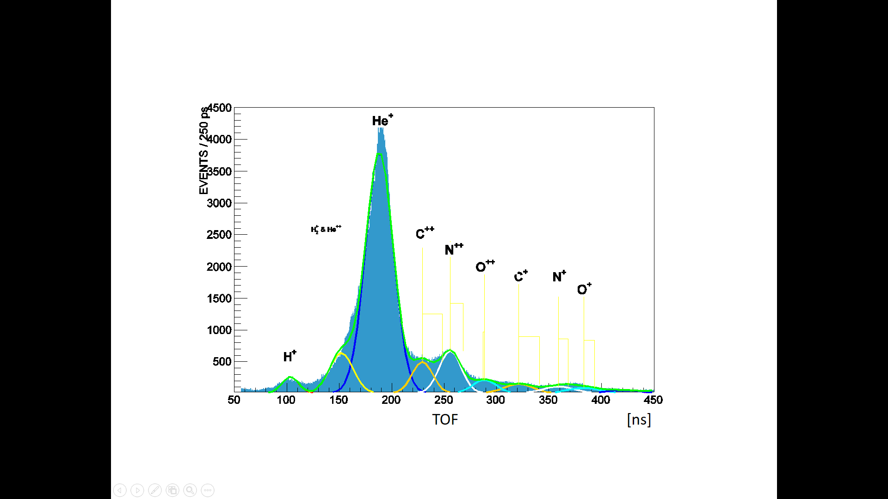
VACUUM INTEGRITY – A 3.5 YEAR-LONG TEST:
ION FEEDBACK & Time-Of-Flight ANALYSIS
A ~100 X LOWER AFTERPULSING RATE THAN IN THE PMTs
CONSTANTLY IMPROVING, EXCEPT FOR Helium
He is ‘omnipresent,’ so how to understand that difference?

Slide 16
ABALONE is
Hans Bethe’s Little Playground
(i.e. higher acceleration voltage is better)
-dE/dx ~ 1/β² ~ m/E_{K}
A. IONIZATION PROBABILITY
Of a ‘vacuum atom’
By a Photoelectron
~ 1/E_{K}
~ 1/HIGH-VOLTAGE
→
~ 100 X LESS IONIZATION THAN IN A PMT
C. ION IMPLANTATION
B. IONIZATION Within
The Photocathode
By an ION
~ 1/E_{K}
~ 1/HIGH-VOLTAGE’
→
~ 100 X LESS ENERGY DEPOOSITED IN THE PHOTOCATHODE THAN IN A PMT
→
FEWER AFTERPULSING ELECTRONS GENERATED PER ION IMPACT
→
LONG-LIVED PC
D. Photoelectron’s energy loss in the Windwlet coating
~ 1/HIGH-VOLTAGE

Slide 17
SIGNAL WAVEFORMS –
RAW vs. FILTERED & AMPLIFIED
RAW DATA
25 keV
1 secondary photon
FILTERED AND AMPLIFIED DATA
20 keV
0 10 ns 50 ns 100 ns
LYSO Decay Time ~ 40 ns

Slide 18
SIGNAL WAVEFORMS - RAW
~ Back-Scattered photoelectron
~ 1 photoelectron
0 50 ns 100 ns
~ 2 photoelectrons
NO FILTERING
NO AMPLIFICATION
5 GHz Scope
U = 25 kV
3X3 SensL J-type GAPD @ -30.5 V
~ 3 photoelectrons

Slide 19
TIMING RESOLUTION
fwhm = 856 ps
Constant fraction @ 15%
0 1 ns 5 ns
0 0.5ns 2.50 ns 5ns

Slide 20
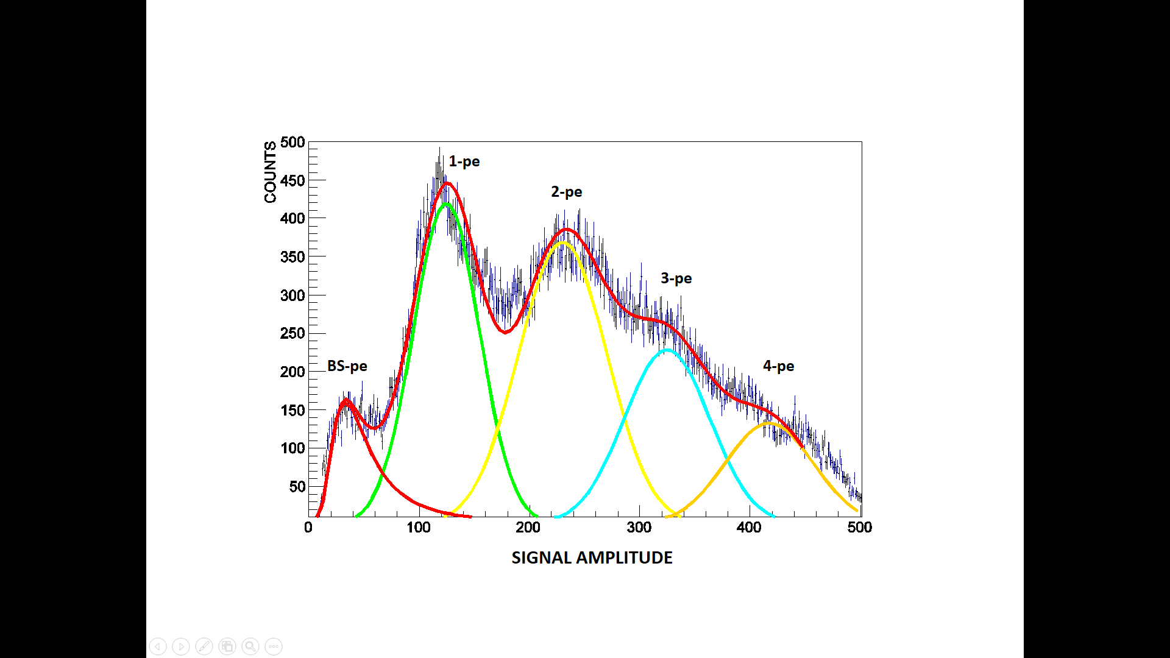
SINGLE-PHOTON RESOLUTION
23 keV

Slide 21
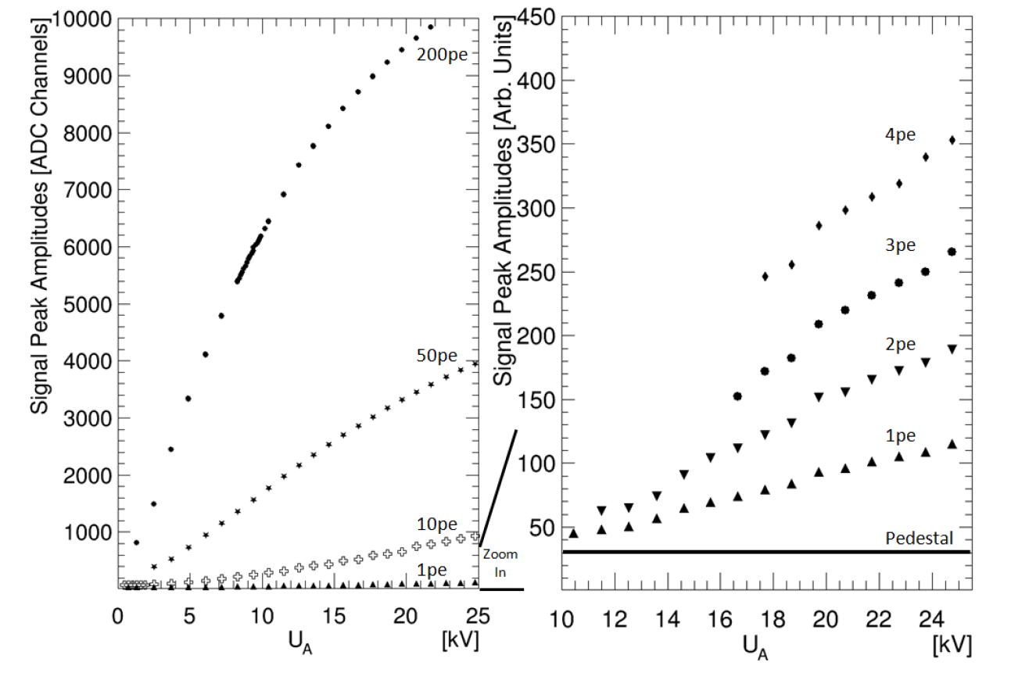
SINGLE-PHOTON RESOLUTION,
DYNAMIC RANGE
AND GAPD-CELL SATURATION

Slide 22
RE-GAINING LINEARITY –
JUST BY ATTACHING A GAPD WITH SMALLER CELLS TO THE VERY SAME ABALONE PHOTOSENSOR
Monte Carlo

Slide 23
THE ELECTRON FOCUSING IS ARRANGED
“BEHIND THE (VACUUM) SCENES” (i.e. in the ‘AIR’)
‘AIR’
‘AIR’
CUT AND “EXPORT” THE FIELD LINES TO THE NEIGHBORING UNITS IN A MATRIX
Patent No. 9,064,678 and patent pending PCT/US15/031188

Slide 24
THE CONCEPT OF ‘TANDEM-ABALONE’ FOR IceCube AND OTHER WATER-CHERENKOV DETECTORS

Slide 25
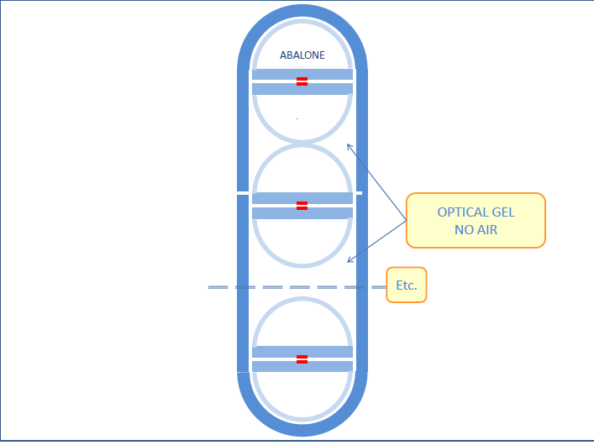
Patent No. 9,064,678
Discussions with Sebastian Boeser and Spencer Klein Ice Cube

Slide 26
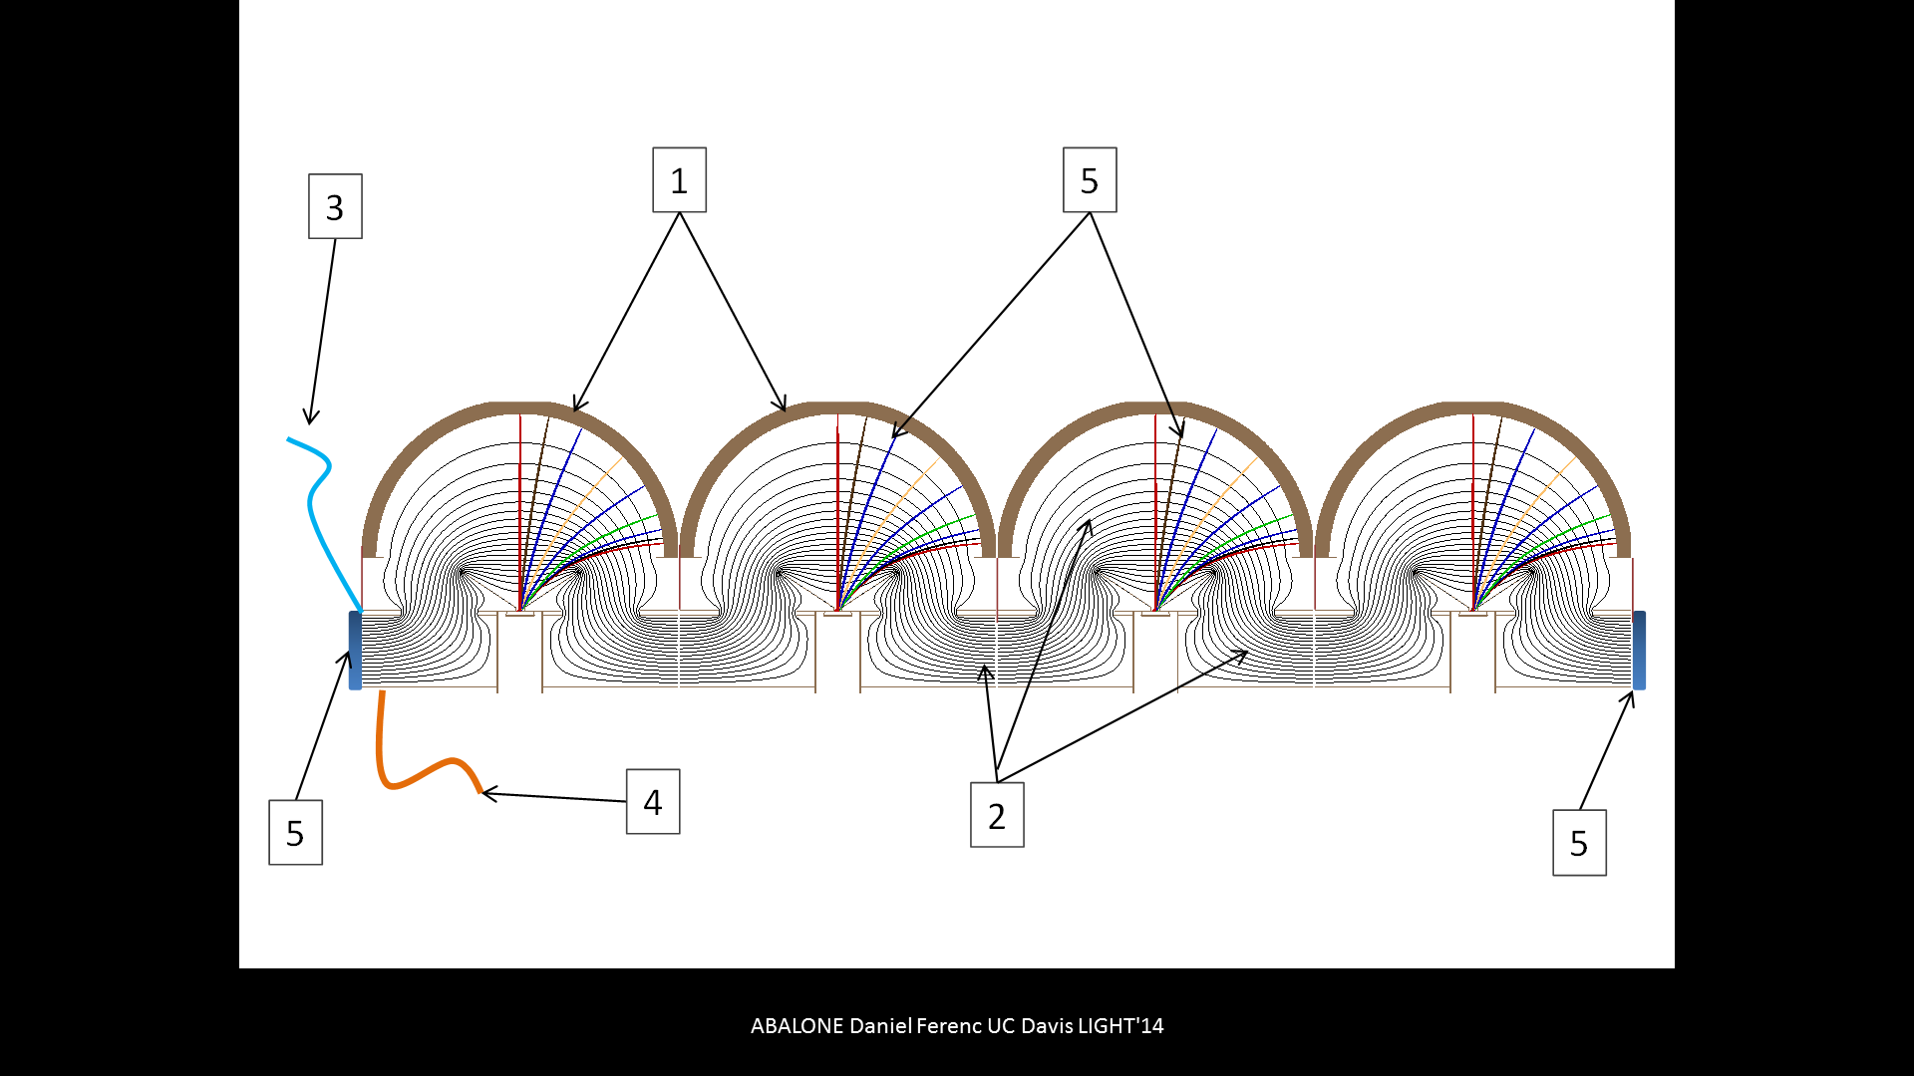
A PANEL MAY BE CURVED: CONCAVE OR CONVEX
Patent No. 9,064,678 and patent pending PCT/US15/031188

Slide 27
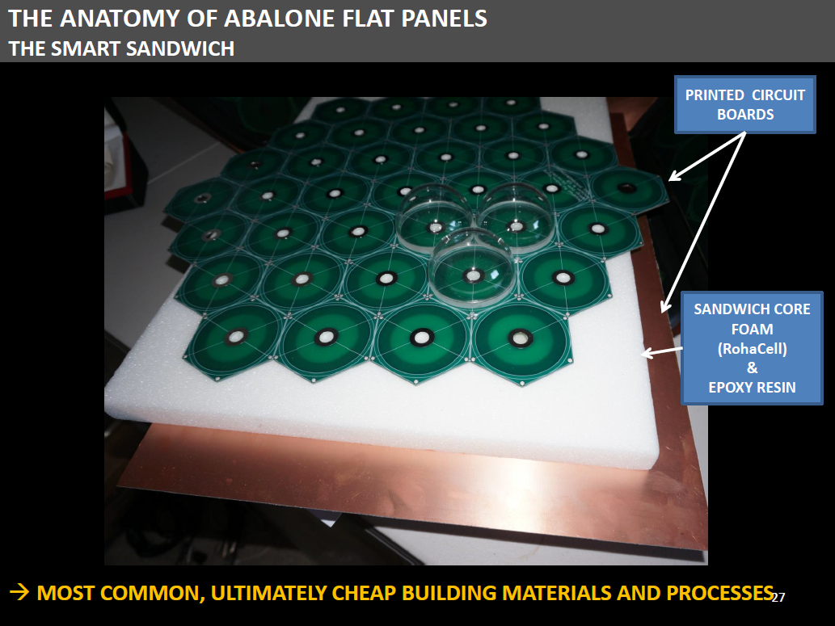
MAY BE CURVED: CONCAVE OR CONVEX
Patent No. 9,064,678 and patent pending PCT/US15/031188

Slide 28
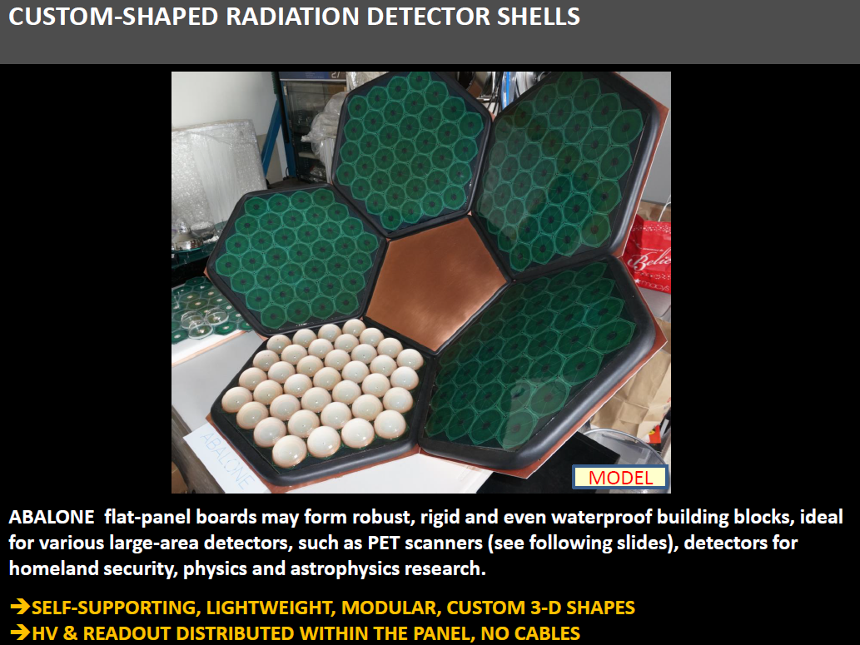
Patent No. 9,064,678 and patent pending PCT/US15/031188
MODULES MAY BE CURVED: CONCAVE

Slide 29
Like KM3NeT DoM, etc.
CONVEX PANELS
HOSTING
ABALONE PIXELS WITH INTEGRATED WINSTON CONES
NO DEAD AREA,
~100% ACCEPTANCE IS POSSIBLE

Slide 30
Two ABALONE Prototype Production Facilities
The UC Davis
ABALONE Photosensor Pilot Production Plant (A4P)
Ideal as a demo for the mass-production method or research
But very slow
PhotonLab, Inc.
All the equipment has been gathered
and we are waiting for space
Optimized for quick prototype production
Based on a recent innovation
Expected to be ~20 times faster

Slide 31

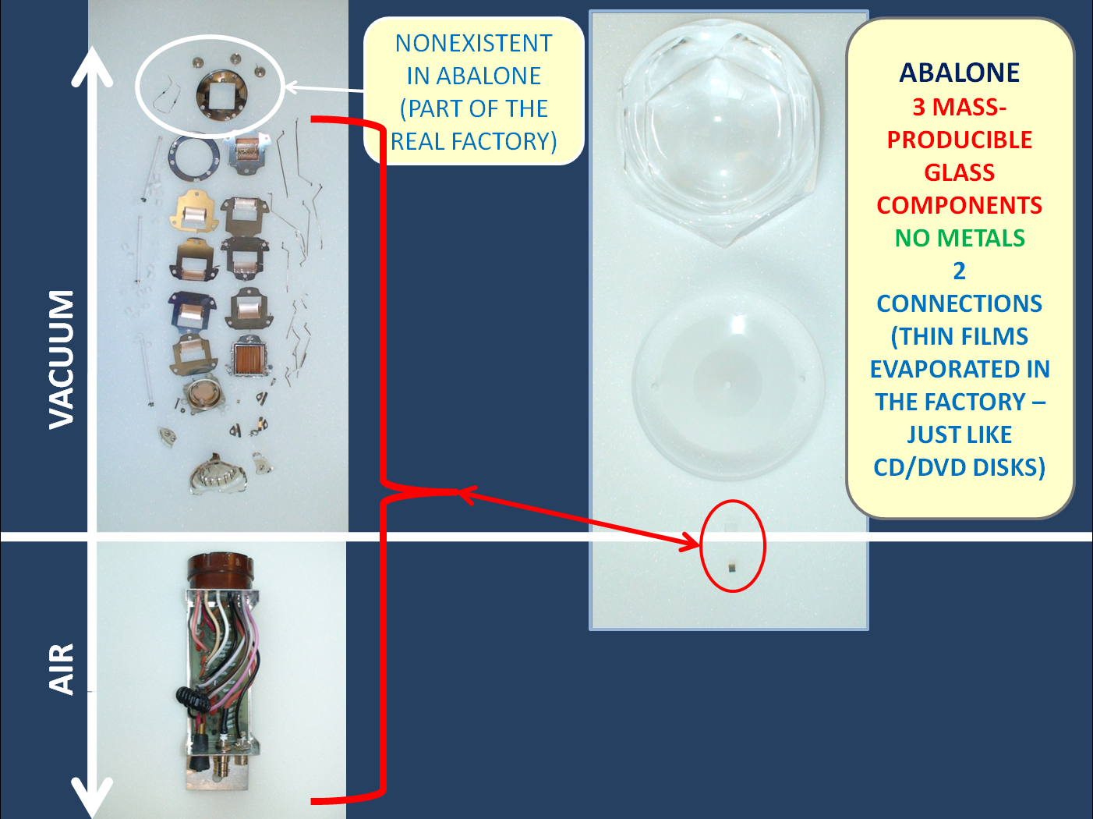
PMT

