Slide 1

GNN Meeting
Mainz 2016
Christian Spiering, DESY

Slide 2
GNN Monthly
Should flank NEWS on the webpage, but also distribute more internal information
Make it accessible via the webpage (with or without password) ?
“Monthly” imposes a rhythm which not always follows the appearance of news
“GNN Monthly” → “GNN News” ?
Need your assessment and advice on quality and style
Need continuous input with appropriate news (including grants, prizes etc.)
Invited contributions?

Slide 3
GNN Science Motivations
  combination of sky maps
  source checks in complementary energy ranges
  cross-checks of results with different systematics
  coordination of alert and multi-messenger policies
  exchange and mutual checks of software
  creation of a common software pool
  common standards for data representation
  ….

Slide 4
GNN Science Motivations
  combination of sky maps
  source checks in complementary energy ranges
  cross-checks of results with different systematics
  coordination of alert and multi-messenger policies
  exchange and mutual checks of software
  creation of a common software pool
  (common standards for data representation)
  ….

Slide 5
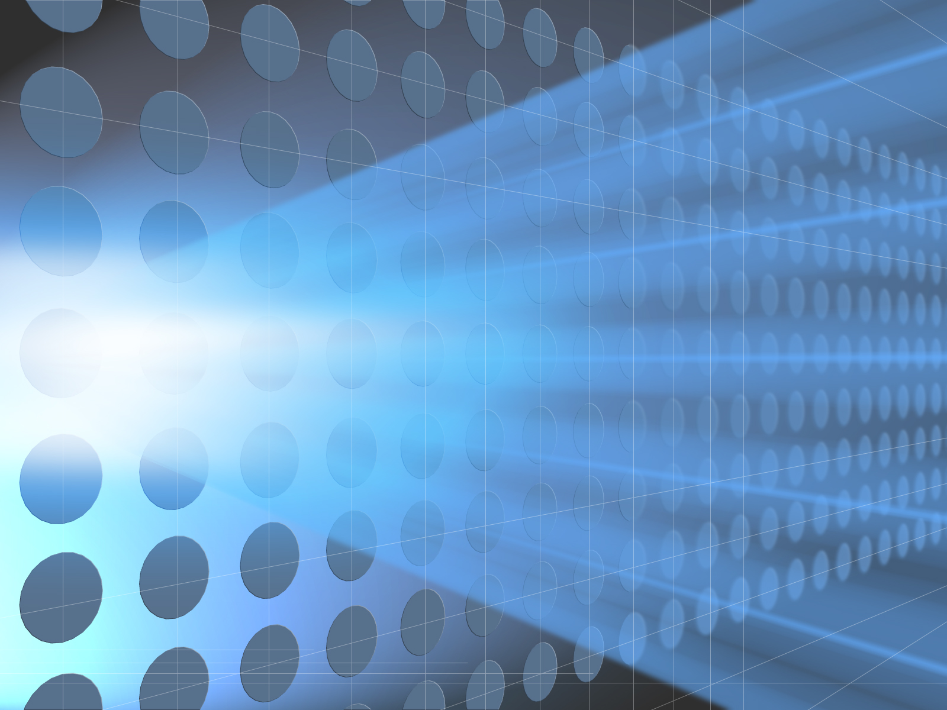
Combining Data
Published:
All-sky point source
Plan:
Galactic plane
Dark matter
More general paper on sensitivities and how detectors in South and North complement each other

Slide 6
Global Policy Aspects
The existence of GNN played (likely) a positive role in some decisions.
The outside world considers us as a forum for defining a common strategy.
In reality this applies only to some aspects.
At this moment, it seems very hard to reach consensus about a “common” PINGU/ORCA strategy. In this field, the 2 communities are just competitors.
The more important is it, to work out a global policy for the high-energy part!
Keyword: Complementarity

Slide 7

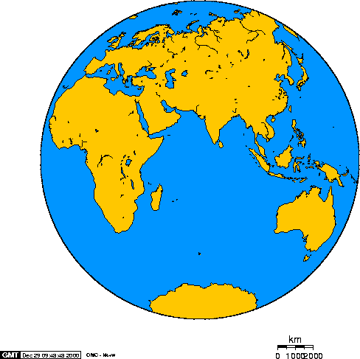
Complementarity
GVD
ARCA
IceCube Gen2

Slide 8
Optimized to …
>1 TeV
@ 1.4 km³
(4-5 km³)
>10 TeV
@ 0.4 km³
(1.5 km³)
>1 TeV >30 TeV
@ 1 km³ @10 km³

Slide 9
Construction
2015 (18) – 2021
(then full KM3NeT)
2015 -2021
(then phase 2)
operating 2021 - 2031

Slide 10
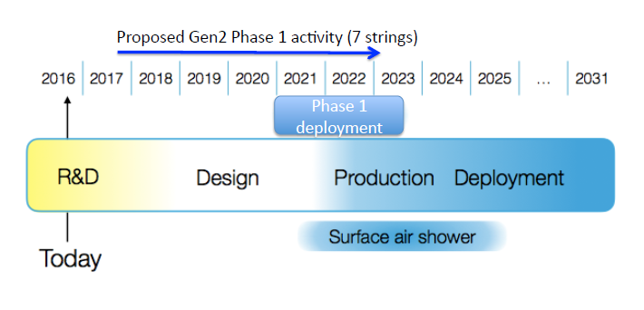
Construction
2015 (18) – 2021
(then full KM3NeT)
2015 -2021
(then phase 2)
operating 2021 - 2031

Slide 11
Medium
Sea
Water
Fresh
Water
optical noise
light scattering
light absorption
medium homogenity
…
Ice

Slide 12
Angular resolution
… as ONE consequence of the medium
Others:
Energy resolution
SN MeV burst detection
….
moderate
-high
high
moderate

Slide 13
Depth (km)
2.7-3.3
0.7-1.2
1.4-2.4 1.4-2.7

Slide 14
Surface veto
No
No
Yes

Slide 15
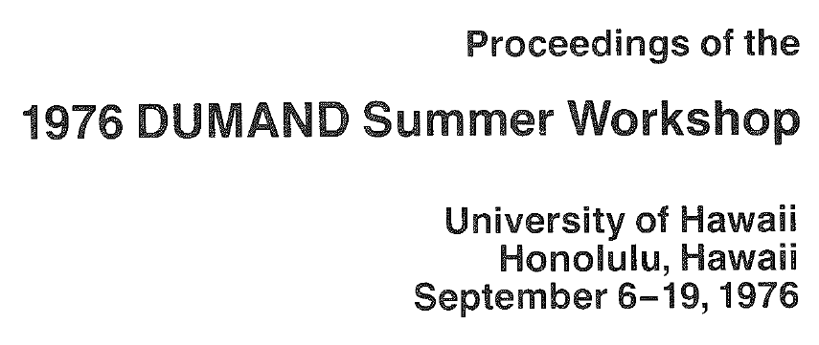
“Legacy of our field” project
Digitize relevant papers/workshops before the arXiv time (and may be the most relevant until now).
  Search function w.r.t. author, collaboration (if any), title, key words and year and conference name (if any).
  Not just a CD but Web Page, possibly organized like a Wiki.
Explore technical possibilities. CS will come with a proposal in the next 2 months. ☹
The 1976 DUMAND Workshop is scanned.

Slide 16
“Legacy of our field” project
Digitize relevant papers/workshops before the arXiv time (and may be the most relevant until now).
  Search function w.r.t. author, collaboration (if any), title, key words and year and conference name (if any).
  Not just a CD but Web Page, possibly organized like a Wiki.
Explore technical possibilities. CS will come with a proposal in the next 2 months. ☹
The 1976 DUMAND Workshop is scanned.
John Learned, C.S. “The DUMAND 1976 Workshop and the Origins of Large Neutrino Detectors” CERN Courier July/August 2016

Slide 17
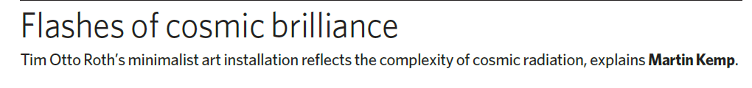
AIS³
Astroparticle Immersive Synthesizer³
At present to be supported
by ApPEC and DESY

Slide 18
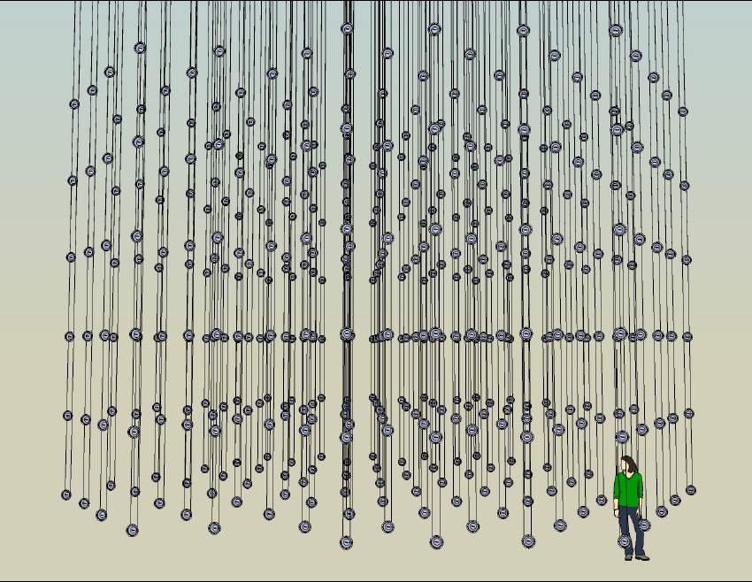
AIS³

Slide 19
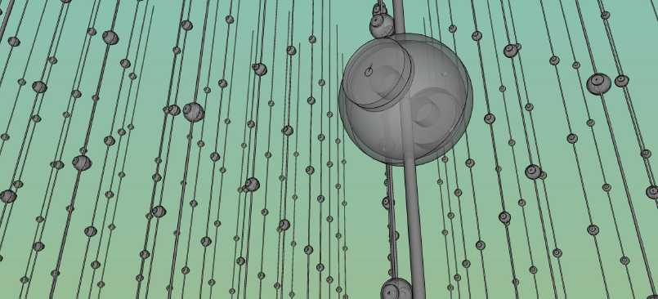
Print Page

Slide 20
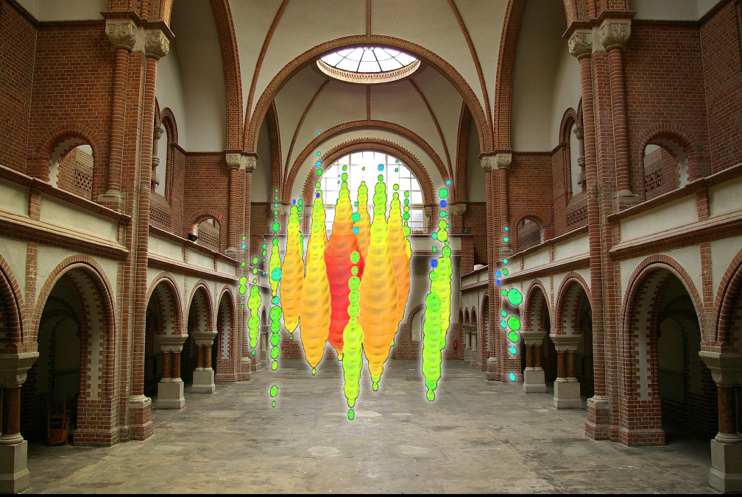
Print Page

Slide 21
Print Page
Looking for exposition
locations all over Europe

Slide 22
GNN Dissertation Prize
10 theses submitted (3 Antares, 7 IceCube)
Criteria
  scientific quality
  form and didactic level
  introduction & description of context
Prize Committee
  Rosa Coniglione, Thierry Pradier, Dorothea Samtleben, Juande Zornoza (Antares)
  Dmitri Chirkin, Spencer Klein, Christian Spiering, Ignacio Taboada (IceCube)
  Zhan Djilkibaev (Baikal)

Slide 23
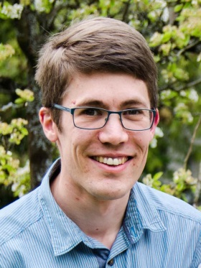
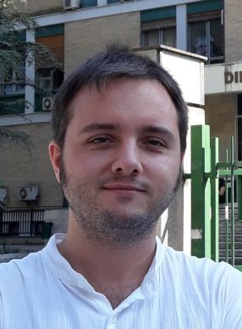
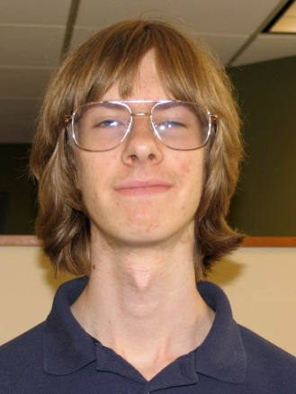
The Winners
Lars Agustín Chris
Mohrmann Sánchez Losa Weaver

Slide 24
The Winners
Lars Mohrmann
  Characterizing Cosmic Neutrino Sources (A Measurement of the Energy Spectrum and Flavor Composition of the Cosmic Neutrino Flux Observed with the IceCube Neutrino Observatory)
Agustín Sánchez Losa
  Search for high energy cosmic muon neutrinos from variable gamma-ray sources and time calibration of the optical modules of the ANTARES telescope
Chris Weaver
  Evidence for Astrophysical Muon Neutrinos from the Northern Sky

Slide 25
And now:
On to science!

Slide 27

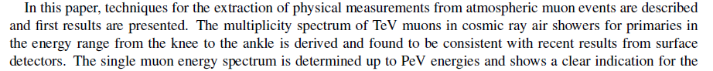
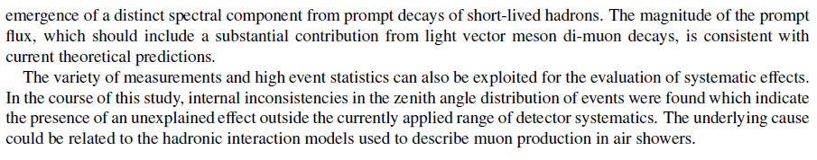
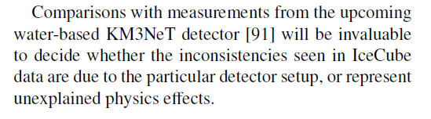
arXiv:1506.07981, Astroparticle Physics Journal

