Slide 1
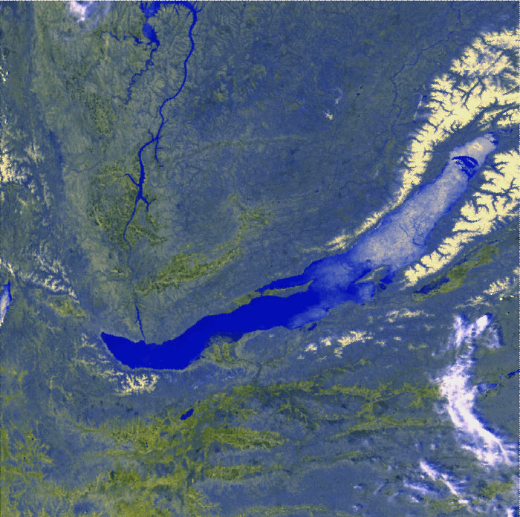
Cascades in GVD
Zh.-A. Dzhilkibaev, INR (Moscow),
for the Baikal Collaboration
MANTS-2016, October 01, 2016

Slide 2
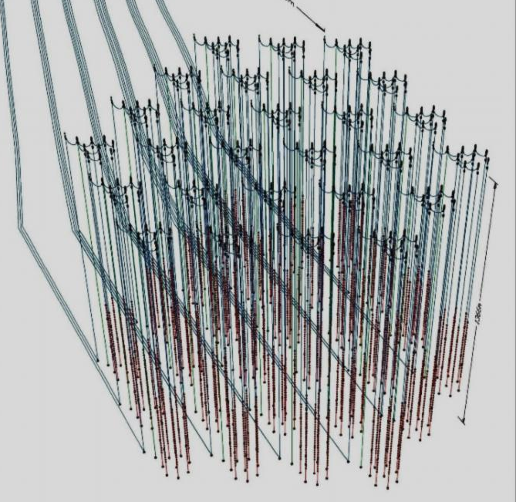
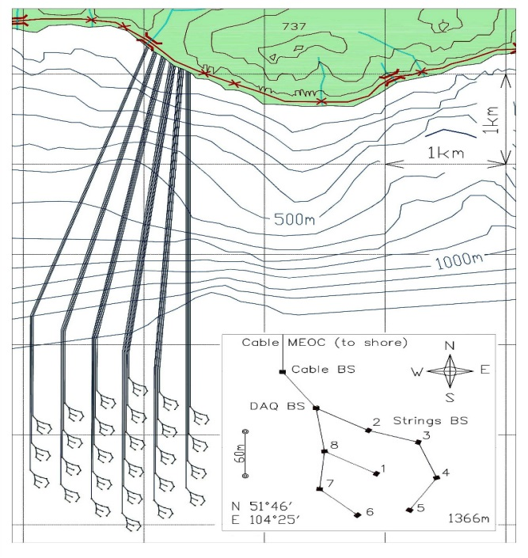
Gigaton Volume Detector (Lake Baikal)
GVD array
Cluster

Slide 3
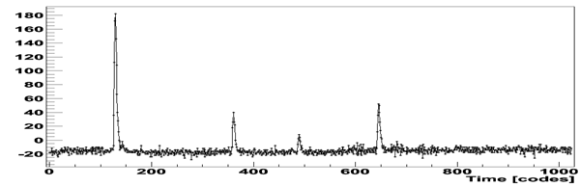
Measuring channel
PMT
Amplifier
90 m coax.cable
FADC
Optical module
Central module
A, mV
Time, 5 ns
Nominal PMT gain 1×10⁷ (PMT voltage 1250 – 1650 V)
Amplifier, k_{amp}=10;
Pulse width ~20 ns
ADC: 12 bit 200 MHz FADC (5 ns time bin);
Waveform information is recorded in a programmable interval (up to 30 mks)
Linearity range: 1 ─ 100 p.e.;

Slide 4
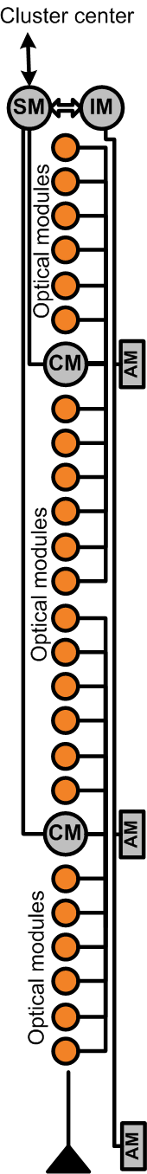
Triggering and Data Transmission
SECTION
CLUSTER
2015: Coincidence
of neighbouring OMs
L/H = 1.5 p.e/4 p.e

Slide 5
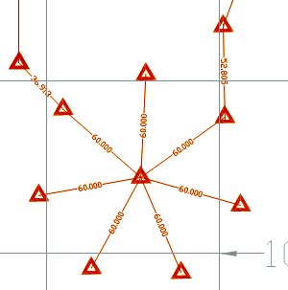
First Demonstration Cluster “Dubna”
(April 2015)
Final Layout
192 OMs at 8 Strings
2 Sections per String
12 OMs per Section
DAQ-Center
Cable to Shore
Acoustic Positioning
System
Instrumentation String
with detector calibration
and environment moni-
toring equipment
Two LED beacons for
interstring calibration
Active depth 950 – 1300 m
Instrumented volume 1.7 Mt
Cable MEOC
L~ 345 m
String section, 12 OMs
- DAQ center
- Instrumentation string
R ~ 40 m
- OE Cable Buoy Station

Slide 6
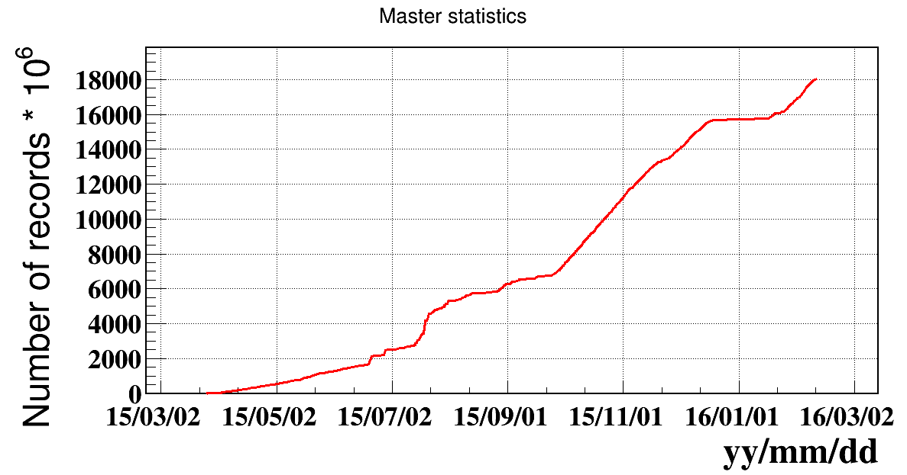
Operation in 2015 yr.
(24 March – 10 February) - 294 days
Operation: 213 days
Efficiency: 72 %
Runs: 622
Data: 1.6∙10⁹ events
Event rate ~ 100 Hz
Life time ~ 184 days
Cumulative number of records
Data sample
Dates 24.10.2015 – 17.12.2016
Life time 41.64 days
Statistics 437 970 024 events
trigger: coincidence of two neighboring OMs
with thresholds low&high = 1.5p.e.&4p.e.
Configuration (24.10-17.12)
7 strings
different configurations during runs

Slide 7
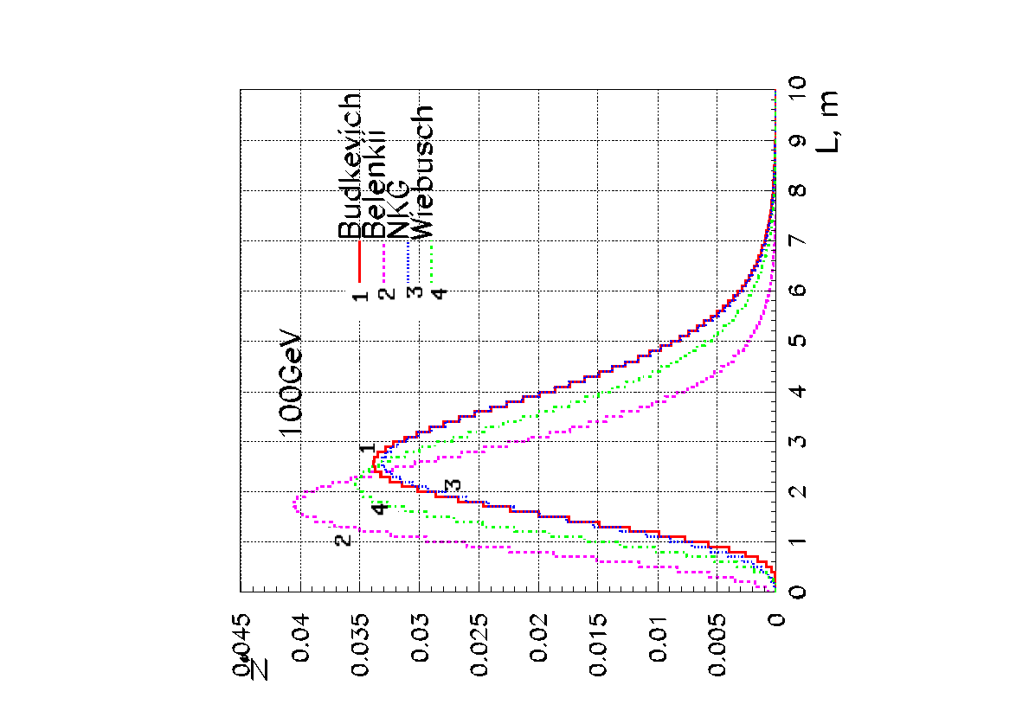
Cascades Detection Mode
Cherenkov radiation
Cascades from ν_{e,τ} & ν_{μ}(NC):
Point-like, strongly anisotropic
  light-source
  - cascade size proportional to ~lnE _{ν}
  (but LPM-effect for >20PeV!)
Light intensity proportional
to neutrino energy ~ E_{ν}∙ 10⁸ γ/TeV
Detection efficiency strongly
  depend on environment
  properties (water/ice).
  Angular resolution ~3°/15° (w/i)
  High energy resolution ~10-20%
cascades
muon
Cascade curve

Slide 8
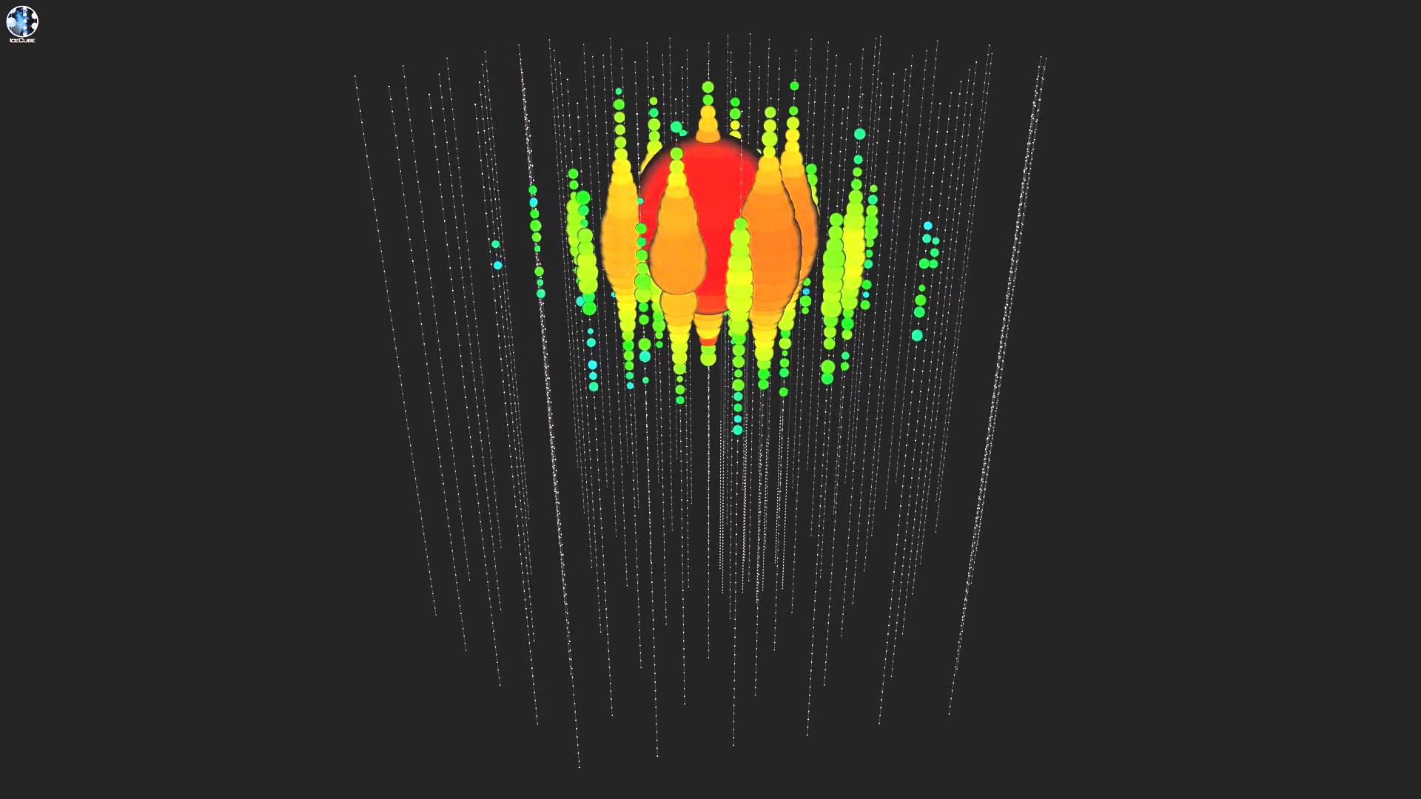
„Big Bird“
~ 2 PeV
IceCube
Notes:
2000 + 260 -240 1140 + 140 -130 1040 + 130 -145

Slide 9
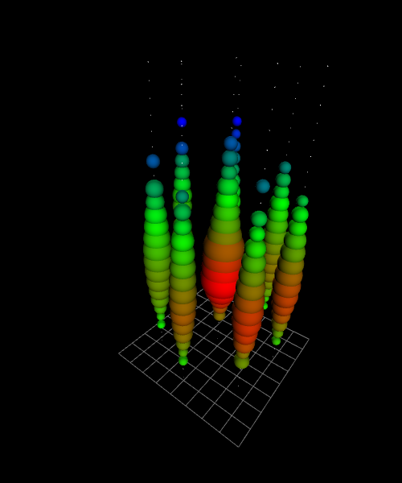
Shower 1.9 PeV, θ = 116°, ρ = 23 m, z = -85 m
Cluster 2015
MC

Slide 10
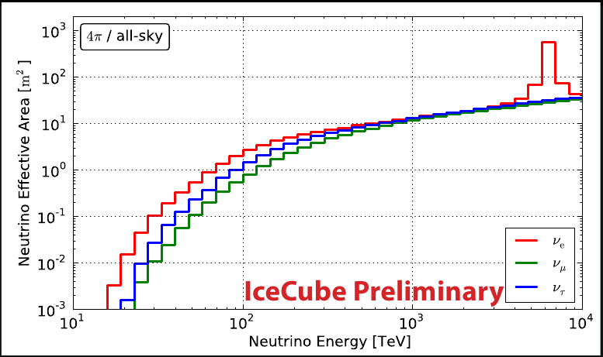
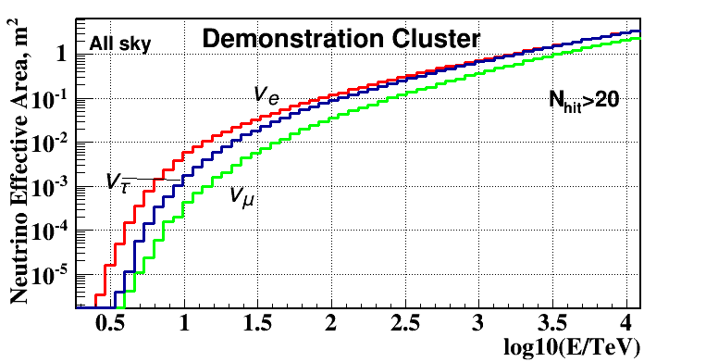
Neutrino Effective Area
IceCube
Demonstration Cluster
(GVD)
S_{cl} ~ (0.05 - 0.1) S_{IC}

Slide 11
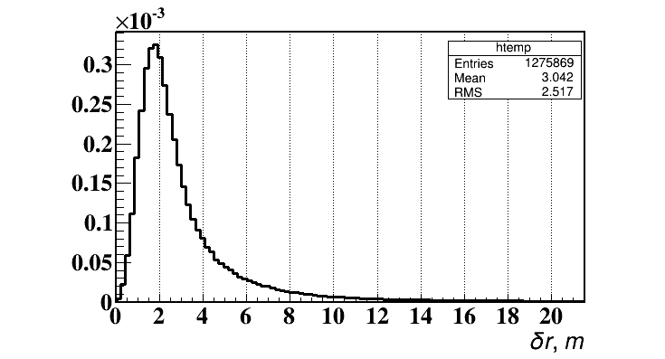
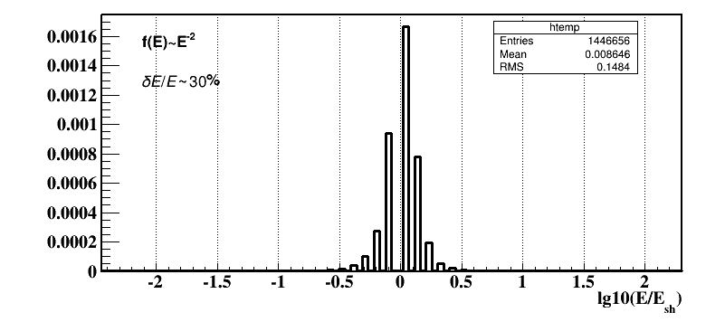
Cluster performance for cascade’s detection
Distance between generated and
reconstructed vertices
Reconstruction of a cascade vertex:
Iterative procedure- OMs with
residual δt > 15 ns are excluded
and final N_{hit} is obtained for
following analysis.
δr = |r_{rec} – r_{gen}| ~ 2 m
(median value)
N_{hit} > 10
Averaged by E⁻²
ν_{e} spectrum
Energy resolution :
δE/E ~ 30%
averaged by E⁻² ν_{e} spectrum
Averaged by E⁻²
ν_{e} spectrum
N_{hit} > 10

Slide 12
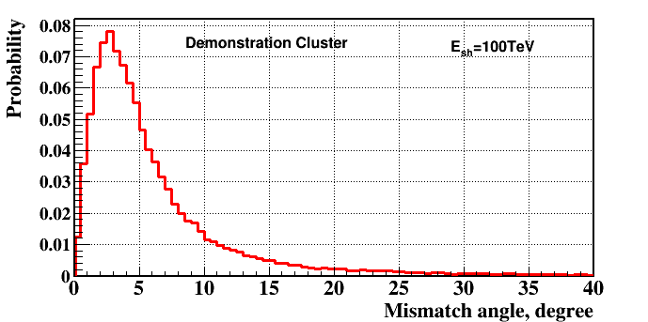
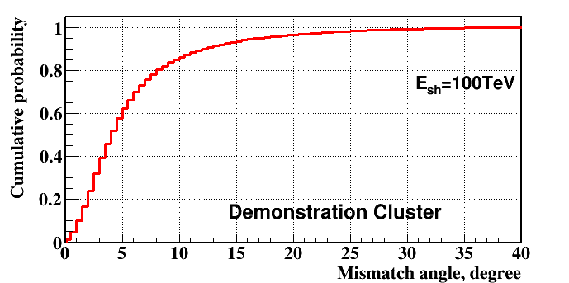
Distribution of mismatch angles
Directional resolution for cascades:
~ 3°- 4° - median value of mismatch angles
N_{hit} > 10
Cumulative distribution
N_{hit} > 10

Slide 13
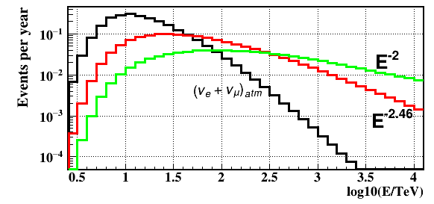
Energy spectrum of astrophysical neutrinos
measured by IceCube:
1.2∙10⁻⁸ E⁻² GeV⁻¹ cm⁻² s⁻¹ sr ⁻¹
4.1∙10⁻⁶ E^{-2.46} GeV⁻¹ cm⁻² s⁻¹ sr ⁻¹
Expected number of detected events in Demonstration Cluster
from astrophysical neutrinos for 1 yr. observation
N_{hit} > 20 OM
Event selection criteria (E_{sh} >100 TeV, N_{hit} >20):
0.4 – 0.6 events/yr - depending on a spectrum, background
conditions, and selection criteria

Slide 14
A search for cascades induced by
astrophysical neutrinos
(analysis of 2015 data – PRELIMINARY!)
Total number of accumulated events – 437 970 024 events
(thresholds: low/high = 1.5/4 ph.el.)
Life time – 3 597 921 s = 41.6 days
After causality cuts – 18 840 822 events
(N_{hit} > 3; |t_{i}-t_{j}| < Δr_{ij}/v + δt)

Slide 15
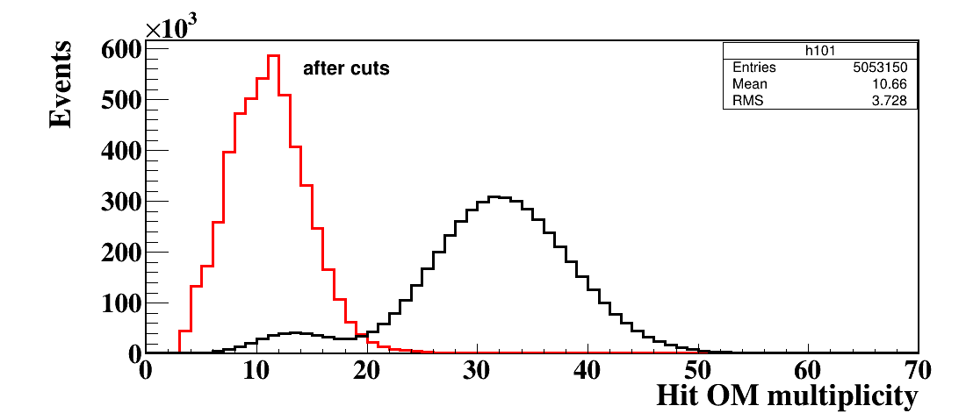
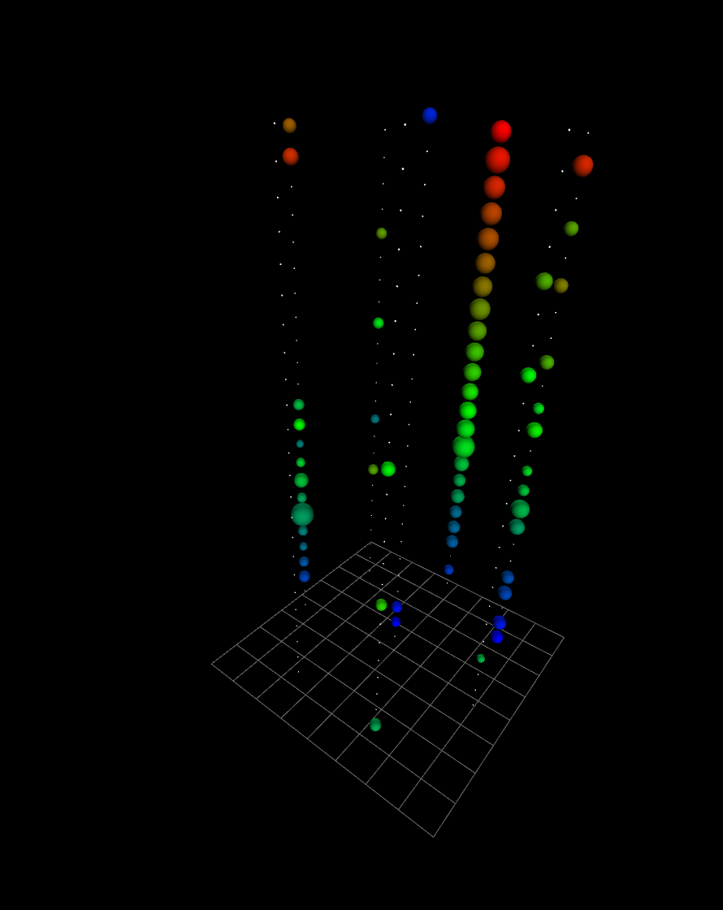
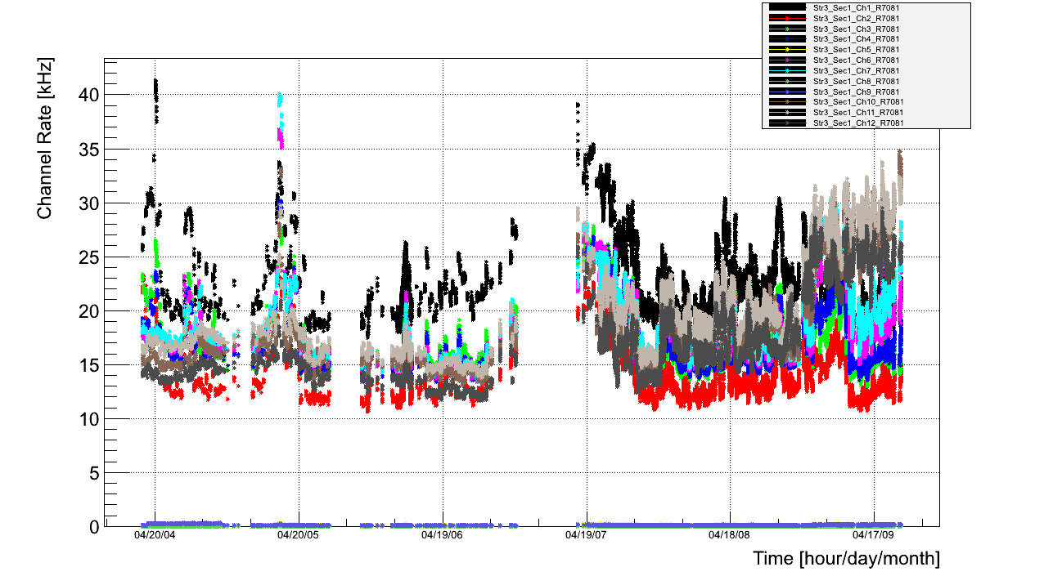
Background muon bundle event
Hit OMs multiplicity
Water light-background

Slide 16
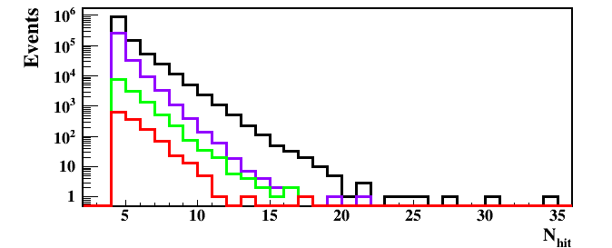
Hit OM multiplicity dependence on cuts
N_{hit} > 20
Cuts | Events | Rejection
Reconstruction of shower coordinates | 1 171 077 | 1
(χ² < 2) & (ρ <150 m; -272m < z < 200 m) | 316229 | 1/3.7
(L_{a} < 10)&(η > 0) | 12931 | 1/90
E > 30 TeV | 1291 | 1/900

Slide 17
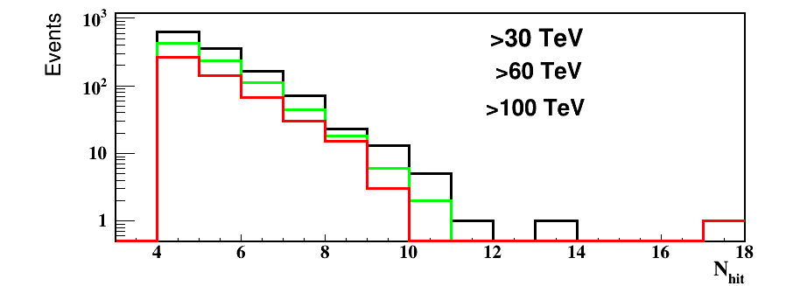
Hit OMs multiplicity after all cuts
One event with N_{hit} = 17 OMs and E > 100 TeV !
Cuts | Events | Rejection
E > 30 TeV | 1291 | 1/900
E > 60 TeV | 859 | 1/1360
E > 100 TeV | 539 | 1/2000

Slide 18
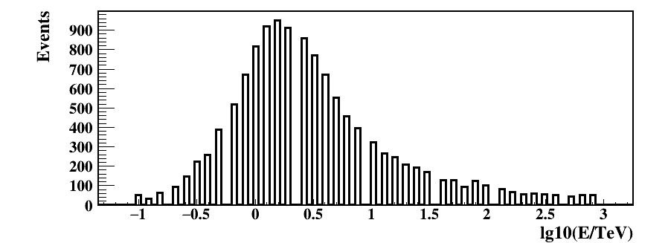
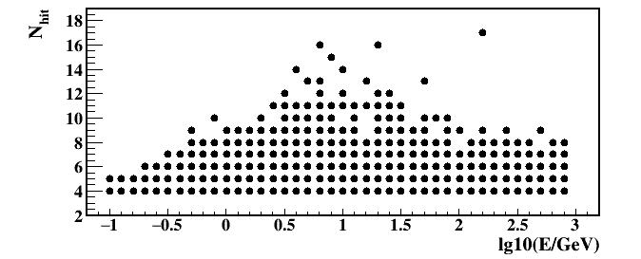
Reconstructed energy of selected events
Hit OM multiplicity vs reconstructed energy
E > 30 TeV
N_{hit} > 10

Slide 19
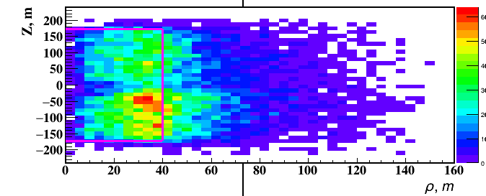
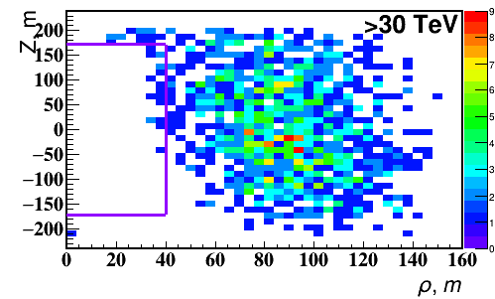
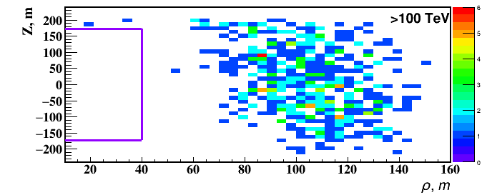
Reconstruction of shower vertex
All events
12931 ev.
E > 30 TeV
1291 ev.
E > 100 TeV
539 ev.

Slide 20
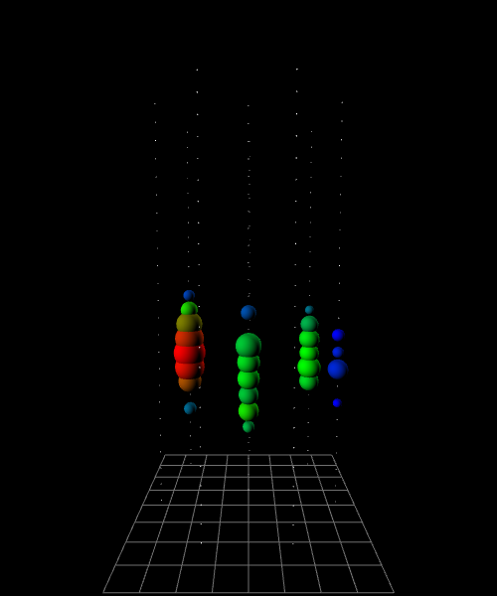
Promising event (e584:8566299)
E = 158 TeV, θ = 59°, ρ = 73 m, z = -62 m
γ
ν
≈shower

Slide 21
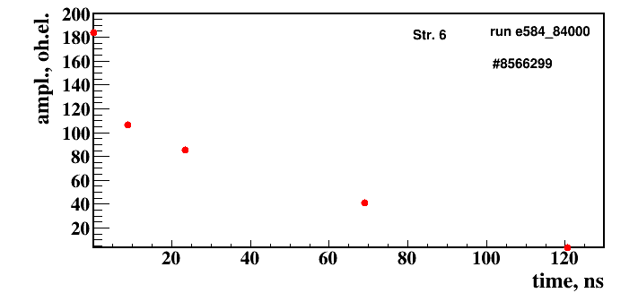
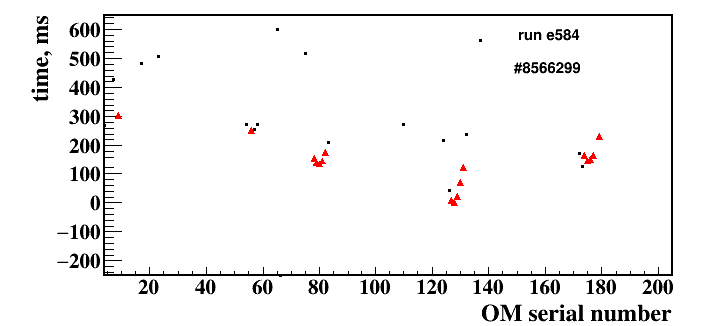
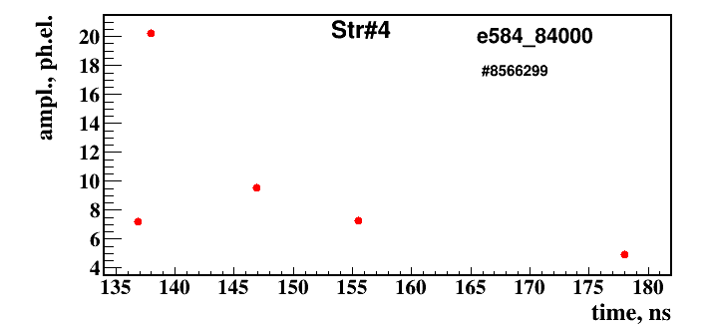
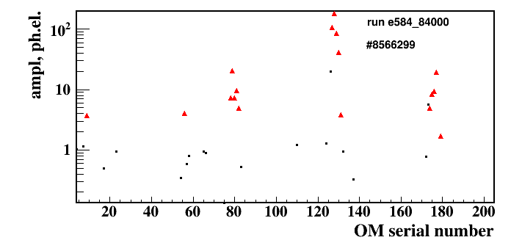
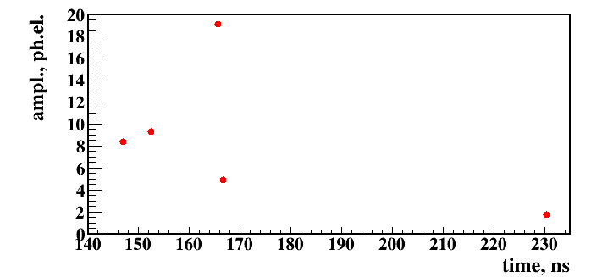
Run e584, event #8566299
Amplitude vs time
Arrival times of hit OMs
Amplitudes of hit OMs
Str.8

Slide 22
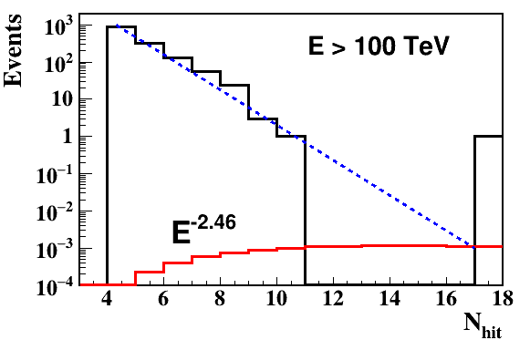
Hit OMs multiplicity after all cuts

Slide 23
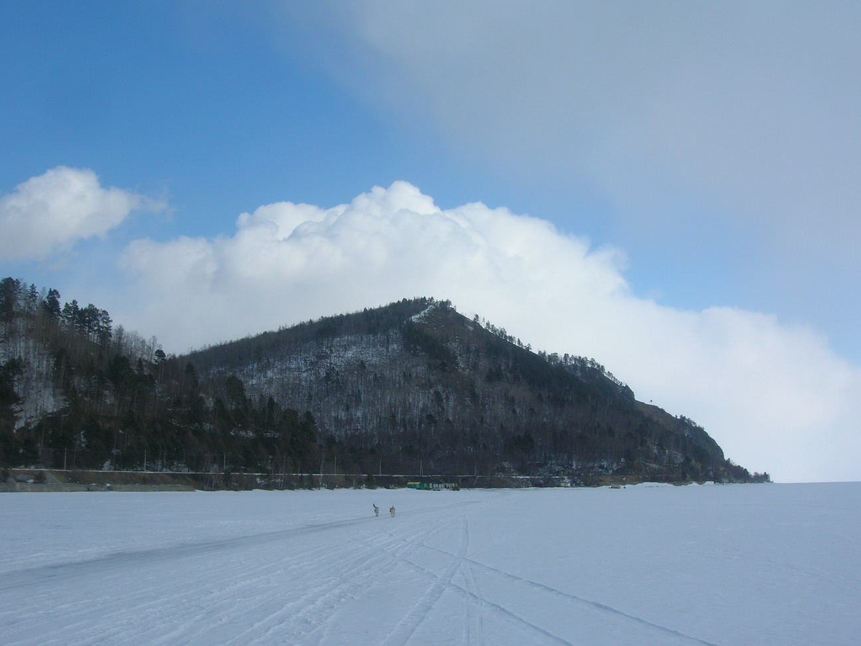
Thank you!

