Slide 1
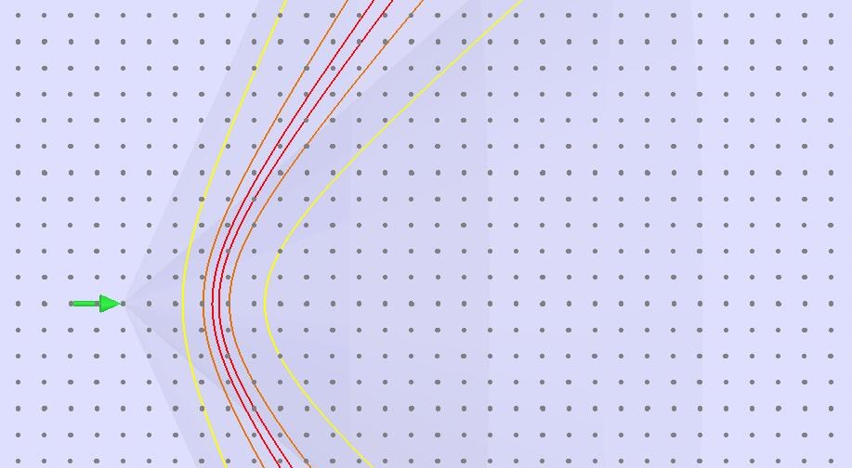
Time-of-Arrival Detection (TOAD) Array
Perry Sandstrom for ARA Collaboration
July 23, 2015

Slide 2
Basic Idea of TOA Detector Array
Cover large area with dense array of 50m deep RAM-drilled holes (15min/hole)
Multiple holes involved in each detected GZK event
Example: 64km^2 array of 1600 holes with 200m spacing => $2M-$5M of hardware
(1) string per hole; (2-4) transient sensors per string (Vertical spacing= 10m)
Each sensor is an integrated Vpol antenna/electronics PCB
Each sensor provides RF envelope to surface for TOT or other digitizer
Each sensor has azimuthally uniform detection pattern
Determine RF elevation independently at each hole
Real-time downward rejection at each hole
Mass-produced array components (approximately 4 configuration items)
Compatible geometry for co-location with CR surface array

Slide 3
GZK Field Contours Confirmation by Spatial Signature (1km deep, horizontal event shown)
Transient
Sensor
Elements
(333m spacing shown)
Event
1 km
E max (r)
~E max (r) /2
~E max (r) /10
“Imaging” technique proposed by Gusev and Zheleznykh ~1983

Slide 4
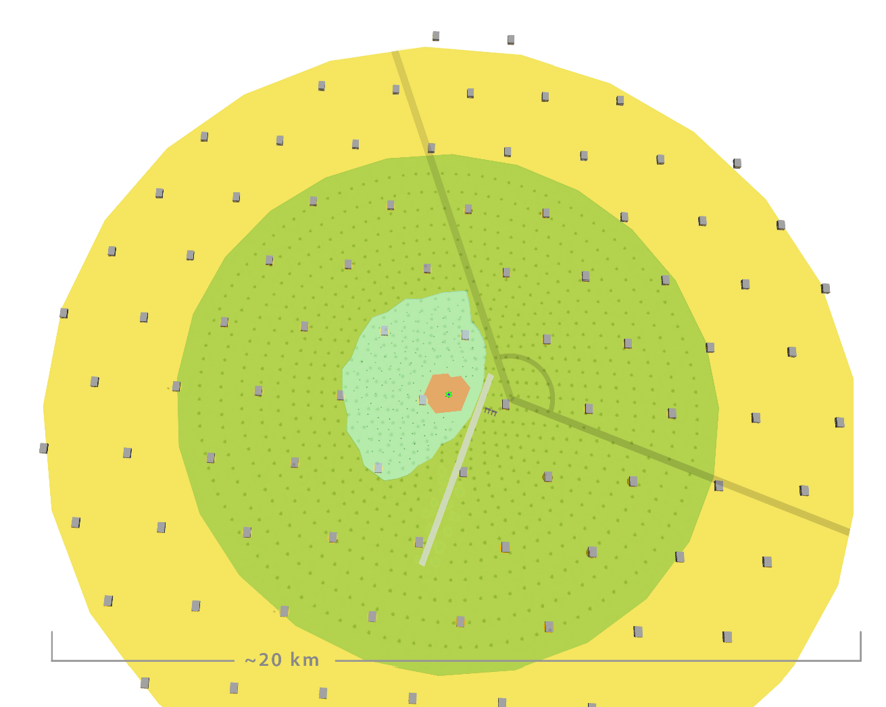
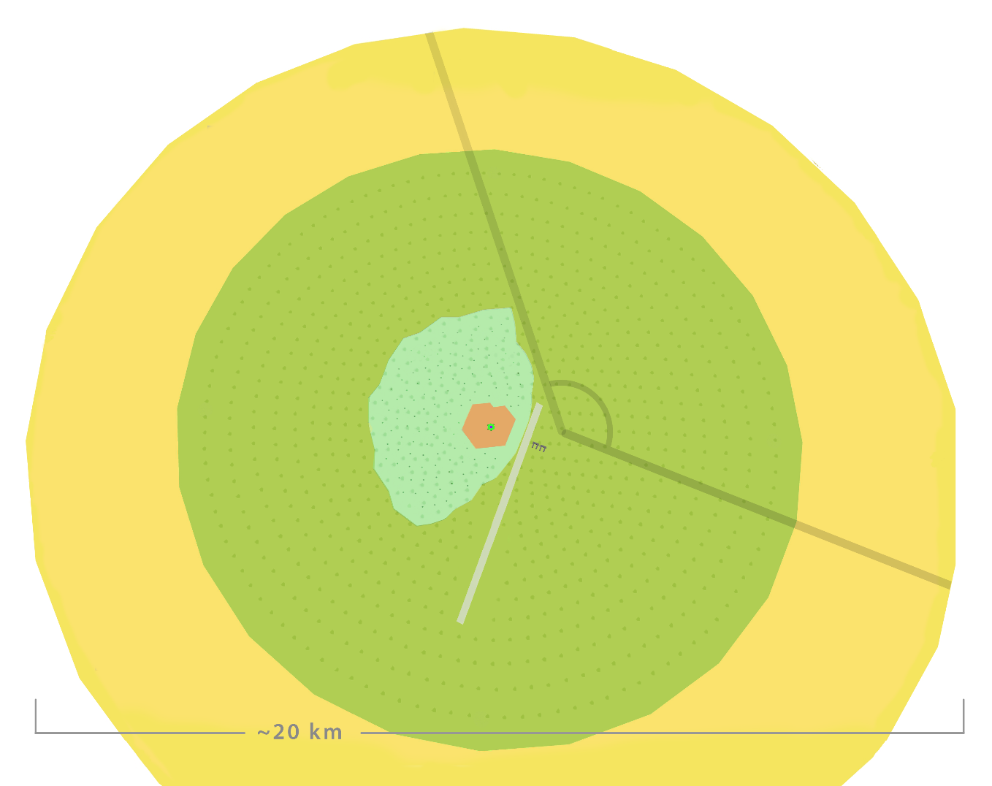
Combined Surface/CR and Radio Array
2km
200m

Slide 5
Conceptual Transient Sensor Array Configuration & Power Requirements
d
(AZ.)
SPA
Surface
Processor
Assembly
20 km
Hole
Dry, 4” dia.
20 km
TDA 1
20m Depth
s
(EL.)
Example
“Kilocube”Array
1000 km³
~10.8KW total
TDA 2
50m Depth
Data Collection /
Power Distribution
Daisy Chain
Wired Power
For Entire Row
e.g. #12, RG8, RG11
Array of holes
180Watts/Row
Hole with (2-4) transient sensors
~3Watts per hole

Slide 6
TDC-Based SPA Block Diagram (prelim) (Arbitrary Elevation Gating- Two TDA channels shown)
TDOA
TOT
Upper
TDA
STOP CH1
Discriminator
Time-Digital
Converter (TDC)
4-fold stops/ch
65ps bin size
Min 200ns window
Lower
TDA
STOP CH2
Discriminator
Envelope
Signals
START
TDC
Settings
ALU
Threshold
Elevation
& Coinc.
Fine Time
Data
Master Clock Pair
Coarse Time
from Master clock
Hit Processor
Adjacent
SPAs
Data Pair
Buffered Hit Data
Serializer
Hit Buffer
Slow Control
Pair
Get Data

Slide 7
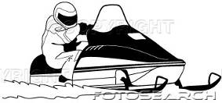
Downward Rejection via Priority, Coincidence Real-Time, Simplest “Elevation Gating”
Reject
A
B
Surface Transients
Surface Processor
TDA (A)
Accept
Highest Detectable Neutrino Trajectory
(36 degree zenith)
A
B
d ~30m
Accept
A
B
Lowest Detectable Neutrino Trajectory
(93 degree zenith)
TDA (B)
Time Difference Of Arrival (TDOA)
Notes:
Blue box is simple F/F based elevation gate (probably inside sensor A)

Slide 8
Programmable Elevation Gating
Allows real-time rejection or acceptance of arbitrary elevation ranges
Horizon Reject
Discriminator threshold can be
lower than transients from surface
without overwhelming data handling
Sky Scan
Cosmic Ray and
calibration studies

Slide 9
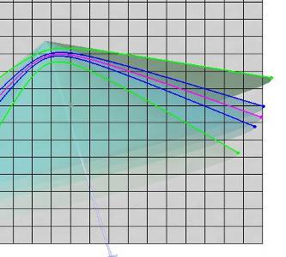
Elevation Gating for GZK
Vpol Array Peak Response to GZK
(neutrino zenith angle)
Corresponding
Elevation Gating
(RF elevation angle)
Earth
Axis
Cutoff due to
Depth of Sensor Plane
Polarization
Response
Horizon
Earth Limb
Cutoff
Earth/Sensor/Array
Axis
Peak Vertical Field Strength
In Detector Array

Slide 10
Time Resolution Requirements for 1 degree broadside accuracy
Ice
TOA System
~10 byte
per hit/hole
Transient Sensor -Azimuth “d”
Transient Sensor -Elevation “s”
Air
Waveform- Capture Systems
~5-10 kilobyte
per hit/station
AURA & ARA
ANITA

Slide 11
Transient Detector Assembly (TDA) Primary configuration item for TOA Detector System
450MHz
Notch
LNA1&2:
100MHz-
800MHz
Band Pass
23dB Gain
0.9dB NF
80dB log Detector
Antenna
Input
Envelope
Output
Pdis ~.5W
V+
3.3V
Reg
Bias-T
Transient Detector Assembly
- Active Antenna sensor for Time Of Arrival (TOA)
- Envelope signals sent to surface
- “Common Mode” design possible for multiple TDAs on single cable

Slide 12
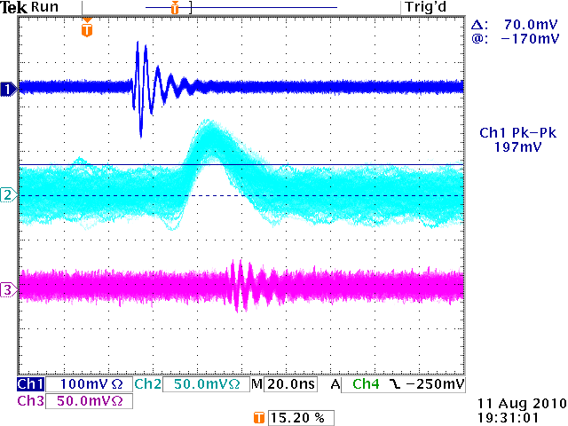
TDA vs. Waveform Capture Low-level Sensitivity
With infinite persistence to show electronics noise
141uV_{p-p}
Input Stimulus
200mV_{p-p}
Stimulus
Att -63dB
Min TDA Stimulus for:
~100% detection
~0% false hits
TDA Response
AURA Front end
(similar to ARA)

Slide 13
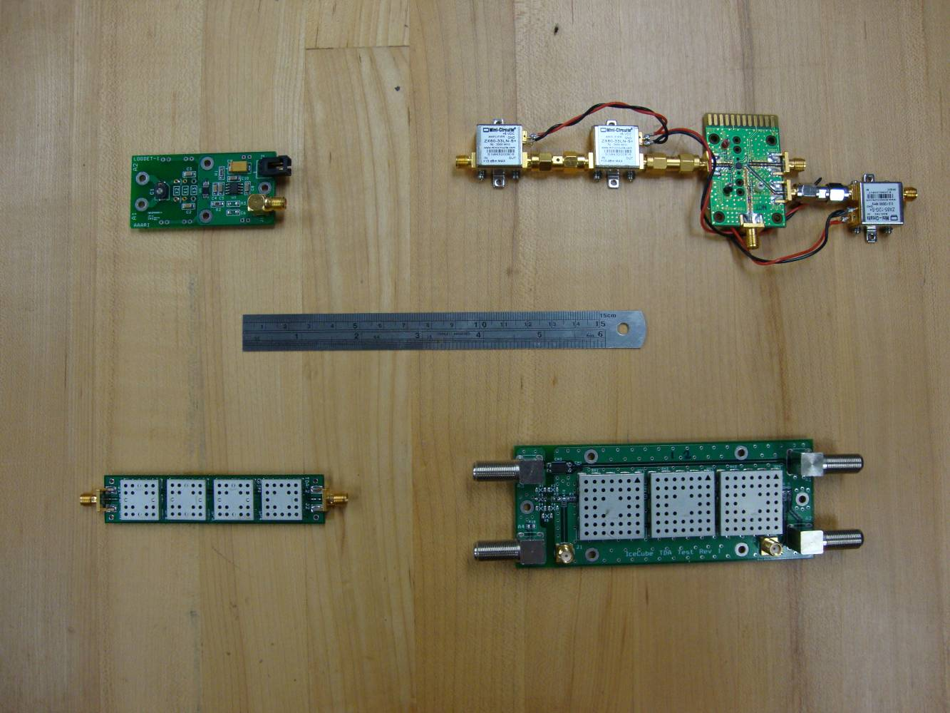
TDA Development
2007
2008
2009
2010
2008

Slide 14
Envelope / TDA Proof-of-Concept Testing South-Pole 08-09
View of snowmobile
from ICL Door
Delta t =20ns
Transient
Wavefront
West
tower
East
tower
Ignition noise transients from idling snowmobile
Snowmobile was approximately 100m distance from ICL.
Snowmobile was perpendicular with West tower.
Signals as acquired by ic-scope-ag1
Time Delay=20ns W-E, consistent with Angle-of-Arrival (AOA)
Snowmobile
(transient source)

Slide 15
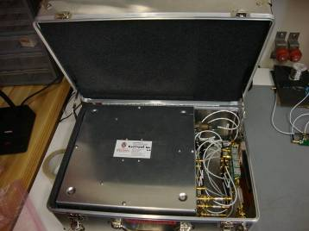
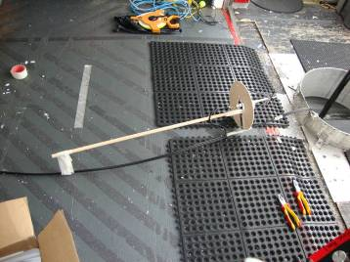
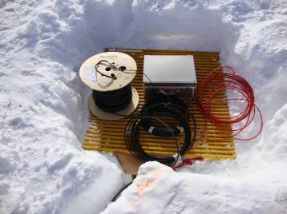
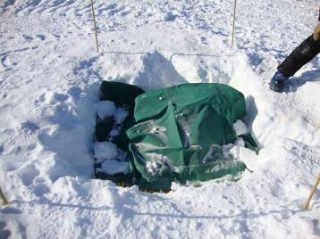
SATRA Deployment Pictures

Slide 16
(due to ice-firn refraction)
Hagar Landsman IceCube radio extension Status and results ARENA 2010

Slide 17
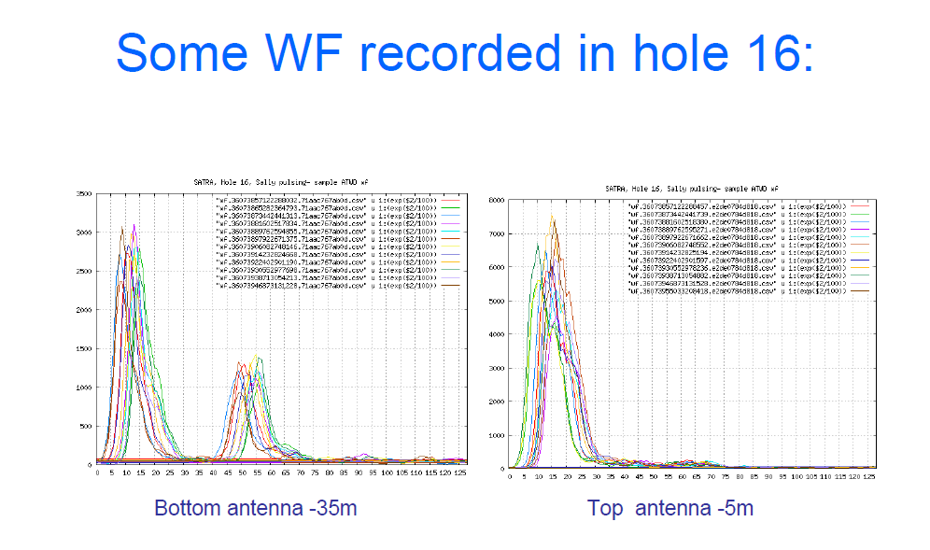
Hagar Landsman IceCube radio extension Status and results ARENA 2010

Slide 18
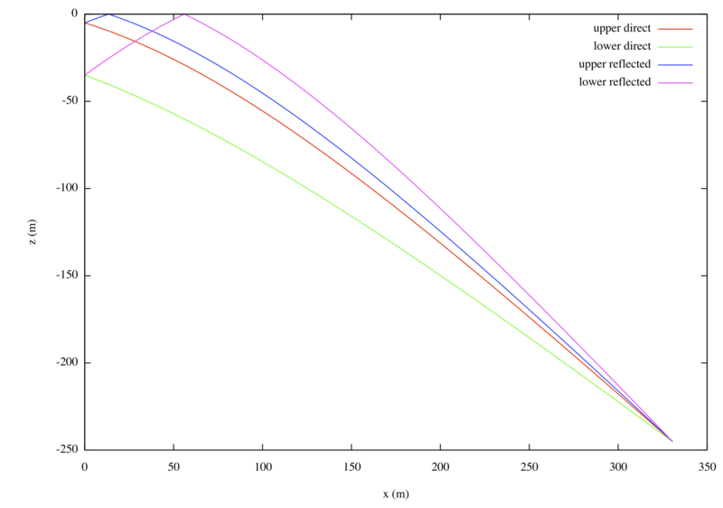
Ray tracing from pulser to SATRA
Top antenna
-5m
surface
Reflected rays
Bottom antenna
-35m
Depth [m]
Direct rays
Source
at -250m
Measured time differences:
Time differences between direct rays
And between direct and reflected rays can be calculated
XY separation [m]
Hagar Landsman IceCube radio extension Status and results ARENA 2010
18

Slide 19
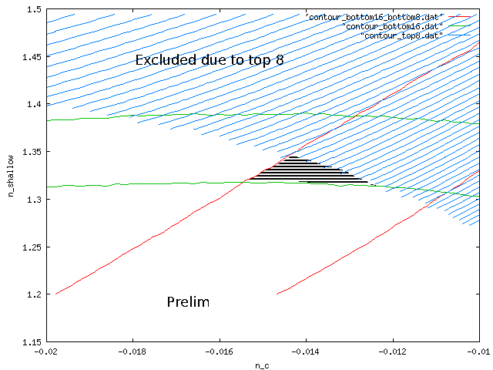
Limits for N(z) found using SATRA
Based on set of hit time differences between antennas
and between primary and secondary hits on the same antenna,
a limit on the index of refraction model can be obtained.
Systematics taken into account: n_deep, Geometry, timing resolution, WF features
Hagar Landsman IceCube radio extension Status and results ARENA 2010

Slide 20
Rapid Air Movement (RAM) Drill

Slide 21
“KiloCube” Conceptual 1000 km³ Time-Of-Arrival Array
Event Confirmation by:
-spatiotemporal signature
-up-going waves at each string
-coincidence over large area
20 km x 20 km firn array
Refraction of Askaryan cone leaving firn not shown
Conic Sections at intersection of Askaryan profile and sensor plane.
(Distortion by ∆N_{ice-firn} not modelled)
~ Thousand+ holes/sensor strings
~ $1K-$3K for each string
~ 50m hole depth
~ 200m hole spacing
~ a few watts / string
E max (r)
~E max (r) /2
~E max (r) /10
Notes:
16km x 20km

Slide 22
Cost and Power Estimates for 20km x 20km (1000m³) Array
Instrumentation Cost /hole
TDA 1 w/cable $500
TDA 2 w/cable $500
SPA $1K
Data/Power Link $1K
Deployment Cost/hole
Fuel (20gal) $300
0.2 operator-days $700
Total Incremental
cost per hole: $4K
Grid Spacing | Total # holes | Array Cost ($4K /hole) | Array Power (2.5W /hole)
200m | 10000 | $40 M | 25 kW
333m | 3600 | $14.4 M | 9.0 kW
500m | 1600 | $6.4 M | 4.0 kW
1000m | 400 | $1.6 M | 1.0 kW
Additional hardware-related costs:
DAQ: $1M Project Overhead: x ~1.5
R&D: $2M
Drill(s): $1M ea.

Slide 23
Things to remember with TOAD setup:
Orders of magnitude less complexity and cost per hole
Orders of magnitude faster and cheaper hole drilling
Depth shadowing “doesn’t matter” with dense array
Event confirmation includes uniquely characteristic spatial signature
Vpol sensors are responsive to strongest part of cone
Vpol sensors allow narrower (e.g. RAM drilled) holes
RAM drill allows more uniform holes and antenna-hole coupling
System can be made with virtually no dead-time
Simpler data volume may allow no “store and forward” (live imager)

Slide 24
Thank You
10 km
Kael Hanson

Slide 25
Supplemental Slides

Slide 26
TDA / WASP/ Array Nominal Sensitivity Pattern
First-order approximation for sub-firn, vertical dipole sensors
Air/Firn
Refraction
of Sky waves
Cos θ
Firn modeled as homogeneous, n=1.5
radio-transparent layer above sensors

Slide 27
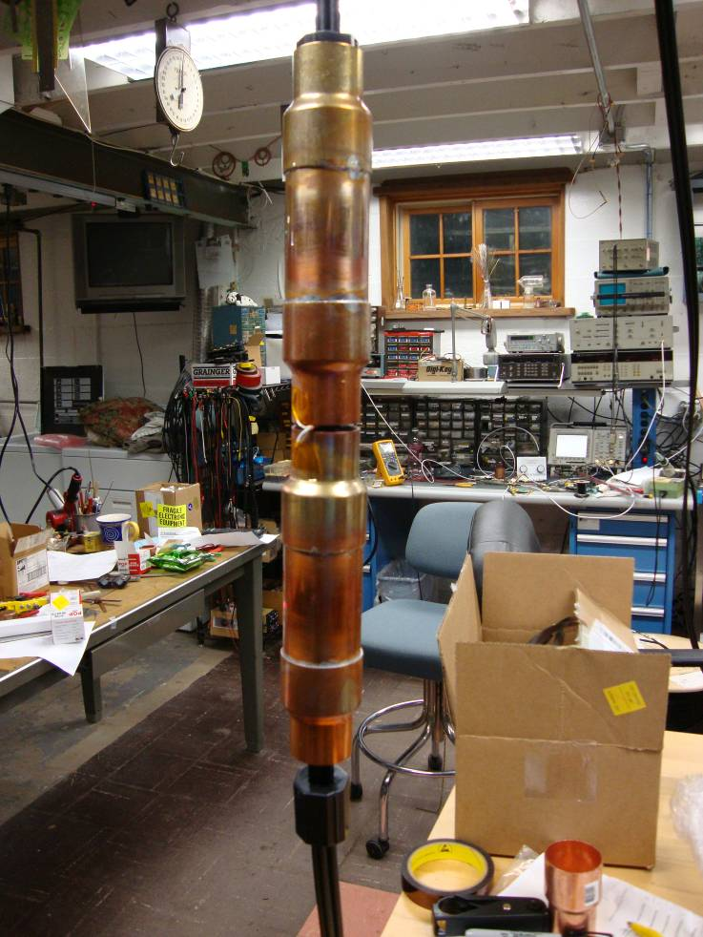
Sensor Prototyping for SP 2010-11
Active Antenna Transient “Sensor”
Azimuthal symmetry with cable pass-through
Designed for RAM Drill (uniform 4” hole)
Ferrite
Ferrite
Ferrite
Ferrite
Ferrite
Ferrite

