Slide 1
RAM DRILL
Perry Sandstrom for ARA Colaboration July 23, 2015

Slide 2
Rapid Air Movement (RAM) Drill

Slide 3
RAM Drill Details
- 5.5 gal diesel per 60m hole (w/ transport)
- Avg. 20min/hole to 60m
- Avg. 17 holes/day with crew of 3
- Reliable drilling of 4” dia to 60m at NPX
Narrower holes (e.g. 3” possible
Transportable on LC130

Slide 4
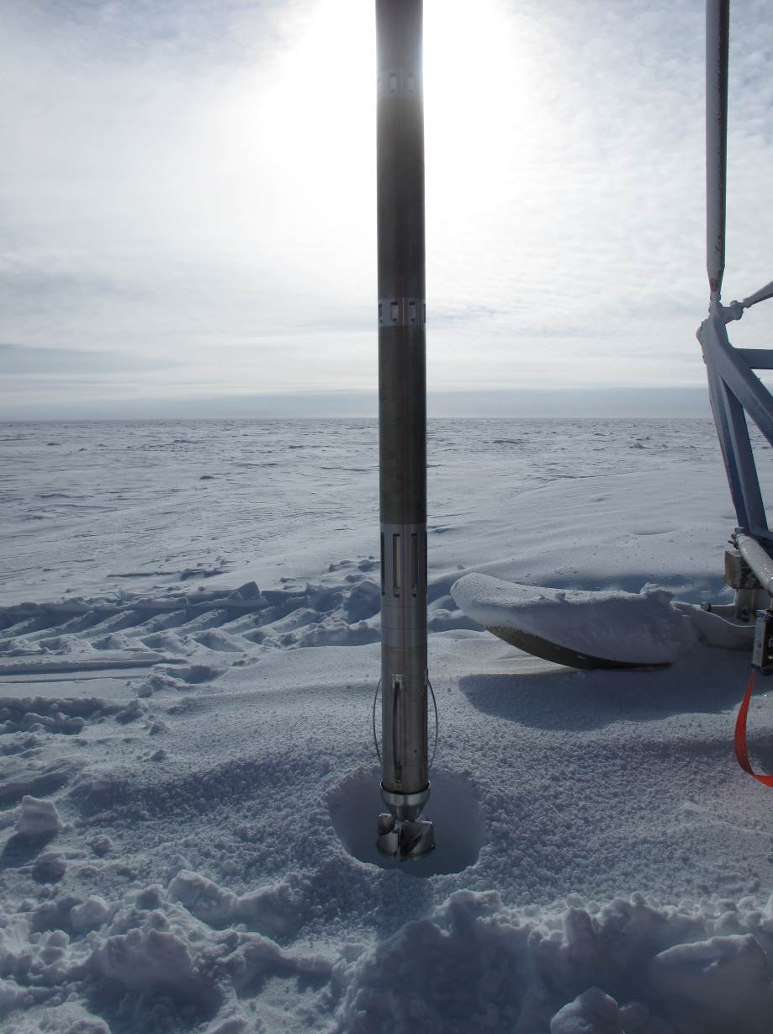
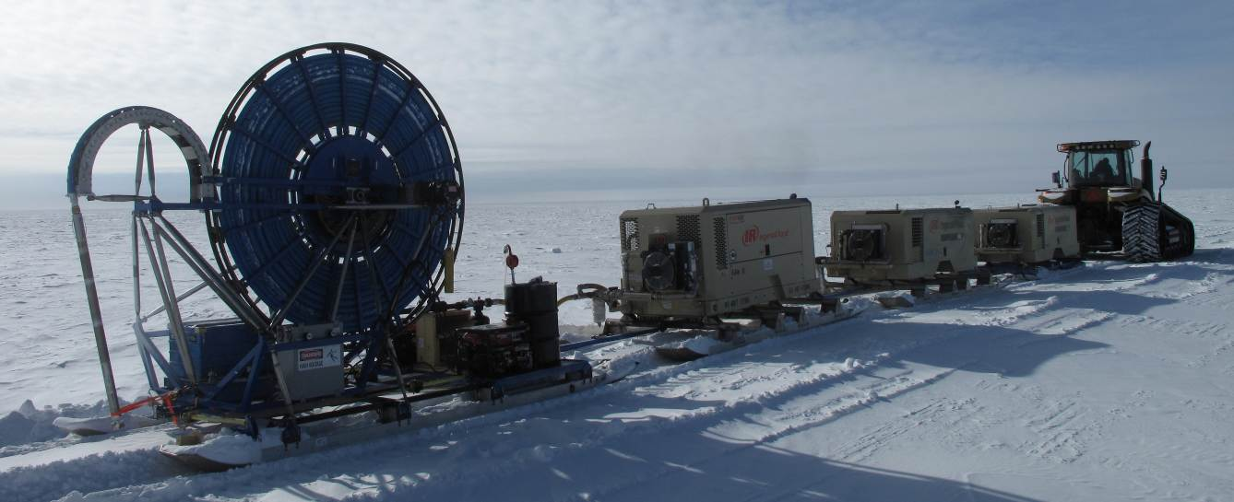
Tested at NPX: Dec 21, 2010 - Jan14, 2011
-50m holes in approx. 20 minutes
-Drilled about 20 holes
-Worked better on packed snow than soft snow in the field
-Maximum hole depth at NPX was 63m (S. Lidstrom)

Slide 5
RAM Drill at NPX

Slide 6
RAM Drill at NPX

Slide 7
Hot Water Hole vs RAM Hole

