Slide 1
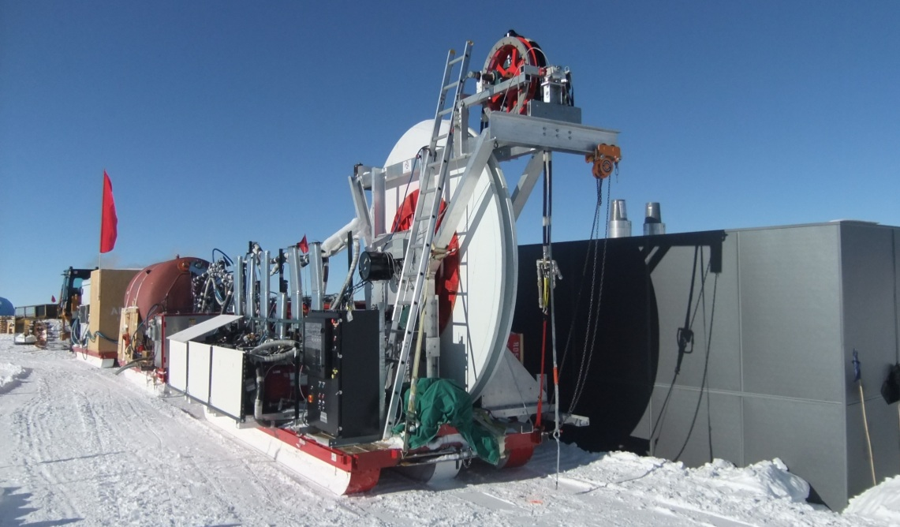


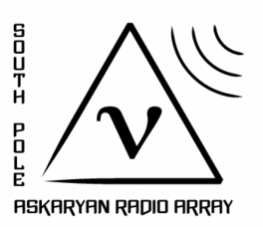

ARA DRILL PROGRAM
Terry Benson
ARA Collaboration Meeting
Madison, WI
7.23.15

Slide 2
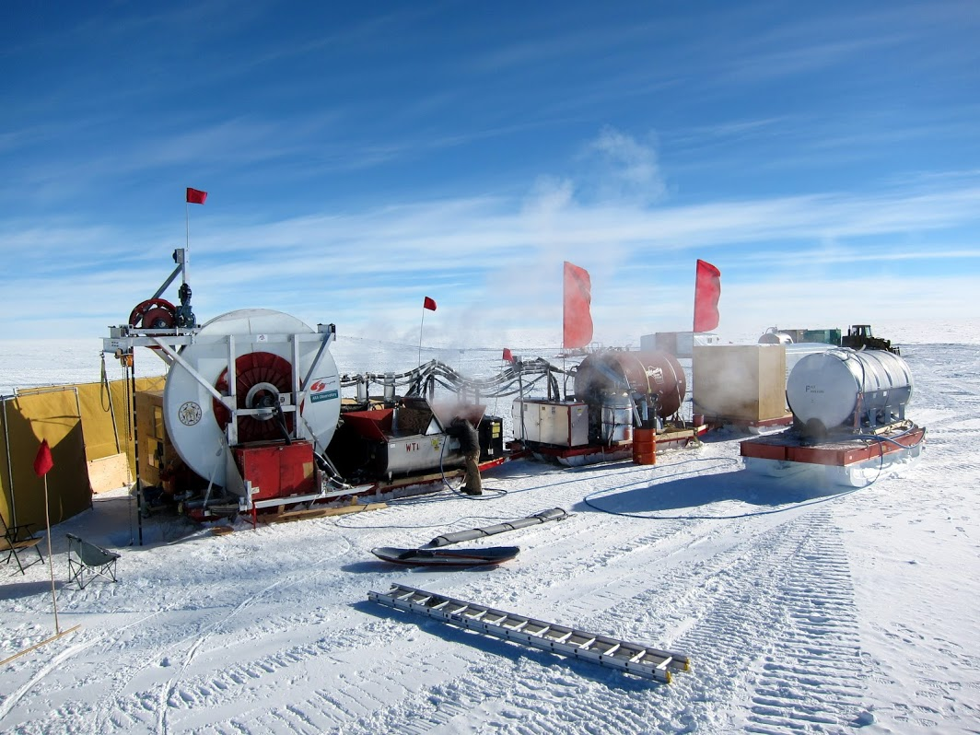
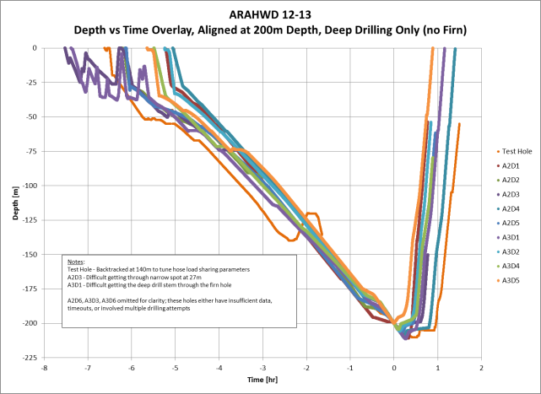


ARA HOT WATER DRILL
Drilling support for the Askaryan Radio Array (ARA) at the South Pole
Overlay of 2012-13 hole profiles
12x production holes (12 planned)
All instrumentation successfully deployed
Hole Requirements:
  φ6in (18cm) min x 200m deep DRY hole
  1 hole per 10 hr (2 holes/day with 2 shifts)
Hot water to make dry holes
Drill/pump-out simultaneously
3-sled train configuration, 34klb (15t) dry weight
300kW thermal power, requires 30kW electrical
12gpm (45 lpm), 85°C, 1000psi (7Mpa)
Crew of 5/shift

Slide 3
ARA Hot Water Drill
History
NOTE
1. Budget includes Capital Equipment and Off-Ice Labor
On-Ice
Activities
ARA Testbed
ARA 1
ARA 2 & 3
ASC Utilities
 | 2010 | 2011 | 2012 | 2013 | 2014 | 2015
Off-Ice Activities | Initial build | Modest Upgrade | Major Upgrade | Modest Upgrade (ASC) | - | -
Off-Ice Budget¹ | ? | ? | $500k | $240k | $220k | $200k
Proposed/Completed Off-Ice Tasks | Scavenge Hunt | 1.5x Capacity Hole Pumpout Melter | New Approach Drillheads Hose Bundle Hose Reel Controls Generators | Hose Re: Drillhead E-Pump Firn Drilling Controls Re: Sheave Repairs Spares | Hose Re: Drillhead E-Pump Firn Drilling Repairs Spares | Hose Re: Drillhead E-Pump Firn Drilling

Slide 4
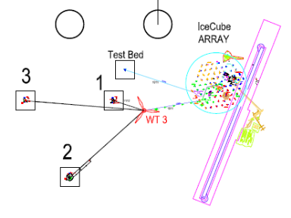
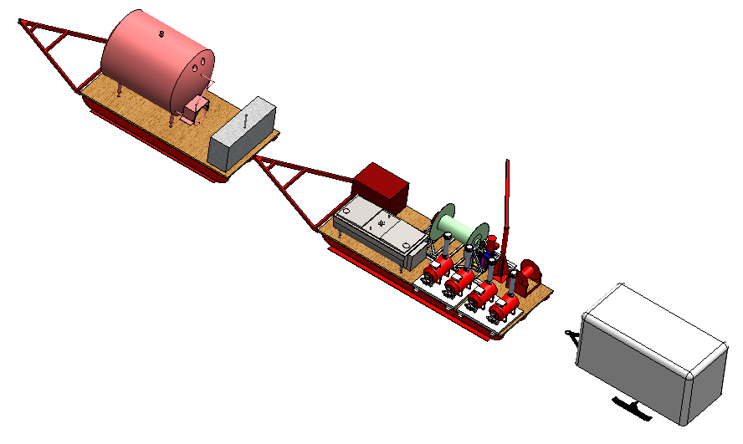
ARA Hot Water Drill
History
NOTE
1. Budget includes Capital Equipment and Off-Ice Labor
On-Ice
Activities
ARA Testbed
ARA 1
ARA 2 & 3
ASC Utilities
 | 2010 | 2011 | 2012 | 2013 | 2014 | 2015
Off-Ice Activities | Initial build | Modest Upgrade | Major Upgrade | Modest Upgrade (ASC) | - | -
Off-Ice Budget¹ | ? | ? | $500k | $240k | $220k | $200k
Proposed/Completed Off-Ice Tasks | Scavenge Hunt | 1.5x Capacity Hole Pumpout Melter | New Approach Drillheads Hose Bundle Hose Reel Controls Generators | Hose Re: Drillhead E-Pump Firn Drilling Controls Re: Sheave Repairs Spares | Hose Re: Drillhead E-Pump Firn Drilling Repairs Spares | Hose Re: Drillhead E-Pump Firn Drilling
Initial build season
IceCube Enhanced Hot Water Trencher -> ARAHWD
5 holes @ ARA Test Bed (40m dry)
1 test hole (180m wet)
Drill under-powered
ARA37 drill vision develops

Slide 5
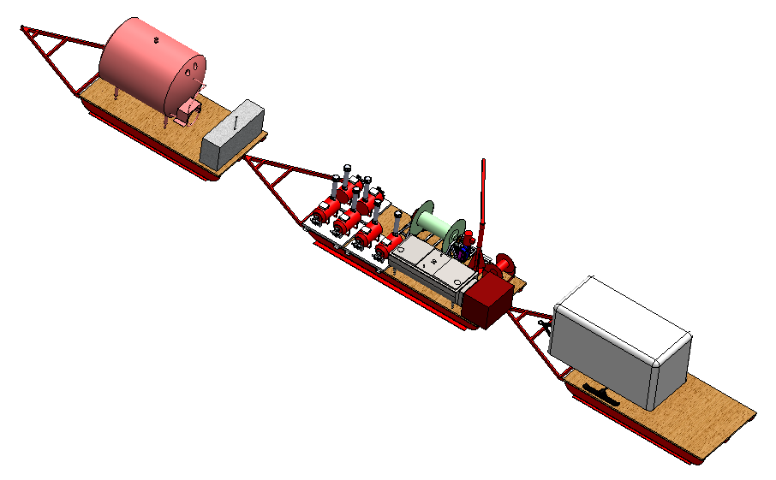
ARA Hot Water Drill
History
NOTE
1. Budget includes Capital Equipment and Off-Ice Labor
On-Ice
Activities
ARA Testbed
ARA 1
ARA 2 & 3
ASC Utilities
 | 2010 | 2011 | 2012 | 2013 | 2014 | 2015
Off-Ice Activities | Initial build | Modest Upgrade | Major Upgrade | Modest Upgrade (ASC) | - | -
Off-Ice Budget¹ | ? | ? | $500k | $240k | $220k | $200k
Proposed/Completed Off-Ice Tasks | Scavenge Hunt | 1.5x Capacity Hole Pumpout Melter | New Approach Drillheads Hose Bundle Hose Reel Controls Generators | Hose Re: Drillhead E-Pump Firn Drilling Controls Re: Sheave Repairs Spares | Hose Re: Drillhead E-Pump Firn Drilling Repairs Spares | Hose Re: Drillhead E-Pump Firn Drilling
First attempt to 200m and dry holes
2 test holes @ ICL
6 instrument holes @ ARA1
Tough drilling season, equipment failures/loss, long shifts
Clear that ARA37 drill vision needed to be realized

Slide 6
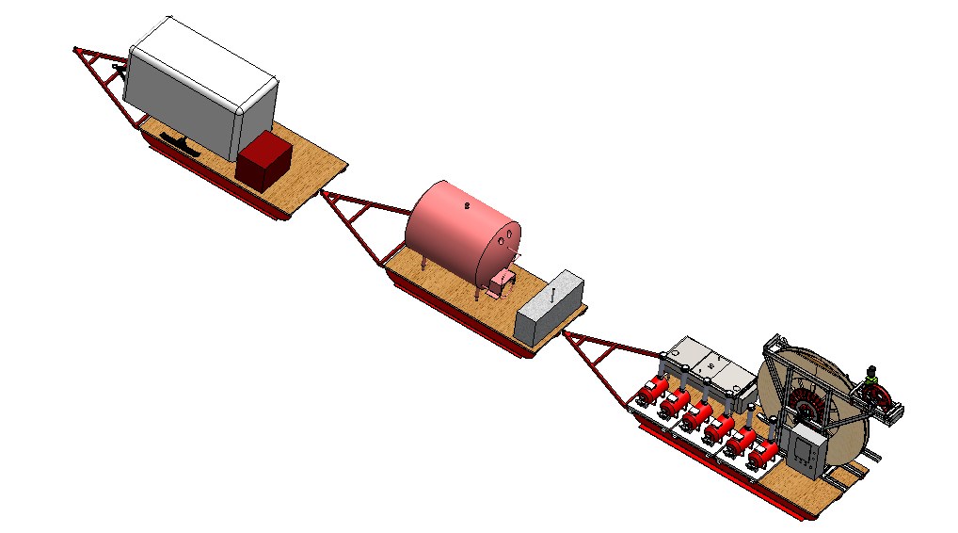
ARA Hot Water Drill
History
NOTE
1. Budget includes Capital Equipment and Off-Ice Labor
On-Ice
Activities
ARA Testbed
ARA 1
ARA 2 & 3
ASC Utilities
 | 2010 | 2011 | 2012 | 2013 | 2014 | 2015
Off-Ice Activities | Initial build | Modest Upgrade | Major Upgrade | Modest Upgrade (ASC) | - | -
Off-Ice Budget¹ | ? | ? | $500k | $240k | $220k | $200k
Proposed/Completed Off-Ice Tasks | Scavenge Hunt | 1.5x Capacity Hole Pumpout Melter | New Approach Drillheads Hose Bundle Hose Reel Controls Generators | Hose Re: Drillhead E-Pump Firn Drilling Controls Re: Sheave Repairs Spares | Hose Re: Drillhead E-Pump Firn Drilling Repairs Spares | Hose Re: Drillhead E-Pump Firn Drilling
SUCCESS!
13 holes to spec, 1 test @ ICL, 6 @ ARA2, 6 @ ARA3

Slide 7
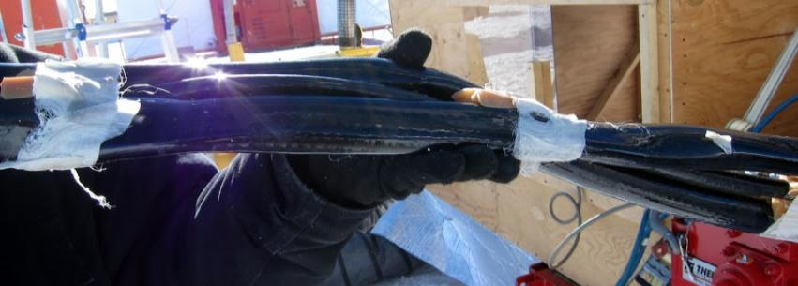
ARA Hot Water Drill
History
NOTE
1. Budget includes Capital Equipment and Off-Ice Labor
On-Ice
Activities
ARA Testbed
ARA 1
ARA 2 & 3
ASC Utilities
 | 2010 | 2011 | 2012 | 2013 | 2014 | 2015
Off-Ice Activities | Initial build | Modest Upgrade | Major Upgrade | Modest Upgrade (ASC) | - | -
Off-Ice Budget¹ | ? | ? | $500k | $240k | $220k | $200k
Proposed/Completed Off-Ice Tasks | Scavenge Hunt | 1.5x Capacity Hole Pumpout Melter | New Approach Drillheads Hose Bundle Hose Reel Controls Generators | Hose Re: Drillhead E-Pump Firn Drilling Controls Re: Sheave Repairs Spares | Hose Re: Drillhead E-Pump Firn Drilling Repairs Spares | Hose Re: Drillhead E-Pump Firn Drilling
SUCCESS!
13 holes to spec, 1 test @ ICL, 6 @ ARA2, 6 @ ARA3
But still lots of lessons, most critically hose performance

Slide 8
ARA Hot Water Drill
History
NOTE
1. Budget includes Capital Equipment and Off-Ice Labor
On-Ice
Activities
ARA Testbed
ARA 1
ARA 2 & 3
ASC Utilities
 | 2010 | 2011 | 2012 | 2013 | 2014 | 2015
Off-Ice Activities | Initial build | Modest Upgrade | Major Upgrade | Modest Upgrade (ASC) | - | -
Off-Ice Budget¹ | ? | ? | $500k | $240k | $220k | $200k
Proposed/Completed Off-Ice Tasks | Scavenge Hunt | 1.5x Capacity Hole Pumpout Melter | New Approach Drillheads Hose Bundle Hose Reel Controls Generators | Hose Re: Drillhead E-Pump Firn Drilling Controls Re: Sheave Repairs Spares | Hose Re: Drillhead E-Pump Firn Drilling Repairs Spares | Hose Re: Drillhead E-Pump Firn Drilling
ARA goes dark
ASC contracts with PSL for Station utility support using the ARAHWD
ASC pays for some upgrades
Mission success
Demonstrate closed-loop glycol carrot drilling
More lessons and issues identified
Now have a downhole camera system
New driller recruits

Slide 9
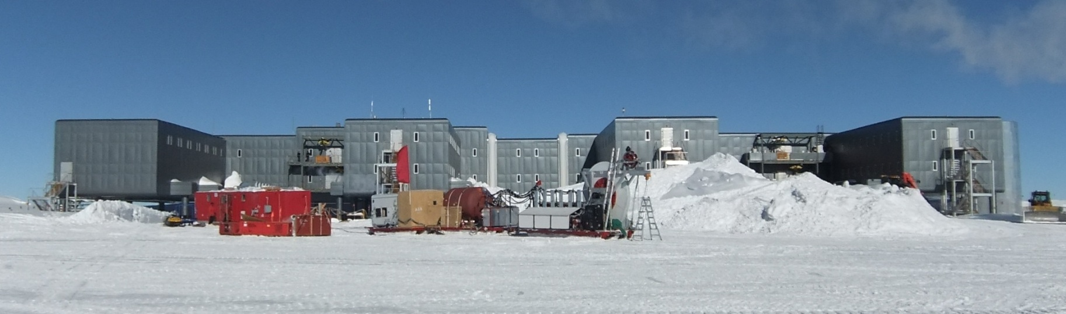
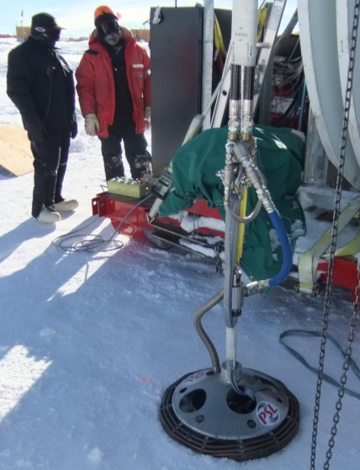
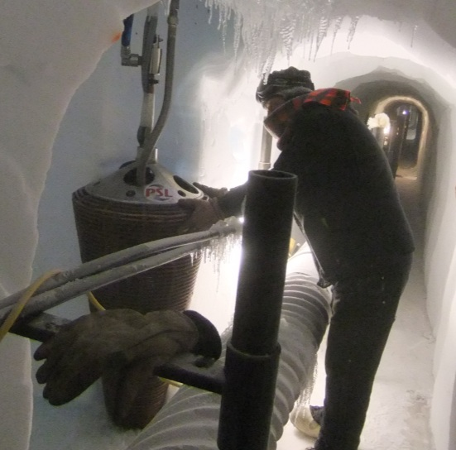
ARA Hot Water Drill
History
NOTE
1. Budget includes Capital Equipment and Off-Ice Labor
On-Ice
Activities
ARA Testbed
ARA 1
ARA 2 & 3
ASC Utilities
 | 2010 | 2011 | 2012 | 2013 | 2014 | 2015
Off-Ice Activities | Initial build | Modest Upgrade | Major Upgrade | Modest Upgrade (ASC) | - | -
Off-Ice Budget¹ | ? | ? | $500k | $240k | $220k | $200k
Proposed/Completed Off-Ice Tasks | Scavenge Hunt | 1.5x Capacity Hole Pumpout Melter | New Approach Drillheads Hose Bundle Hose Reel Controls Generators | Hose Re: Drillhead E-Pump Firn Drilling Controls Re: Sheave Repairs Spares | Hose Re: Drillhead E-Pump Firn Drilling Repairs Spares | Hose Re: Drillhead E-Pump Firn Drilling
ARA goes dark
ASC contracts with PSL for Station utility support using the ARAHWD
ASC pays for some upgrades
Mission success
Demonstrate closed-loop glycol carrot drilling
More lessons and issues identified
Now have a downhole camera system
New driller recruits

Slide 10
ARA Hot Water Drill
History
NOTE
1. Budget includes Capital Equipment and Off-Ice Labor
On-Ice
Activities
ARA Testbed
ARA 1
ARA 2 & 3
ASC Utilities
 | 2010 | 2011 | 2012 | 2013 | 2014 | 2015
Off-Ice Activities | Initial build | Modest Upgrade | Major Upgrade | Modest Upgrade (ASC) | - | -
Off-Ice Budget¹ | ? | ? | $500k | $240k | $220k | $200k
Proposed/Completed Off-Ice Tasks | Scavenge Hunt | 1.5x Capacity Hole Pumpout Melter | New Approach Drillheads Hose Bundle Hose Reel Controls Generators | Hose Re: Drillhead E-Pump Firn Drilling Controls Re: Sheave Repairs Spares | Hose Re: Drillhead E-Pump Firn Drilling Repairs Spares | Hose Re: Drillhead E-Pump Firn Drilling

Slide 11
ARA Hot Water Drill
History
NOTE
1. Budget includes Capital Equipment and Off-Ice Labor
On-Ice
Activities
ARA Testbed
ARA 1
ARA 2 & 3
ASC Utilities
 | 2010 | 2011 | 2012 | 2013 | 2014 | 2015
Off-Ice Activities | Initial build | Modest Upgrade | Major Upgrade | Modest Upgrade (ASC) | - | -
Off-Ice Budget¹ | ? | ? | $500k | $240k | $220k | $200k
Proposed/Completed Off-Ice Tasks | Scavenge Hunt | 1.5x Capacity Hole Pumpout Melter | New Approach Drillheads Hose Bundle Hose Reel Controls Generators | Hose Re: Drillhead E-Pump Firn Drilling Controls Re: Sheave Repairs Spares | Hose Re: Drillhead E-Pump Firn Drilling Repairs Spares | Hose Re: Drillhead E-Pump Firn Drilling

Slide 12
Summary of Lessons and Unresolved Issues
From 12-13 (ARA2 and 3) and 13-14 (ASC Utility Work)
Hose performance, longevity
  Hose and bundle design
  Hose protection: Drillhead recirculation
  Hose protection: Reel and sheave modifications
Hole evolution (ice ridges) and firn-to-deep operational transition
Filter clogging and gas engine reliability (main pump)
Motor controls and data systems need optimization

Slide 13
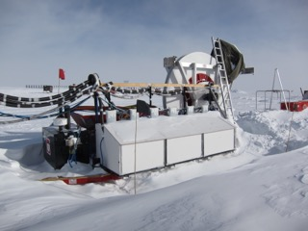
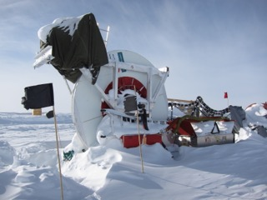
Preparing for another field season
Current status
Last operated during 13-14 season, startup and operations went well
14-15 recon shows drill is weathering well in storage
90m of hose bundle without cable
Open issues with hose reliability
Now know that better filtration is required
Now know that engine/pump reliability is a concern
All items in the North are accounted for
  Spare hose
  Primary and spare cable
  Drillheads
  Retroed DNF

Slide 14
Preparing for another field season
This list assumes a 3-station drilling campaign
Tasks Ahead (reduced version)
Procure another set of hose and reconstruct bundle
Implement drillhead recirculation (hose protection)
Rebuild pumping unit with electric motor and improved filtration (EPump)
Use what’s left to build closed-loop glycol carrot
  Technical solution to painful firn drilling to deep drilling transition
  Can be run overnight unattended, shaves time off each shift
Or, use what’s left to restock spares and maintenance items TBD
Ship equipment Southbound
Recruit an experienced drill crew
A full version plan, for reference, adds..
Further hose and bundle design (more R&D)
Minor hose reel modifications to improve hose longevity
Upgrade hose reel motor drives

Slide 15
Preparing for another field season
Rough Total Drill Budget
Off Ice Labor | 520 hr engr, 600 hr tech | $100k
On Ice Labor | 240 hr engr, 1050 hr tech | $105k
Capital Equipment |  | $75k
Hose and Cable Bundle | $25k
Drillhead Recirculation | $15k
Electric Pump and Filtration | $20k
Mini Carrot Head | $15k
TOTAL |  | $280k

Slide 16
Preparing for another field season
The Big Question:
How many ARA Stations can the proposal support per season from a drilling perspective?
 | Money $280k | Time 4 weeks on-ice
1 Station | YES | YES
2 Stations | YES This is the same as ‘12-’13… At minimum, buying hose and making a new bundle should support 2 stations | MAYBE, VERY AGGRESSIVE Based on the ‘12-’13 experience, this would take 18 elapsed days of active drilling, not leaving enough time at start and end
3 Stations | PROBABLY Only if the reduced plan can be fully realized so hose longevity is improved | NO
4+ Stations | NOT WITH CONFIDENCE More would need to be invested in optimizing hose design and improve its handling to improve longevity | NO

Slide 17
Preparing for another field season
Important Early Tasks
Recon at Pole 1 year before a field season is recommended
Hose is long-lead, and a critical requirement. Would need to establish contact with hose vendor no later than March preceding a field season
EPump module and small carrot are also long-lead in-house items, design would need to begin in March/April

Slide 18

Synergy between ARA and ASC
ASC needs to rework up to 9 vertical egress shafts out of the South Pole Station tunnel system
PSL has studied this effort under contract with ASC (2013 and 2014), one conclusion was to use closed-circuit hot carrot technology with IceCube IFD or ARAHWD to create the new holes
Preliminary timeline would be 1 to 2 shafts per season, starting ??
This is a perfect opportunity for synergy between ASC egress shaft project and ARA drilling
  Some cost sharing for remaining upgrades?
  Shared resources
  Efficient use of people on-ice and system commissioning/decommissioning cycle
  One model: Drill 3 stations over 4-5 weeks, drill crew stays another 1-2 weeks to create shafts and shut down drill
ASC prefers the IFD over ARAHWD because of the reduced crew footprint
Discussions are needed between ARA and ASC

Slide 19
Questions?

