Slide 1
DDA Based on DRS4 chip
Mony Orbach
High Speed Digital System Laboratory

Slide 2
Goal
DDA based on off-the-shelf DRS4 chip
DRS4 is PSI sampling chip. Relatively low cost.
High reliability, low-cost sampler, with low power consumption

Slide 3
Specifications
Input: 4 analog signals, $2Vpp$ Bandwidth: $150\sim 850 MHz$
Output: 4 channel, 14-bit sample resolution
2K sample per channel
Programmable sampling speed, supports 1.7 GSPS to 5 GSPS sample rate
Recovery time 3msec
power consumption <1W
Fully operational in $−40℃$
Notes:
At 3.1Gsps 6nsec sampling time

Slide 4
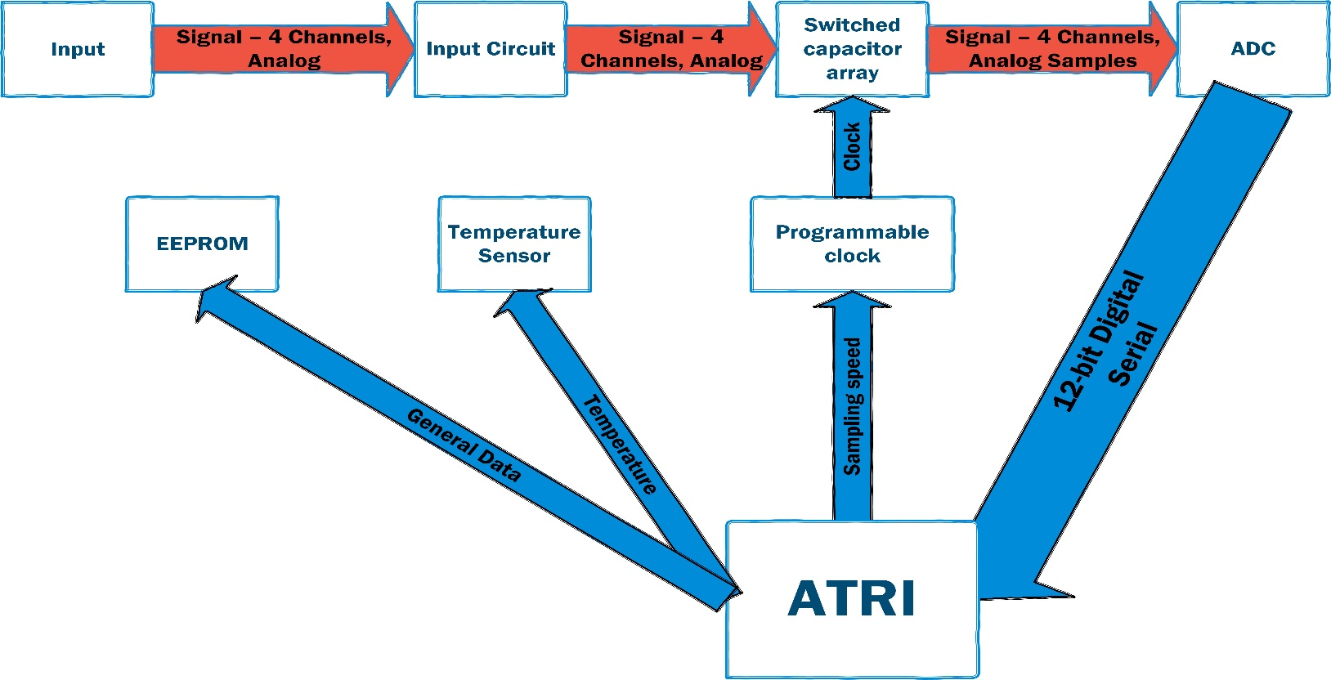
DDA Block Diagram
14 bit sampler

Slide 5
4 Layers PCB
Top – signals
Ground
VCC (3.3 digital, 2.5 analog, 2.5 digital)
Bottom – signals

Slide 6
Signal layers (Top and Bottom)
Top, Analog, Mixed, Digital

Slide 7
Inner layer – Power (VCC , GND)

Slide 8
Board test environment
miniATRI will be used as a test environment
Dedicated Tests will be written for the new DDA
If successful, can be adopted to ARA system.
Notes:
Prices:
MIC3775 - 2$ * 2
AD9222 ~ 77$
DRS4 - 100$
LTC6904 - 9$
TMP - 5$
EEPROM- 1$
Board ~~ 20$

Slide 9
Statues and Time table
Bought all electrical parts for new DDA
PCB board in production. ETA 3 weeks
Time table
16/8/2015 – PCB arrival
1/9/2015 – PCB bring up
10/9/2015 initial test with miniATRI
Notes:
Prices:
MIC3775 - 2$ * 2
AD9222 ~ 77$
DRS4 - 100$
LTC6904 - 9$
TMP - 5$
EEPROM- 1$
Board ~~ 20$

Slide 10
Any Questions?

