Slide 1
NTU ARA Hardware Status
Pisin Chen
LeCosPA, NTU, Taiwan
ARA Collaboration Meeting
July 2015

Slide 2
Hardware Production Outline
2012: ARA 2-3 Production (Deployed)
2013-2014: ARA 4-5 Production (Done)
2015: ARA 6-7 Production (In progress)
2016: ARA 8 (Planed)

Slide 3
ARA 4-5 Production & Shipping
Antennas
8 top V-pol + 10 bottom V-pol + 16 H-pol
→ Delivered to OSU, Nov 2014
LNA boxes
32 assemblies
→ delivered to OSU, Nov 2014
DAQ box enclosures
→Ready for shipping
Cables
RF cables + 200m power cables
→Ready for shipping

Slide 4
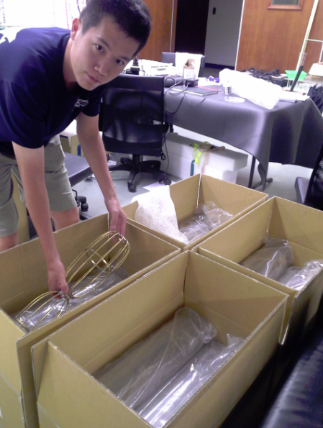
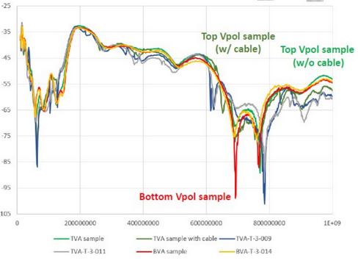
ARA 6-7 Production Status -V-pol Antenna
All birdcages production completed! (July 2015)
Housings, cables, ropes are ready for assembly
→ will be completed during summer
V-pol Bird Cage Test (S21 Measurement)
ARA 6/7
ARA 4/5

Slide 5
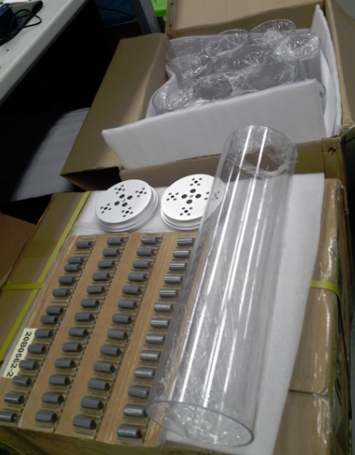
ARA 6-7 Production Status -H-pol Antenna
All materials (Ferrite bids, pc tubes, endcaps, etc.)are ready for
assembly
will be completed
during summer

Slide 6
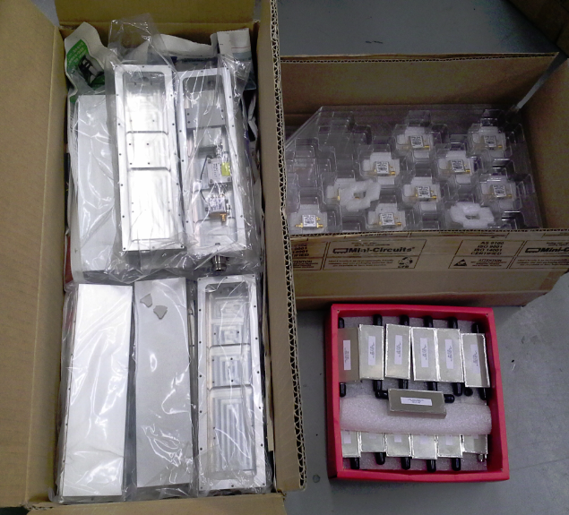
ARA 6-7 Production Status -LNA Box
All materials (LNA/Lark Filer/Bias-T/Enclosure) are ready for assembly
will be completed
during summer

Slide 7
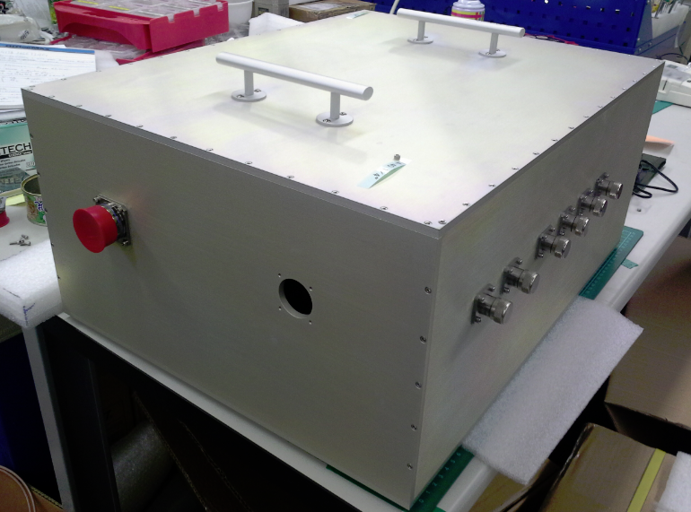
ARA 6-7 Production Status -DAQ Box Enclosure
Enclosures production completed
All connectors are attached (except the fiber connector)
Ready for shipping
But, internal structures
not produced yet
(Design TBC with Patrick)
Handles (for uncovering)
Vent hole(for uncovering)
For fiber connector

Slide 8
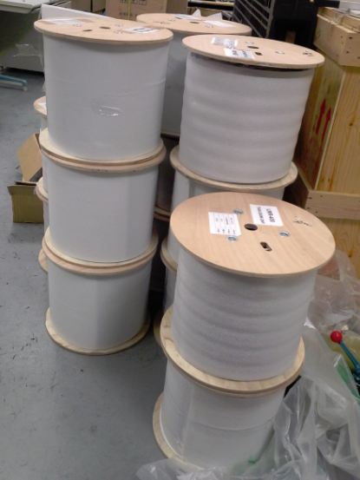
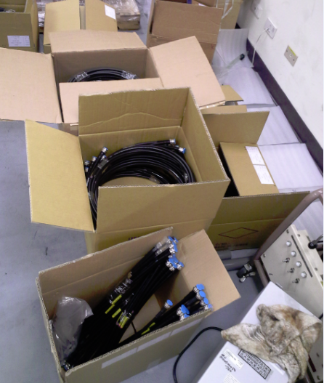
ARA 6-7 Production Status -Cables
All cables (RF cables + 200m power cables) are ready for shipping

Slide 9
ARA 6-7 Production Summary
ARA 6-7
Antennas/LNAs/Cables/DAQ Enclosures
will be ready by the end of this summer!
You don’t believe?
→ See next page

Slide 10
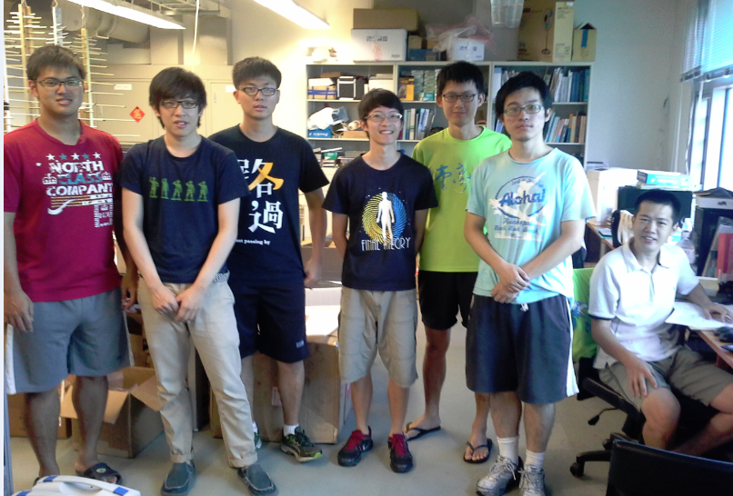
ARA 6-7 Production Manpower
7 regular members + 7 summer interns
A subset of members

Slide 11
Issues for shipping
We prefer to ship the hardware to the USA rather than Antarctica (cheaper and easier).
Shipping to OSU (Nov 2014) took such a long time for paperwork.
→ is there any way to improve?

Slide 12
Breaking News
Taiwan’s MOST has announced the renewal of our Vanguard Program funding for another 4 years (2015-2019)!

