Slide 1
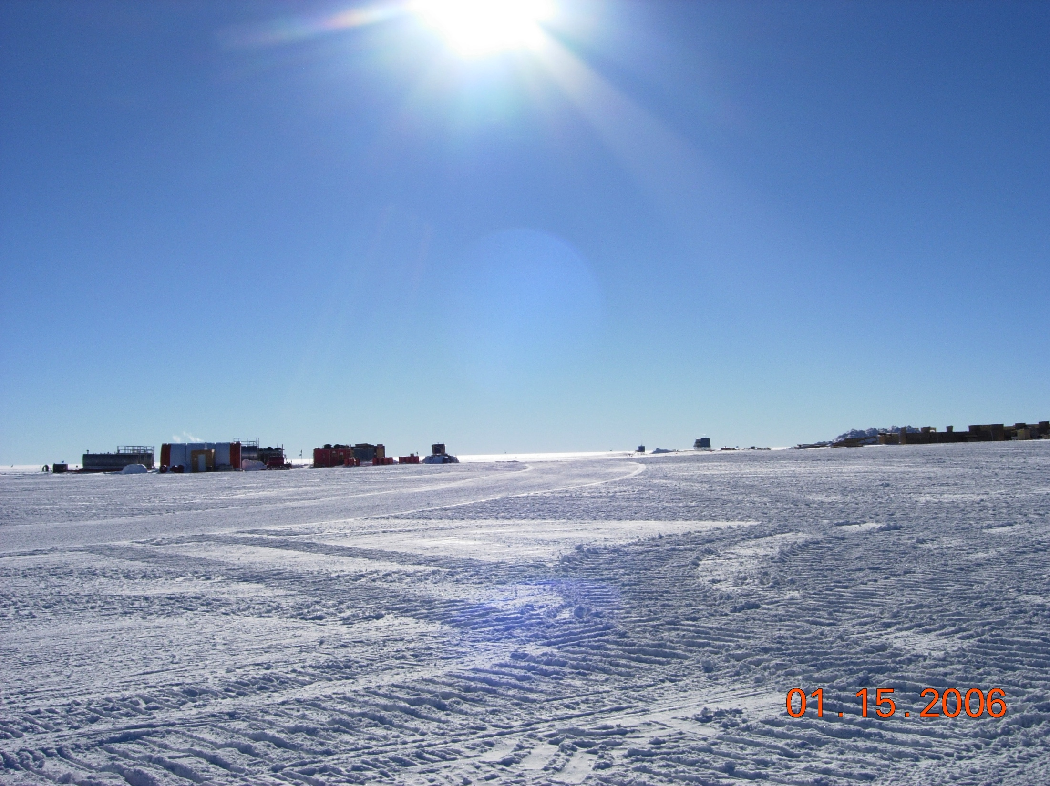

Calibration Overview & Update & Plans
Kara Hoffman
University of Maryland

Slide 2
Deployed ARA Station
Planned ARA Station
South Pole
Test Bed
IceCube
3
1
South Pole Station
2
Skiway
2 km

Slide 3
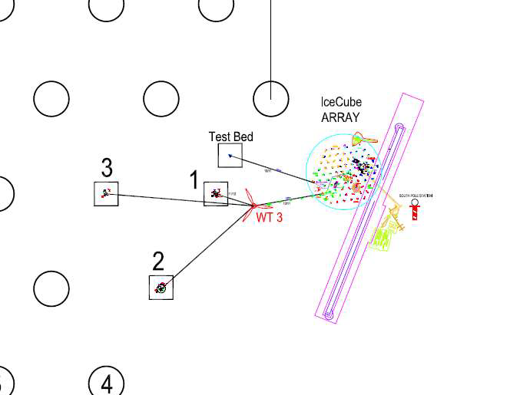

Slide 4
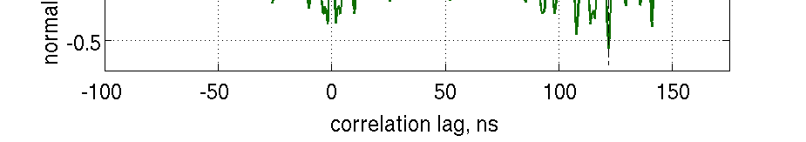
Additional deep pulsers on IceCube strings
last access to deep IceCube holes in 2010-2011
3 high voltage calibration transmitters installed on IceCube strings- 2 at 1450 m and 1 at 2450 meters
Nominal 5 kV pulsers
For calibration and radioglaciological studies
Reflected ray from mirroring!

Slide 5
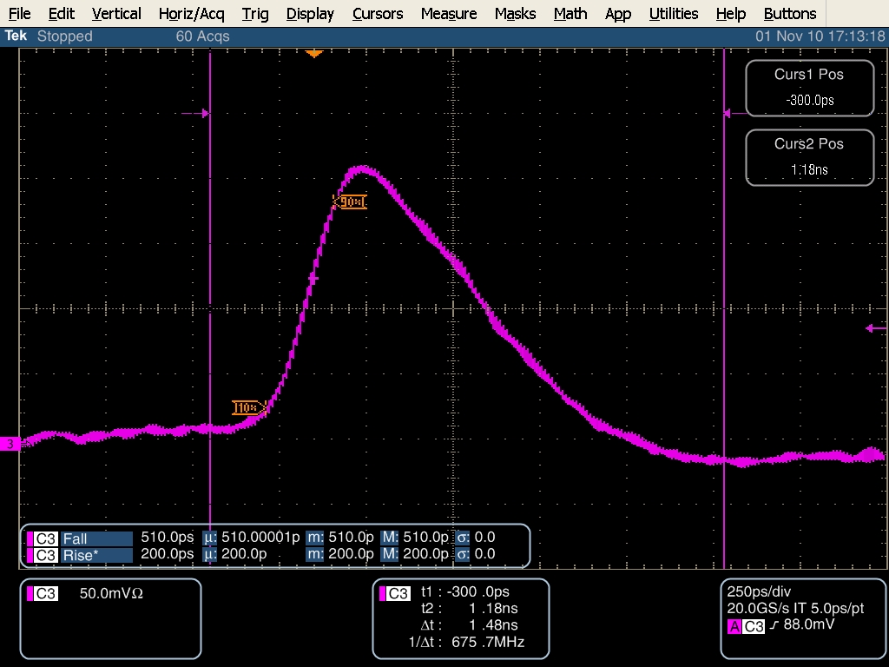
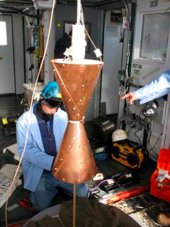
Deep pulser installation
3 deployed on last IceCube strings in Dec 2011
2 at 1450m
1 at 2450m

Slide 6
Deep Pulser Data & Status
All three pulsers were run successfully the season they were installed.
The pulser at 2450m, was seem at the testbed 3.2 km away at a 40 degree angle. This yielded the longest point to point measurement of ice attenuation to date, but the 2450 m pulser appeared to fail shortly after.
Mike DuVernois took new pulser runs with all pulsers in the last Pole season. The 1450m pulsers were seen in the ARA stations.
Despite “going rogue” and running for a long time unintentionally, the 2450m pulser has not been seen in ARA data. This is despite the fact that the data on the IceCube host string was unusable due to the interference. This is a bit of a mystery.
We are looking for an opportunity piggyback on deep drilling operations (Espresso? IceCube Gen2?) to install an additional deep pulser.

Slide 7
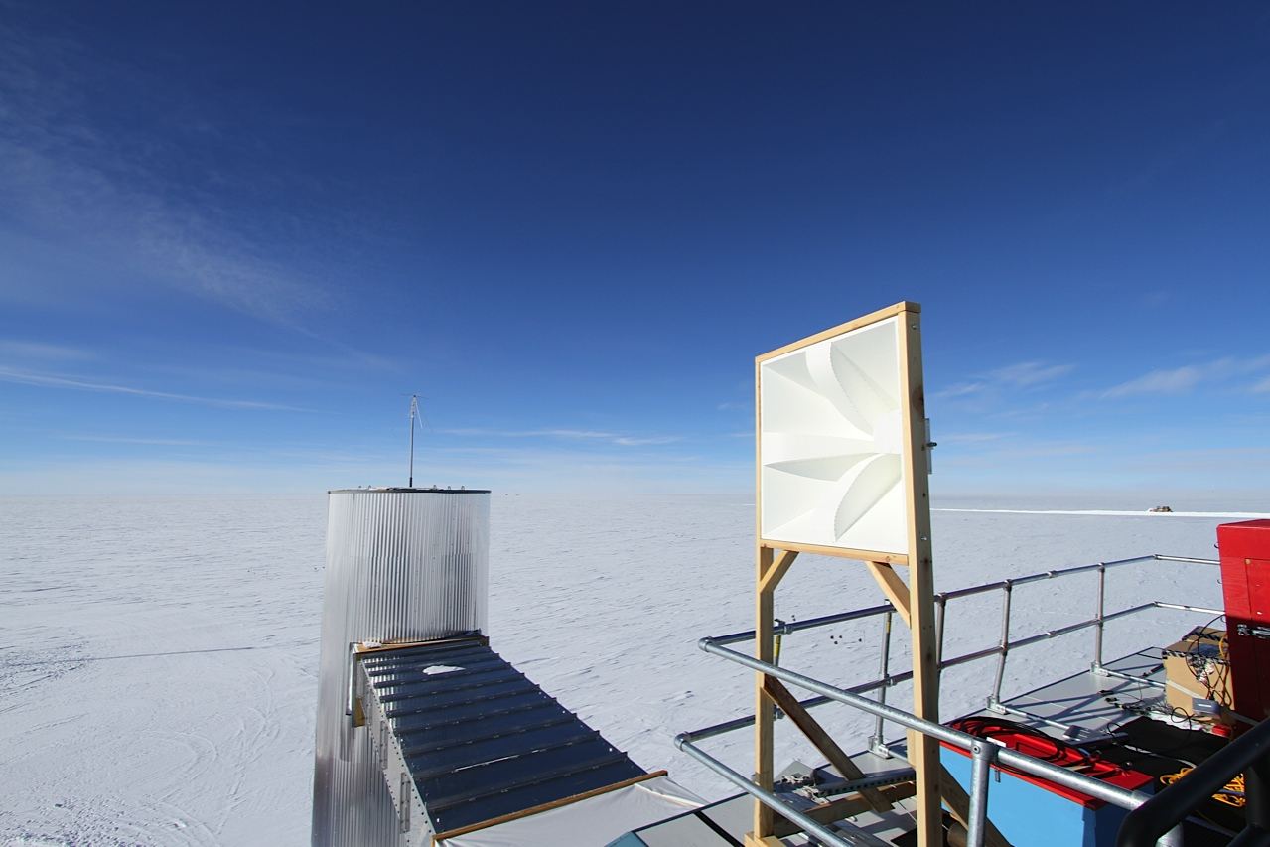
Rooftop pulser
High voltage pulser
Quadridge antenna

Slide 8
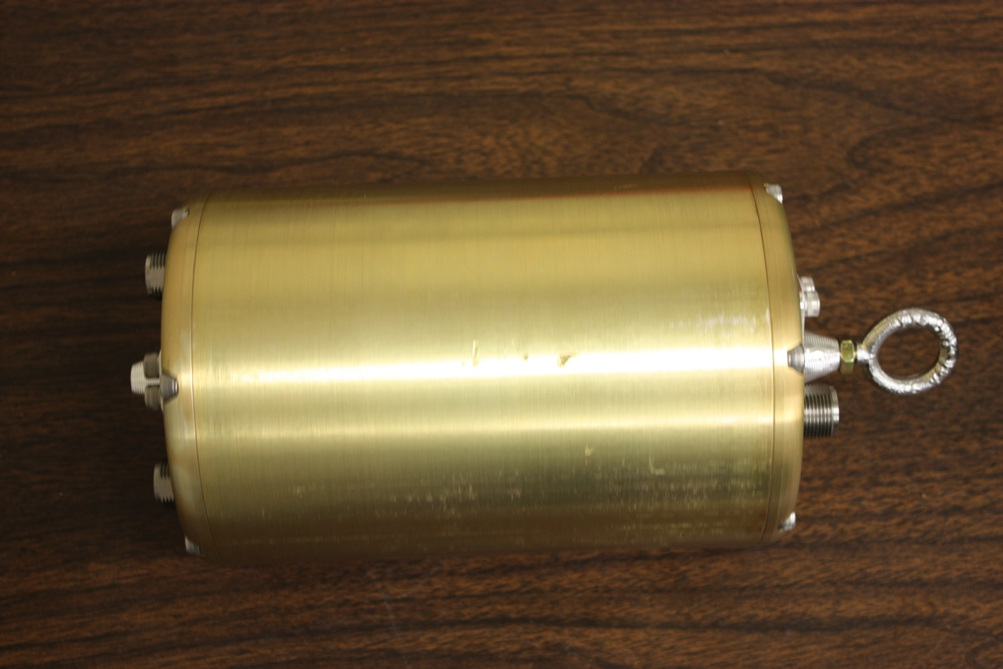
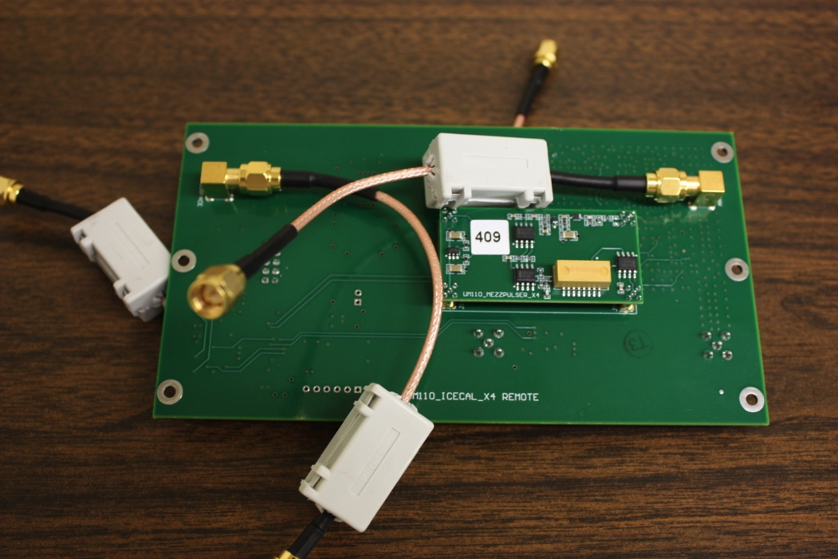
ARA local pulsers
Includes high frequency pulse generator and noise diode
Can pulse automatically at 1 Hz, or can accept triggers from the station clock
Remotely set attenuator can provide 31 dB of attenuation in 1 dB steps
Can select either horizontal or vertical antenna
System (including topside control board) draws ~2W of power
Power and CANBUS communication go over a single cable
TTL boosted clock is transmitted to the downhole pulser on a second clock

Slide 9
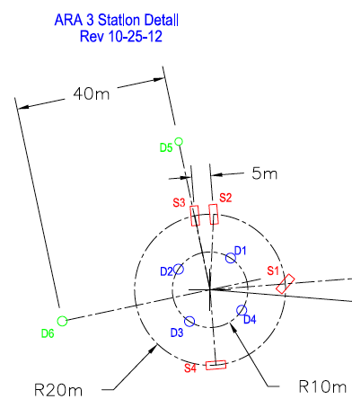
Drilling is expensive and time consuming!
Would like to find a way to limit the number of holes drilled.
Calibration pulsers
Receiver strings

Slide 10
Can we integrate the antennas into the string?
Configuration 1
Steepest angle of sight: 35 degrees
Shallowest angle of sight: 26 degrees
Steepest angle of sight: 55 degrees
Shallowest angle of sight: a few degrees
Configuration 2
Could be a technical challenge to cram more stuff down the hole.
Ryan Maunu (UMD) played with simulations on this
receivers
transmitters
14.14m
14.14m

Slide 11
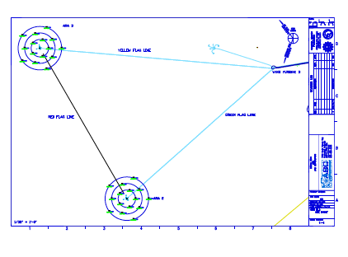
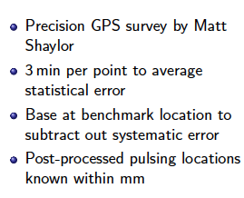
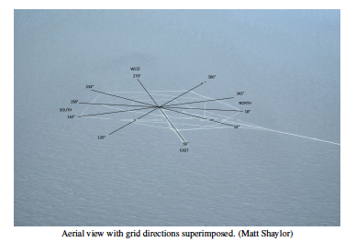
Surface pulser
In 2013-2014 ARA 2 and 3 were surveyed:
Mike DuVernois had plans to resurvey in 2014-2015 season with improved triggering.

Slide 12
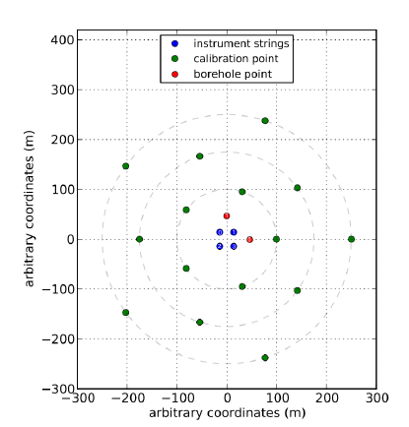
Local station calibration points

Slide 13
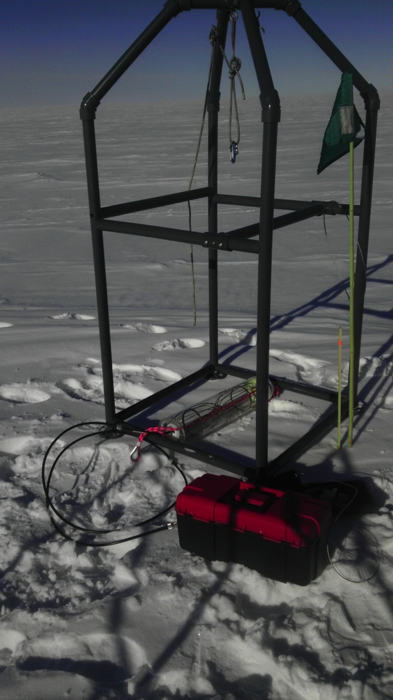
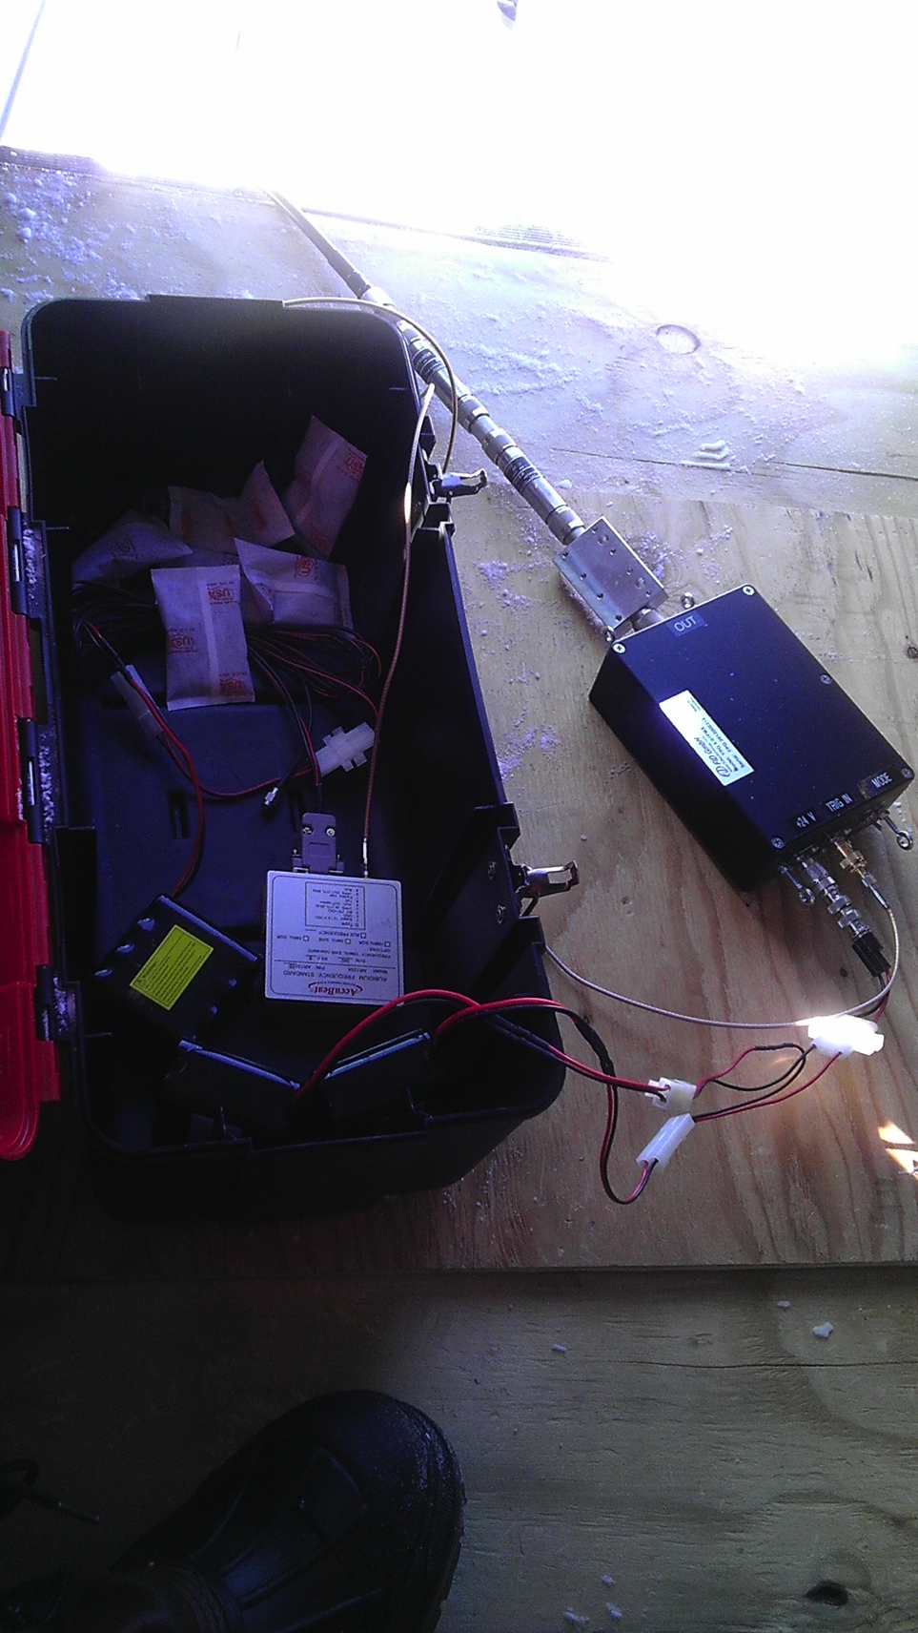
Retrievable
pulser setup

Slide 14
Retrievable Pulser
Purpose was to lower a pulser on a wench, measurements from various depths.
Could be done using a calibration hole pre-deployment or, ideally, a dedicated hole a distance from the station.
CW, high voltage, and low voltage pulsers available, along with attenuators.
Fell off the schedule in the past, but should be considered for next deployment season.

Slide 15
To Do List
Include recording of which antennas/pulser canisters were installed in which holes
Make an inventory of existing calibration data (including 2014-2015 data taken by Mike D.)
Use feedback from data analysis to improve characterization of remaining calibration apparatus
Try to squeeze in a retrievable pulser (or dedicated extra drilled hole)
Look for opportunities to installed additional deep pulsers
Continue efforts to look at data we have

