Slide 1
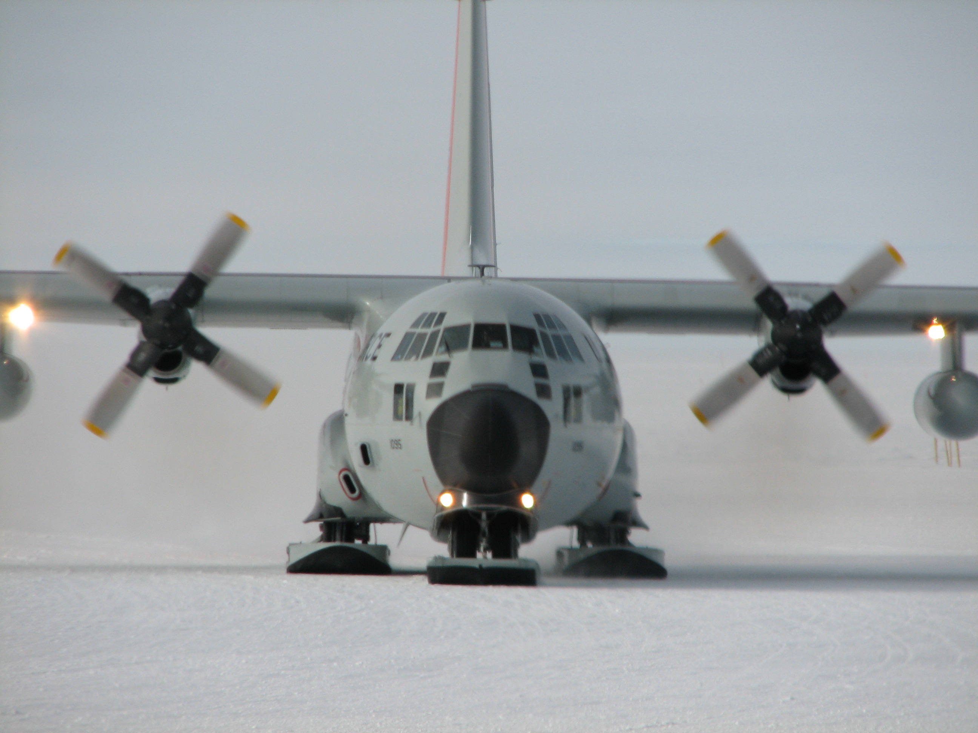
Welcome to WIPAC
IceCube Madison BootCamp 2015
Kael Hanson

Slide 2
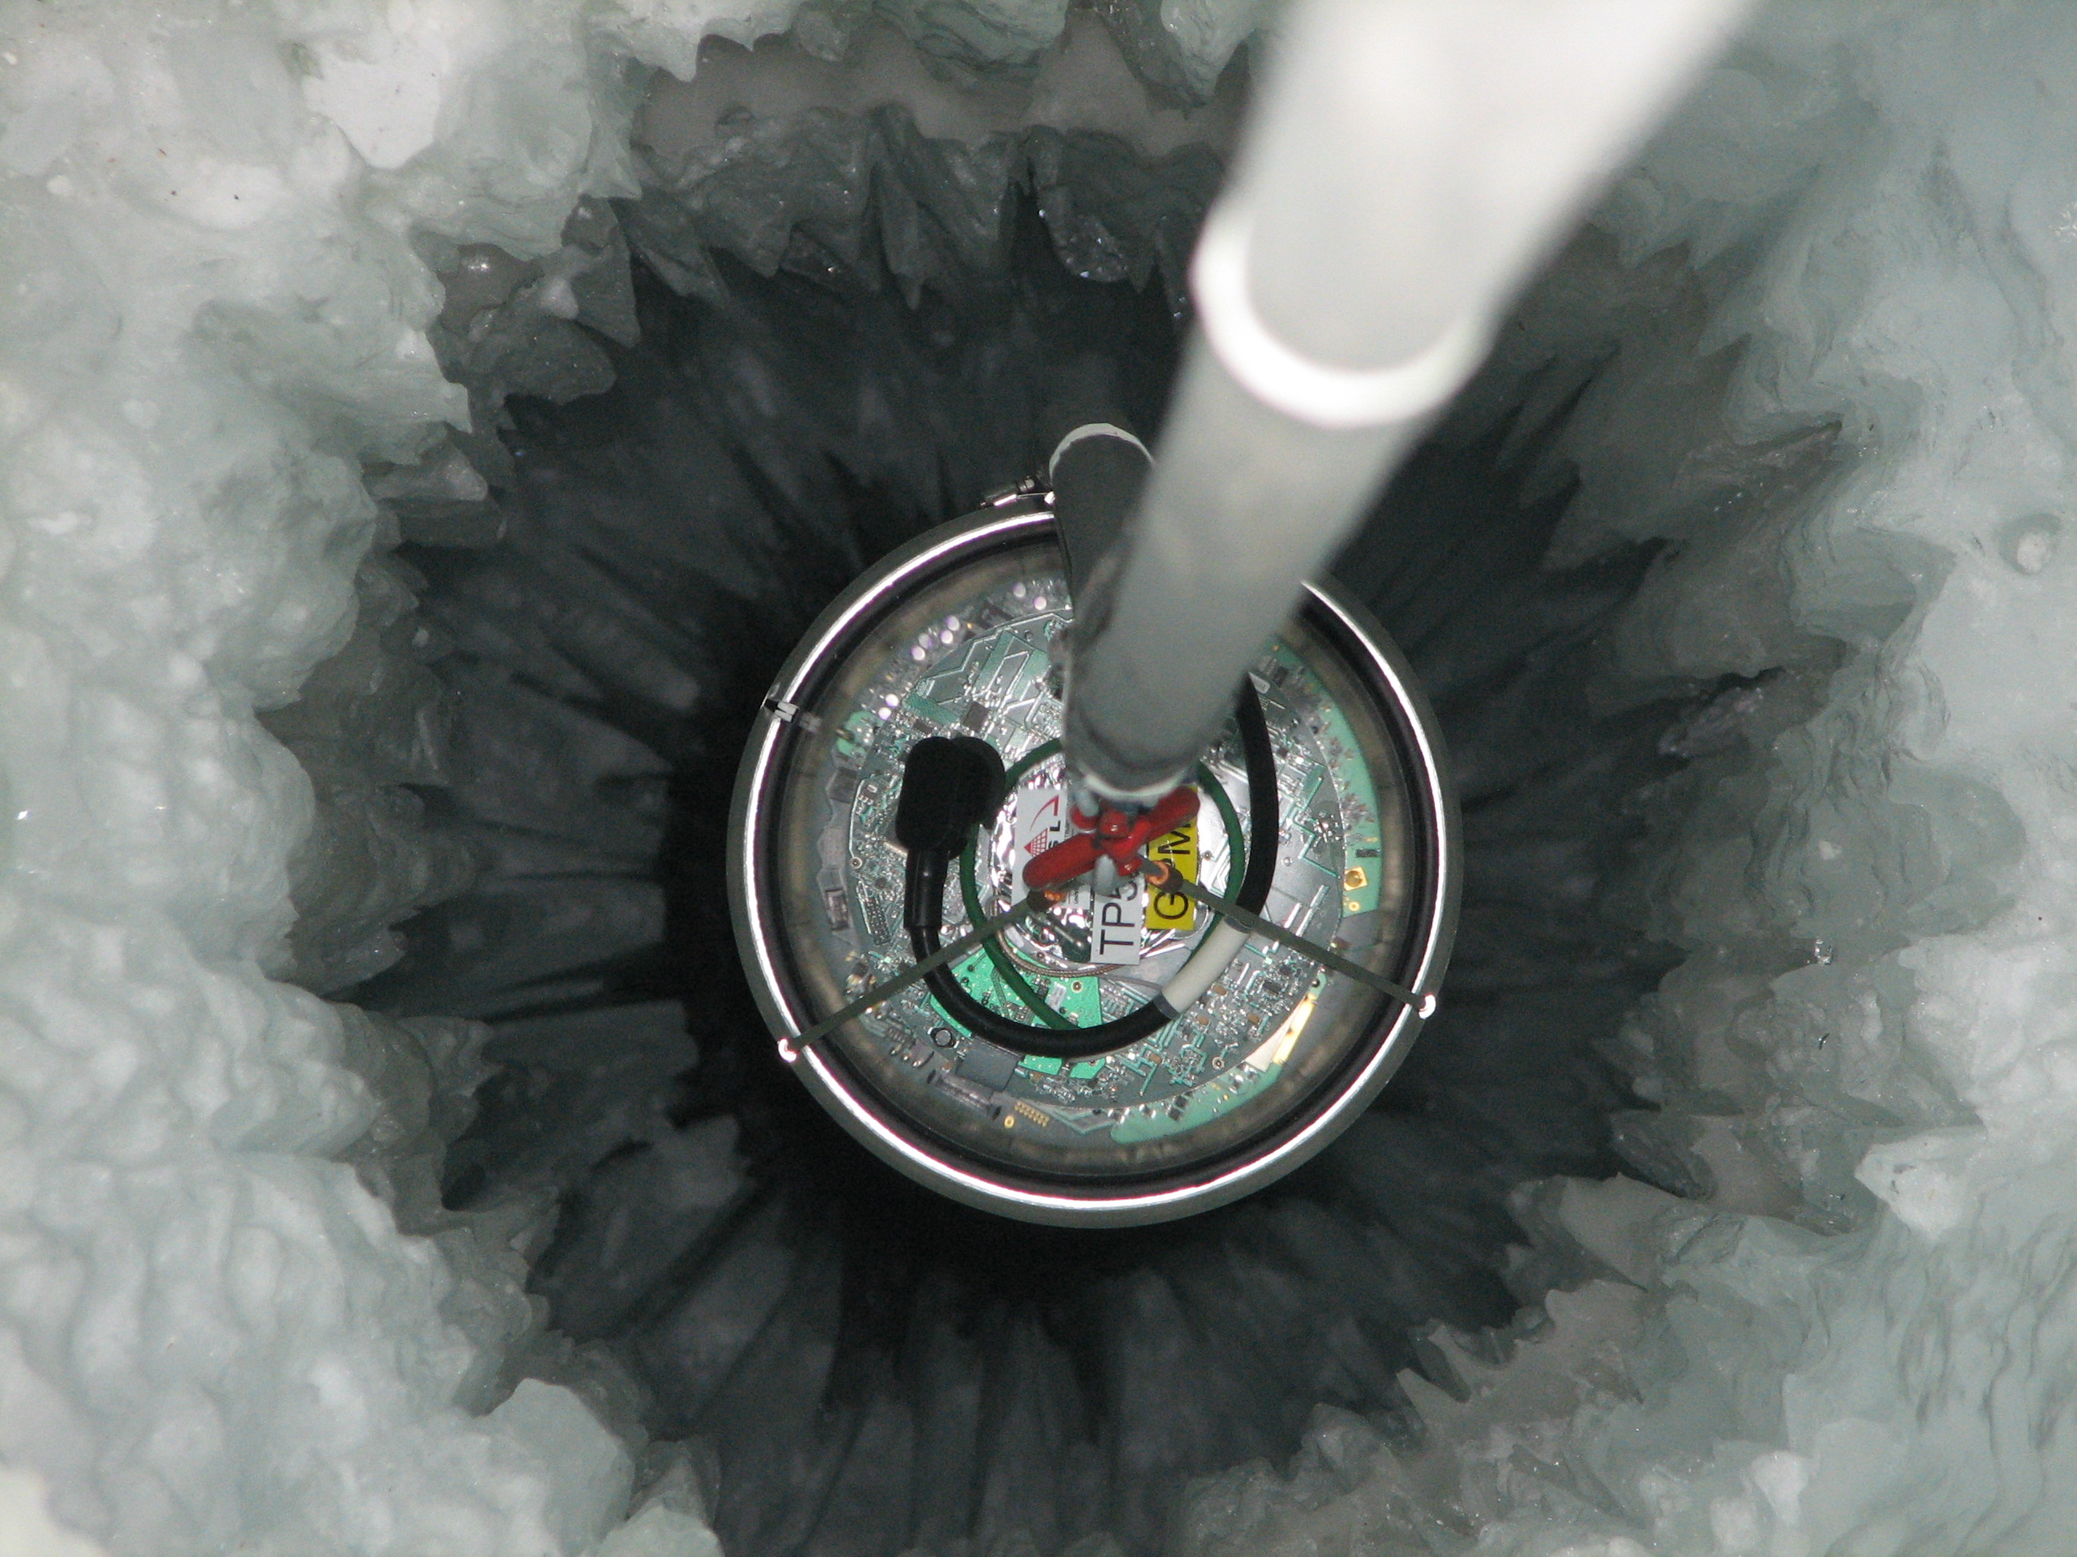
WIPAC – the Mission
Educate and train future leaders in particle astrophysics through a vibrant science program.
Operate the IceCube Neutrino Observatory in partnership with the international collaboration and extract scientific results from the data collected.
Advance scientific opportunities by supporting the design, construction, and operation of a wide platform of experiments.
Provide expertise and resources for the development of innovative instrumentation.
Engage the public and students of all ages in scientific progress through education and outreach programs and activities.
Category | Count
Technical and Administrative Staff | 46
Faculty | 5
Grad Students | 22
PostDocs | 9
Undergrads | 22
Total | 104

Slide 3
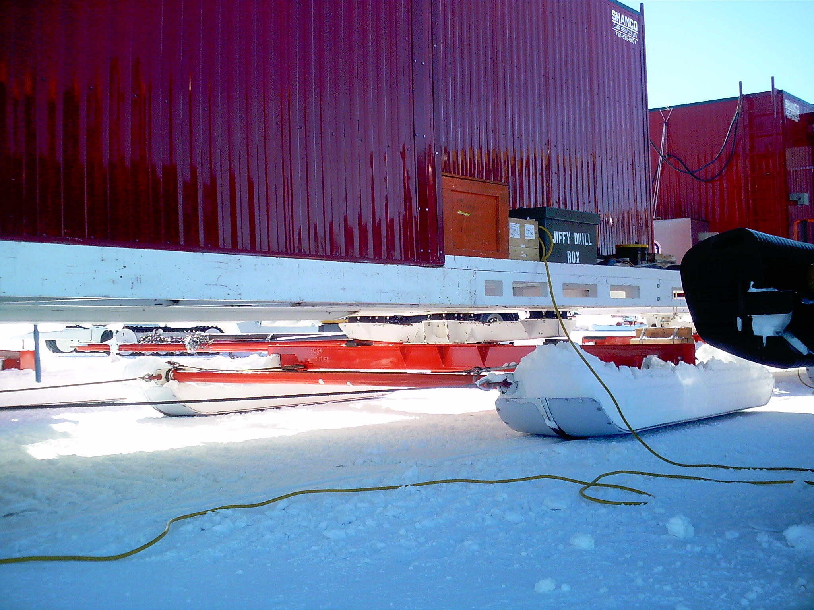
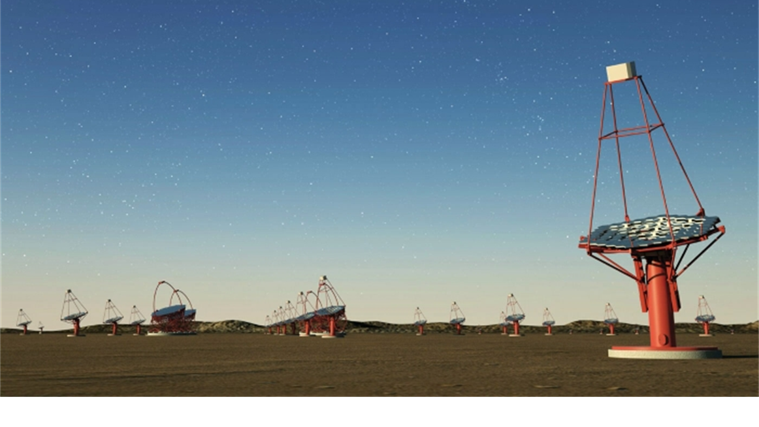
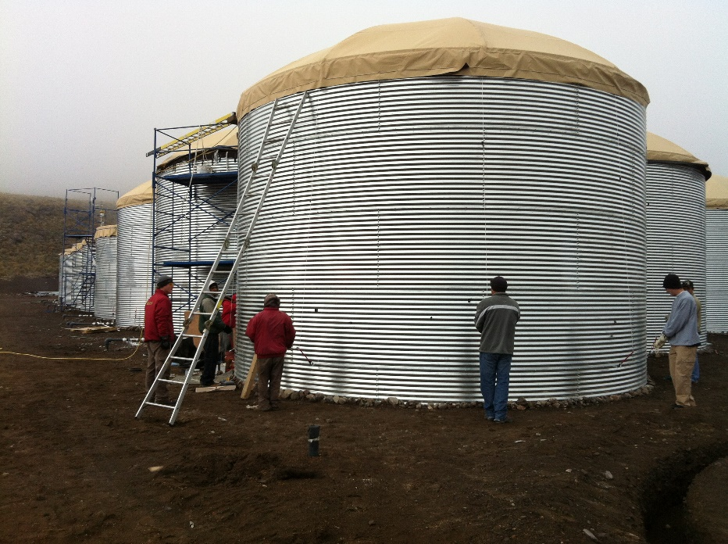
Services Provided
IceCube Maintenance & Operations
IT services for the Collaboration: operation of 2 computing clusters with total of 2000 CPU cores, >250 GPU cores, and > 5 PB of online storage.
Daily operations of the IceCube detector including training and supervision of Winter-overs.
Centralization of mass data filtering and simulation production.
Management of the NSF CA including administration of sub-awards and annual reviews.
IceCube (and general) public relations and broader impacts.
Advancing the scientific field: support science and engineering for ARA, HAWC, CTA, DM-Ice, Future IceCube (Gen2), CHIPS, and other initiatives.
Training next-generation of scientists: Bahcall Fellowship program offers post-doctoral researchers opportunity to work on IceCube and autonomy pursue their own research interests.
Our visitor program attracts world-class researchers to work with the WIPAC team for extended periods – in 2014-2015:
Jenny Thomas (CHIPS, MINOS+) from University College London, UK
Bannanje Acharya (INO) from Tata, India
Markus Ackermann (IceCube) from DESY-Zeuthen

Slide 4
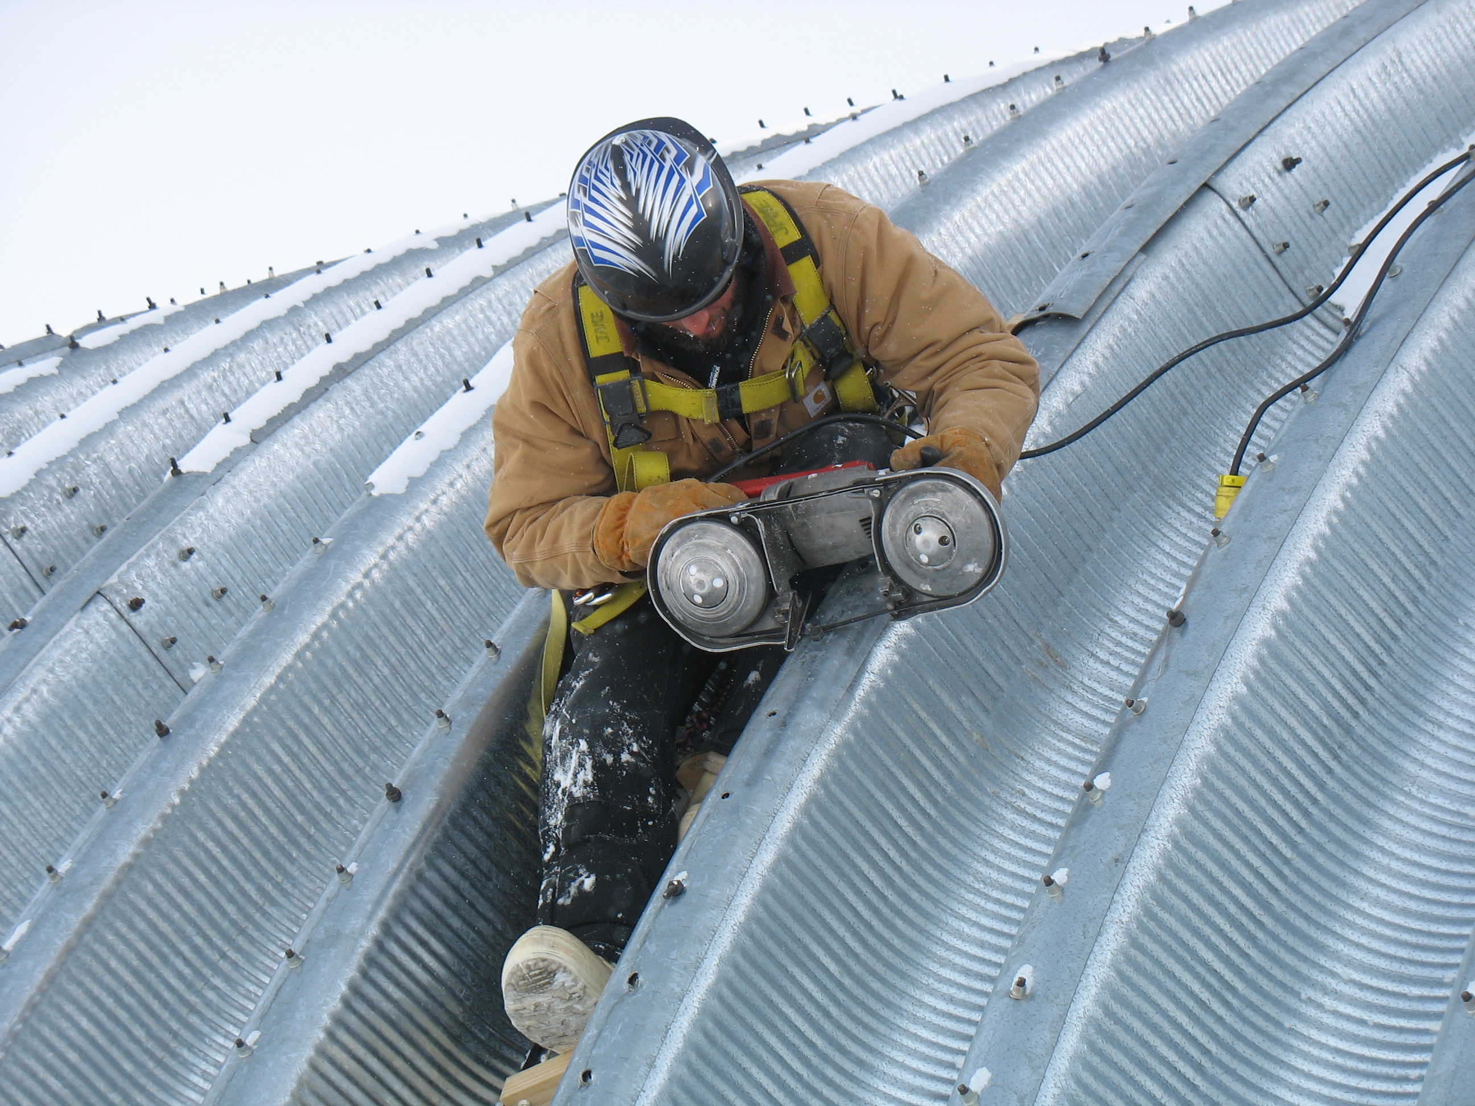
IceCube Help Wanted
Why do we run these boot camps? Because we need YOU!
IceCube relies on the scientific and technical input (ideas, data analysis, code, and more) of the entire collaboration to achieve its goals.
How can you help?
Finish your thesis – do a great analysis, defend it, and publish.
Give back to your IceCube peers – we all need to contribute effort to make IceCube a better system. Maybe this is directly related to your research and maybe it is not.
Write great software and/or work on infrastructure : get plugged into S/W development.
Help with understanding the detector.
Think of new ideas for enhancing IceCube.
Mentor the students coming in behind you.
Bring IceCube to the world: have a broad impact on the science community and the general population. People are really interested in what you are doing!
Consider spending an entire year at South Pole (a.k.a. Winter-Over).

Slide 5
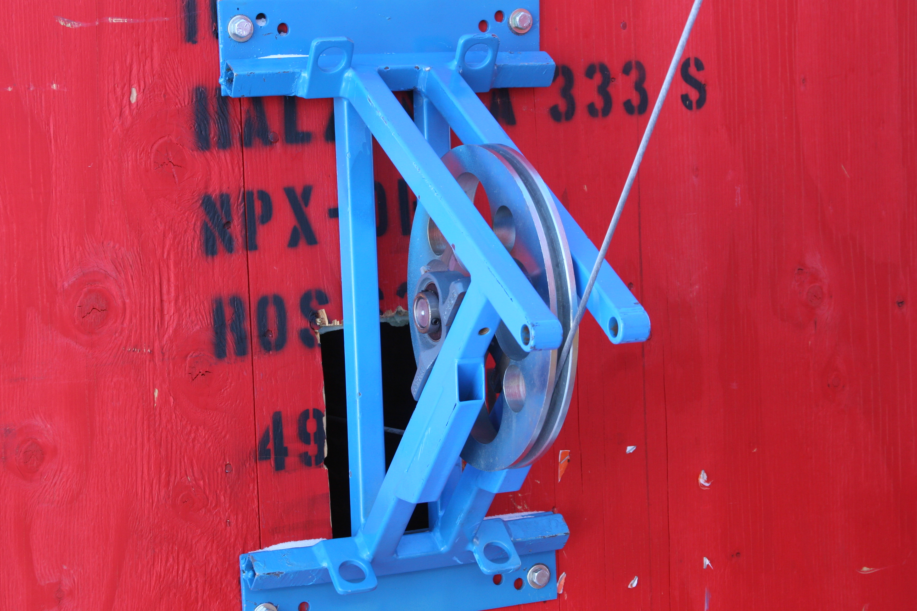
IceCube History
Know where you come from

Slide 6
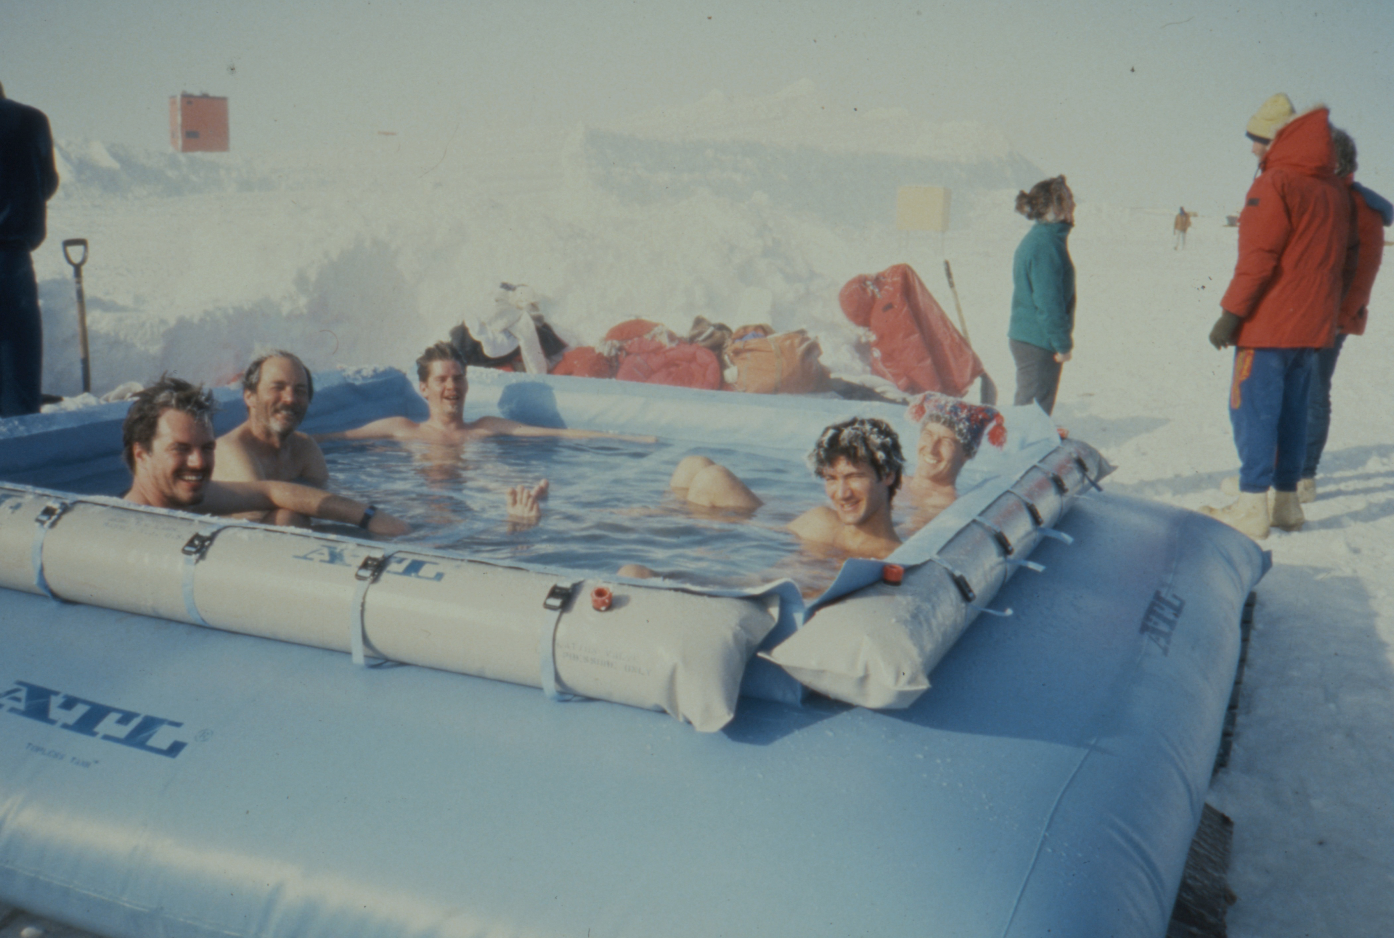
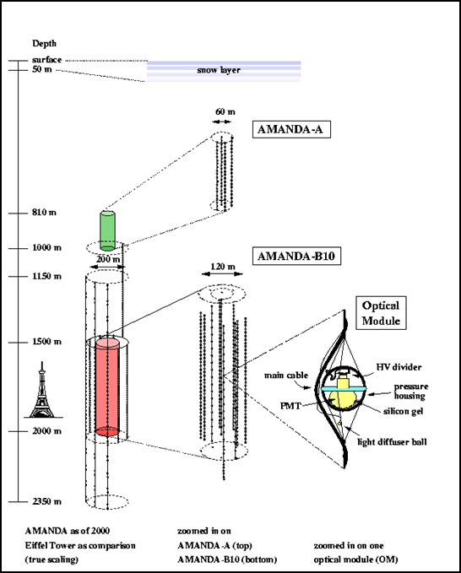
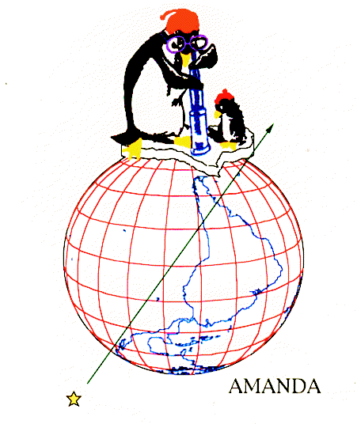
First there was AMANDA
What can I say? It was a different world back then …
In addition to the different social dynamic of the collaboration,
The AMANDA modules were ANALOG!
Extremely high gain (10⁹) 12-stage 8” PMTs directly driving 2 km cables.
Pulses were SLOOOOOOW and we used CAMAC instrumentation to digitize the peak ADC and the ToT
Ah yes and there was crosstalk …
Strings 11-19 had optical fibers but they broke about 20% of the time.
Then there was String 18 …
Oh yes, and String 17 was stuck
And we had to re-calibrate all timing offsets each year using a really painful procedure.
One of a handful of non X-rated pictures from the AMANDA days

Slide 7
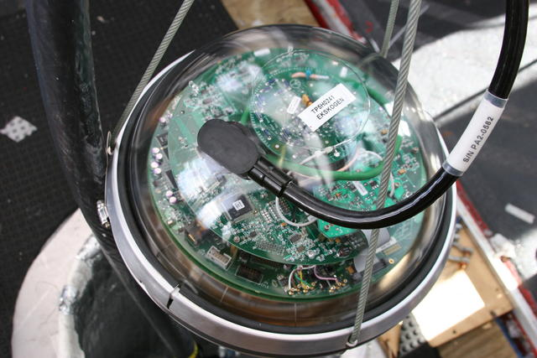
IceCube: the Optimized Production Version
The basic design of AMANDA was good but …
Scaling to >5000 channels we realized that something had to be done. The single charge measurement of AMANDA hurt reconstructions, but the maintenance issue was the real show stopper – IceCube had to be a detector which could deliver the science and be operated.
Then there was the small matter of getting 300 million dollars.
IceCube trivia: the first two IceCube-style DOMs deployed were called Frankendom (it died but came back to life) and Scarface (the glass sphere had obvious shearing marks on it) and were deployed in 2003-2004 at the surface in an early shipment to Pole (along with some Snickers bars). They probably still would work …
We had to ramp up quickly and learn a lot about the mid-scale production environment – by Fall 2004 we had 400 DOMs all tested and ready to ship to Pole.
Over the next 6 years 3 production sites (UW, DESY-Z, Sweden) would furnish the remaining 5000 modules. And now … look where we are!

Slide 8
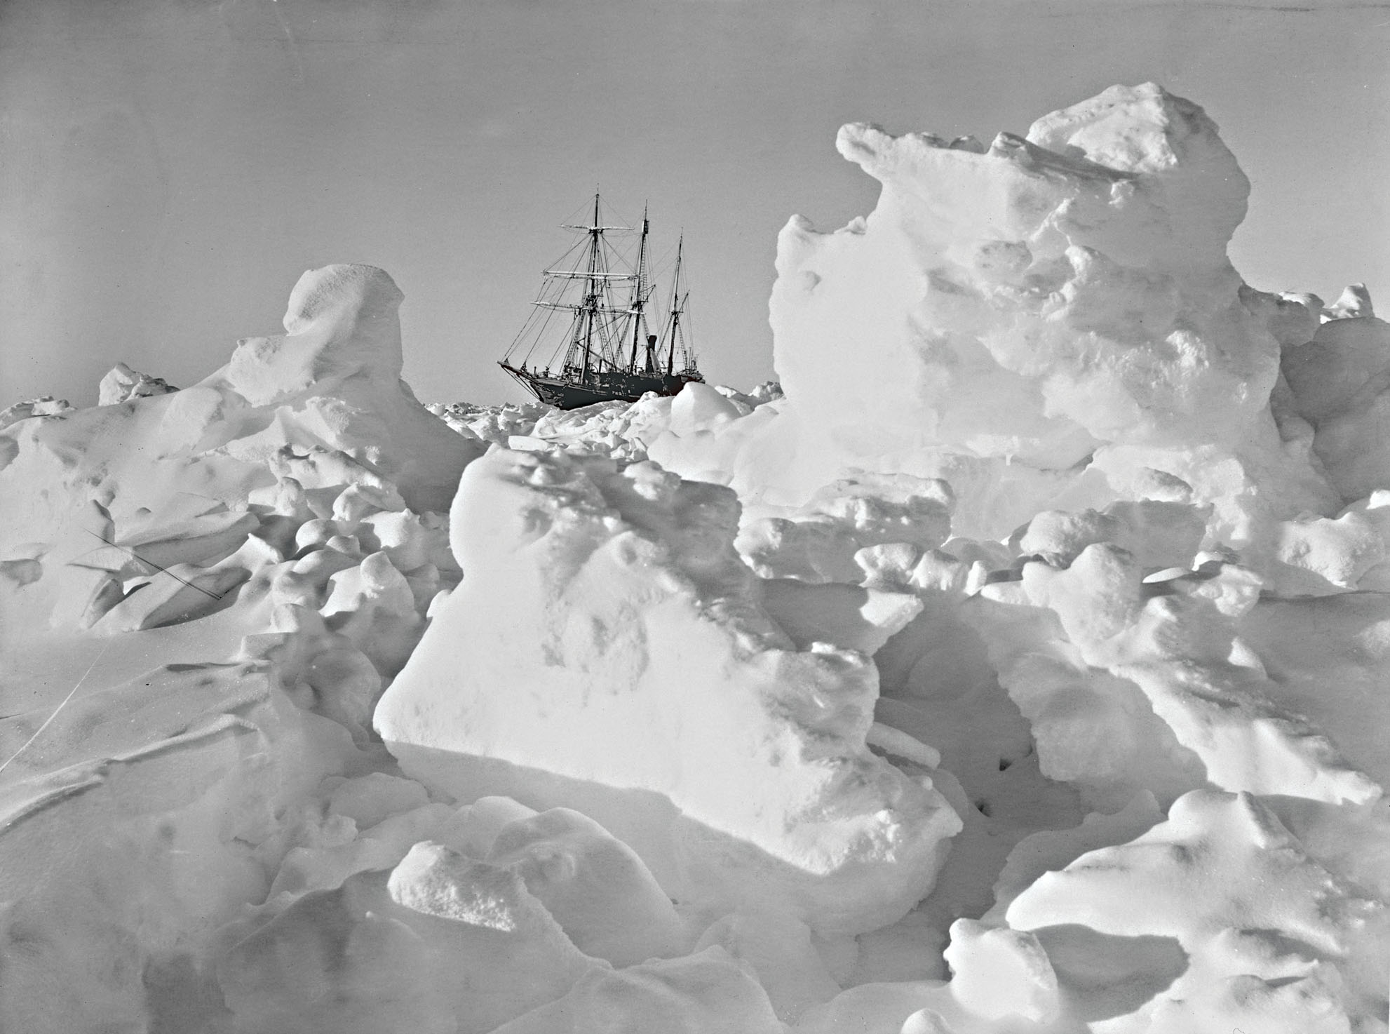
The Future of Neutrino Astrophysics at the South Pole
IceCube Gen2

Slide 9
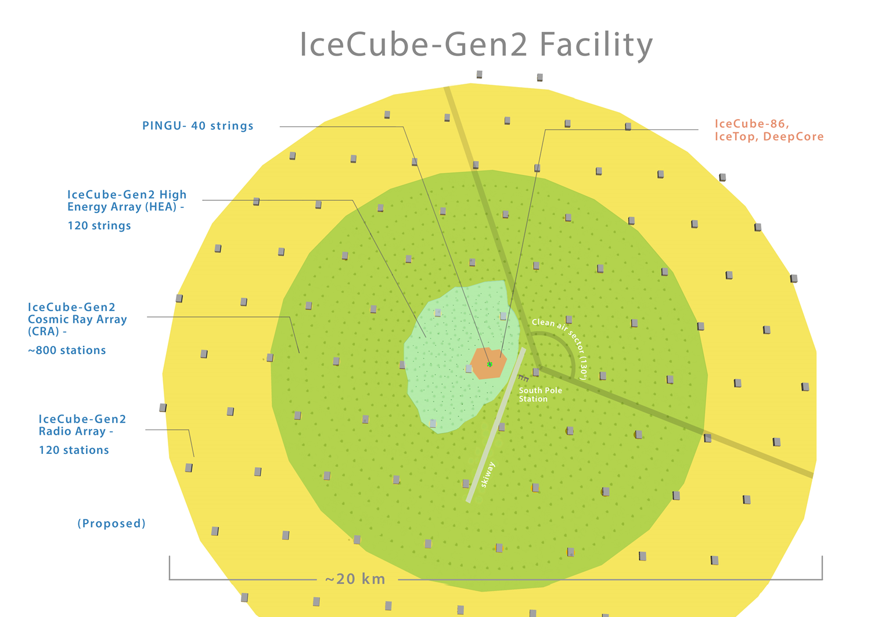
The IceCube HEX/PINGU/Radio/CR Gen2 Facility

Slide 10
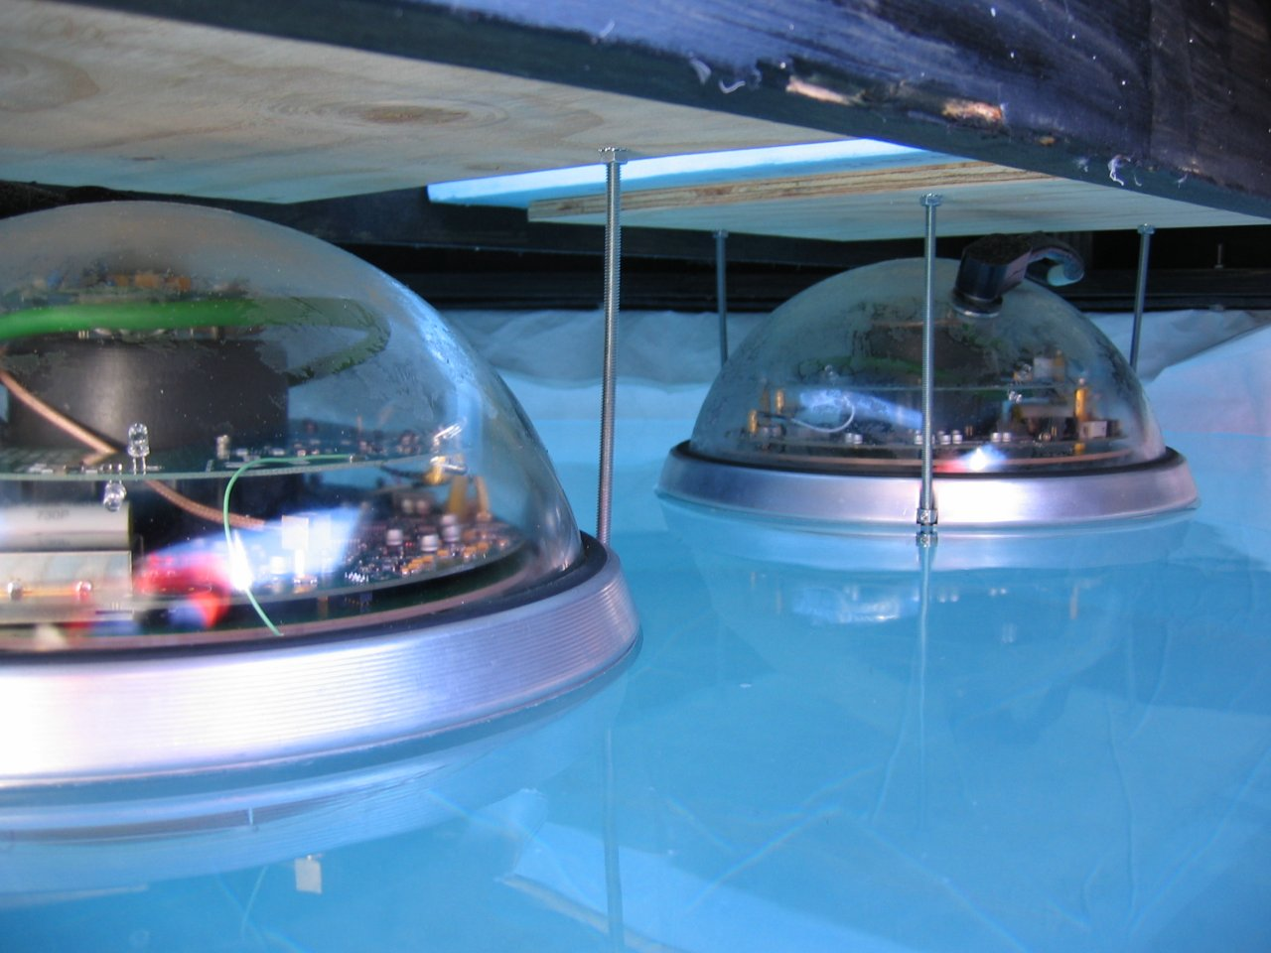
Send-off
OK, enough said – the interesting techinal download now begins
You will enrich not only your IceCube-specific toolbox but also get tutorials on using general Python / NumPy / SciPy / Matplotlib and statistics.
Cram as much as you can into this week – there is a lot of material to cover and the experts are here.
The weather this week is going to be exceptionally warm – take advantage of some cool hangouts such as the Terrace and enjoy the lake view.

