Slide 1
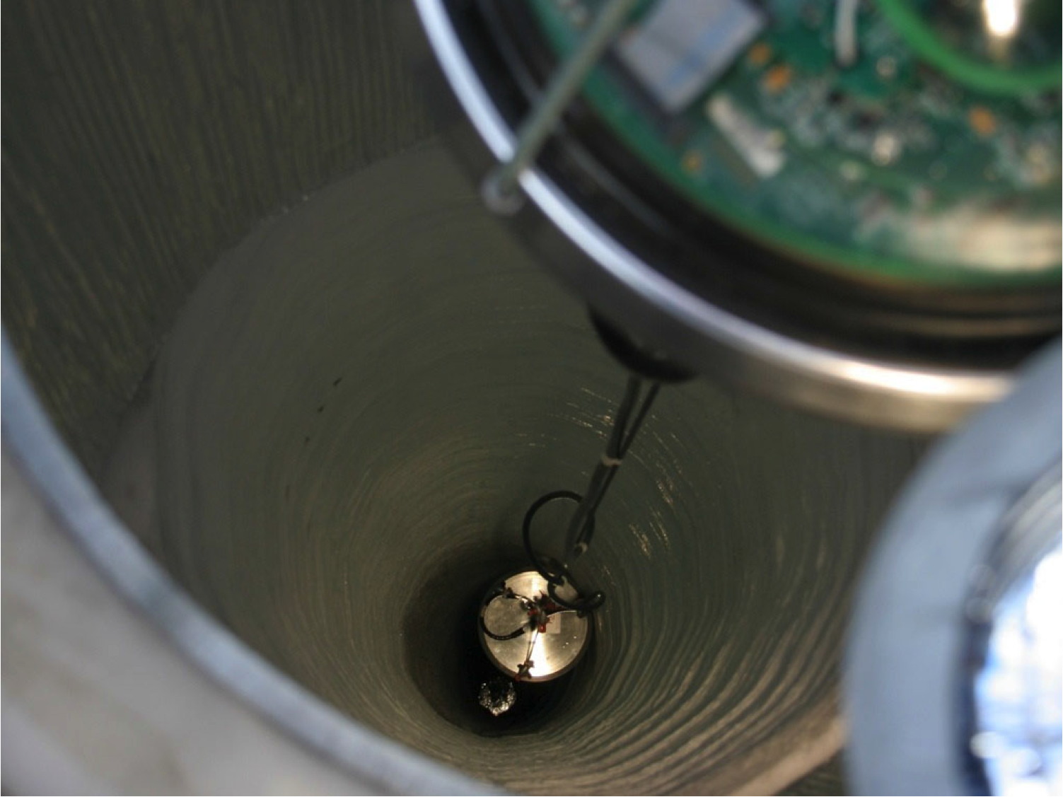




DM-Ice17: Direct Dark Matter Detection at the South Pole
Wright
Laboratory
Antonia Hubbard
University of Wisconsin - Madison

Slide 2
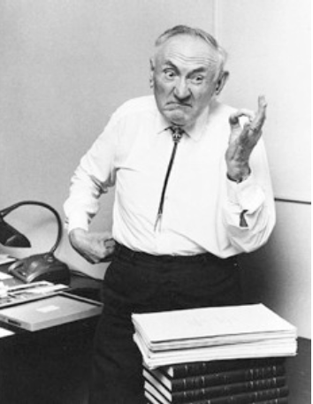
First Evidence of Dark Matter
1933: Fritz Zwicky analyzes the Coma cluster and sees a large discrepancy
Galaxies are moving too fast!
Infers that unseen “dark” matter is dominating the gravitational movement

Slide 3
Evidence: Rotation Curves
M33 observations
Dark matter
Visible matter
Gas
Corbelli and Salucci (2000)
Notes:
M33: 21-cm line
Visible: optical
Gas: radio and X-ray

Slide 4
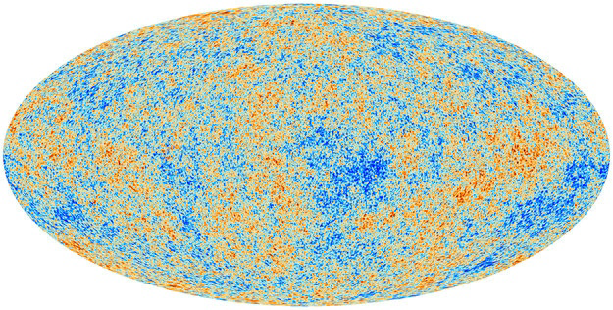
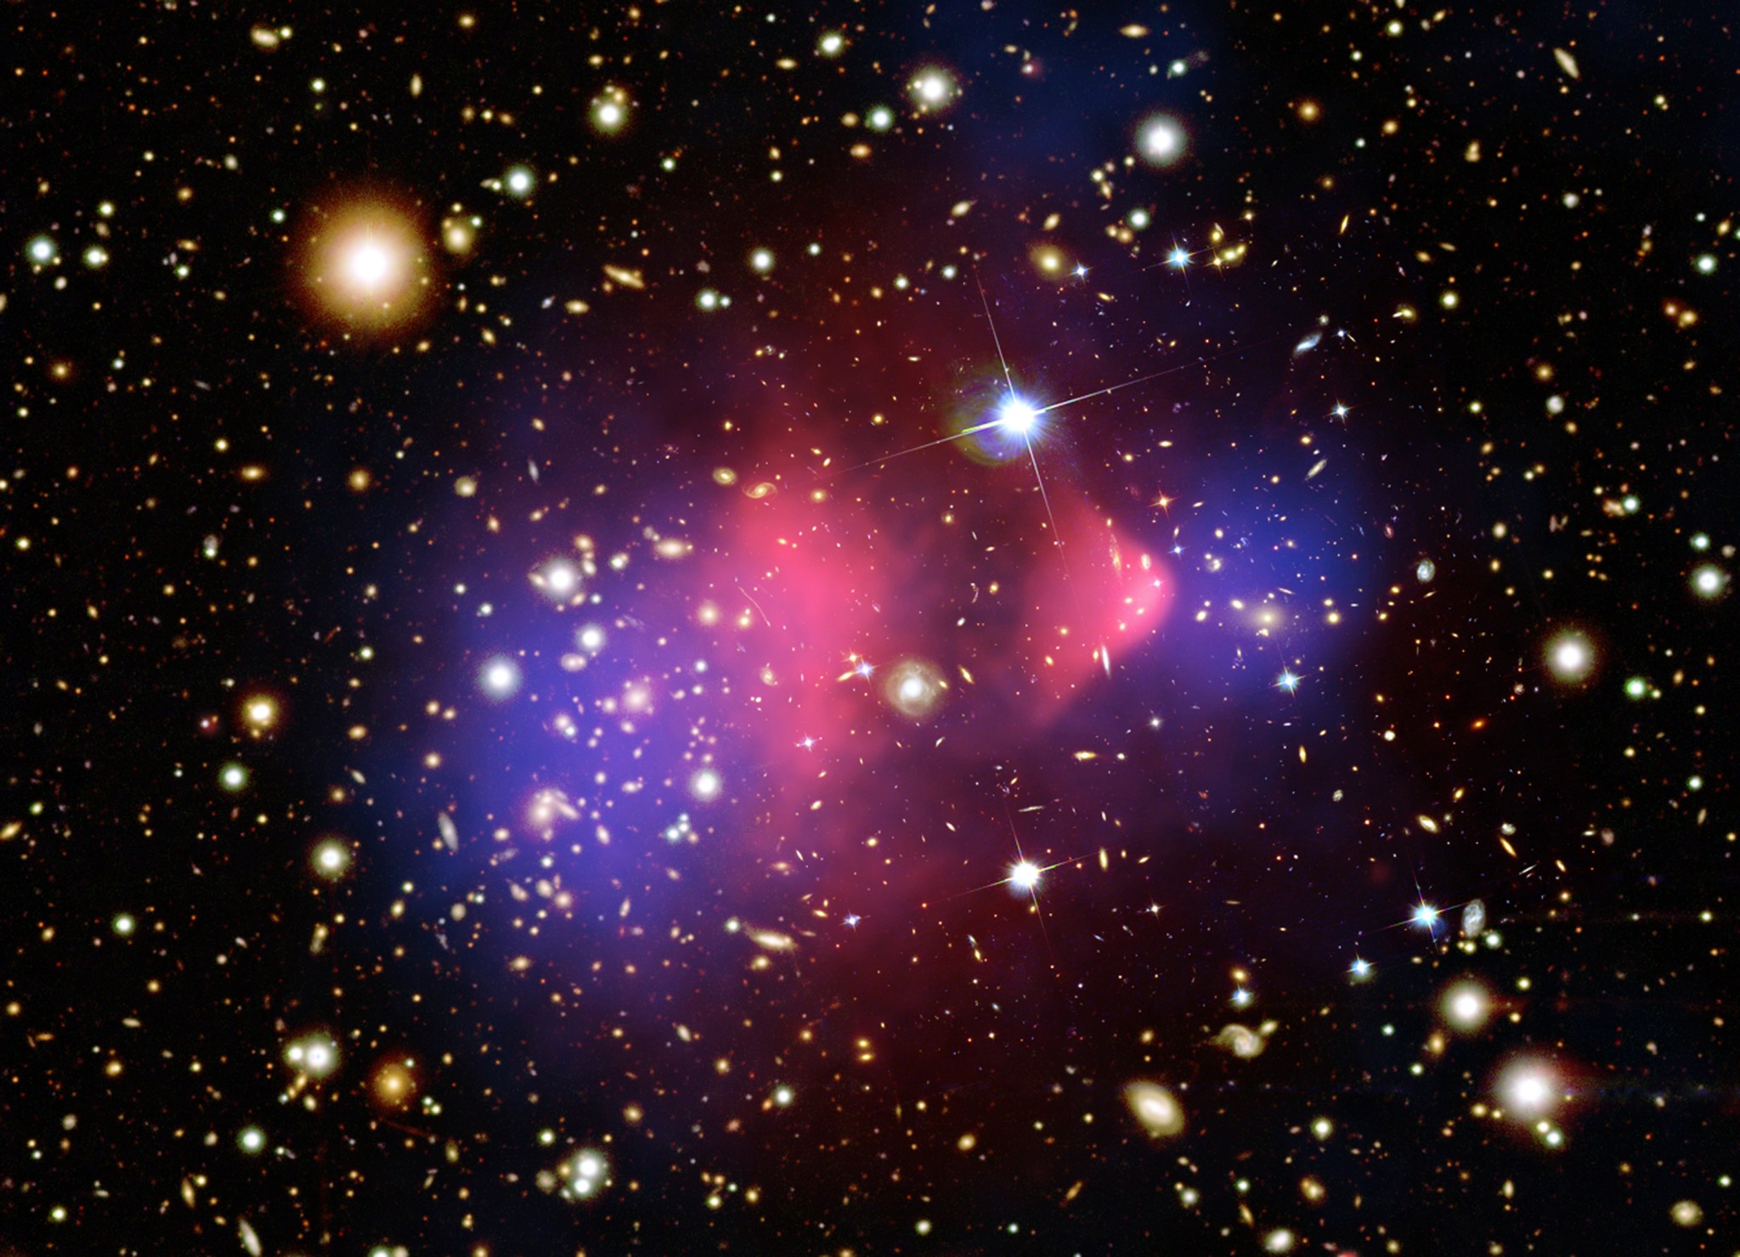
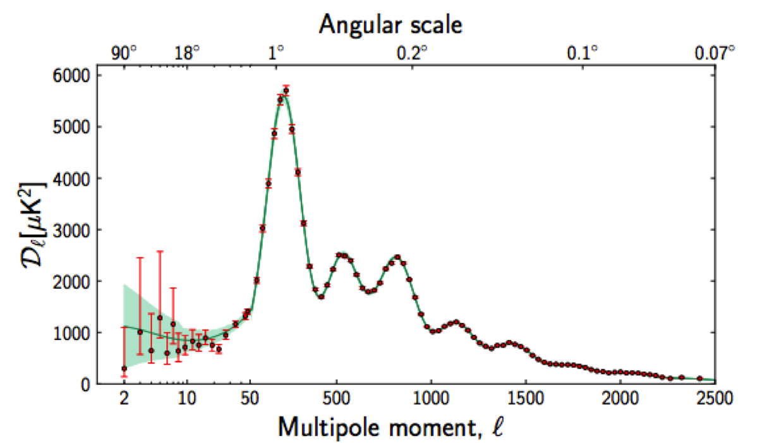
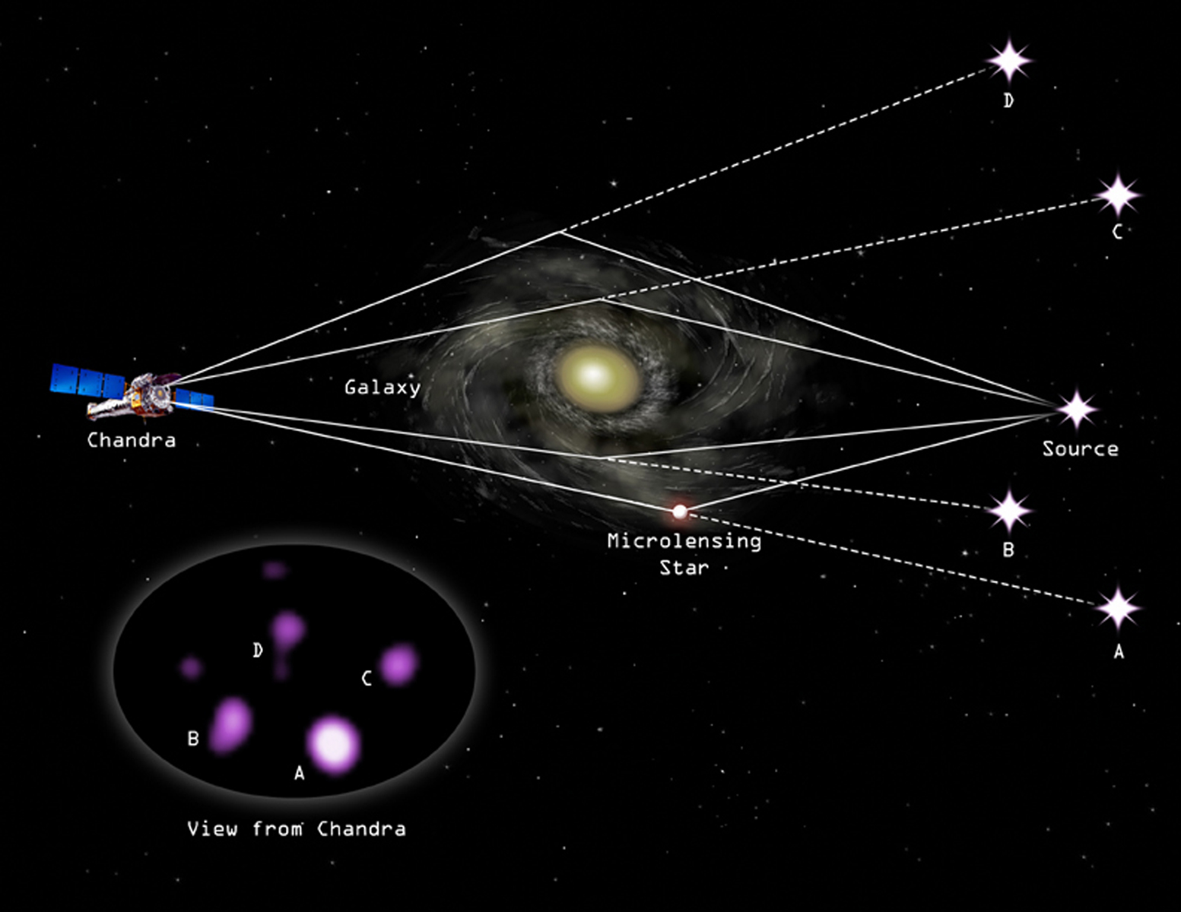
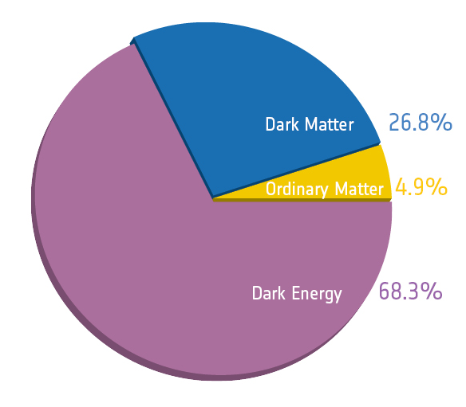
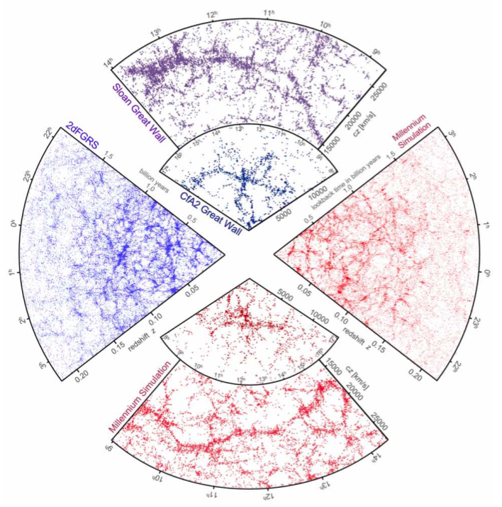
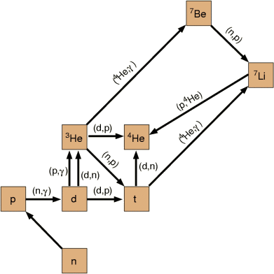
Evidence for Dark Matter
CMB
BAO
arXiv: 1303.5075
Bullet
NASA
Chandra
ESA/Planck Collaboration
Lensing
LSS
doi: 10.1038/nature04805
Weiss
BBN
Rotation curves
ESA/Planck Collaboration
Corbelli and Salucci (2000)

Slide 5
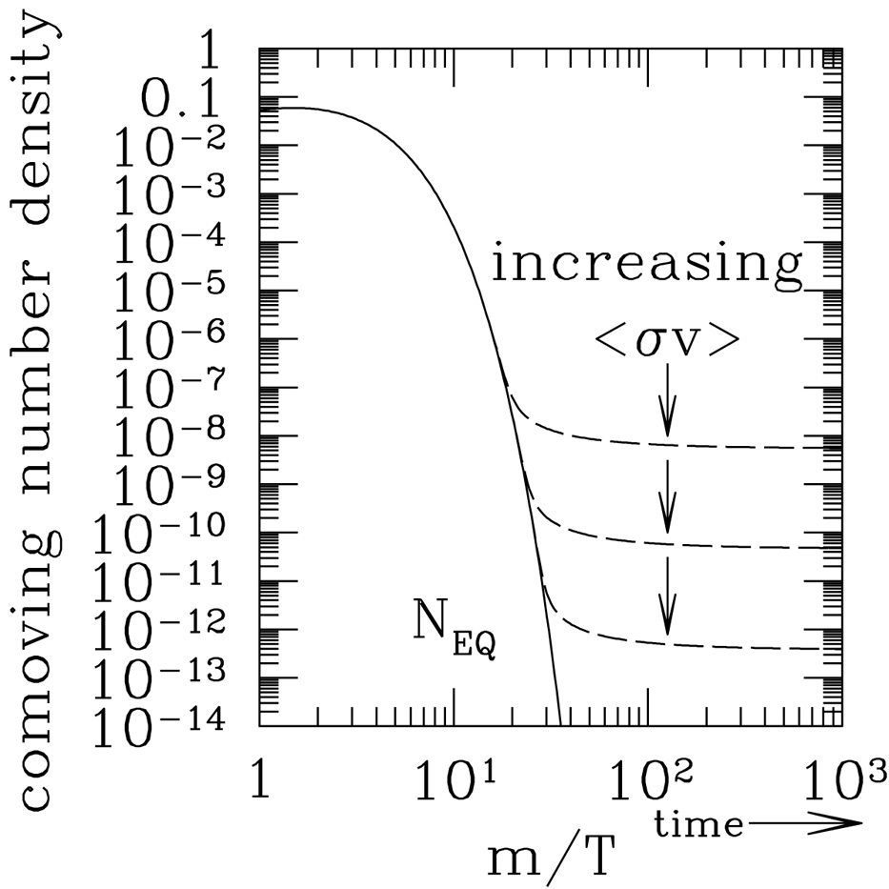

What is Dark Matter?
Requirements
Stable, massive, non-baryonic, neutral
WIMPs: Weakly-Interacting Massive Particles
“WIMP Miracle”: weak cross-section matches predictions
GeV - TeV mass
Beyond the Standard Model

Slide 6
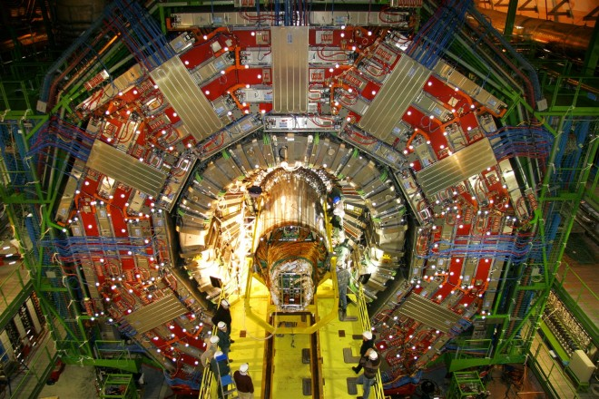


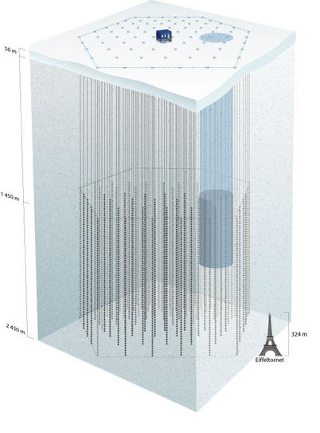
Dark Matter Detection
Collider Production
Produce WIMPs and
detect them as missing energy
Direct Detection
Detect nuclear recoil from WIMP-nucleon scattering
χ
χ
WIMP
nuclear recoil
Indirect Detection
Search for excess of
annihilation products
(solar core, GC…)
Particle physics
SI elastic:
σ ~ 10⁻⁴⁴ -10⁻⁴⁷cm²
Astrophysics
ρ₀ = 0.3 GeV/cm³
v: WIMP wind ~220 km/s

Slide 7
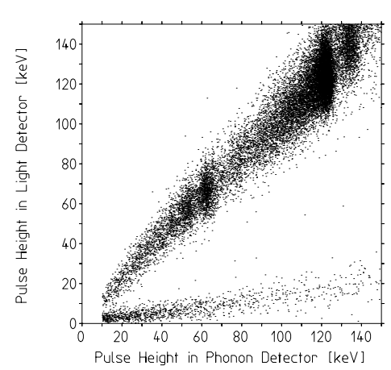
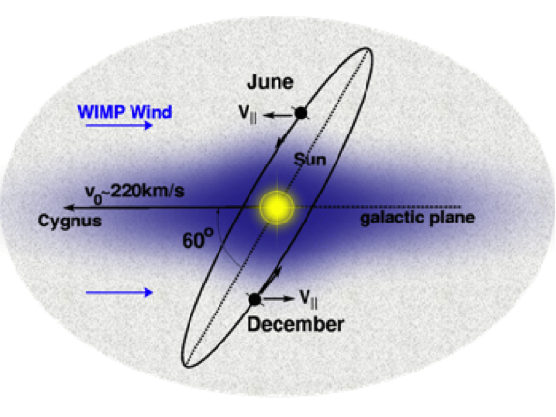
Direct Detection Techniques
To identify signal over background:
Separate electronic and nuclear recoils
Observe modulation: annual or diurnal
CRESST 2001
7% WIMP flux annual modulation
WIMP max
WIMP min
Notes:
- Earth’s galactic velocity

Slide 8
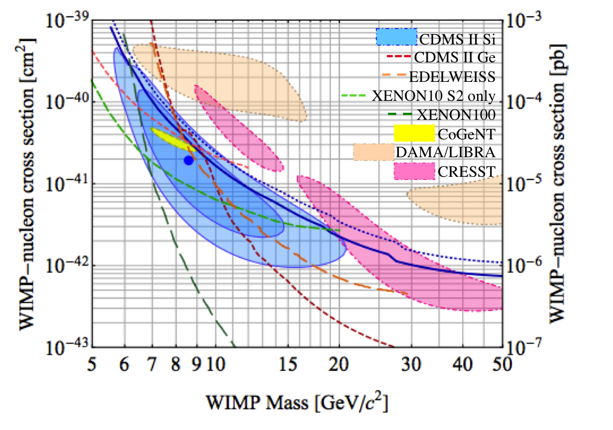
Positive Hints of Detection
CDMS Si (2013)
3σ excess
Excluded by CDMS Ge
CoGeNT (2011)
2.8σ annual modulation
Postulated to be surface events
CRESST (2011)
4σ excess
Signal excluded after detector upgrades and background reduction
CDMS 2013
DAMA (2013)
Scintillation
14 annual modulations
9.5σ
DAMA: only result not excluded by same target medium/collaboration, although KIMS (using CsI(Tl)) has ruled out Iodine recoils

Slide 9
Tension between results
PandaX 2015

Slide 10
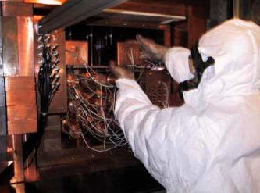
DArkMAtter (DAMA)
Largest signal at 9.5σ annual modulation over 14 years
NaI(Tl) scintillation detectors
1% modulation on 1 dru background
1 yr period; May 24±7 phase
DAMA 2008
2 – 6 keV

Slide 11
DAMA Result Controversy
Signal excluded by other experiments
Could something else be modulating?
100s of papers suggesting environmental backgrounds, internal backgrounds, experiment systematics…
Is the threshold moving? Temperature change in electronics? Radon? Muons?
No background explanation can successfully explain the signal
DAMA max
355
350
345
340
335
330
325
Muon flux [km⁻²s⁻¹]
Borexino 2012

Slide 12
DAMA Controversy: Muons
DAMA max
Argument: The DAMA signal may be muons or muon-induced neutrons. Blum 1110.0857
No. The muon rate is not high enough, and it is out of phase with the modulation. Bernabei 1202.4179, Fernandez-Martinez 1204.5180
A second modulation could combine with muons to be in phase with DAMA.
Davis 1407.1052
The muon signal may be amplified by cascades of events following muons.
Nygren 1102.0815
No second modulation has been shown to produce this.
Bernabei 1409.3516,
Klinger 1503.07225
This has not been observed in DAMA. Bernabei 1202.4179
New annual modulation experiments must understand their muon backgrounds and provide new information!

Slide 13
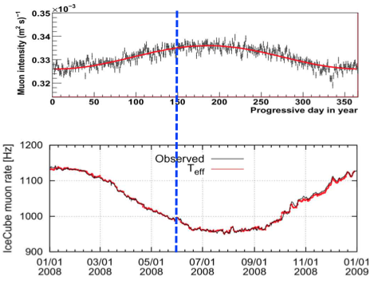
The DM-Ice Concept
Complement DAMA and study modulation
NaI(Tl) detector of similar size and threshold
Minimize potential modulating background
Constant temperature
Constant -20° C
Understand muon background
IceCube coincidence
Neutron moderation
Water ice
Clean environment
2500m overburden
U, Th ~ 0.1 – 1 ppt
K ~ 0.1- 1 ppb
Northern hemisphere muons (IceCube)
DAMA phase
Southern hemisphere muons (IceCube)
Notes:
Ice = neutron moderation

Slide 14
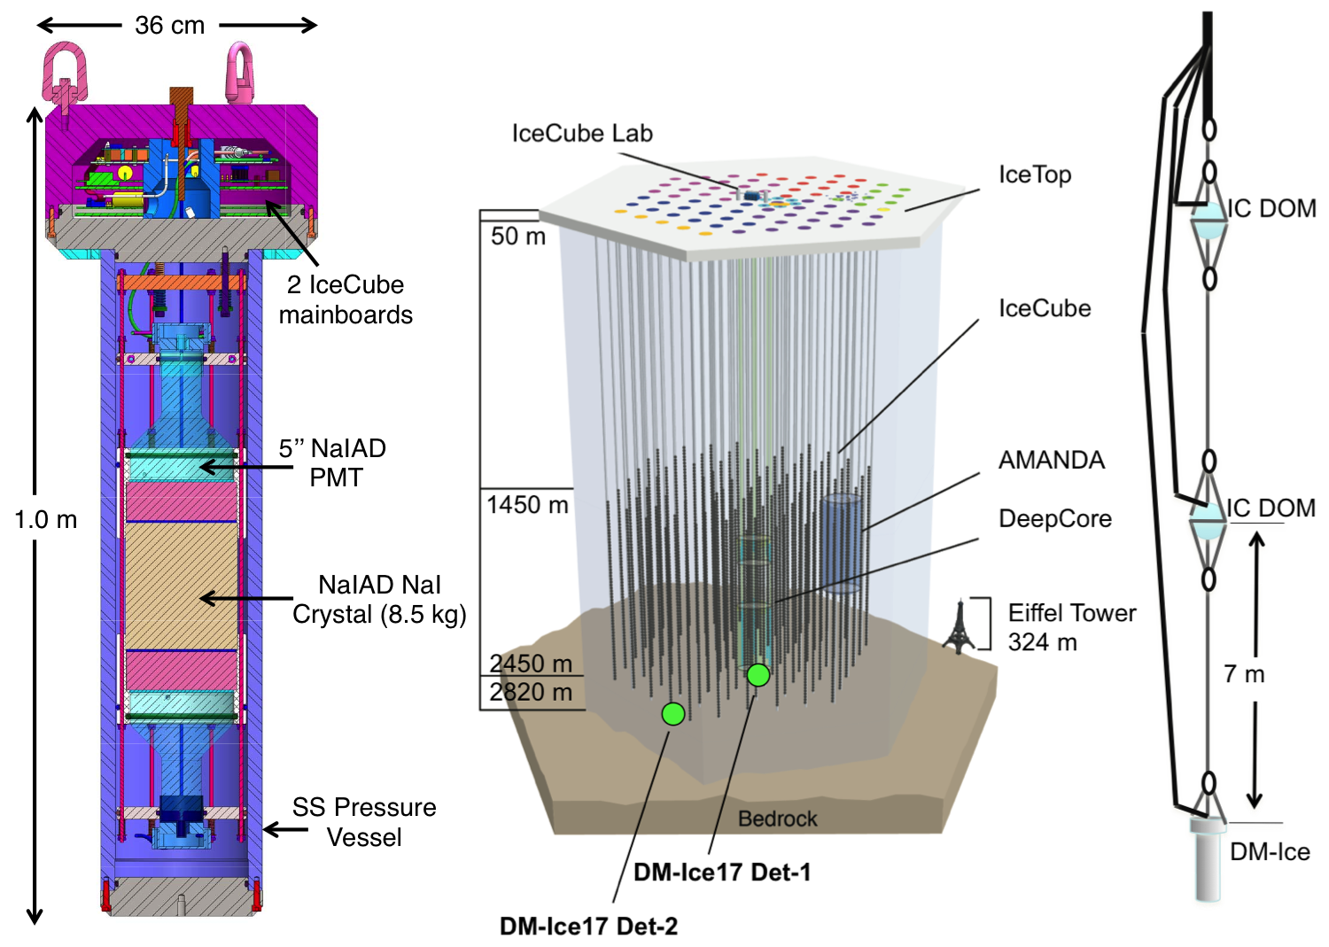
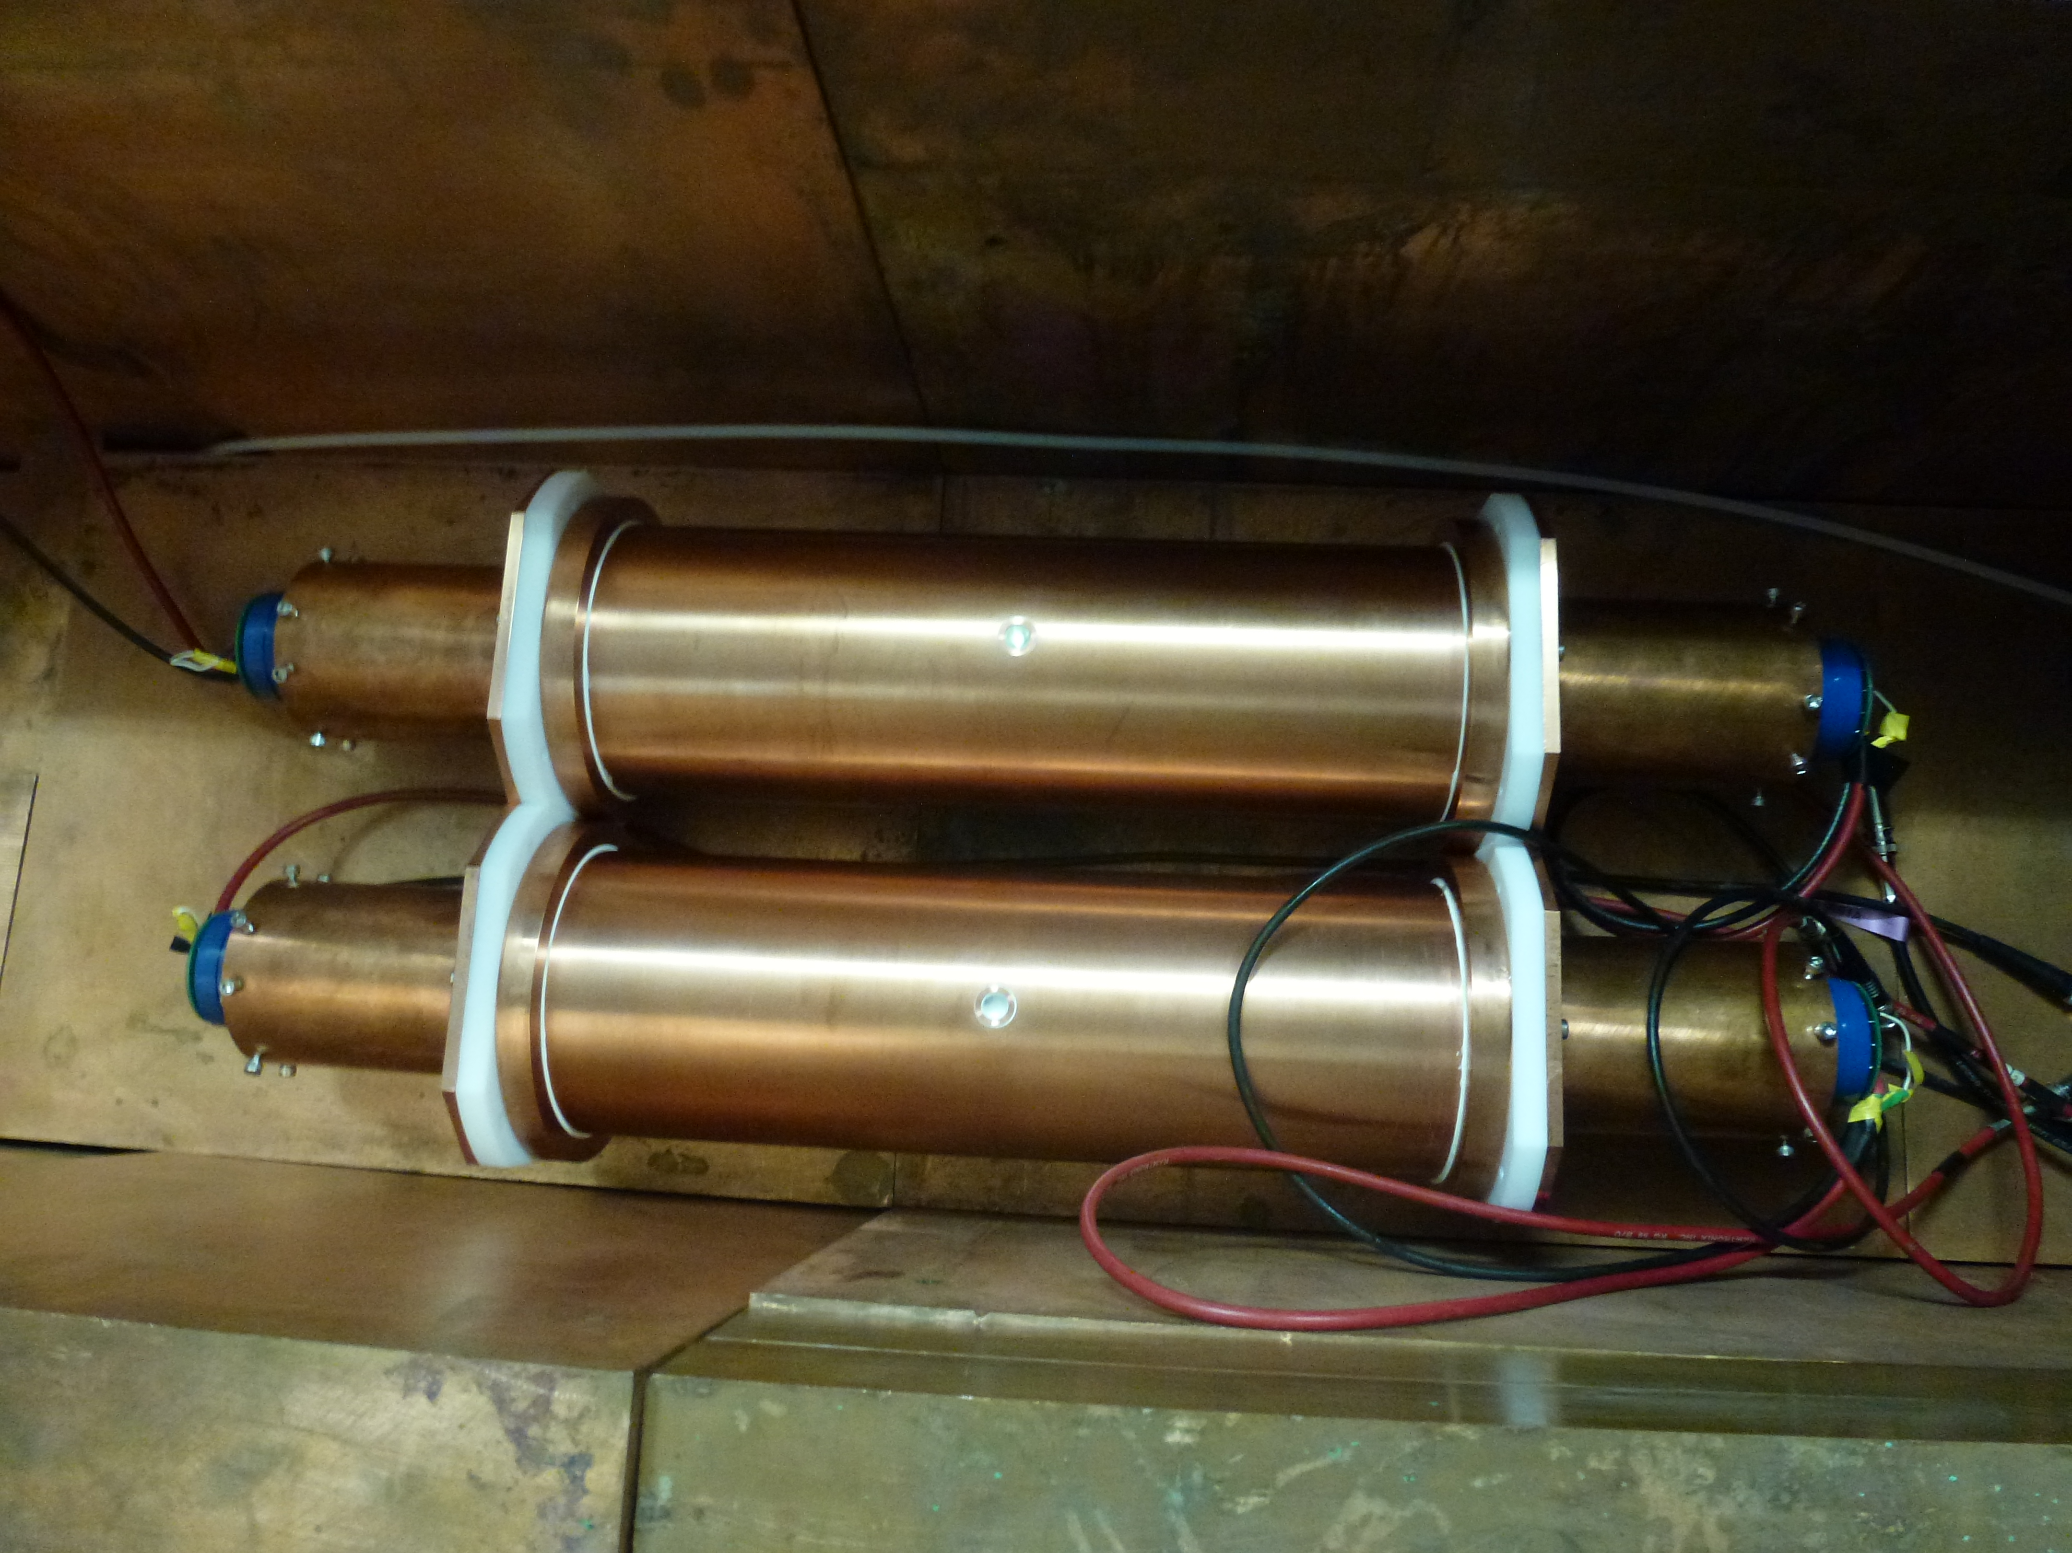
DM-Ice
DM-Ice17
Determine feasibility
DM-Ice is a phased program that will run in both hemispheres to test the dark matter interpretation of the DAMA modulation
DM-Ice250
Set limits
Southern
Southern
DM-Ice37
Detector R&D
Northern
Northern

Slide 15
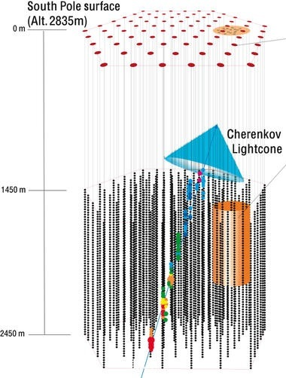
IceCube Neutrino Observatory
5160 PMTs in 1km³
1500 – 2500 m deep
Neutrinos: up-going
Atm. muons: down-going
Neutrinos are
1/10⁶ events!

Slide 16
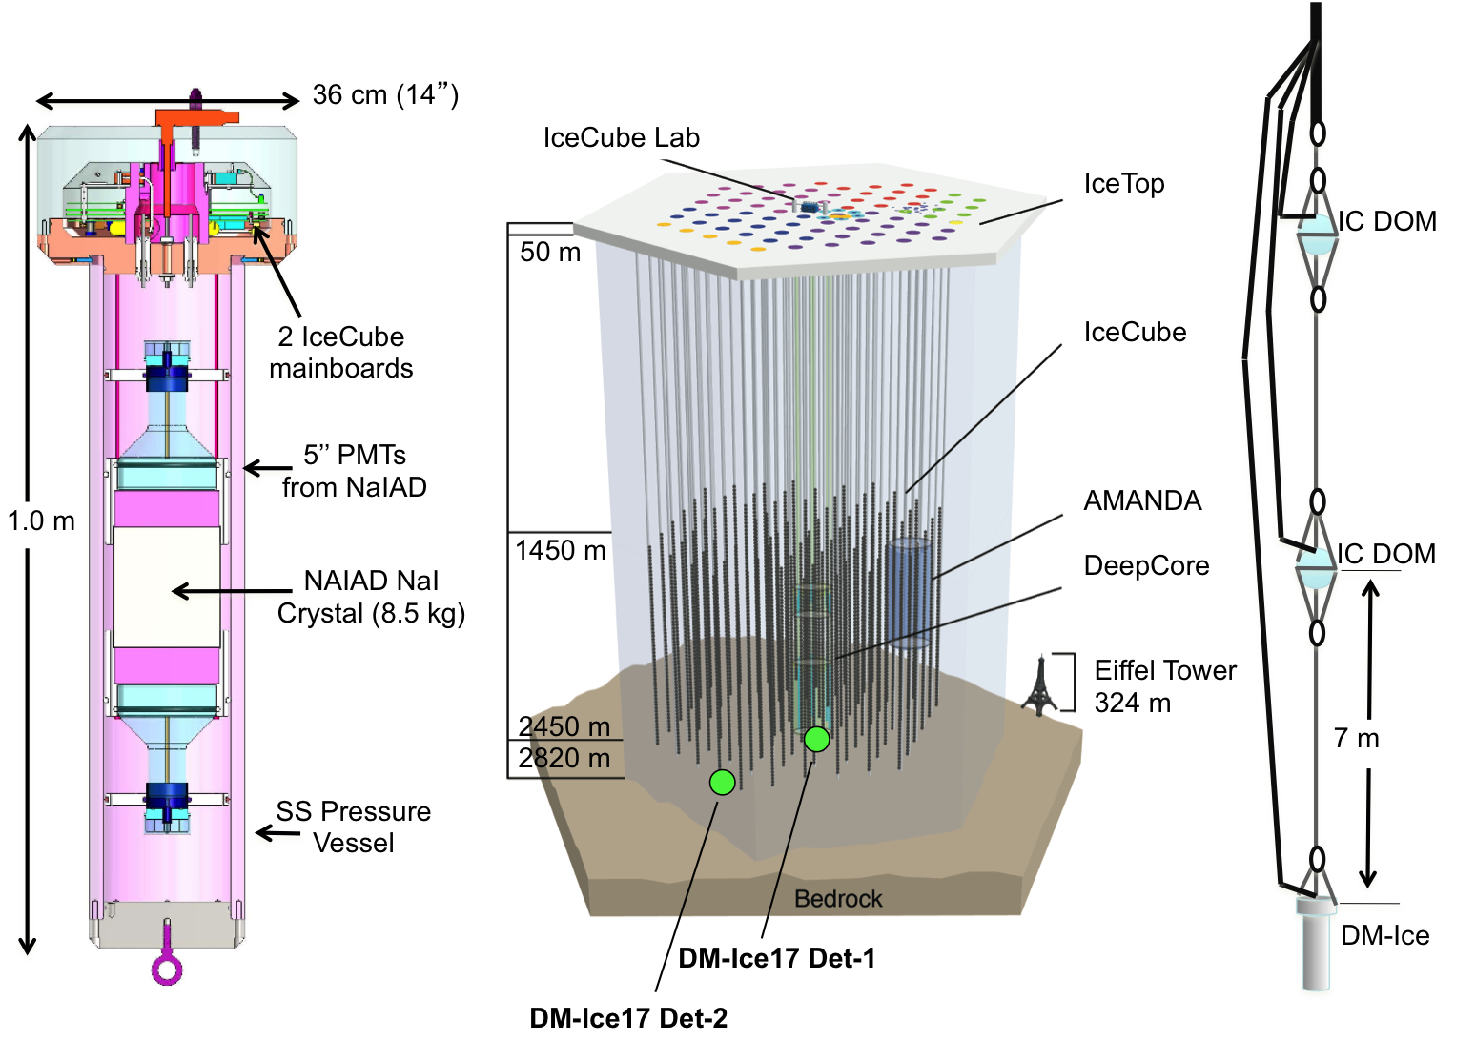
DM-Ice17 Goals
Illustrate feasibility of NaI(Tl) detector in South Pole ice
Environmental studies
Backgrounds, stability
IceCube muon coincidence

Slide 17
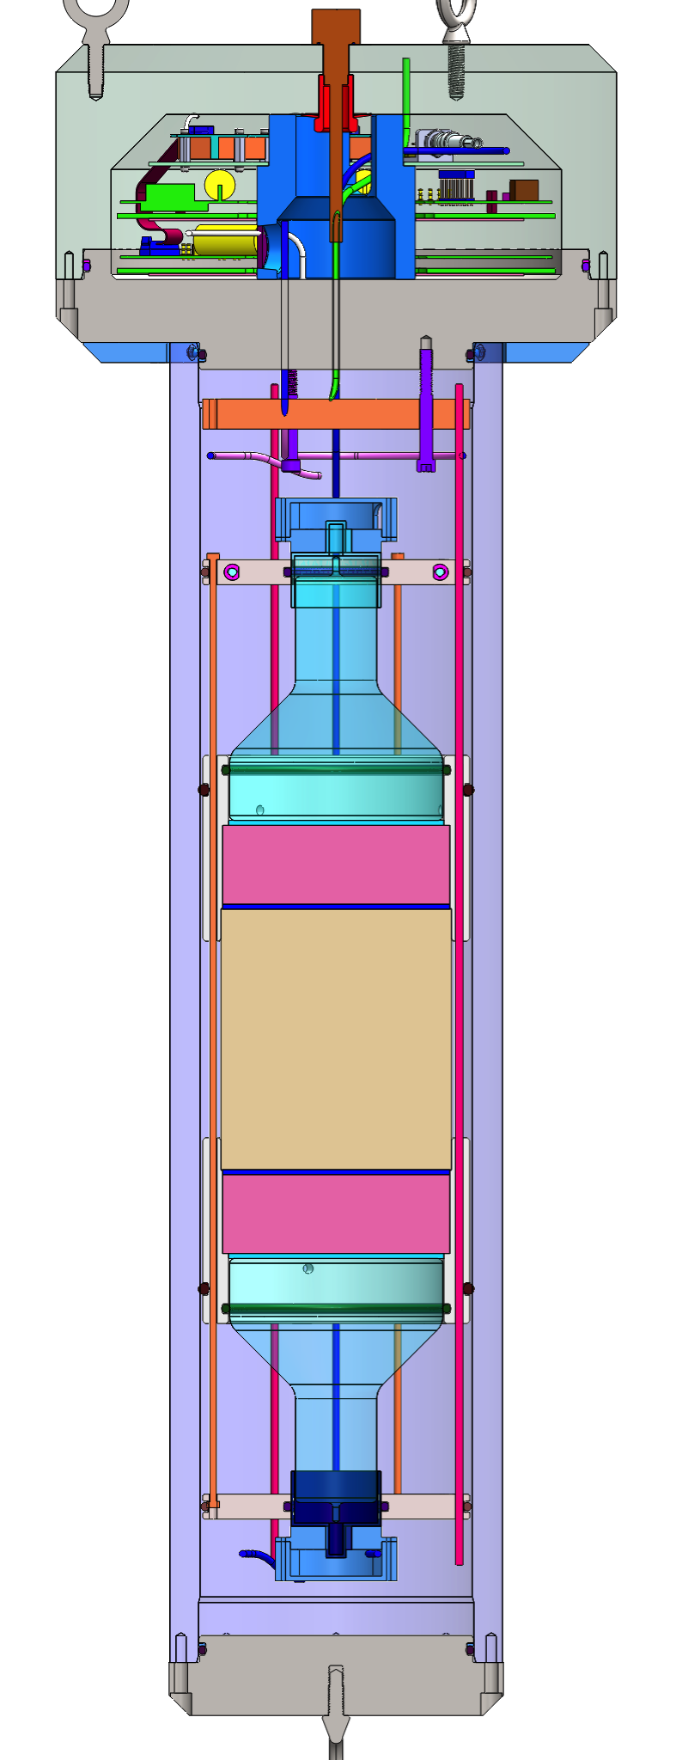
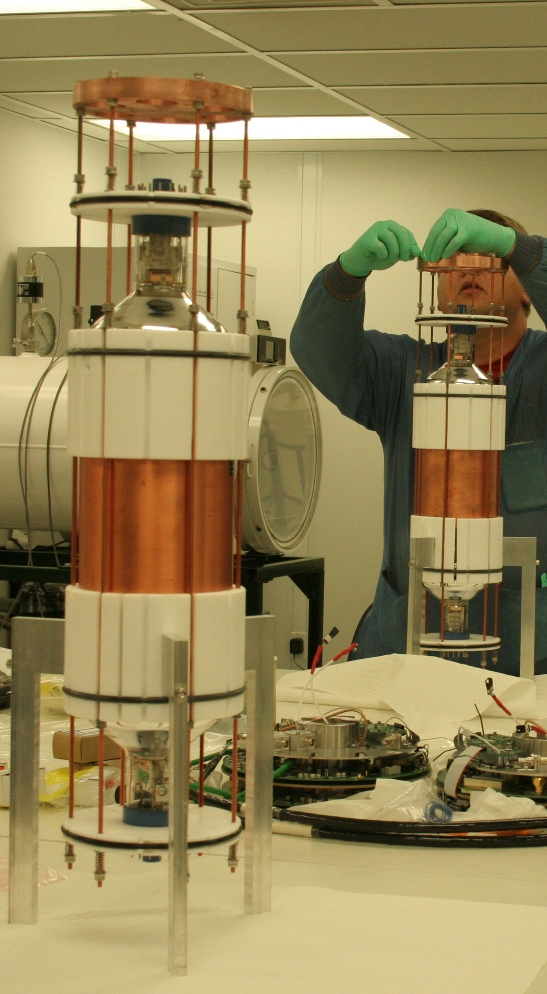
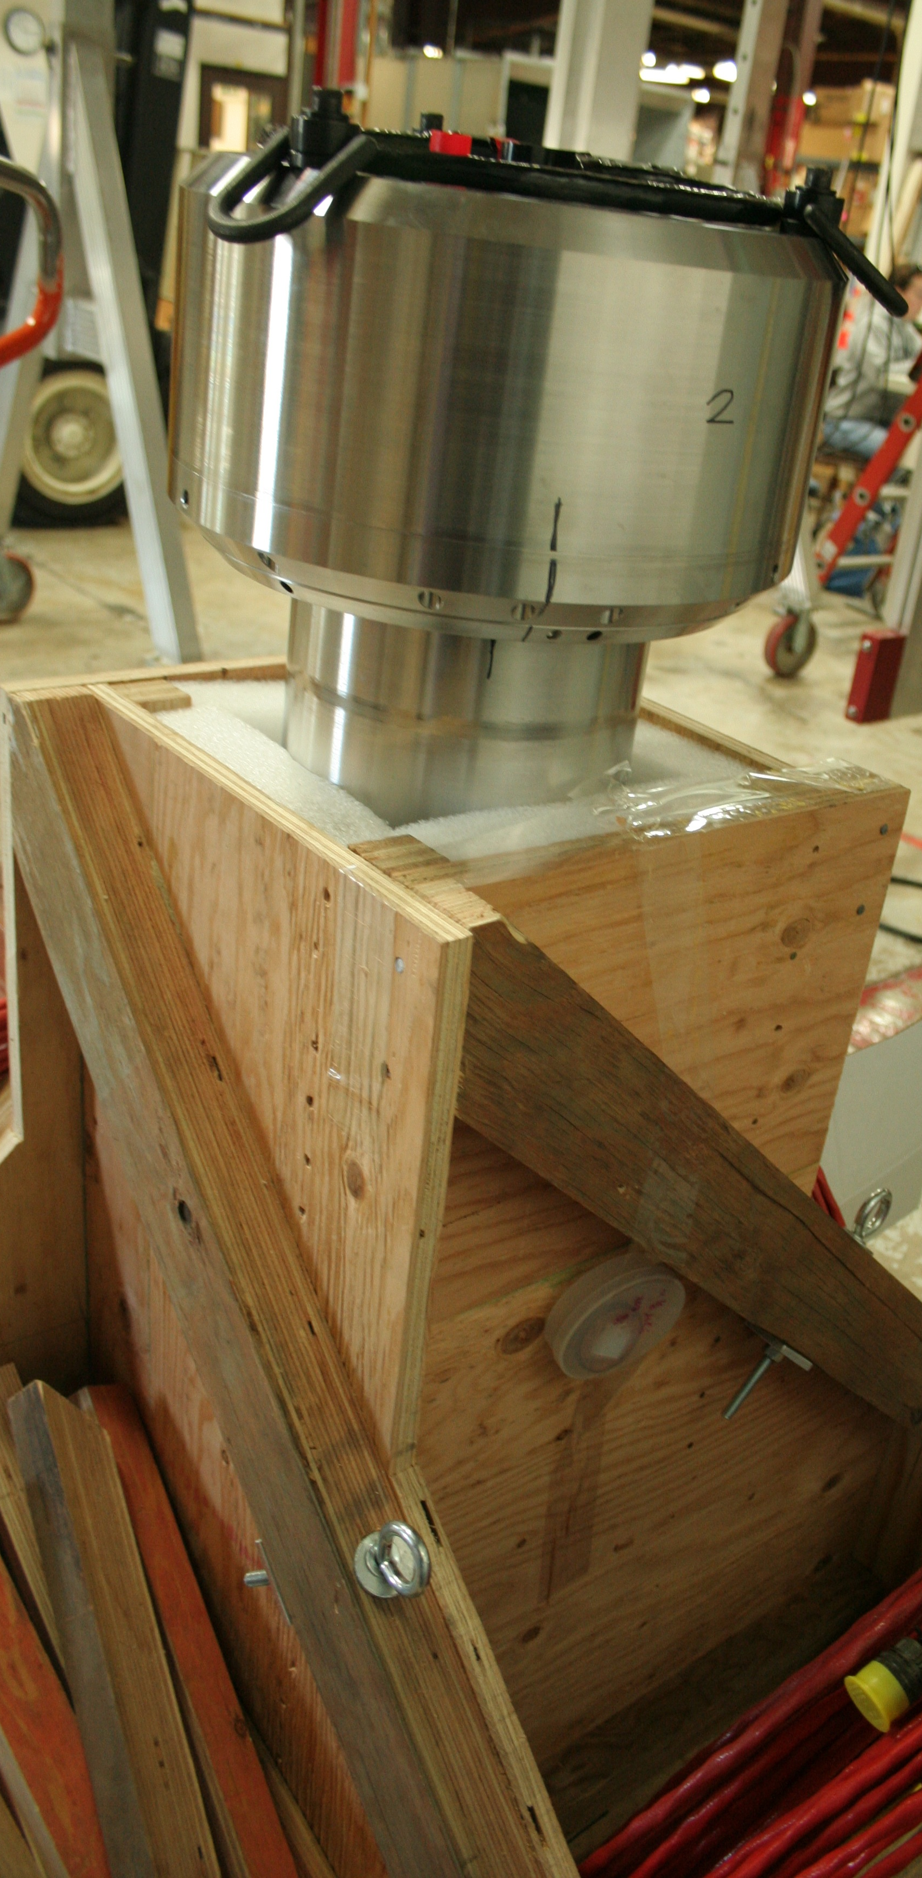
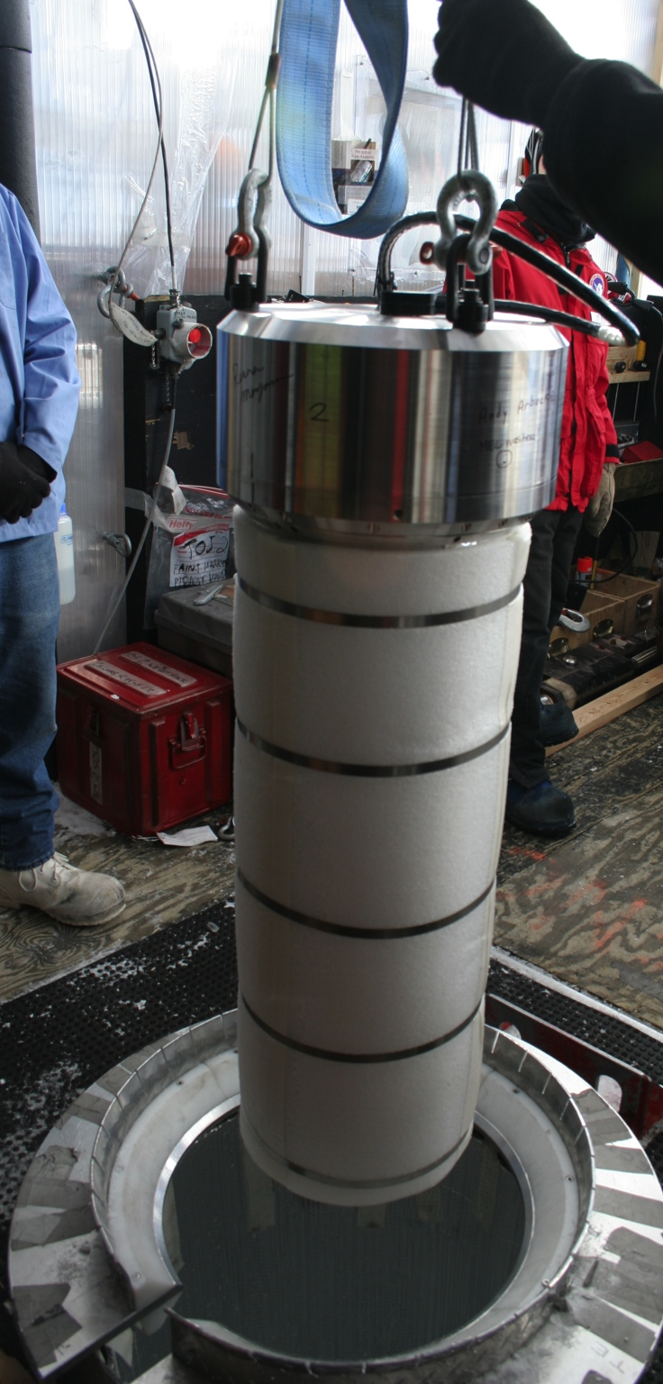
DM-Ice17
Summer 2010
October 2010
December 2010

Slide 18
DM-Ice17 Data
Stable data taking since January 2011
99% uptime
Calibrated using internal contamination
Source runs taken before deployment
700 keV

Slide 19
Low Energy Background Model
Largest contamination from NaI(Tl) and PMTs
⁴⁰K
7.9±0.4 dru
¹²⁵I
²¹⁰Pb
¹²⁵I X-rays
²¹²Pb
²¹⁰Pb
DM-Ice 2014
keV

Slide 20
Cosmogenic Activation
Short-lived isotopes verify the energy calibration
¹²⁵I verification through half-life, measured to be 59.4±2.7 days, consistent with the quoted value of 59.40±0.01 days
DM-Ice 2014

Slide 21
Muon Background
~3 muons/crystal/day
Identified through energy and pulse shape
Modulation agrees with IceCube observations
DM-Ice
DM-Ice Fit
IceCube

Slide 22
IceCube Coincidence
DM-Ice goals: verify muon identification; provide energy, direction
IceCube goals: improve reconstructions with known location along track

Slide 23
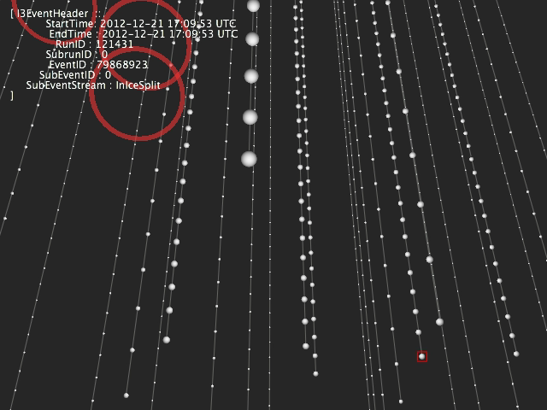

Slide 24
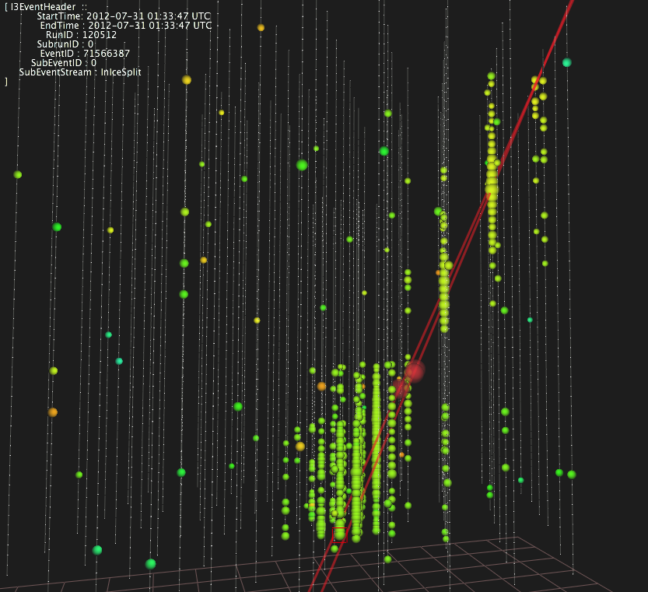
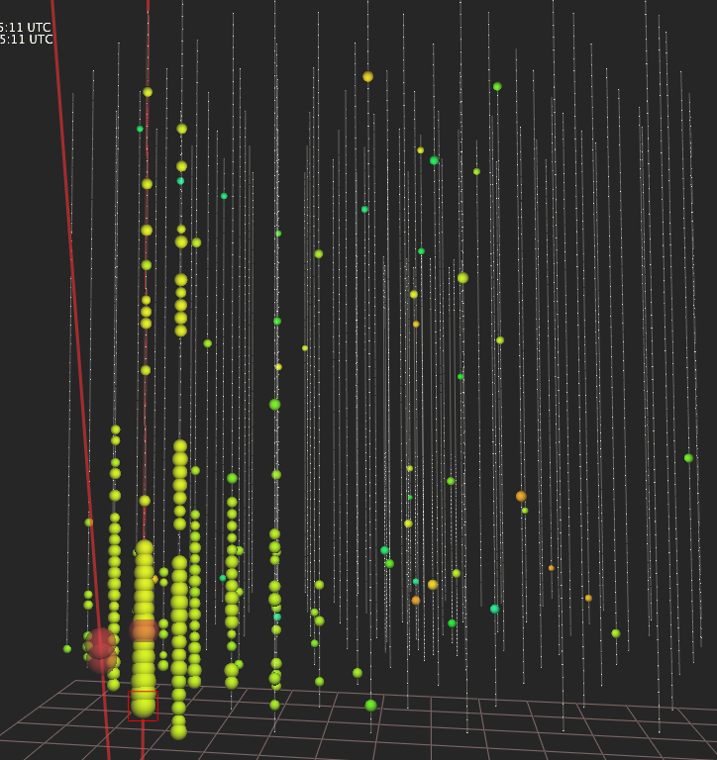
Coincidence Results
Up to 93% (33%) of Det-1 (2) muons are coincident
Including DM-Ice’s location lowers the reconstruction fail rate and verifies precision
Fewer misreconstructions particularly for low energy
Det-1
Det-2

Slide 25
DM-Ice
DM-Ice17
Determine feasibility
DM-Ice is a phased program that will run in both hemispheres to test the dark matter interpretation of the DAMA modulation
DM-Ice250
Set limits
Southern
Southern
DM-Ice37
Detector R&D
Northern
Northern

Slide 26
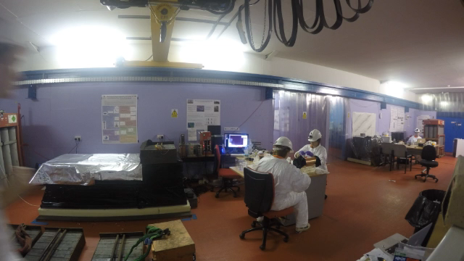
DM-Ice37
2-18.3 kg crystals running at Boulby
Background reduction from
DM-Ice/ANAIS/
KIMS effort
Crystals | ⁴⁰K [mBq/kg] | ²¹⁰Pb [μBq/kg] | ²²⁸Ra-²⁰⁸Tl
DM-Ice17 | 17 | 1500 | 160
DAMA | 0.6 | 24.2 | 8.5
In progress | 1.5 | 188 | 2

Slide 27
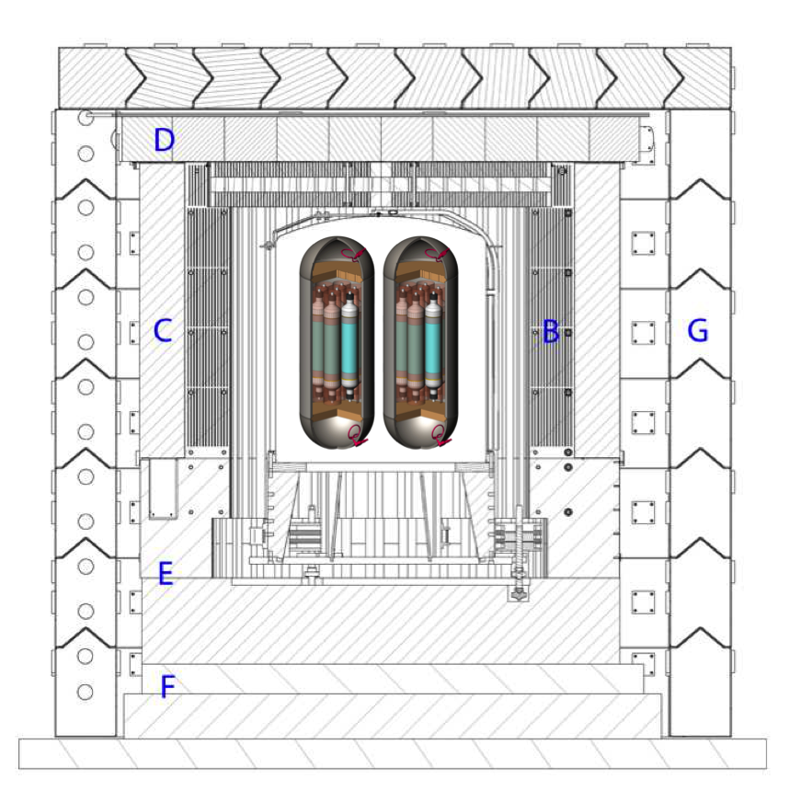
Future of DM-Ice
DM-Ice37
Reached 3 dru background
R&D to get cleaner
Goal < 1 dru
DM-Ice17: 7.9 dru
DM-Ice250 North
Boulby: clean, well modeled environment
ZEPLIN shielding available
DM-Ice250 South
Co-deployment with PINGU will be mutually-beneficial

Slide 28
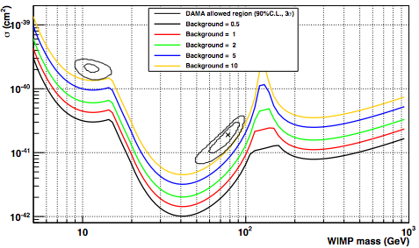
Conclusions
This is an exciting time for dark matter!
DM-Ice17: successful operation in the ice
Mutually beneficial analysis with IceCube
R&D progressing swiftly
DM-Ice250: unique position to definitively test DAMA by running in both hemispheres
500 kg*years

Slide 29
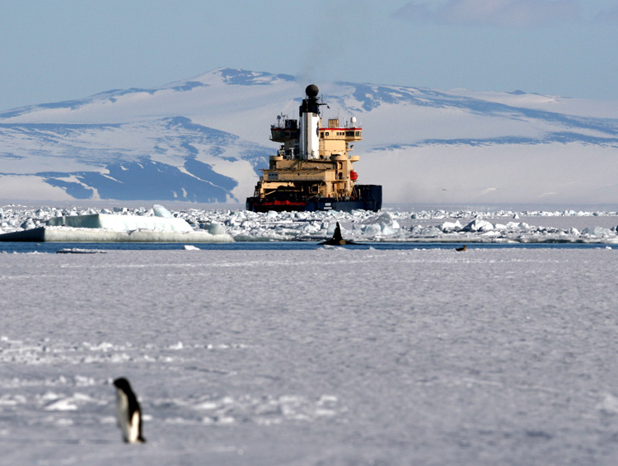
Questions?
Questions?

Slide 30
Direct Detection Experiments
Calorimetry
CRESST-I
CUORE
EDELWEISS
CDMS
CRESST-II
Scintillation
DM-Ice
DAMA
ANAIS
SABRE
KIMS
Ionization
CoGeNT
COUPP
PICASSO
DRIFT
PICO
XENON
PandaX
LUX

Slide 31
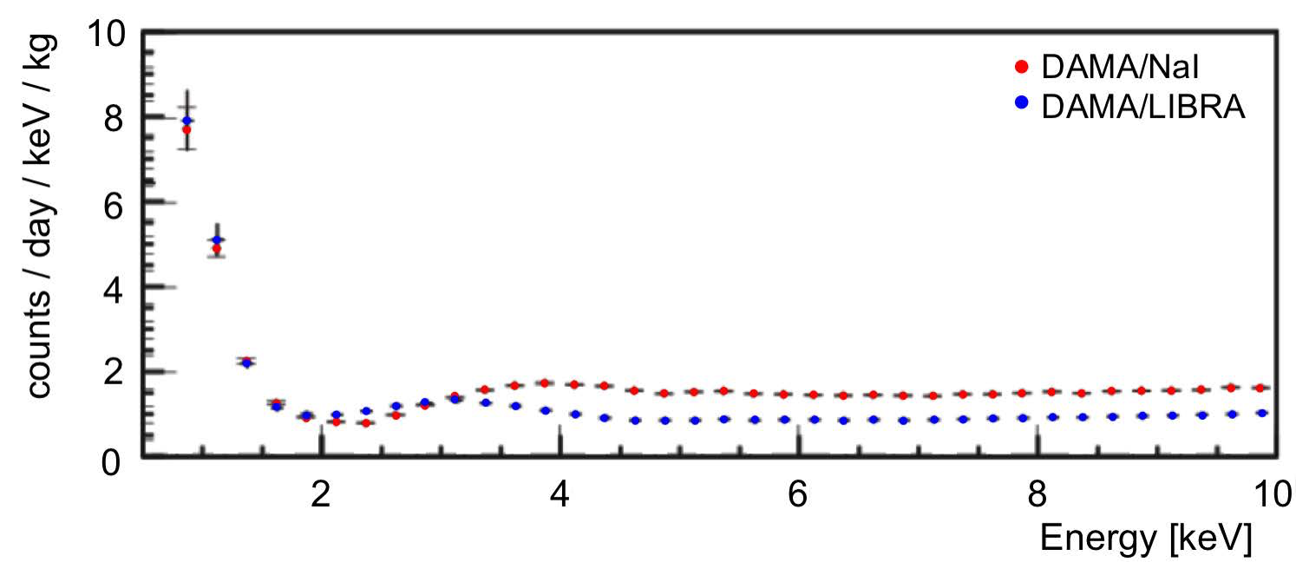
DAMA Data
⁴⁰K
Spectrum
Modulation

Slide 32
Scintillation Mechanism

Slide 33
DM-Ice17 Data

Slide 34
Pre-Deployment Source Runs
Boulby, UK
⁵⁷Co, ⁶⁰Co
PSL, WI
²⁰⁷Bi
Calibration estimate

Slide 35
Noise Removal

Slide 36
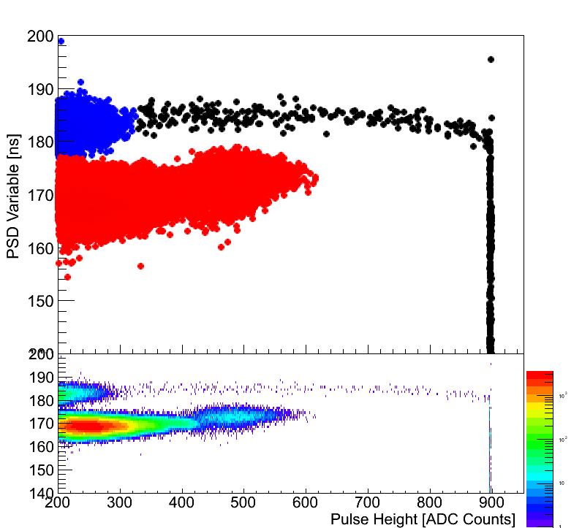

Muon Identification
Muons are identified with their high energy depositions and pulse shape variable using the pulse height (h_{i}) at time (t_{i}):
Gammas
Muons
Alphas
Expect 0 α, 3 γ in muon sample/year

Slide 37
Coincidence Processing
DM-Ice17 observes a muon
No
Was IceCube reading out?
(Is Level2 data available?)
Deadtime
(1.8%)
Yes
Is there a Muon Filter/sDST MinBias/sDST NCh event within [-1,+6] μs of the DM-Ice17 muon?
No
No coincidence
Yes
Coincident:
Run missing reconstructions
Output coincident event

Slide 38
Effect on Misreconstructions
Total number coincident: 1666 (43% coincident)
Expected accidental coincidence/crystal ~ 20
Misreconstruction rate reduced in Det-1 from 17% to 6.3%
Improvement from NCh only
Detector | Total | Zenith > 90° | Energy < 100GeV | Distance > 20m | Nan Reco
Det-1 Traditional | 1072 | 115 | 62 | 141 | 5
Det-1 DM-Ice seed | 1072 | 44 | 23 | 166 | 0
Det-2 Traditional | 594 | 145 | 23 | 94 | 1
Det-2 DM-Ice seed | 594 | 100 | 22 | 111 | 0

Slide 39
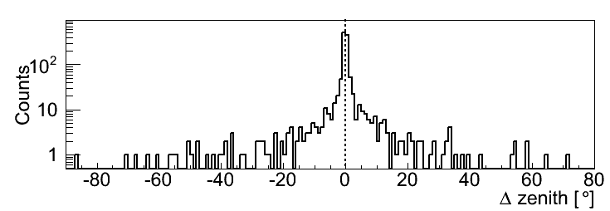
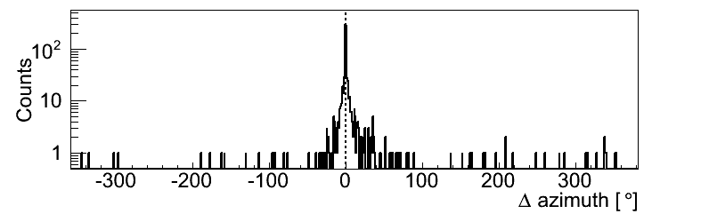
Reconstruction: Zenith & Azimuth
Comparison of reconstruction parameters with/without DM-Ice seeds confirms IceCube resolution
Difference distributions centered about 0 ± 0.7°

Slide 40
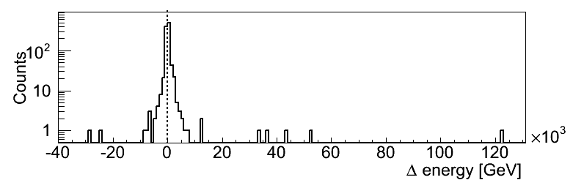
Energy
DM-Ice17 slightly prefers a higher energy reconstruction
Through-going events
Difference centered about 84 ± 600 GeV
1400m 2200m
1600m 2400m*
1800m 2600m*
2000m
10⁰ 10¹ 10² 10³ 10⁴ 10⁵ 10⁶
Muon energy [GeV]

Slide 41
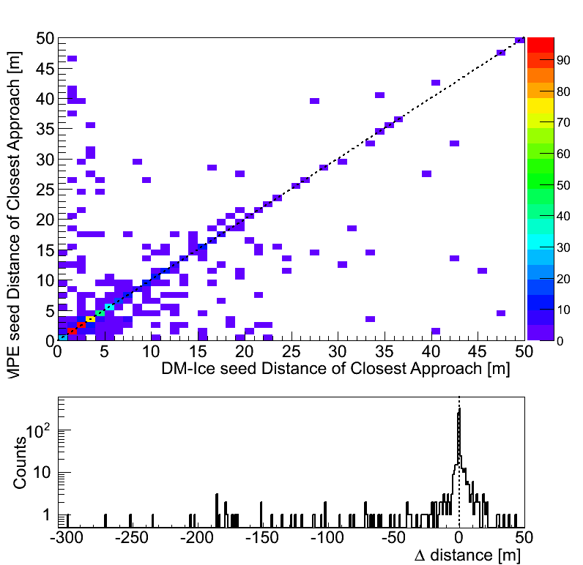
Reconstruction Comparisons
Distance of closest approach indicates room for improvement
53% of events reconstruct closer with DM-Ice seed
MPE
resolution
MPE
resolution
10⁰ 10¹ 10² 10³ 10⁴
Distance of Closest Approach [m]

Slide 42
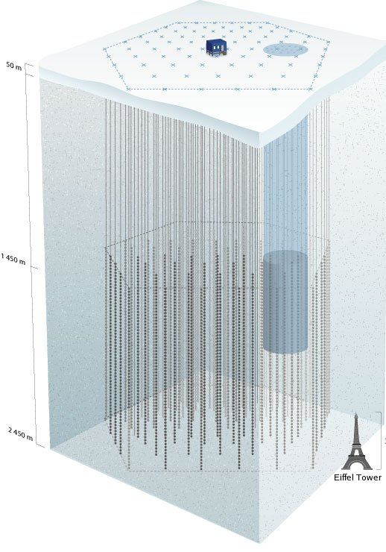
Conclusions: DM-Ice17/IceCube
Successful coincidence identification
IceCube verifies DM-Ice muon tag
Energy and direction information
DM-Ice17 offers a calibration tool for IceCube
Particularly for low energy
Interest from low energy, calibration, and reconstruction working groups
Future: optimization of reconstruction use, integration of IceTop, PINGU development

Slide 43
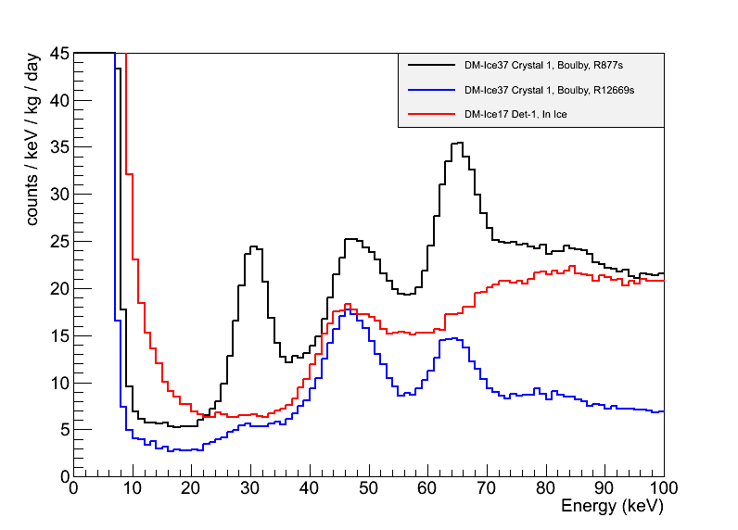
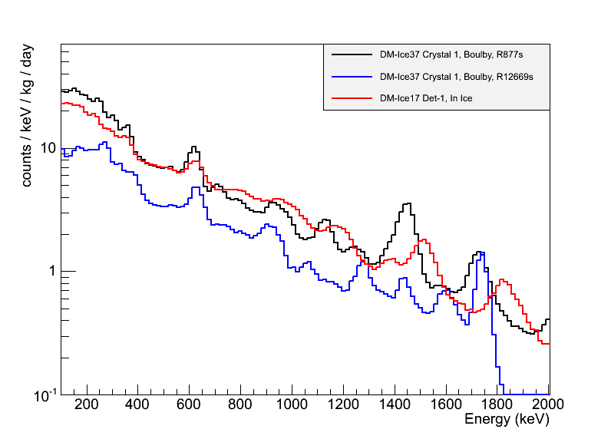
DM-Ice37 Contamination
Collective NaI(Tl) effort (DM-Ice, ANAIS, KIMS)
Goal set by DAMA: 1 dru in ROI
Currently: 3 dru above noise energies
Noise removal in progress
DM-Ice17: 8 dru
3 mBq/kg ⁴⁰K, ²¹⁰Pb reduction in R&D
Significant improvements
in location and PMTs

Slide 44
DM-Ice37 Phosphorescence
Phosphorescence observed with R&D crystals
~300 ms decay
Longer time in ice likely from older crystals
Exposure to radiation can produce crystal defects and traps
muon
Preliminary
0 0.5 1 1.5 2 2.5 3
Trigger time [s]

