Slide 1
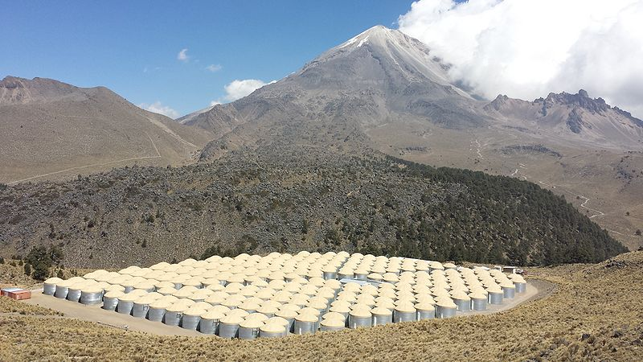


HAWC: A New Gamma-Ray Observatory to Probe Nature's Highest-Energy Accelerators
Tom Weisgarber
University of Wisconsin-Madison
IceCube Bootcamp
10 June 2015

Slide 2
High-Altitude Water Cherenkov Observatory
HAWC is a co-planar array of 300 detectors, each of which is an instrumented 185,000 liter water tank. It is located in Mexico at 4100 meter altitude
The primary goal of the HAWC Observatory is to detect gamma rays from astrophysical sources (Galactic and Extragalactic)
Detection of cosmic rays a secondary but important goal

Slide 3
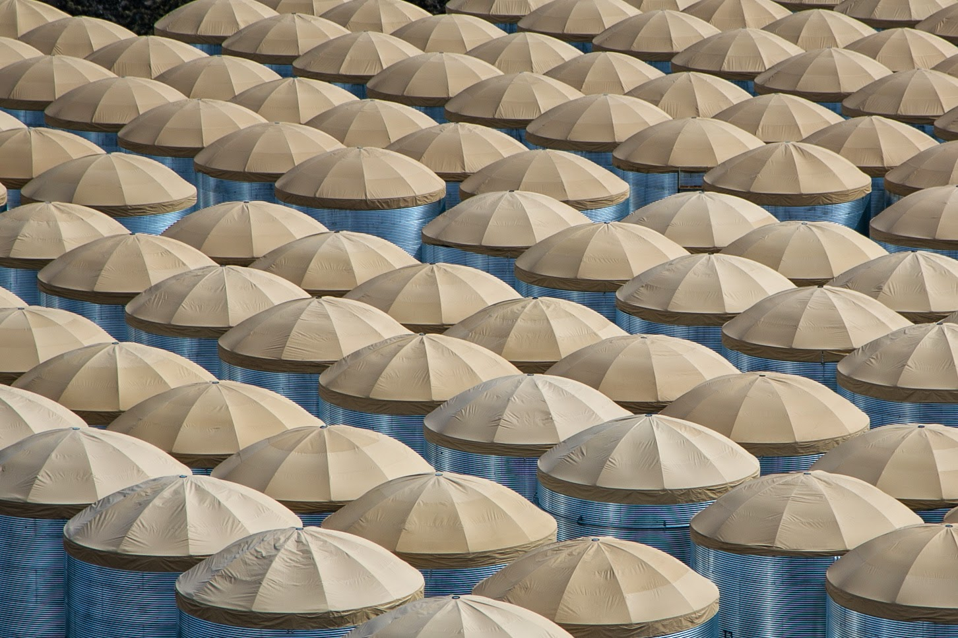
Outline
Outline
Science
TeV Gamma-Ray Astronomy
Cosmic Rays and their Sources
Detection Techniques
Air Showers
The HAWC Observatory
Results
First Look at HAWC Data

Slide 4
Particle Astrophysics
“Classical” Astronomy – electromagnetic spectrum from radio to X-rays.
Gamma-Ray Astronomy – photons (light particles) with energies 10¹⁰ larger than optical light.
Cosmic Rays – protons and heavier nuclei with energies up to several Joule, the highest particle energies observed in the Universe.
Neutrinos – tightly connected to cosmic rays and their sources, but neutral and not subject to deflection in magnetic fields (= easier for “astronomy”).

Slide 5
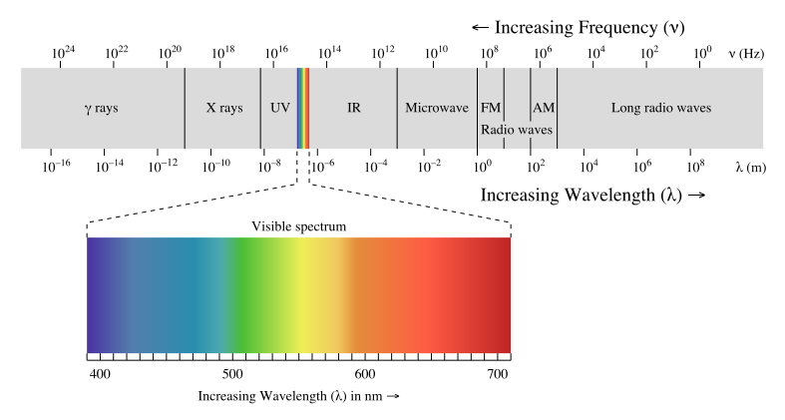
Electromagnetic Spectrum
TeV gamma-ray
astronomy
Energy

Slide 6
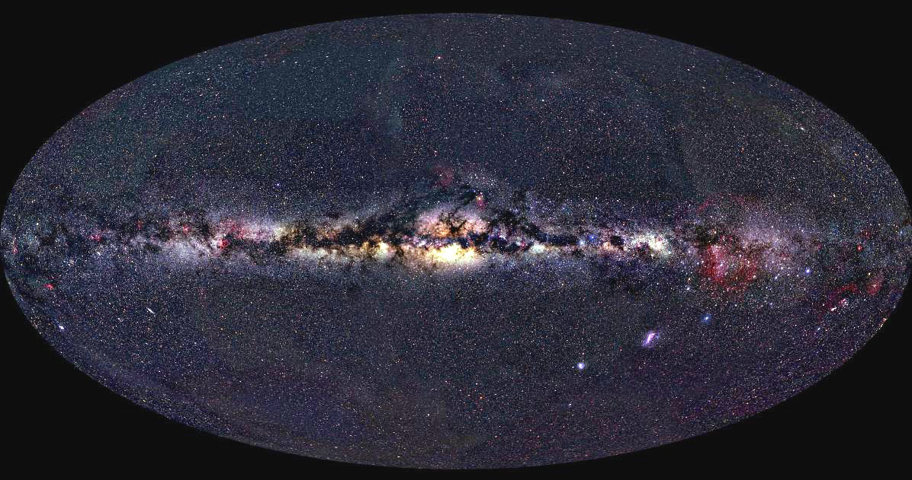
The Multiwavelength Sky
The most familiar
wavelength: optical…
Stars, low density gas
~eV

Slide 7
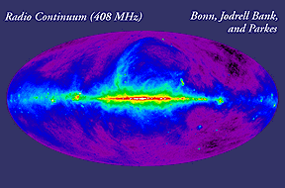
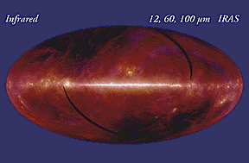
Going to Lower Energy…
radio
2 meV
Scattering of free electrons
in ionized interstellar gas
Interstellar dust warmed by absorbed starlight, starforming regions
infrared
0.01 – 2 eV

Slide 8
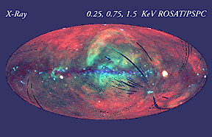
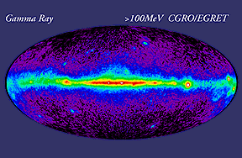
Going to Higher Energy
X-ray
1000 eV = 1 keV
Hot gas
Collisions of cosmic rays with nuclei in interstellar clouds
Gamma ray
>100 MeV

Slide 9
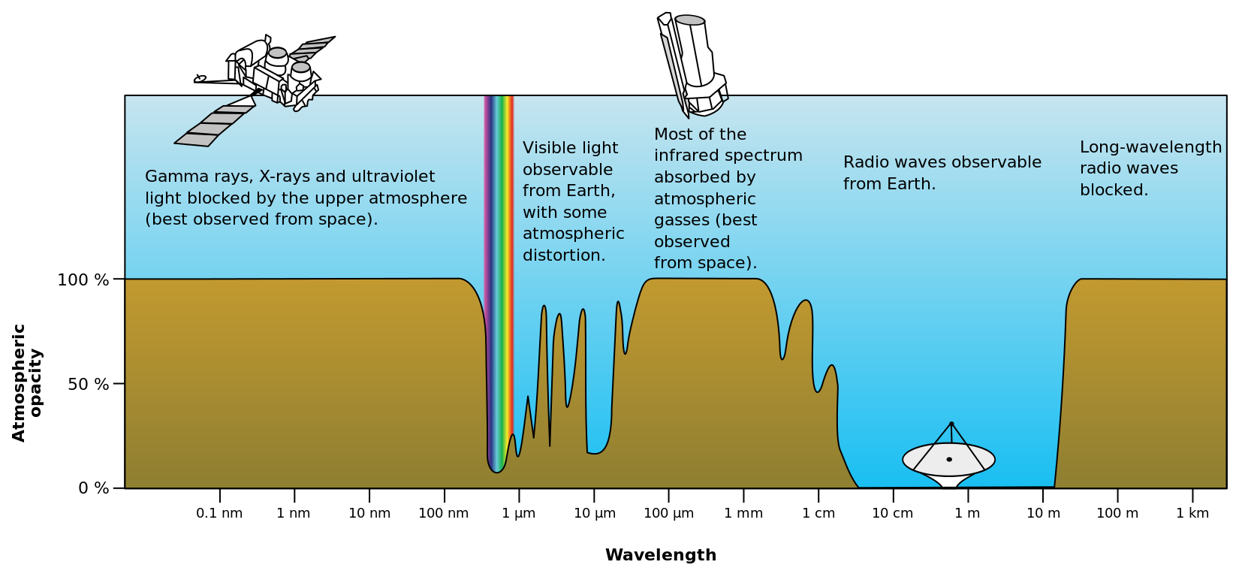
Observation Techniques
energy
Gamma Rays X-Rays UV Optical Infrared Radio
Source: NASA

Slide 10
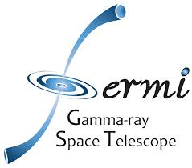
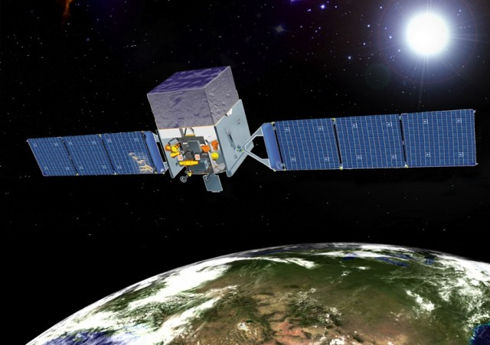
The Sky at GeV

Slide 11
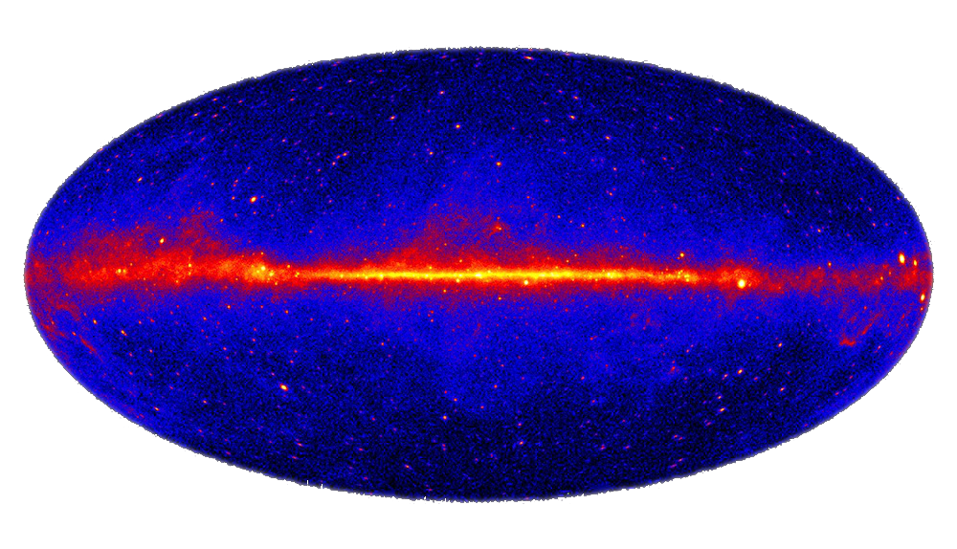
GeV Sky (10⁹ eV)
NASA’s Fermi Gamma-Ray Telescope
Fermi-LAT 2-year all-sky survey at energies > 1 GeV.
~2000 gamma-ray sources.
arXiv:1108.1435 (ApJ Supp.)
Galactic
coordinates

Slide 12
Sources of Gamma Rays
Most gamma rays with energy > 100 MeV originate in collisions of cosmic rays with nuclei in interstellar clouds (so the Milky Way is a diffuse source of gamma-ray light).
Superimposed are several gamma-ray pulsars, e.g., the Crab, Geminga, and Vela pulsars along the Galactic plane.
Away from the plane, many of the sources are known to be active galactic nuclei.

Slide 13
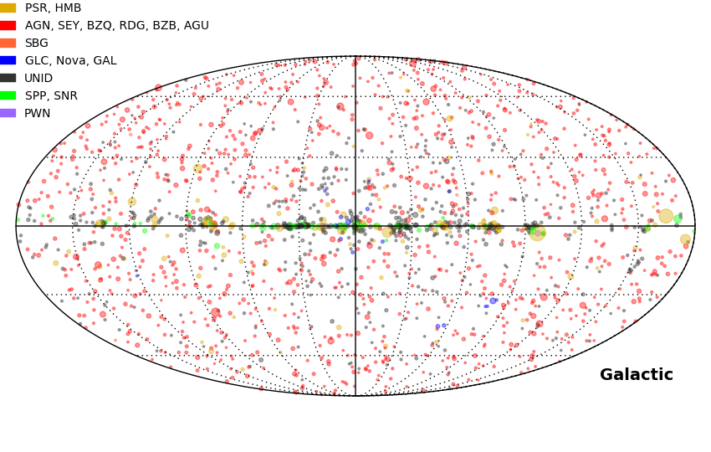
GeV Sky (10⁹ eV)
Can we go to even higher energies?

Slide 14
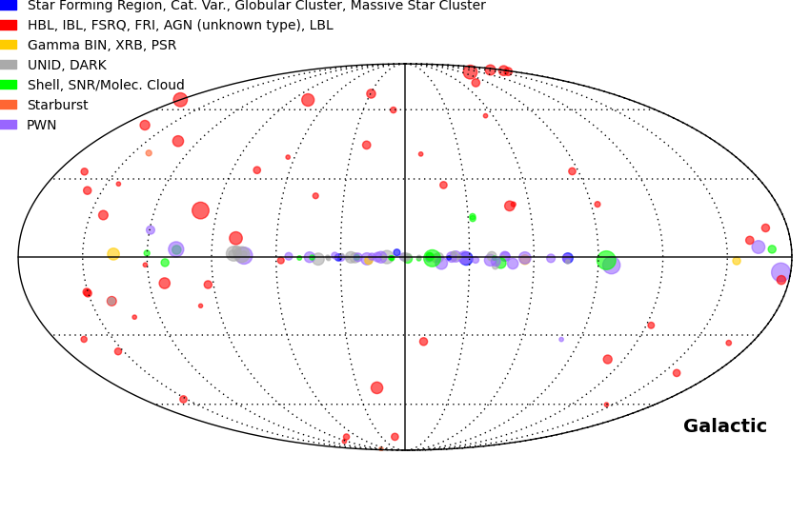
TeV Sky (10¹² eV)
http://tevcat.uchicago.edu
TeV Catalog (2015)
~160 sources (~100 Galactic).
Not an all-sky survey - catalog is strongly biased.

Slide 15
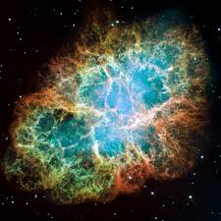
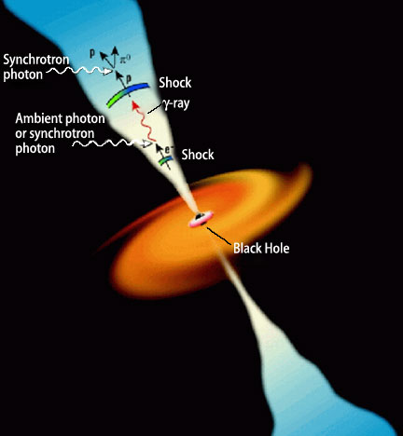
TeV Sources
Galactic Sources:
Supernova Remnants, pulsars,…
Extragalactic Sources:
Active Galactic Nuclei,…

Slide 16
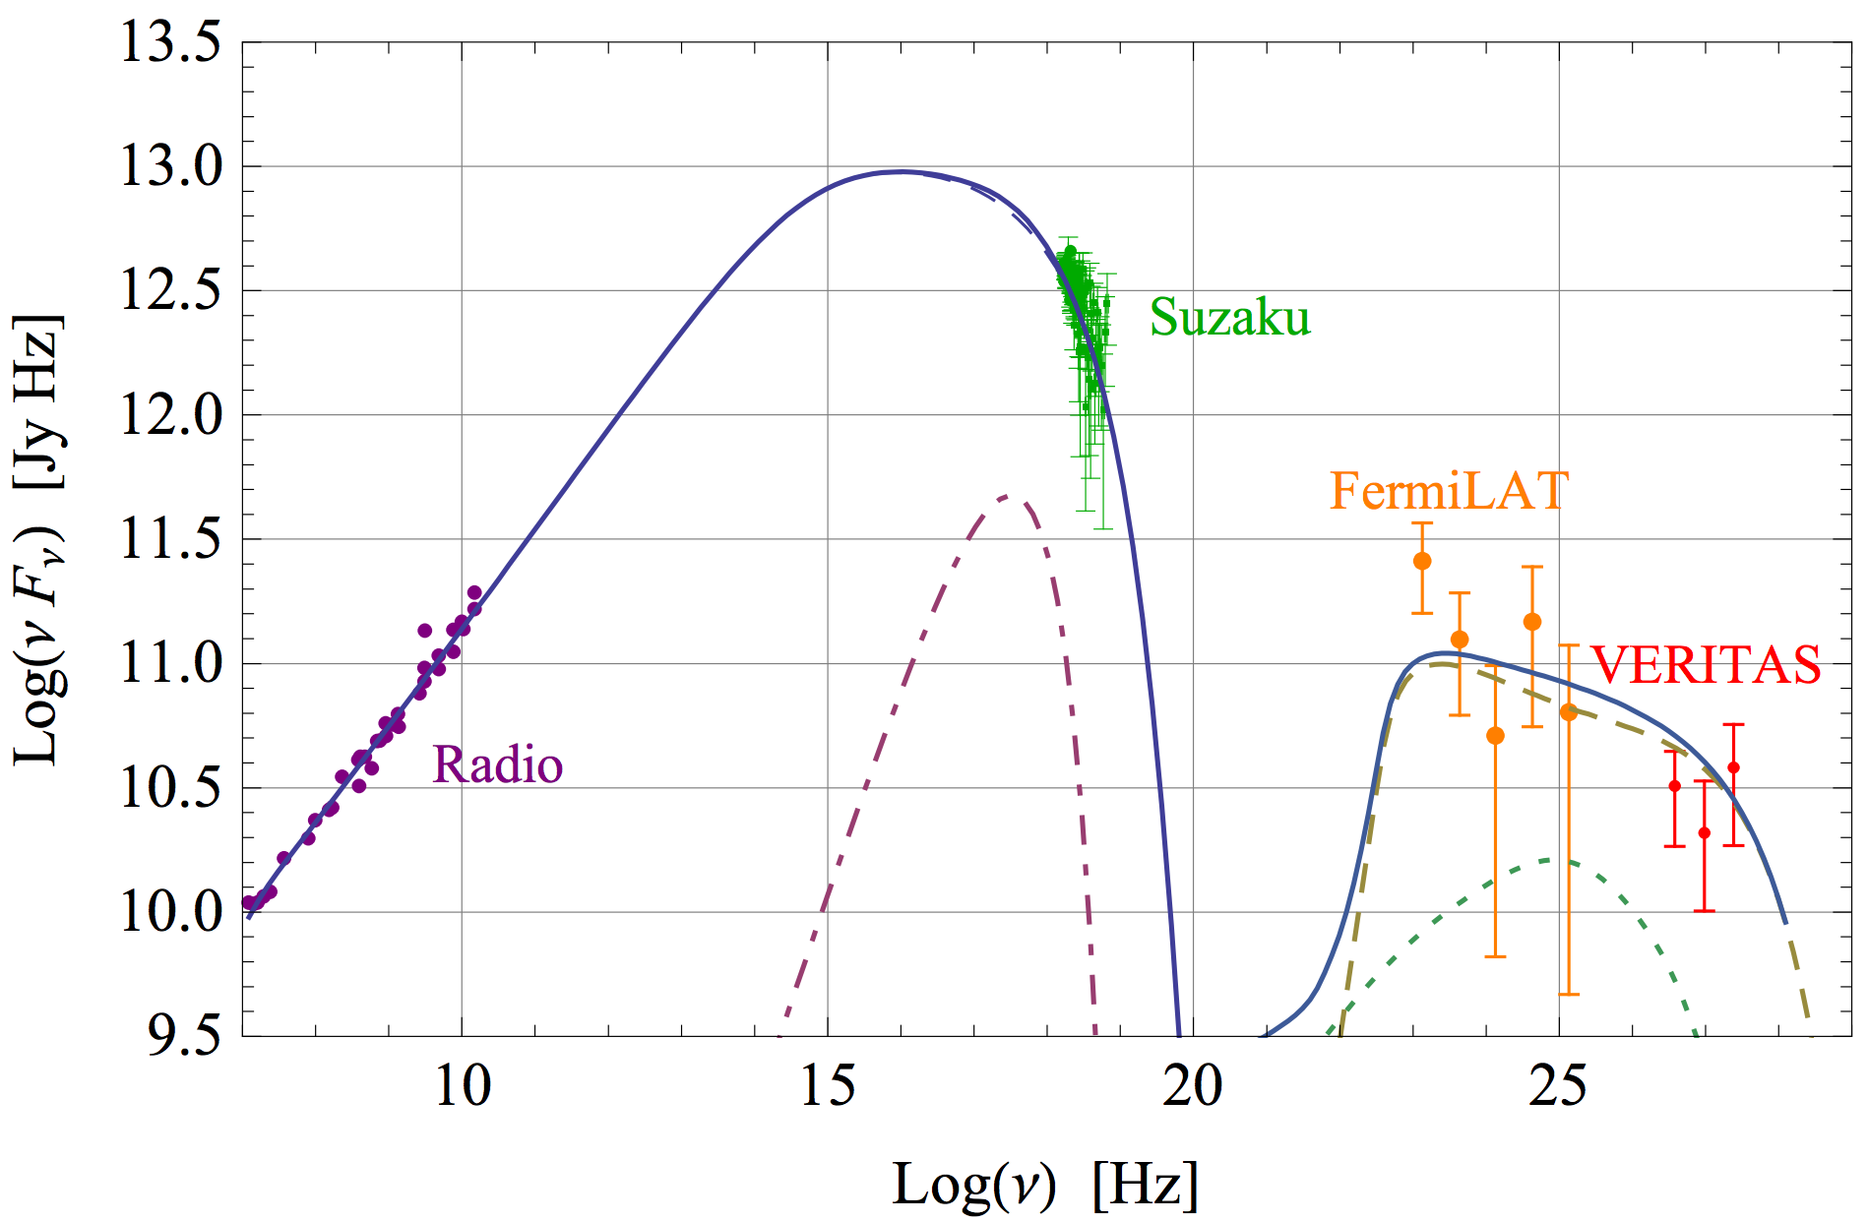
SN 1572 (Tycho’s SNR)
G. Morlino and D. Caprioli, A&A 538 ( 2012) A81
Energy [eV]
10⁻³
10³
10⁹

Slide 17
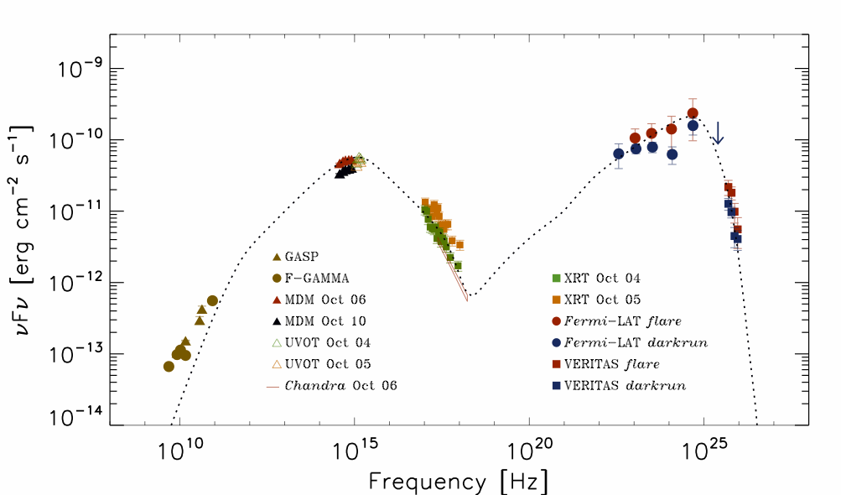
AGN 3C 66A
Spectral Energy Distributions have a characteristic two-hump structure.
GeV
TeV
optical
X-ray
radio

Slide 18
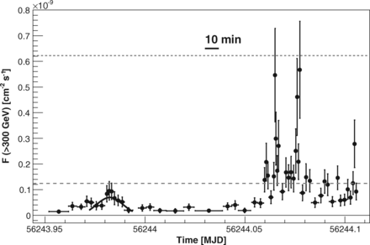
Variability of the TeV Sky
IC310 observed by the MAGIC telescope (Science, 28 November 2014)

Slide 19
Why Study the TeV Band?
TeV gamma rays are the highest energy gamma rays observed so far – this is the energy frontier of (photon) astronomy!
TeV sources emit radiation over more than 15 orders of magnitude in energy, from radio to TeV!
Historically, opening new windows in astronomy results in major, unforeseen discoveries.
Among the most tantalizing possibilities: the TeV window might help to identify the sources of cosmic rays and solve a hundred year old mystery…!

Slide 20
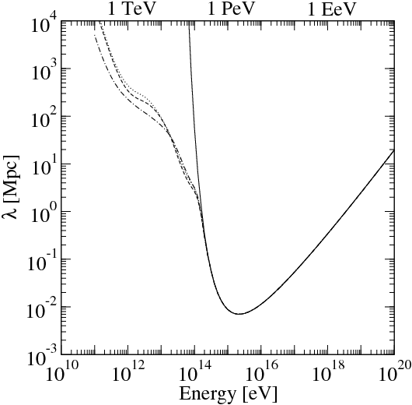
Energy Frontier, A Relative Term

Slide 21
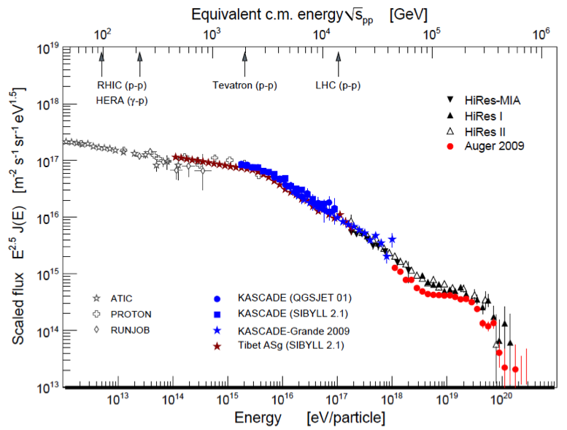
Cosmic-Ray Energy Spectrum
Extragalactic?

Slide 22
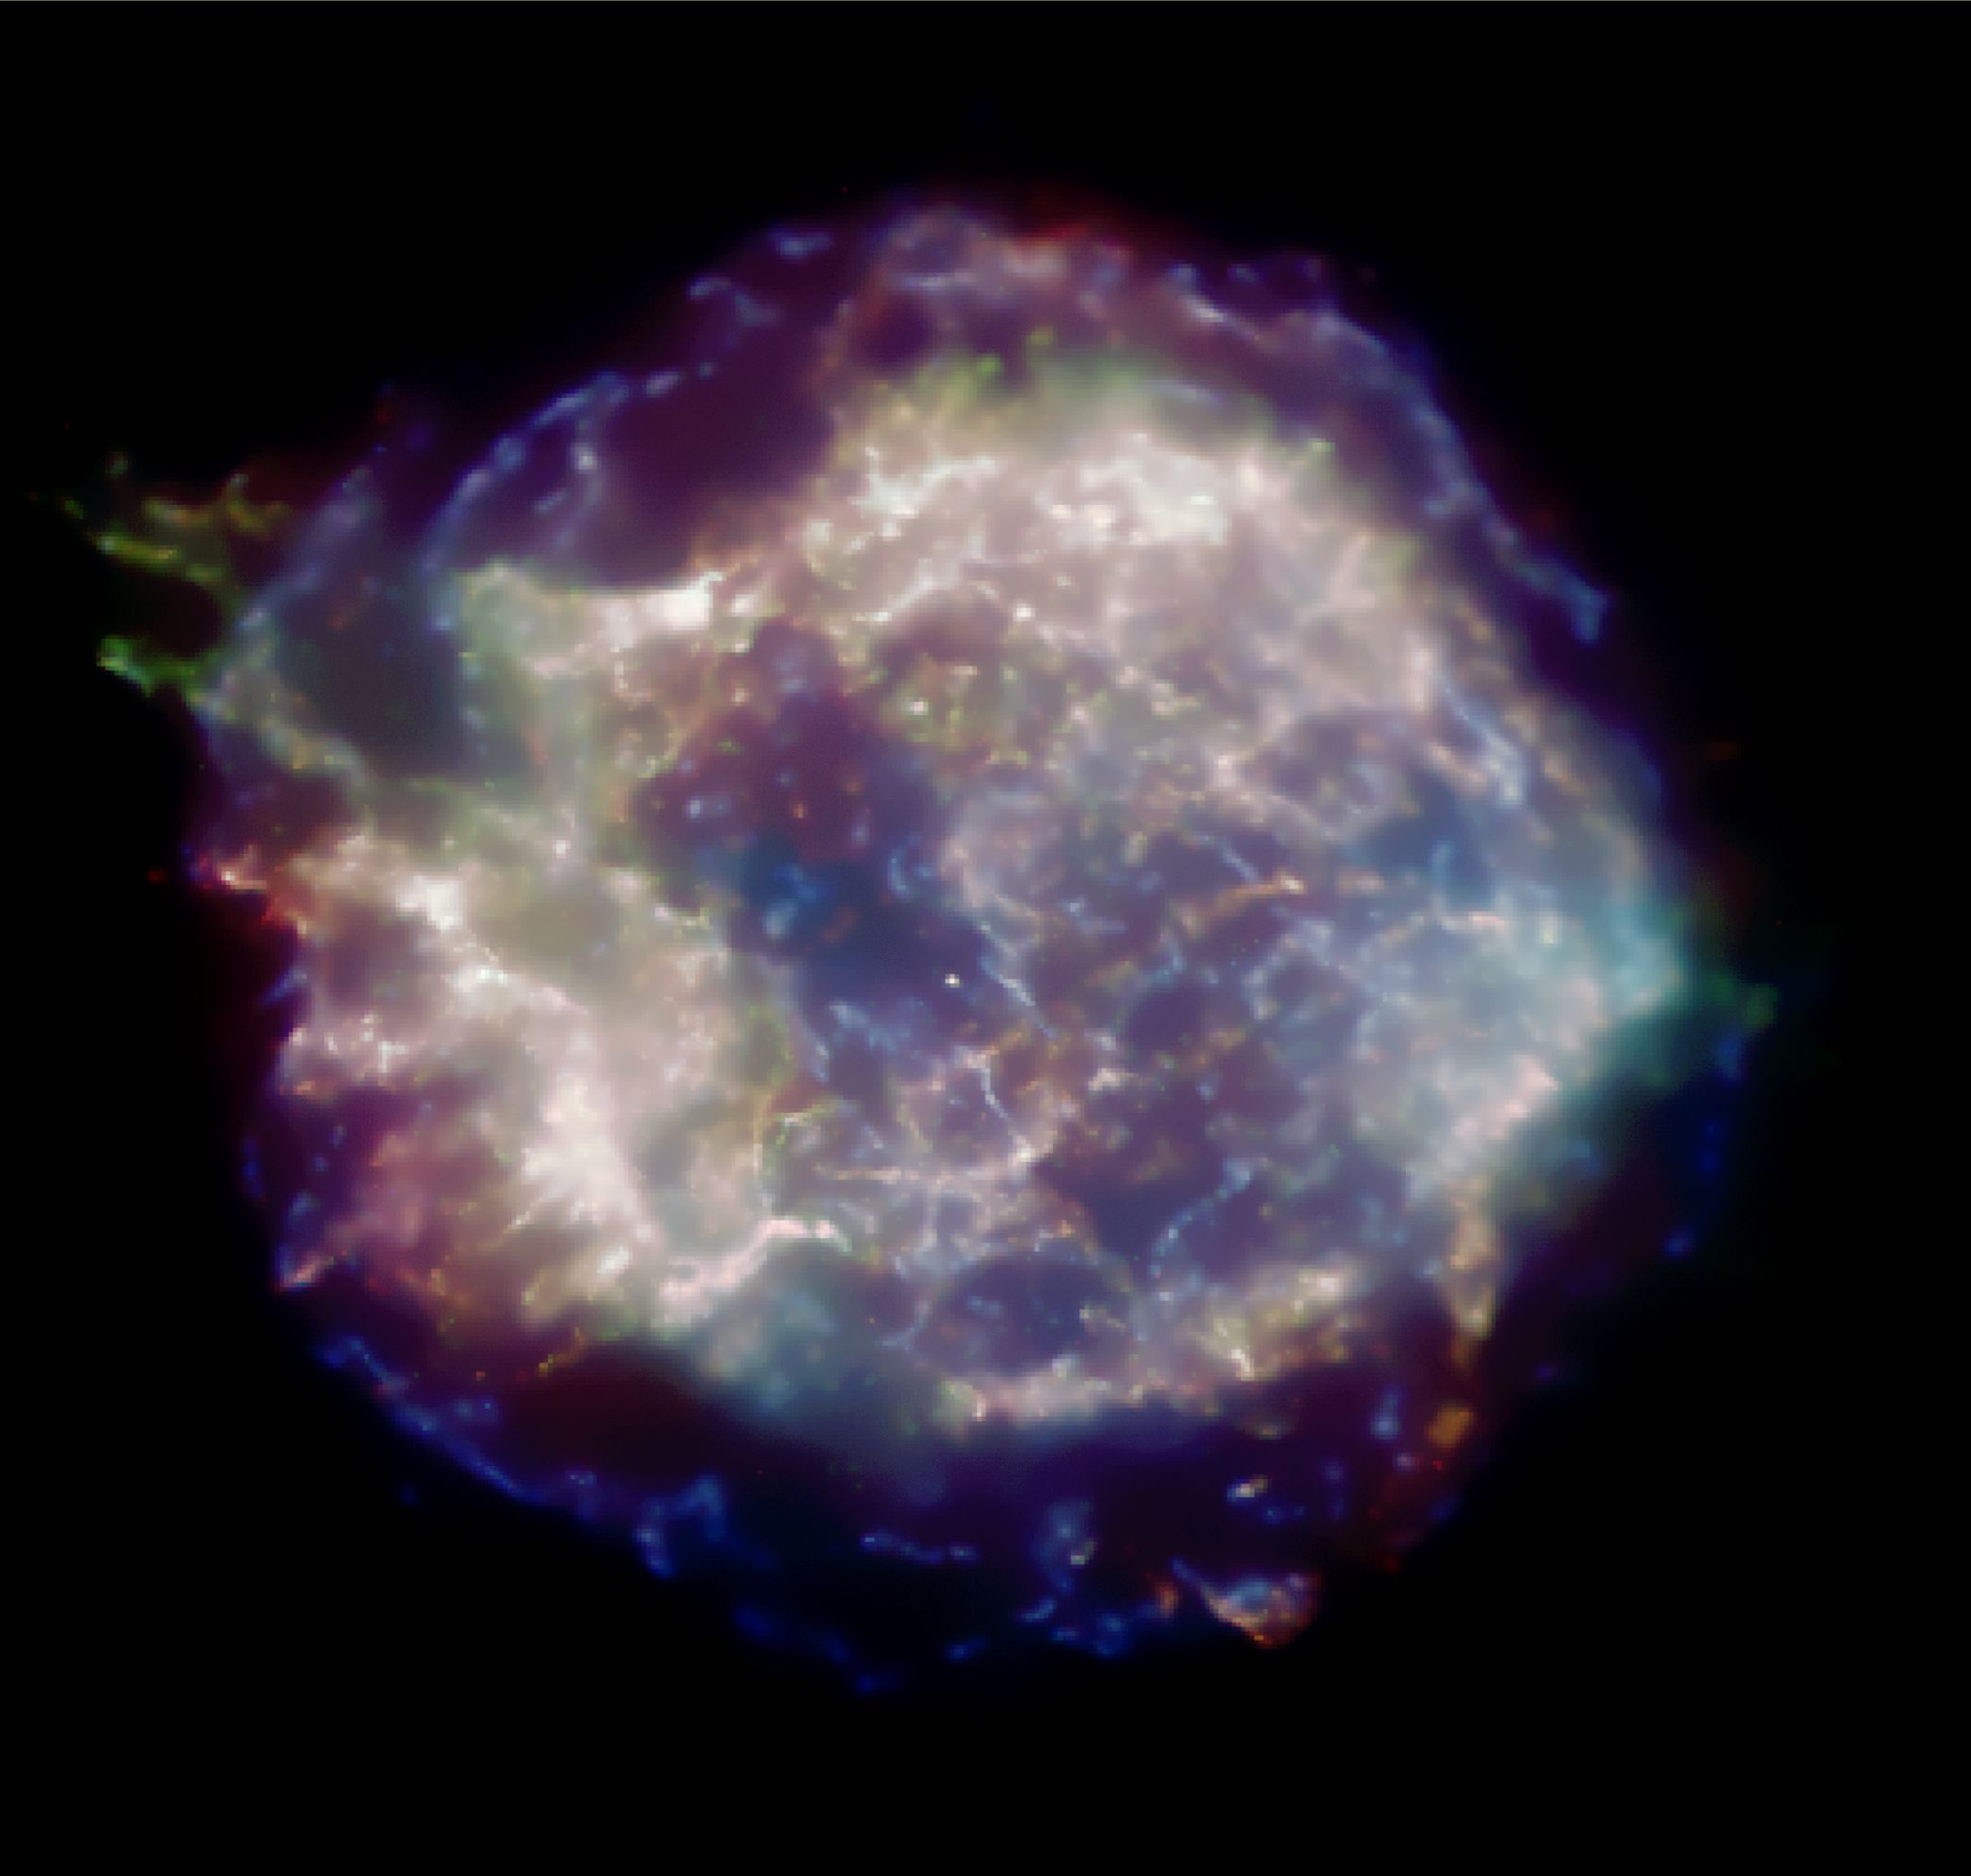
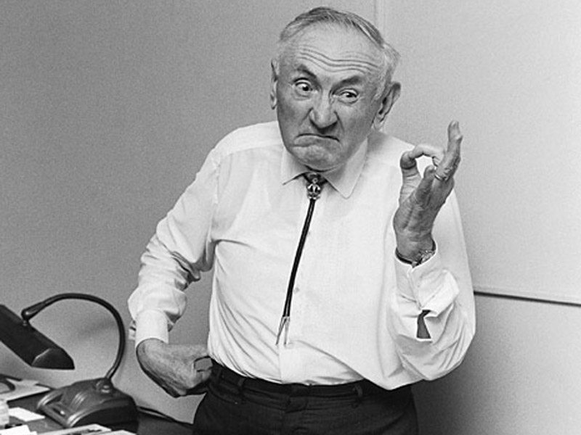
Galactic Cosmic Rays
Baade and Zwicky suggested in 1934 that supernova remnants could be the sources of Galactic cosmic rays.
Fritz Zwicky
Cas A, Chandra (NASA)

Slide 23
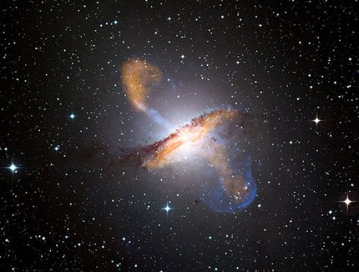
Extragalactic Sources
Active Galactic Nuclei (AGN) are possible sources for the highest energy cosmic rays.
AGN consist of a supermassive black hole, an accretion disk, and two jets in which shocks move outward.
Centaurus A (ESO 2.2 m WFI + APEX + Chandra)

Slide 24
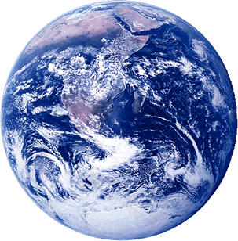
Cosmic-Ray Astronomy?
No source of Galactic or extragalactic cosmic rays has been identified so far.
The problem: cosmic rays are charged, and the universe is full of magnetic fields.
Below 10¹⁹ eV (at least) we expect the arrival directions of cosmic rays at Earth to be magnetically scrambled.
B-field
Cosmic ray
Cosmic Accelerator

Slide 25
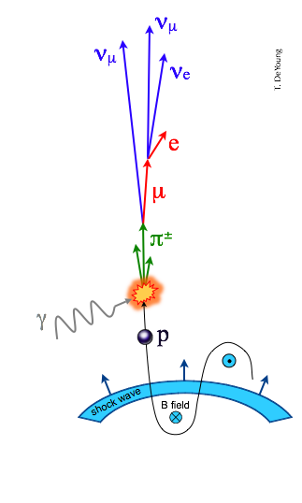
Gamma Rays
Cosmic rays interact with their surroundings.
The interactions will produce decay products:
Gamma rays
Neutrinos
Both are neutral and come to us in a straight line!
Energy escaping the source is distributed among cosmic rays, gamma rays, and neutrinos.

Slide 26
Multi-Messenger Astrophysics
Each channel has relative strengths and weaknesses:
Cosmic rays: ✓ largest flux, ✗ deflected by magnetic fields
Gamma-rays: ✓ undeflected, ✗ attenuated, ✗ ambiguous origin
Neutrinos: ✓ undeflected, ✓ unattenuated, ✗ difficult to observe
IR Starlight
B-field
Molecular Cloud
TeV gamma-ray
neutrino
Cosmic ray
Cosmic Accelerator

Slide 27
Messenger Particles
Cosmic rays are deflected by magnetic fields. No sources found so far.
Neutrinos are the “smoking gun” for cosmic-ray acceleration, but difficult to detect. No sources found so far.
Gamma rays are easy to detect; we have identified ~160 sources of TeV gamma rays!
Problems:
TeV gamma rays can be produced in other ways and are no “smoking gun” for cosmic-ray acceleration.
Gamma rays are absorbed by other radiation on their way from the sources to us, so we cannot see across the Universe

Slide 28
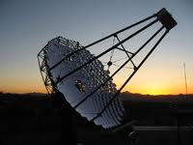
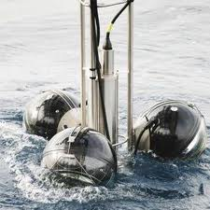
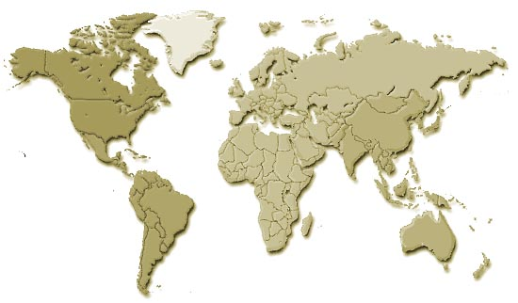
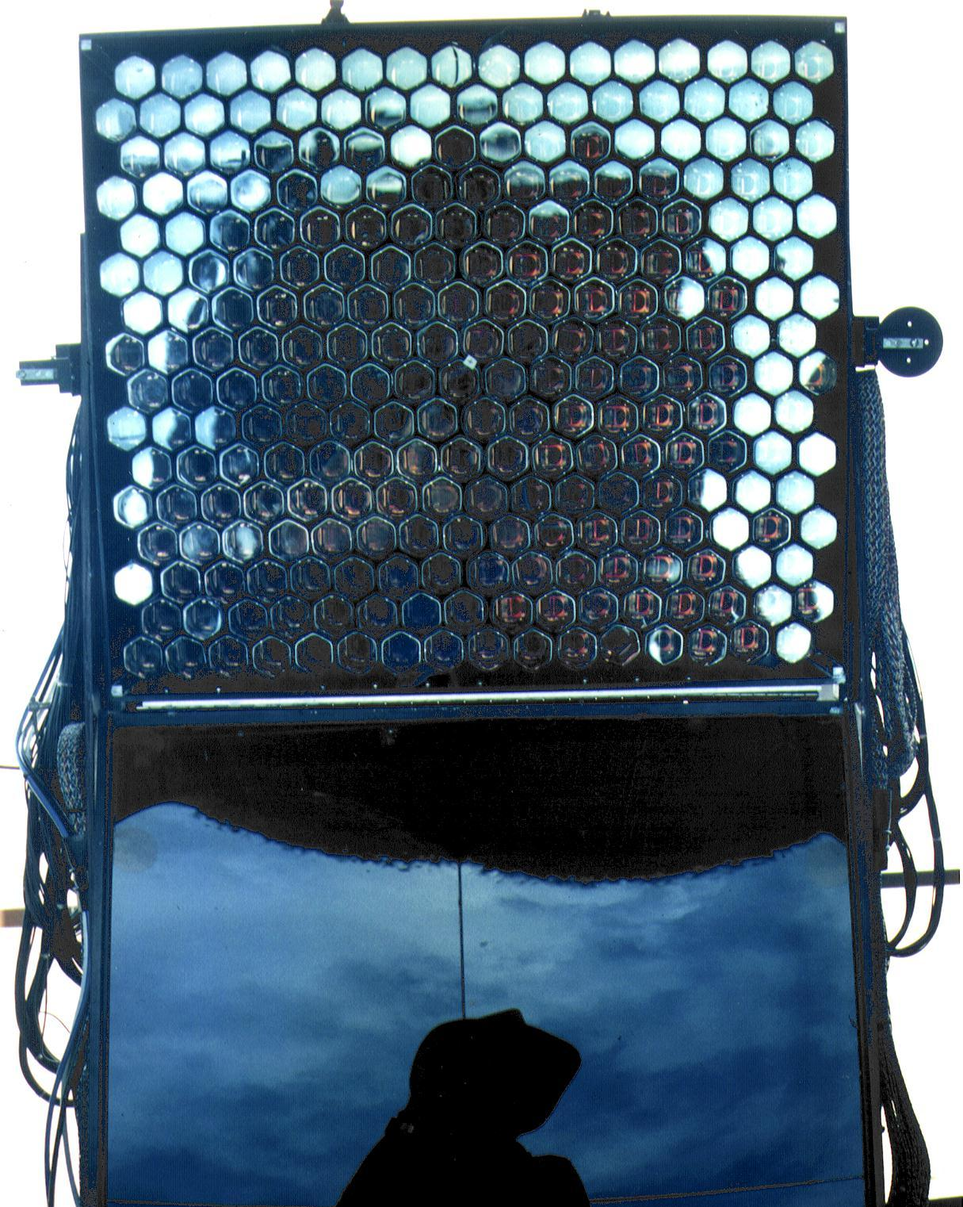
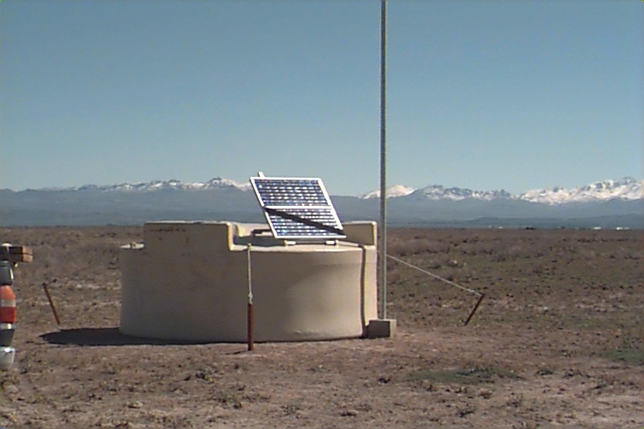
A World-Wide Effort
Antares/
KM3NeT
Veritas
Arizona
Yakutsk
Haverah Park
HiRes/TA
MAGIC
Lake Baikal
Utah
Milagro
AGASA
HAWC
Mexico
H.E.S.S.
Namibia
Auger
SUGAR
Argentina
IceCube
South Pole

Slide 29
Detecting TeV Gamma Rays
The flux of TeV gamma rays is more than 6 orders of magnitude smaller than at GeV energies, where the Fermi satellite operates. To get sufficient flux, the experiment must cover a large area, at least soccer field size…
… so the experiment must be Earth-bound.
The Earth’s atmosphere is 100% opaque to gamma rays at TeV energies.
Gamma rays and cosmic rays interact with air molecules and develop cascades of secondary particles, so-called air showers. The atmosphere acts as a giant calorimeter. We can use this to our advantage!

Slide 30
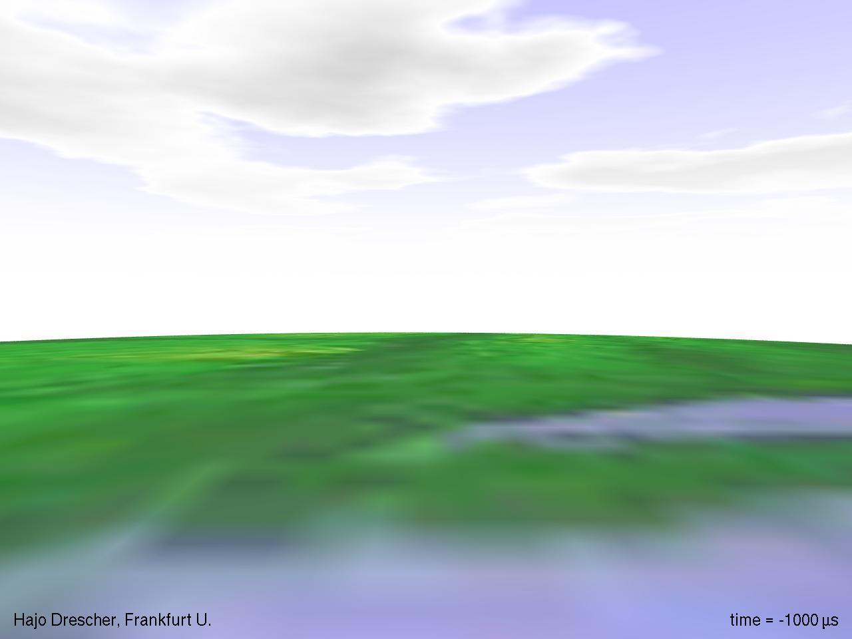

Slide 31
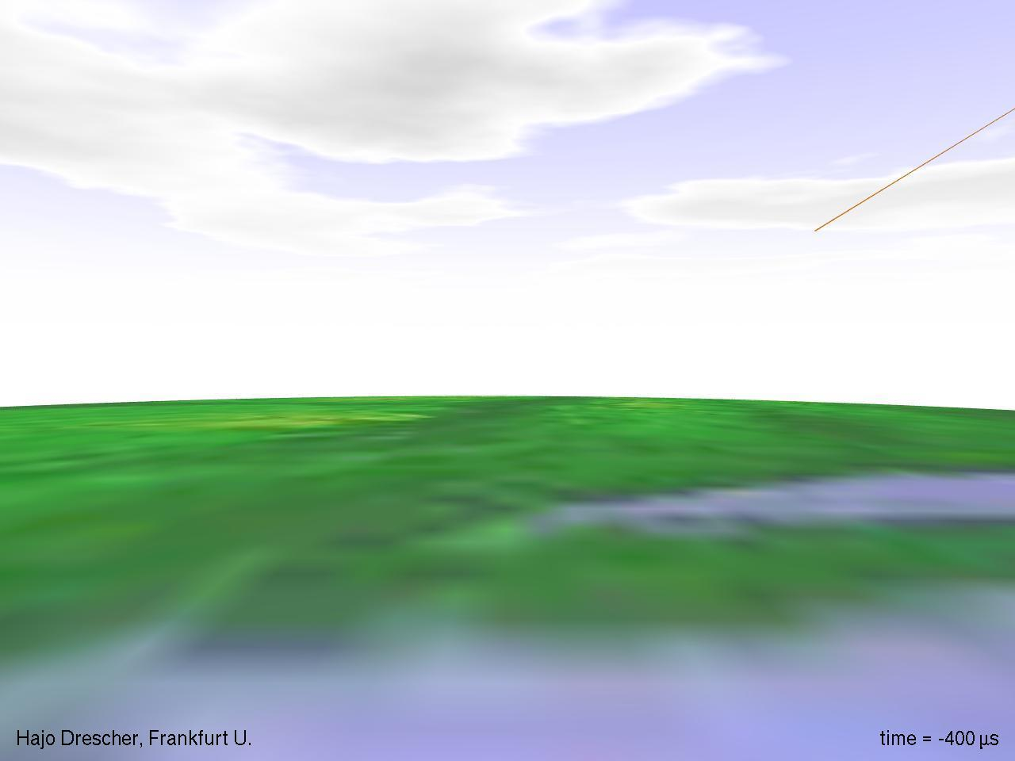

Slide 32
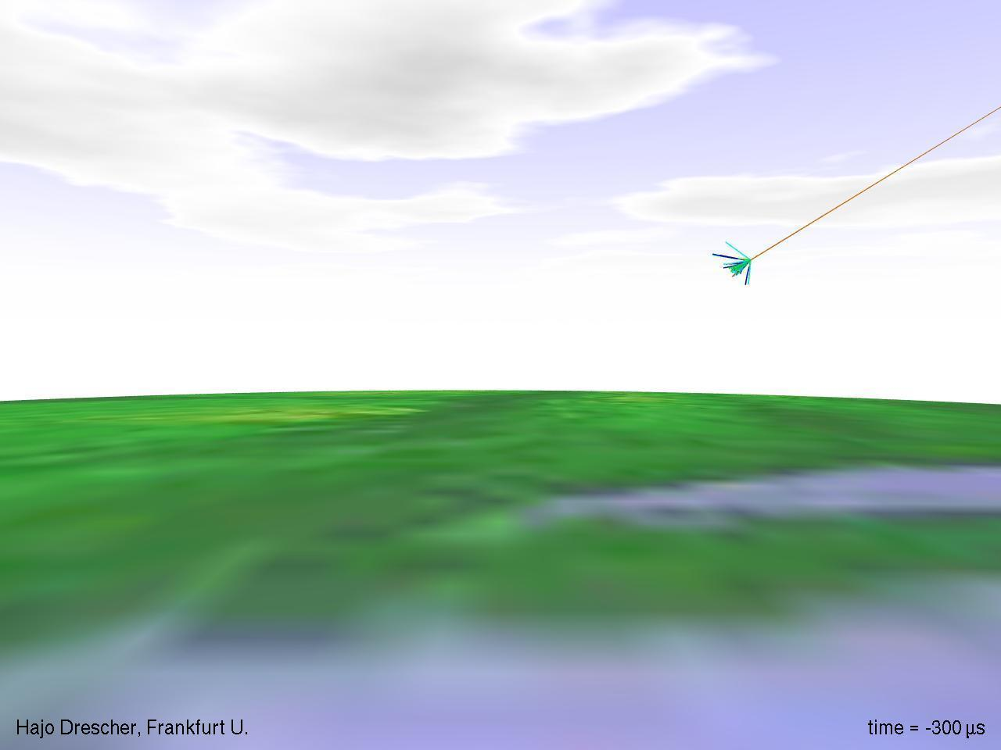

Slide 33
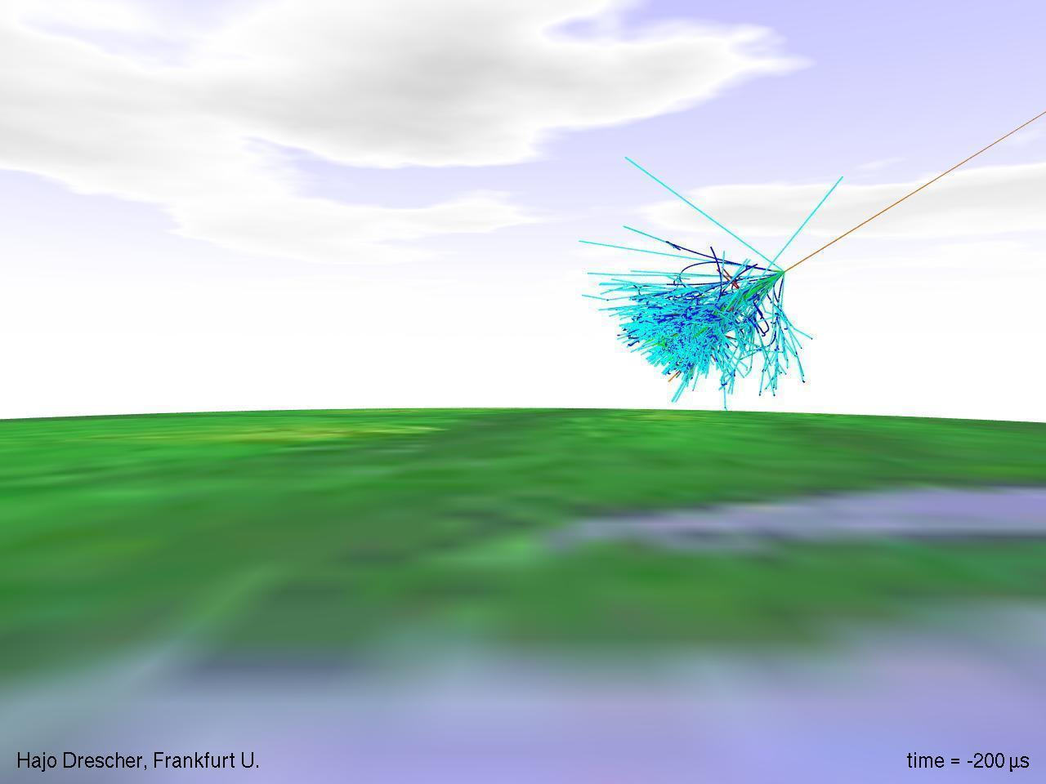

Slide 34
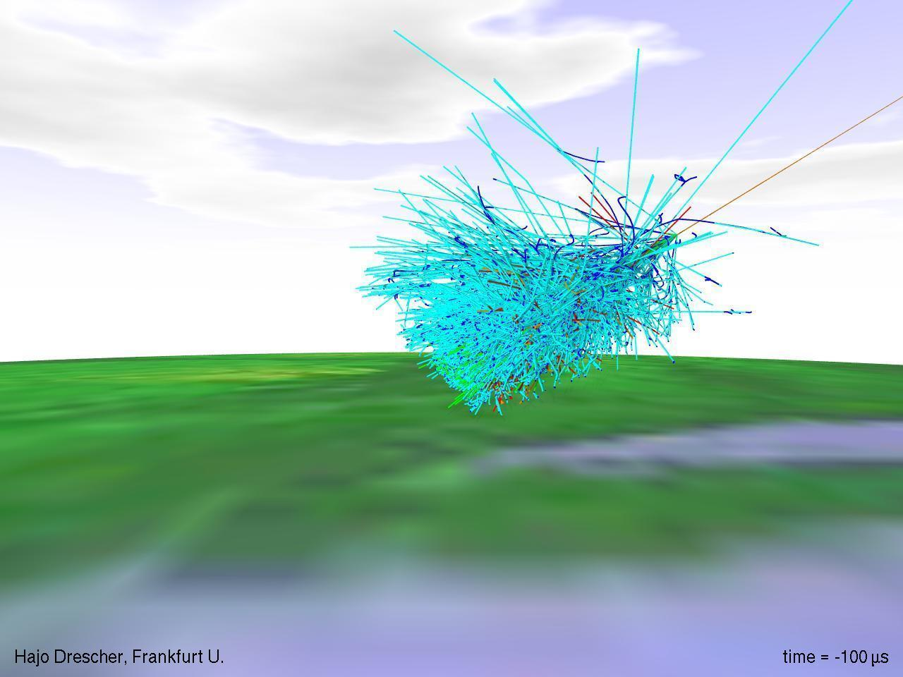

Slide 35
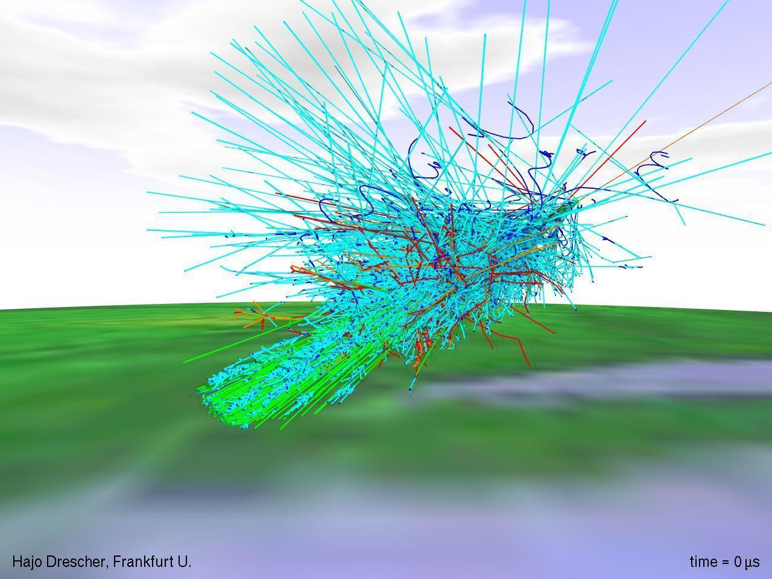

Slide 36
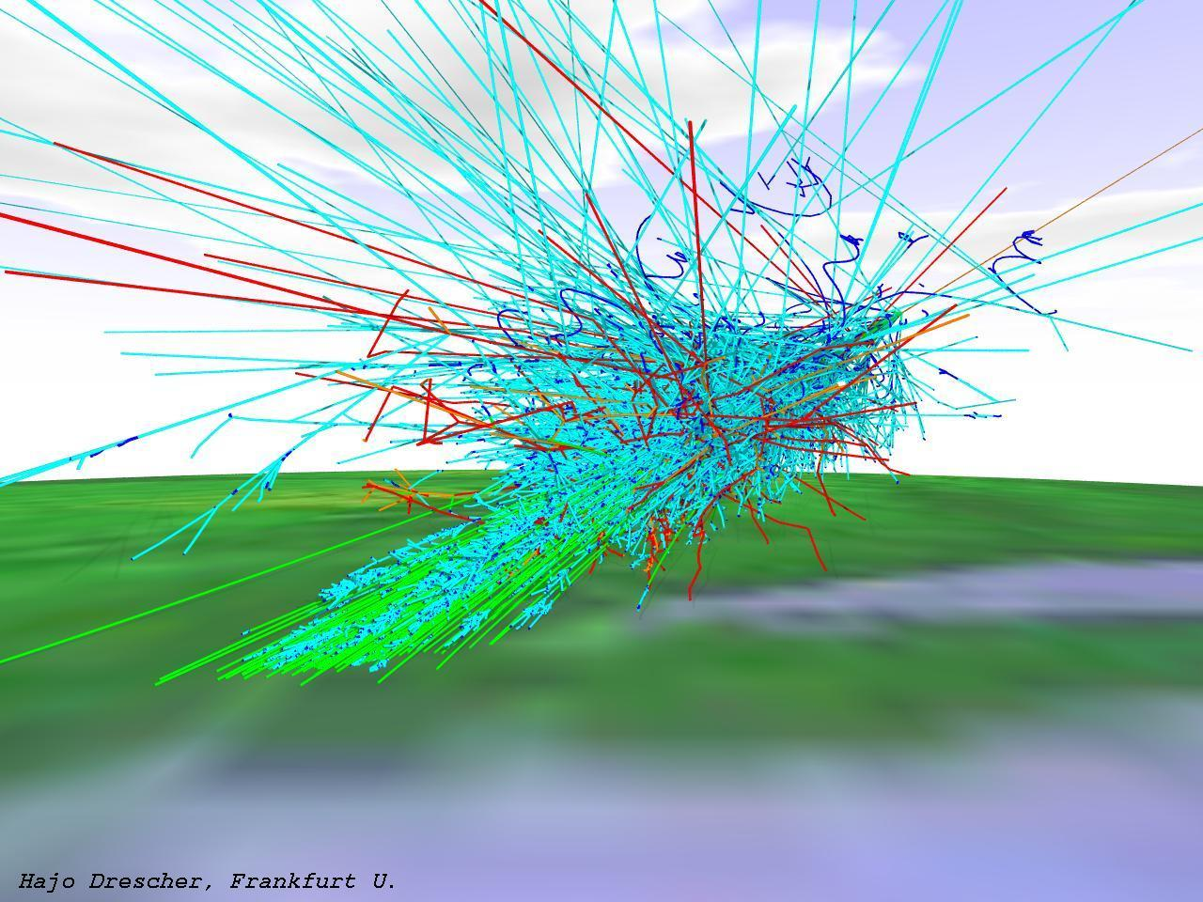
muon flux at sea level:
1 per cm² per minute

Slide 37
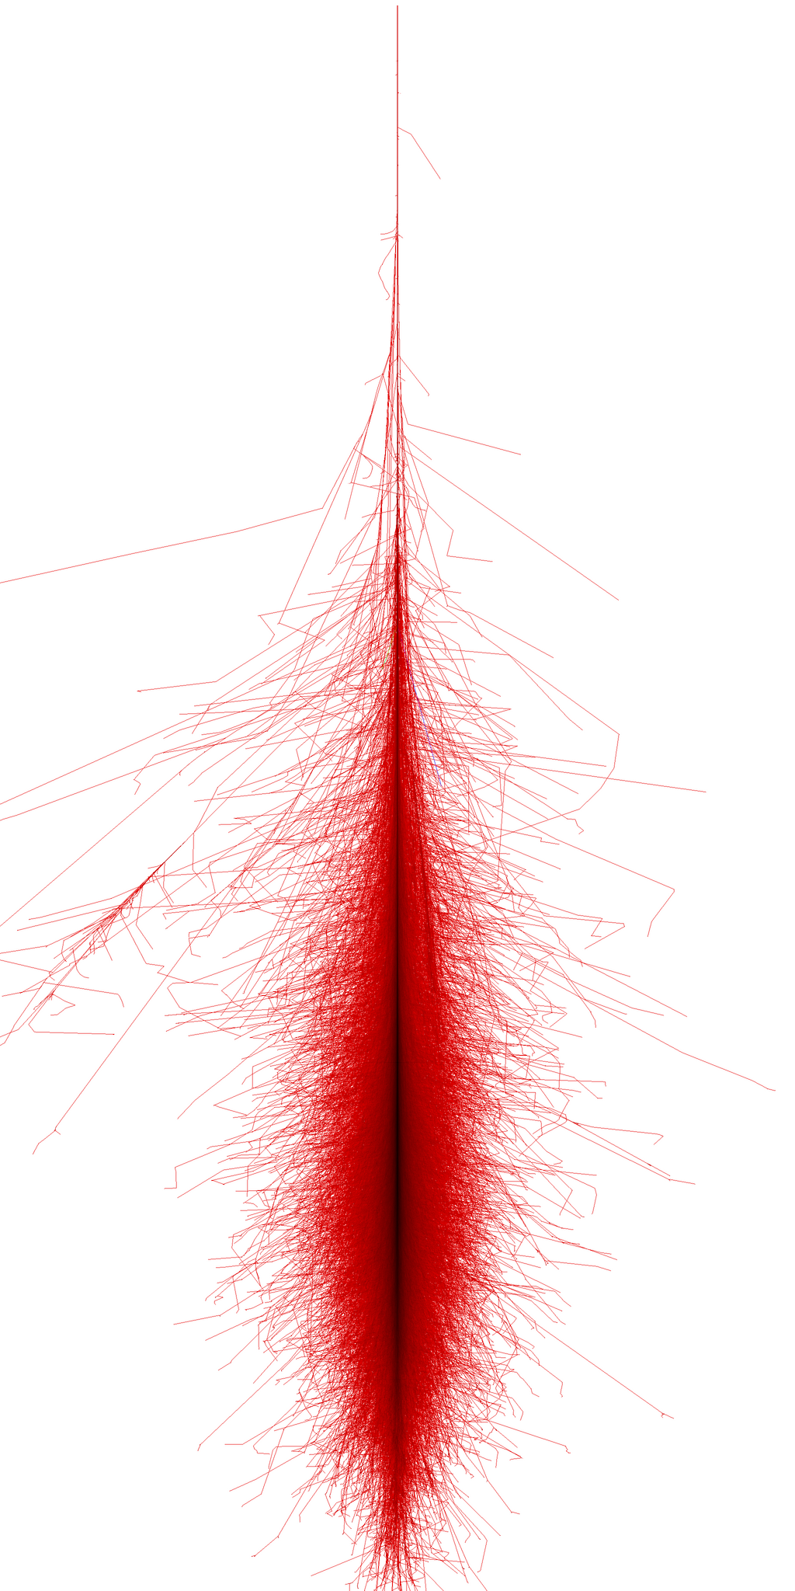
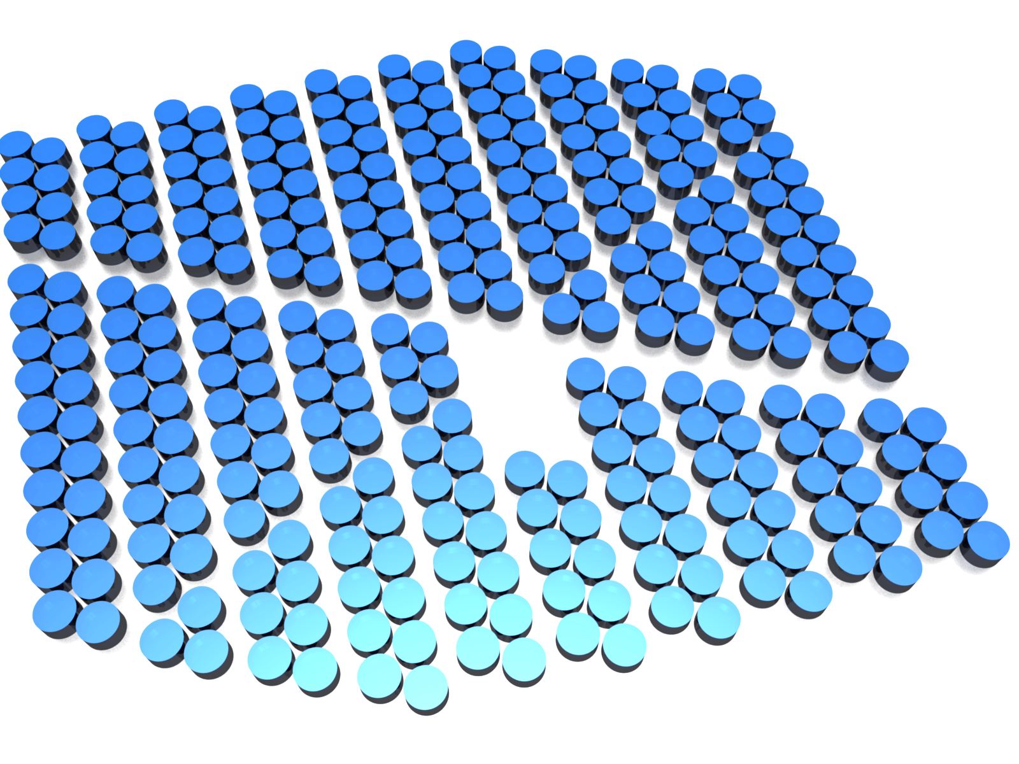
Detecting TeV Gamma Rays
(Two) methods for detecting air showers:
A fraction of the secondary particles hits the ground and can be detected by arrays of particle counters.
The air shower particles are relativistic and produce Cherenkov light which can be picked up by light detectors.
Both techniques use Cherenkov light and photomultiplier tubes…

Slide 38
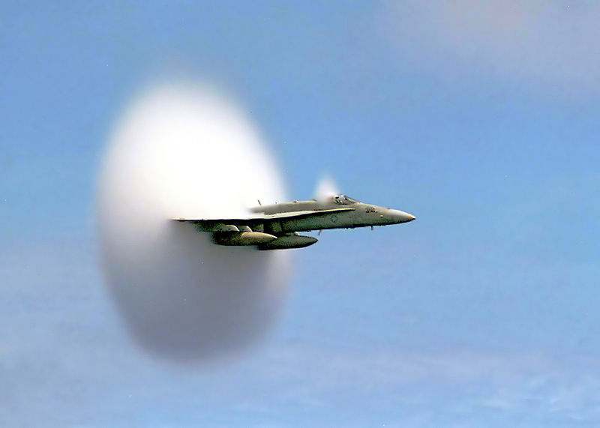
Cherenkov Light
this object is probably not emitting Cherenkov light

Slide 39
Cherenkov Light
Cherenkov light is produced when particles travel through a medium (air, water,…) at a speed faster than the speed of light in the medium.
Cherenkov light is emitted in the forward direction, and the emission angle depends on the index of refraction n of the medium.
air
n = 1.0003
θ = 1.4°
water
n = 1.333
θ = 41°
Air Cherenkov Detectors
Water Cherenkov Detectors

Slide 40
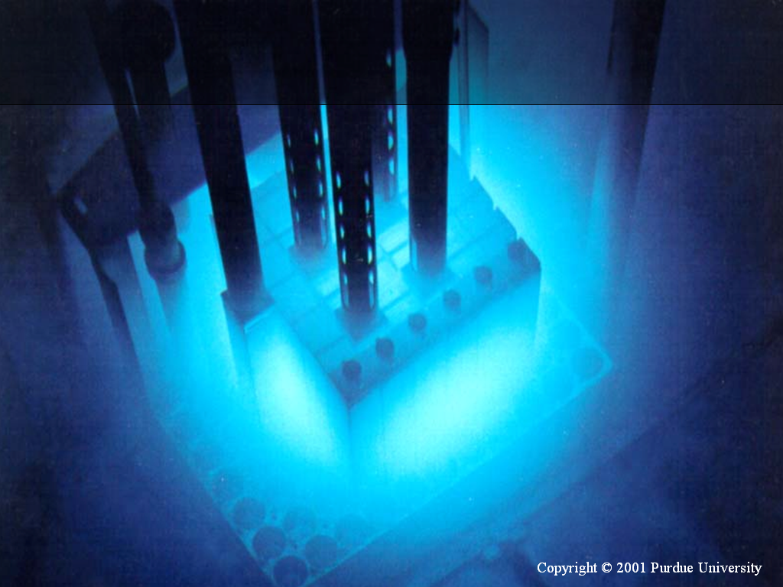

Slide 41
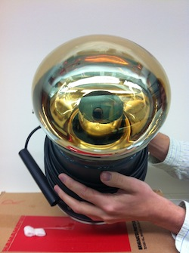
Photomultipliers (PMTs)
Photomultipliers are light detectors that act like light bulbs in reverse.
A photon hits the glass surface, which is coated with a material that easily emits electrons (photoelectric effect).
The electron is accelerated towards a metal plate at the center, where it kicks out more electrons.
The process is repeated until there is a measurable current.

Slide 42
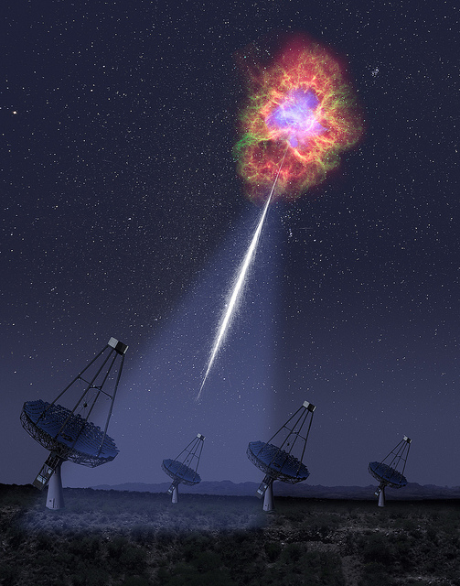
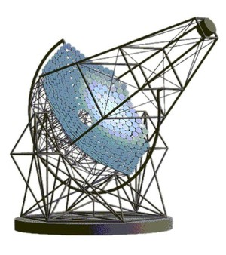
Air Cherenkov Telescopes
Air Cherenkov telescopes detect the Cherenkov light cone produced by the particle shower.
They consist of systems of small mirrors that reflect the light into cameras made of arrays of photomultipliers.
Cherenkov angle ~1°
© SCIENCE magazine

Slide 43


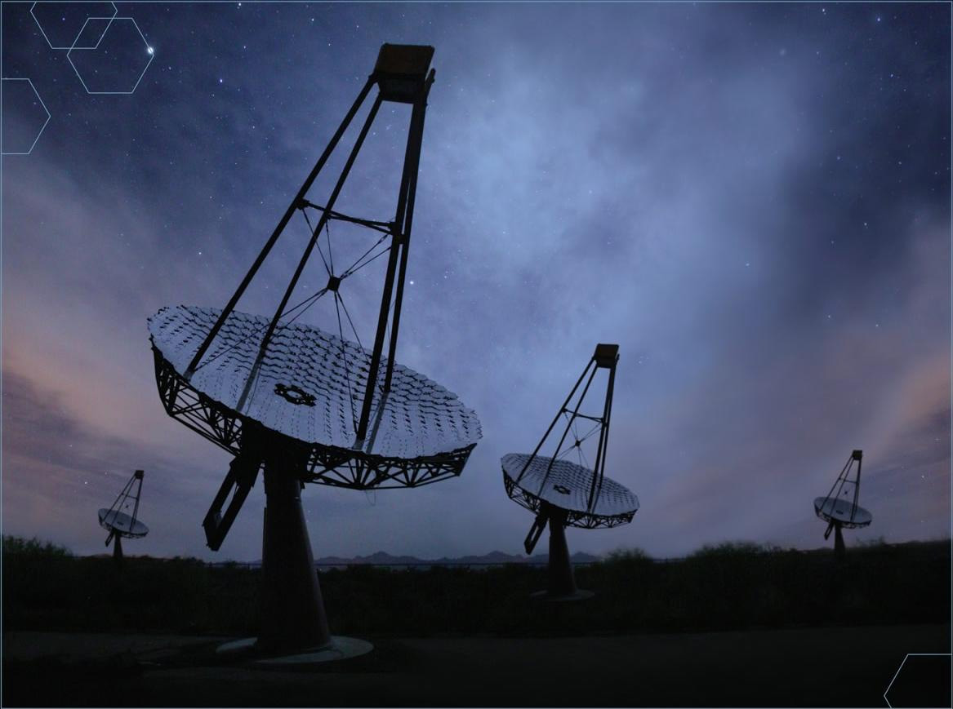
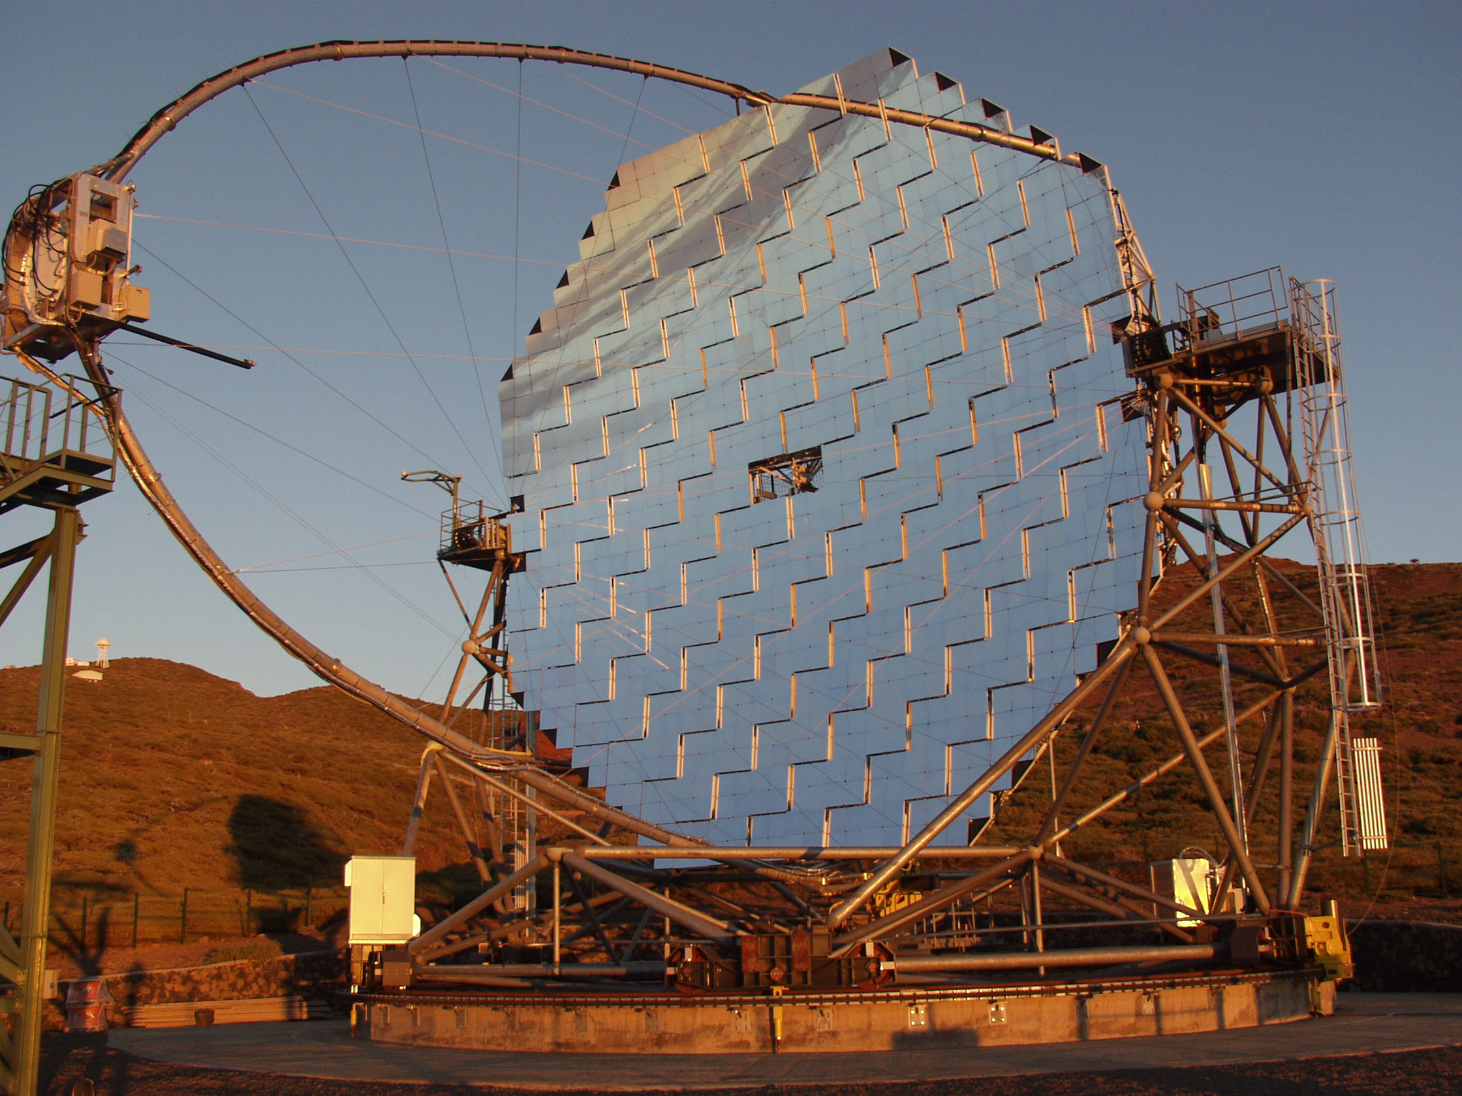

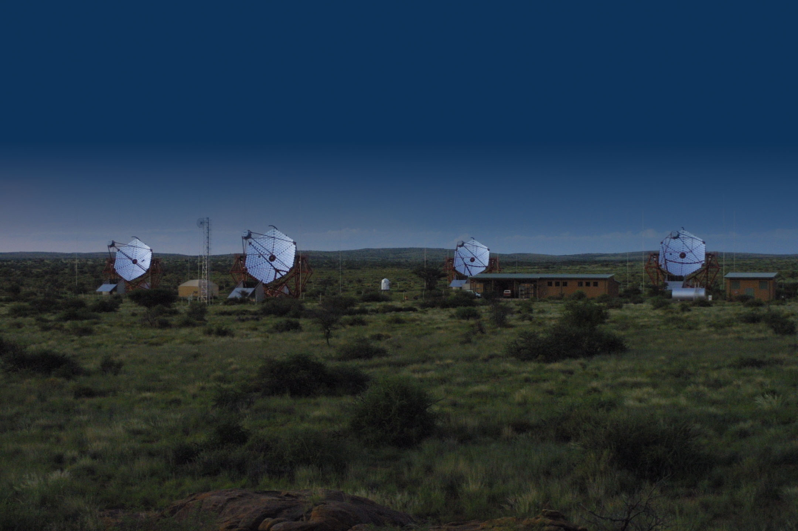
Air Cherenkov Telescopes
MAGIC
VERITAS
H.E.S.S.

Slide 44
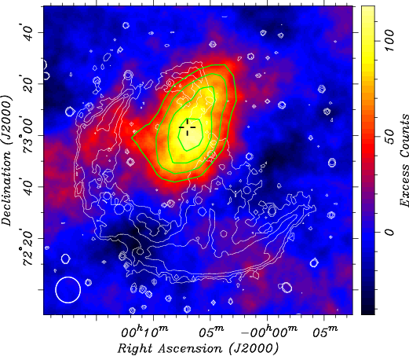
Air Cherenkov Telescopes
Pros:
Excellent sensitivity, with a typical angular resolution of about 0.1°.
They produce detailed pictures of individual sources.
Cons:
They are pointed instruments that can only observe one object at a time.
Only operate during dark nights and have a limited duty cycle (~1000 hours/year).
VERITAS image of the SNR CTA1

Slide 45
Water Cherenkov Detectors
Alternative approach: measure the air shower particles when they hit the ground.
Water is the cheapest detector material: the particles of the air shower move through the water volume and generate Cherenkov light that is captured by photomultipliers.

Slide 46
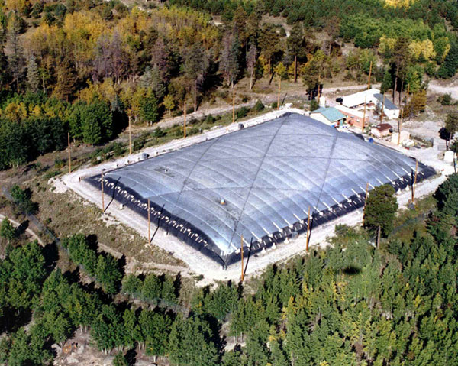
Milagro
Location: Jemez Mountains (near Los Alamos) at 2630 m altitude, 36º N.
60m × 80m water-filled pond with light-tight cover and 723 8’’ PMTs.
Operated between 2000 and 2008.

Slide 47

Water Cherenkov Technique
Pros:
Large duty cycle (>95%), independent of weather and daylight.
Large field-of-view.
Large effective area.
Cons:
Much lower sensitivity for point sources.
Angular resolution ~1°.
High energy threshold (~10 TeV).
Significance of Milagro Crab signal in ~8 years of data

Slide 48

Height Matters!
HAWC
Milagro

Slide 49




Slide 50

The HAWC Observatory
20°N
HAWC
Parque Nacional Pico de Orizaba,
Mexico (97° W, 19° N)
95°W

Slide 51


Large Millimeter Telescope
Sierra Negra
4640m
Pico de Orizaba
5636m
HAWC Site
4100m

Slide 52


HAWC Site
Puebla,
Mexico City
160 m
Veracruz

Slide 53

The HAWC Detector
Altitude 4100 meter site at Sierra Negra, Mexico (~19º N), near the Large Millimeter Telescope.
22,000 m² area (57% coverage).
300 water tanks:
7.3 m diameter × 4.5 m depth.
3 upward-facing 8’’ PMTs and one upward-facing 10’’ PMT (with high quantum efficiency) on the bottom of each tank.

Slide 54



The HAWC Detector
Charged particles from air showers penetrate tanks.
Particles produce Cherenkov radiation which is recorded in four PMTs.
Timing and charge in each PMT used to reconstruct direction of primary particle.
Angular resolution is better than 0.5° at TeV energies.
Shower Plane

Slide 55


Background Rejection
Hadron showers: muons and high energy particles far from core, “spotty.”
Gamma showers: electromagnetic, smooth.

Slide 56


Tanks and Bladders

Slide 57

Tank Construction

Slide 58


Cabling
Buried coaxial cables used to connect PMTs to high-voltage supply and front-end electronics in the counting house.
Total length of cable used: 180 km.

Slide 59

300 water Cherenkov detectors with 185,000 liters of waters each
= 55,500,000 liters of water
Mexico has a population of 120,000,000.
This is about 0.5 liters of water per person!

Slide 60

Data taking started
60

Slide 61

Tank Construction

Slide 62


Inauguration Day March 20, 2015

Slide 63



HAWC Collaboration
México
Benemérita Universidad Autónoma de Puebla
Centro de Investigación y de Estudios Avanzados
Instituto Nacional de Astrofísica Óptica y Electrónica
Universidad Autónoma de Chiapas
Universidad de Guadalajara
Universidad de Guanajuato
Universidad Michoacana de San Nicolás de Hidalgo
Universidad Nacional Autónoma de México
Instituto de Astronomía
Instituto de Física
Instituto de Ciencias Nucleares
Instituto de Geofísica
USA
Colorado State University
George Mason University
Georgia Institute of Technology
Harvey Mudd College
Los Alamos National Laboratory
Michigan State University
Michigan Technological University
NASA/Goddard Space Flight Center
Ohio State University at Lima
Pennsylvania State University
University of California, Irvine
University of California, Santa Cruz
University of Maryland
University of New Hampshire
University of New Mexico
University of Utah
University of Wisconsin-Madison

Slide 64







HAWC @ UW
Dan Fiorino Zig Hampel-Arias Ian Wisher Juan Carlos Diaz Velez
Stefan Westerhoff Tom Weisgarber Michael DuVernois

Slide 65

HAWC Science Goals
Provide an unbiased survey of the northern sky at TeV energies
and observe every northern TeV source every day!
Galactic Sources of Gamma Rays
Supernovae remnants
Crab Nebula (SN 1054)
Recent GeV flares
Extended objects (e.g. molecular clouds)
Galactic plane (sources and diffuse)
Extragalactic (z<0.1) Sources of Gamma Rays
Active galactic nuclei (AGN)
Flaring
Multiwavelength campaigns (Fermi-LAT)
Gamma-ray bursts (GRBs)
Counterpart (Fermi-LAT/optical telescope alerts)
Constrain EBL and IGMF
Nearby galaxies
Starburst galaxies (many SNRs)
Particle Physics
Indirect dark matter searches
Lorentz invariance violation
Theoretical particle searches (e.g Q-balls)
Cosmic Rays
Cosmic-ray anisotropy
Electron/positron spectrum

Slide 66

FiRst light
The Shadow of the Moon
First Look at the Gamma-Ray Sky
Large Scale Cosmic-Ray Anisotropy

Slide 67


Shadow of the Moon
The Moon blocks part of the nearly isotropic cosmic-ray flux causing a “cosmic-ray Moon shadow” on Earth.
The Moon’s apparent diameter is about 0.5°.
Observing the width of the Moon shadow is a good way to access the angular resolution and pointing accuracy of the detector.

Slide 68
Moon Shadow

Slide 69

HAWC Detector
HAWC-111

Slide 70

HAWC-111, 206 days
1/3rd of detector!

Slide 71



HAWC-111, 206 days
Crab Nebula
(SNR)
Markarian 421
(AGN)
1/3rd of detector!
Galactic Plane

Slide 72

HAWC-111, 206 days
equatorial coordinates

Slide 73

HAWC-250
equatorial coordinates

Slide 74


HAWC - Fermi
Preliminary
Highest energy γ’s from LAT (E>50 GeV) with a preliminary map from HAWC-250
(slide courtesy M. Ajello)
Notes:
LAT map is E>50 GeV Pass 8 photons for 6 years of data projected in Mollweide and smoothed.

Slide 75



HAWC-250
equatorial coordinates

Slide 76


Mrk 421 Time Dependence
AGN Mrk 421 in HAWC-111 data (7 day periods)
Currently testing alerts with an online flare monitor
Monitor known AGN to coordinate flare observations
All-sky search for unknown transients

Slide 77


Gamma Ray Bursts
GRB 130427A
GRB 130702A
The Astrophysical Journal 800:70, 2015

Slide 78

Large Scale Cosmic Ray Anisotropy
Contaminated by solar dipole
Require full year of stable detector configuration to average over artifacts

Slide 79

Small Scale Cosmic Ray Anisotropy
The Astrophysical Journal 796:108, 2014
Region C
Region B
Region A

Slide 80

Small Scale Cosmic Ray Anisotropy
The Astrophysical Journal 796:108, 2014
Region C
Region B
Region A

Slide 81

Small Scale Cosmic Ray Anisotropy
The Astrophysical Journal 796:108, 2014

Slide 82
Summary
TeV gamma-ray astronomy is the energy frontier of astronomy.
HAWC is designed to perform a wide field of view synoptic survey of the TeV sky.
Large field of view: unbiased survey.
Large uptime: increased sensitivity to transients.
High-energy response: will help identify cosmic ray sources.
It is an exciting time: a new window on the Universe is opening!

Slide 83

http://www.hawc-observatory.org
https://hawc.wipac.wisc.edu

