Slide 2
Surface air showers
Cosmic ray science
Veto
Scintillator/fiber arrays
Proposal ?

Slide 3
Cosmic Ray Science
Transition: galactic … extra-galactic
  energy spectrum
  composition
  anisotropy
Measurement and reconstruction
  shower size
  muon content (proxy for hadrons)
    in-ice
    surface
  confusion
    interaction depth
    hadronic models

Slide 4
Cosmic-ray physics with IceCube Gen2
Energy content of CR determines possible sources of neutrinos
Extra-galactic origin likely
Location of transition from galactic to extra-galactic affects energy estimate
Galactic
Extra-Galactic
at 10¹⁰ GeV (10¹⁹ eV)

Slide 5
Auger suggestion of change in phase in CR anisotropy in transition region (from talk by H. Dembinski)

Slide 6
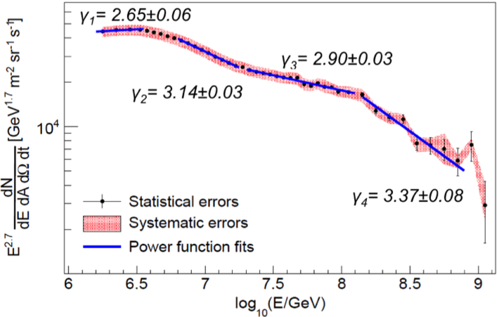
Primary spectrum from IceTop
Phys. Rev. D 88, 042004 (2013).
IceTop has superior energy resolution
10⁷ – 10⁹ GeV: transition from galactic to extragalactic
Can we extend to EeV with Gen2 ?

Slide 7
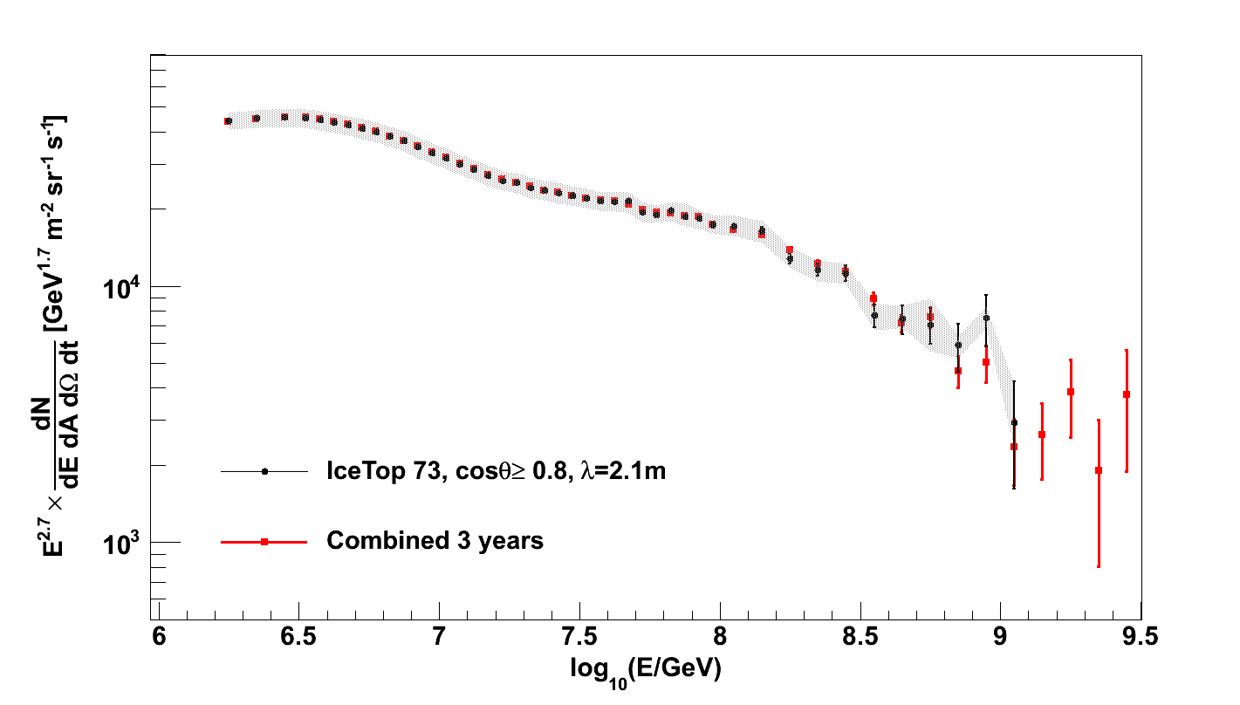
Spectrum measured by IceTop
2.67 yrs livetime
→ 100,000 > 100 PeV
10⁷ > 10 PeV
total 10859 events
above 100 PeV
2739
4226
1613
963
Δlog₁₀E = 0.05
608
321
38
174
125
52
4
12
9
Δlog₁₀E = 0.1
9
Increase IceTop statistics by 2 x 6
3
Factor 6 increase in area
(2010-2011 + 2011-2012 + 2012-2013)
Factor 2 by going to 60º

Slide 8
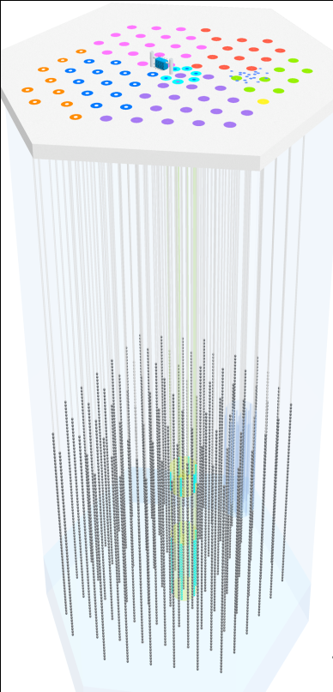
Aperture for coincident events: ν, γ, cosmic rays
0.26 km² sr
~ 10 km² sr
IceTop
1450 m
2450 m

Slide 9
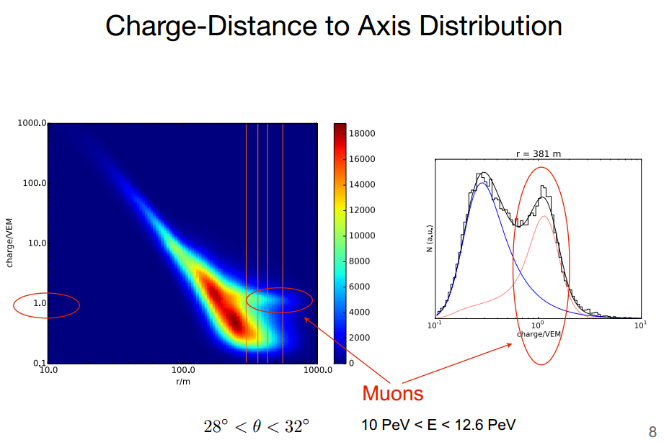
Muon ldf

Slide 10
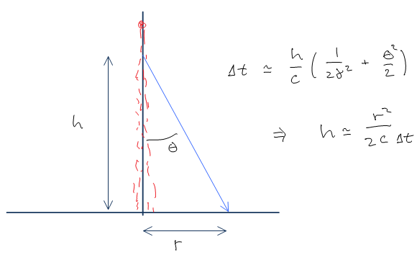
Surface muons
surface & deep muons probe different parts of shower
isolated muons are more useful
  can be counted
  r,t give production height

Slide 11
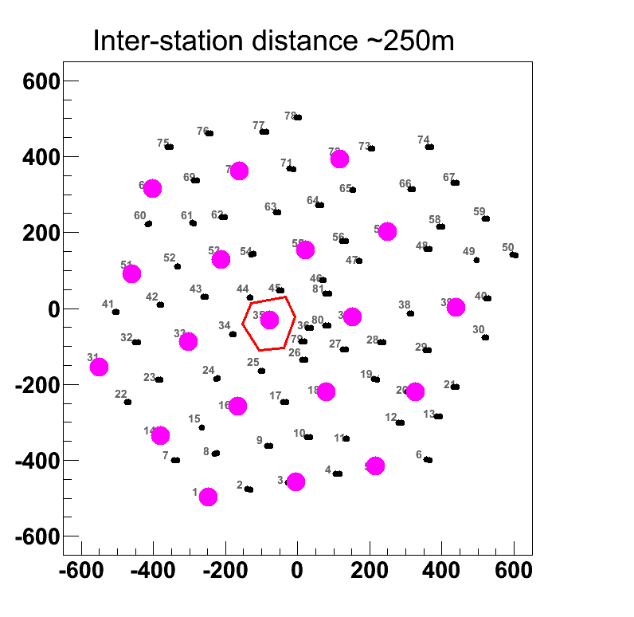
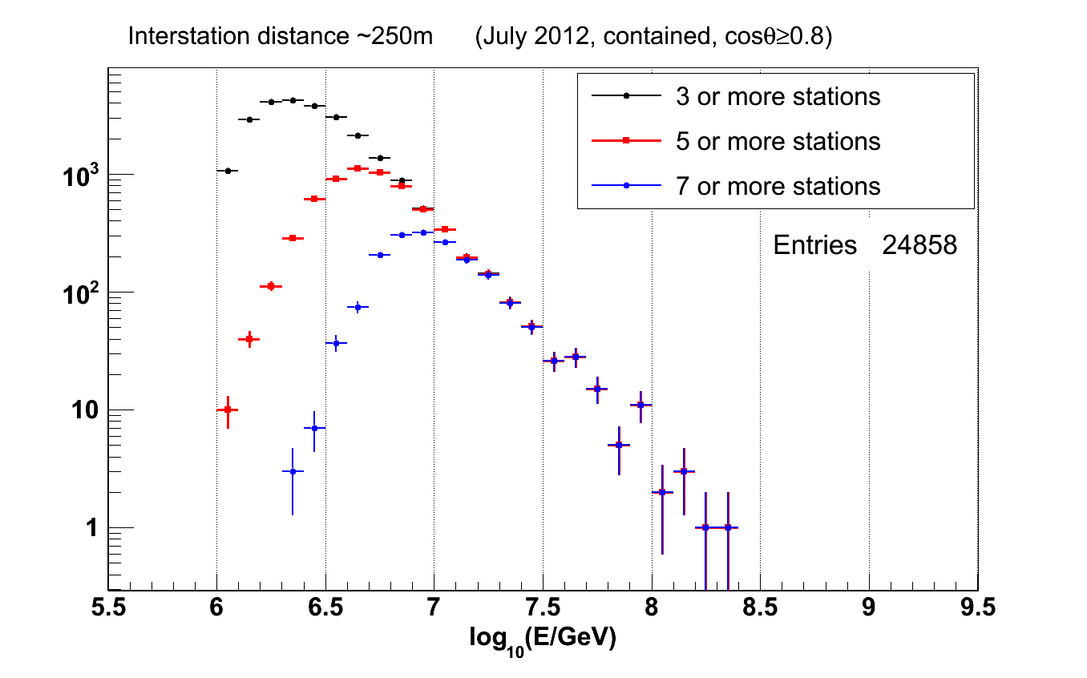
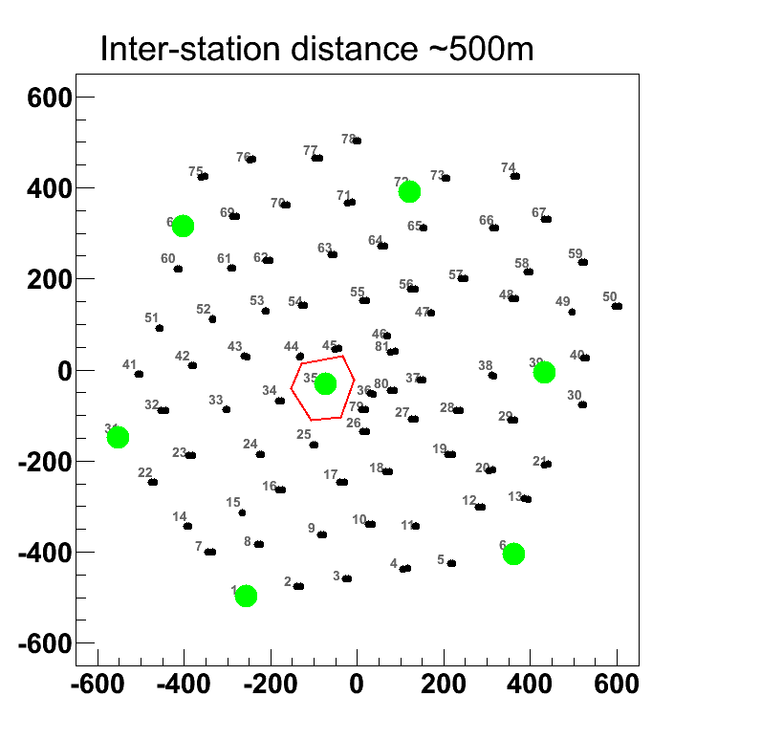
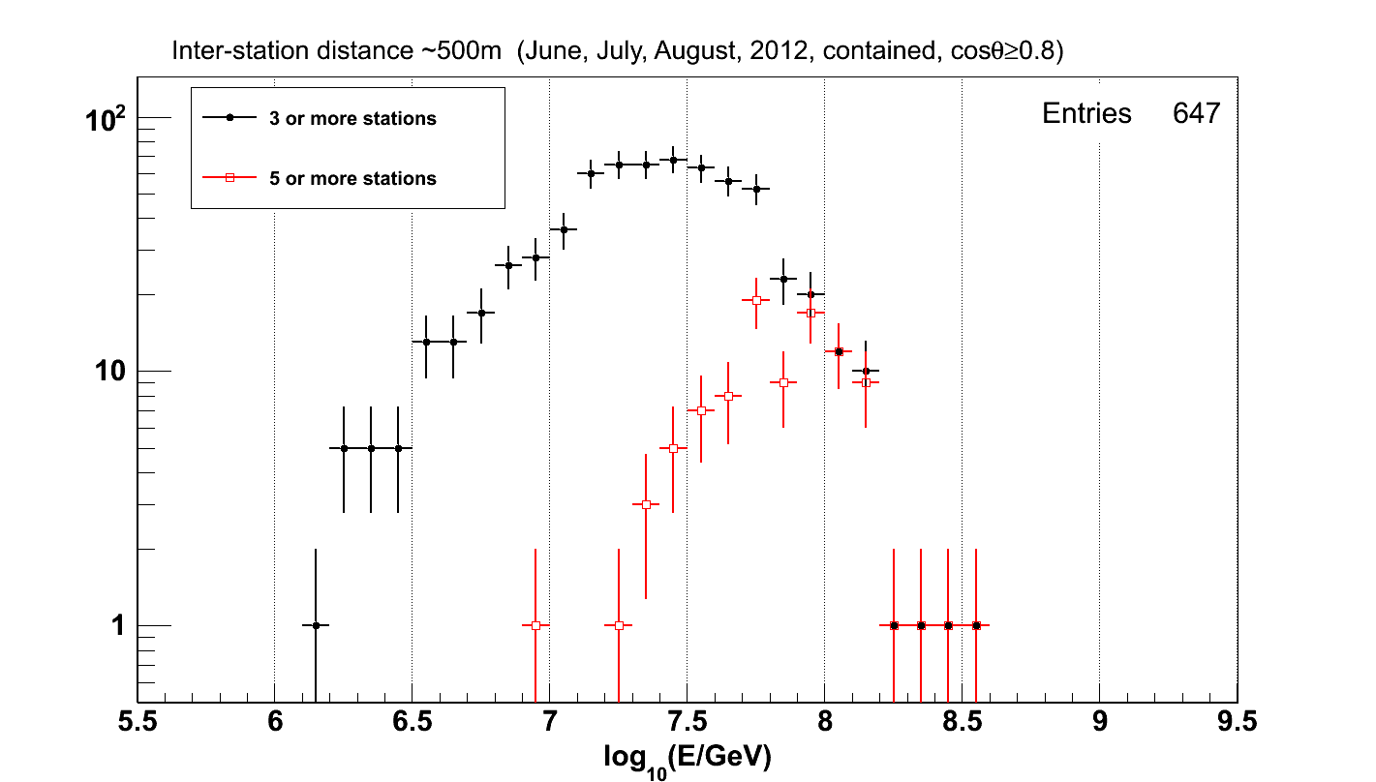
Predefine “New” arrays with 250m and 500 m spacing
Count stations from the “New” list participating in the event.
250 m spacing:
low threshold ~10 PeV
300-350m spacing
seems optimal
for ~50 PeV threshold
500 m spacing:
threshold moves to 100 PeV
➔ too high
Note: Auger infill: 85 detectors in two grids of 750m (covering 23.5 km²) and 433m (covering 5.9 km²) spacing.
TALE: 100 scintillator counters at 400m spacing (13 km²)

Slide 12
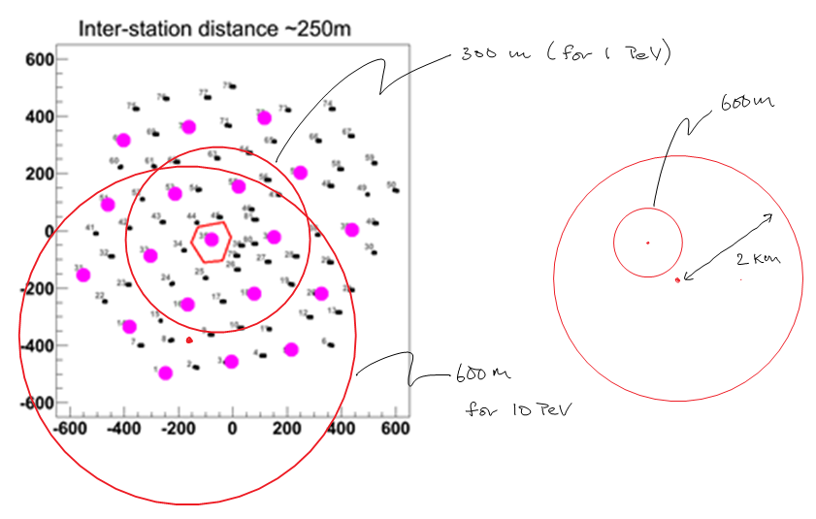
Improved muon coverage
Icetop
~ Gen-2
(not to scale)

Slide 13
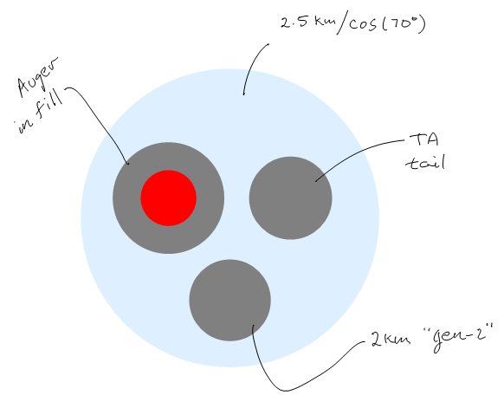
Size matters

Slide 14
Benefits of dense array
Ad-hoc comments from Javier …

Slide 15
CR physics with Gen2 IceTop
Composition/spectrum analysis in transition region:
  100,000 events > 100 PeV
  1000 events > EeV
Composition-dependent anisotropy at 10 PeV
  10⁷ events > 10 PeV
  event-by-event composition information
    muon LDF and e-m LDF for each event
    in-ice muons
    muon production profile helps with first interaction

Slide 16
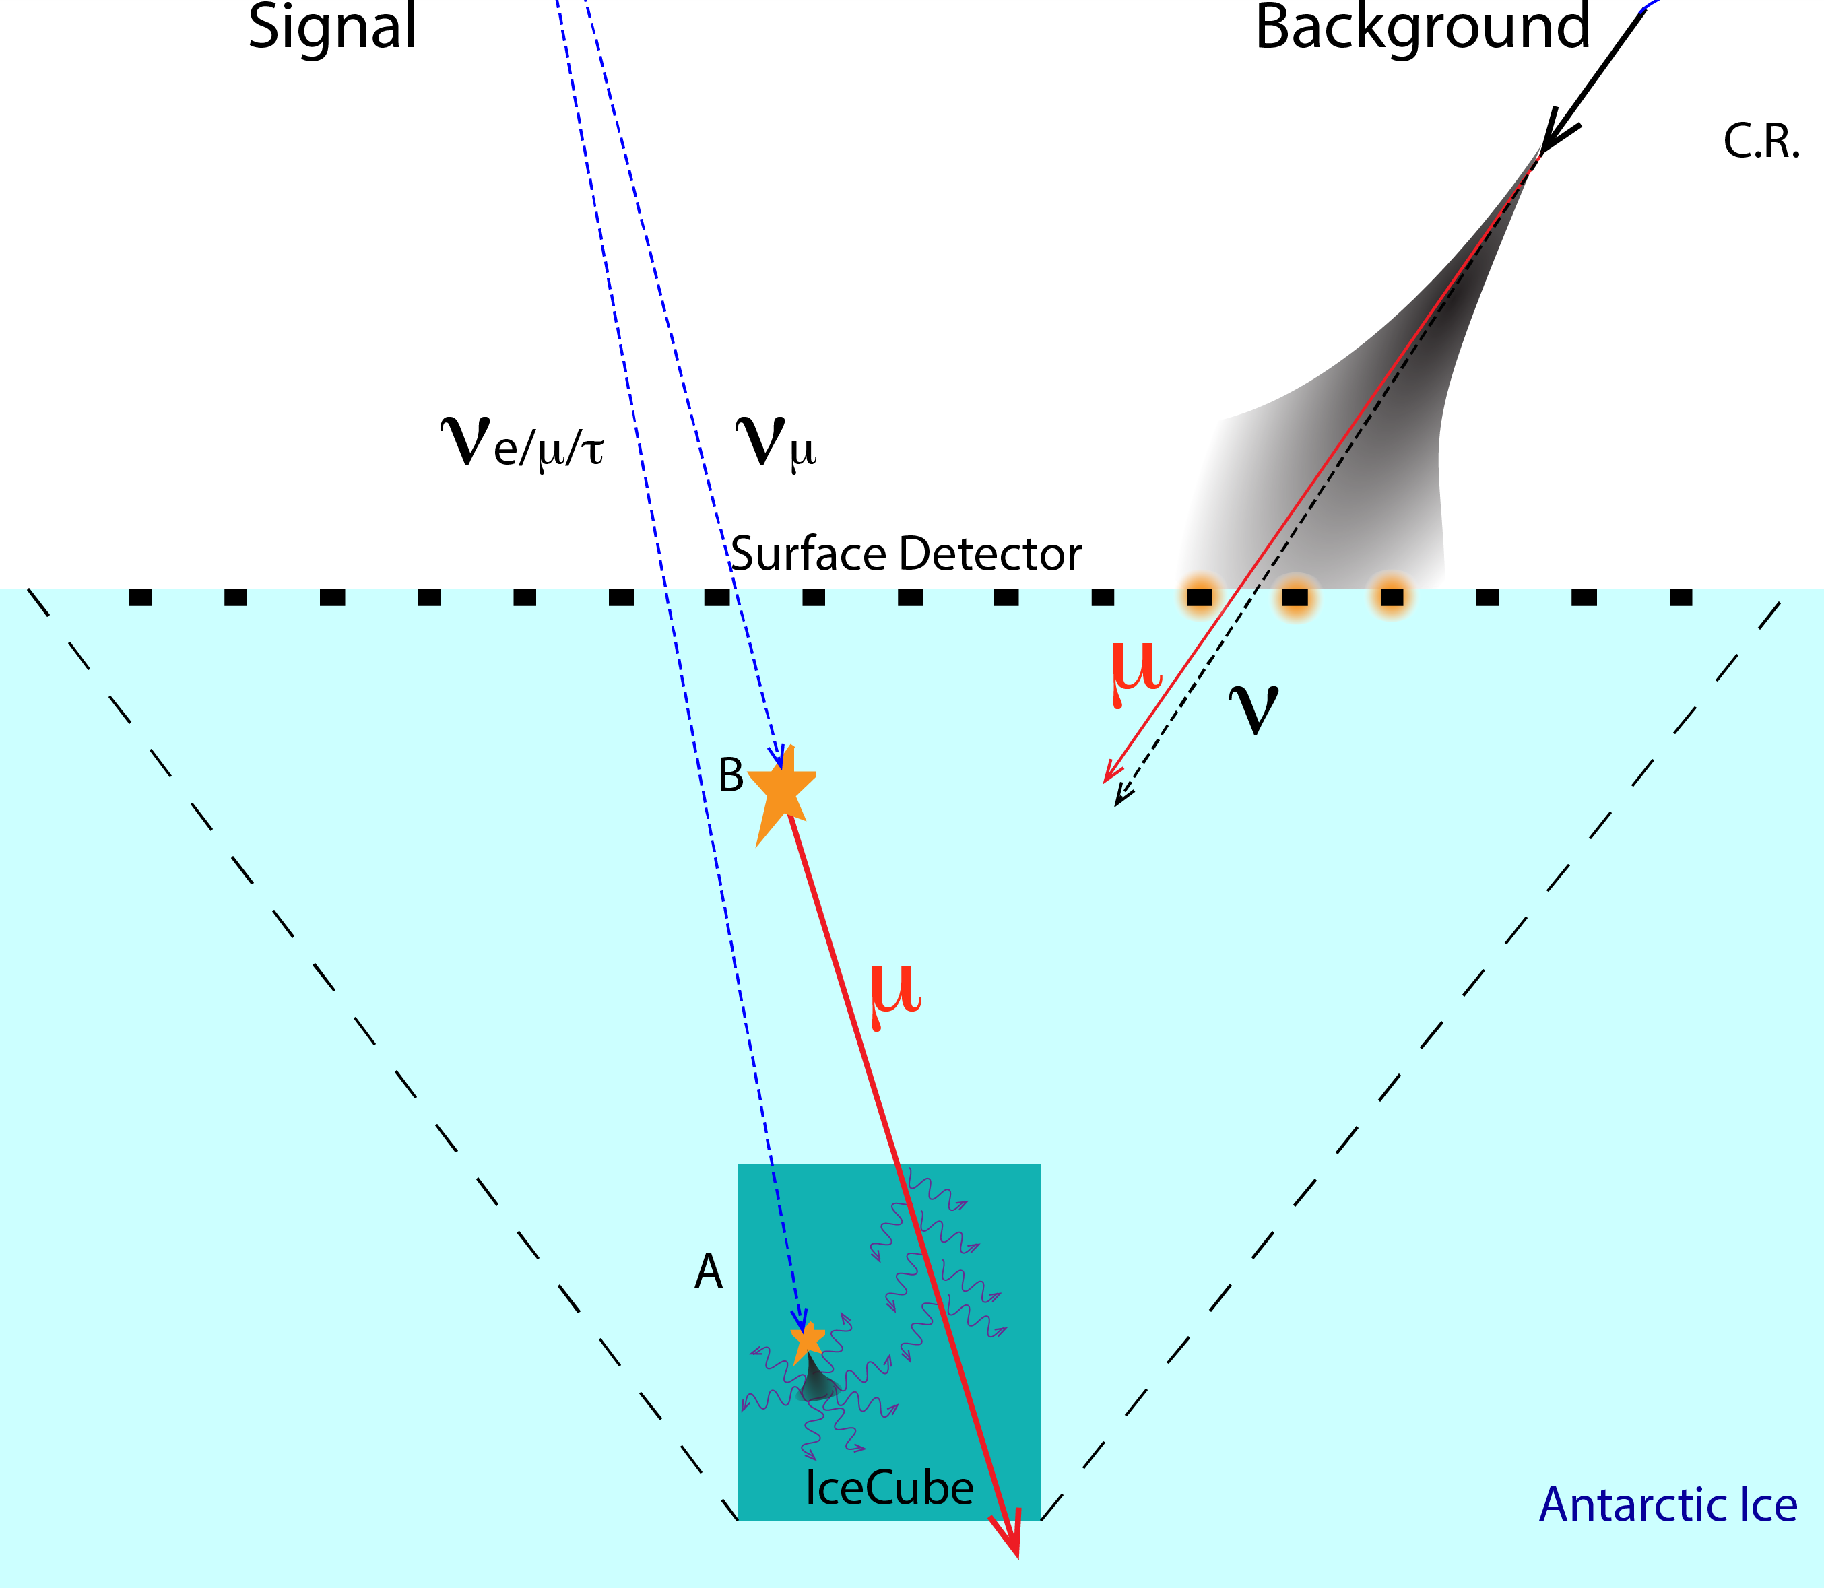
IceTop as Veto

Slide 17
Rates from 1 TeV Paper Flux
All rates are above 100 TeV and all directions unless stated.
 | CC | NC | tracks (CC/3)
IceCube | 7.6 | 3.0 | 2.5
IceCubes | 0.1 | 0 | 0.1
NextGen contained | 52.5 | 20.9 | 17.5
NextGen contained (θ < 80°) | 27.7 | 11.1 | 9.2
IceVeto150 (E > 100 TeV) | 20.7 | 0 | 20.7
NextGen (surface vetoed) | 3.6 | 0 | 3.6
NextGen (E > 30 TeV) | 9.4 | 0 | 9.4
NextGen (E > 15 TeV) | 15.9 | 0 | 15.9
NextGen (E > 10 TeV) | 22.5 | 0 | 22.5
Low-energy surface veto tracks in ORANGE

Slide 18
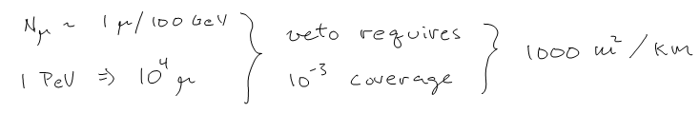
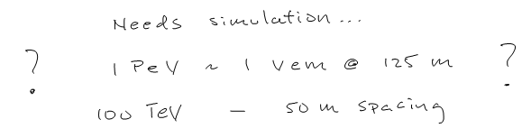
design parameters: μ and e,γ
μ: emphasize area to collect muons.
e,γ: eliminate gaps by dense array

Slide 19
Imagine a slide from sebastian

Slide 20
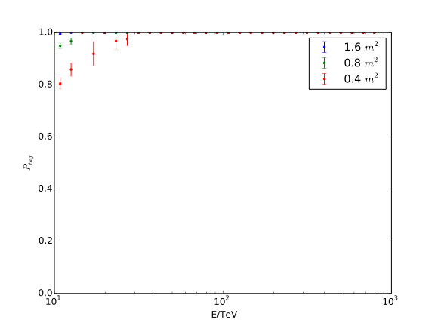
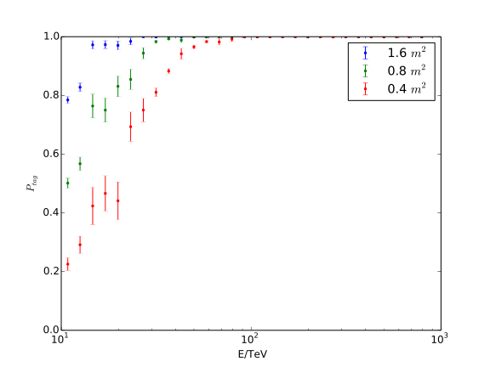
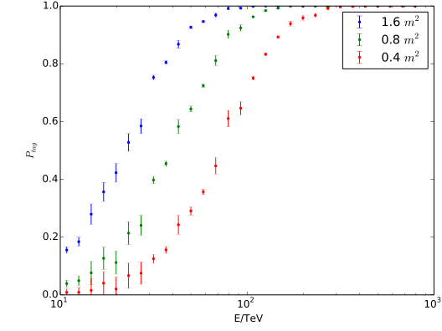
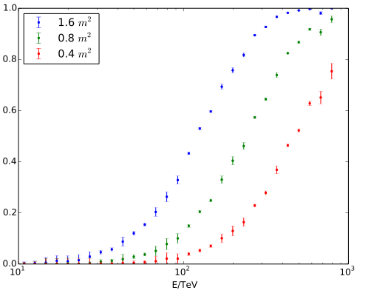
Quasi-vertical: em veto
31 m spacing
62 m spacing
250 m spacing
125 m spacing

Slide 21
Some hardware concepts
Scintillator + fiber + photon counting
  extruded plastic scintillator … MINOS (Delia, Perry)
  liquid scintillator … NOvA
  simple scaling suggests < $300/m²
  tracking options cost *2
  muons: 1000 m² /km² (Sebastian)
  em: 300 m² /km² (? Javier)
Engineered “Snow” + Cerenkov + Fiber

Slide 22
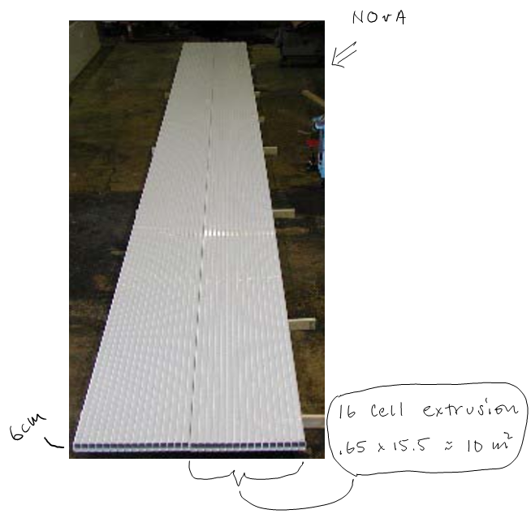
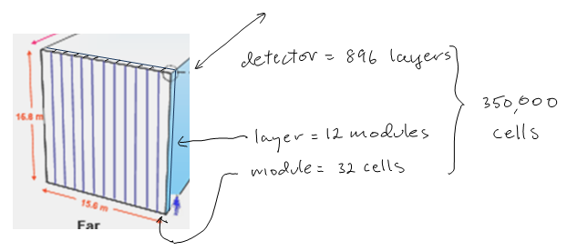
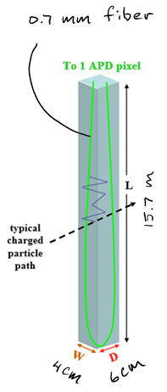
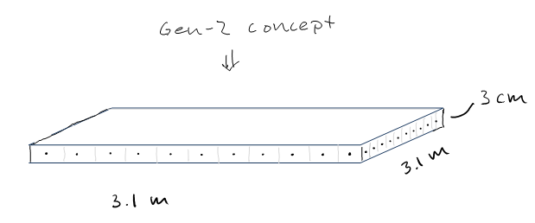
NOvA Modular design
cost scaling
$350/m²

Slide 23
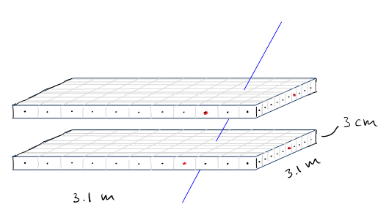

Concept-II
Coarse muon tracking to reduce false positive by 10.
Cost: … $10K per 10 m² $→$ $7M
  additional 50 channels + $2000
  2 * layers

Slide 24
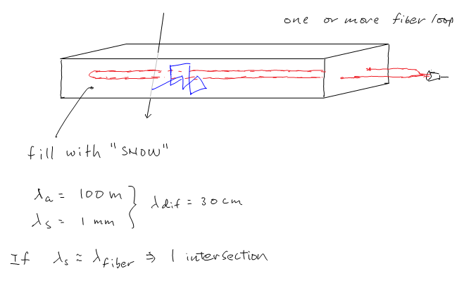
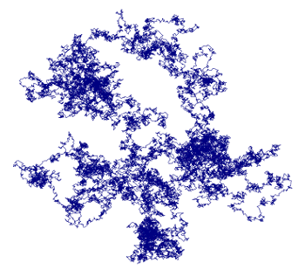
Fiber collection from diffusing Cerenkov module

Slide 25
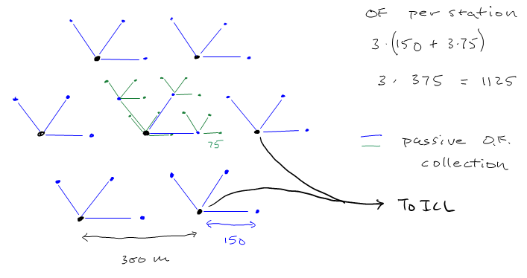
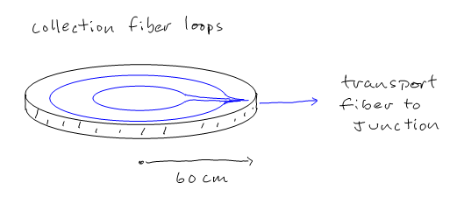
copper free passive modules (for veto)

Slide 26
Proposal … now ?
Goals
  2 additional cc vertical astrophysical mu/yr
  cosmic ray spectrum and composition to > EeV
  science platform for Gen-2 R&D
Parameters
  2 km radius
  60 m grid (powered nodes at 240 m spacing)
  elements: 1 - 4 m²
Hardware
  Scintillator + Fiber
  250 powered DAQ stations.
  Fractal passive sub-arrays.

Slide 27
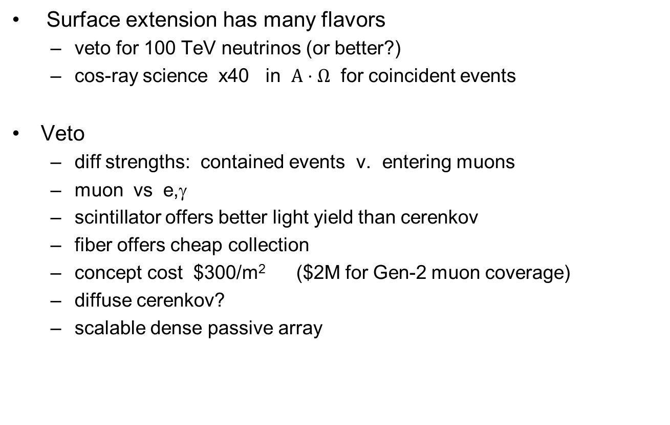
Summary
Surface extension has many flavors
  veto for 100 TeV neutrinos (or better?)
  cos-ray science x40 in $A⋅Ω$ for coincident events
Veto
  diff strengths: contained events v. entering muons
  muon vs e,γ
  scintillator offers better light yield than cerenkov
  fiber offers cheap collection
  concept cost $300/m² ($2M for Gen-2 muon coverage)
  diffuse cerenkov?
  scalable dense passive array

Slide 29
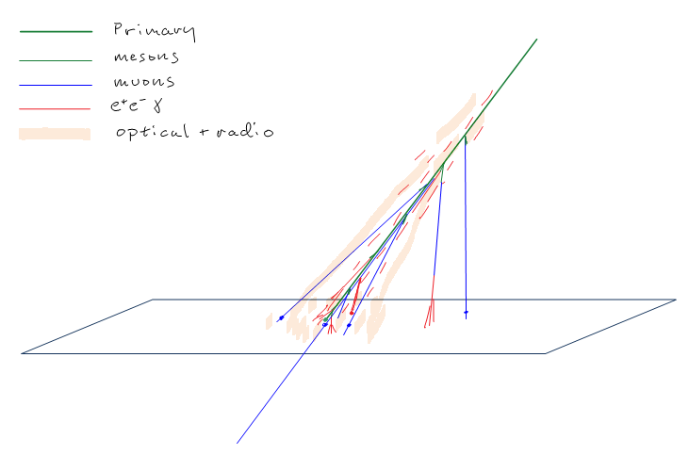
Air shower footprints

Slide 30
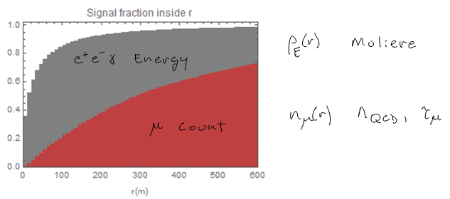
Footprints II
μ: produced all along the shower
e,γ: arrive from one radiation length above detector

Slide 31
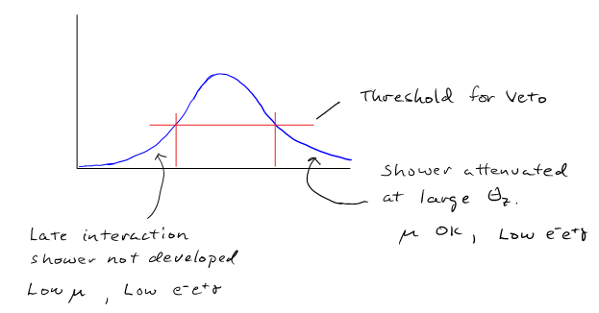
Conditions for veto FAIL
High energy neutrino produced at first interaction
Need simulation of extreme showers
  early: shower dies
  late: tight shower sneaks in

Slide 32

IceTop – the current detector
Signal:
  C-yield: 150γ / MeV
  collection efficiency $4⋅10$⁻³
  0.6 pe / MeV
VEM
  $30000 γ→130 pe$
rad component
  $\sim 20 pe=30 MeV$
perlite
0.9 m
ice
Diffusely reflecting liner
2 m

Slide 33
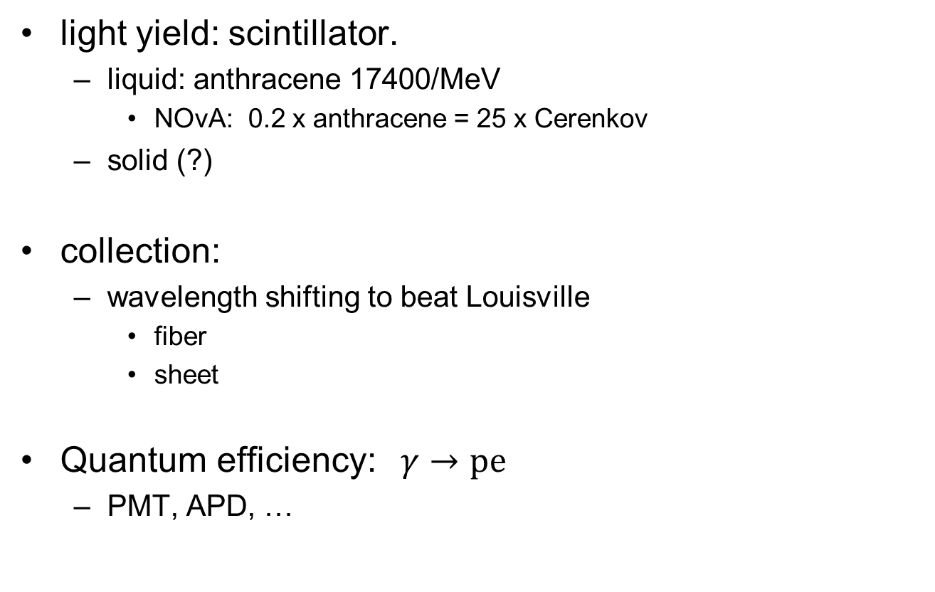
Alternatives
light yield: scintillator.
  liquid: anthracene 17400/MeV
    NOvA: 0.2 x anthracene = 25 x Cerenkov
  solid (?)
collection:
  wavelength shifting to beat Louisville
    fiber
    sheet
Quantum efficiency: $γ→pe$
  PMT, APD, …

Slide 34
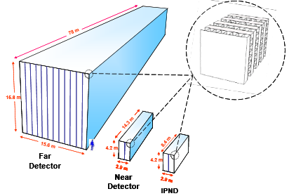
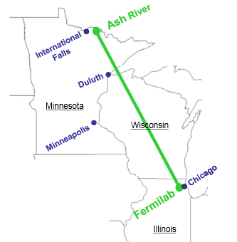
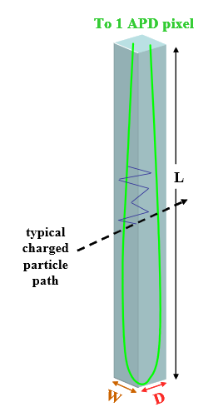
NOvA – a fiber/scintillator tracking detector
Technical Design Report (2007)
  NOvA - TDR
Project Overview and Assessment (2014)
  Cooper Derwent CD-4 Project Overview and Assessment.pdf

Slide 35
Modular design

Slide 36
Signal collection
Scintillator: γ − production
WS Fiber:
  collection
  transport
APD: conversion
  S/N

Slide 37
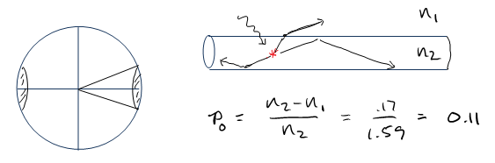
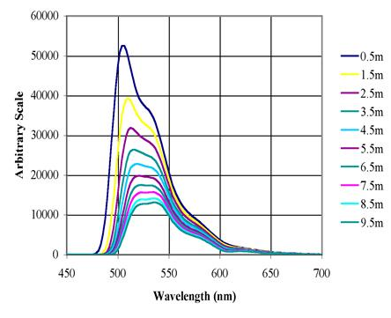
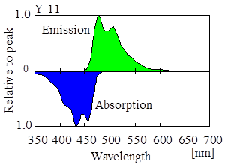
Improve fiber performance (?)
index of refraction contrast
shorter fibers

Slide 38
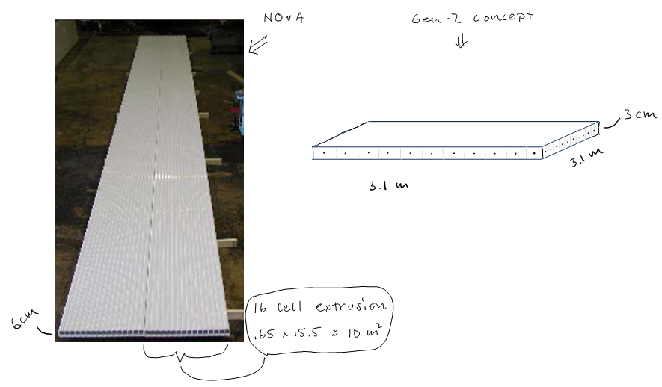
Concept: NOvA $→$ Gen-2

Slide 39
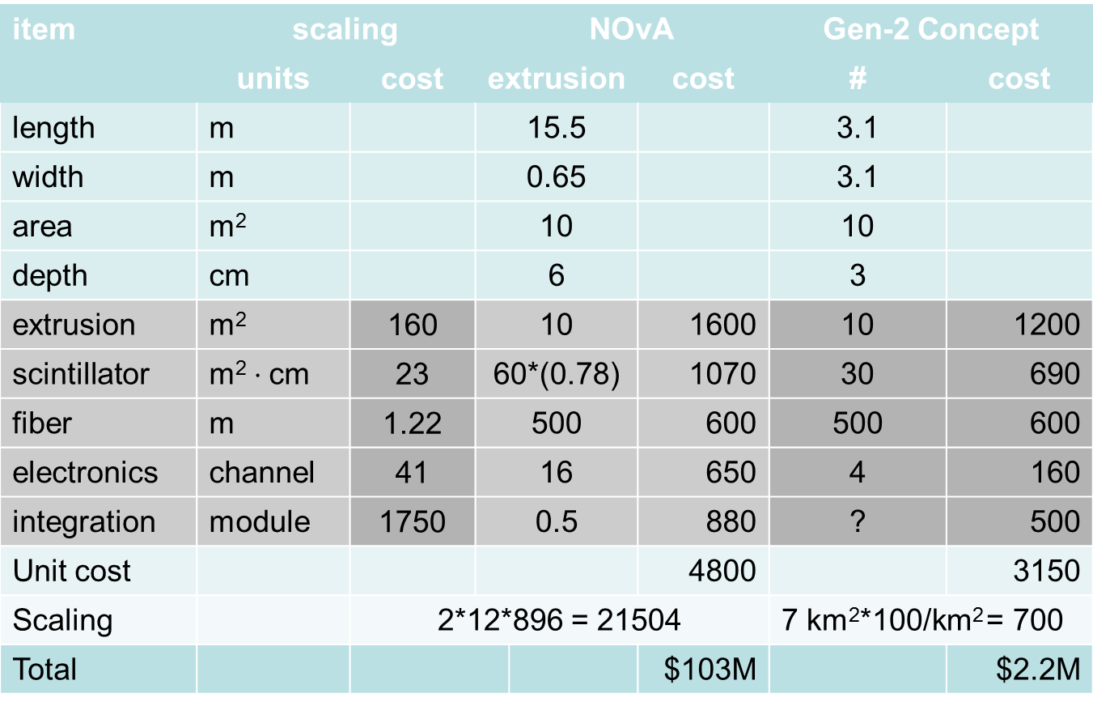
Concept: NOvA $→$ Gen-2
item | scaling |  |  | NOvA |  |  | Gen-2 Concept
 | units | cost | extrusion |  |  | cost | # | cost
length | m |  | 15.5 |  |  |  | 3.1
width | m |  | 0.65 |  |  |  | 3.1
area | m² |  | 10 |  |  |  | 10
depth | cm |  | 6 |  |  |  | 3
extrusion | m² | 160 | 10 |  |  | 1600 | 10 | 1200
scintillator | m²$⋅$ cm | 23 | 60*(0.78) |  |  | 1070 | 30 | 690
fiber | m | 1.22 | 500 |  |  | 600 | 500 | 600
electronics | channel | 41 | 16 |  |  | 650 | 4 | 160
integration | module | 1750 | 0.5 |  |  | 880 | ? | 500
Unit cost |  |  |  |  |  | 4800 |  | 3150
Scaling |  | 2*12*896 = 21504 |  |  |  |  | 7 km²*100/km² = 700
Total |  |  |  |  |  | $103M |  | $2.2M

