Slide 1
Using MINOS scintillators as a surface veto
Delia Tosi / Chris Wendt
UW Madison

Slide 2
References for these slides
Slides from MINOS workshops, for example:
http://www-off-axis.fnal.gov/workshops/stanford03/transparencies/michael_minosscin.ppt
Public reports, for example:
www-numi.fnal.gov/minwork/info/tdr/mintdr_5.pdf

Slide 3
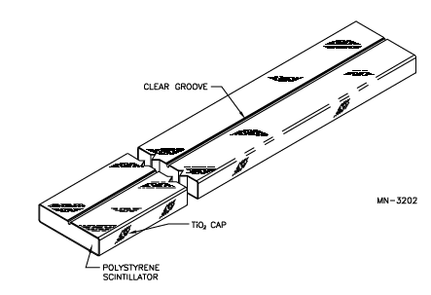
Basic unit
8 m
1.0 cm x 4.1 cm Dow Styron 663 W polystyrene + wavelength shifters PPO (1%) and POPOP (0.03%) [ 300 T, 600 km of 4.1 cm²]
WLS Fiber: Kuraray double-clad 1.2 mm diam., 175 ppm Y11 : shifts blue light to green [780 km]
Clear groove
TiO₂ CAP Reflector
Notes:
WLS fiber1.20 +0.024 -0.005 mm diam.
175 ppm Y11 fluor (K27)
polystyrene core, double clad (PMMA and polyfluor)
“Non-S Type” PS core is of almost no oriented polystyrene chain and is optically isotropic and very transparent.
This conventional standard type has good attenuation length, but it showed weakness against cracking caused by bending or handling during assembling.

Slide 4
Test performed on strip and unglued fiber
Strip and fiber were put in freezer and temperature was cycled a few times down to -80 C (in steps and in one shot)
Stress test (banging the strip against solid surface) was performed several times imposing harsh temperature change
TiO₂ does not show any sign of deterioration, fiber looks good and kept flexibility

Slide 5
Module tests
We got 4 pieces of scintillator panels from MINOS far detector:
2 pieces have optical connectors (OC)
2 pieces have no connectors
Cables:
2 (clear fibers): OC assembly ←→ OC assembly
1 (clear fibers) : OC assembly ←→ single fibers
Electronics:
MCPMT assembly + 2 “cookies” to feed fibers (see slides later)

Slide 6
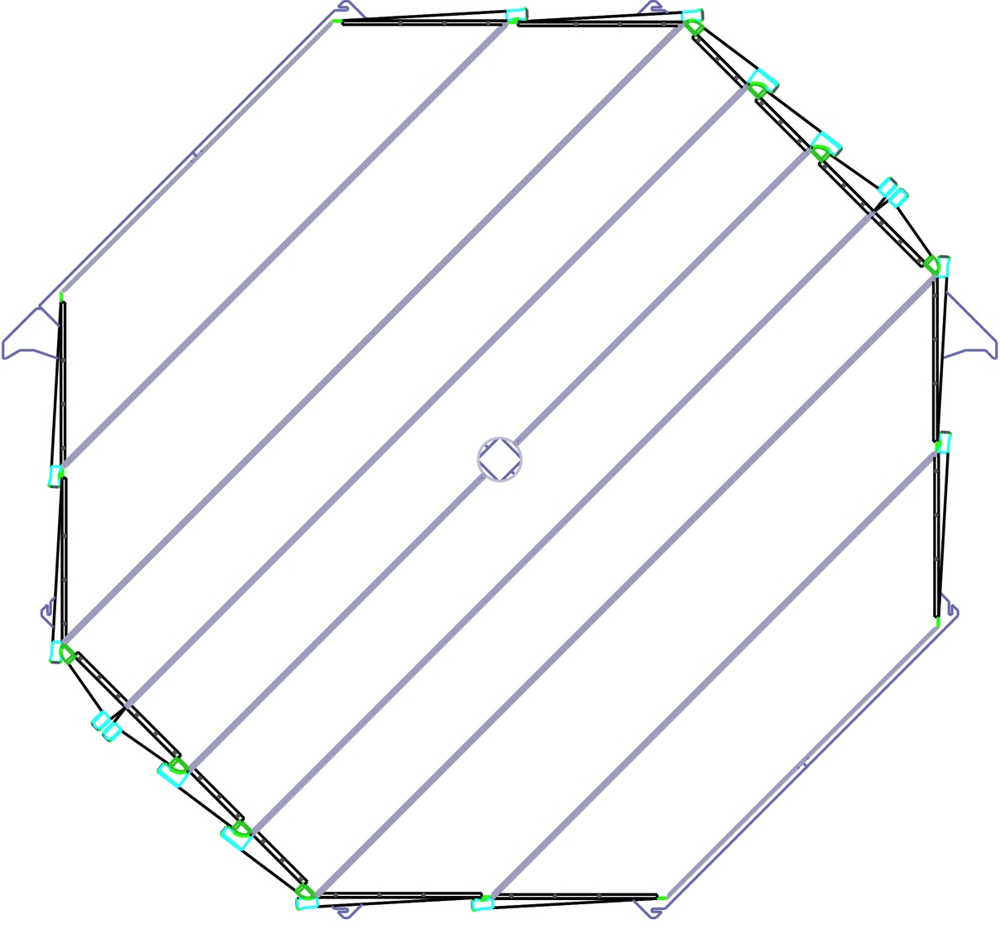
Far detector module layout
Clear Fiber: Like WLS, no fluor, 1100 km of fiber built into cables with 20/28 fibers.
8 modules per plane
Four 20-wide modules in middle
Four 28-wide modules on edges
Two center modules have coil-hole cutout
90’’ ~ 2.3 m
28
Coil Bypass
28
20
20
20
20
28
28

Slide 7
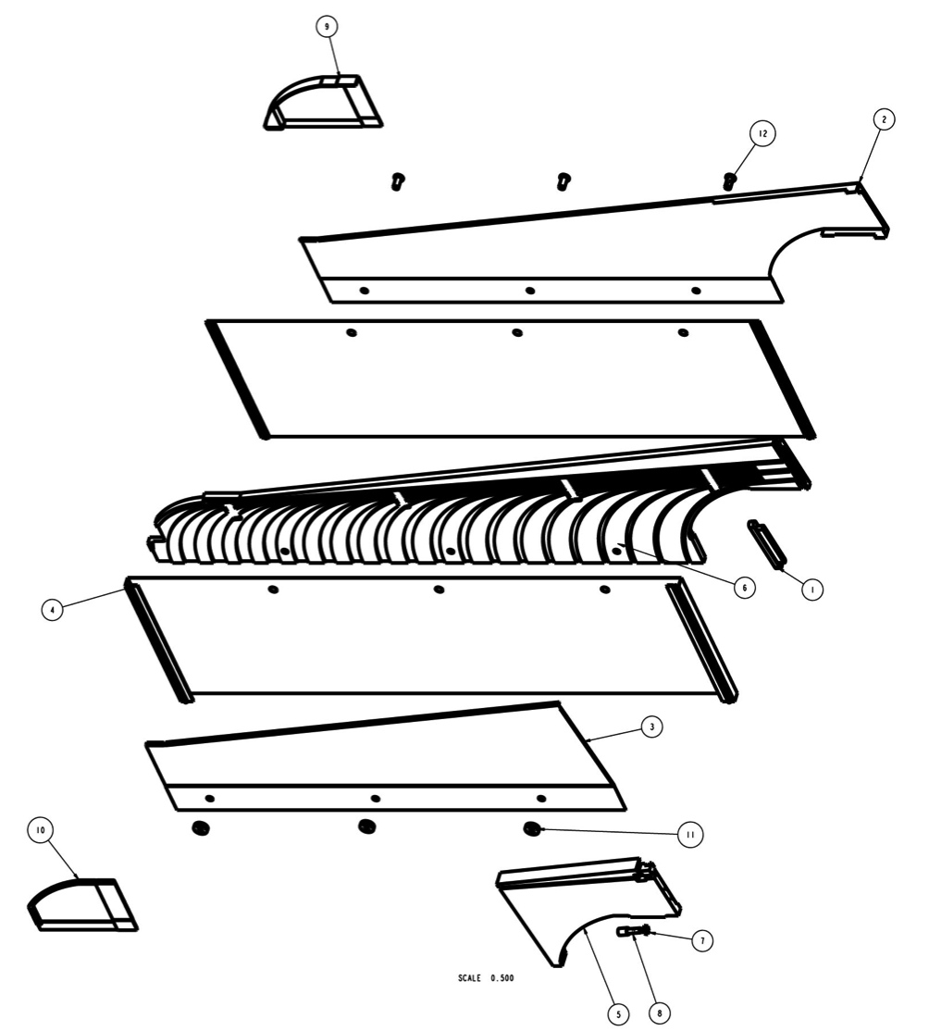
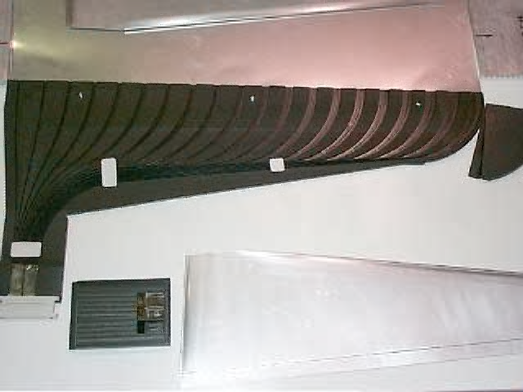
Module overview
Assembly Drawing for manifold
Module: assembly of scintillator strips wrapped by aluminum sheets.
WLS fibers are routed through end manifolds to bulk optical connectors.
Modules, connectors and cables are light-tight (until you open them).
Top variable
width seal
Top Al cover
Top Al light case
Light Case
Fiber routing
manifold
Connector
Manifold base with fiber grooves
Bottom Al light case
Variable width seal
Bottom Al Cover
Light injection cover
Light injection
manifold
Bottom variable
width seal
Formed Al cover
Optical
connector
Module parts for “straight-out” manifold

Slide 8
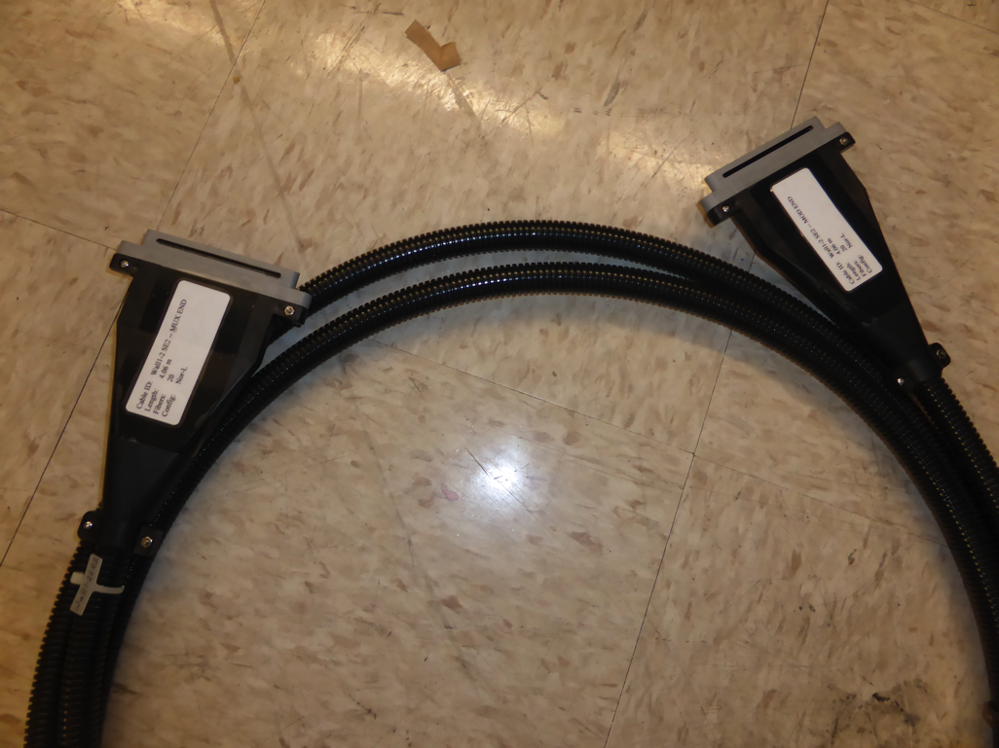
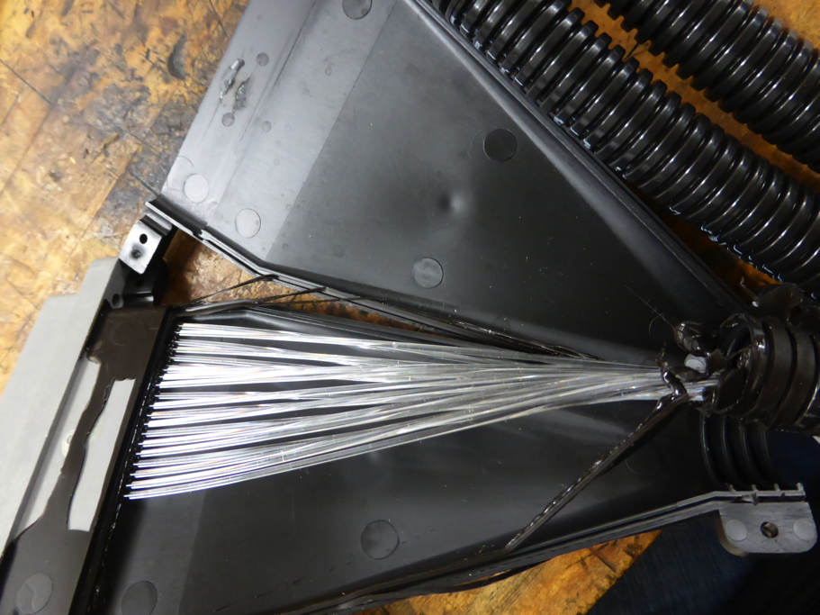
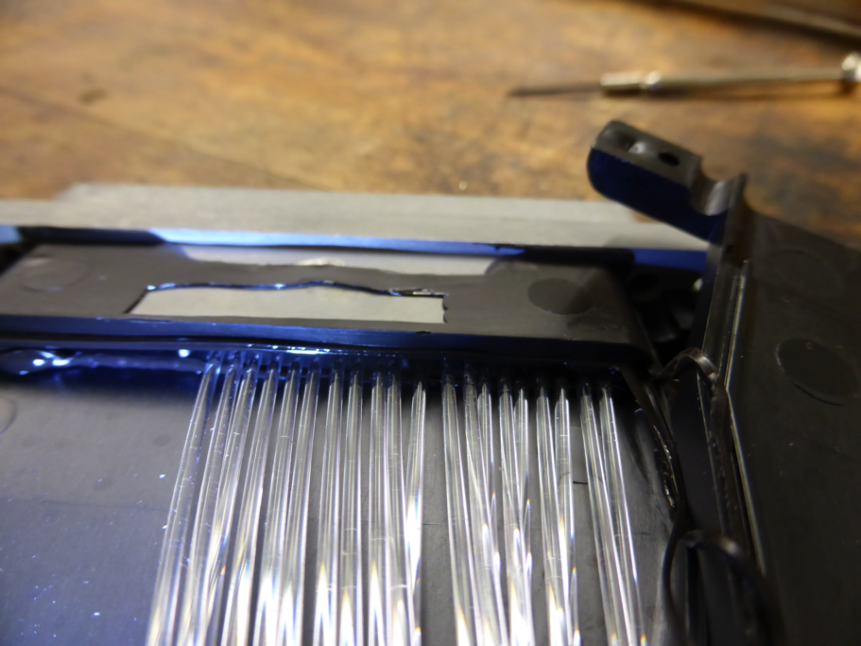
Cables

Slide 9
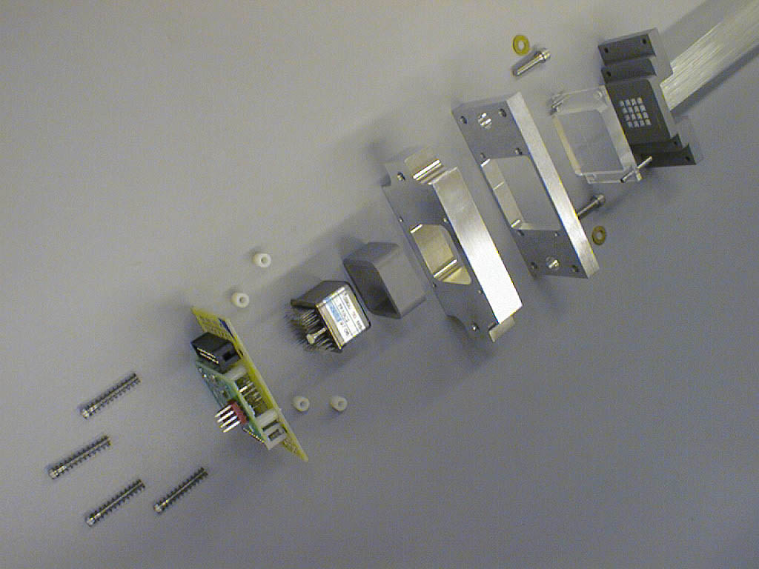
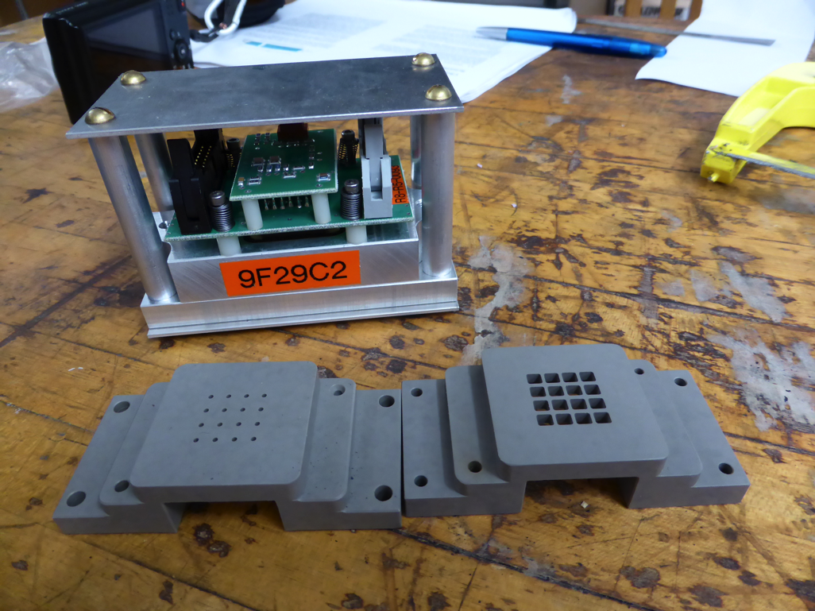
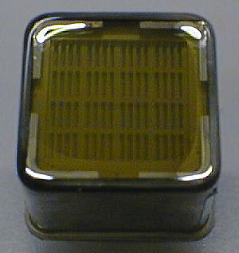
Electronics
Cookie with fibers
PMT Mounting
Components
Alignment
window (not
installed)
Adjustable mounting
bracket (alignment)
PMT jacket
M16 PMT
Spring loaded PMT base
Fiber Layout
Hamamatsu R5900 multi-anode PMTs:
16 pixel tubes for the far detector (pixel size 4mm x 4mm)
64 pixel tubes for the near detector (pixel size 2mm x 2mm)
Gain of 10⁶ consistent to x2 (M16) or x3(M64)
QE at 520 nm typically 13.5%
Good single pe peak
Very fast signals and low time jitter.
Notes:
The 384 signal fibers are routed to three Hamamatsu M multichannel PMTs through precision machined cookies. Eight fibers are routed to each 4mmx4 mm pixel. Two of the PMTs in a far detector MUX box see 8 x16=128 fibers from single planes the third PMT sees 8x8=64 fibers from each plane The ribbon cable connectors are inserted into the front plate according to a pattern that minimizes fiber lengths within the MUX box

Slide 10
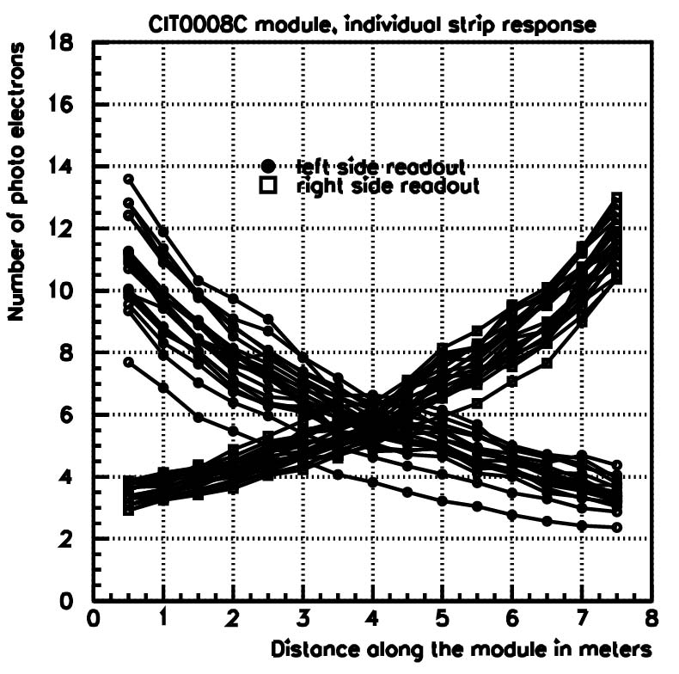
Expected performance
Light output: 10.6 p.e. reading out from both sides for a 2 GeV muon (5.5 p.e. min)
Time measurement: < 2 ns per strip for signals > 10 p.e.
Calibration:
Relative near/far energy response to within 2%
Absolute hadronic energy response to within 5%.
Performance variation vs time:
Decay of fluors
Monitored with calibration devices (laser, muons)
Individual Strip Responses
Number of observed photoelectrons
Distance along the module (m)
Do we need to include a calibration device in out prototype?
From reference

Slide 11
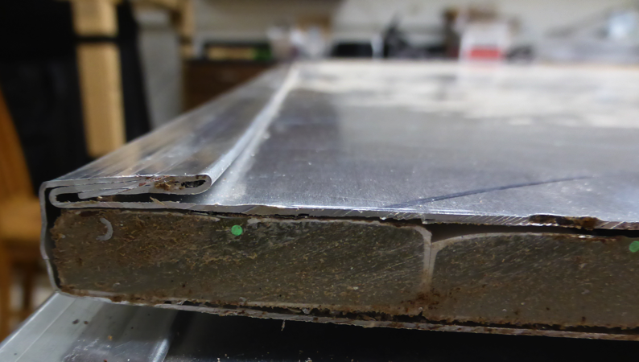
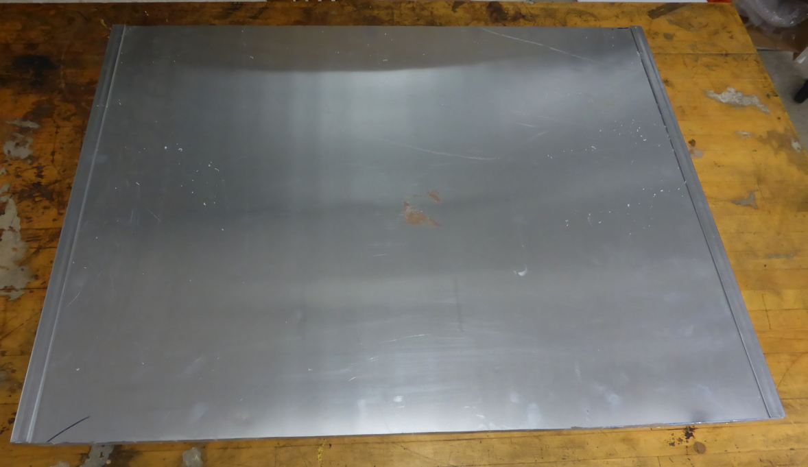
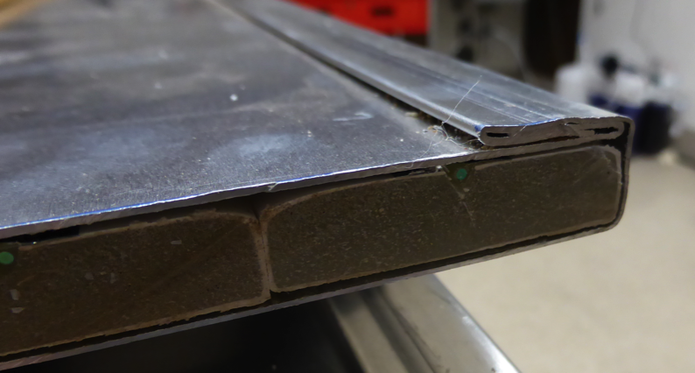
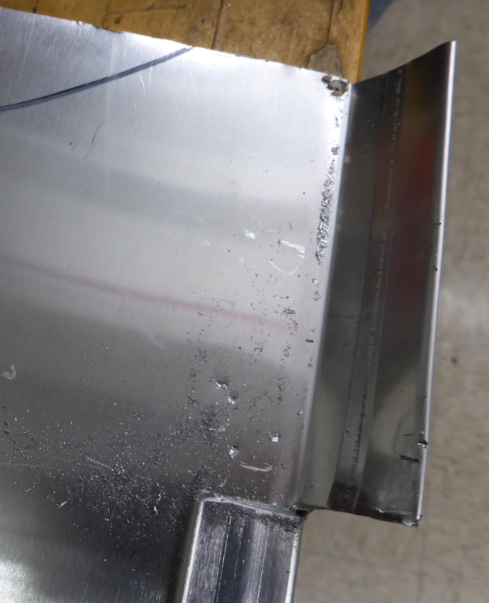
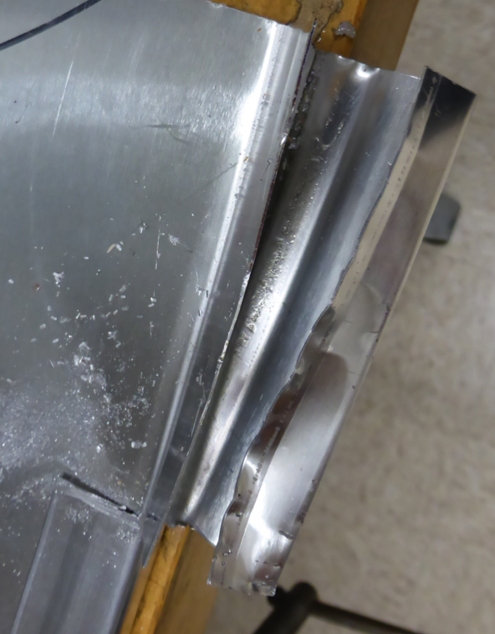
Making our own small test module
W = 32 inches
L = 24 inches
Fits in the Chamberlin freezer

Slide 12
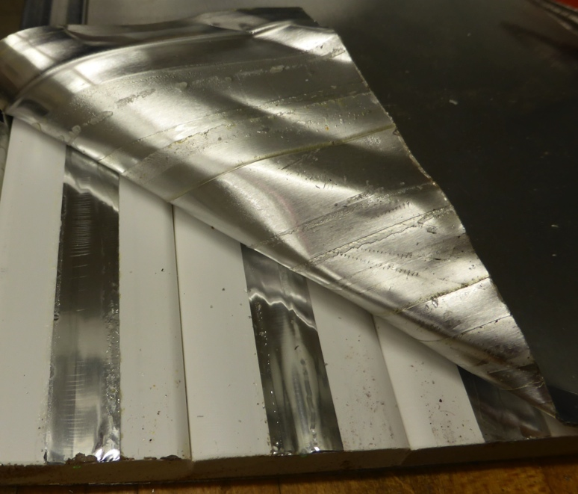
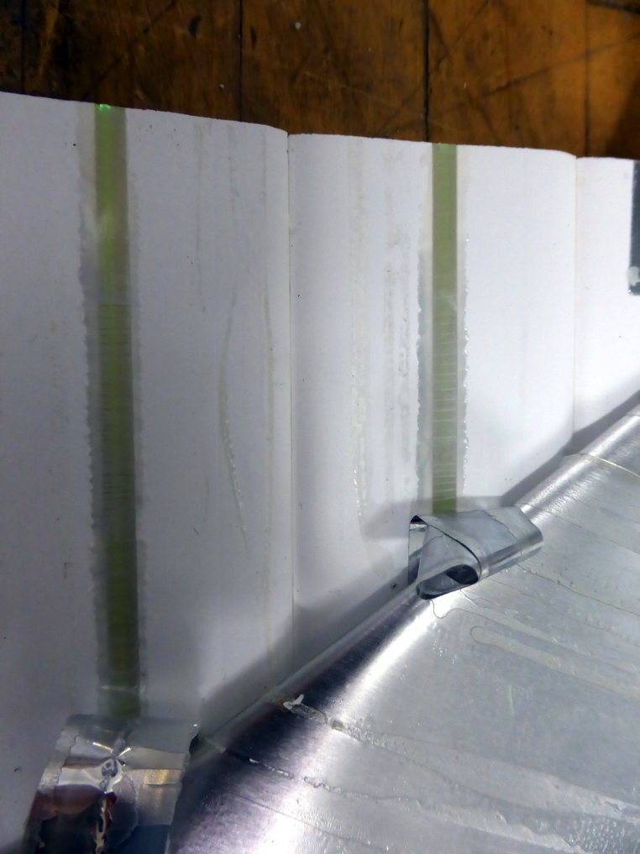
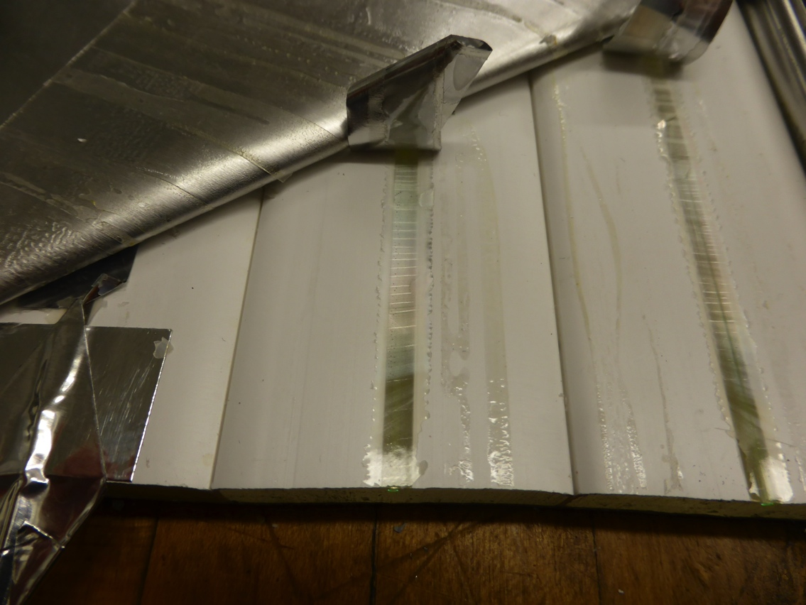

Slide 13
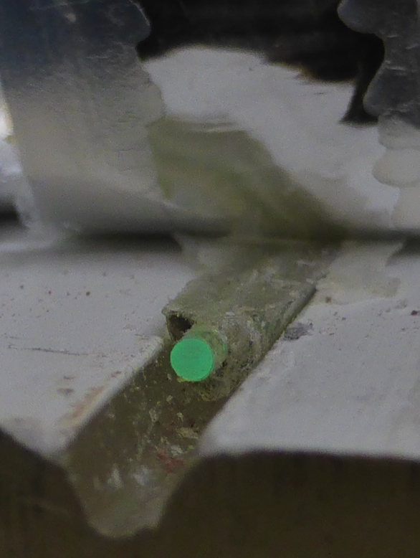
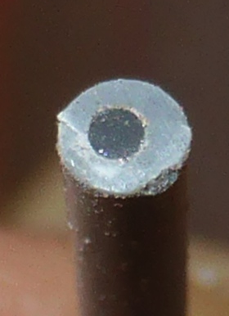
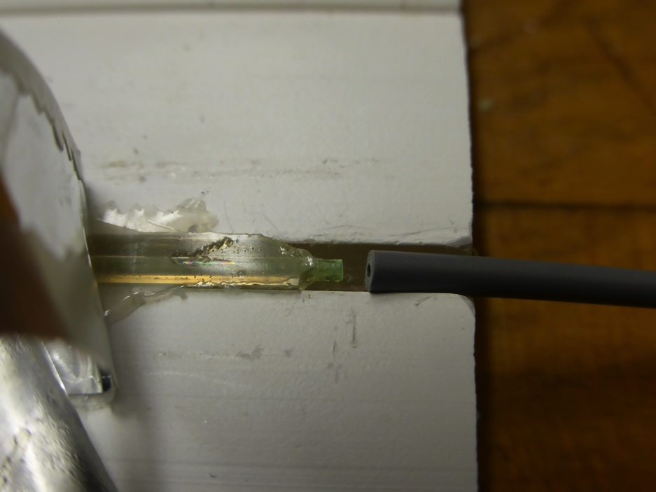
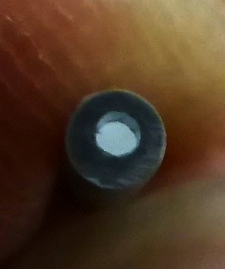
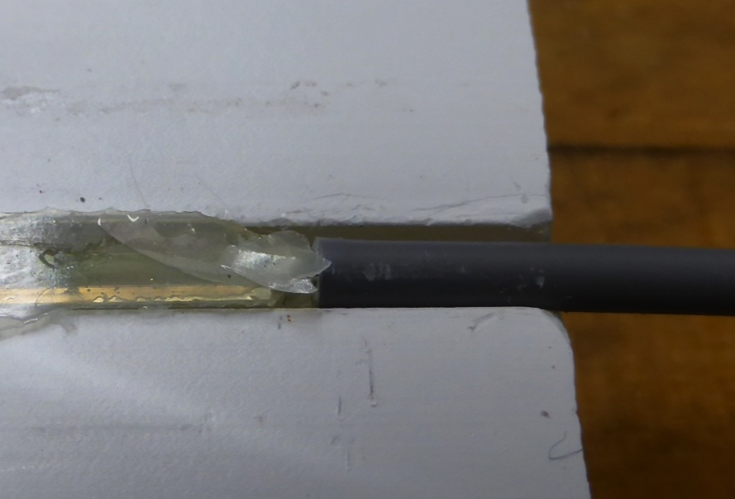
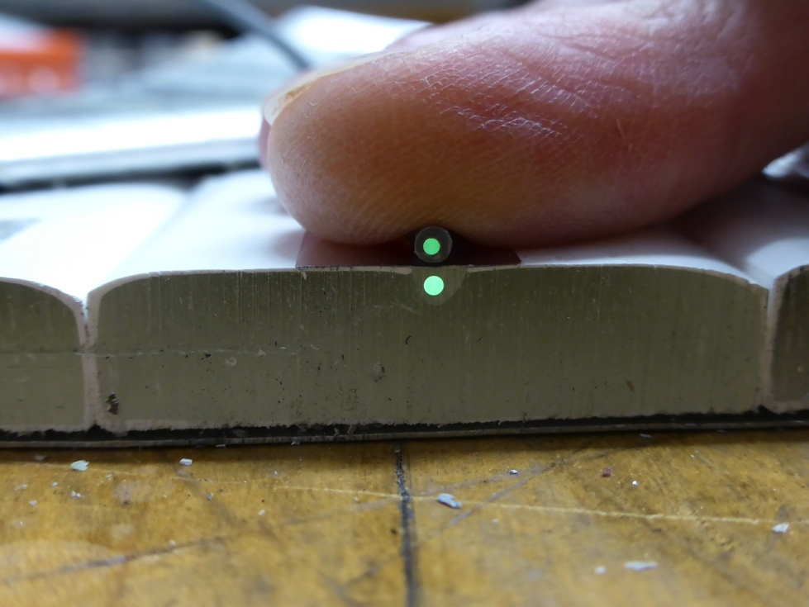
Toray PFDU-FB1000

Slide 14
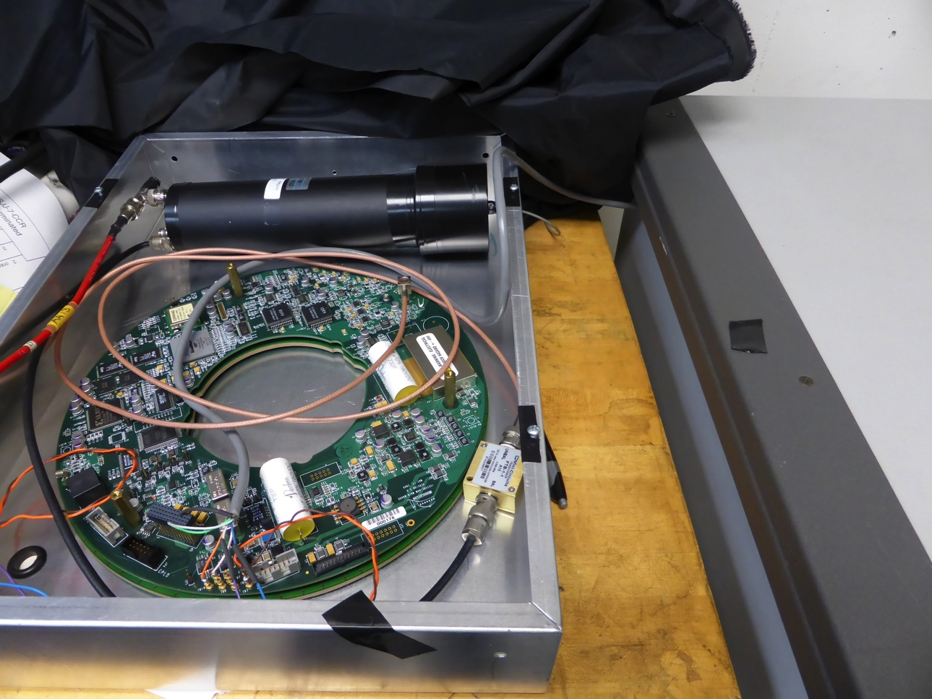
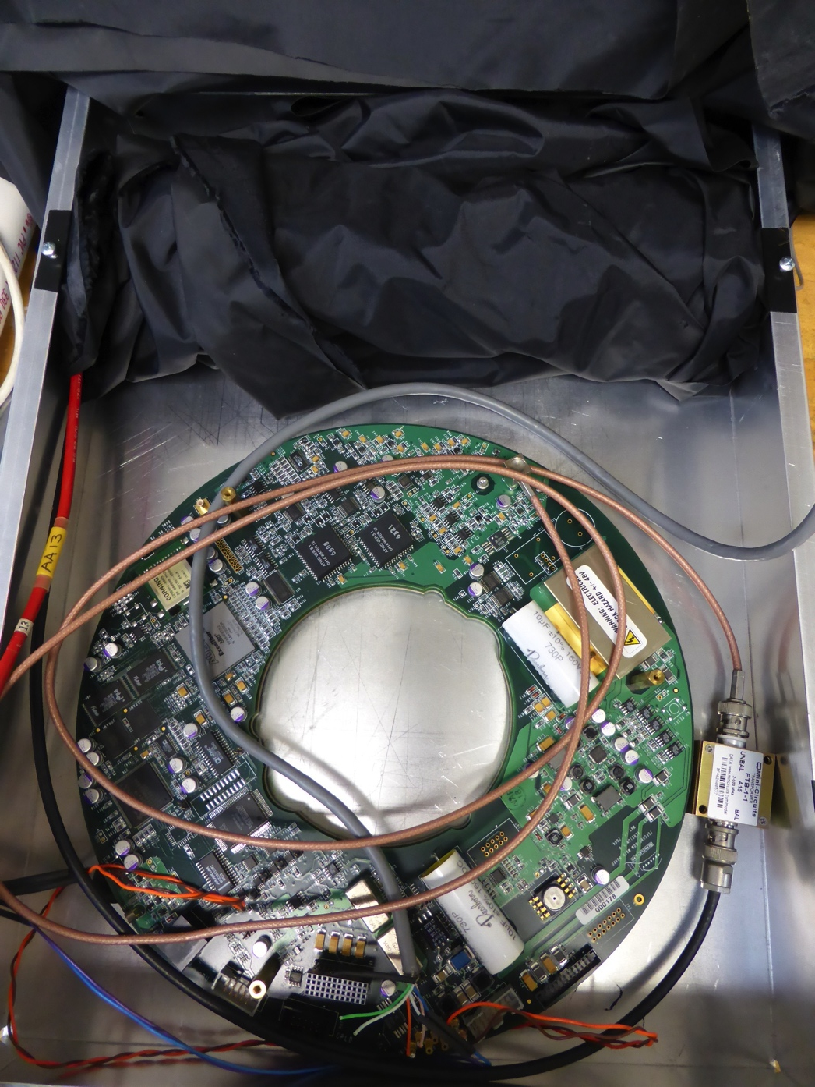
Fiber connected to 2” PMT Hamamatsu RD2759 (2kV – 1e7 gain) connected to mainboard
DOM Platypus placed under strip and connected in LC mode
Notes:
Optical fiber is Toray PFDU-FB1000 (datasheet is in our elog at http://elog.icecube.wisc.edu/AbsCal/154 )
It's 1mm diameter, most of that is PMMA core and then there is the thin fluoropolymer cladding for internal reflection, see the datasheet if you want more detail. There is a graph in there showing no effect of operating at -55C, by the way.
The DOM is called "Platypus", it was one of two that were used by John Kelley & Jim Braun for testing when developing the DOMCal program. The other one in there is "Titanium".
The 2" PMT is Hamamatsu H7195, serial number RD2759 (the same one as mentioned in the elog entry above). We run it around 1e7 gain.

Slide 15
Test of mini module
Goal of planned test:
How much light we get from a muon?
Glue is expected to brittle at low temperature. Does this effect the light output? By how much?
Planned test:
Run at room temperature and verify we can see a signal
Monitor performance vs decreasing temperature
Inspect visually the assembly after temperature cycle
We ran a first test at room temperature
Computer died shortly afterwards so we have not gone down in temperature

Slide 16
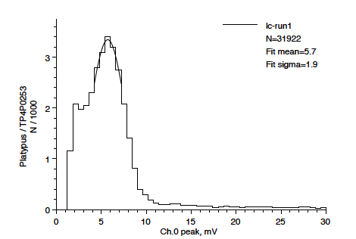
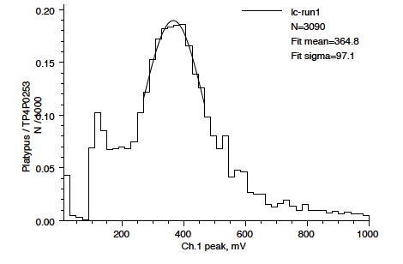
Platypus DOM plots
Ch1 muon signal at 360 mV ~ 65 SPE
1 SPE signal in Ch0 at ~6 mV
We select pulses in sync -100 ns to +100 ns to a signal in ch1 DOM > 0.2 V

Slide 17
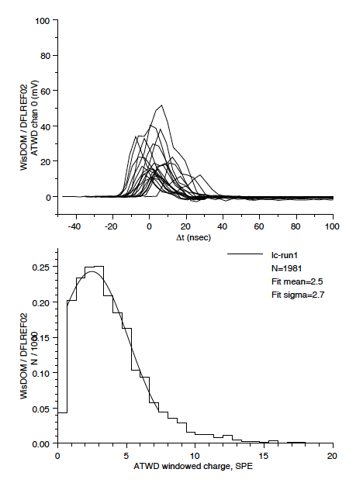
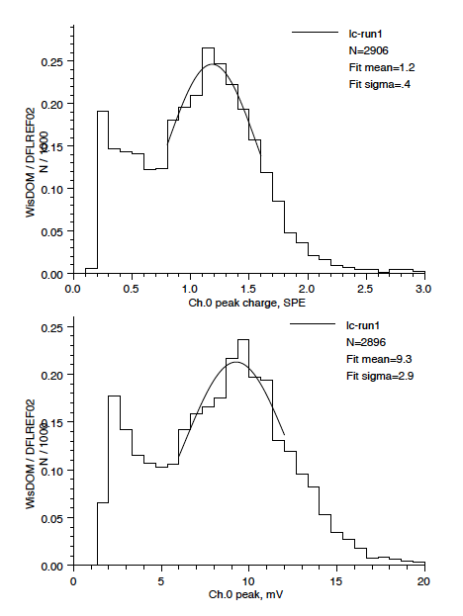
Scintillator plots
Peak at 2.5/1.2=2 SPE

Slide 18
What’s next
Set up a new computer to take data
Take measurements at room and low temperature
Possibility to improve coupling with splice and coupling gel
Need a plan B if glue fails catastrophically
Switch to electronics for deployment
Test the whole setup in freezer at PSL

Slide 19
If we need to build something different
Many things can be studied and improved:
Light output dependencies:
Light output <linear with scintillator thickness but depends on aspect ratio.
Light output inversely proportional to strip width (actually about 1.3x for 2 vs 4 cm.)
Light output with two fibers = 1.8x light with one fiber.
Light output vs fiber radius ~ R^{1.3}
Difference between fiber in hole vs fiber in groove:
A fiber glued into the groove is 1.8 times better than a dry fiber
A dry fiber in the groove is 10% worse than a dry fiber in a hole
Increase thickness? or use more strips on top of each other?

Slide 20
Backup

Slide 21
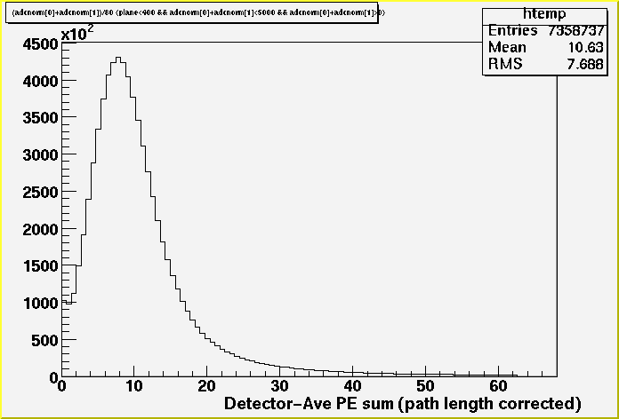
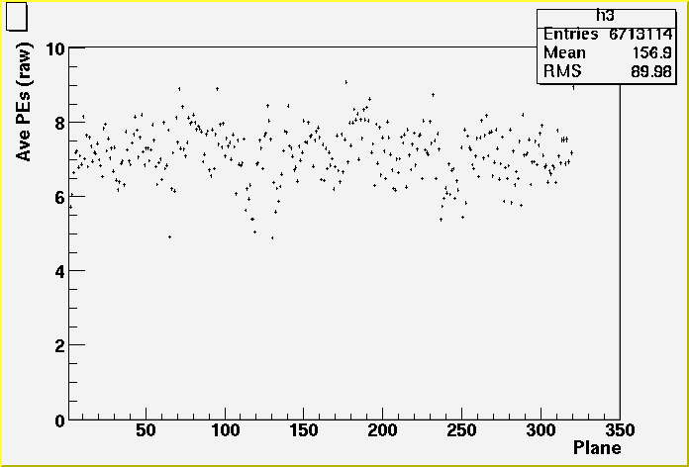
Light output at the far detector
From reference
The most significant design critereon for the far detector was the light output.
>4.7 pe’s/muon (2 GeV muons) for the average sum of two strip ends.
The measured light output is almost a factor of two higher than the design requirement.
Mean = 10.6 pe’s
(~8.5 for 2 GeV muons)
Light output is stable!
Light output measured for all strips for muons in the far detector. The light output is corrected to 1 cm pathlength per plane but is not corrected for PMT gain variations.
Average light output for one-side of readout vs plane number in the detector. (Not corrected for pathlength or gain variations). This shows the uniformity in the hardware and raw response.

Slide 22
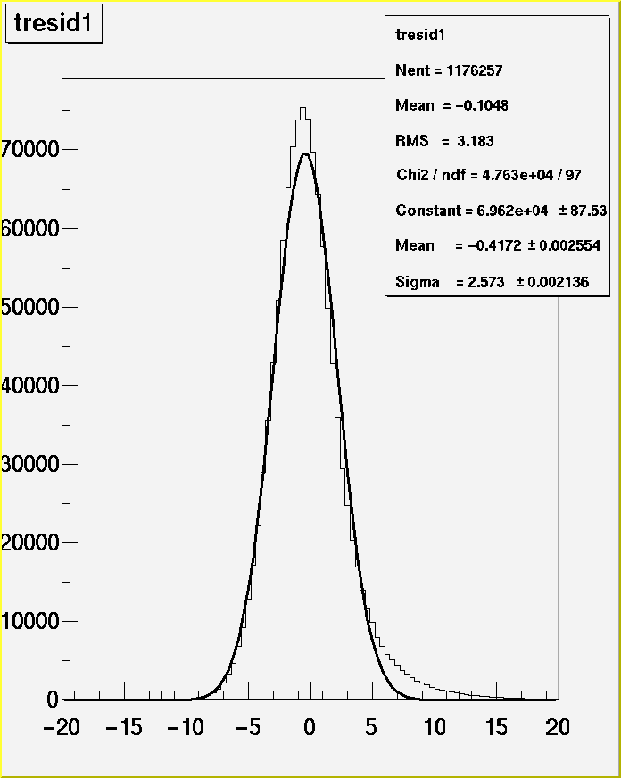
Time Resolution in the Far Detector
The time resolution of the MINOS scintillator system is determined primarily by the decay time of the Y11 fluor in the WLS fiber ~ 8 ns.
The time resolution for each scintillator strip is expected to be ~2.5 ns based on the photoelectron statistics for muons.
Current measurement of resolution using downgoing muons in the far detector is σ=2.6 ns/plane.
The direction of muons can be determined with ~ 10 planes for contained vertex events.
To distinguish upgoing from downgoing through-going muons ~ 20 planes are needed.
Distribution of measured time residuals for muons
Passing through all strips in the far detector. The
Time resolution of 2.6 ns is calculated from this data.
From reference

Slide 23
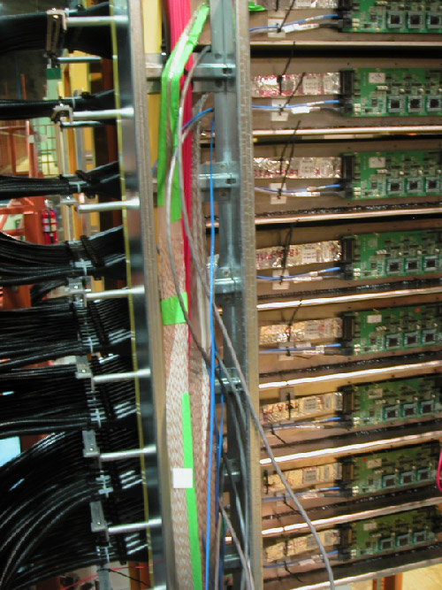
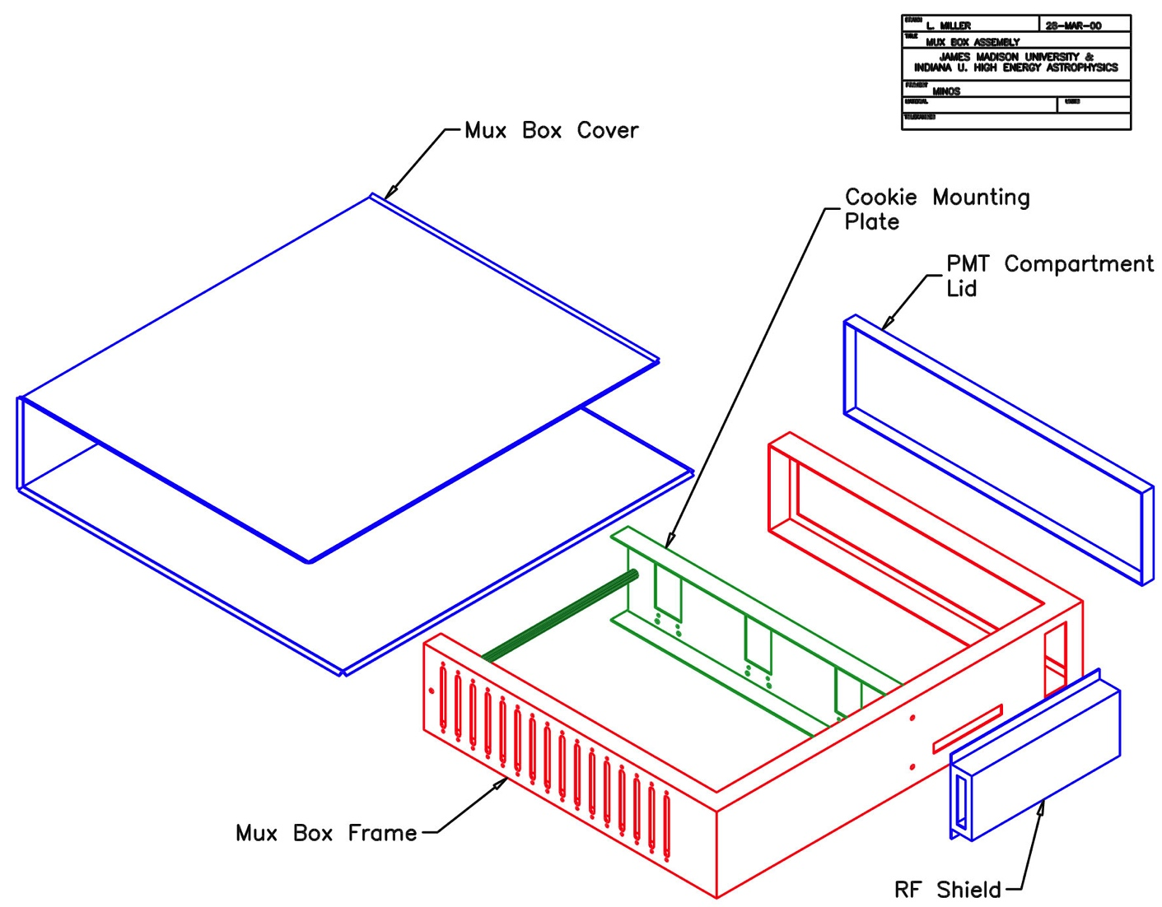
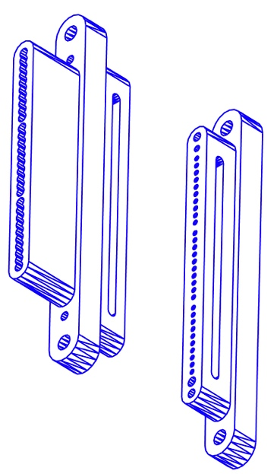
PMT Boxes and Connectors
Cookie with fibers
PMT Mounting
Components
View of PMT
boxes installed
on the far detector
Alignment
window (not
installed)
Adjustable mounting
bracket (alignment)
PMT jacket
M16 PMT
Spring loaded PMT base
Far detector (shown)
3 M16 PMTs/box
8 fibers per pixel
Front-end
electronics
Connector pair

Slide 24
Overview of Costs (Far Detector Only)
EDIA/Setup Production Total
$k $k $k
Scintillator System 2950 12100 15050
Scintillator 750 2430 3180
WLS Fiber 220 1170 1390
Module Components 400 1400 1800
Module Fabrication 1100 2400 3500
Clear Fiber Cables 100 2090 2190
PMTs 180 1670 1850
PMT Boxes 200 940 1140
Readout Electronics (32k channels) 4500
Steel 1000 3500 4500
Installation 1000 3800 4800
Cavern/outfitting 12000
Scintillator system cost/m² $470 $580
Scale-up by factor of ~4? $330 $400

Slide 25
MINOS Building Blocks
Scintillator Module Components
Extruded Scintillator
MINOS Cost = $9/kg (about 2 m) includes QC checks, handling, delivery.
New die ~$10k
New profile ~$50-100k (depends on how radical the changes are)
New vendor ~$100k+ (depends on competence of vendor)
Kuraray: MINOS quote ~$13/kg… MINOS did not accept. This was the only competing offer.
WLS Fiber:
MINOS cost = $1.55/m
On average need L_{scin} + 0.7m x (1,2)
Small production cost ~ $3.50/m (~10km)
Cost scales as ~R² and light as R^{1.3}. Biggest practical radius was good value for MINOS but maybe not if lower light is OK. MINOS fiber is 1.2 mm diameter. 1.4 mm is probably the largest possible using these techniques.

Slide 26
More MINOS Building Blocks
Scintillator Module Components (cont.)
Aluminum ~ $12/m² of module (2 skins)
Manifolds, etc ~ $200/module (~$5-10k startup for different styles)
Glues, expendables ~$12/m² of module
Connectors ~$5/ module
Scintillator Module Assembly
~20 hours/module for MINOS, style of module matters very little
Setup for different style modules ~ 2 weeks = 800 hours
Setup with MINOS equipment at new site and new crew ~ 4000 hours
New equipment equivalent to MINOS ~ $400k.
Cost at Caltech rate for MINOS ~$400/module
Full module costs:
MINOS Cost: $660/module + $180/m² : 8m module = $2100 = $260/m²

Slide 27
More MINOS Building Blocks
Readout Component Costs
Clear fiber cables
$1.15/m for raw clear fiber
$1.00/m for conduit
$8/ cable for connectors and shrouds
2 hours/cable assembly labor (~$44/cable)
Example: 24 fibers x 4m = $170
PMTs
M16 ~ $760/tube + $40/base + $200/mounting +$400/routing box = $1400/tube
In MINOS far detector: $1400/tube = $88/pixel = $11/fiber end readout (8fib/pix)
M64 ~ $1300/tube + $50/base + $200/mounting + $400/routing box = $1950/tube
In MINOS near detector: $1950/tube = $30/pixel = $30/fiber end readout (1fib/pix)
Other stuff: (LEDs, HV…) ~$200k for a “small” system
Electronics:
MINOS far detector: ~$400k + $40/channel (pixel, $5/fiber end)
MINOS near detector ~$600k + $200/channel (pixel/fiber end)
DAQ system ~$300k

