Slide 1
Surface detector R&D
Context to M&O and to Extensions
Albrecht Karle
UW-Madison

Slide 2
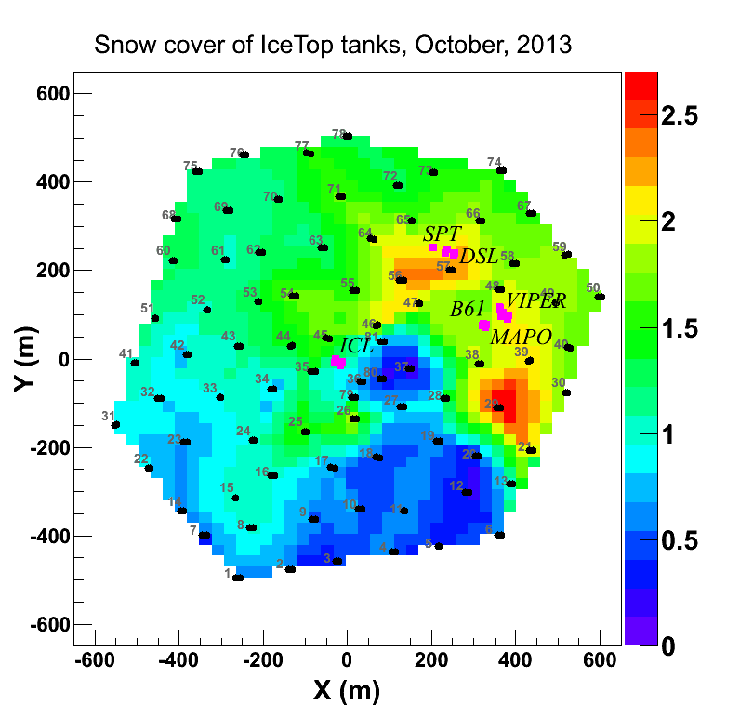
Snow management and IceTop maintenance
NSF has circulated a plan, which results in ending the snow management. That means IceTop stations will begin to sink deeper.
We did not fight this very hard since it is literally an uphill battle and the amounts of snow were substantial.
Here I discuss an alternate approach.

Slide 3
Snow management and IceTop maintenance
Response:
IceCube Maintenance includes maintenance of IceTop which is integral part of IceCube.
Mitigation:
Design, build and deploy surface detectors that can be added to IceTop stations that are most affected.
Have a verbal agreement by program officer (V.P.) for that approach. I think the expectation is that it it does not add cost or not significant and that it is not too big of a deal.
Have added language in next year M&O plan to perform some R&D towards this goal.
Will add a task to the M&O proposal that performs this. However make not too much fuzz about it.

Slide 4
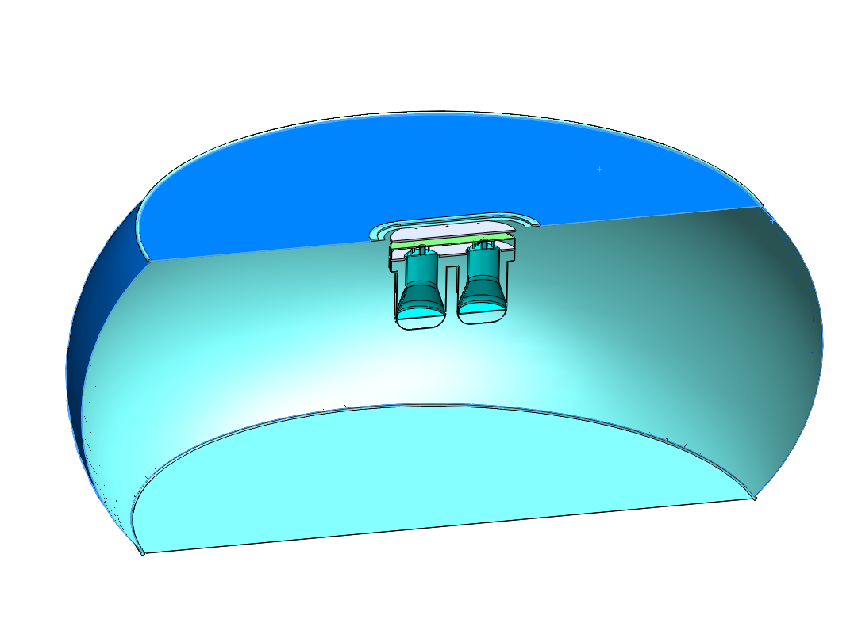
Earlier ideas for IceVeto modules focused on water/ice tanks, bags
Talks at previous collaboration meeting
Sessions.

Slide 5
Suggested approach: Scintillators with WLS fiber readout
Started to have a closer look at MINOS scintillators (Thanks to our friends at MINOS for helpful discussions and materials, J. Thomas, K. Lang, others.)
Possibility to try out actual MINOS scintillator.
Possible field activity next season (2015/16)?
Questions/assumptions
A scintillator would be a valuable as additon to IceTop
- could be justified as maintenance. (Has zero discrimination of muons and electrons/gammas. But we still have IceTop)
Readout individual fibers or just the analog sum (multi or single channel photodetector)?
What cable connection: IceTop freeze control cables or something different?

Slide 6
Suggested approach: Scintillators with WLS fiber readout
This R&D effort should be compatible and at least synergistic with R&D for a future extension.
This is not only about IceTop maintenance.
That means we want to keep requirements for a large detector array in mind.
This does not mean that other veto strategies should not be considered and pursued. However this one, I believe, we can justify within M&O.
Low impact deployment
Water/ice tank deployment seems hard to imagine on a scale of 1000s of detectors
Light weight, 2 people should be able to carry a 2 m^2 detector.
Probably cost effective.
….
Goal of afternoon session to explore this option

Slide 7
Copied from a MINOS talk

Slide 8
Copied from a MINOS talk

Slide 9
Copied from a MINOS talk

Slide 10
Scintillator: Extruded Polystyrene with 1.0% PPO + 0.030% POPOP.
Module cost in MINOS: 260 $/m^2 (could be less if we can use those)
Add housing and electronics for a module of scale 2 m^2,
Possibly below 1.5k for 2 m^2 modules
3000 such modules - $5M + cables and deployment

Slide 11
Other discussion, …

Slide 12
Requirements for HEX
Energy threshold
IceCube diffuse numu best fit (E^-2.2):
12 signal and 12 background events/yr above 52 TeV
Requirement: Good efficiency at 50TeV?
Veto extension:
Can double background free neutrino events above some energy, ~100 TeV
Cost effective way to add neutrinos?
It’s not easy: Every veto gets hard at energies at or below 100TeV
In-Ice veto with 250m spacing is hard and always has reduced volume, but should do ok at zenith >65°
Surface veto also gets hard, but should do ok at zenith <65°

Slide 13
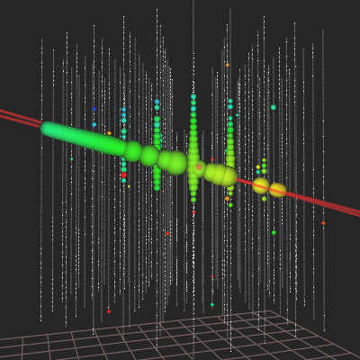
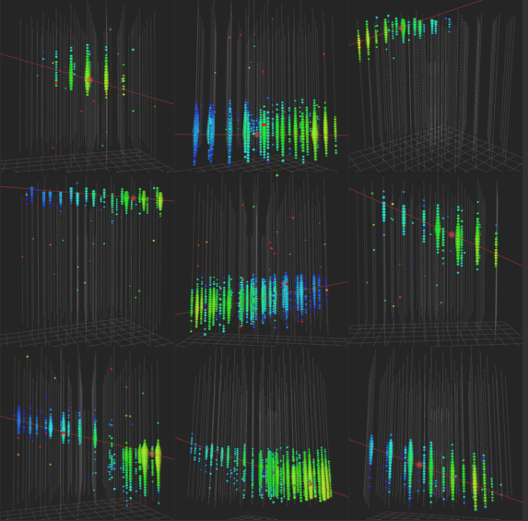
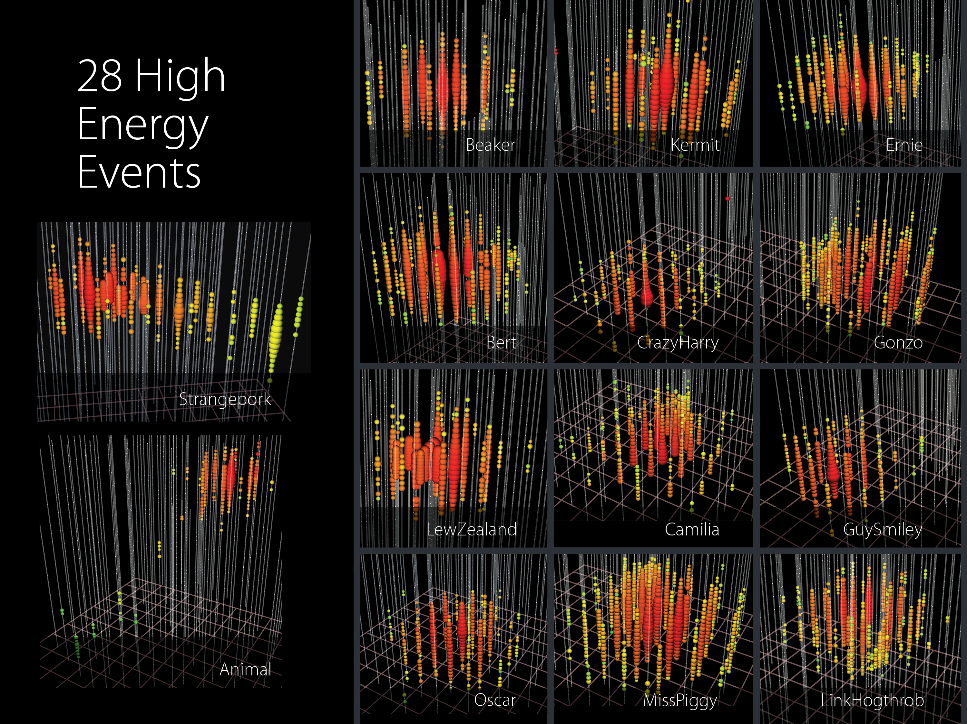
IceCube results
Through going muons
Events with contained vertex
Northern hemisphere
Neutrino events (best fit) above 50 TeV “true” muon energy:
Astrophysical: 12 events/yr
Atmospheric: 12 events/yr
Significance: ~2.7 sigma/yr
Mostly Southern hemisphere
Neutrino events above 60 TeV:
Astrophysical: 6 /yr
Atmospheric: 1/yr
Significance: ~3 sigma/yr
Highest energy: ~550 TeV
(neutrino energy likely in PeV range)
Highest energy: 2 PeV

Slide 14
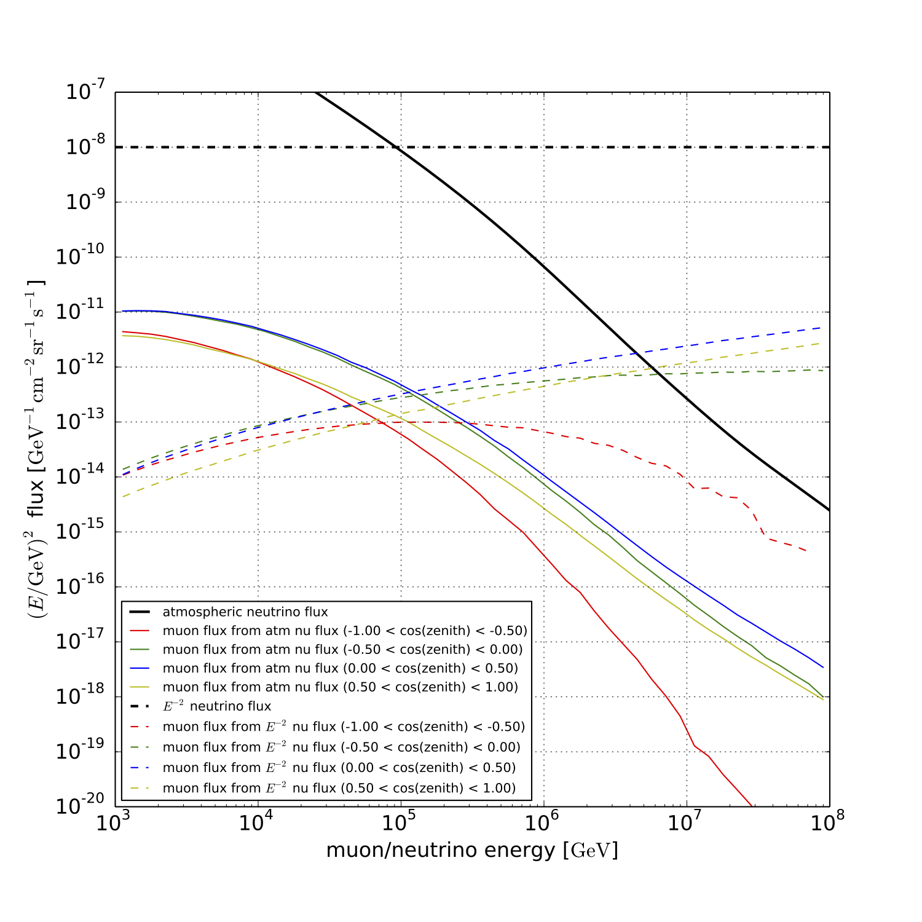
Neutrino and muon fluxes
Astrophysical neutrinos
Atmospheric neutrinos
Astrophysical muons

Slide 15
Neutrino and muon fluxes
Astrophysical neutrinos
Atmospheric neutrinos
Muons from atmos. nus
Muons from astro. neutrinos
Signal region begins to dominate above ~80 TeV
Detector should be efficient
above ~30 TeV?

Slide 16
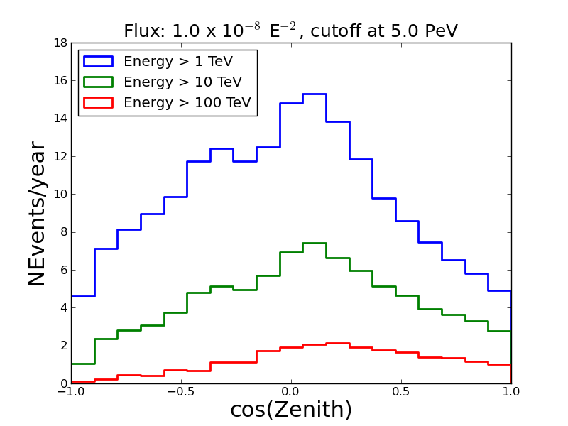
Muon rates from astrophysical flux in IceCube vs zenith angle
Muon fluxes vs zenith angle,
Atmospheric
Astrophysical
Cosmic ray muons
upgoing
downgoing
Can we detect some more of these?
We do that already at some level in the HESE analysis
(contained neutrino vertex)

Slide 17
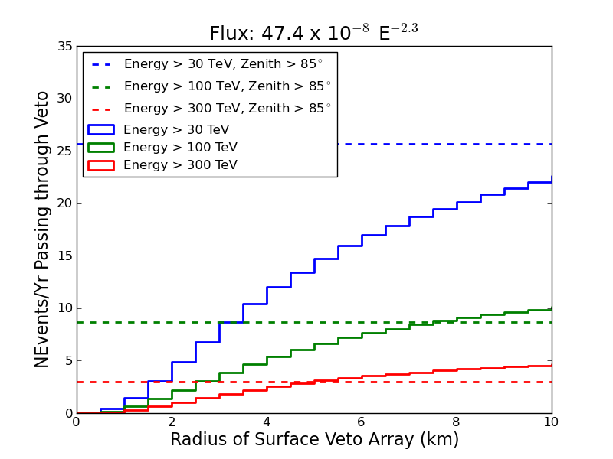
If we had a surface veto, how many signal events would gain?
R
θ

Slide 18
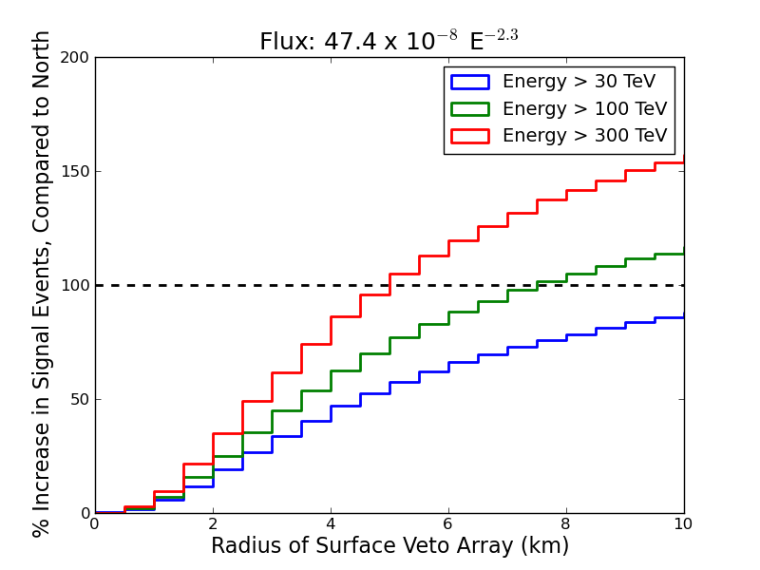
If we had a surface veto, how many signal events would gain?
R
~75% increase in rate >100TeV
θ
Surface array to 5 km

Slide 19
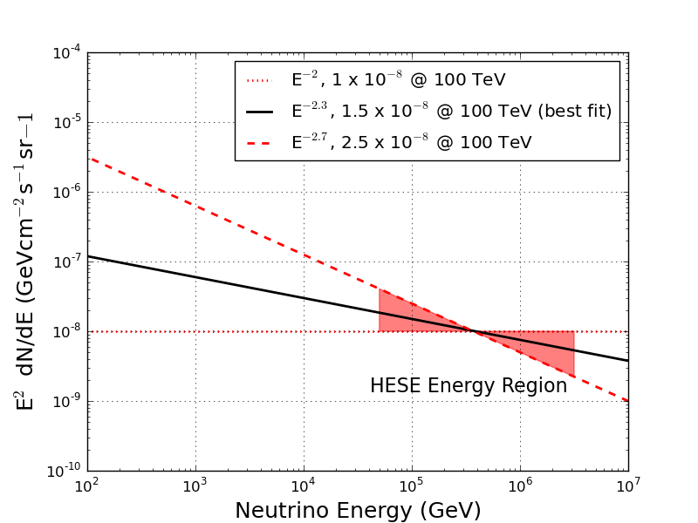
If we had a surface veto, how many signal events would we gain?
IceCube only numbers
Normalizations for each flux chosen using IceCube flux results (HESE contours)
All fluxes are simulated without any cutoff

Slide 20
If we had a surface veto, how many signal events would we gain?
IceCube only numbers
Normalizations for each flux chosen using IceCube flux results (HESE contours)
All fluxes are simulated without any cutoff
Northern hemisphere
(upgoing, zenith > 85°)
Southern hemisphere ( < 85°)
(downgoing, zenith < 85°)
Flux | # of Events/year above Muon Energy
 | 1 TeV | 10 TeV | 100 TeV
E⁻² | 110 | 44 | 11
E^{-2.3} | 220 | 60 | 9
E^{-2.7} | 740 | 110 | 7
Atm. | 15000 | 500 | 5
Flux | # of Events/year above Muon Energy
 | 1 TeV | 10 TeV | 100 TeV
E⁻² | 80 | 44 | 18
E^{-2.3} | 160 | 57 | 13
E^{-2.7} | 590 | 100 | 10
Atm. | 10500 | 350 | 5

