Slide 1
Using Stokes’s Theorem
(and borrowing from accelerator physics)
to Instrument Large Areas
for
Relativistic Charge Detection
(http://arxiv.org/abs/1502.04763)
David Saltzberg and Peihao Sun
University of California Los Angeles
IPA workshop
May 4, 2015

Slide 2
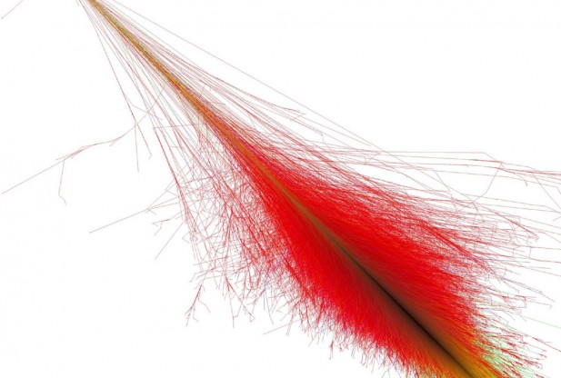
An example of relativistic Currents
100 PeV
  ➔ about 10⁸ charges at shower maximum
  ➔ about 2×10⁷ electron excess (~30 fC)
Image credit: Fabian Schmidt via Redorbit.com

Slide 3

100% instrumentation of an area with a line
Example existing large area detection
  Sampled, E.g.
    Pierre Auger =1600 tanks ➔16,000m²
    Really large (3×10⁹ m², sampled) for air showers of course
  100% coverage by Super-Kamiokande:
    ~1600 m²
Ampere’s Law (Stokes Theorem)
  What happens in an area can be detected along a contour (savings of one dimension)
  A 100m radius detector ➔ 31,400 m²

Slide 4
Concept View

Slide 5
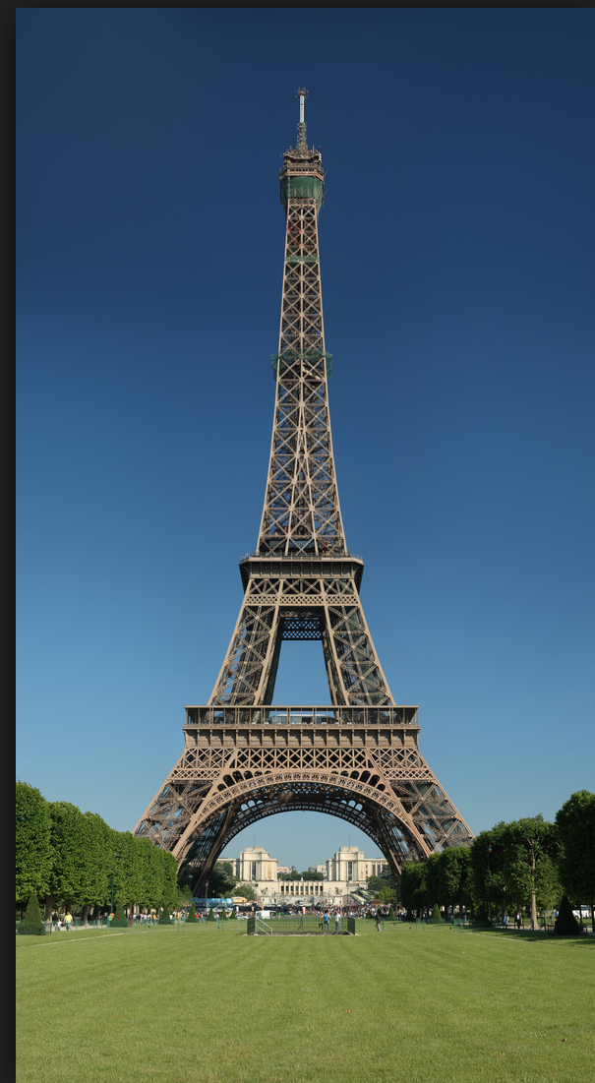
Concept View
Pulse n

Slide 6
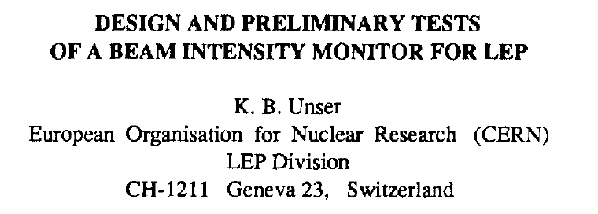
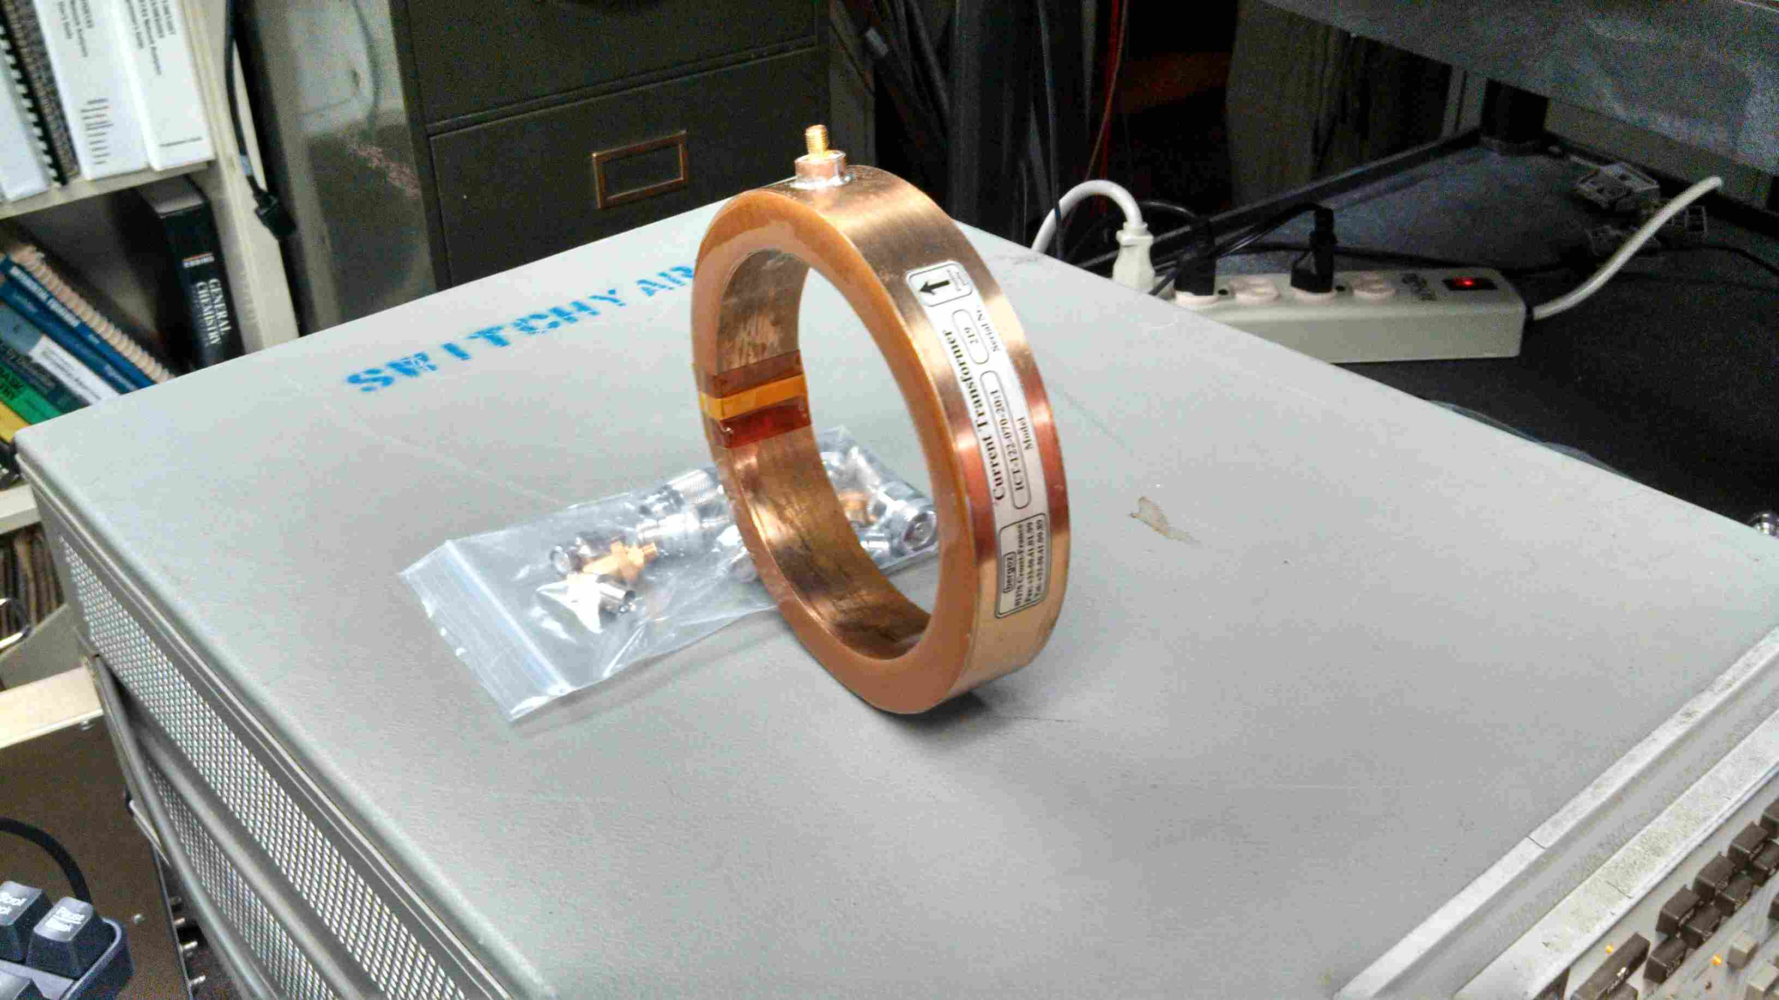
An existing technology
Integrating Current Transformer
  Invented late 1980s for LEP
10K. B. Unser, Proceedings of the IEEE Particle Accelerator Conference, Chicago, 1989 (IEEE, 1989), p. 71.
A real device. (Bergoz)
Measures beam bunch charges:
~ 5 fs – 5 ns
12cm

Slide 7
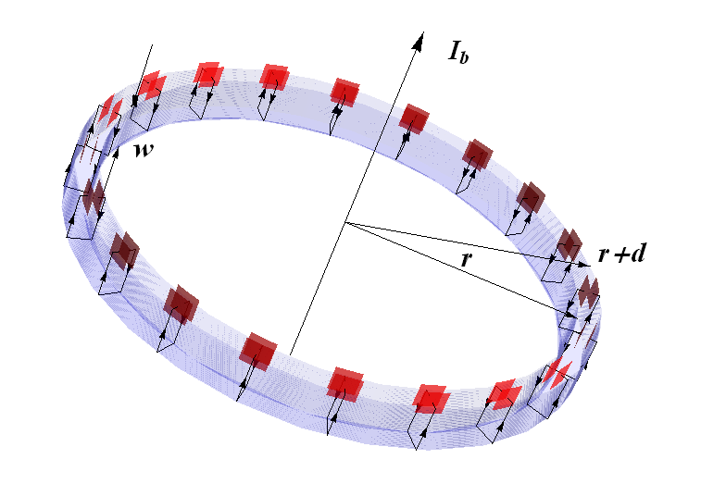
ICT Principle
Charge the primary capacitors:
Net Q on capacitors = Q of passing bunch charge

Slide 8
Increasing size
We could apply this same technique to Particle Astrophysics
  Radius: 10cm → 100m, 1 km, or more?
  Uses Stokes’s Theorem to instrument large area very cheaply.
  Cosmic Rays, Exotica?
  On mountaintops, underground, unfurled in space

Slide 9
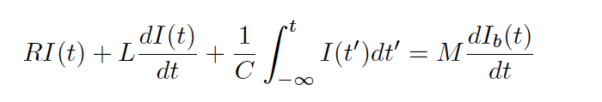
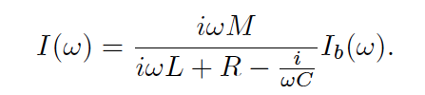

Charging Phase: ~RLC circuit
First model: RLC circuit
So
(M=L) ➔ Q_{beam} winds up on capacitor as long as ….
Need high ω➔ only sensitive to fast moving charges
More advanced model, using complex mu (in supplement)
M=beam/toroid
mutual inductance
L=toroid self-inductance

Slide 10
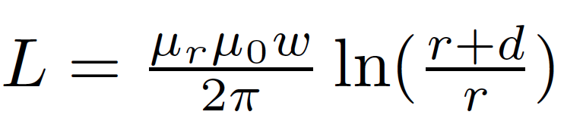
Charging Phase
~ 1/r
100m radius toroid
As r⬆ L⬇
So need C⬆
But tradeoff:
Higher C➔
lower V on capacitor

Slide 11
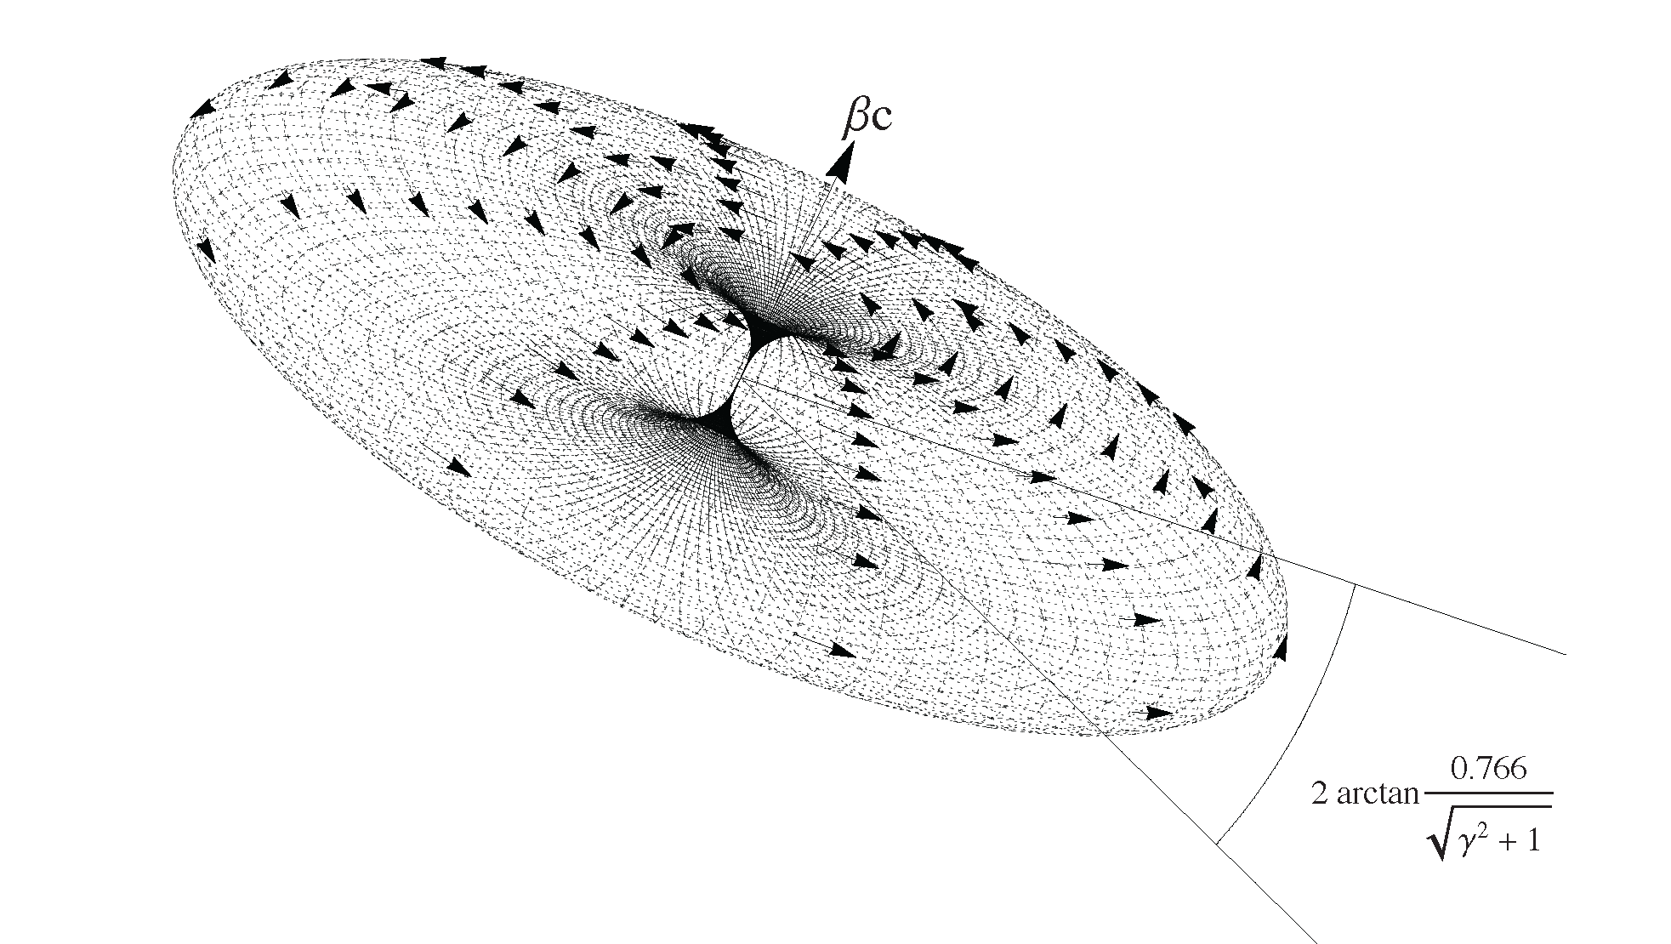
Magnetic Field
Large device is only sensitive to relativistic charges
  If magnetic field not compressed, signal is too slow to charge the capacitor.
Contours of |B|. Drawn for γ=10.
(Recall γ at shower max is 100-200)

Slide 12
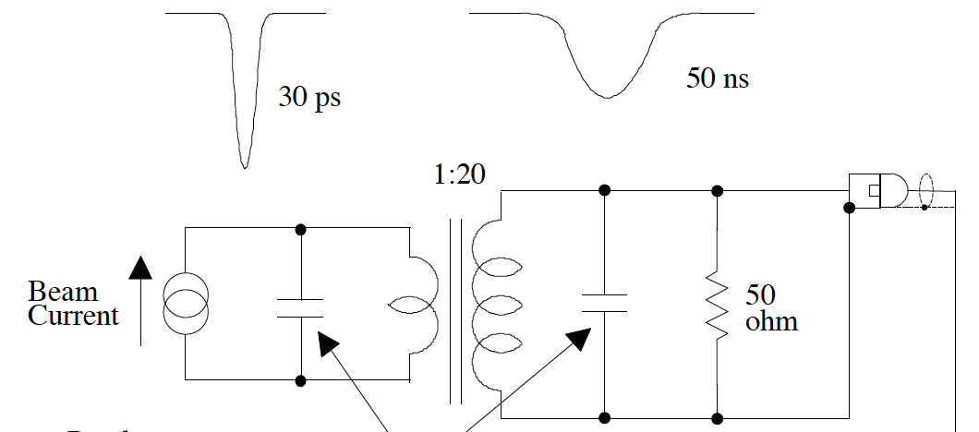
Discharging Phase
Inductively pickup discharge of primary capacitor and slow it down:
capacitors
Optional:
amplification
Figure from ALS Beam Instrumentation
Beam Charge Monitoring
Jim Hinkson, July 1998

Slide 13
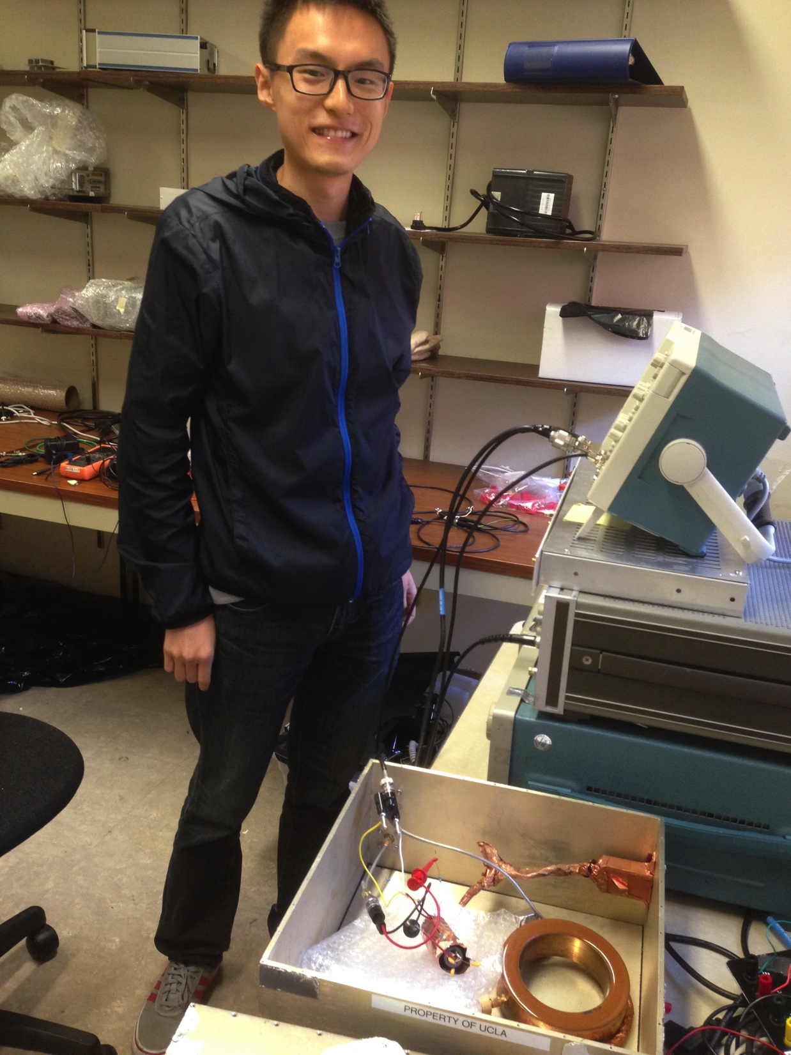
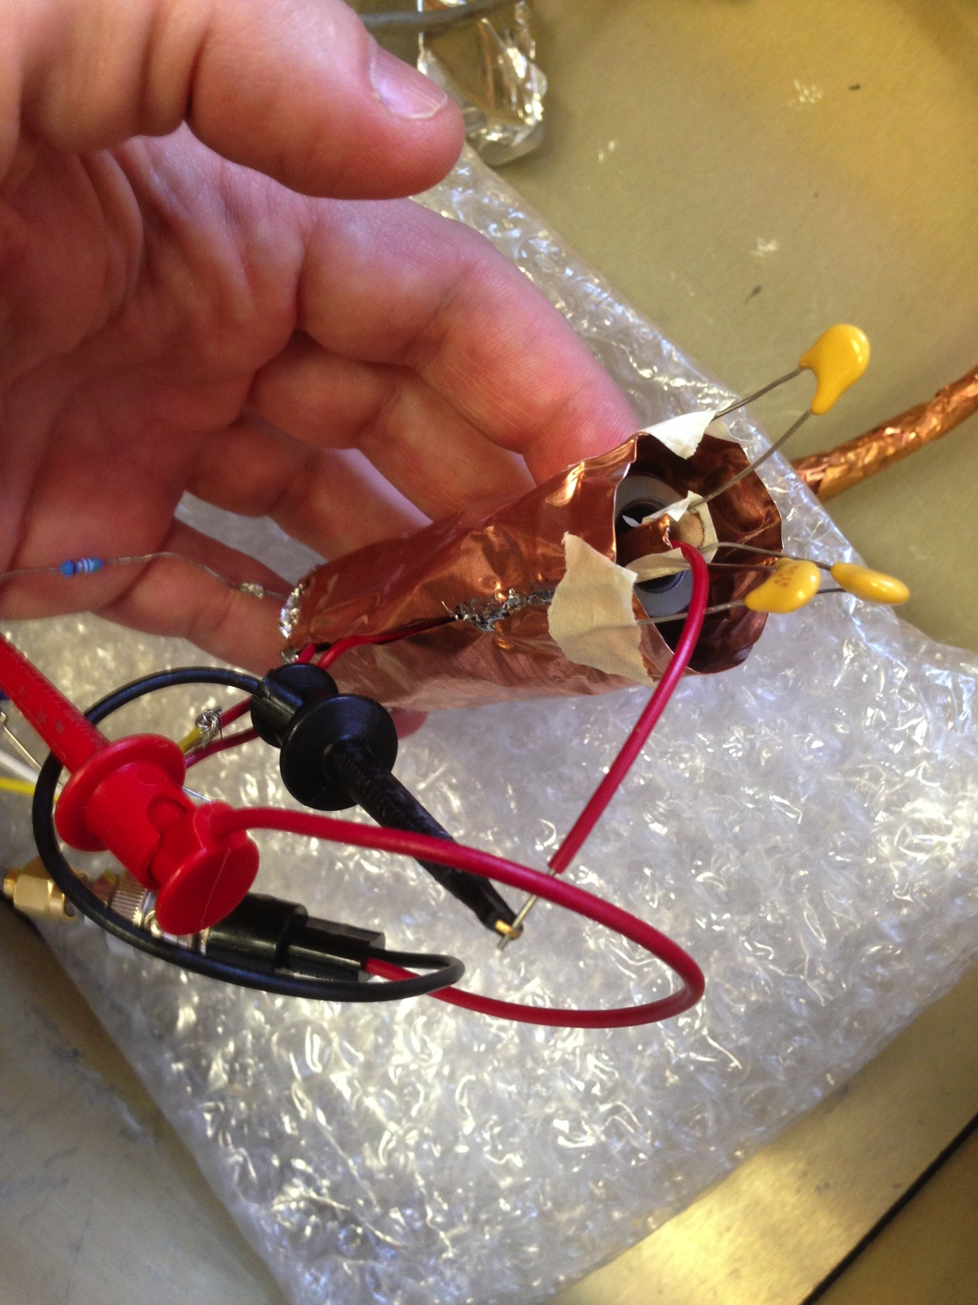
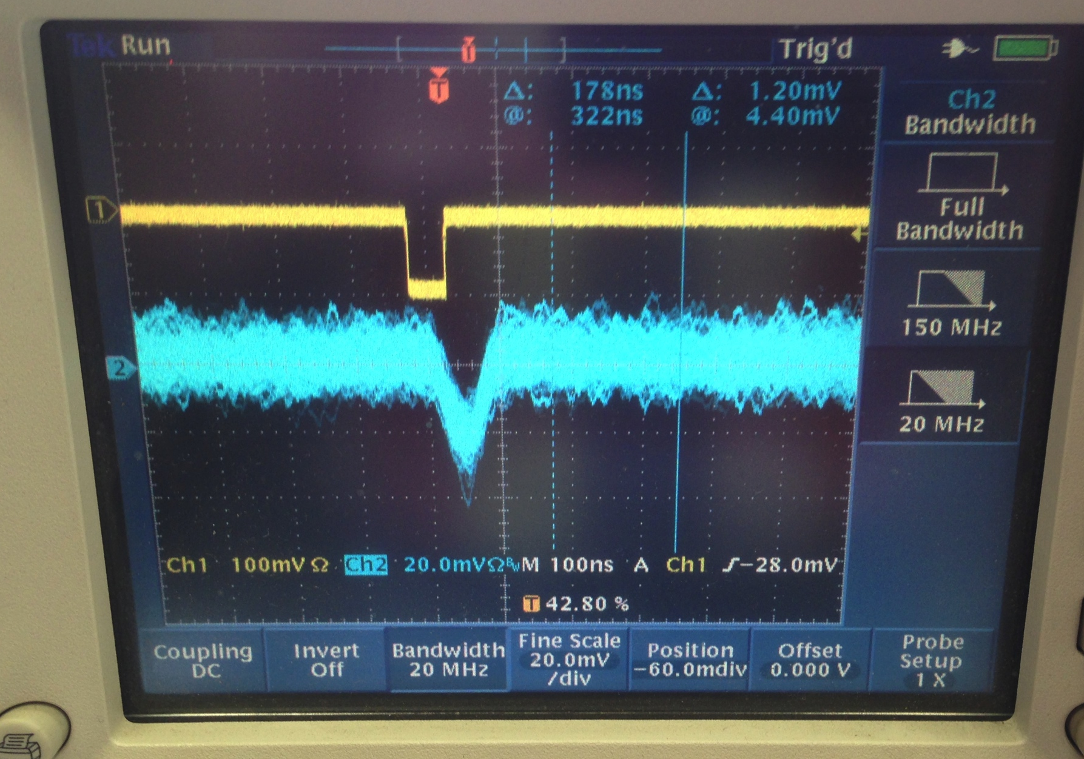
Remarkably Robust: version 0
We built one in ~4 hours using items around the lab <$20.
  Output looked essentially the same as Bergoz $10k version. That’s how we knew it was going to be robust.
~100 pC = 600M e-
Peihao Sun

Slide 14
Side Note: Fast B detection
Seems to “cheat” on bandwidth.
Can measure femtosec fields using a 100 MHz scope.
  Because it effectively “latches”.
  User-added bandwidth information is that there is only one pulse.

Slide 15
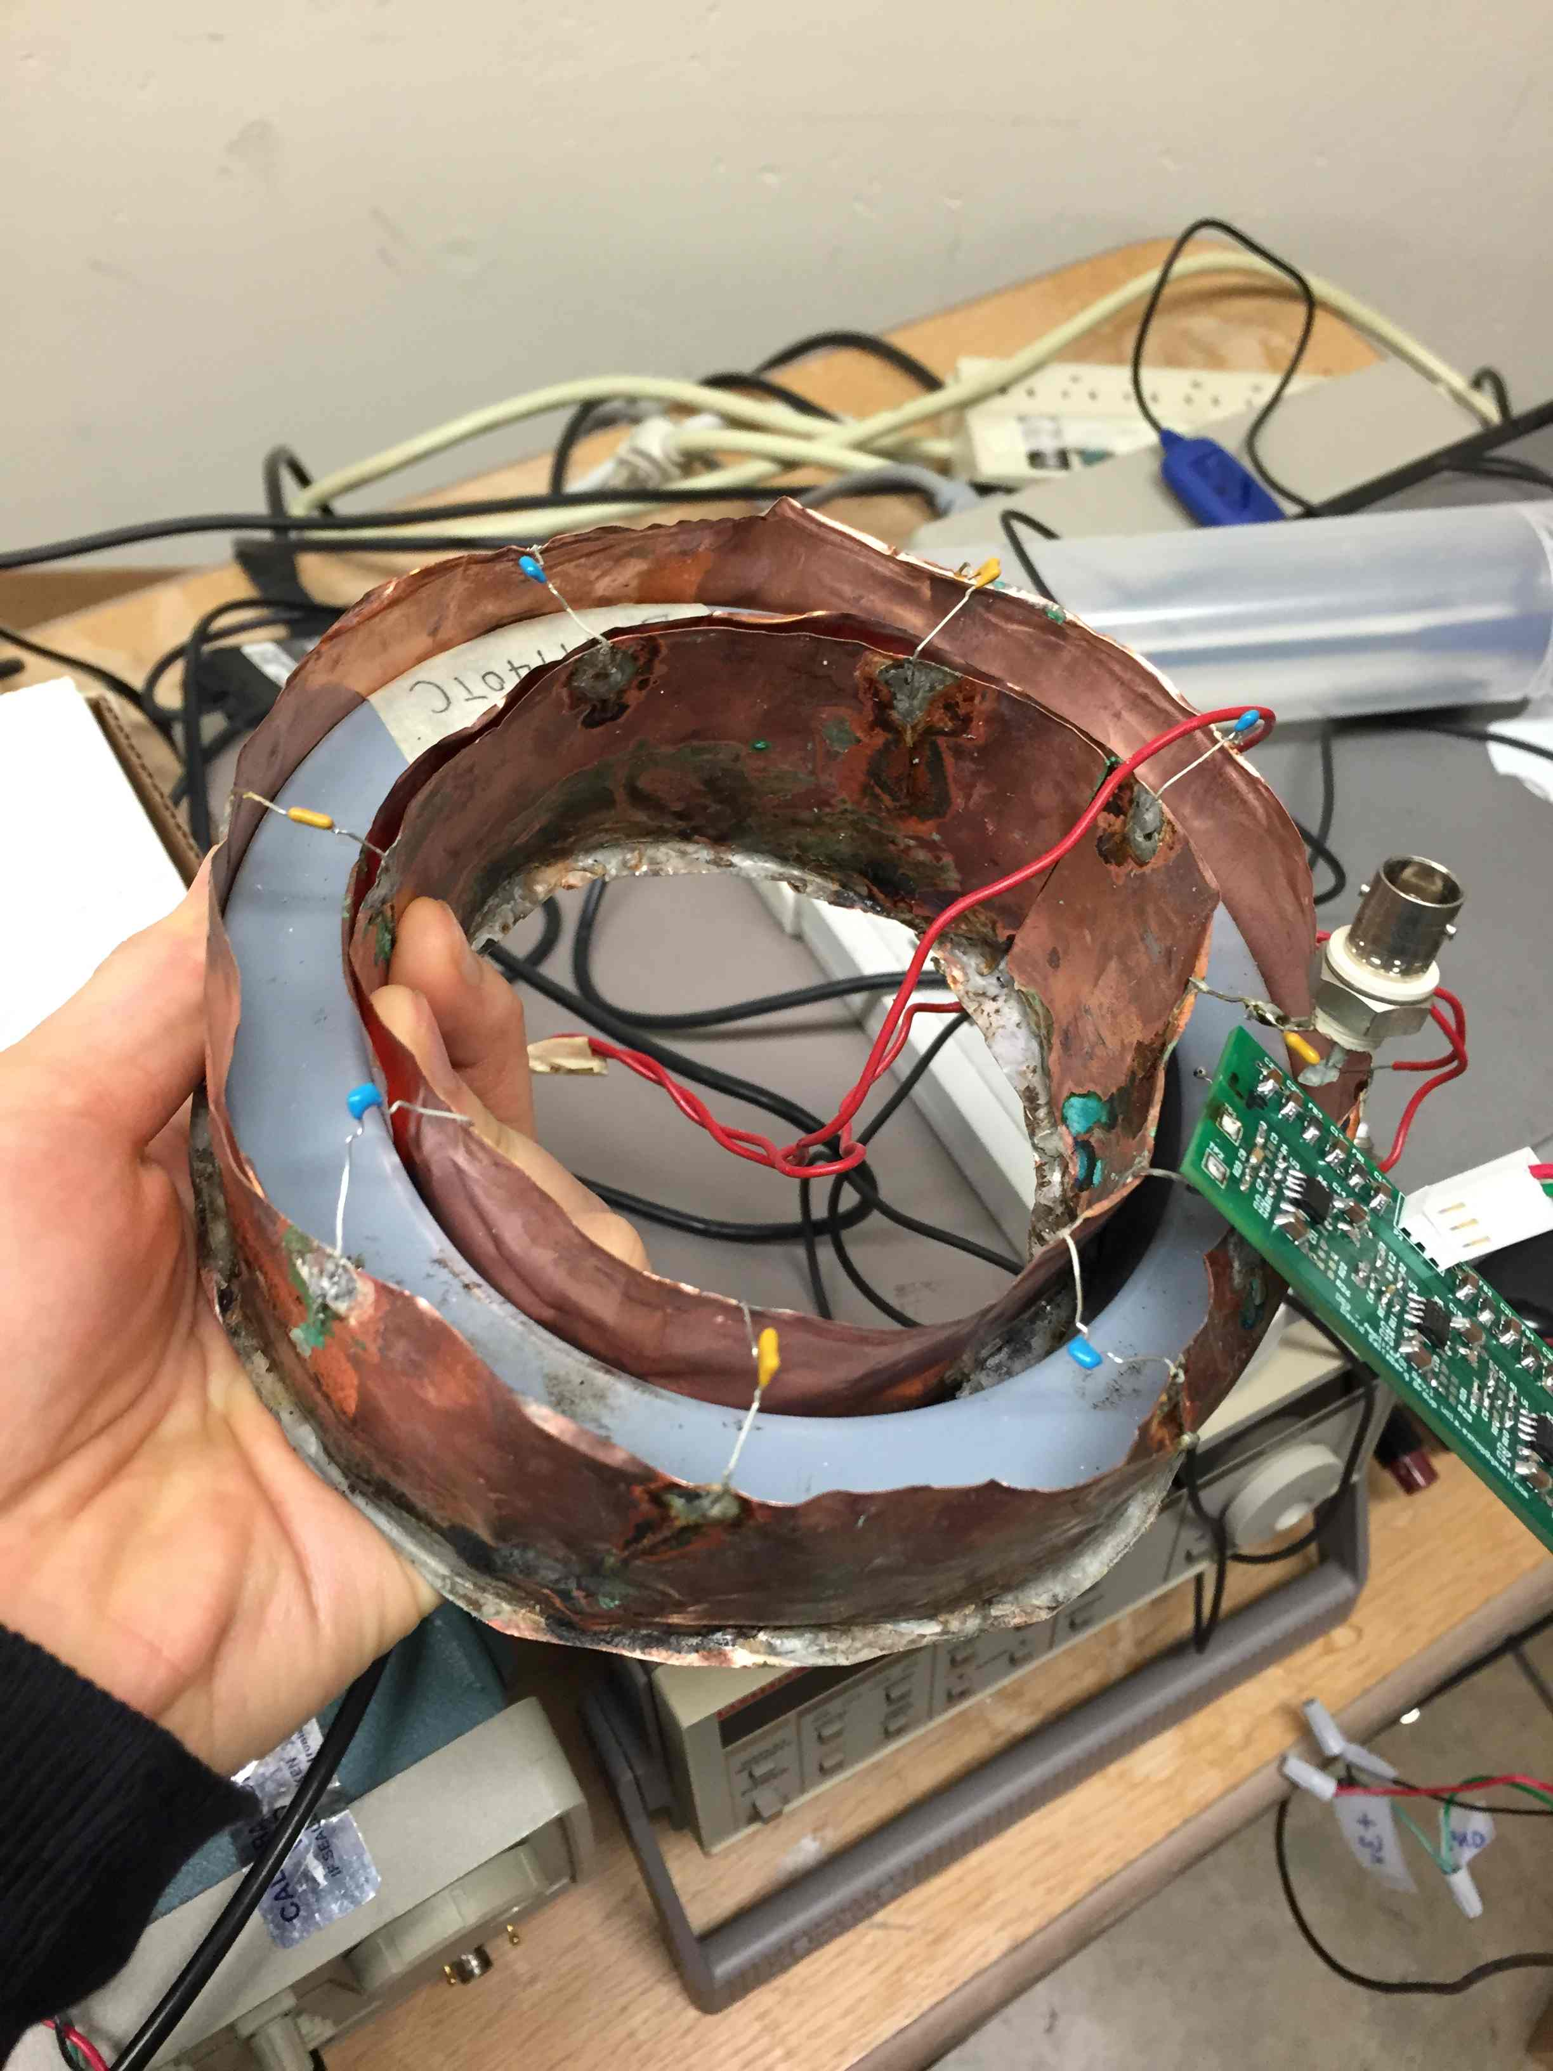
Direct Version of Discharging Phase
We don’t need the fast discharge. Cosmic particles (and many beam bunches) are rare (widely spaced).
Instead, let it ring,
  Simpler circuit
  longer signal,
  lower frequency→ higher mu
  lower bandwidth➔less noise, cheaper

Slide 16
Output simulation
1m prototype
ICT for beams
Fast CR detector
slow CR detector

Slide 17
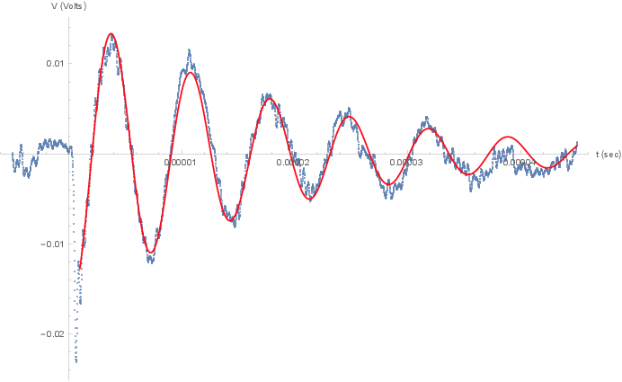
Laboratory Data
Input: 0.153 pC
Measured: 0.154 pC
10 usec
10000 averages
(can find single shots with cross-correlation--supplement)
(Run #9)

Slide 18
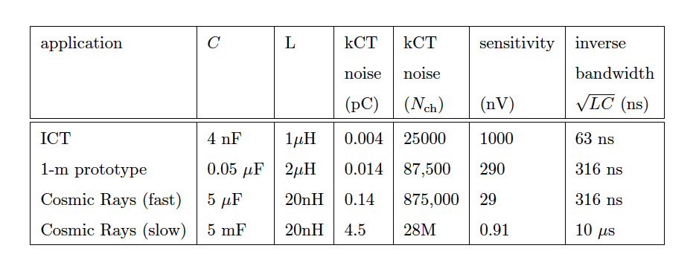
Limiting Sensitivity?
Capacitor thermal noise
“kCT noise” 1 degree of freedom ½kT = ½ Q²/C
But have multiple samples. May really be limited by real-world amplifiers & environmental noise

Slide 19
Applications
An new UHECR detection technique
A possible CR Veto detector*
Theorists—other large Q non-showering relativistic particles?
  Missed by FD, SD, etc.
  Too rare for Super-K
*Idea thanks to Keith Bechtol

Slide 20
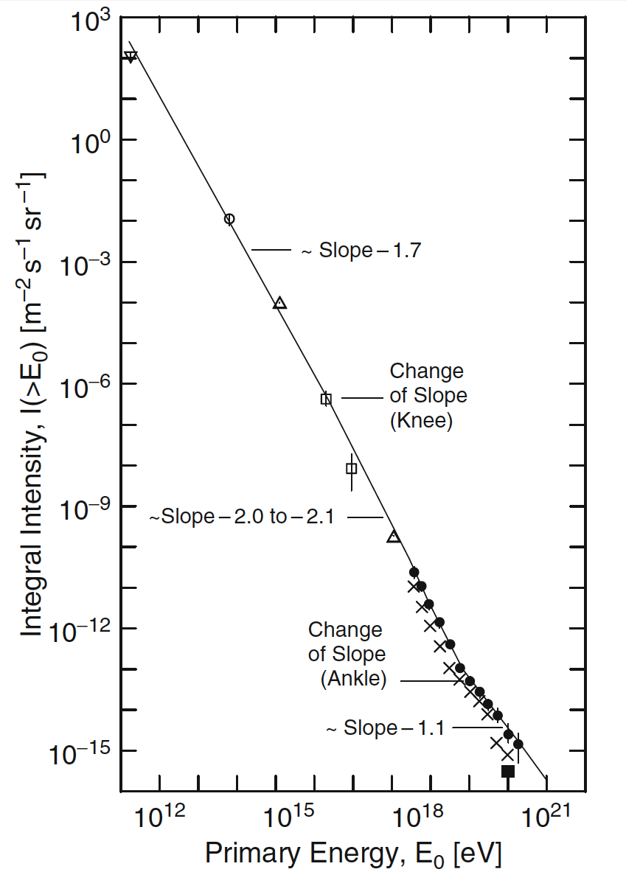
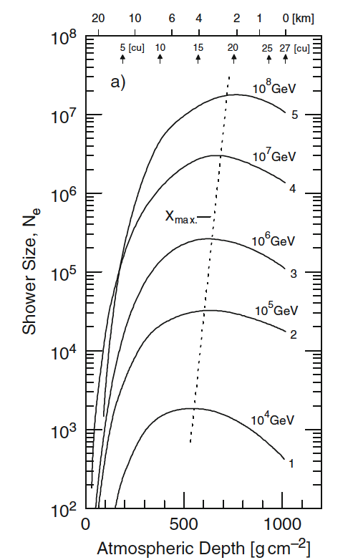
Example: Cosmic Ray Detection
Figures from P.K.F. Grieder
Threshold = 875k charges,
×5 for clear signal, only 20% charge excess
➔ 22M charges for minimum energy detection.
22M charges
@ 100 PeV
5×10⁻¹⁰
/m²/s/sr
Detection rate > 500 events/year!!!
(Next step: full simulation)
fluctuations→ lower threshold

Slide 21
Summary
Ampere’s Law (Stokes’s Theorem)
  Reduce 100% area → contour
Threshold of 100 PeV is achievable for cosmic rays
As Veto, needs lower threshold
Challenge to Theorists
  Are other exotic particles detectable?

Slide 22
EXTRA SLIDES

Slide 23
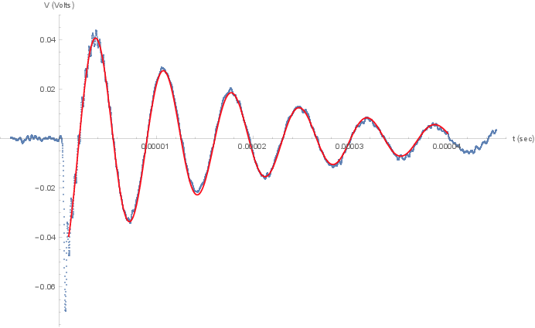
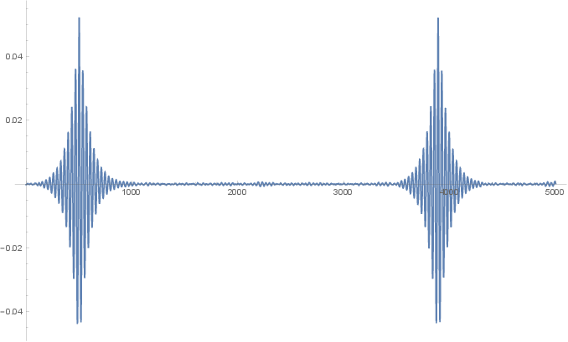
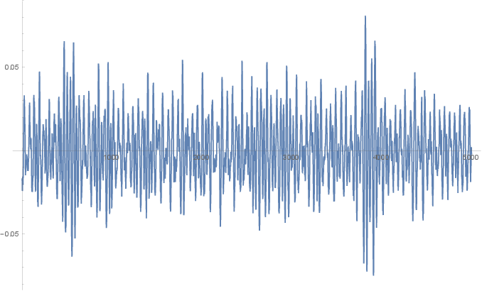
Cross Correlation Analysis
Time domain (10k averages)
0.471 pC
Pulse n
Pulse n+1
Xcors of averaged signals
Pulse n+1
Pulse n
Xcors of single-shot signals
(roughly 0.65 pC measured)
(Run 8)

Slide 24

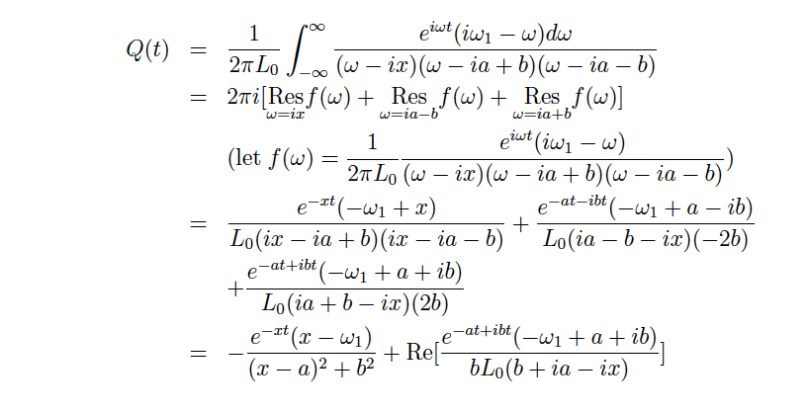
More advanced calculation
True mu is complex:
4 pages of math!
See P. Sun: http://elog.pa.ucla.edu/Toroid+Project/9
But essential result is you get the usual RLC value for low-frequency mu.

