Slide 1
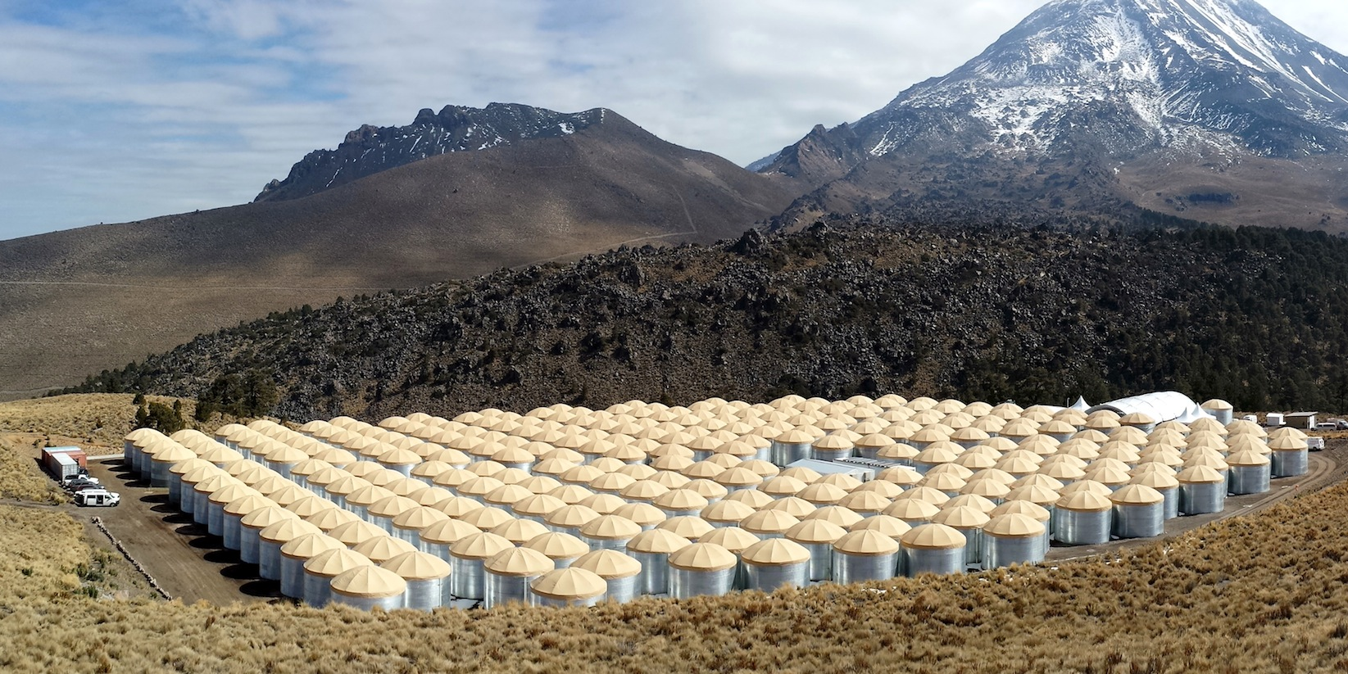
Monitoring TeV Gamma-ray Sources for Flaring States with HAWC

Slide 2
Outline
The HAWC Detector / Collaboration
Flaring Sources in the TeV
Sources Being Monitored
Bayesian Block Method
Online Alerts
Ian G Wisher – IPA Madison 2015
Notes:
Define Crab and flaring

Slide 3
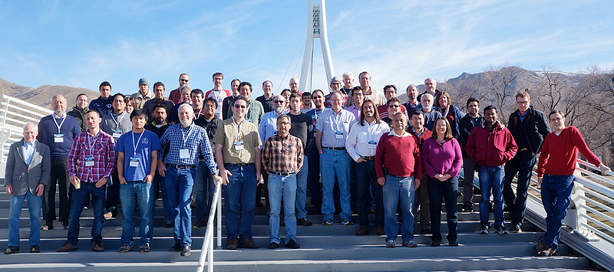
HAWC Collaboration
Mexican and American Collaboration:
34 Institutions ( 14 MX, 20 USA )
256 People ( 136 MX, 119 USA )
Ian G Wisher – IPA Madison 2015

Slide 4
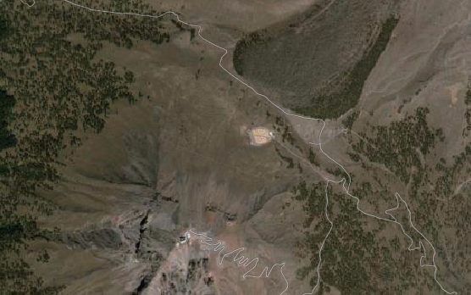
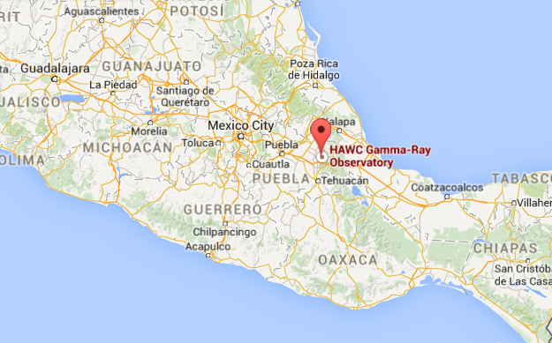
Pico de Orizaba
Where is the HAWC Detector?
Pico de Orizaba
Located in the beautiful Sierra Negra
Mountains
HAWC
LMT
18.995 N
97.307 W
4100 m a.s.l.
Ian G Wisher – IPA Madison 2015

Slide 5
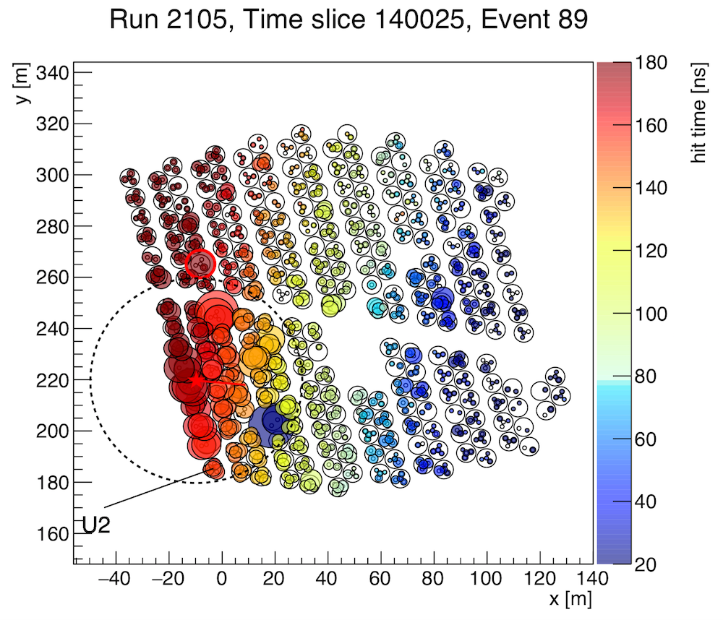
HAWC Detector
300 Water Cherenkov Detectors (Tanks)
7.3 m diameter, 5 m height, 185 kL
55 kT of Water Total
1200 semi-hemispherical PMTs
3 8” PMTs
1 10” PMT per tank
Survey instrument with ~2 sr FoV
Sensitive to 100 GeV - 100 TeV
11/2010
02/2012
08/2012
05/2013
01/2014
04/2015
Ian G Wisher – IPA Madison 2015

Slide 6
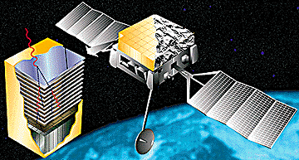
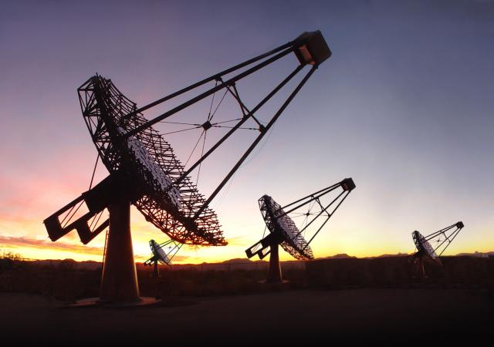
HAWC Detector
Wide Field of View,
Continuous Operations
TeV Sensitivity
Fermi
AGILE
EGRET
HAWC
ARGO
Milagro
Tibet ASγ
VERITASHESS
MAGIC
Ian G Wisher – IPA Madison 2015

Slide 7
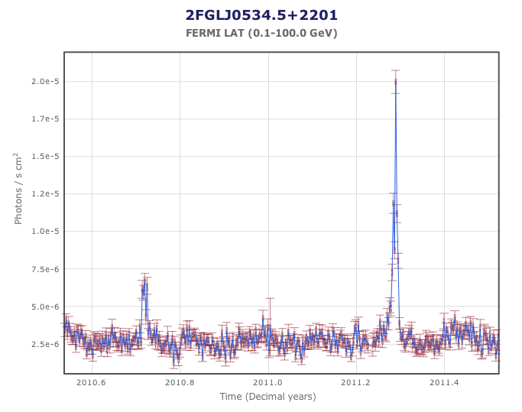
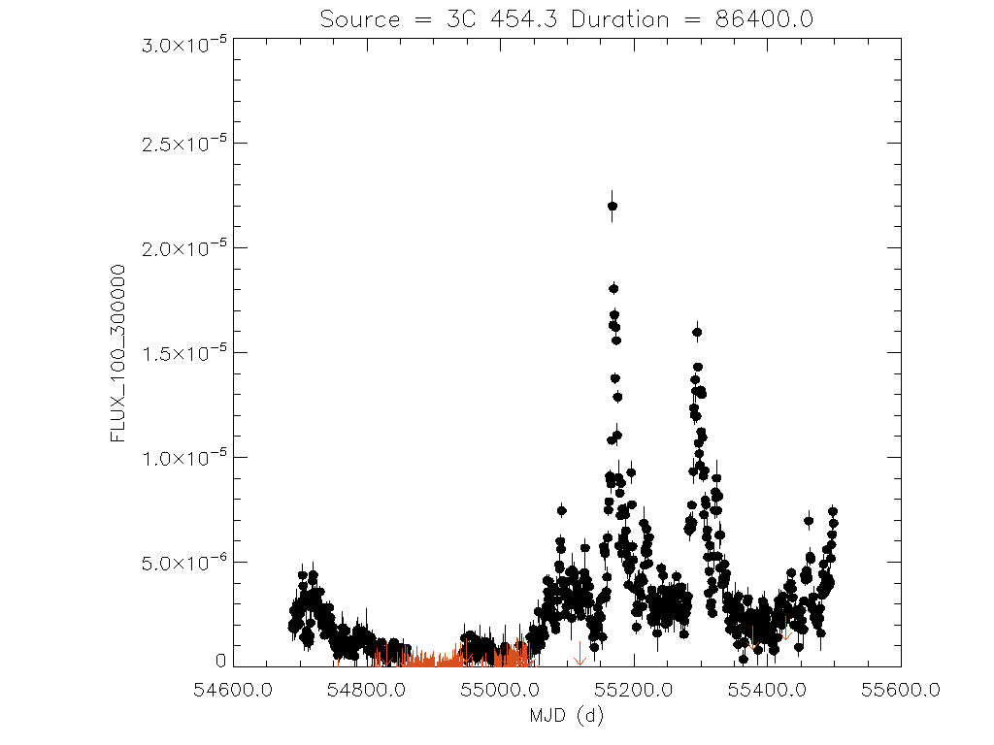
Flaring Sources at a TeV
AGN are known to have highly time-variability flux
Fluxes will be quoted in Crab units:
Fermi-LAT: 3C 454.3
arXiv:1011.0169
Data Centre for Astrophysics
Ian G Wisher – IPA Madison 2015
Notes:
Define Crab and flaring

Slide 8
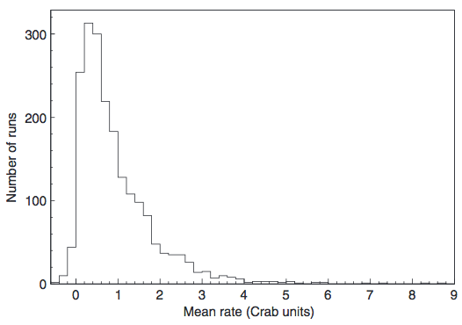
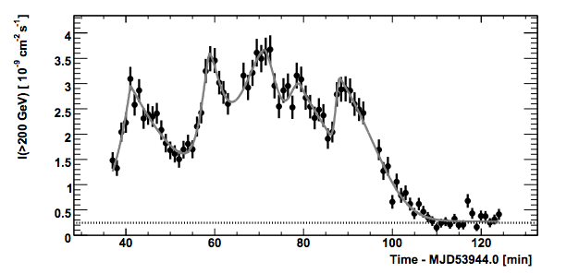
Extreme Flares with HAWC
In addition, sources occasionally flare to extreme fluxes for sometimes extended periods of time.
Substantial gains from monitoring with better coverage / uptime
Mrk 421
Whipple data
28-minute runs
PKS 2155−304
Acciari et al. 2014, Astropart. Phys. 54, 1
( 878.4 h spread over 783 nights )
Coverage of ~0.7%
~4 hours a day in HAWC
Coverage of ~24%
10 Crab Flare
(HESS) Aharonian et al.
arXiv:0706.0797
Ian G Wisher – IPA Madison 2015
Notes:
Define Crab and flaring

Slide 9
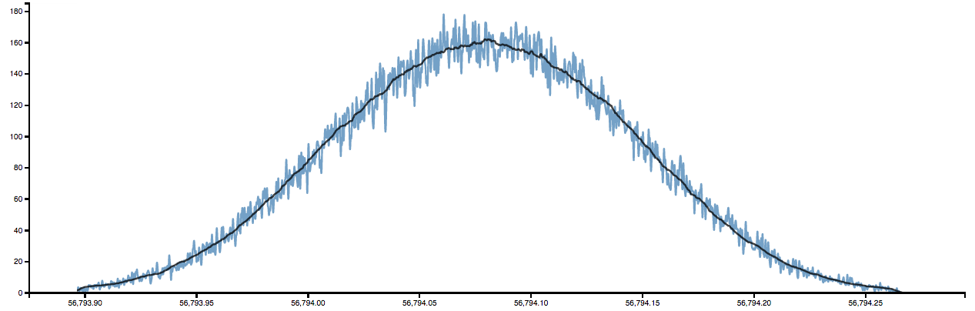
How can HAWC contribute?
Contribute to multi-wavelength observations key for blazar studies
Provide coverage of sources with a high uptime detector
Science Goals:
Unbiased blazar activity studies
Intrinsic emission during flares
EBL anomaly
Lorentz invariance violation
Proton Acceleration
Intergalactic Magnetic field
HAWC operate >95% uptime
Crab duty cycle: ~20%
Mrk 421 duty cycle: ~15%
Example Background for a Source Transit
counts
Ian G Wisher – IPA Madison 2015
Notes:
Citations smallers

Slide 10
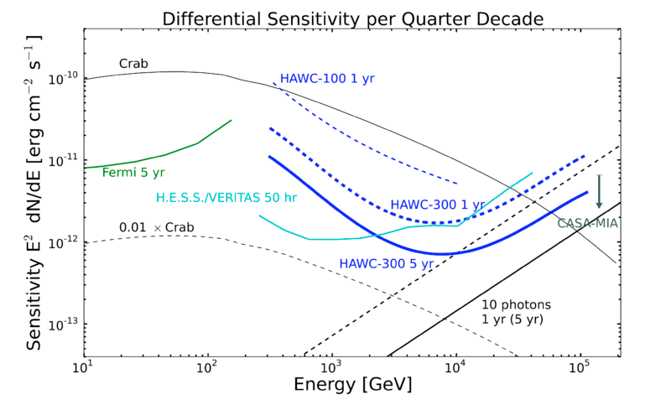
HAWC Sensitivity
HAWC 1-year sensitivity to all sources transiting near zenith becomes comparable to a 50-hour IACT observation at ~4 TeV
Ian G Wisher – IPA Madison 2015

Slide 11
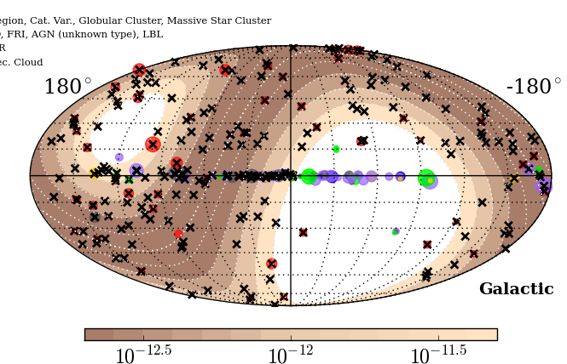
Sources Monitored by HAWC
Currently monitoring 240 sources:
Monitoring all
extragalactic sources in TeVCat
2FGL Blazars z ≤ 1
All TeVCat:
Between Dec 80 and -50
Pulsars and Binaries
In the future: all-sky monitoring
Ian G Wisher – APS April Meeting

Slide 12
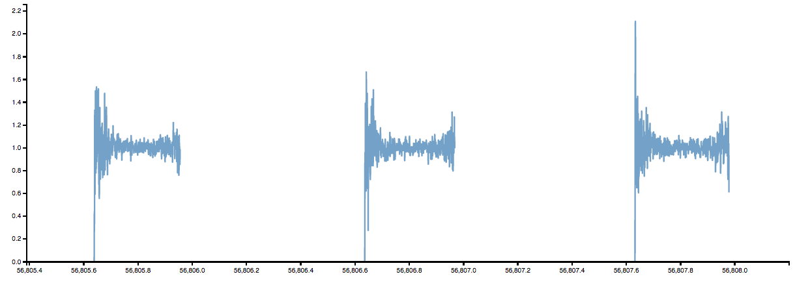
Light curve Generation
Online analysis will run to provide real time alerts of detected transients.
Implementation is Bayesian block algorithm (Scargle et al. 2013, ApJ 764, 167)
N_{on} is counts in signal region and N_{off} is expected counts from cosmic rays
Full Poisson treatment of likelihood fitness function
Alerts will be issued without human intervention
(Currently online alerts being tested)
Accounts for variation of detector sensitivity with zenith angle
Ian G Wisher – IPA Madison 2015
Notes:
Define N_on and N_off
Define Baysian

Slide 13
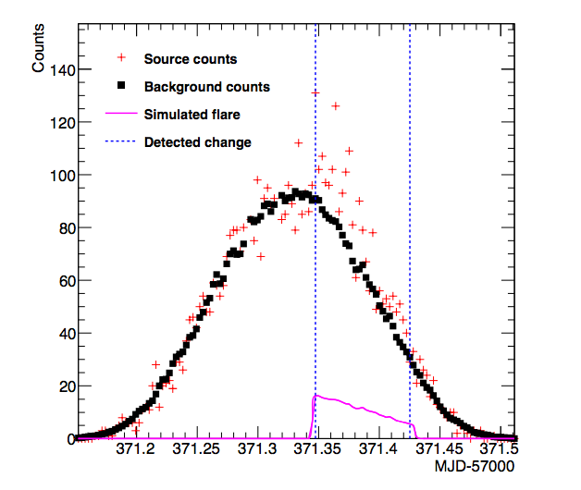
Sensitivity from Simulation
Current flare monitoring benchmarks for injected flares with a type 1 error:
1 false positive per year per 20 sources
PRELIMINARY
Probability of Catching Flares (HAWC111)
Flare Strength | Flare Duration | Detection Probability
10 Crab | 2 hours | >50%
10 Crab | 1 hour | ~30%
10 Crab | ½ hour | ~10%
5 Crab | 4 hours | ~10%
New data offers immediate improvement
False positive rate can be adjusted
Evidence for flares can be found at sub alert threshold levels
Ian G Wisher – IPA Madison 2015

Slide 14
Setting Type 1 Errors
Verify that the prior / false positive rate correspondence extends to lower priors
( false positive rate is adjustable via the prior of detecting a change point )
Ian G Wisher – IPA Madison 2015

Slide 15
Setting Type 1 Errors
Verify that the prior / false positive rate correspondence extends to lower priors
( false positive rate is adjustable via the prior of detecting a change point )
A
B
Ian G Wisher – IPA Madison 2015

Slide 16
Probing Sub threshold Flares (1)
Bayesian Bloch method assumes the prior is set at some point that satisfies the Neyman –Pearson Lemma.
(+) With decreasing the prior the false positive rate decrease proportionally and approaches zero.
(-) With decreasing prior the false negative rate increases do not accepting lower amplitude flares
To look at this we take a source and blank spots on the sky at the same declination and do Li+Ma significance calculation of the # of change points detected as a function of prior.
Ian G Wisher – IPA Madison 2015

Slide 17
Probing Sub threshold Flares (2)
Varying the prior changes what amplitude of flare the analysis is sensitive to
Scan for prior that minimizes: type I and type II errors
Simulation of Mrk421 like source for one month
Type II Errors
Type I Errors
Variable sources detectable even in absence of isolated strong flares
Ian G Wisher – IPA Madison 2015

Slide 18
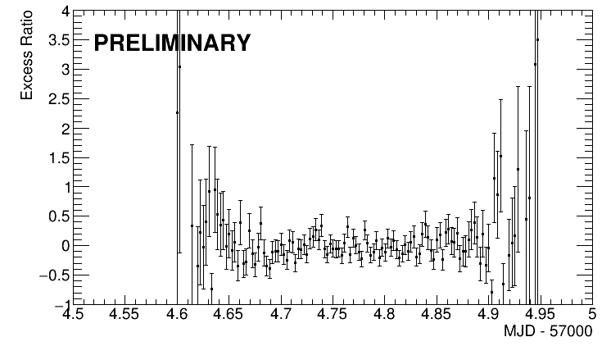
Low priors
Using a Ratio in the Bayesian blocks likelihood function accounts for
changes as the sources transits through the field of view of the detector
Assumes gammas and protons changes proportionally with zenith.
This assumption does not stay true for changes in the detector configuration…
Ian G Wisher – IPA Madison 2015

Slide 19
HAWC Online Alert System
Alerts are sent automatically for high significance detections
and with minimal human intervention for lower significance detections
System automatically checks detector stability
Totally Latency less than 5 minutes
EMS
Database
GCN
Online Reco
Physics Alerts
Alerts Server
Latency:
< 60 s
< 60 s
< 120 s
Total < 4 min
Ian G Wisher – IPA Madison 2015

Slide 20
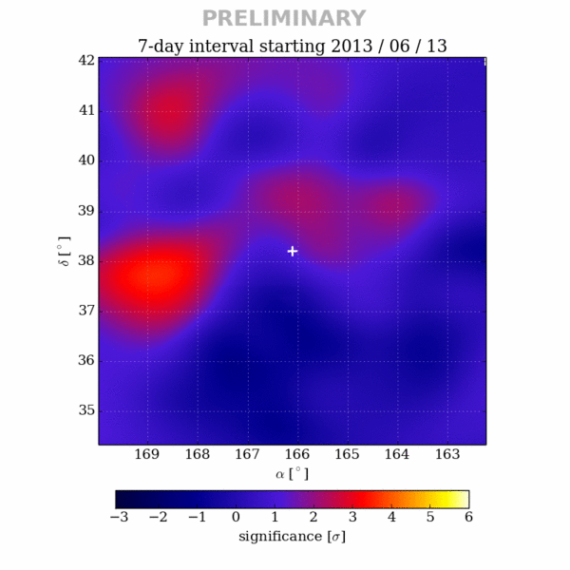
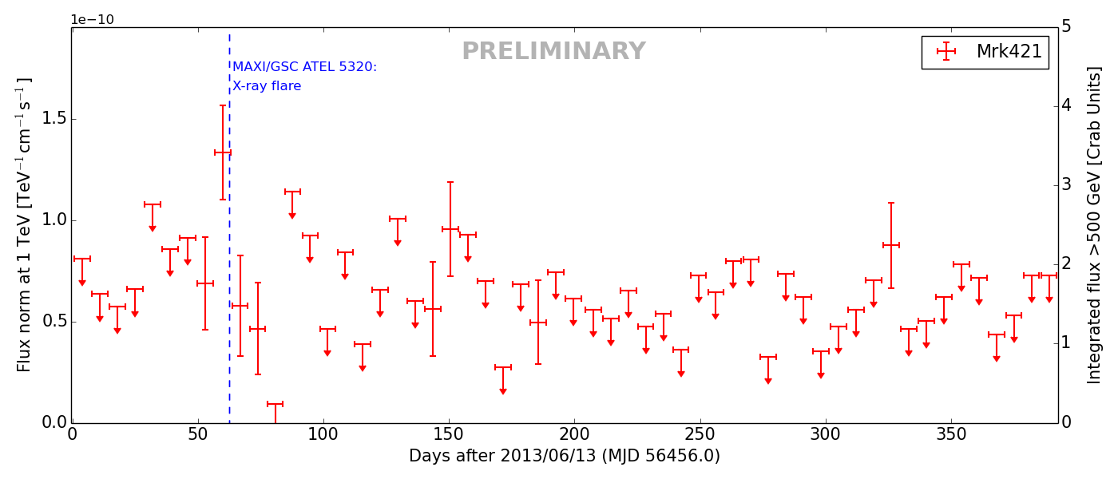
HAWC Offline Searches
Offline searches for variability (Robert Lauer)
Can search over longer time scales
Full Likelihood treatment of light curves
Preliminary plots for Mrk421 in August 2013
Ian G Wisher – IPA Madison 2015

Slide 21
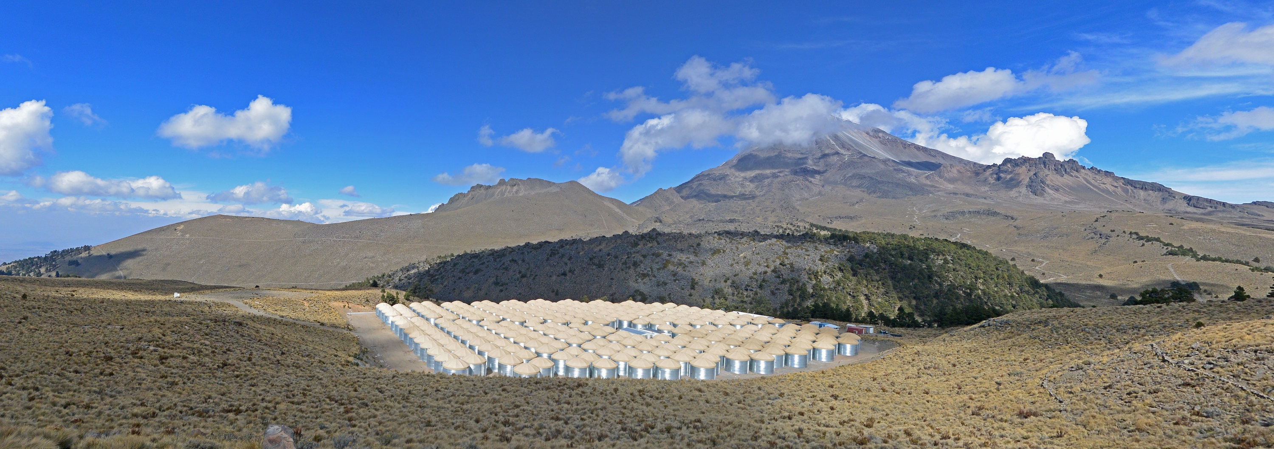
Summary
Stay tuned for first alerts from HAWC
Extreme flares currently detectable,
sensitivity improvements Imminent
New era is coming in TeV flare detection!
Ian G Wisher – IPA Madison 2015

Slide 22
Supporting Material

Slide 23
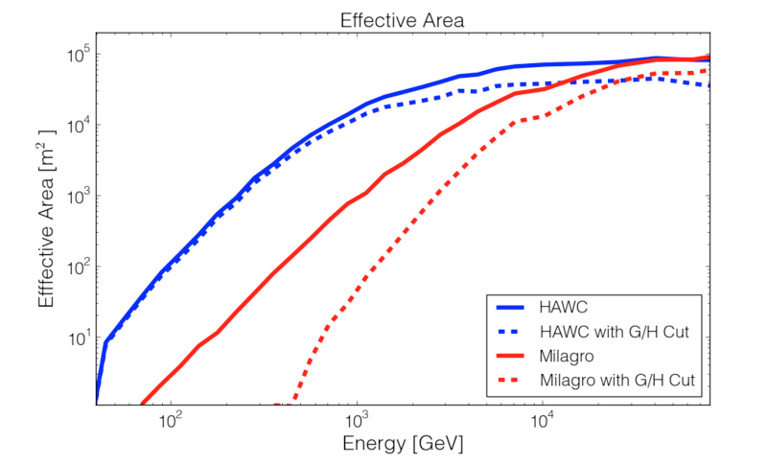
Performance Figures
Ian G Wisher – IPA Madison 2015

Slide 24
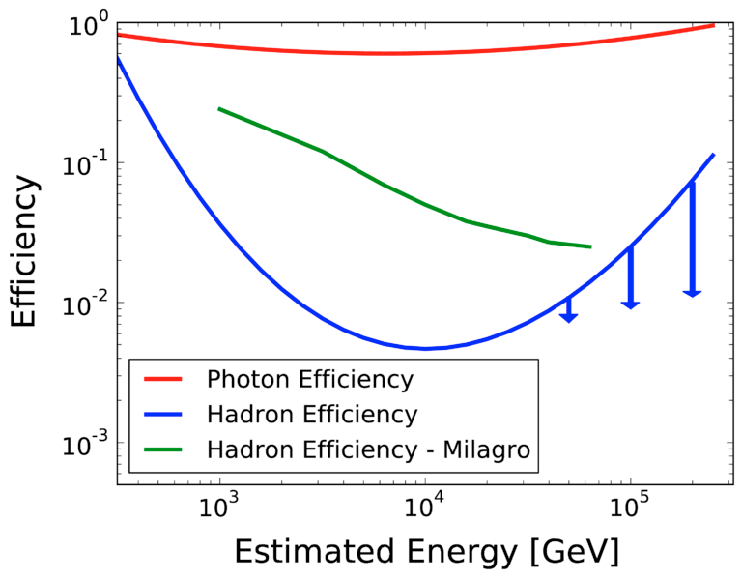
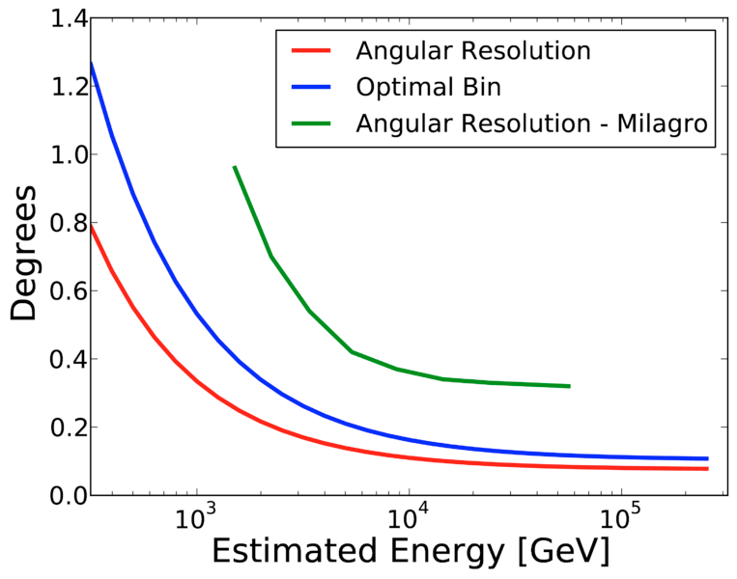
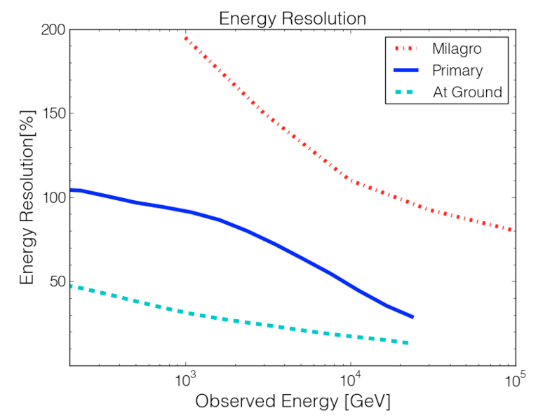
Performance Figures
Ian G Wisher – IPA Madison 2015

Slide 25
Where is the HAWC Detector?
Pico de Orizaba
HAWC
Large Millimeter Telescope
Ian G Wisher – IPA Madison 2015

