Slide 1



Project Overview
& Report
MANTS-GNN
Geneva, September 2014
Christian Spiering, DESY Zeuthen

Slide 2
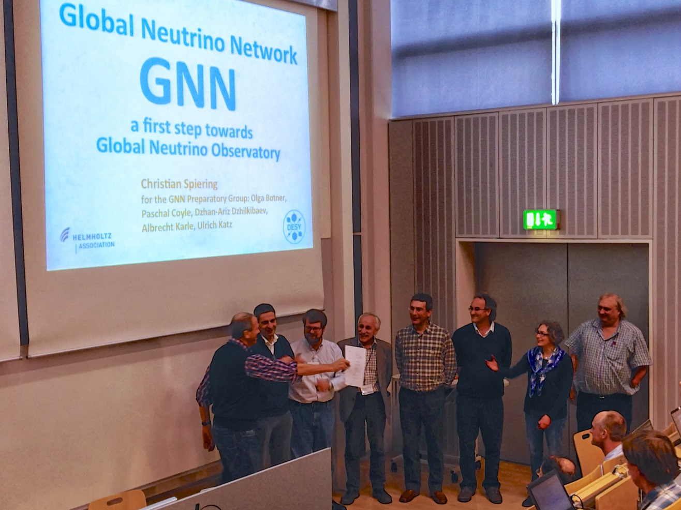
Oct. 2013, Munich

Slide 3
The Global Neutrino Network Poster S6-554 C. Spiering
The Global Neutrino Network
Cooperative projects e.g.
  combinations of sky maps
  cross-checks of results with different systematics
  coordination of alert and multi-messenger policies
  ← AMON meeting Dec. in Zeuthen
  exchange and mutual checks of software
  creation of a common software pool
  standards for data representation ← see F.o.M. discussion
  exchange of expertise through mutual working visits
  exchange of expertise by forming ad-hoc advisory committees of members of the participating collaborations
Organization of schools /topical workshops
Common legacy of public documents ← see below
Annual award for an outstanding PhD thesis ← see below
Public web page http://www.globalneutrinonetwork.org
Joint outreach activities
Coordinated relations with other fields of science

Slide 4
ECRS 2014

Slide 5
Mutual Representations in SACs
… from the GNN MoU:
exchange of expertise by forming ad-hoc advisory committees of members of the four participating collaborations, if requested by a participating party;
this may generate better understanding of data, optimization of future detector configurations, or technological solutions for the next generation arrays.

Slide 6
Mutual Representations in SACs
KM3NeT
  from IceCube: Per-Olof Hulth, Elisa Resconi, Subir Sarkar, Christian Spiering
IceCube
  from KM3NeT: Gisela Anton → GNN board 19.9.: add 1 or 2 more
GVD SAC (Berezinsky, de Wolf, Gersthein, Rubakov, Spiering)
  meeting in Dubna at June 13, 2014 → Recommendations
  from KM3NeT: Els de Wolf
  from IceCube: Christian Spiering
Plan to call a GVD Technical Advisory Committee including members of KM3NeT and IceCube

Slide 7
MANTS and VLVNT
VLVNT 2015:
  Rome. Late September/ early October
  Science Organization Committee: Els de Wolf, Chad Finley, Igor
  Belolaptikov + ….
VLVNT 2017:
  Dubna. Local organization chair – Igor Belolaptikov
MANTS 2016:
  Link it either to VLVNT or to IceCube/Antares meeting.
  Exploration of possible dates underway

Slide 8
Miscellaneous
PhD prize
  proposals to be submitted by supervisors or PIs
  13-2 months before MANTS meeting
  1-page English summary (i.e. English, French, Russian, …) possible
  must have been successfully defended
Webpage
  make it a working instrument
  Start with collection of „legacy of neutrino astronomy“ document
Common policy on the European level (ESFRI) ?

Slide 9
Recommendation of the GNN board for this meeting
Be as open as possible!
Presentations should help learning from each other and promoting cooperation, where practicable.
Information will stay confidential within our collaborations and not be given to outsiders.

Slide 10

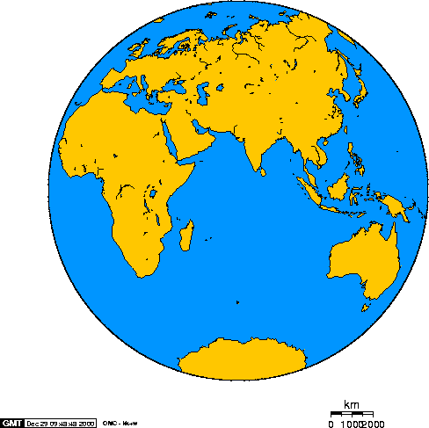
The future @ Baikal, Mediterranean Sea, South Pole
GVD
KM3NeT
(ORCA)
GNN
Next Generation IceCube
HEX (+PINGU + …)

Slide 11
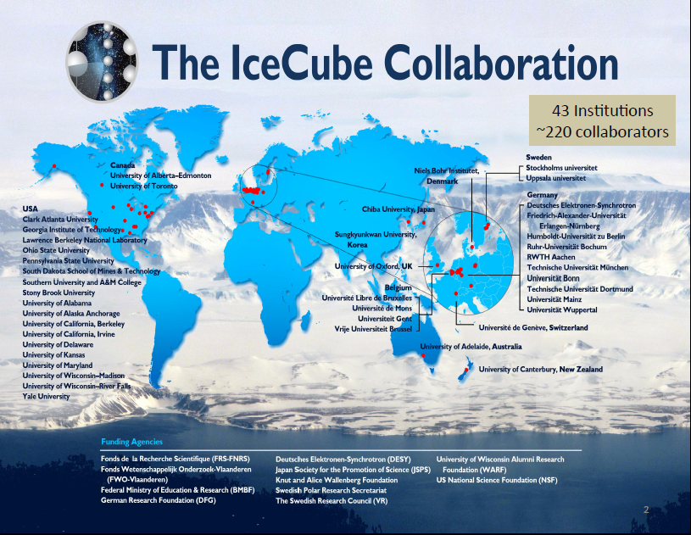

Slide 12
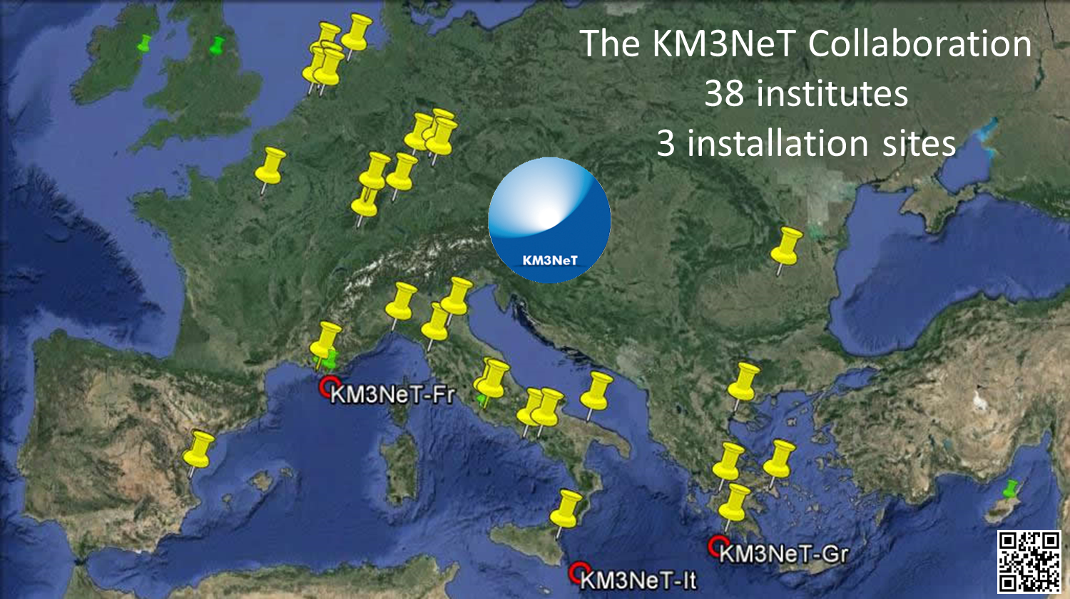
KM3NeT

Slide 13
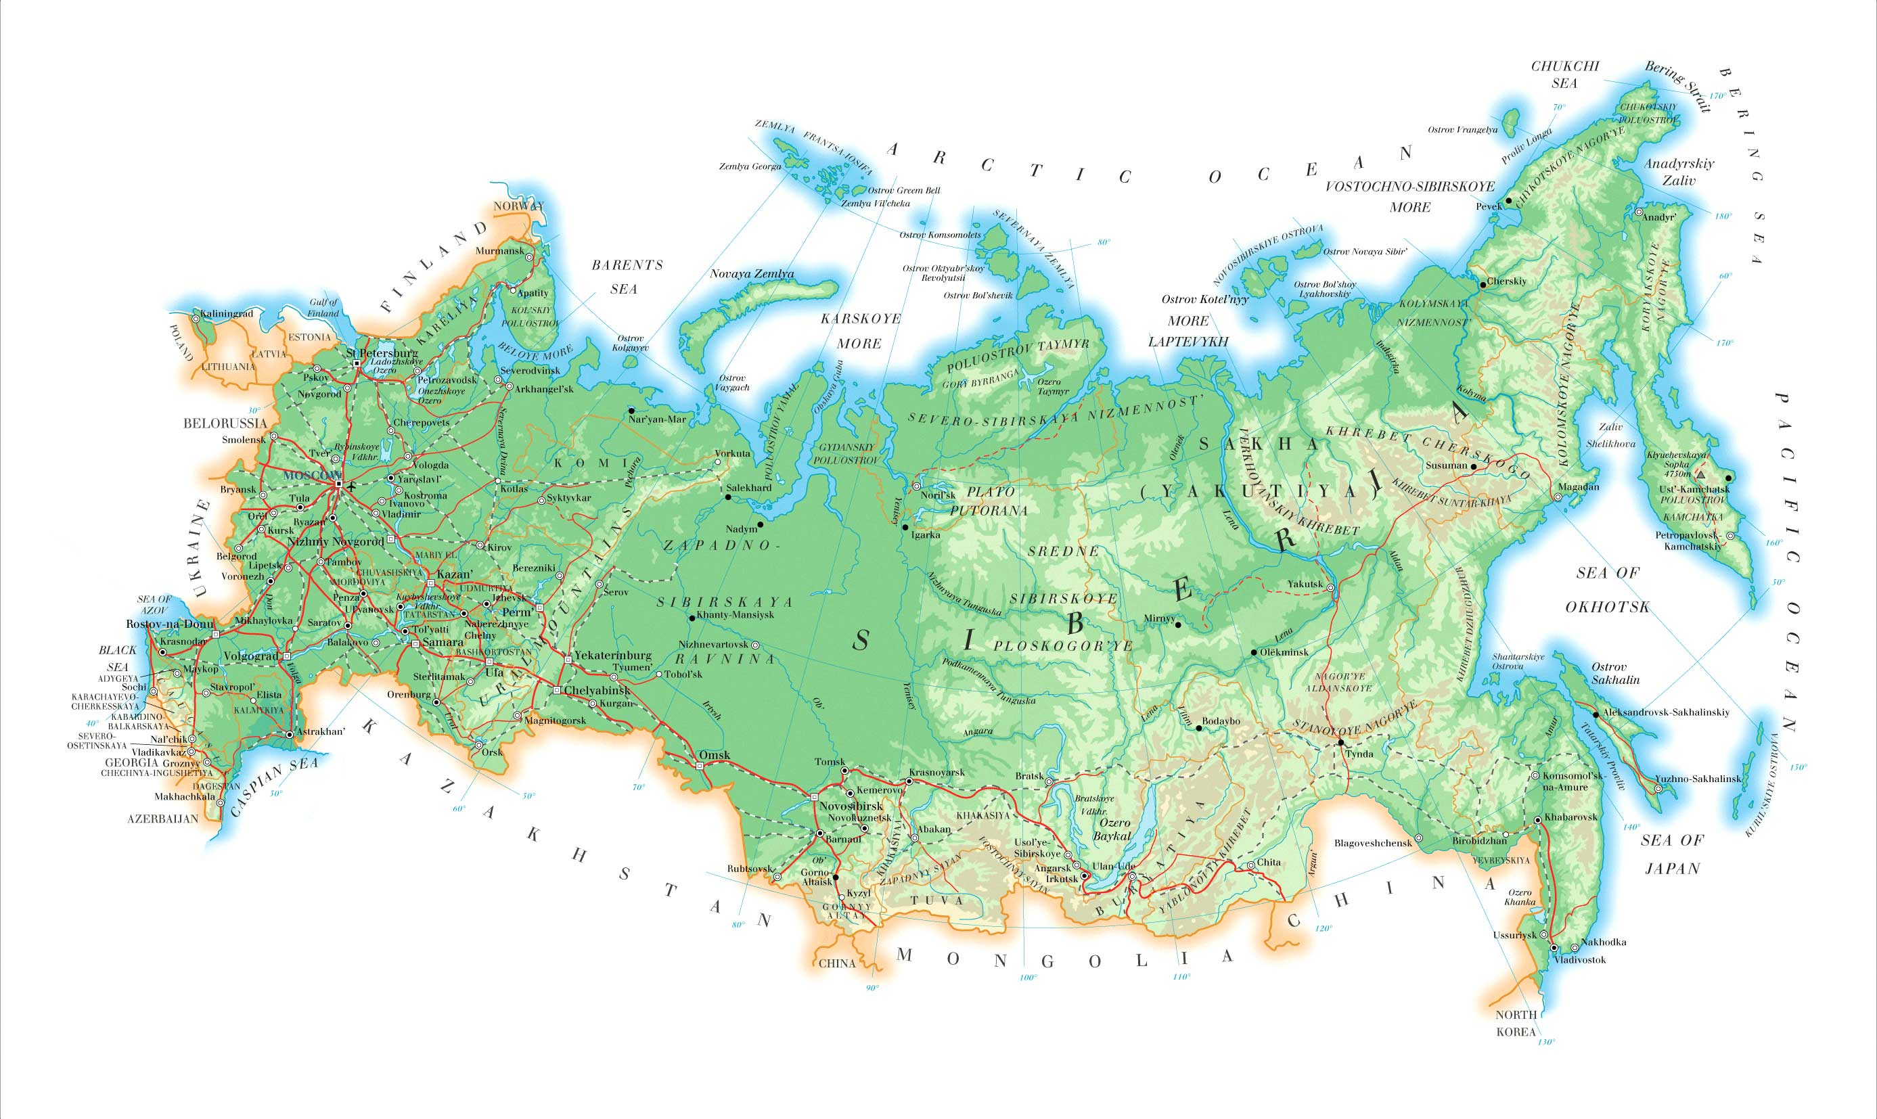
The Baikal Collaboration
~ 50 authors, 6 institutions (role of Dubna increasing!)
State Marine U. Petersburg
JINR Dubna INR, MSU Moscow
Techn State U. Nizhni Novgorod
Irkutsk State University
Germany: EvoLogics GmbH

Slide 14
KM3NeT

Slide 15
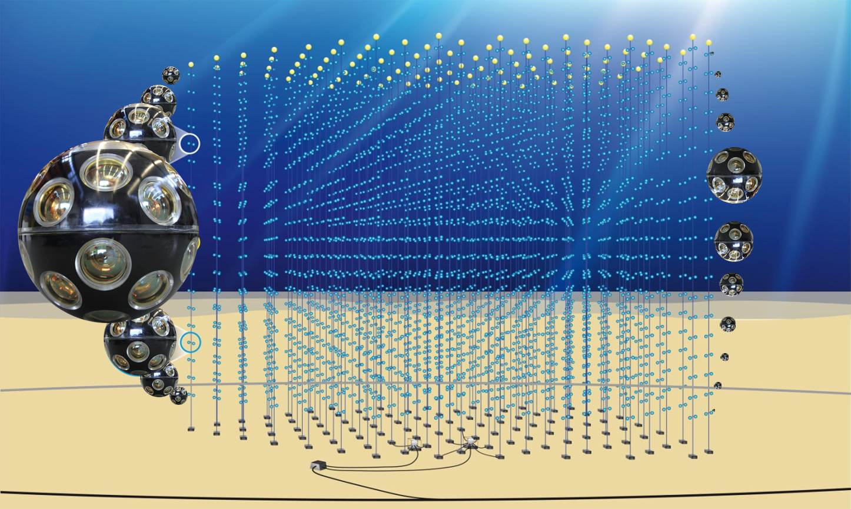
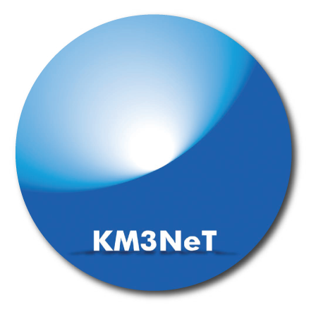
KM3NeT
Distributed infrastructure
- KM3NeT-France (Toulon) ~2500m
- KM3NeT-Italy (Capo Passero) ~3400m
- KM3NeT-Greece (Pylos) ~4500m
Until 2015: construction of KM3NeT phase I detectors in France and Italy:31M€ (+8M€)

Slide 16
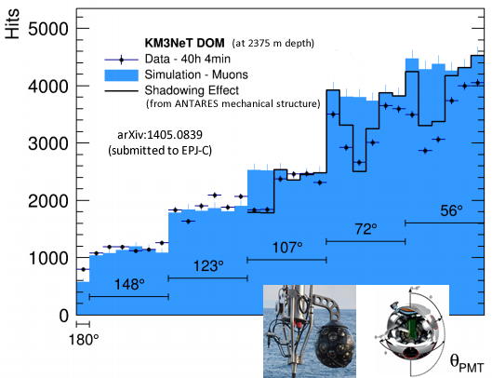
Directionality of a single DOM

Slide 17
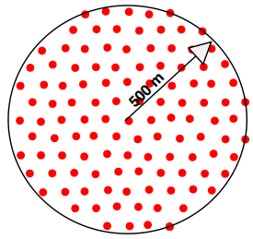
6 blocks at 3 locations: 6 x 0.6 km³
115 strings per block
18 DOMs per string
31 PMTs per DOM
France
Italy
Greece

Slide 18
2 blocks at 2 locations: Phase 1.5 (2020)
France
ORCA
Italy

Slide 19
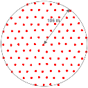
2 blocks at 2 locations: Phase 1.5 (2020)
France
ORCA
Italy
? Italy or France

Slide 20
Phase-1 (Italian site)
8 towers
Start with 8 towers
(necessary to match spending profile and to demonstrate construction activity, not nominal part of KM3NeT)
Add 24 strings until 2016
3-4 times the sensitivity of ANTARES
Demonstrate feasibility and extract “physics on a 3-times-Antares scale”
24 strings

Slide 21
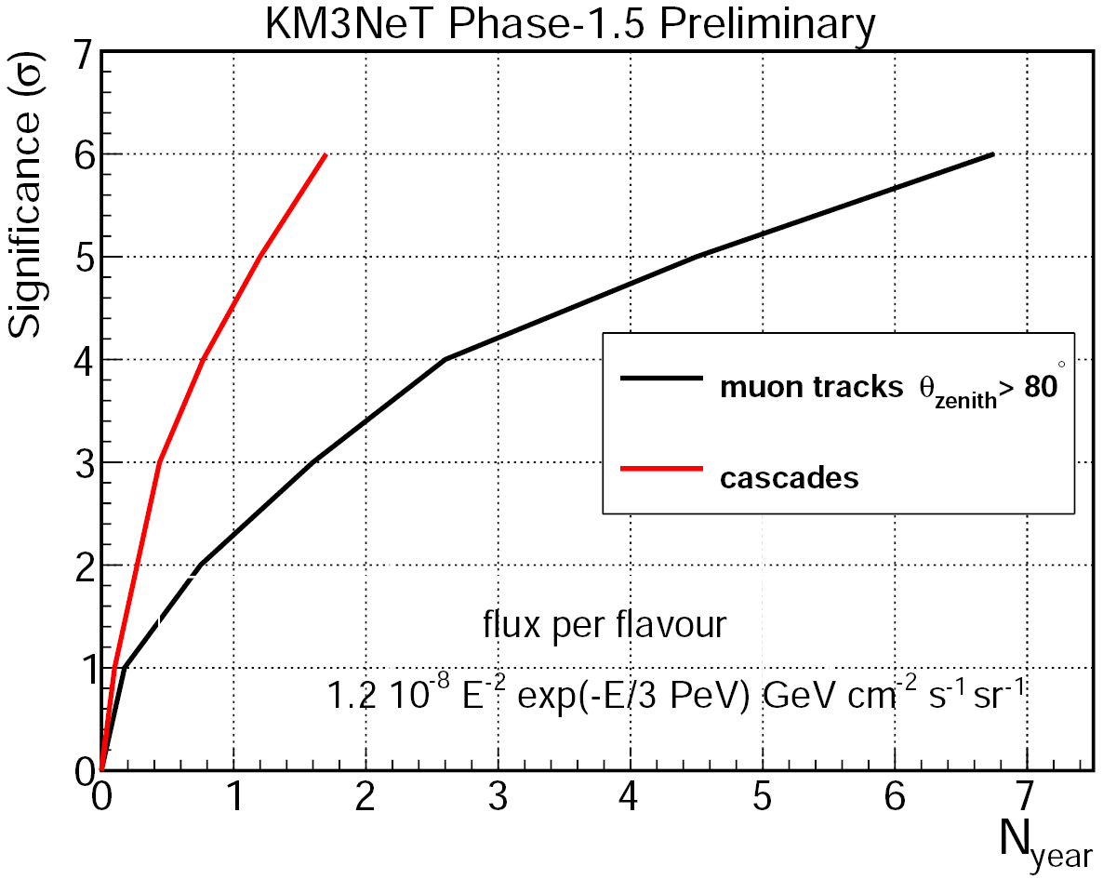
KM3NeT Phase 1.5
Measure IceCube signal!
Cost: 80-90 M€ (including Phase-1)
Diffuse neutrino fluxes:
Sensitivity to IceCube signal

Slide 22
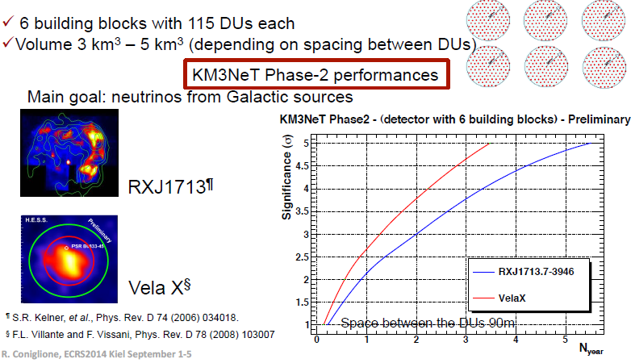
KM3NeT phase 2 R.
Main goal: Galactic sources

Slide 23
Phases of KM3NeT
Phase | Total cost [M€] (cumulative) | Primary deliverable Size | Status
1 | 31 | Proof of feasibility of network of distributed neutrino telescope ~ 3 x ANTARES | Funded
1.5 | 80–90 | Measurement of neutrino signal reported by IceCube ~ 1 x IceCube | Letter of Intent
2 | 220–250 | Neutrino astronomy ~ 4 x IceCube | was on ESFRI road map

Slide 24
Gigaton Volume Detector
Baikal GVD

Slide 25
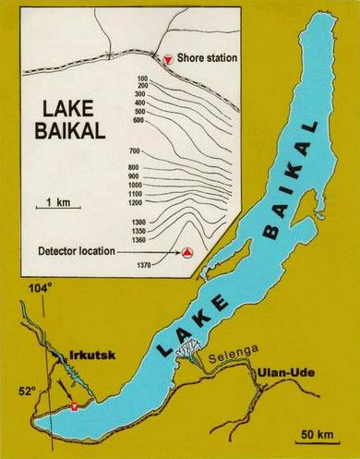
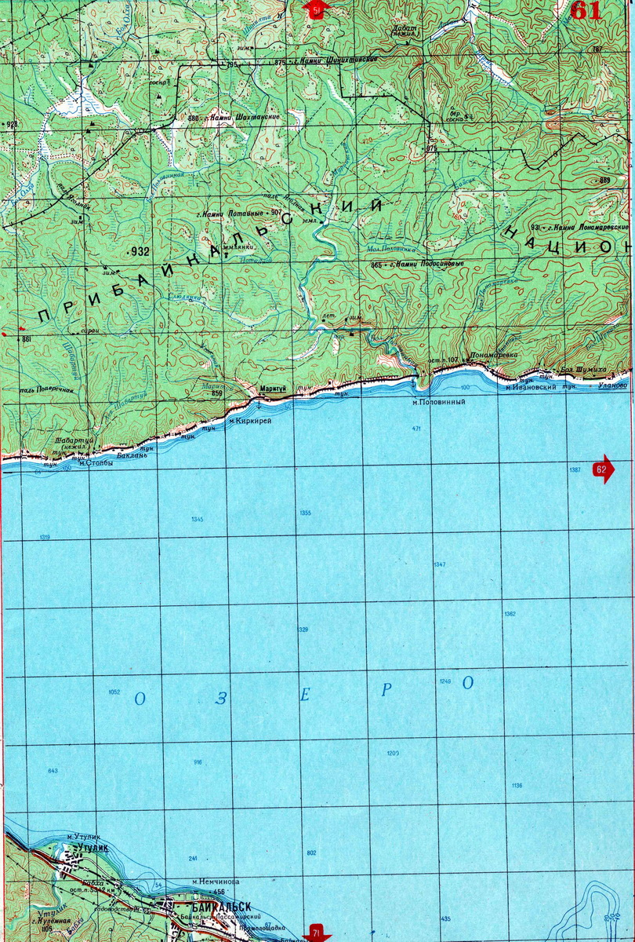
Gigaton Volume Detector GVD
>250 km³
0.5 to 1.5 km³ Detector in Lake Baikal

Slide 26
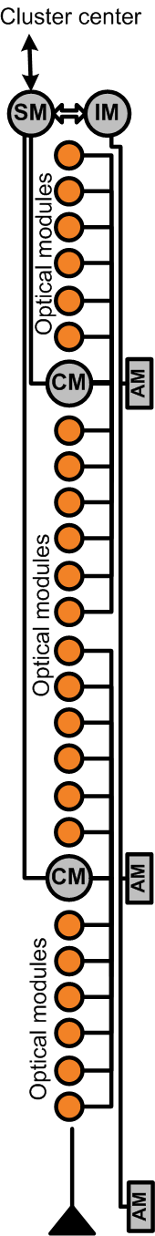
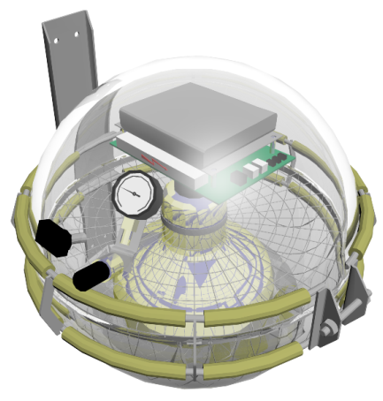
GVD: clusters and DOMs
Clusters with 8 strings each
Cluster diameter 120 m
Height 375 m
24 OMs per string
L~ 345 m
PMT
Hamamatsu
R7081-HQE
∅ = 10”
QE ~ 0.35%
String section, 12 OMs
R ~ 60 m

Slide 27
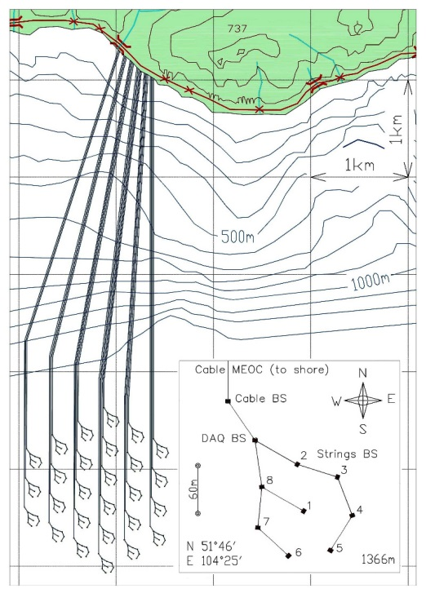
Gigaton Volume Detector
 | Phase 1 | Phase 2
Total # of OMs | 2302 | 10368
# of clusters | 12 | 27
# OMs/string | 24 | 48
Depth, m | 950–1300 | 600–1300
Instr. volume | 0.4 km³ | 1.5 km³
Phase-1 (in red) to be completed in 2020.
May also consist of 6 clusters with 48 OM/string (but also 0.4 km³).

Slide 28
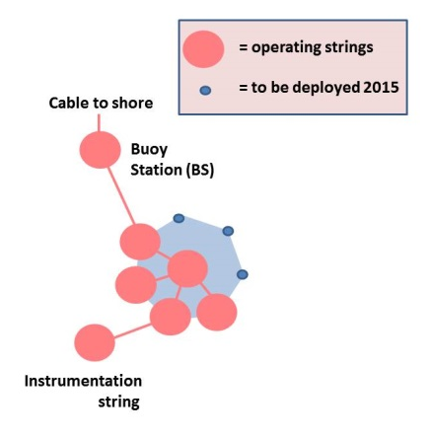
The first GVD cluster
First cluster:
to be completed
March 2015
April 2014

Slide 29
GVD timeline
-pro cumulative number of clusters vs. year
R&D and component prototype tests: 2008 – 2010
  DOMs, readout system, data transmission, calibration, ..
Array protoyping and engineering array (1.cluster): 2011 – 2015
  electro-optical shore cable, ½ string, 3 x ½ string, 3 full strings ,… → 1 cluster
Year | 2015 | 2016 | 2017 | 2018 | 2019 | 2020
baseline | 1 | 1 | 3 | 5 | 7 | 10
Compressed baseline | 1 | 2 | 4 | 7 | 10

Slide 30
Next Generation IceCube
NGIC

Slide 31
South Pole infrastructure for neutrino (astro-)physics
Device Volume Threshold Primary Goal
PINGU few Mton 2-3 GeV ν mass hierarchy
HEX* 7-12 km³ ~10 TeV ν astronomy
cosmogenic neutrinos
Surface veto ~120 km² veto for IceCube
CR physics
ARA ~120 km² ~50 PeV cosmogenic neutrinos
* High Energy Extension. Including IceCube (1 km³ with 100 GeV threshold)

Slide 32
South Pole infrastructure for neutrino (astro-)physics
Device Volume Threshold Primary Goal
PINGU few Mton 2-3 GeV ν mass hierarchy
HEX* 7-12 km³ ~10 TeV ν astronomy
cosmogenic neutrinos
Surface veto ~120 km² veto for IceCube
CR physics
ARA ~120 km² ~50 PeV cosmogenic neutrinos
* High Energy Extension. Including IceCube (1 km³ with 100 GeV threshold)
White paper end 2014 / early 2015, Proposal 2016

Slide 33
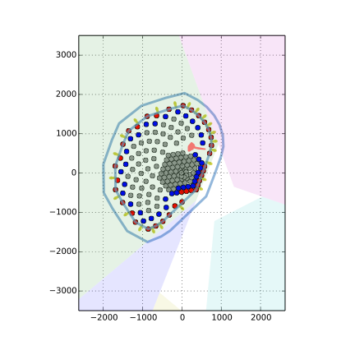
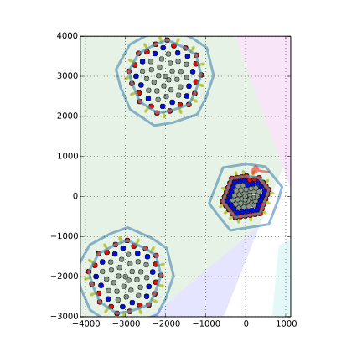
HEX (High Energy Extension)
IceCube + 96 strings
Spacing 240 m
IceCube +
2 x 60 strings
spacing 240 m
~ 136 strings
+ surface veto detector
Including PINGU for oscillations (40 strings)
Various versions of DOMs under discussion
(see technology session)

Slide 34
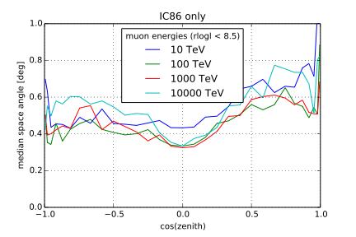
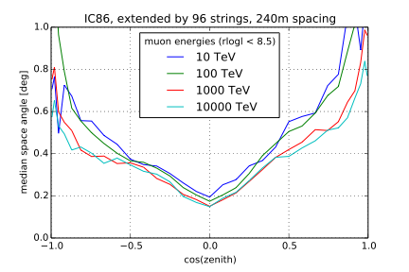
Angular resolution

Slide 35
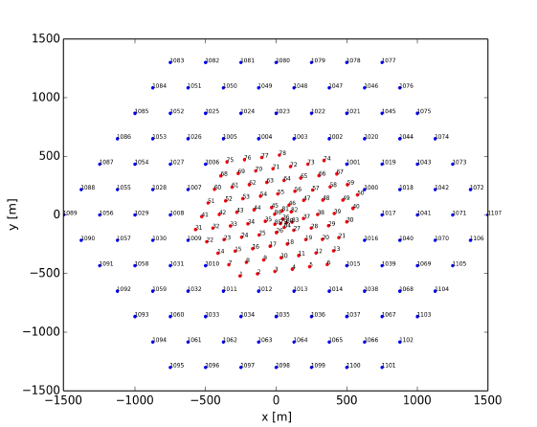
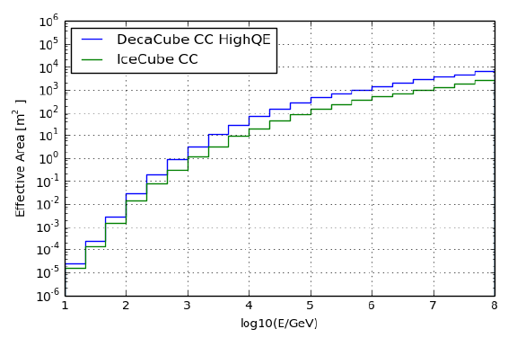
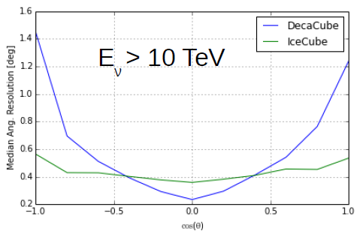
A symmetric benchmark detector

Slide 36
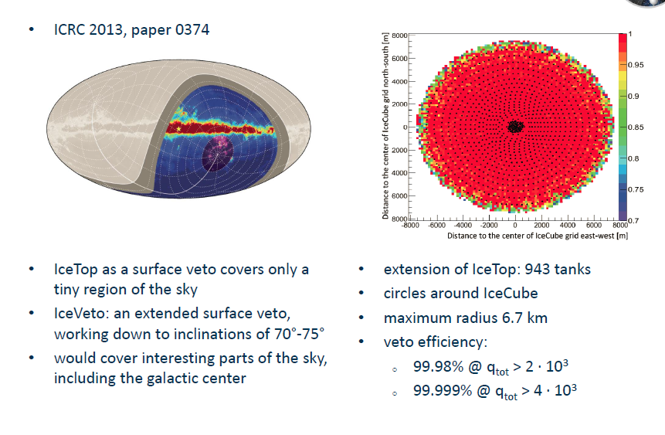
IceVeto
>100 TeV: Earth opaque
Expect most of the signal from above
Need a veto against atm. shower particles
  Self-veto of deep-ice detector
  Surface veto

Slide 37
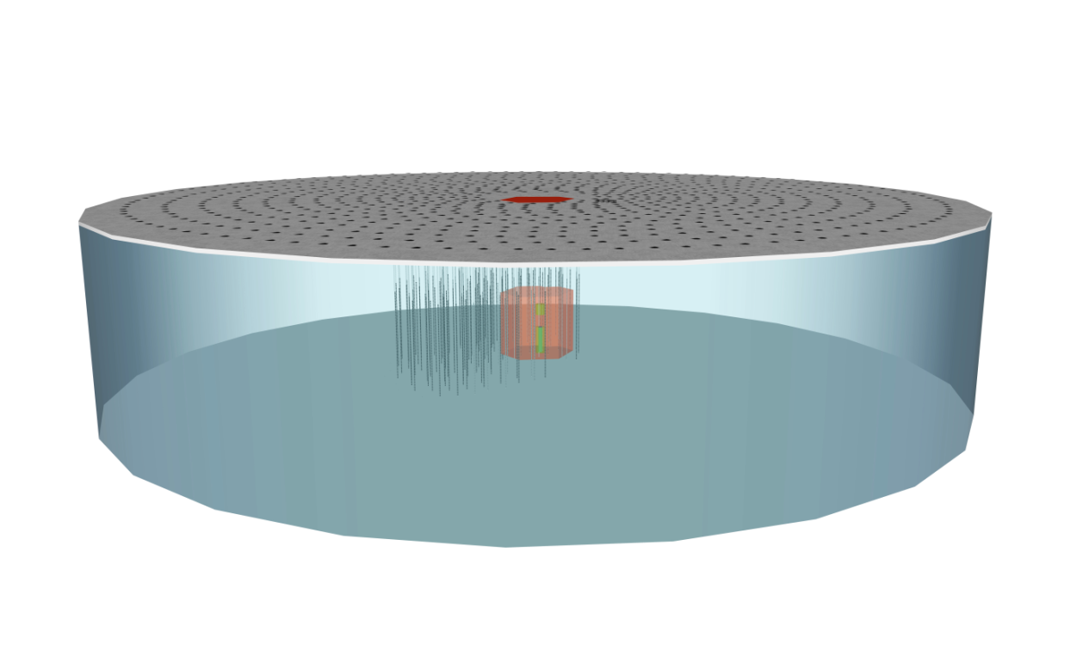
IceVeto
~1m

Slide 38
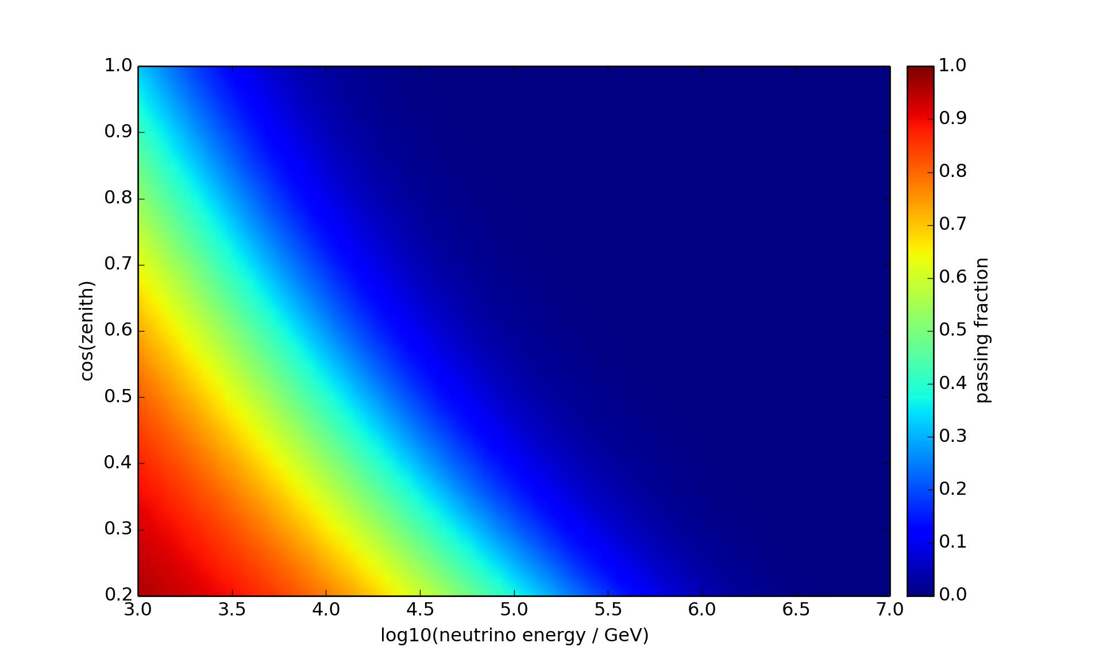
Event Passing rates vs. energy and zenith
Veto could give 50-75%
more events above 100 TeV
(averaged over 4 π)

Slide 39
Schedule assuming deployement start in season 2018/19
Description | Strings Installed | Cumulative strings installed | Austral Summer
PINGU(+HEX) | 8 | 8 | 18/19
PINGU | 16 | 24 | 19/20
PINGU + HEX | 18 | 42 | 20/21
HEX | 20 | 62 | 21/22
HEX | 20 | 82 | 22/23
HEX | 20 | 102 | 24/25
HEX | 20 | 122 | 25/26
HEX | 14 | 136 | 26/27
Albrecht Karle, Arlington Meeting April 24, 2014

Slide 40
Global timeline (optimist´s view?)
2014 2015 2016 2017 2018 2019 2020 2021 2022 2023 2024
KM3NeT-1 constr.
KM3NeT-1.5 construction
Relevant physics
ORCA
2 (1) x 0.6 km³
+ 1 x 0.4 km³
GVD 1.cluster
GVD-1 construction
Relevant physics
IceCube: more and better data.Relevant physics all the time
5-10 km³
NGIC construction (finish 2027)
NGIC: R&D + preparatory phase
PINGU
Relevant physics

Slide 41
Global timeline (optimist´s view?)
2014 2015 2016 2017 2018 2019 2020 2021 2022 2023 2024
towards KM3NeT-2
(3-4 km³)
towards GVD-2
(1.5 km³)
KM3NeT-1 constr.
KM3NeT-1.5 construction
Relevant physics
ORCA ?
5 km³
GVD 1.cluster
GVD-1 construction
Relevant physics
IceCube: more and better data.Relevant physics all the time
5-10 km³
NGIC construction (finish 2027)
NGIC: R&D + preparatory phase
PINGU ?
Relevant physics

Slide 42
Physics timeline
Diffuse spectrum, flavor ratio, understanding charm contribution
  IceCube (statistics)
  Independent measurement: KM3NeT-1 (?) → 2018
  KM3NeT-1.5, GVD → 2020
Sharp cut-off below Glashow resonance ?
  IceCube (statistics)
Anisotropy/point sources
  IceCube (statistics, more and better upgoing muon data)
  Water detectors: KM3NeT, GVD (North, angular resolution) → 2020
Gamma rays provide more constraints
  IACTs, HAWC, LHAASO, Tunka-HiSCORE

Slide 43
End

Slide 44
Goals of GNN
organize schools and topical workshops, specifically the MANTS meetings and VLVNT conferences
provide forum for exchanges and consultation between partners
work toward framework for coordination of cooperative actions and self-organization of the neutrino astronomy community
establish common legacy of public documents that would form the foundation of the field (like Technical Design Reports, VLVNT proceedings, etc.)
create an annual award for an outstanding PhD thesis
create a public web page http://www.globalneutrinonetwork.org/
stimulate joint outreach activities,
coordinate relations with other fields of science, such as particle physics, astrophysics, environmental sciences, geosciences, marine biology and oceanography, and glaciology
to prepare a foundation for even closer future cooperation, the GNO

Slide 45
Goals of GNN
Encourage formation of cooperative projects directed at the most effective use of our infrastructures by facilitating the combination of experimental data to achieve more reliable results and to further increase the sensitivity beyond that of individual detectors, e.g.
combinations of sky maps
cross-checks of results with different systematics
coordination of alert and multi-messenger policies
exchange and mutual checks of software
creation of a common software pool
standards for data representation
exchange of expertise through mutual working visits of scientists and engineers
exchange of expertise by forming ad-hoc advisory committees of members of the four participating collaborations, if requested by a participating party; this may generate better understanding of data, optimization of future detector configurations, or technological solutions for the next generation arrays.

