Slide 1
ANTARES constraints to a Galactic component of the HESE ν’s
Maurizio Spurio
MANTS@CERN 21/9/2014

Slide 2
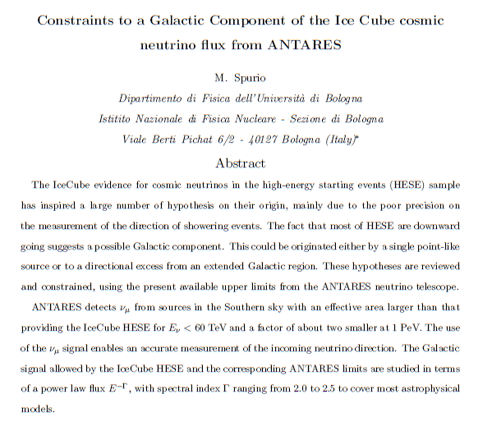
Details: see arXiv 1409.4552

Slide 3
A galactic component in HESE
A correlation with the galactic plane/center is quoted statistically non-significant in the PRL;
The expected signal from the Northern hemisphere (~purely extragalactic) is a factor of 2 larger than measured;
Assuming 3.6 Up and symmetric extragalactic contribution, the expected Down HESE of extragalactic origin are: =6.2 (5.8) events for the E^{-2.0} (E^{-2.5}) spectrum.
Galactic contribution= 13.7-6.2 ≅ 7.5 events

Slide 4
HESE effective area for:
Downgoing
Upgoing
Effective area(cm²)
Energy (GeV)
Effective area(cm²)
Energy (GeV)

Slide 5
Comparison between HESE/ANTARES A_{eff}
IceCube = 4π, high energy sample (E_{ν}>30 TeV), almost bck free
ANTARES= ν_{μ} only, southern sky only

Slide 6
The HESE signal
From IceCube
PRL113(2014)101101
It is possible, using the effective area, to obtain the normalization factor Φ^{D,Γ} for any spectral index Γ;
This extend the possible range of astrophysical models for the signal
In particular, we are interested on a possible Galactic component

Slide 7
The HESE normalization factors for different Γ’s (1)
Valid for a generic E^{−Γ} spectrum
Derived from the IC effective areas
observed events
livetime
Diffuse flux
Detector response, computed numerically

Slide 8
The HESE normalization factors for different Γ’s (2)
By imposing the same N_{IC} from the previous formula:

Slide 9
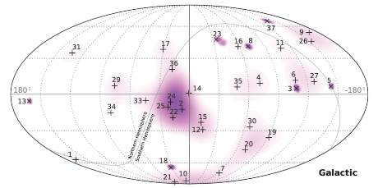
I) A point-like Galactic source
Galactic contribution from a point-like source
n_{p} events out N_{IC} are due to this source, with energy spectrum:
The normalization factor can be derived with the use of the A_{eff} (E)
The normalization factor depends on the diffuse normalization factor (for Γ=2.0 , that reported in the IceCube paper)
Same formula as in:

Slide 10
I) A point-like Galactic source
Thus:

Slide 11
ANTARES has upper bounds
For different energy spectra E^{−Γ}: (similar method using the A_{eff})

Slide 12
Results
The ANTARES 90% C.L. upper limit excludes that a single point-like source produces more than 5 HESE, assuming Γ=2.0.
A single point-like source yielding a cluster of more than 2 events is excluded for Γ=2.3
A clusters made of two or more events is excluded for Γ> 2.3.

Slide 13
II) Enhanced diffuse Galactic source
Signal due to a extended source, comparable with the IC angular resolution
Size ΔΩ much larger than the ANTARES angular resolution
n_{ΔΩ} events out N_{IC} are due to this source, with energy spectrum:
ΔΩ

Slide 14
Predictions (n_{ΔΩ}, ΔΩ) vs. Γ
Δω
ΔΩ
Δω
This is observed as a directional cosmic neutrino flux

Slide 15
ANTARES bounds?
At present, missing constraints;
Problem: for an extended source, large background of atmospheric neutrinos (∼50 events in a 8° radius);
Strategy: suppress the atmospheric neutrinos using the muon estimated energy
Compare background in ON/OFF regions
Method already used in the FB analysis
Sensitivity:

Slide 16


Slide 17
ANTARES sensitivities on an enhanced cosmic ν flux
I assume an ANTARES analysis similar to that on FB;
Sensitivity extrapolated to a region with different size and assuming a generic spectral index Γ;
Effective area, before the cut on the energy estimator E_{obs}, equal to A_{eff} used for the point-like source;
1
3.5
11.6
36.3
116
343
  Optimization on the cut on E_{obs} has an effect on the number of accepted background events (reduces the effective area);
  This effect increases the ratios for softer Γ w.r.t. E⁻² by a multiplicative factor
  No (first-order) effects for changing the size Δω;
    Signal: events/Δω ; events/Δω

Slide 18
Perspectives for an enhanced diffuse flux search in the hot spot region
ΔΩ
8°
ΔΩ
20°

Slide 19
The results in disagreement with:
Reason: wrong computation of the directional neutrino flux in this paper
(Table 3 and 4 are wrong by factors 209 and 33, respectively

Slide 20
Conclusions
The galactic component in the HESE sample quantitatively estimated (it could be over-fluctuation…)
Due to the similarity on the IC HESE/ANTARES effective areas, a point-like signal or an enhanced diffuse signal in the Galaxy can be seen/excluded by ANTARES
1) Presence of a point-like source. Upper limits already published by ANTARES constrain severely some hypothesis, in particular for energy spectra E^{−Γ} with Γ>2.2
2) Extended source, seen as an enhanced diffuse flux. Model yielding more than 2 events within ΔΩ = 0.06 sr and Γ≥ 2.0 can be confirmed or excluded by ANTARES by means of an analysis similar to that already done on FB
The role of KM3NeT- Phase 1 (A_{eff} about 3-4 of ANTARES)

