Slide 1
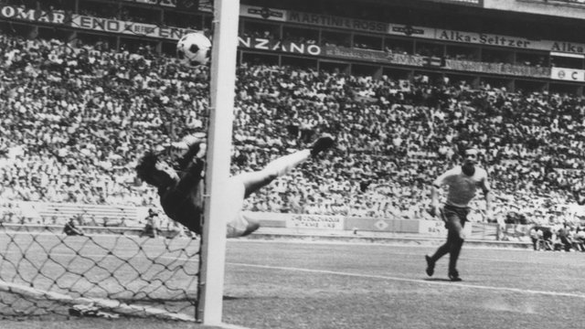
WELCOME !
to an event rich with tradition
Begins 16:00 EDT 12-6-2014
immediately following …

Slide 2
Welcome to
2014
…and beautiful Annapolis Maryland!

Slide 3
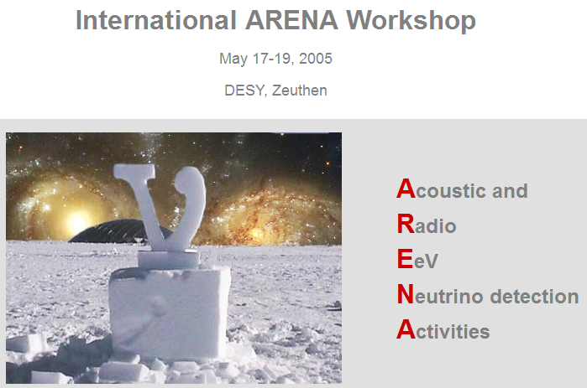
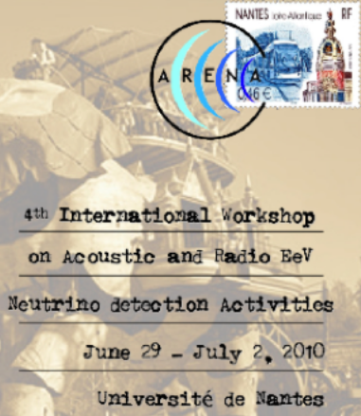
ARENA 2006

Slide 4
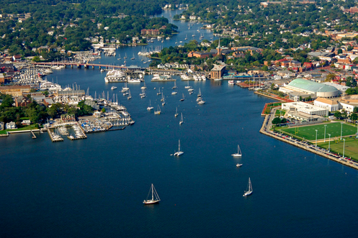
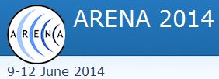
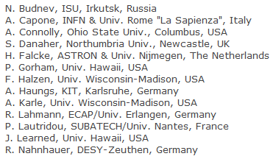
ARENA Advisory Board
Local Organizing Committee
Kara Hoffman
David Seckel
Naomi Russo
Maura Perkins
Kim Krieger
Ryan Caulfield & Ryan Maunu

Slide 5
Sponsors
The Center for Experimental Fundamental Physics at the University of Maryland
The University of Maryland/NASA Goddard Joint Space Institute
The Bartol Research Institute at the University of Delaware
The University of Maryland Department of Physics
The University of Delaware Department of Physics and Astronomy
The Wisconsin IceCube Particle Astrophysics Center

Slide 6
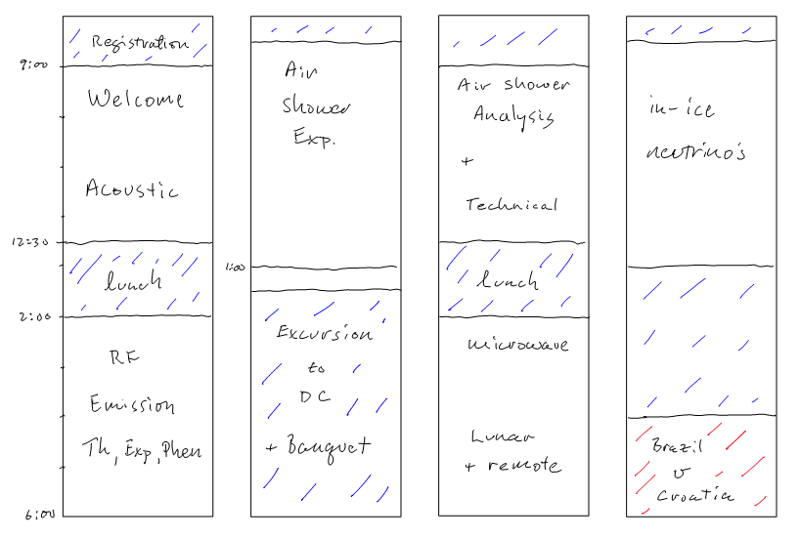
Program

Slide 7
Let’s begin ….

