Slide 1
Drilling Deep in South Pole Ice
T. Karg, R. Nahnhauer
DESY

Slide 2
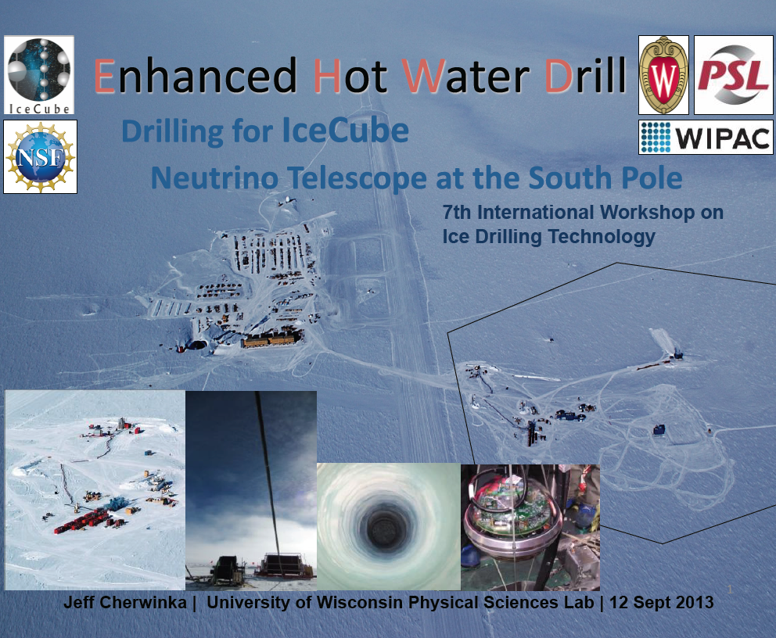
The success of IceCube is strongly connected with the success of drilling deep holes in the ice

Slide 3
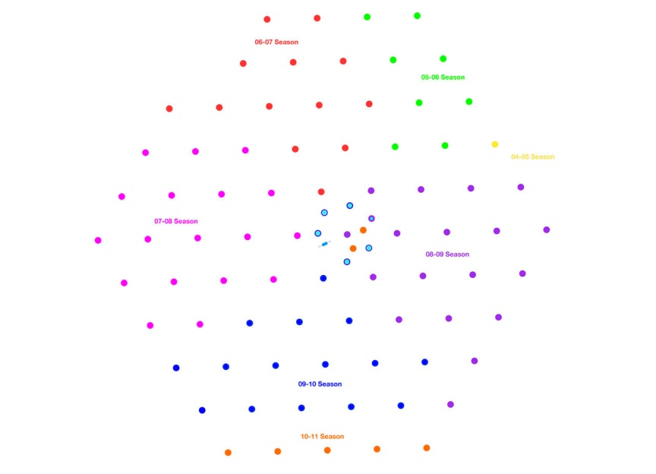
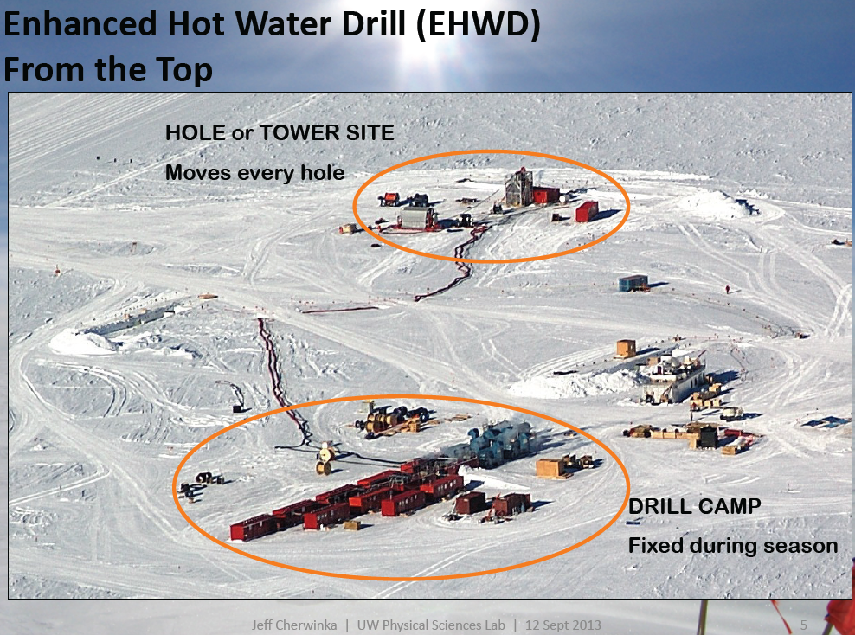
R = 300 m

Slide 4
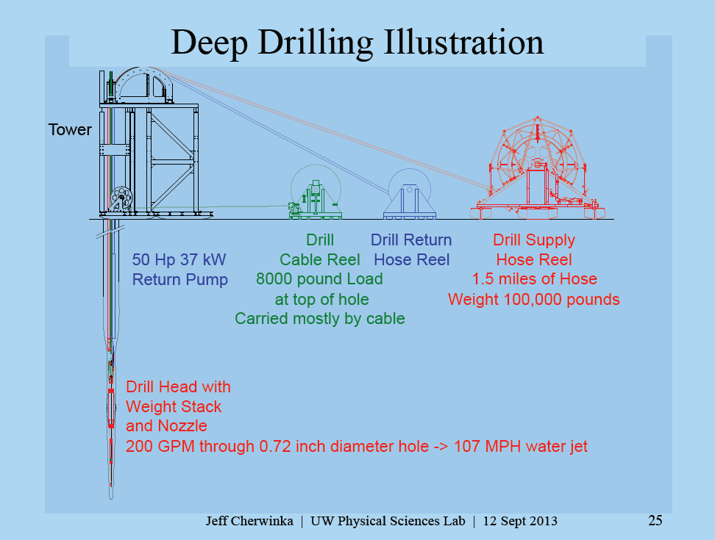

Slide 5
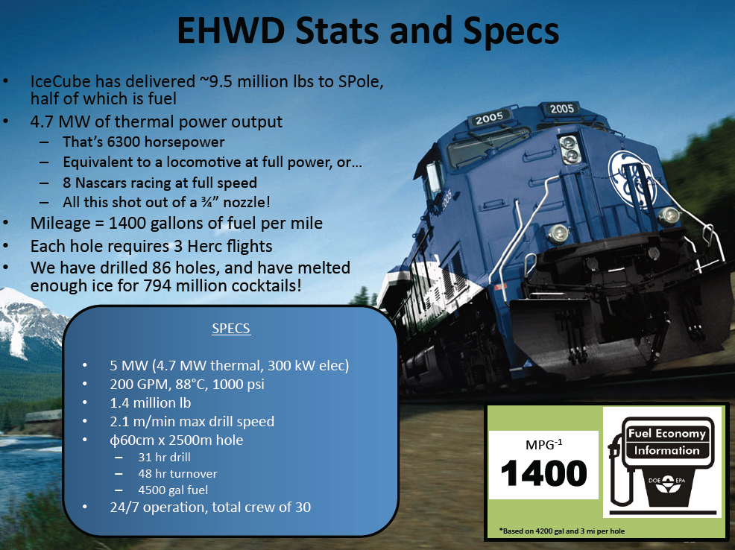
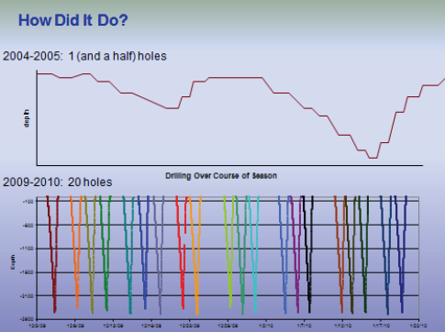
from J. Cherwinka

Slide 6
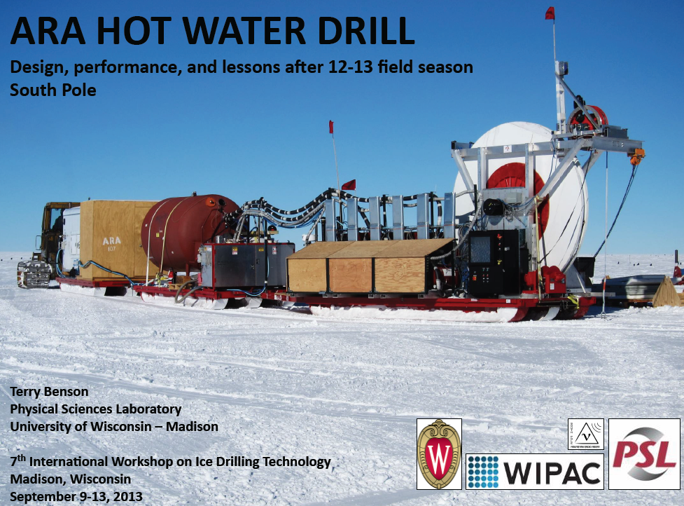

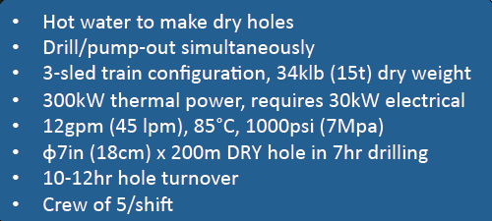
Next step: movable drill for distances > 500 m
2 km distance between stations

Slide 7
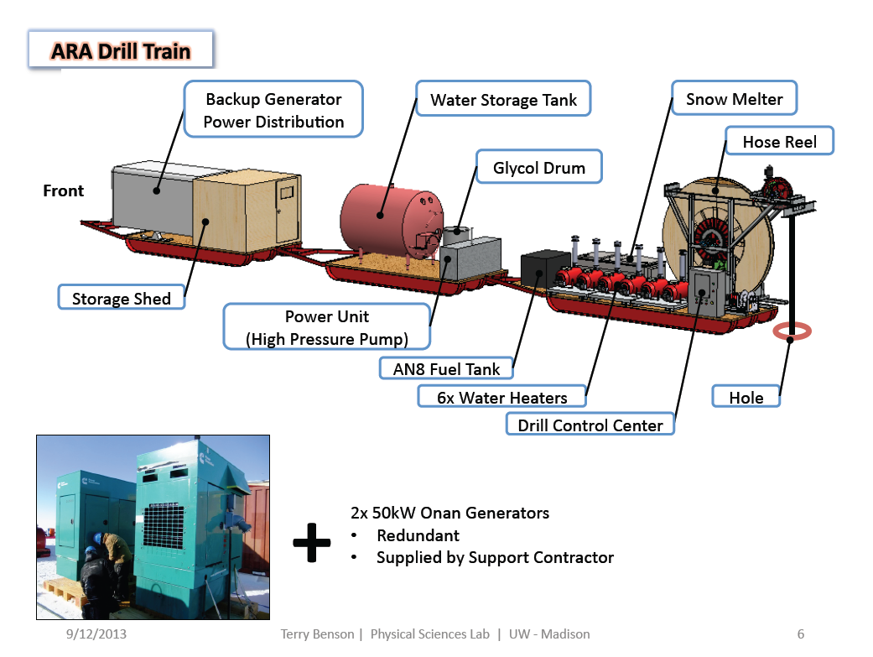

Slide 8
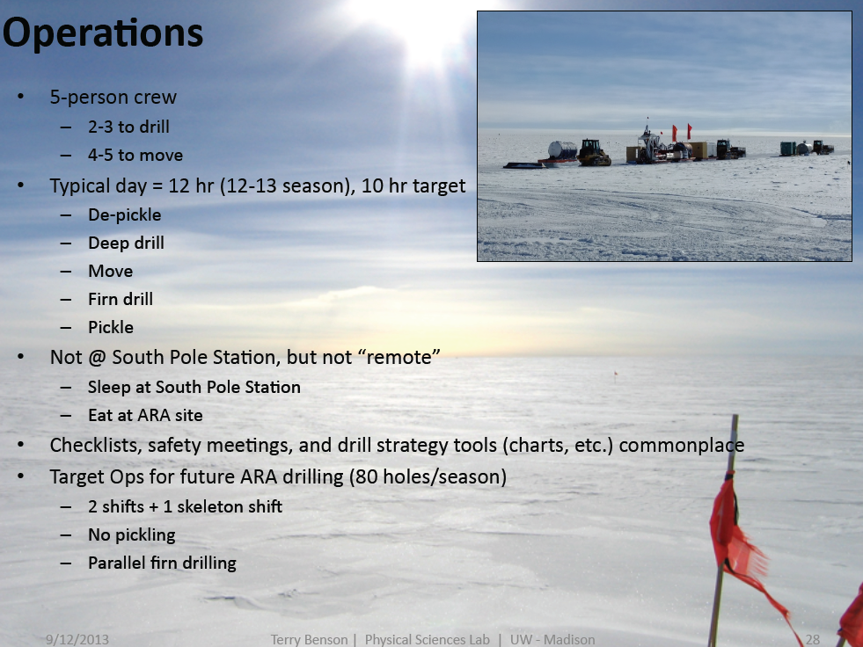

Slide 9
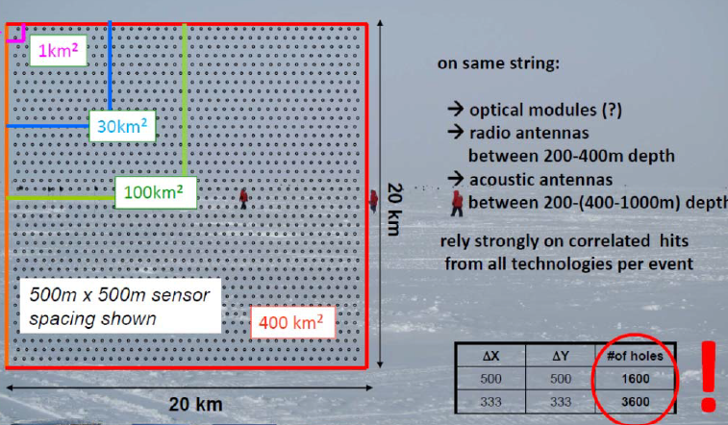
What about very large, deep arrays with dense instrumentation ?

Slide 10
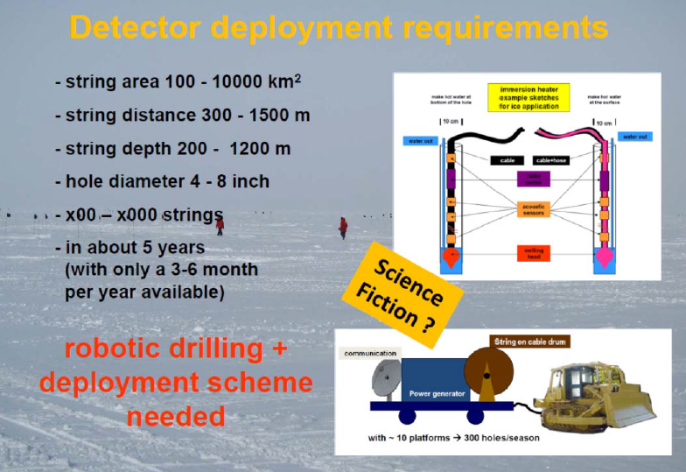
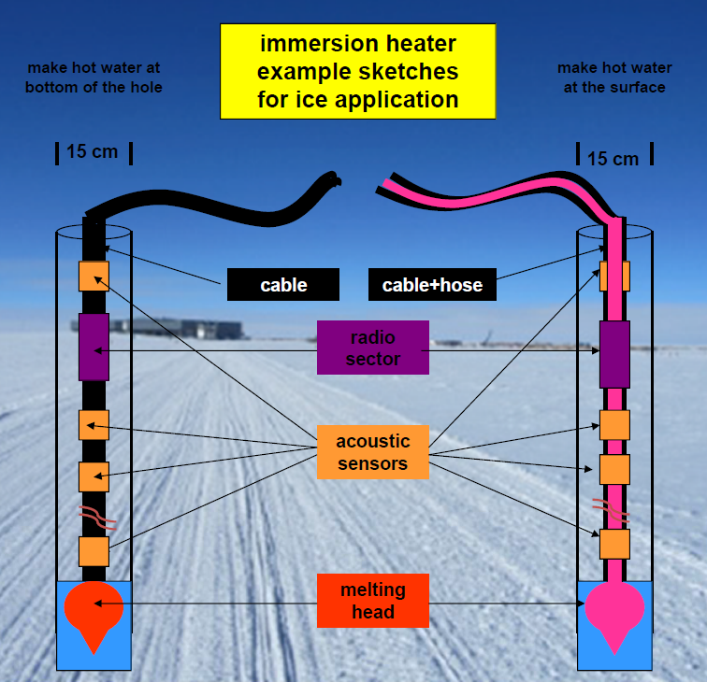
instrumented area 100 -10000 km²

Slide 11
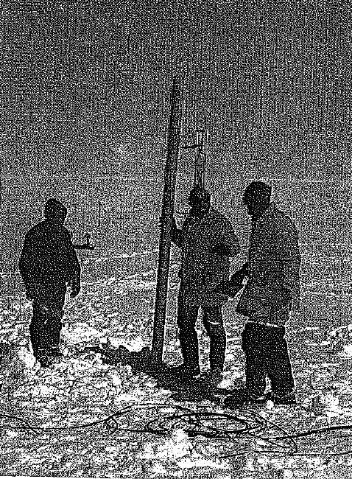
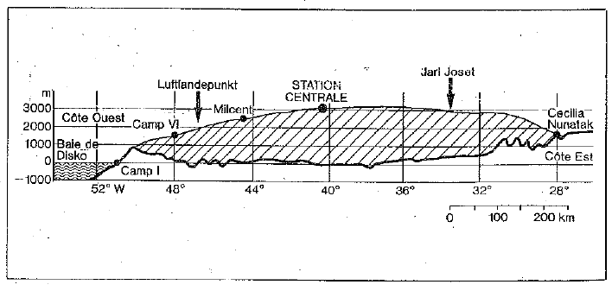
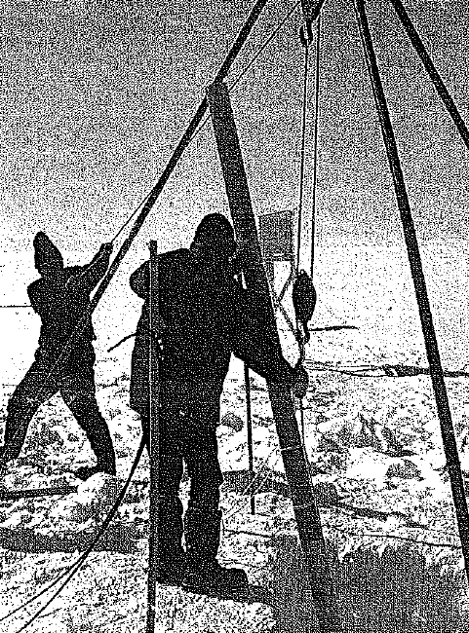
Solution proposed and tested 50 years ago:
The Philberth Probe
Deployment of two autonomous thermal probes to a depth of 220 m and 1000 m by Karl Philberth and his team
Time: Summer 1968
Location: Jarl Josef glacier, Greenland
Firn temperature -28.5 °C
Height: 2850 m
Ice thickness: ~2500m

Slide 12
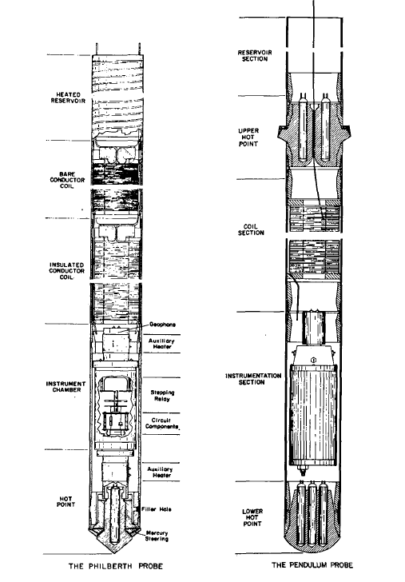
Probe size:
D=11 cm,
L = 280 cm,
wire length = 3000 m
Probe speed:
v = 50 m/day
Power used:
P = 4 kW
Inclination:
vertical
Depth measurement:
by coil inductance
Temperature measurement:
T = -29.0 °C at 220 m
T = -29.3°C at 600 m !!
T= -30.0 °C at 1000m
original Philberth
Aamot

Slide 13
 | who | when | where | what | max depth
 | Philbert | 1968 | Greenland | thermal probe | 220 m - 1000 m
 | Aamot | 1971 | Antarctica | thermal probe | ~100 m
 | Hansen | 1973 | Antarctica | thermal probe | 112 m
 | Hansen | 1979-1993 | Lab tests | thermal probes | lab tests
 | Hansen, Kelty | 1993-1994 | Greenland | thermal probe | 7 m -135 m
 | AWI | 1995 | Antarctica | thermal probe
 | NASA | 2001 | Lab tests (outdoor?) | thermal probe + water jet | 5m (plan: 300 m ??)
 | Dachwald (IceMole) | 2010-2012 | Alps | thermal probe (curvd pass) | 5m
 | Dachwald (Enceladus) | 2012-2015 | Alps, Antarctica | thermal probe (curved pass) | > 20 m ?
 | Stone (Valkyrie) | 2010-20xx | Lab tests | water jet (laser powered)
drill application
space application
First Philberth probe has shown best performance for deep drilling until today

Slide 14
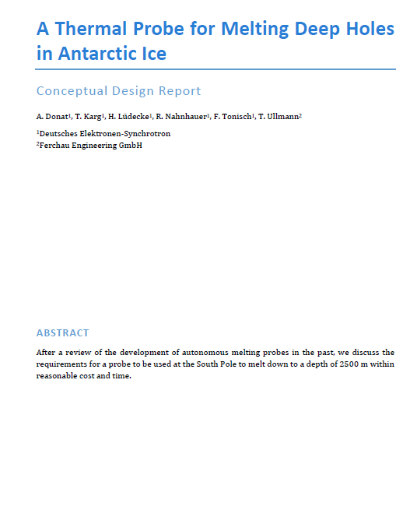
Try to design and build a “Philberth” probe for drilling application with up to date mechanical and electronic components
Available at: https://wiki.icecube.wisc.edu/index.php/IceCube_Extensions
Second step:
think about possible payload installation
for prototype testing
➔ for real detector installation
all references missed in the talk can be found here

Slide 15
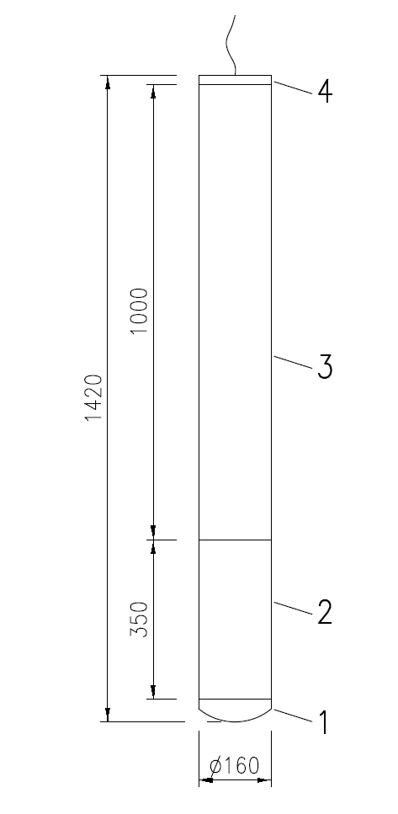
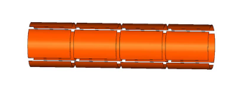
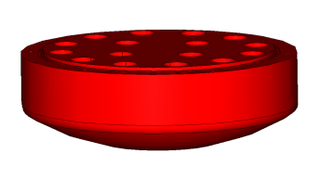
Mechanical
design
Segments:
4) Top cover with wire exit,
heated
3) Coil chamber for 3000 m
wire to surface,
heated by segmented heater
mats at wall (controllable)
2) Sensor and electronic
container,
pressure resistant
1) Head with heaters,
single heater controllable

Slide 16
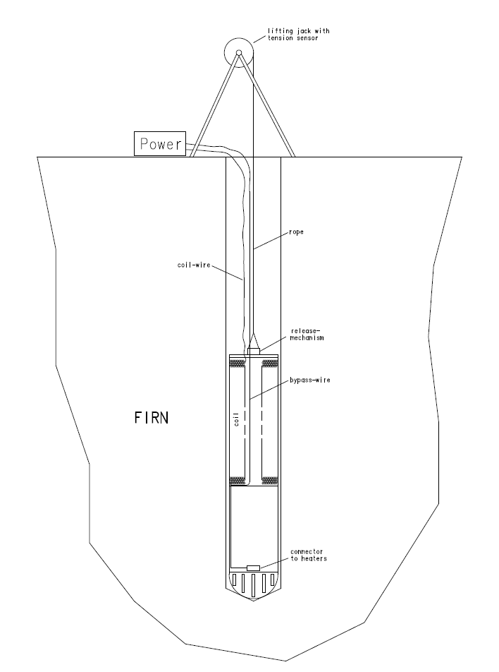
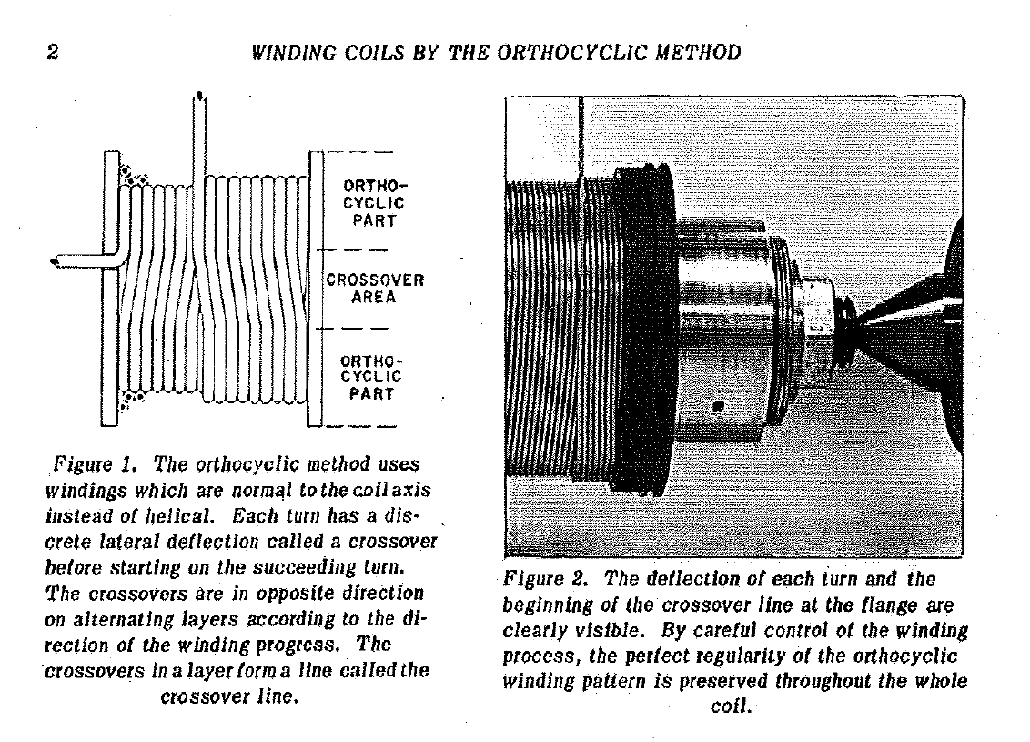
Mechanic details
Deployment
startup phase:
Coil winding:
➔ probably most difficult part of
construction
➔ use orthocyclic method (?)

Slide 17
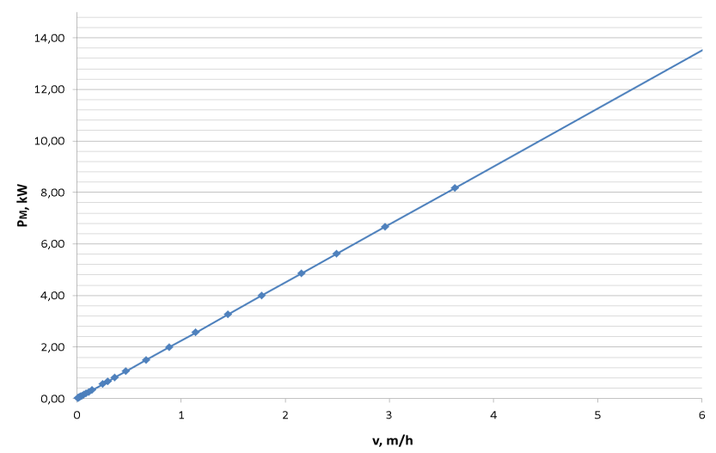
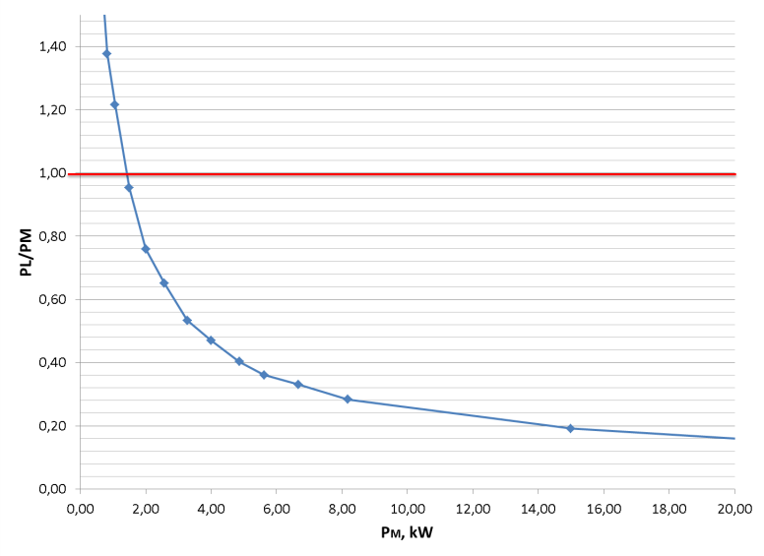
Power requirements for melting:
probe should go down in the ice with certain speed v:
➔ need melting power P_{m} = πr²vq_{m} , q_{m}=ρ(H_{m}+c_{p}ΔT)
➔ need lateral power to avoid re-freezing of walls
P_{l} = Tvr²f(L/vr²), P_{tot} = P_{m} + P_{l}
with v = 2 m/s
P_{m} = ~5 kW
P_{tot} = 7 kW
with
~15% contingency
P_{tot} = 8 kW !

Slide 18
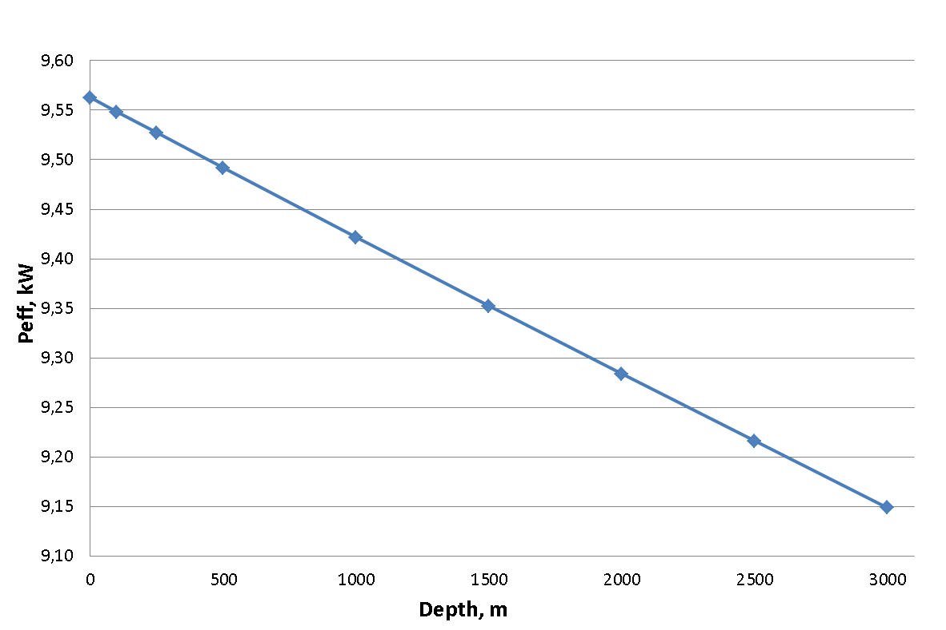
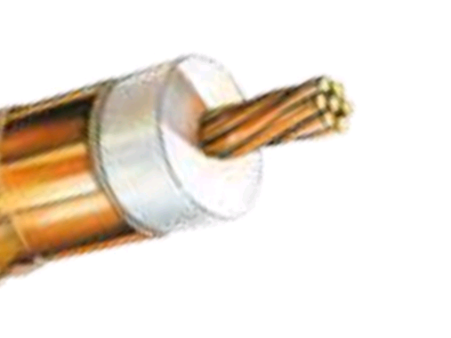
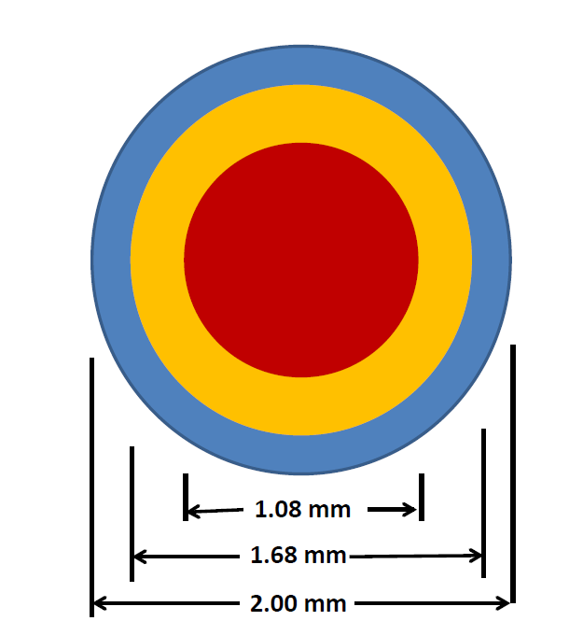
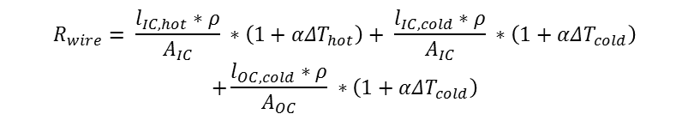
Electric power
assume surface generator
with 10 - 15 kW power
transformed to 2500 V DC
load of probe: 500 Ω
resistance of cable is depth dependent
$$R_{wire}= \frac{l_{IC, hot}∗ρ}{A_{IC}} ∗\left(1+αΔT_{hot}\right)+ \frac{l_{IC,cold}∗ρ}{A_{IC}} ∗\left(1+αΔT_{cold}\right)$$
$$+\frac{l_{OC,cold}∗ρ}{A_{OC}} ∗\left(1+αΔT_{cold}\right)$$
cable cross section:
HELU

Slide 19
Steering and data acquisition
Slow control
➔ Voltages and currents monitored
for all subsystems
➔ Temperature measured at
representative points
➔ Bearing measured by inclinometer
➔ Cable payout measure for depth
determination
➔ Acoustic positioning system
Expected data rates :
Quantity | Rate (Hz) | Size (Bytes / reading)
Surface
Voltage on cable (top end) | 10 | 4
Current into cable (top end) | 10 | 4
Probe
Voltage on cable (bottom end) | 10 | 4
Current out of cable (bottom end) | 10 | 4
Voltages and currents at various points 20 test points to be defined, 4 bytes / pt. | 1 | 80
Temperature at various points 10 test points to be defined, 4 bytes / pt. | 1 | 40
Unspooled cable length | 0.1 | 4
Inclinometer | 0.1 | 8
Acoustic positioning | 0.01 | 6152
Total data rate over cable: |  | 263 bytes / sec.
Heater element steering
➔ water temperature 80 °C – 90 °C
➔ probe vertical
➔ foresee emergency procedure
➔ foresee in-ice re-start

Slide 20
Cost estimate
Surface equipment | Cost/€
Generator | 5000.-
Transformer | 3000.-
Rectifier | 1000.-
PC + electronics | 2000.-
Mechanics | 1000.-
Total | 12000.-
Total +20% cont. | 14400.-
Probe equipment | Cost/€
Cable | 6000.-
Mechanics | 1000.-
Heating system | 3000.-
Electronics | 2000.-
Sensors | 3000.-
Total | 15000.-
Total +20% cont. | 18000.-
Drilling fuel *) | Amount for 2500 m / l | Cost / € | +20% cont.
Kerosene | 3250 | 1850.- | 2200.-
*) cost without transport, 2.96 $/gal, 0.73€/$
Important: only 2-3 persons necessary for probe deployment

Slide 21
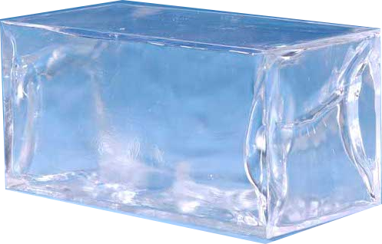




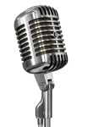
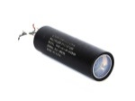
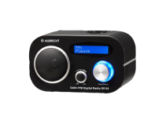
Possible first application(s)
Devices located in sensor chamber:
- radio sender
- loudspeaker
- light source
- radio antenna
- microphone
- photomultiplier
detector calibration
→ evaluation of ice properties

Slide 22
Summary
➔ It is possible to build an autonomous melting probe with modern
technologies at reasonable cost
➔ It has to be evaluated if there is interest by other groups to start
such a project as a common effort
➔ The next step could be the construction and test of a corresponding
prototype following the Philberth concept
In parallel alternative designs should be developed
(water jet, heated wire from surface, ….)
➔ First applications could be the study of ice properties and the
deployment of calibration sources at any wanted location

