Slide 1


ARENA 2014
The calibration and testing of a transmitter array
for acoustic neutrino detection
S. Danaher, E. Bentley, D Johnson

Slide 2

Outline
1. Introduction
2. Aims
3. Single Hydrophone
4. Hydrophone Array Simulation
Outline
5. Hardware Design and Build
6. Laboratory Experiment
7. Deployment at ANTARES site
8. Data analysis
9.Conclusion & Future work
2

Slide 3
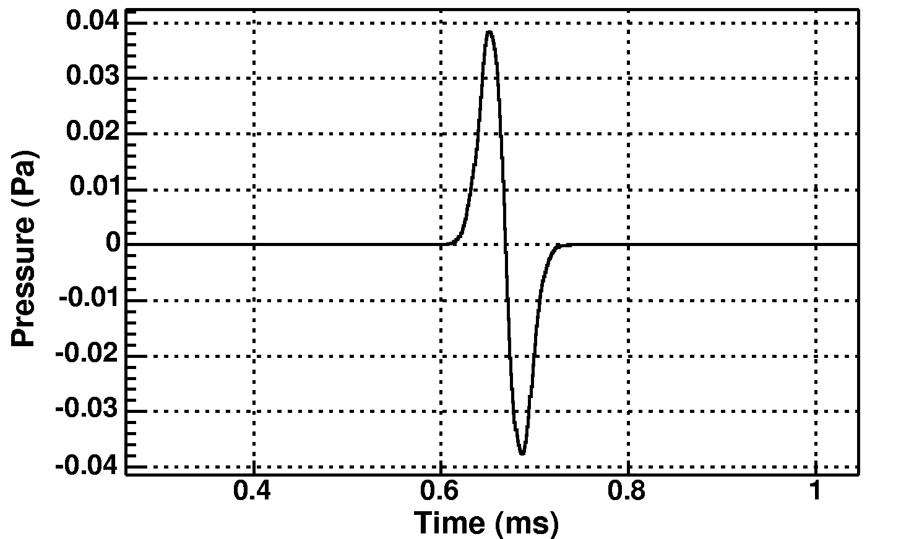
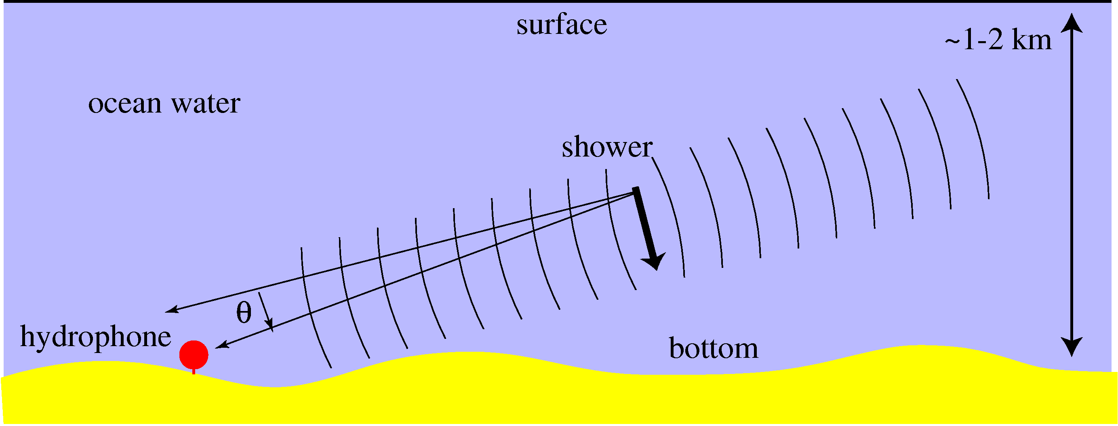
1
Introduction: Acoustic Detection
"pancake" propagates ⊥ to shower direction
Neutrino detection methods
3
3
Optical Cerenkov
-Works well in water, ice
-Attenuation lengths 50m to 100m
-Sensitive to low energy
Acoustic Detection
Very long attenuation lengths in water (order 10km), ice and salt
Radio Cerenkov
Long (order km) attenuation lengths in ice and salt
neutrino
Antenna Array
Radio Cerenkov
Hydrophone Array
PMT Array
Optical Cerenkov
Cascade
Cascade
Acoustic Pressure Waves
neutrino
muon
neutrino
Collaborations
-AMANDA
-ANTARES (FR)
-NEMO
-IceCube
-KM3NeT
Collaborations
-ANITA
-FORTE
-GLUE
-RICE
Collaborations
-SAUND (USA)
-ACoRNE (UK)
Source: Dr.Lee Thompson (ARENA 2008)

Slide 4
2
Aims
Simulation and study of acoustic transmitter array for neutrino emulation
Design and construction of the acoustic transmitter array.
Calibration and experiment of acoustic transmitter array at the laboratory
Deployment of acoustic transmitter array at ANTARES site, France
Exploding Wires – Groundhog Day!
Thanks and a request

Slide 5
3
New Hydrophone Model
state x₁ | Voltage across ceramic equivalent capacitance
state x₂ | velocity of mass 1
state x₃ | position of mass 1
state x₄ | velocity of mass 2
state x₅ | position of mass 2
input u₁ | Applied Voltage
input u₂ | Shared External Pressure
output y₁ | Weighted velocity
output y₂ | Current
Based on piezoelectric effect
Twin mass model good compromise

Slide 6
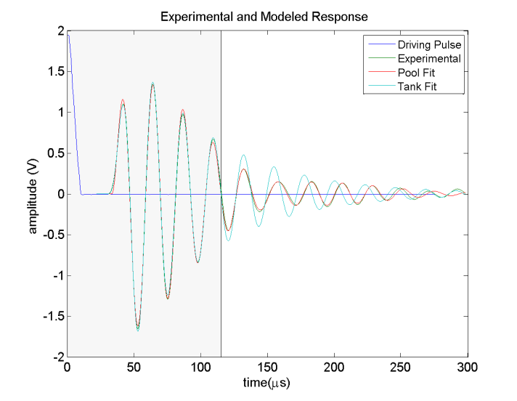
3
New Hydrophone Model
Standard Control Theory used to convert to TF model
Indirect Technique for calibration and Experimental and Modeled response.
Once the correct model has ben determined,
Fourier Techniques are used to determine the driving pulse

Slide 7
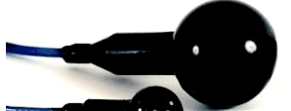
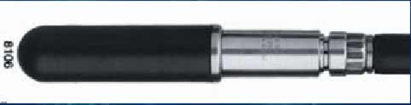
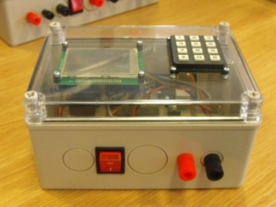
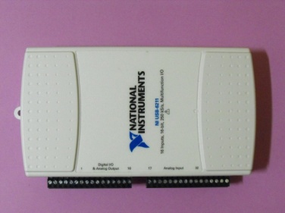
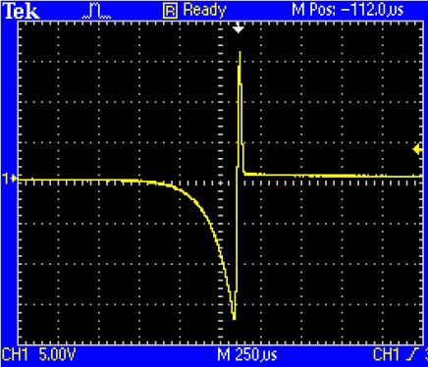
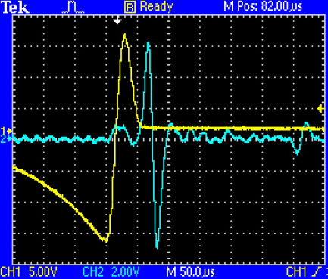
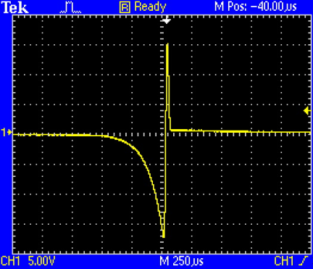
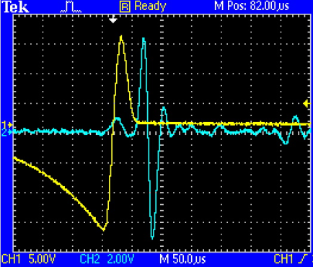
3
Hydrophone Calibration (Contd)
Input driving
Tx hydrophone
Bruel & Kyaer (B&K) 8106
Needed signal
PIC module
PIC18F4585-I/P
NI USB-6211
Sampling Rate : 250 kS/s
Number of samples: 1500 samples
Resolution of Analog output : 12 bits
Sampling Rate : 250 kS/s
Number of samples:1500 samples
Resolution of Analog output : 16 bits

Slide 8

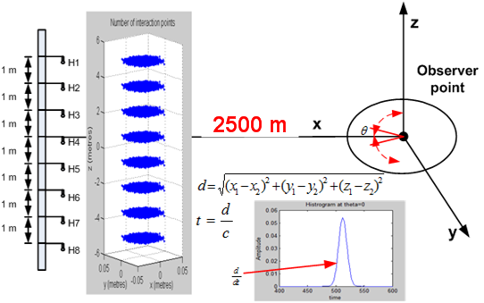


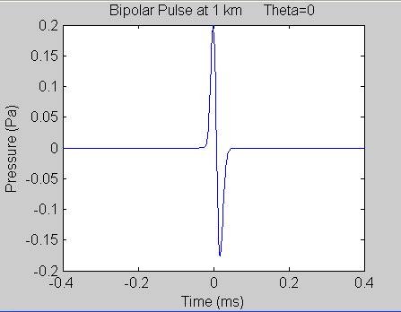
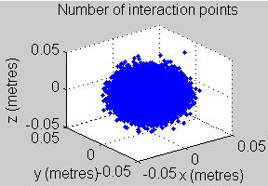
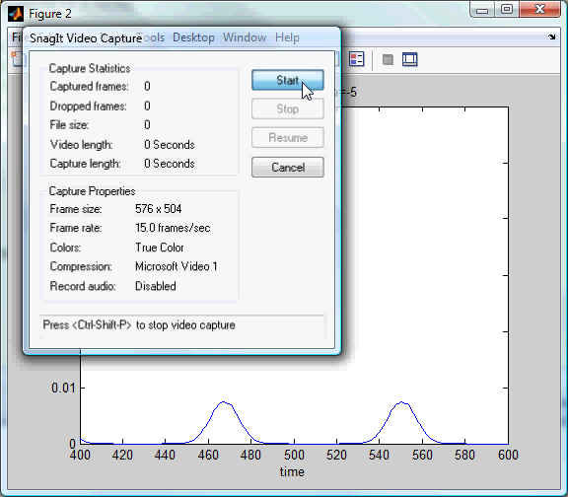
4
Hydrophone Array Calibration :Simulation
Simulation of 8 hydrophone array TX

Slide 9
4
Hydrophone Array Calibration :Simulation
Energy per angle at 2475 m from GeV of thermal energy shower deposition, under Mediterranean sea conditions
ANARES
Amplitude in time of the acoustic bipolar pulse generated from
GeV thermal energy shower deposition at 2475 m under Mediterranean sea condition .

Slide 10
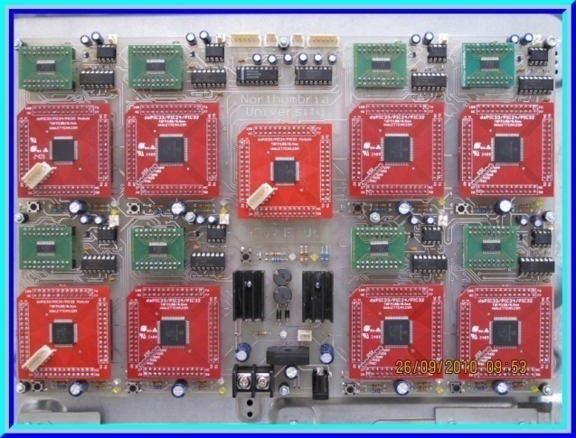
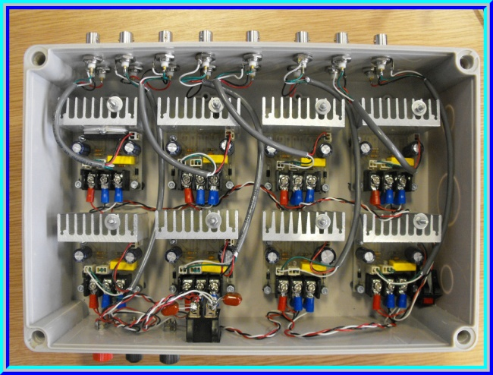
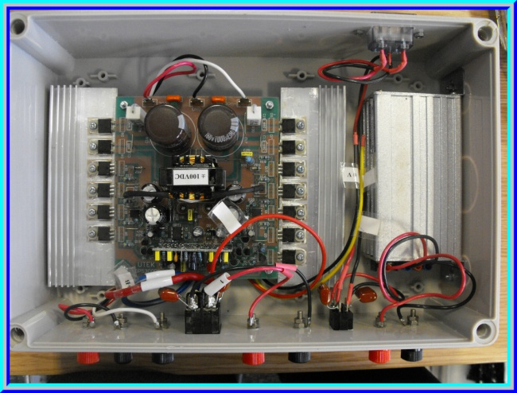
5
Hardware Design and Implementation
8 channel arbitrary wave form generator module
dsPIC33FJ256MC710-I/P Digital signal Controllers
One master , Eight Slave Controllers
I2C Interface, Interrupt trigger
DAC8822 16-bit Digital to Analog Converter
Maximum Sampling rate 1MS/s ( Experiment used: 500KS/s)
8 channel power amplifier module
APEX PA94
High voltage power operational amplifier 900V (+/-450V) (Experiment used : +/-100V)
High Slew Rate 500V/us
High Output current 100mA
Adjustable Output voltage gain
+12Vdc to +/-100V dc-to-dc converter Module
- Convert +12Vdc to +/- 100Vdc for Power Amplifier
- Battery supported

Slide 11
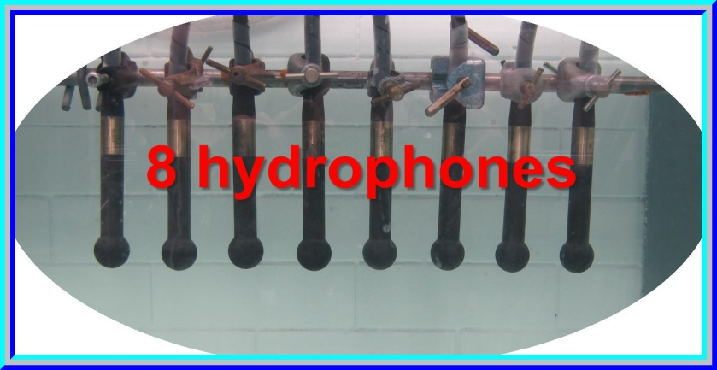
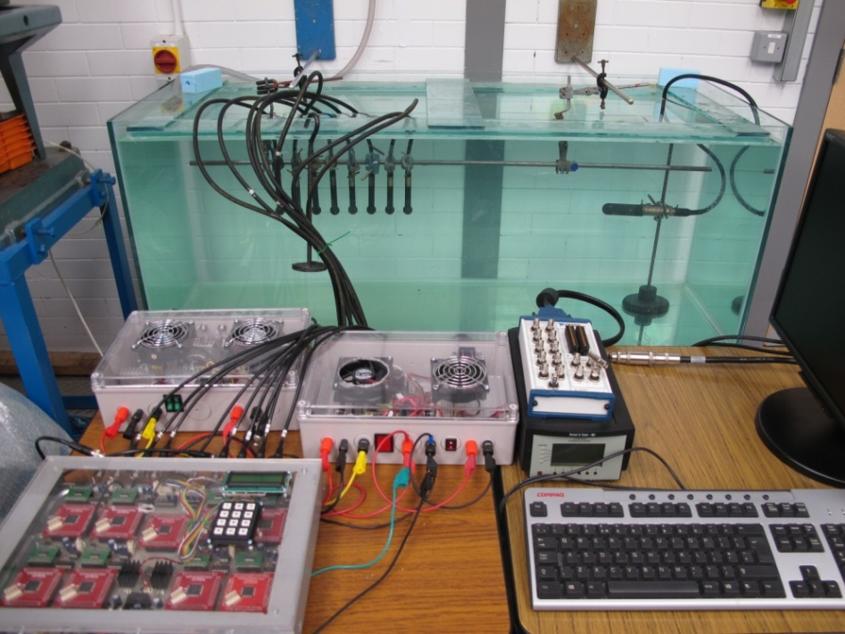
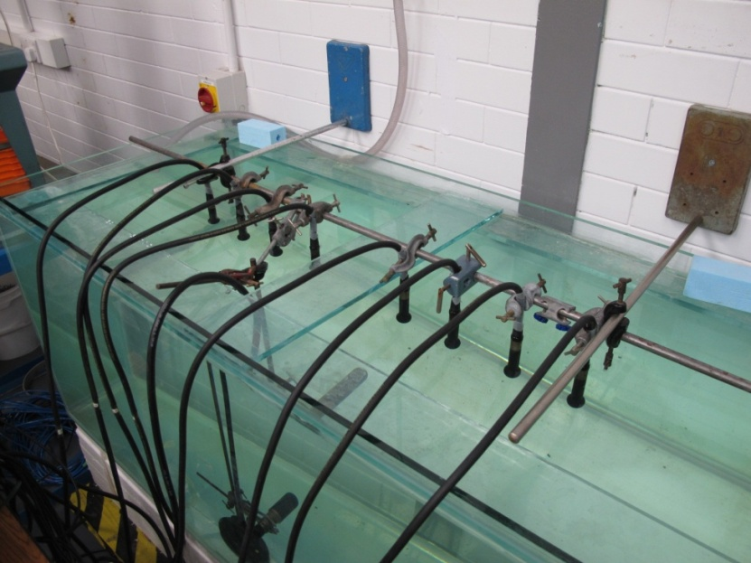
6
Laboratory Experiment
Laboratory at Northumbria University
11

Slide 12
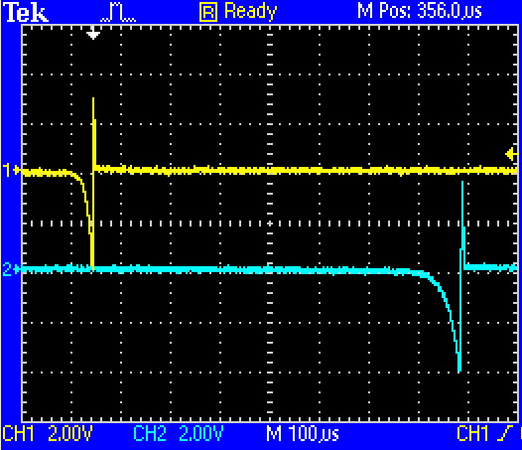
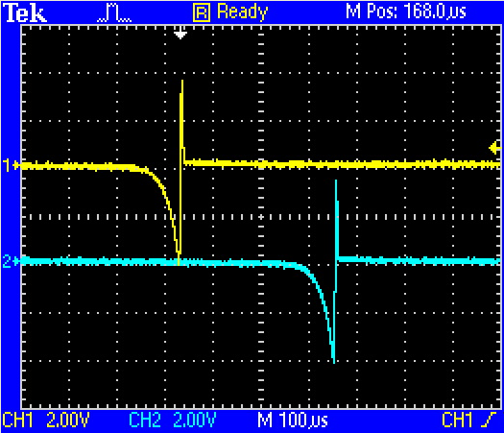
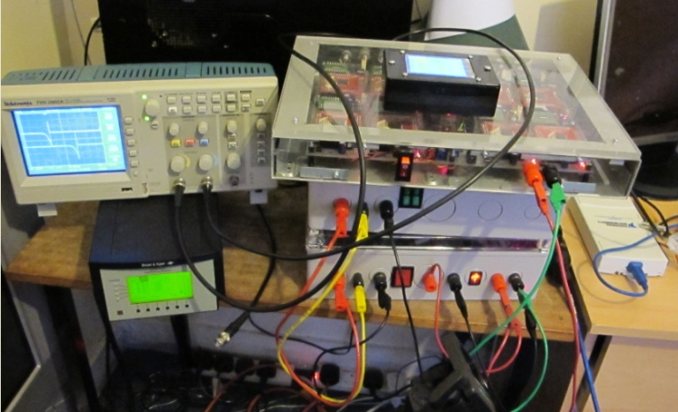
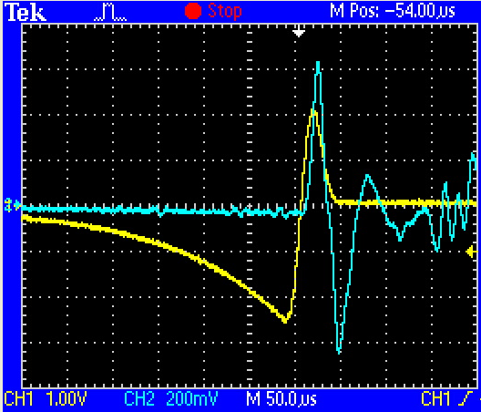

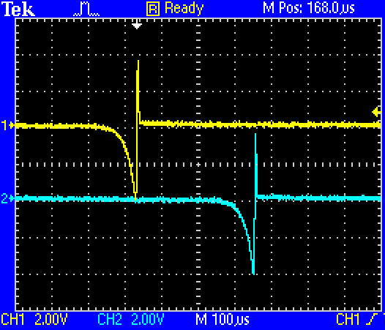
6
Laboratory Experiment
8 Channels hydrophone Tx
Ch1
Ch5
Ch2
Ch6
Bipolar pulse output from Channel 1
Ch3
Ch7
Ch4
Ch8

Slide 13
6
Laboratory Experiment
13

Slide 14
6
Laboratory Experiment (Result)
The measurement of bipolar signal Using NI and dsPIC modules
No of Hydro phone | PXI-6713 module |  |  | dsPIC module
 | Centre | Left | bottom | Centre | Left | bottom
H1 | 1.54 | 1.46 | 1.56 | 1.68 | 1.54 | 1.58
H2 | 1.64 | 1.60 | 1.66 | 1.76 | 1.62 | 1.60
H3 | 1.84 | 1.76 | 1.74 | 1.86 | 1.74 | 1.72
H4 | 1.98 | 1.84 | 1.80 | 1.96 | 1.92 | 1.86
H5 | 2.30 | 2.06 | 2.08 | 2.30 | 2.04 | 2.10
H6 | 2.46 | 2.24 | 2.30 | 2.48 | 2.22 | 2.30
H7 | 2.56 | 2.28 | 2.36 | 2.58 | 2.30 | 2.32
H8 | 2.86 | 2.64 | 2.78 | 2.88 | 2.70 | 2.74
Calculation H1+...H8 | 17.18 | 15.88 | 16.28 | 17.50 | 16.08 | 16.22
Measurement H1-8 | 16.4 | 15.0 | 15.8 | 16.6 | 14.8 | 16.00
 | *All units are in Vp-p

Slide 15
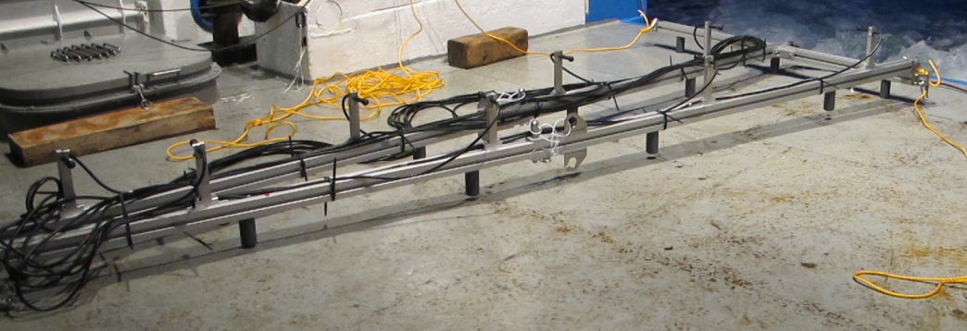
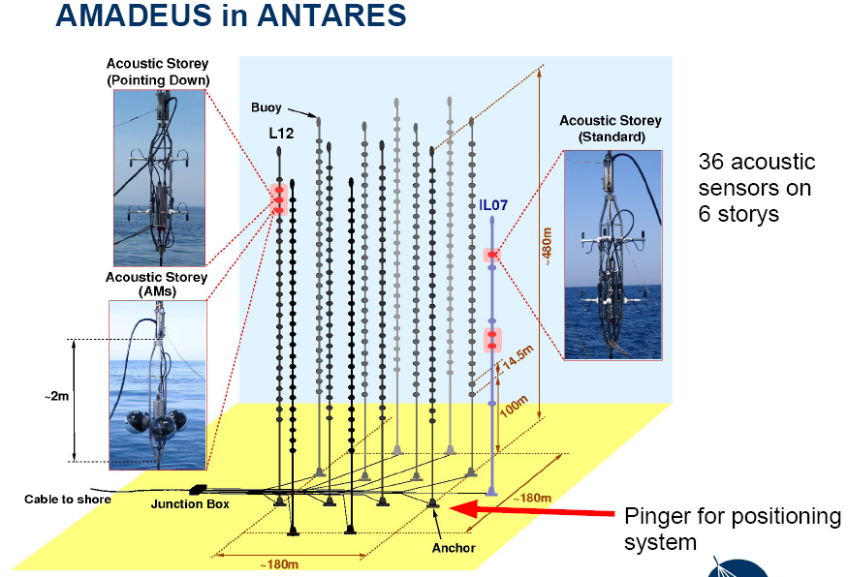
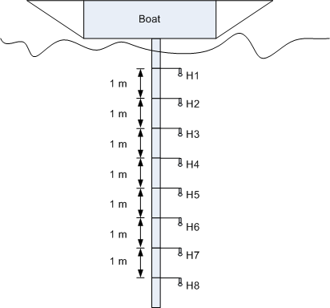
7
Deployment at ANTARES, France
Deployment at ANTARES (France)
8 channel transmitter module
Deployment at ANTARES
17 September 2011

Slide 16
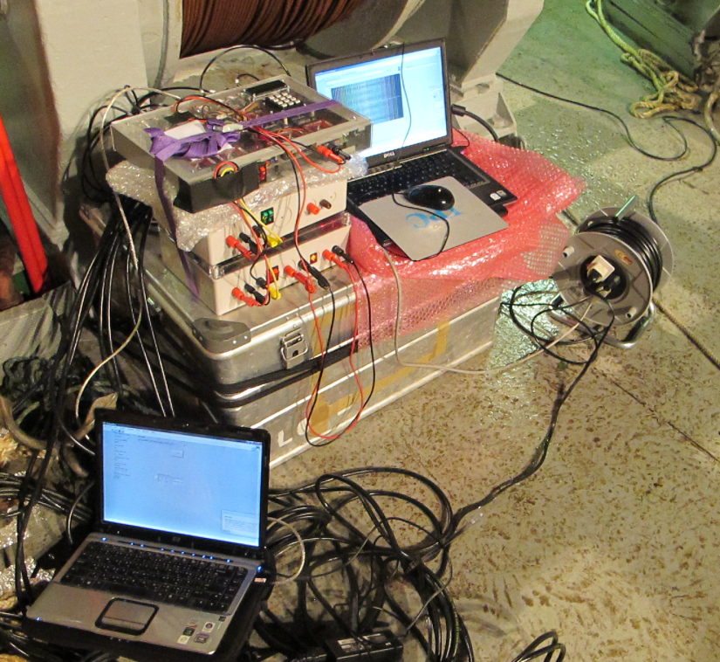
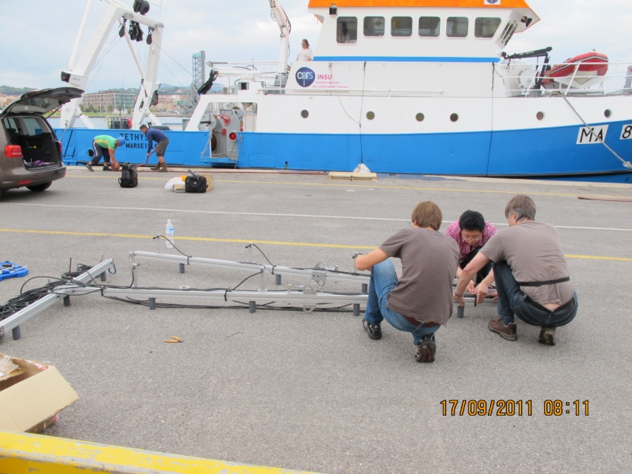
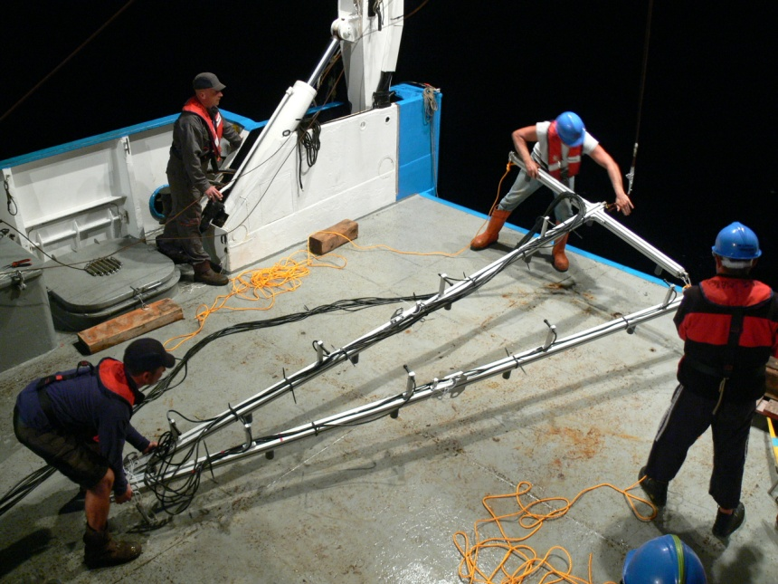
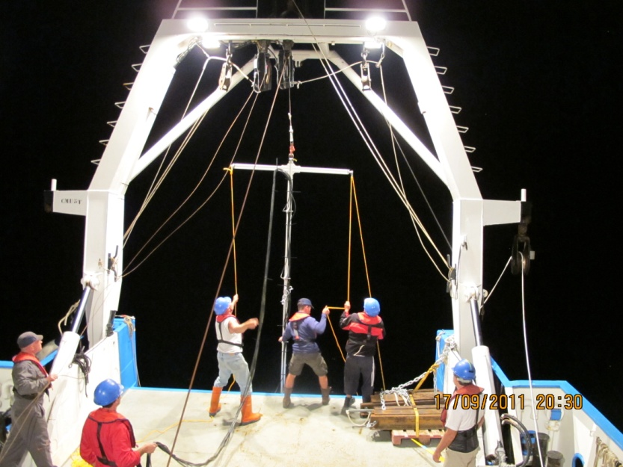
7
Deployment at ANTARES, France

Slide 17
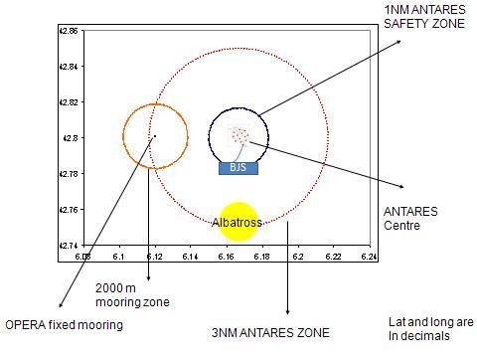
7
Deployment at ANTARES, France
Signal injecting time
18:25 UTC,20.25 (local) : Arrive site, set up array frame to stern A frame
18:45 UTC,20.45 (local) : Set up electronics
19:00 UTC,21.00 (local) : Start measurement with dsPIC module: for 5KHz,
10KHz,15KHz
19.10 UTC,21.10 (local) : Bipolar pulse, and Orthogonal pulses
19.35 UTC,21.35 (local) : Start Labview measurements: 5KHz,10KHz,15KHz
and bipolar pulse.
20.00 UTC,22.00 (local) : Finish measurements

Slide 18
Sadly ship about 1km from expected position.
Beam-formed pancake swept over wrong part of seabed.
Single hydrophones too weak to detect (fine for UK ACoRNe array which is c 100m below sea surface)
Upgraded hydrophones on order from Sensor Technology (Canada) for nearly 2 years!

Slide 19
ACOUSTIC NEUTRINO DETECTOR CALIBRATION USING ELECTRICALLY GENERATED ACOUSTIC PULSES
This approach is based on earlier work
‘Scaling Underwater Exploding Wires’ J. R. McGrath NRL Report 6266 December 17, 1965 in which 4 microsecond rise time underwater acoustic pulses were generated by 100J discharges, derived from a 0.5uF capacitor charged to some 20kV, through a thin wire.
Investigation was carried out to determine whether the 100J discharge of a large electrolytic capacitor charged to a more practical 350V would allow production of short rise time acoustic pulses. If the rise time achieved is short enough it would allow use of such pulses to replace the traditional system of ‘reverse hydrophone’ pulse generation used for the calibration of acoustic Neutrino detectors. The energy in such a pulse can exceed that of the energy of a pulse produced via reverse hydrophones, and the equipment required is less complex.

Slide 20
ELECTRICAL CIRCUIT
6 cm
5cm 0.2mm diameter copper wire
Energy stored in charged Capacitor = 135 J
WATER
Hydrophone

Slide 21
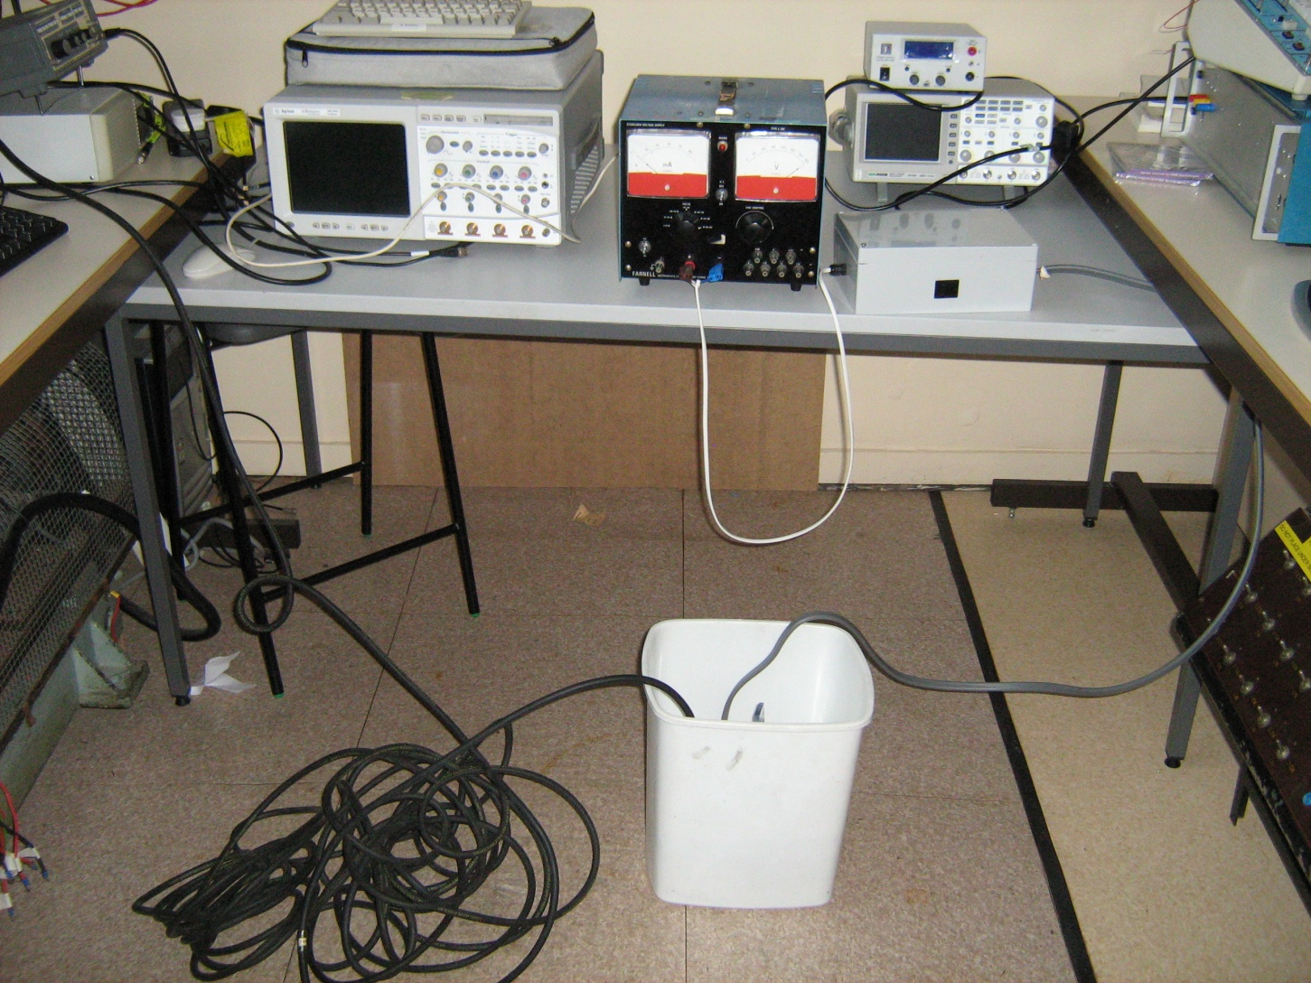
EXPERIMENTAL LAYOUT
350V power supply
Capacitor + limiting resistor
+switching gear
Water tank containing exploding wire + hydrophone

Slide 22
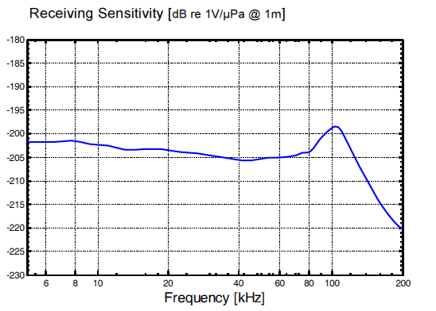
EXPERIMENTAL RESULTS SHOWING OUTPUT VOLTAGE OF HYDROPHONE
Replacing the high voltage capacitor used in the original 1965 work with a large value medium voltage electrolytic type storing an equal amount of energy increased the acoustic pulse rise time from 4μs to 30μs. But this is good enough
The pulse rise time is still fast enough to be used in calibrating acoustic Neutrino detectors.
Further improvements in rise time are possible.
The hydrophone survived!

Slide 23
CONCLUSION
Replacing the high voltage capacitor used in the original 1965 work with a large value medium voltage electrolytic type storing an equal amount of energy increased the acoustic pulse rise time from 4μs to 30μs.
The pulse rise time is still fast enough to be used in calibrating acoustic Neutrino detectors.
Further improvements in rise time are possible.

Slide 24
9
Conclusion & Future work
The simulation Hydrophone array transmitter for acoustic neutrino detection has been done.
Design and construction of hydrophone array transmitter have been built.
The experiment of Hydrophone array transmitter at laboratory has been tested.
The deployment of hydrophone array transmitter at ANTARES site has been operated on 17 September 2011
Hydrophones to weak for deep sea arrays – awaiting more powerful ones
Acknowledgement
ACoRNE collaboration, UK.
ECAP Collaboration, Germany.
Dominique Lefevre of INSU, : Sea water operation organizer.
School of CEIS Northumbria University,
Ministry of Science and Technology, Thai government:
Sponsorship for my full time PhD.
Request and Questions?

