Slide 1
Neutrino Telescopes as targets for Long-baseline neutrino beams
J. Brunner
CPPM (Marseille)
ν

Slide 2
Why consider Beams ?
PINGU / ORCA Motivations
Fast : Construction within few years
Significant measurement after few years
Stay within low budget
Neutrino Beams
Expensive & long(er) Timescale
→ counter intuitive
Matter effects with Atmospheric Nu’s
More challenging than originally hoped for
Beam allows for complementary measurement
Neutrino Beams
Easier to motivate if pointing towards an existing detector
Maybe possible in “parasitic mode”

Slide 3
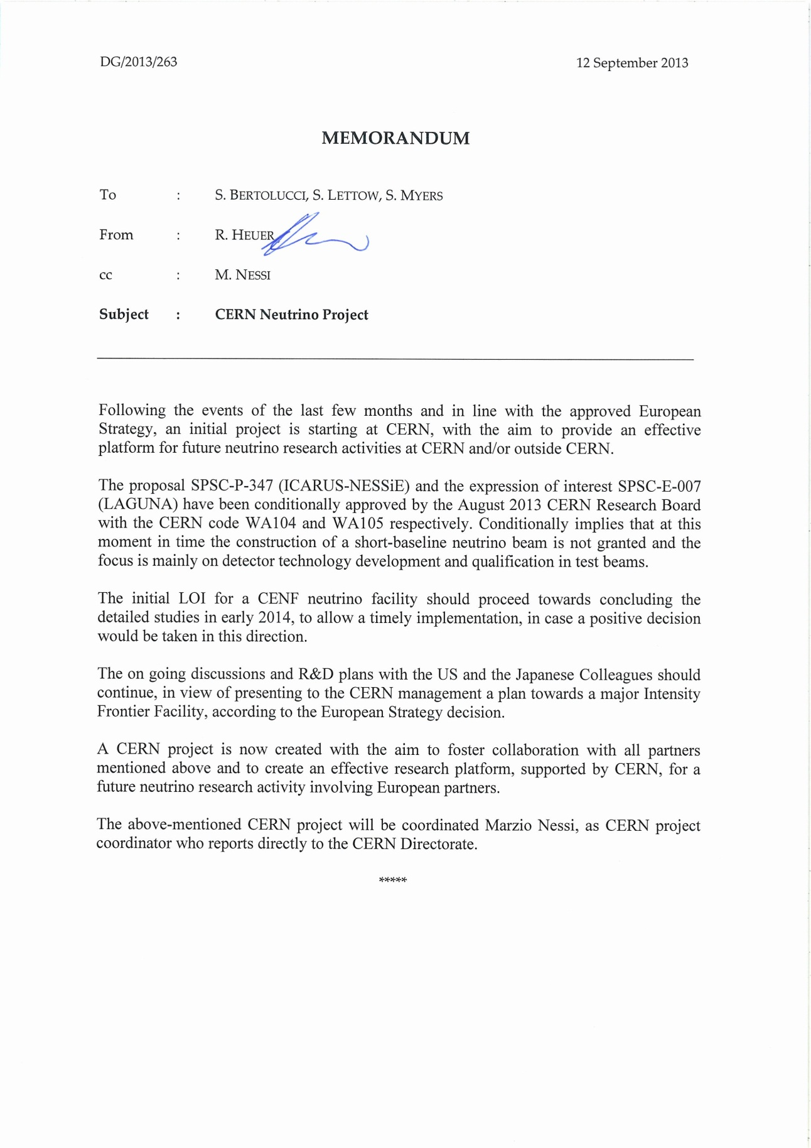
Why consider Beams ?
Recently : change of paradigm for European LBL program
Opens new, so far neglected options

Slide 4
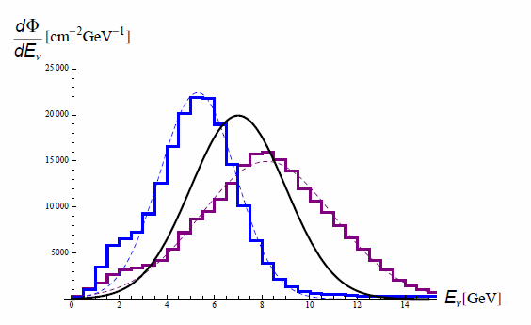
Neutrinos from Beams
Eliminate ambiguities
Improve mass hierarchy sensitivity
arXiv:1301.4577
Narrow band beam 6-9 GeV
10²⁰ p.o.t.

Slide 5
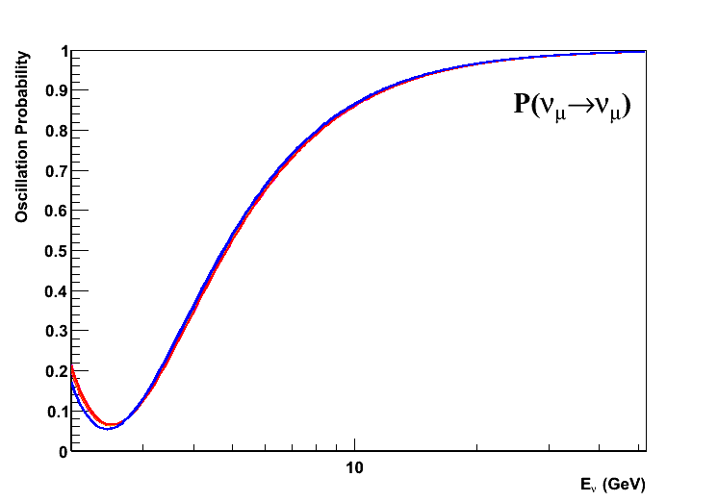
P(ν_{µ}→ν _{µ})
GLOBES
cosθ = 0.1
Baseline = 1274 km
Inclination = 5.7˚
NH
IH

Slide 6
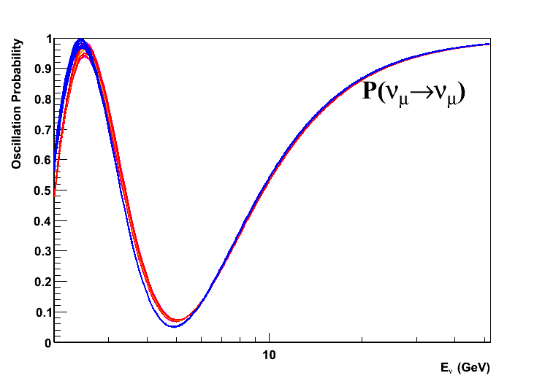
P(ν_{µ}→ν _{µ})
GLOBES
cosθ = 0.2
Baseline = 2548 km
Inclination = 11.5˚
NH
IH

Slide 7
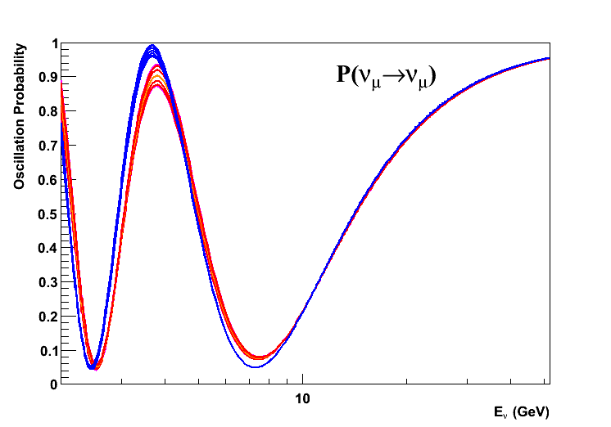
P(ν_{µ}→ν _{µ})
GLOBES
cosθ = 0.3
Baseline = 3823 km
Inclination = 17.4˚
NH
IH

Slide 8
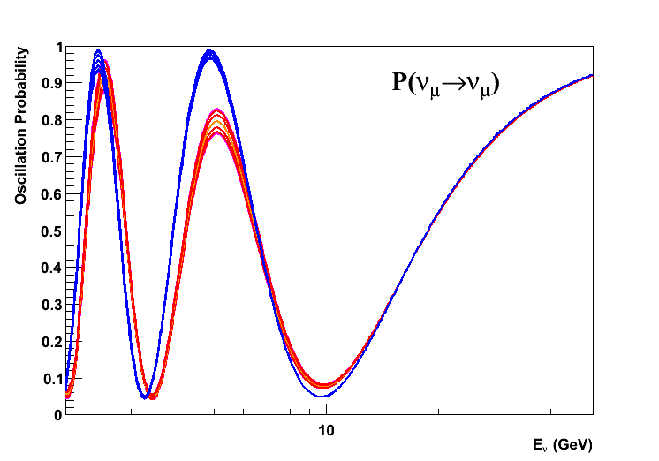
P(ν_{µ}→ν _{µ})
GLOBES
cosθ = 0.4
Baseline = 5097 km
Inclination = 23.6˚
NH
IH

Slide 9
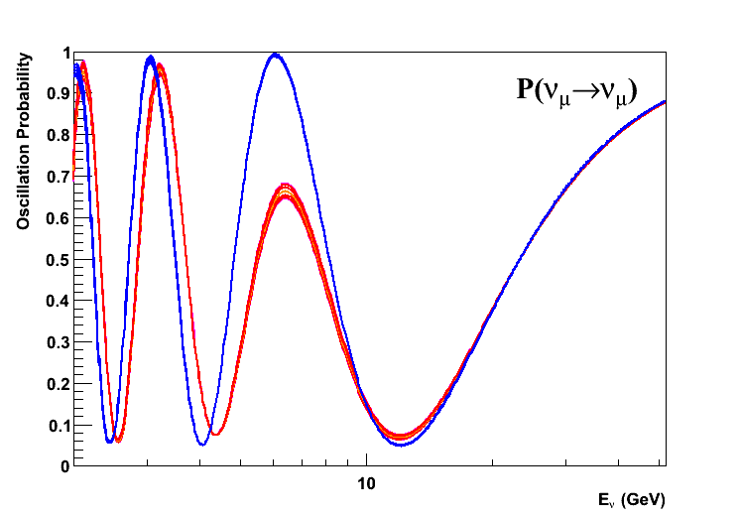
P(ν_{µ}→ν _{µ})
GLOBES
cosθ = 0.5
Baseline = 6371 km
Inclination = 30.0˚
NH
IH

Slide 10
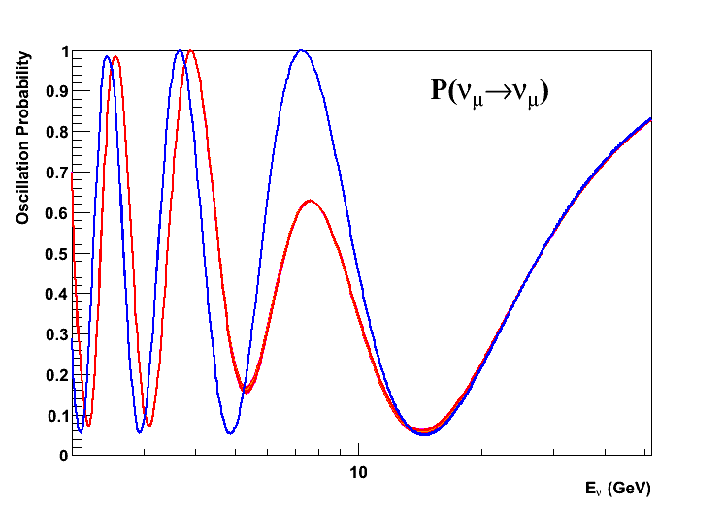
P(ν_{µ}→ν _{µ})
GLOBES
cosθ = 0.6
Baseline = 7645 km
Inclination = 36.9˚
NH
IH

Slide 11
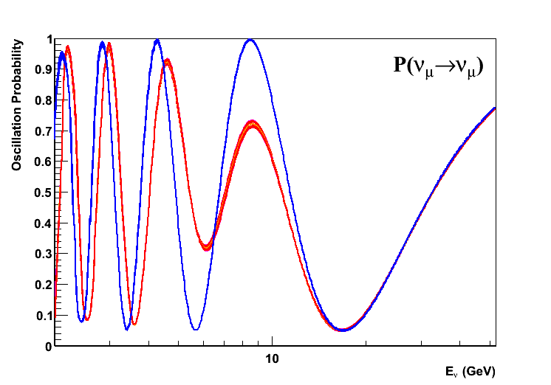
P(ν_{µ}→ν _{µ})
GLOBES
cosθ = 0.7
Baseline = 8919 km
Inclination = 44.4˚
NH
IH

Slide 12
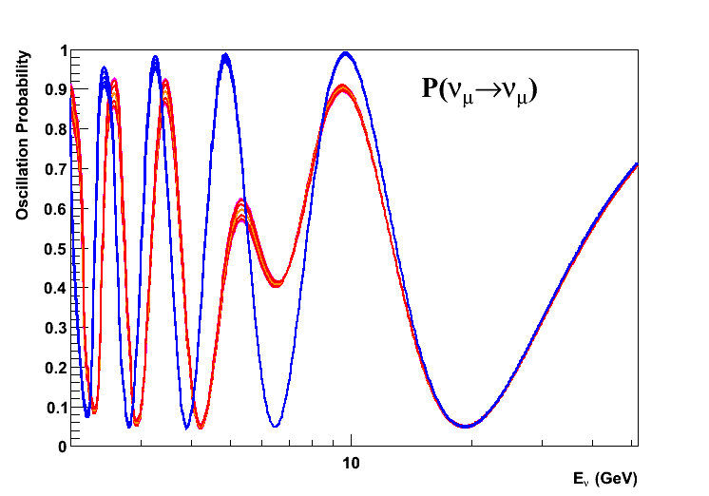
P(ν_{µ}→ν _{µ})
GLOBES
cosθ = 0.8
Baseline = 10194 km
Inclination = 53.1˚
NH
IH

Slide 13
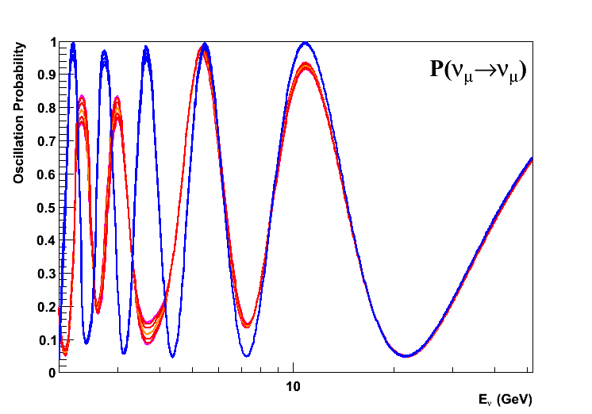
P(ν_{µ}→ν _{µ})
GLOBES
Beam to IceCube
cosθ = 0.9
Baseline = 11468 km
Inclination = 64.2˚
NH
IH

Slide 14
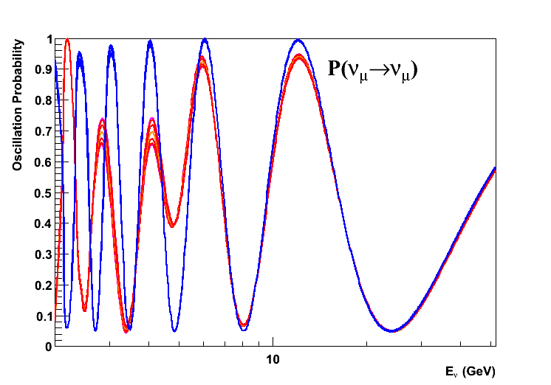
P(ν_{µ}→ν _{µ})
GLOBES
cosθ = 1.0
Baseline = 12742 km
Inclination = 90.0˚
NH
IH

Slide 15
Counting Muons from Beam Neutrinos
Optimal Beamline : 7000-8000 km
Favoured Option:
FermiLab – KM3Net site in Mediterranean Sea
1300 versus 950 events for both mass hierarchy hypotheses in Mton underwater detector (ORCA)
→ Inverse approach : Counting “Electrons”
arXiv:1301.4577

Slide 16
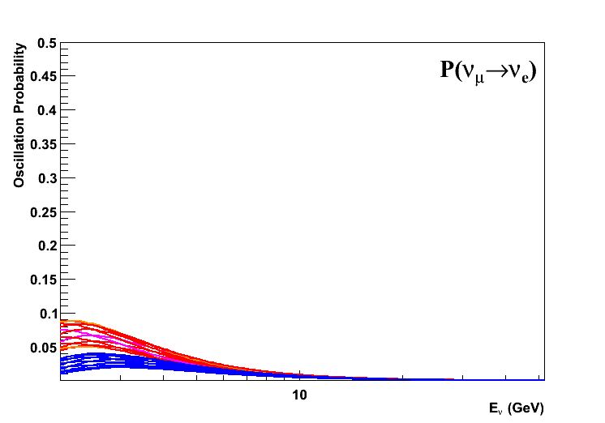
P(ν_{µ}→ν_{e})
GLOBES
(CP-phase varied in steps of 30˚)
cosθ = 0.1
Baseline = 1274 km
Inclination = 5.7˚
NH
IH

Slide 17
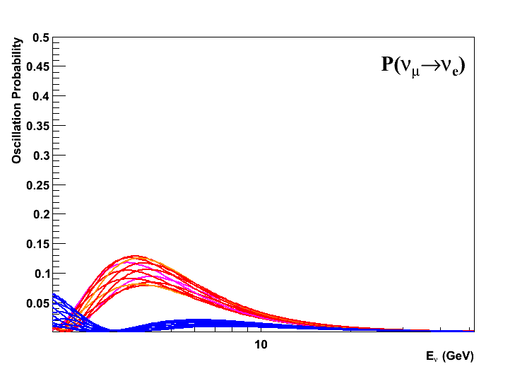
P(ν_{µ}→ν_{e})
GLOBES
cosθ = 0.2
Baseline = 2548 km
Inclination = 11.5˚
NH
IH

Slide 18
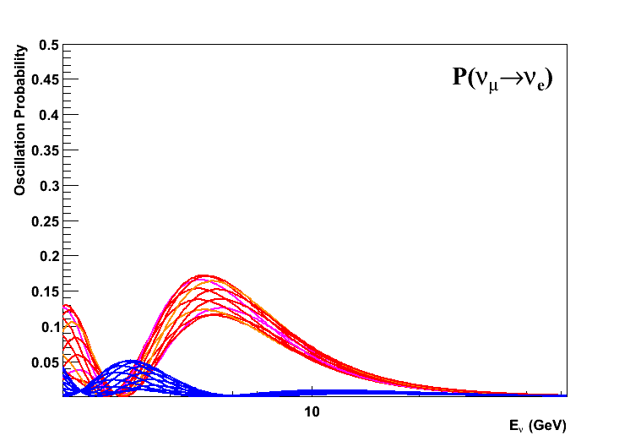
P(ν_{µ}→ν_{e})
GLOBES
cosθ = 0.3
Baseline = 3823 km
Inclination = 17.4˚
NH
IH

Slide 19
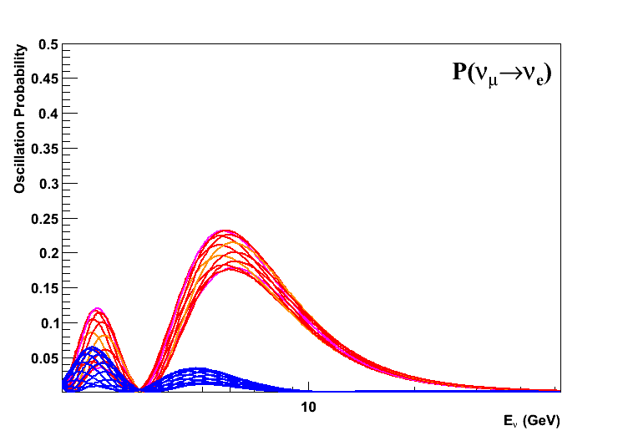
P(ν_{µ}→ν_{e})
GLOBES
cosθ = 0.4
Baseline = 5097 km
Inclination = 23.6˚
NH
IH

Slide 20
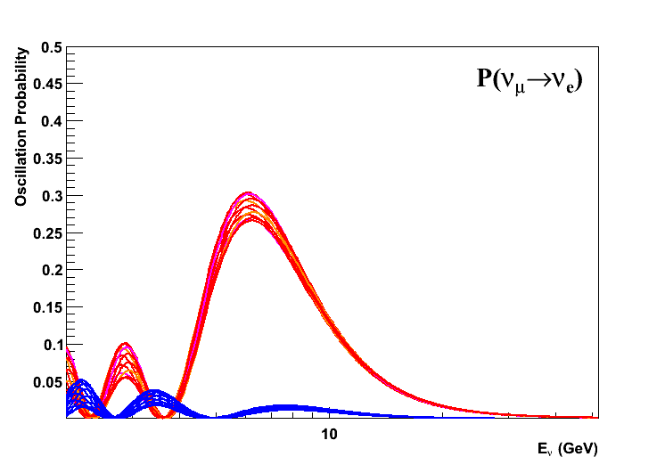
P(ν_{µ}→ν_{e})
GLOBES
cosθ = 0.5
Baseline = 6371 km
Inclination = 30.0˚
NH
IH

Slide 21
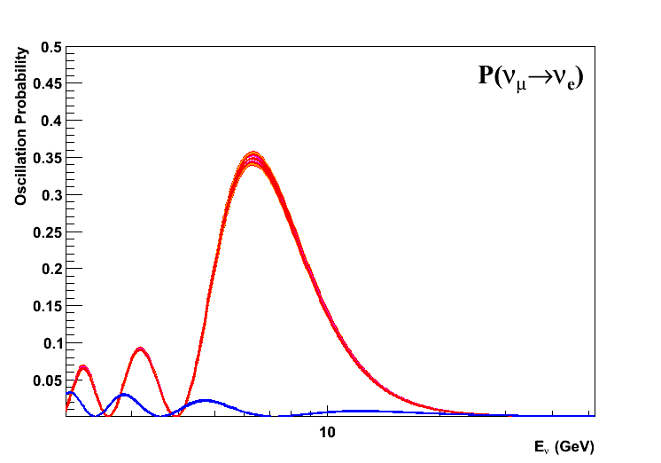
P(ν_{µ}→ν_{e})
GLOBES
cosθ = 0.6
Baseline = 7645 km
Inclination = 36.9˚
NH
IH

Slide 22
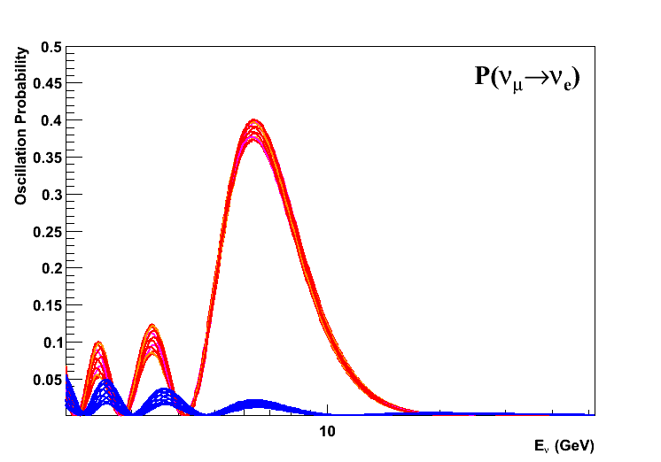
P(ν_{µ}→ν_{e})
GLOBES
cosθ = 0.7
Baseline = 8919 km
Inclination = 44.4˚
NH
IH

Slide 23
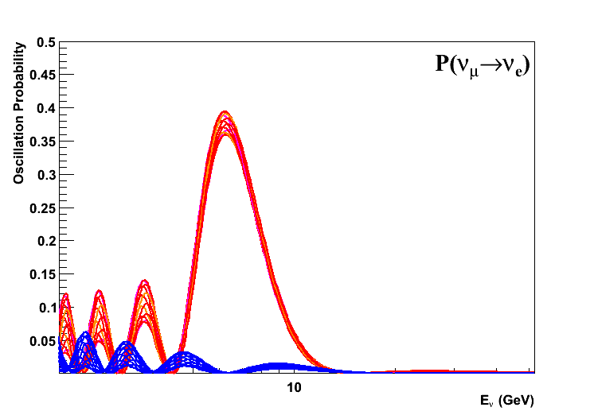
P(ν_{µ}→ν_{e})
GLOBES
cosθ = 0.8
Baseline = 10194 km
Inclination = 53.1˚
NH
IH

Slide 24
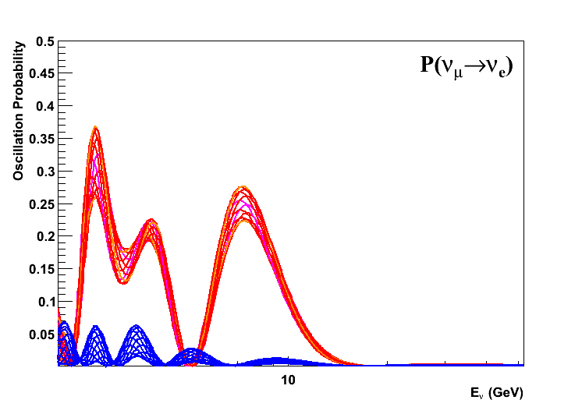
P(ν_{µ}→ν_{e})
GLOBES
Beam to IceCube
cosθ = 0.9
Baseline = 11468 km
Inclination = 64.2˚
NH
IH

Slide 25
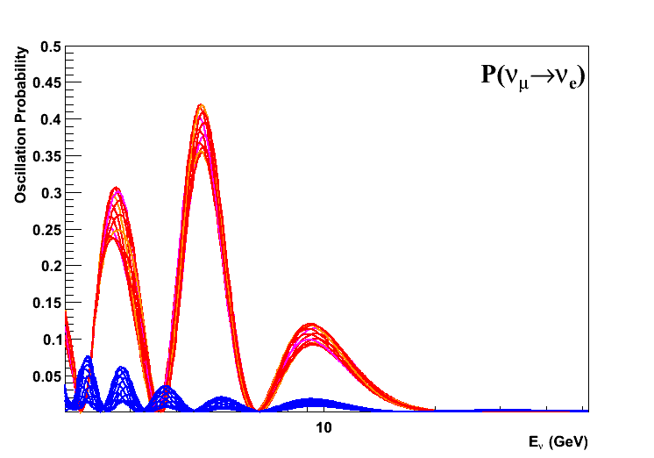
P(ν_{µ}→ν_{e})
GLOBES
cosθ = 1.0
Baseline = 12742 km
Inclination = 90.0˚
NH
IH

Slide 26
Optimal Baseline ?
For L>2000km the oscillation probabilities are always well separated for both MH hypotheses
To find optimal baseline calculate event rates
N ~ 1/L²
N ~ E (cross section)
Fixed beam profile
ORCA detector response
NH
IH

Slide 27
Optimal Baseline
L=2600km maximizes the difference in event rates between two MH hypotheses
Event rate difference
NH - IH

Slide 28
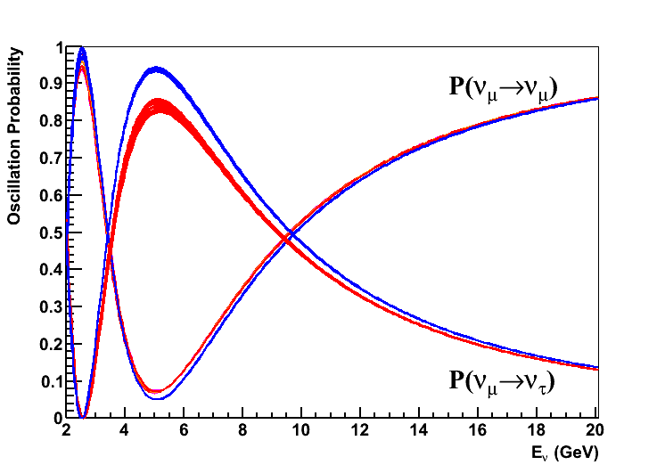
Oscillation Probabilities
All relevant oscillation probabilities taken into account
Full 3-flavour treatment
CP-phase variations included

Slide 29
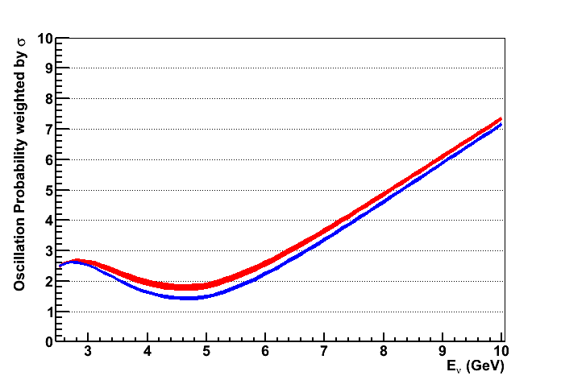
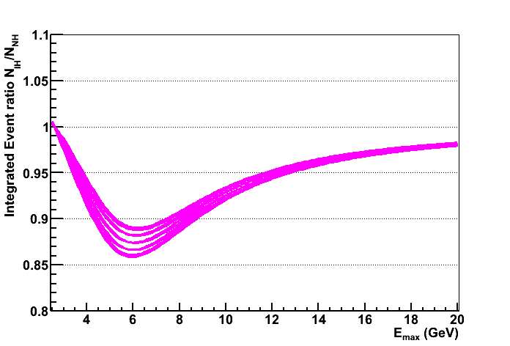
Optimal Energy Range ?
Cross section weighted sum of oscillation probabilities
Allows to find optimal energy range for MH determination
No flavour tagging or CC/NC separation used
Kinematical suppression of ν_{τ} exploited
NH / IH
Ratio of Integrals IH/NH
(2.5 GeV - E_{max})

Slide 30
Optimal Energy Range
“Event counting” , no flavour ID : 2-6 GeV
11-14% suppression of IH w.r.t. NH
Ratio of Integrals IH/NH
(2.5 GeV - E_{max})

Slide 31
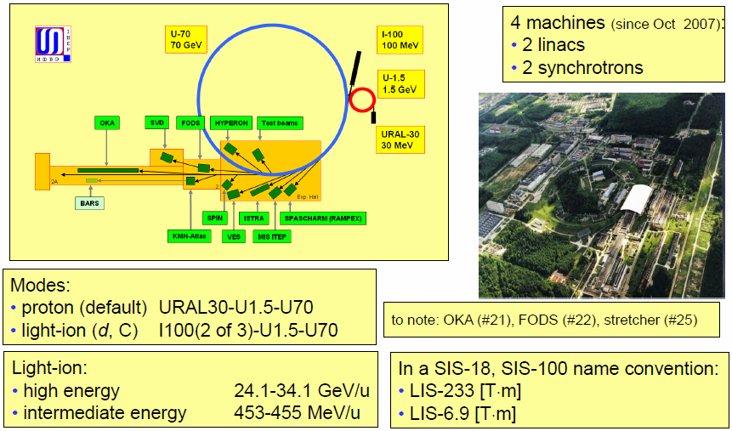
Proton Accelerator Complex Protvino
Presentation S. Ivanov (IHEP) on 22/11/2012 @ CERN → Talk Wednesday

Slide 32
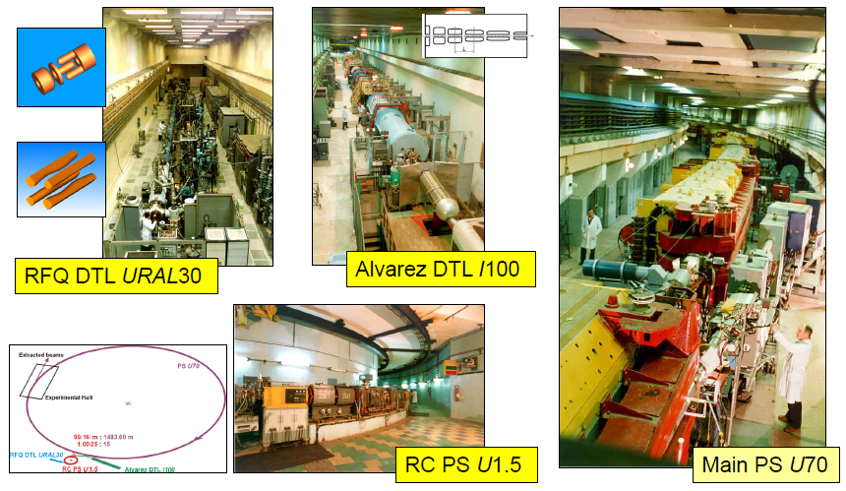
Proton Accelerator Complex Protvino
Presentation S. Ivanov (IHEP) on 22/11/2012 @ CERN

Slide 33
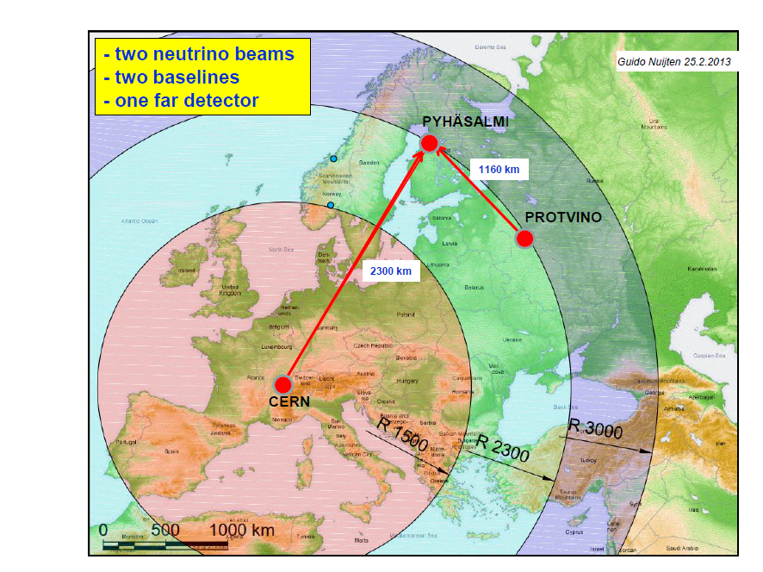

Slide 34
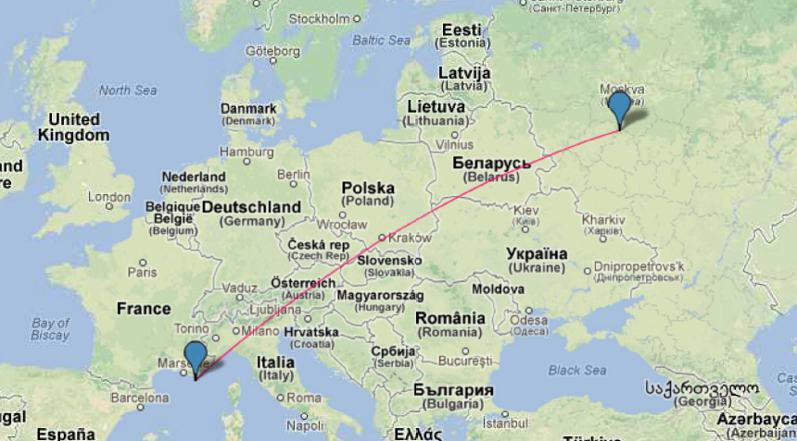
Protvino – ANTARES (ORCA)
Baseline 2588km ; beam inclination : 11.7˚ (cosθ = 0.2)
Deepest point 134km : 3.3 g/cm³

Slide 35
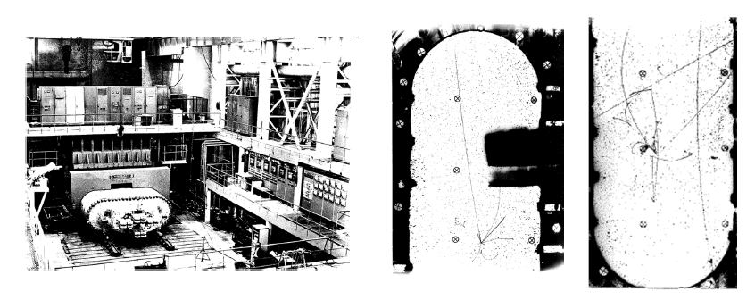
SKAT bubble chamber
Shielding
SKAT
p
target
Decay pipe
55m
focus
140m
270m
245m
Courtesy: R. Nahnhauer

Slide 36
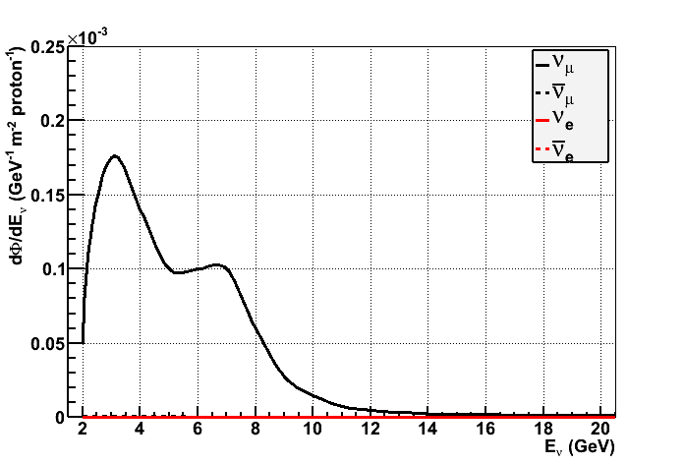
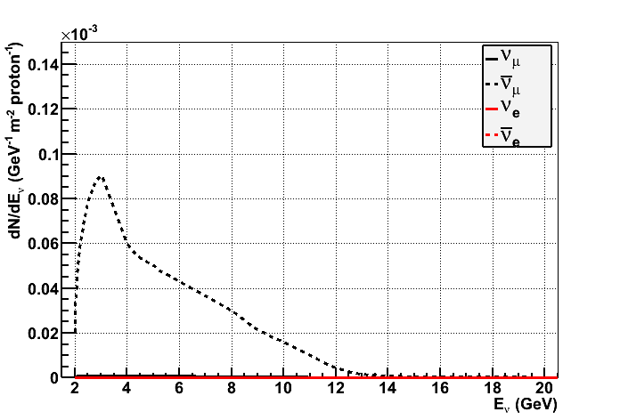
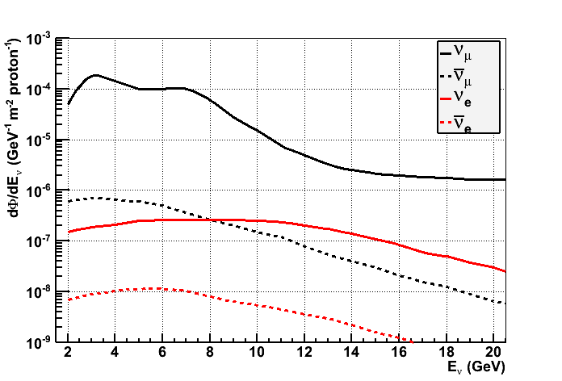
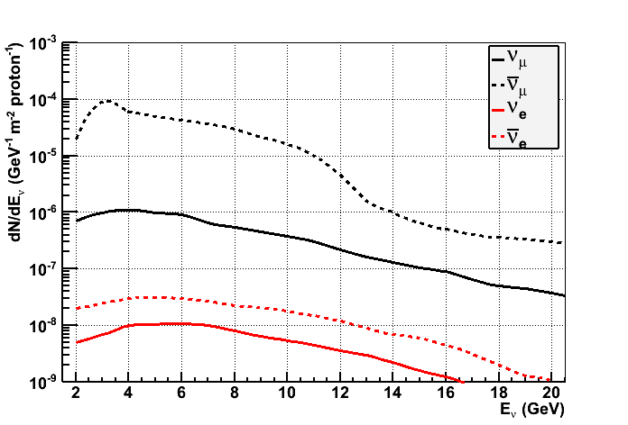
Beam parametrisation (1988)
Neutrino Focus
Anti-Neutrino Focus
Scaling to ANTARES site
(0.245/2600)²
Z. Phys. C 40 (1988) 487

Slide 37
Beam parametrisation (1988)
Very clean ν_{µ} beam
Less than 1% contaminations from other flavours
Most neutrinos between 2-8 GeV
Z. Phys. C 40 (1988) 487

Slide 38
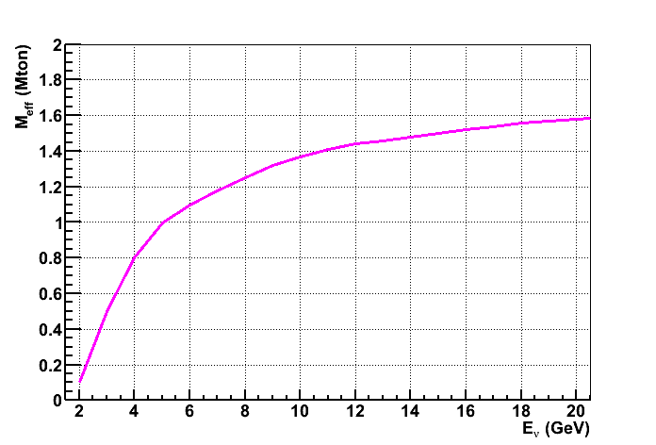
Effective Mass
From ORCA simulations (preliminary)
Same function used for all CC interaction
Same light output for ν_{µ} and ν_{e} → ok
Conservative for ν_{τ} due to escaping neutrinos
NC evaluated at E/2
A. Trovato (LNS)

Slide 39
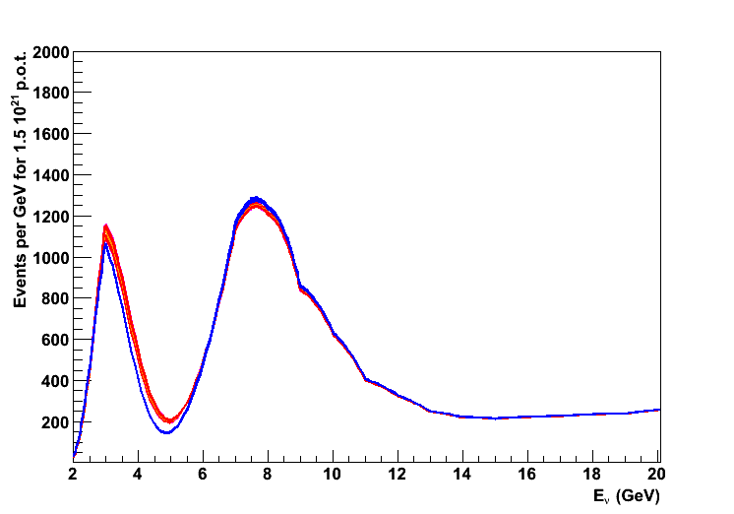
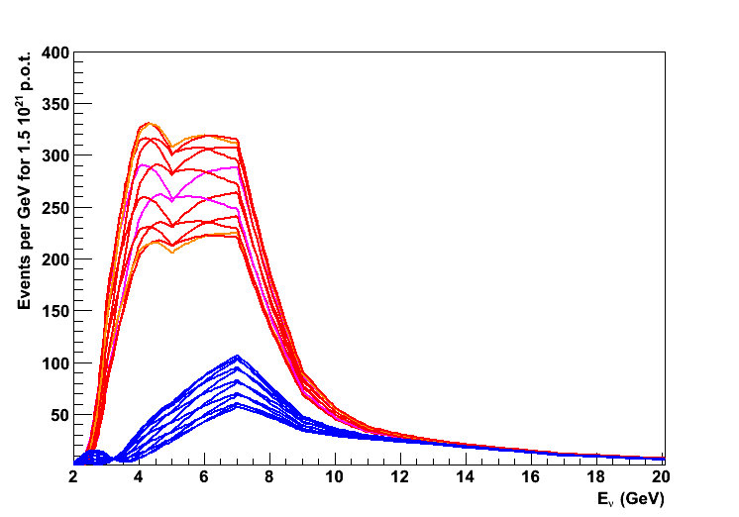
Event rates - Signal
Event numbers for 1.5 10²¹ p.o.t.s
20 σ statistical separation of both Mass Hierarchy hypotheses from signal
10000 muon events for beam normalisation
3.5% separation between MH hypotheses
Other contributions: ν_{τ}: 1316 +/- 13 ; 1416 +/- 8 ; NC : 4732
NH 10927 +/- 24
NH 1621 +/- 255
IH 10548 +/- 43
ν_{e} CC
ν_{µ} CC
IH 497 +/- 100

Slide 40
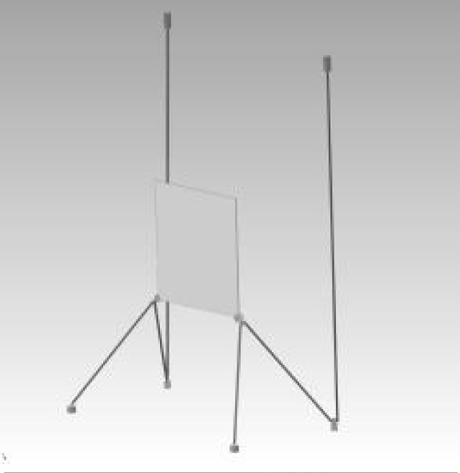
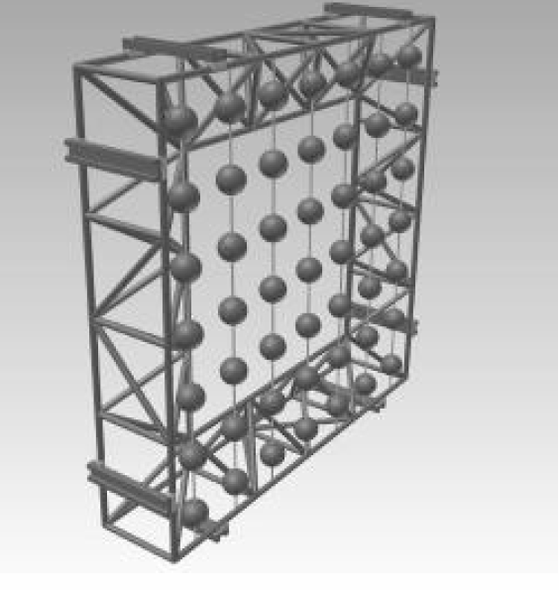
Flavour identification
Need to separate “tracks” from “cascades”
2004 @ Villars : C2GT project (F. Dydak)
CERN to Gulf of Taranto

Slide 41
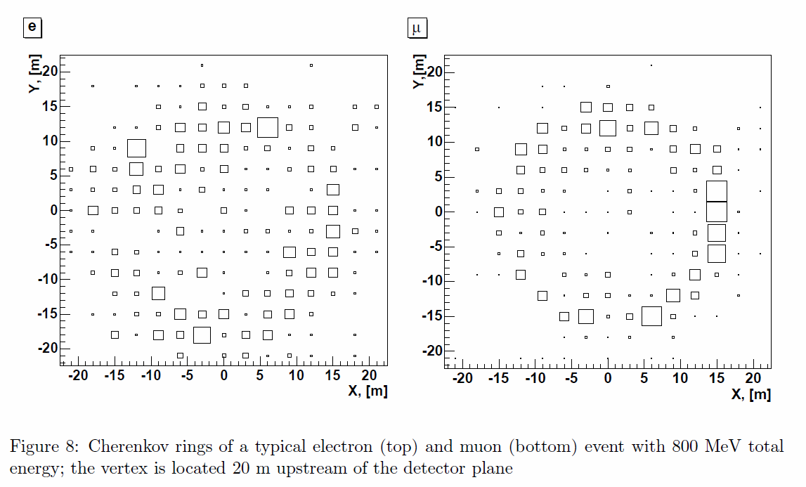
Flavour identification
2004 @ Villars : C2GT project (F. Dydak)
Clean separation of ν_{µ} CC and ν_{e} CC at 0.8 GeV
OM spacing 3m

Slide 42
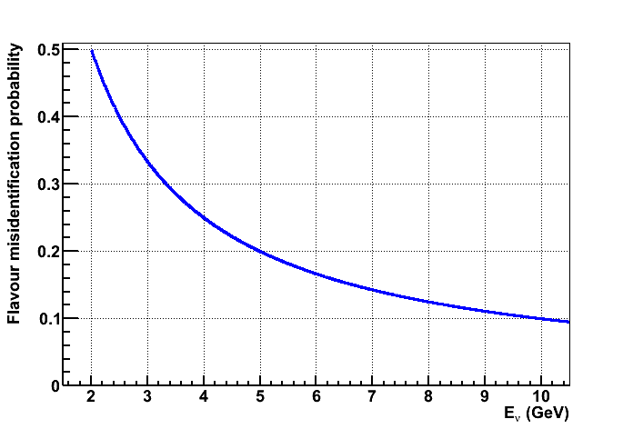
Flavour identification
Misidentification probability :
assume same for both directions
50% at 2 GeV → random ; 20% at 5 GeV ; 10% at GeV

Slide 43
V. Ludwig (ECAP)

Slide 44
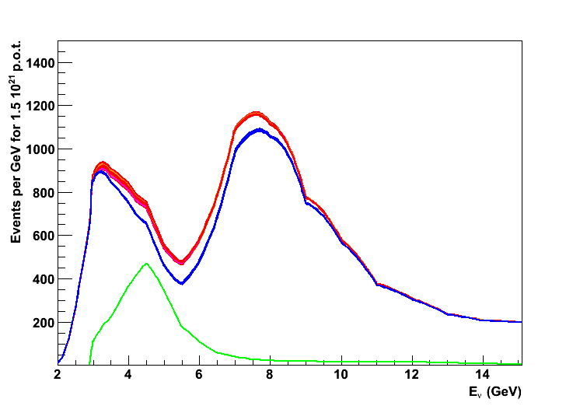
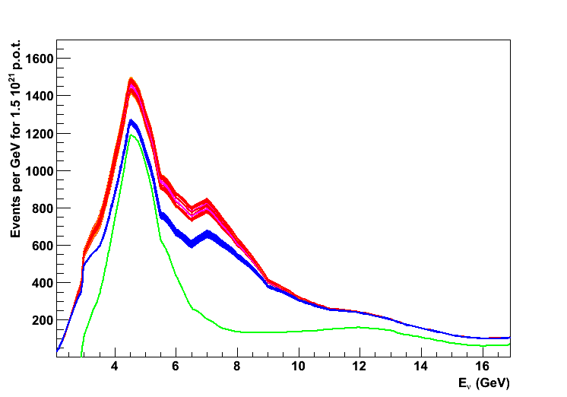
Event rates – All Flavours & Mis-ID
Event numbers for 1.5 10²¹ pots
9-18% difference for NH/IH
7 σ statistical separation of MH hypotheses
Can allow for 3-4 % syst. uncertainty
No requirement of energy reconstruction
tracks
cascades
NH 10690 +/- 45
NH 7300 +/- 200
IH 10244 +/- 15
IH 6420 +/- 80

Slide 45
Systematic Uncertainties
Detector Response
Water parameters
Extensively studied in ANTARES
Neutrino flux
Can be monitored with muon events
Neutrino Cross Section
Ongoing and planned short baseline Experiments
Oscillation parameters
ORCA with atmospheric neutrinos

Slide 46
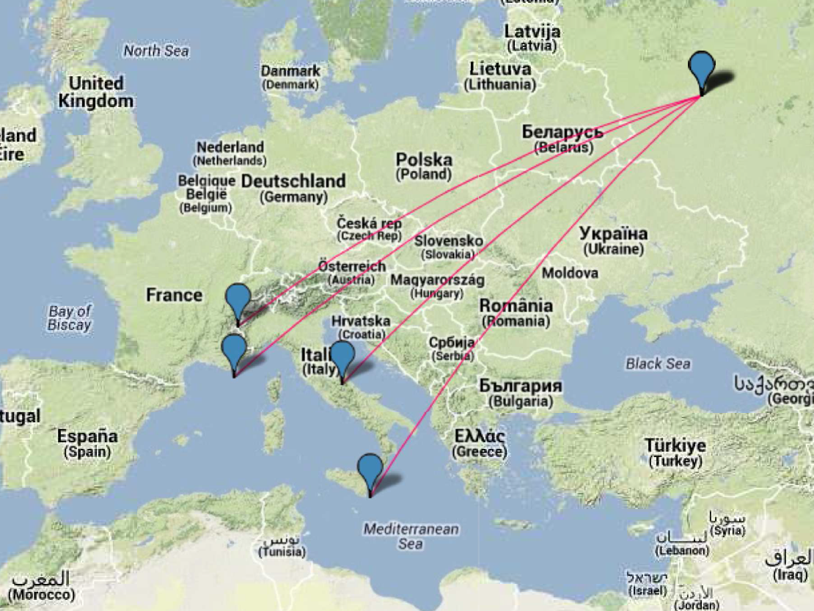
Synergies between potential Sites
Protvino
4.1˚
11.0˚
Modane
2393km
13.6˚
Antares
2588km
Gran Sasso
2189km
Nemo
2574km

Slide 47
Conclusion
Upgraded proton accelerator at Protvino well suited for LBL towards Mediterranean Sea
Needed : 10²¹ p.o.t. within few years
Preliminary Performance Figures of ORCA encouraging
Synergy with Underground Labs in the same beam
Complementary to measurement with atmospheric ν
Complementary between ORCA / PINGU
→High Significance determination of Mass Hierarchy

Slide 48
Common plots for ORCA & PINGU?
Oscillations probabilities and Neutrino fluxes
Number of events per year for each MH in bins of [E_{ν} (true), θ_{ν}(true)], for each flavor
Can be done at several stages (trigger, rec, selection)
Make sure all combinations are included (e.g ν_{e}→ν_{μ})
Detector resolutions
Median (+1σ;-1σ) Erec vs E_{ν} (true)
Correlation matrices (root format?)
E_{ν} (rec) vs E_{ν} (true) [1-30 GeV]
θ(rec) vs θ_{ν}(true)
Effective mass vs E_{ν} (true) for ν_{μ} and anti-ν_{μ}
Sensitivity vs exposure (Mt.year)
Specify ingredients (resolutions, eff mass, NC inclusion, flavor misID)

Slide 49
Backup

Slide 50
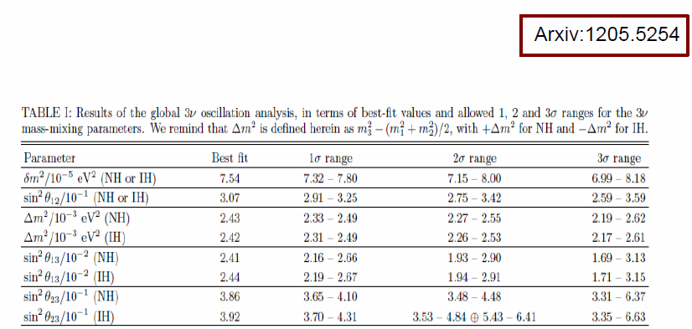
Oscillation parameters
Taken from Global Fit (Fogli et al.) for both hierarchy options
CP phase left free

Slide 51
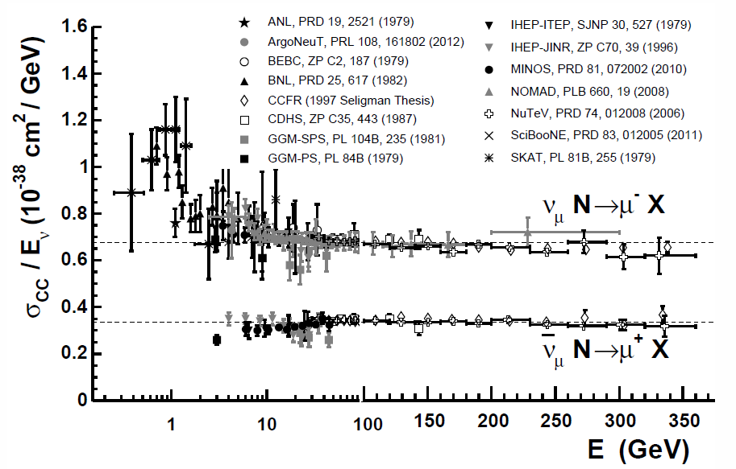
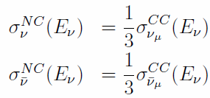
Neutrino Cross sections
Simple parton scaling assumed (QE, Res. ignored)
Flavour universality
m_{τ} threshold
NC approximation

Slide 52
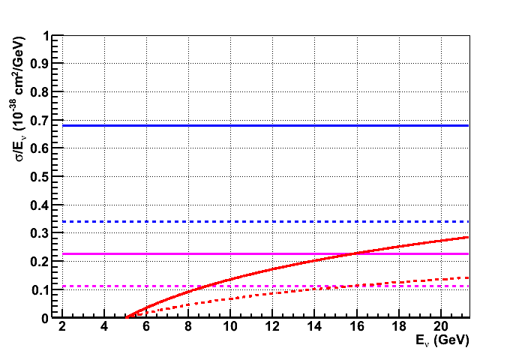
Neutrino Cross sections
Simple parton scaling assumed (QE, Res. ignored)
Flavour universality
m_{τ} threshold
NC approximation
NC, CC: ν_{e} ν_{µ} ν_{τ}
Solid : neutrino , dashed : antineutrino

Slide 53
Event rates
Here : no flavour misidentification
CC Rates
NC Rates

Slide 54
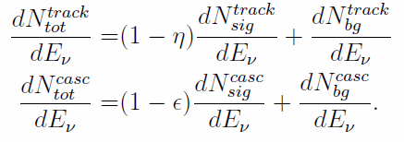
Event rates
Include Background and Flavour tagging
Total Background :
Total Event Rate :

