Slide 1

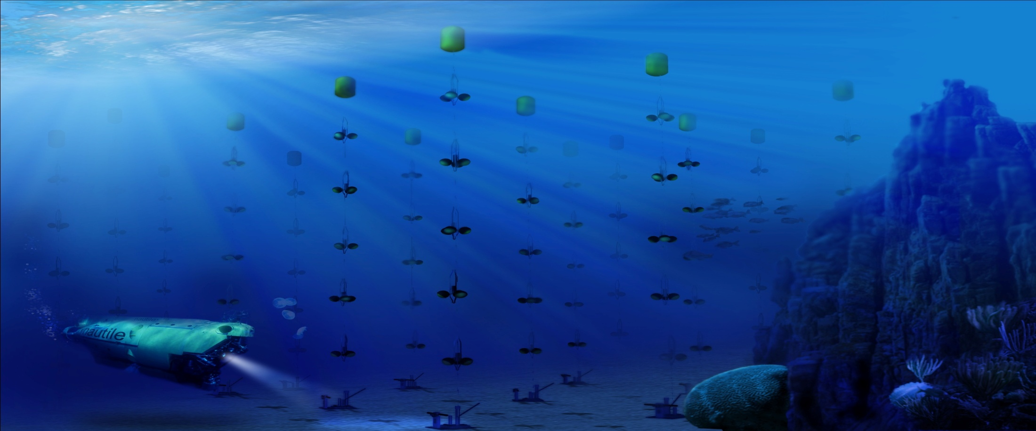
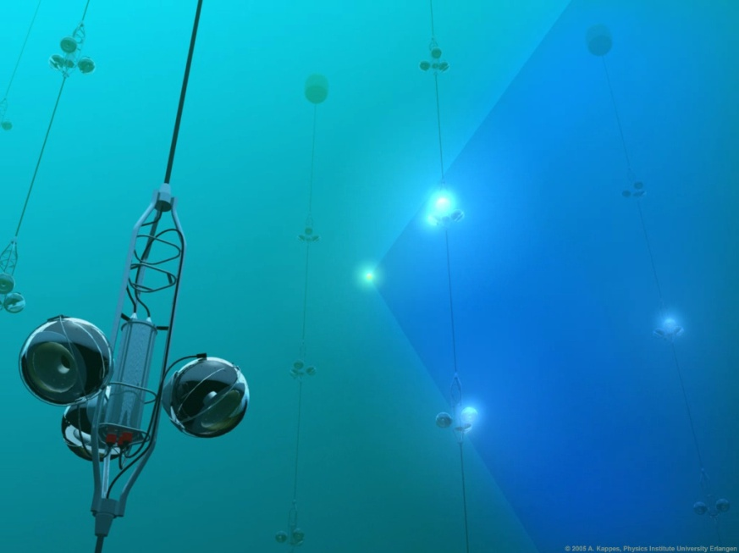
ANTARES Highlights
J.J. Hernandez-Rey
IFIC (CSIC-UV)
MANTS Meeting, 14-15 October 2013, Garching Germany

Slide 2
Highlighted topics
Point sources
+ 2 special extended sources
+ 2-pt correlation function
Fermi Bubbles,
Diffuse flux limits
GRBs
Flaring sources
Dark Matter (Sun)

Slide 3
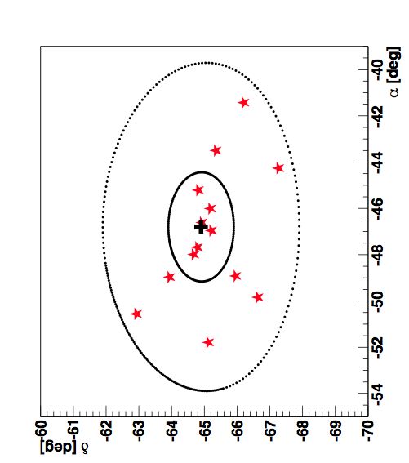
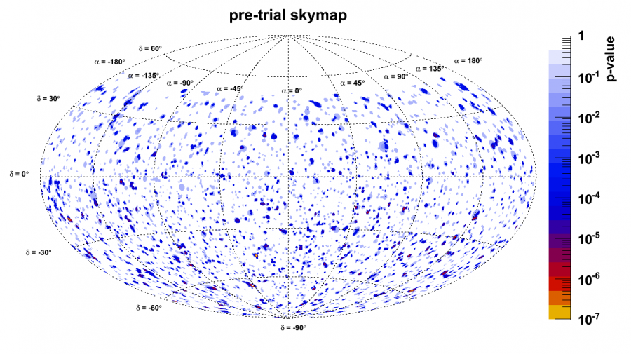
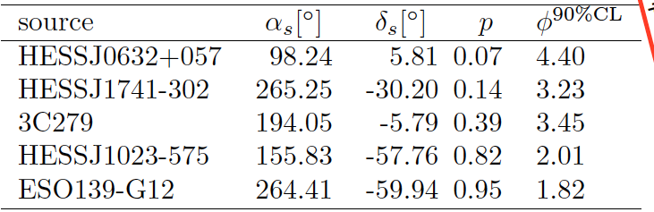
Point sources
3
PRELIMINARY
Updated search 2007-2012 (1340 days)
5516 neutrino candidates (90 % of which being better reconstructed than 1⁰)
Same most significant cluster with 6 additional events: p-value = 2.1% (2.3 σ)
Compatible with background hypothesis
Fixed search
5 most significant:
PRELIMINARY
Equatorial coordinates
Limits on normalization factor
(E/GeV)⁻² 10⁻⁸ GeV⁻¹ cm⁻² s⁻¹

Slide 4
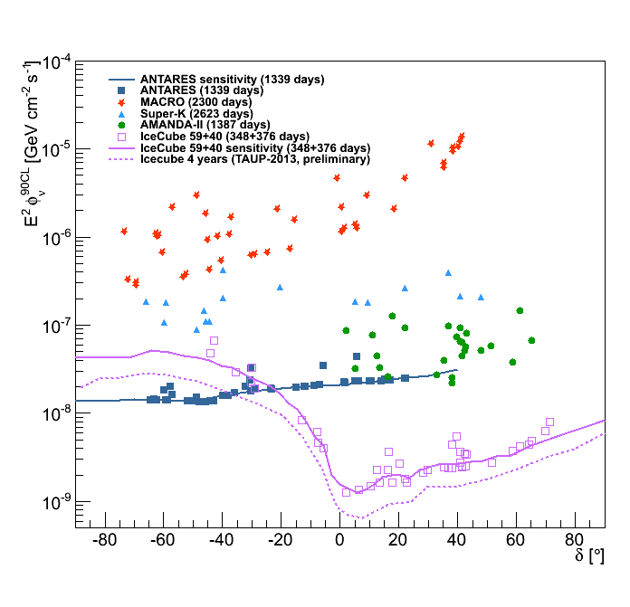
Point Sources
New limits 40 % better than previous result (ApJ. 760 (2012) 53)

Slide 5
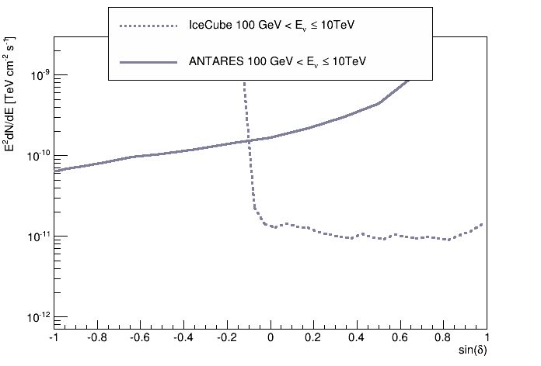
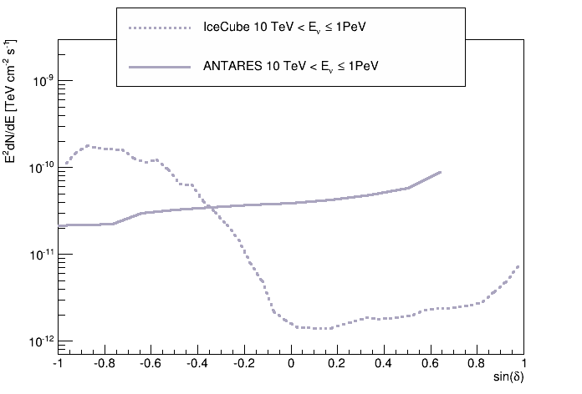
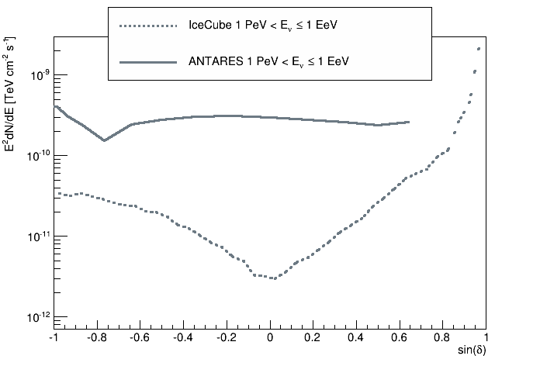
PS limits in different energy ranges

Slide 6
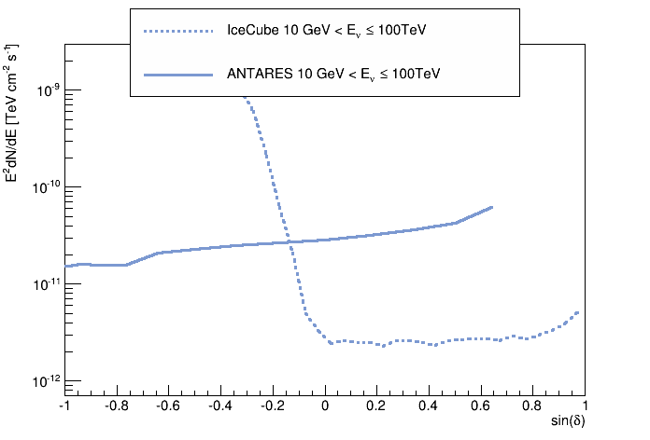
PS sensitivity by energy range

Slide 7
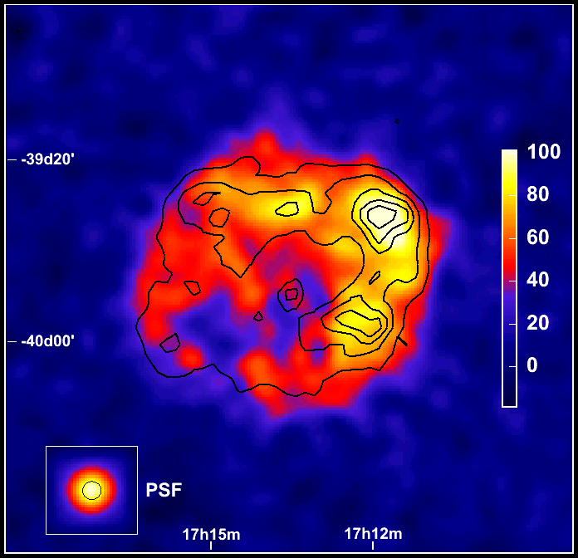
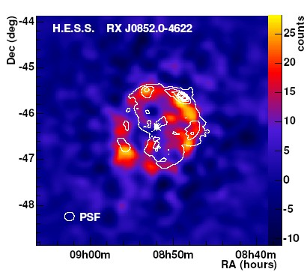
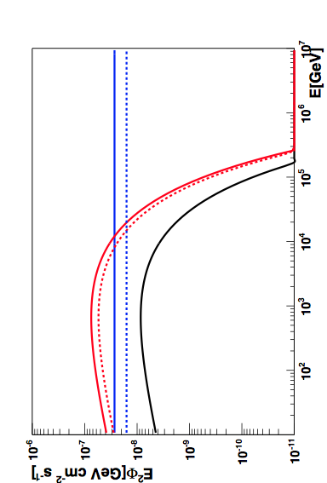
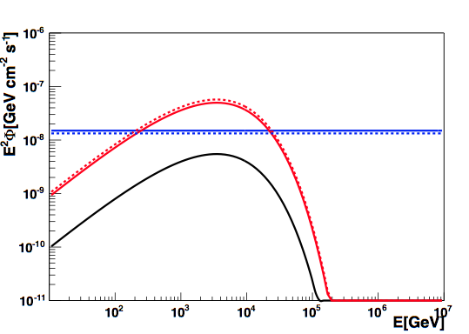
Extended sources
7
Dedicated study for :
RXJ1713 and Vela-X
Energy cut-off and
source extension (HESS)
 Kappes et al. 2007, ApJ, 656, 870
pred. flux
ANTARES preliminary
point limit
2007-2010
ANTARES preliminary
point limit
2007-2012
Morph limit
2007-2010
Morph limit
2007-2012
Events: 7 observed.
8.0 expected
Events: 4 observed.
5.2 expected.
7

Slide 8
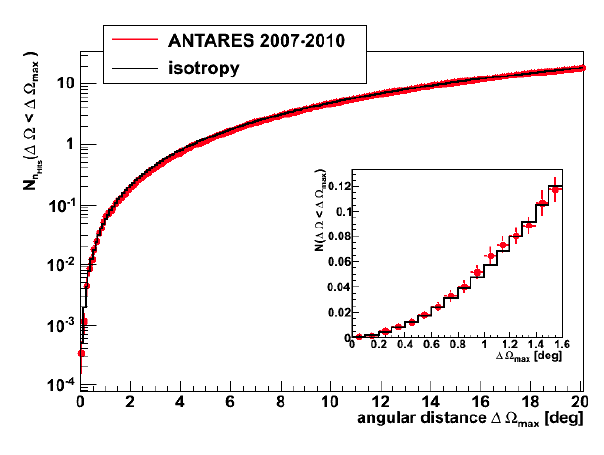

2-pt correlation function
Uses energy proxy (nhits) as weight. Post-trial p-value 9.6% for angles <1.1°

Slide 9
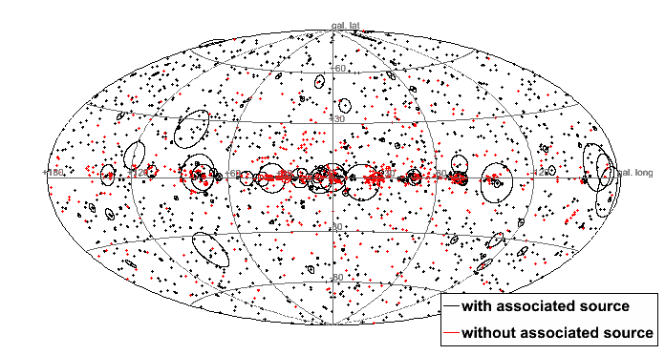
Correlation with Fermi/LAT: 2FGL
1873 sources
ANTARES: nHit weights
2FGL: gamma-ray flux (1-100GeV)
1873 sources
Post-trial p-value 68% for angles < 0.6°

Slide 10
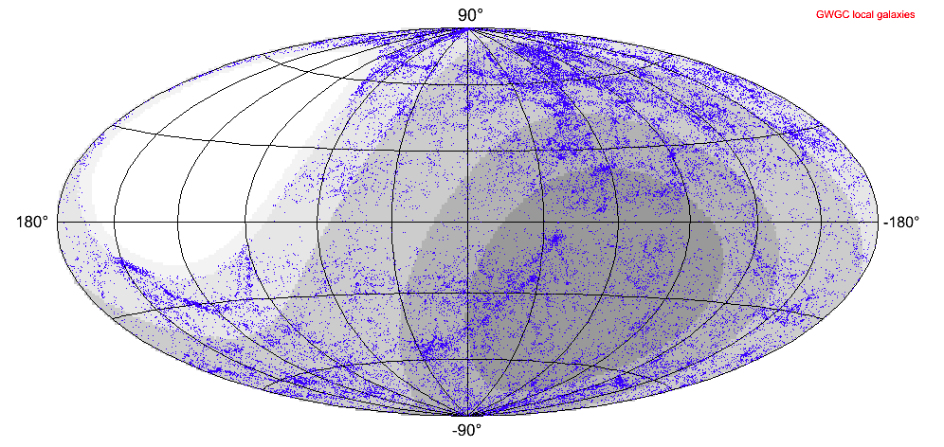
Correlation with galaxies: GWGC
~53.000 entries
Scanning 2pt correlation up to 5°
(pseudo-experiments very time consuming).
Post-trial p-value 96% for angles < 0.3°
ANTARES: nHit weights
GWGC: D⁻² weighting

Slide 11
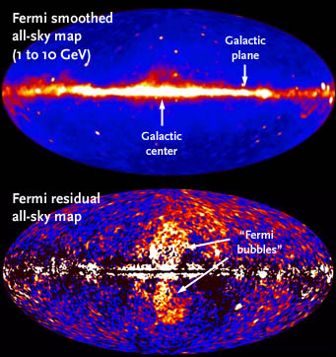
Fermi Bubbles
Excess of γ- (and X-)rays in extended “bubbles” above and below the Galactic Centre.
Homogenous intensity, hard spectrum (E⁻²) probably with cutoff.
  M. Su et al., Ap. J. 724 (2010)
Origin still unclear
promising Galactic wind model involves hadronic processes ( Crocker & Aharonian, PRL 2011): accelerated cosmic rays interacting with ISM → π → γ,ν Φ_{ν} ≈ 0.4 x Φ_{γ}
In the field of view of ANTARES
background estimated from average of
3 non-overlapping “off-zone” data regions
(same size, shape and average detector efficiency)

Slide 12
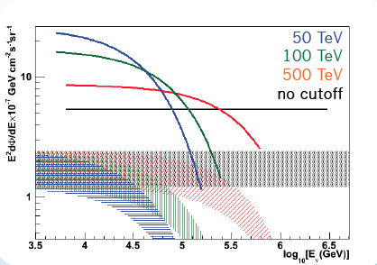
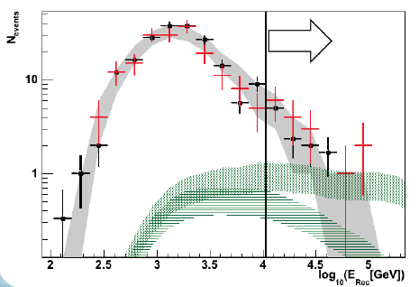
Fermi Bubbles
12
12-line data sample: May 2008 - Dec 2011 (806 days livetime). Only muon neutrinos.
E_{μ} estimation based on Artificial Neural Networks procedure.
Optimization tuned on off-zone background events (MRF).
PRELIMINARY
N_{obs} = 16
<N_{bkg}> = 11
PRELIMINARY
Nevents
E²F x 10⁻⁷ GeV cm⁻² s⁻¹ sr⁻¹
No significant
excess (1.2 σ)
on-zone
off-zone average
expected signal (≠ cutoff, 50TeV cutoff)
Upper limits with respect to different models
65% improvement expected with 2012-2016 data

Slide 13
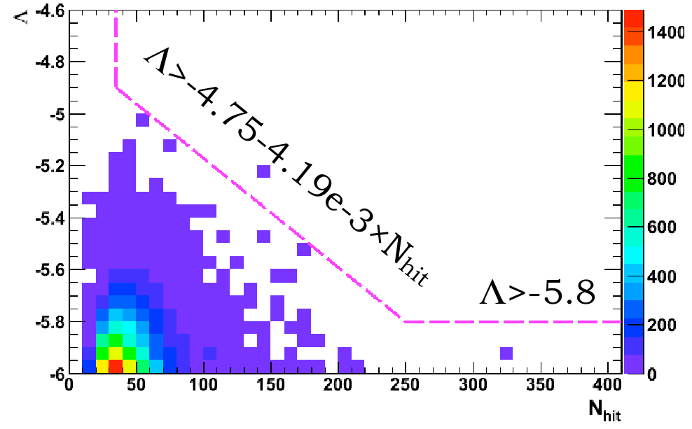
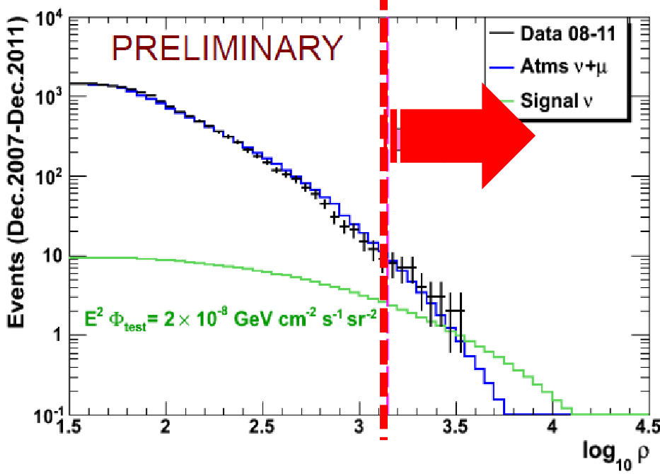
Diffuse flux I (heuristic cuts)
Using track reconstruction parameters for
suppression of atmospheric muon background
Energy estimate by dE/dx algorithm
μ – CC I
live time | 885 d
sensitivity | 4.7 x10⁻⁸ GeV/cm² sr s
upper limit | 4.8 x10⁻⁸ GeV/cm² sr s
validity range | 45 TeV-10 PeV
bkg. expectation | 8.4
events in data | 8

Slide 14
Diffuse flux II - multivariate analysis
hitselections
classifiers
Track
parameters
Energy
estimate
Strong use of track quality parameters
energy reconstruction through ANN
x_{A1}, x_{A2}, ...
x_{B1}, x_{B2}, ...
x_{C1}, x_{C2}, ...
x_{D1}, x_{D2}, ...
#μ_{int}
#ν_{atm}
#ν_{cosm}
x_{A}
x_{B}
x_{C}
x_{D}
μ – CC II
live time | 903 d
sensitivity | 4.2 x10⁻⁸ GeV/cm² sr s
upper limit | 7 x10⁻⁸ GeV/cm² sr s
validity range | 65 TeV-10 PeV
bkg. expectation | 8.3
events in data | 12
MRF
x_{A}
x_{C}
x_{C}
x_{D}
Select
cut variables
2) cut MC set on all
combinations of
defined cut values

Slide 15
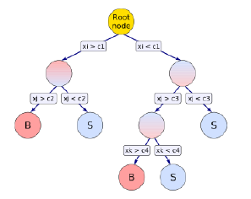

Diffuse flux III – Boosted DT UHE
Designed for UHE, but can be use for WB flux
Uses both reconstruction strategies,
pre-selection cuts applied.
BDT technique
μ – CC III
live time | 933 d
sensitivity | 3.6 x10⁻⁸ GeV/cm² sr s
upper limit | Not yet
validity range | 56 TeV -28 PeV (560 TeV-140 PeV cosmogenic)
bkg. expectation | 0.6
events in data
Boosted Decision Tree.
Multivariate, binary decisions based on the
selected variables

Slide 16
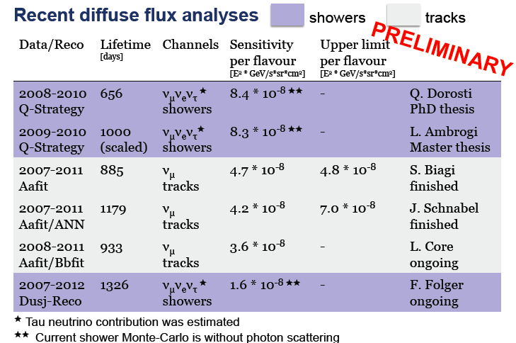
Diffuse flux - Summary
For progress in shower analysis see Florian Folger’s talk later.

Slide 17
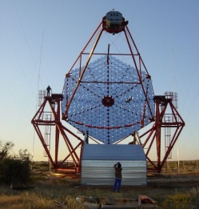
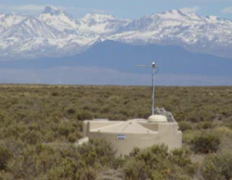
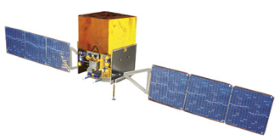
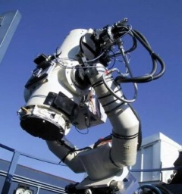
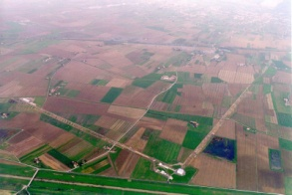
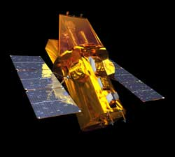
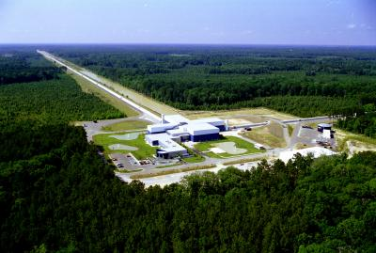
The Multi-messenger Program
17
GeV-TeVγ-rays
Fermi / HESS…
UHECR
Auger
HE neutrinos
Optic / X-ray
TAROT, ROTSE / Swift, ZADKO
Gravitational Waves
Virgo / Ligo
A way to better understand the sources and the related physics mechanisms.
A way to increase the detector sensitivities (uncorrelated backgrounds).

Slide 18
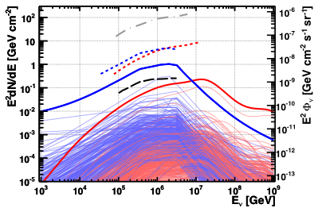
GRB triggered searches
18
Search for neutrino events in coincidence with observed GRB
Analysis of GRBs from late 2007 – 2011:
296 long GRBs,
Total prompt emission: 6.6 hours
Information from FERMI/SWIFT/GCN
GRB simulations of expected neutrino
fluence:
NeuCosmA [Hümmer et al. (2010)]
Guetta [Guetta et al. (2004)]
Quality cut optimized for NeuCosmA
& highest signal discovery probability
No events found within 10° window from GRB
Expected: 0.48 (Guetta), 0.061(NeuCosmA)
Dedicated analysis for GRB130427
PRELIMINARY
Grey: first ANTARES limit (40 GRBs, 2007)
 JCAP 03(2013) 006
Black: IceCube IC40+59 (215 GRBs)
arXiv1307.0304 (to appear in A&A)
Notes:
Long GRBs associated to SN type 1 b/c
NeuCosmA = full numerical treatment of the neutrino flux. Relies on SOPHIA, acounts for energy loss of secondaries, oscillations.
The high energy component is due to Kaons (ignored in Guetta)
Guetta is analytical → Delta resonance → doubly broken power law for numus (3 if anti-numus are added)→ fluxes as predicted by Guetta et al are excluded by IceCube
On peut noter que le GRB 110918 represente la moitié de la somme totale.
Data analysis : seulement les muons à moins de 10°
Method : extended likelihood ratio used to define a test statistics . S = PSF pour le flux en question. B = cte over narrow time and angular window, from data (from long term mean background rate measuements)+ 50% safety factor (conservative agains fluctuations).
Optimization pour une decouverte à 3 sigma (vu le faible taux d’evt attendu), sauf pour GRB110918 (5 sigma). L’optimisation est faite pour chaque GRB individuels (donc un jeu de lambda, beta, S,B associé)
La limite est un facteur 38 au dessus de la prédiction.
NOTE : GRB 130427

Slide 19
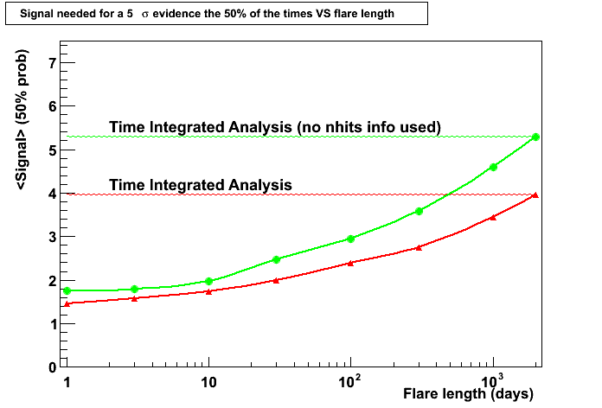
Flaring sources
19
Improved search with 40 blazars
2008-2011 data (750 days )
86 flaring periods 2FGL+Fermi Flare Advocates
Allow a lag of ± 5 days for the flares
4 energy spectra considered
(E⁻¹, E⁻², E⁻¹ and cutoff 1TeV, E⁻¹ and cutoff 10 TeV).
MDP optimization on Lambda quality cut only.
Improved likelihood with energy proxy (Nhits)
Separate optimization for 6 most significant flares
Lowest p-value (10%) for 3C279
δ=-40º
Notes:
Blazars : radio-loud AGN with jets pointing towards us
Flares : several times the intensity of quiescent state (5 sigma above quiescent state)
Light curve : 1 bin = 1 dat +Time flare +/- 0.5 days → 1 flare is at least 2 days
LAT on board of FERMI
Data: : excludes high biolum
Data is seen as 2 component :: signal + bkg
Signal and Bakg PDF are described by the product of 3 components:
Signal: time (lightcurve), space (PSF) and energy (Nhit distrib)
Bkg : meme direction, temps, energy for all muon data
Test stat : likelihood ratio (Ps+bkg /Pbkg) to be maximized
Discovery potential = Number of signal events needed to achieve a p-value <5 sigma in 50% of the trials

Slide 20
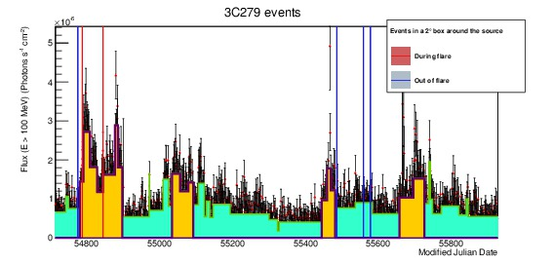
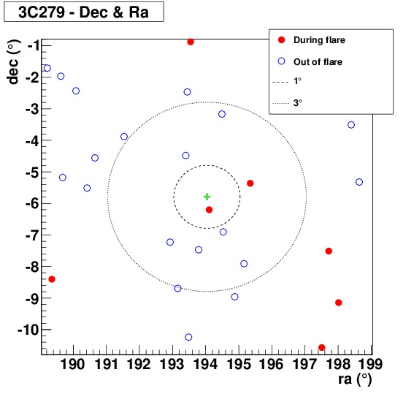
Events from 3C279
3C 279 (279 flaring days)
2 events compatible
in time and direction
54789 MJD
at 0.5° with high energy
(89 hits, Λ=-4.5)
54845 MJD
at 1.1° lower energy
(52 hits, Λ=-5.45)

Slide 21
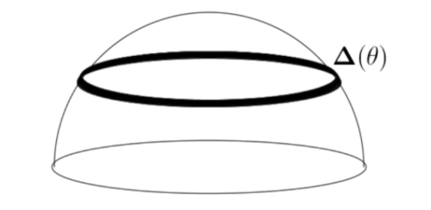
Dark matter search
Year | Lines | Days
2007 | 5 | 192
2008 | 9-12 | 180
2009 | 8-12 | 210
2010 | 9-12 | 240
2011 | 12 | 275
2012 | 12 | 224
From the Sun using 2007-2012 data
  4.5 times more statistics (1321 days).
  Events reconstructed on a single line are also used: azimuth angle missing, but “almucantar restriction” good enough to reject background. Sizeable increase of events at low energy.
  Theoretical models: adaptative full simulation within the CMSSM and MSSM-7 (including Higgs information plus XENON-100 limits).
Sun visibility
~ 50%

Slide 22
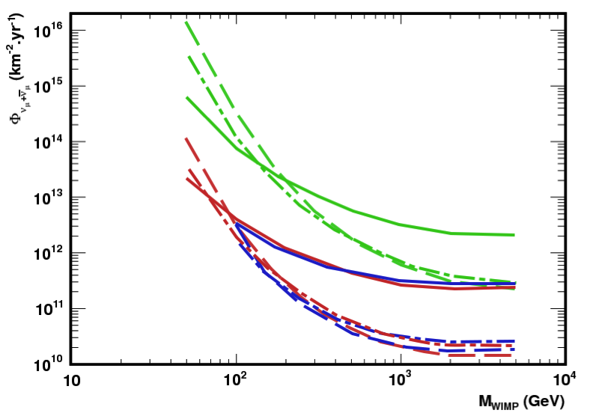
Flux sensitivities (2007-2012)
Factor ~4
AAFit Multi-line
+
BBFIt Multi-line
+
BBFit Single-line
Factor ~6
bb
W+W-
τ+τ-
Factor ~1.5

Slide 23
Unblinded - BBFIT Multiline (differential)
tchi2 < 1.4

Slide 24
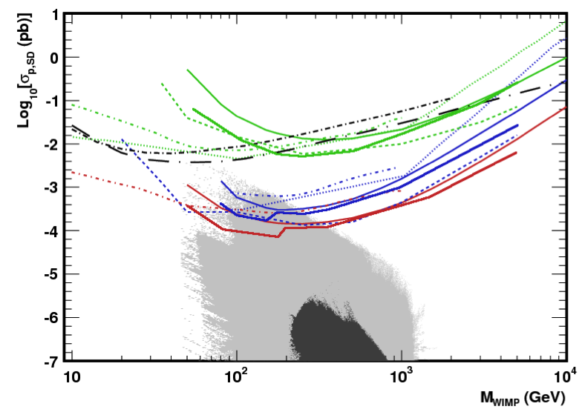
Spin-dependent cross-section limits & MSSM-7
IceCube-79
(dashed)
ANTARES 2007-2008 (upper solid lines)
Baksan
1978-2009
bb
SuperK
1996-2008
COUPP 2010-2011
Baksan
1978-2009
ANTARES 2007-2012
(lower solid lines)
W⁺W⁻
τ⁺τ⁻
MSSM-7
CMSSM

Slide 25
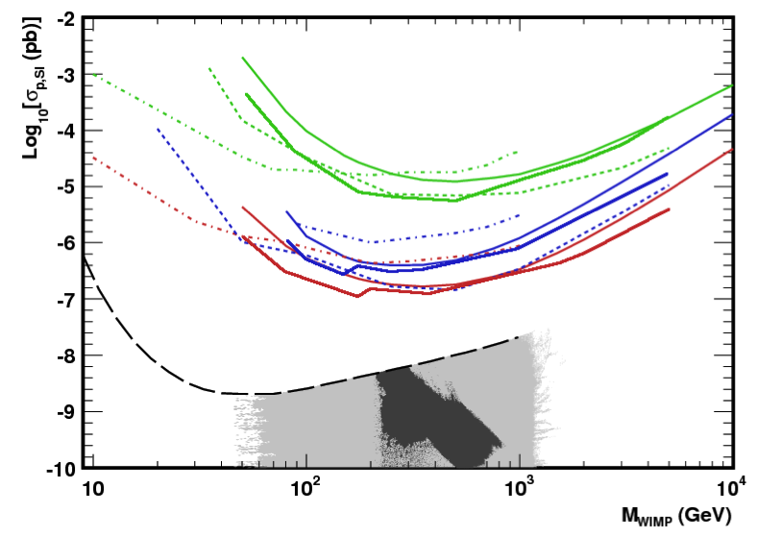
Spin-independent cross-section limits & MSSM-7
IceCube-79
ANTARES 2007-2008
bb
W+W-
τ+τ-
ANTARES 2007-2012
XENON-100
MSSM-7
CMSSM

Slide 26

Conclusions

Slide 27
BACKUP

