Slide 1
What do the spectral breaks in CR spectrum tell us?
One Century Later
Triumph of the High Resolution Measurements
Serap Tilav
Bartol Research Institute
University of Delaware

Slide 2
When looked in detail the CR spectrum is not a boring simple power law
Direct Measurements
Satellite, Balloon
Indirect Measurements
Air Shower Experiments

Slide 3
Proton Break
240 GeV
He Break
2 X 240
= 480 GeV
Fe Break
26 X 240
= 6240 GeV
PAMELA /ATIC/ CREAM II
reveal
rigidity dependent
spectral breaks
and
remarkable hardening
after the breaks
Air Shower Experiments
?
Perfect demonstration
of Peters cycle:
When protons accelerated
to E^{p}_{max} a nucleus with Ze will be accelerated up to
E^{z}_{max} = Ze x R = Z x E^{p}_{max}
where magnetic rigidity
R = Pc/Ze

Slide 4
Spectral Indices of the hard component

Slide 5
All Particle Spectrum
from Air Shower Experiments
selection based on variety of techniques:
    cherenkov
    fluorescence
    scintillators
    muon counters
Gaisser’s cross-calibrated spectrum:
5-20% energy shift to align
features in the spectrum
arXiv:1303.3565 [astro-ph.HE] 14 Mar 2013
Gaisser , Stanev ,Tilav

Slide 6
The mean logarithmic mass <lnA> from Air Shower Experiments
IC40/IT40, Tunka-133, Auger are published by the experiments
Kascade/HiRes/TA do not provide <lnA>
Use derived data by Kampert and Unger analysis
K. H. Kampert and M. Unger, Astropart. Phys., 2012, 35(10): 660

Slide 7
Fit the combined spectrum
with Gaisser’s formulation
of Peters cycle
elements
Amplitude
spectral index
Z dependent cutoff energy

Slide 8
Amplitudes and indexes of all elements are defined by the CreamII data. Only the cutoffs need to be fit.
Fe spectrum is the key to the whole puzzle.
The Cream Fe data, when extended with the same index up to an energy where it makes 100% of the all particle spectrum, defines the maximum cut off energy for Fe.
This point turns out to be 26*400 TeV = 10.4 PeV.
This means proton cuts off at 400 TeV
Amplitudes, integral indexes, cutoff energies
Proton: 7800, 1.66, 400 TeV
He : 2800, 1.58, 2x400 TeV
C : 110, 1.4, 6x400TeV
0 : 140, 1.4, 8x400 TeV
Fe : 25, 1.2, 26x400 TeV

Slide 9
However
<lnA> data tells us
the knee is not 100% Fe.
Since the amplitudes are locked
by the Cream data,
the only way to fit <lnA> is
to bring the cutoff energy down
and fill the rest with light elements
of a new Peters cycle
(a new population of particles)

Slide 10
== Method ==
Make a template for Population 2
similar to Population 1
Scan for cutoff energy by sliding the
template until best agreement with
lnA is reached.
The cutoff energies defined by the proton
under the first iron (according to lnA)
and the second iron not to overproduce
the spectrum around 100 PeV.
Initially the indices are same as Pop1.
Next, the amplitudes are adjusted by
fitting Pop1+Pop2
Pop1 cutoff energy comes down from
400 TeV to 120 TeV,
and Pop2 indices are adjusted, amplitudes
are fitted again.

Slide 11
Population 1 alone
after Population 2 injected
in order to accommodate Pop2
overlapping with Pop1,
the cutoff energy of Pop1
comes down to 120 TeV after the fits.
Note: there is yet another population
before Pop1. When data below the breaks
are fitted with another population
Pop1 fit parameters change slightly.
The biggest change is the spectral indexes
for Proton and He
and 90 TeV < E¹_{cutoff} < 150 TeV
Population 2 alone
Pop2 cutoff at 4 PeV gives the overall
best fit. (Fe cuts off at 26*4= 104 PeV)
Note:
When Pop0 is fitted this cutoff changes
along with the Pop1 cutoff.
3.5 PeV < E²_{cutoff} < 4.5 PeV

Slide 12
Proceed with the same method to inject another Peters cycle as Population 3
The best fit is achieved with only Proton and Iron making up the spectrum, other elements are reduced to negligible amounts.
However, a gap is left between Pop2 and Pop3 and lnA is not described well.
It was necessary to include the ultraheavy element groups as inspired by the lowE CR measurements
without ultraheavy nuclei
with ultraheavy nuclei

Slide 13
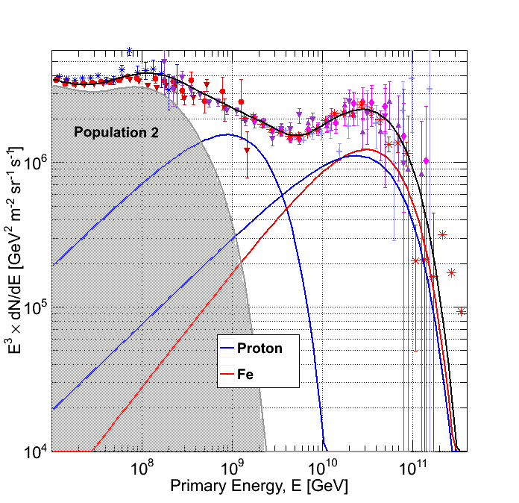
There has to be another proton under the iron bump to bring <lnA> down
This extra proton has a much harder spectrum with E^{-2.2} and cuts off around 22 EeV
➔ extra-galactic proton cutting off due to GZK?

Slide 14
Pop3 for TA/HiRes
Pop4 Proton makes up most of the bump.
Pop3 for Auger
Pop3 Fe + Pop4 Proton make up the bump.

Slide 15
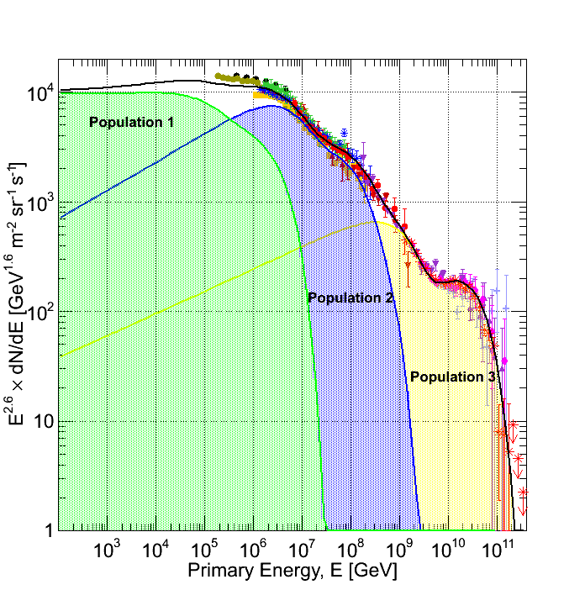
At least 3 Populations of Peters Cycle are needed to explain the spectrum and <lnA>
from ~ 200 GeV up to 200 EeV
Population 1: The classical supernova cutting around 100 TeV
Population 2: “Galactic PeVatron” to produce the IceCube neutrinos
Population 3: Another powerful source superposed with extra-galactic protons cutting by GZK
Spectral index of 2.7 is the superposition of much harder indexes of elements

