Slide 1
The Galactic Center and The Fornax Galaxy Cluster
An Indirect Detection Source Comparison Case Study
IPA 2013
May 13, 2013
Sheldon Campbell
Center for Cosmology and AstroParticle Physics
The Ohio State University

Slide 2
Outline
Motivate indirect detection from the galactic center and nearby galaxy clusters.
Constrain the dark matter distribution.
kinematical data
cluster X-ray emission
Compare the strength of annihilation signals.
The Fornax Cluster
The Galactic Center
Consequences for indirect detection experiments, IceCube in particular.

Slide 3
Indirect Detection of Dark Matter
Annihilating cosmic dark matter detectable astrophysical radiation
Intensity $I=P\left(E\right)⋅J\left(\hat{n}\right)$ $P\left(E\right)=\frac{σv}{8πm^{2}} \frac{dN}{dE}(E)$ $J\left(\hat{n}\right)=\int_{line of sight}^{ }{ρ^{2} dℓ}$
Brightest regions are those that are a combination of close, and dense over considerable volume.
particle properties
J-factor: astrophysical
distribution

Slide 4
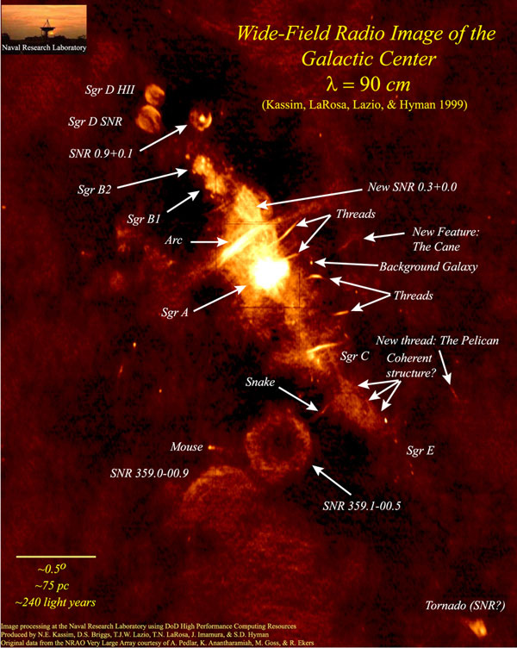
Where is Dark Matter Annihilation Brightest?
Galactic Center is a very well-motivated candidate!
Relatively nearby.
Expected to be very dark matter dense (based on simulations).
Observational evidence for a cored halo profile?
If so, nearby substructure-rich galaxy clusters might be as bright.

Slide 5
The Milky Way Dark Matter Halo
Our halo may have a cusp at the core.
as seen in dark-matter-only cosmological simulations.
$$ρ\left(r\right)=\frac{ρ_{s}}{\frac{r}{r_{s}}{\left(1+\frac{r}{r_{s}}\right)}^{2}} \\ ρ\left(r\right)=ρ_{−2 }exp\left[−\frac{2}{α}\left[{\left(\frac{r}{r_{−2}}\right)}^{α}−1\right]\right]$$
Also plausible are cored profiles.
$ρ\left(r\right)=\frac{ρ_{c}}{\left(1+\frac{r}{r_{c}}\right)\left[1+{\left(\frac{r}{r_{c}}\right)}^{2}\right]}$
NFW profile
Einasto profile
Burkert profile

Slide 6
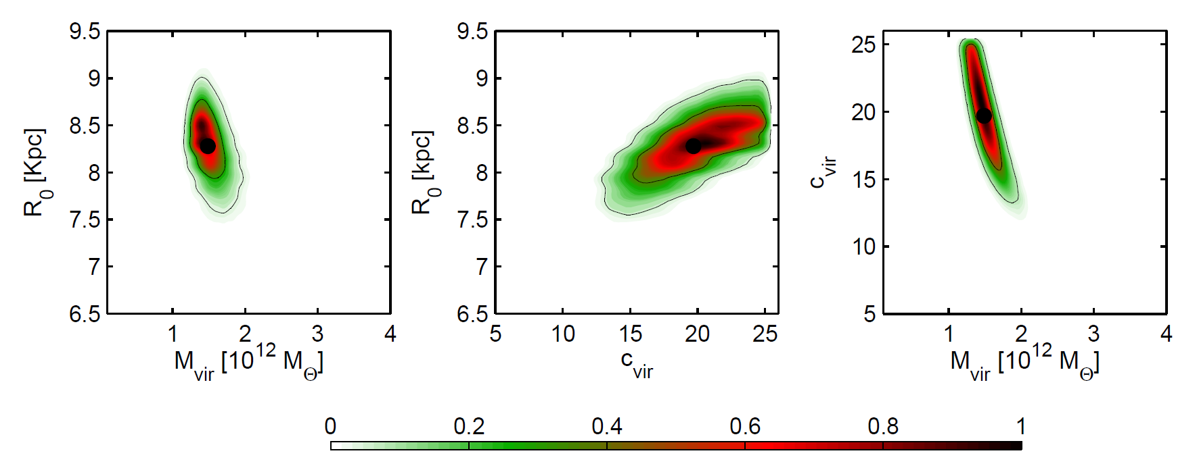
Constraints from Kinematical Galactic Tracers
Catena, Ullio, JCAP 1008 (2010) 004
NFW profile
$$ρ\left(r\right)=\frac{ρ_{s}}{\frac{r}{r_{s}}{\left(1+\frac{r}{r_{s}}\right)}^{2}}$$
Nesti, Salucci, arXiv:1304.5127
The solar system velocity strongly constrains the value of $ρ_{s}r_{s}^{2}$.
The J-factor goes roughly as $ρ_{s}^{2}r_{s}$.

Slide 7
Constraints from Kinematical Galactic Tracers
Einasto profile
$$ρ\left(r\right)=ρ_{−2 }exp\left[−\frac{2}{α}\left[{\left(\frac{r}{r_{−2}}\right)}^{α}−1\right]\right]$$
Also consistent with
current data for a significant range of parameters.

Slide 8
Constraints from Kinematical Galactic Tracers
Burkert profile
$ρ\left(r\right)=\frac{ρ_{c}}{\left(1+\frac{r}{r_{c}}\right)\left[1+{\left(\frac{r}{r_{c}}\right)}^{2}\right]}$
Nesti and Salucci point out that the cored Burkert profile has less tension with data than the cusped profiles.

Slide 9
Galactic Center J-factor Profile
NFW
In the case that our halo profile is cored, it is advantageous to also consider signals from nearby galaxy clusters…
Einasto
Burkert

Slide 10
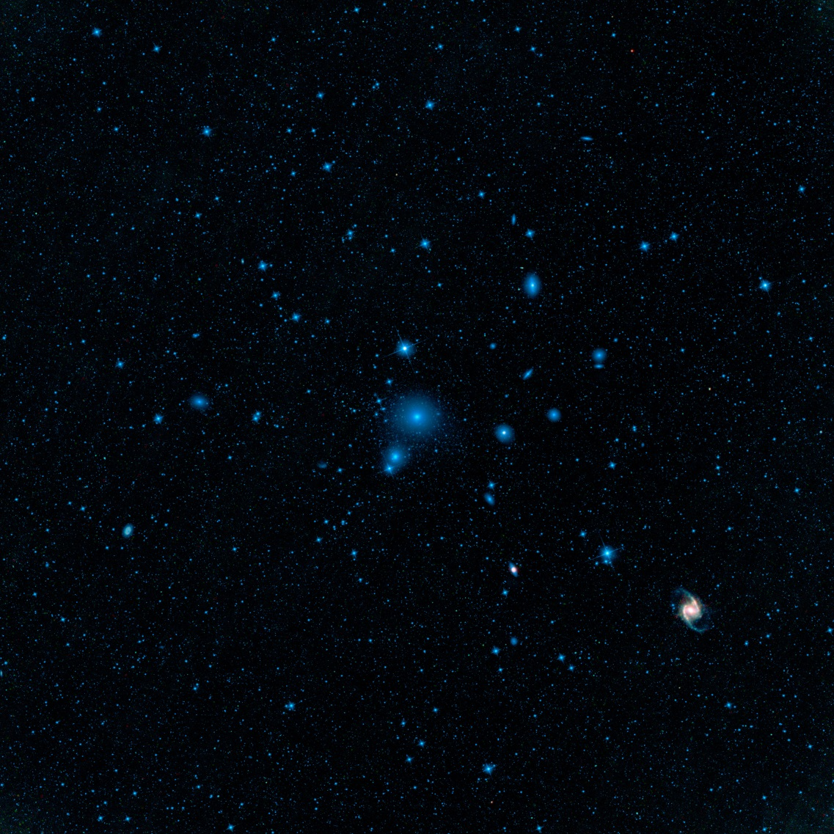
The Fornax Galaxy Cluster
A good target because:
It is BIG.
$6^{ο}$ diameter in the sky.
It is near.
20 Mpc away.
It may have abundant substructure that could make it very bright to us.
WISE Experiment, NASA/JPL-Caltech/UCLA

Slide 11
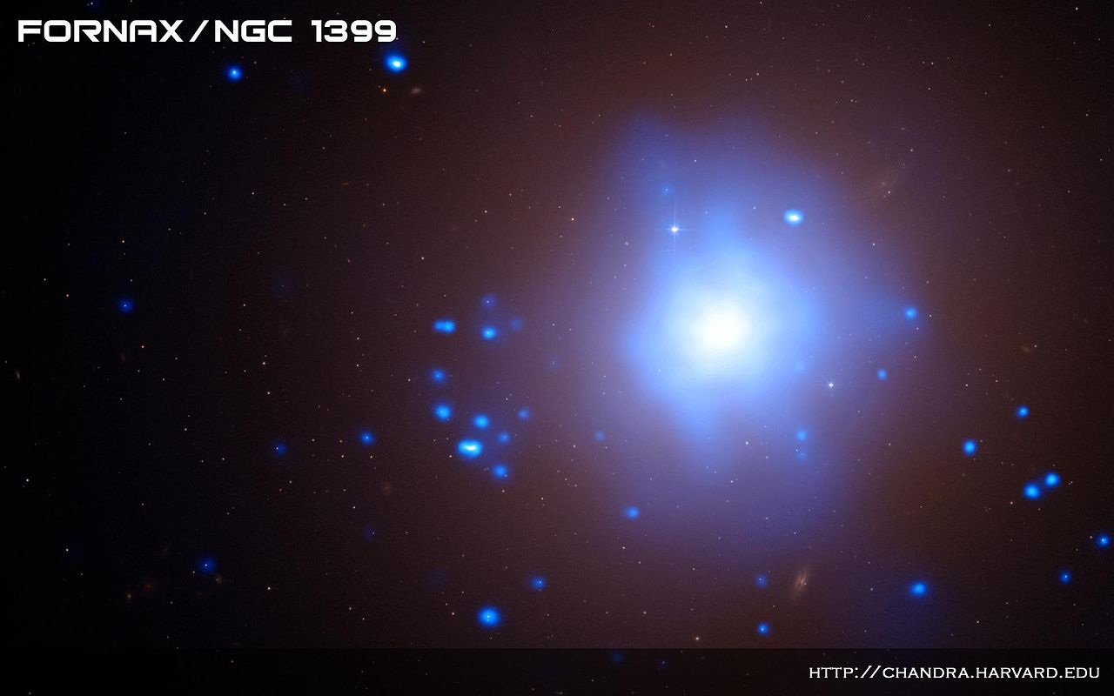
X-ray Cluster Intensity Profiles
Pressure-supported gas at the
cluster center thermally emits X-rays.
If spherical, and in hydrodynamical equilibrium, the total gravitational potential may be reconstructed.
$$I\left(R\right)\sim {\left[1+{\left(\frac{R}{r_{c}}\right)}^{2}\right]}^{−3β+1/2} \\ ρ\left(r\right)\sim \frac{r^{2}+3r_{c}^{2}}{{\left(r^{2}+r_{c}^{2}\right)}^{2}}$$
The X-ray intensity profile is well-described by
the β-model. Reiprich, Bohringer (2007)
This corresponds to a cored dark matter profile.
What would the X-rays look like in an NFW profile?

Slide 12
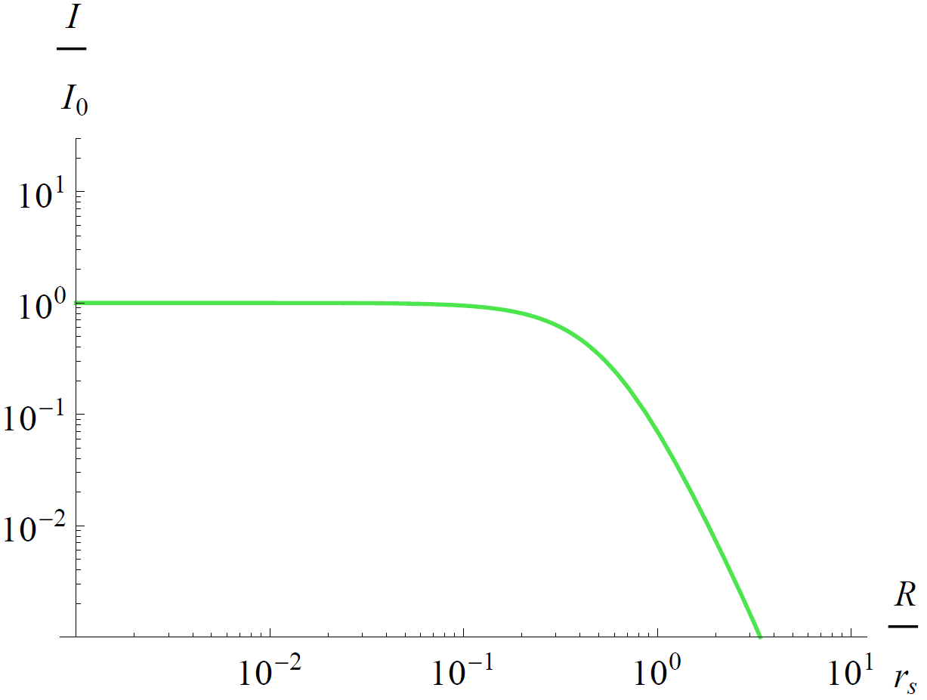
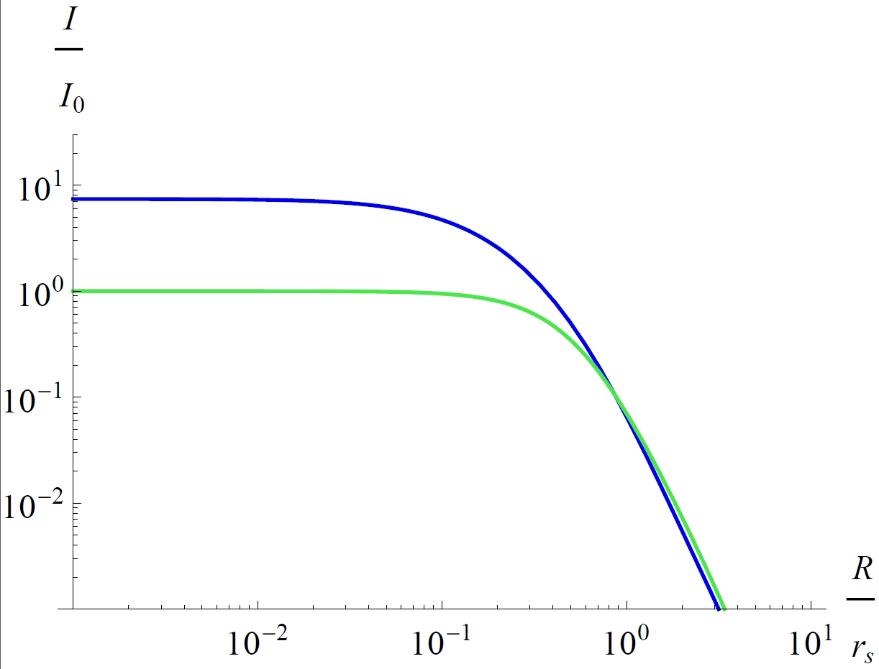
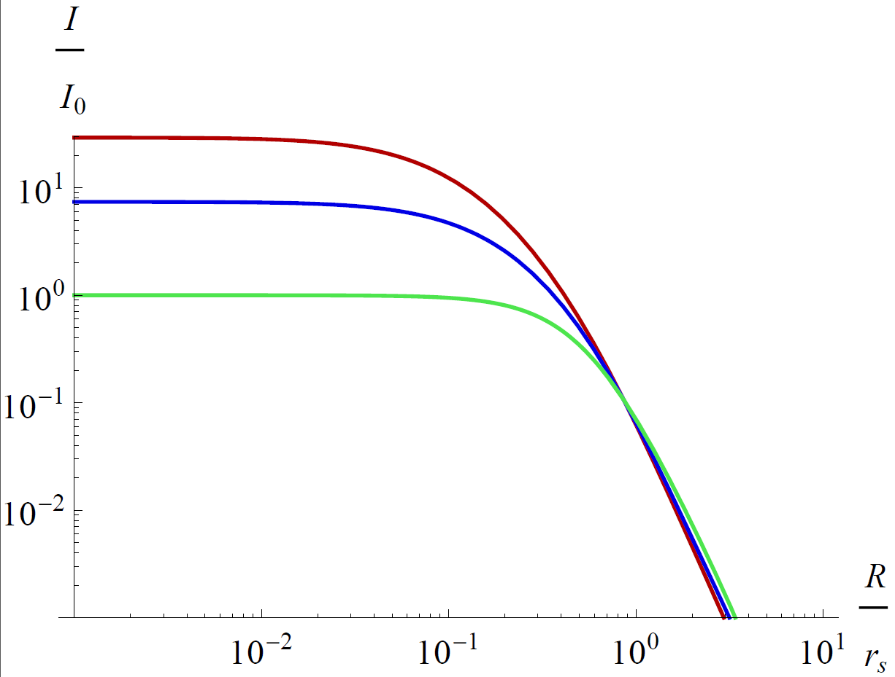
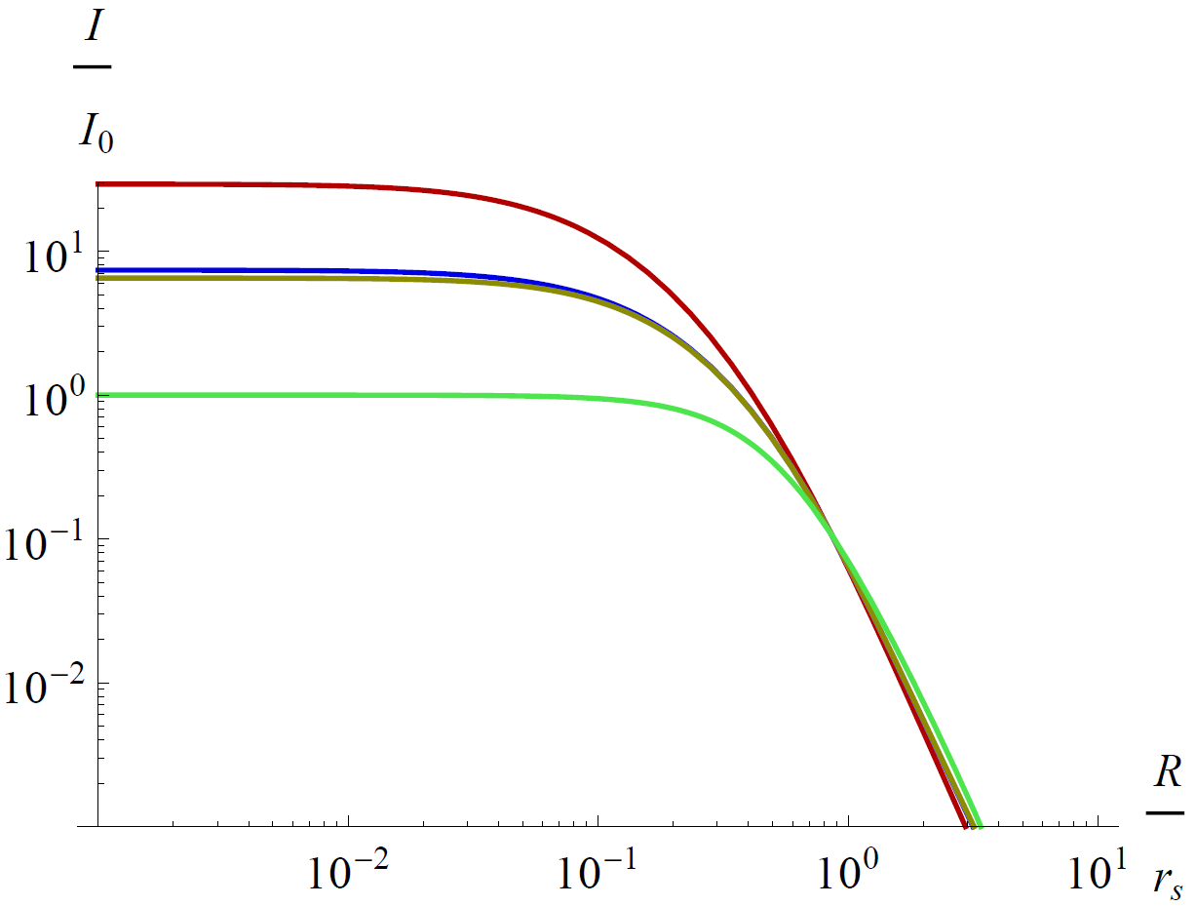
Using X-rays to Constrain the Halo Profile
A best-fit β-model fits the X-ray data very well.
Assuming spherically distributed matter with gas in hydrodynamical equilibrium:
An NFW profile with same scale radius is similarly shaped, offset.
Similarly for the Einasto profile with α=0.16.
And with α=0.26.

Slide 13
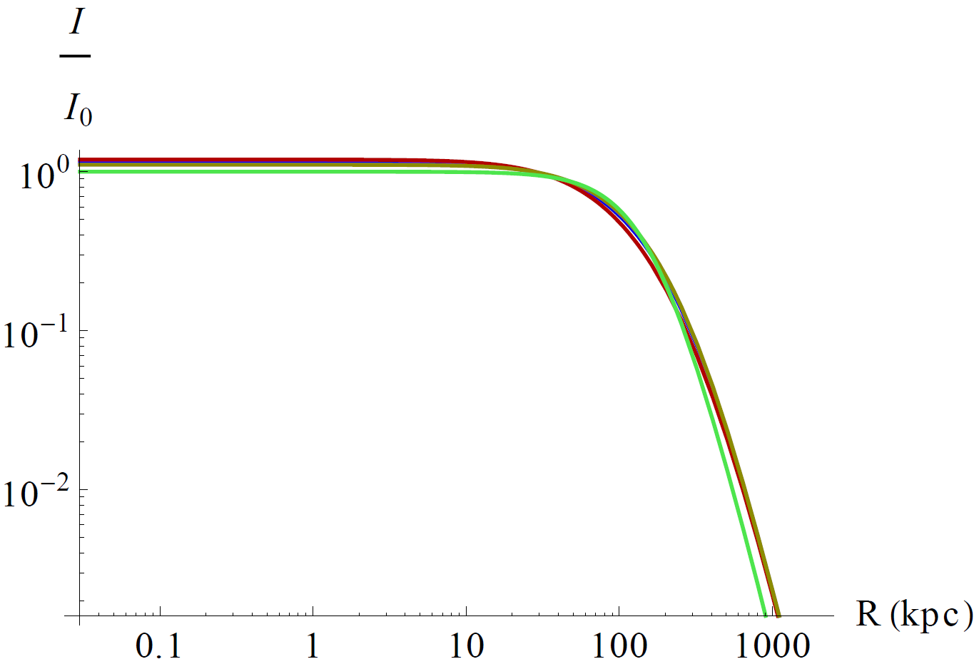
The scale radius for each profile is determined from X-ray data.
Surprisingly, all profiles are consistent with the
X-ray data, given an appropriate scale radius.
Cluster density profiles may also constrained by:
kinematic data,
weak lensing.

Slide 14
Substructure Models for Galaxy Clusters
Three recently published models of substructure were considered:
Gao et al. (2011), G11:
Based on the Phoenix and Aquarius simulations.
A fitting formula for the angular surface intensity of substructure.
Kamionkowski et al. (2010), K10:
Density Probability Distribution Function profile.
Fit to the Via Lactea II simulation.
Suggested scaling for galaxy clusters by Sánchez-Conde et al. (2011).
Pinzke et al. (2011), P11:
Used the Aquarius simulations and scaled up to cluster sized halos.
Found a double-power law fit the primary substructure intensity profile.
Scaled down to $M_{min}={10}^{−6} M_{⨀}$. I also try $M_{min}={10}^{−12} M_{⨀}$.

Slide 15
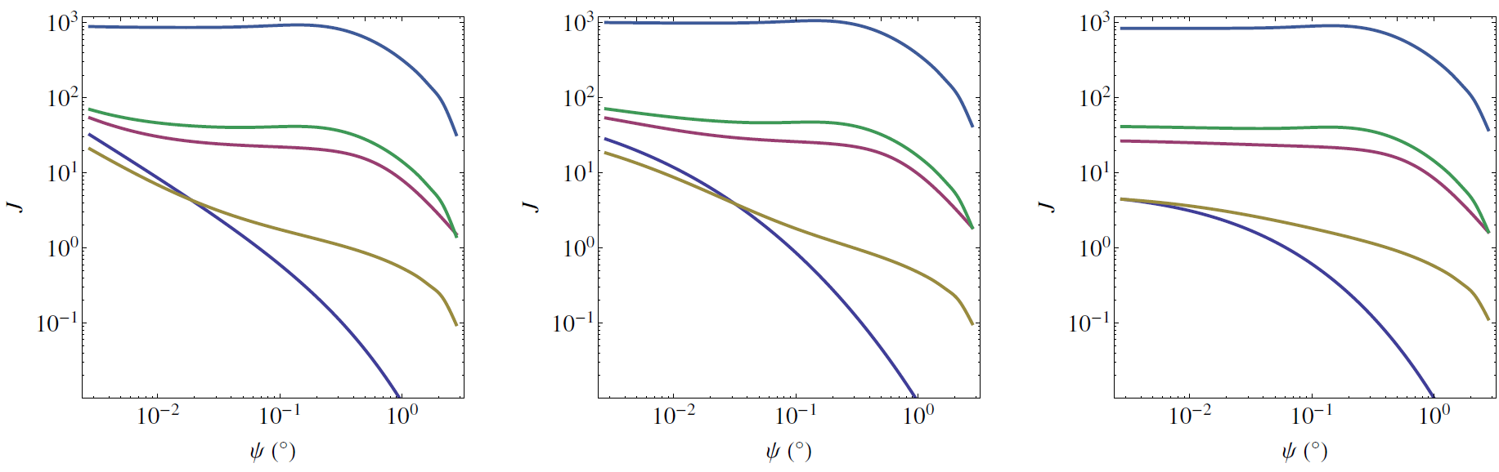
J-factor Profiles for the Fornax Cluster
NFW
Einasto ($α=0.16)$
Einasto ($α=0.26)$
$$M_{min}={10}^{−12} M_{⨀}$$
P11
G11
K10
smooth
The modest substructure models bring the J-factor to levels similar to the
J-factor of the cored galactic center.
We need the X-ray constraint to remain satisfied…

Slide 16
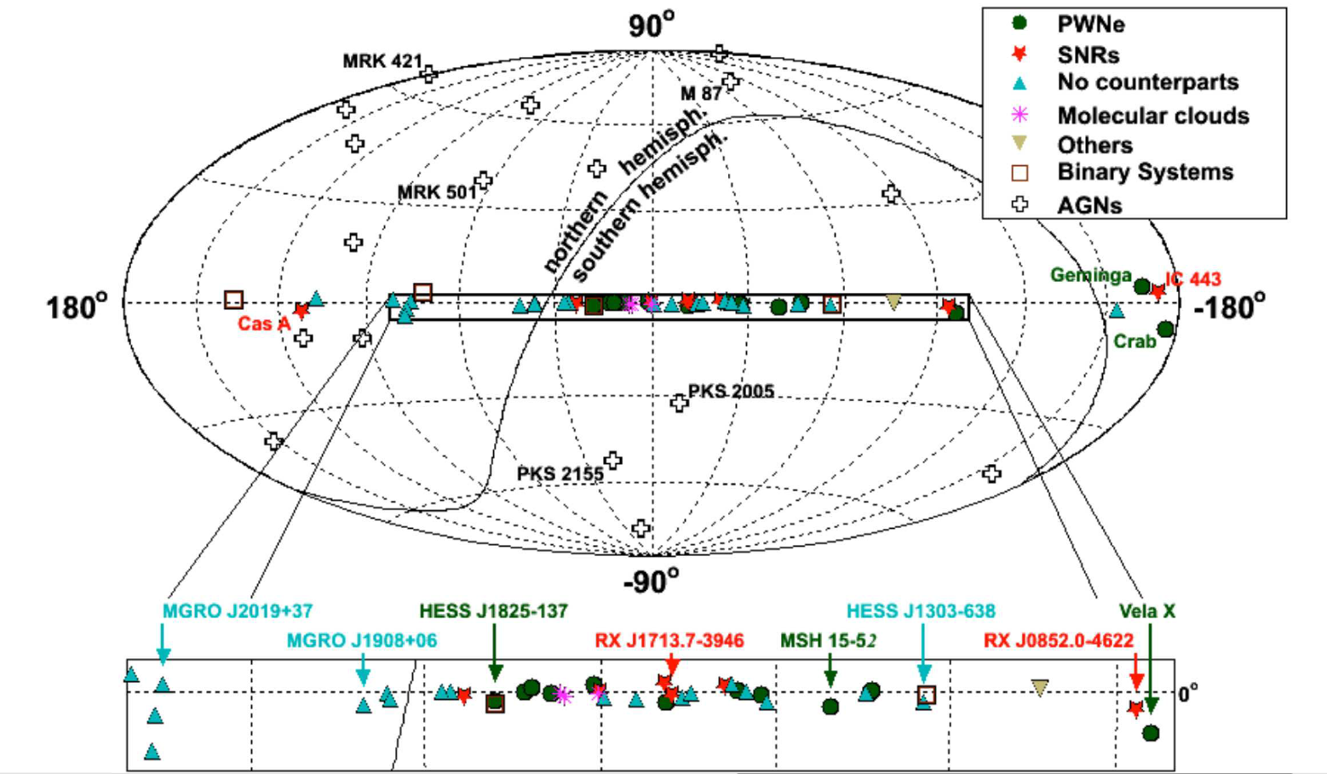
TeV Gamma-Ray Emitters and The Fornax Cluster
Fornax
Wiebusch, arXiv:0907.2263

Slide 17
Conclusions
The galactic center may be an excellent target for dark matter indirect detection, given its close proximity and bountiful dark matter abundance.
If the galactic dark matter halo profile is cored, the Fornax Cluster may provide an equally suitable target, if its substructure should prove as abundant as simulations suggest.
The galactic center dark matter search analysis at IceCube may be extended to include the Fornax Cluster, as it also resides in the southern sky.

