Slide 1
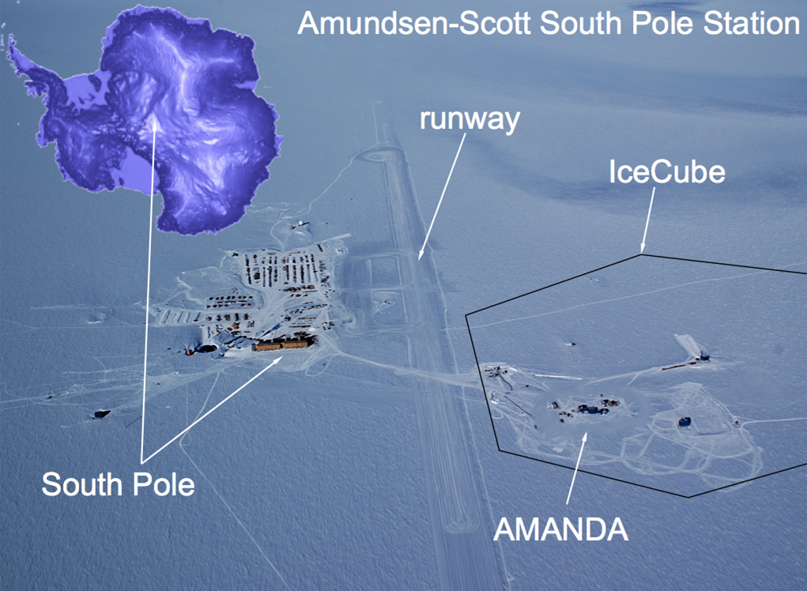
Operation and First Data of DM-Ice17 at the South Pole
DM-Ice17
DM-Ice
IPA 2013
Madison, WI
May 13
A Dark Matter detector in the South Pole Ice
Matthew Kauer
University of Wisconsin - Madison
(on behalf of the DM-Ice collaboration)

Slide 2
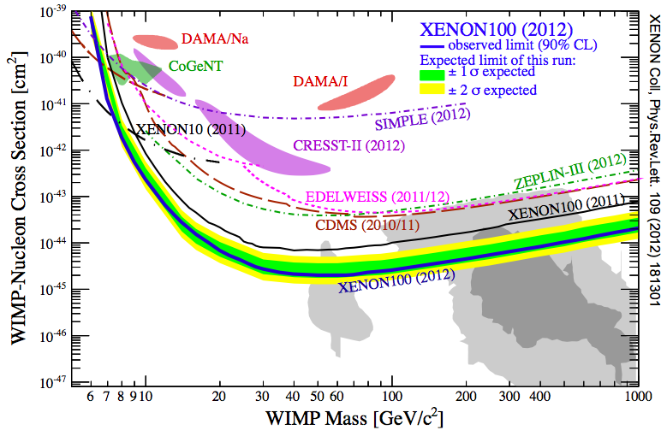
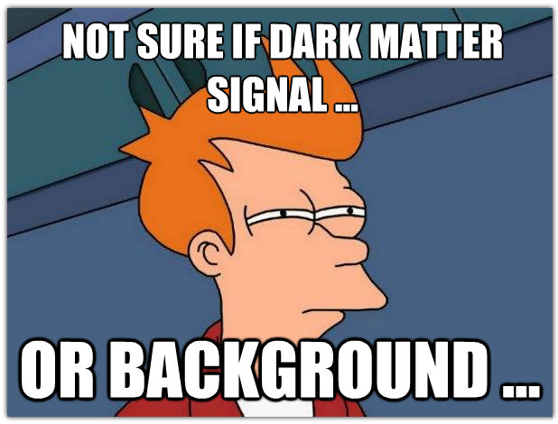
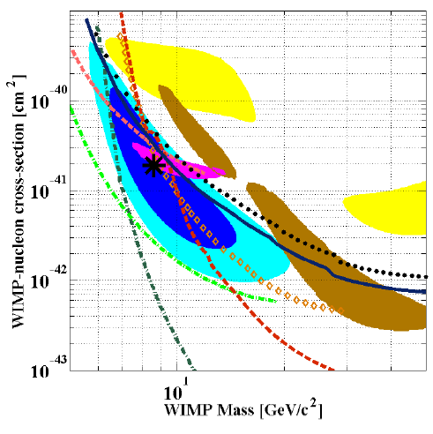
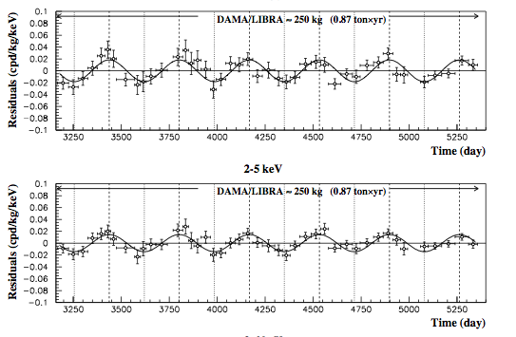
“Tension” in the field
DAMA 8.9σ Modulation:
Phase: 146 ± 7 days
Period: 0.999 ± 0.002 yr
Background: ~ 1 cpd/kg/keV
Amplitude: 0.01 cpd/kg/keV
CDMS II
Silicon Analysis
140 kg.days
3 events 5-7σ
DAMA/LIBRA
CRESST
CoGeNT
arXiv: 1304.4279
XENON-10
68%
90%
XENON-100
CDMS-II (Si)
EDELWEISS
CDMS-II (Ge)

Slide 3
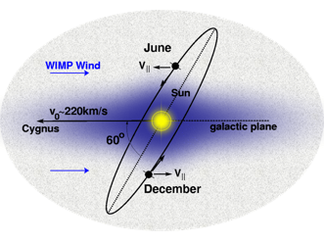
Annual Modulation Dark Matter Searches
with NaI Detectors
Northern Hemisphere | Gran Sasso DAMA/Libra 250kg running | Gran Sasso SABRE (Princeton) R&D | Canfranc ANAIS ~100kg starting in 2014? | (Japan) PICO-LON (Korea) KIMS
Southern Hemisphere | South Pole DM-Ice 17 kg running R&D for 250 kg | ANDES Lab (proposed) expected start 2018
ice
rock
Several groups conducting ultra-pure crystal R&D with several vendors to go to the full scale
Only experiments in the Southern Hemisphere can definitively confirm DAMA.

Slide 4
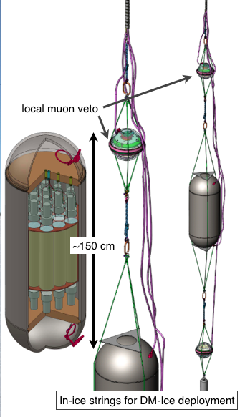
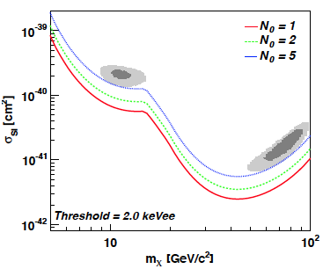
DM-Ice (250 kg NaI)
Use NaI(Tl)
Eliminate uncertainties due to detector effects and dark matter models
Crystal Array for sophisticated event tagging
Detection (5σ) or exclusion
500 kg*yr NaI (same scale as DAMA)
Threshold < 2 keV_{ee}
Background < 5 cpd/kg/keV
Go to the South Pole
Seasonal effects have opposite phase
2200 mwe overburden
Ice < 1 ppt U/Th (radon ~0)
Ice < 1 ppb K
Ice == great neutron moderator
DM-Ice (250 kg)
arXiv:1106.1156
DM-Ice Sensitivity
500 kg•yr NaI
(2 - 4 keV) with 1, 2, and 5 dru bkg

Slide 5
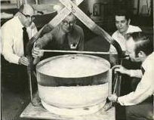
Global NaI Powder R&D
From simulation, internal backgrounds dominate, particularly 3 keV ⁴⁰K
DAMA’s crystals (NIMA 592 (2008) 297– 315) :
²³⁸U : 1 - 10 ppt
²³²Th : 1 - 10 ppt
^{nat}K : < 20 ppb
NAIAD crystals : 5 - 10x DAMA bkg (PLB 616 (2005) 17–24)
DM-Ice17 now has 2 NAIAD crystals
32” diameter NaI Crystal
Manufacturer | Form | Measurement | ²³⁸U (ppt) | ²³²Th (ppt) | ^{nat}K (ppb)
Saint Gobain | Powder | DAMA (HPGe) | < 20 | < 20 | < 100
Saint Gobain | Crystal | DAMA/LIBRA | 0.7 - 10 | 0.5 - 7.5 | < 20
Saint Gobain | Crystal | ANAIS-0 | 6.1 | 3.2 | 410
Saint Gobain | Crystal | DM-Ice (FNAL)
Sigma-Aldrich | Powder (standard grade) | DM-Ice (HPGe) | 40 | 89 | 440
Sigma-Aldrich | Powder (astro grade) | DM-Ice (HPGe) | 63 | < 95 | < 126
Sigma-Aldrich | Powder (astro grade) | A-S (ICPMS) | - | - | ~ 4
Alpha-Spectra | Powder | DM-Ice (HPGe) | < 100 | < 200 | < 120
Alpha-Spectra | Powder | ANAIS-25 (HPGe) | < 55 | < 130 | < 90
Also working with SICCAS (Shanghi)
Technical challenge == a method to measure K < 100 ppb level
ICPMS is promising → < 10 ppb
Samples have been sent…

Slide 6
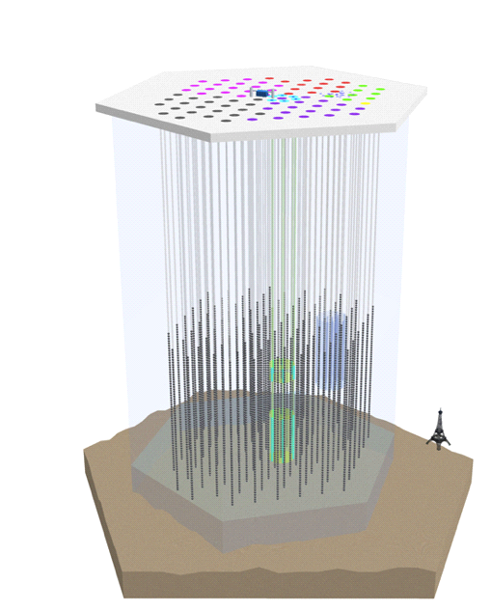
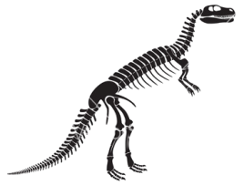
DM-Ice17 Deployment
IceCube
lab
Feb 2010
a great idea!
50m
Dec 2010
IceCube DAQ
NAIAD crystals
deployed at Pole
10 months
Co-Deployed with IceCube at the South Pole in December 2010
A 17 kg NaI detector
Operation since Jan. 2011
Data run from June 2011
1450m
String 79
String 07
2450m
Goals…
determine the feasibility of deploying a remotely-operable detector in the Antarctic Ice
Assess the environmental stability
Establish the radiopurity of the Antarctic ice / drill ice
Explore the capability of IceCube to veto muons
Look for modulations
2820m
bedrock
2200 M.W.E. overburden
~85 muons/m^2/day

Slide 7
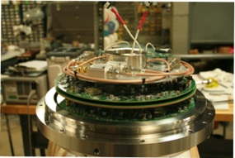
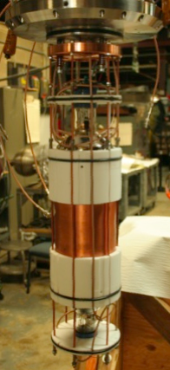
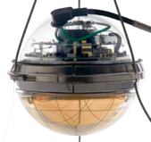
DM-Ice17 (prototypes)
36 cm (14”)
IceCube DOM 59
Prototype x2
2 HV control boards
2 IceCube mainboards
PMTs:
5” ETL 9390-UKB
IceCube DOM 60
1.0 m
NAIAD NaI Crystal
(Ø 5.5” x 6”, 8.5 kg)
5 cm quartz lightguides
(Suprasil B)
7 m
PTFE light reflectors
Stainless Steel Pressure Vessel
DM-Ice

Slide 8
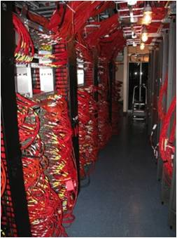
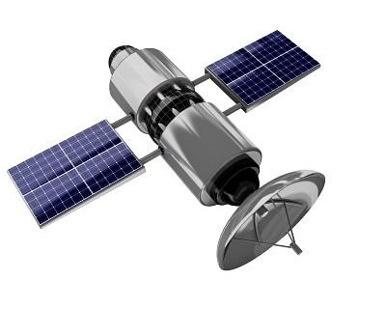
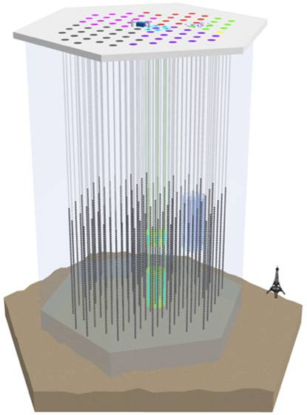
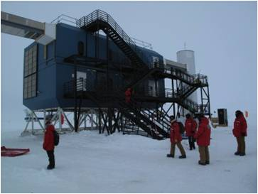
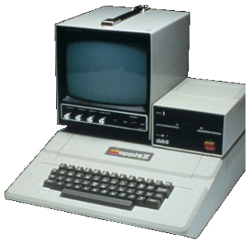
Data Transfer
Remotely programmable sample rate, HV & threshold
Each PMT set to trigger ~ 0.3 spe
Waveform recorded only when coincidence between both PMTs w/in 800 ns on a single crystal
Waveform from each PMT digitized separately in the ice by IceCube mainboards and sent to hub
Time stamp synchronized to IceCube GPS and calibrated for transit time
Data sent over satellite to Madison, WI

Slide 9
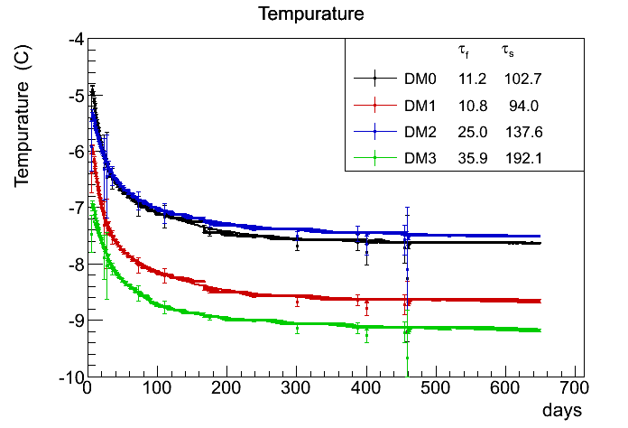
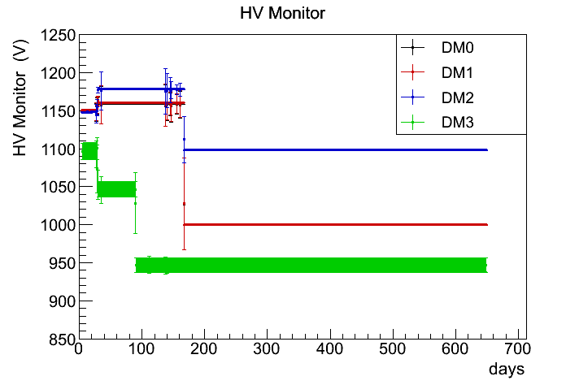
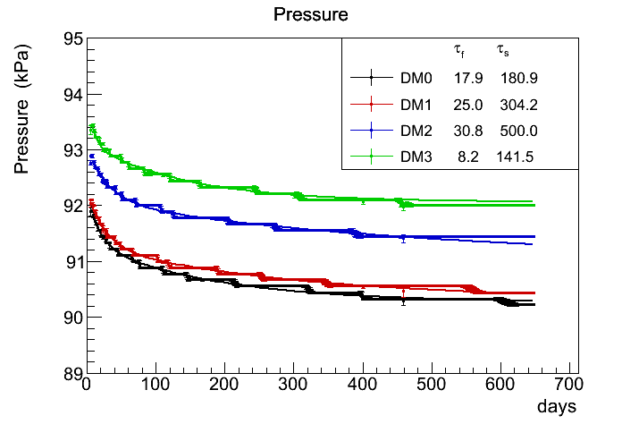
Detector Monitoring
Temp and pressure sensors mounted on the mainboards
Temperature of the boards
~10°C above surrounding ice
Fast (2-3 weeks) decrease during freeze-in
Slower decrease over a few months after freeze-in
Pressure follows similar trend as temperature (ADC resolution limited)
High Voltage on the PMTs
Values recorded every 2 sec. before April 2012. Every 60 sec. since April 2012.
data
data
data

Slide 10
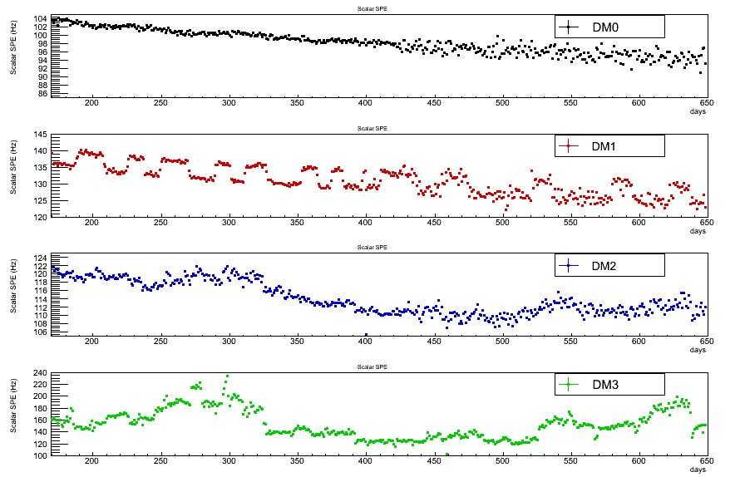
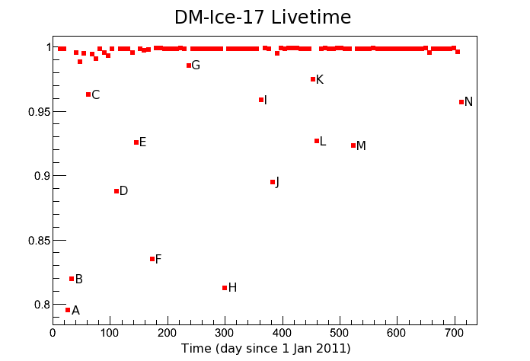
Detector Monitoring
data
PMT Trigger Rates
Single PMT trigger rates
General decay over time
Single trigger rate variation seems mostly in the noise (not observed in coincident data)
DM-Ice17 Livetime
Data run since June 2011
99.75% uptime
well known down times (power cycling, pedestal and dark noise runs)
data

Slide 11
Signal Channels
4-channel output
Record each event passing coincidence between PMTs
ATWD = 14bits dynamic range
Energy = sum over entire ATWD waveform
5-6 photoelectrons/keV
Sum over 600 ns
FADC currently does not resolve as well
Stable data taking since June 2011
29.6 kg.yr of stable data to date
99.75% livetime
x16 ATWD - 0
x2 ATWD - 1
x0.25 ATWD - 2
FADC

Slide 12
Energy Spectrum: Gammas
Internal contamination lines used for calibration
DM-Ice17 Prototype1 Spectrum
²¹²Pb (Th-chain) + ²¹⁴Pb (U-chain)
²¹⁴Pb (U-chain)
cnts/day/kg/keV
Main backgrounds:
U-chain
Th-chain
⁴⁰K
⁶⁰Co
²¹⁴Pb (U-chain)
²⁰⁸Tl (Th-chain) + ²¹⁴Bi (U-chain)
⁶⁰Co
⁴⁰K
²¹³Bi (U-chain)
²¹⁴Bi (U-chain)
²⁰⁸Tl (Th-chain)
18 months of data from both PMTs on a single crystal

Slide 13
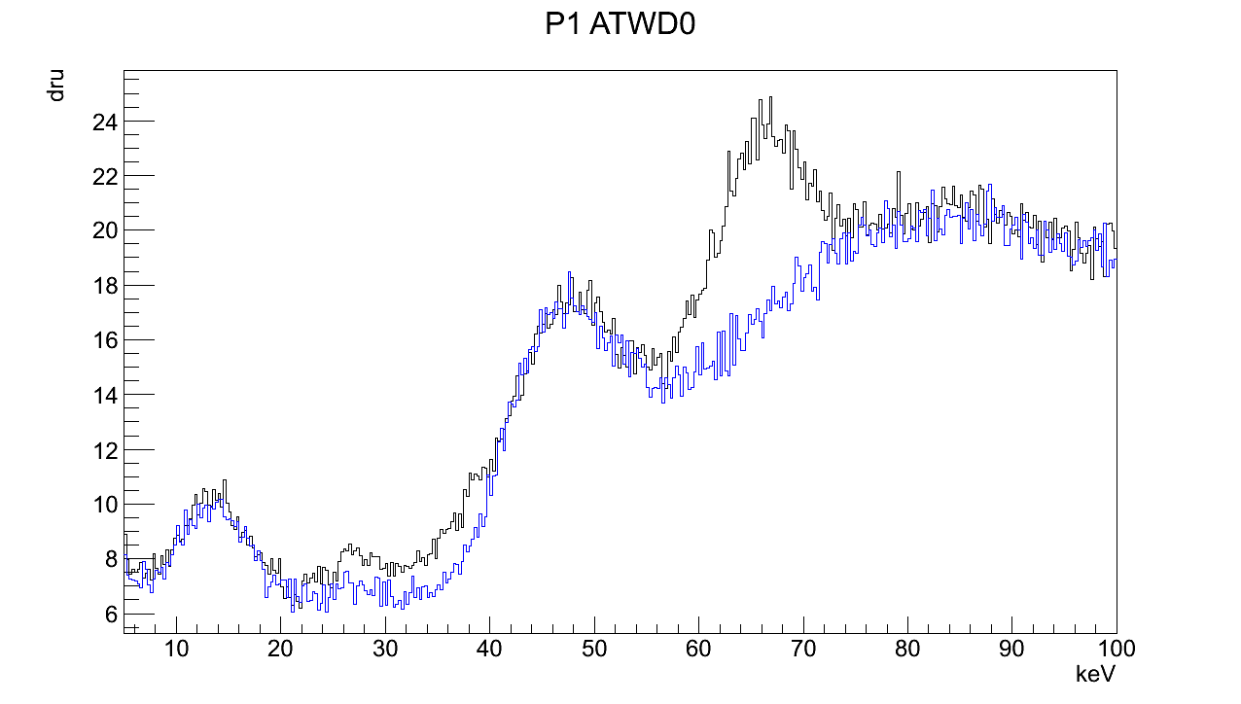
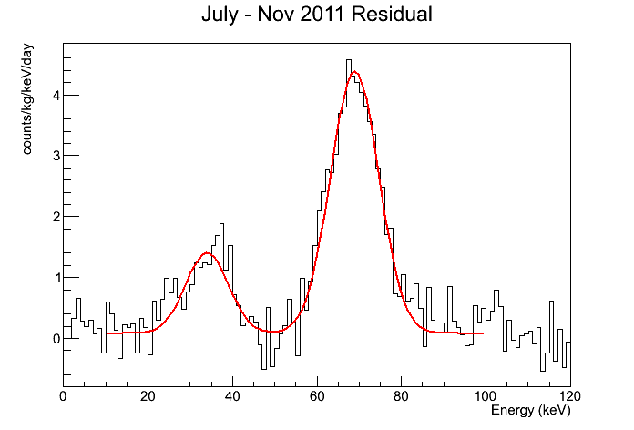
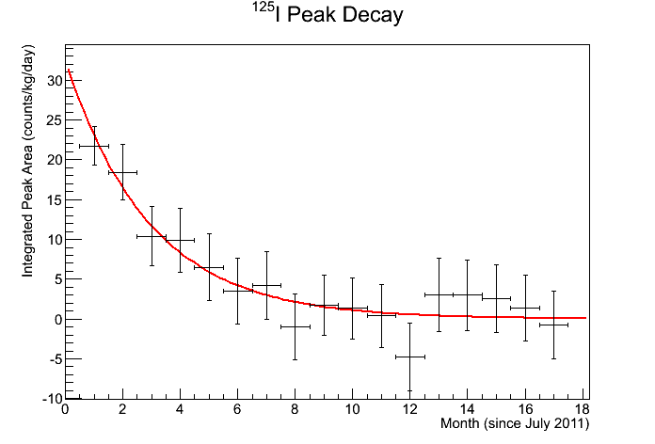
Cosmogenic ¹²⁵I (in the NaI crystal)
Decay of ¹²⁵I
July – April Residual
¹²⁵I (67.3 keV)
cnts/kg/day/keV
surface X-rays
July 2011
April 2012
¹²⁵I X-rays
²¹⁰Pb (46.5 keV)
Verified by 59 day half-life
keV
Cosmogenic lines verify our energy calibration; this is particularly useful for the prototype since we do not have an in-ice source.

Slide 14
Resolution of DM-Ice17
σ/E
DM-Ice17 uses NAIAD PMTs and crystals.
DM-Ice17 Prototype 2
DM-Ice17 Prototype 1
NAIAD
DAMA switching readout channel
DAMA
DM-Ice17 has resolution competitive with other NaI crystal experiments, studied down to 3 keV.
Small NaI Detector
DM-Ice17: 1 month of data from both PMTs for each crystal.
Small NaI: E. Sakai, IEEE Transactions on Nuclear Science NS-34 (1987) 418.
NAIAD: The NAIAD experiment B. Ahmed et al, Astropart. Phys. 19 (2003) 691.
DAMA: R. Bernabei et al., Nucl. Instrum. Methods A 592 (2008) 297.

Slide 15
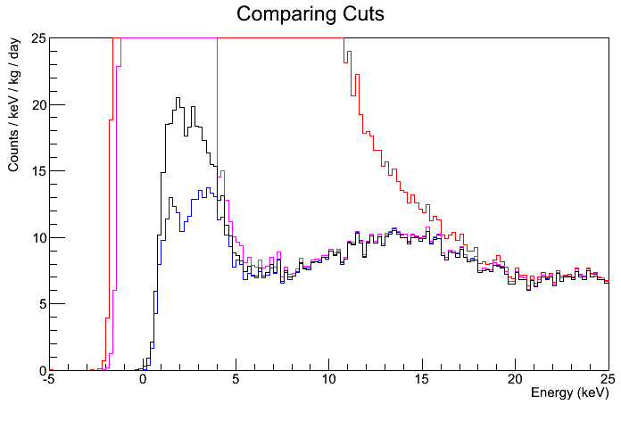
3 keV ⁴⁰K Peak
--- No Cut
--- EMI & Thin
--- Peak Finding
--- Steppiness
We understand our spectrum well down to 4 keV.
Below 4 keV, we are capable of revealing the ⁴⁰K peak despite the difficulties of single crystal analysis.
At 6 keV we see 7.2 ± 0.4 cpd/kg/keV. Simulations for the full scale DM-Ice give 1-2 cpd/kg/keV @ 5 keV (not including multi-crystal “hit” rejection)
Notes:
----- Meeting Notes (4/9/13 12:43) -----
Summary .. "we understand…" "rates are…" "consistent with dama… " "compared to NAIAD…" "can see 3 keV even in single crystal analysis.." "

Slide 16
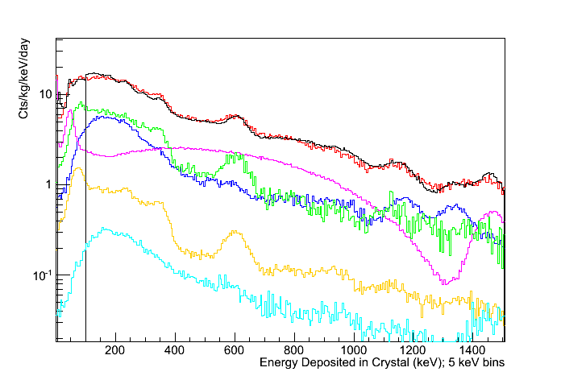
Background Model
All components measured/estimated and simulated
Data
PMTs
Total Sim.
Crystal
Quartz
Pressure Vessel
Drill Ice
Notes:
1. inputs to sim agrees with data
2. full scale sim looks good enough
3. ice is clean

Slide 17
Region of Interest
18 months of data from both PMTs on a single crystal
Good agreement with simulation above 20 keV
Surface event simulation at 12 keV in progress
We understand our detector to 4 keV
NAIAD published to 4 keV; we are pushing lower
We model our 3 keV peak to within a factor of 2 of simulation
Understanding efficiencies <3 keV in progress
---- Data
cpd/kg/keV
3 keV from ⁴⁰K
---- Simulation
7.2 ± 0.4 cpd/kg/keV
¹²⁵I cosmogenic
Energy (keV)
²¹⁰Pb surface event; simulation in progress
Looking ahead:
Backgrounds in ROI 5x higher than simulated for full scale DM-Ice
Multi-crystal veto will suppress 3 keV events

Slide 18
Conclusions:
successfully deployed two detectors 2450 meters in the ice
incredibly stable environment
calibration from internal/external backgrounds (no calib sources)
Geant4 background model in agreement with data
good understanding down to 4 keV ( ~ 7 cpd/kg/keV)
pushing our energy threshold < 2 keV
DM-Ice (250 kg)
arXiv:1106.1156
DM-Ice Sensitivity
500 kg•yr NaI
(2 - 4 keV) with 1, 2, and 5 dru bkg
Successful
Deployment

Slide 19
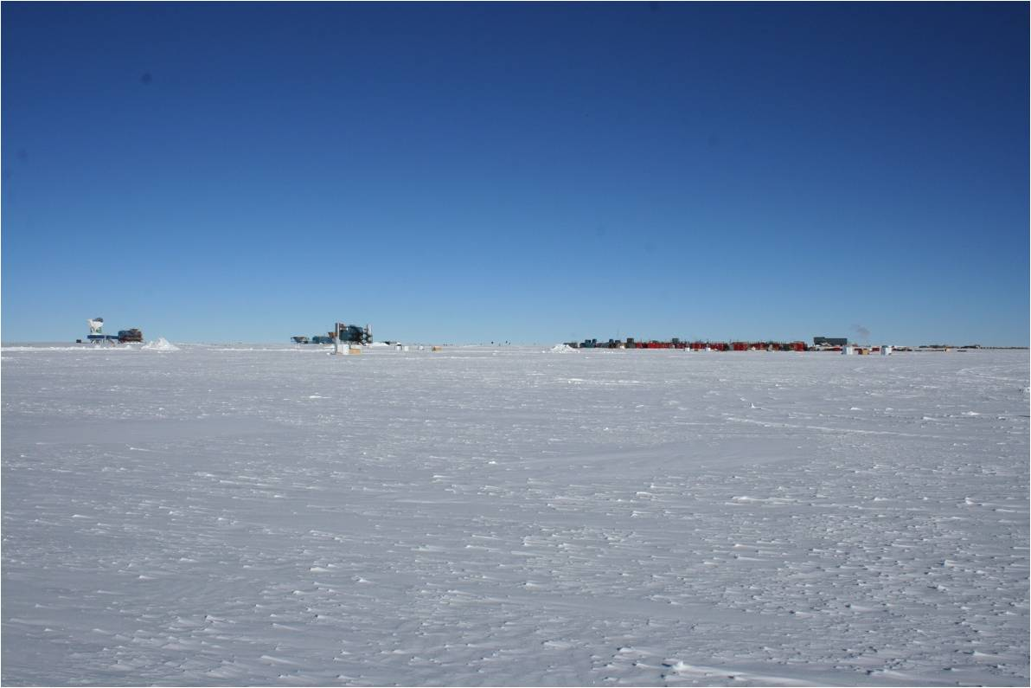
University of Wisconsin – Madison
Reina Maruyama, Francis Halzen, Karsten Heeger, Albrecht Karle, Carlos Pobes, Walter Pettus, Zachary Pierpoint, Antonia Hubbard, Bethany Reilly, Matthew Kauer
University of Sheffield
Neil Spooner, Vitaly Kudryavtsev, Dan Walker, Matt Robinson, L. Thompson, Sam Telfer, Calum McDonald
University of Alberta
Darren Grant
Shanghai Jiao Tang University
Xiangdong Ji, Changbo Fu
Penn State
Doug Cowen, Ken Clark
NIST-Gaithersburg
Pieter Mumm
University of Stockholm
Chad Finley, Per Olof Hulth, Klas Hultqvist, Christian Walach
University of Illinois at Urbana-Champaign
Liang Yang
Fermilab
Lauren Hsu
DigiPen
Charles Duba, Eric Mohrmann
Boulby Underground Science Facility
Sean Paling
SNOLAB
Bruce Cleveland
NSF ANT-1046816
PHY-1151795

Slide 20
BACKUP SLIDES

Slide 21
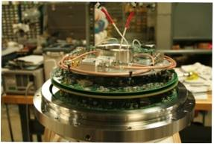
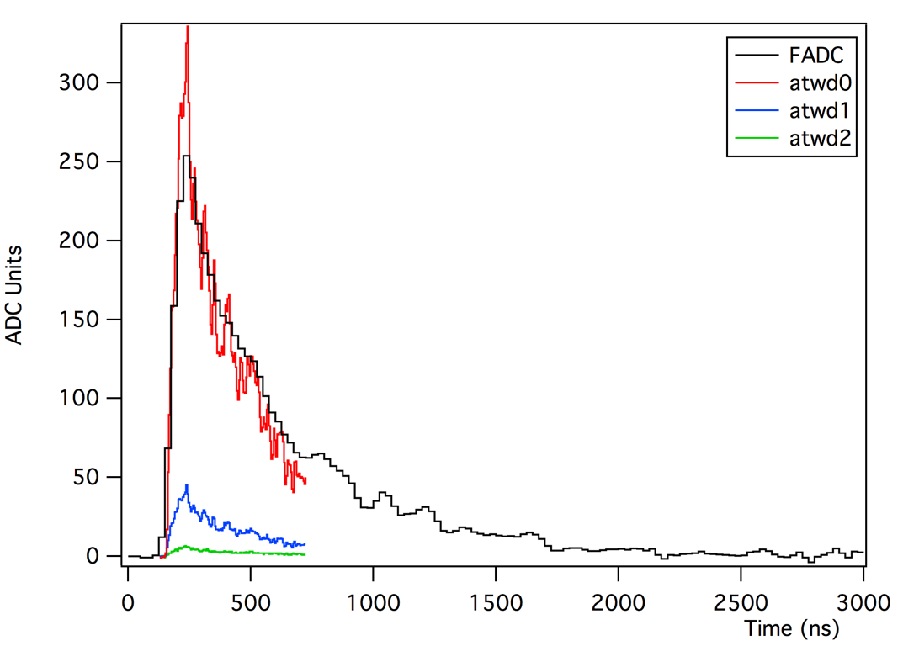
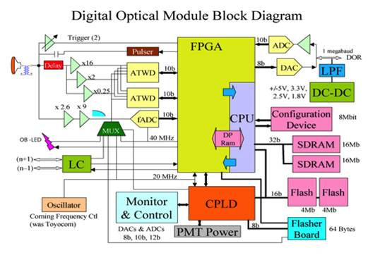
Data Acquisition and Digitizing
PMT thresholds | ~ 0.3 PE
Coincidence requirement | < 800 ns
FADC (@ 40 MHz) | 255 bins = 6.375 us
ATWD (@ 200 MHz) | 128 bins = 600 ns
PMT Trigger Rate | 100-150 Hz
Coincidence Trigger Rate | ~ 4 Hz
–-–- ATWD ch0 (x16)
––-- ATWD ch1 (x2)
––-- ATWD ch2 (x0.25)
––-- FADC
IceCube mainboards
Thoroughly engineered and tested
Slightly modified for DM-Ice

Slide 22
Scintillation Events
ADC Counts
Signal comes from scintillation in the crystal.
Coincidence required between the two attached PMTs (800 ns).
At high energies, signal has the characteristic scintillation pulse shape.
At low energies, increasingly events are just a series of single photo-electrons.
ADC Counts
ADC Counts

Slide 23
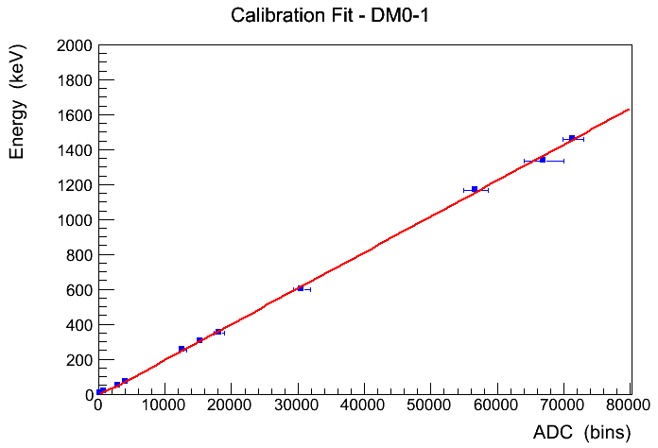
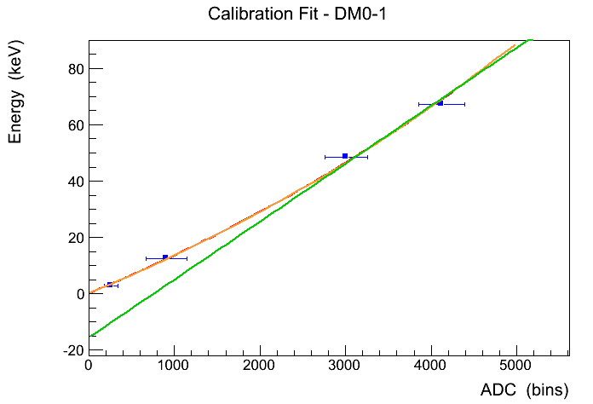
Energy Calibration
High energy fit ( > 100 keV) is linear
Low energy fit ( < 100 keV) deviates from linearity
Separate fit for low energy < 100 keV
As observed in other literature:
Rev.Sci.Inst. 27, 589 (1956)
Nuc.Inst.Meth. 15, 55-58 (1962)
J.Appl.Phys. 107, 113513 (2010)
High energy fit intercepts at -15 keV

Slide 24
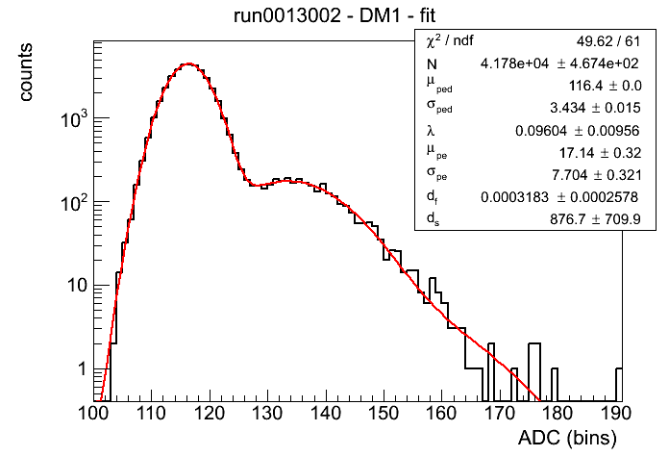
NaI Light Yield
Obtain 1pe-ped separation from dark noise runs (ie no coincidence requirement)
Normalize the energy to keV using the energy calibration
pedestal
1pe
xtal-1 = 6.1 +/- 0.07 pe/keV
xtal-2 = 4.9 +/- 0.05 pe/keV
Consistent with:
DAMA = 5.5 – 7.5 pe/keV
NaiAD = 5 – 8 pe/keV

Slide 25
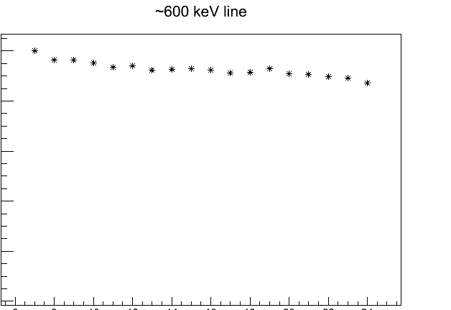
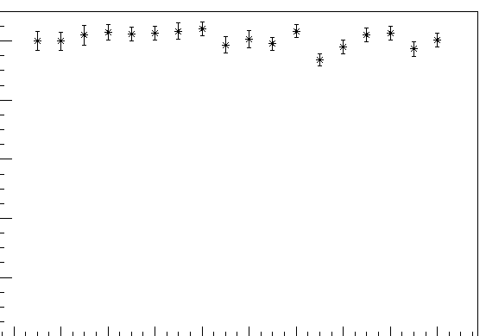
Detector Stability
Detector calibration is stable to 1.3% over 18 months.
1.3% decrease over 18 months in light collection (peak position) observed at 600 and 1460 keV
No observable change in calibration at 45 keV
We have not had to change our calibration with time
Any changes at higher energies are smaller than our resolution
1
1
0.98
0.98
45 keV
0.96
0.96
Relative ADC units
Relative ADC units
0.94
0.94
0.92
45 keV
0.92
600 keV
0.90
6
8
10
12
14
16
18
20
22
24
0.90
Months after deployment
6
8
10
12
14
16
18
20
22
24
Months after deployment

Slide 26
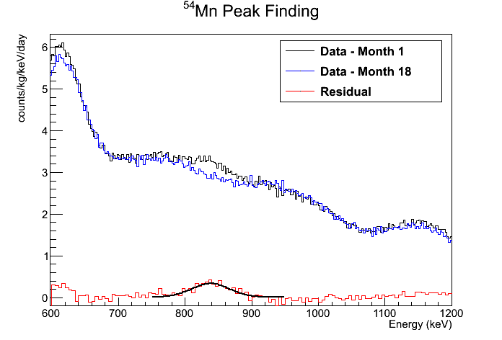
Cosmogenic ⁵⁴Mn (in the steel)
⁵⁴Mn Peak Finding
gamma expected from ⁵⁴Mn
E_{γ} = 835 keV
t_{1/2} = 312.03 days
counts/kg/keV/day
Energy (keV)
 | Fit | Expectation
Energy (keV) | 836.1 ± 3.0 | 834.8
Sigma (keV) | 36.9 ± 3.7 | 23.3
Deploy Rate (decays/day) | 51,700 ± 6,500 | 135,800

Slide 27
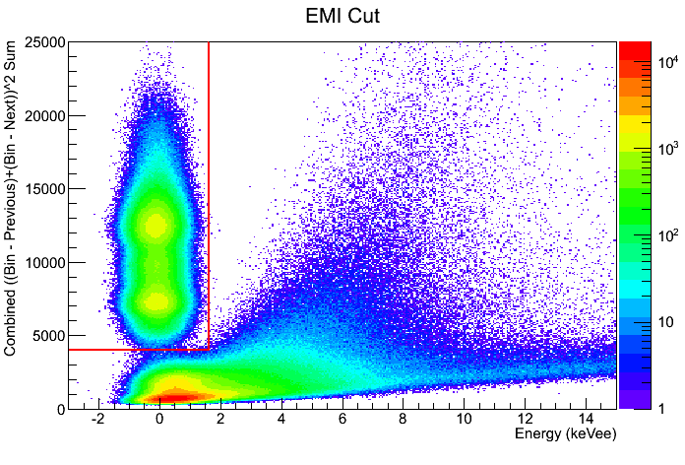
EM Interference (EMI) Events
ADC Counts
Electromagnetic interference caused by the hardware monitoring can trigger the detector.
Monitoring reduced from every ~2 seconds to every ~60 seconds in March 2013 to reduce this event rate.
This change reduced EMI events from 21% of all events to 0.9% of all events in prototype 1.
Current cut variable relies on ‘spikiness’ of waveform :
Sum( ( (next – bin) – (bin – previous) ) ^2 )
EMI Cut Variable vs. Energy
EMI
Notes:
Why pulse shape discrimination and not timing?

Slide 28
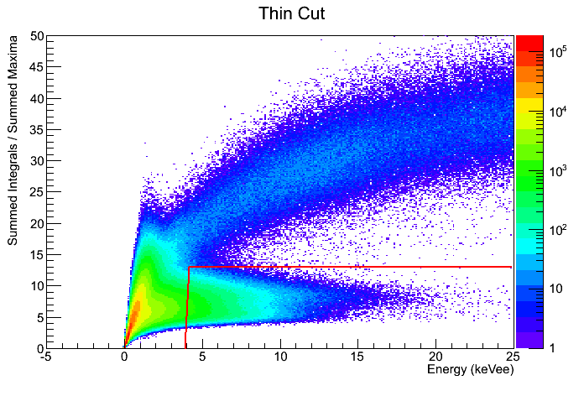
“Thin Pulse” Events
Interactions within the light guides and/or PMTs can also trigger the detector.
These events are referred to as thin events due to their characteristic pulse shape.
Current cut variable :
Pulse Integral / Pulse Maximum
Current cut value chosen to preserve 75% of signal with a signal to noise ratio > 10 in cut region.
Current Energy Threshold : 4 keV
ADC Counts
Thin Cut Variable vs. Energy
Other noise
Scintillation
Thin
Notes:
Efficiency of the cut determined by plotting the cut variable with strict energy cuts.
The resulting histogram is fit with gaussians which are used for determining the cut efficiency
----- Meeting Notes (4/9/13 12:43) -----
Change title of plot

Slide 29
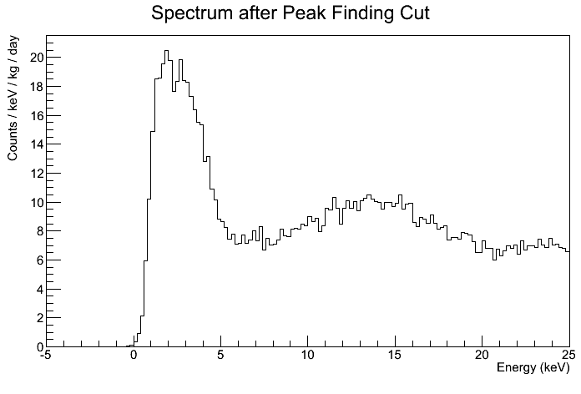
Peak Finding Cut (Dm-Ice Madison)
ADC Counts
“Peak Finding” in theory counts the number of photoelectrons in each PMT.
In practice, a simple peak finding algorithm is used to count local maxima above a threshold.
Cut Requirement : Each PMT sees >4 peaks
Energy Spectrum after Peak Finding Cut

Slide 30
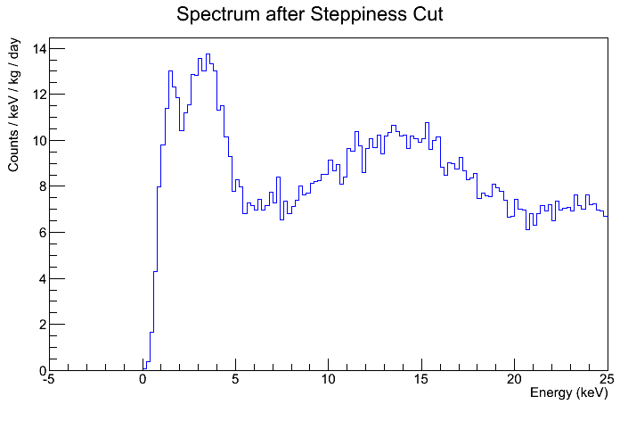
Steppiness Cut (DM-Ice Sheffield, UK)
ADC Counts
Steppiness in essence requires multiple SPEs to occur in quick succession in at least one PMT.
This is achieved by requiring a smoothed waveform to break a threshold.
Steppiness is not a good cut of thin pulses so a series of cuts is required to remove them.
Energy symmetry between the two PMTs
Mean time symmetry between the two PMTs
Mean time
Tail energy fraction
Smoothing
ADC Counts
Energy Spectrum after Sheffield Cuts

Slide 31
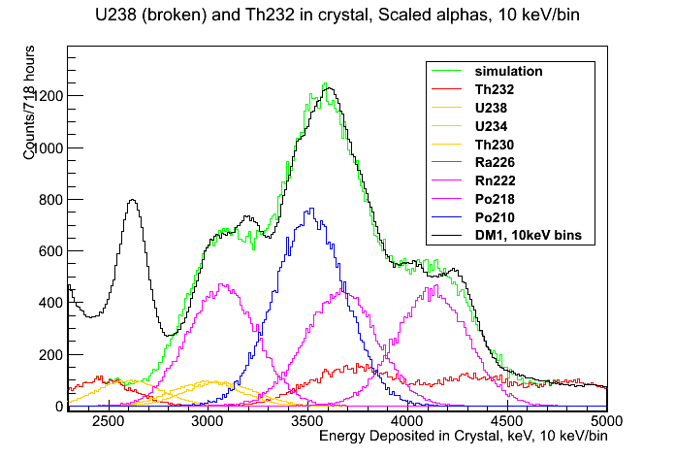
Internal Crystal Contamination
Internal ²³⁸U and ²³²Th contamination in our crystal is estimated by looking at the alpha region
Matching simulation to data yields this estimate
²³⁸U chain is out of equilibrium
Alpha quenching is similar to that seen by DAMA
²¹⁰Po
²²⁶Ra
²²²Rn
²¹⁸Po
²³²Th
²³⁸U
²³⁴U
²³⁰Th
 | DM-Ice17 (uBq/kg) | DAMA (uBq/kg) | DM-Ice17 to DAMA ratio
U238 | No info | 2 | -
U234 | 93 | 12 | 7.8
Th230 | 93 | 12 | 7.8
Ra226-Pb210 | 933 | 18 | 52
Bi210-Pb206 | 1680 | 33 | 51
Th232 | 214 | 6 | 36
Alpha Quenching
DM-Ice17: α/γ = 0.50 + 0.0245 * Eα(MeV)
DAMA: α/γ = 0.47 + 0.0257 * Eα(MeV)

Slide 32
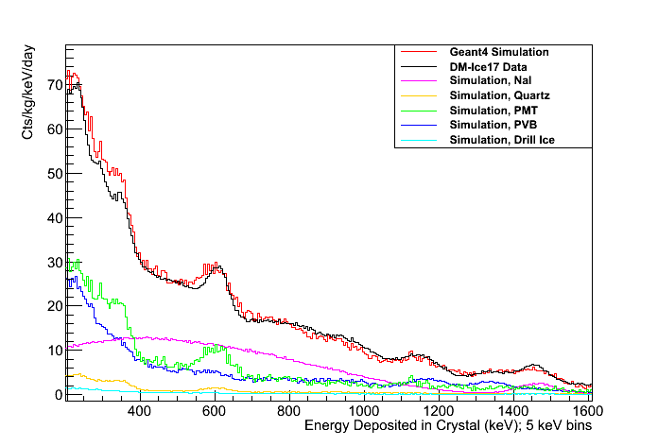
⁴⁰K in the Crystal
⁴⁰K in the crystal is estimated from the beta shoulder
Matching simulation to data yields about 650 ppb ⁴⁰K
---- Data
---- Total Sim
---- Crystal
---- Quartz
---- PMTs
---- Pressure Vessel
Notes:
Say this is the most sensitive feature (not 1460, 3 keV)

