Slide 1
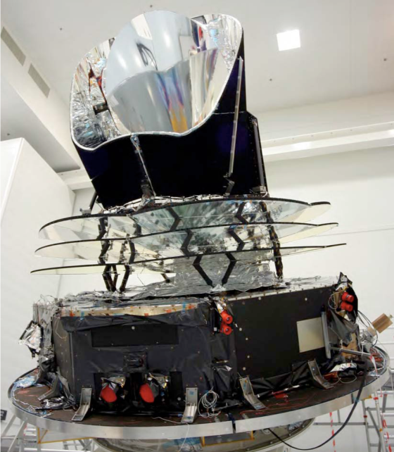
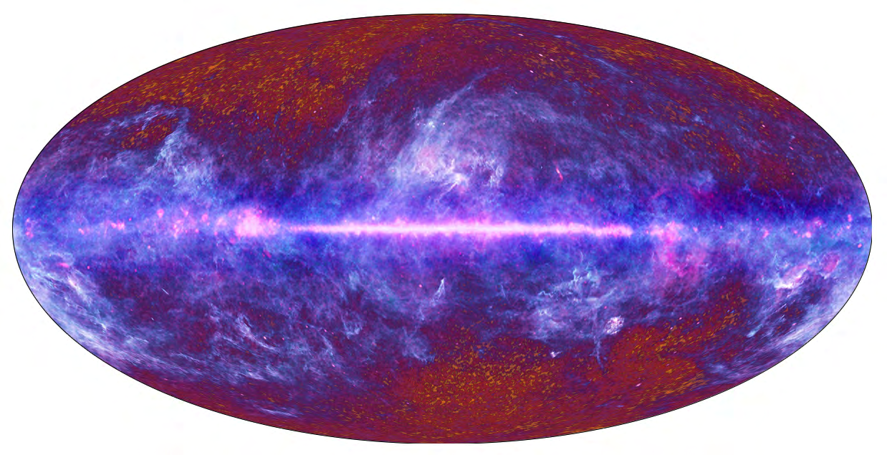
Recent Results from the Planck Satellite
Sarah Church
KIPAC, Stanford University

Slide 2
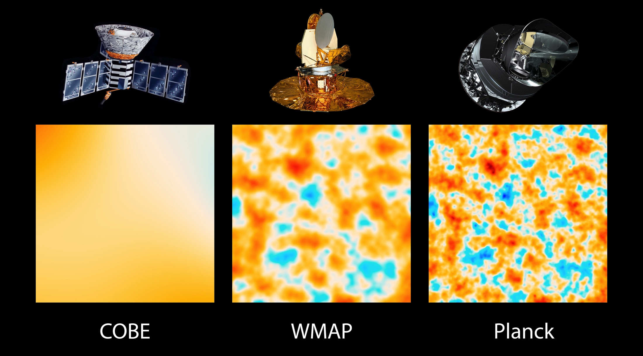
Planck – 3rd generation CMB satellite
Planck compared to WMAP:
3x the angular resolution
25x the sensitivity,
broader frequency coverage

Slide 3
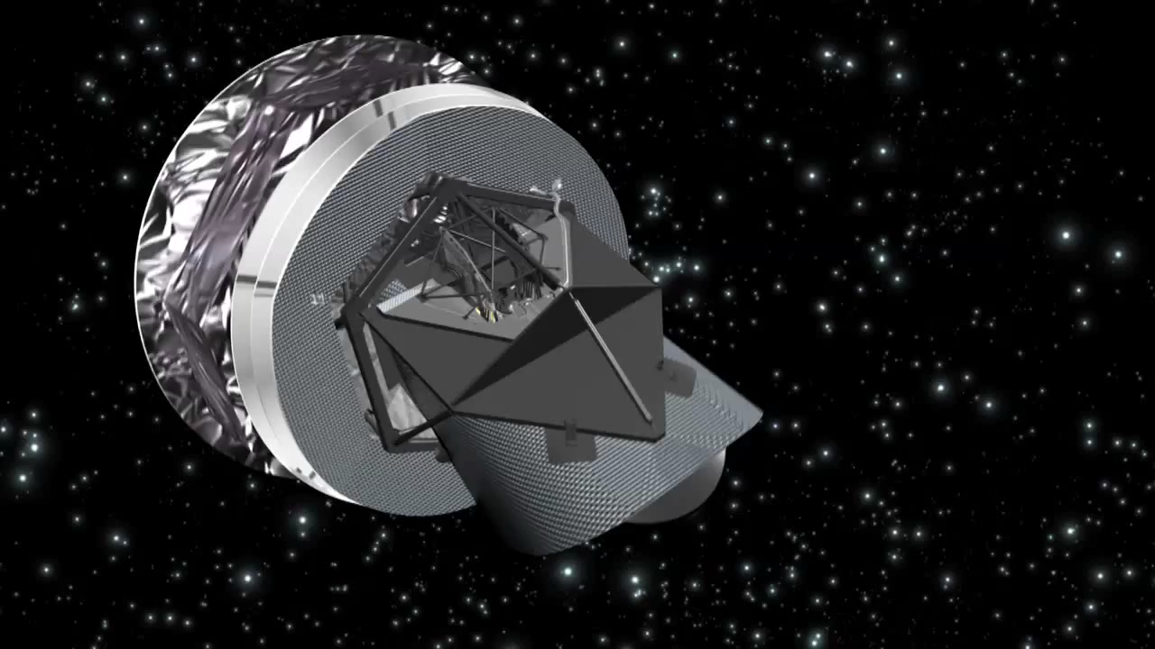
The Planck Satellite
Launched May 2009
Full-sky maps at ~25 to ~1000 GHz
March 2013 data release covers 15.5 months data

Slide 4
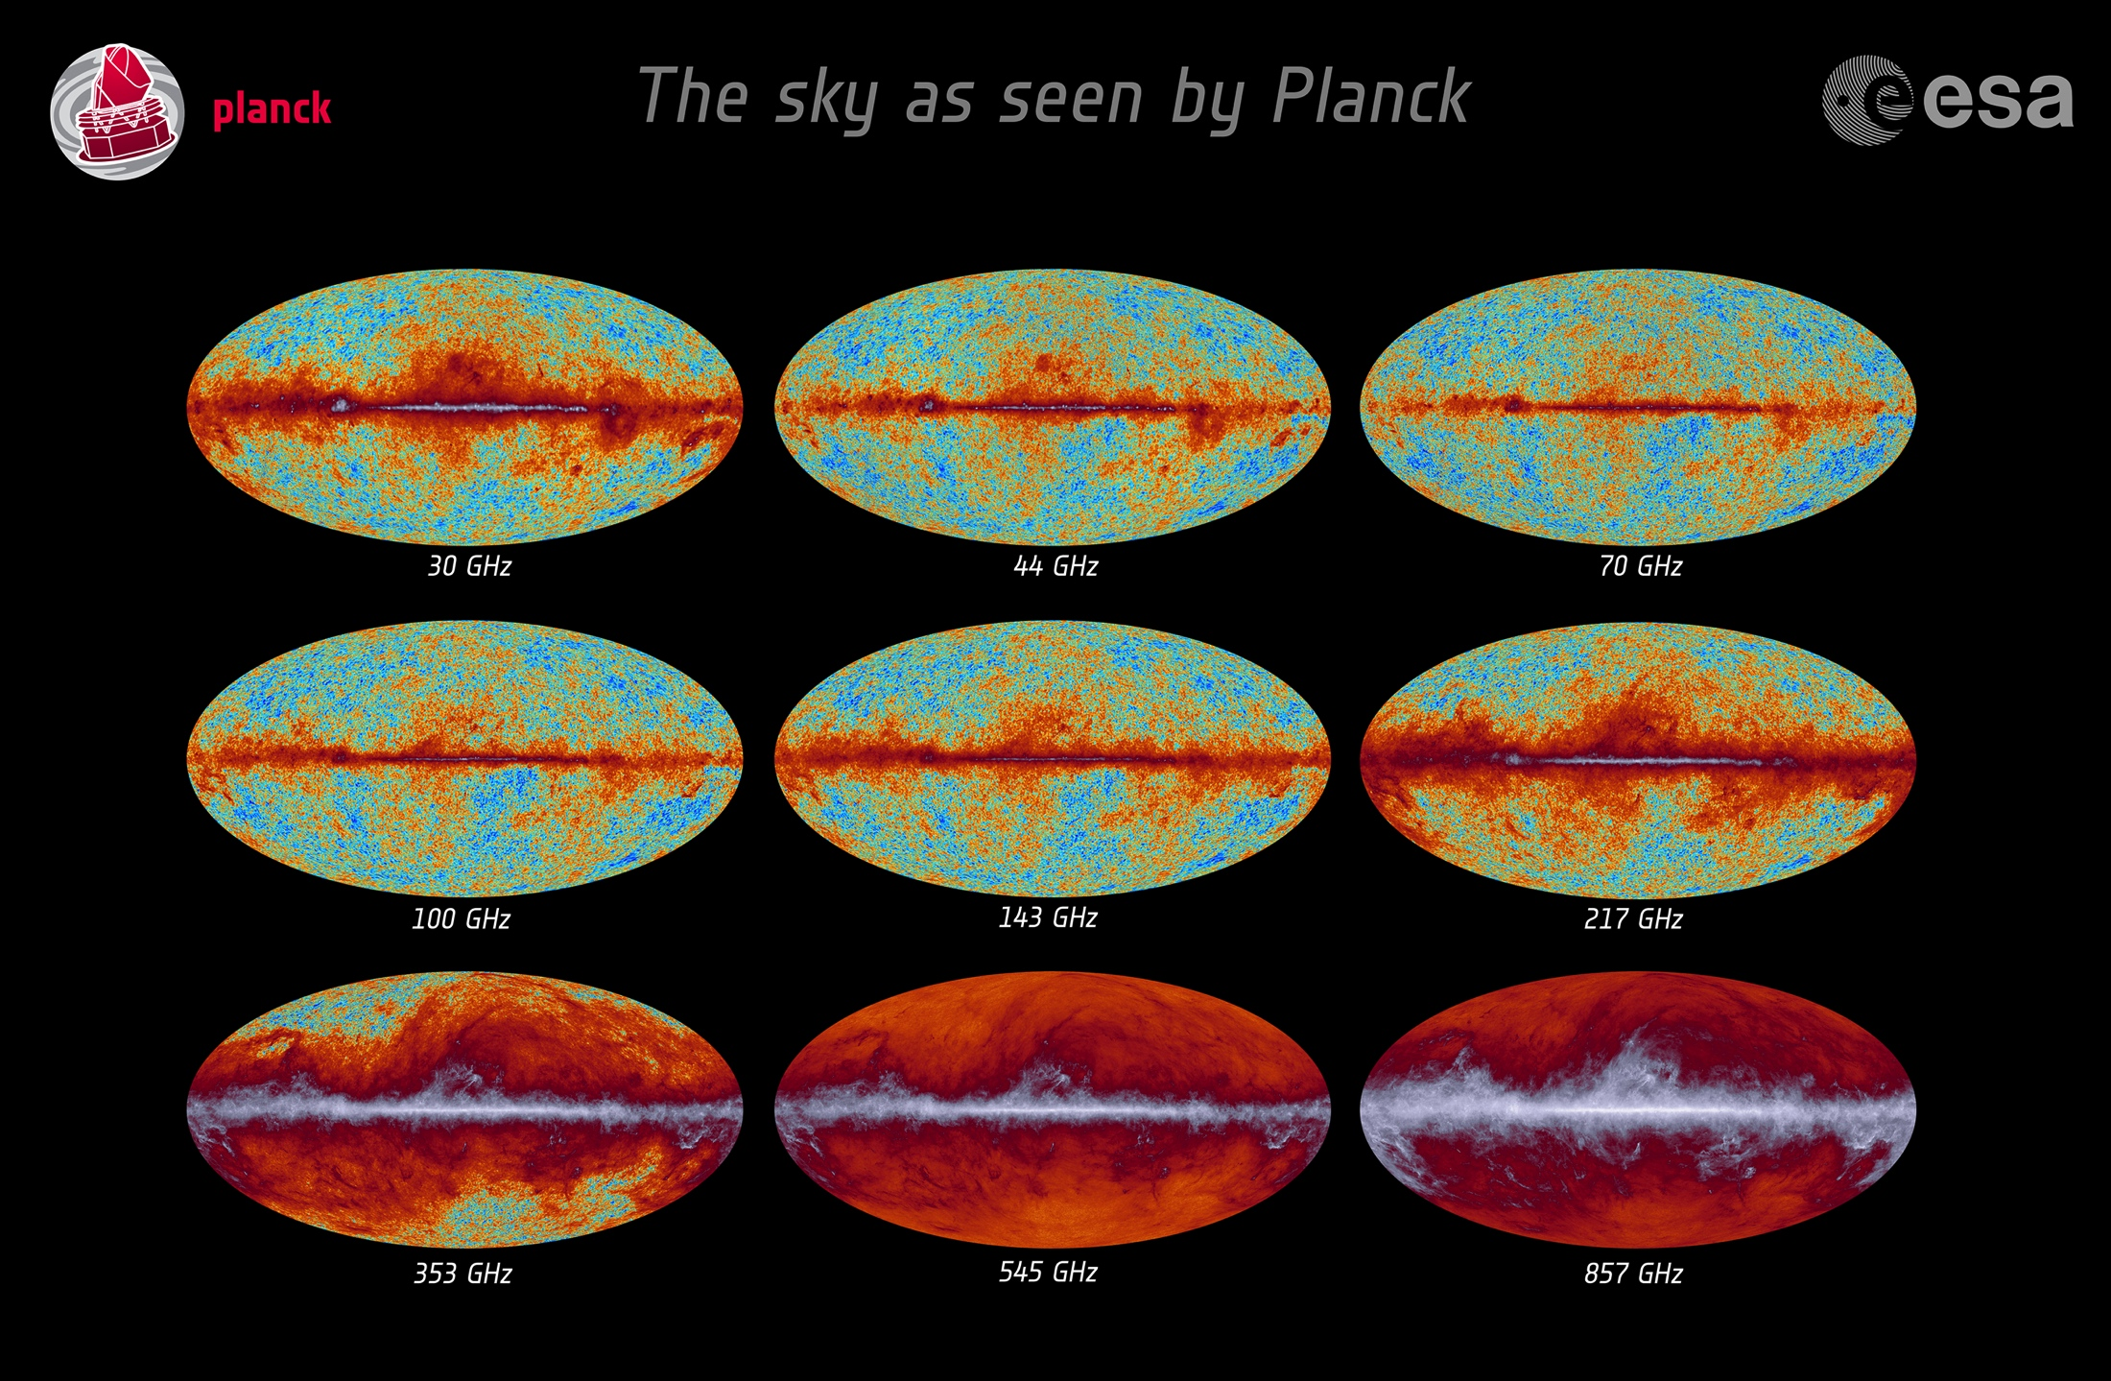
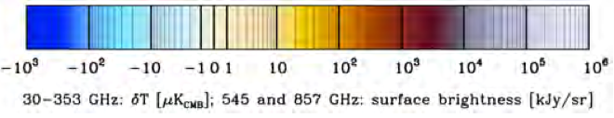

Slide 5
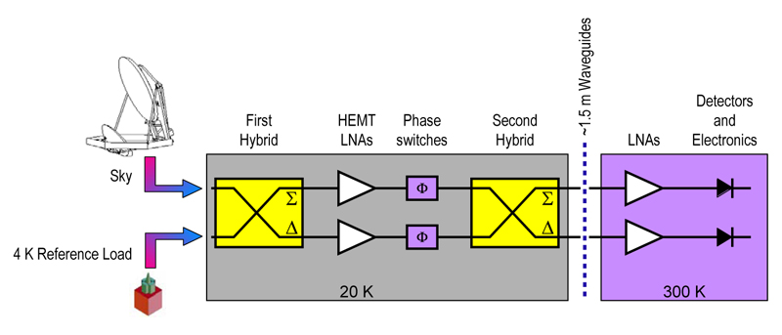
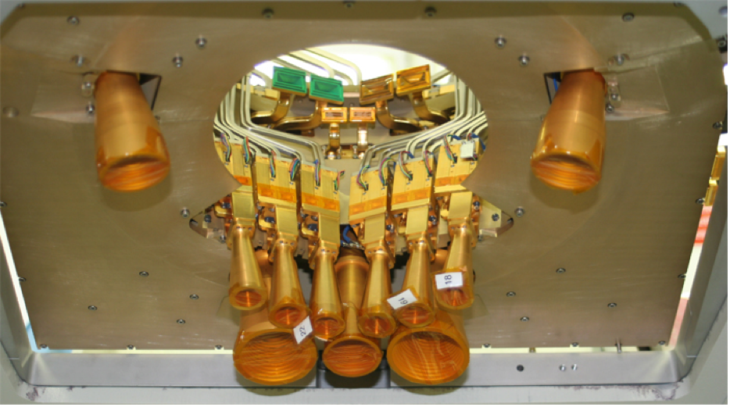
Planck Low Frequency Instrument
pseudo-correlation radiometers, based on HEMT low noise amplifiers

Slide 6
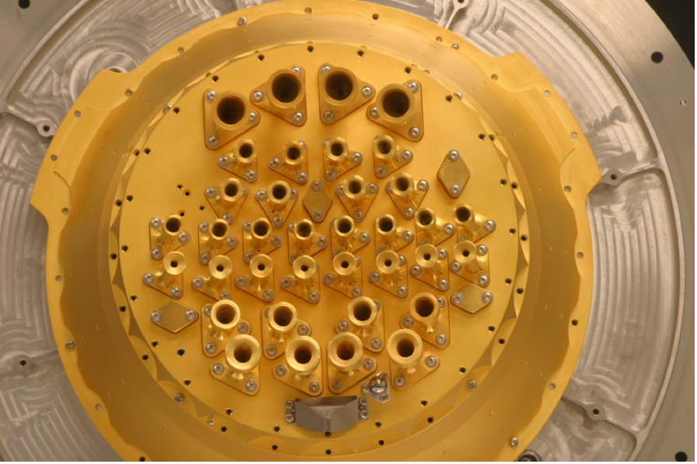
High Frequency Instrument
NTD-Germanium bolometric detectors

Slide 7
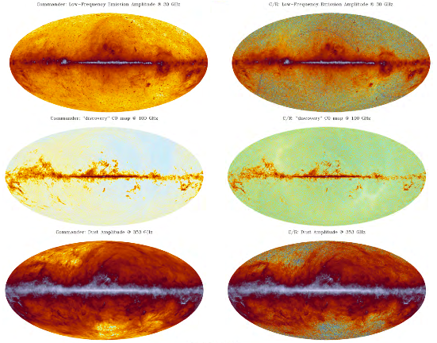
Broad Frequency Coverage Allows Foreground Removal
Low frequency
Carbon Monoxide
Dust
1 degree
7’

Slide 8
Selected Planck Data Products

Slide 9
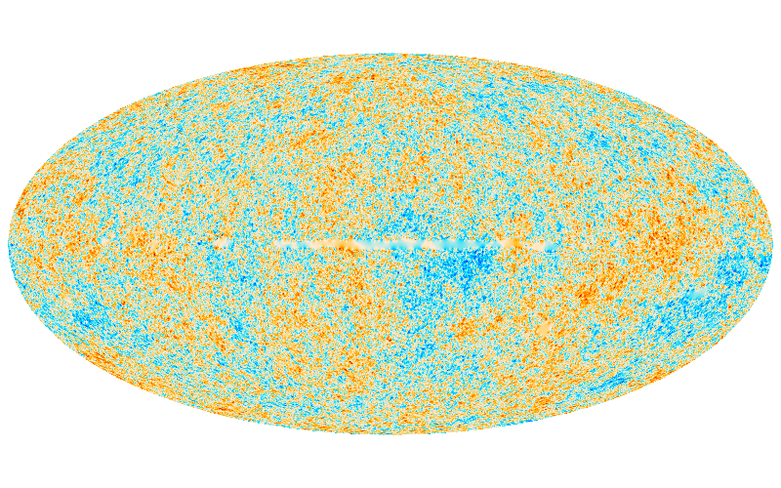
CMB Map and Power Spectrum
7 acoustic peaks detected at high significance

Slide 10
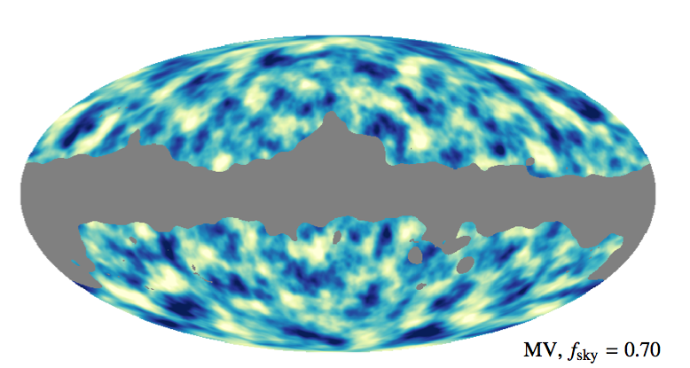
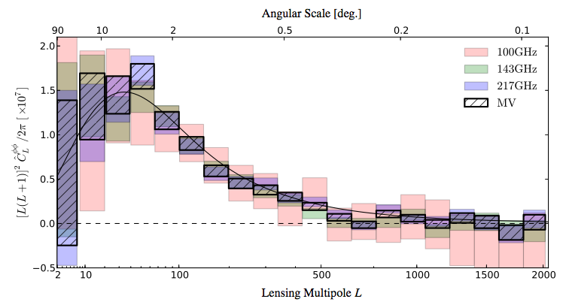
Gravitational potential of matter between us and last scattering reconstructed from lensing of CMB fluctuations
Notes:
MV – minimum variance combination

Slide 12
Science Highlights that I’ll Discuss
Powerful test of ΛCDM
  Standard theory of particle physics + 6 parameter model gives excellent fit to Planck data
  Some tension in best fit parameter values compared to other data sets, e.g. high Ω_{m}, low H₀
Extensions to the model
  Neutrino Constraints
  Inflationary Parameters

Slide 13
The physics of CMB fluctuations are straightforward
Initial power spectrum of scalar modes and tensor modes (arise naturally from quantum fluctuations stretched out by inflation)
Matter fluctuations begin to collapse as they enter the horizon
Physical size of fluctuation
Time at which a given fluctuation enters the horizon
TIME

Slide 14
The physics of CMB fluctuations are straightforward
Initial power spectrum of scalar modes and tensor modes (arise naturally from quantum fluctuations stretched out by inflation)
Matter fluctuations begin to collapse as they enter the horizon
Gravity + radiation pressure couple the baryons and the photon background ⇒ oscillations in the photon-baryon fluid
Physical size of fluctuation
Time at which a given fluctuation enters the horizon
TIME

Slide 15
The physics of CMB fluctuations are straightforward
Initial power spectrum of scalar modes and tensor modes (arise naturally from quantum fluctuations stretched out by inflation)
Matter fluctuations begin to collapse as they enter the horizon
Gravity + radiation pressure couple the baryons and the photon background ⇒ oscillations in the photon-baryon fluid
Decoupling removes radiation support; matter fluctuations are frozen into the CMB
Physical size of fluctuation
Time at which a given fluctuation enters the horizon
TIME
Decoupling

Slide 16
The physics of CMB fluctuations are straightforward
Initial power spectrum of scalar modes and tensor modes (arise naturally from quantum fluctuations stretched out by inflation)
Matter fluctuations begin to collapse as they enter the horizon
Gravity + radiation pressure couple the baryons and the photon background ⇒ oscillations in the photon-baryon fluid
Decoupling removes radiation support; matter fluctuations are frozen into the CMB
Scalar modes on certain angular scales are enhanced by this process, leading to the acoustic peaks in the CMB
Largest fluctuation that has had time to collapse
ΔT large (maximal compression)
Physical size of fluctuation
ΔT intermediate
ΔT small (maximal rarefaction
Time at which a given fluctuation enters the horizon
TIME
Decoupling

Slide 17
See as acoustic peaks in the power spectrum
7 acoustic peaks detected at high significance

Slide 18
Relation to parameters
Angular diameter distance
Acoustic peak
Sound speed horizon
Planck
Physics of peaks depend only on baryon/photon ratio, and non-relativistic to relativistic energy density (total matter to photons + neutrinos) → determines r_{s}
Distance depends on geometry and late time effects on the expansion rate.

Slide 19
Relation to parameters
Angular diameter distance
Acoustic peak
Sound speed horizon
Planck
Angular size measured to 0.1% precision from Planck

Slide 20
Data are fit with the “Standard Model” of Cosmology
Standard model of particle physics…..
+ general relativity…..
+ ΛCDM in its simplest form
  spatially-flat
  parameters – Ω_{b}h², Ω_{m}h², Ω_{Λ}, τ
  a power-law spectrum of adiabatic scalar perturbations -- n_{s}, A
If curvature is included, spatial flatness is implied to percent level precision using Planck CMB data alone.

Slide 21
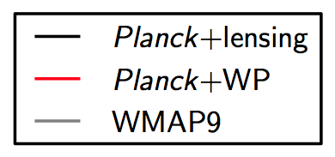
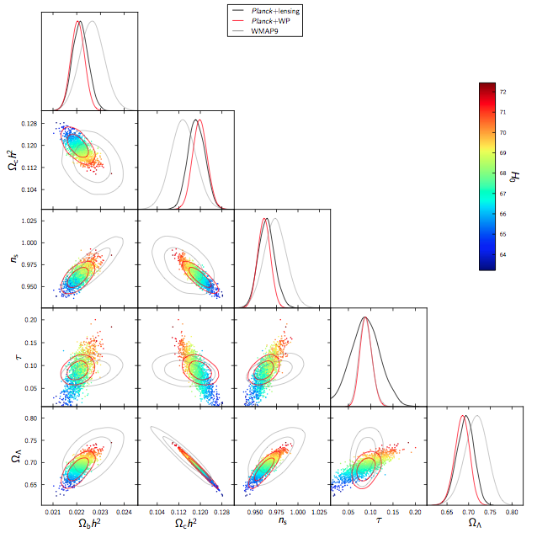

Slide 22
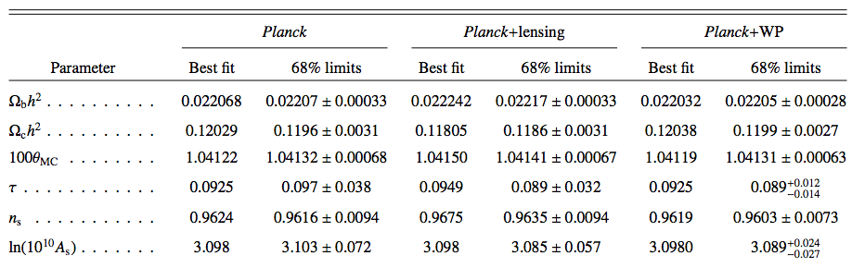
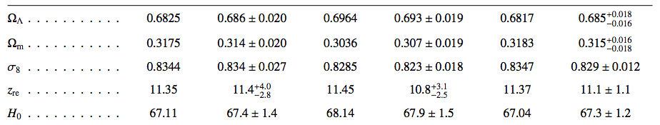
Parameters

Slide 23
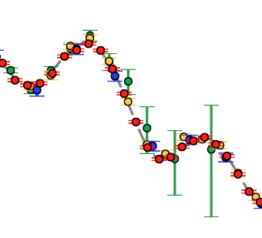
Comparison with other data sets
High-L
{
High l data constrain foreground signals that are not well resolved by Planck. Consistency check on parameters

Slide 24
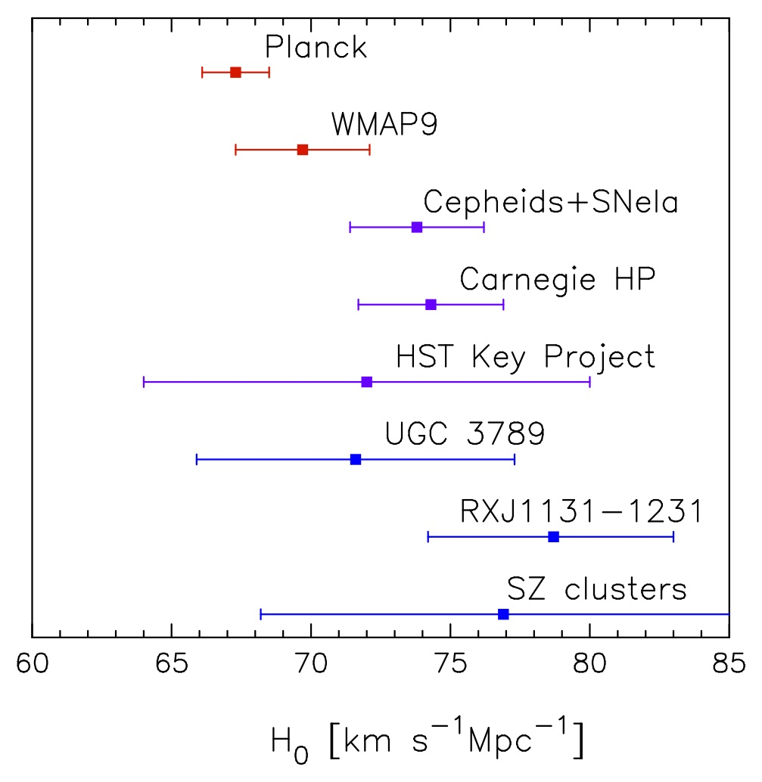
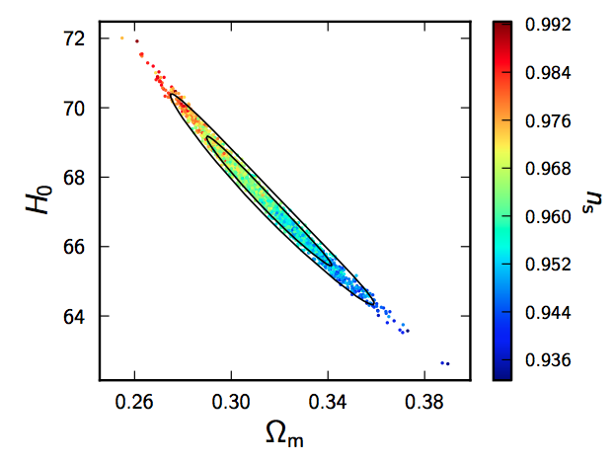
Some tension with low-z measurements of H₀
From Planck alone:
H₀ = 67.4 ± 1.4 km s⁻¹ Mpc⁻¹
Ω_{m} = 0.315 ± 0.017.
Contours from adding WMAP polarization data

Slide 25
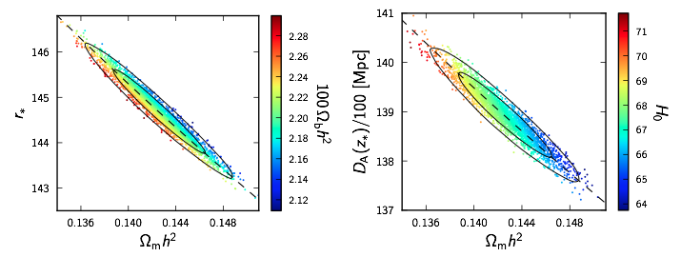
Higher values of H₀ are difficult to match with the standard ΛCDM model
Well-constrained angular scale of acoustic peaks depends on
The addition of WMAP polarization data and high-l data limits the degeneracy

Slide 26
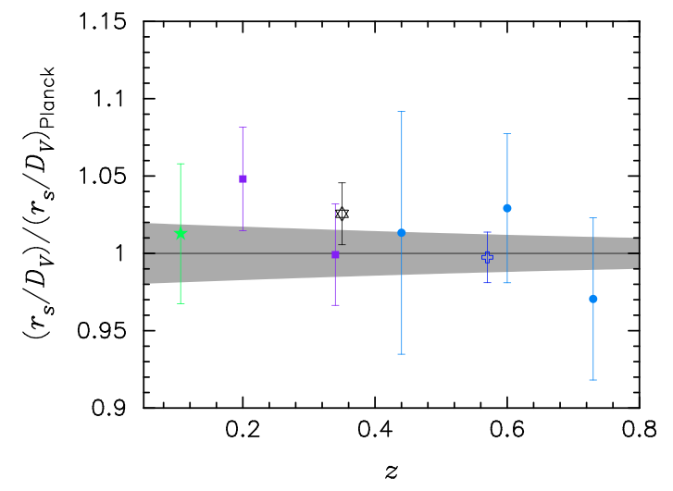
ΛCDM model predicts an acoustic scale for BAO measurements that agrees well with data
Consistency check for the H₀ measurements

Slide 27
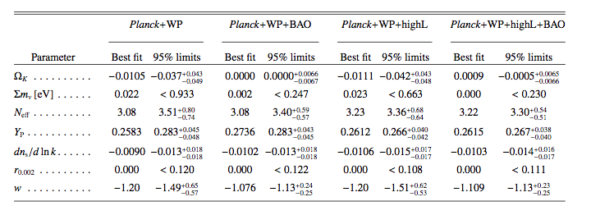
Helps to set constraints on additional parameters above and beyond the 6-parameter model

Slide 28
Helps to set constraints on additional parameters above and beyond the 6-parameter model

Slide 29
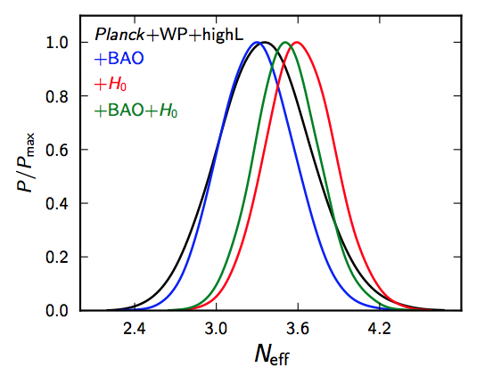
Neutrinos
Effect of increasing radiation density via addition of neutrino families is to suppress small scale power in the CMB
Low-z measurements of H₀ push N_{eff} to a higher value
Notes:
Increases expansion rate, universe is younger at decoupling. But free streaming is random so less affected than sound horizon. Therefore fluctuations erased

Slide 30
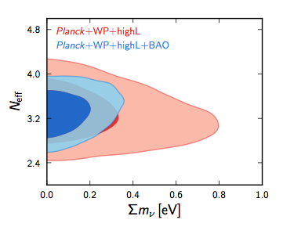
CMB plus BAO also constrains the sum of the neutrino masses

Slide 31
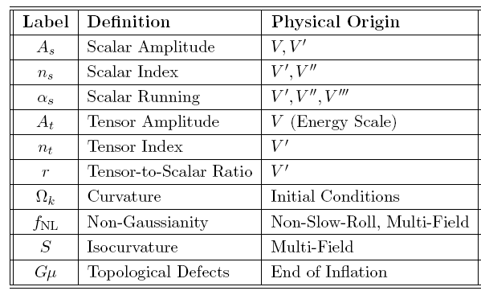
Planck Probes Inflationary parameters
}
Matter power
spectrum
}
Primordial
Gravitational
waves
Zero to 1%
Not detected
See review Baumann et al., arXiv:0811.3919

Slide 32
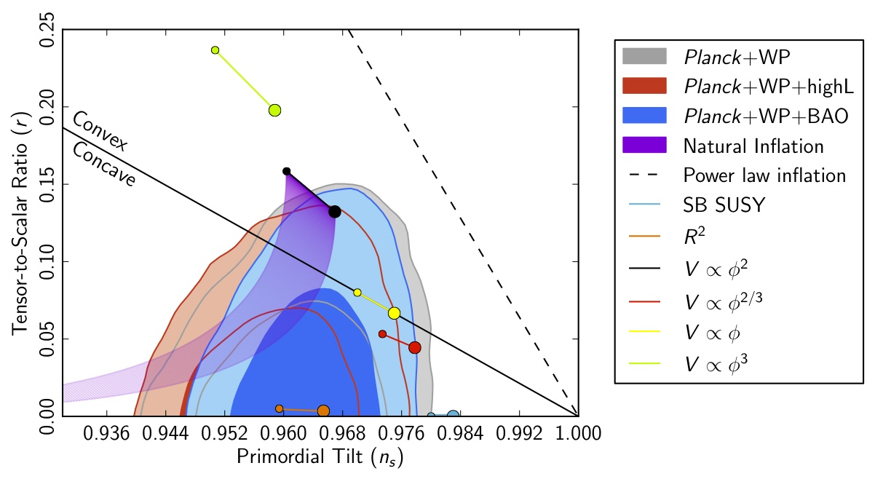
Implications for Inflation
Consistent with single-field slow-roll inflation
Notes:
models can have a convex or concave potential, depending on the sign of ∂2V or ∂2f when observable ∂φ2 ∂φ2
scales exit the Hubble radius and φ = φ∗. Convex models (∂2V/∂φ2 ≤ 0) have η∗ < 0 and belong to the region where ns ≤ 1 and 0 ≤ r ≤ −8(ns − 1). Concave models (∂2V/∂φ2 ≥ 0) occupy the
3
rest of the (r, Ns) plane.

Slide 33
Summary
A wealth of data from Planck has provided strong evidence for the standard ΛCDM.
There are a vast number of science results that I didn’t have time to touch upon!
There are some discrepancies with non-CMB data that the Planck team is working to resolve.
2014 will see another data release – more temperature data; polarization data.

Slide 34
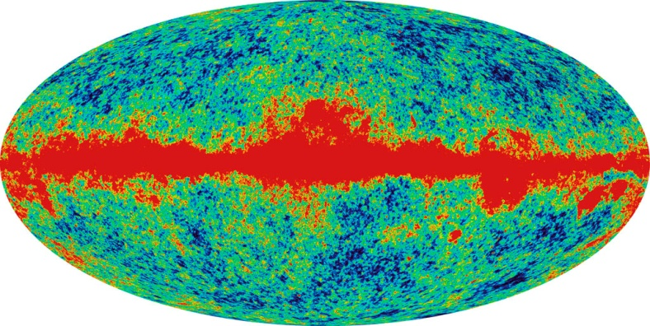
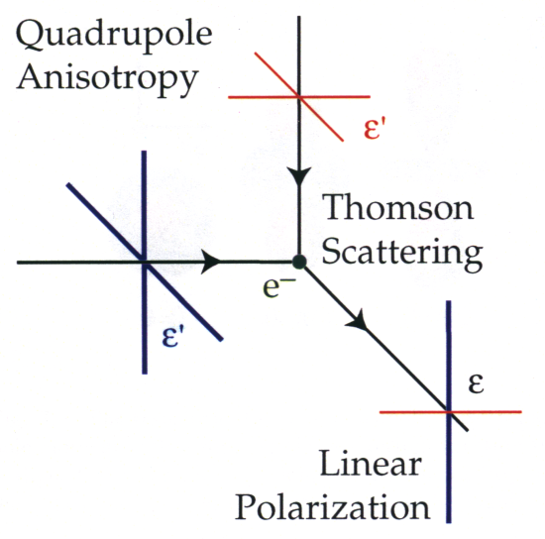
Looking ahead – the CMB isn’t done yet!
Spatial temperature variations:
Frequency spectrum
COBE satellite
WMAP satellite 2003
WMAP, Planck
Polarization generated by anisotropic Thomson scattering
The polarization percentage is high (around 10%), but the signal is still very weak
Once again the physics is well-understood
Precision cosmology equally feasible using polarization
Picture by W. Hu

Slide 35
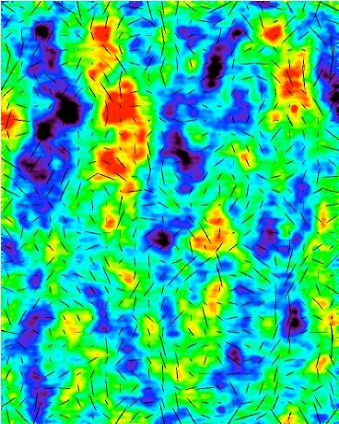

“E” and “B” modes
B modes
ONLY FROM TENSOR MODES (gravitational waves)
E modes
E Fourier mode
B Fourier mode
See, e.g. Bunn, 2005
QUaD Experiment (Brown et al. 2009)

Slide 36
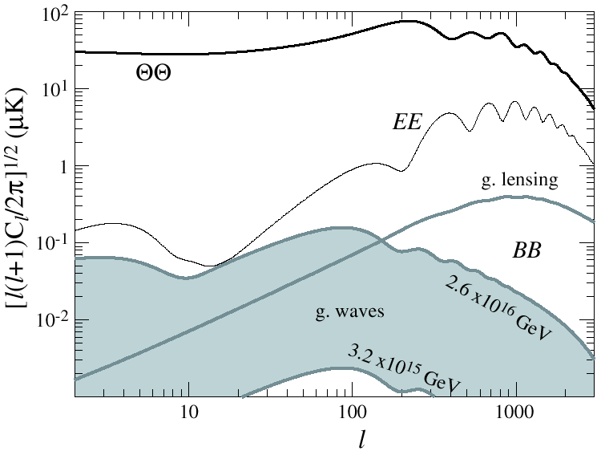
Polarization measurements require greater sensitivity than temperature measurements...
Temperature spectrum mapped by Planck WMAP
X10000 fainter!
Reionization bump detected by WMAP
Planck Polarization data release 2014
Gravitationally lensed E-modes probe large scale structure formation, neutrino mass, dark energy
Picture credit, Wayne Hu
Projected effect of a gravitational wave background
The range shown for the gravitational wave background spans the maximum allowable level pre-Planck, WMAP, and the minimum detectable from CMB measurements

Slide 37
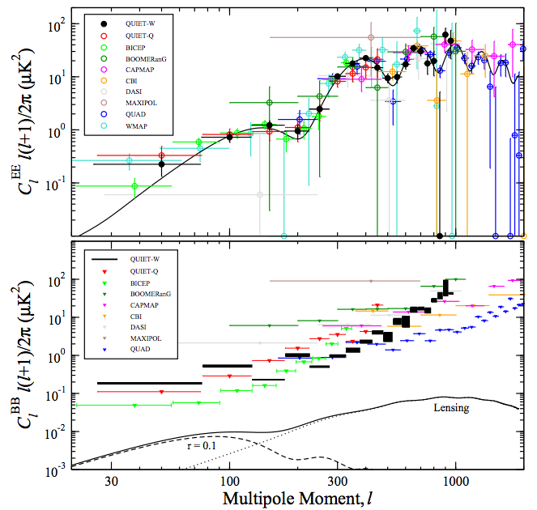
Current status of field
Planck data to come 2014

Slide 38
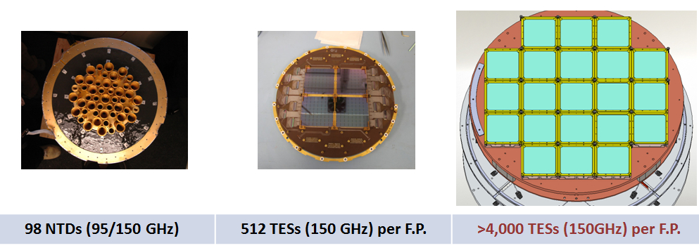
Looking ahead – the CMB isn’t done yet!
The Planck data (polarization to come 2014) are honing in on cosmological parameters with ever greater precision
However, significantly stronger limits on interesting new physics will require a new generation of CMB polarization experiments
  Deep integrations on areas of clean sky with tens of thousands of polarization-sensitive detectors
  Much stronger limits on neutrino and inflationary physics
Presentation by Chao-Lin Kuo at the Cosmic Frontier Workshop, SLAC, March 2013
Stage-IV CMB
Duplicate (>10x)
Focal planes
Stage I
Planck-style
QUaD, BICEP
Stage II
Fielded
Keck, SPT, Polarbear, ACT
Stage III
Being built

Slide 39
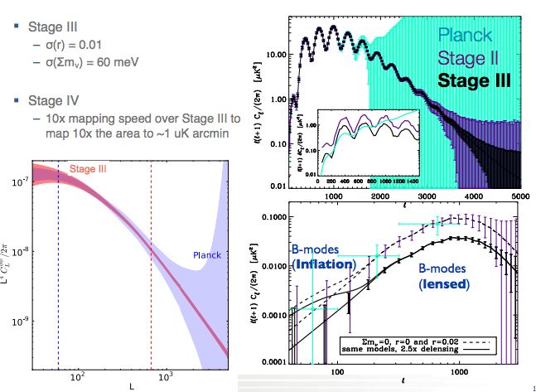
Presentation by Clarence Chang at the Cosmic Frontier Workshop, SLAC, March 2013
Being built
Snowmass Working Group CF5

