Slide 1
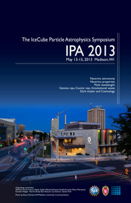
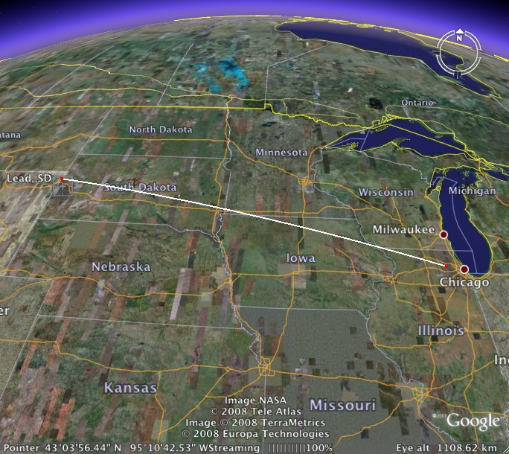


LBNE: Status and Outlook
Jon Urheim, Indiana University,
Representing the LBNE Collaboration
IceCube Particle Astrophysics Symposium
Madison WI, 14 May 2013
LBNE
ν
ν
1300 km
ν
ν
ν
ν

Slide 2
Outline
  Scientific Motivation
  LBNE is…
    Technical Summary
    Science Collaboration
  Staging the Experiment
    Overview
    Strawman Scheme w/ Cost Estimates
  Oscillation Parameter Sensitivities
    With a 10 kt Liquid Argon TPC Far Detector (LBNE10)
    With the full LBNE and with Project X
  LBNE Beam and Far Detector
  Time permitting:
  Underground Science
    Proton Decay
    Super Nova Burst Neutrinos
    Atmospheric Neutrinos
  Near Detector Physics
Acknowledgements:
- M. Diwan
- J. Strait
- R. Wilson
- M. Bishai
- LBNE Physics
Analysis Group
- LBNE Scientists,
Engineers & Tech
LBNE
ν
ν
1300 km
ν
ν
ν
ν

Slide 3
Scientific Motivation for LBNE
  CP Violation in neutrino sector
    Key ingredient for baryon asymmetry of the universe?
  Neutrino Mass Hierarchy
    GUTs, String Theory, Impact on Dirac vs. Majorana nature
Testing the Three-Flavor Paradigm
  Precision measurements of oscillation parameters
  New physics -> non-standard interactions, sterile neutrinos… (beam+ atmos.ν’s)
  Precision neutrino interactions studies (near detector)
Observation of Nucleon Decay
    Grand Unification
Neutrino Astrophysics
    Supernova ν burst flux and energy spectrum
These science goals led to DOE CD-0 approval in January 2010
  It took a decade of high-level review panel recommendations (P5, NAS etc.) to achieve this

Slide 4
LBNE is…
A new neutrino beam at Fermilab
  700 kW, 60 – 120 GeV proton beam, 2.3 MW capable beam line
A near (neutrino) detector complex on the Fermilab site
A 1300-km baseline: Fermilab to SURF – nearly optimal for oscillation physics
A 34-kt Liquid Argon TPC, located underground at SURF (4850’ overburden)
An optimized-cost/time-effective path to the science
  Large θ₁₃ means δ_{CP} is accessible
This conceptual design …
  Completed a successful CD-1 Director’s Review (March 2012)
  Was subject to considerable scrutiny for cost and schedule
  Estimated cost (July 2012): ~ $1.5 B (incl. contingency & escalation)

Slide 5
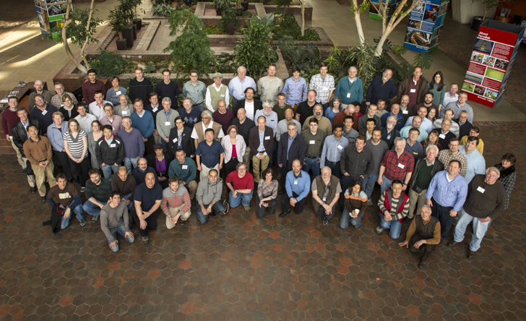
LBNE is …
Alabama
Argonne
Boston
Brookhaven
Cambridge
Catania
Columbia
Chicago
Colorado
Colorado State
Columbia
Dakota State
Davis
Drexel
Duke
Duluth
Fermilab
Hawaii
Indian Group
Indiana
Iowa State
Irvine
Kansas State
Kavli/IPMU-Tokyo
Lawrence Berkeley NL
Livermore NL
London UCL
Los Alamos NL
Louisiana State
Maryland
Michigan State
Minnesota
MIT
NGA
New Mexico
Northwestern
Notre Dame
Oxford
Pennsylvania
Pittsburgh
Princeton
Rensselaer
Rochester
Sanford Lab
Sheffield
SLAC
South Carolina
South Dakota
South Dakota State
SDSMT
Southern Methodist
Sussex
Syracuse
Tennessee
Texas, Arllington
Texas, Austin
Tufts
UCLA
Virginia Tech
Washington
William and Mary
Wisconsin
Yale
372 collaborators, 62 institutions, 5 countries (April 2013)
Fermilab, March 2013

Slide 6
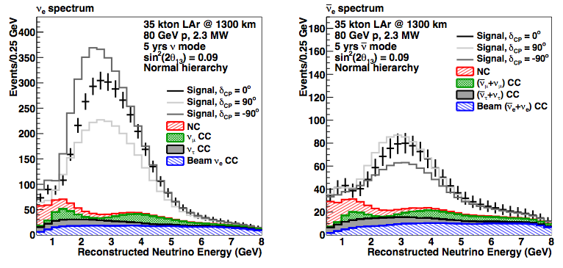
LBNE CPV Principle of Operation
L. Whitehead
For illustration showing only the Normal Hierarchy case

Slide 7
LBNE: Chained & Liberated

Slide 8
Staging the Experiment
March 2012 DOE asked us to stage LBNE construction; an external review panel considered reconfiguration options including different far sites (including existing MINOS and NOvA sites)
  We accepted the recommendation to proceed with emphasis on the most important aspects: 1300 km baseline, a site with infrastructure to support a massive underground detector (SURF) and a full capability beam
December 2012: CD-1 approval for $867M first phase DOE funding
  We have completed an extensive cost/schedule for 10 kt LAr far detector (LBNE10) on the surface but the design is not fixed
  CD-1 approval explicitly allows for scope change enabled by new partners with additional resources
First phase goal: greater than 10 kt far detector underground and a full capability near detector
There has been good progress towards international partnerships (encouraged by European Strategy statement)

Slide 9
Plausible scenarios for scope recovery in phase 1
Assuming DOE initial investment of $867M
Additional Investment (TPC) | Capability Added | Science Gained | Science Priority
+ $140M | Underground placement | ATM nus, p-decay, SNB nus | Very High
+ $130-190 | Near Detector | Enhanced LB physics, near detector physics | Very High
+ $200-350 | Add FD mass (>30 kt) | Precision CP and other 3-flavor paradigm measurements; p-decay | Very High

Slide 10
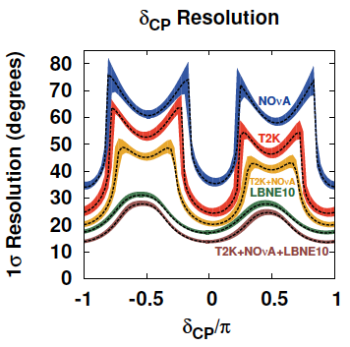
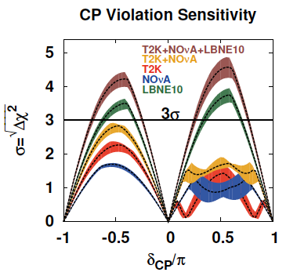
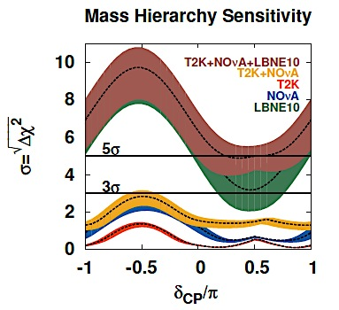
Even absent these, LBNE10 would be a Major Advance
PRELIMINARY Sensitivity Metrics
M. Bass
Normal Hierarchy known
Normal Hierarchy case
Bands: 1σ variations of θ₁₃, θ₂₃, Δm₃₁² (Fogli et al. arXiv:1205.5254v3)

Slide 11

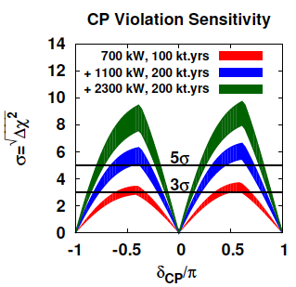
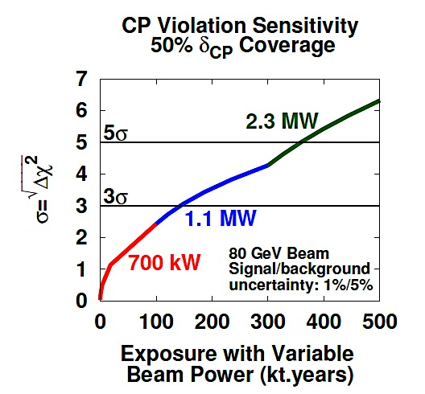
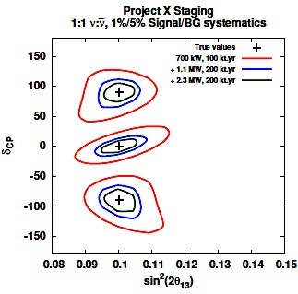
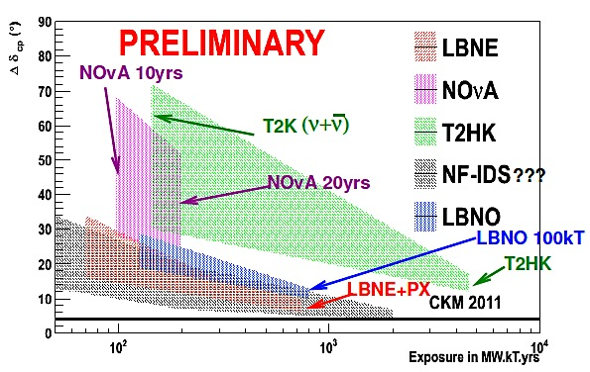
Full LBNE + Project X = Beyond-Awesome
Bands: Beam design range
PRELIMINARY
Sensitivity Metrics
M. Bass
M. Bishai

Slide 12
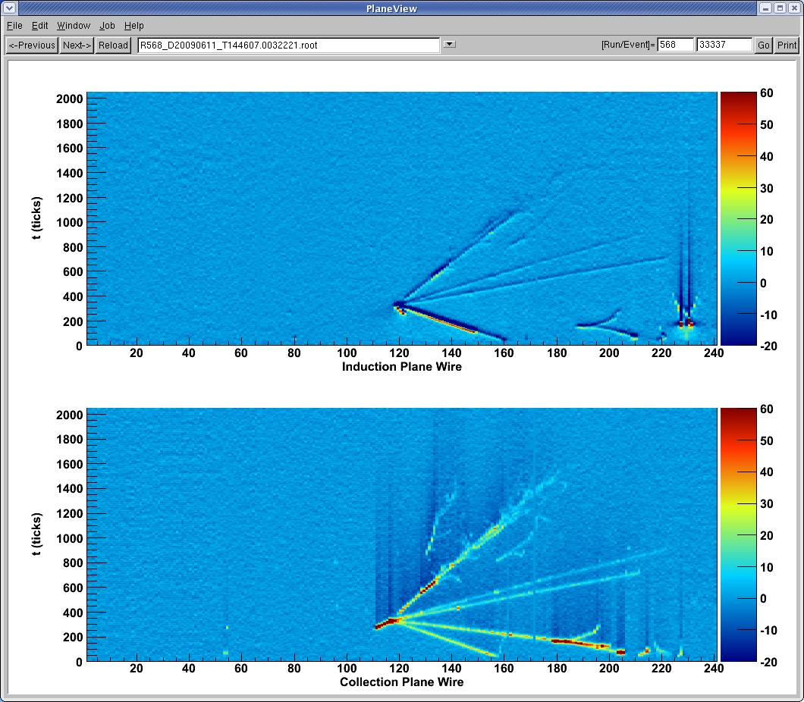
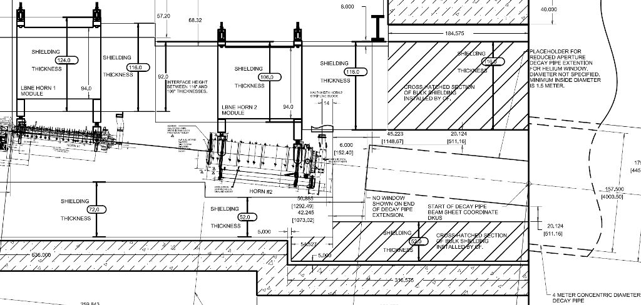
LBNE Beam and Far Detector
4 m dia.
Target Hall, horns, decay pipe
NuMI neutrino event in ArgoNEUt

Slide 13
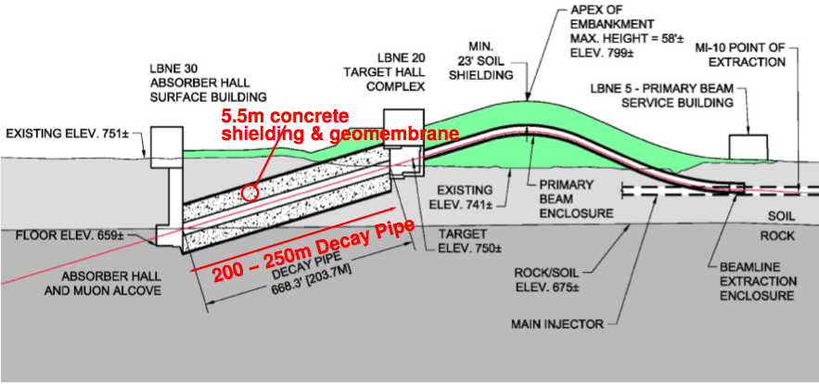
LBNE Beam Line
Novel ‘beam-on-a-hill’ layout, designed for 60-120 GeV @ 2.3 MW
Tritium ok,
Even with 5.6º pitch !!
Cost (CD-1): ~ 390M in AY$ , incl. conv. facilities & 30% contingency

Slide 14
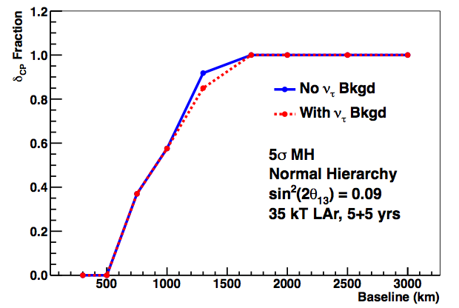
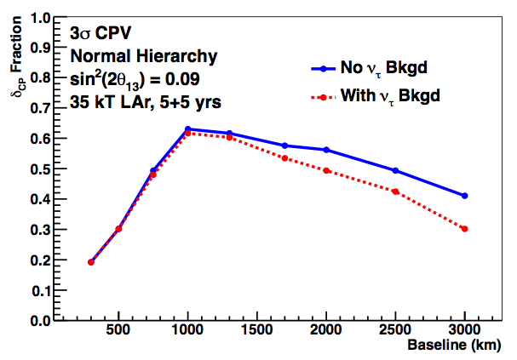
Choice of Far Detector Site / Baseline
Mass Hierarchy Sensitivity at > 5σ
M. Bishai
CPV Sensitivity at > 3σ
1300 km

Slide 15
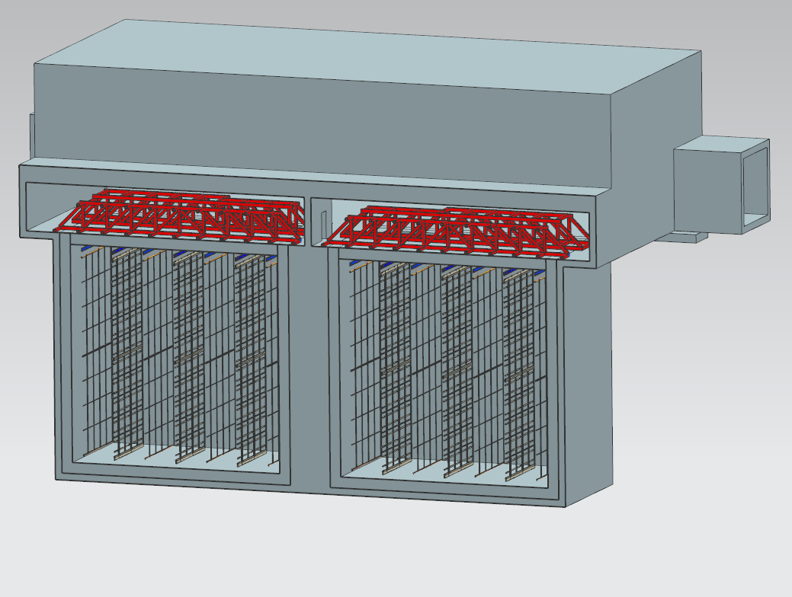
“LBNE10” Liquid Argon TPC Far Detector
Key Features:
  13 kt (active) / 10 kt (fiducial)
  Two modules (cryostats)
  “Membrane” style cryostat w/ passive insulation
  Modular TPC: Anode wire plane assemblies (APA’s) and cathode plane assemblies (CPA’s) hung from rails along cryostat roof.
  Submerged CMOS electronics mounted on APA frames
  Scintillation photon detectors
  FULL LBNE Far Detector is just a scaled-up version of this !!
Detector 2
Detector 1
ν beam
Alternating Anode and Cathode Planes
2.3 m drift

Slide 16
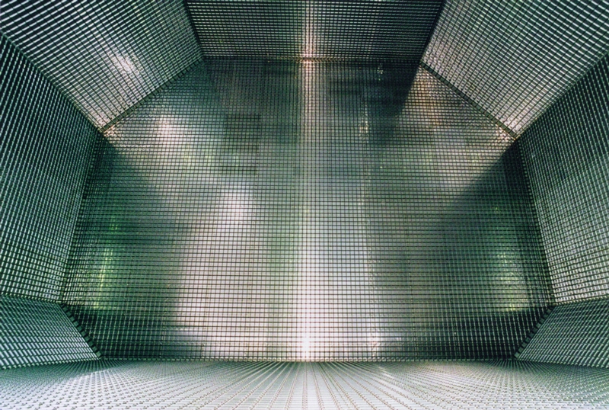
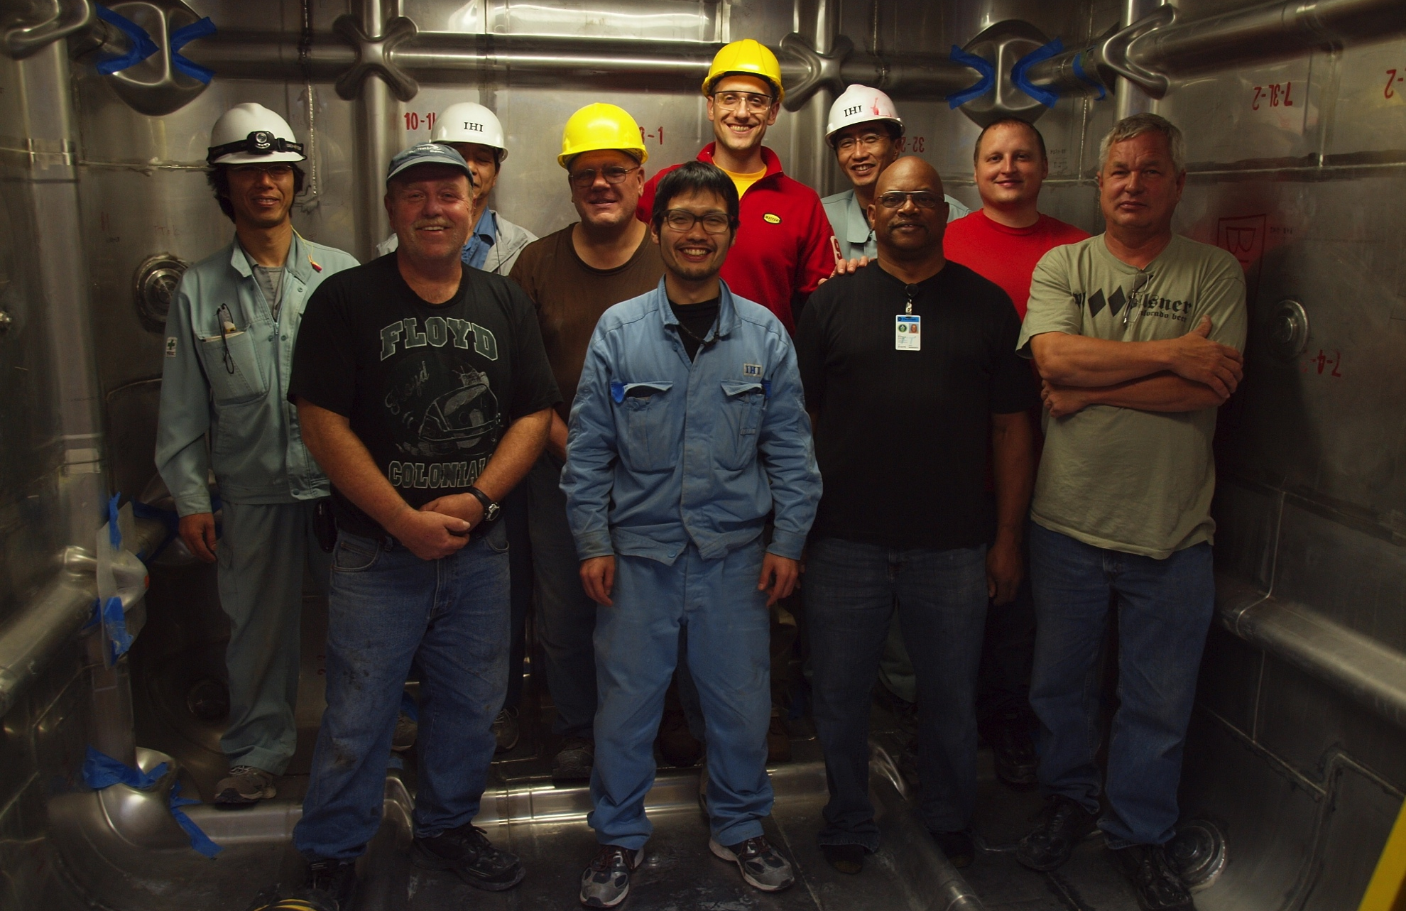
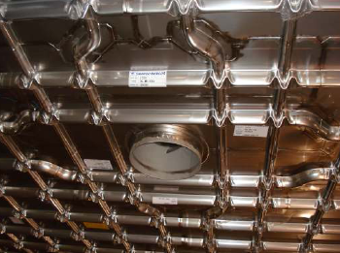
Membrane Cryostat Technology
Below: 35t prototype: SS membrane vessel constructed at FNAL, Fall 2012

Slide 17
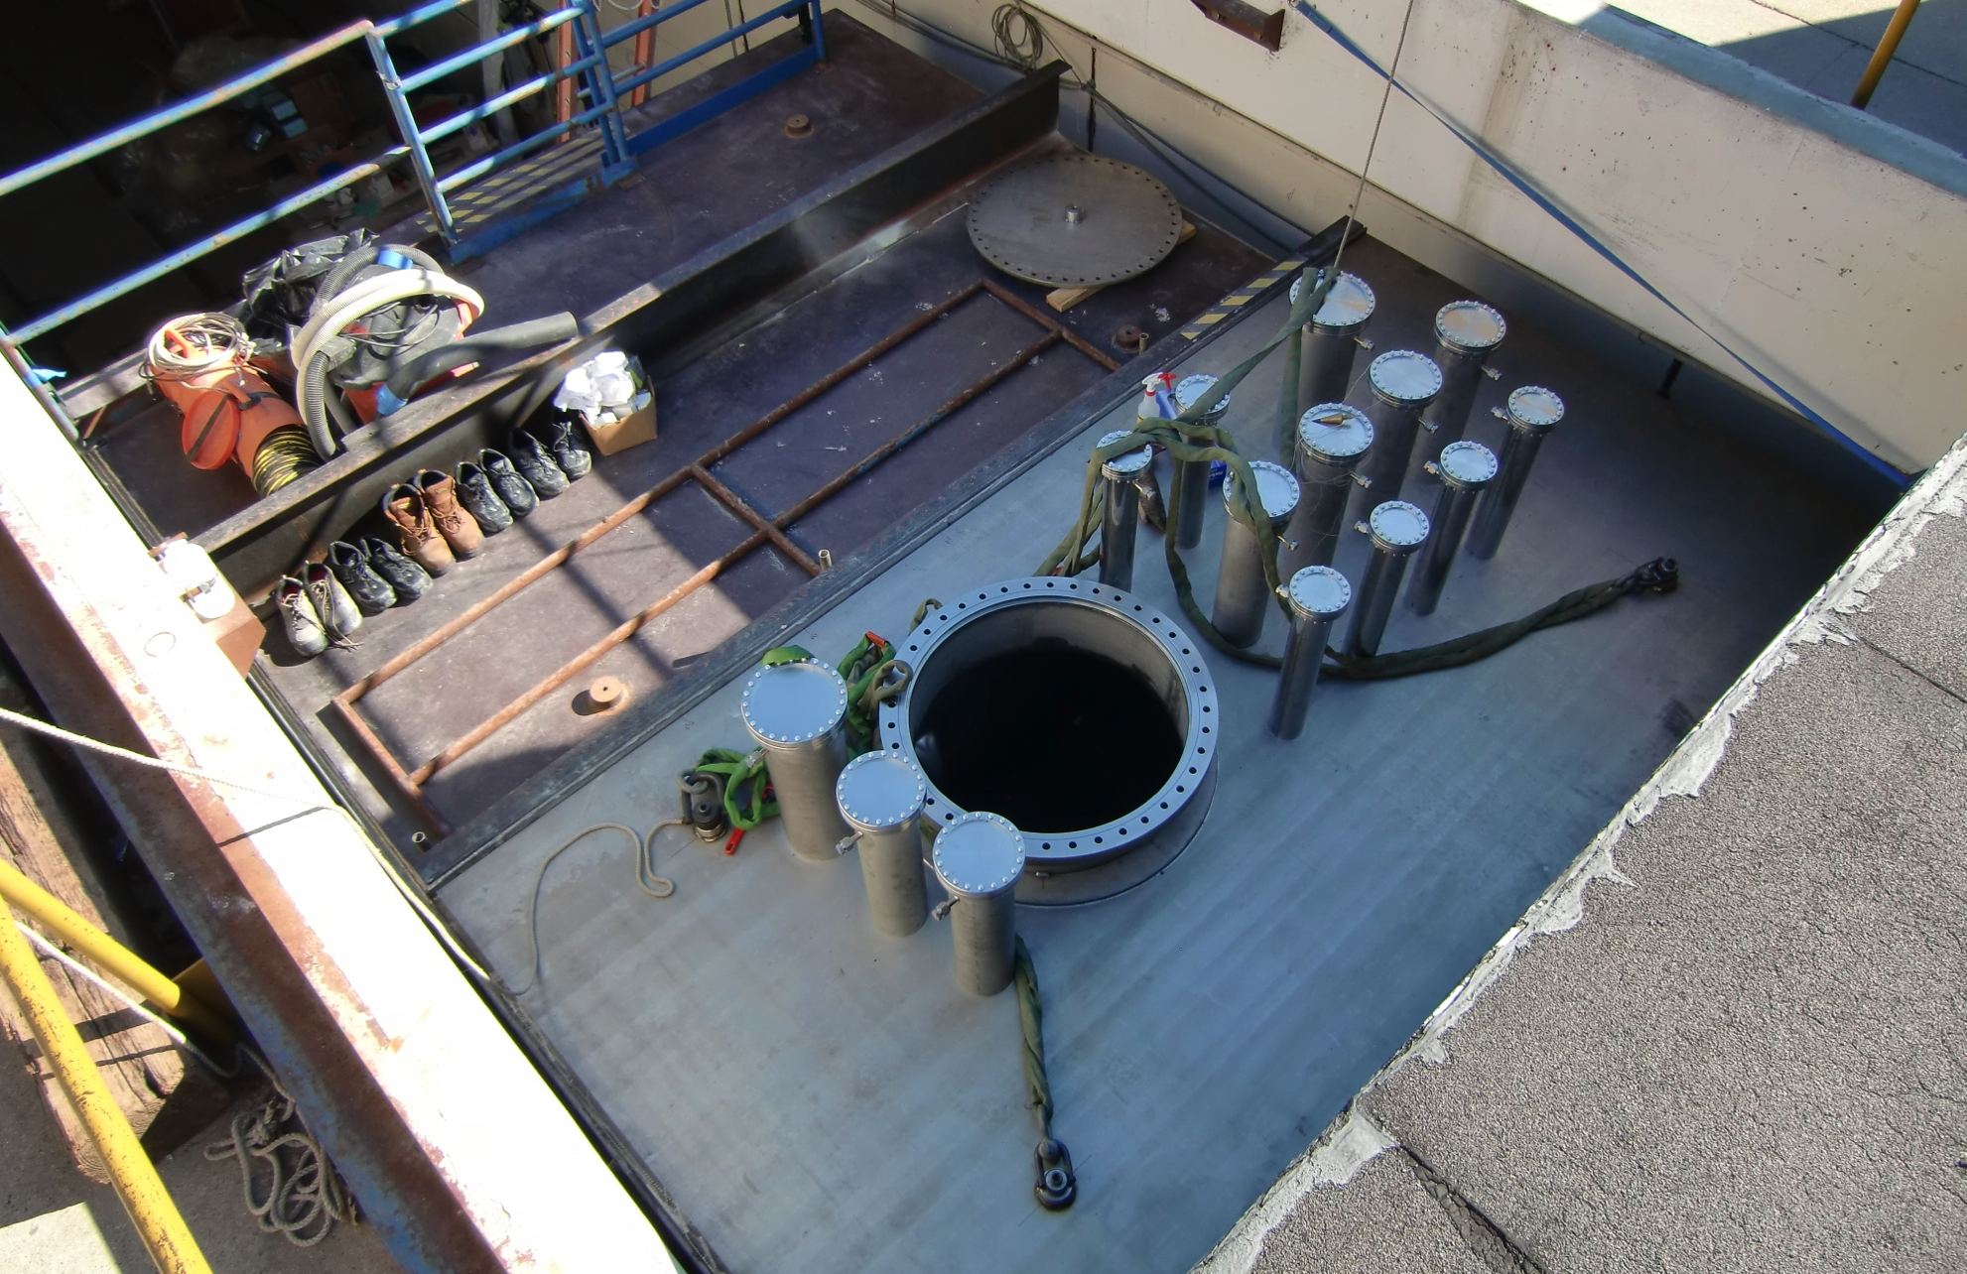
LBNE 35-ton Prototype Membrane Cryostat
FNAL R&D program has demonstrated attainment of needed Argon purity w/o evacuation in a conventional (cylindrical) 30-ton tank (LAPD).
→ Now test LBNE-style construction:
Will do purity tests in 35t membrane prototype (Phase-I) later this year
Will test prototype TPC components in late 2014.

Slide 18
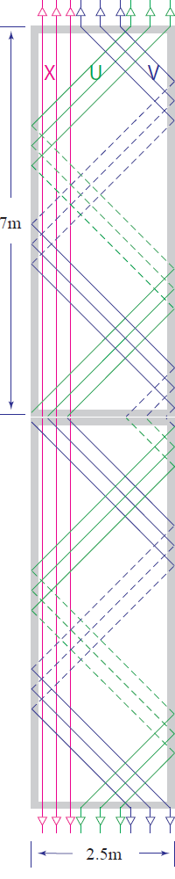
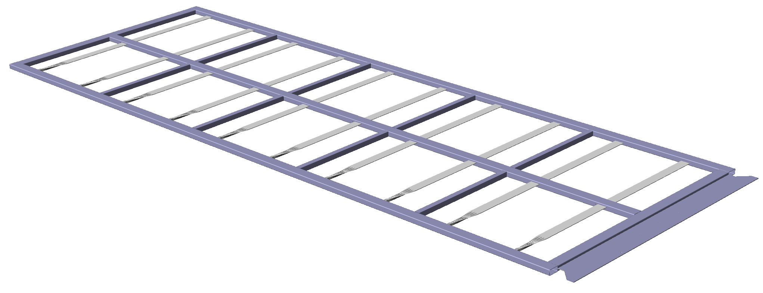
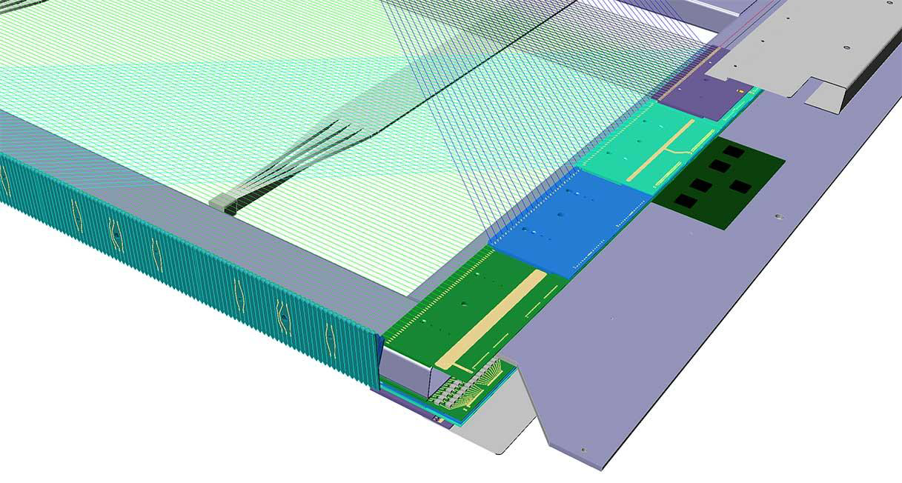
The TPC Anode Plane Assembly
Key features:
SS 304 channel frame
Four wire planes, each side:
  collection, 2 x induction +/- 45º, shaper
  induction wires wrap, allowing top readout
  ~4.5mm pitch, 2560 sense wires per APA
  CMOS front-end/ADC asics on FEBs on frame
Scintillation photon detector ‘paddles’ embedded
  wls-coated acrylic light guide bars
  SiPM readout
Prototoypes will go
into 35t vessel in 2014!

Slide 19
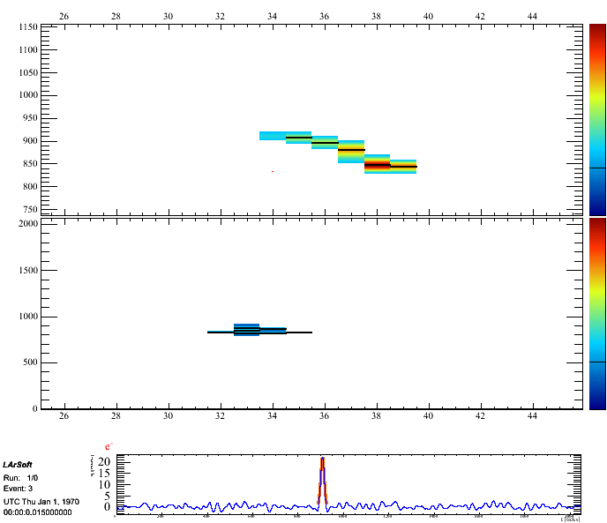
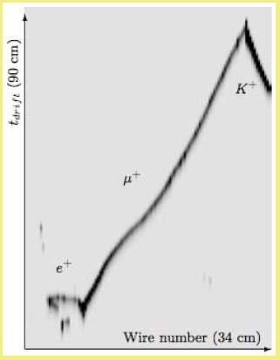
Underground Science with LBNE
Simulated p → K⁺ ν― decay
Simulated 10 MeV Supernova ν

Slide 20
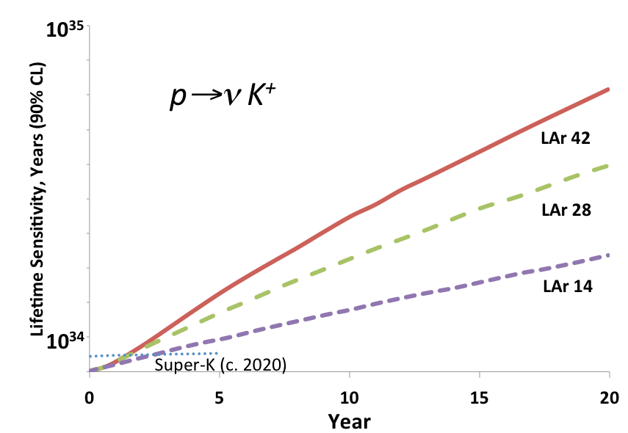
Nucleon Decay
kt
kt
kt
LAr has high efficiency for SUSY-favored decay modes
High spatial precision and energy resolution enable reconstruction of many potential decay modes

Slide 21
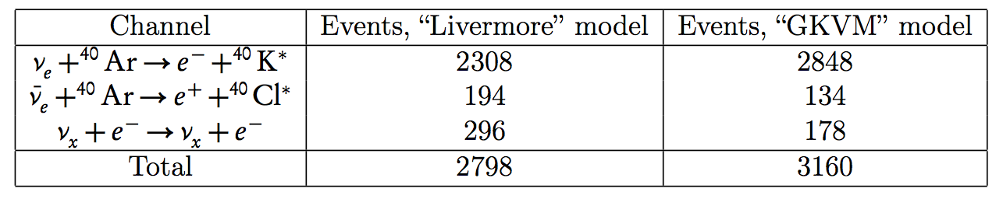
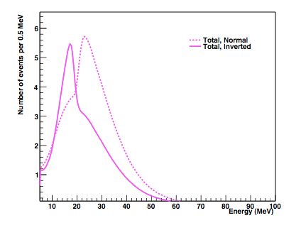
Supernova Neutrino Burst Detection
SN at galactic core (10 kpc) – several 1000 interactions in 34 kt LAr in 10’s of seconds
Complementary to Water Cherenkov
Fantastic for particle physics and astrophysics
(c.f. SN1987A ~dozen events significance)
Late ~1 sec time-slice model for NH & IH

Slide 22
Atmospheric Neutrinos
  Large range of energy and baseline
  Independent determination of mass hierarchy
    (or add significance to beam measurement)
  θ₂₃ octant sensitivity
  Searches for new physics
  Nu-e sensitivity complementary to water Cherenkov
    detectors (anti-nu-e)
Sensitivity Projections (including combinations w/ beam data analyses)
are being developed / evaluated, and will be presented next week at the
ISOUP symposium in Asilomar.
Preliminary analysis (not based on GLOBES) shows:
– excellent agreement w/ Globes-based beam data senstivities
– considerable enhancement to beam-only sensitivities w/ atm ν’s

Slide 23
Summary
LBNE represents an optimized but realizable approach to the “precision era” of neutrino oscillation and underground physics
  Baseline is long enough, and short enough for practical considerations (beam line)
  Detector technology gives high precision, and is easily scalable
  Broad, exciting physics program, and robust to future developments in the field
DOE has approved (CD-1) an initial phase at reduced scope relative to full LBNE…
  LBNE10 will do physics while maintaining key full-scope elements (beam line/baseline)
…but is receptive/encouraging of scope restoration w/ additional partners, and…
…global conditions are conducive for participation from international partners
Challenges & novel aspects of beam line & detector development are fun!

Slide 24
Additional Material

Slide 25
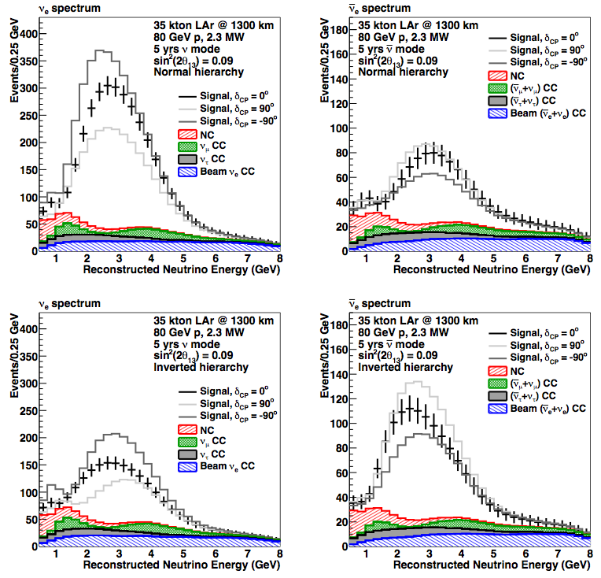
ν_{e} appearance signals, 35kt, 2.3 MW, 5+5yrs
L. Whitehead

Slide 26
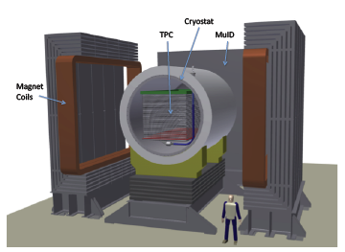
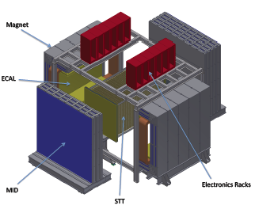
Near Detector Concepts
Liquid Argon TPC Tracker
(~18 ton LAr)
Fine-Grained Tracker
(~0.14 ton Ar@140atm)

Slide 27
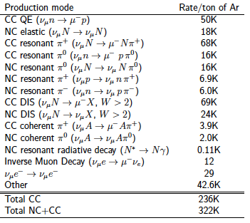
Near Detector Physics
1 x 10²⁰ POT
*
  Characterize beam for Long-Baseline measurements
  Evidence for sterile neutrinos
  Large dataset for neutrino interaction studies
* 120 GeV proton beam, 250 kA horn current,
2-m radius x 250-m decay pipe
No detector efficiency/acceptance

Slide 28
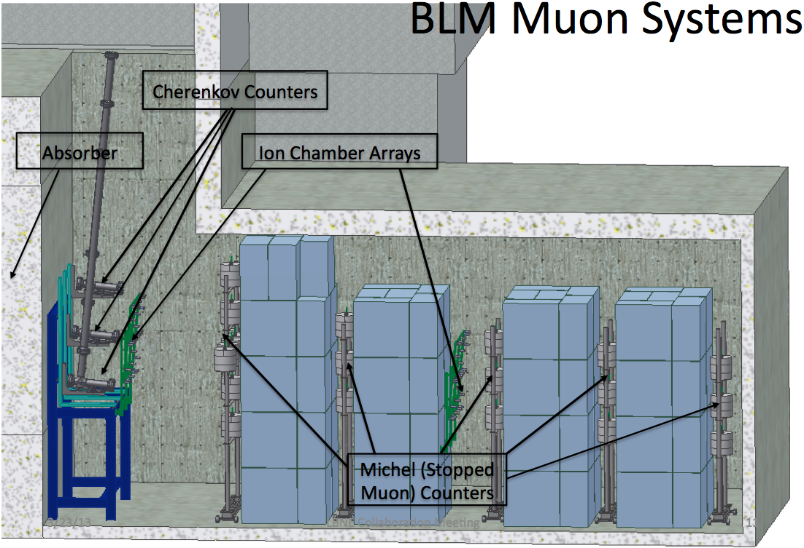
Beam muon detectors

