Slide 1




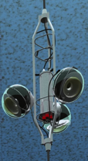
Results from the
ANTARES Neutrino Telescope
J.P. Gómez-González (on behalf of the ANTARES Collaboration)
Instituto de Física Corpuscular (CSIC-UV)

Slide 2
Outline
Introduction
The ANTARES detector: status
Physics analysis in ANTARES:
  Recently published results
  Ongoing progress
Conclusions
WIPAC, 2013
1
J.P. Gómez-González
Notes:
This review focus on some of the most relevant analysis done in ANTARES, including the most recent published results and the ongoing analysis.
Including point-source searches, diffuse flux, flaring analysis, fermi babels or dark matter searches.

Slide 3
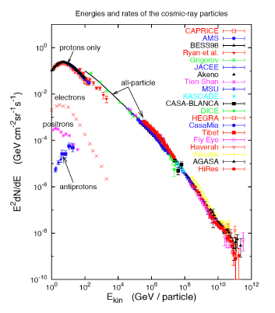
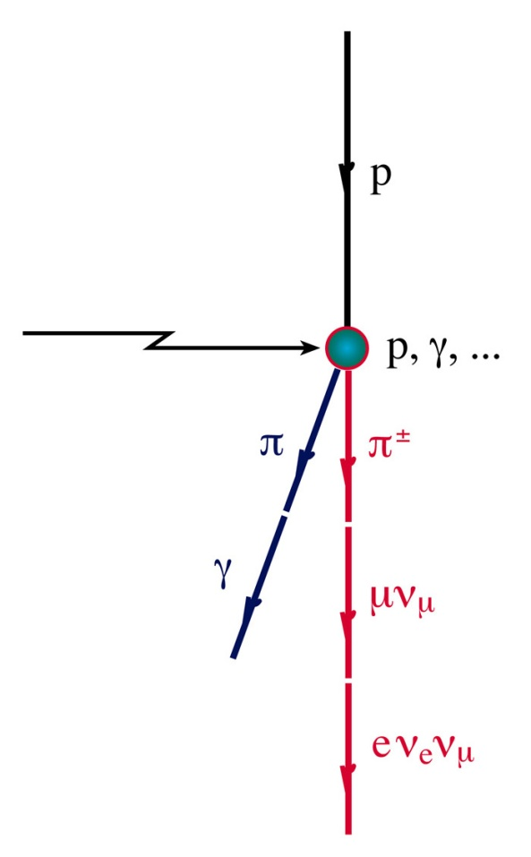
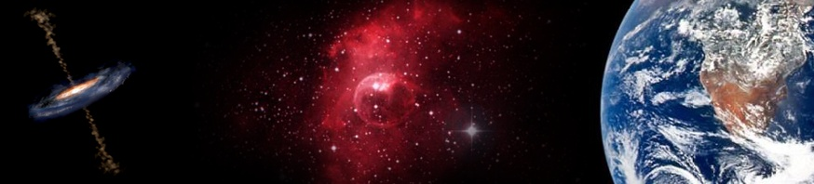
Neutrino astronomy
High energy cosmic rays acceleration sites proposed: SNRs, Microquasars, AGNs and GRBs…
Neutrinos produced in the interaction of nucleons with the ambient matter or radiation
Probes of the deepest universe
p
n
γ
ν
WIPAC, 2013
2
J.P. Gómez-González
Notes:
This review focus on some of the most relevant analysis done in ANTARES, including the most recent published results and the ongoing analysis.
Including point-source searches, diffuse flux, flaring analysis, fermi babels or dark matter searches.
Charged particle, because the interact with the galactic and extra-galactic magnetic field, lose the directionality information. With neutral particles we do not have this proble,, but while photon may be absorbed in their trip, neutrinos can travel very largest distances, turning out (in this respect) ideal probes to explore the deepest universe.
The search for such sources is naturally oriented towards those astrophysical objects in which high energy processes are observed to take place.

Slide 4
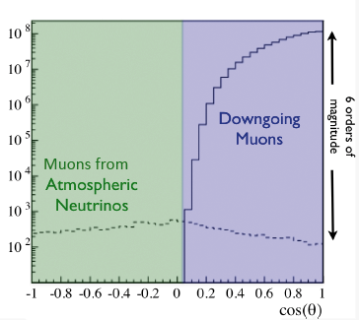
Detection principle
Detector at Southern Hemisp.
Cherenkov light
Muon
Neutrino
4
Cherenkov photons induced by relativistic muons are detected with a PMT array embedded in a transparente medium
Neutrino and muon are almost collinear at ~TeV energies
Physical background: atmospheric muons and atmospheric neutrinos from cosmic ray interaction in the upper shells of the Atmosphere
WIPAC, 2013
3
J.P. Gómez-González
Notes:
To detect these neutrino we put an 3-D array of PMTs in a transparent medium. The PMTs collect the light induced by relativistic muons produced in the interaction of a high energy neutrino in the surroundings. At energies of ??? The incident neutrino and the muon are almos collinear, which allows the posibility for doing astronomy. This detection principle howevers is not bg free, muons from atmospheric muons or neutrinos dejan a signal which is indistinguible of the ???. In order to reduce these bgs we can use the Earth as a shield by rejecting the events which are not upward going.
This review focus on some of the most relevant analysis done in ANTARES, including the most recent published results and the ongoing analysis.
Including point-source searches, diffuse flux, flaring analysis, fermi babels or dark matter searches.

Slide 5
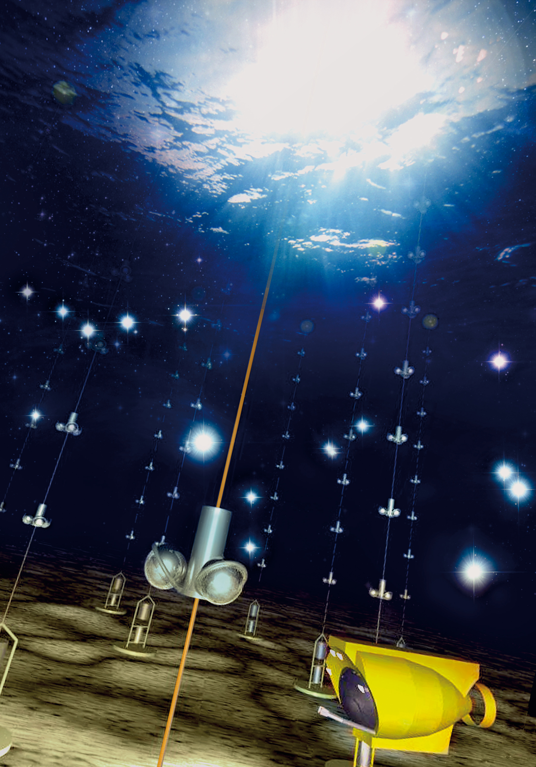
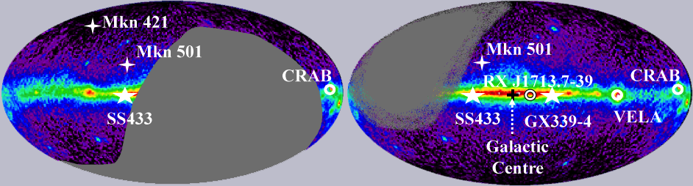
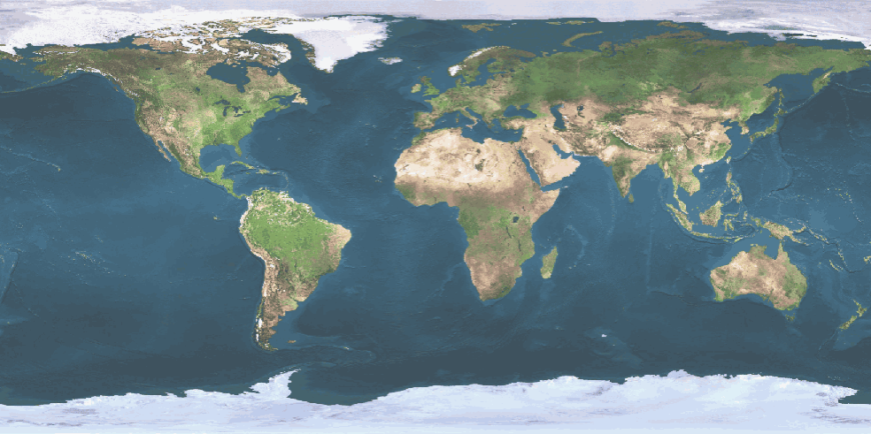
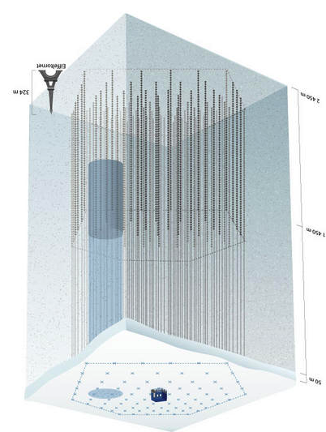
Neutrino telescopes
GVD
KM3NeT
IceCube
ANTARES
Upgoing neutrino sky
WIPAC, 2013
4
J.P. Gómez-González
Notes:
The ANTARES detector is placed in the Northern Hemisphere, looking at the upgoing neutrino sky covering.
Because of the small neutrino cross-section and the tiny fluxes, large instrumented volumes are neede.
Transparent to see the Cherenkov light.
The visible upgoing neutrino sky is shown.
IceCube analysis study the events coming above the horizon so the have near 4PI sky coverage.
Both telescopes are complementary in energy.

Slide 6
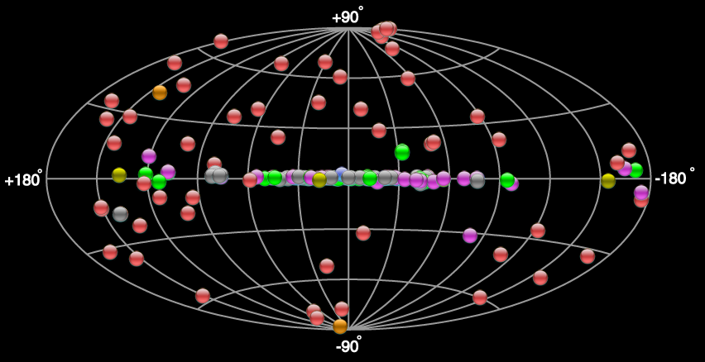
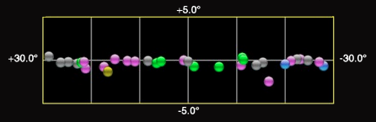
Sea water embedded NTs
Advantages of sea water:
  Larger scattering length → better angular resolution
  Weaker depth-dependence of optical parameters
  Possibility of recovery
  Changeable detector geometry
Disadvantages:
  Larger absorption length
  Bioluminescence, ⁴⁰K background, biofouling (optical background)
Mediterranean site → Optimum
visibility for the Galactic center
WIPAC, 2013
5
J.P. Gómez-González
Notes:
In comparison with ice embedded neutrino telescopes, sea water as medium of Cherenko light detection offers a larger scattering length, which results in a better angular resolution. A weaker depth-dependence of the optical parameters, and a easily recovery and the posibility to change the array geometry.
Disadvantages are the larger absorption length of the light in water, and the enviromental background emission produce by bioluminiscence bacteria and
40K decay, as well as the biofuling producing XXX

Slide 7
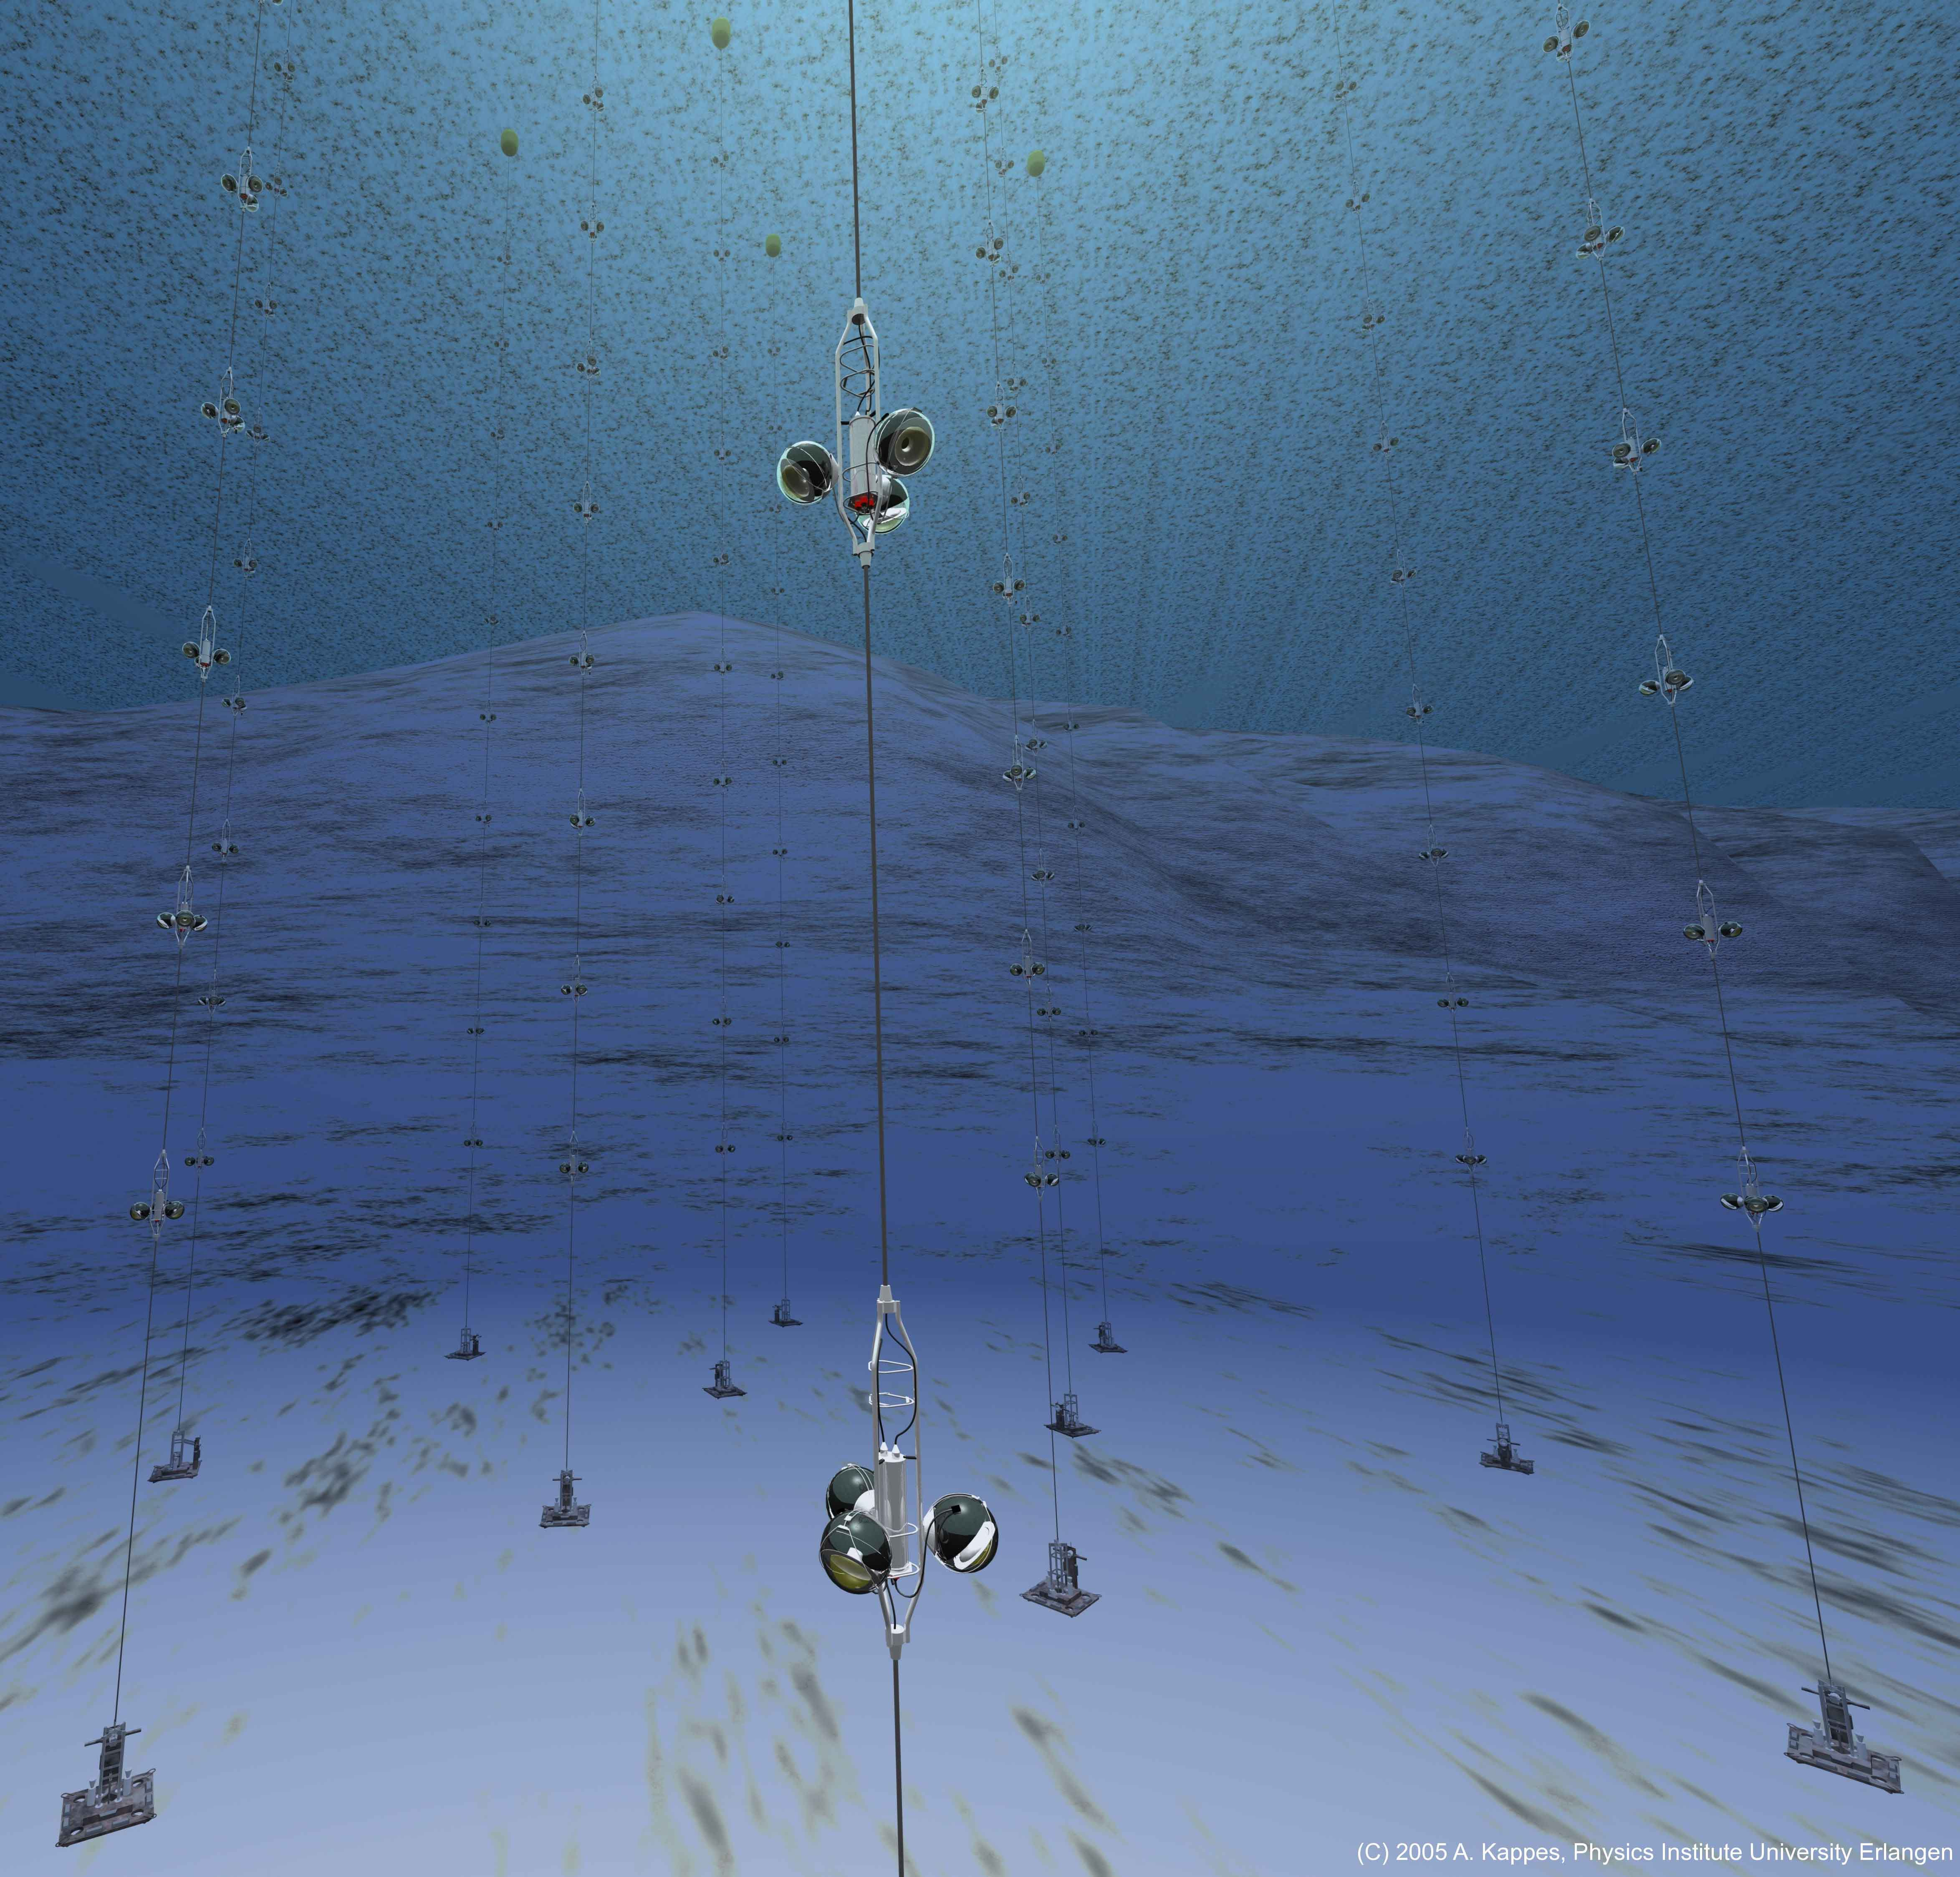
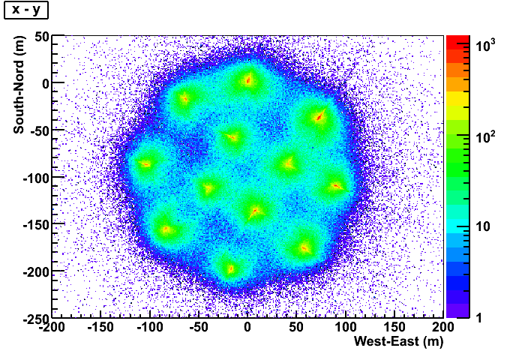

The ANTARES detector
ANTARES has 885 10” PMTs distributed in triplets of storeys along 12 strings of 450 meters longitude placed 2475 depth following an octagonal layout.
WIPAC, 2013
6
J.P. Gómez-González
Notes:
The ANTARES detector has 885 PMTs (10 inches size) distributed in triplets of storeys along 12 strings of 450 meter longitude which are anchored to the sea bead floor at a depth of 2475 meters and distributed following an octagonal layout. The OMs, glasse spheres containing one PMT each, are facing 45º dowwards to increase the upgoing neutrino detection. Here you can see a footprint of the detector made by The instrument started collected data with 5 lines in January 2007 and its fully operative since May 2008.

Slide 8
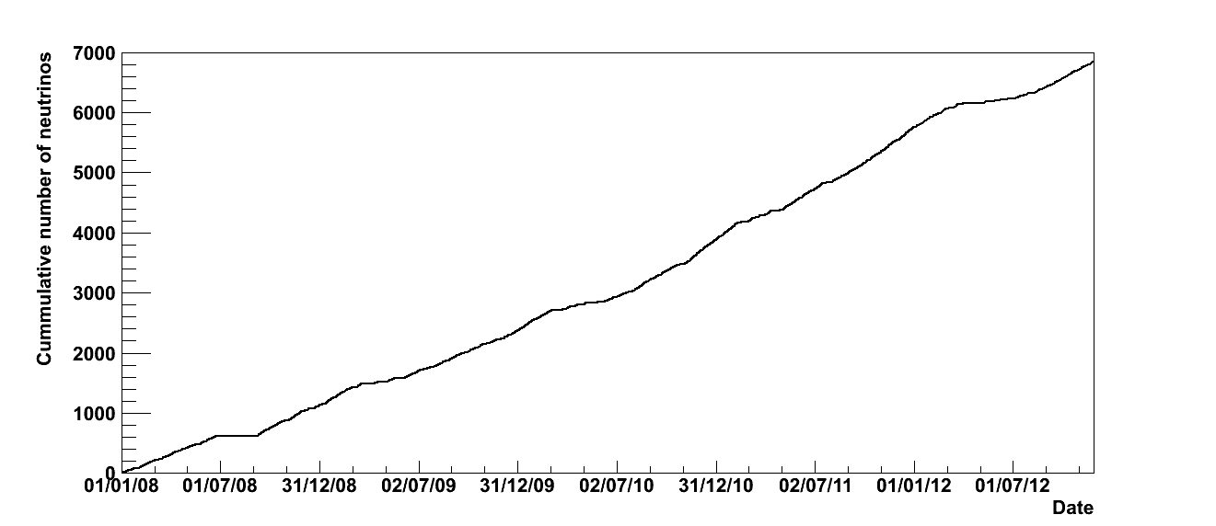
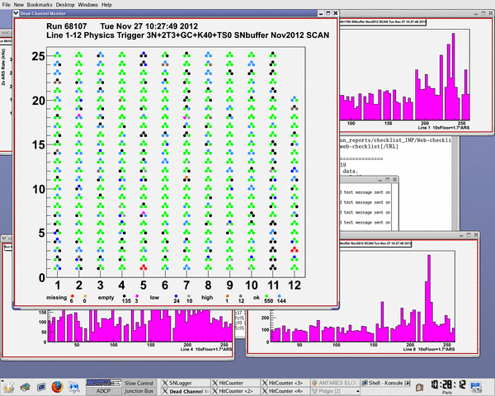
Data taking
ANTARES started data taking in 2007 and it is fully operative since May 2008
Upgoing atmospheric neutrinos detected at a rate of ~3/day
Duty cycle time improving each year
Ongoing analysis are using data with more than 3 years of livetime
Live channels in November 2012 ~85%
WIPAC, 2013
7
J.P. Gómez-González
Notes:
ANTARES started to collect data in January 2007 (with 5 detection strings) and its fully operative since 2008. In this state is detecting upgoing neutrinos at a rate of 3 events per day. The duty cycle increasing every year because the reduction of maintenance ??? But the effect of the bioluminescence activity…
The analysis in progress using more than 3 years of data livetime.

Slide 9
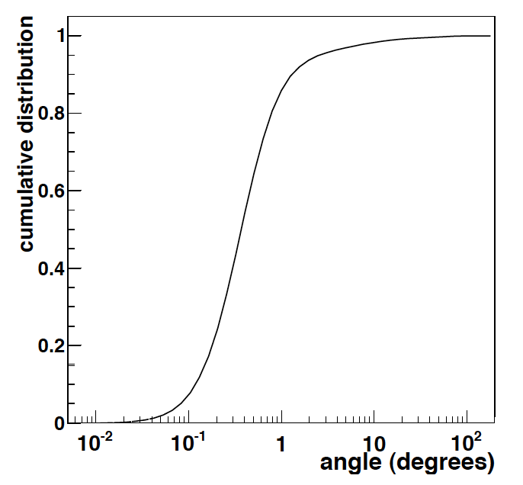
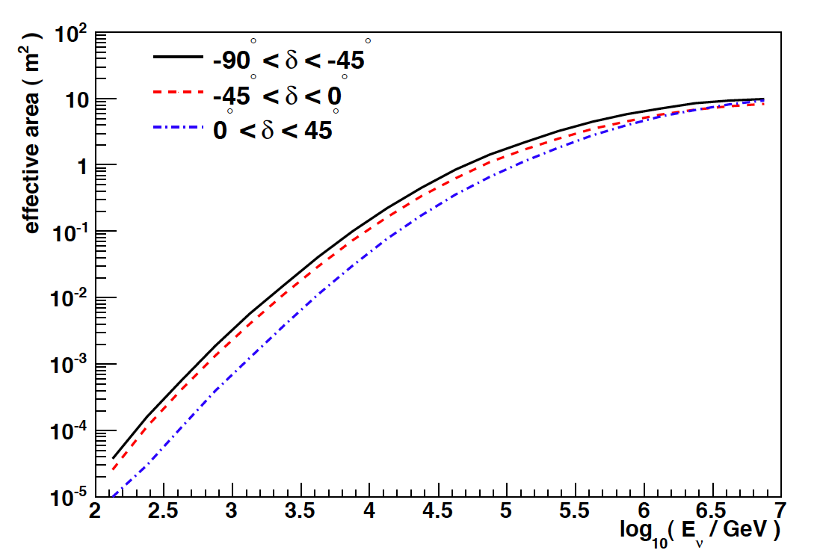
Detector performance
Angular resolution better than 0.5º
Effective detection surface ~10m² at higher energies
Good pointing accuracy to do astronomy but low event rates
WIPAC, 2013
8
J.P. Gómez-González
Notes:
The detector performance of this instrument is mainly characterized by the angular resolution and the effective area. The angular resolution is better than 0.5º at energies of the neutrino above the TeV. The effective surface is of few square meters at 100 TeVs.
Angular resolution governs the capability of the telescope to discriminate between signal/background.
The effective area, increasing with the energy, allow us to convert fluxes to event rates.
Because the neutrino cross-section is very small and so are the ﬂuxes, it is

Slide 10
Event selection
Track reconstruction use the hit time and position information: methods are based on the the maximization of the likelihood for the time residuals.
Searches conducted on data samples made up by well reconstructed upgoing events:
Good data/mc agreement in the final quality cuts region:
3058 events in data / 2766 ± 743 background (2007-10 sample)
WIPAC, 2013
9
J.P. Gómez-González
Notes:
Reconstruction algorithms, using t
We requiere events reconstructed as upgoing, we apply a cut on the angular error estimate (<1º) and on the quality of the reconstruction.
Uncertainty on the atmospheric muon and atm. Neutrino fluxes are 50% and 30% respectively.

Slide 11
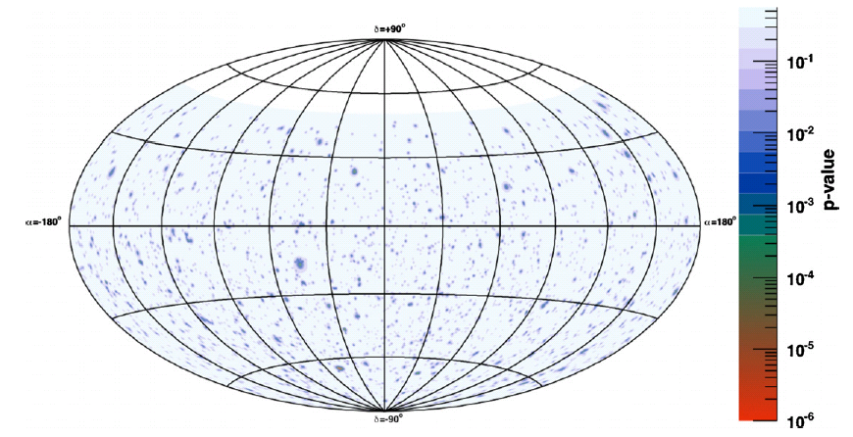
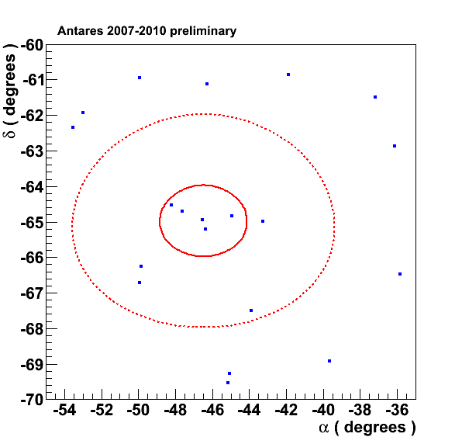
Full-sky survey
Most significant (2.2σ) cluster found in the
full-sky search at (α,δ)=(-46.5º, -65.0º)
Published in ApJ 760 (2012) 53
WIPAC, 2013
10
J.P. Gómez-González
Notes:
In a full-sky survey, the most significant cluster of events was found at the best fit coordinates. The inset on this equatorial map of pre-trial significance shows the neutrino candidates around the position of this cluster consists on 5 events at 1º of the fitted position.
Its significance is 2.2 expressed in number of deviation using the two-sided convention, which is stil compatible with a background fluctuation.

Slide 12
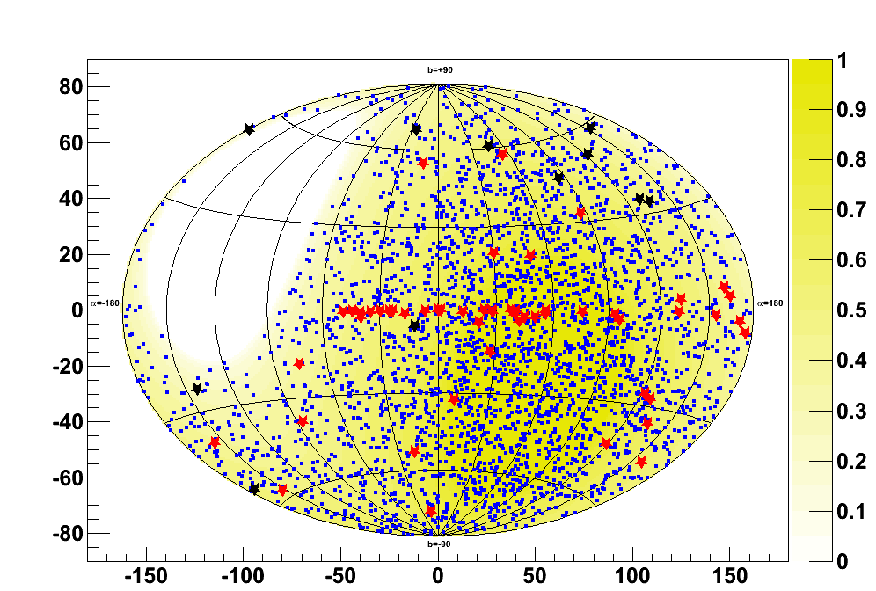
List of candidate sources
Candidate sources producing high energy gamma-ray emission
Locations where to search for neutrinos in correlation with gravitational lensing objects
WIPAC, 2013
11
J.P. Gómez-González
Notes:
In order to improve the search sensitivity by reducing the effective number of trials associated with a full sky scan.
The results of this analysis also includes the search using an a-priori defined candidate list of sources.
The list of candidate sources include both galactic and extragalactic sources (SNRs, Microquasars, Blazars…). In additon we have look for cosmic neutrino emission at the position of 11 gravitational lensing objects which were chosen on the basis of.
It is well know that
The visibility for this analysis is shown in the Z axis.

Slide 13
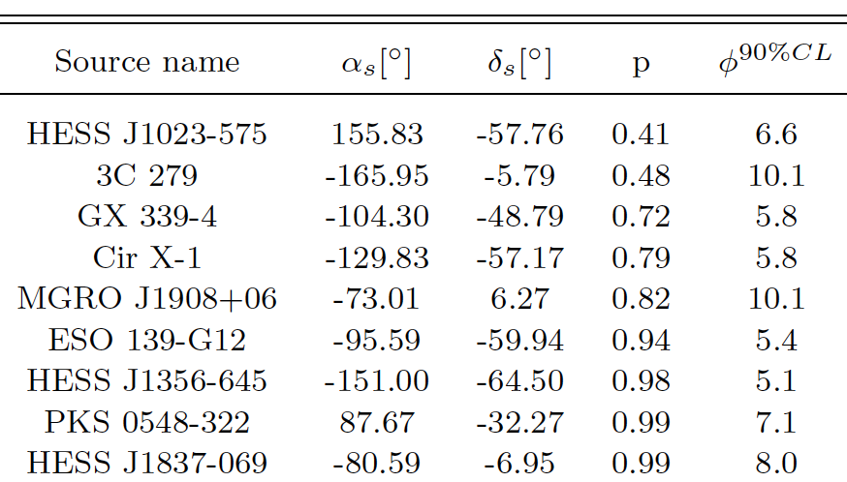
Candidate list search
Gamma-ray candidate sources: Largest deviation (41% p-value) is compatible with the only background hypothesis
Gravitational lensing candidates: Less background-like cluster (SDSS J1004+4112) has a 0.49 (0.99) p-value after trials correction: looking at 11 (62) sources
WIPAC, 2013
12
J.P. Gómez-González
Notes:
No significant excess of events over the expected background was found at any of the 62 positions examined. The largest deviation in the list of High energy
Gamma ray sources correspond to the location of HESS J1X, the post-trial significant of this cluster is 41%. The less background gravitational lensing candidate is

Slide 14
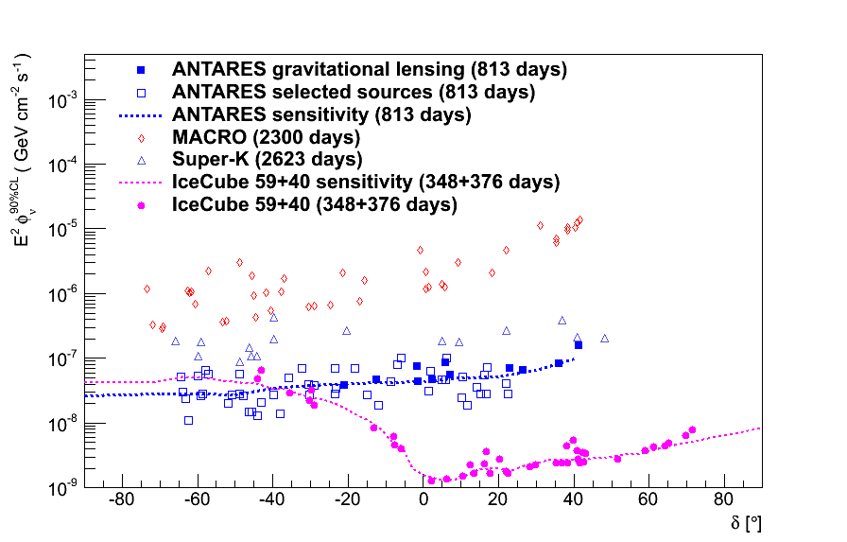
Upper limits
Best limits in the TeV-PeV range for sources in the Southern
Hemisphere¹.
By 2016, limits expected to improve by a factor ~2.5.
¹IceCube energy threshold for the Southern Hemisphere is ~1 PeV.
WIPAC, 2013
13
J.P. Gómez-González
Notes:
The results of this analysis, published in ApJ (NO LOS DEL LENSING) include some of the most stringent limits to the neutrino flux for sources in the Souther Hemisphere. By 2016, it is expected these limits to improve by a factor 2.5

Slide 15
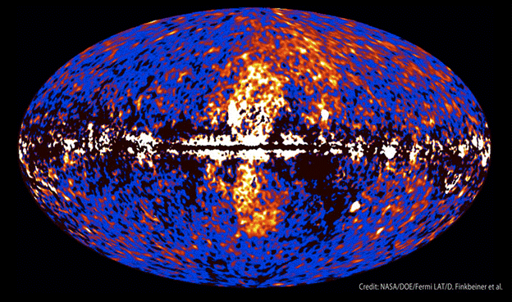
Fermi bubbles
Villante & Vissani in Phys. Rev. D 78 (2008) 103007: Ф_{nu}~1/2.5Ф_{gamma} ~ E⁻²1.2*10⁻⁷GeV cm⁻² s⁻¹ sr⁻¹ and neutrino cutoff may be obtained from the proton cut off x_{ν}≈x_{p}/20 (50 TeV-500 TeV)
WIPAC, 2013
14
J.P. Gómez-González
Notes:
MENCIONAR EXTENDED SOURCES
In 20XX? The Fermi satellite discovered the existence of two gigantic structures at the center of our galaxy. The
Fermi bubbles are characterized by a gamma-ray emission with a hard an uniform spectrum, which can be hardly explained by the Inverse Compron process
process of the highly relativistic cosmic ray electrons requiring very specific acceleration features. A population of relic cosmic ray protons and heavier ions would naturally explain all the features of the Fermi bubbles.
This is threfore a promising target for ANTARES, which has an excellent visibility of the Galactic Center and therefore of the Fermi bubles.
In comparison to IceCube the visibility of the bubbles is almost 100%

Slide 16
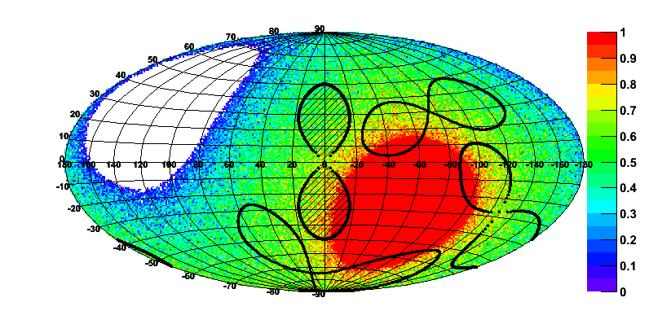
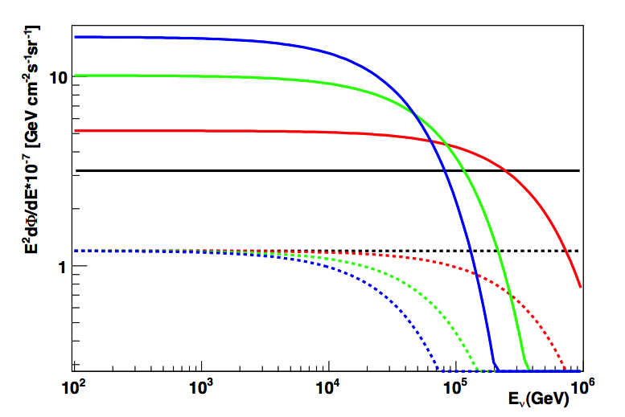
Fermi bubbles
Preliminary
50 TeV cutoff
100 TeV cutoff
500 TeV cutoff
no cutoff
On/Off zones analysis method applied on 2008-2011 data:
the background is estimated from average of three “bubbles” shifted
in time.
solid: flux limits
dotted: predicted flux
Number of background events (Off) = 33/3 =11
Observed events = 16 events
WIPAC, 2013
15
J.P. Gómez-González
Notes:
To search for neutrino from the Fermi bubbles an off-zone method was used which main idea is to compare the signal measured in the Fermi bubbles area (on-zone, delimited by this region - SEÑALANDO) with the background estimated from the data itself in the area chosen outside (off-zone). The estimated background in both zones should have the same properties. The proposed off-zone was selected in a way so that it has the same size and shape as the on-zone. This allows to have the same expected number of bg events. 3 off-zones are used to reduce the bg uncertainty.
Aftaer unblinding data from 2008-11 the number of observed events was 16 events when we expected 11 background events (Off) = 33/3 =11, a result which should be interprested as a background fluctuation.
PAPER ONGOING
Upper limits more than 2 times above expected signal for optimistic models

Slide 17
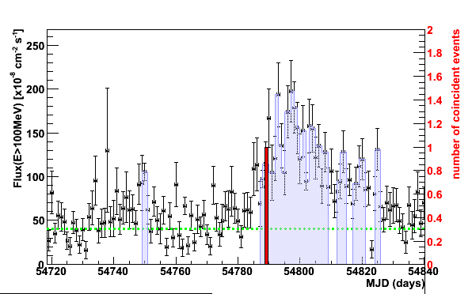
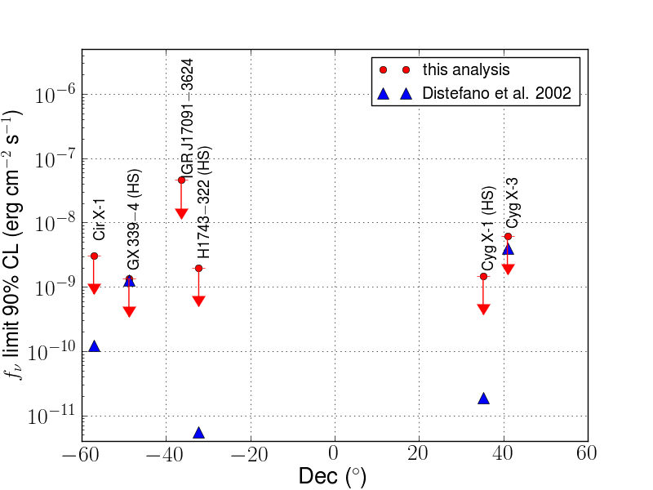
Flaring sources
Blazars:
Microquasars:
10 flaring objects in 2008: PKS0208-512, AO0235+164, PKS1510-089, 3C273, 3C279, 3C454.3, OJ287, PKS0454-234, Wcomae, PKS2155-304
3C279: 1 event compatible with the source direction (Δα=0.56⁰) and time distribution, the post trial value is 10%
6 flaring sources in 2007-2010: Circinus X-1, GX339-4, H 1743-322, IGRJ17091-3624, Cygnus X-1, Cygnus X-3
No neutrinos found in coincidence with outbursts
Preliminary
Published in Astropart. Phys. 36 (2012)
WIPAC, 2013
16
J.P. Gómez-González
Notes:
Searches for high energy flaring processes astrophysical objects have been conducted on a number of blazars and microquasars selected from satellite observations catalogues. Blazars (left): Only for 3C279 one event was found inside the search window. Upper-limit on the neutrino fluence is shown in the plot.
10 promising flaring blazars selected from Fermi catalogue. Search uses time PDF on the basis of light curves features.
Green -> baseline
Red -> the time of the one neutrino in the sample: agular distance to the source is 0.56º
Results from the first time-dependent search for cosmic neutrino sources by the ANTARES telescope were published in Astrop. Phy. Last year.
The time-dependent analysis was applied to bright and variable Fermi blazar sources reported in the first-year Fermi LAT catalogue [16] and in the LBAS catalogue (LAT Bright AGN sample [17]). Sources were selected in the sky visible to ANTARES and that had at least one day binned gamma-ray flux in the high state periods greater than 80x10−8 photons cm−2 s−1 above 100 MeV.
The light curves published on the Fermi web page for the monitored sources [22] 1are used for this analysis. They correspond to the one-day binned time evolution of the average gamma-ray flux above a threshold of 100 MeV since August 196 2008.
The dashed line (green) corresponds to the fitted baseline. The red histogram displays the time of the associated ANTARES neutrino event.
Microquasar analysis: No events found, upper limits shown in comparison with Distefano et al predictions.
Less bg-like source is H1743-322 with 80% post-trial p-value.
In this work, microquasars are assumed to emit a ux of neutrinos that has the same energy dependence as the one obtained from the shock acceleration mechanism.
BLAZARS:
The gamma-ray light curves of bright blazars measured by 27 the LAT instrument on board the Fermi satellite reveal important time vari28 ability on timescales of hours to several weeks, with intensities much larger 29 than the typical flux of the source in its quiescent state
MICROQUASARS:
The search for neutrinos from microquasars was conducted in this work with a multi-messenger approach. In microquasars harbouring a black hole, the X-ray and radio bands follow a correlated pattern during outbursts. More speci cally, a mildly relativistic steady jet is observed during hard X-ray states, a major ejection is observed during transitions from a hard to a soft X-ray state, whereas the jet is not observed during the soft state. This scheme was applied using the data from the X-ray monitors RXTE/ASM and Swift/BAT to define the periods in which the black hole microquasars were supposed to accelerate a relativistic jet. In the case of a neutron star microquasar a custom time selection was applied. In another case, the data from the gamma ray telescope Fermi/LAT were used to de ne the outbursting periods. A total of 6 microquasars were selected for the analysis. For 3 black hole microquasars among the selected ones, the search for neutrinos was split between the hard state and the state transition periods.

Slide 18
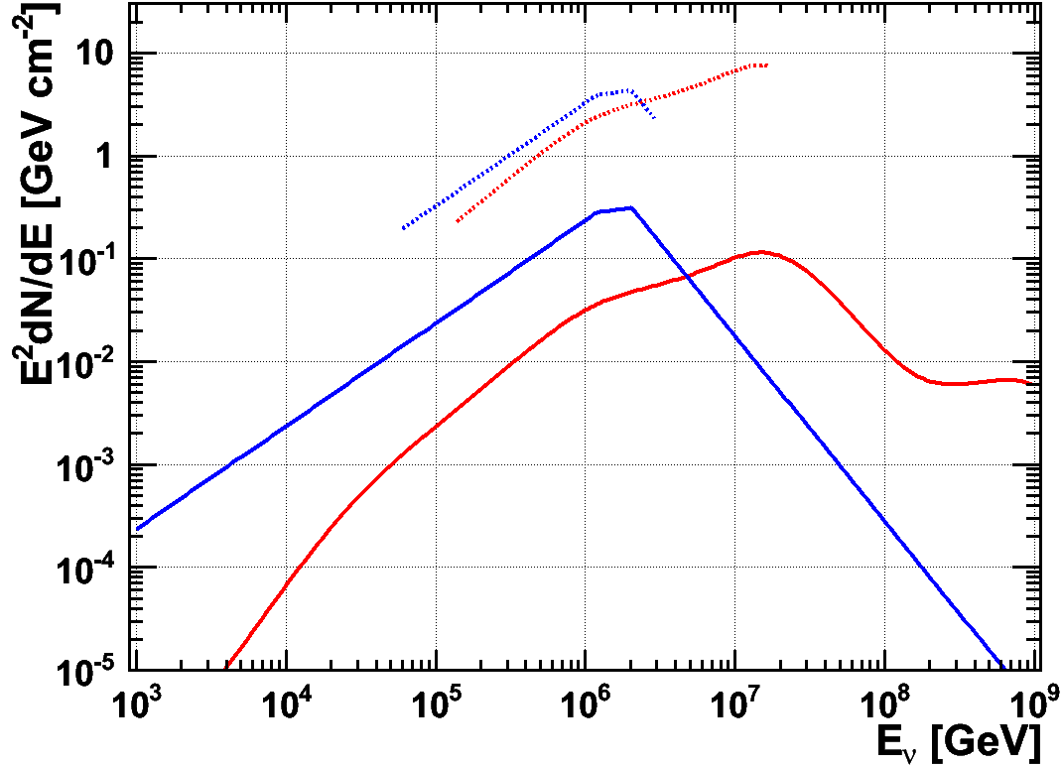
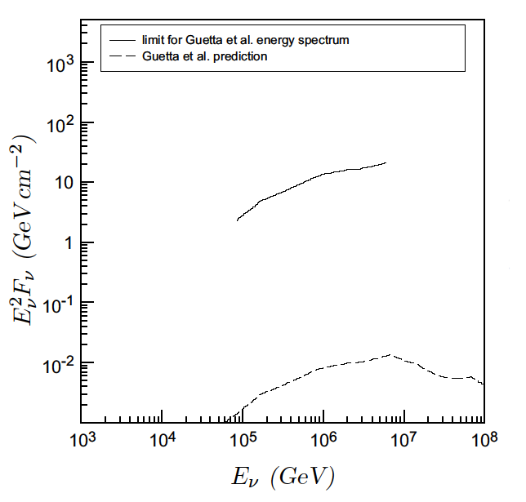
Correlation with GRBs
Catalogues from Swift and Fermi satellites
Search in correlation with GRBs using 2008-2011 data:
297 selected GRB with total prompt emission duration of 6.5 hours
ANTARES Limits
Preliminary
Guetta model
Analysis with 40 GRBs and total prompt emission duration of 1882s.
NeuCosmA model
Published in JCAP03 (2013) 006
WIPAC, 2013
17
J.P. Gómez-González
Notes:
Huge background reduction due to coincidence requirement:
→ few neutrinos sufficient for discovery
GRBs are interesting targets for to llok for neutrino emission. These phenomena emiitng
Gamma-ray bursts (GRBs), transient flashes of gamma-rays having a duration of sub-seconds up to several hundred seconds, are the most powerful known extra-galactic events. Several models predict a burst of high-energy neutrinos in concurrence with the ash of gamma-rays, also referred to as the prompt emission
First analysi,s published in JCAP03, was done using data from the first year of ANTARES operation when the detector was less than half its final configuration size. 40 GRBs were selected from GRB observations by satellite instruments. No correlation was found between the neutrinos and the selected GRBs. 90% CL FC upper limits on the fluence of muon-neutrino. The limit set on the diffuse flux is about 294 times the WB flux prediction.
A search for neutrino-induced muons in correlation with a selection of 40 gammaray bursts that occurred in 2007
ICECUBE RESULTS:
Some of those models have already been challenged by the recent IceCube measurements [2]. In particular, the IceCube results do not support the notion of GRBs as primary source of ultra high-energy cosmic rays, at least under the assumption that these ultra high-energy cosmic rays are protons coming from the decay of photohadronically produced neutrons and are therefore connected to neutrinos
RIGHT PLOT: 3 sigma limits on GRB neutrino emission for all 297 GRBs and the most promising GRB110918. In blue: spectra and limits according to the Guetta model, in red: accordingt to NeuCosmA. Thin lines show the spectra of the individual bursts, with the thick lines showing the sum of all. Dashed lines show the 90% confidence limits we can put on both spectra in the energy ranges where we expect 90% of the detected flux. The righthand axis gives the inferred quasi–diffuse flux limit assuming an annual long burst rate of 667 per year. The integrated search duration of all bursts is 6.55 hours (23577.3 s). The IceCube IC40+59 limit is also shown in grey. We see that it lies around a factor of 4 below the summed up Guetta fluxes, and even below the (single) flux of GRB110918. That means, that IceCube could have already put an upper limit on the emission of this single bursts, if it would have been visible for this detector. On the other hand, the IceCube as well as the ANTARES limits cannot constrain any part of the NeuCosmA spectrum. Additionally, the limit we can put on the flux of GRB 110918 with a search time window of 73.376s is shown.

Slide 19
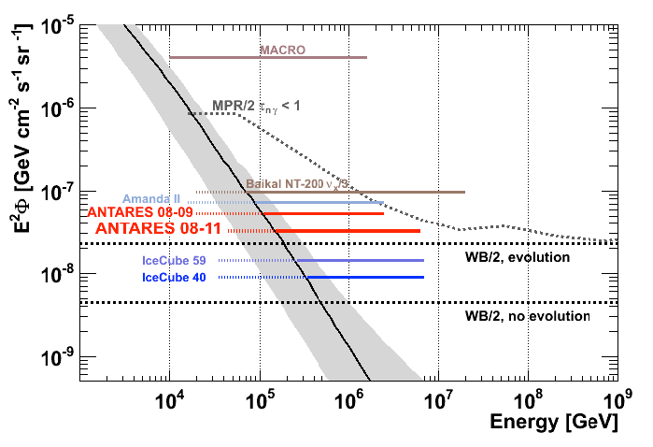
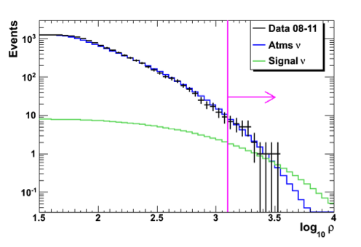
Diffuse flux
Energy-dependent variable used for selecting signal: ραdE/dx.
Data from 2008-2011.
Preliminary
E²Φ_{90%C.L.}= 3.2×10⁻⁸ GeV cm⁻² s⁻¹ sr⁻¹
[45 TeV<E<6.3 PeV]
Previous analysis published in
Phys. Lett. B 696 (2011)
WIPAC, 2013
18
J.P. Gómez-González
Notes:
The discrimination between the cosmic neutrino signal and the atmospheric neutrino background is done on the basis of the energy. It relies on energy estimators.
Need reliable energy estimator
The estimator uses as input parameters the collected charge in p.e., the detector efficiency for photons coming from the reconstructed event and the track length in a fiducial volume surrounding the instrumented volume by 2 light attenuation lengths.
After unblinding no discrepancies have been found between data and MC (no excess of events): 7 events are observed in data when expected 7.9 background events and 1.8 signal events. An upper limit is set on the cosmic neutrino diffuse flux which is a factor X better than our previous result using 2008-09 data.
90% of the signal is contained in the region 45 TeV<E<6.3 PeV

Slide 20
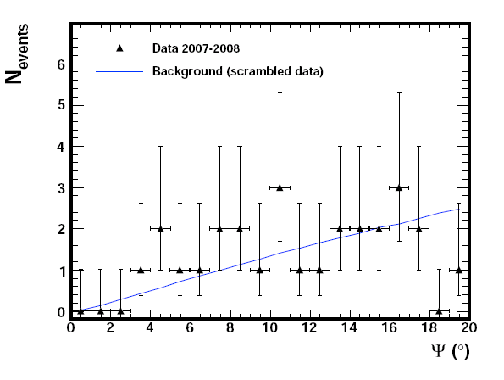
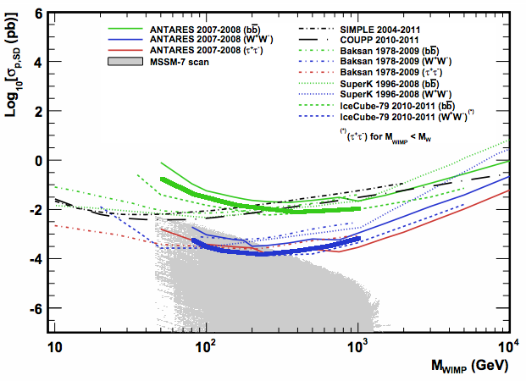
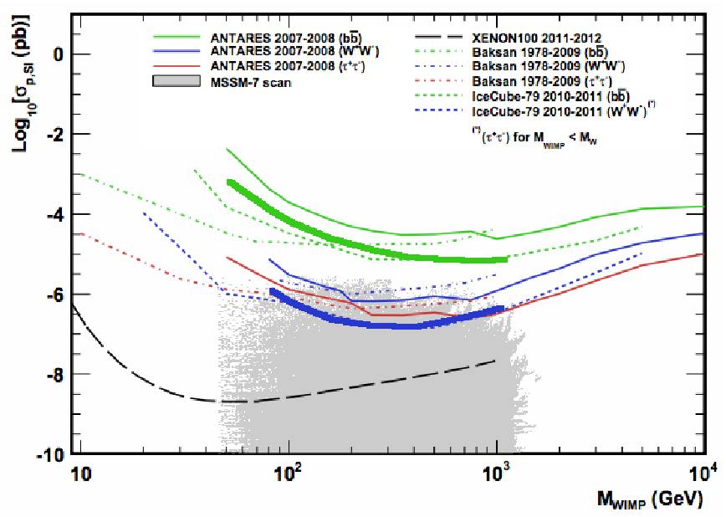
Dark matter searches
Search for neutrino events coming from the Sun using 2007-08 data:
- Number of observed events agrees
with expected background.
- No signal from DM annihilation from Sun.
- Set limits on WIMP-proton cross-section.
Improvement in sensitivity with 2007-2012 data
2007-2008
2007-2008
2007-2011
2007-2011
Preliminary
WIPAC, 2013
19
J.P. Gómez-González
Notes:
Indirect searches for dark matter in the form of WIMPS exploit the radiation signature (neutrino flux) produced by the self-anihilation of WIMPs accumulated in astrophysical objects such as the galactic halo or the Sun.
the fi search for dark matter anihilation in the Sun was done in ANTARES using data from 2007-08.
FIRST plot: A total of 27 events was found within 20º spatial angle (aperture of the search cone in the Sun direction, optimized by MRF), which is compatible with the bg expectation. Therefore, 90%CL upper limits on the SD and SI neutrino cross-sections (?the neutrino flux?) as a function of the WIMP mass in the range 50GeV to 10TeV were calculated for three self-anihilation channels.
Ongoing analysis, using 4 additional years of data taking, shown sensitivity to improve by a factor X.
Rejection of atmospheric neutrinos by looking into a cone towards the Sun direction.
Plots: Sensitivities to SD/SI cross-sections
If dark matter is made of WIPMS we hace the posibility for find signal by looking at neutrinos coming from the core massive objects where dark matter particles may become gravitationally traped. Eventually these wimps anihilate themselves, in a process which could involve the emission of high energy neutrinos as a secondary products of the WIMPs anihilation reaction.
WIMPs gravitationally trapped via elastic collisions in the sun

Slide 21
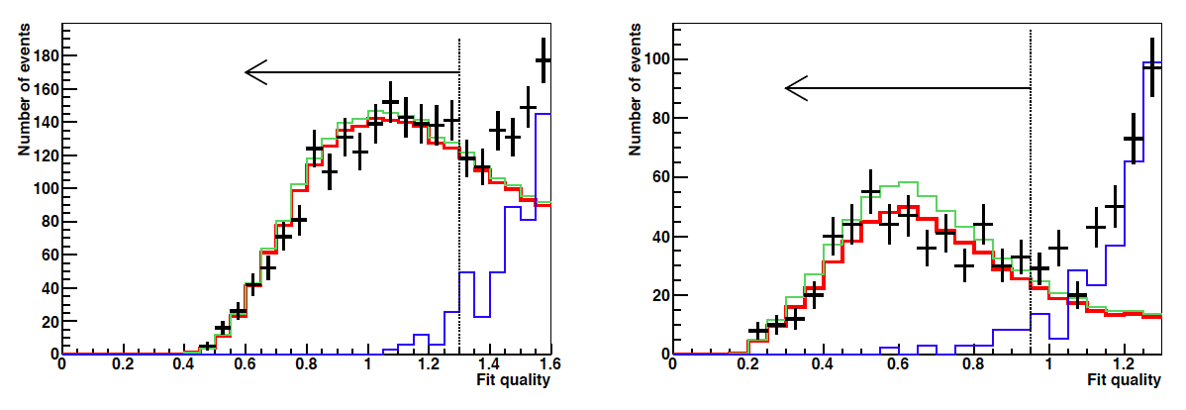
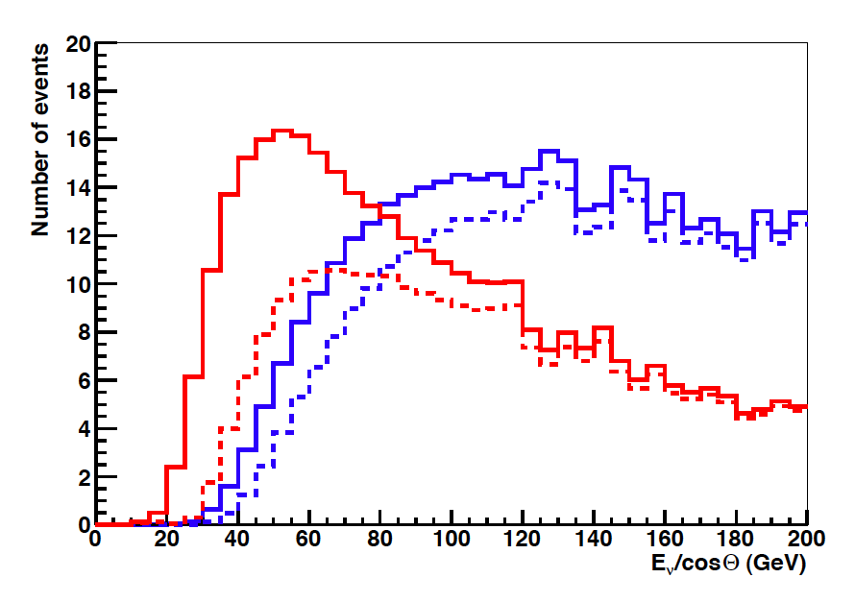
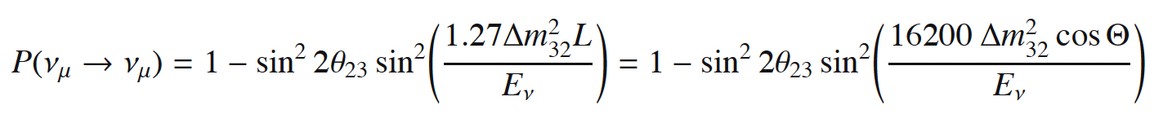
Neutrino oscillations
No azimuth information is needed: single-line reconstruction is enough and allow us to lower energy threshold (20 GeV)
solid: no osc / dashed: osc
red: single-line / blue: multi-line
Multi-line
Single-line
WIPAC, 2013
20
J.P. Gómez-González
Notes:
Last analysis I discuss is the atmospheric neutrino oscillation parameters measurement we have recently published.
For this analysis the lowest energy of detectable muons from neutrino interactions is 20 GeV, which is low enough for the
observed muon neutrino flux induced events to be significantly suppressed by neutrino oscillations.
First oscillation maximum for vertical upgoing neutrinos is at 24GeV
To move down this threshold use of single-line events is crucial.
A devoted reconstruction method was the inclusion of single-line events (reco in only one line) which allows to lower significantly the energy threshold.
The oscillation probability does not depend on the azimuth angle.
Being the muon energy estimated from the observed muon range in the detector.
Neutrino oscillations will cause a suppression of vertical upgoing muon neutrinos of 24 GeV energy crossing the Earth.
Muon tracks are reconstructed with energies as low as 20 GeV and used to measure the oscillation parameters of atmospheric neutrinos
The parameters determining the oscillation of atmospheric neutrinos are extracted by ﬁtting the event rate as
a function of the ratio of the estimated neutrino energy and reconstructed ﬂight path through the Earth.
Oscillation maximal P(Nu_mu → Nu_mu) = 0 at 24 GeV → reconstruct low energy neutrinos
Neutrinos with 24 GeV → Muons travel around 120 m
The inclusion of single-line events is a special feature of the reconstruction method and allows to significantly lower the energy threshold of the
final atmospheric neutrino sample. Whereas for multi-line events the threshold energy of the final neutrino sample is
about 50 GeV due to the 65 m horizontal gap between lines, single-line events are reconstructed down to 20 GeV for
nearly vertical tracks
The lowest energies of detectable muons from neutrino interactions are about 20 GeV. For upgoing atmospheric neutrinos which traverse
the Earth, this threshold is low enough for the observed ﬂux of νµ induced events to be signiﬁcantly suppressed by
neutrino oscillations

Slide 22
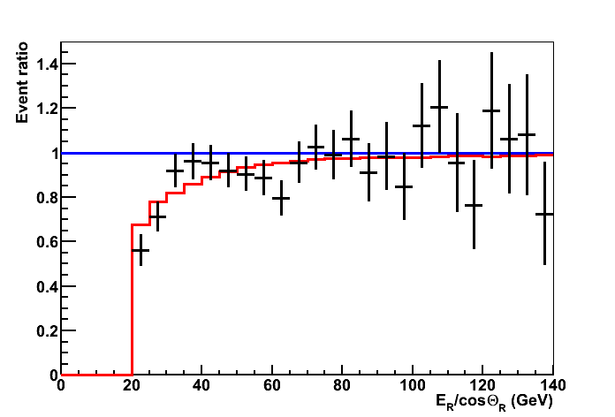
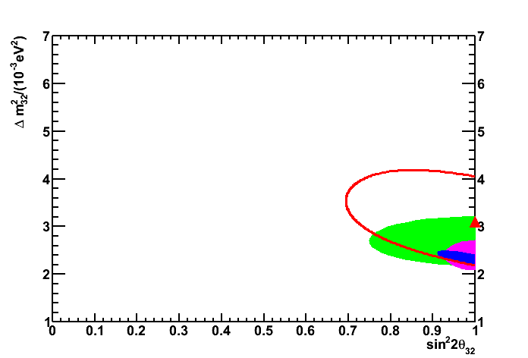
Neutrino oscillations
Systematic uncertainties:
Absorption length: ±10%
Detector efficiency: ±10%
OM angular acceptance
Spectral index of ν flux: ±0.03%
5% error on slope vs E_{R}/cosΘ_{R}
Published in Physics Letters B 714 (2012)
68%CL contours
no osc
ANTARES
K2K
Super-K
MINOS
data (863 days)
best fit
Δm²=(3.1±0.9) 10⁻³ eV² (assuming maximal mixing)
WIPAC, 2013
21
J.P. Gómez-González
Notes:
Systematic uncertainties lead to a correlated distortion of the ER/ cos_R distribution. They are implemented as pull factors in the χ2 function to be minimised.
Measurement contours of the oscillation parameters in a two-ﬂavour approximation are derived. Assuming maximal mixing, a mass diﬀerence of ∆m2_32 = (3.1 ± 0.9) · 10−3 eV2
is obtained, in good agreement with the world average value. This result demonstrates a good understanding of
the performance of the ANTARES telescope at its lowest accessible energies. It is the ﬁrst such measurement by a
high energy neutrino telescope and underlines the potential of future low energy extensions of the existing neutrino
telescopes for such physics.

Slide 23
Physics analysis
Astroparticle physics:
Point-like sources
Diffuse flux
Diffuse galactic plane neutrino flux
Flaring blazars / microquasars
GRBs
Fermi Bubbles
Searches:
Dark matter annihilation
Magnetic monopoles
Nuclearites
Multi-messenger astronomy:
Gravitational waves, Auger CRs,
optical telescopes
Particle physics:
Neutrino oscillation
Atmospheric neutrino flux
Atmospheric muon flux
Cosmic ray anisotropy / composition
Shower reconstruction
Electromagnetic showers
Detector related:
Timing / Positioning
Moon shadow
Water optical properties
Group velocity of light
Acoustic
Bioluminescence
WIPAC, 2013
22
J.P. Gómez-González
Notes:
I have tried to summarize the most recent and important anaysis and results obtained in ANTARES. There are many other physics analysis been done in our Collaboration.
The ANTARES list of published paper can be found here (web)

Slide 24
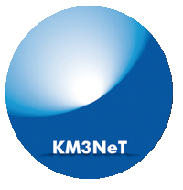
Conclusions
ANTARES is the largest neutrino telescope in the Northern hemisphere, the first one undersea.
Detector is working fine, within design specifications.
Technical challenge successfully realized.
Maintenance in deep sea is possible.
Data collection ongoing.
Long-term investment in software framework and procedures.
  Results from different searches and physics analysis published.
  New data analysis ongoing
Milestone towards a km³ underwater detector (KM3NeT)
Next talk from A. Kappes
WIPAC, 2013
23
J.P. Gómez-González

Slide 25
Thanks for your attention!

Slide 26
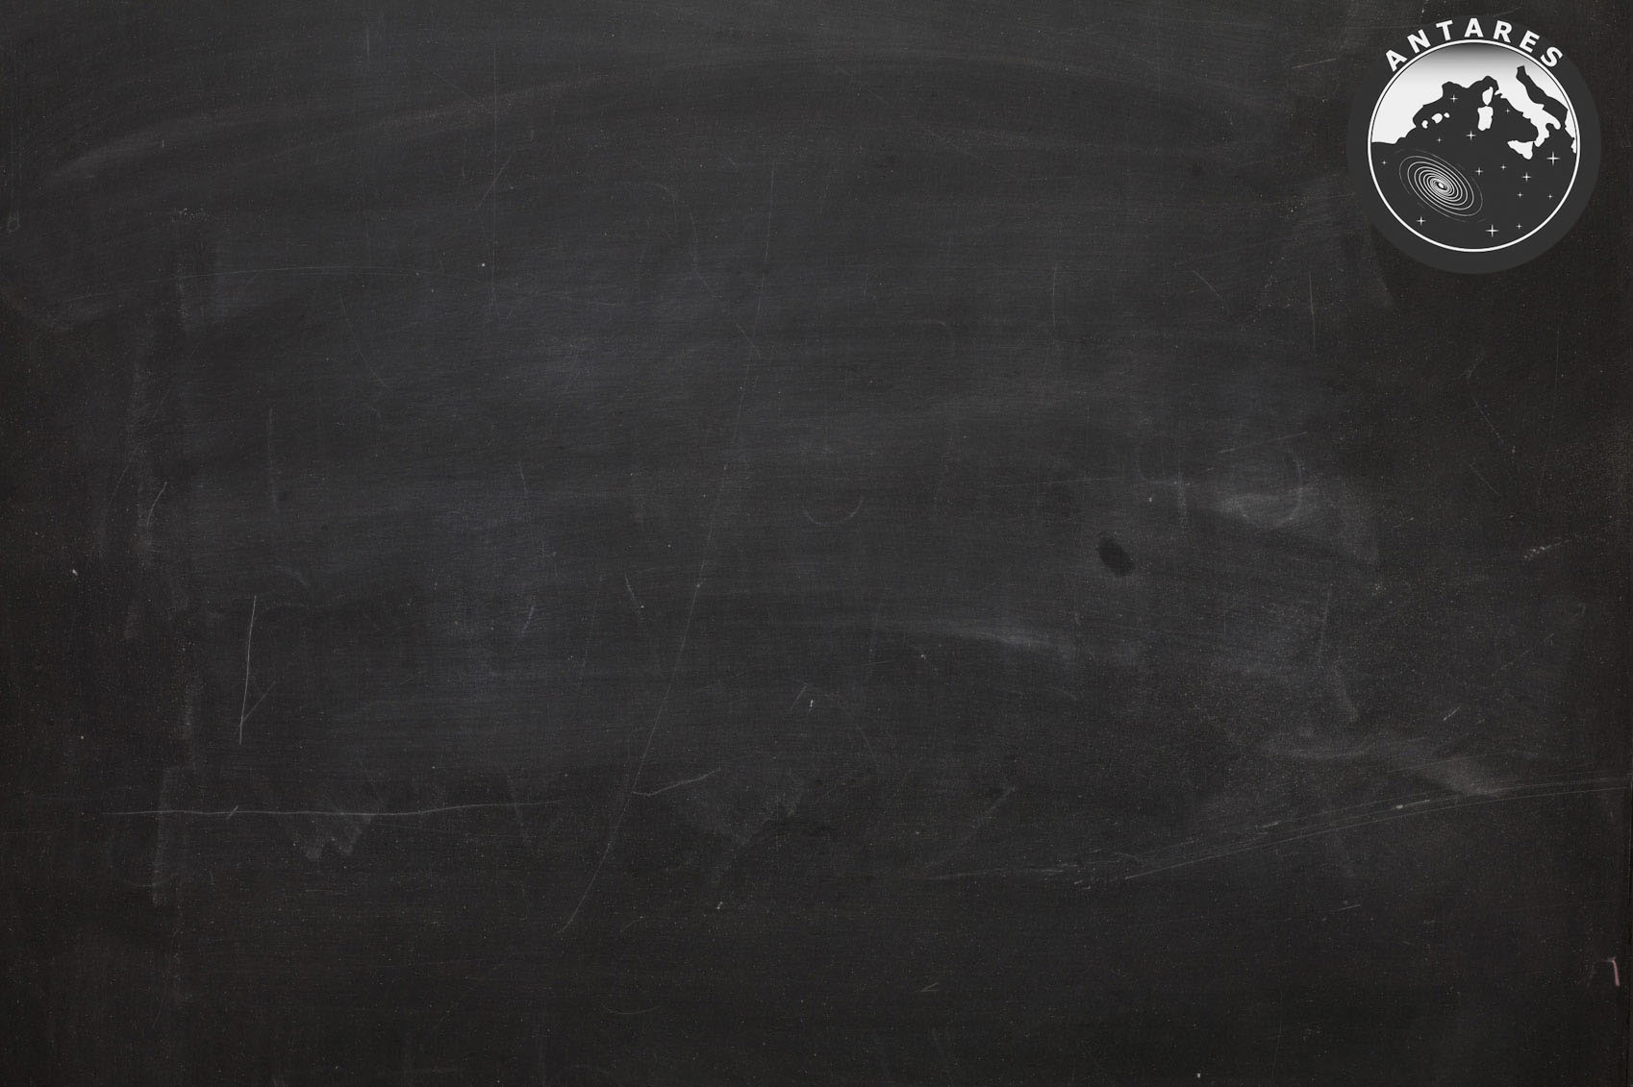
Backup slides…
WIPAC, 2013
1
J.P. Gómez-González

Slide 27
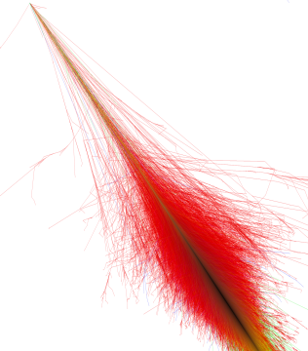
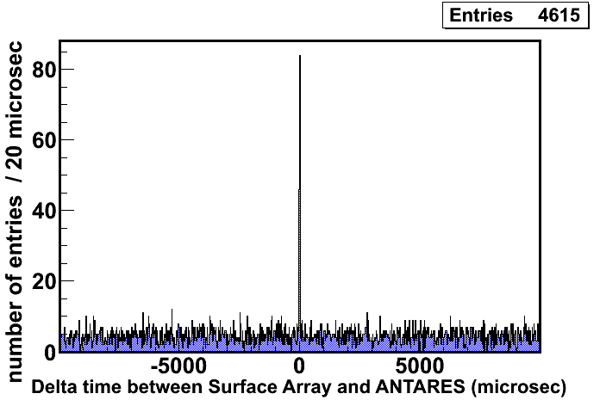

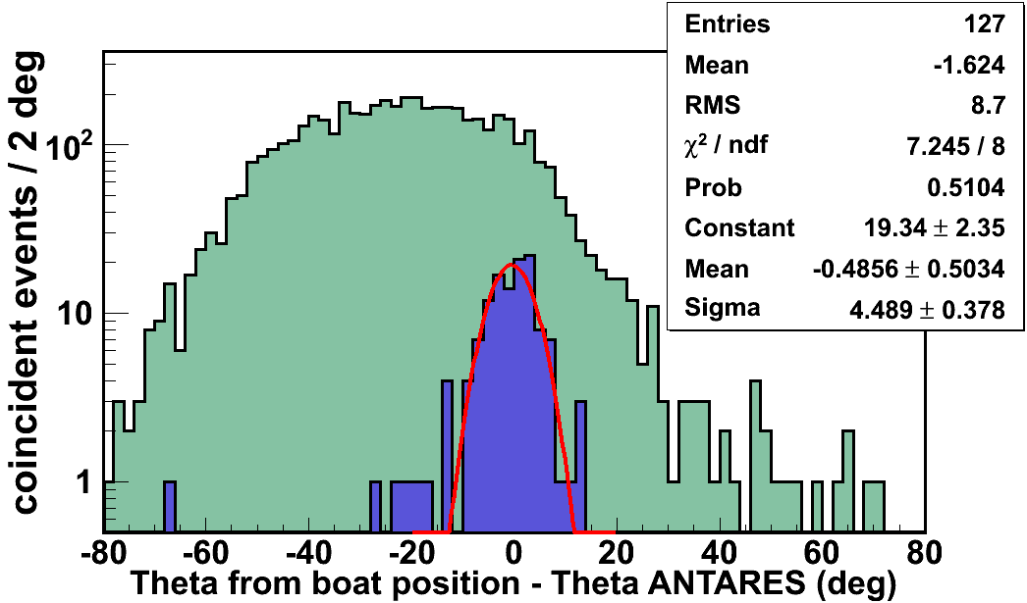
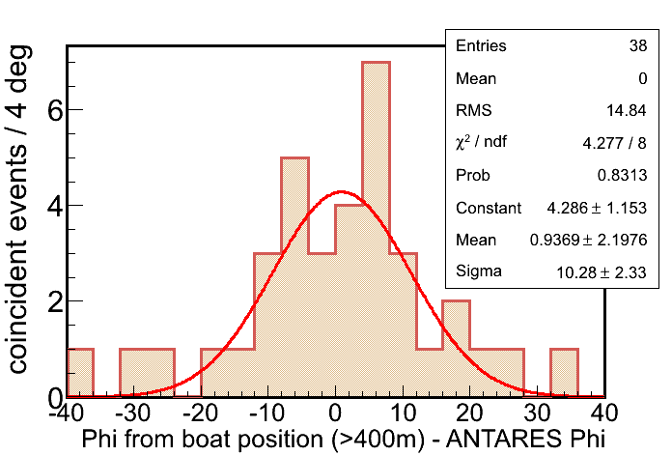
Absolute pointing
Zenith
Phi
ANTARES
(0,0)
Boat
(x,y)
Constraints:
Zenith: -0.5±0.5°
Azimuth: 0.9±2.2°
R>400m
10ms
10µs
WIPAC, 2013
1
J.P. Gómez-González

Slide 28
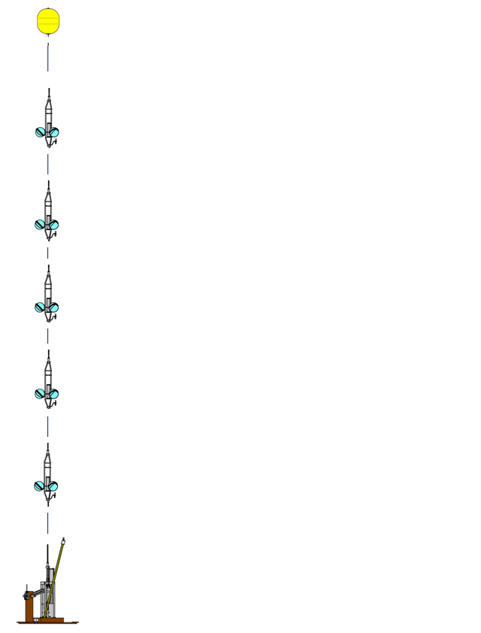
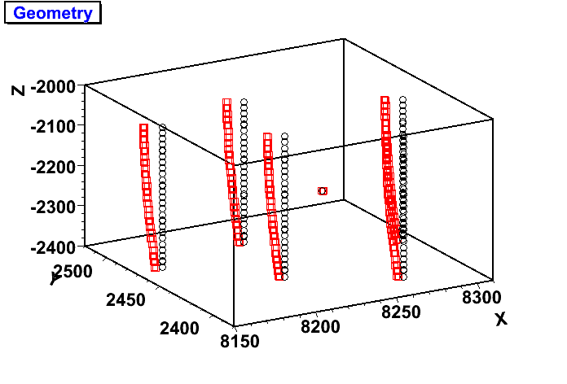
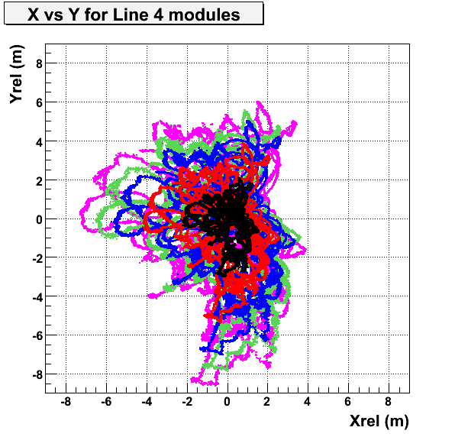
Calibration: positioning
Measure every 2 min:
distance line bases
to 5 storeys/line
and also storey
headings and tilts
Storey 1
Storey 8
Storey 14
Storey 20
Storey 25
Published in JINST 7 (2012) T08002
Radial displacement
WIPAC, 2013
1
J.P. Gómez-González

Slide 29
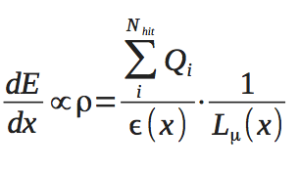

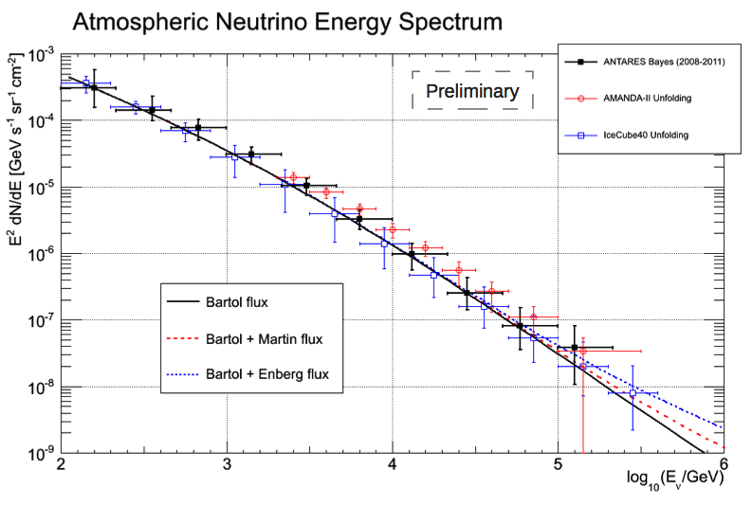
Atm. neutrino spectrum
Preliminary
WIPAC, 2013
1
J.P. Gómez-González

Slide 30

Gravitational lensing
List of selected sources
WIPAC, 2013
1
J.P. Gómez-González

Slide 31


Velocity of light in sea water
1. Flash light with fixed λ from a given position
2. Measure time when light reaches PMT
→ group velocity of light, refractive index (my own work)
Published in AP 35 (2012) 9
Group velocity of light measured at eight different wavelengths in Mediterranean Sea at a depth of 2.2 km
WIPAC, 2013
1
J.P. Gómez-González

Slide 32

Exotic physics: monopoles
ANTARES sensitivity to monopoles
(9-12 lines, 2008 data, 116 days)
Extremely high energy deposition: 8000 times m
Direct Cherenkov light for  > 0.74
Through δ-rays for  > 0.51
Monte Carlo generation done
A dedicated reconstruction needed
Astr. Part. Physics 35 (2012) 634-640
WIPAC, 2013
1
J.P. Gómez-González

Slide 33

Exotic physics: nuclearities
Search of nuclearites (strangelets, quark nuggets, Q-balls).
Very characteristic signature:an extended source of photons “heated wire”
Analysis ongoing. Good prospects for limits
WIPAC, 2013
1
J.P. Gómez-González

Slide 34

Calibration: timing
Published in ???
WIPAC, 2013
1
J.P. Gómez-González

Slide 35
ANTARES vs IceCube
Sky:
Northern
Southern
Full ANTARES (2007+2008)
RXJ1713.7
Supernova Remnant
Dashed: IceCube (IC22)
IceCube energy threshold ( > PeV) for Southern Sky sources, whereas
ANTARES sensitive at few TeV (more relevant for galactic sources)
WIPAC, 2013
1
J.P. Gómez-González

