Slide 1



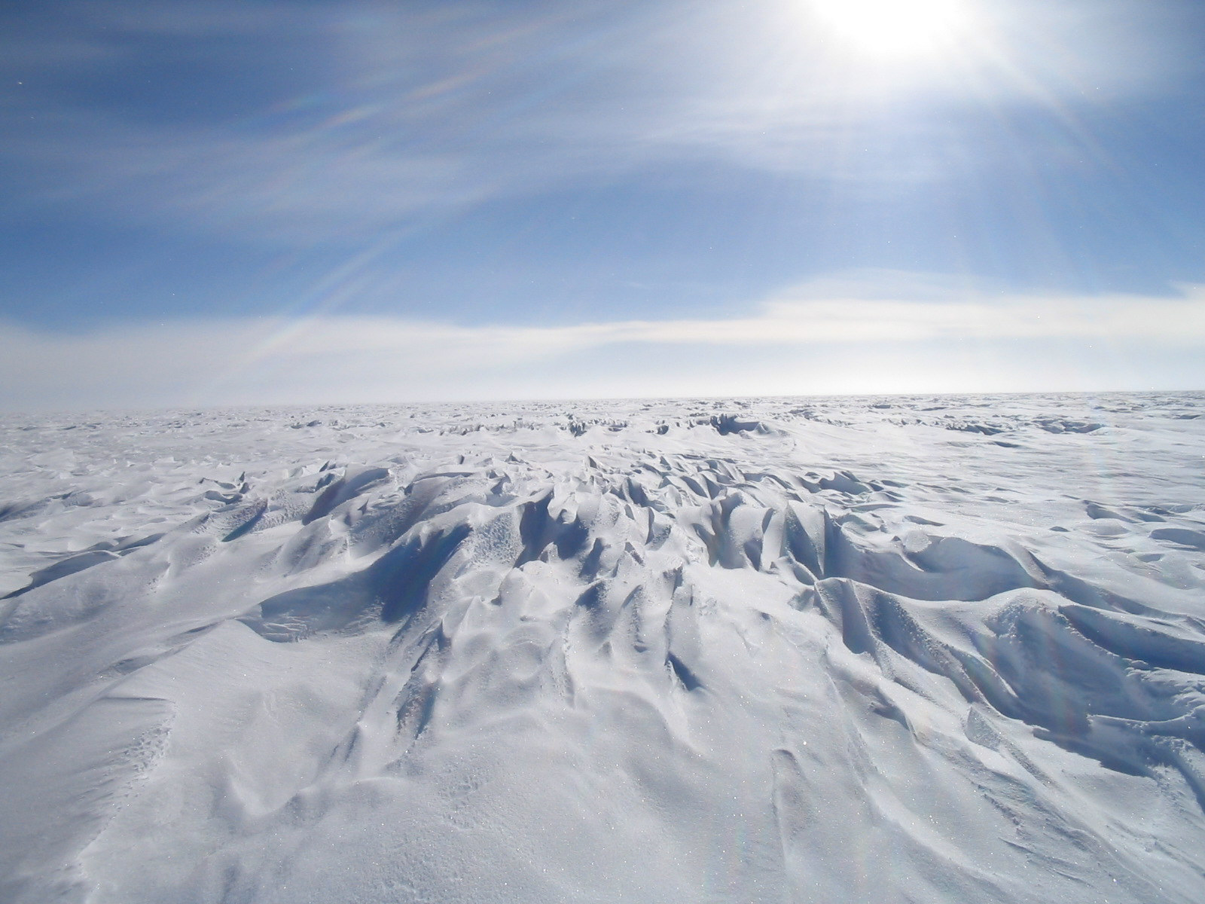
Towards Neutrino Astronomy: the IceCube Experiment at the South Pole
Stefan Westerhoff
University of Wisconsin-Madison
June 11, 2012

Slide 2
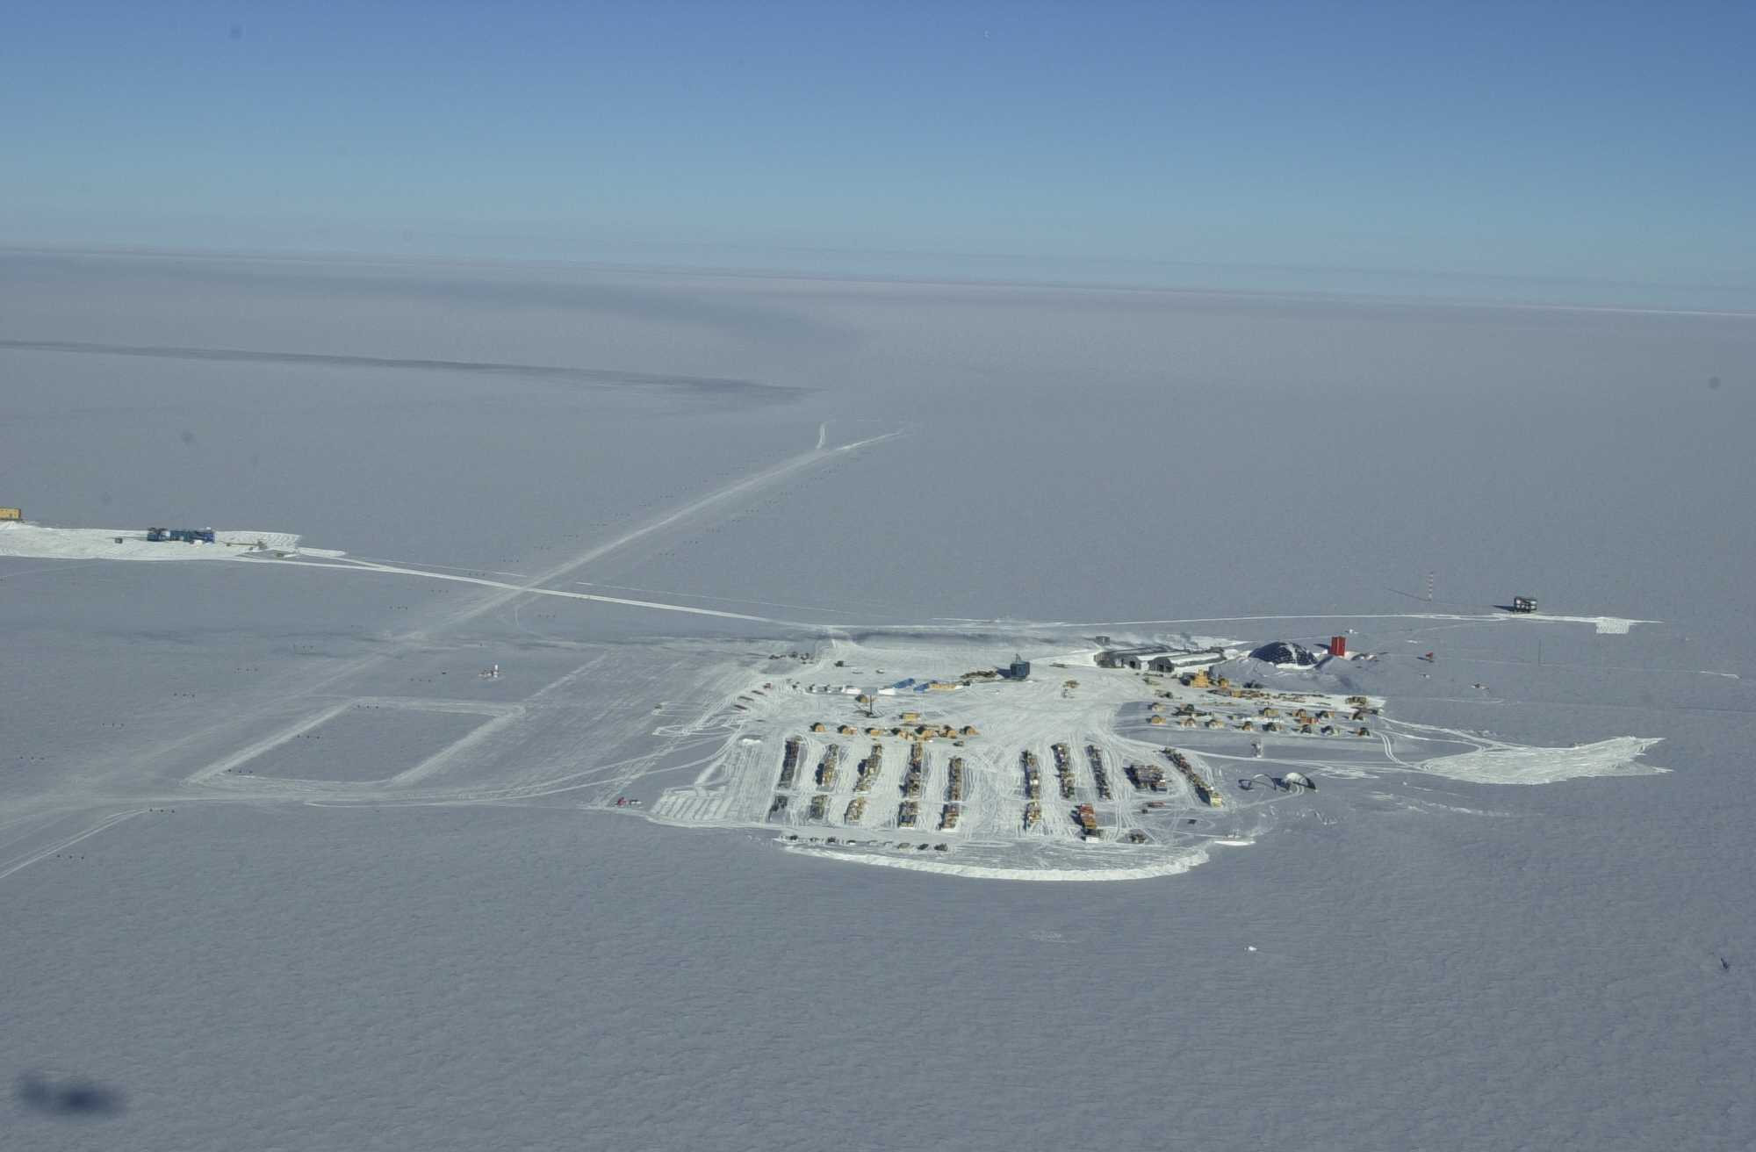
IceCube: An Unusual Telescope
IceCube is a cubic-kilometer-size detector frozen into the ice near the geographic South Pole, at a depth of 1500 - 2500 meters.
The detector volume is about a billion tons of ice, instrumented with more than 5000 light detectors.
The primary goal of the IceCube experiment is to detect neutrinos from extragalactic sources.
By detecting these neutrinos, we learn more about the most energetic and most violent objects in the Universe!

Slide 3
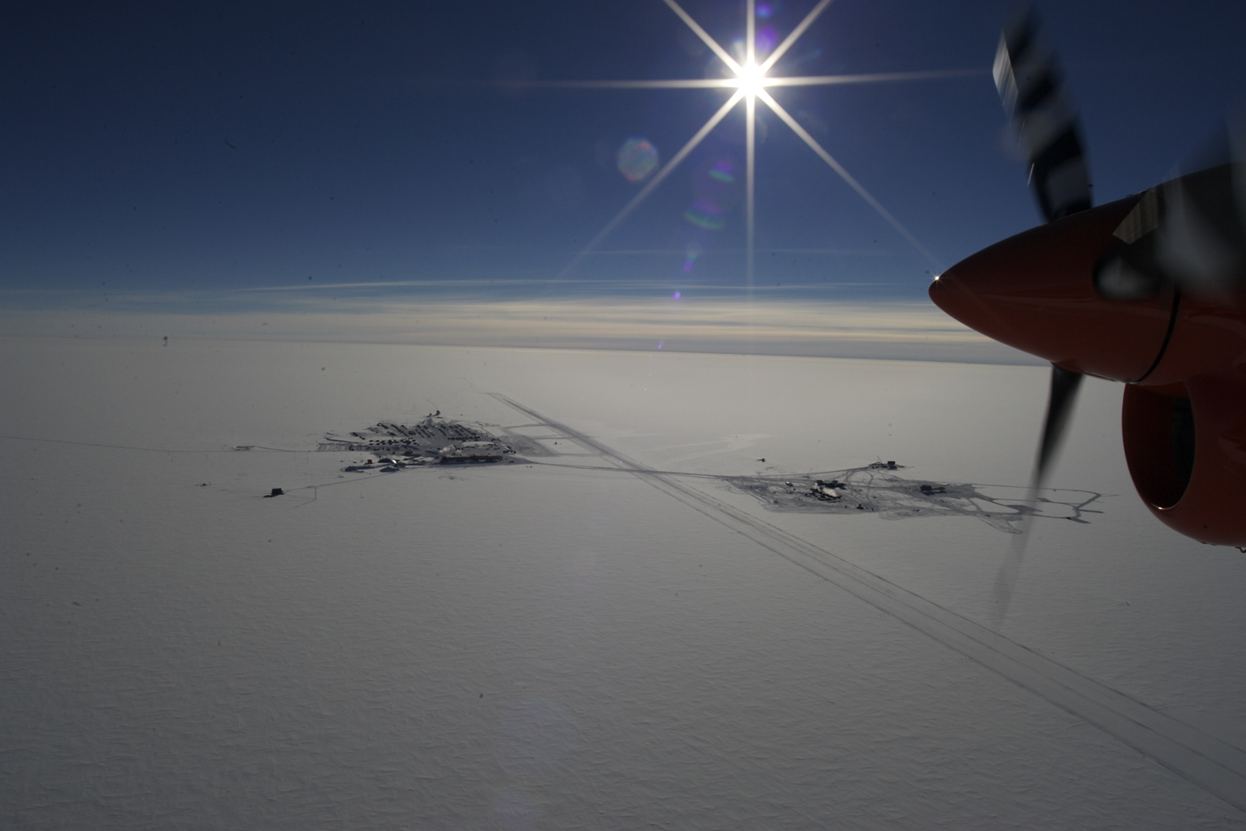
Amundsen-Scott South Pole Station

Slide 4
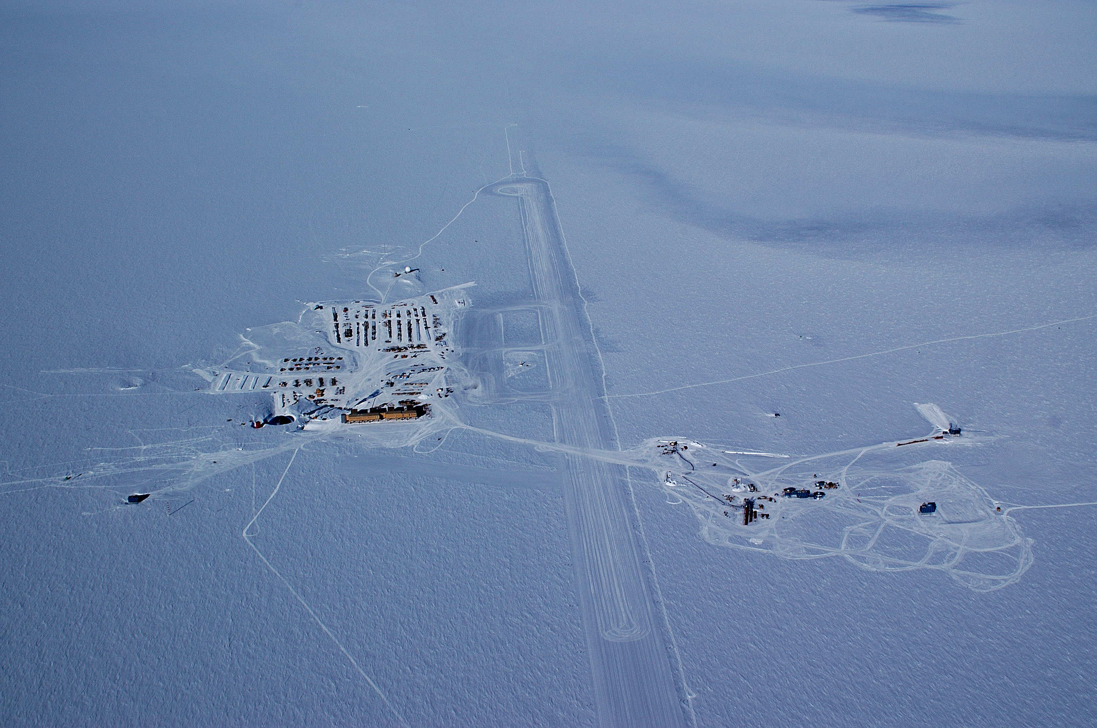
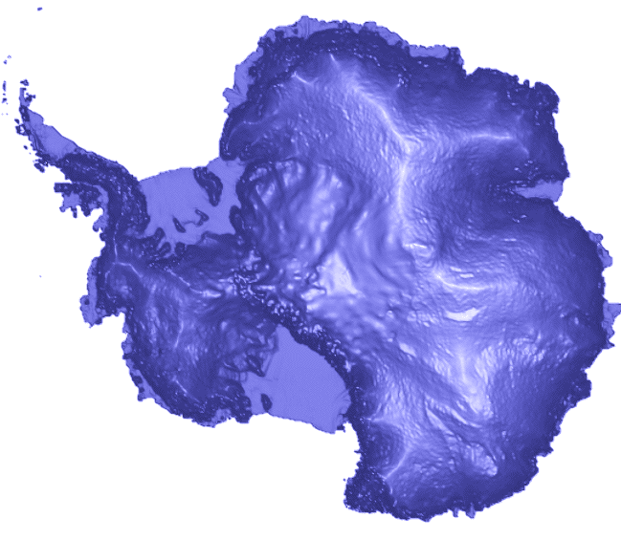
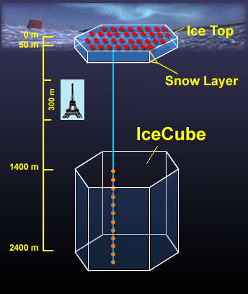
Where are we ?
runway
South Pole
IceCube

Slide 5
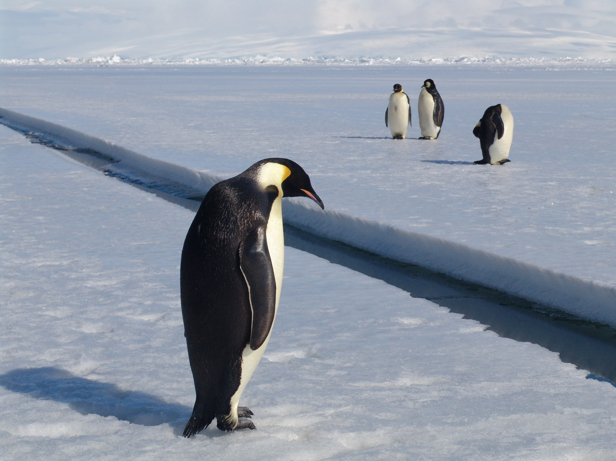
Why?

Slide 6
Outline
Particle Astrophysics - Searching for the Most Energetic Sources of the Universe
Cosmic Rays and the Pierre Auger Observatory in Argentina
IceCube: Towards Astronomy with Neutrinos

Slide 7
Particle Astrophysics
“Classical” Astronomy – electromagnetic spectrum from radio to X-rays.
Gamma-ray Astronomy – photons (light particles) with energies 10¹⁰ larger than optical light.
Cosmic Rays – protons and heavier nuclei with energies up to several Joule, the highest particle energies observed in the Universe.
Neutrinos – tightly connected to cosmic rays and their sources, but neutral and not subject to deflection in magnetic fields (= easier for “astronomy”).
energy

Slide 8
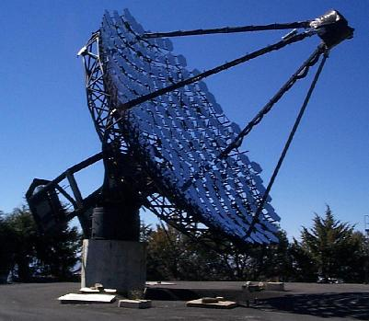
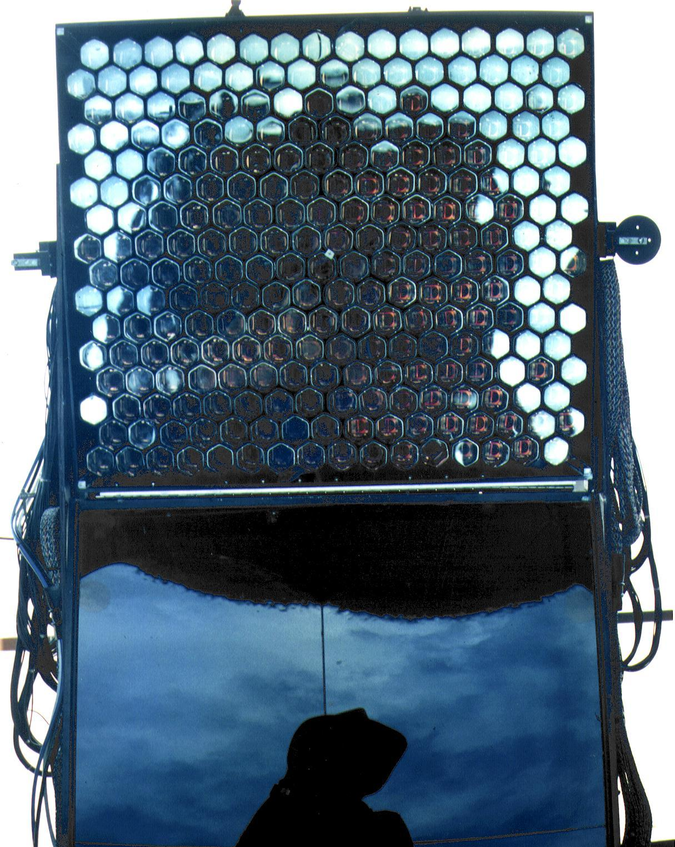
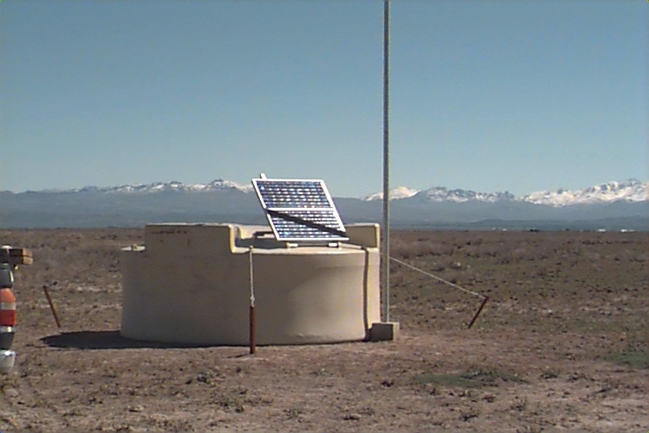
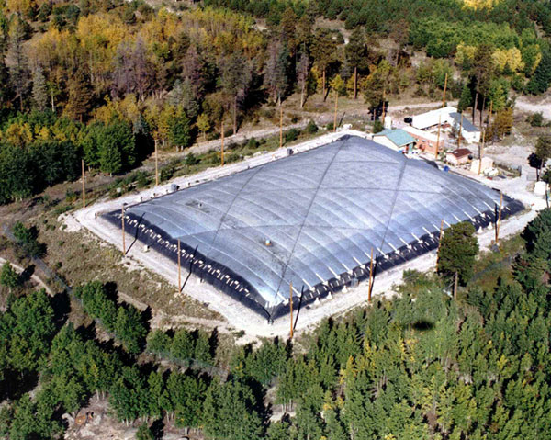
Particle Astrophysics “Telescopes”

Slide 9
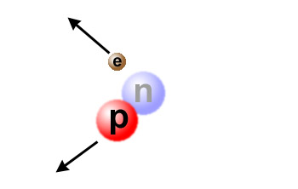
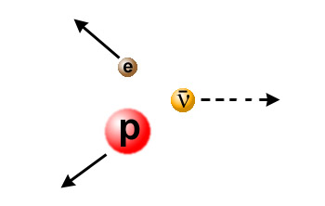
Neutrinos
The fundamental building blocks of atoms (and therefore of the world we know) are…
  Neutrons
  Protons
  Electrons
In nuclear reactions, neutrons can turn into protons and vice versa by emitting an electron (β decay).
Something is missing… or total momentum is not conserved!

Slide 10
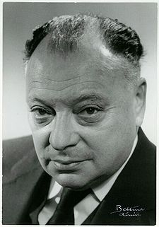
Neutrinos
To “fix” the picture, Wolfgang Pauli invented a new particle that is very light and has no charge - the neutrino (the “small neutral one”).
Neutrinos usually escape unseen - they interact very little with anything, move almost at the speed of light and are difficult to catch.
“I have done a terrible thing, I have postulated a particle that cannot be detected.”
Wolfgang Pauli (1900-1958)

Slide 11
Neutrinos
The neutrino was eventually detected by Reines and Cowan in 1956 in a nuclear reactor, three years before Pauli’s death.
Pauli’s response: “Everything comes to him who knows how to wait.”
Neutrinos are produced wherever there are nuclear reactions, for example in the Sun. More than 50 trillion (50×10¹²) solar neutrinos pass through your body every second.
Wolfgang Pauli (1900-1958)

Slide 12
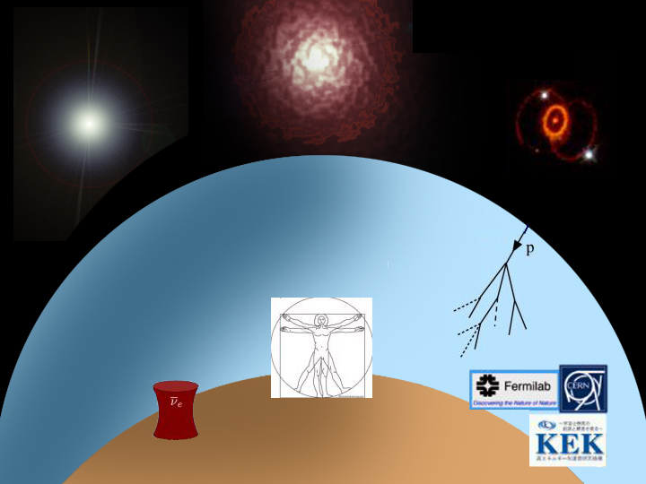
Big Bang
Sun
Supernova
1987a
Atmosphere
Human Body
Nuclear
Reactors
Accelerators
Earth

Slide 13
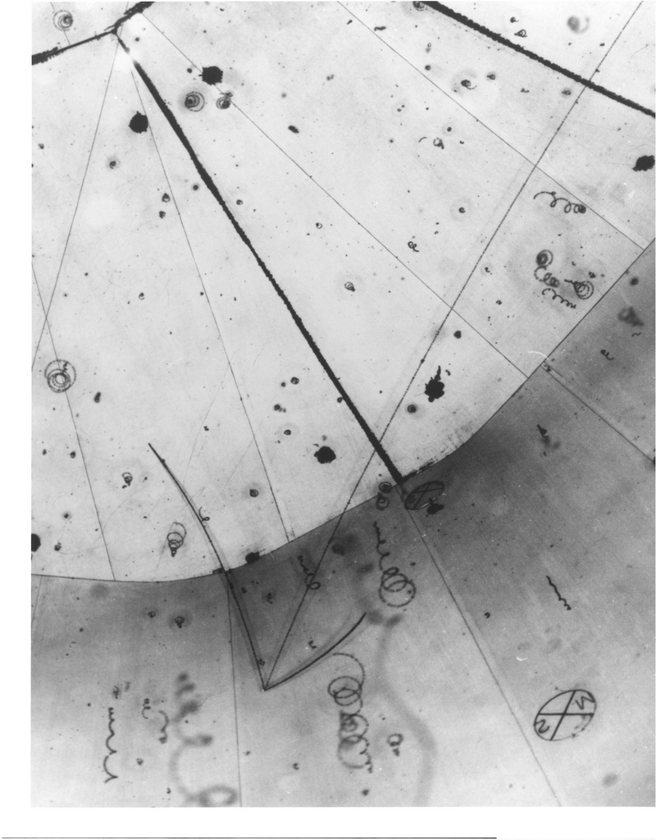
The Thing About Neutrinos
Neutrinos rarely interact - they just zip through almost everything - and are therefore hard to detect!
pion
muon
proton
neutrino
© Argonne National Lab

Slide 14
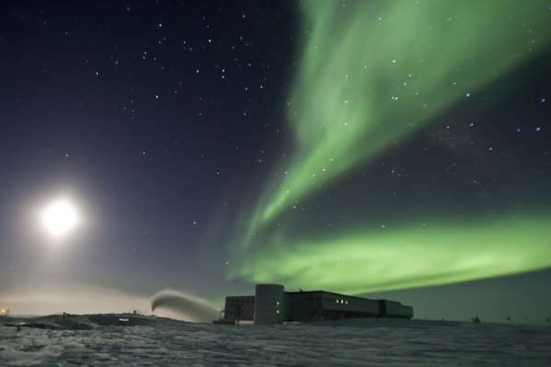
Why do we expect to see neutrinos from astrophysical sources?

Slide 15
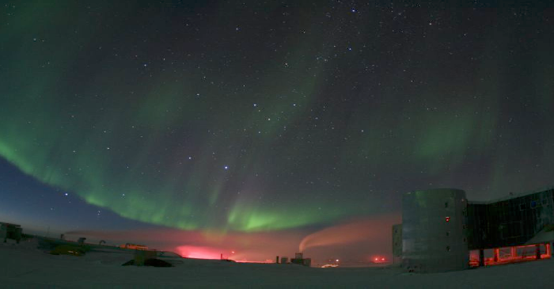
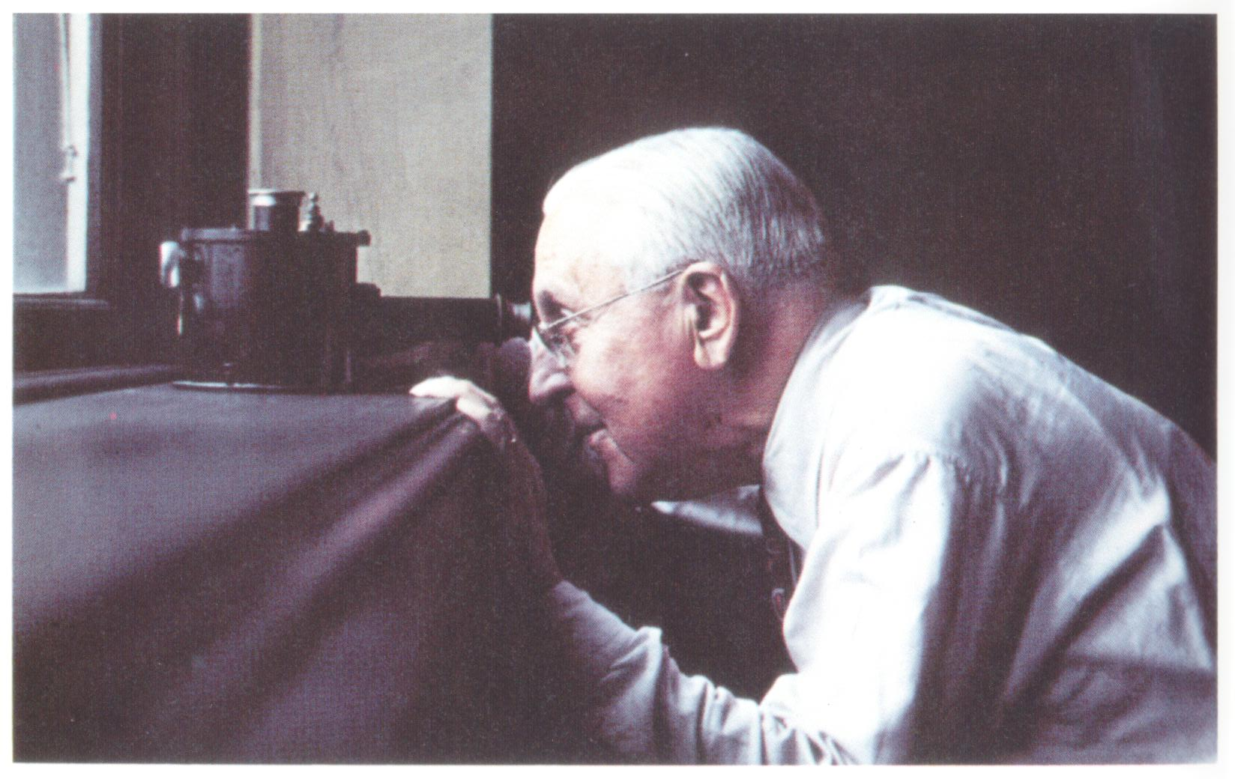
Cosmic Rays -
a 100-year old mystery

Slide 16
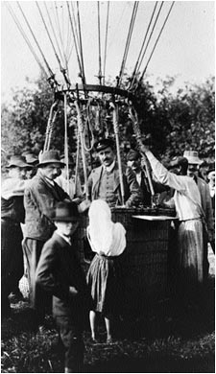
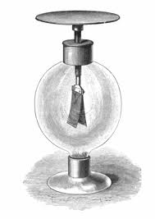
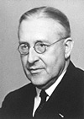
Victor Hess, 1912
Electroscopes discharge slowly even if no radioactive material is around - does the Earth radiate?
Victor Hess (1883-1964)

Slide 17
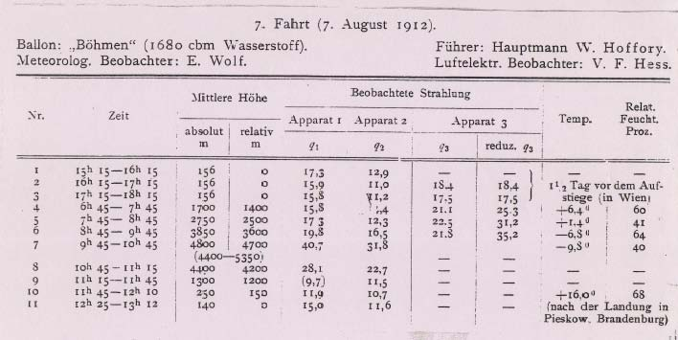
Balloon Data
Going up as high as 17,500 feet, Hess showed that the radiation level increases with altitude!

Slide 18
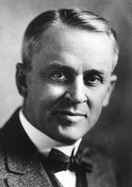
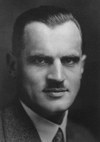
Cosmic “Rays?”
Nuclei? Electrons? Photons?
After their discovery, the chemical nature of cosmic “radiation” was unclear for some time.
The name “cosmic rays” reflects Robert Millikan’s belief that they were gamma rays from space.
In the 1930s, it became clear that cosmic rays are mainly energetic particles.
Most ultra-high-energy cosmic rays are protons and heavier nuclei.
Robert A. Millikan
(1868-1953)
Arthur H. Compton
(1892-1962)

Slide 19

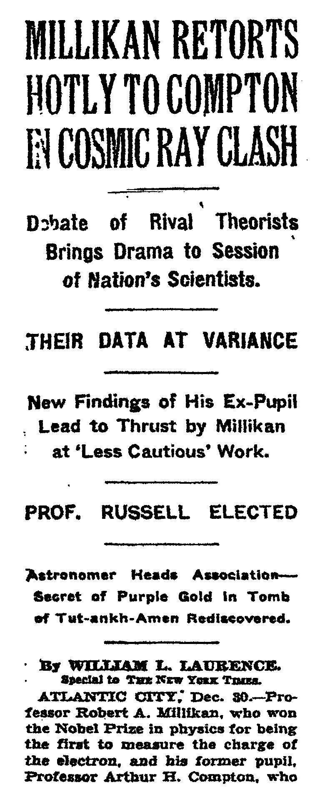
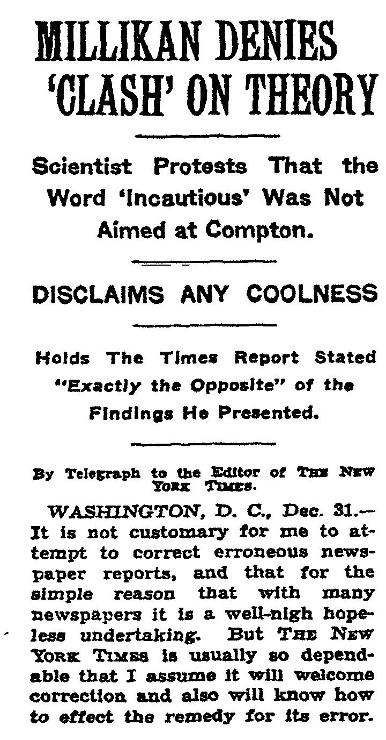
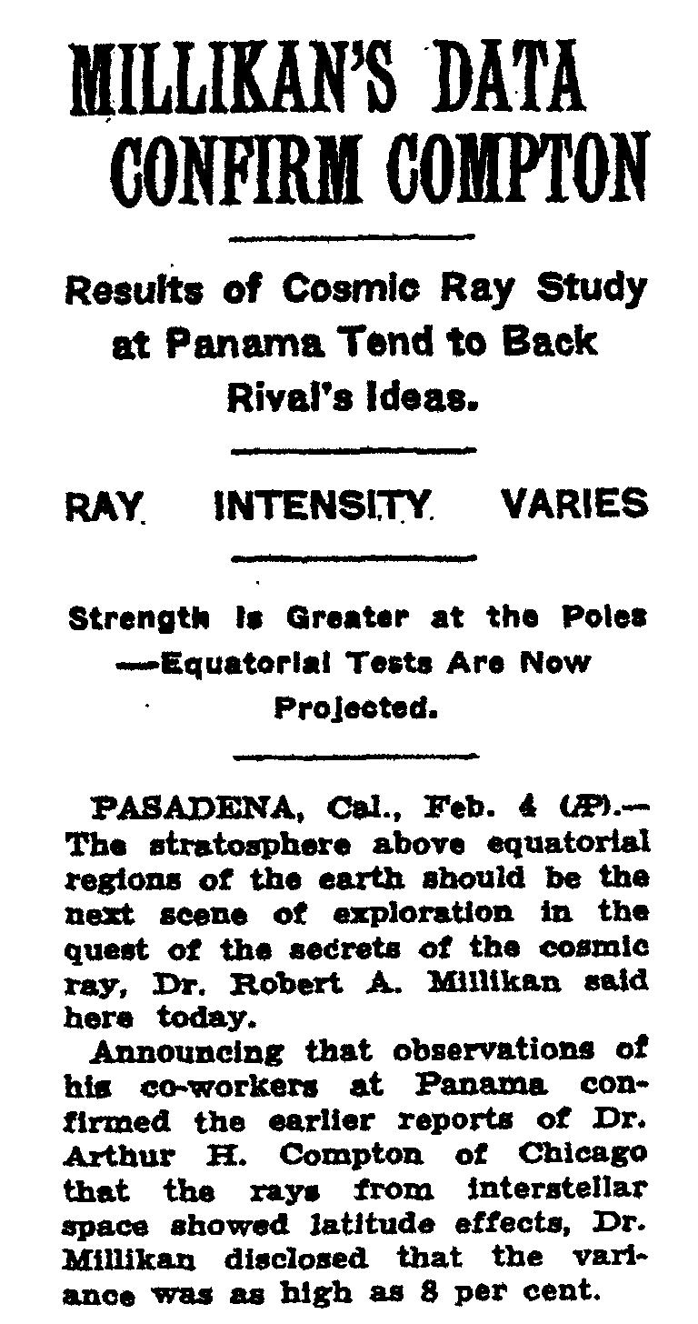

Slide 20
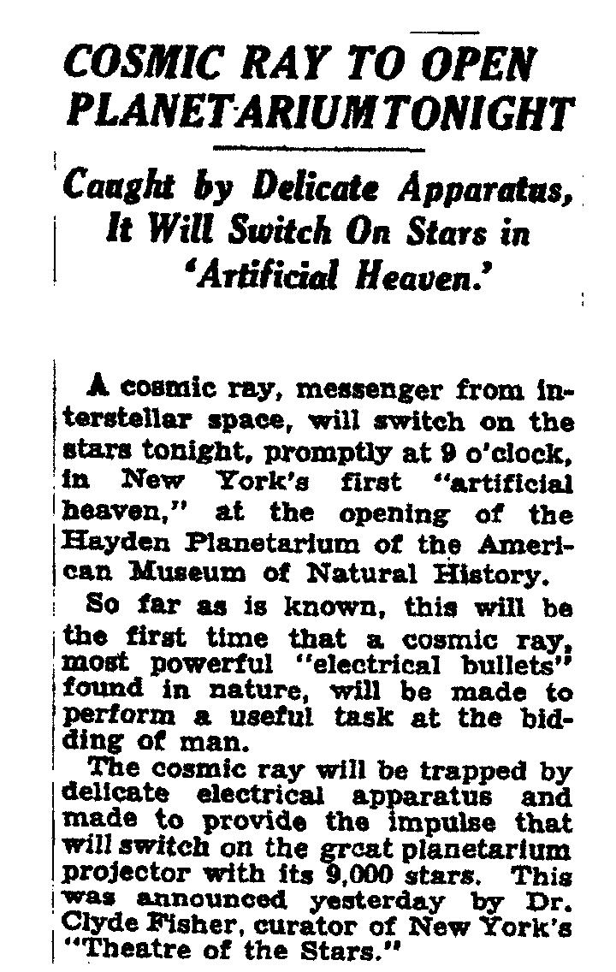
New York Times, Oct. 2, 1935
Opening of the Hayden Planetarium at the American Museum of Natural History
“So far as is known, this will be the first time that a cosmic ray… will be made to perform a useful task at the bidding of man.”

Slide 21
Cosmic rays are charged particles (protons or heavier nuclei) that continuously rain down on Earth from outer space.
A small fraction of them have energies in excess of several Joules, which makes them the highest energy particles in the known Universe.
Where do they come from? Do they point back to their sources? Can we do astronomy with these particles?

Slide 22
Electronvolt eV
Our usual unit of energy, the Joule, is inconvenient when dealing with sub-atomic particles. Particle physicists therefore usually use of different unit, the electronVolt.
1 electronVolt (eV) is the amount of energy gained by an electron (or a particle with the same charge) when it is accelerated through an electrostatic potential difference of 1 Volt.
e⁻
1 eV = 1.60 ×10⁻¹⁹ Joule
-
+
1V

Slide 23
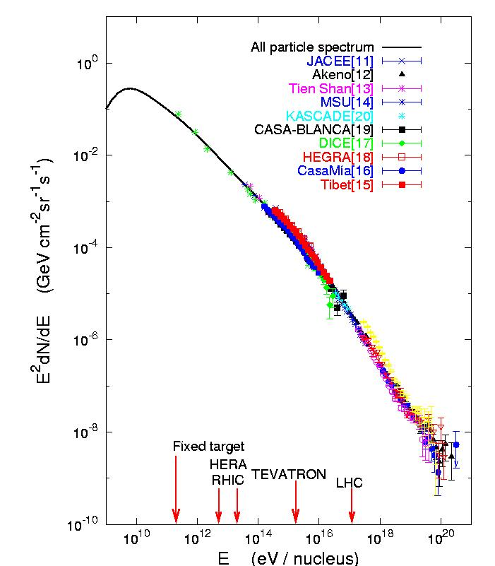
Cosmic Rays Energy Spectrum
Cosmic ray energy spectrum is nonthermal:
  Energy distribution has no characteristic temperature.
  Source energy is given to a relatively small number of particles.
Energies of the nonthermal Universe (up to 10²⁰ eV) are well beyond the capabilities of thermal emission processes.
The origin of cosmic rays at energies above GeV is unknown - no astrophysical object has ever been definitively identified as an accelerator of high energy nucleons.
Knee

Slide 24
Cosmic Rays Energy Spectrum
Accessible to experiment:
  Energy spectrum.
  Chemical composition.
  Arrival directions.
Astronomy with charged particles?
  Protons and nuclei are charged and therefore subject to deflection in Galactic and intergalactic magnetic fields (of unknown strength)!
Knee

Slide 25
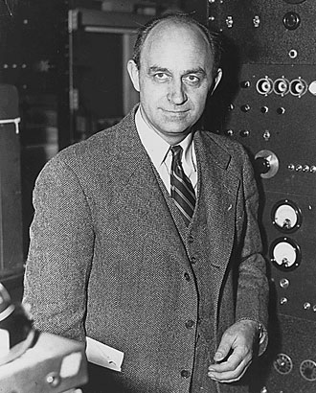
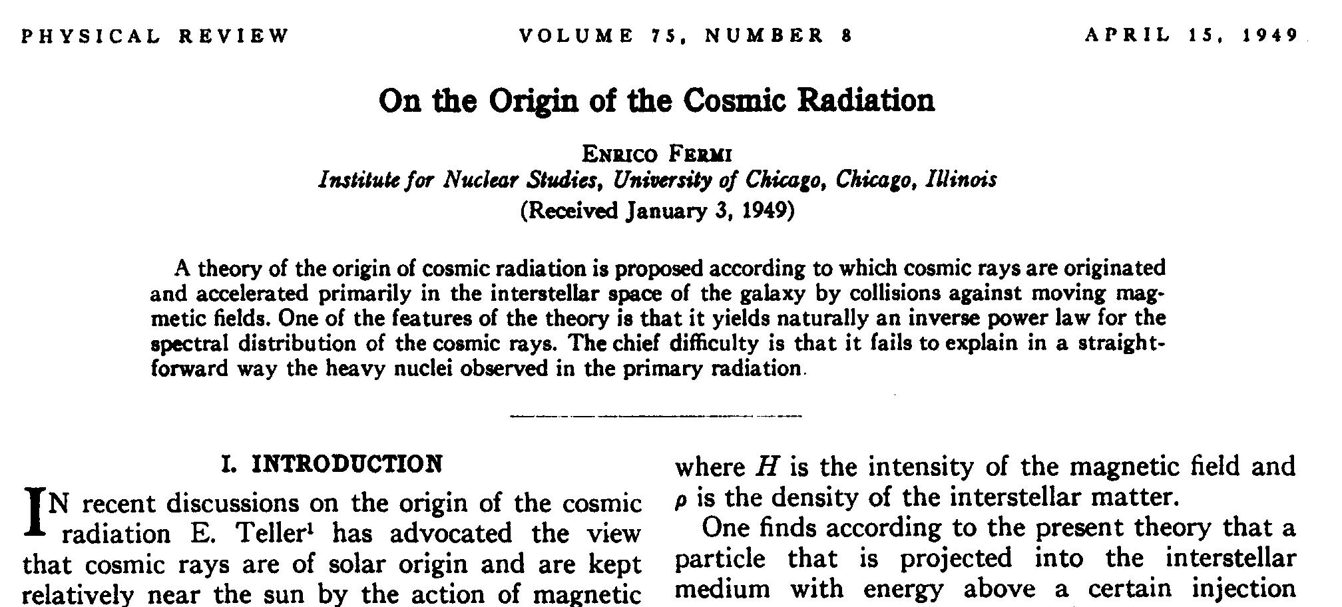
Acceleration Mechanism
A possible acceleration mechanism was suggested in 1949 by Enrico Fermi.
Particles are accelerated “by collisions against moving magnetic fields.”
Enrico Fermi (1901-1954)

Slide 26
Power Law
How can we get a power law?
Assume particles are not accelerated in one single step, but little by little in a process that repeats n times, with an energy gain per step of
After n steps, the energy is
… so the number of steps needed to reach energy E is

Slide 27
Power Law
Complication: after every step, the particle can escape from the acceleration region with some probability P_{esc} . Once it escapes, its energies does not increase any more.
The probability P_{n} that the particle reaches energy E_{n} is equal to the probability that the particle has not escaped for n encounters:
The number N of particles with energy > E_{n} is proportional to the number of particles that remain in the acceleration region for more than n steps:

Slide 28
Power Law
This can be re-written as
Note:
with
a process with a repeated energy increase ΔE = ξ E per step naturally gives a power law.
ν = frequency of acceleration
T = characteristic time of process
reaching higher energies takes longer; if the accelerator has a limited lifetime, only some characteristic maximum energy can be reached.

Slide 29
Source Candidates?
In Fermi's cosmic ray shock accelerator, protons speed up by bouncing off moving magnetic clouds in space - just like a tennis ball is faster after it bounces off a wall moving towards the observer.
Shock acceleration is a tedious process - the particles gain energy over many (10⁷ or more) collisions.
This is not the correct model, but the model can be improved: replace magnetic clouds by shock fronts…
incoming cosmic ray
magnetic
field
outgoing cosmic ray
moving magnetic
cloud or
shock front

Slide 30
Fermi Acceleration
Second order Fermi acceleration (charged particle interactions with clouds containing turbulent magnetic fields):
First order Fermi acceleration (1977) (replace cloud by shock front)
β = velocity of cloud (typically β < 10⁻⁴)
⇒ power law guaranteed!
β = velocity of shocked gas relative to the
unshocked gas (typically βc ≅ 10⁴ km/s)
power law guaranteed plus the spectral index is independent of the properties of the shock wave and depends only on the ratio of upstream to downstream velocities.
predicts a unique spectral index for diverse environments.

Slide 31
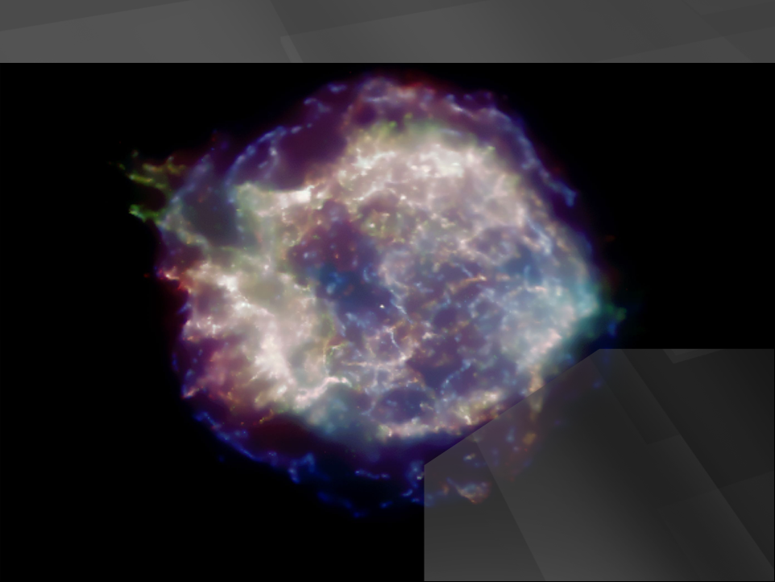
Cas A supernova remnant in X-rays
shock fronts
Fermi acceleration when
particles cross
high B-fields

Slide 32
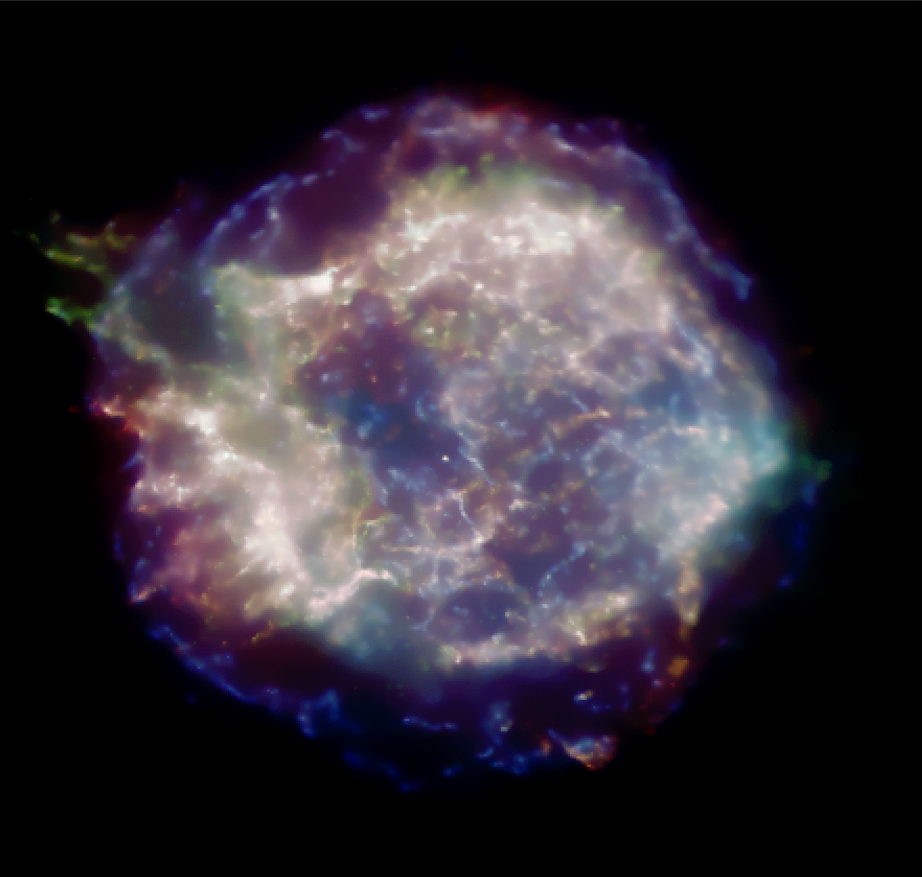
Cosmic Particle Accelerators
Baade and Zwicky suggested in 1934 that supernova remnants could be the sources of Galactic cosmic rays.
Particles are accelerated in diffuse shocks associated with young (~1000 year old) supernova remnants expanding into the interstellar medium.
The shock sweeps up the ~1 proton/cm³ density of hydrogen in the Galactic plane.
Fermi acceleration occurs in the high magnetic fields in the outer reaches of the shock.
Cas A, courtesy Chandra (NASA)

Slide 33
Cosmic Particle Accelerators
Supernovae can account for cosmic rays with energies up to ~10¹⁶ eV.
The strongest argument for this scenario is based on energy considerations:
  Observed energy density of galactic cosmic rays: ~ 10⁻¹² erg/cm³
  Supernova remnants: 10⁵¹ erg every 30 years: ~ 10⁻¹² erg/cm³
Supernova remnants provide the environment and energy to explain the galactic cosmic rays.
Cas A, courtesy Chandra (NASA)

Slide 34
Spectral Index
shock front
shock viewed in the
frame in which it is
stationary
A.R. Bell,
MNRAS 182 (1978) 147
u₁
u₂
upstream downstream
with
For a strong shock wave, the ratio of the upstream to downstream velocities depends only on the ratio of specific heats of the gas:
for a fully ionized gas

Slide 35
Spectral Index
shock front
shock viewed in the
frame in which it is
stationary
A.R. Bell,
MNRAS 182 (1978) 147
u₁
u₂
upstream downstream
The escape probability is the ratio

Slide 36
Spectral Index
shock front
shock viewed in the
frame in which it is
stationary
A.R. Bell,
MNRAS 182 (1978) 147
u₁
u₂
upstream downstream
Final result:
The spectral index is independent of the absolute magnitude of the velocity of the plasma - it depends only on the ratio of upstream to downstream velocities.
The spectral index is “universal” and its value comes close to what is needed to explain the cosmic ray energy spectrum.

Slide 37
Fermi Acceleration
First order Fermi acceleration is faster than second order, but it is by no means fast.
The time scale of a typical SN blast wave is roughly the time it takes the expanding shell to sweep through its own mass of the interstellar medium - after that, it slows down.
  Example:
  This means that of order 30 SN actively accelerate cosmic rays at any given time.

Slide 38
Fermi Acceleration
The finite lifetime of the SN blast wave as a strong shock limits the maximum energy per particle that can be achieved with Fermi acceleration:
The cosmic ray energy spectrum extends well beyond E_{max}, so acceleration in SNRs cannot account for the full spectrum!
This limit can be raised if the SN does not explode into the average interstellar medium, but into an environment formed by the wind of its progenitor (stellar wind SN). This raises the limit for E_{max} by about two orders of magnitude (Völk & Biermann, 1988).

Slide 39
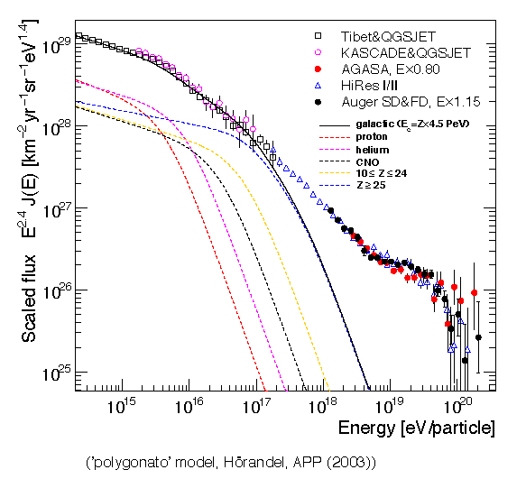
Polygonato Model
Standard Model of “knee:”
  Maximum energy
  Leakage from Galaxy
Between 10¹⁷ and 10¹⁹ eV transition from Galactic to extragalactic sources

Slide 40
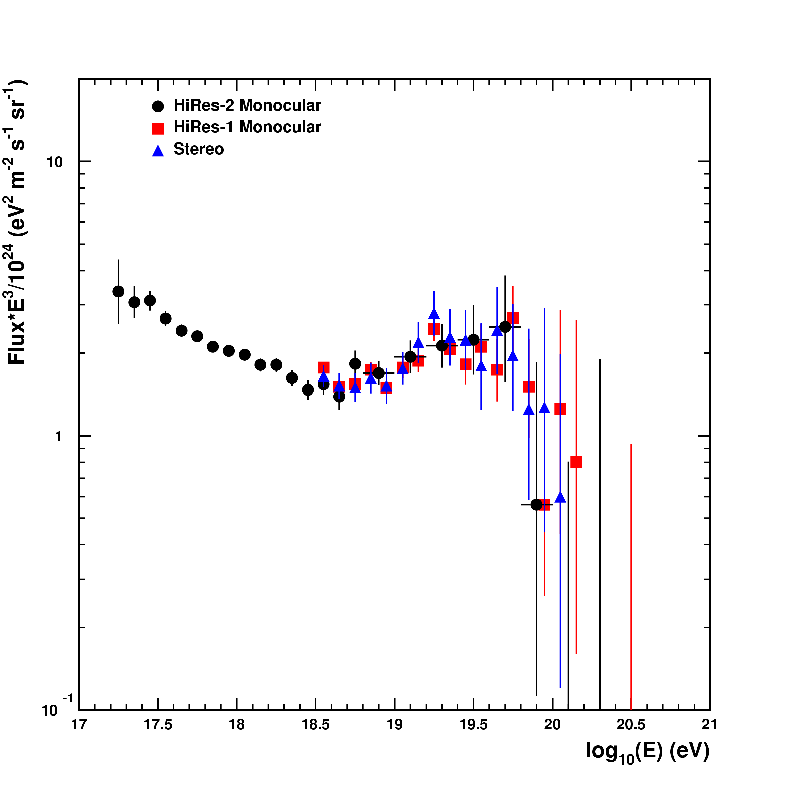
Cosmic Particle Accelerators
Above ~10¹⁸ eV, the gyroradius of a proton in Galactic magnetic fields exceeds the size of the Galaxy, so cosmic rays above this energy must be extragalactic all the way to the highest observed energies ~10²⁰ eV.
Direct support for this scenario comes from the observation of the absorption of the particle flux by the microwave background (“GZK cutoff”) by the HiRes and Pierre Auger cosmic ray experiments.
Flux × E³
HiRes Collaboration,
PRL 100 (2008) 101101
energy

Slide 41
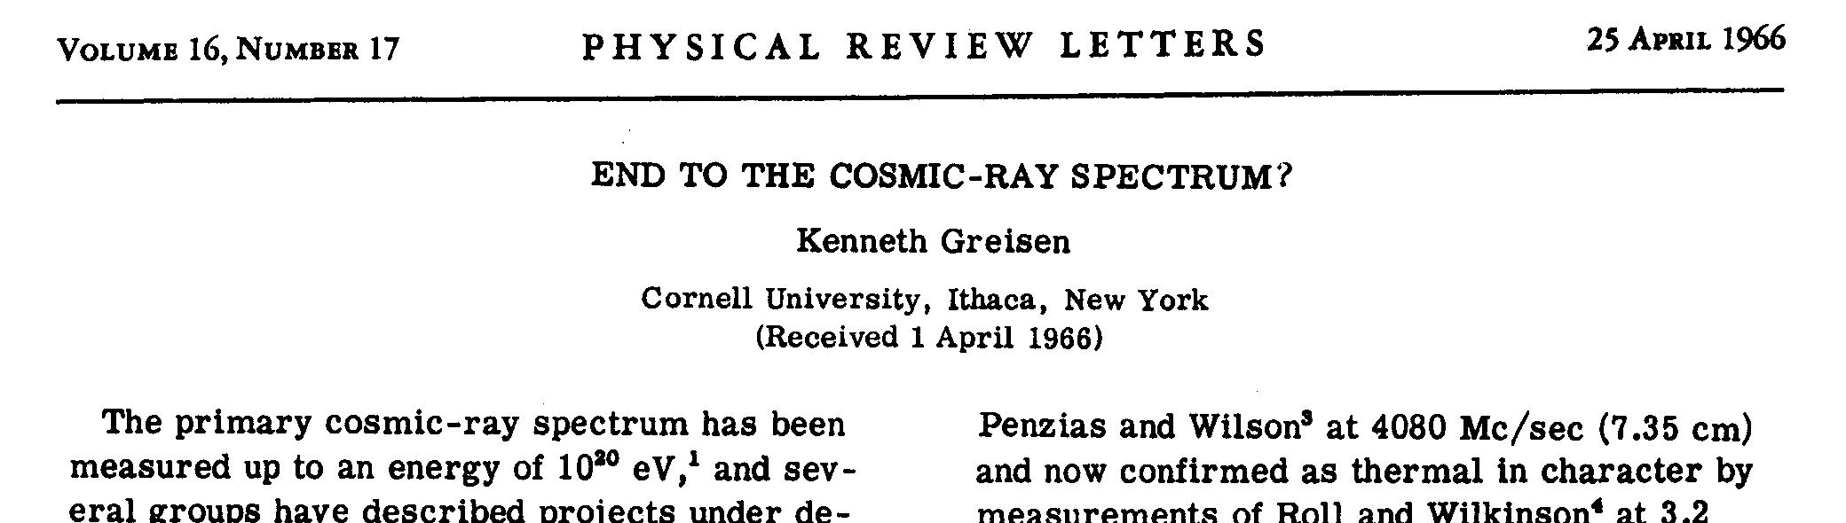
GZK Suppression
Cosmic rays interact with the 2.7 K microwave background.
Protons above ~ 6×10¹⁹ eV suffer severe energy loss from photopion production.
Proton (or neutron) emerges with reduced energy, and further interaction occurs until the energy is below the cutoff energy.
Greisen-Zatsepin-Kuz’min Suppression

Slide 42
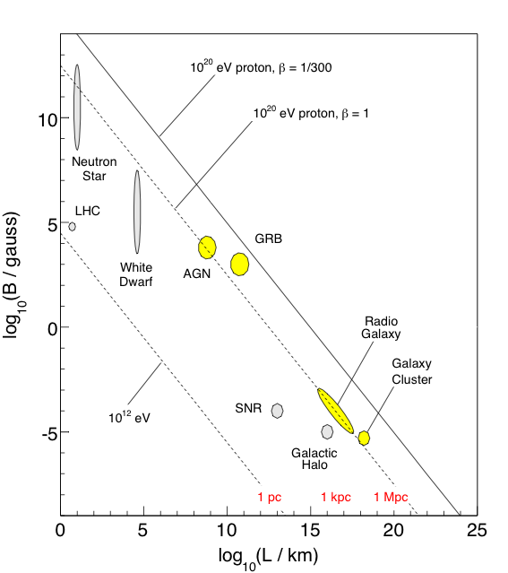
Extragalactic Sources?
A. M. Hillas, Ann. Rev. Astron. Astrophys. 22, 425 (1984)

Slide 43
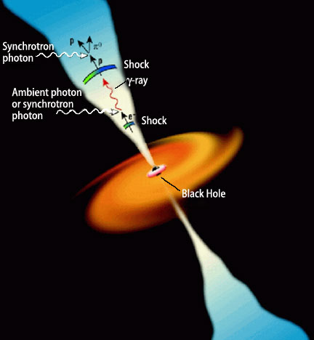
Cosmic Particle Accelerators
Active Galactic Nuclei (AGN) are possible sources: they consist of a supermassive black hole, an accretion disk, and two jets in which shocks move outward.
Energy considerations work out for AGN …
… but also for Gamma Ray Bursts (GRBs), so both AGN and GRBs are leading candidates.
But again, no extragalactic object has been unambiguously identified as a source of cosmic rays…

Slide 44
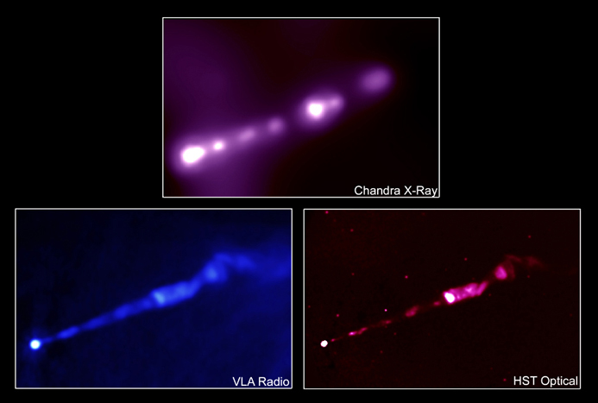

Slide 45
Origin of Cosmic Rays
Galactic origin
- Supernovae
- …
Extragalactic origin
- Active Galactic Nuclei
- …
Knee

Slide 46
How can we find the sources of cosmic rays?
Do cosmic rays point back to their sources?
Is astronomy with (charged) particles possible?

Slide 47
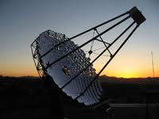
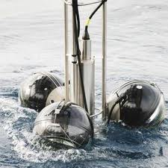

A World-Wide Effort
Antares/
KM3NeT
Veritas
Arizona
Yakutsk
Haverah Park
HiRes/TA
Lake Baikal
Utah
Milagro
AGASA
HAWC
Mexico
H.E.S.S.
Namibia
Auger
SUGAR
Argentina
IceCube
South Pole

Slide 48
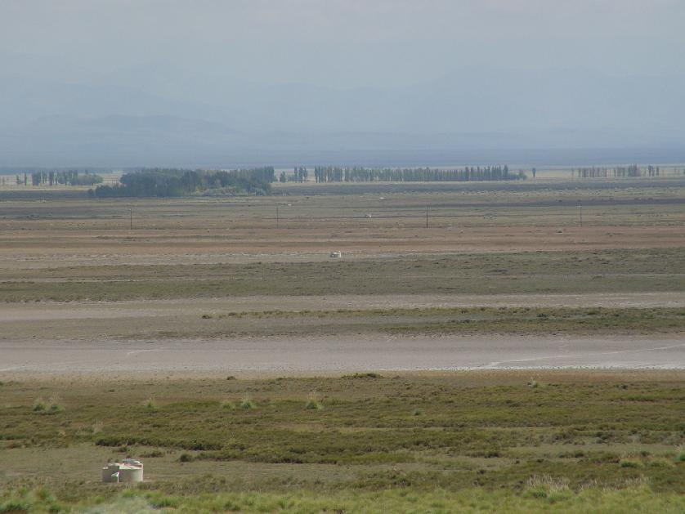
A Tale of Two Experiments

Slide 49
Integral Flux
flux
1 particle
per m² per second
1 particle
per m² per year
“Knee”
1 particle
per km² per year
Requires large,
Earth-bound detectors!
“Ankle”
energy

Slide 50
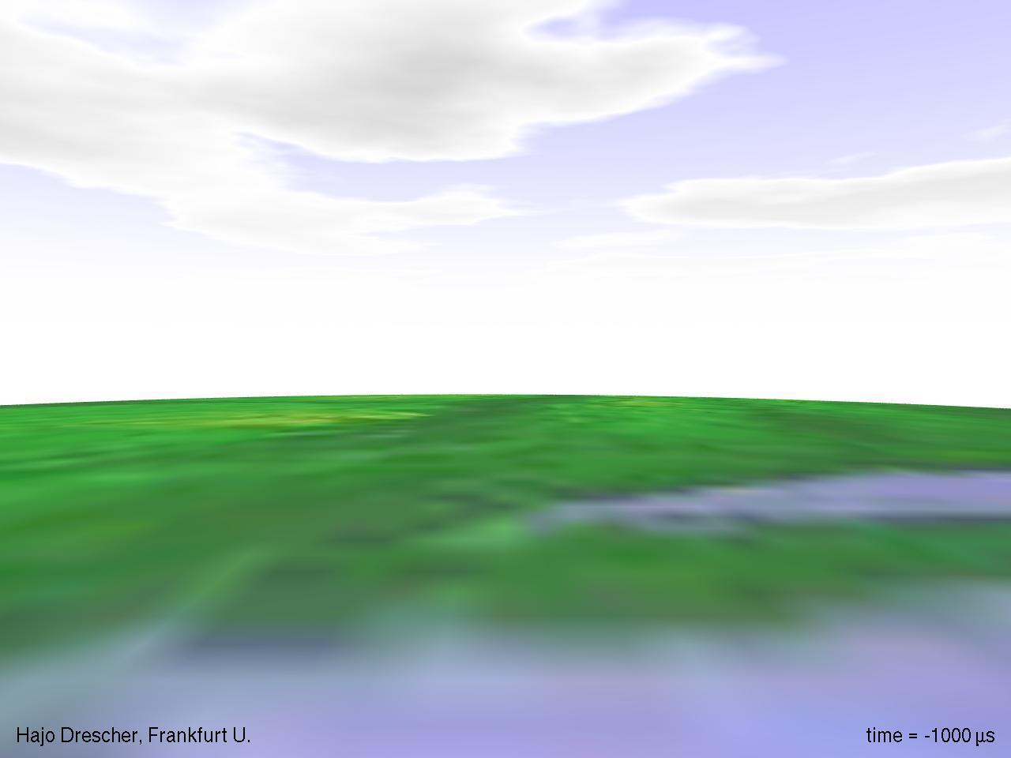

Slide 51
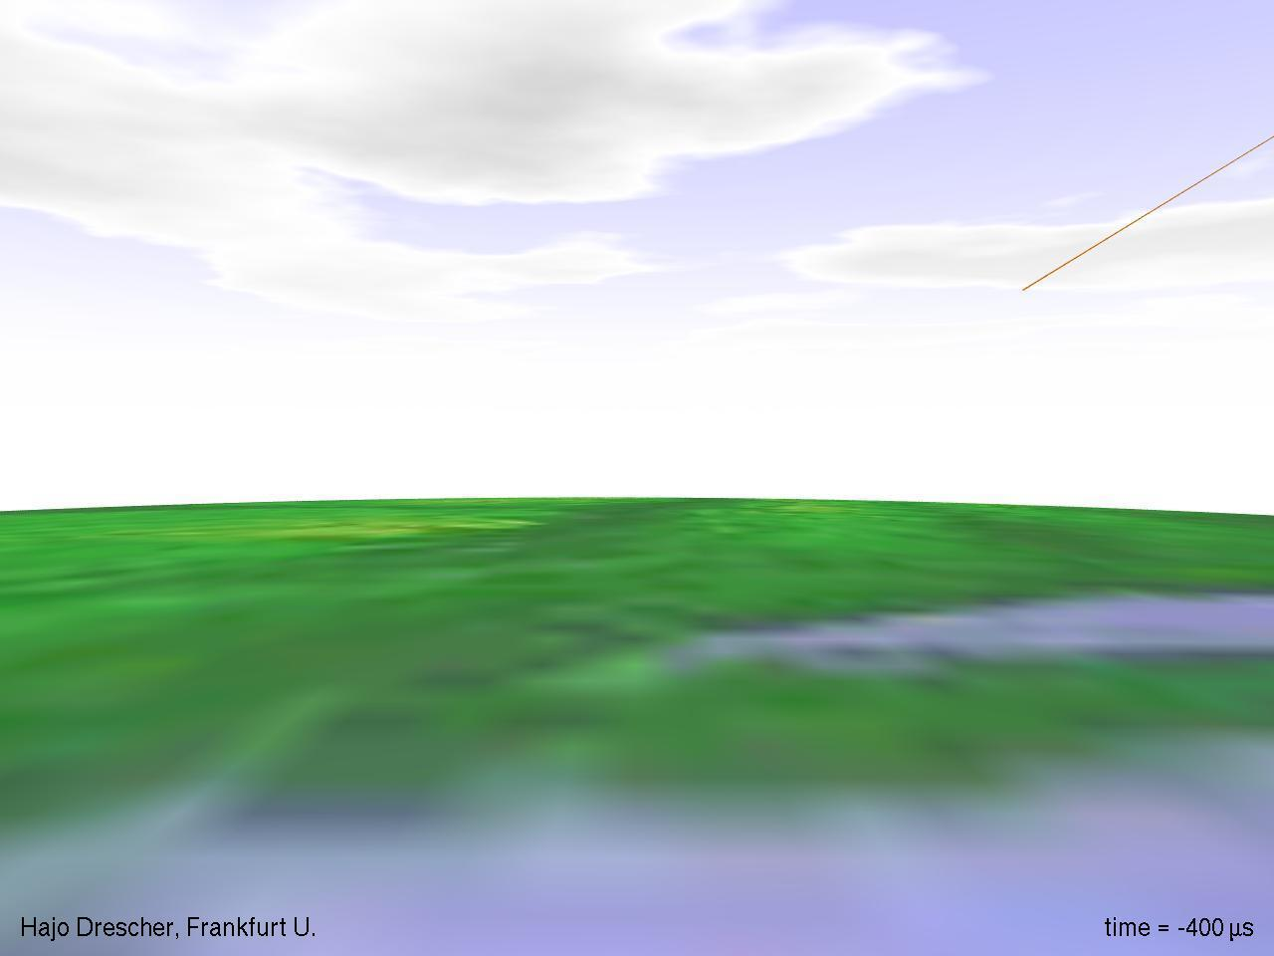

Slide 52
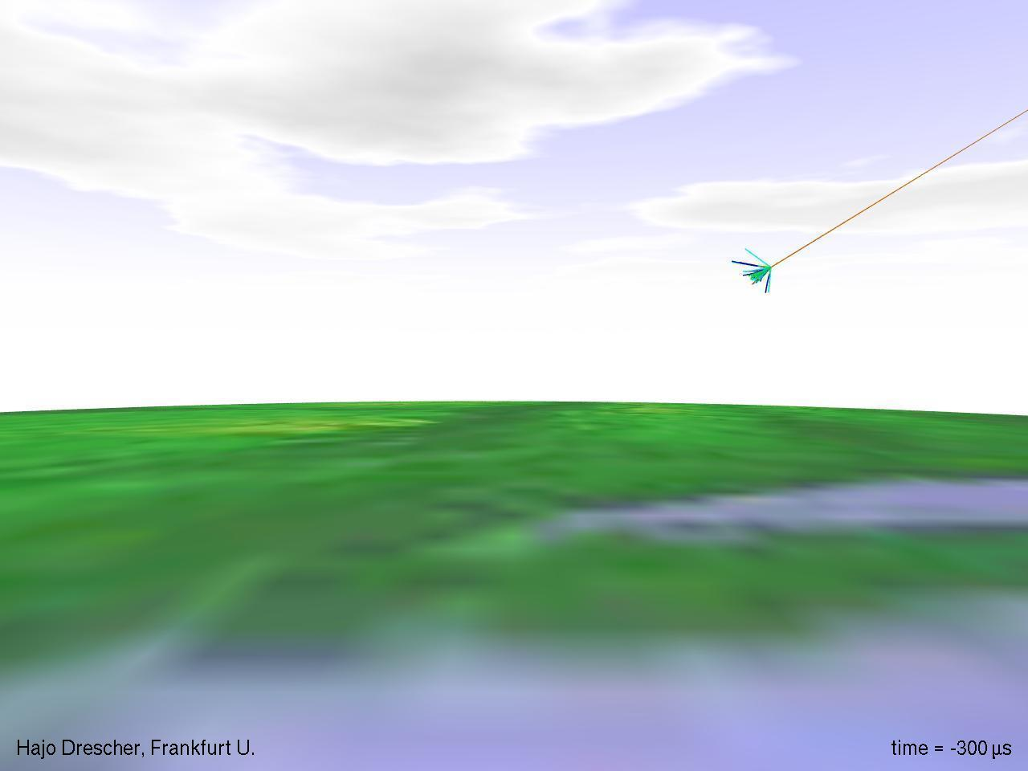

Slide 53
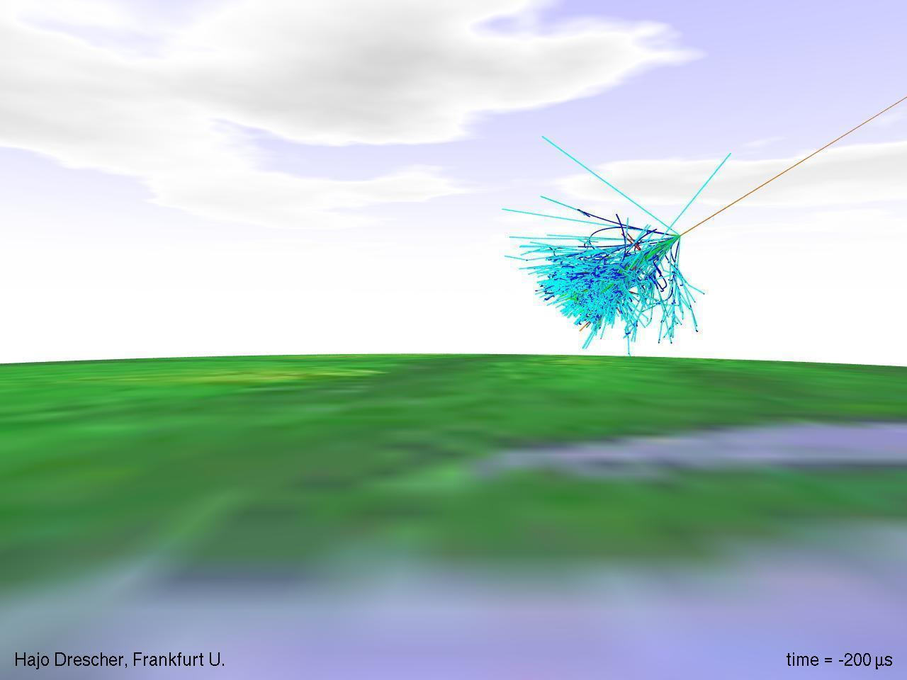

Slide 54
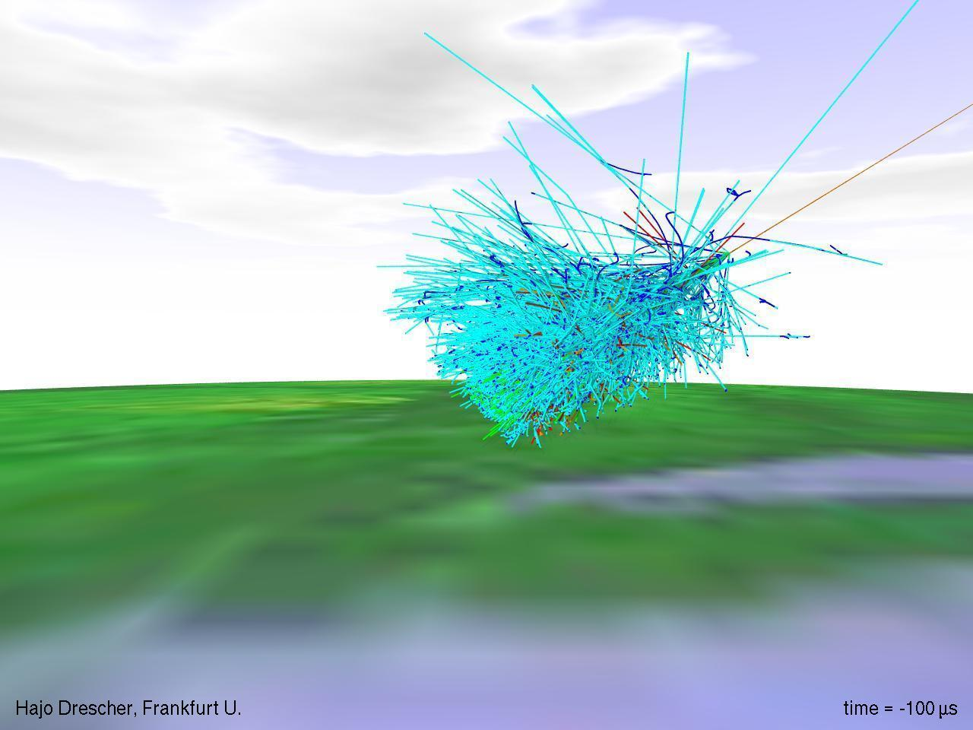

Slide 55
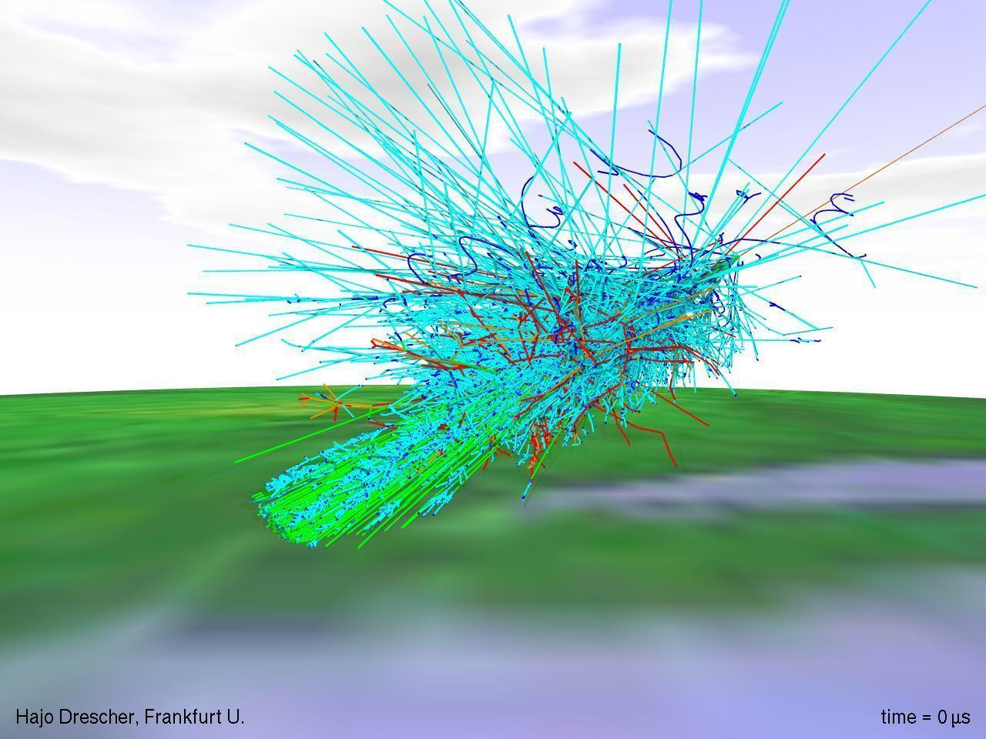

Slide 56
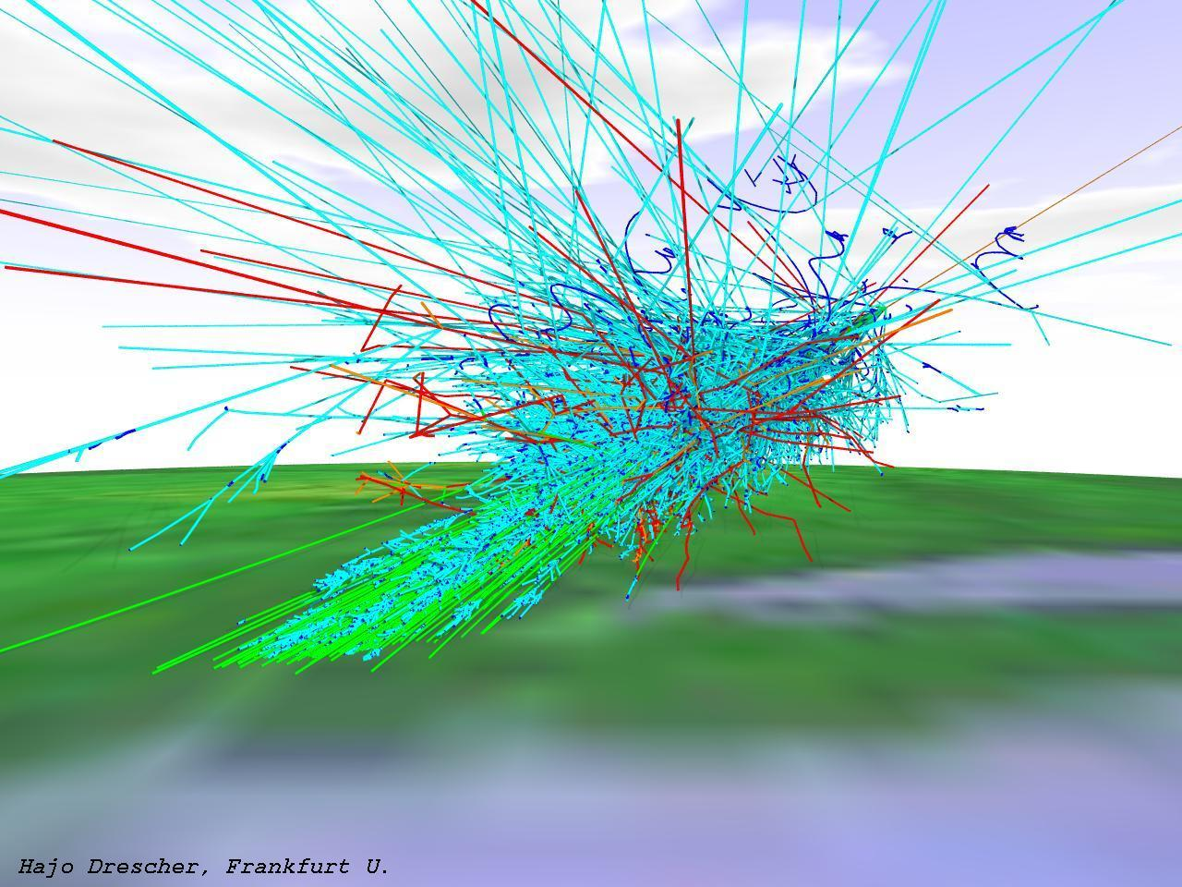
muon flux at sea level:
1 per cm² per minute

Slide 57


Detection Techniques
Camera with 440 PMTs
(Photonis XP 3062)

Slide 58

Pierre Auger Collaboration
International effort involving more than 350 scientists at 72 institutions in 18 countries:
  Argentina, Australia, Bolivia, Brazil, Czech Republic, France, Germany, Italy, Mexico, Netherlands, Poland, Slovenia, Spain, United Kingdom, USA, Vietnam
www.auger.org
auger.physics.wisc.edu

Slide 59


Surface Detector
3000 km² area

Slide 60

Notes:
60
In this animation the measurements of an actual shower were used to simulate the shower that initiated the event. The shower is like a curved pancake of particles that moves down through the atmosphere at near the speed of light – not slow and jerky as shown here.
Showers start about 10 km up in the atmosphere. The radius of curvature of the shower front is measured so that the beginning point of the shower can be determined. The curved shower front is clearly seen in the animation.

Slide 61



Fluorescence Detector

Slide 62



Slide 63

Arrival Directions
northern sky
equatorial coordinates

Slide 64

Skymap at the Highest Energies
472 AGN with z < 0.018 (red crosses), 27 cosmic ray arrival directions with 3.1º circle, color indicates relative exposure, position of CenA (white cross).
Centaurus A
4 Mpc, 11 million light years
Auger Collaboration, Science 318 (2007) 938

Slide 65
There are first indications that the cosmic ray flux might not be isotropic at the highest energies, but no source has been positively identified so far.
Maybe the particles do not point back to their sources - intergalactic and Galactic magnetic fields might scramble the arrival directions even at the highest energies!
Cosmic rays are not the only messenger from high energy sources -where there are cosmic rays, there are also neutrinos!

Slide 66

Messenger Particles
Cosmic rays are not the only messenger from high energy sources - a cosmic ray source is also a beam-dump.
Cosmic rays inevitably interact with radiation and gas surrounding their source, e.g.
Energy escaping the source is distributed among cosmic rays, gamma rays, and neutrinos.

Slide 67
Neutrino Production
Neutrinos are the ideal “messenger particle:”
  Neutrinos propagate in a straight line and are not easily absorbed - they can get away from the source!
  However, they are not easily “absorbed” in detectors, either… we need km³ size detectors!

Slide 68
Requirements for a Neutrino Detector
Large detector volumes - of order ~ km³ if we want to detect a few neutrinos from astrophysical sources per year…
Neutrinos must interact near or in the detector and produce a particle that can be detected, for example a muon.
The detector must be shielded from the enormous background of atmospheric muons, so it needs to be deep below some absorbing material.
At the same time, the absorbing material must allow for detection of light from particles created by neutrinos.

Slide 69

Blue light travels 200+ meters in ice…

Slide 70
80 Stations, each with:
86 strings
1.5 km - 2.5 km deep
typically 125 m spacing between strings
60 Modules per string
1 km³ -- 1 billion tons of instrumented volume
Notes:
70

Slide 71

IceCube Collaboration
http://icecube.wisc.edu
36 institutions, ~250 members
Canada
University of Alberta
US
Bartol Research Institute, Delaware
Pennsylvania State University
University of California - Berkeley
University of California - Irvine
Clark-Atlanta University
University of Maryland
University of Wisconsin - Madison
University of Wisconsin - River Falls
Lawrence Berkeley National Lab.
University of Kansas
Southern University, Baton Rouge
University of Alaska, Anchorage
University of Alabama, Tuscaloosa
Georgia Tech
Ohio State University
Barbados
University of West Indies
Sweden
Uppsala Universitet
Stockholms Universitet
Germany
Universität Mainz
DESY-Zeuthen
Universität Dortmund
Universität Wuppertal
Humboldt-Universität zu Berlin
MPI Heidelberg
RWTH Aachen
Universität Bonn
Ruhr-Universität Bochum
UK
Oxford University
Japan
Chiba University
Belgium
Université Libre de Bruxelles
Vrije Universiteit Brussel
Universiteit Gent
Université de Mons-Hainaut
Switzerland
EPFL, Lausanne
University of Geneva
New Zealand
University of Canterbury
ANTARCTICA
Amundsen-Scott Station
Notes:
71

Slide 72


Slide 73



Digital Optical Module
electronics
photomultiplier tube

Slide 74


IceCube
25 m
45 m

Slide 75

Drill tower
Hose winch
IceTop Tanks
Hot water generator
5 megawatt hot water drilling system

Slide 76
A photomultiplier
starts its journey
to 2500 m…

Slide 77

IceCube Configurations
IC-86
10-11 Season
IC-79
09-10 Season
IC-59
08-09 Season
IC-40
07-08 Season
IC-1
04-05 Season
IC-9
05-06 Season
IC-22
06-07 Season
M. Santander

Slide 78

IceCube Concept
Shielded and
transparent medium
Lattice of
photomultipliers

Slide 79
IceCube Concept
Neutrino travels
through the Earth.
ν_{μ}

Slide 80
IceCube Concept
Infrequently, a neutrino causes a nuclear interaction in the ice and produces a muon.
μ
ν_{μ}

Slide 81
IceCube Concept
The muon produces Cherenkov light, and photomultipliers capture and map the light.
μ
ν_{μ}

Slide 82

IceCube Concept
The muon produces Cherenkov light, and photomultipliers capture and map the light.
μ
ν_{μ}

Slide 83

Cherenkov Light
… is produced by charged particles traveling faster than the speed of light.
optical equivalent to supersonic boost

Slide 84


Slide 85

Event Display
Number of hit modules: 148
est. angular error: 0.84°

Slide 86

IC40 Data ~ 1 TeV neutrino-induced muon
2010 July 24
Chad Finley - Oskar Klein Centre - Stockholm University
86

Slide 87

IC40 Data ~ 300 TeV cosmic ray muon bundle
2010 July 24
Chad Finley - Oskar Klein Centre - Stockholm University
87

Slide 88



Neutrino Event Signatures
“Tracks” from muons
    Good angular resolution ~1° or less.
    Currently the most important channel in IceCube (long tracks ⇔ large detector volume).
    For E > TeV, muon energy loss per meter depends ~linearly on the muon energy; resolution ~0.3…0.4 in log E.
Cascades from electrons
    Showers, not track-like.
    All energy loss inside the detector, good energy resolution ~0.1 in log E.
“Double bang” events from taus

Slide 89




Moon Shadow
Cosmic rays blocked by the moon lead to a deficit in the distribution of downward going muons in the detector.
IC59 ~-12σ significance, Gaussian fit 0.61°± 0.05°, systematic pointing error < 0.1°
IC59 preliminary
IC59 preliminary

Slide 90


Cosmic Ray Background
Cosmic ray air showers produce muons and neutrinos reaching the detector
Southern Sky
Background:
Atmospheric muons from cosmic rays
(~7⋅10¹⁰/year)
Northern Sky Background:
Atmospheric neutrinos from cosmic rays
(~8⋅10⁴/year)

Slide 91

All-Sky Point Source Search
Point source search in IC40+IC59 data sets
  Livetime: 348 days (IC59) + 375 days (IC40)
  Data set size: 107,00 events (43,339 upgoing + 64,230 downgoing)
IC40+IC59 skymap in equatorial coordinates
Northern Sky
Atmospheric neutrinos as dominant background
E ~ 10 to several 100 TeV
Southern Sky
Atmospheric muons as dominant background
E > PeV

Slide 92

All-Sky Point Source Search
Likelihood ratio analysis using the point-spread function and energy of events; analysis gives increased weight to high-energy events.
IC40+IC59
preliminary
pre-trial probabilities

Slide 93
All-Sky Point Source Search
(α,δ)= (74.45°,-18.15°)
n_{src}=18.3
- log p = 4.65
Most “significant” excess:
IC40+IC59
preliminary
pre-trial probabilities

Slide 94


All-Sky Point Source Search
Post-trial significance for the “hot spot” is estimated by applying identical analysis to scrambled data sets.
A “hot spot” with a pre-trial - log p = 4.65 is found in ~74% of searches ⇒ not a significant excess
preliminary
-logp

Slide 95

Source Lists
preliminary

Slide 96

GRB Search
IceCube has reached the sensitivity to test models of ultra-high energy cosmic ray (UHECR) acceleration in GRBs.
Model assumptions:
  GRBs are responsible for the flux of extragalactic cosmic rays, starting above the “knee” and dominating at the “ankle.”
  Protons escape via proton-γ interactions.
Is expected prompt neutrino emission consistent with IceCube?
knee
ankle

Slide 97

GRB Search
Null result disfavors GRB/UHECR scenarios with their standard parameters with high significance (~12σ for IC59+IC40).
preliminary

Slide 98

Atmospheric Neutrinos
Astrophysical sources of neutrinos are expected to have a harder spectrum than atmospheric neutrinos.
“Conventional” atmospheric neutrino spectrum:
Critical energy for charm is 10⁷ GeV, so “prompt” neutrinos from charm decay have a (harder) spectrum that reflects the primary spectrum.
⇒ charm contribution is expected to become dominant at higher energies
⇒ important and uncertain background for diffuse flux from astrophysical sources.

Slide 99

Atmospheric Neutrinos
Phys. Rev. D83 (2011) 012001

Slide 100

Diffuse Flux
If individual sources are too weak to be detected, the sum of neutrinos from all (unresolved) extragalactic sources (AGN,…) might nevertheless produce a detectable diffuse flux.

Slide 101

Cosmic Rays in IceCube
By measuring downward going muons from air showers, IceCube can study the arrival direction distribution of cosmic rays in the energy range ~10 TeV to several 100 TeV and produce a cosmic ray sky map of the southern sky.
Muons produced in downward going cosmic ray air showers are detected by IceCube at a rate of > 1000 Hz.
cosmic ray
air shower
muons from air showers

Slide 102


Cosmic Ray Anisotropies
Anisotropies in the arrival direction distribution of >TeV cosmic rays have been observed on large scales (dipoles) and smaller scales (~10°-20°) in the northern and southern sky.
Origin of anisotropies is unknown.
Tibet III
IceCube 22
Milagro
IceCube 59

Slide 103
IceCube Physics
Diffuse flux from extragalactic sources. Neutrino point sources. Origin of galactic and extragalactic comic rays. Atmospheric neutrino flux. Gamma Ray Bursts and time-dependent phenomena. Supernova burst monitoring. GZK neutrinos. Atmospheric physics. Indirect WIMP searches. Relativistic monopoles and other exotic phenomena. Lorentz invariance violation. Search for non-standard model neutrino interactions. Cosmic rays with IceTop. Multimessenger approaches.
The unknown…

Slide 104
"If we knew what the discoveries were likely to be, it would make no sense to build such a telescope.” George Ellery Hale

