Slide 1

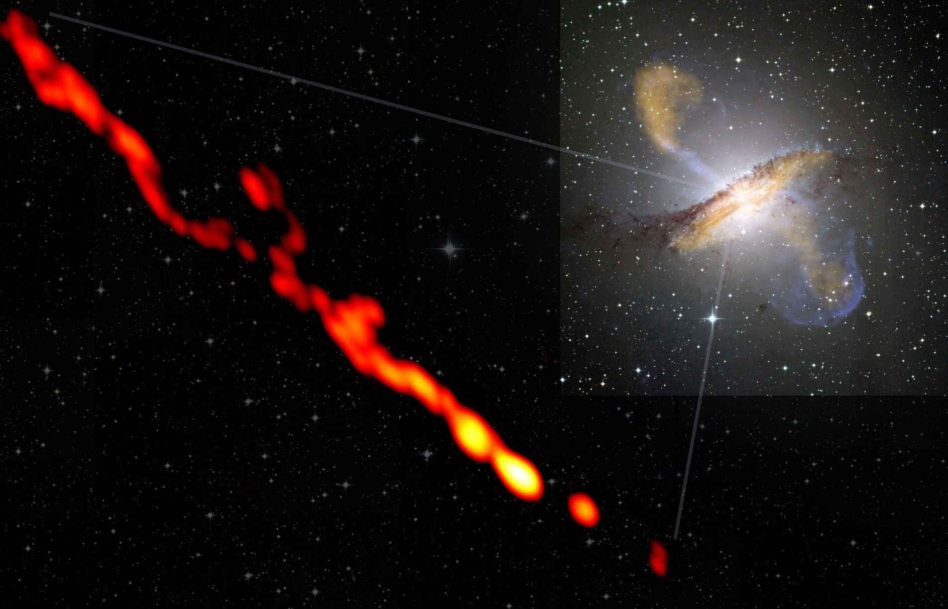
On-line analysis
D. Dornic

Slide 2
Introduction
Why doing on-line analysis ?
  To have a fast answer to any transient astrophysical phenomena
  To have a more complete follow-up program if we find some interesting signal (for example, for a GRB, obtain the redshift or the host environment properties, or trigger TeV observation by HESS/MAGIC/VERITAS in case of a flare…)
  Generalization of the ToO program
What sources ?
  Gamma Ray Bursts
  Short & large AGN, μquasar, SGR flares

Slide 3
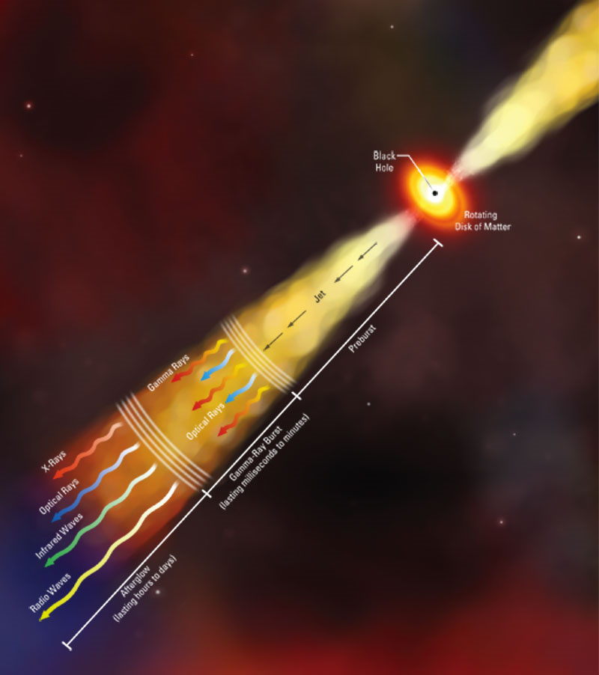
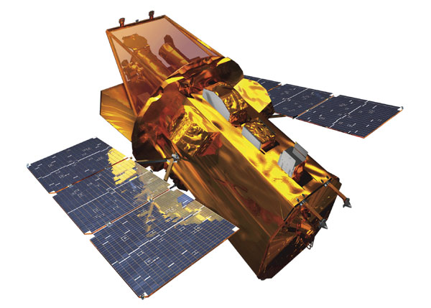
On-line analysis
Transient GRB, AGN…
Alert received
ANTARES
On-line transient analysis
ν
GRB special DAQ
Buffer data 2min without filtering => off-line analysis
TAToO alert sending system

Slide 4
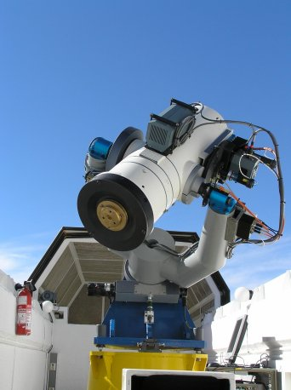
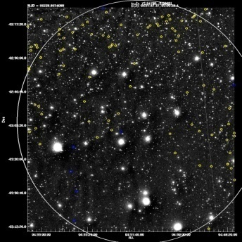
TAToO
Right now, it is the only physic analysis in ANTARES which use the on-line reconstruction “on-line”
Reconstruction “on-line” (<10ms)
Trigger: multiplet / HE singlet
Alert neutrino (GCN)
1.9° x 1.9°
ANTARES
ν
Real time
Sent <10s
We use only the well reconstructed events (very strict cut on tchi2, very good purity, >95% …).
Blinding: event selection done a priori

Slide 5
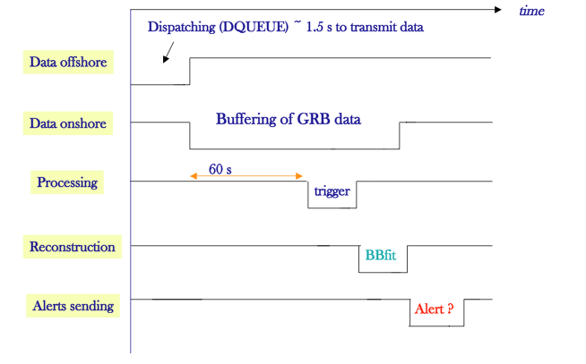
On-line DAQ
dumped when GCN alerts
data writer
On-line analysis
The minimum delay is around 66s to treat an event

Slide 6
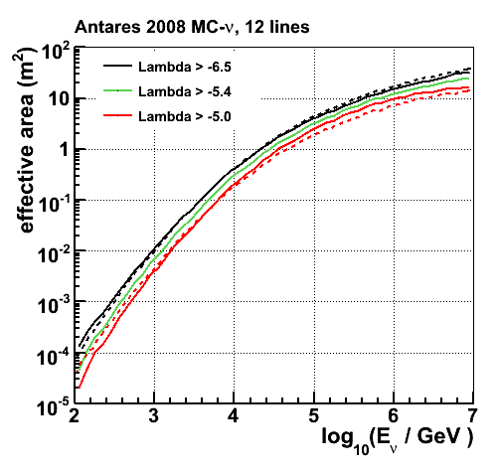
On-line Reconstruction
On-line reconstruction tool: BBFit v4r1 fast and robust
Based on simplified nominal geometry (straight lines + nominal storey orientation)
Minimisation in 2 steps:
chi2 + M-est
Point source analysis
BBfit 20% lower at high E
Median angular resolution
Crossover at ~5TeV
E⁻² | v4r1
N=2 | 1.07
N>1 | 0.61
N>2 | 0.50
HE | 0.44
Dashed: BBfit
Solid: AAfit
All selected ν
N>1
BBfit 20%higher low energies if same purity requires
J. Brunner (CERN 2011)

Slide 7
Off-line Reconstruction
Off-line reconstruction tool: AAFit v0r9 precise and efficient (physics analysis)
Based on the full dynamical geometry (computed every 2 minutes) + most precise calibration
Track minimization: likelihood
Run about once per year
Point source analysis
BBfit 20% lower at high E
Median angular resolution
Crossover at ~5TeV
E⁻² | v0r9
N>1 | 0.4
HE | 0.25
Dashed: BBfit
Solid: AAfit
All selected ν
N>1
BBfit 20%higher low energies if same purity requires
J. Brunner (CERN 2011)

Slide 8
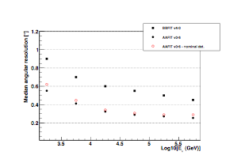
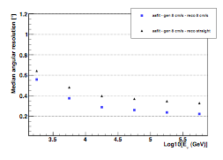
Quasi on-line Reconstruction
Use the on-line BBFit tool with loose cut (1-2 event per min) to pre-select the events and run the off-line AAFit tool
Simplifications:
Calibration on-line (tuned every 3-4 months)
Positioning calibration (quite long delay): first step use only the nominal geometry (cf study of Manuela)
Absence of fast data quality information
Effect of the storey orientation & lateral extension
Effect of the line shape
M. Vecchi, ANTARES-PHYS-2011-009

Slide 9
Principle of the analysis
Transient GRB, AGN…
Alert received
ANTARES
ν
On-line analysis
Look for Signal + Background in the buffer
Neutrino candidate data buffered on-line
Neutrino candidate data buffered on-line => not dependent if the delay of the reception of the alerts with respect to the start of the phenomena

Slide 10
Principle of the analysis
Proposition: implement a binned analysis (a bit like the Mieke’s 2007 GRB analysis)
=> define cone around the direction (example, 2º for a GRB search)
=> time period, ΔT where to look (example, for a GRB T90 or longer cf Fermi LAT results, width of the GeV flare)
The value of these 2 parameters will depend on the nature of the trigger (+ event selection)
Alert
data stream
+ check of the stability of the event rate
signal, ΔT
sliding background window
event selection done a priori (prescription for the blinding), high neutrino purity
background extracted from the data

Slide 11
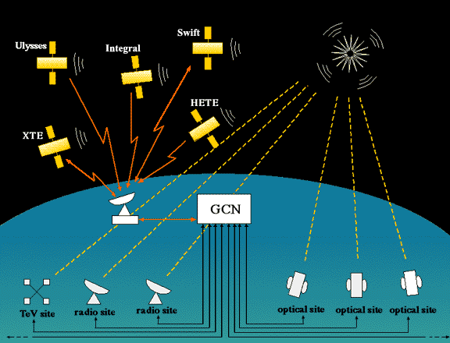
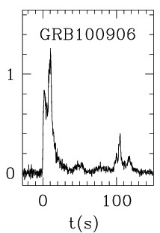
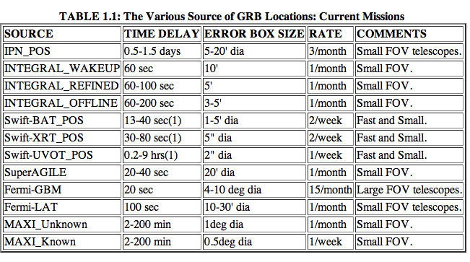
External triggers
GRB alerts are distributed via the GCN (Gamma-ray Coordinates Network) mainly of the SWIFT, FERMI and IPN alerts
Typical delay: ≈10-40s
False rate ≈30-40%
ANTARES already client of the GCN for the special GRB data-taking (M. Bouhwuis)
GRB

Slide 12
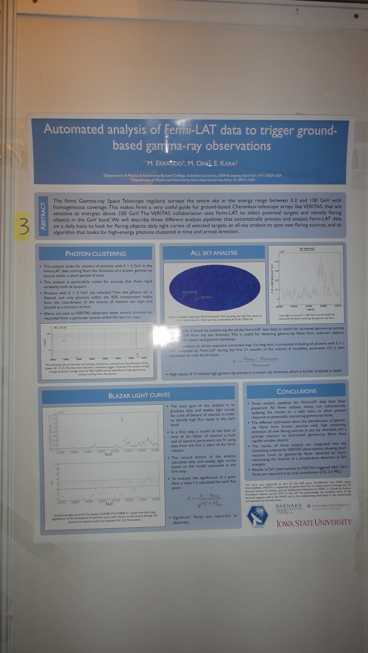
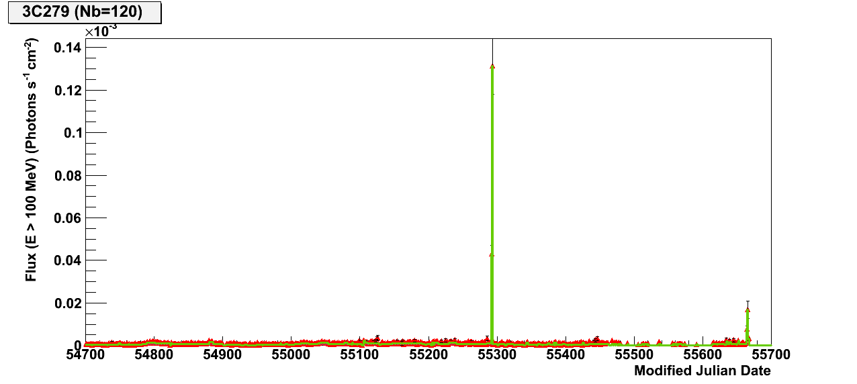
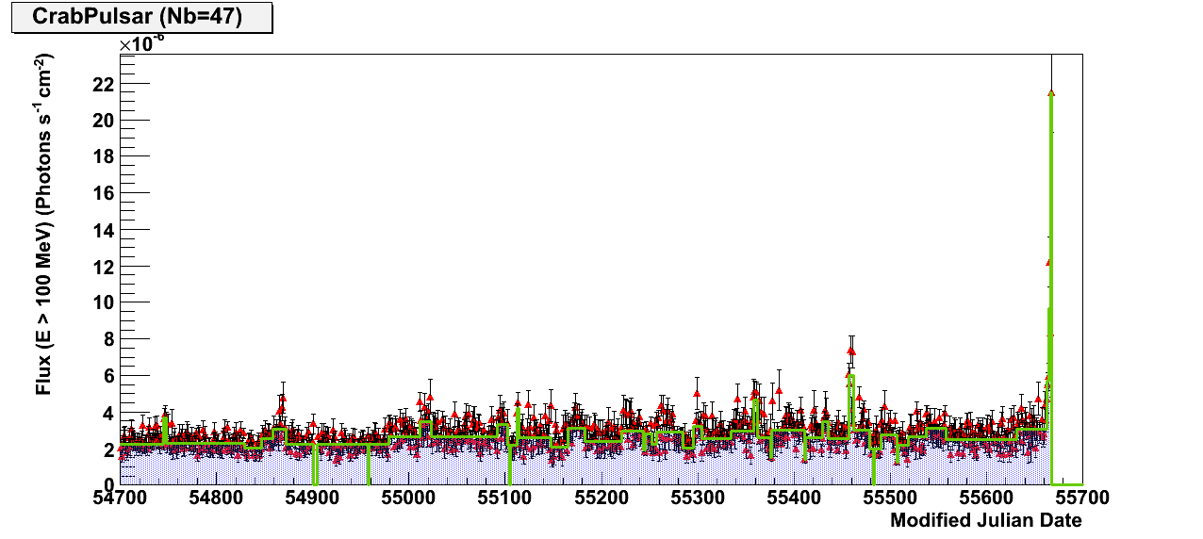
External triggers
The most important discoveries are reported on the Astronomer’s telegrams (A-tel)
Analysis of the daily light curve for the Fermi LAT monitored source list
External Fermi on-line analysis
AGN
μ-quasar
ICRC 2011
3C279
CrabPulsar

Slide 13
Open questions
There is no technical problem to implement this on-line analysis.
Transition on-line to off-line analysis
How do we interpret a result positive or negative?
- Keep only the on-line analysis ? dangerous with regards on the simplifications
Probable improvement: speed up the offline calibration delivery down to few minutes (3 months)
- Run off-line analysis: more accurate but what is the bias between the 2 analysis (trial factor…)
The strategy should be defined before any action.

Slide 14
Open questions
Transition on-line to off-line analysis
A possible strategy waiting for a full on-line calibration:
We will always run the offline analysis more accurate
hours to days
Fast off-line analysis
AAFit + offline calib
1 min
Alert
On-line analysis
AAFit + online calib
Std off-line analysis
AAFit + offline calib
“Significance”
Significance
The “online” significance will only serve as a trigger to faster the offline analysis in case something interesting is found (example σ>2)
=> send a GCN message
The “offline” significance will be the real one. Of course, we need to take into account as trials the number of flare/GRB already analyzed on-line

