Slide 1


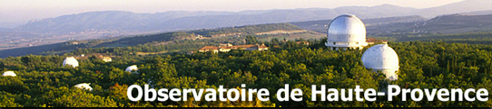


Optical follow-up of high energy neutrinos detected by the ANTARES telescope
Damien Dornic
Michel Ageron
Imen Al Samarai
Jose Busto
Vincent Bertin
Jurgen Brunner
Manuela Vecchi
Stéphane Basa
Michel Boer
Auguste Le Van Su
Damien Dornic
IRAPInstitut de Recherche en Astrophysique et Planétologie
Alain Klotz
Carl Akerlof
Weikang Zheng
Fabian Schussler
Bertrand Vallage

Slide 2
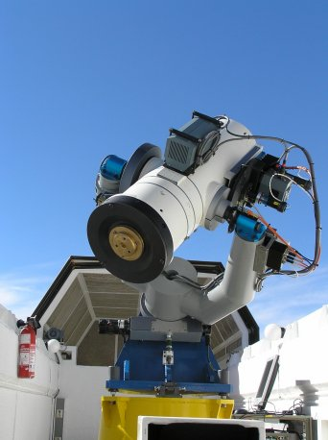
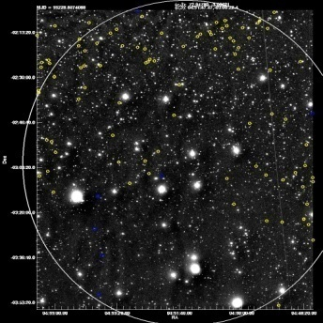
TAToO principle (rolling search)
TAToO: Optical follow-up of special neutrinos detected by ANTARES (GRB, GRB chocked, flare of AGN…)
Reconstruction “on-line” (<10ms)
Trigger: multiplet / HE singlet
Alert neutrino (GCN)
1.9° x 1.9°
ANTARES
ν
Real time
Sent <10s
Performances: duty cycle ~87% + capable to send alerts in ~1 min
Sky coverage (>2π sr) + high duty cycle
Very good sensitivity (1 neutrino could yield to a discovery !!!)
No hypothesis on the nature of the source
Avantages:

Slide 3
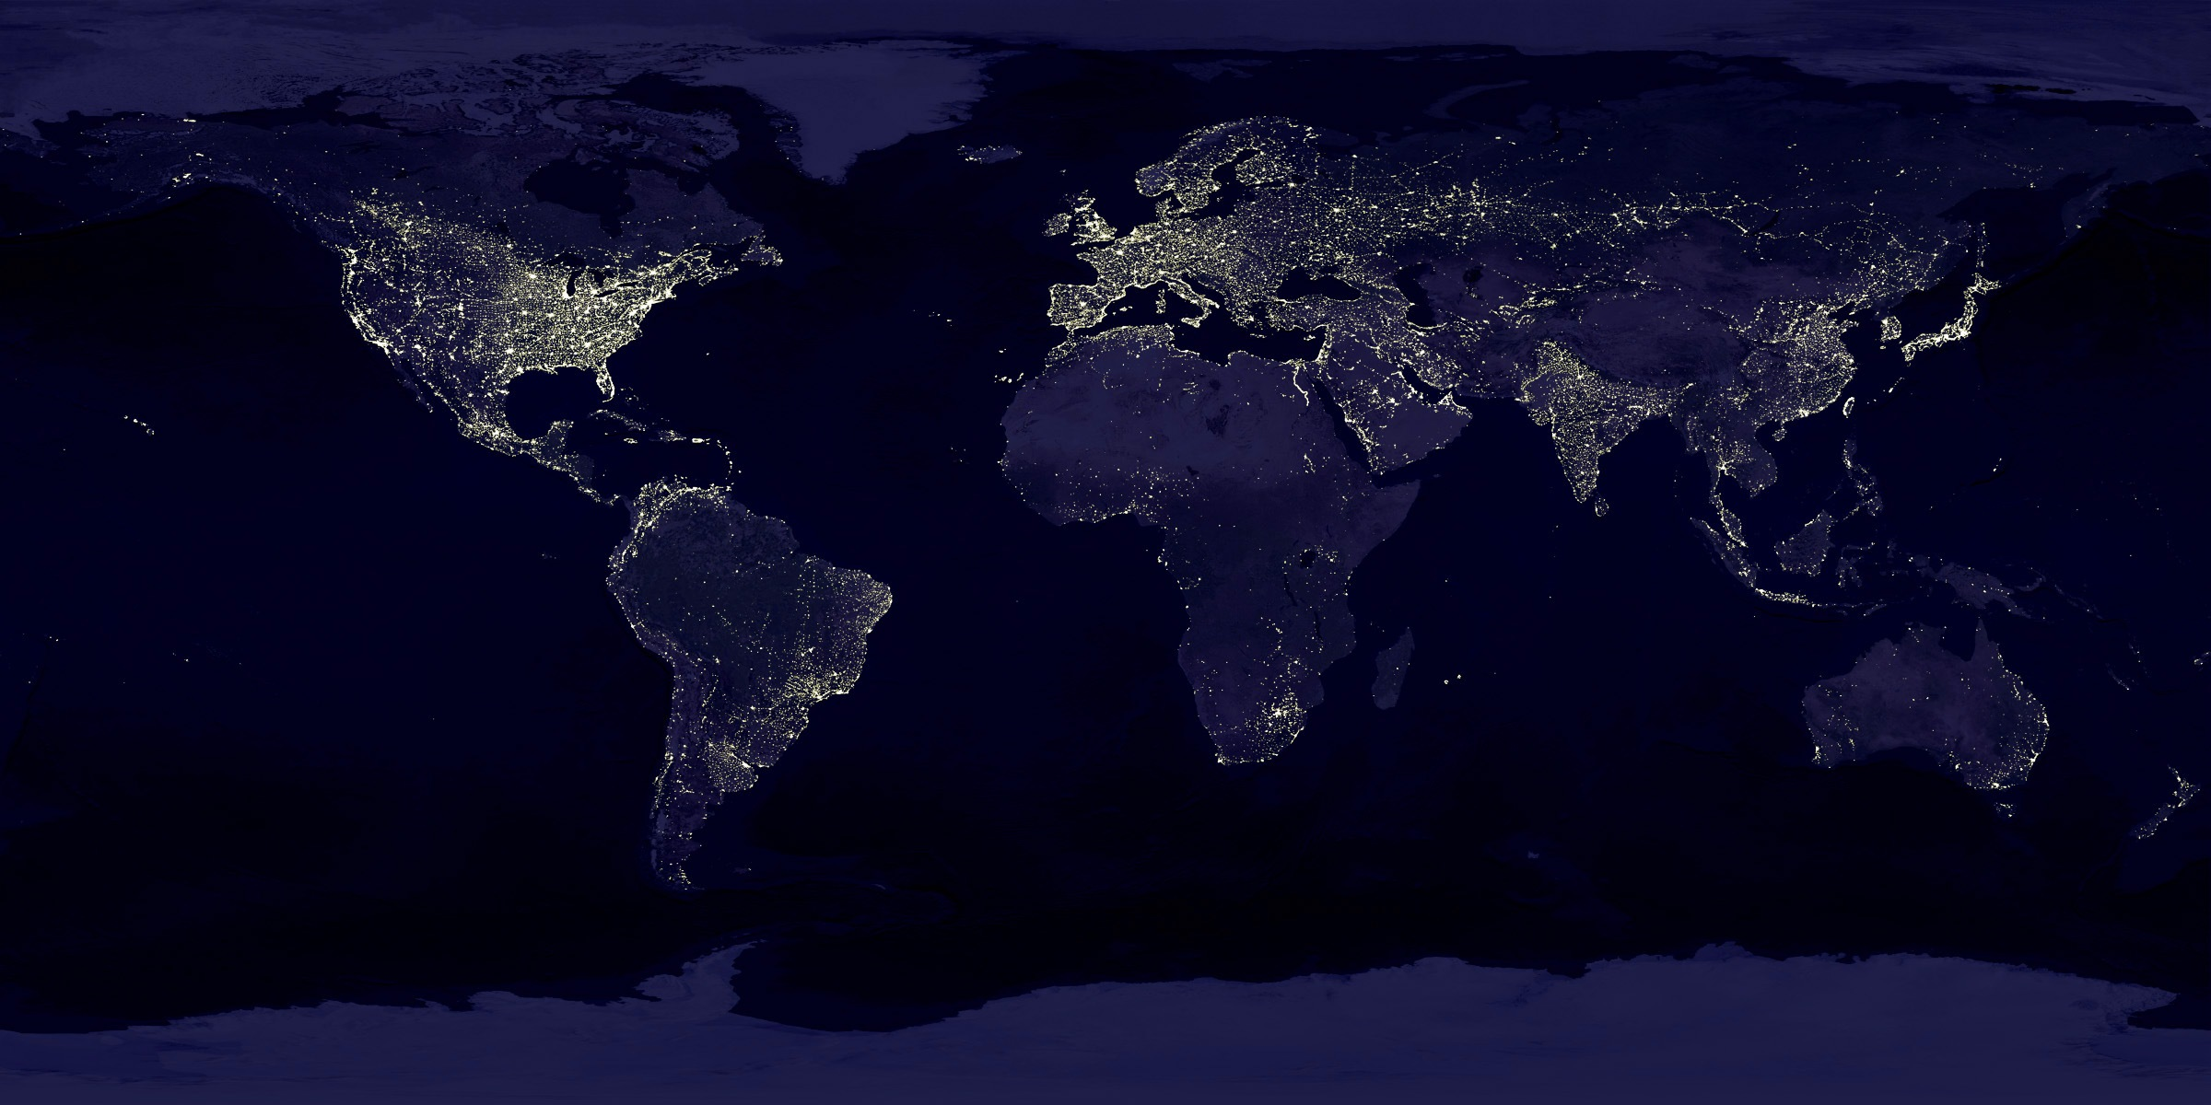
Optical telescope network
TAROT
2 robotic telescopes of 25 cm (FOV: 1.86° x 1.86°), M_{LIM} ~ 19 (T_{exp} = 180s)
ROTSE
4 trobotic telescopes of 45 cm (FOV: 1.85° x 1.85°), M_{LIM} ~ 19 (T_{exp} = 60s)
ZADKO
1 robotic telescope 1 m (FOV: 0.4° x 0.4°), M_{LIM} ~ 21 (T_{exp} = 180s)
ROTSE 3a & 3c: not operational
ZADKO: upgrade of the dome

Slide 4
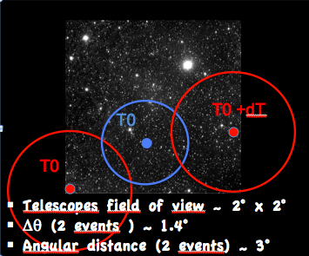
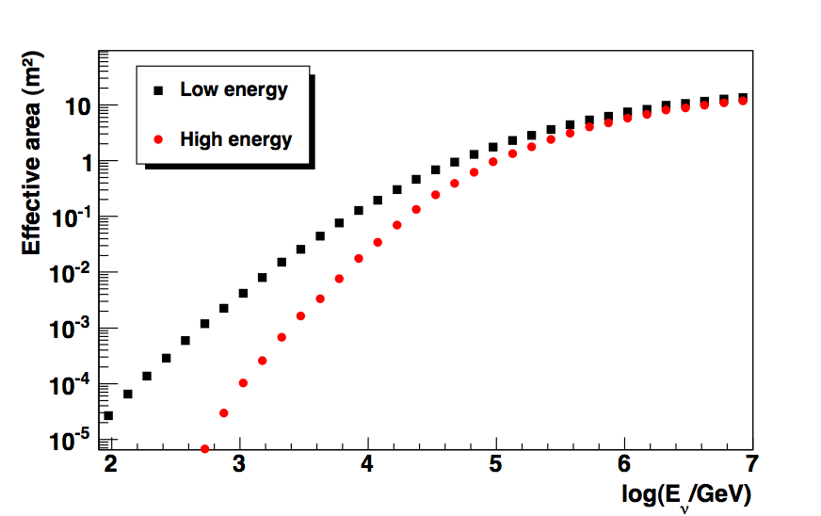
Alert definition
Multiplets
A burst of 2 ν or more detected in
Time window : 15 mn
Direction window : 3°
HE neutrino events
Up-going only + Best reconstructed
Cuts on simple energy estimators
number of touched floors and hits amplitude (pe)
Tuned to trigger 1 to 2 false alerts /month
mean energy :~5 TeV
Expected Doublet alert rate ~1/25 yr
Data : No doublet detection in 3 years
Expected significance ;
N = 2 → ~3σ (N = 3 → ~5σ)
Neutrino effective area
✪ 4

Slide 5
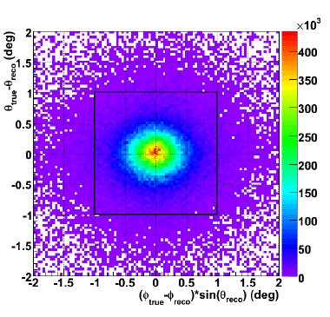
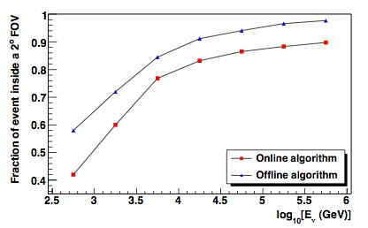
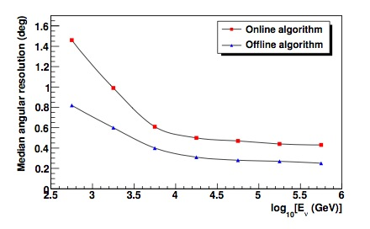
TAToO: Expected performance
Expected off-line performances
1.86°
1.86°
1st loop : On-line
~80% of the HE reconstructed events are in the telescopes FOV
The ANTARES Telescope Neutrino Alert System
Ageron et al. Submitted to Astroparticle Physics arXiv:1103.4477
✪ 5

Slide 6
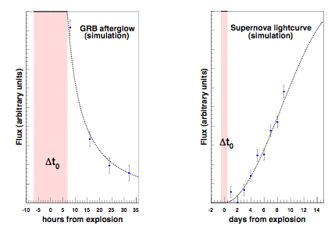
Observation strategy
Expected optical light curve for a typical GRB afterglow and a SN
M. Kowalski, A. Mohr, Astropart.Phys.27:533-538,2007
T0
T0+1
…
T0+7
T0+9
T0+15
T0+27
T0+45days

☒
☑
☑
☑
☑
☑
☑
☑
☑
☑
☑
☑
ν alert
☑
☑
Prompt
Follow-up observations
TAROT (T_{exp}=180s)
ROTSE (T_{exp}=20/60s)

Slide 7
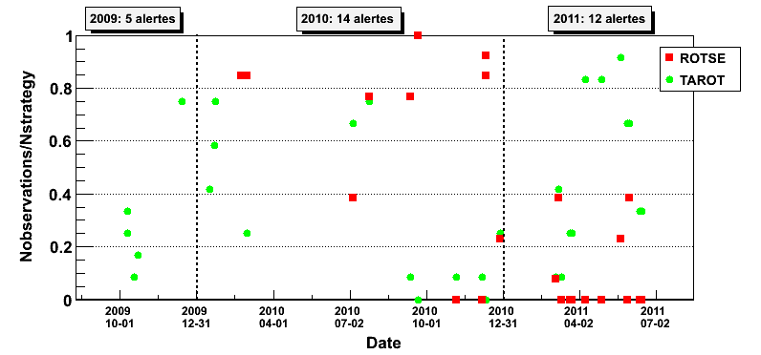
Observation strategy
T0
T0+1
…
T0+7
T0+9
T0+15
T0+27
T0+45days

☒
☑
☑
☑
☑
☑
☑
☑
☑
☑
☑
☑
ν alert
☑
☑
Prompt
Follow-up observations
TAROT (T_{exp}=180s)
ROTSE (T_{exp}=20/60s)

Slide 8
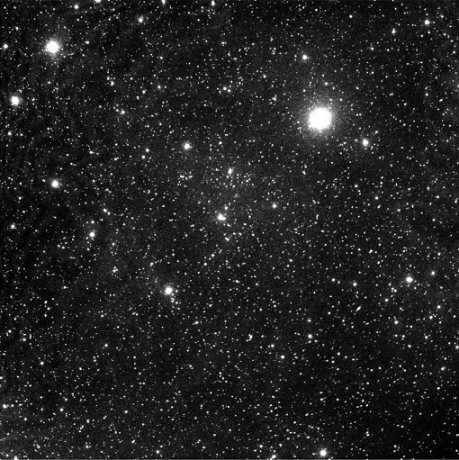
Optical data: Oct 2009 to May 2011
39 neutrino alerts
10
Telescope maintenance
Too close to the sun
…
Fits images
2048 x 2048 pix
1 pix ~ 3 arcsec
29 with optical data
5 with only one night data
6 with bad quality data
18 with exploitable data
ROTSE and/or SNLS
software transient source search pipeline
8 with «prompt» data

Slide 9
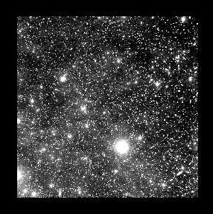
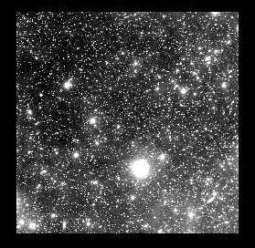
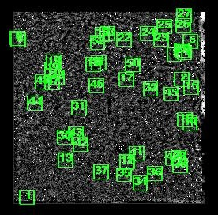
Optical image analysis
2 independent software chains based on the image subtraction:
- SNSL / LAM adapted to the TAROT/ROTSE image quality
- ROTSE SN pipeline
Due to the very large FOV and the quite poor image quality, the image analysis is quite challenging …
Image from TAToO Follow-Up
Reference Image (No signal)
Residual Image
Cuts on :
SNR
Flux variation
FWHM …
PSF matched

Slide 10
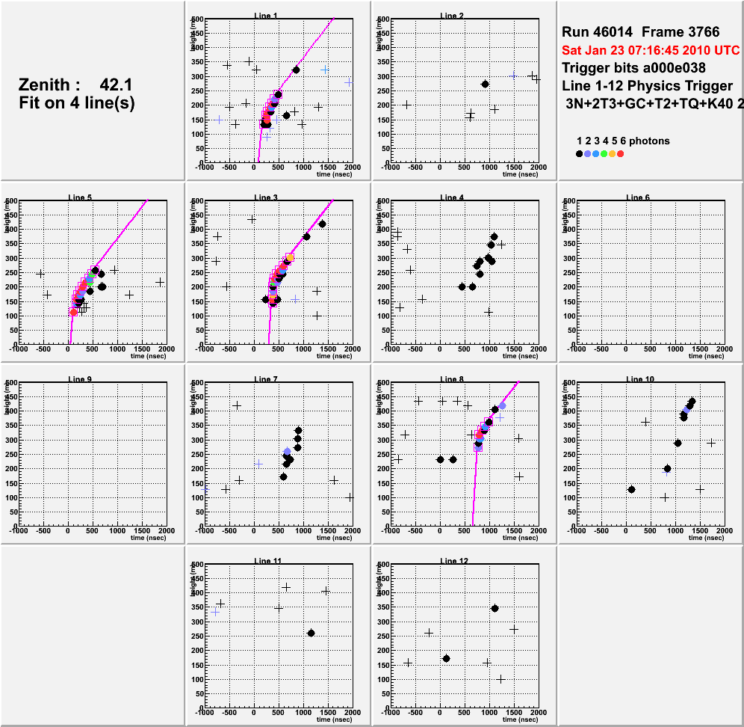
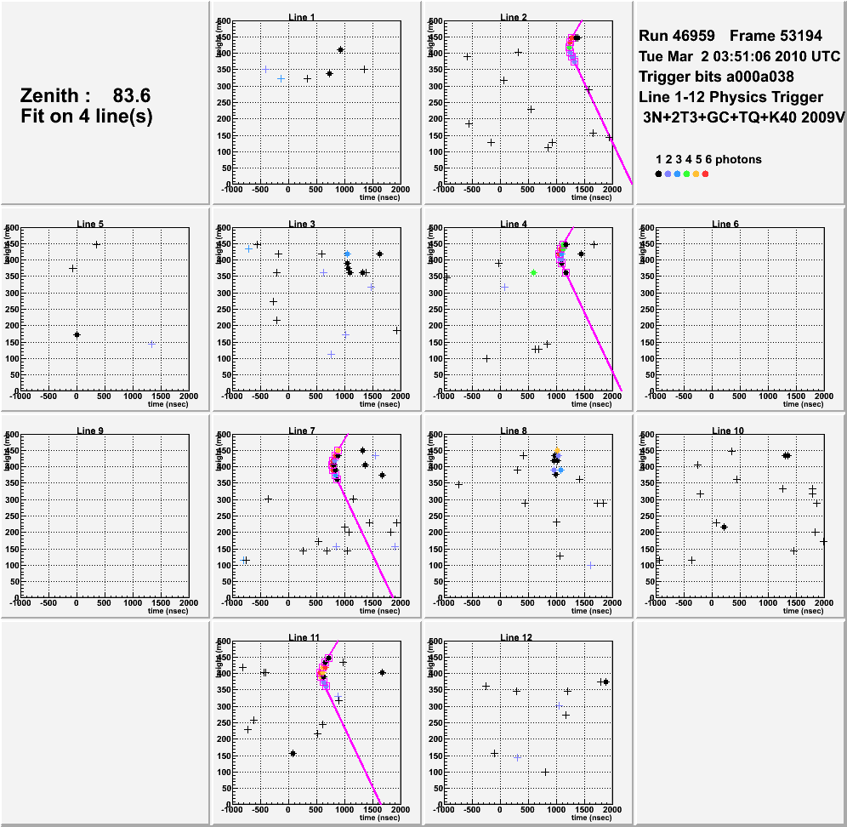
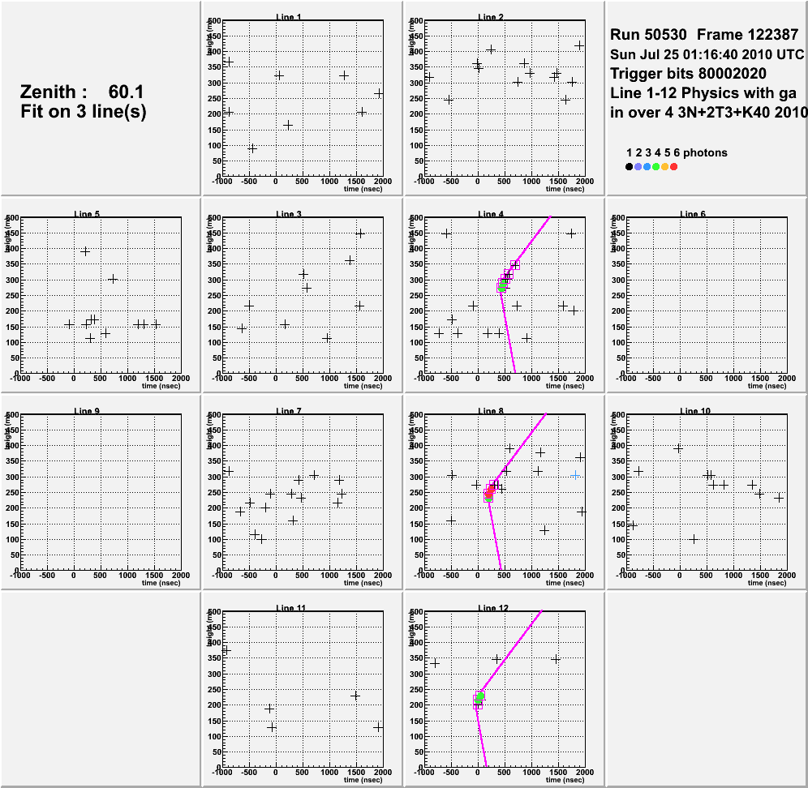
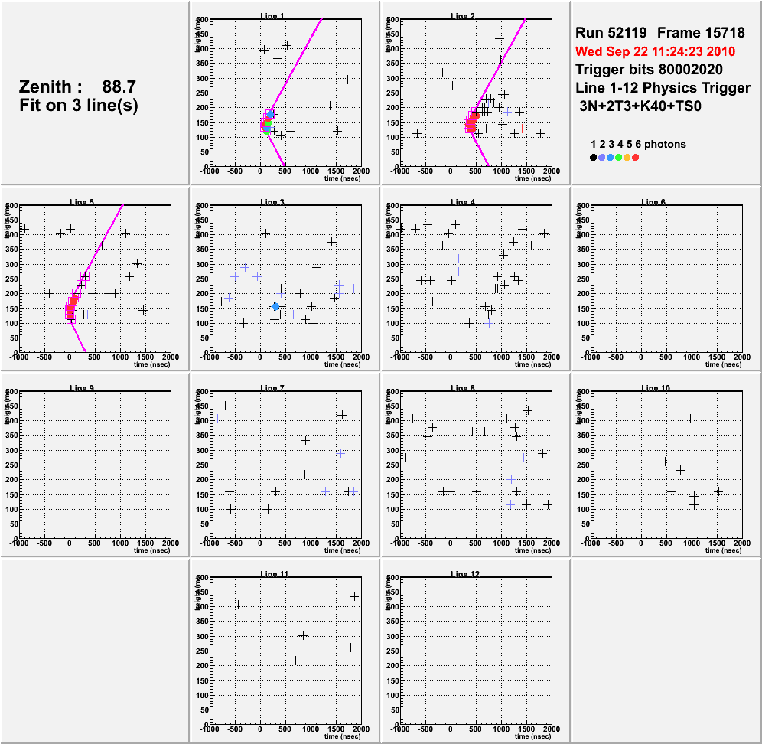
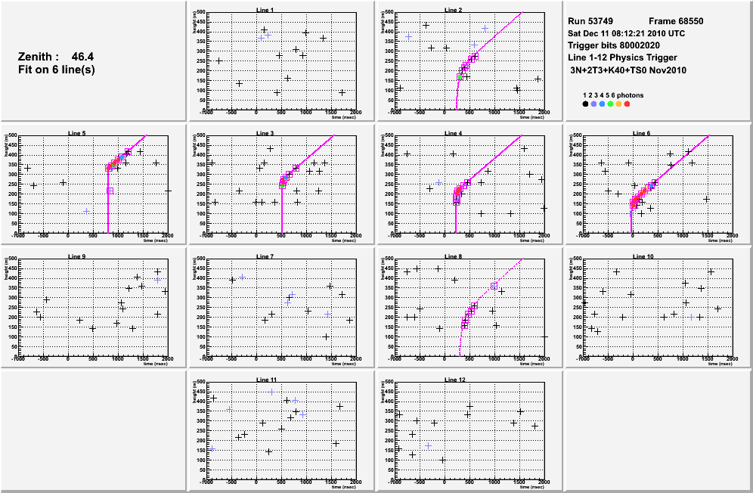
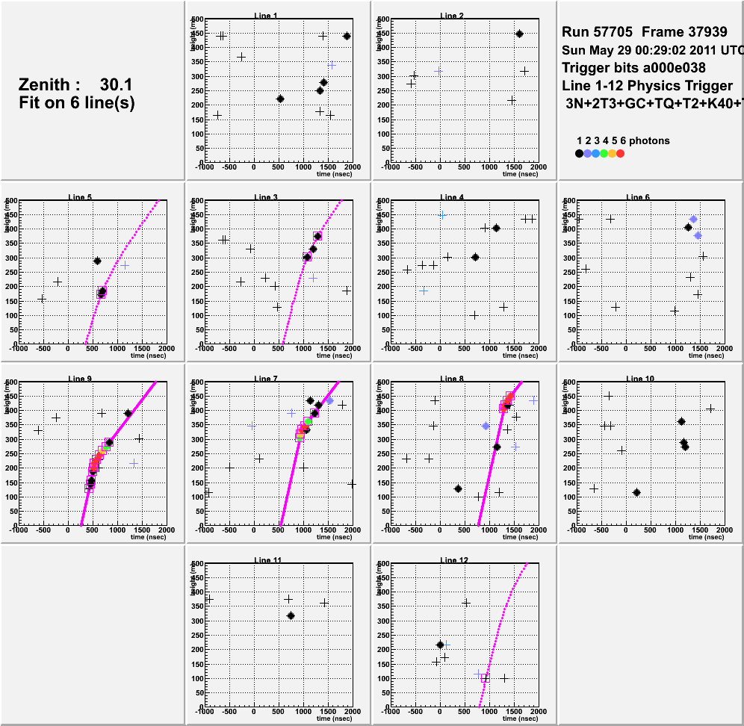
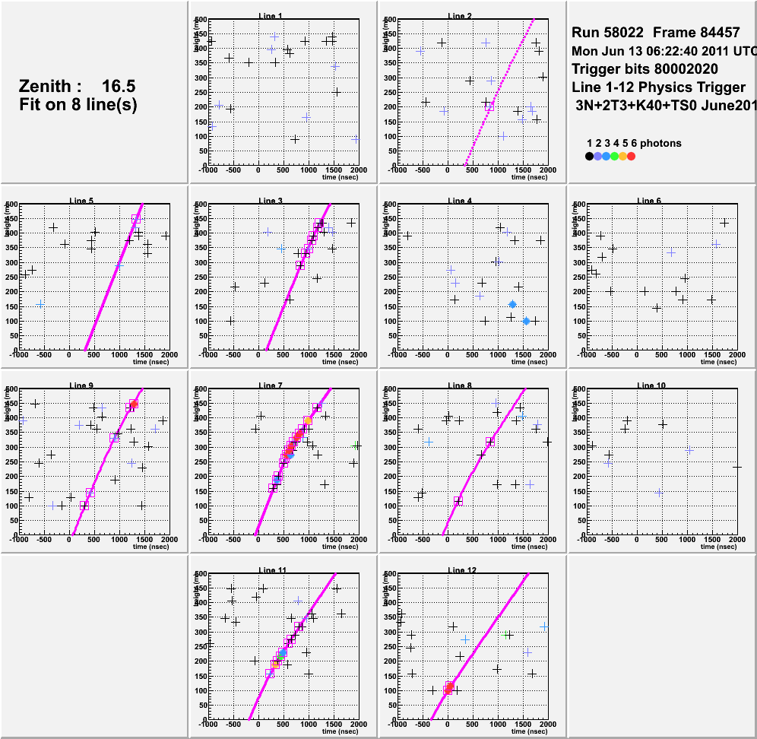
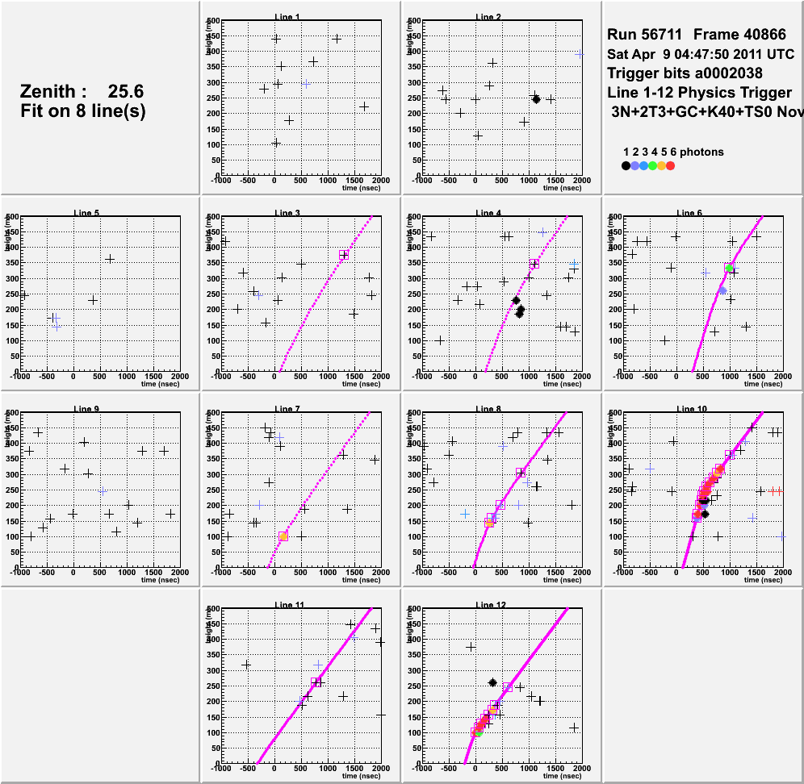
TAToO “prompt” alerts
10 alerts with “prompt” images (images taken within a day after the neutrino detection) => only 8 have reasonably good image quality for the analysis.

Slide 11
Search for GRB afterglows
Looking for a fast decreasing signal in the “prompt” images (< 1 day after the neutrino trigger) => 8 alerts in 2010-11
Alert | Telescope | Number of images | Exposure | Observation time since trigger
ANT100123A | Rotse 3c | 17 images | 20 s | 15h20mn15s
ANT100302A | Rotse 3b | 30 images | 20 s | 24h20mn8s
ANT100725A | Rotse 3c | 28 images | 20 s | 0h01mn15s
ANT100922A | Rotse 3a | 30 images | 20 s | 1h08mn06s
ANT101211A | Rotse 3c | 8 images | 60 s | 12h03mn30s
ANT110409A | Tarot Chili | 6 images | 180s | 0h04mm17s
ANT110529A | Tarot Chili | 18 images | 180s | 0h07mm33s
ANT110613A | Tarot Chili | 12 images | 180s | 0h01mm08s

Slide 12
Analyse images prompt
Analysis done in 3 different ways:
Image by image
Coadd 4 Images
Coadd 8 Images
Limiting magnitude : 15 mag
Search for a variable signal on the scale of few seconds..
Limiting magnitude~ 16 mag
Search for a transient signal on the scale of few minutes

Slide 13
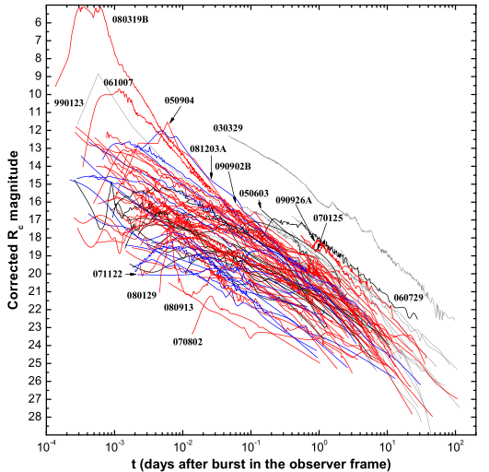
GRB afterglow results
No GRB-like candidate detected
Confirm the Opera effect
Best observation starts with a delay 68 s after the neutrino
(Minimum delay ~ 66 s induced by ANTARES DAQ)
Preliminary
Alert | Delay (days) | U.L. Mag S/N=5, 50% | Galactic extinction
ANT100123A | 0.64 | 11.9 | 0.2
ANT100302A | 1.01 | 13.6 | 0.2
ANT100725A | 8.7e-4 | 13.3 | 0.3
ANT100922A | 4.7e-2 | 14.0 | 0.5
ANT101211A | 0.50 | 13.0 | 0.1
ANT110409A | 3.0e-3 | 18.4 | 6.7
ANT110529A | 5.2e-3 | 15.6 | 1.2
ANT110613A | 7.8e-4 | 17.0 | 2.3

Slide 14
Conclusion
Optical follow-up of ANTARES neutrino alerts operational since mid-2009: 39 alerts sent
7 robotical telescopes: TAROT/ROTSE/ZADKO
In few days, update of the alert sending system with a pointing 0.3º (median) for the high energy events
Optical image analysis done with 2 independent pipelines
First results on the search of GRB afterglow in the 2010-11 alerts: no GRB candidate (confirmation of the Opera effect)
Search for ccSNe on-going.
Future of the ToO: Rotse will probably be stopped soon. TAROT will be OK for the next few years
Extend to further optical telescopes: SkyMapper (Australia), PTF (US) or SWIFT

