Slide 1


GALPROP code for Galactic CR propagation and associated photon emissions
http://galprop.stanford.edu
Igor Moskalenko
Stanford University & KIPAC

Slide 2
What is GALPROP
The GALPROP project began in late 1996 in Max-Planck-Institut für extreterrestrische Physik (Garching) – 15 years of development!
First release in 1998 (FORTRAN90)
Second release in 2001 (C++ & FORTRAN)
Current version release 54.1
A de facto standard in calculations of CR propagation and diffuse photon emissions; used by Fermi-LAT
Key concept
  Different data (e.g., direct CR measurements, γ-rays, synchrotron radiation) are related to the same Galaxy and need self-consistent modeling
  Models need to be as realistic as possible with minimal assumptions
  Requires numerical modeling

Slide 3
Relevance to anisotropy studies
GALPROP provides distributions and spectra of cosmic ray species corresponding to the “old” well-mixed component of cosmic rays
Diffuse Galactic emission is calculated based on distribution of propagated cosmic rays and interstellar medium
Excesses in diffuse emission over GALPROP predictions are essentially “sources” – accelerators of cosmic rays – or systematic uncertainties in the input (gas maps, interstellar radiation field)
A comparison of GALPROP predictions with data shows such features and allows their robustness to be checked
GALPROP can solve a time-dependent transport equation – not used very often
Therefore, GALPROP is an instrument to test the hypotheses of cosmic ray propagation using all available data on cosmic rays and diffuse emission
GALPROP can also be used to test the origin of the observed anisotropy

Slide 4
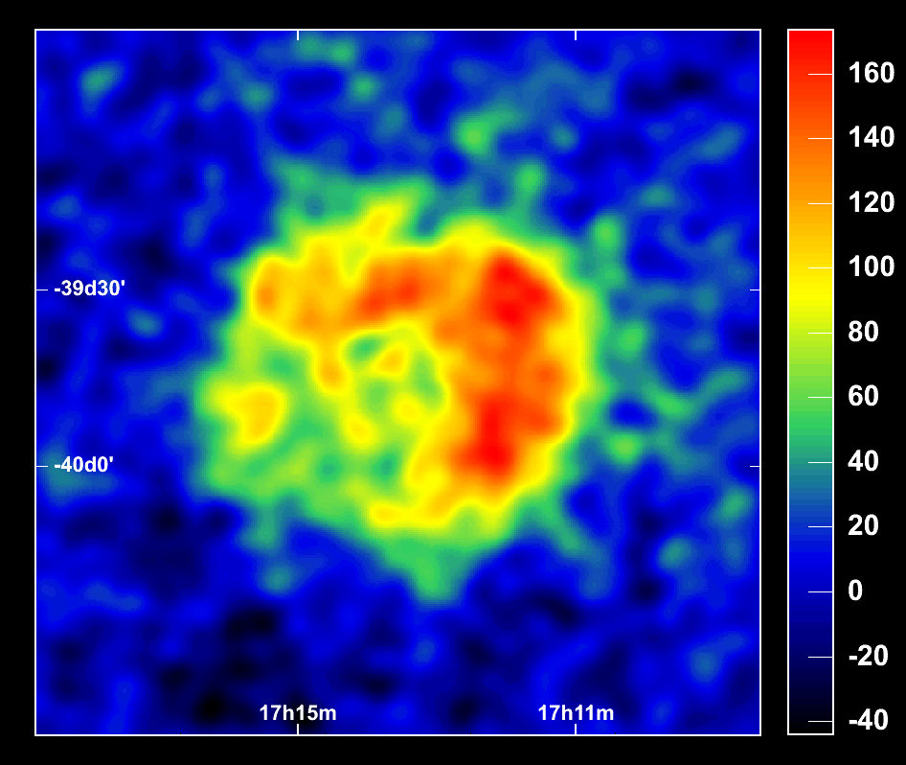
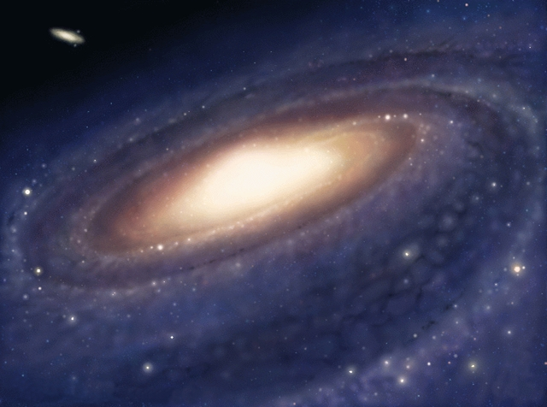
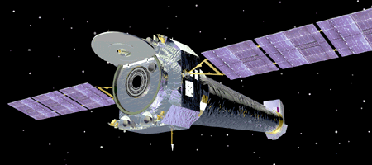
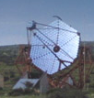
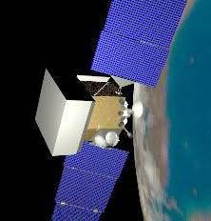
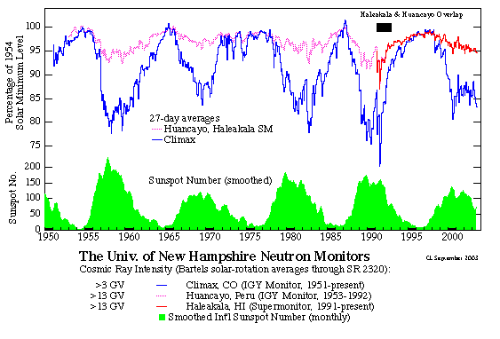
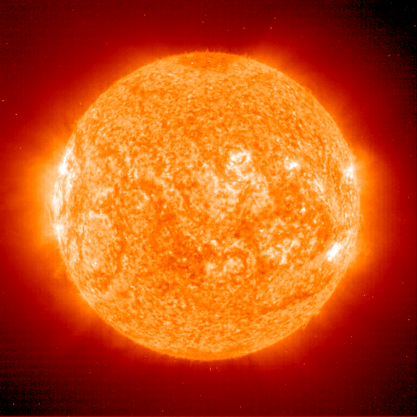
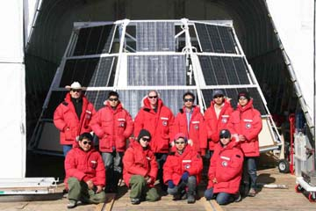
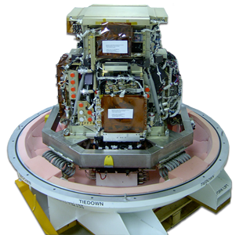
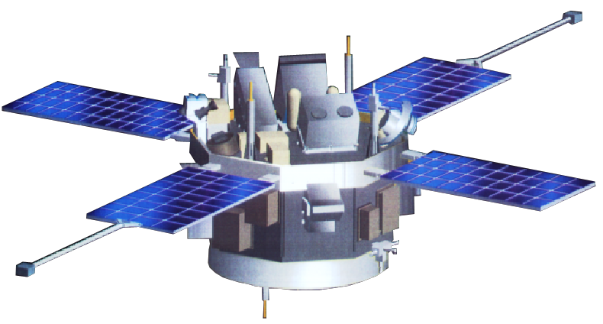
CRs in the Interstellar Medium
SNR RX J1713-3946
ISM
  42 sigma (2003+2004 data)
X,γ
Chandra
±
synchrotron
e
B
IC
HESS
HESS
P
He
CNO
•diffusion
•energy losses
•diffusive reacceleration
•convection
•production of
secondaries
ISRF
PSF
bremss
WIMP
annihil.
_
gas
π
X,γ
+
0
P,
P
-
Fermi
e
+
-
π
±
GALPROP
e
gas
solar modulation
_
+
-
P
π
p
LiBeB
Flux
±
He
CNO
e
20 GeV/n
BESS
CR species:
Only 1 location
modulation
ACE
PAMELA
helio-modulation

Slide 5
Components of GALPROP
ISM Astro input:
  Gas distribution from HI and CO gas surveys (energy losses from ionization, bremsstrahlung; secondary production; γ-rays from π⁰-decay, bremsstrahlung)
  Interstellar radiation field (inverse Compton losses/γ-rays for e±)
  Cosmic ray source distribution(s)
Nuclear & particle production cross sections + the reaction network (cross section database + LANL nuclear codes + phenomenological codes)
Theory: Propagation, diffusive acceleration, convection
Numerically solve transport equations for all cosmic ray species (stable + long-lived isotopes + pbars + leptons ~90) in 2D or 3D
Derive the propagation parameters corresponding to the assumed transport phenomenology and source distribution

Slide 6

Timeline of γ-ray, CR, and particle experiments
HESS
MAGIC
TeV
VERITAS
Milagro
HAWC
CTA
GeV
Fermi
AGILE
“Today”
LHC
TRACER
CALET
TeV
CREAM
ATIC
AMS-02
GeV
PAMELA
BESS-Polar
Super-T
MeV
ACE
2005
2010
2015
2020

Slide 7
GALPROP WebRun
GALPROP WebRun is a service that allows to run GALPROP via the World Wide Web (even from a smart phone)
No local installation of the code or related libraries is necessary, only a web browser is required
Available at http://galprop.stanford.edu/webrun
No specific experience is necessary (First-time user, Advanced user modes)
Calculations can be performed on a cluster at Stanford University, using the most recent version of GALPROP, older versions are also available
Allows for processing of batch jobs
The service is free and open to the community. Registration is required
Acknowledge by citing the web-page and the introduction paper (Vladimirov et al., Computer Physics Comm. 182 [2011] 1156-1161)

Slide 8
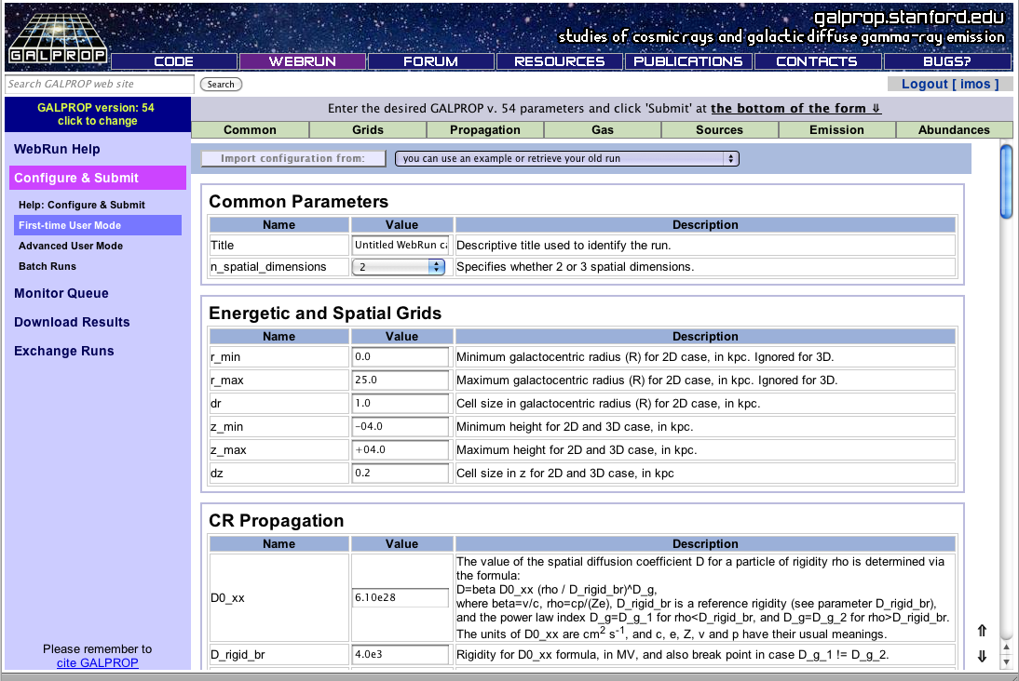
Configuring GALPROP via WebRun
Parameter validation via input web forms to avoid mis-confgured runs
Single or batch runs are possible, each is checked before run

Slide 9
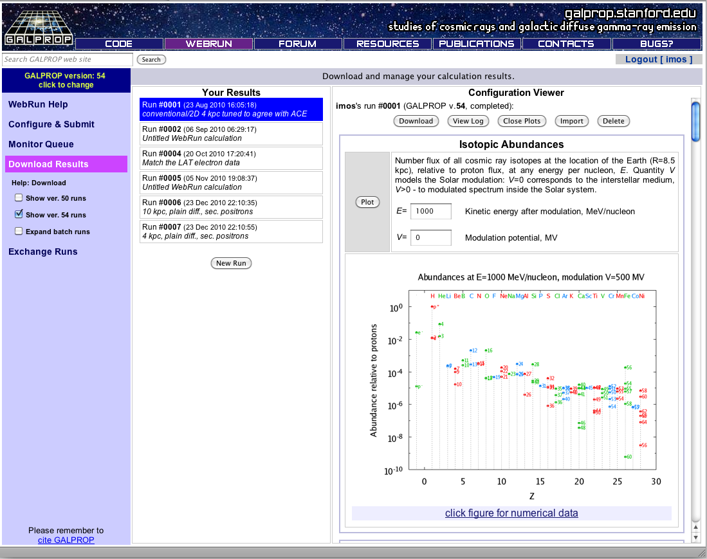
Obtaining results of a GALPROP run
FITS file format, tarball available for (URL) download following run
Quick visualization available using build-in plot templates

Slide 10
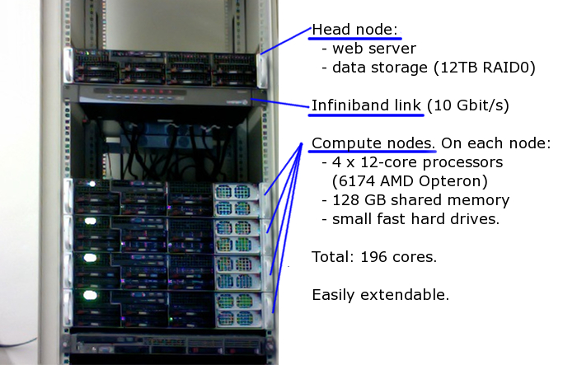
Computing cluster (galprop.stanford.edu)

Slide 11
Recent results
Cosmic-ray propagation model constraints from global parameter scans (Bayesian analysis) – Trotta et al., ApJ 729 (2011) 106
Large-scale studies of the diffuse emission with Fermi-LAT – submitted to ApJ
Global cosmic-ray-related luminosity and energy budget of the Milky Way – Strong et al., ApJ Lett. 722 (2011) L58
Decoding the Inner Galaxy – work in progress
Testing the origin of high energy cosmic rays – Vladimirov et al. arXiv: 1108.1023

Slide 12

Constrains on CR propagation models from global scans
Important for many related topics (e.g., indirect DM searches)
So far, global parameter scans were only possible with analytical or semi-analytical propagation models, but reliability may be a problem
Recent improvements to the GALPROP code together with efficient sampling techniques and Bayesian methods now allow a fully numerical exploration of the parameter space

Slide 13
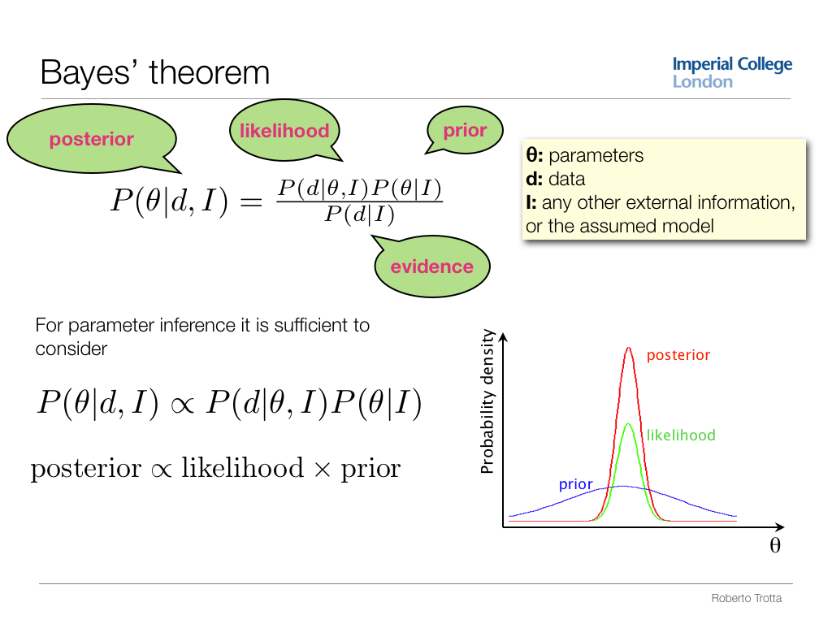

Slide 14
CR data sets
Representative CR experiments
HEAO-3: 0.6 – 35 GeV/nucleon (Engelmann+’1990) – B/C is confirmed by Pamela
ACE: 50 – 200 MeV/nucleon (de Nolfo+’2006)
ISOMAX: ~1 GeV/nucleon (Hams+’2004)
ATIC-2: 30 GeV/nucleon – 1 TeV/nucleon (Panov+’2008)
CREAM-1: 30 GeV/nucleon – 1 TeV/nucleon (Ahn+’2008)
Data sets
B/C, ¹⁰Be/⁹Be ratios
C, O spectra
Other fitting parameters:
Modulation potentials ϕ = {ϕ₁, ϕ₂, ϕ₃, ϕ₄} – free parameters for each experiment
  simple “force-field” approximation
  to account for different choices of the local interstellar spectrum
“Variance” rescaling parameters τ = {τ₁, τ₂, τ₃, τ₄, τ₅} – error bar rescaling parameters
  to account for systematic errors in different experiments

Slide 15
Sampling algorithm
SuperBayeS code (SUpersymmetry Parameters Extraction Routines for Bayesian Statistics, Ruiz de Austri+’06, Trotta+’08): http://superbayes.org
Markov Chain Monte Carlo methods
Nested sampling algorithm (John Skilling’04,’06) and MultiNest (Feroz&Hobson’08)
Computational effort ~13 CPU years, ~1.4×10⁵ samples
Fit a total of 76 data points, 16 parameters, best fit chi-squared/dof ~ 1
Posterior mean <Θ> ≈ M⁻¹ Σ_{i=0…M-1} Θ^{(i)}

Slide 16
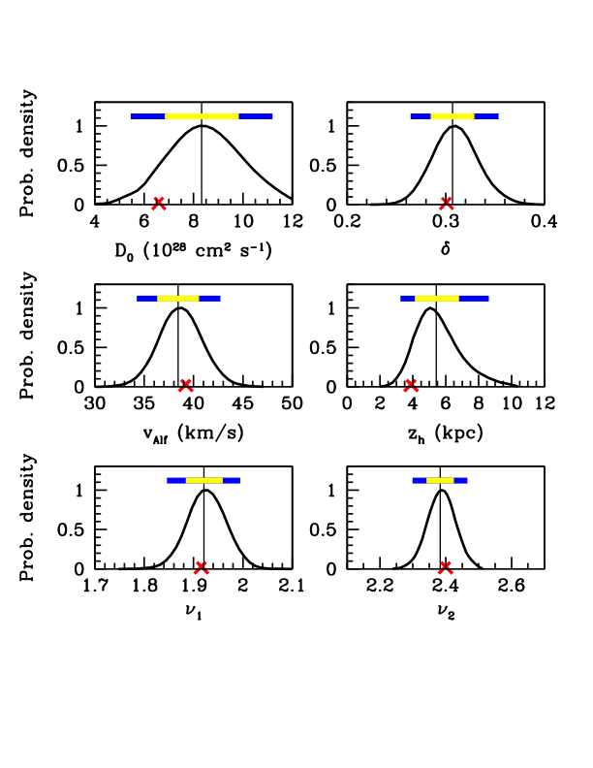
Posterior probability distributions
Normalization of the diffusion coeff. and its index
color bar – 68%, 95% error ranges
vertical line – posterior mean
✗ - the best fit
Reacceleration model
  δ = 0.3 – very close to classical value 1/3 for Kolmogorov diffusion
All parameters are very close to those derived by the “eye-fitting” method
Alfven speed Halo size
Injection index below/above the break @ 1 GV

Slide 17
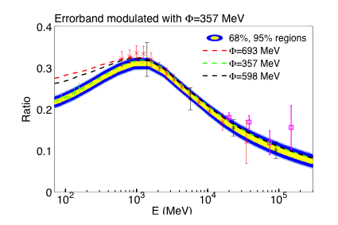
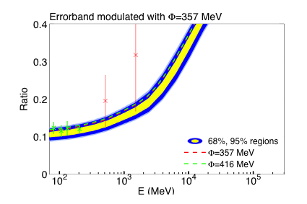
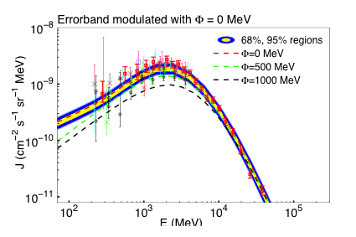
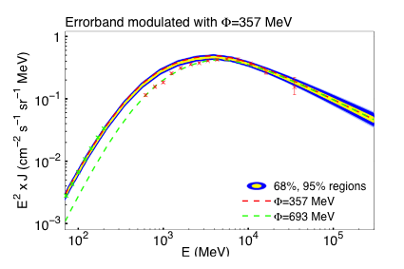
Examples: B/C and Be ratios, C and pbars
Be¹⁰/Be⁹ ratio
B/C ratio
Carbon
pbars
(not fitted!)

Slide 18
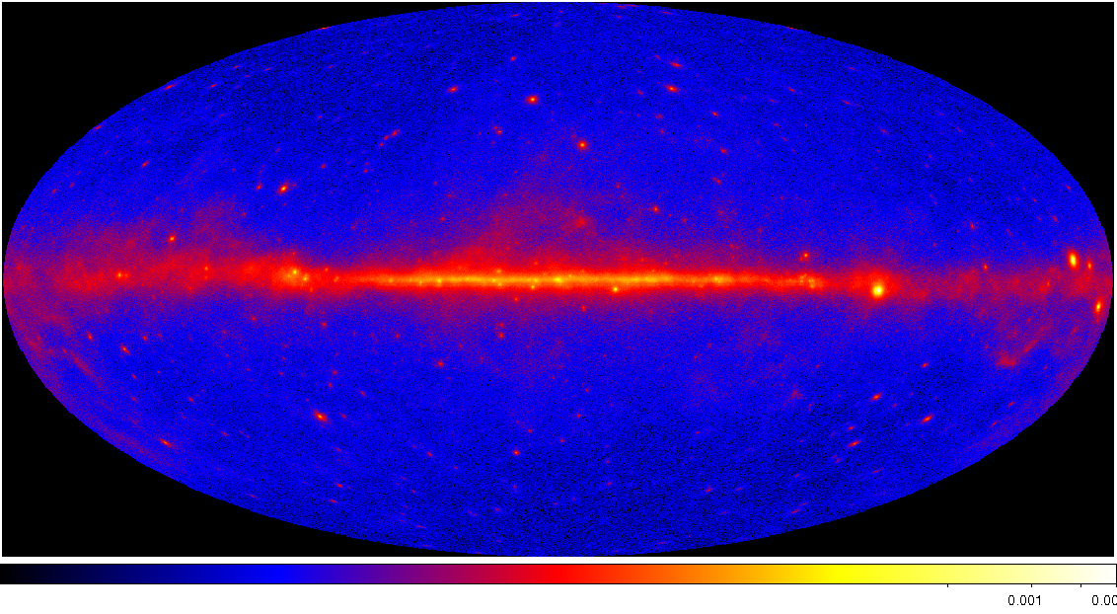
CRs and Diffuse Galactic Emissions
(gamma-rays, synchrotron)
Origin and propagation of cosmic rays
  Nature and distribution of CR sources
  Abundances of primary species
  Production of secondary species
  The propagation mode and its relationship to magnetic turbulence in the ISM
Interstellar Medium (gas species)
  Distribution of HI, H₂, HII gas
  Nature of X_{CO} relation in Galaxy
  Distribution and intensity of interstellar radiation field and formation of H₂
Foreground against which sources are detected
  Point sources: limitation on sensitivity
  Extended sources: disentanglement
  Indirect dark matter detection
  Predicted γ-ray/CR signals
  relies on accurate treatment of standard astrophysical sources
  Foreground for isotropic diffuse background
  Whatever its nature
  Synchrotron foreground
  WMAP & PLANCK
Fermi-LAT

Slide 19
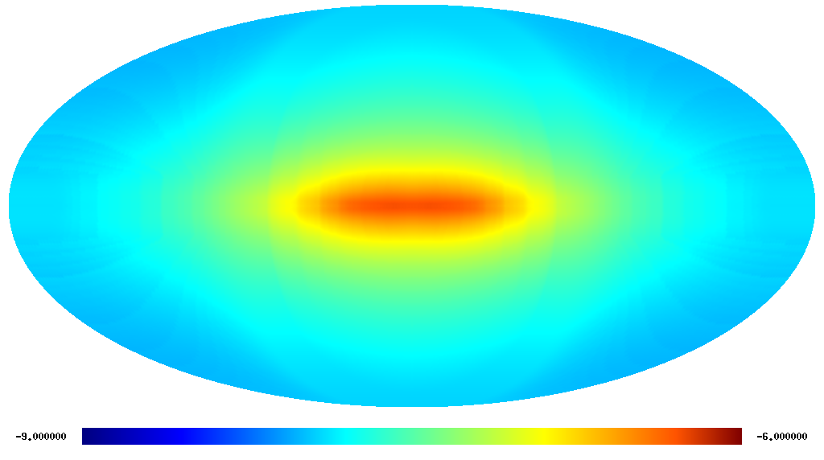
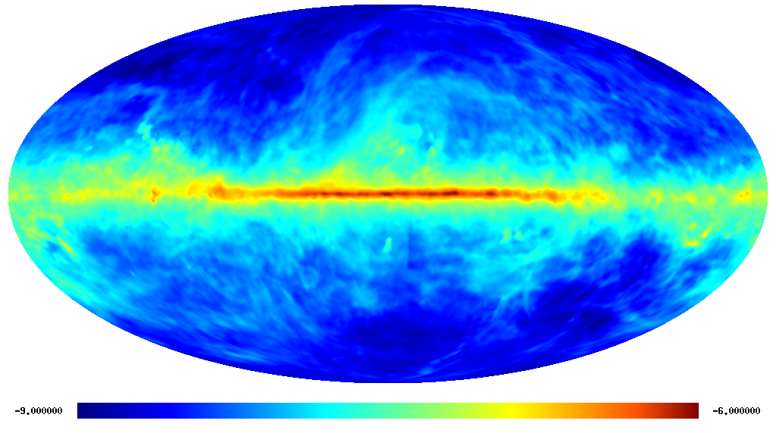
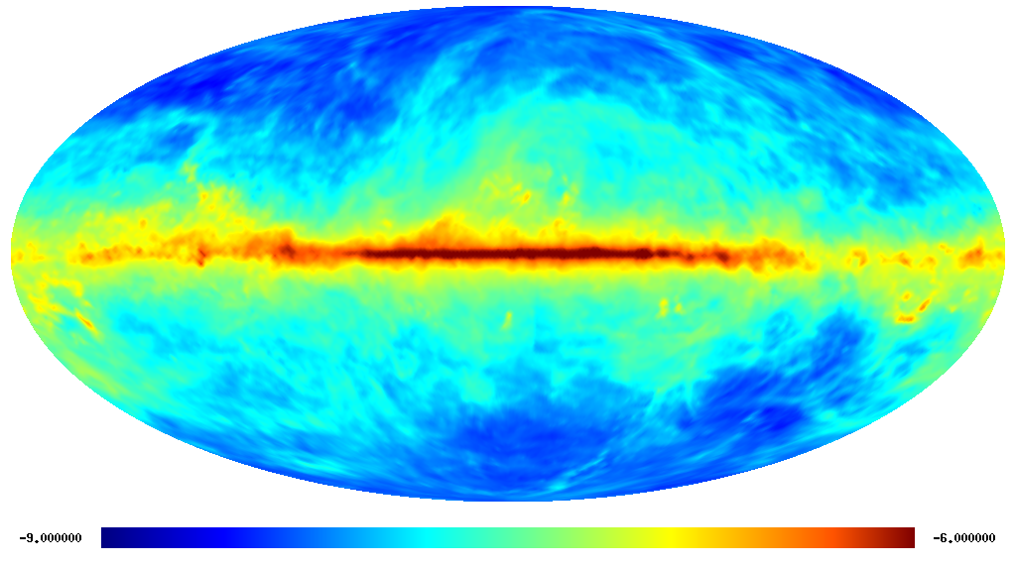
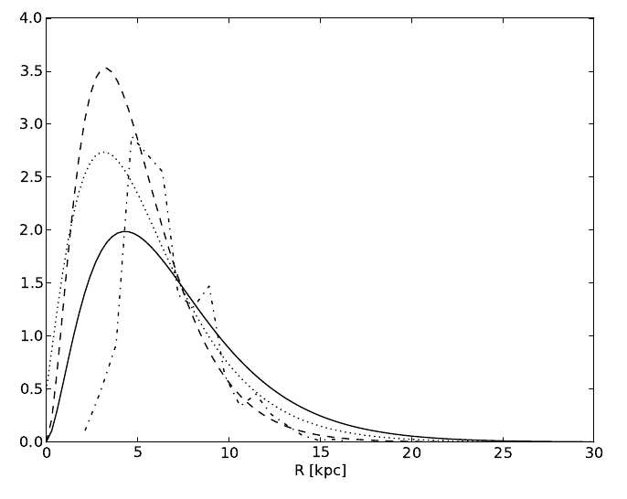
Large scale study of the diffuse emission
“Conventional model”: CR spectra are consistent with local measurements (CR nuclei, Fermi electrons)
GALPROP code with diffusion-reacceleration model for CR propagation
Propagation parameters are fixed from CR data
Grid of 128 models covering plausible confinement volume, CR source distributions, etc.
Corresponding model sky maps compared with data using maximum likelihood
Iterative process since the model parameters depend on outcome of the fit
IC
π⁰
Brems
Pulsars (Lorimer’06)
Pulsars (Y&K’04)
OB (Bronfman’00)
SNRs (CB’98)

Slide 20
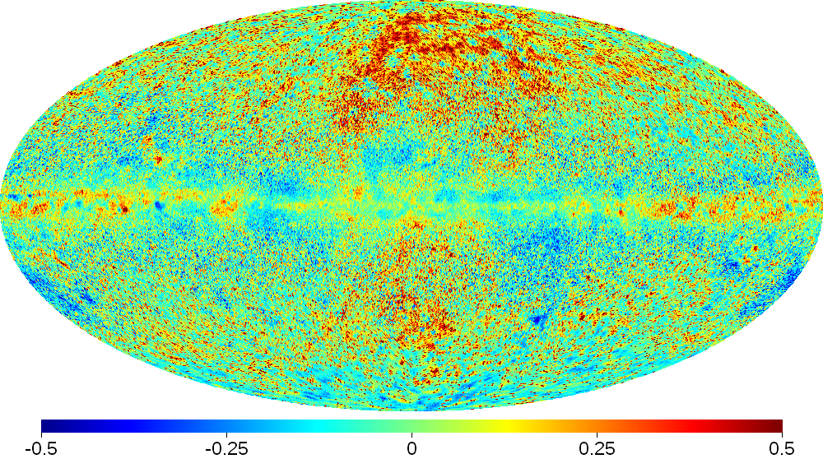
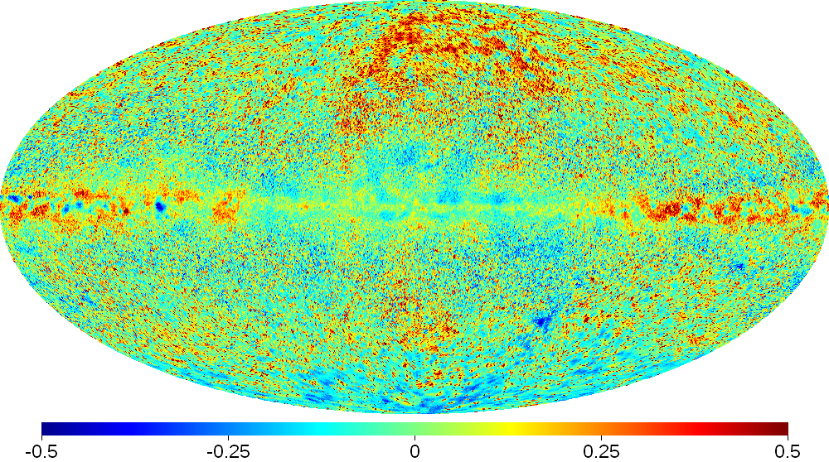
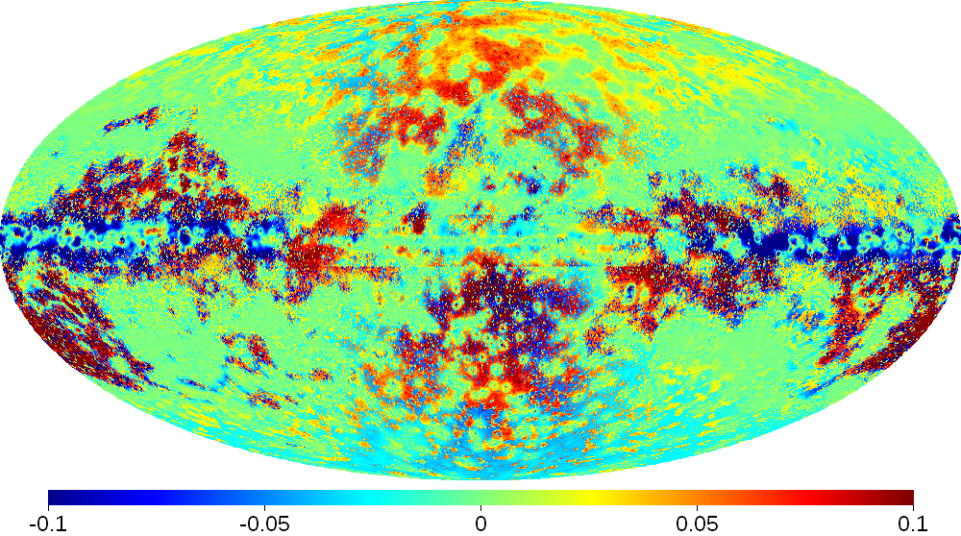
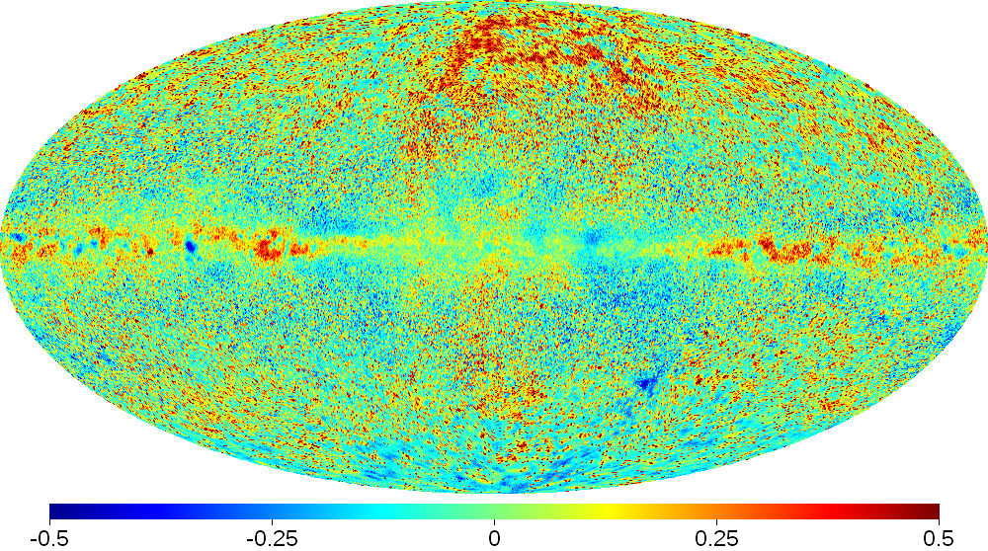
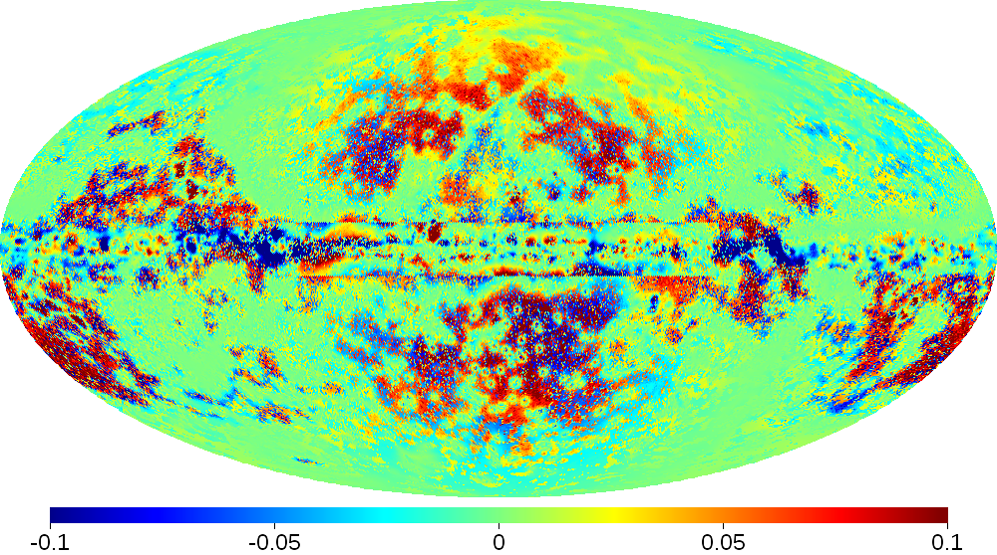
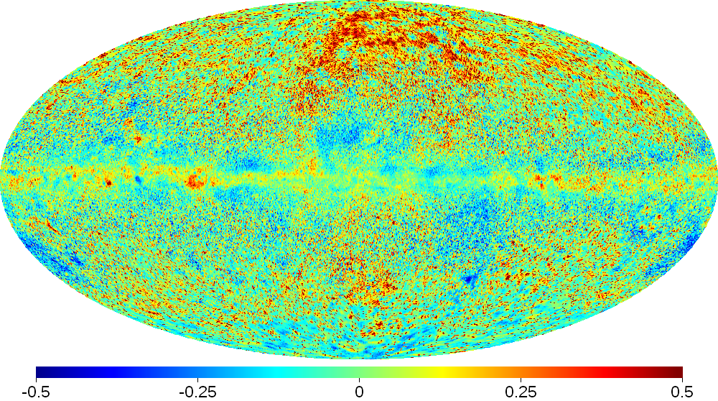
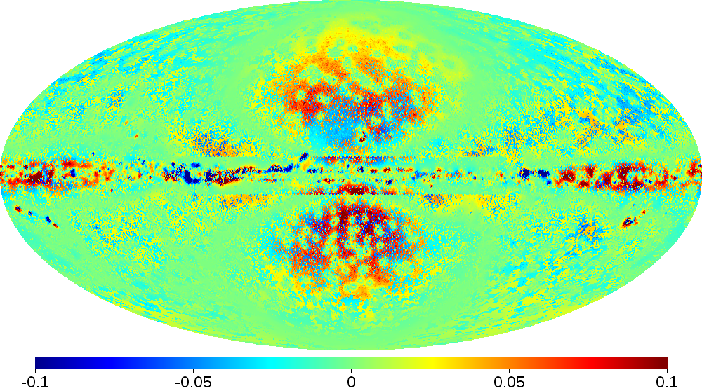
Large scale study: residuals
Model 2
PRELIMINARY
Agreement for models is overall good, but features are visible in residuals at ~% level
Difference between illustrative models shown in right maps : structure due to variations of model parameters
Models details:
2: SNR^{Z}4^{R}20^{T}150^{C}5
44: Lorimer^{Z}6^{R}20^{T}∞^{C}5
93: Yusifov^{Z}10^{R}30^{T}150^{C}2
119: OB^{Z}8^{R}30^{T}∞^{C}2
44
2- 44
93
2- 93
119
2- 119

Slide 21
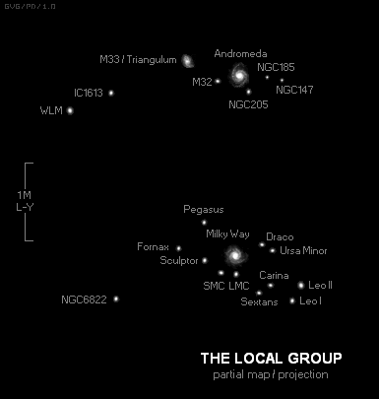
Milky Way from far far away…
Strong et al., ApJ Lett. 722 (2011) L58

Slide 22
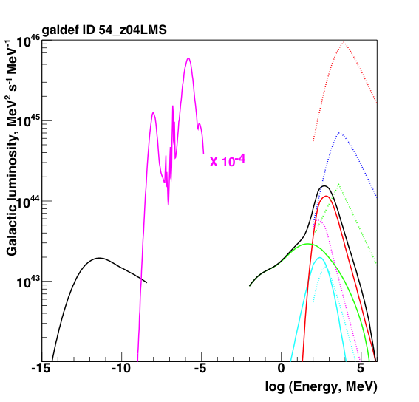
Multi-wavelength luminosity of the MW
optical
p
“Proximity” of the MW plus direct measurements allow us to construct its detailed “microscopic” model (GALPROP)
Integral properties of the MW – a useful template for studies of the normal galaxies
IR
He
e⁻
synch
γ total
IC
π⁰
bremss

Slide 23
Milky Way as electron calorimeter
Calculations for Z_{halo}= 4 kpc
Leptons lose ~60% of their energy
γ-rays: 50-50 by nucleons and by leptons
Cosmic rays
7.90×10⁴⁰ erg/s
Primary nucleons
98.6%
Synchrotron
0.35%
Ionization
losses
1%
0.29% (20.8%)
0.06% (13.4%)
Primary
electrons
1.41%
Secondary
leptons
e⁺: 0.33%
e⁻: 0.10%
Bremsstrahlung
0.15%
0.09% (6.6%)
0.06% (13.5%)
0.1% (21.1%)
0.5% (34.8%)
Inverse Compton
0.58%
0.59% (41.4%)
0.16% (34.6%)
Neutral pions
0.85%
Total gamma rays
1.6%
* The percentages in brackets show the values relative to the luminosity of their respective lepton populations

Slide 24
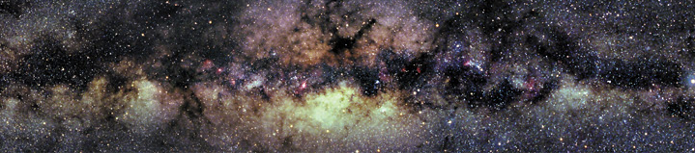
Gamma-ray emission from the inner Galaxy
Work in progress…

Slide 25
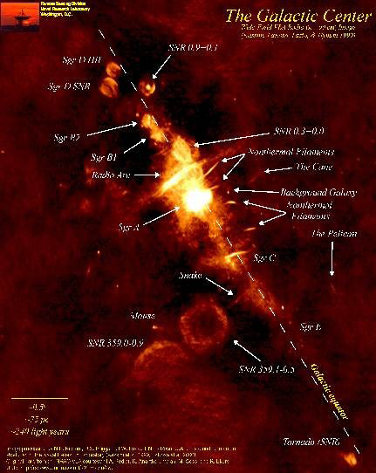
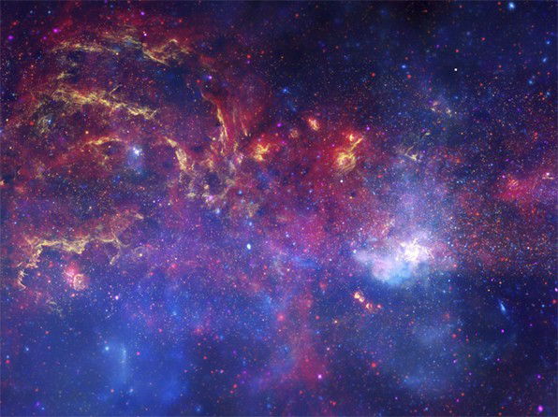
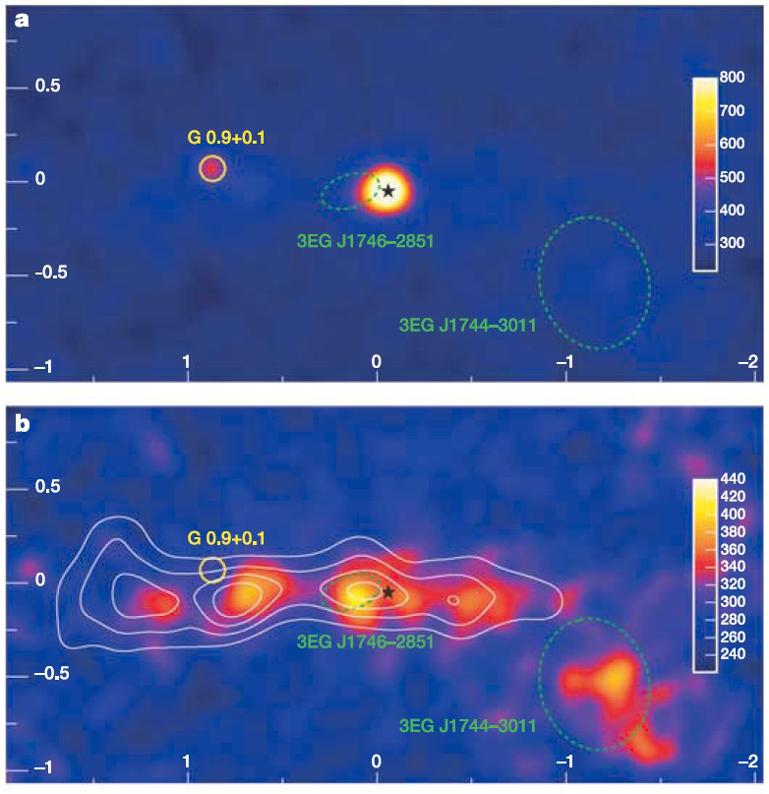
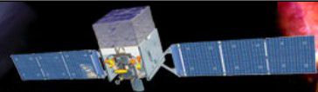
Inner Galaxy
Optical/IR/X-rays
HESS TeV γ-rays
Radio 90 cm
~0.3°
l=±2°
The region surrounding the GC is complicated containing
  Many astrophysical sources
  Intense emission by cosmic rays interacting with ISM
  Potential signal of particle dark matter
Continuous collection of data by the Fermi-LAT significantly adds to the available data allowing these topics to be addressed

Slide 26
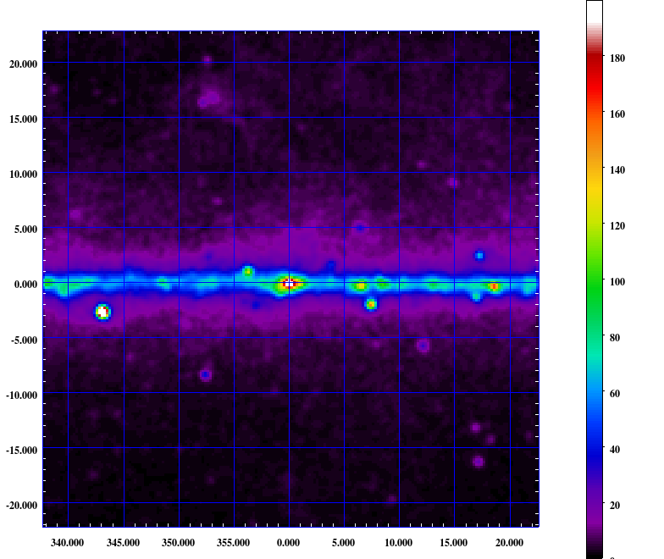
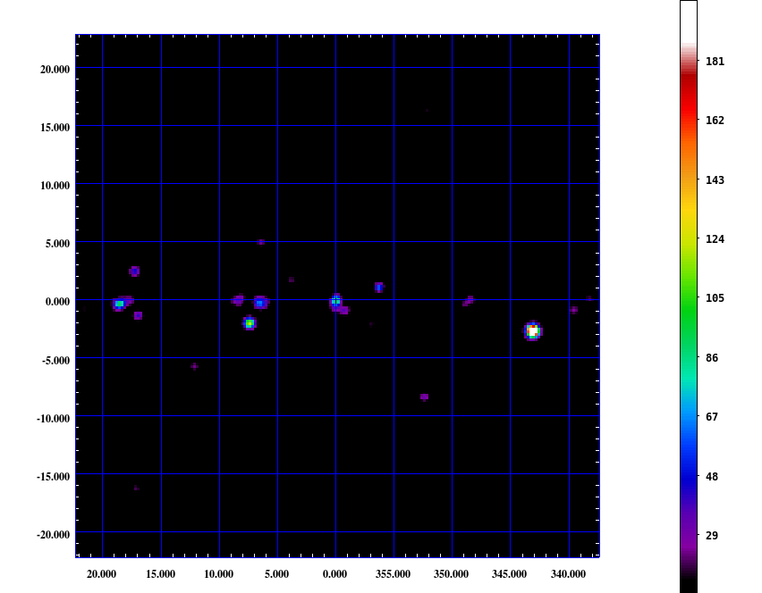
Taking fog away:
Subtraction of the diffuse emission
PRELIMINARY
32 Months data
Data - Model
Galactic latitude (deg)
Galactic latitude (deg)
Galactic longitude (deg)
Galactic longitude (deg)
Data and (Data – Model) above 1 GeV for 45°×45° region about the Galactic Center
The majority of the diffuse emission is removed using physically-motivated model based on GALPROP
Peaks in residual emission consistent with known sources or a PSF

Slide 27
Testing the origin of high-energy cosmic rays
Vladimirov et al. arXiv: 1108.1023

Slide 28
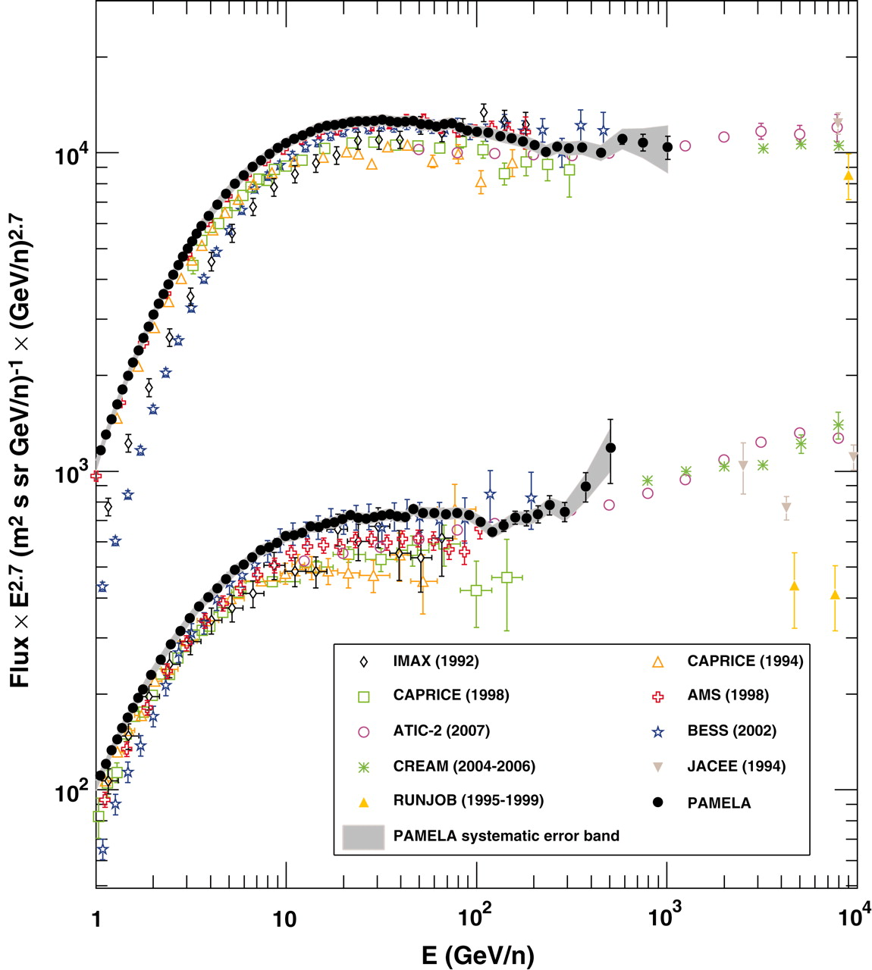
Proton and helium absolute fluxes
Adriani+2011
Data from three experiments (ATIC, CREAM, PAMELA) are all consistent and indicate spectral hardening above ~100 GeV/nucleon
He spectrum is clearly flatter than the proton spectrum
A new break may provide us with a hint on the origin of high energy CRs

Slide 29
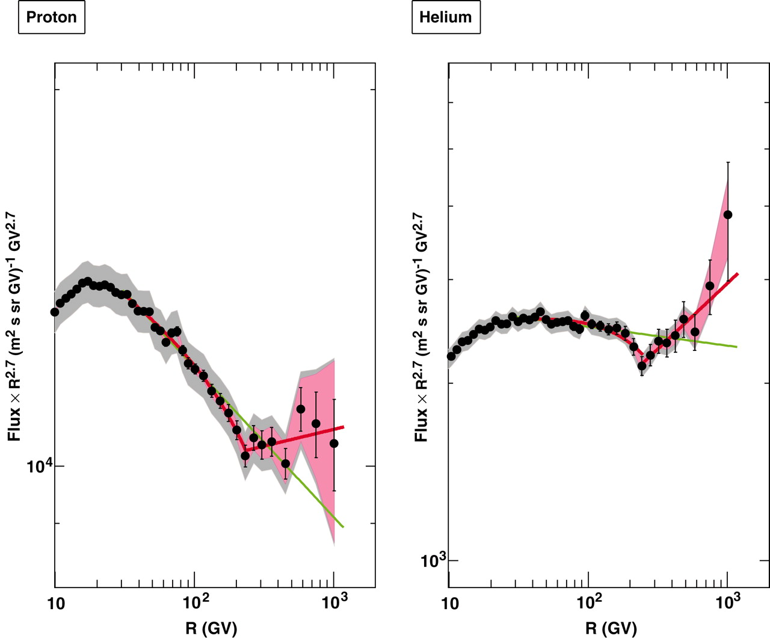
PAMELA: Proton and helium spectra vs. rigidity
The same break rigidity for p and He ~240 GV
The spectrum becomes flatter above the break
Spectral softening near the break, the “dip”
The differences between p and He spectral indices Δ = δ_{p} - δ_{He} are about the same below and above the break
Hardening
break
rigidity
break
rigidity
dip

Slide 30
Rationale
Scenario P: interstellar Propagation effects
  Change in CR transport: D ~ ρ^{δ}, δ = 0.3/0.15 below/above the break
Scenario I(a): CR Injection effects, a source with spectral break
  Breaks in the injection spectrum of CR sources
Scenario I(b): CR Injection effects, a composite source
  Two types of CR sources (soft and hard) uniformly mixed in the Galaxy
Scenario H: local High energy source
  Low energy CRs are produced by sources distributed in the Galaxy
  High energy CRs are coming from a local source
Scenario L: local Low energy source (special case!)
  High energy CRs are produced by sources distributed in the Galaxy
  Low energy CRs are coming from a local source
  No reacceleration, δ = 0.67 below/above the break
Scenario R: Reference model
  Tuned to pre-PAMELA CR data
Calculations employ GALPROP Webrun: http://galprop.stanford.edu

Slide 31
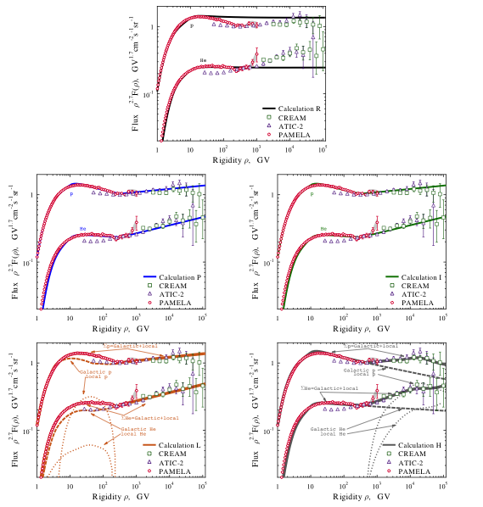
P and He spectra in different scenarios
Reference
All scenarios are tuned to the data, except the Reference scenario
Scenarios L and H: the local source component is calculated by the subtraction of the propagated Galactic spectrum from the data
The local source is assumed to be close to us, so no propagation; only primary CR species
R
Propagation
Injection
P
I
Local LE
Local HE
L
H

Slide 32
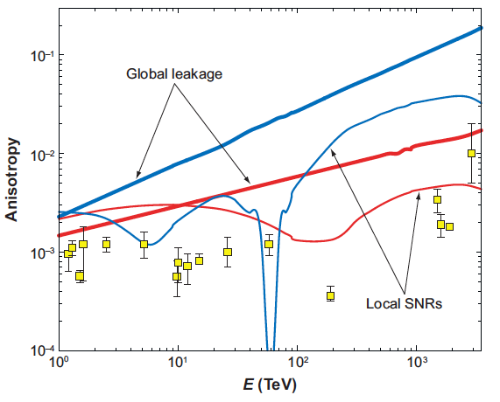
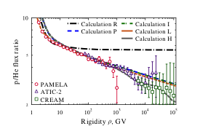
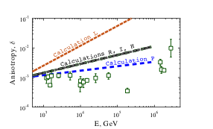
p/He ratio and CR anisotropy ratio in different scenarios
CR anisotropy
p/He ratio
Ptuskin+’2006
Tipical fluctuations
The lower anisotropy figure illustrates the effect of local sources, but it depends on their assumed ages, distances, and the spectra of accelerated particles
Local sources

Slide 33
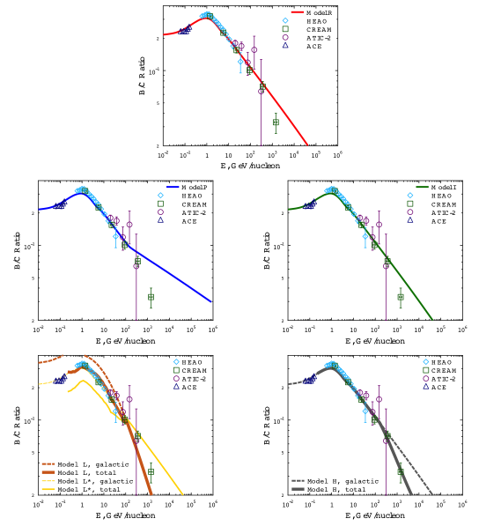
Example: B/C ratio in different scenarios
B/C is flatter in Scenario P
Local sources are assumed to produce only primary isotopes
B/C is steeper in scenario L and H, but due to the different reasons
  Scenario L: P-L index of the diffusion coefficient steepens to 0.67
  Scenario H: there is no Boron in the local source, but there is Carbon
R
P
I
L
H

Slide 34
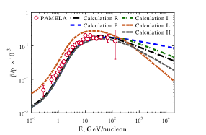
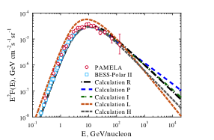
Antiprotons and pbar/p ratio in different scenarios
Antiprotons
pbar/p ratio
All scenarios are consistent with existing antiproton data (except scenario L)
Predict different behavior at HE

Slide 35
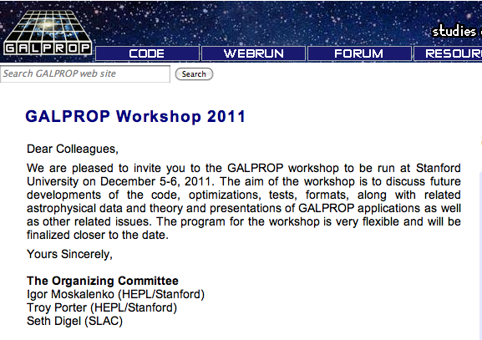
NOT LATE!

Slide 36
Back up slides

Slide 37
New features of most recent release (v.54.1)
Technical
Configuration management via GNU autotools
Different compiler targets and testing (g++, icc, open64, llvm), Linux and OS X
Parallelization via OpenMP
Memory usage optimization
Multiple data format outputs (HEALPix, Fermi MapCube, FITS)
Built as library for external linking (e.g., with DarkSUSY, SuperBayeS)
Bugzilla available at GALPROP website
WebRun – run via browser different versions of GALPROP (even from a smart phone)
Datasets
Improved HI and CO gas maps from surveys (e.g., LAB, NANTEN)
Interstellar radiation field calculated with FRaNKIE code (full 3D radiative transport)
3D modeling of magnetic field, polarization treatment (WMAP, Plank)
CROSECS project – to improve on the isotopic production cross sections

Slide 38

Running calculations
Simultaneous runs are allowed dependent on resources
Shared fairly between users with load balancing

Slide 39
Why?
Constraining CR propagation − important for many related topics (e.g., indirect DM searches)
So far, global parameter scans were only possible with analytical or semi-analytical propagation models, but reliability may be a problem
Recent improvements to the GALPROP code together with efficient sampling techniques and Bayesian methods now allow a fully numerical exploration of the parameter space

Slide 40
The Likelihood Function
Θ – a set of model parameters
ϕ = {ϕ_{1,} ϕ_{2,} ϕ_{3,} ϕ₄} – a set of modulation potentials; the number of modulation potentials corresponds to the number of data sets (experiments)
Φ_{X}(E_{i}, Θ,ϕ) – the computed spectrum for CR species X
Φ_{X}^{ij} – the measured spectrum (i runs through the data points for each experiment j)
σ_{ij} – reported standard deviations
τ_{j} – error rescaling parameters
The full likelihood for all 5 experimental data sets:
– assuming that individual energy bins are independent

Slide 41

Input parameters and prior ranges

Slide 42

p/He ratio (Blasi & Amato 2011)
Proposed a model where the difference between p and He spectral slopes is explained by fragmentation of He
Requires τ_{fragm} < τ_{esc}
Works only for Kolmogorov diffusion (δ ~1/3)
Requires fine tuning: grammage ×2, somewhat different D₀
Required grammage is too large (excess B, pbars)
Does not take into account production of secondary ³He
We ADOPT different injection spectra for p and Z>1 ad hoc

Slide 43

Disentangling the many sources of gamma-ray emission is challenging
The emission from the inner Galaxy consists of a number of components:
Outer Galaxy
True inner Galaxy
Point sources
Unresolved point sources
To disentangle the components of the emission we apply a physical model based on GALPROP
There are uncertainties in each component -> physically motivated fitting procedure
Outer
Inner
Outer

Slide 44

Residual emission for 15°×15° about the GC
The majority of the diffuse emission is removed using physically-motivated model based on GALPROP
Peaks in residual emission consistent with known sources or a PSF
Work in progress…
PRELIMINARY
PSR J1732-3131
Galactic latitude (deg)
PSF >1 GeV
Galactic longitude (deg)

Slide 45

Isotropic diffuse gamma-ray emission
Abdo et al., PRL 104 (2010) 101101

Slide 46

Diffuse emission at low to high Galactic latitudes
Pion-decay and inverse Compton emission are two dominant components – allow us to probe the average CR proton and electron spectra along the line of sight
The GALPROP predictions agree well with the LAT data
High latitudes
Low latitudes
Abdo+’10
Mid-latitudes

Slide 47

Spectrum of isotropic diffuse γ-ray emission
index=2.41±0.05
2010
Accessed every 6 years (1998, 2004, 2010, 2016?,…)
Time-dependent: increasingly steepens with time…

