Slide 1
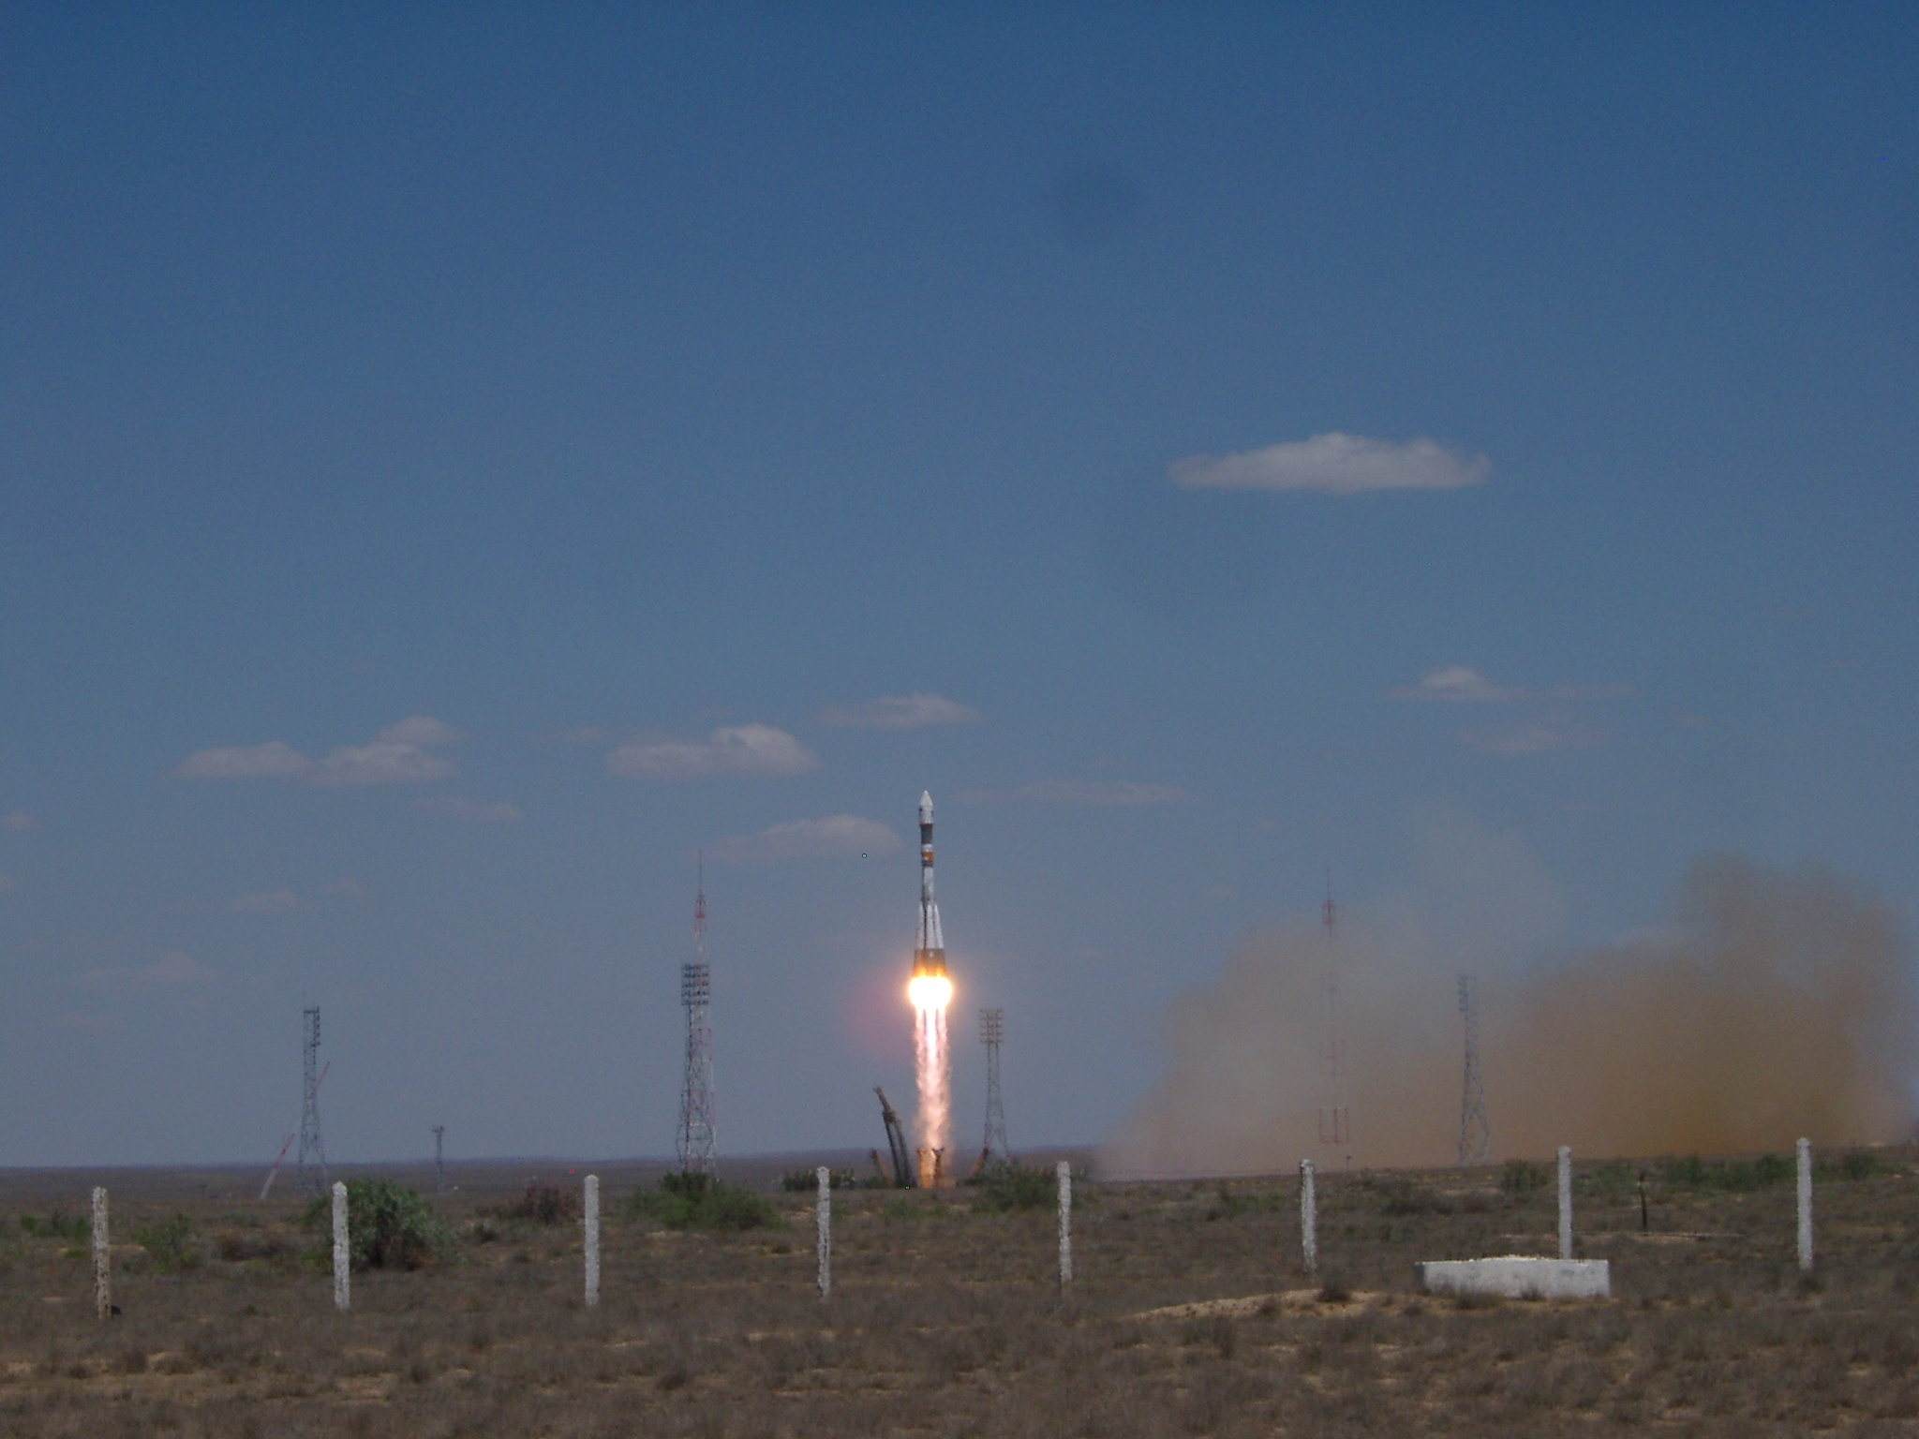
Cosmic-Ray Measurements with the PAMELA Experiment Mirko Boezio INFN Trieste, Italy On behalf of the PAMELA collaboration Cosmic Ray Anisotropy Workshop 2011 – Madison, WI October 29th 2011

Slide 2

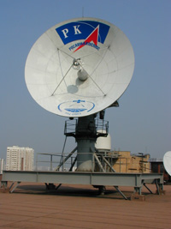
PAMELA milestones
Launch from Baikonur → June 15th 2006, 0800 UTC.
‘First light’ → June 21st 2006, 0300 UTC.
• Detectors operated as expected after launch
• Different trigger and hardware configurations evaluated
PAMELA in continuous
data-taking mode since
commissioning phase
ended on July 11th 2006
Main antenna in NTsOMZ
Trigger rate* ~25Hz
Fraction of live time* ~ 75%
Event size (compressed mode) ~5kB
25 Hz x 5 kB/ev → ~ 10 GB/day
(*outside radiation belts)
Till ~now:
~1800 days of data taking
~26 TByte of raw data downlinked
>2x10⁹ triggers recorded and analyzed

Slide 3
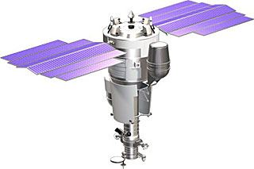
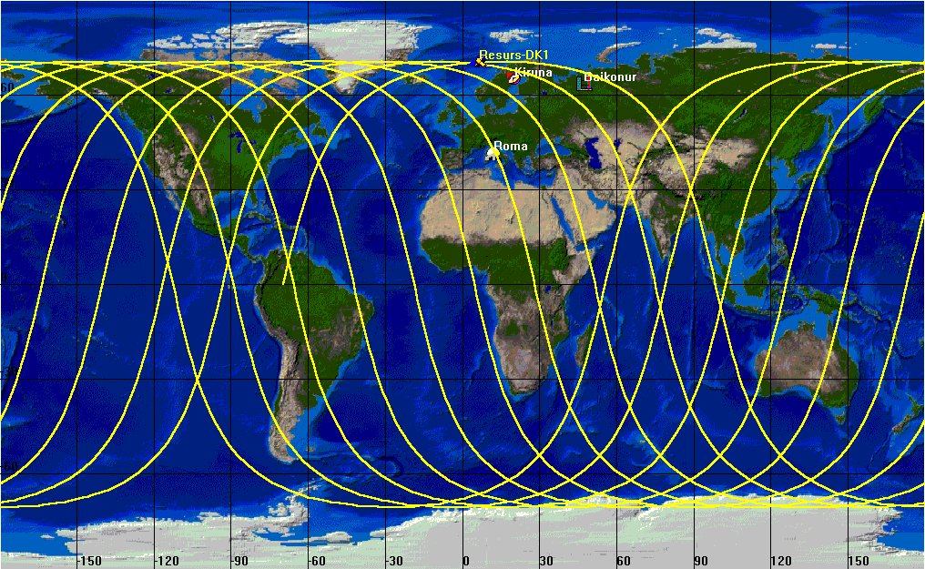
Resurs-DK1 satellite + orbit
Resurs-DK1: multi-spectral imaging of earth’s surface
PAMELA mounted inside a pressurized container
Lifetime >3 years (assisted, first time February 2009), extended till end 2011
Data transmitted to NTsOMZ, Moscow via high-speed radio downlink. ~16 GB per day
Quasi-polar and elliptical orbit (70.0°, 350 km - 600 km) – from 2010 circular orbit (70.0°, 600 km)
Traverses the South Atlantic Anomaly
Crosses the outer (electron) Van Allen belt at south pole
PAMELA
Resurs-DK1
Mass: 6.7 tonnes
Height: 7.4 m
Solar array area: 36 m²
350 km
70º
SAA
610 km
~90 mins

Slide 4
PAMELA Apparatus

Slide 5
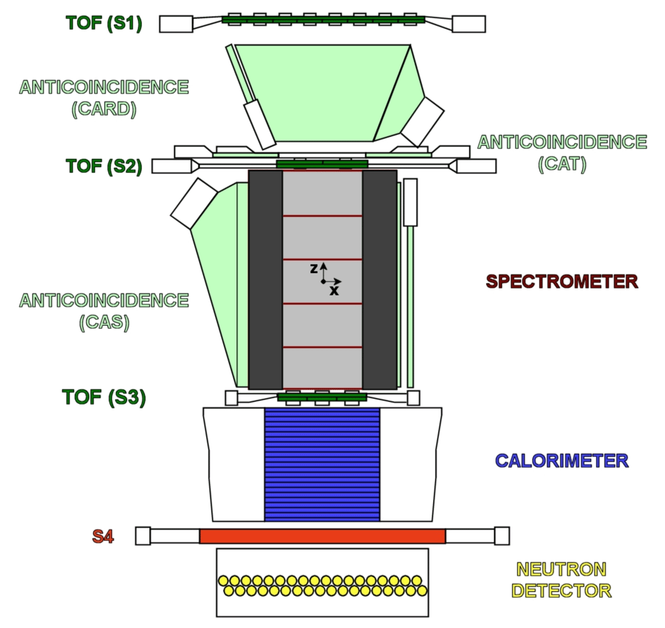
PAMELA detectors
Main requirements → high-sensitivity antiparticle identification and precise momentum measure
+ -
Time-Of-Flight
plastic scintillators + PMT:
Trigger
Albedo rejection;
Mass identification up to 1 GeV;
- Charge identification from dE/dX.
Electromagnetic calorimeter
W/Si sampling (16.3 X₀, 0.6 λI)
Discrimination e+ / p, anti-p / e⁻
(shower topology)
Direct E measurement for e⁻
Neutron detector
³He tubes + polyethylene moderator:
High-energy e/h discrimination
GF: 21.5 cm² sr Mass: 470 kg
Size: 130x70x70 cm³
Power Budget: 360W
Spectrometer
microstrip silicon tracking system + permanent magnet
It provides:
- Magnetic rigidity → R = pc/Ze
Charge sign
Charge value from dE/dx
Notes:
Overview of the apparatus

Slide 6
Cosmic Ray Spectra
Cosmic-Ray Acceleration and Propagation in the Galaxy

Slide 7
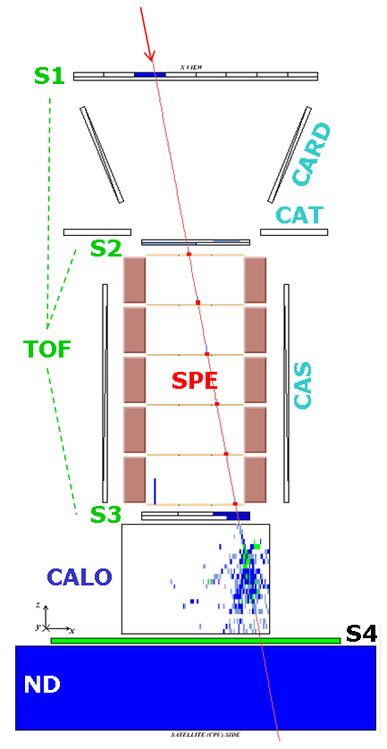
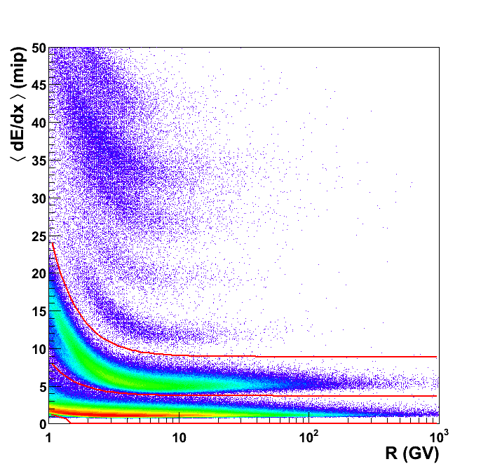
H/He Selection
Single good-quality track in the spectrometer
→ Particle rigidity (R = pc/Ze )
Downward-going (β>0) & positive-curvature (R>0) trajectory
→ Positive-charge particle from above
Clean pattern through the apparatus
→ Not an interaction product
Energy deposits in the tracking system consistent with H and He nuclei
→High-statistic (~10⁸)
sample of H and He
(no isotope separation)
→Negligible bk of
-interaction products
-misidentified particles
He
H

Slide 8
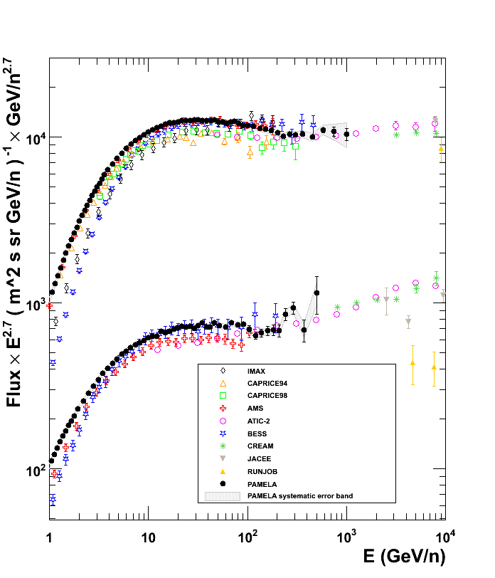
Proton and Helium Nuclei Spectra
O. Adriani et al., Science 332 (2011) 69

Slide 9
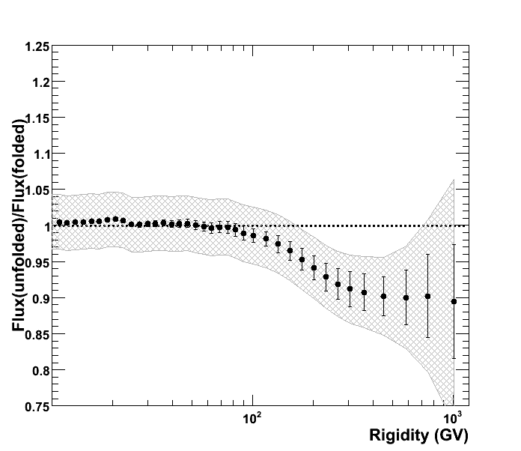
Spectrum unfolding
Protons
Real-energy spectrum
Physical and instrumental effects
Measured-energy spectrum
10%
Statistical unfolding procedure
Bayesian unfolding
Spectrometer response matrix from MC

Slide 10
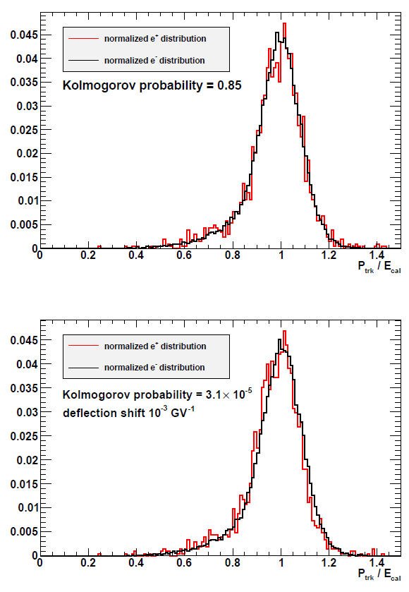
Spectrometer Systematic Uncertainties
With real data:
The spectrometer may have a charge-sign dependent systematic
A calorimeter systematic has no such dependence
A systematic deflection shift causes an offset between e⁻ and e⁺ distribution
Upper limit set by positron statistics:
Δη_{sys} ~1∙10⁻⁴ GV⁻¹

Slide 11
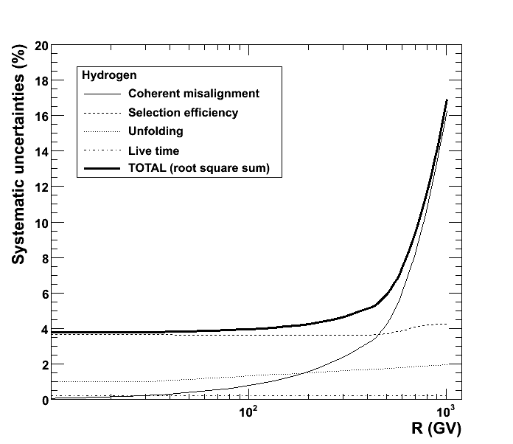
Overall systematic uncertainties
At low R selection-efficiency uncertainties dominate
Above 500GV tracking-system (coherent) misalignment dominates
spectrometer systematic error
selection-efficiency uncertainties

Slide 12
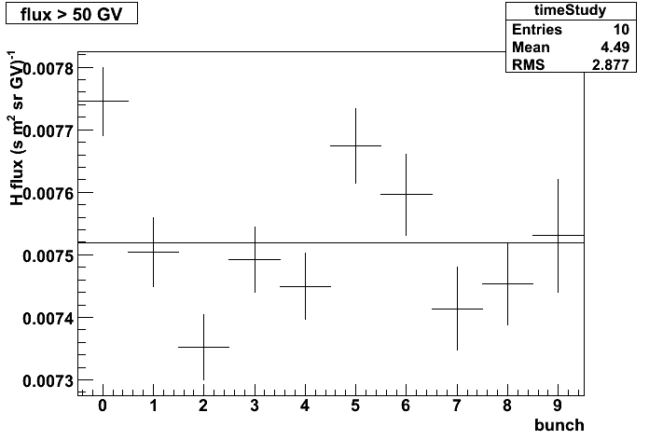
Check of systematics
Integral proton flux (>50GV)
Fluxes evaluated by varying the selection conditions:
Flux vs time
Flux vs polar/equatorial
Flux vs reduced acceptance
Flux vs different tracking conditions (⇒ different response matrix)
…
3%
Time interval (2 months)

Slide 13
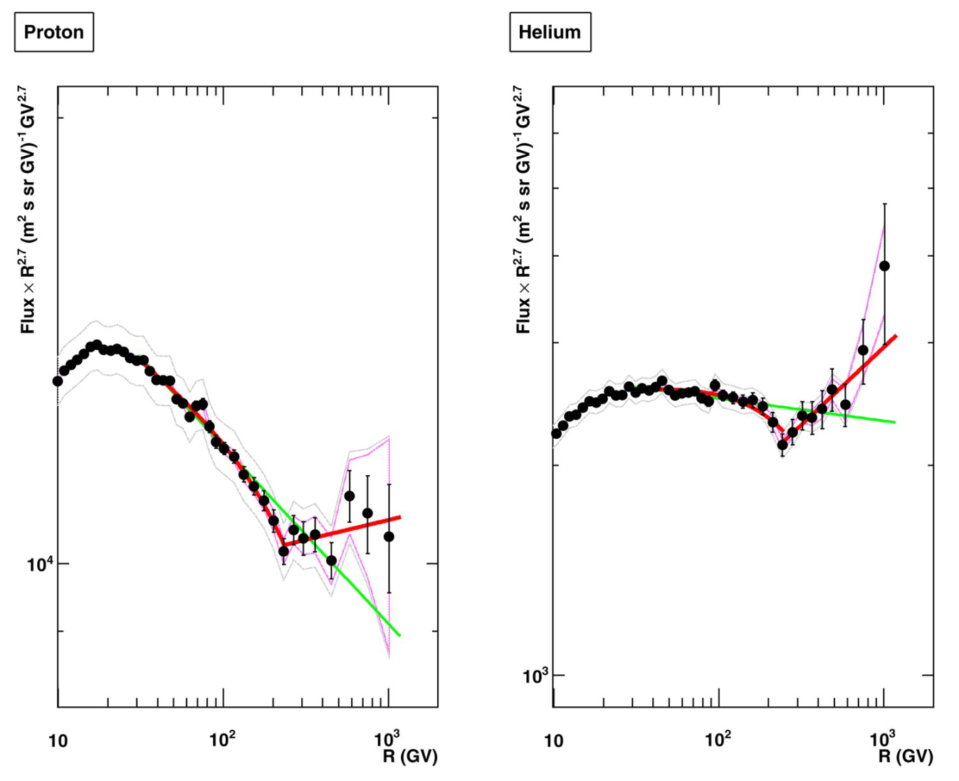
H & He absolute fluxes @ high energy
2.85
Spectral index
2.77
2.67
2.48
Deviations from single power law (SPL):
Spectra gradually soften in the range 30÷230GV
Spectral hardening @ R~235GV Δγ~0.2÷0.3
SPL is rejected at 98% CL
Origin of the structures?
- At the sources: multi-populations, etc.?
- Propagation effects?
232 GV
243 GV
Solar modulation
Solar modulation
H
He

Slide 14
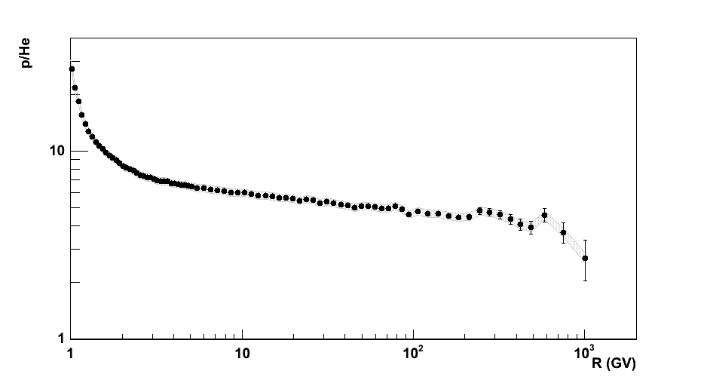
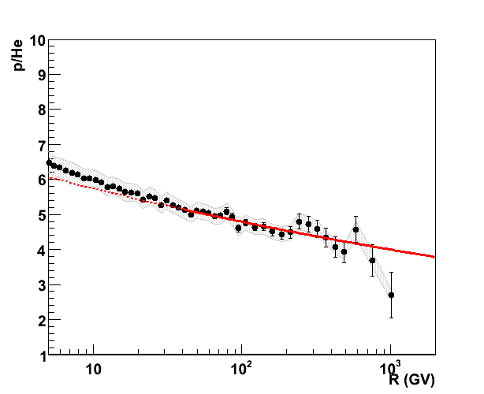
H/He ratio vs R
Instrumental p.o.v.
Systematic uncertainties partly cancel out
Theoretical p.o.v.
Spallation effects during propagation: Blasi & Amato: arXiv:1105.4521
acceleration effects: M. Malkov et al., arXiv:1110.5335
Or?
Power-law fit (χ²~1.3)
α_{He}-α_{p} = 0.078 ±0.008

Slide 15
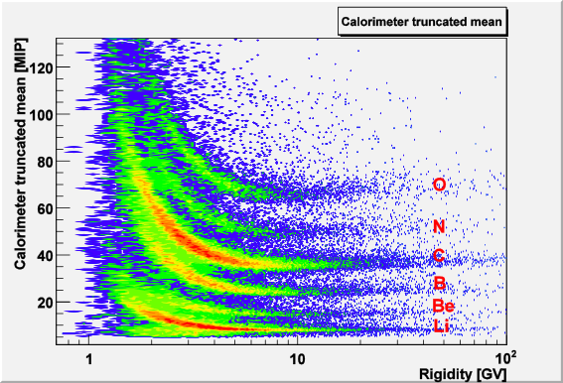
Light Nuclei Selection
Carbon
Li
B
Be
Produced as Secondaries
Information on Cosmic Ray
Transport

Slide 16
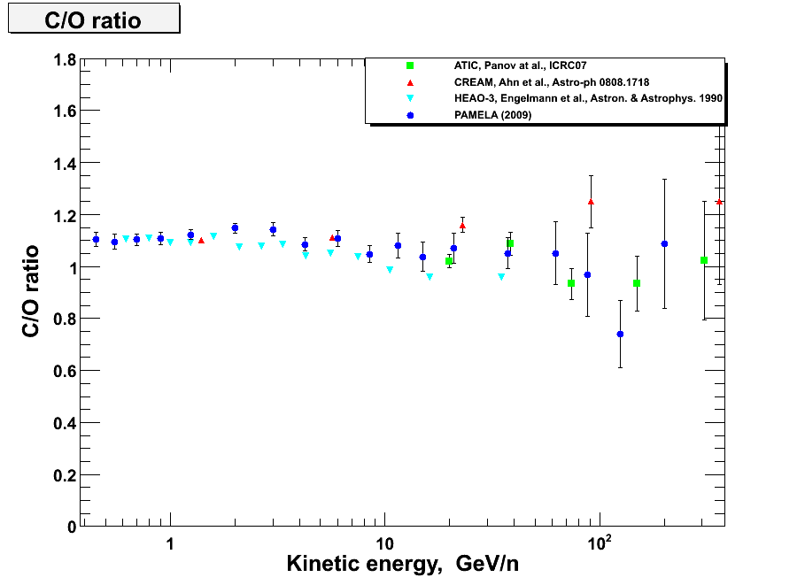
C/O ratio
Preliminary
Preliminary

Slide 17
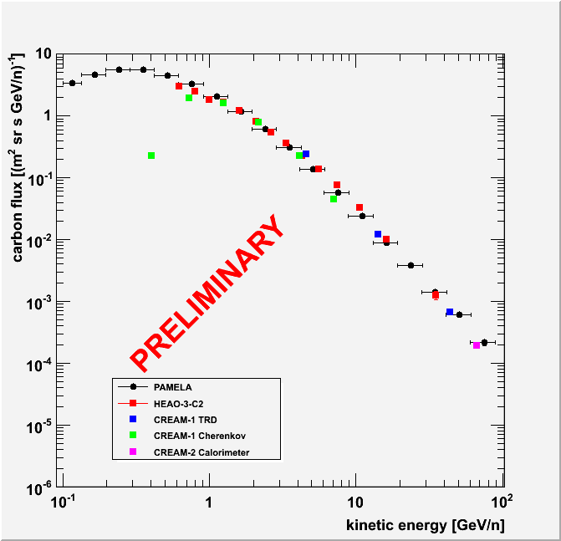
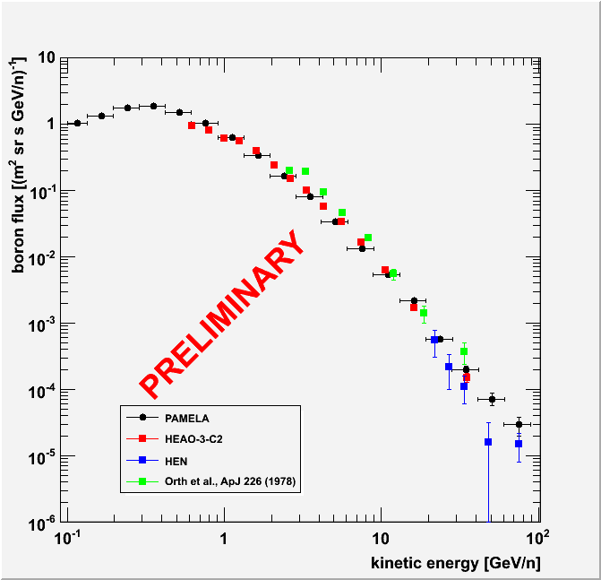
Boron and Carbon nuclei Spectra
Carbon
Boron

Slide 18
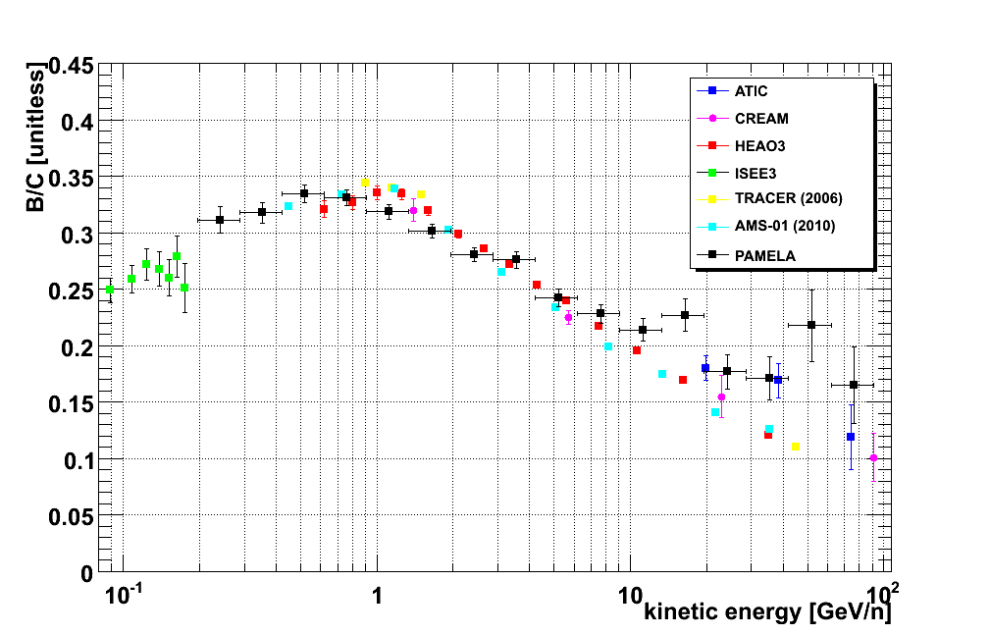
Secondary nuclei
Preliminary!!
Preliminary
LBM
B nuclei of secondary origin:
CNO + ISM → B + …
Local secondary/primary ratio sensitive to average amount of traversed matter (l_{esc}) from the source to the solar system
Local secondary abundance:
study of galactic CR propagation
(B/C used for tuning of propagation models)

Slide 19
ELECTRONS

Slide 20
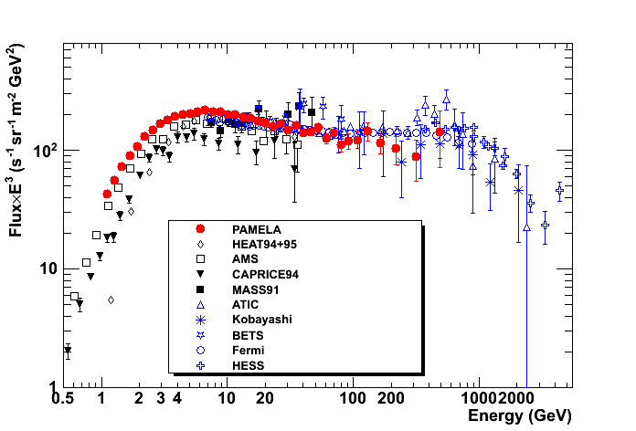
PAMELA electron (e⁻) spectrum
Flux=A • E^{-γ}
γ = 3.18 ±0.05
e⁻
e⁺ + e⁻
O. Adriani et al., PRL 106 (2011) 201101.

Slide 21
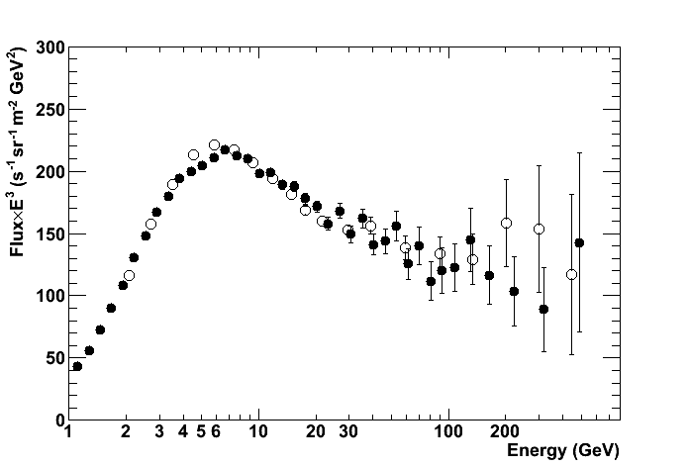
PAMELA electron (e⁻) spectrum
Tracker based
Calorimeter based

Slide 22
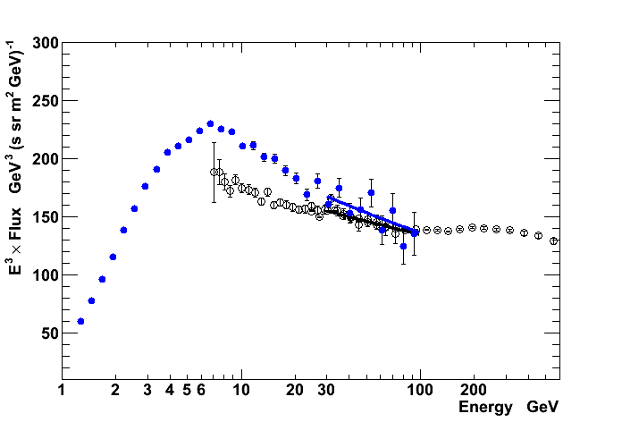
PAMELA & Fermi electron (e⁻+e⁺) spectra
Flux=A • E^{-γ}
γ = 3.17 ±0.07
Flux=A • E^{-γ}
γ = 3.112 ±0.002

Slide 23
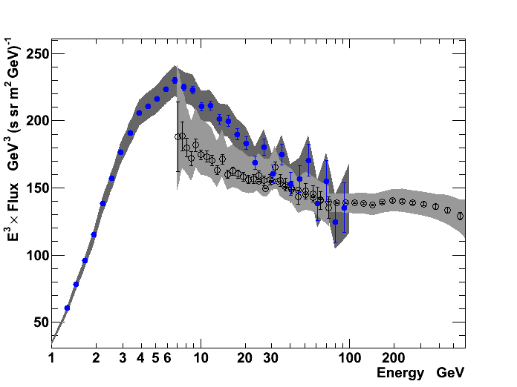
PAMELA & Fermi electron (e⁻+e⁺) spectra

Slide 24
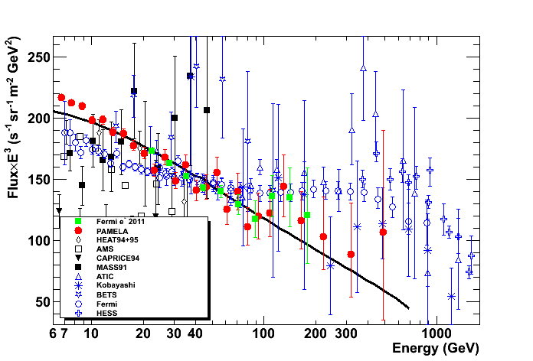
PAMELA & Fermi electron (e⁻) spectra
Adriani et al., Phys. Rev. Lett. 106, 201101 (2011)
Ackermann et al., arXiv: 1109.0521

Slide 25
Antiparticles with PAMELA

Slide 26
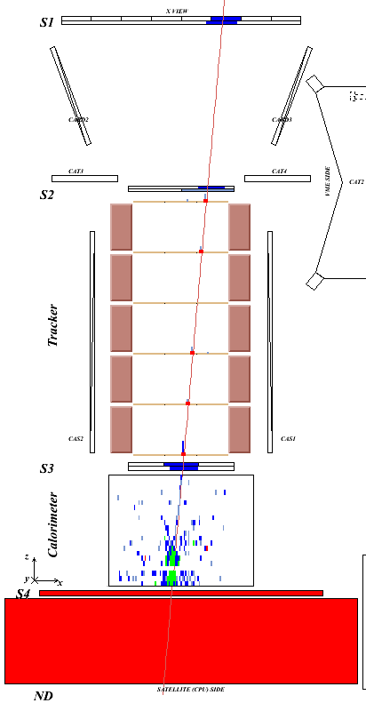
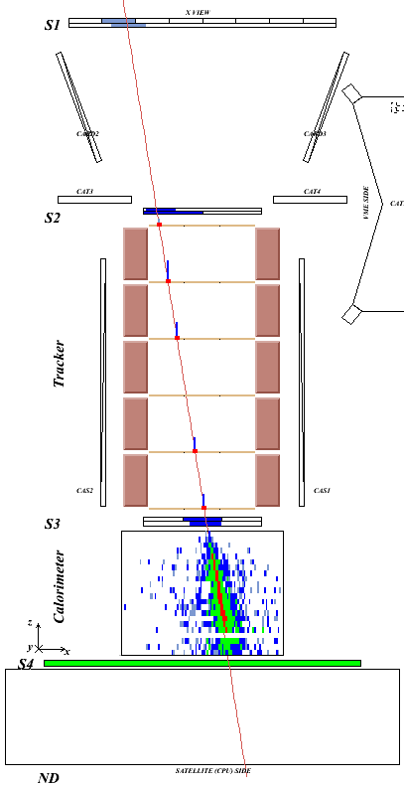
Antiproton / positron identification
Time-of-flight: trigger, albedo rejection, mass determination (up to 1 GeV)
Bending in spectrometer: sign of charge
Ionisation energy loss (dE/dx): magnitude of charge
Interaction pattern in calorimeter: electron-like or proton-like, electron energy
Antiproton (NB: e⁻/p ~ 10²)
Positron
(NB: p/e⁺ ~10³⁻⁴)

Slide 27
ANTIPROTONS

Slide 28
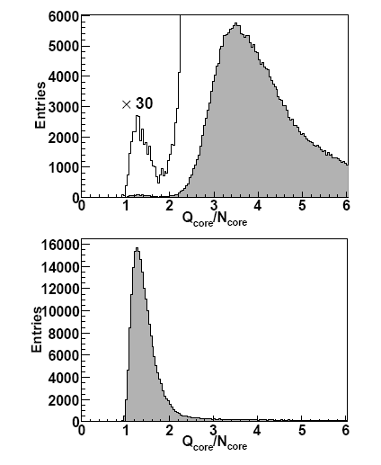
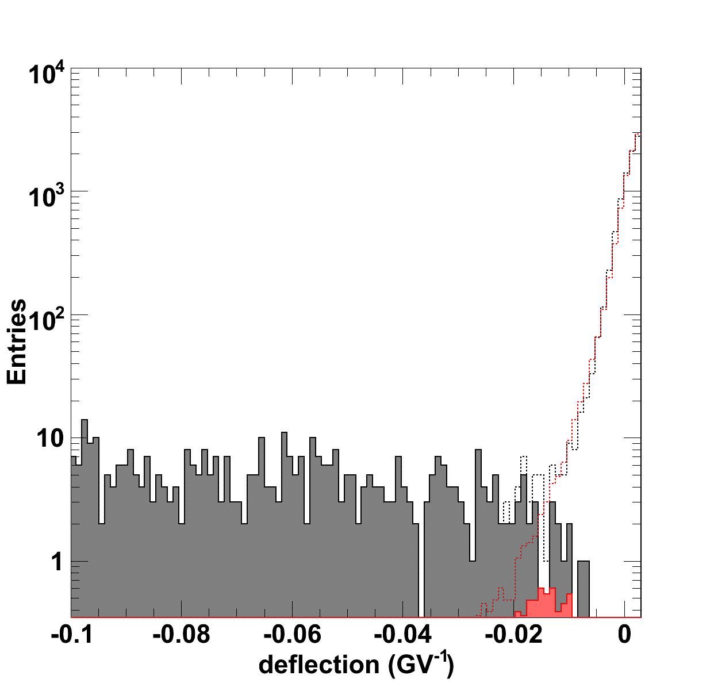
Antiproton Identification
p
e⁻
Calorimeter
selection
p
Tracker Identification
Protons (& spillover)
Antiprotons

Slide 29
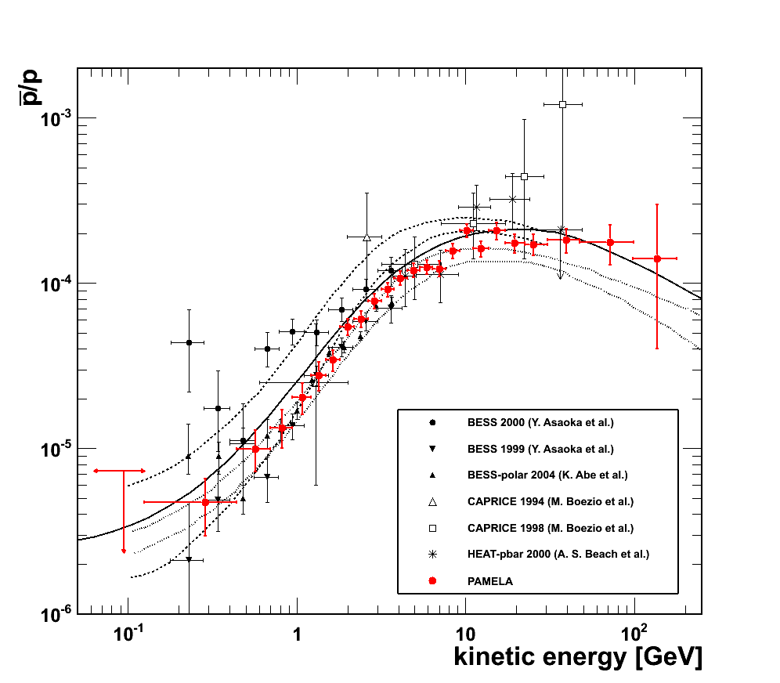
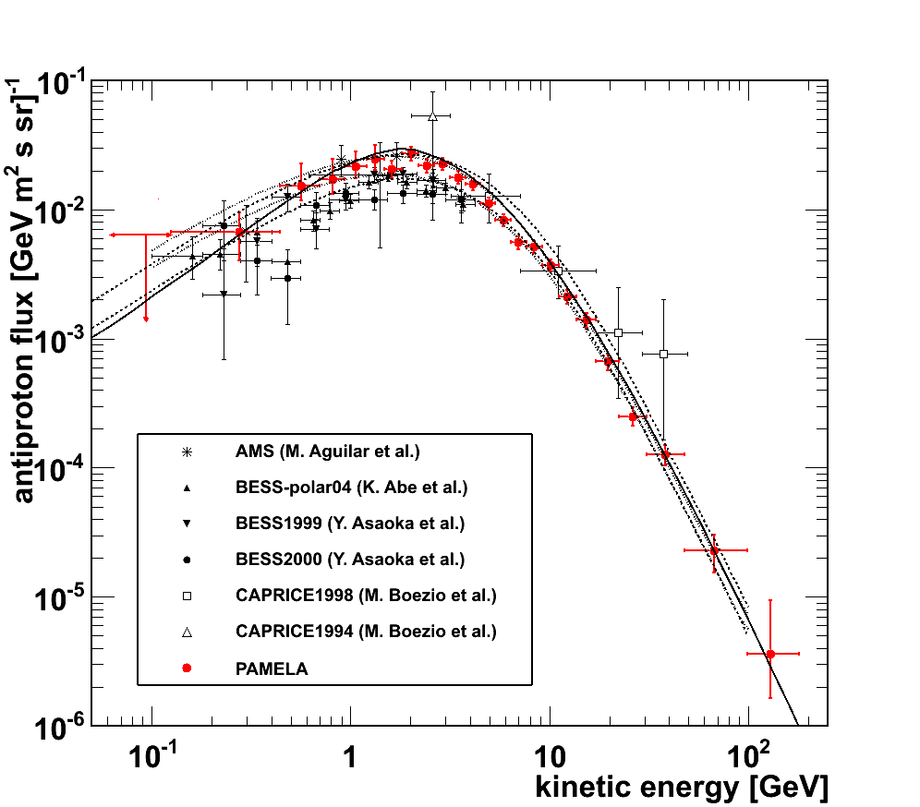
Antiproton Results
Simon et al. (ApJ 499 (1998) 250)
Ptuskin et al. (ApJ 642 (2006) 902)
Donato et al. (PRL 102 (2009) 071301)
O. Adriani et al., PRL 102, 051101 (2009); PRL 105, 121101 (2010)

Slide 30
POSITRONS

Slide 31
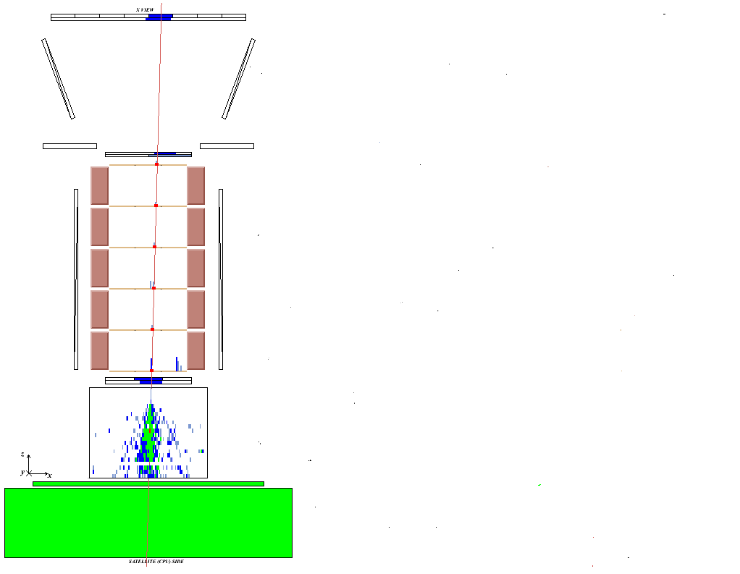
Proton / positron discrimination
Time-of-flight: trigger, albedo rejection, mass determination (up to 1 GeV)
Bending in spectrometer: sign of charge
Ionisation energy loss (dE/dx): magnitude of charge
Interaction pattern in calorimeter: electron-like or proton-like, electron energy
Proton
Positron

Slide 32
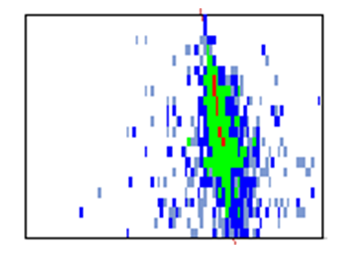
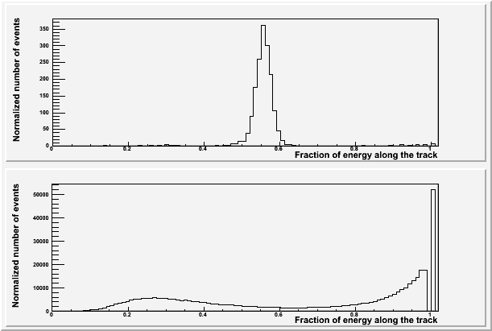
Positron selection with calorimeter
Fraction of energy released along the calorimeter track (left, hit, right)
e⁻
planes
LEFT
HIT
RIGHT
p (int)
p (non-int)
strips
p (non-int)
e⁺
0.6 R_{M}
p (int)
for em showers
90% of E contained
in 1 R_{M}
Rigidity: 20-30 GV
Notes:
32
Total negative → 3067
Total positive → 189055
Selected electrons → 2032
Selected positrons → 322

Slide 33
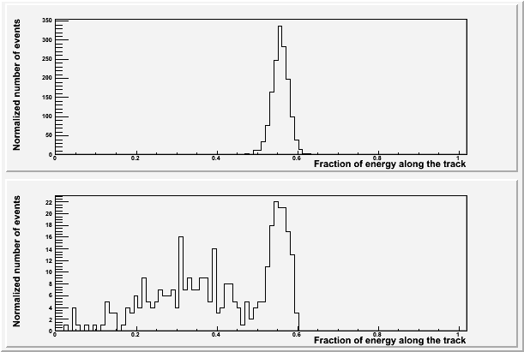
Positron selection with calorimeter
Rigidity: 20-30 GV
e⁻
e⁺
p
Fraction of charge released along the calorimeter track (left, hit, right)
+
Energy-momentum match
Starting point of shower
Notes:
Total negative → 3067
Total positive → 189055
Selected electrons → 2032
Selected positrons → 322

Slide 34
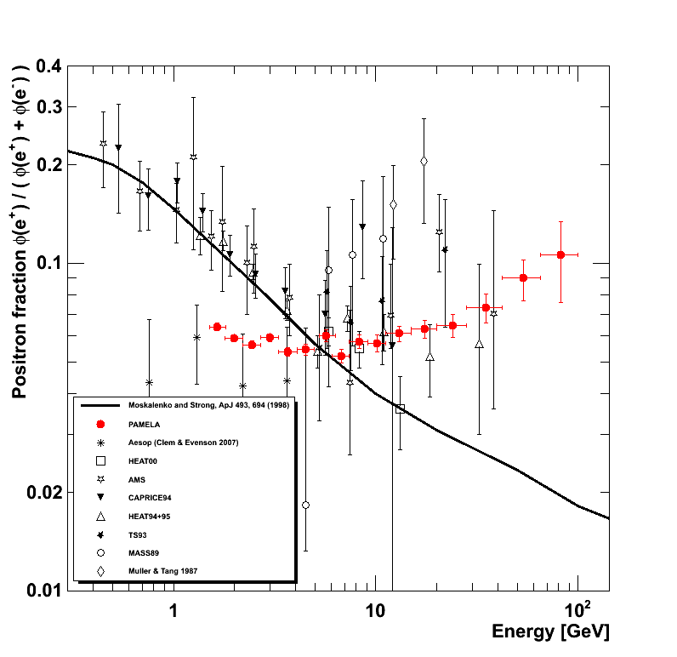
Positron to Electron Fraction
Secondary production Moskalenko & Strong 98
Adriani et al., Astropart. Phys. 34 (2010) 1
Nature 458 (2009) 607

Slide 35
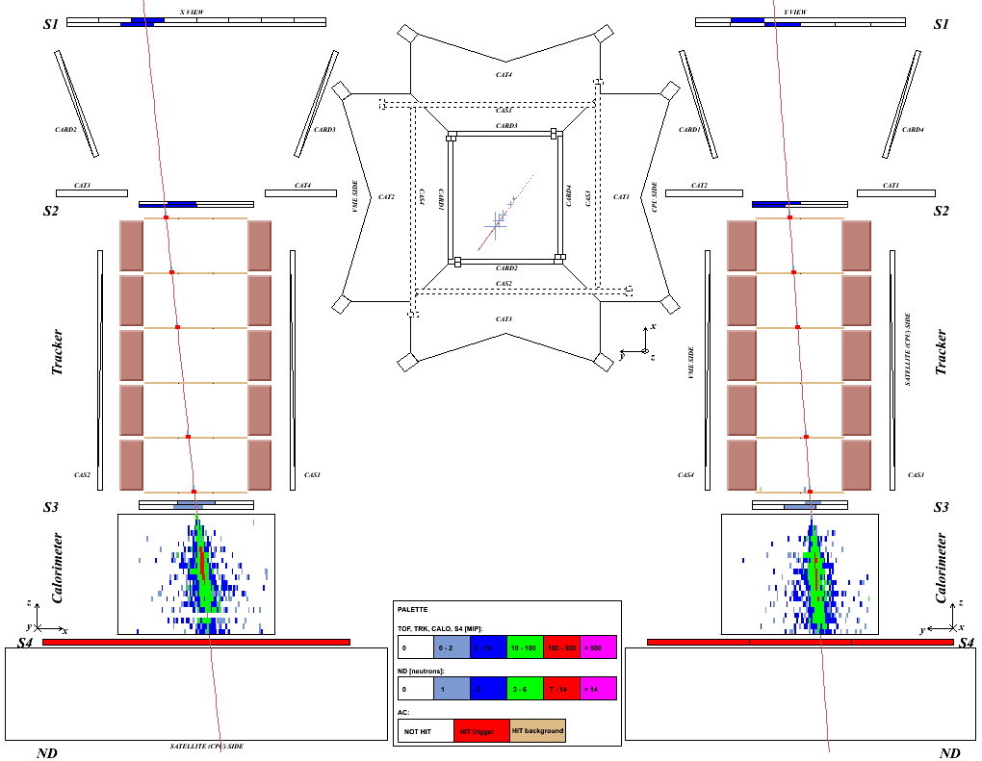
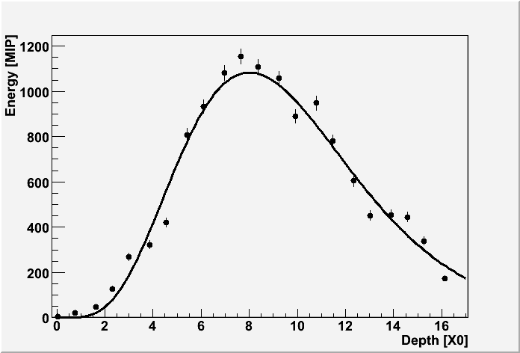
Flight data: 51 GeV/c
positron

Slide 36
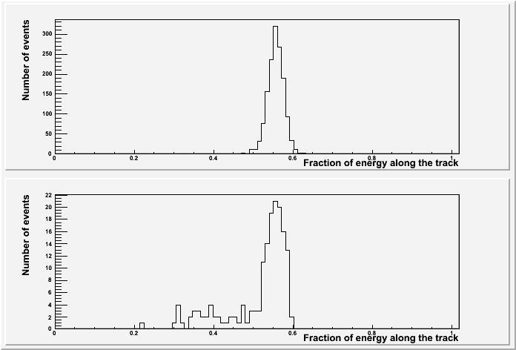
Positron selection with calorimeter
Rigidity: 20-30 GV
e⁻
e⁺
p
Fraction of charge released along the calorimeter track (left, hit, right)
+
Energy-momentum match
Starting point of shower
Longitudinal profile
Notes:
Total negative → 3067
Total positive → 189055
Selected electrons → 2032
Selected positrons → 322

Slide 37
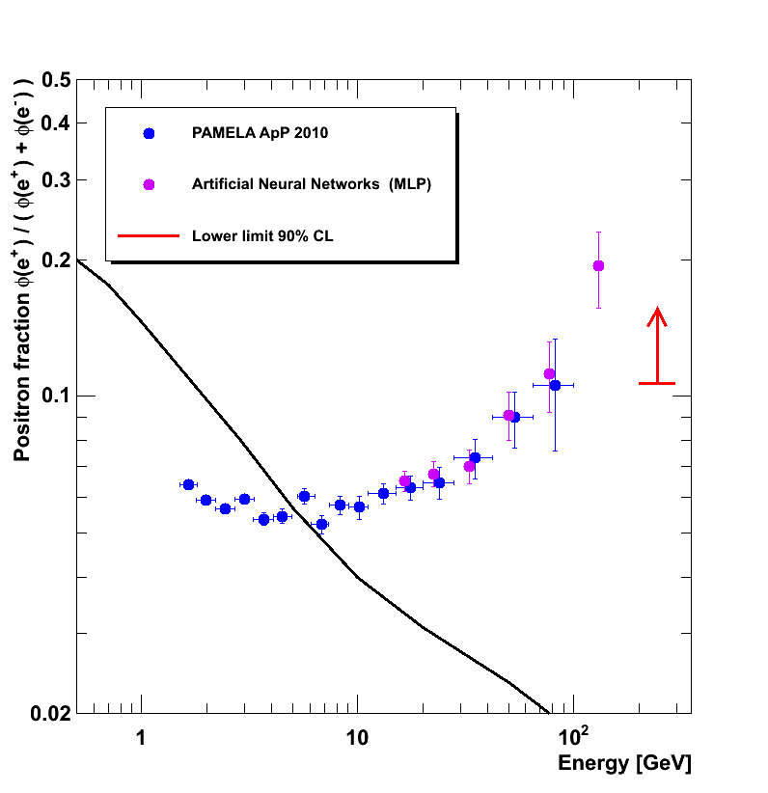
PAMELA Positron to Electron Fraction
Preliminary
Using all data till beginning of 2010, the whole calorimeter and multivariate classification algorithms we can improve the statistical significance
and extend the measurements above 100 GeV
Secondary production Moskalenko & Strong 98

Slide 38
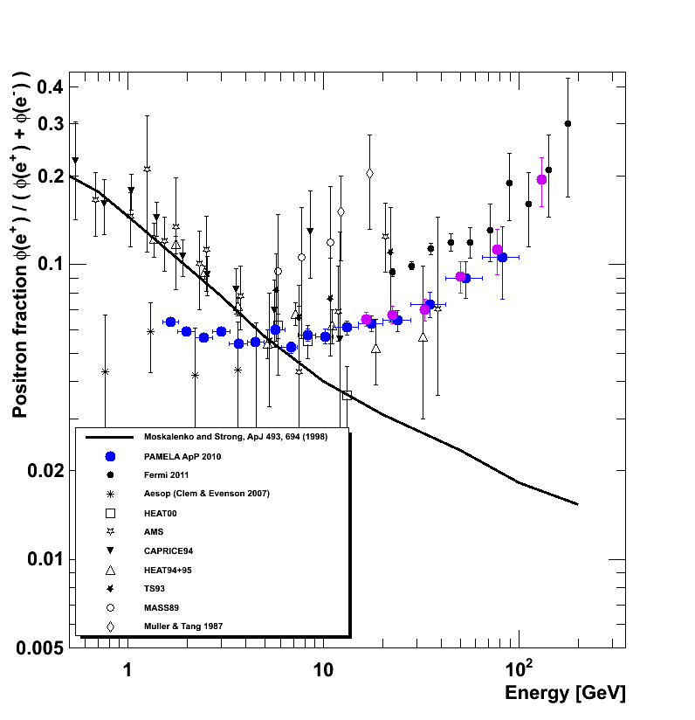
Positron to Electron Fraction
Preliminary
arXiv: 1109.0521

Slide 39
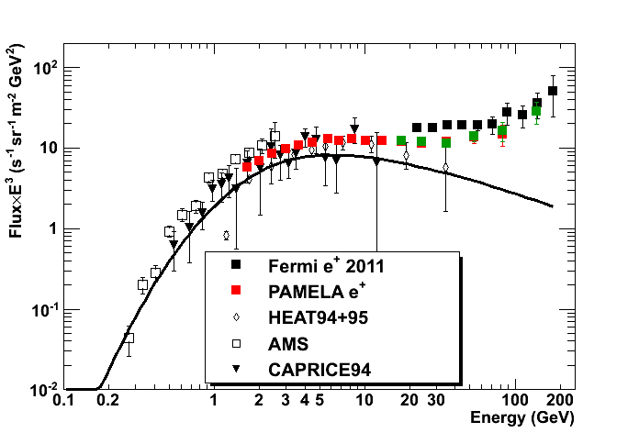
Positron flux
PAMELA positron spectra
Preliminary
arXiv: 1109.0521
MLP

Slide 40
A Challenging Puzzle for CR Physics
Uncertainties on:
Secondary production (primary fluxes, cross section)
Propagation models
Electron spectrum
But antiprotons in CRs are in agreement with secondary production

Slide 41
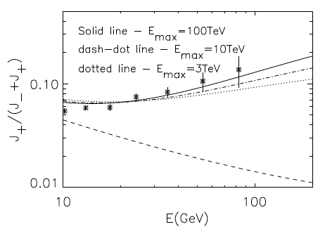
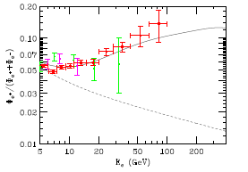
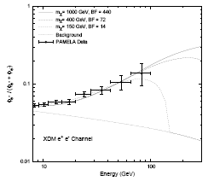
A Challenging Puzzle for CR Physics
P.Blasi, PRL 103 (2009) 051104; arXiv:0903.2794
Positrons (and electrons) produced as secondaries in the sources (e.g. SNR) where CRs are accelerated.
D. Hooper, P. Blasi, and P. Serpico, JCAP 0901:025,2009; arXiv:0810.1527
Contribution from diffuse mature &nearby young pulsars.
I. Cholis et al., Phys. Rev. D 80 (2009) 123518; arXiv:0811.3641v1
Contribution from DM annihilation.

Slide 42
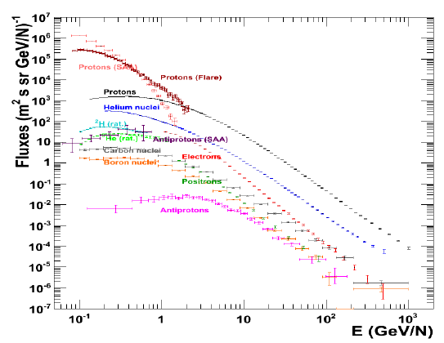
Summary PAMELA Results

Slide 43
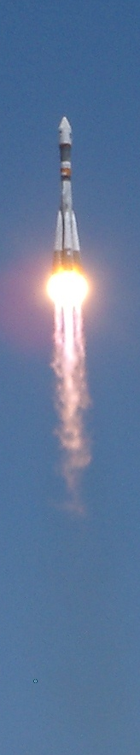
Summary
PAMELA has been in orbit and studying cosmic rays for 5 years. >10⁹ triggers registered and >25 TB of data have been down-linked.
The proton and helium nuclei spectra have been measured up to 1.2 TV. The observations challenge the current paradigm of cosmic ray acceleration and propagation.
Antiproton-to-proton flux ratio and antiproton energy spectrum (~100 MeV - ~200 GeV) show no significant deviations from secondary production expectations.
High energy positron fraction (>10 GeV) increases significantly (and unexpectedly!) with energy. Primary source?
The e⁻ spectrum up to 600 GeV shows spectral features that may point to additional components.
Waiting for AMS to compare contemporary measurements.

Slide 44
Thanks!

Slide 45
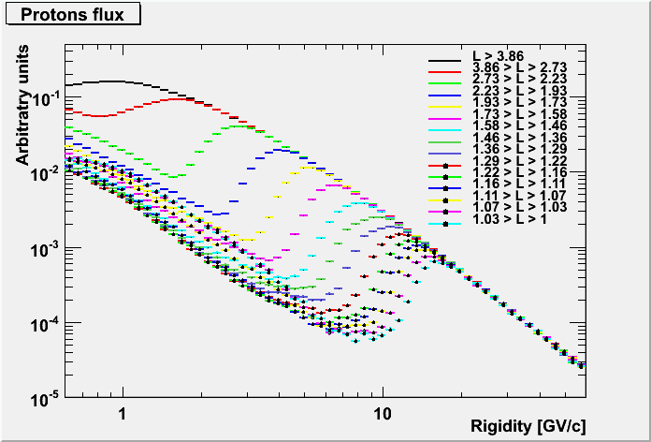
Proton Flux over PAMELA Orbit

Slide 46
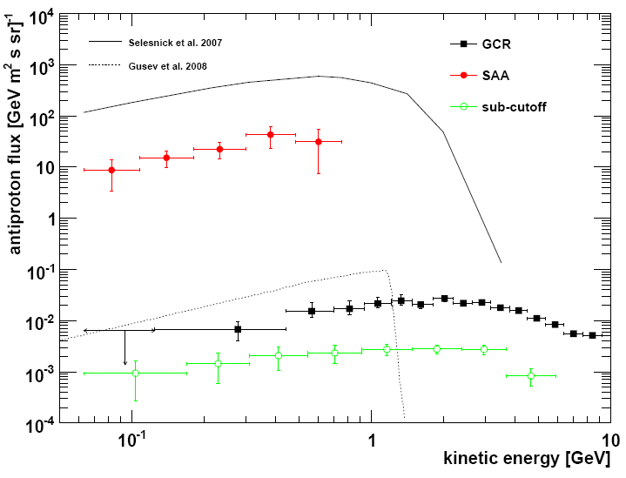
PAMELA trapped antiprotons
O. Adriani et al., APJL 737 L29 (2011); arXiv:1107.4882

Slide 47
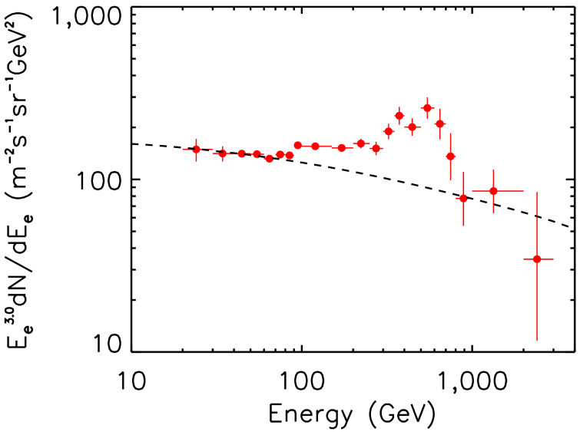


All three ATIC flights are consistent
Preliminary
Preliminary
ATIC 1
ATIC 2
ATIC 4
ATIC 1+2+4
ATIC 1+2
“Source on/source off” significance of bump for ATIC1+2 is about 3.8 sigma
J Chang et al. Nature 456, 362 (2008)
ATIC-4 with 10 BGO layers has improved e , p separation. (~4x lower background)
“Bump” is seen in all three flights.
Significance for ATIC1+2+4 is 5.1 sigma

Slide 48

PAMELA e⁻ and e⁺ spectra
Flux=A • E^{-γ}
γ = 3.18 ±0.05
GALPROP
“New Primary Contribution”

Slide 49

What about……….. Antinuclei?
Preliminary

Slide 50

H isotopes separation
0.9 GV < R < 1 GV
p
d

Slide 51

PAMELA ²H/⁴He
Preliminary

Slide 52

PAMELA ³He/⁴He
Preliminary

Slide 53

A Challenging Puzzle for CR Physics
P.Blasi, PRL 103 (2009) 051104; arXiv:0903.2794
Positrons (and electrons) produced as secondaries in the sources (e.g. SNR) where CRs are accelerated.
H. Yüksak et al., arXiv:0810.2784v2
Contributions of e- & e+ from Geminga assuming different distance, age and energetic of the pulsar
I. Cholis et al., Phys. Rev. D 80 (2009) 123518; arXiv:0811.3641v1
Contribution from DM annihilation.

Slide 54
Solar Modulation

Slide 55
Positron to Electron Fraction
Solar Modulation?
?
Secondary production Moskalenko & Strong 98
Adriani et al, Astropart. Phys. 34 (2010) 1 arXiv:1001.3522 [astro-ph.HE]

Slide 56



Solar modulation
A⁺
A⁻
A⁺
A⁻
~11 y
Low fluxes!
¯
PAMELA
+
PAMELA p flux
Decreasing solar activity
Increasing flux
Preliminary
Preliminary
PAMELA e⁻ flux

Slide 57

Charge-sign dependent modulation over two solar maxima
Electron measurements form ISEE/ICE (Clem et al., 1996; Evenson, 1998) and KET (Heber et al). He measurements from IMP (McDonald, 1998; McDonald et al., 2001).
Courtesy of M. Potgieter

Slide 58

PAMELA proton spectra 2006-2009 and theoretical models

Slide 59

Time Dependence
Preliminary
Increase of the flux measured by PAMELA from July 2006 to December 2008

Slide 60

PAMELA Electron to Positron Ratio and Theoretical Models
Preliminary
U.W. Langner, M.S. Potgieter, Advances in Space Research 34 (2004).

Slide 61
Other PAMELA Results

Slide 62


Solar Physics: December 13th 2006 event
from 2006-12-1 to 2006-12-4
from 2006-12-13 00:23:02 to 2006-12-13 02:57:46
from 2006-12-13 02:57:46 to 2006-12-13 03:49:09
from 2006-12-13 03:49:09 to 2006-12-13 04:32:56
from 2006-12-13 04:32:56 to 2006-12-13 04:59:16
from 2006-12-13 08:17:54 to 2006-12-13 09:17:34
Decrease of high energy component
Preliminary
Increase of low energy component
Increase of low energy component
O. Adriani et al., to appear in Astrophys. J.
Notes:
62

Slide 63


Subcutoff particles spectra
→Atmospheric neutrino contribution
→Astronaut dose on board ISS
Indirect measurement of cross section in the atmosphere
@Kamioka
--- M. Honda, 2008

Slide 64





South-Atlantic Anomaly (SAA)
SAA morphology
SAA
Latitude
Altitude
Altitude
Neutron rate
Longitude
Notes:
64

