Slide 1


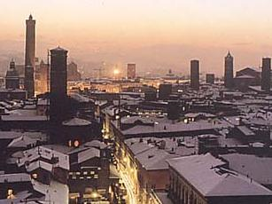
Strategies for the ν diffuse searches in antares
MANTS’09, Berlin
M. Spurio (Bologna), on the behalf on many colleagues

Slide 2
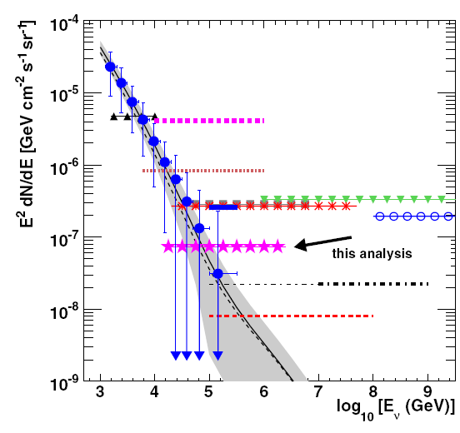
1. Two different energy ranges:
VHE
neutrinos
UHE
neutrinos
Atmospheric
neutrinos

Slide 3
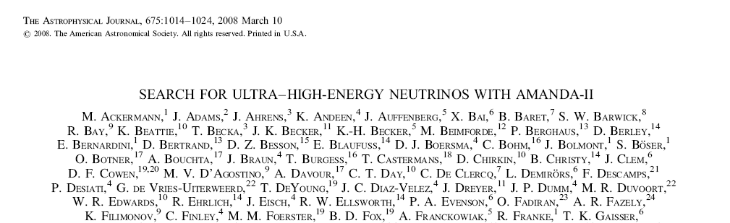
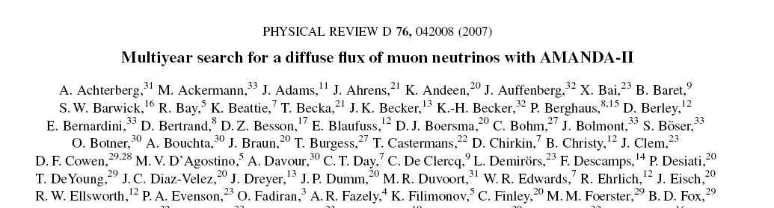
Our references
Calculation of limits, .., what assumptions go in there, including systematic errors, Feldman and Cousins or Neuman, integrated E-2 limits or differential limits.
VHE
neutrinos
UHE
neutrinos
Atmospheric
neutrinos

Slide 4
VHE range
Sensibility study for ν_{μ}, ν_{x} in PhD thesis
  D. Denans Détermination de la sensibilité d'Antares au flux diffus de neutrinos cosmiques en utilisant les gerbes contenues, December 2006
  Université Paris VII - Denis Diderot - UFR de physique, CEA/Dapnia
  Juan De Dios Zornoza Sensitivity to diffuse fluxes and energy spectrum reconstruction in the Antares neutrino telescope, January 2005, Un. Valéncia
  Alain Romeyer Étude de la sensibilité du détecteur ANTARES à un flux diffus de neutrinos cosmiques de haute énergie, April 2003, Université Denis Diderot - Paris VII, CEA/Dapnia, France
  B. Hartmann, Reconstruction of neutrino-induced hadronic and electromagnetic showers in the ANTARES experiment, June 2006, Erlangen university- Erlangen, Germany
  Work in progress in Erlangen, Bologna, …
See antares web pages: antares.in2p3.fr

Slide 5
UHE range
Sensibility study for ν_{μ}, ν_{x} in PhD thesis
  C. Colnard Ultra-high energy neutrino simulations, 16 April 2009
  University of Amsterdam, Nikhef, Amsterdam, The Netherlands
  D. Castel Détection des neutrinos muoniques de haute énergie dans l'expérience Antares,18 July 2008, Université de Haute Alsace, France
See antares web pages: antares.in2p3.fr

Slide 6
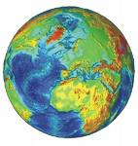
2. Differences between Ice and Water
VHE=5.2 sr
Ice
advanced status (larger exposure)
smaller optical background
Water
smaller downgoing background (atmospheric muons)
ICE view
UHE
Common problems (prompt neutrinos)
Water+Ice Experiments=Complete sky coverage

Slide 7
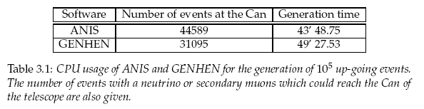
3. MC tools. comparisons between event generators
C. Colnard thesis:
  GENHEN (up to E_{ν}∼10⁹ →10¹⁰GeV) vs. ANIS (E_{ν}<10¹² GeV)
  Lepton propagation, KM3 vs. MMC
  Other checks
ANIS ∼ 40% faster than GENHEN

Slide 8
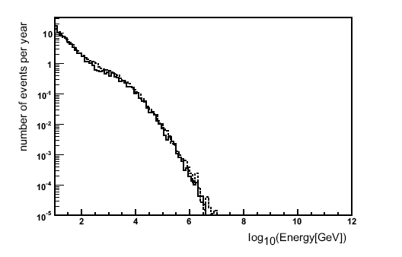
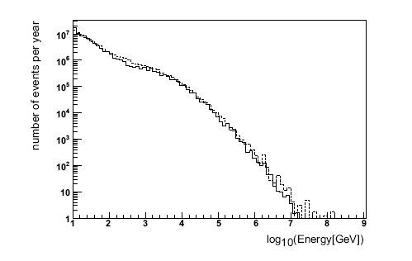
Comparable results
Upward-going muon neutrino rates simulated with GENHEN (dashed) and ANIS (solid line), assuming a diffuse AGN-like spectrum, for energies between 10 and 10⁹ GeV. Only events with a neutrino or secondary muons which could reach the telescope are displayed.
AGN-like signal
Atmospheric
neutrinos
Atmospheric muon neutrino rates simulated with GENHEN (dashed) and ANIS (solid like).

Slide 9
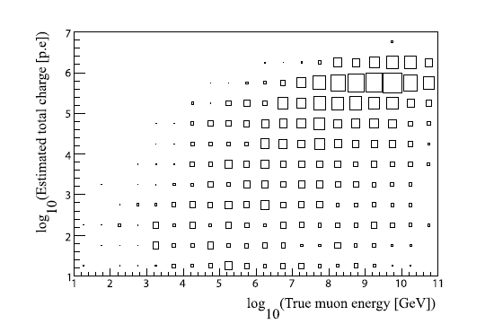
Signal (VHE+UHE)
C. Colnard (using ANIS); ARS digit. not included

Slide 10
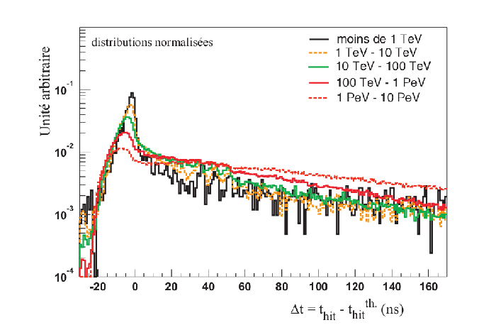
Time distribution
(from D. Castel)

Slide 11
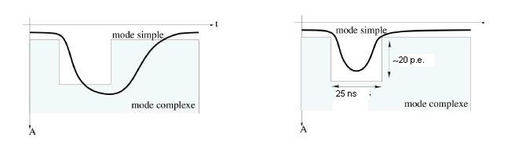
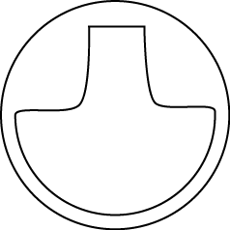
3. DAQ: “ARS” mode
Hit saturation: 20 p.e.
Max multiplicity hits: 4 μs/250 ns ≈ 15
OM: 900
Max detectable p.e. = 3×10⁵
ARS0
40 ns
ARS1
40 ns
Dead time ∼ 250 ns
OM#
time
Photons

Slide 12
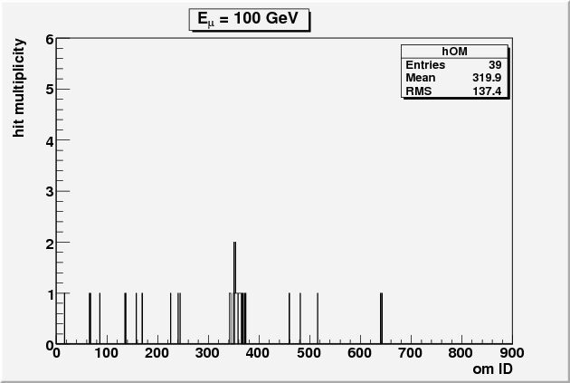
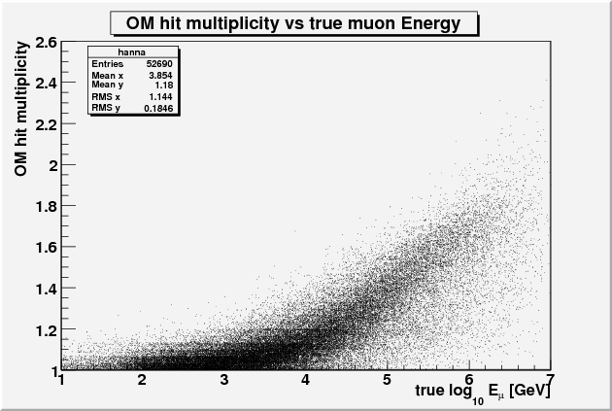
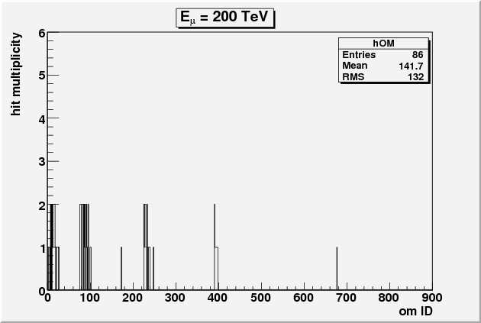
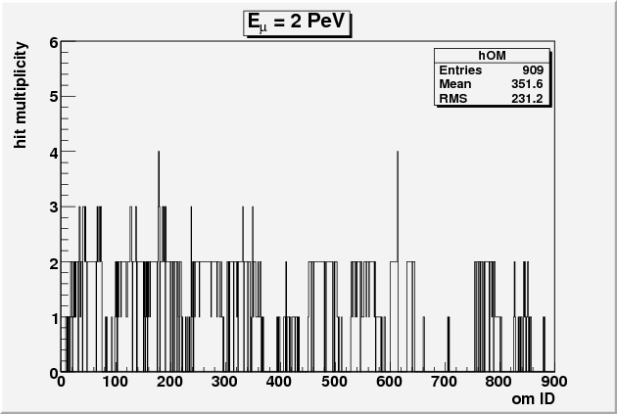
4. How to evaluate the event energy?
From S. Biagi

Slide 13
5. Background
Atmospheric neutrinos (same generators)
Atmospheric muons
  Full MC simulation (Corsika, different primary CR and interaction models)
  Parameterization (MUPAGE), optimized for biased production of atmospheric background
  NOTE: work motivated also by the 63 d of background for 807 days livetime in PRD76,042008

Slide 14
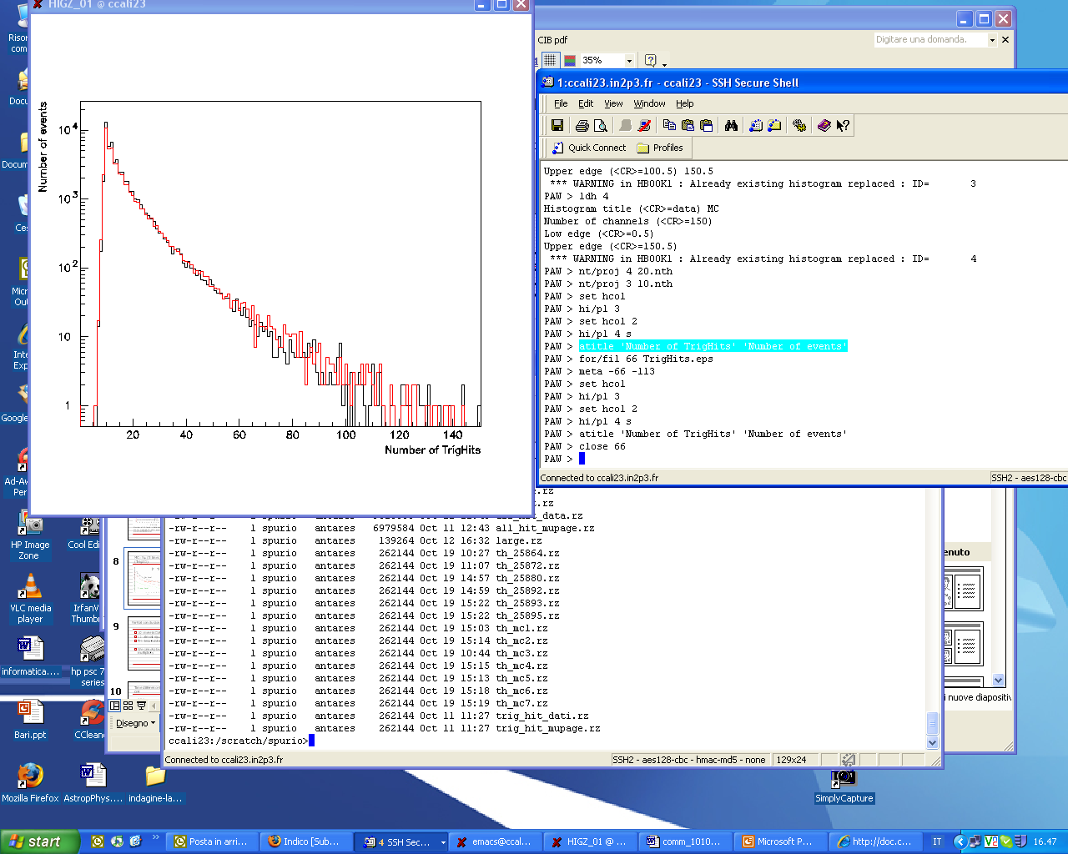
Example of MUPAGE application
Data/MC comparison (see other presentations)
Negligible contribution of “simultaneous” downward going showers.
Trigger rate (5 line)= 7×10⁻⁴ Hz. CFR∼2-3Hz in AMANDA
Number of triggered hits in data and MC
(5 line data)

Slide 15
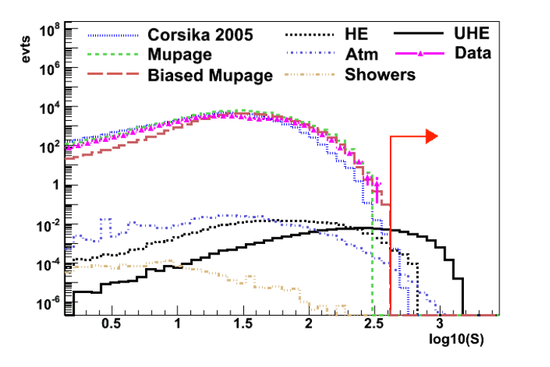
MUPAGE (background) for UHE
From D. Castel

Slide 16
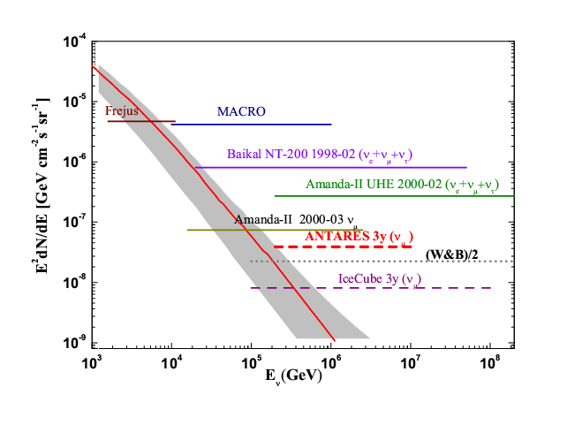
6. Expected sensitivities: VHE ν_{μ}
Notes:
So now we can include these values the formula we have seen previously. To do that, we have used the program PLOE++, used in the AMANDA collaboration and we calculate that the ANTARES sensitivity to diffuse fluxes when the systematic effects are included is 9.0x10⁻⁸ after one year. After three years, the limit is 4.3x10⁻⁸. This means an increase of 15% in the limit due to systematics.
So in this plot we can compare these values with other expermients.
Here we have the atmospheric neutrinos and some signal models. And these are the limits obtained by previous experiments. The ANTARES sensitivity for one and three years can be seen here.
Further experiments like ICECUBE will set these limits lower.

Slide 17
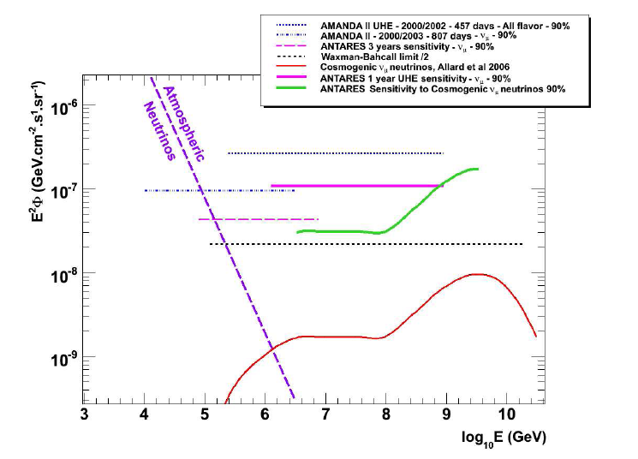
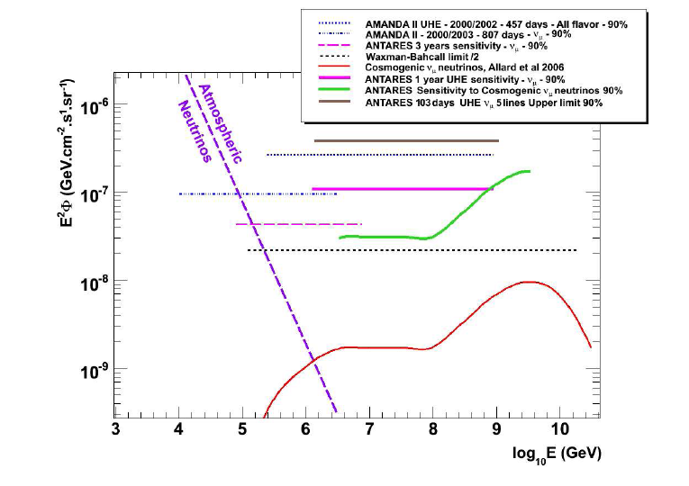
7. Expected sensitivities: UHE ν_{μ}
AMANDA (ICRC09)
D. Castel

Slide 18
Conclusions
MC simulation (IceCube/Antares) gives compatible results
Analyses “to put a limit” oriented
We hope to switch to “confirm a signal” oriented analyses

Slide 19
Spares

Slide 20
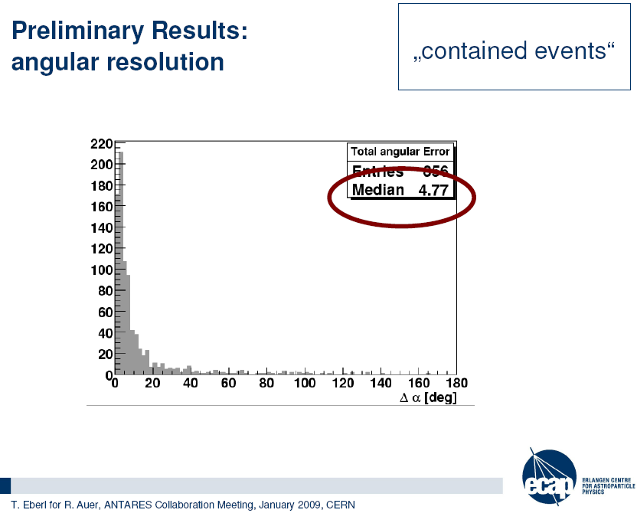
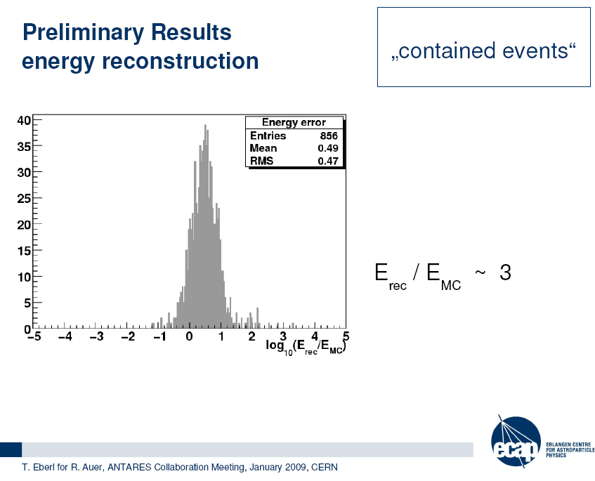

Slide 21
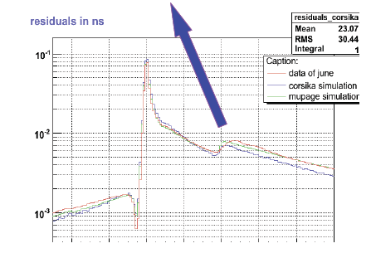

Slide 22
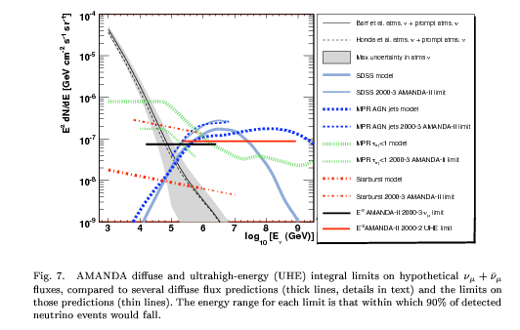

Slide 23
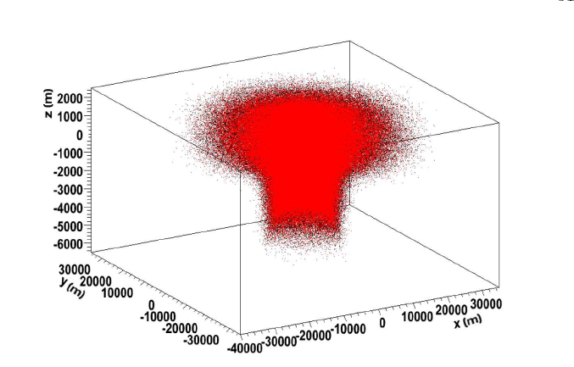
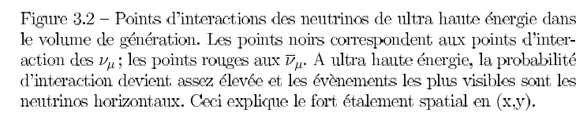
D. Castel

Slide 24
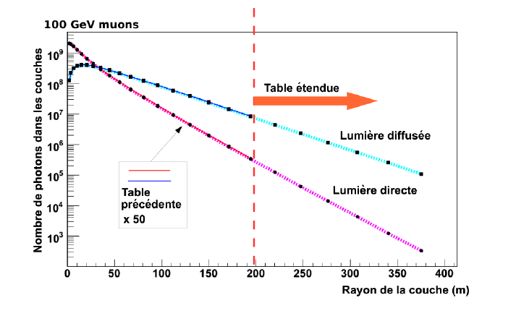

Slide 25
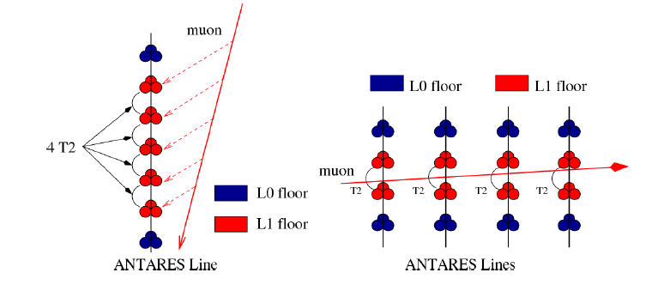

Slide 26
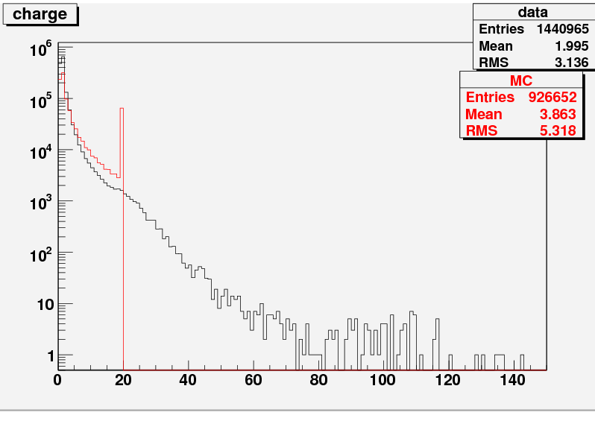
Charge measurement on ARS
Hit saturation: 20 p.e.
Max multiplicity hits: 4 μs/250 ns ≈ 15
OM: 900
Max detectable p.e. = 3×10⁵
From S. Biagi
Events
#p.e.

Slide 27
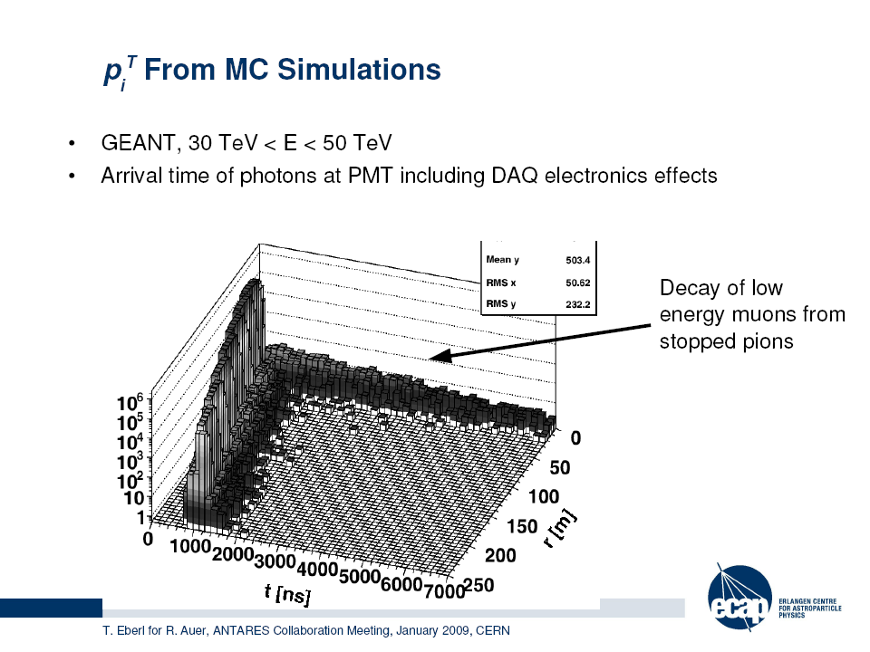
Photon field
From Erlangen group
(R. Auer, T. Eberl,…)

