Slide 1

A hybrid Machine Learning-Likelihood Approach to event reconstruction for iacts
Georg Schwefer, Dan Parsons, Jim Hinton for the CTA Consortium
Workshop on Machine Learning for Analysis of High-Energy Cosmic Particles
Bartol Research Institute (Online), 28.01.2025

Slide 2

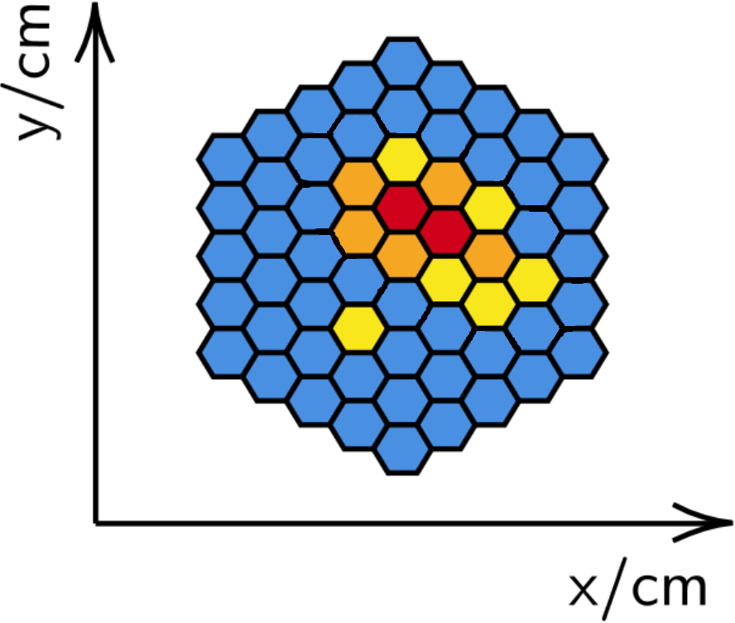
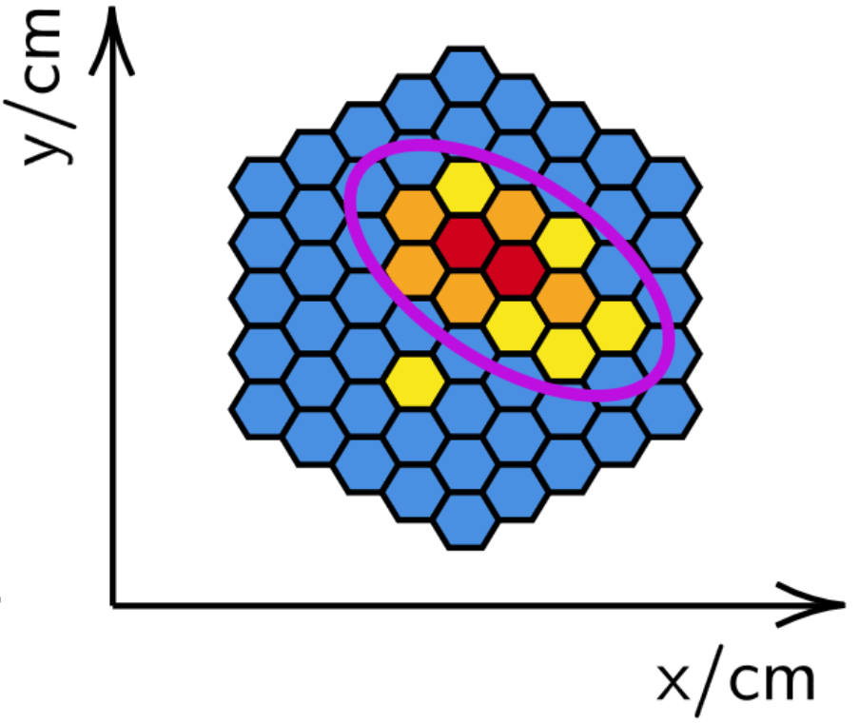
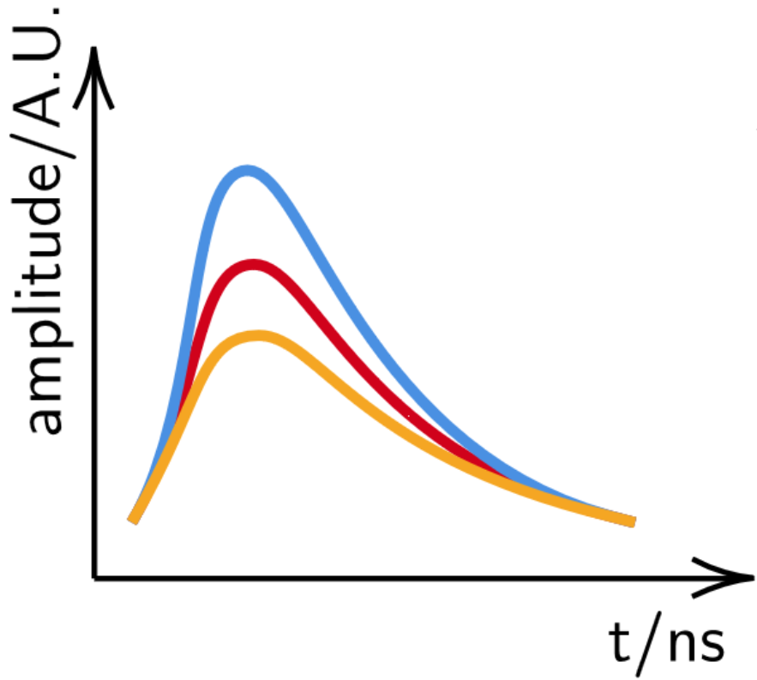
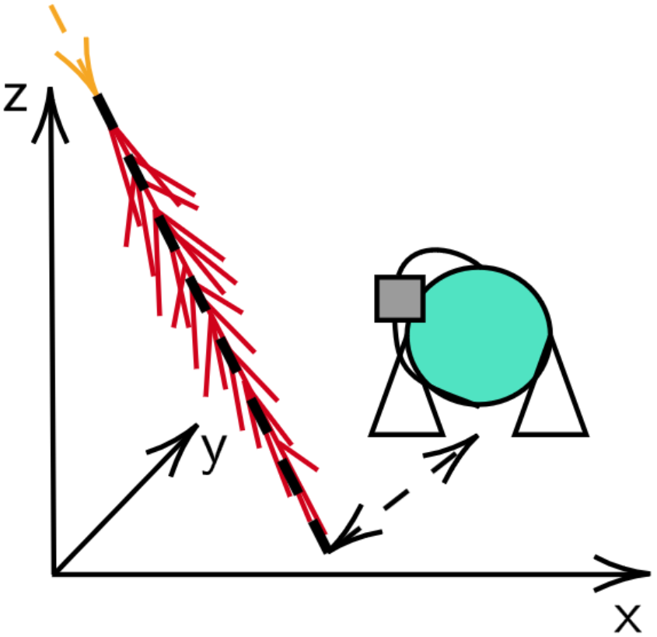
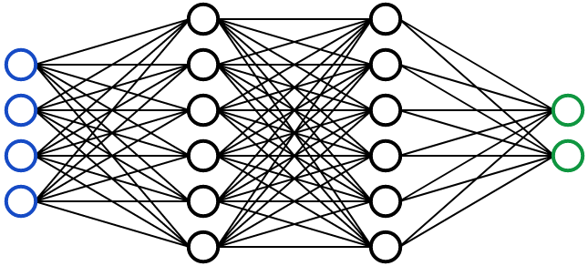
IACT Event Reconstruction
"Classical"
Image extraction
Image parametrization
Geom: Hillas/Disp
Energy: BDT/Lookup
Energy
Source Position
Core location
Shower maximum
Waveforms
"Machine Learning"
2

Slide 3
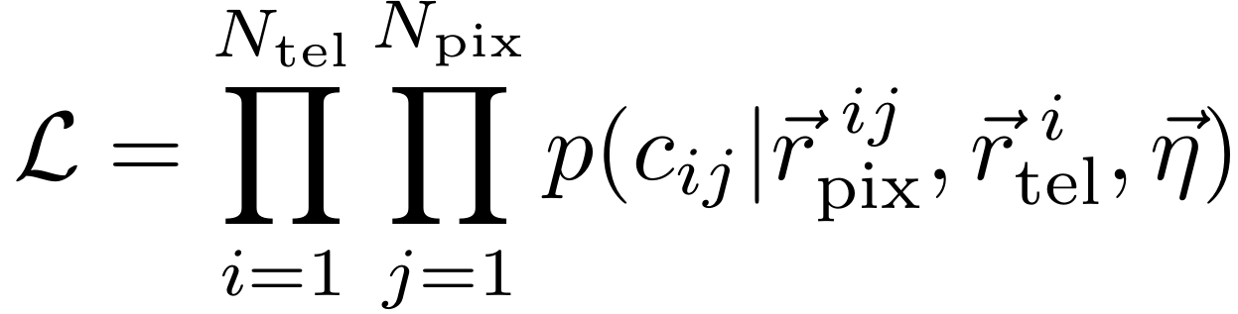
Likelihood-Fitting Reconstruction
Image extraction
Pixel-wise charge likelihood
Energy
Source Position
Core location
Shower maximum
Use full image information
Fully traceable
Optimal for correct likelihood
ImPACT:
Analytical (asymmetric) gaussian likelihood
Expectation values from MC templates
Waveforms
  How good is the ImPACT likelihood?
3

Slide 4
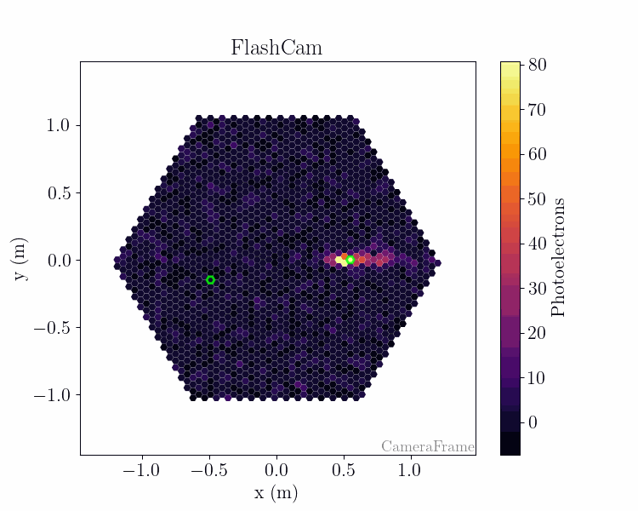
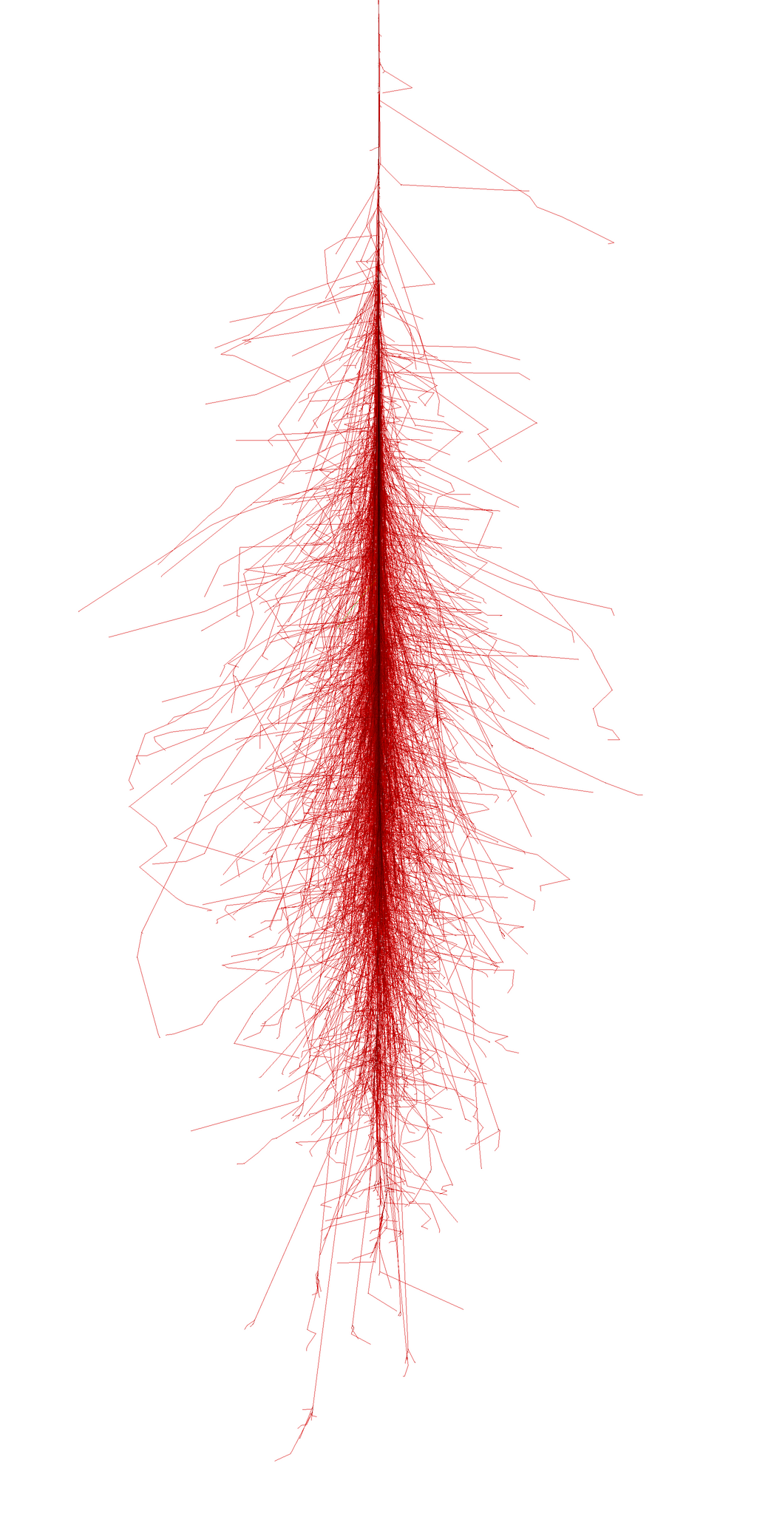
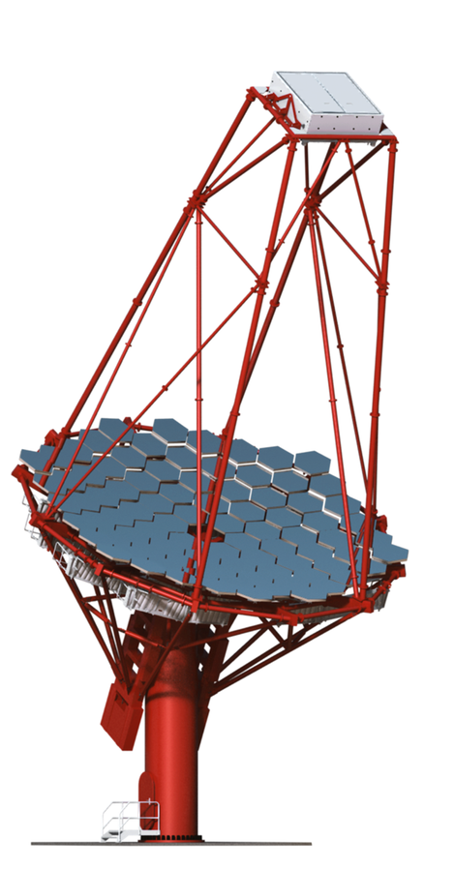
Charge Probability distribution
Flashcam-MST
Fixed gamma ray energy
Fixed impact distance
  Inspect distributions in individual pixels
4

Slide 5
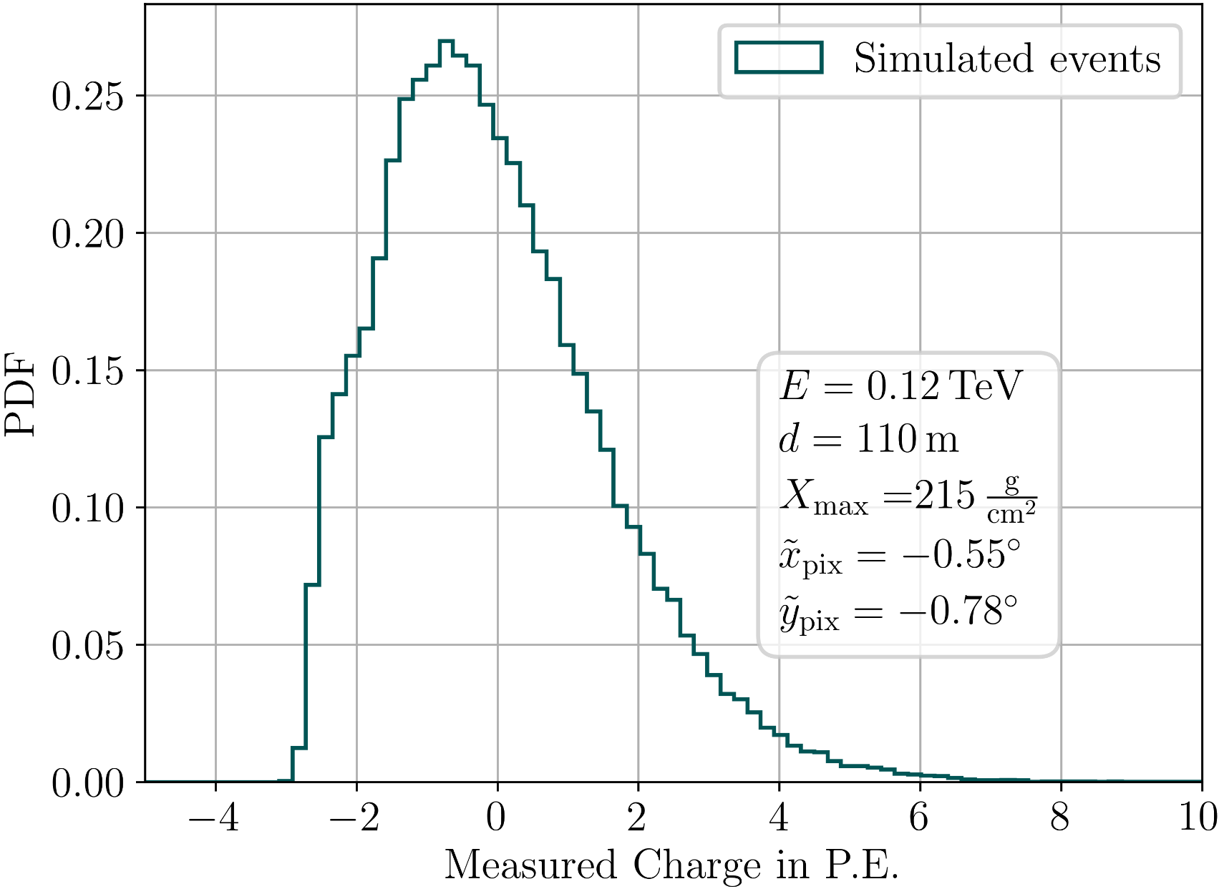
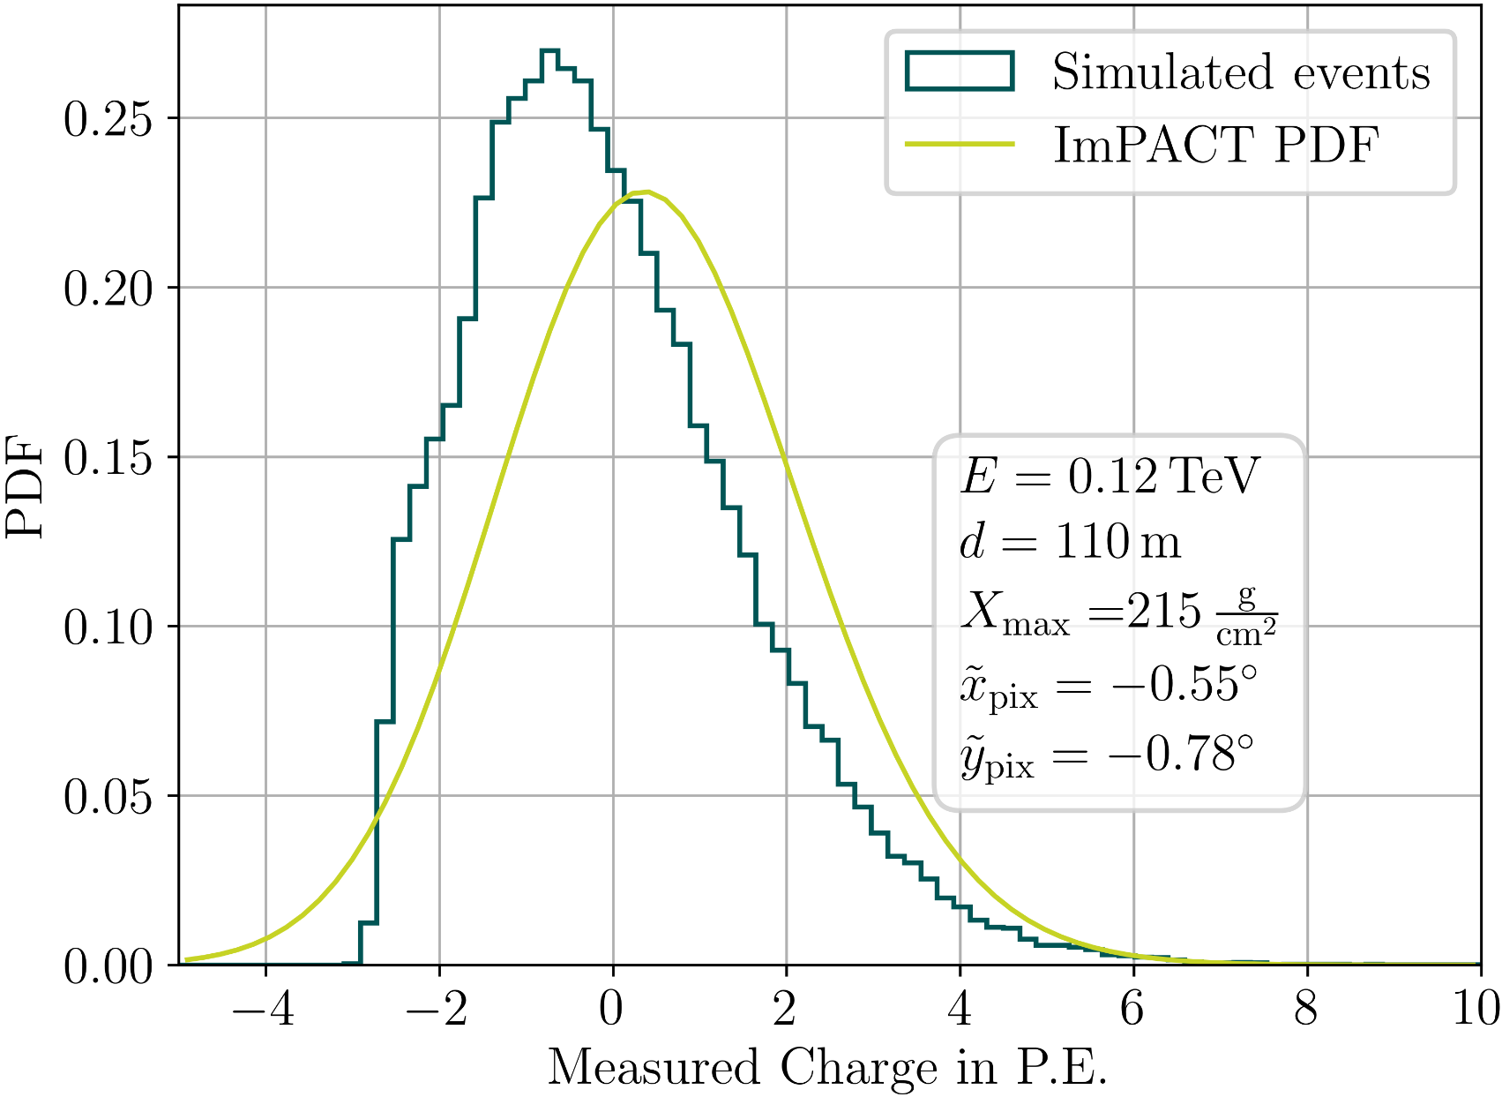
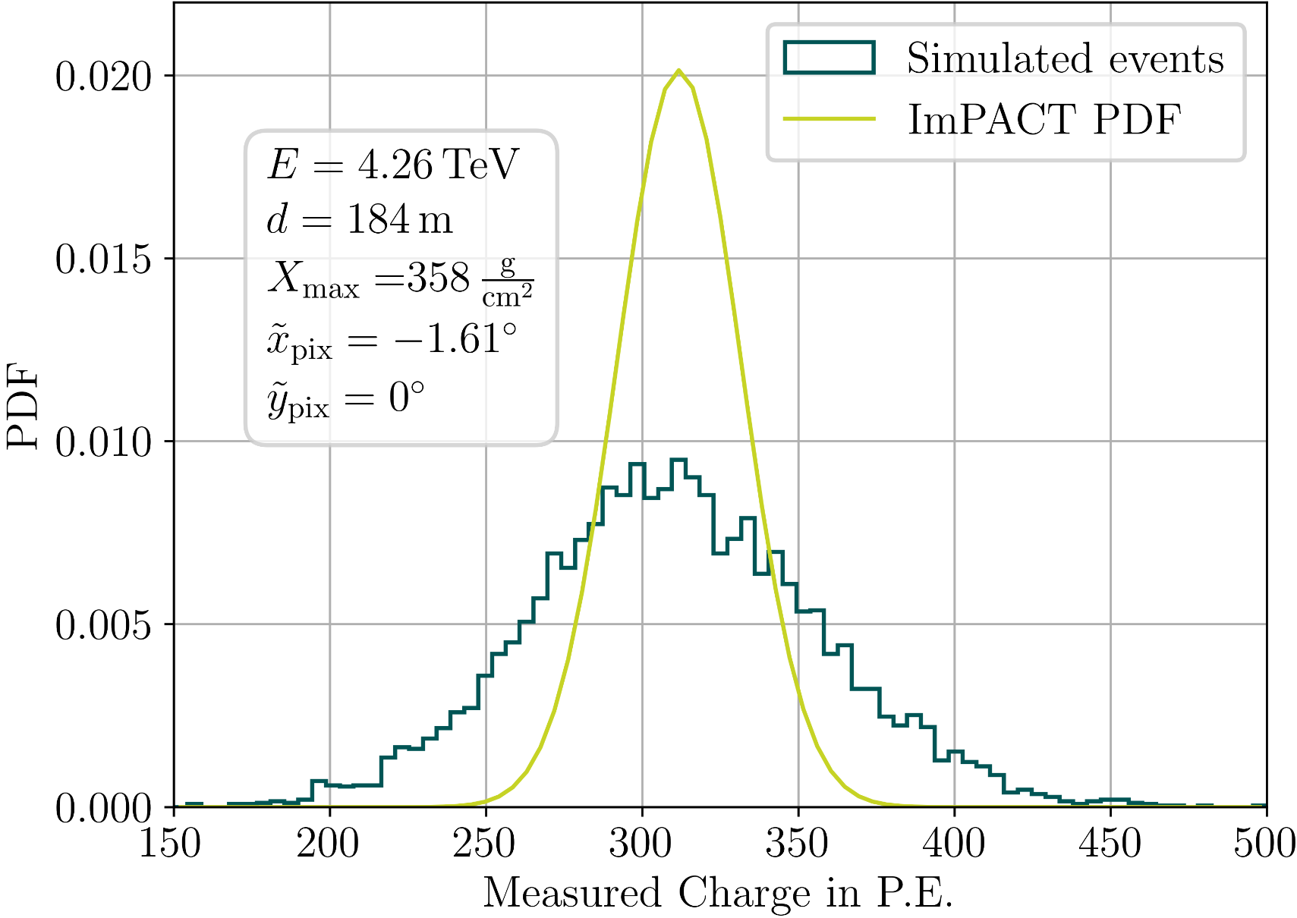
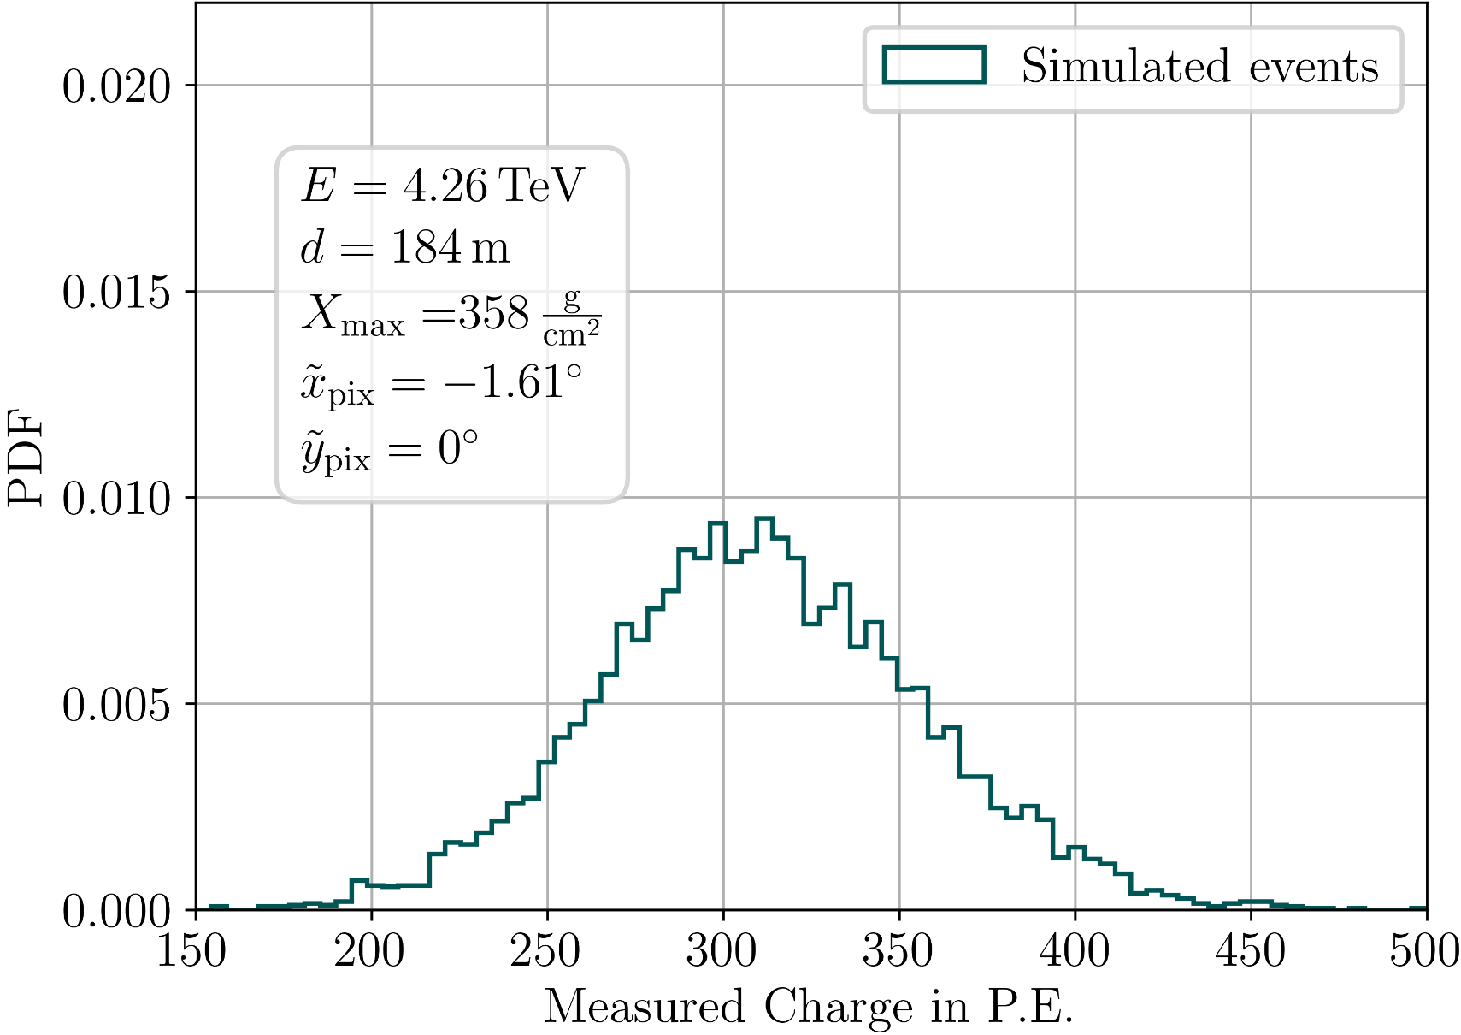
Charge Probability distribution
Flashcam-MST
5

Slide 6








Neural Ratio Estimation
arXiv:2208.10166, ARXIV1903:04057
Goal: Estimate likelihood
For optimization for
Measured Pixel Charge
Telescope and shower parameters
Likelihood-to-evidence (LtE) ratio
Trick: LtE ratio from binary classifier function
Bayes
with
Approximate with
Binary Classifier Neural Network
6

Slide 7


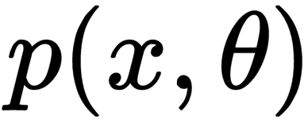
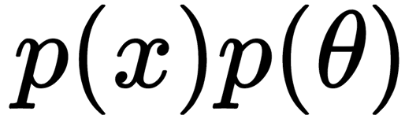
Binary classifier neural network
Class | Pixel x​ | Pixel y​ | Energy​ | Impact D.​ | Xmax​ | Charge​
1 | 0.5 deg​ | 1 deg​ | 1 TeV​ | 100 m​ | 250 g/cm2​ | 20 p.e.​
1 | ...​ | ...​ | ...​ | ...​ | ...​ | ...​
0 | -2 deg​ | 0.3 deg​ | 80 GeV​ | 50 m​ | 150 g/cm2​ | 10 p.e.​
0 | ...​ | ...​ | ...​ | ...​ | ...​ | ...​
Pixel x​ | Pixel y​ | Energy​ | Impact D.​ | Xmax​ | Charge​
0.5 deg​ | 1 deg​ | 1 TeV​ | 100 m​ | 250 g/cm2​ | 20 p.e.​
...​ | ...​ | ...​ | ...​ | ...​ | ...​
-2 deg​ | 0.3 deg​ | 80 GeV​ | 50 m​ | 150 g/cm2​ | 10 p.e.​
...​ | ...​ | ...​ | ...​ | ...​ | ...​
Class 1:
Pixels from MC events
🔀︎
Class 0:
Shuffle charge between rows
Normalisation layer
6 hidden layers
64 nodes
swish activation
Training:
~20000 trainable parameters
Binary cross-entropy loss
Convergence in an hour on 10 cores
Output
Sigmoid activation
Schwefer, Parsons, Hinton 2024
FreePACT: Likelihood-free ImPACT
7

Slide 8
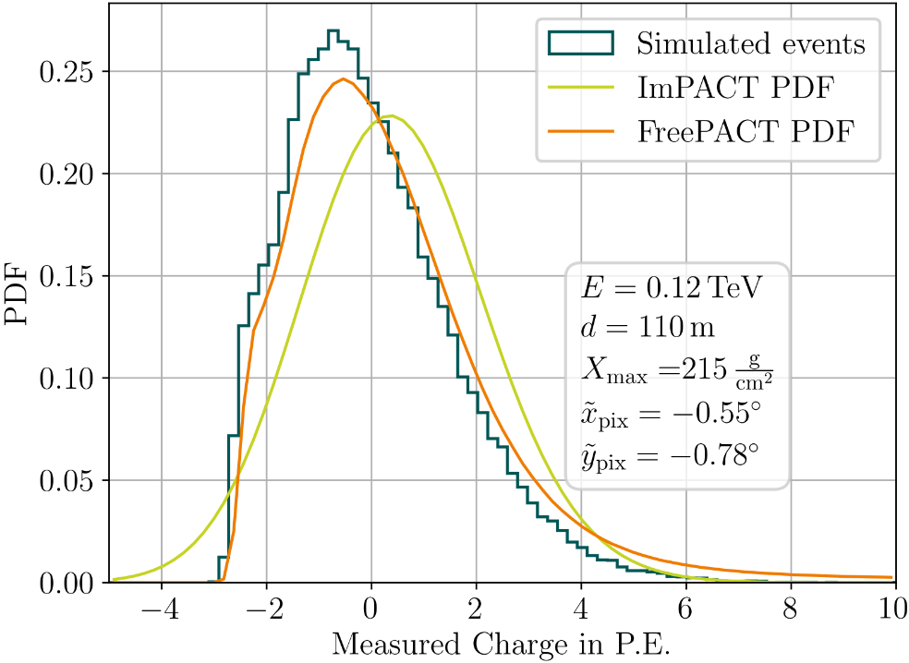
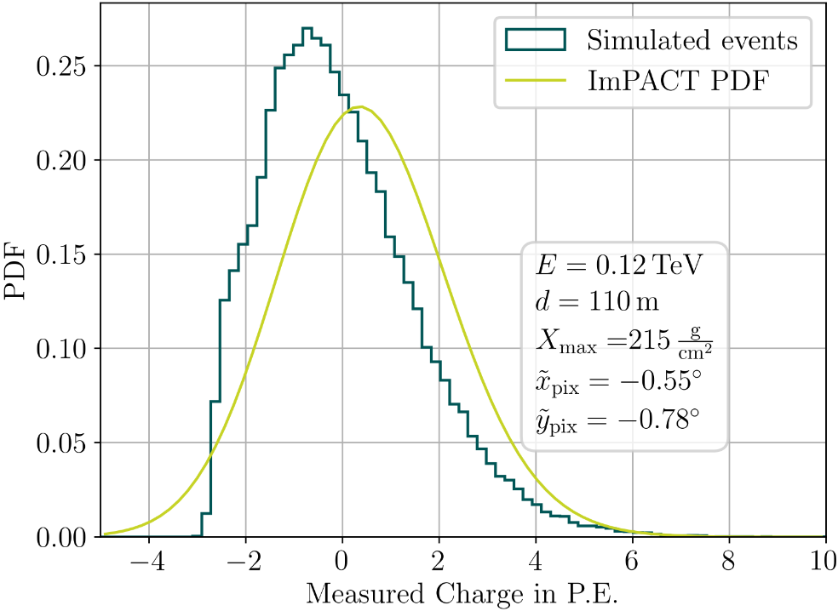
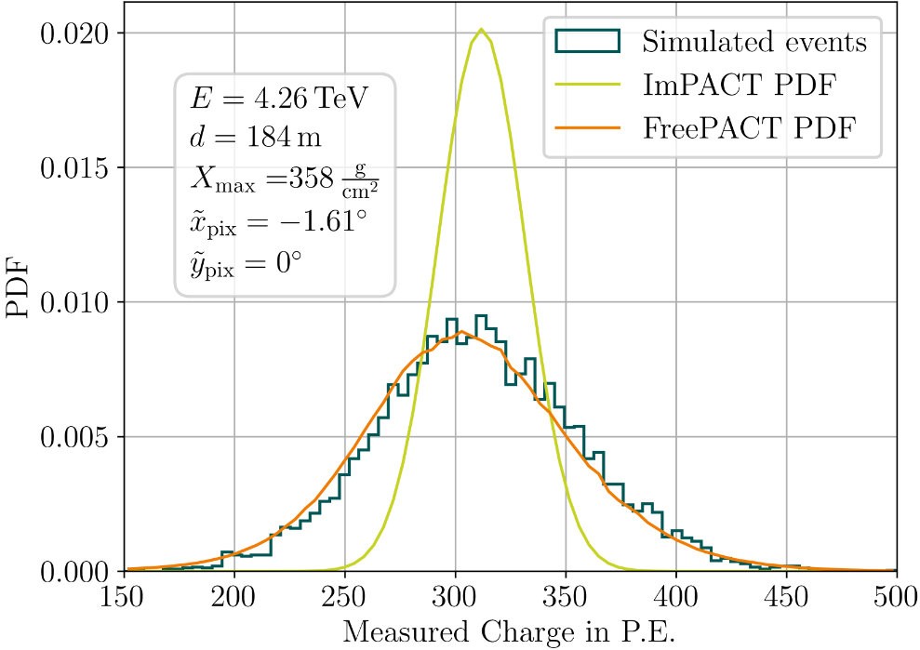
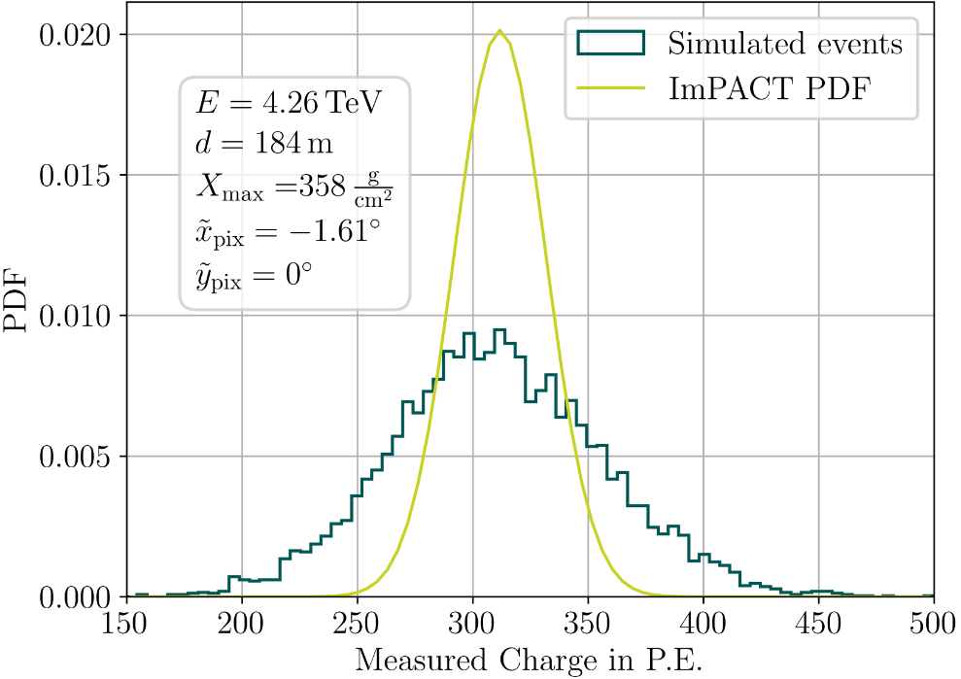
LEARNED Charge Probability distribution
Flashcam-MST
Schwefer, Parsons, Hinton 2024
8

Slide 9
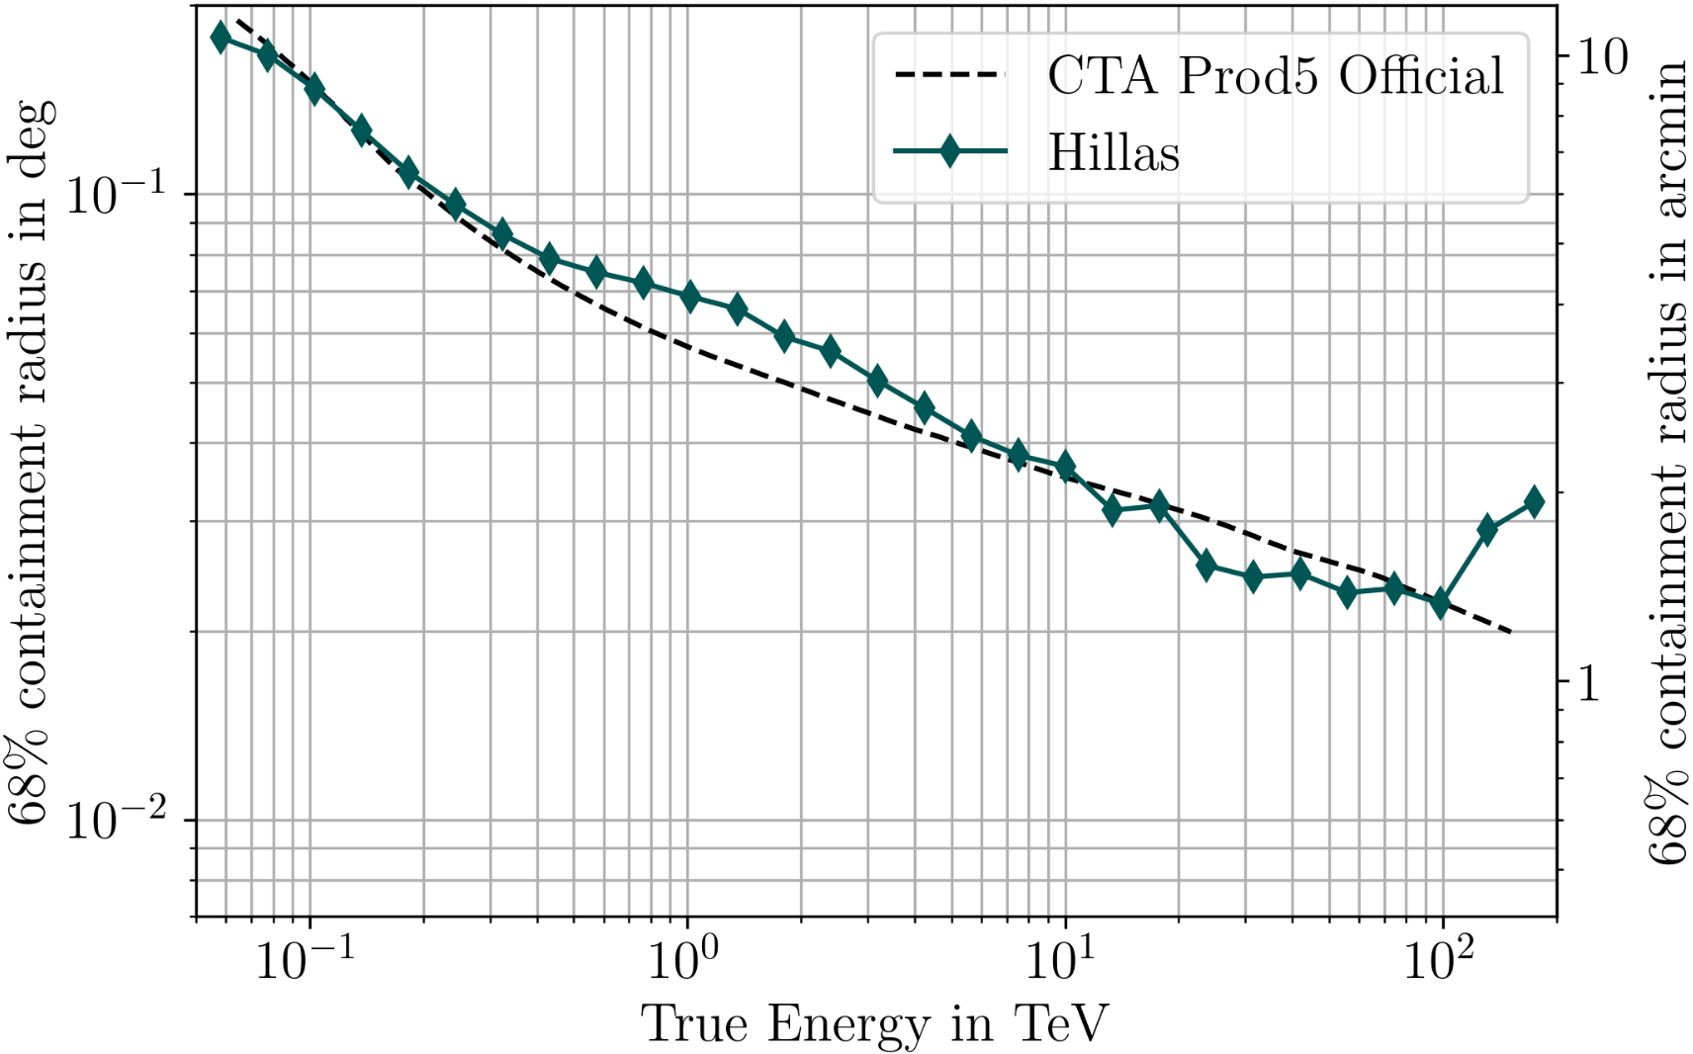
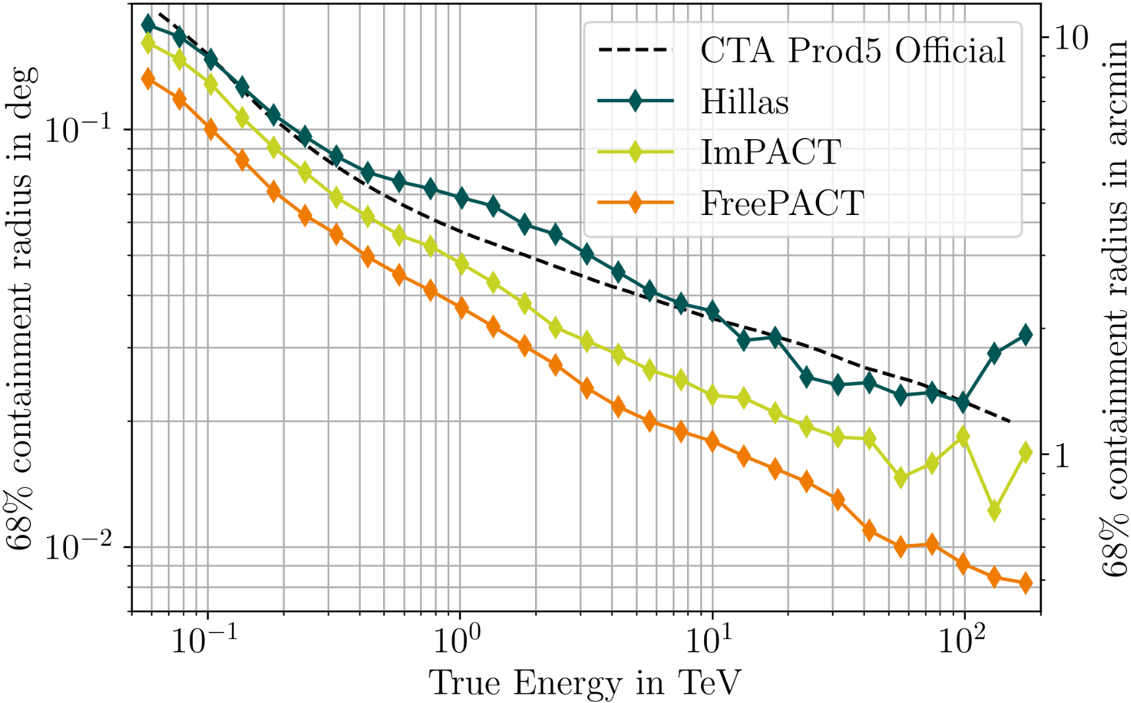
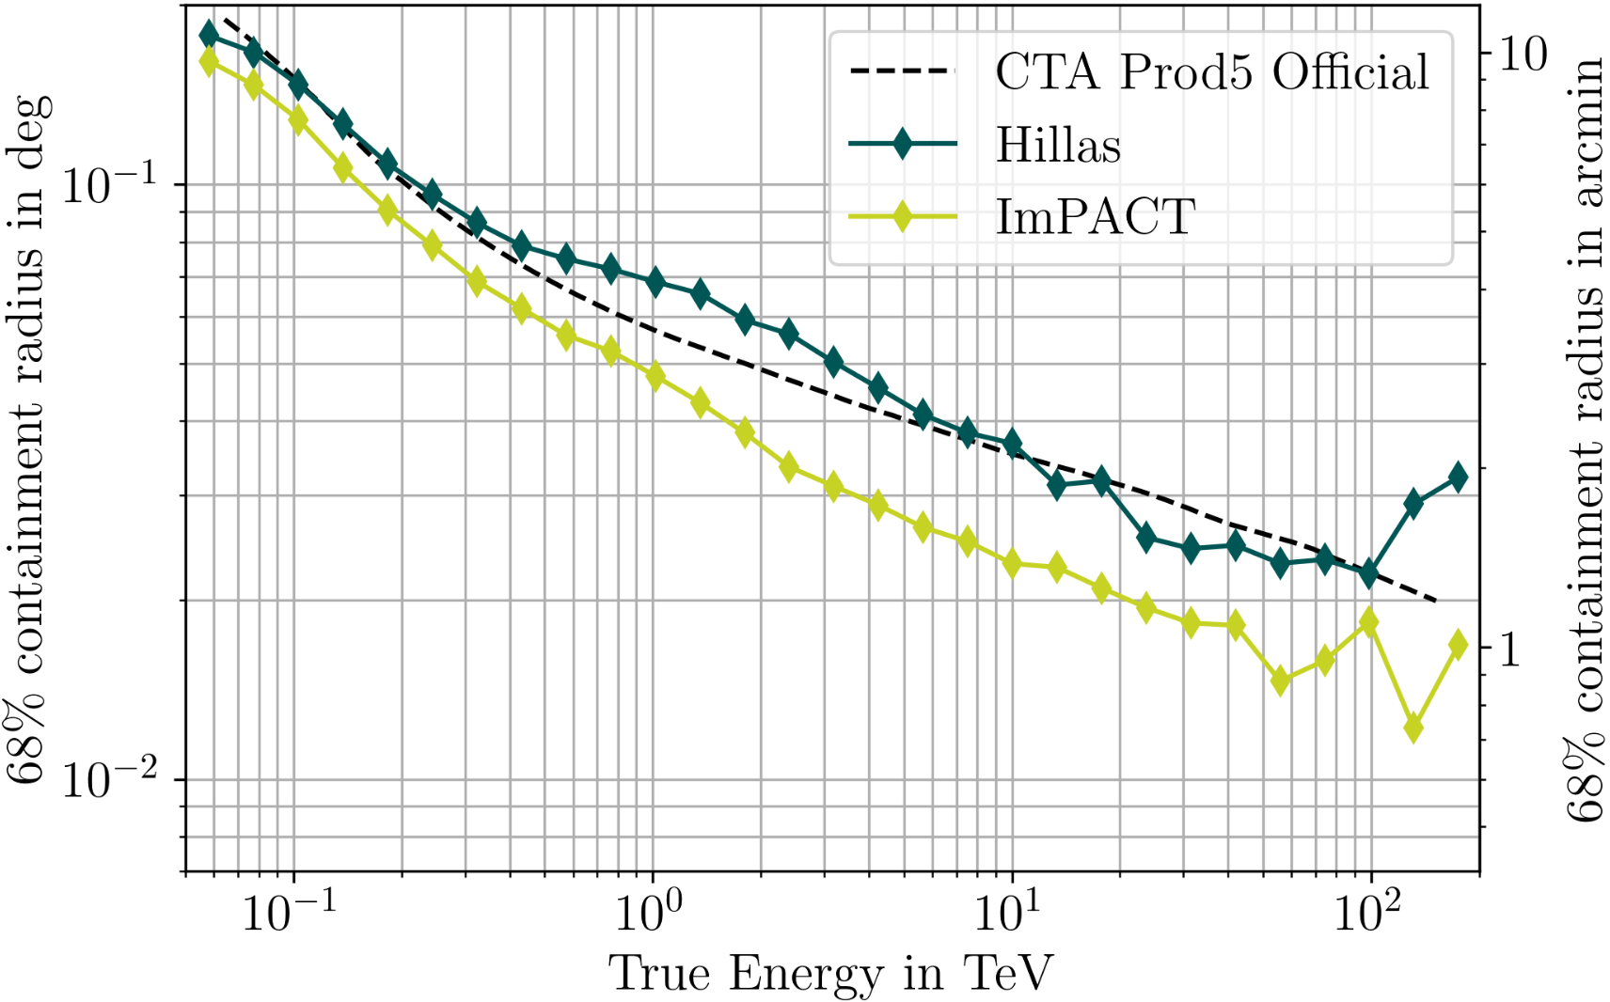
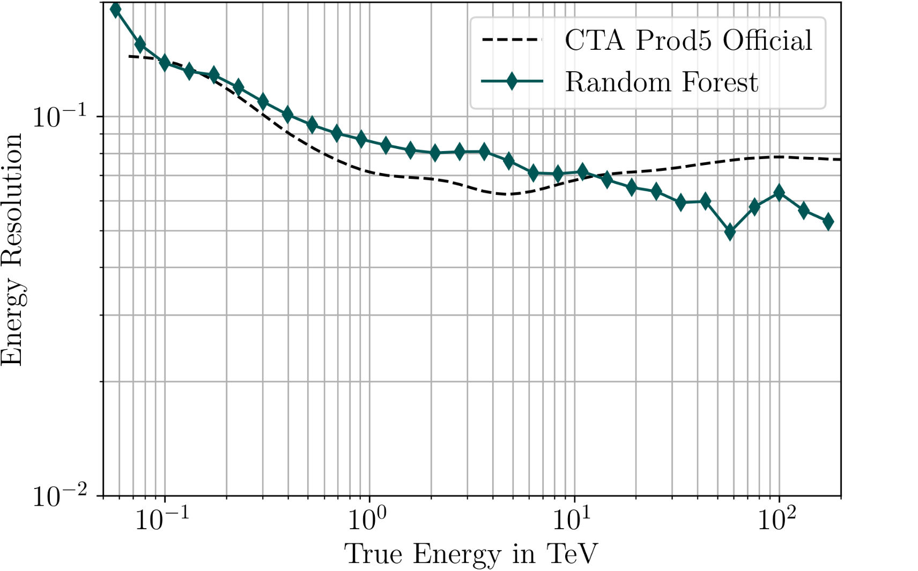
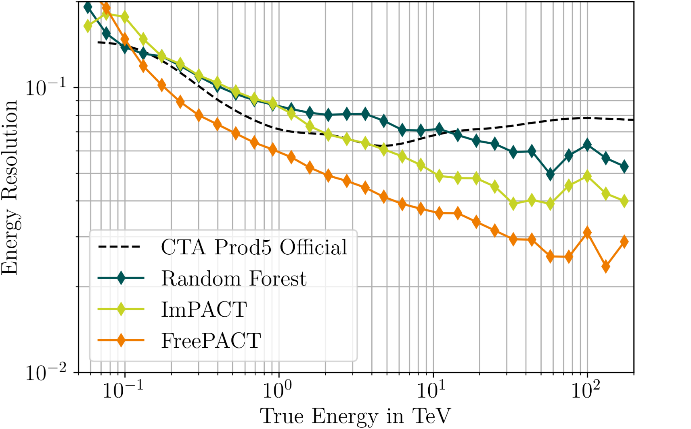
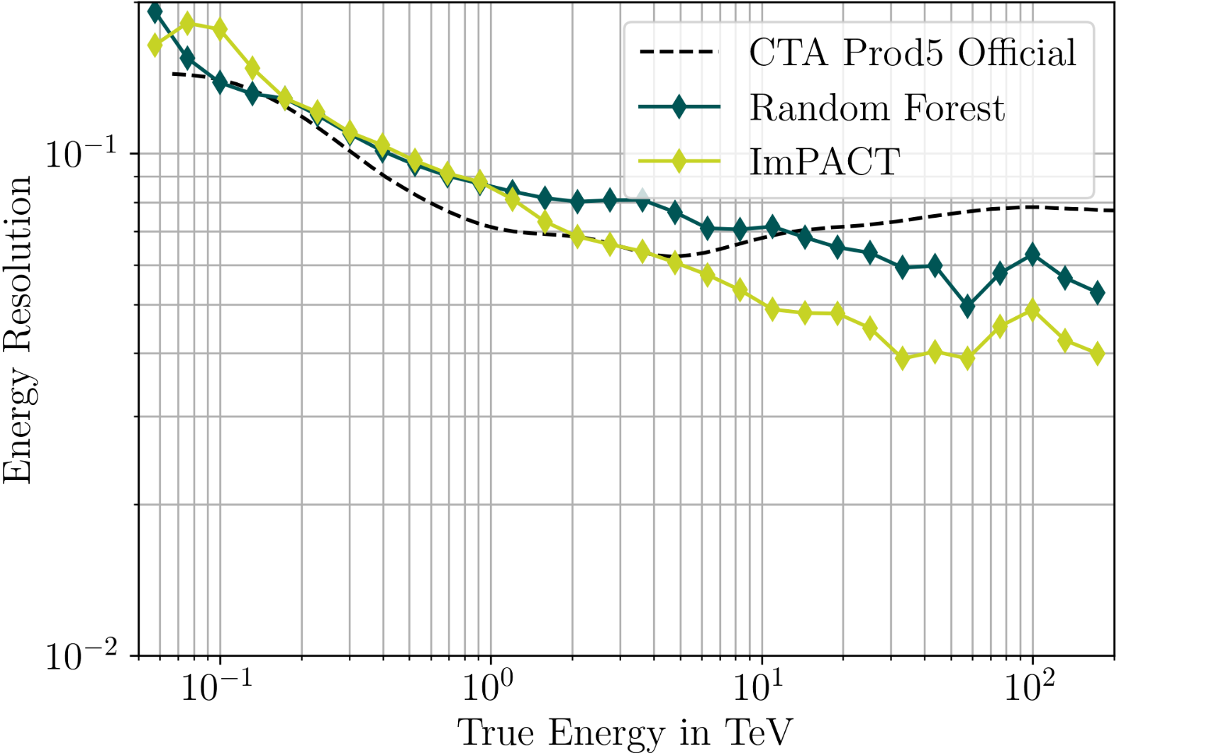

Resolution Curves
CTA south alpha array: 14 MSTs + 37 SSTs​
On-axis gamma rays at 20 deg zenith
Angular Resolution
Energy Resolution
Sub-arcminute resolution above 10 TeV
Schwefer, Parsons, Hinton 2024
9

Slide 10


Summary
FreePACT: Hybrid machine learning-likelihood reconstruction for IACTs
Likelihood reconstruction is a proven method for IACTs
Idea: Replace analytical likelihoods with proxy from Neural Ratio Estimation
Significant gain in energy and angular resolution + operational advantages
Taking this further
  Goodness-of-fit for improving g/h separation
  Using image timing in reconstruction
Check out the paper: Schwefer, Parsons, Hinton 2024
10

Slide 11
Backup

Slide 12
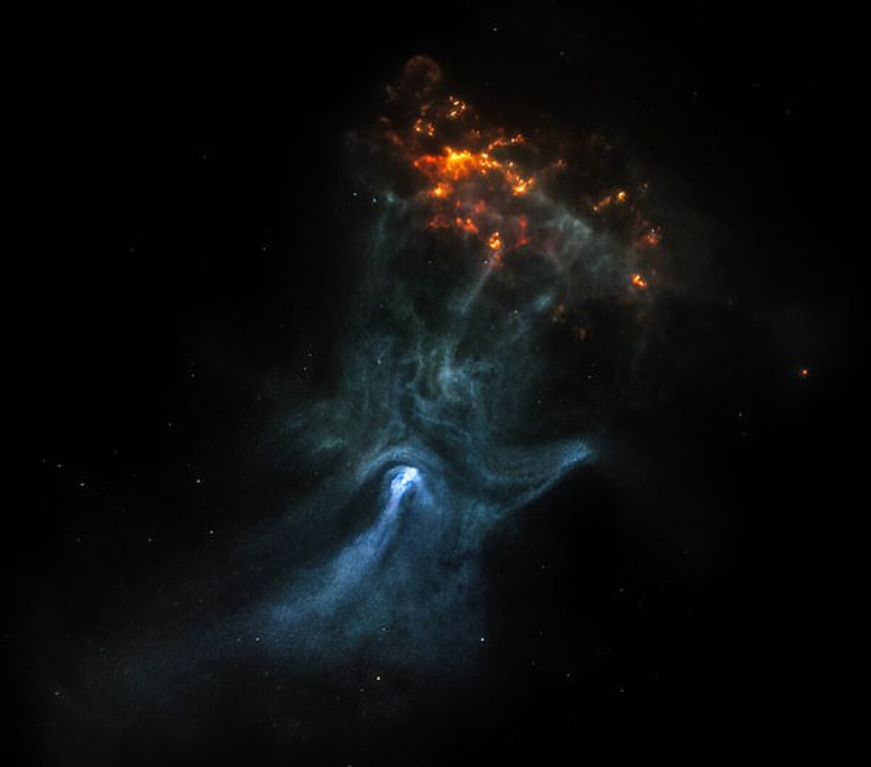




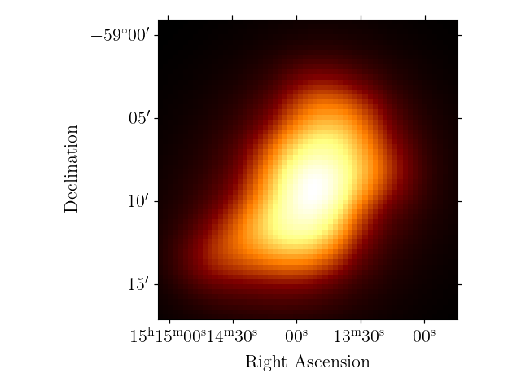

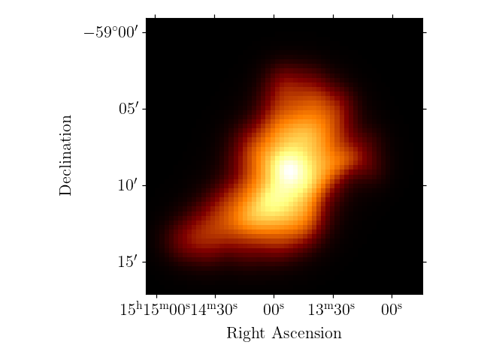
Science Application: Resolving the PWN MSH 15-52
Chandra
X-Rays: Synchrotron radiation
Gamma-Rays: Inverse Compton
~ 10 arcmin
Create gamma ray model assuming
and
Infinite statistics limit images
H.E.S.S. public
CTAO South Prod5 official
FreePACT CTAO South
Schwefer & Hinton in prep.
10

