Slide 1
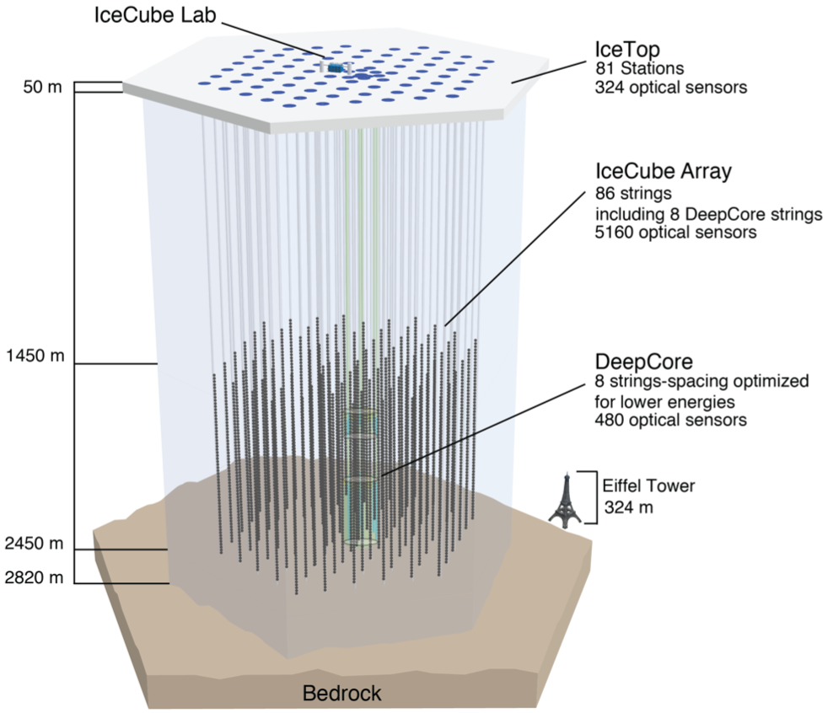
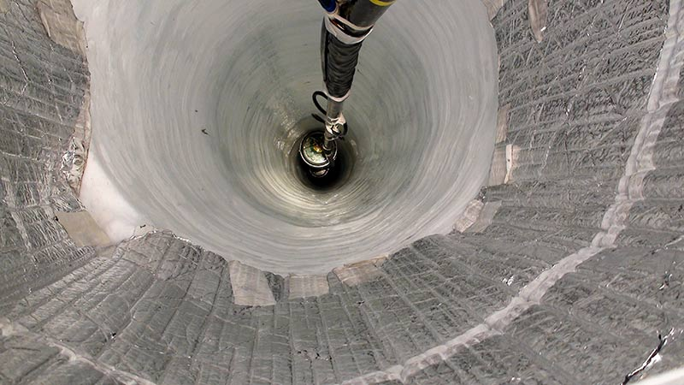
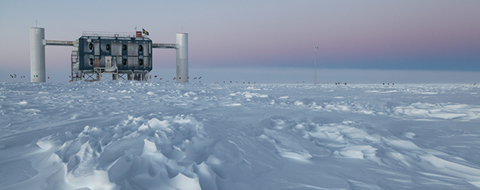
IceCube calibration: ice properties
AMANDA (turned off in 2009)
19 strings, 677 optical sensors
Dmitry Chirkin, UW Madison
IceCube summer school 2024

Slide 2
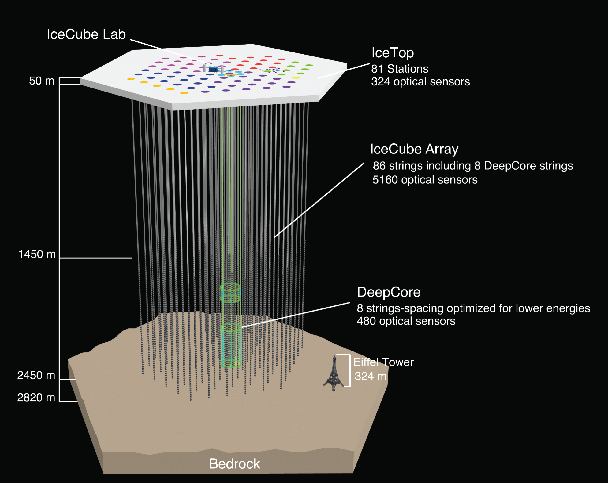
IceCube calibration: ice properties
AMANDA-A
AMANDA (turned off in 2009)
19 strings, 677 optical sensors
Dmitry Chirkin, UW Madison
IceCube summer school 2024

Slide 3
Ice model evolution
AMANDA-A (1994): dominated by air bubbles
AMANDA II (2006): clear ice at depths 1.4-2.3 km
IceCube (2013): layer tilt, ice anisotropy
IceCube (2023): birefringence, precise 2d tilt
SPICE models

Slide 4
Ice model evolution
AMANDA-A (1994): dominated by air bubbles
AMANDA II (2006): clear ice at depths 1.4-2.3 km
IceCube (2013): layer tilt, ice anisotropy
IceCube (2023): birefringence, precise 2d tilt
SPICE models
added ice anisotropy
Other local/hole ice or detector effects

Slide 5
Measuring Scattering & Absorption
Install light sources in the ice
Use light sensors to:
- Measure how long it takes
for light to travel through ice
- Measure how much light is delayed
- Measure how much light does not
arrive
Use different wavelengths
Do above at many different depths
scattered
absorbed

Slide 6
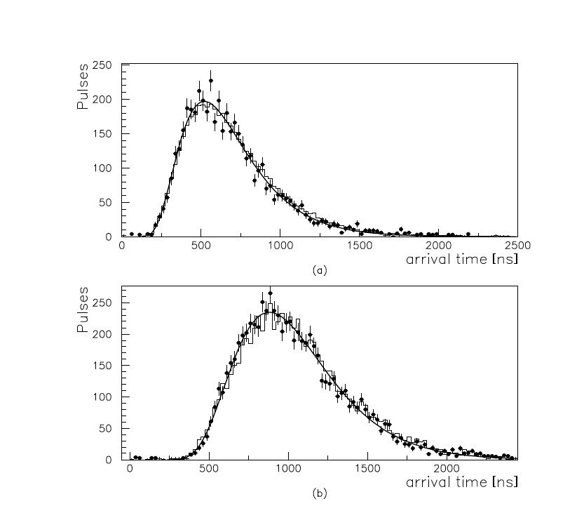
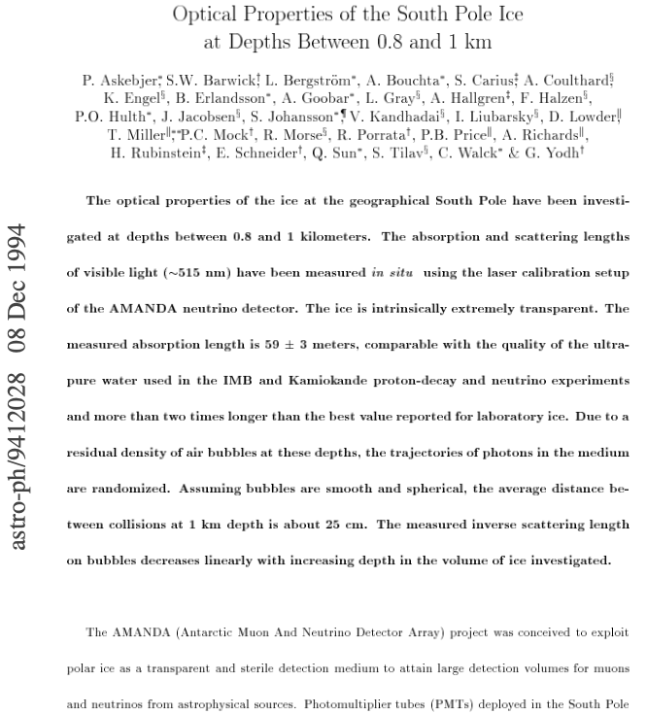
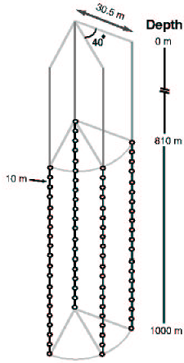
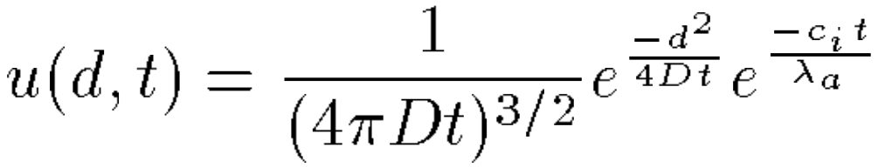
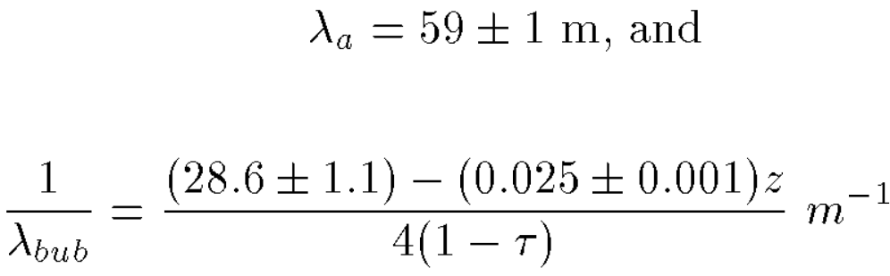
AMANDA-A: scattering on air bubbles!
a: 21 m – 91 ns
b: 32 m – 142 ns
1994
0.2 m/ns
5 ns/m
Analytical description (diffusive regime)
Possible due to very small scattering length

Slide 7
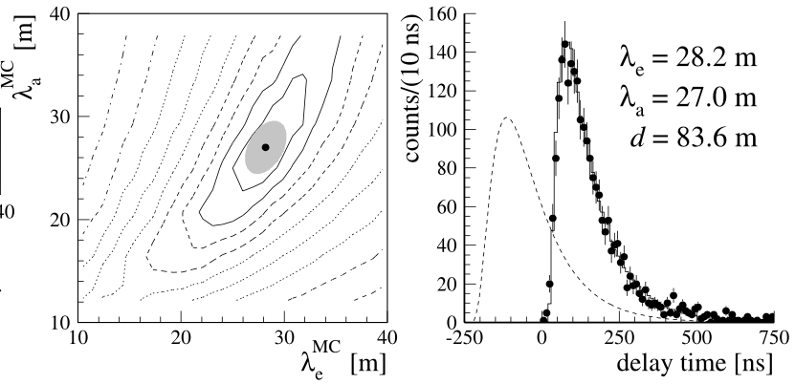
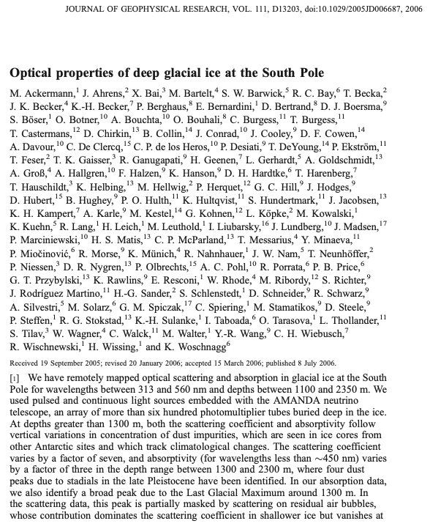
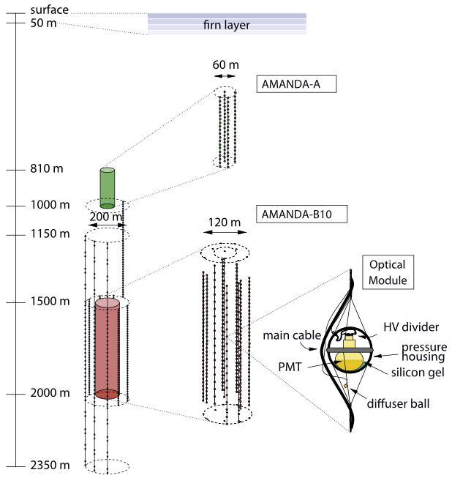
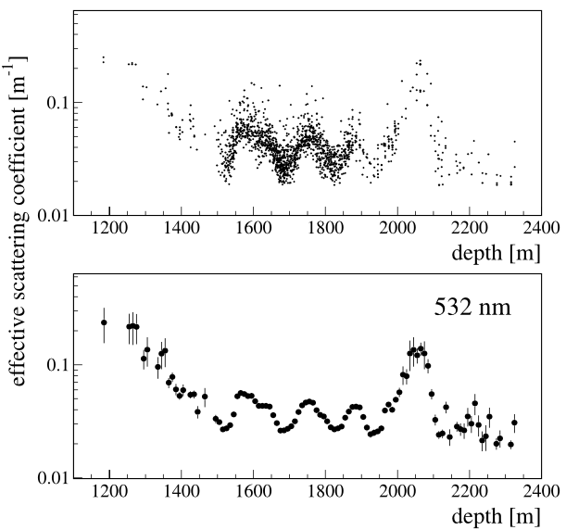
AMANDA-II: comprehensive ice model
2006
“millennium” ice model followed up with AHA (unfolded and extrapolated) and WHAM! (updated with IceCube flasher data)

Slide 8
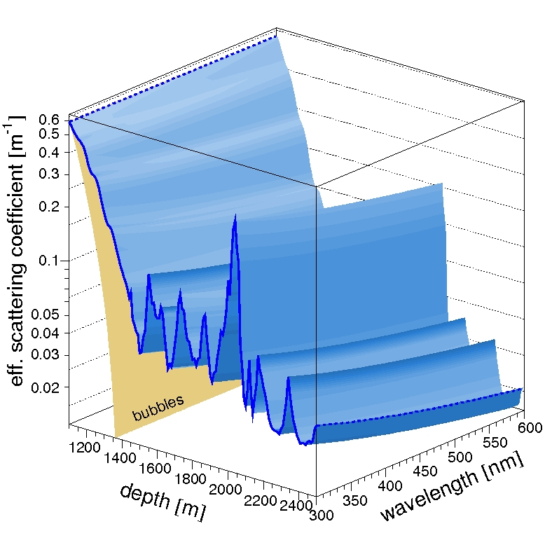
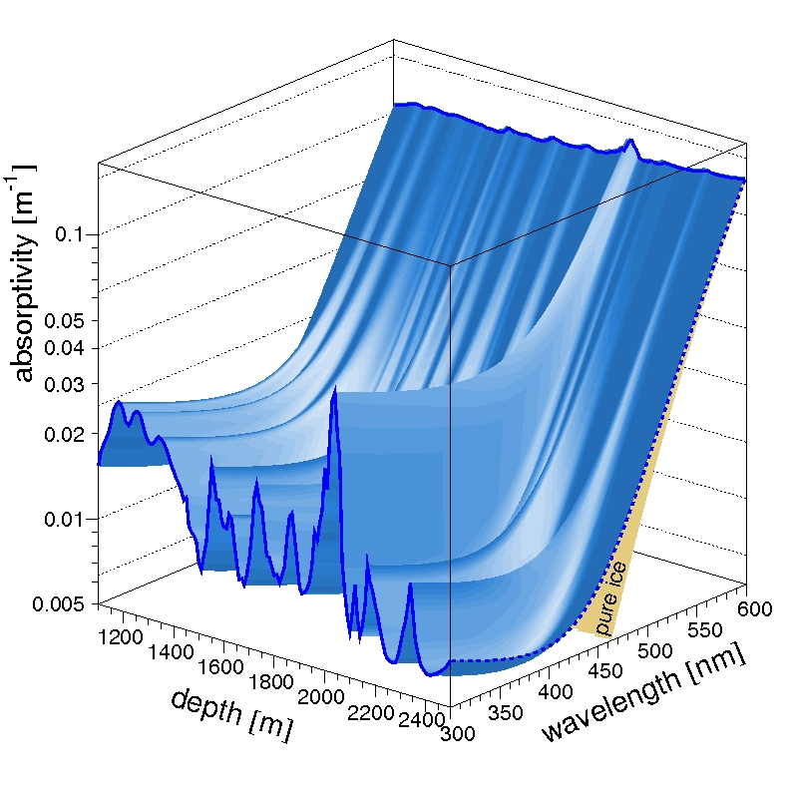
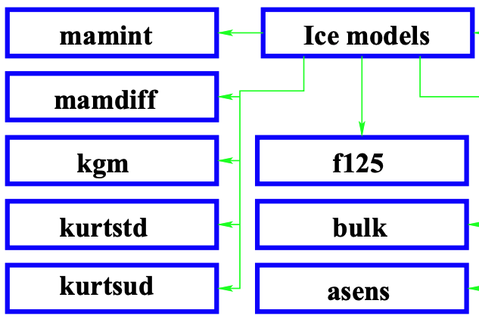
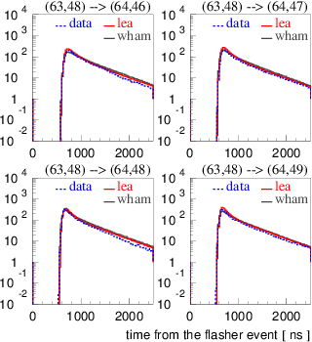
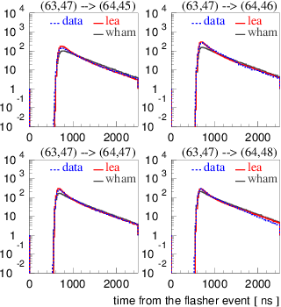
AMANDA-era ice models
2011
Kurt
KGM (Kurt-Gary)
MAM (modified absorption)
Millennium/Y2K
AHA 2006-2007
Lordi
WHAM! (Water Hardened Antarctic Measurement)
1995-2003
Models with an IceCube wiki page
Comparison with SPICE family (lea)

Slide 9
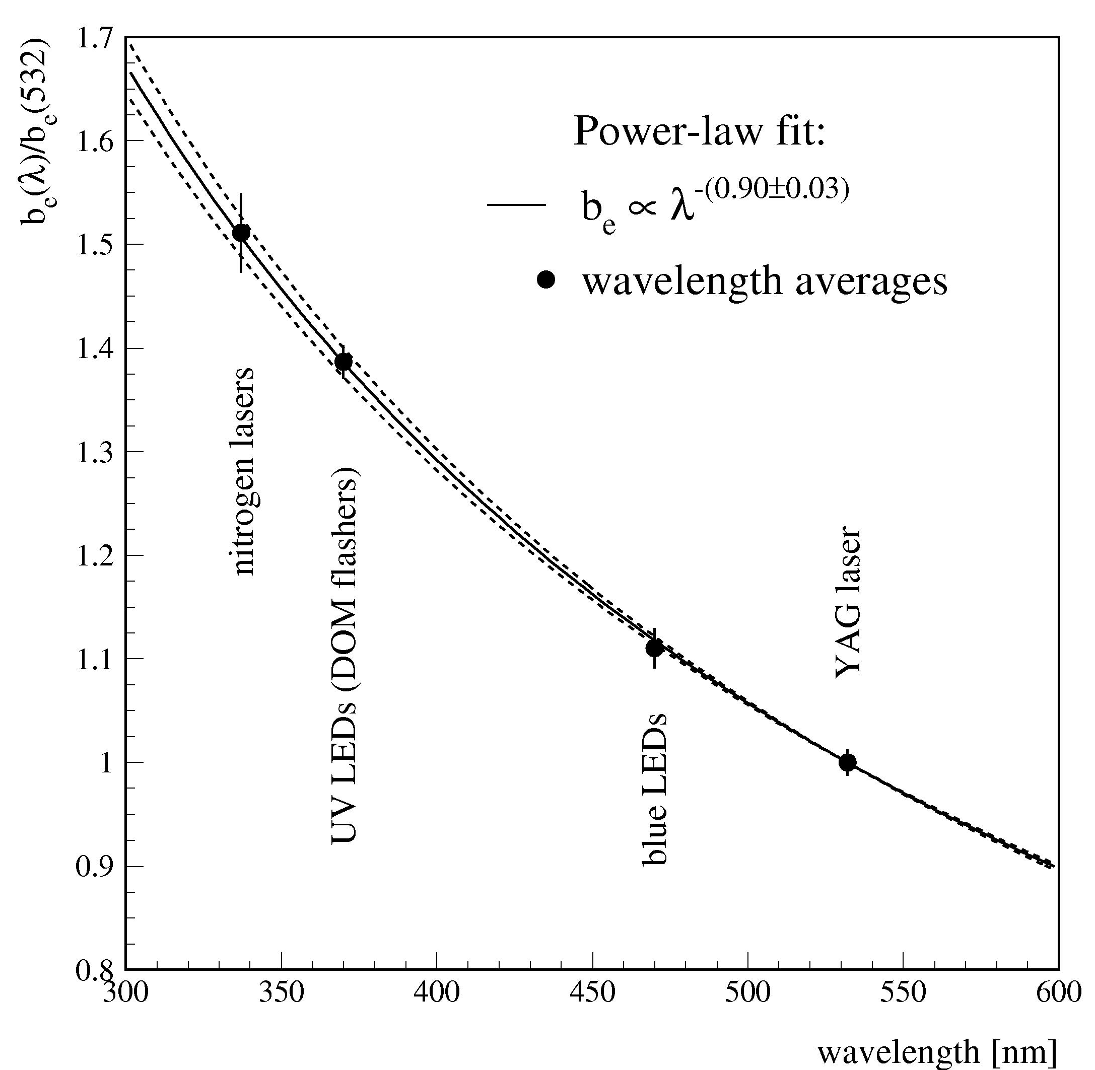
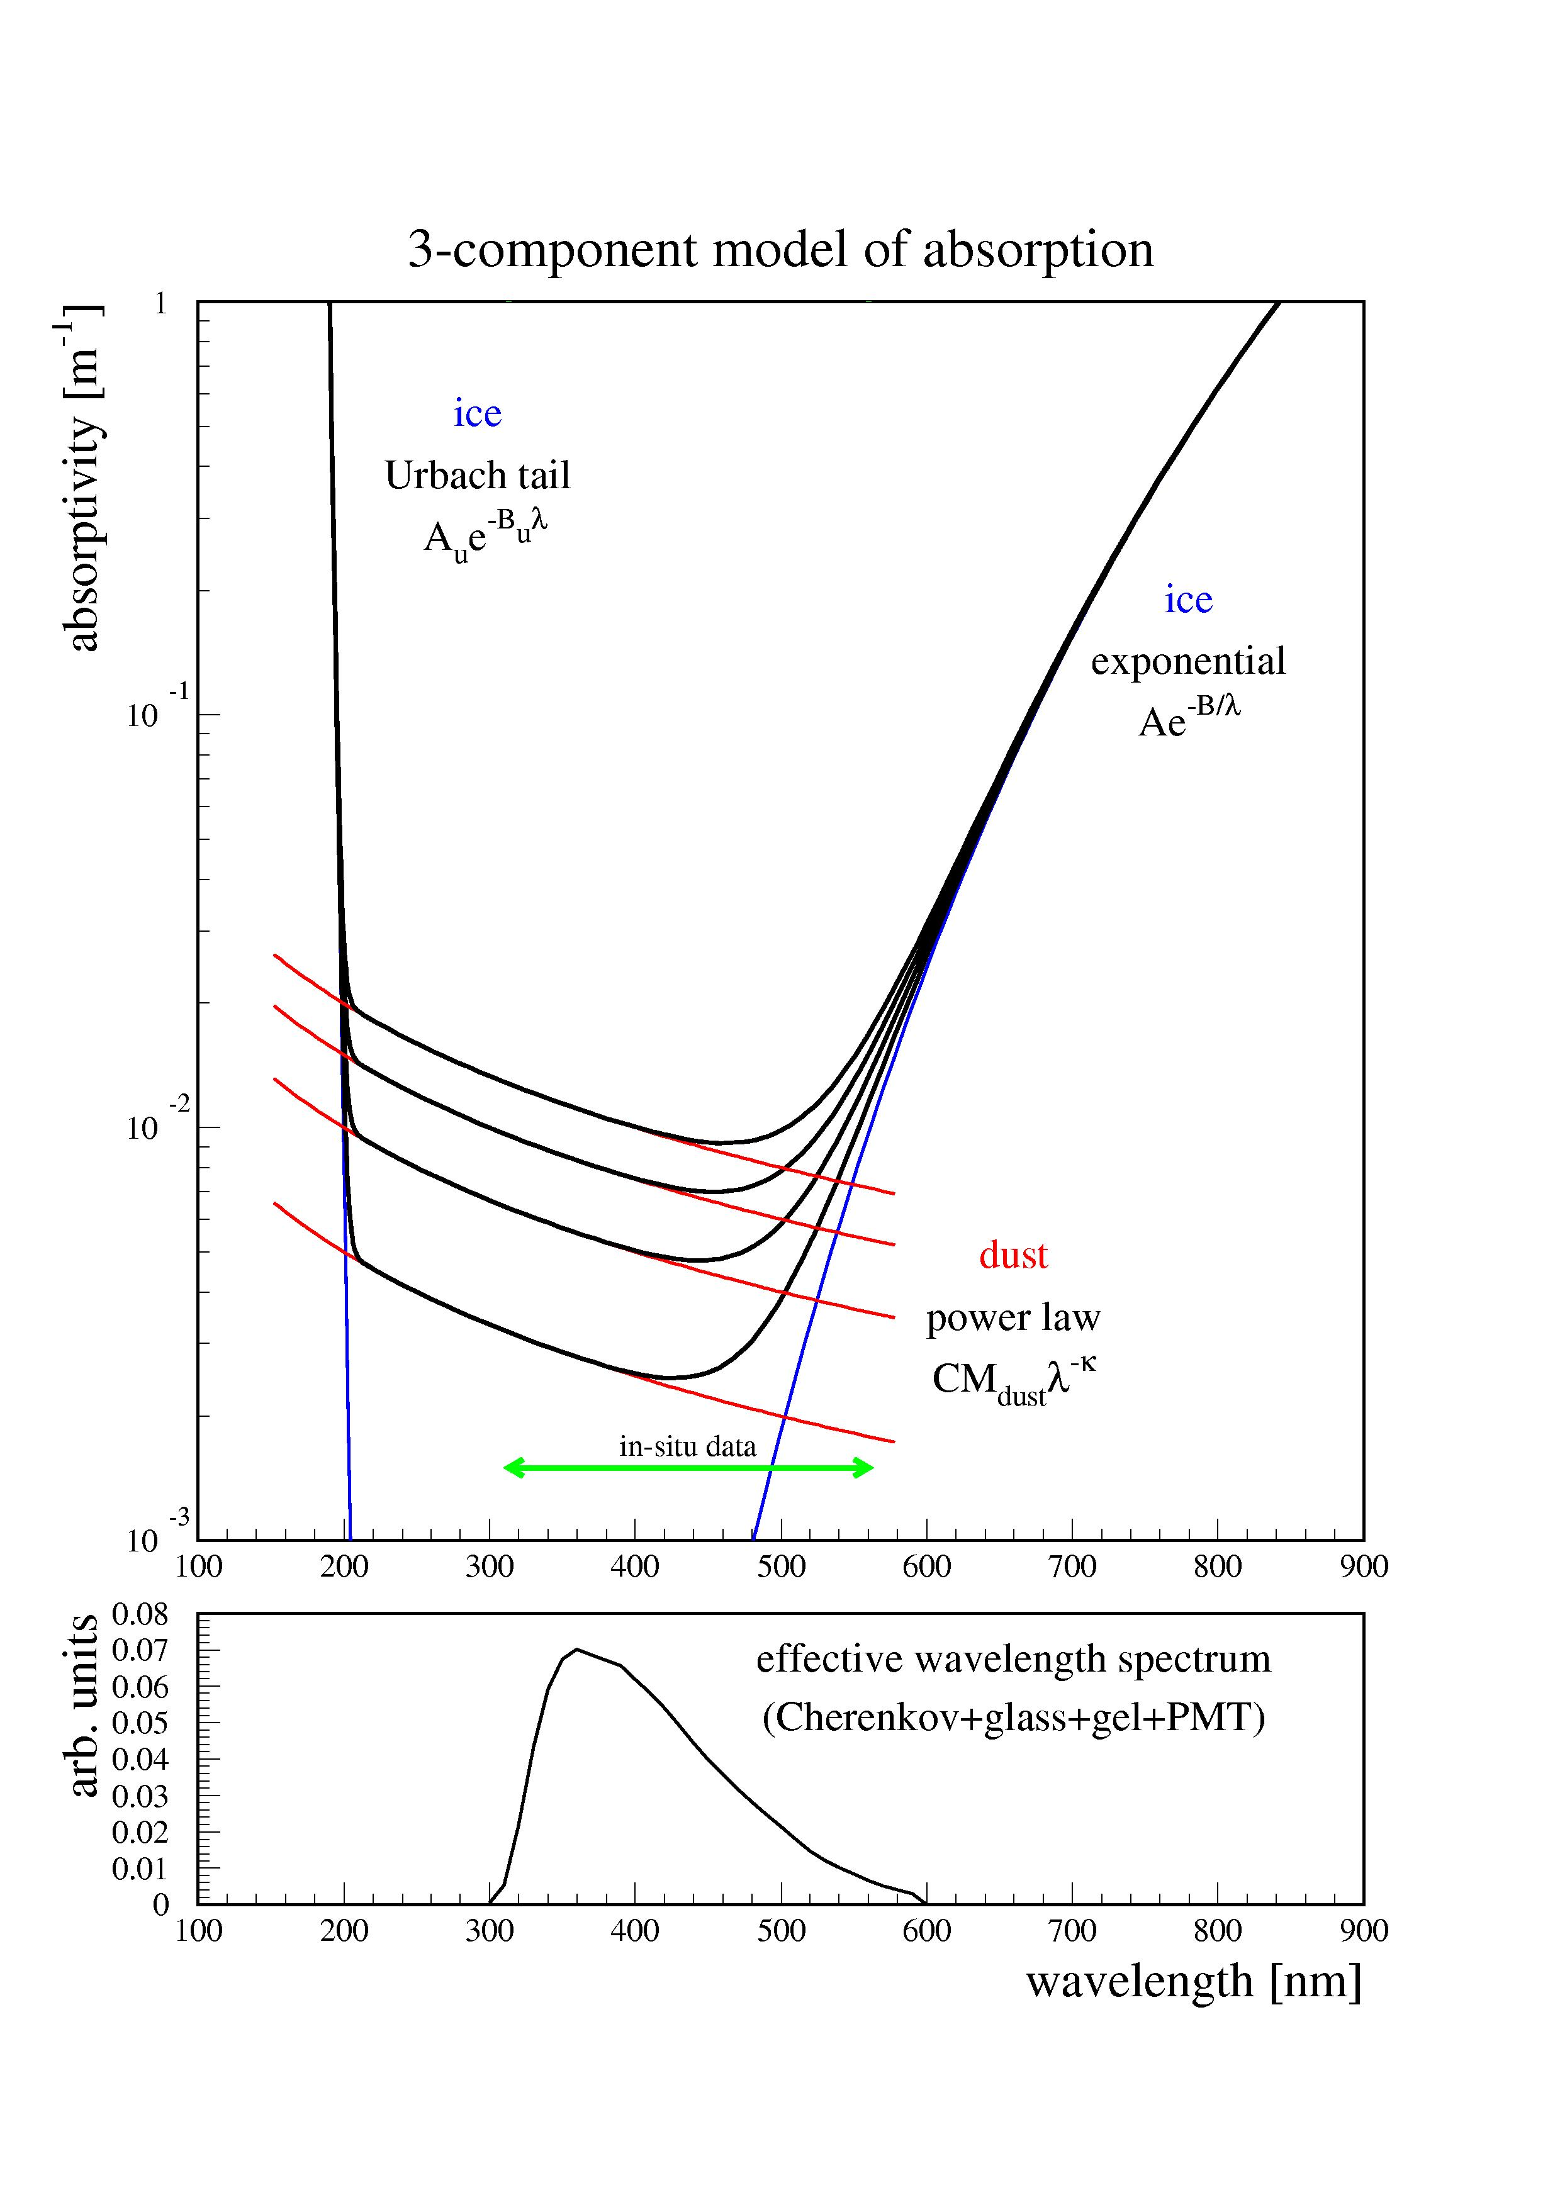
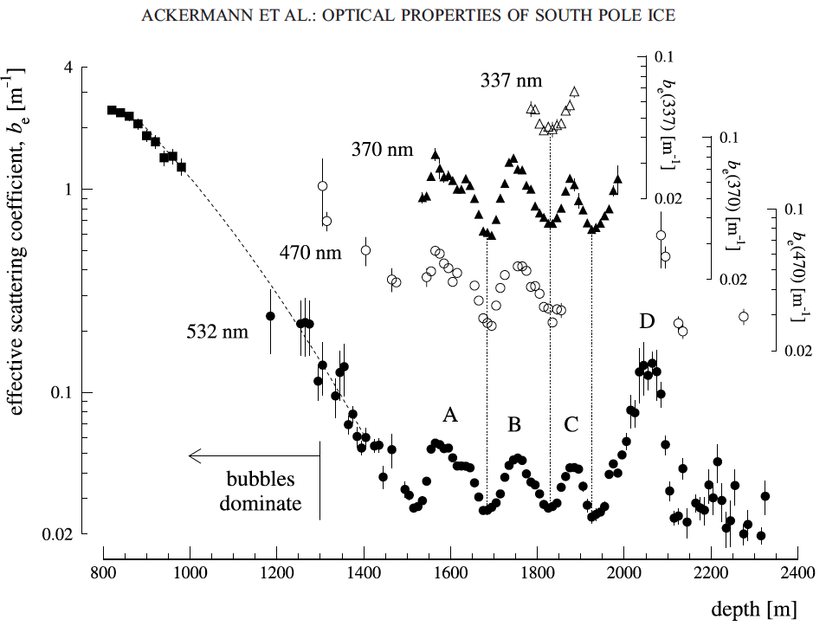
AMANDA-II: comprehensive ice model
Ice is extremely transparent between 200 nm and 500 nm
Ice is very transparent at depths below 1350 m
Scattering and absorption are determined by dust concentration
Wavelength dependence of dust scattering and absorption follow power law
Wavelength dependence was verified with IceCube, but is still used basically unchanged

Slide 10
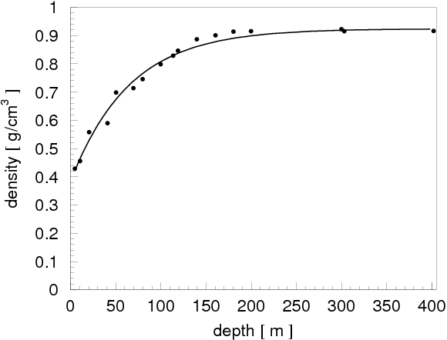
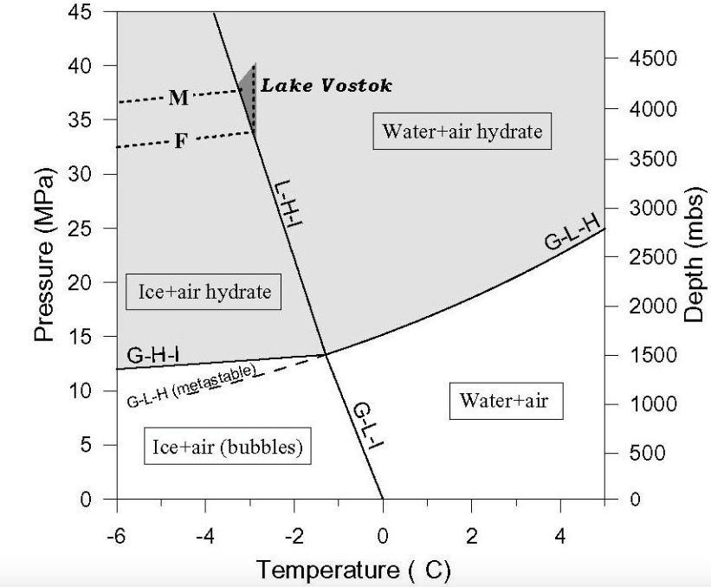
Trapped air bubbles and their conversion into air hydrates
At some depth between 0 and 200 m air bubbles become trapped and are squeezed into the ice as ice packs under pressure.
-50…-20 C
At depth of 1350 m all air bubbles have converted into air hydrates,
which have the same refractive index as ice, so no longer a nuisance

Slide 11
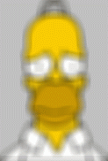


Ice layer parametrization
In each 10-meter layer define:
  scattering
  absorption
  ice crystal density
Source is
blurred
10 m
scattering
absorption
Source is
dimmer
a = inverse absorption length (1/λ_{abs})
b = inverse scattering length (1/λ_{sca})

Slide 12
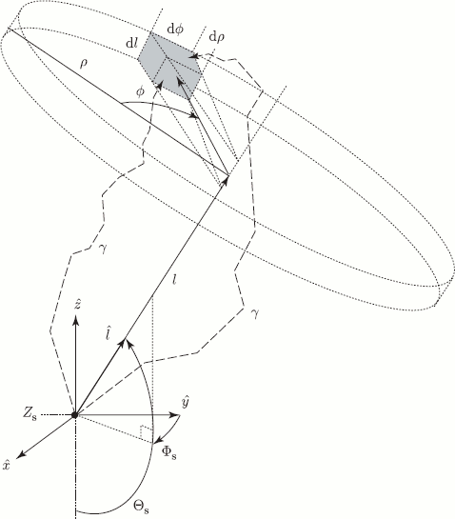
Photon tracking with tables
First, run photonics to fill space with photons, tabulate the result
Create such tables for nominal light sources: cascade and uniform half-muon
Simulate photon propagation by looking up photon density in tabulated distributions
Table generation is slow
Simulation suffers from a wide range of binning artifacts
Simulation is also slow! (most time is spent loading the tables)

Slide 13
Direct photon tracking
photon propagation code (ppc) or OpenCL simulation (clsim)
propagate photons directly when needed
insert photon
length to absorption
distance to next scatter
scatter
propagate to next scatter
check for intersection with OMs
Check for distance to absorption
hit
lost

Slide 14
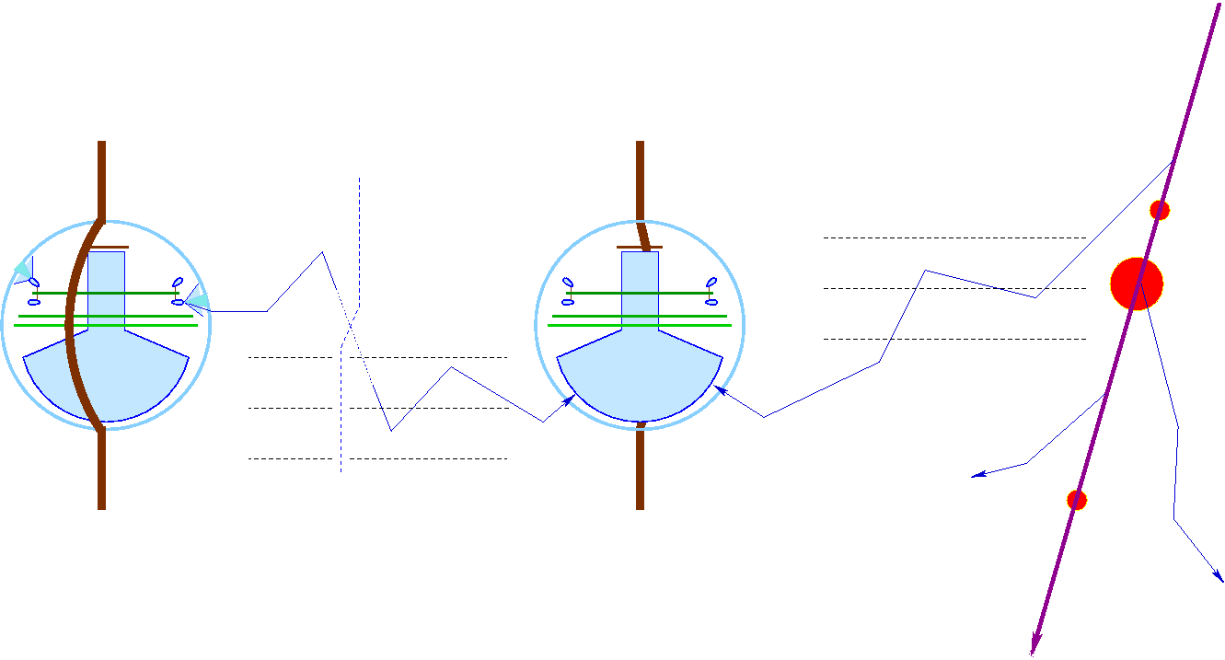
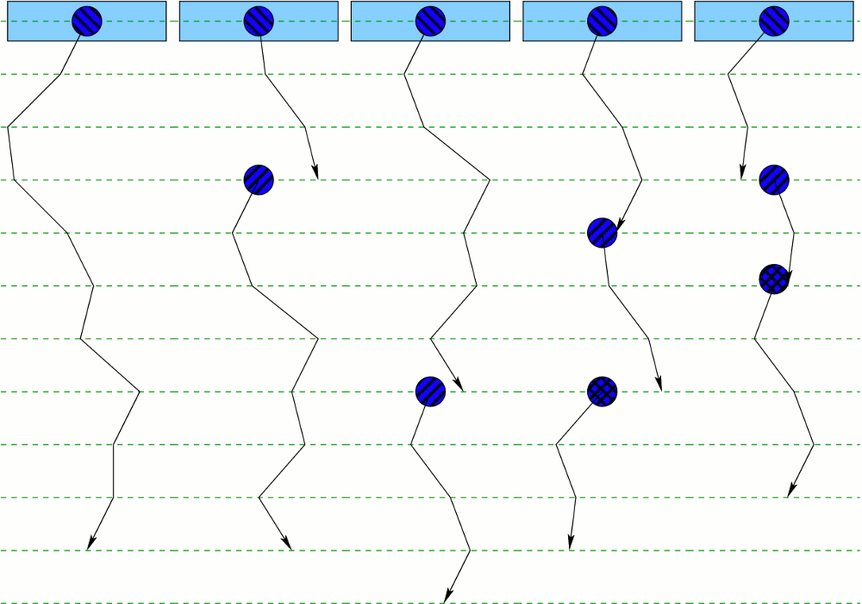
Simulation: Direct photon tracking
execution threads
propagation steps
scattering (rotation)
photon absorbed
Same code used for both flasher simulation/ice calibration and muon/physics data simulation
new photon created
(taken from the pool)
threads complete
their execution
(no more photons)

Slide 15
Oversized DOM treatment
This is a crucial optimization.
The oversize model was chosen carefully to produce the best possible agreement with the nominal x1 case.
Some bias is unavoidable since DOMs occupy larger space:
x1: diameter of 33 cm
x5: 1.65 m
x16: 5.3 m
nominal DOM
oversized DOM
oversized ~ 5 times
photon

Slide 16
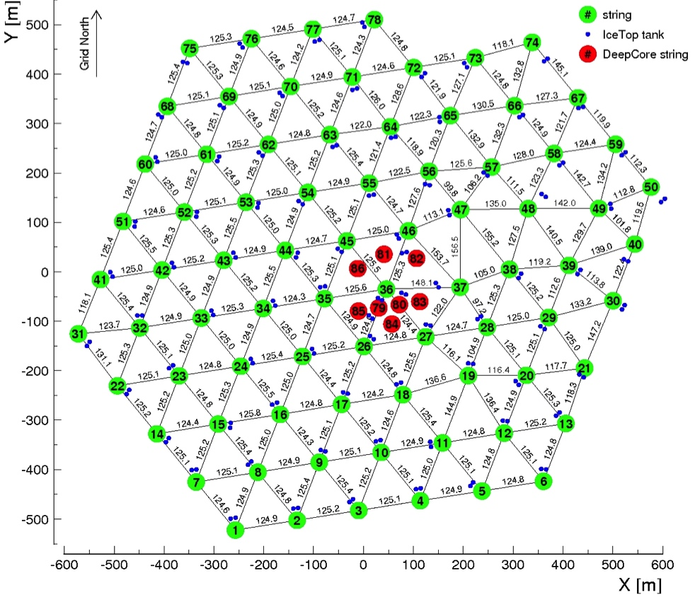
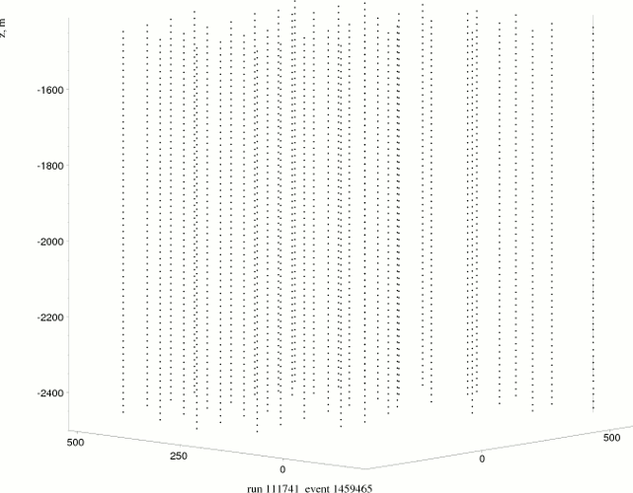
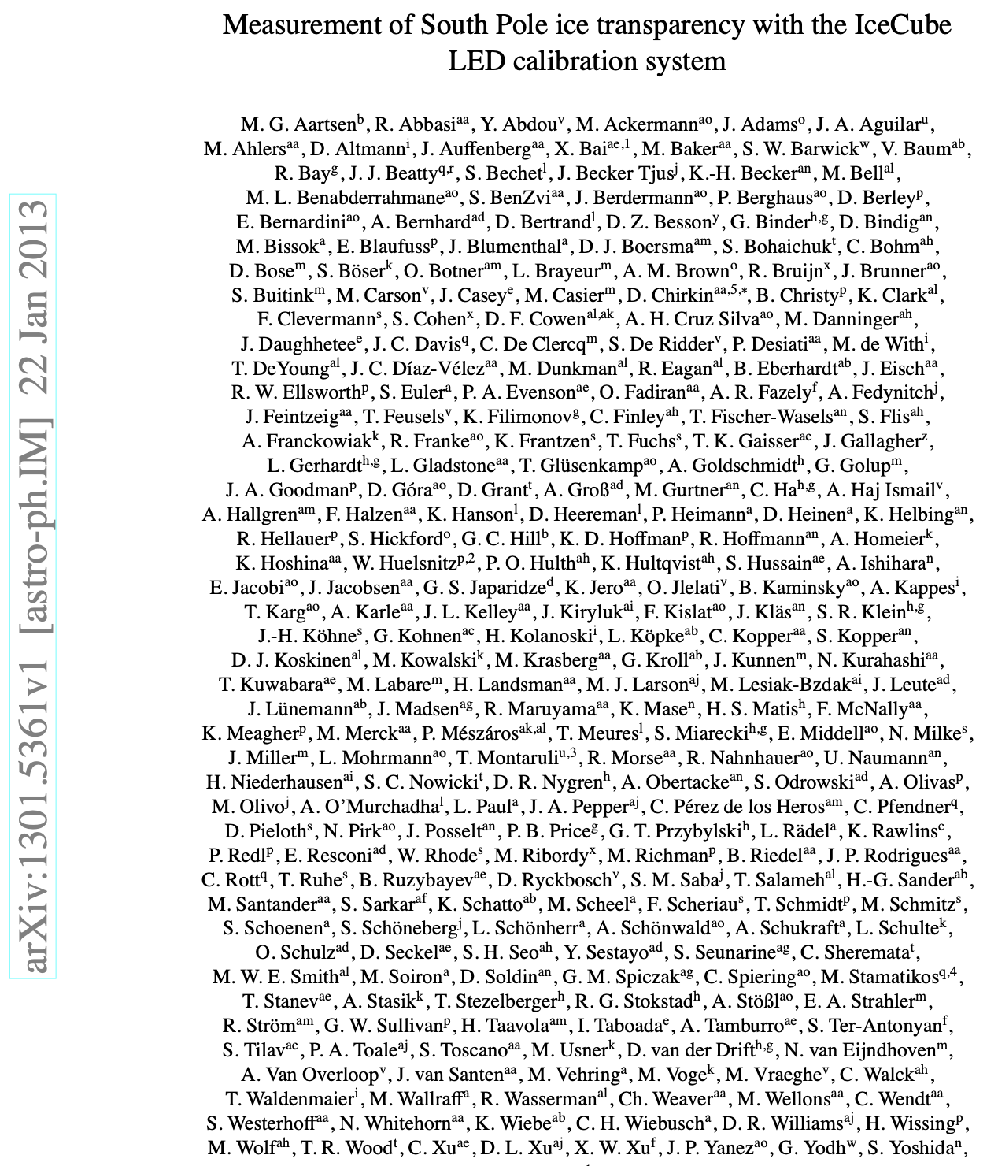
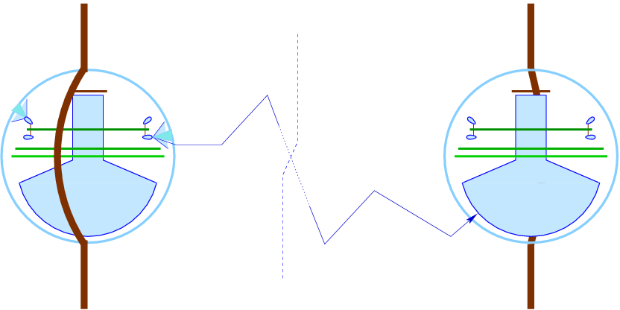
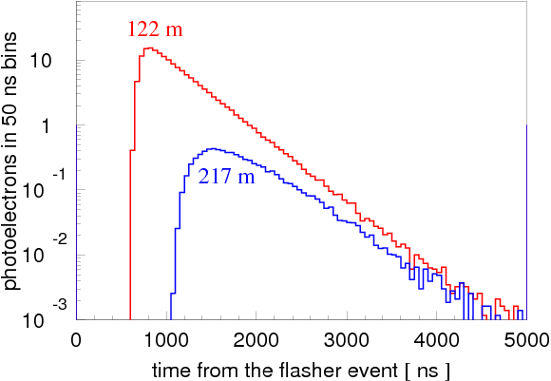
SPICE models: simultaneous direct fit to all layers
2013

Slide 17
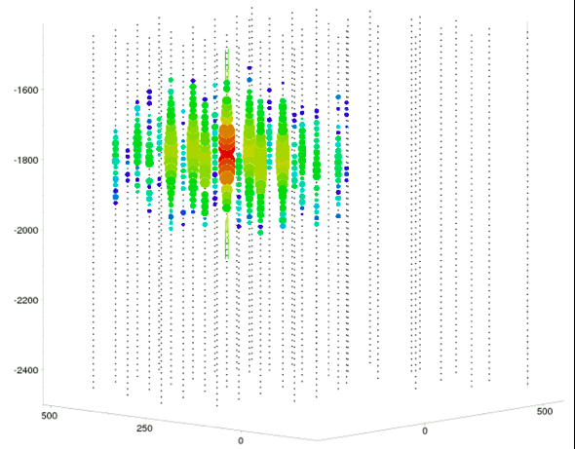
SPICE models: simultaneous direct fit to all layers
2013

Slide 18
Mie scattering theory
Continuity in E, H: boundary conditions in Maxwell equations
θ
Analytical solution!
However:
Solved for spherical particles
Need to know the properties of dust particles:
refractive index (Re and Im)
radii distributions
e^{-ikr+iωt}
e^{-i|k||r|}
r
18

Slide 19
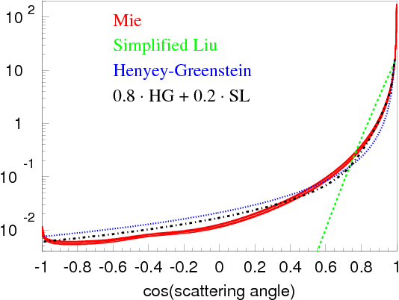

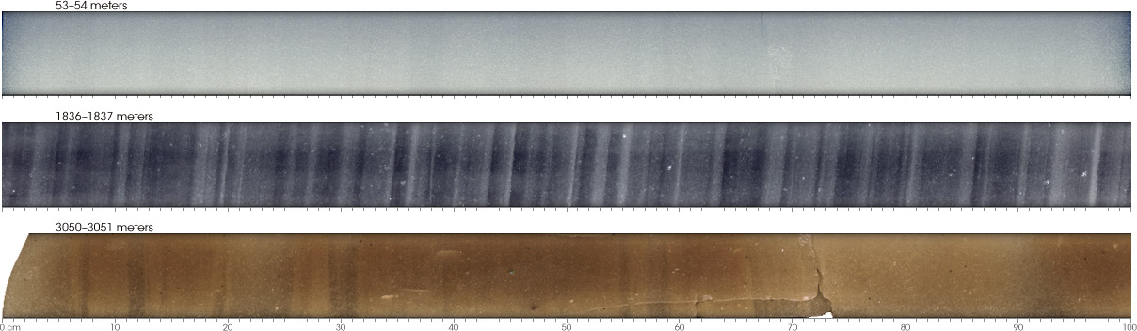

Approximation to Mie scattering
θ
Simplified Liu:
Henyey-Greenstein:
Mie:
Describes scattering on acid, mineral, salt, and soot with concentrations and radii at SP collected in ice cores elsewhere in Antarctica
f_{SL}

Slide 20
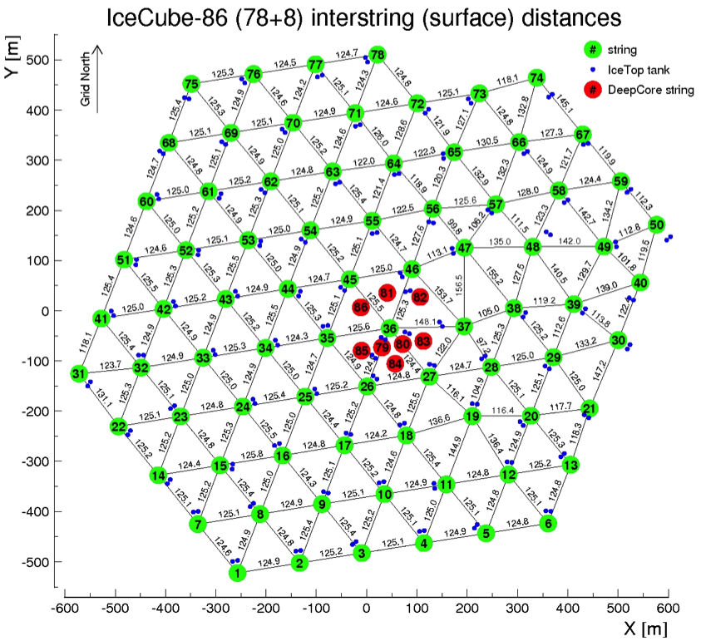
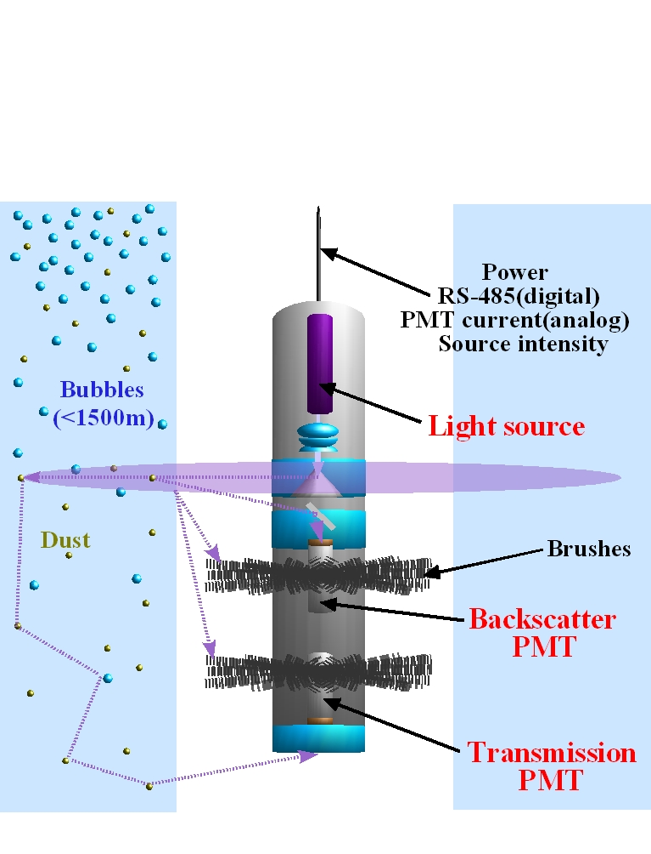
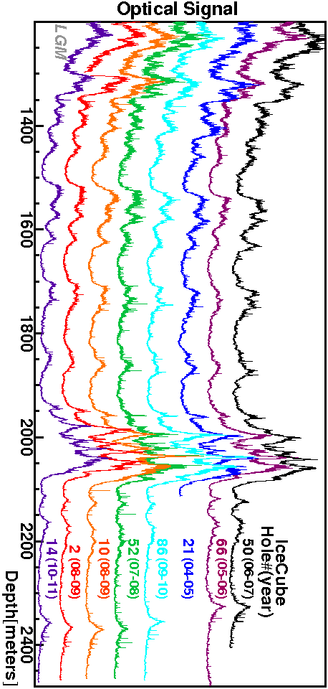
Dust logger mapping of the ice tilt
Dust logger
N
E
ice layer tilt direction: 225º SW
The ice layers (i.e. layers of ice with similar optical properties) change in depth by as much as 60 m when going from NE to SW corners of the detector

Slide 21
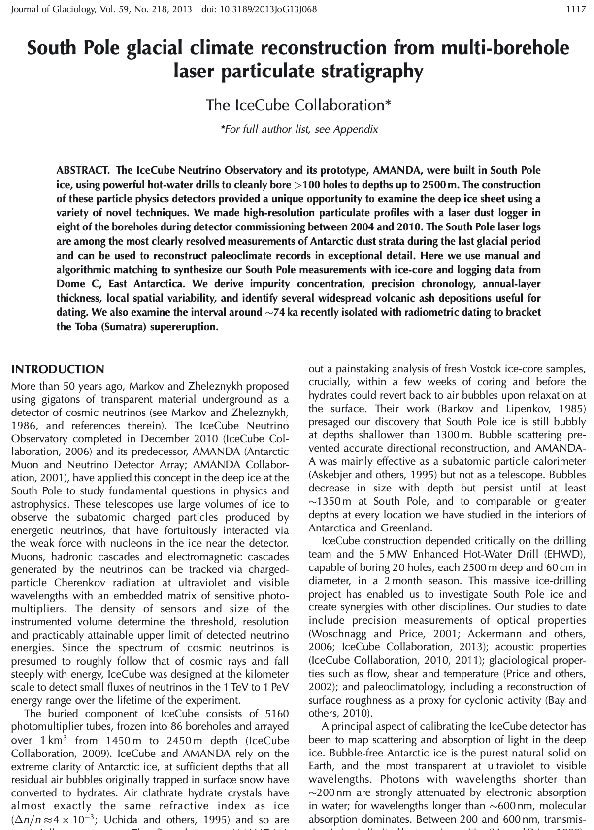
Dust logger mapping of the ice tilt
Dust logger
2013
N
E
ice layer tilt direction: 225º SW
The ice layers (i.e. layers of ice with similar optical properties) change in depth by as much as 60 m when going from NE to SW corners of the detector

Slide 22
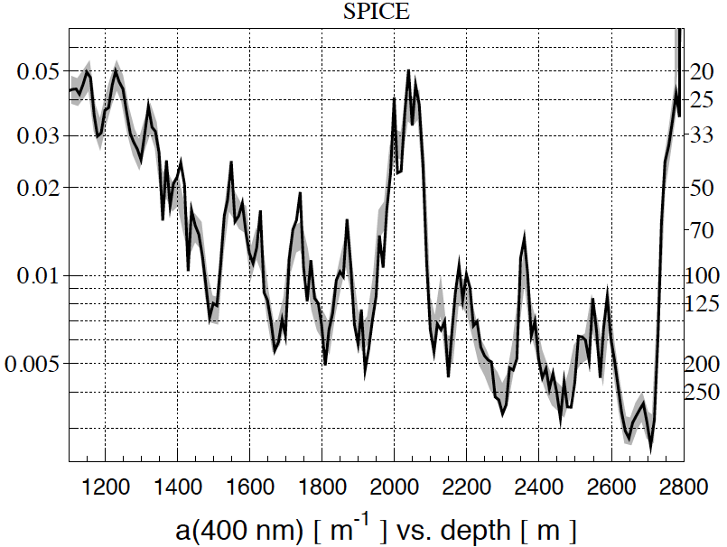
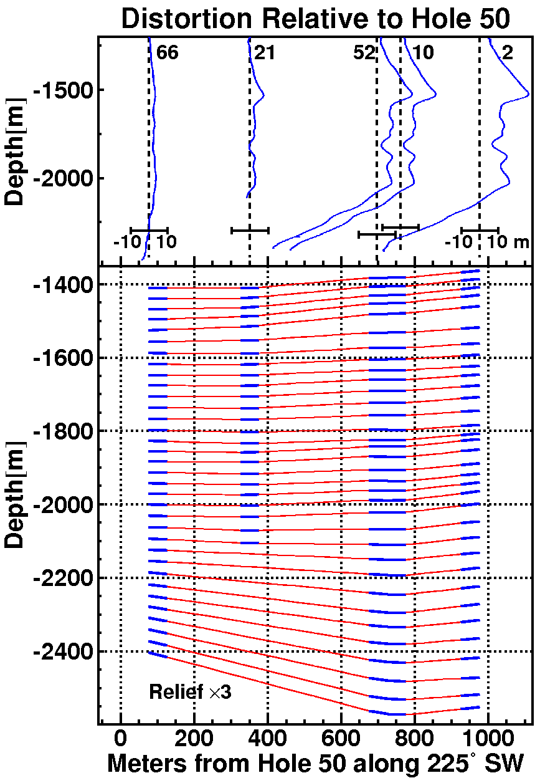
Correlation of fitted optical properties with dust logger data
black line: fit to flasher data
gray band: scaled merged dust log
SPICE 2
(m⁻¹)
(m)
extrapolation region
fit region (inside detector)
(outside detector)

Slide 23
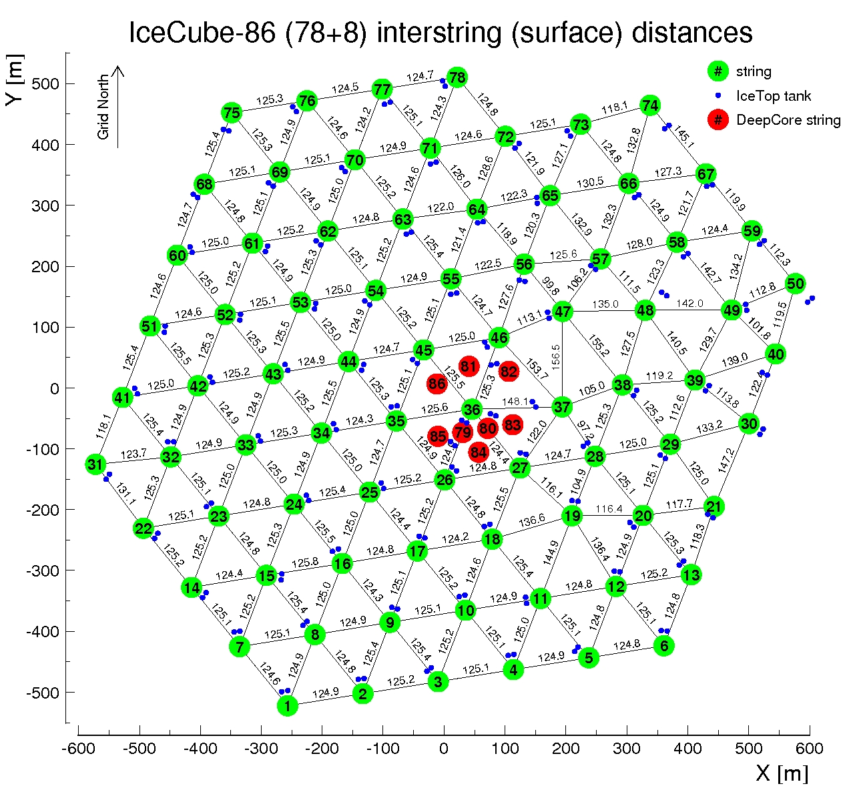
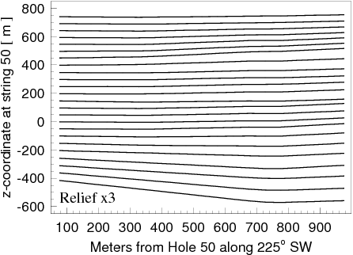
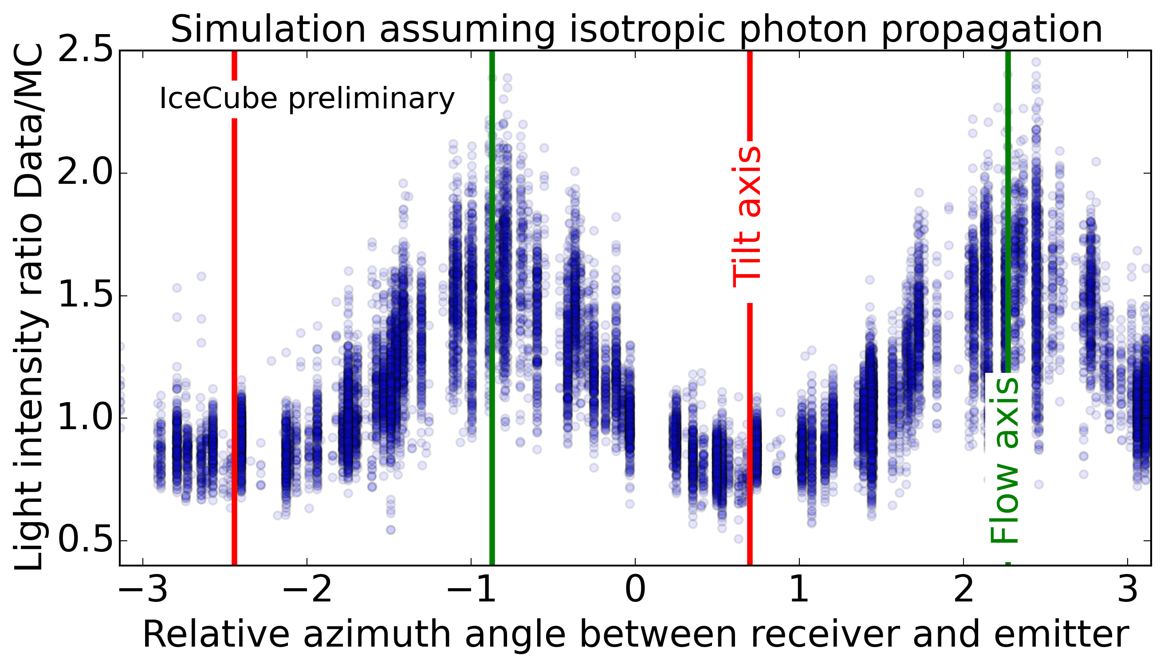
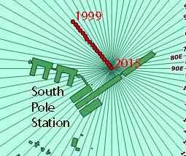
Glacial ice flow, ice layer tilt, and optical anisotropy
SPICE Lea
N
Ice Layer tilt direction
225º SW
E
Ice flow direction
41º NW
Less attenuation
41º NW

Slide 24
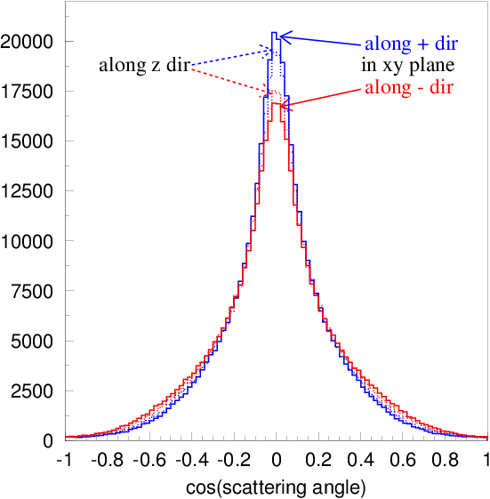
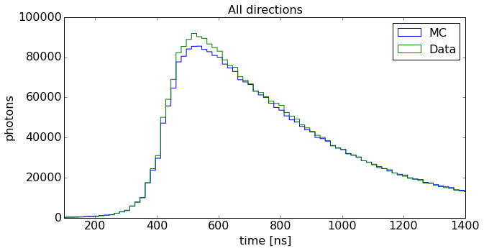
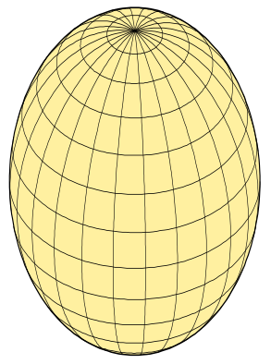
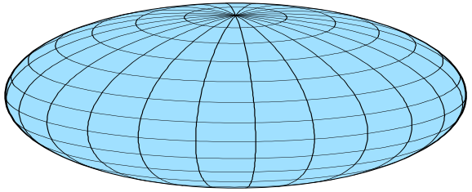
Models of optical ice anisotropy in IceCube
scattering-based
Scattering (mainly): direction dependent scattering function (ICRC 2013)
Absorption (mainly): direction dependent absorption (studied in 2018)
Introduced depth-dependence (2017)
Discrepancies between data and simulation remain
Cannot simultaneously fit total charge and
arrival time distribution to statistical precision
SPICE Lea, 3.2.x
Absorption driven
absorption-based
prolate
oblate
SPICE EMRM
Scattering driven

Slide 25
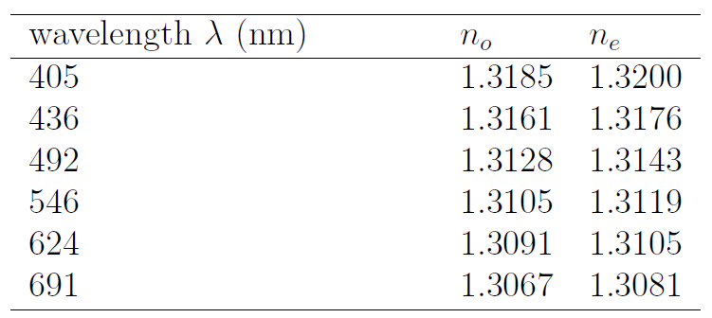


Birefringence
Ice is a birefringent material with n_{e}-n_{o}=0.0015. This tiny difference builds to a macroscopic effect due to 1000s of ice crystal boundaries crossed per meter of traveled distance
At each grain boundary every ray is split into two reflected and two refracted rays, one ordinary and one extraordinary ray each
Wave vector component parallel to surface is conserved,
norm is proportional to the refractive index
Poynting vectors are derived from wave vectors and boundary conditions
Outgoing ray is randomly sampled from Poynting vectors according to Poynting theorem (Poynting vector component through the plane is conserved)

Slide 26






Scattering patterns birefringent ice
Running MC simulation with realistic crystal size, elongation, and orientation distributions (correlated to flow direction):
Diffusion is largest on flow axis and smallest orthogonal to it
Photons on average get deflected towards the flow axis
→ photons effectively fly a curve towards the flow axis
after ~ 1 m of propagation:
towards flow
along flow
orthogonal to flow

Slide 27


Scattering patterns birefringent ice
Running MC simulation with realistic crystal size, elongation, and orientation distributions (correlated to flow direction):
Diffusion is largest on flow axis and smallest orthogonal to it
Photons on average get deflected towards the flow axis
→ photons effectively fly a curve towards the flow axis
after ~ 1 m of propagation:
2024
towards flow
along flow
orthogonal to flow

Slide 28


Average (at ~125 m) waveform

Slide 29

Ice layer tilt
Ice at the South Pole is flowing downhill at a rate of ~10 m/year
While the surface of the ice is flat, the bottom of the ice sheet rests atop of bedrock, which has irregular features such as hills and valleys
The ice sheet deforms as it flows through these features, and this results in lower ice layers following the shape of the bedrock; the closer to bedrock, the more the ice layers deviate from the flat that we see on the surface
An ice layer consists of ice deposited at around the same time, so should have the same concentration of impurities across the layer, thus same scattering and absorption properties. The “dirtier” layers will create bands of reflected radar signal

Slide 30

Per-DOM flasher fits
Slide by M. Rongen

Slide 31

Iterative Positive-Definite Fit (IPDF)
A second-order Taylor expansion is used to fit the shape of the llh in the vicinity of best previous solution
  i.e., a paraboloid fit
  llh values are computed for nominal+100-1000 random perturbations set of simulations at each iteration
Some regularizations are necessary
  α: stiffness of paraboloid fit (curvature)
  β: correlation terms (to smooth unnecessary up/down oscillations in solution)
  γ: norm of solution (to keep it in bounds of the perturbation set)
Search for solution (minimization)
A direct matrix regularized inversion was tried first but often resulted in non-positive-def solutions
Newton’s gradient descent method was adopted with explicit positive-definite curvature matrix
L = Σ_{i}(Q^{i}+C₀-f_{i})² + α(Σ_{kn}a_{kn}²)² + β(Σ_{k}(D_{kn}(b_{n}+T_{n}))²)² + γ(Σ_{n}b_{n}⁴),
where Q^{i} = Σ_{k}(a_{kn}(x_{n}^{i}-b_{n}))².
Value of L at the minimum
regularization term (2nd derivative, etc.)
a_{kn}a_{km} is curvature matrix
deviations solution vector (main result)

Slide 32
Paraboloid Fit
ice
Curvature matrix AA^{T}
2nd order Taylor expansion around the (presumed) minimum is a paraboloid with the curvature expressed as AA^{T} (to enforce positive-definite quality)
Solution vector consists of:
10000 tilt corrections (on a grid of 80 xy locations, times 125 depth points)
513 ice parameters at grid point 36 (scattering, absorption, crystal density at 171 depth points)
The paraboloid is flat as possible, by regularization reducing the norm of AA^{T}
Additional regularizations to smooth the jaggedness in tilt solutions
10000 tilt components (80 grid locations * 125 depth points)

Slide 33

Ice tilt fitted with IceCube calibration data
Regions outside of detector hexagon outline are extrapolations
Regions above and below +-500 m are outside the detector volume, and as such, are also extrapolations
Shown are ice layer shifts wrt. a point near string 36 (close to detector center)
The 1d gradient tilt (only accounting for tilt in the direction NE-SW) appears to be a better approximation at the bottom of the detector
Across the entire fitted depth range there appears to be an additional component that changes the depth of ice layers along the ice flow (layers getting shallower downstream)
main tilt gradient direction
ice flow direction (10 m/year)

Slide 34

Ice tilt fitted with IceCube calibration data
Regions outside of detector hexagon outline are extrapolations
Regions above and below +-500 m are outside the detector volume, and as such, are also extrapolations
Shown are ice layer shifts wrt. a point near string 36 (close to detector center)
The 1d gradient tilt (only accounting for tilt in the direction NE-SW) appears to be a better approximation at the bottom of the detector
Across the entire fitted depth range there appears to be an additional component that changes the depth of ice layers along the ice flow (layers getting shallower downstream)
main tilt gradient direction
ice flow direction (10 m/year)

Slide 35


Hole ice cameras
AMANDA:
Swedish camera deployed in 1998 in AMANDA hole 13
IceCube:
Bubble camera deployed in the 2006/7 season with string 57
Swedish camera deployed in the 2010/11 season with the last string (80)

Slide 36


Slide 37


Refrozen hole ice is more complex than thought before the Swedish Camera took its pictures
We find:
DOM touches the hole wall, is 2/3 of the hole diameter
Most of the HI is transparent, except for the milky central column centered in the hole and 1/3 of hole diameter (referred to as HI in the following, starting with the next line)
HI diameter is ½ of DOM diameter

Slide 38
Things we learned
Dust/impurities
Air bubbles/hydrates
Hole ice
Ice anisotropy Ice tilt
Dust logger
N
Ice Layer tilt direction
225º SW
E
Ice flow direction
41º NW
anisotropy axis
41º NW

Slide 39
Covariance matrix calculation
Direct inversion of matrix AA^{T} with
  tilt free to float (invert, then show ice-only components)
  tilt frozen at best solution (freeze tilt components, then invert)
this is done with the SVD decomposition of matrix A, so SV can be calculated and shown
Now have ice model sampler, which (basically) calculates solution to Ax=αξ, α: scaling, ξ: normal random
  this reduces paraboloid (Ax)² to Σα²ξ².
Sampler needs to have space of ice models constrained to regularized tilt models
  this is done by including regularization matrices into AA^{T}.
Compare direct inversion with covariance calculation from ice samples

Slide 40


Estimated uncertainties/covariance matrix
Ice+tilt sampling
direct calculation
all layers
2450 m
2080 m
1990 m
At 1σ: all
tilt: 21 cm
ice: 2.7 %
1450 m
1450 m
1990 m
2080 m
2450 m

Slide 41


Estimated uncertainties/covariance matrix
Ice+tilt sampling
from 10⁵ samples
excl. layers
outside
2450 m
2080 m
1990 m
At 1σ: all
tilt: 21 cm
ice: 0.7 %
1450 m
1450 m
1990 m
2080 m
2450 m

Slide 42
Recent ice model progression

Slide 43
Ice model progression (zoomed out)

Slide 44
summary
Much progress over 30 years
In this presentation I listed 12 AMANDA-era models and 20 SPICE-era models
Improvements can be gauged with llh, model error, and average waveform plot
We have a full description of statistical uncertainties of ice layer properties and tilt corrections
with a covariance matrix of size 10388 by 10388
However, interpretation of uncertainties is complicated since we have not yet reached the statistical floor
Are we still missing a major piece of the ice model puzzle?

Slide 45
Timeline
AMANDA ice models: model error
bulk, f125, mam, mamint, stdkurt, sudkurt, kgm, …
millennium (published 2006) → AHA (2007) 55%
IceCube ice models:
WHAM (2011) 42%
SPICE 1 (2009) 29%
SPICE 2, 2+, 2x, 2y (2010) added ice layer tilt
SPICE Mie (2011) fit to scattering function 29%
SPICE Lea (2012) fit to scattering anisotropy 20%
SPICE (Munich) (2013) 7-string, LED unfolding 17%
SPICE³ (CUBE) (2014) llh fixes, DOM sensitivity fits 11%
SPICE 3.0 (2015) improved RDE, ang. sens. fits 10%
SPICE 3.1, 3.2 (2016) 85-string, correlated model fit <10%
SPICE HD, 3.2.2 (2017) direct HI and DOM sens., cable, DOM tilt
SPICE EMRM (2018) absorption-based anisotropy single
SPICE BFR (v1, v2) (2020) birefringence-based anisotropy LEDs
SPICE FTP (v0, v1) (2022) precise fit to tilt across detector volume
SPICE FTP (v2, v3) (2023) w/precise covariance matrix calculation
Model error (precision in charge prediction): <10%
Extrapolation uncertainty: 13% (sca) / 15% (abs)
Linearity: < 2% in range 0.1 … 500 p.e.

Slide 46
llh and model error
The quantity that we use during the fit is “llh”, which is constructed as a saturated Poisson likelihood for data and simulation with their expectation values compared with the “model error term”:
For each flasher LED configuration, this quantity is summed over Bayesian-blocked time bins in receiving DOMs and normalized by their number. Then this normalized quantity is summed for all flasher configurations (of which we have 60614 – 12 LEDs times 5160 DOMs minus broken and cDOMs and minus some failed LEDs).
We have made multiple improvements to llh over the years, with each new ice model much better than the previous one. Naturally, a question arises: how far are we from the best possible llh? Say, if the physics of flasher LED events is modeled perfectly, in the absence of any (known or unknown) systematic uncertainties, what is the expected value of the llh? We can refer to such a value as a “statistical floor” of llh.

Slide 47

Model error
The size of σ in the model error term in the llh construction is estimated from plots as shown here. A logarithm of charge ratio in simulation over data is histogrammed for all receiving DOMs for all flasher configurations. The charge we use in this construction is integrated over the time window used by this analysis (i.e., full charge per receiving DOM).
The plot shows 5 histograms (with their rms and width of fitted gaussian listed in the caption) for different threshold value of accepted charge: (1) no cut, (2) 1 p.e., (3) 10 p.e., (4) 100 p.e., and (5) 400 p.e.
The rms/width at each threshold level depends on statistics of data and simulation (i.e., how many events in data and simulation for each configuration). Typically, data has more than 100 events, while simulation (shown here) has only 10. We usually take the middle value (10 p.e. cut – 12.9% here). This number will reduce to 11.8% for 100 simulated events. We had previously estimated (for SPICE 3.2) that after subtracting statistical contribution the model error is 9.8%.

Slide 48



Summary of geometry corrections

Slide 49




Relative in-ice DOM efficiencies (RDE)
New calculation with SPICE FTPv3
To moderate your expectations:
calculation with former ice models
strong correlation with the location in ice

Slide 50
Relative in-ice DOM efficiencies: correlation to FAT

Slide 51
Relative in-ice DOM efficiencies: correlation to FAT

Slide 52

Life after SPICE FTPv3
revisiting the known unknowns
These are known effects; most were previously estimated some with earlier ice models. Here the following is evaluated with the recent SPICE FTPv3 ice model:
statistical floor
flasher data issues and cleaning
LED beam decomposition models
RDEs (relative in-ice DOM efficiencies)
hole ice (direct bubble column simulation)
geometry verification

Slide 53

Ice crystal grain size vs. depth
Due to the assumptions on unconstrained parameters (elongation, absorption anisotropy…) the size has an overall scaling uncertainty
The fixed parameters (such as fabric) may also bias the result
Still we see that grain size increases with depth and in particular below the dust layer
Grain size seems to be anticorrelated to scattering
  → crystals are smaller where scattering is stronger, i.e., where there is more dust

Slide 54

Ice anisotropy with Pencil Beam
IceCube upgrade to be deployed in 2025/26
Will contain new calibration devices including several pencil beam devices
Laser-like beam can sweep over a range of directions, allowing to distinguish models of anisotropy and measure the scattering function directly.

