Slide 1
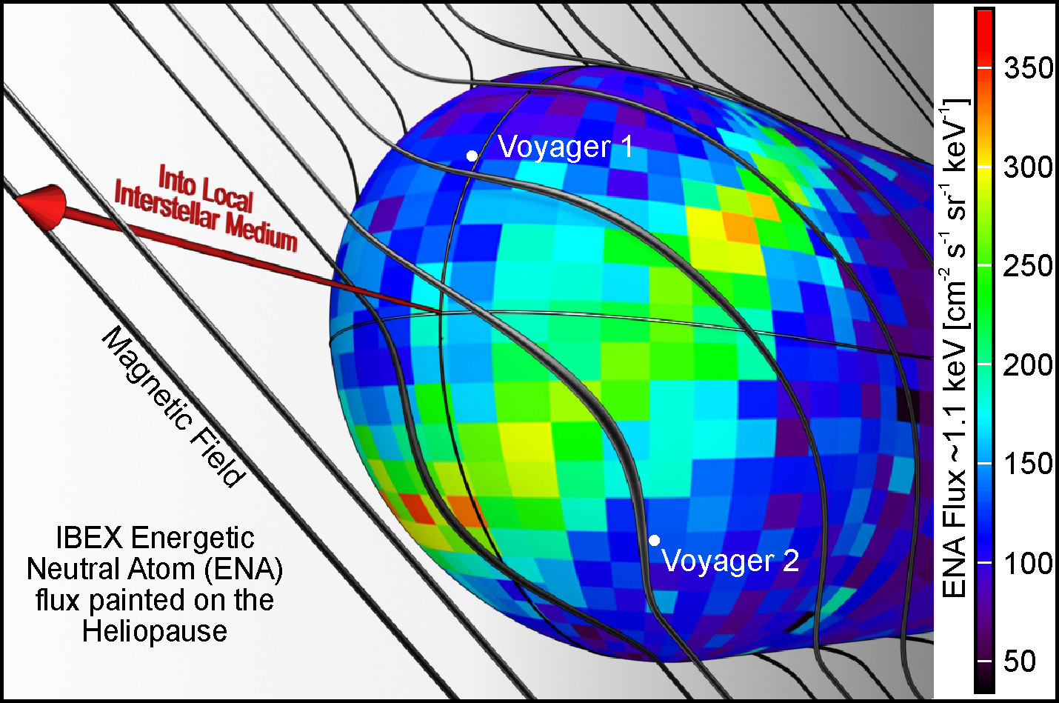
Configuration of Local Interstellar Magnetic Field around Heliosphere
Purpose: Map local interstellar
magnetic field (ISMF) in order to relate it to the ISMF controlling IBEX ribbon of energetic neutral atoms (ENAs).
Cover Science Magazine, Nov 2009

Slide 2
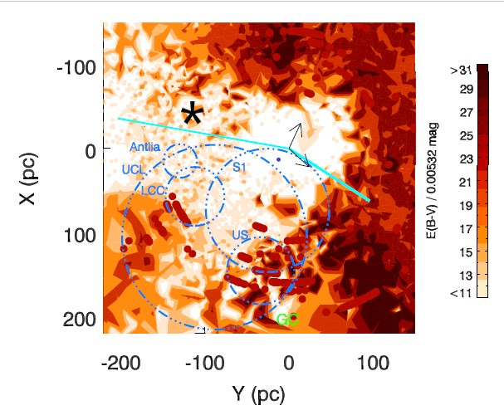
Get New Polarization Data for nearby stars inside Local Bubble
NEW Polarization DATA
Background image: Redding of Starlight projected onto Galactic Plane defines Local Bubble
(2) New polarization data collected for stars within 41 pc of heliosphere(thick dashed circle)
Old superbubbles distort interstellar magnetic field in low density local bubble.
(4) Ambient ISMF: cyan-lines; local bubble ISMF (pulsar data) and IBEX ribbon ISMF
(5) Eps CMa (asterisk): B1.5II, 22000K, ionizes the Local Interstellar Cloud (LIC) at heliosphere
(6) Sun near boundary of radio continuum “S1/S2” shells around Scorpius region Wolleben 2007)
(7) Plotted HI Bubbles: include Upper Centaurus Lupis, Lo wer Centaurus Crux, Upper Scorpius (de Geus 1992).
All data projected onto galactic plane.
PROJECT: Map ISMF within 40 pc of Sun using starlight polarized aligned
Credits: Reddening figure from Frisch Dwarkados 2018
LIC LSR velocity
Local Bubble
ISMF
IBEX ISMF
Galactic
Center

Slide 3
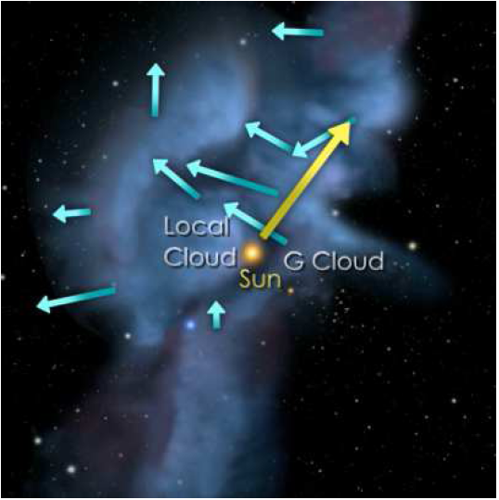
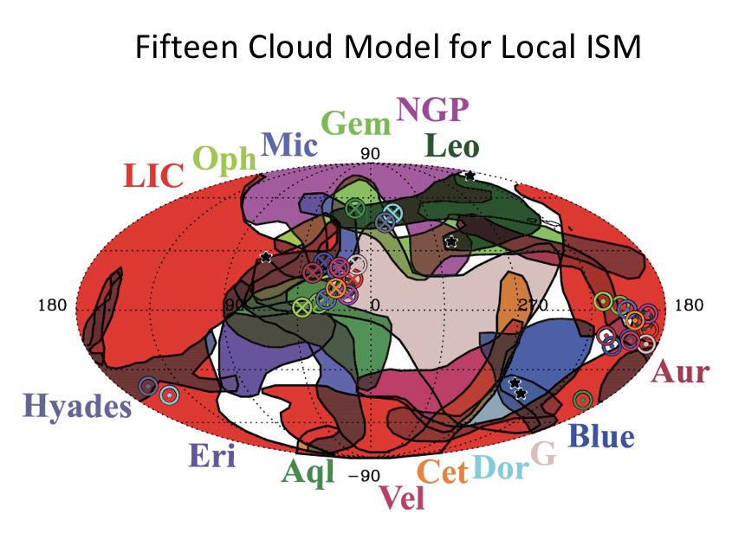
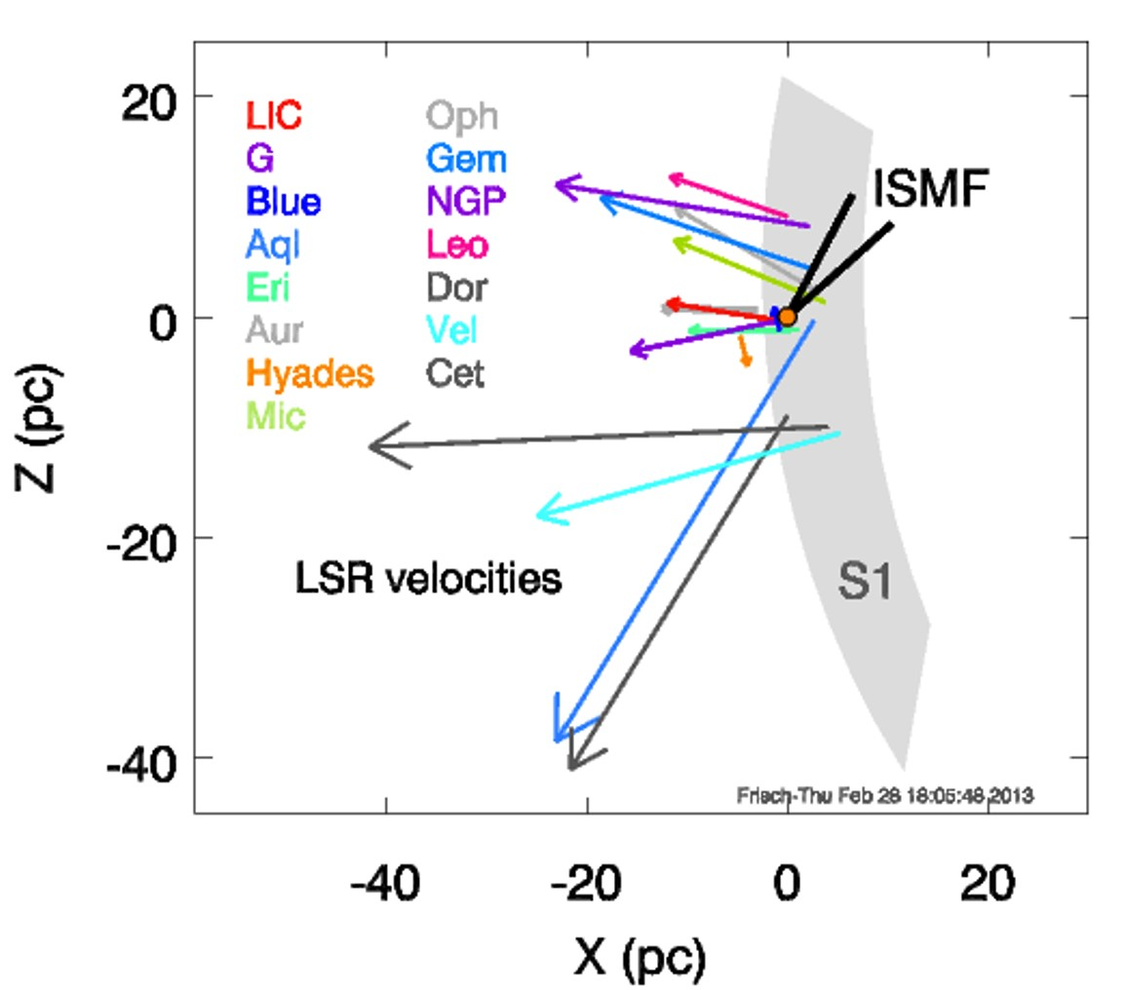
Modeling nterstellar Optical and UV Absorption lines as Clouds
+-7 pc
Galactic Center
Fig. Credit: Frisch,
Adler Planetarium, NASA

Slide 4
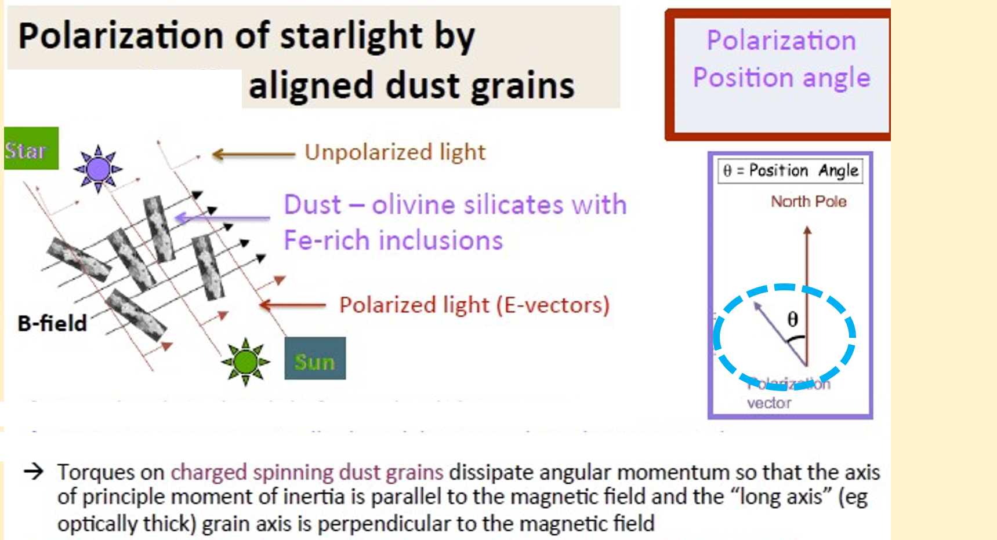
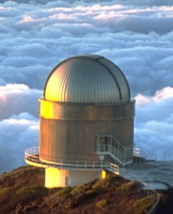

Slide 5
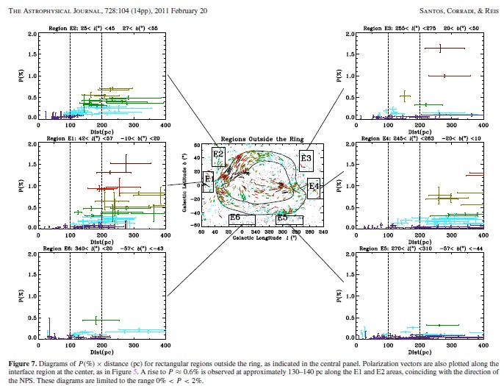
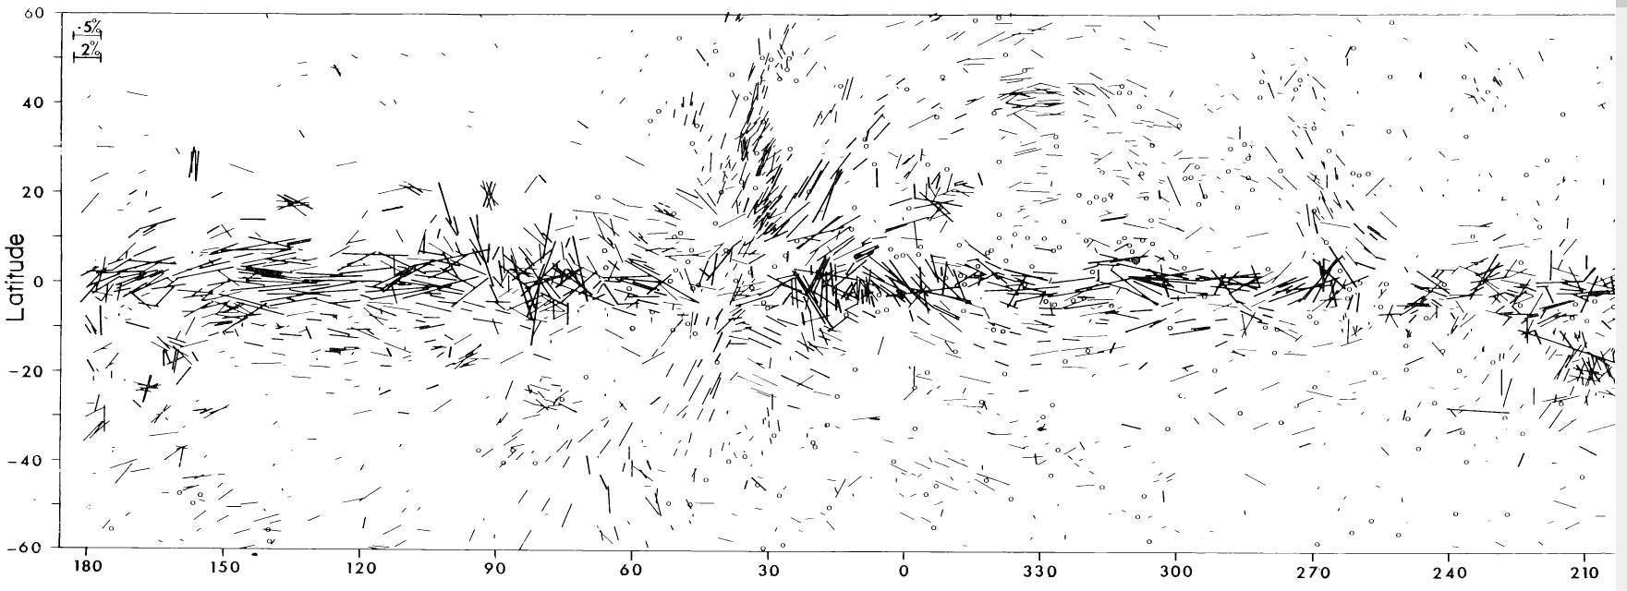
ISMF of Loop I Superbubble 20th/21st Century Data
Santos et al. 2011
Mathewson Ford 1972
We have now surveyed the local ISMF by collecting new polarization data at over 10 observatories in both hemispheres on three continents (US, Brazil, Australia) and four islands (Canary, Hawaii, Maui, Tasmania). Over half of new data from Vilppu Piirola (U. Tuku, Finland and his colleagues).

Slide 6
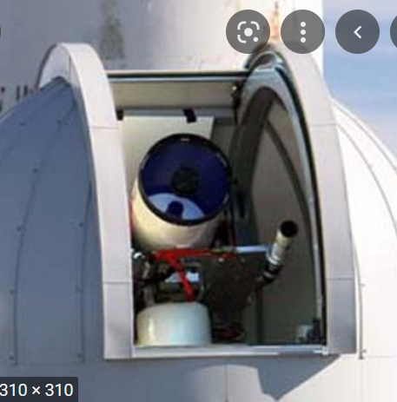
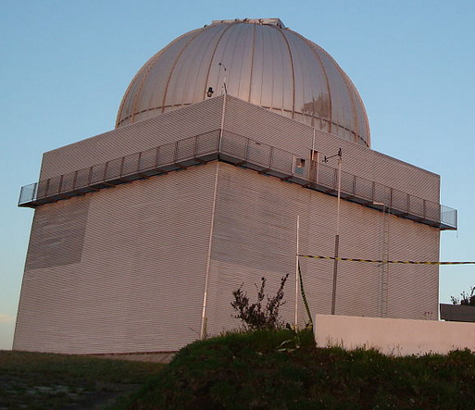
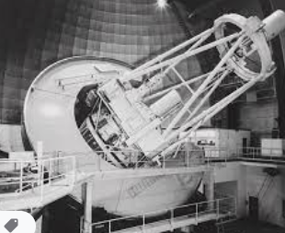
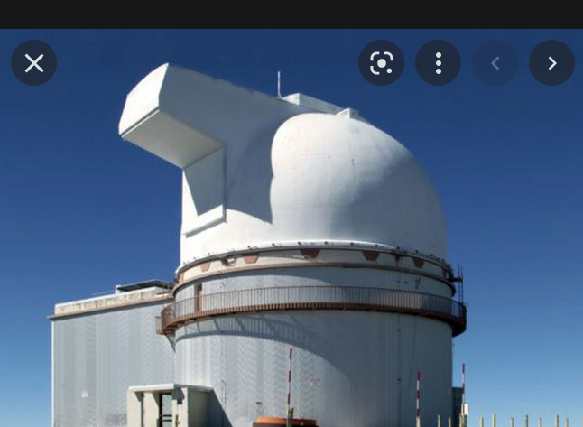
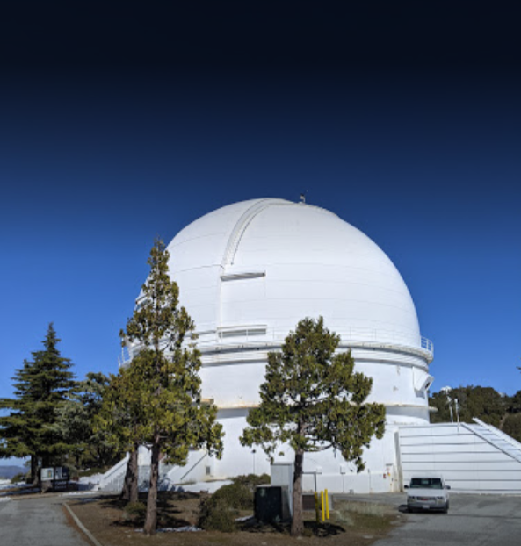
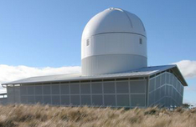
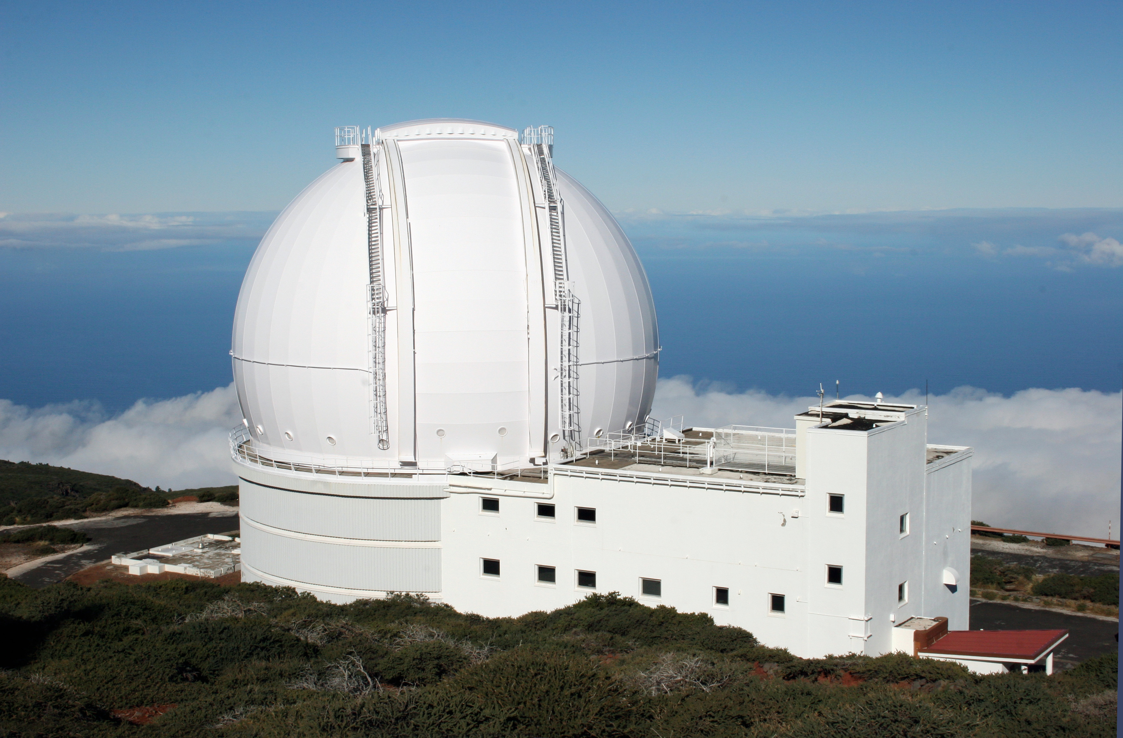
New Linear Polarization Data Collected at Observatories around World
T60, Haleakala, Japan/US
Picos dos Dios, Brazil
Anglo-Australian Telescope
U88, Mauna Kea, US
Lick Observatory, US
Greenhill Observatory. Tasmania
William Hershel
Canary Islands
Nordic Optical Telescope/Finland,Sweden
New data collected at over 10 observatories in both hemispheres on three continents (US, Brazil, Australia) and four islands (Canary, Hawaii, Maui, Tasmania). Over half of new data from Vilppu Piirola and collelagues (Finland)

Slide 7
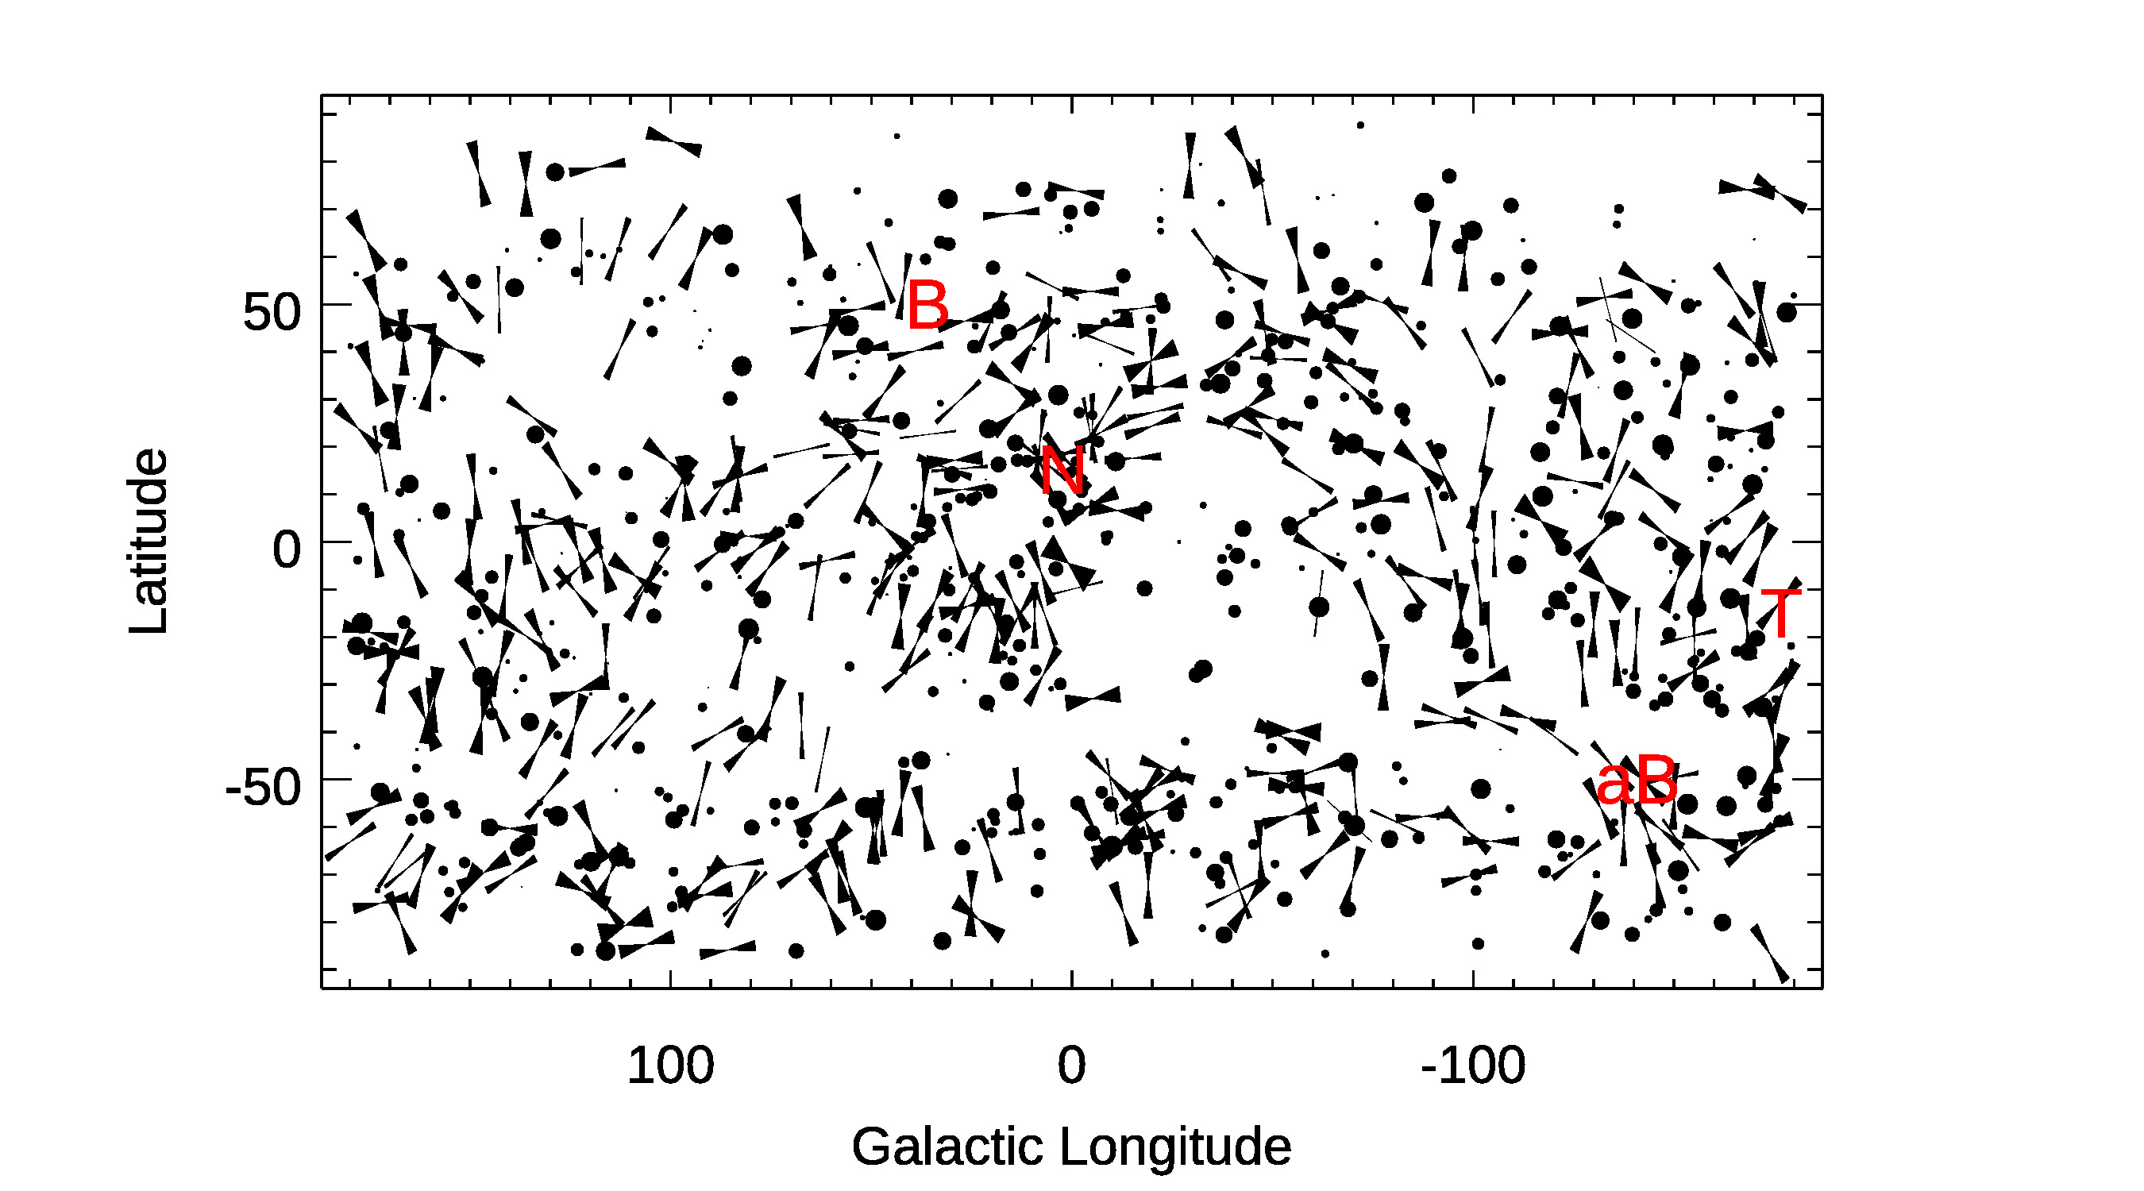
Polarization Data give ISMF orientation (galactic projection)
331 Stars, 20th and 21st century data
Stars with distance uncertainties
that include 40 pc
Symbols:
“dots”: P/dP<1.95 (P=polarization)
dot radius proportional to P/dP
Polarization position angles (PA):
angular extent ~ uncertainties
“Space marks”:
Nose of heliosphere
B, aB: ISMF orientation

Slide 8
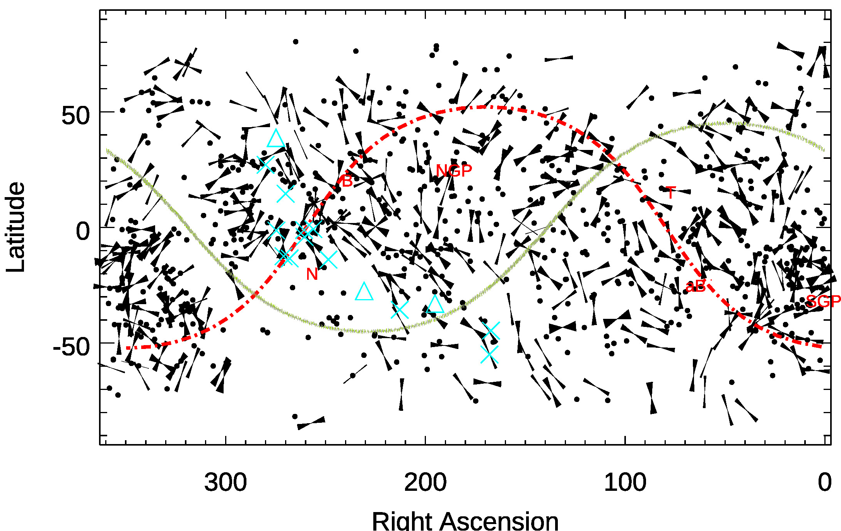
Polarization data RA, DEC
(celestial coordinates)
* Cyan ” * ”: voyager khz emissions from beyond heliopause.
Cyan triangles: QSO intraday variables
Red letters/numbers: CMB multipole, oriented quadrupole vectors derived from WMAP ILC 3-year maps
_{BxV} _{plane : Purple dash-dot plane}

Slide 9
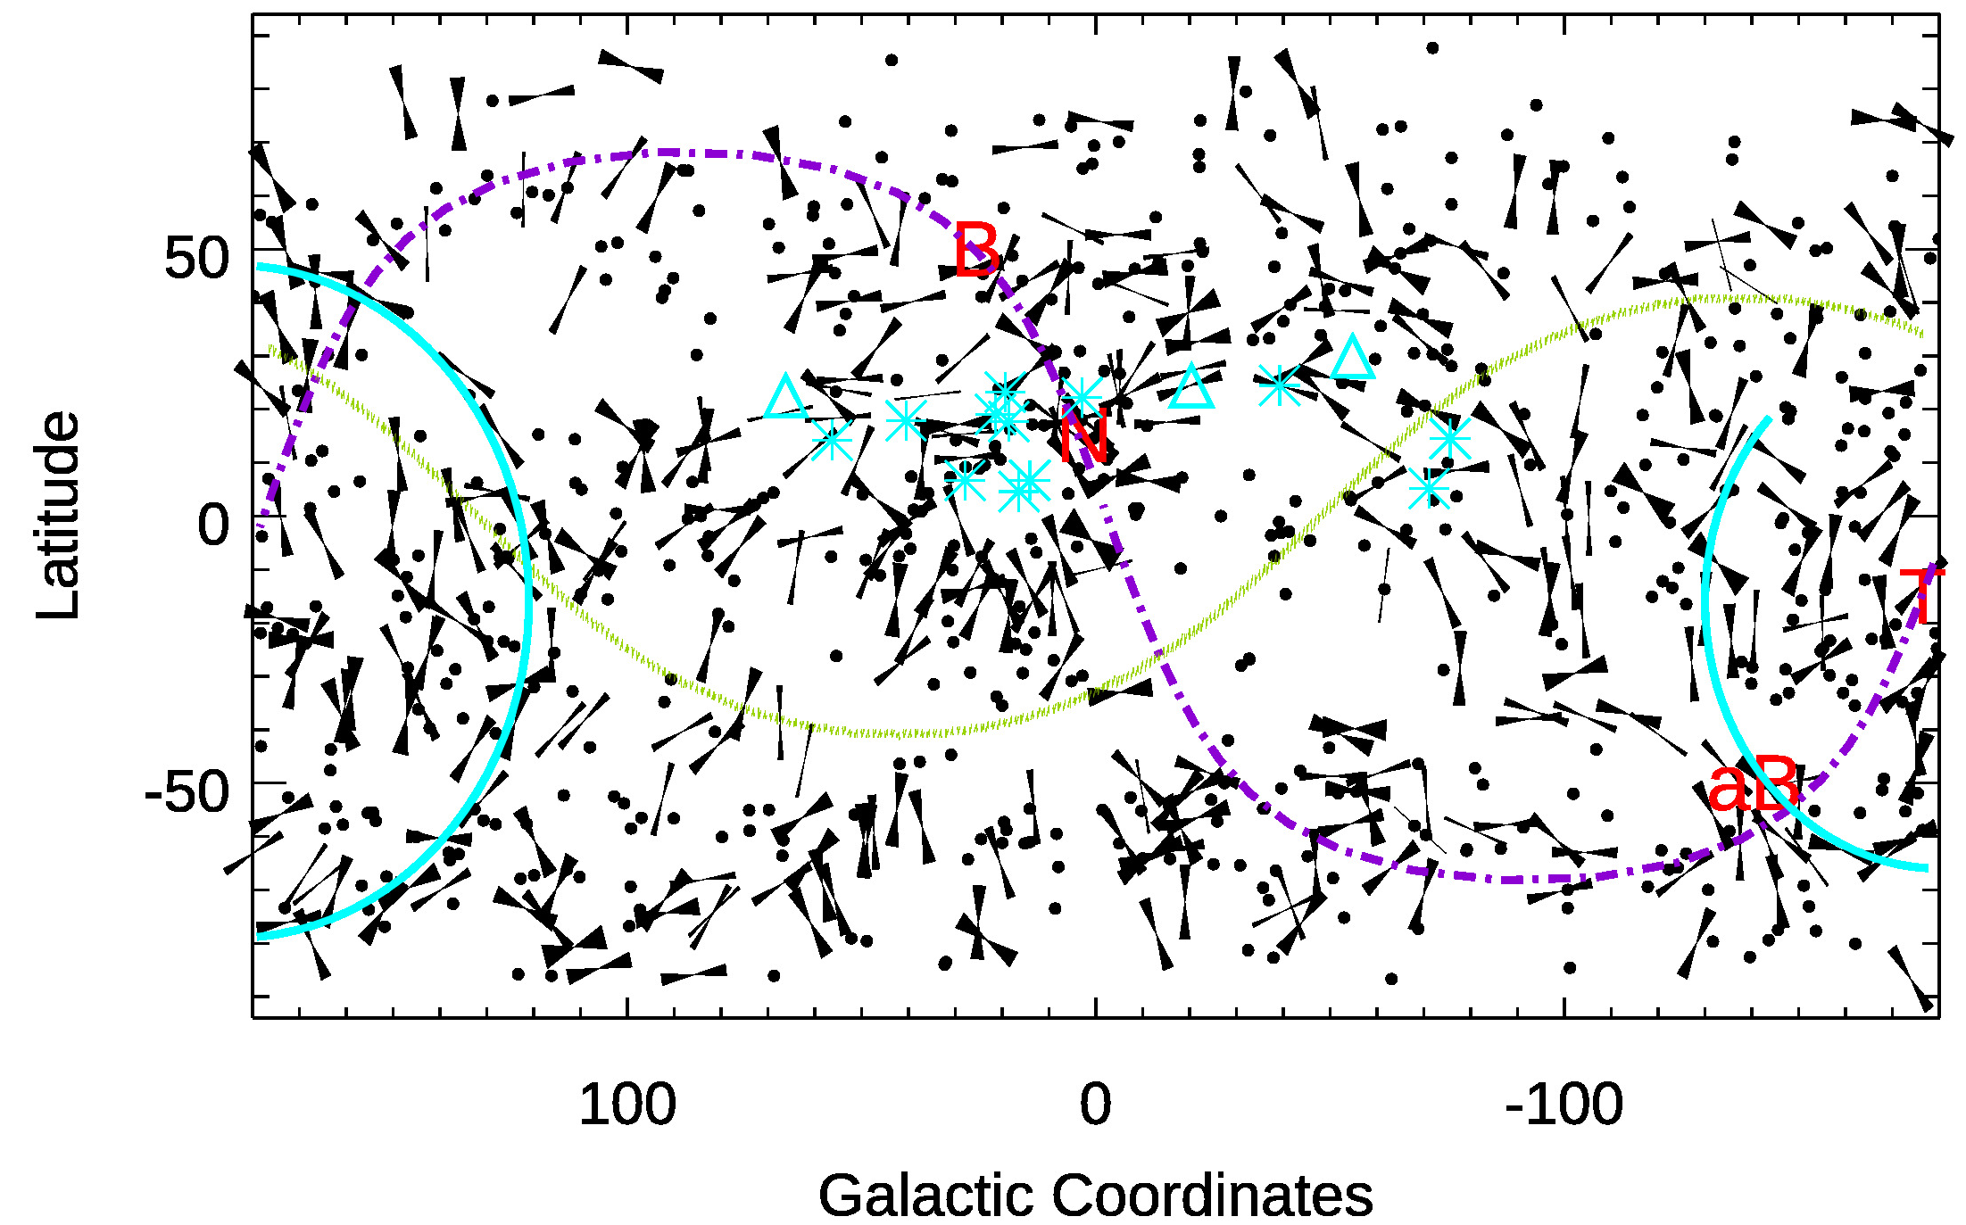
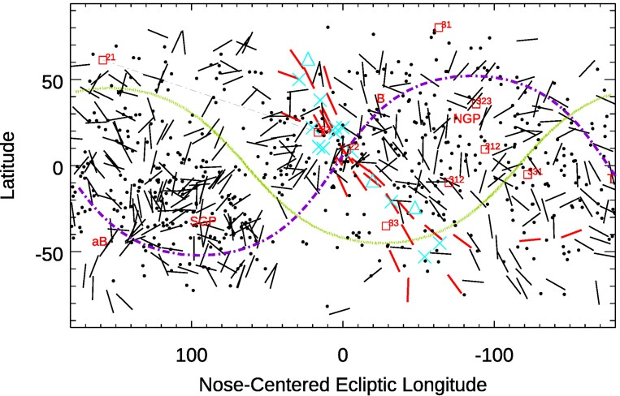
Galactic Ecliptic Equatorial
Polarization data and features in three projections
Heliotail: Surrounded by Magnetic halo traced by polarization data
Other: QSO intraday variables (e.g. Linsky Redfield 2008)
Red letters and numbers: CMB multipole, oriented quadrupole vectors derived from WMAP ILC 3-year maps (Copi et al. 2007 )
B x V (“B cross V”) plane (dash-dot) is basic symmetry plane of heliosphere
Filament A: Red polarizations shown in ecliptic projection (new discovery)
Two giant cyan arcs around heliotail (new discovery)

Slide 10
Determining ISMF orientation from Position Angles of Polarized Starlight

Slide 11
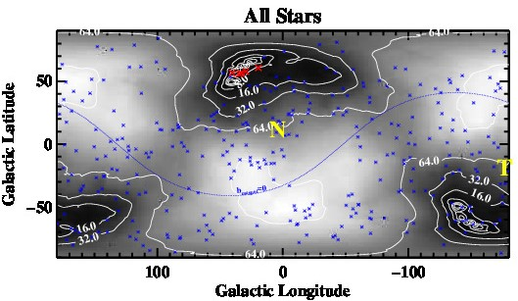
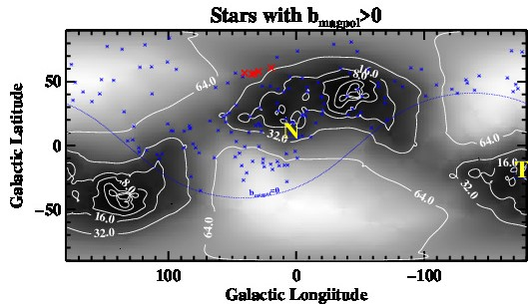
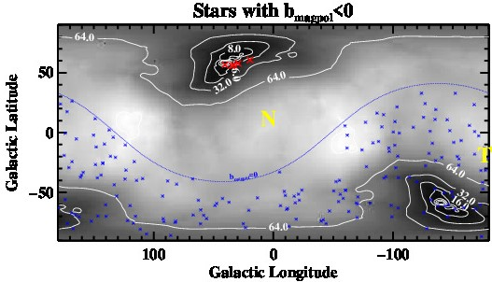
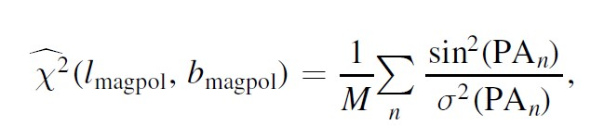
Probabilities that Polarization Position Angles trace ISMF at each location
GALACTIC COORDINATES
Figures show reduced chi^2 fit based on probability density function for ISMF at each location
Three data samples:
Left image: fit to all 301 stars: Best-fitting ISMF toward B_magpol at L=42 deg, B=49 deg
Middle image: Best fitting ISMF for stars within 90 deg of B_magpol (“B_magpol>0”)
Right image: Best fitting ISMF for stars over 90 deg of B_magpol (“B_magpol<0”)
Highest probability ISMF orientation found for “B_magpol<0”

Slide 12
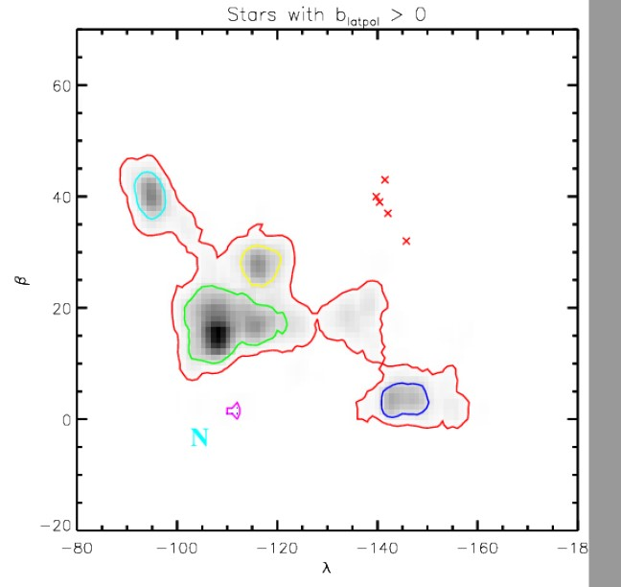
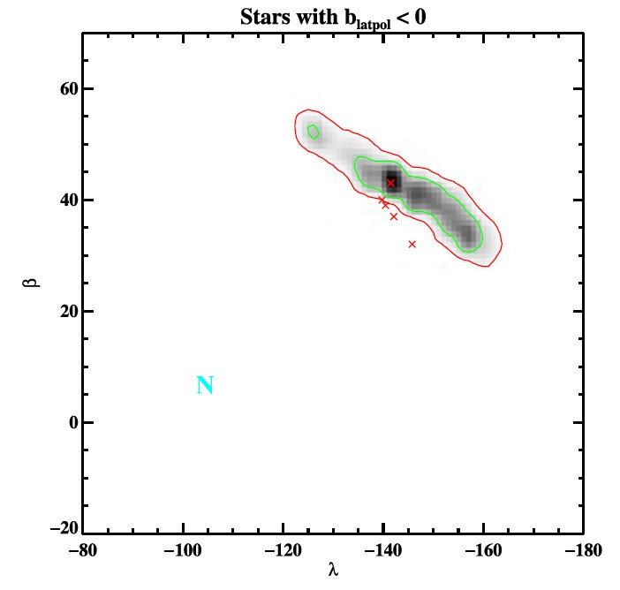
Probability density function for ISMF at each location in Ecliptic Coordinates
Best ISMF fits for stars more than 180. deg from fit to entire data set fit:
λ=219 deg +/− 15 deg, β=43 deg +/-17deg
Probability density function conspicuously elongated parallel to IBEX ribbon centers (red dots, bottom fig.).
WHY? Unrecognized ,magnetic filament or bow wave wrapped around heliosphere?
2σ
Green/red Probability contours: 1-sigma/2-sigma
Notes:
References:
Frisch et al. 1999
Slavin et al. 2012
Frisch et al. 2022

Slide 13
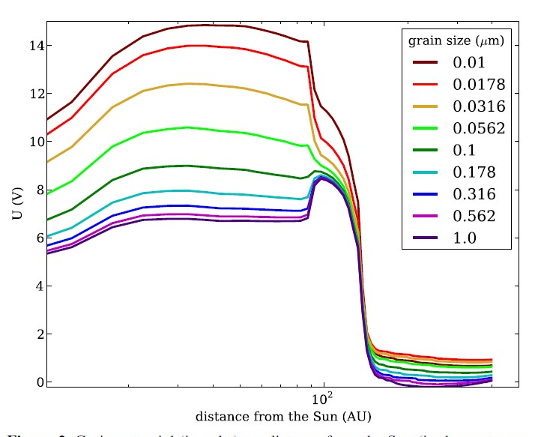
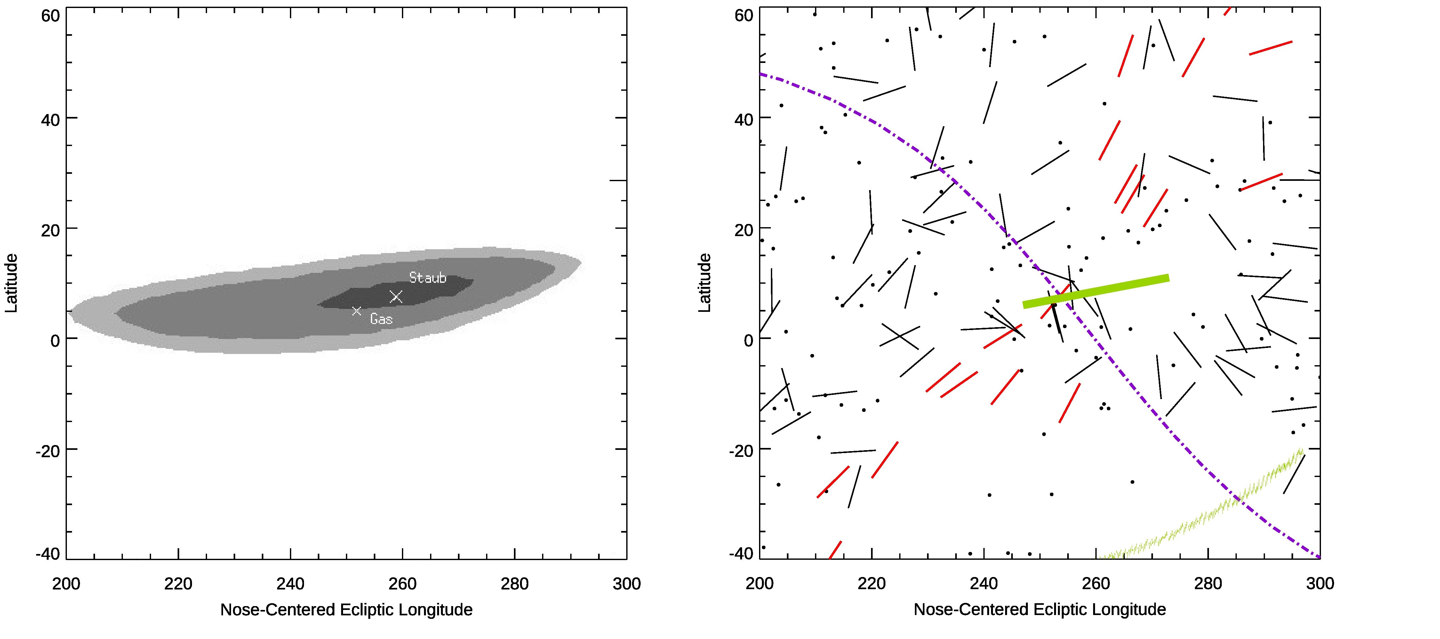
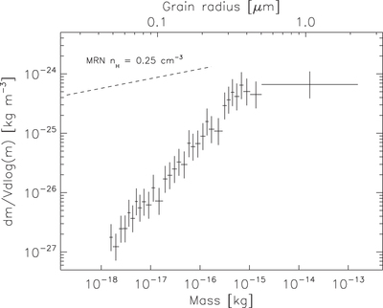
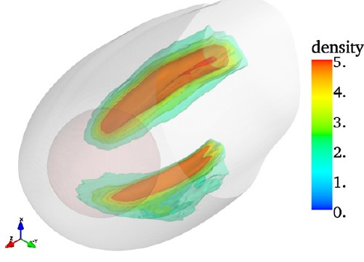
Filament A: Story of Charged Interstellar Dust Grains Interacting with Heliosphere
Left to Right:
Grain potential (V) for interstellar grains in heliosheath (Slavin et al. 2012)
Upwind Direction of large grains enter heliosphere. Ulysses and Galileo Data collected early 1990’s (Frisch et al. 1999)
Filament A (with BV plane) (Frisch et al. 2022)
Small grains excluded from inner heliosphere by high Q/M (Frisch et al. 1999, Slavin et al. 2012, Sterken et al. 2015)
Plumes of dust around the heliosphere from Slavin et al. 2012 simulations
Notes:
References:
Frisch et al. 1999
Slavin et al. 2012
Frisch et al. 2022

Slide 14
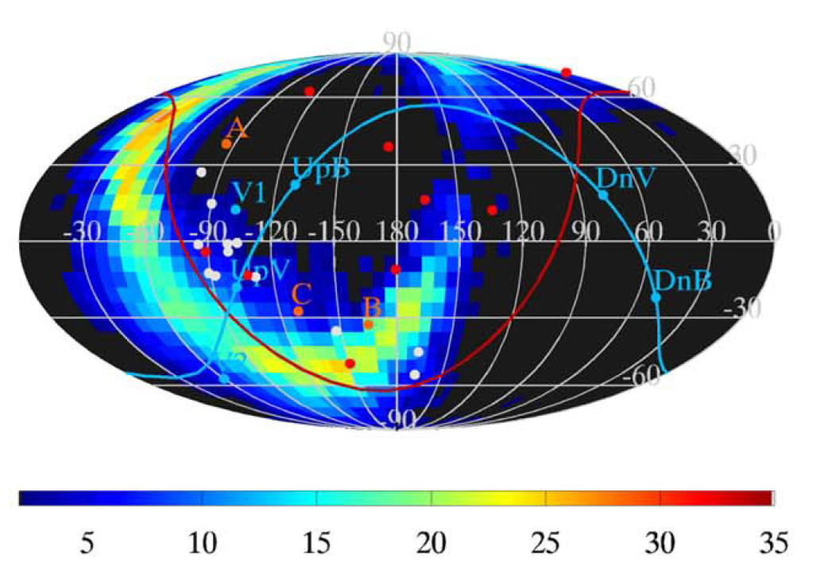
IBEX Ribbon (in RA, DEC)
_{“C”: IBEX ribbon in RA, DEC}
“V” letters: Voyager spacecrafrt locations
_{white dots: 3 khz emission} _{s} _{V!/V2}
Red dots: CMB multipole moments
_{Red Letteres: QSO} _{intraday variables}
_{upV/downV: upwind/downwind}
_{upB/downB: +/- ISMF poles}

Slide 15
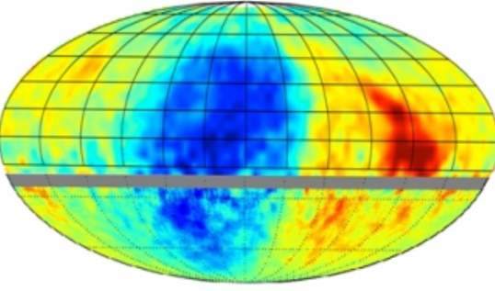
IBEX Ribbon (L) and Tibet AS gamma GCR data (R)

Slide 16
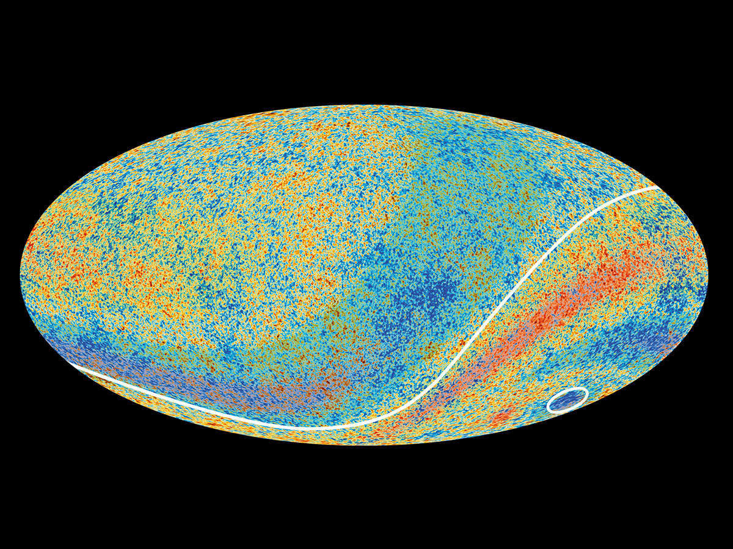
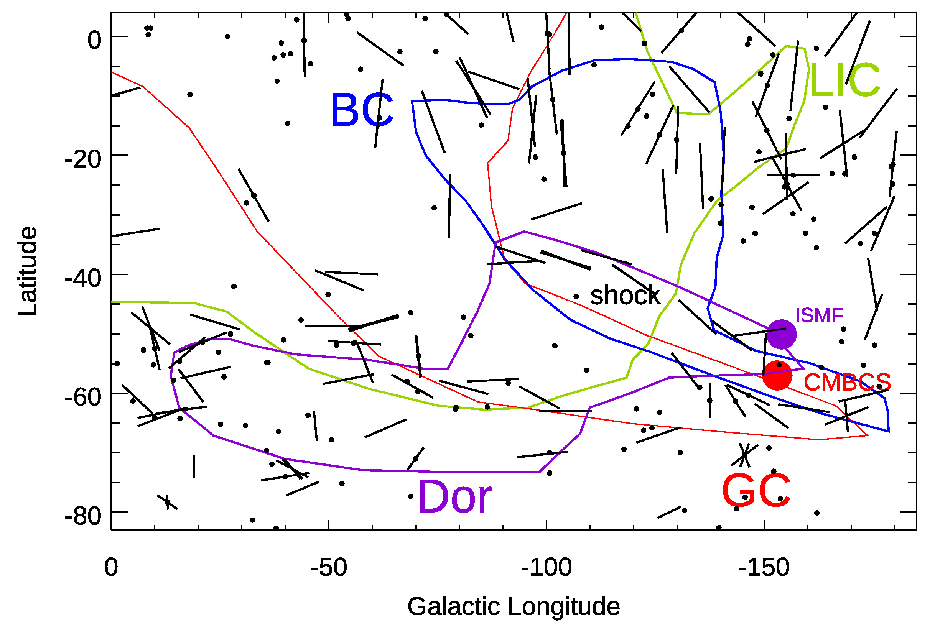
ISMF, CMB Dark Spot, Colliding Clouds
View Parallel to ISMF shows CMB dark spot
Look along opaque axis of aligned dust grains and see CMB “Dark Spot” within 10 deg of ISMF (Frisch et al. 2022)
Plank image with CMB dark spot

