Slide 1
Turbulence in the very local interstellar medium
Voyager 1 and 2 in situ observations
Federico Fraternale, N. V. Pogorelov
The University of Alabama in Huntsville
Cosmic Ray Anisotropy Workshop
Layola University, Chicago IL, May 16-19, 2023

Slide 2
Outline
Introduction (turbulence of the VLISM)
LISM vs VLISM power spectra of turbulence
Magnetic field fluctuations observed in situ by Voyager 1 and 2
Quasi periodic behavior of low energy electron GCR count rates in the VLISM
Summary

Slide 3
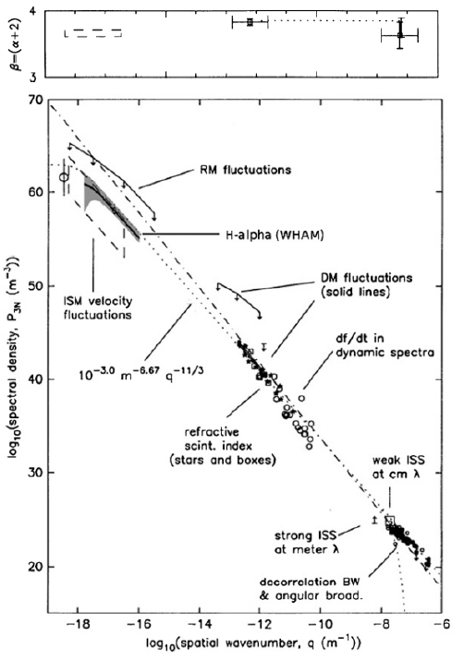
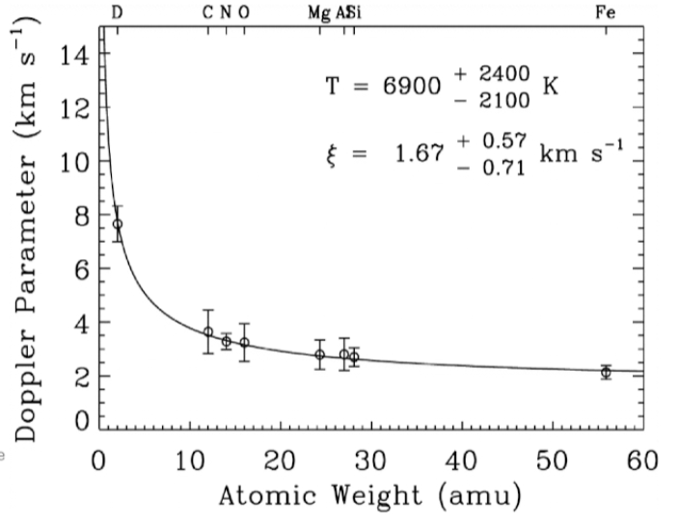
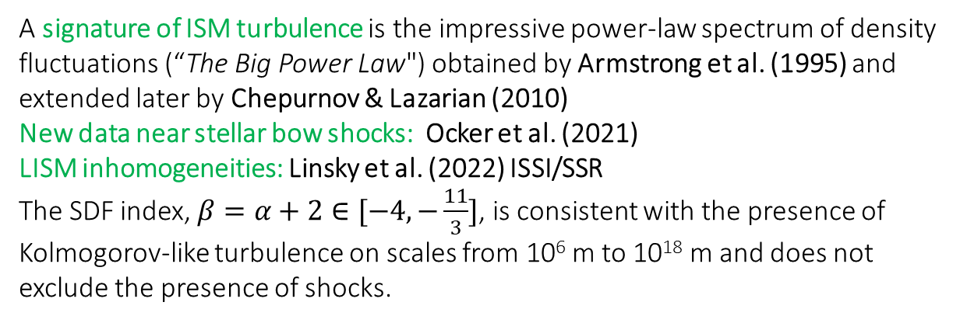
Introduction: turbulence of the LISM and VLISM
The ISM has been long recognized to be turbulent on scales up to 1000 pc (Lee and Jokipii, 1976; Armstrong et al., 1981)
A signature of ISM turbulence is the impressive power-law spectrum of density fluctuations (“The Big Power Law") obtained by Armstrong et al. (1995) and extended later by Chepurnov & Lazarian (2010)
New data near stellar bow shocks: Ocker et al. (2021)
LISM inhomogeneities: Linsky et al. (2022) ISSI/SSR
The SDF index, $β=α+2∈[−4,−\frac{11}{3}]$, is consistent with the presence of Kolmogorov-like turbulence on scales from 10⁶ m to 10¹⁸ m and does not exclude the presence of shocks.
Redfield and Linsky (2004):
-Turbulence properties from adsorption line measurements.
-VLISM turbulence is subsonic.
Frisch et al (2011 )obtained the turbulent component of 9°1° for the draped ISMF near the Sun in the upwind direction.
Armstrong et al. (1995)

Slide 4
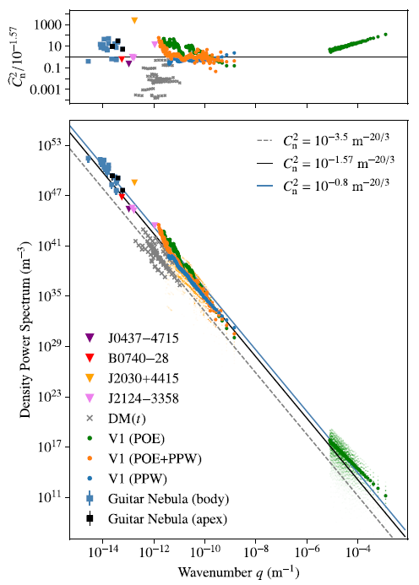
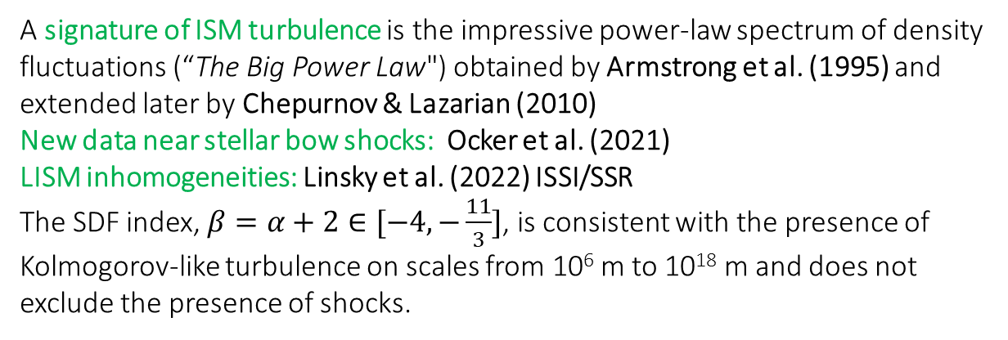
The ISM has been long recognized to be turbulent on scales up to 1000 pc (Lee and Jokipii, 1976; Armstrong et al., 1981)
A signature of ISM turbulence is the impressive power-law spectrum of density fluctuations (“The Big Power Law") obtained by Armstrong et al. (1995) and extended later by Chepurnov & Lazarian (2010)
New data near stellar bow shocks: Ocker et al. (2021)
LISM inhomogeneities: Linsky et al. (2022) ISSI/SSR
The SDF index, $β=α+2∈[−4,−\frac{11}{3}]$, is consistent with the presence of Kolmogorov-like turbulence on scales from 10⁶ m to 10¹⁸ m and does not exclude the presence of shocks.
Redfield and Linsky (2004):
-Turbulence properties from adsorption line measurements.
-VLISM turbulence is subsonic.
Frisch et al (2011 )obtained the turbulent component of 9°1° for the draped ISMF near the Sun in the upwind direction.
Ocker et al. (2021)

Slide 5
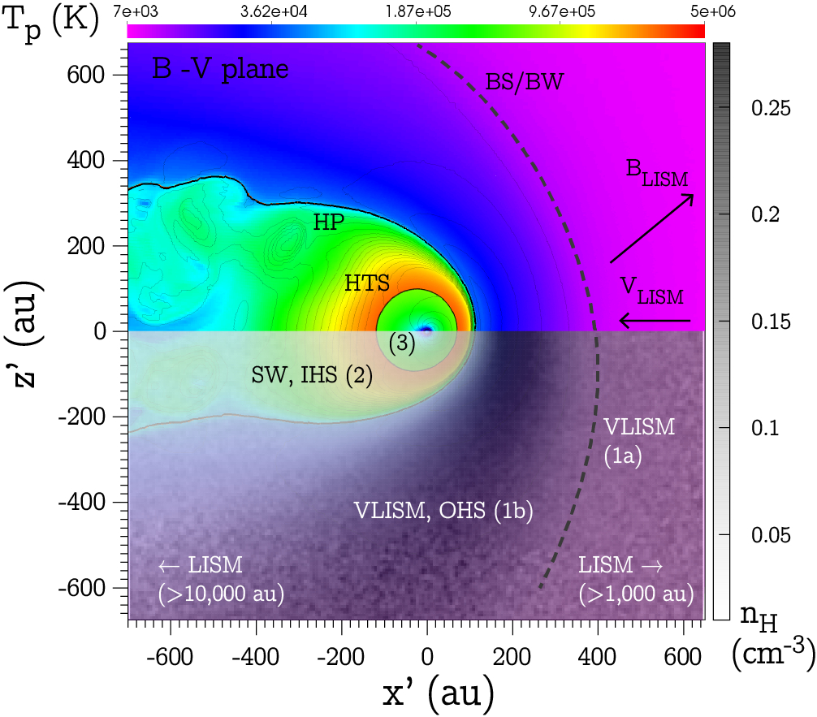
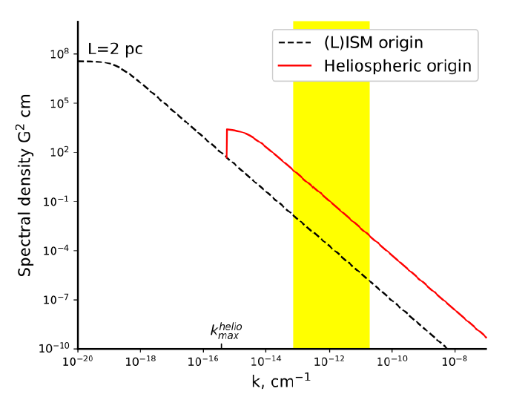
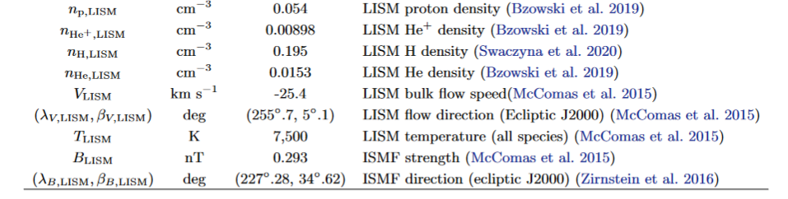
Review paper:
Fraternale et al. SSRv (2022)
“Turbulence in the outer heliosphere”
The HP motion injects turbulence and waves on frequencies <3 x10-9 Hz
Local shock/turbulence interactions.
Coulomb collisions.
Ion-neutrals charge exchange and elastic collisions
Kinetic-scale processes associated with shocks and instabilities of suprathermal ions
GCR/turbulence interaction.
The pristine interstellar turbulence and its possible mediation by the bow shock or wave.
See also Burlaga et al (2018)
Zank et al. (2019)
Major shock/compression waves
Electron plasma oscillation events/2-3 kHz radio emissions
Galactic cosmic ray (GCR) anisotropy; enhancements in front of shocks; oscillations
Compressible and incompressible fluctuations of B
Electron density fluctuations
Observations

Slide 6
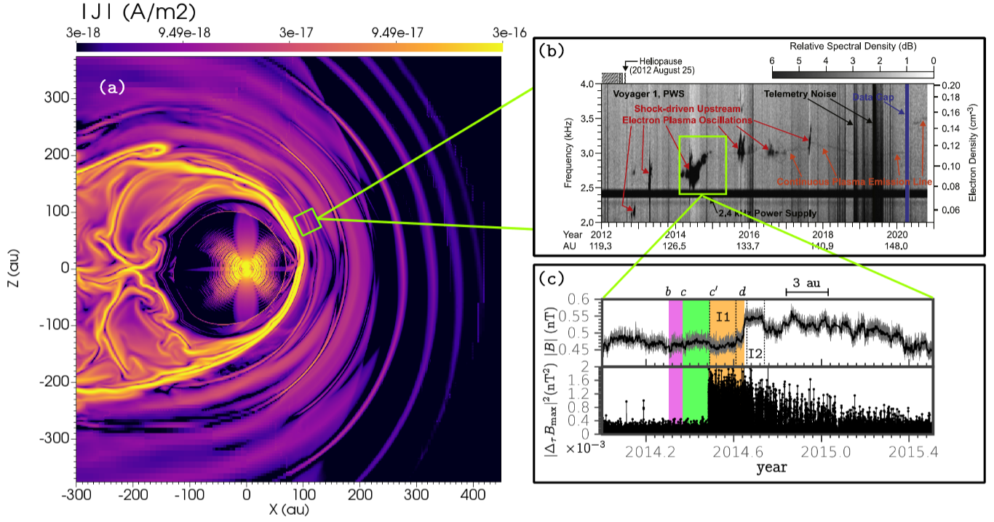
The forcing effect of the heliosphere on the VLISM. Compressible (mostly) fluctuations radiate from the HP into the VLISM due to solar-cycle dynamics.
A time dependent, global, 3D numerical model of the SW/LISM interaction (MS-FLUKSS code). Here, the solar cycle is nominal.

Slide 7
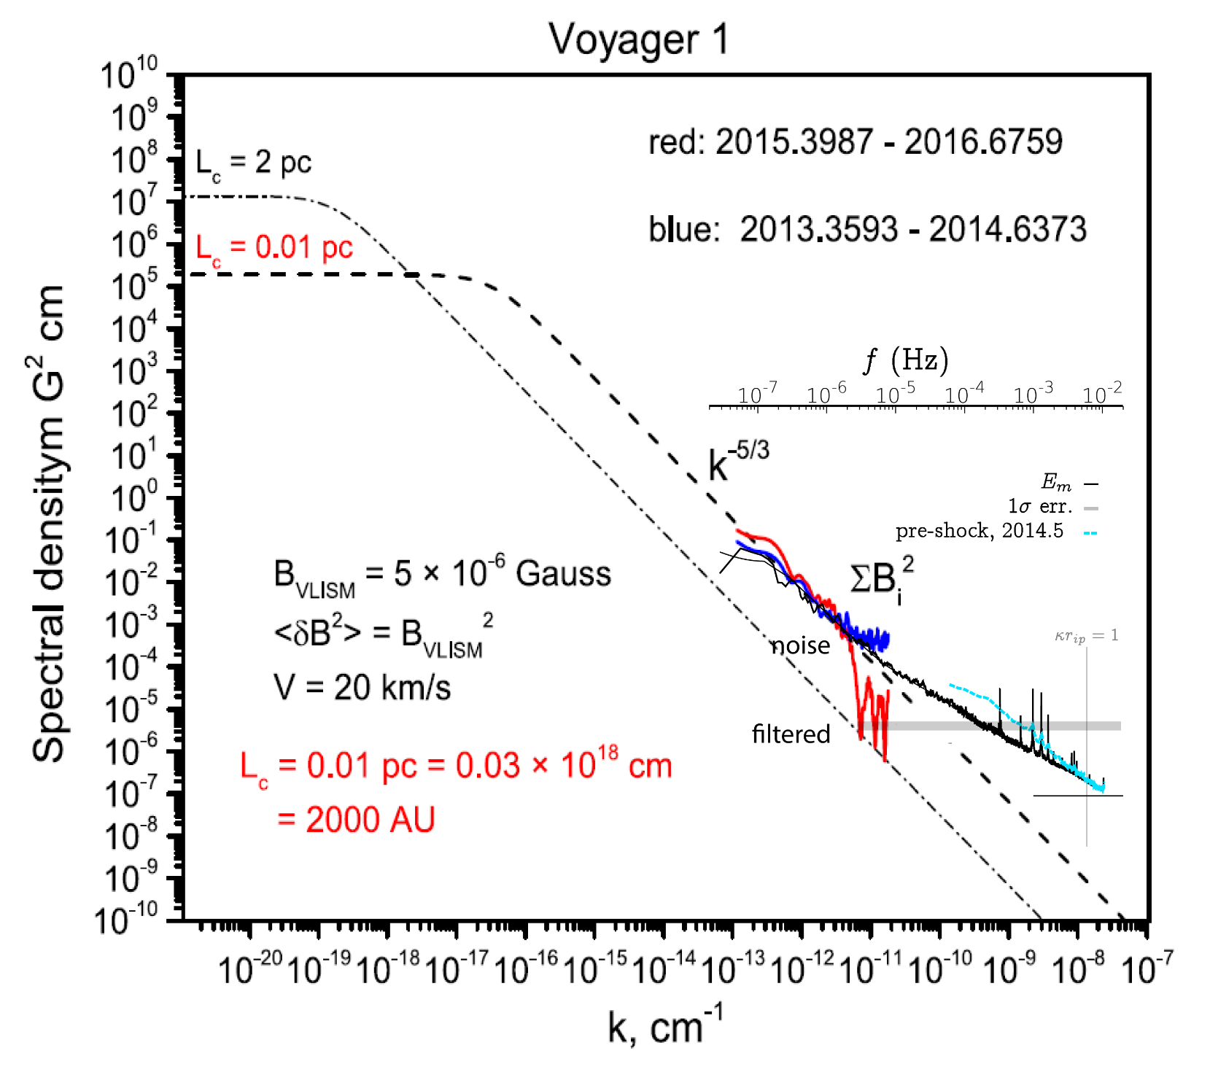
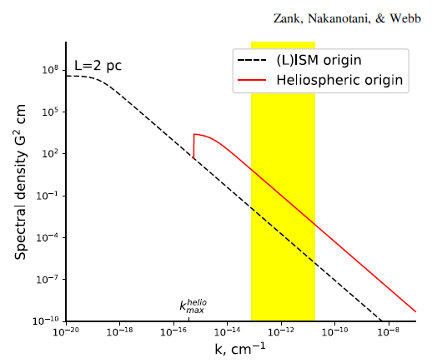
Turbulence of the LISM: outer scale
Burlaga, Florinski, & Ness, ApJ, 2018
Black curve: spectrum from high resolution V1 data (48 s)
Fraternale & Pogorelov, ApJ, 2021
260 au
Light blue curve: spectrum in front of shock wave S2. Similar enhancement found in late 2018.
Xu, S. & Li, H. ApJL (2022)
Fraternale, Pogorelov, & Burlaga, ApJL, 2020
Fraternale et al 2020,2021
Zank, Nakanotani, & Webb, ApJ, 2019
1/f

Slide 8
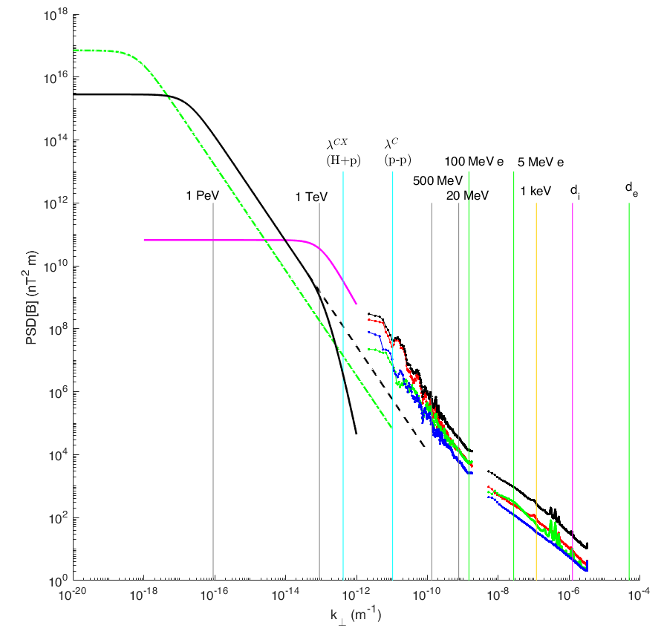
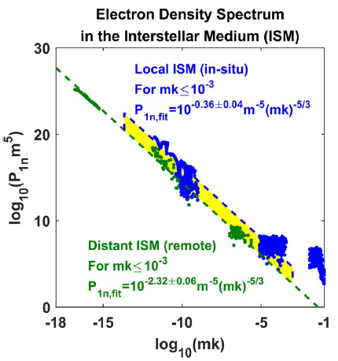






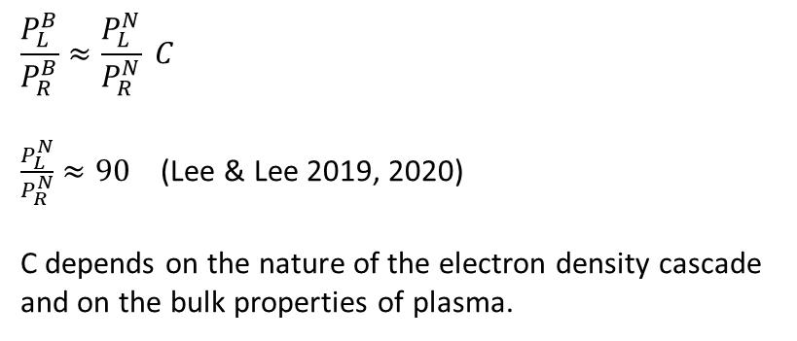

$$L=50 pc$$
$B_{0}=0.3 nT$
$δB/B_{0} ∼1$
$$\frac{P_{L}^{B}}{P_{R}^{B}}≈\frac{P_{L}^{N}}{P_{R}^{N}} C$$
$\frac{P_{L}^{N}}{P_{R}^{N}}≈90$ (Lee & Lee 2019, 2020)
C depends on the nature of the electron density cascade
and on the bulk properties of plasma.
$$L=2 pc$$
$$−5/3$$
$$M_{A,inj}^{turb}<1$$
$$β∼0.4−0.8$$
shocks
$$δB_{inj}/B∼0.25$$
Lee & Lee Nat (2019)
1/f
Notes:
A rough estimate gives
$C≈1 slowR−fastL$
$$C≈{\left(\frac{β_{L}}{β_{R}}\right)}^{2}{\left(\frac{B_{0L}}{B_{0R}}\right)}^{2}{\left(\frac{ρ_{0L}}{ρ_{0R}} \right)}^{2}∼1−20 slowR−slowL$$
$$C≈\frac{4}{γβ_{L}^{2}}{\left(\frac{B_{0L}}{B_{0R}}\right)}^{2}{\left(\frac{ρ_{0L}}{ρ_{0R}} \right)}^{2}≈1−30 slowR−fastL$$

Slide 9
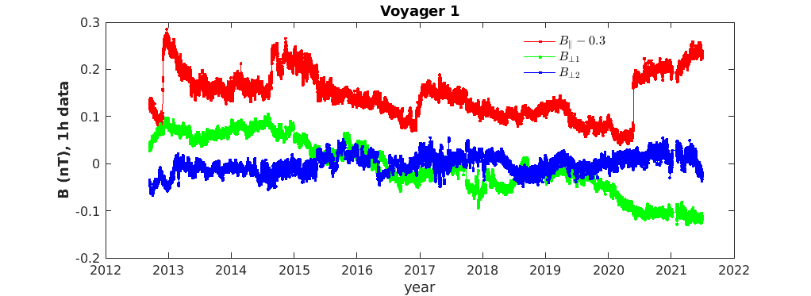
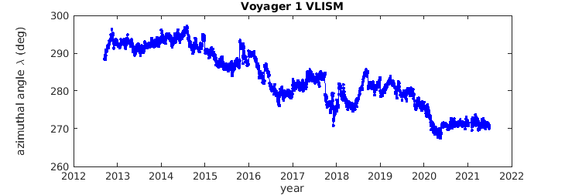
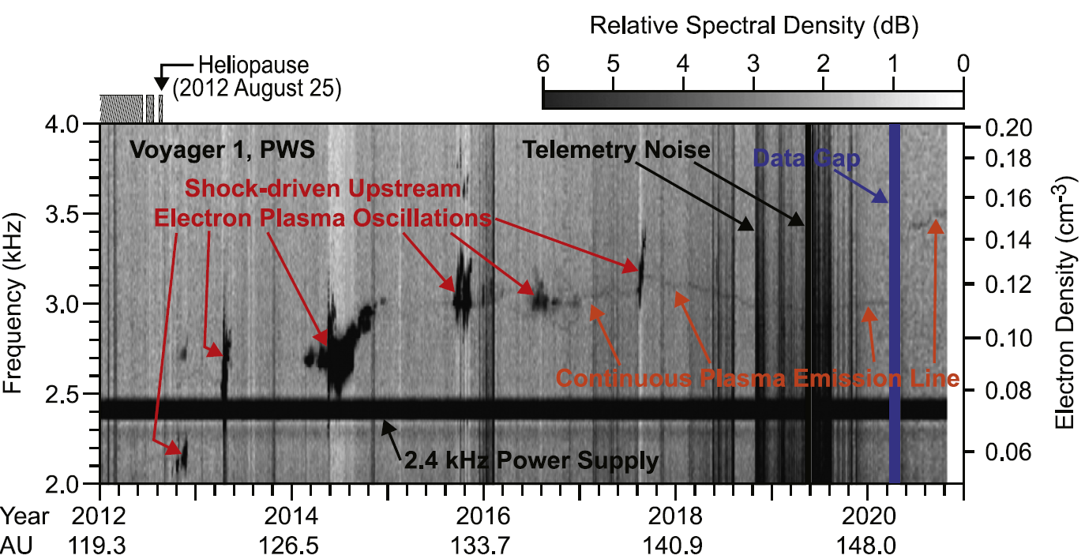
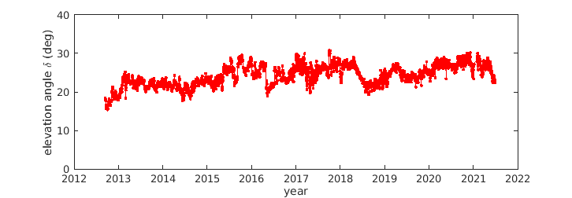
Fluctuations of B in the VLISM (OHS): V1
Recent Voyager 1 data: a large pressure front (or shock) Burlaga et al. (2021) , with increasing magnetic field behind it.
The average (r.m.s.) change in the angles is only about 2.8 deg. The maximum is 9 degrees (azimuthal angle).
Gurnett et al. (2021)

Slide 10
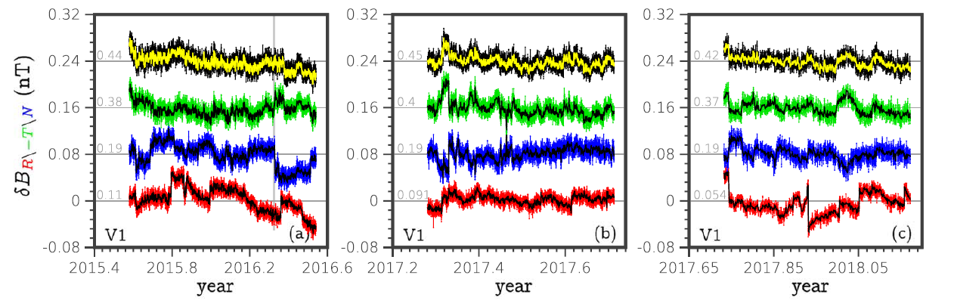
Fluctuations of B in the VLISM: waveforms
Fraternale & Pogorelov, ApJ 2021
“quiet interval”
“disturbed interval”
“quiet interval”
Quasi periodic fluctuations in “disturbed” regions behind shocks were observed at V1 by Burlaga et al (2016, 2019, 2022). Fraternale & Pogorelov (2021) show they are ubiquitous .
Periodicities range from$10−100$ days ($ℓ∼0.2−2 AU$). Mixed compressive/transverse nature
Global numerical simulations (Kim et al 2017, see also Pogorelov et al. 2021) show that steepening waves may continuously sweep the OHS and overtake each other.
“N-wave” profiles (Whitham 1974) largely contributes to the intermittency found recently at intermediate scales ($τ∈\left[{10}^{4},{10}^{6}\right] s$) - Fraternale et al 2019, 2021, Burlaga et al 2021.

Slide 11
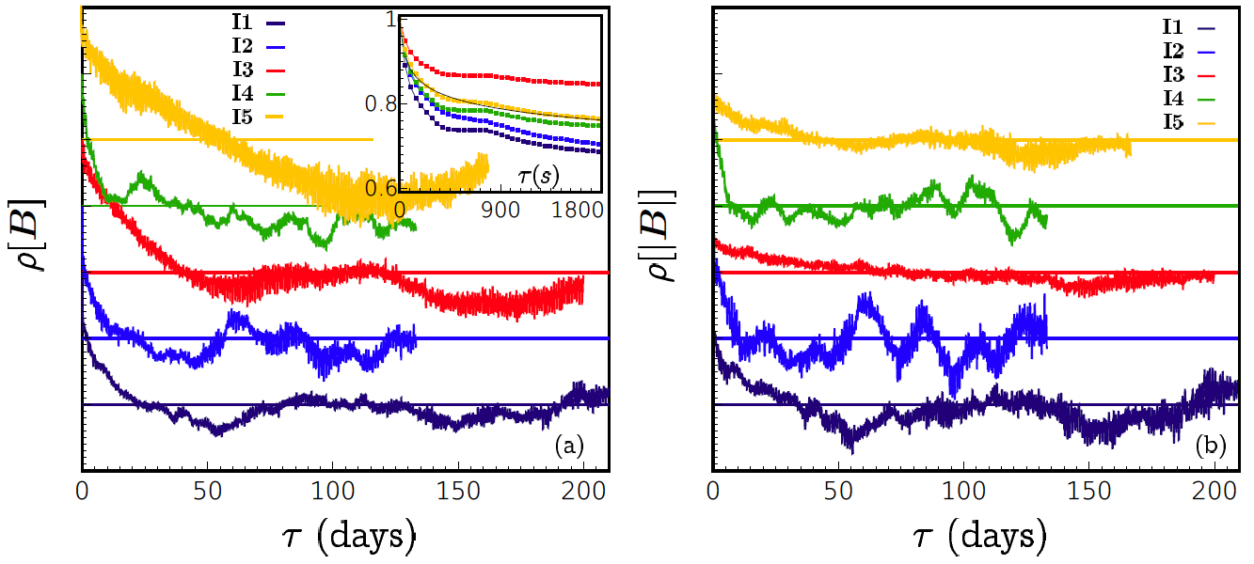
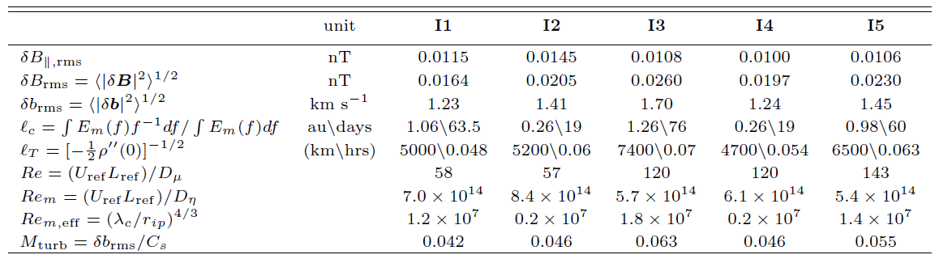
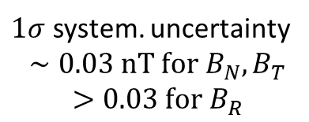
Turbulence in the VLISM: correlation functions
$1σ$ system. uncertainty
$$∼0.03 nT for B_{N}, B_{T}$$
$$>0.03 for B_{R}$$
Fluxgate magnetometer sensitivity: 0.005 nT
Fraternale & Pogorelov, ApJ 2021

Slide 12
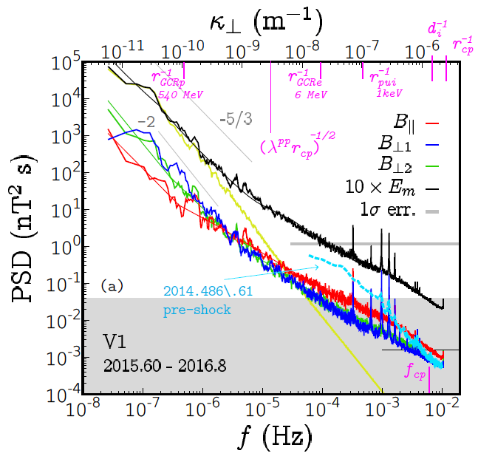
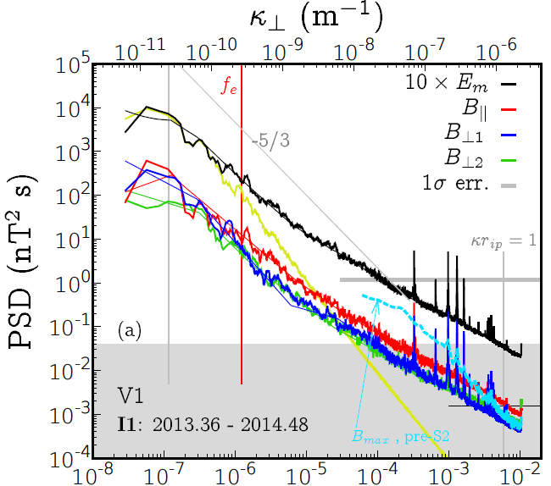
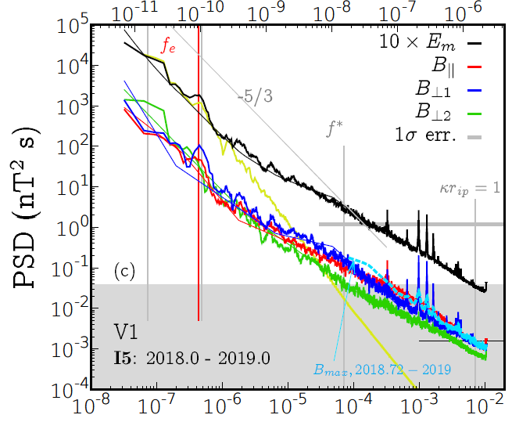
Turbulence in the VLISM: power spectral density
Magnetic field fluctuations
$MHD scales , f∈\left[10^{−8}, 10^{−6}\right]$ Hz
Effect of heliospheric forcing, quasi-periodic waves
Spectral index occasionally larger than Kolmogorov’s
Burgers-like turbulence phenomenology (strong wave turbulence)?
Fraternale & Pogorelov, ApJ 2021 (see tables)

Slide 13
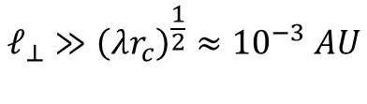
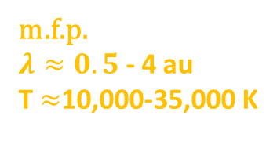

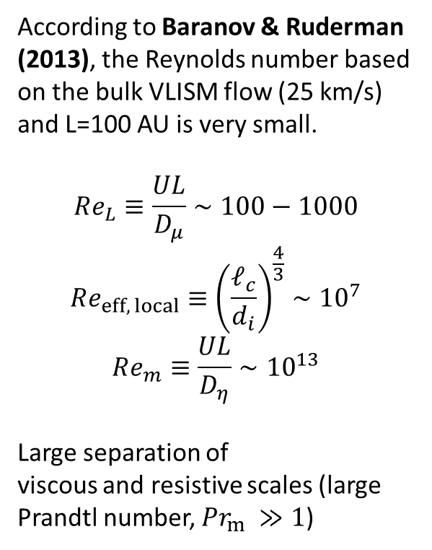
Turbulence in the VLISM: power spectral density
Magnetic field fluctuations
According to Baranov & Ruderman (2013), the Reynolds number based on the bulk VLISM flow (25 km/s) and L=100 AU is very small.
$$Re_{L}≡\frac{UL}{D_{μ}}∼100−1000$$
$$Re_{eff, local}≡{\left(\frac{ℓ_{c}}{d_{i}}\right)}^{\frac{4}{3}}∼{10}^{7}$$
$$Re_{m}≡\frac{UL}{D_{η}}∼{10}^{13}$$
Large separation of
viscous and resistive scales (large Prandtl number, ${Pr}_{m} ≫1$)
Does the “viscosity-damped” 1/k spectral regime discussed by apply to the VLISM context? Cho & Lazarian (2002)
m.f.p.
$λ≈0.5$ - 4 au
T $≈$10,000-35,000 K
$$ℓ_{⊥}≫{\left(λr_{c}\right)}^{\frac{1}{2}}≈{10}^{−3} AU$$
$$ℓ_{∥}≫λ (?)$$

Slide 14
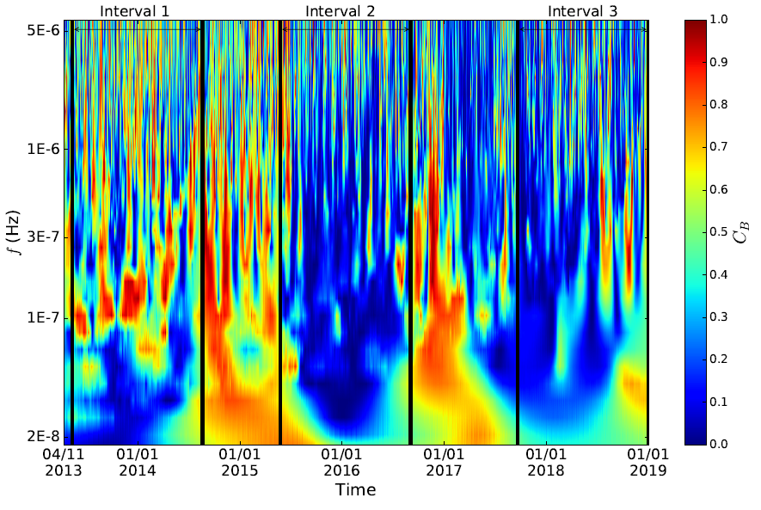
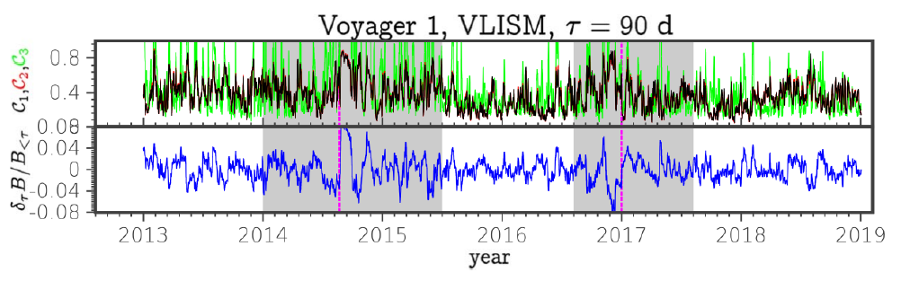
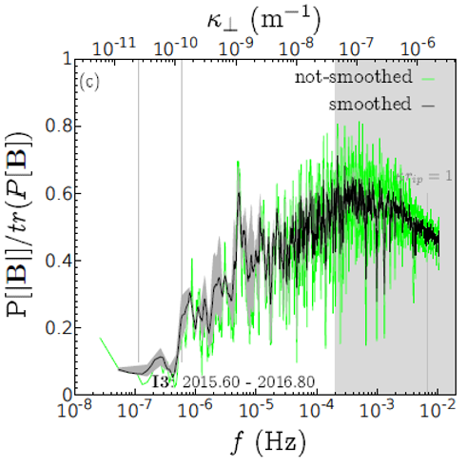
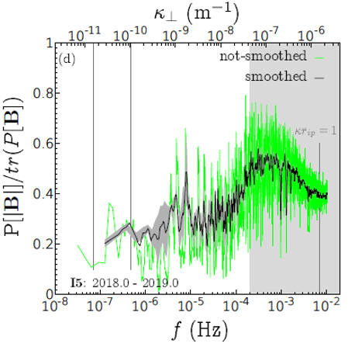
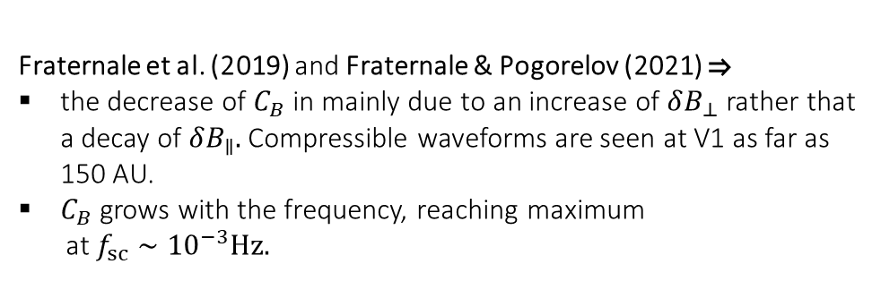
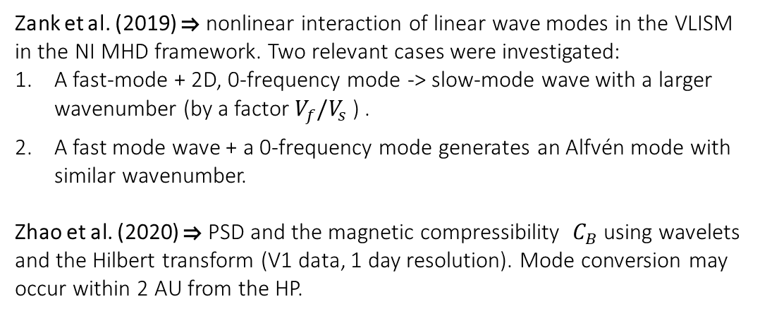
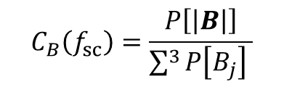
Turbulence in the VLISM
Zank et al. (2019)  nonlinear interaction of linear wave modes in the VLISM in the NI MHD framework. Two relevant cases were investigated:
A fast-mode + 2D, 0-frequency mode -> slow-mode wave with a larger wavenumber (by a factor $V_{f}/V_{s}$ ) .
A fast mode wave + a 0-frequency mode generates an Alfvén mode with similar wavenumber.
Zhao et al. (2020)  PSD and the magnetic compressibility $C_{B}$ using wavelets and the Hilbert transform (V1 data, 1 day resolution). Mode conversion may
occur within 2 AU from the HP.
Magnetic compressibility
Zhao et al. (2020)
$$C_{B}\left(f_{sc}\right)=\frac{P\left[\left|B\right|\right]}{\sum^{3}{P\left[B_{j}\right] }}$$
Fraternale et al. (2021)
Fraternale et al. (2019) and Fraternale & Pogorelov (2021) 
the decrease of $C_{B}$ in mainly due to an increase of $δB_{⊥}$rather that a decay of $δB_{∥}.$ Compressible waveforms are seen at V1 as far as 150 AU.
$C_{B}$ grows with the frequency, reaching maximum
at $f_{sc}∼{10}^{−3}Hz.$

Slide 15
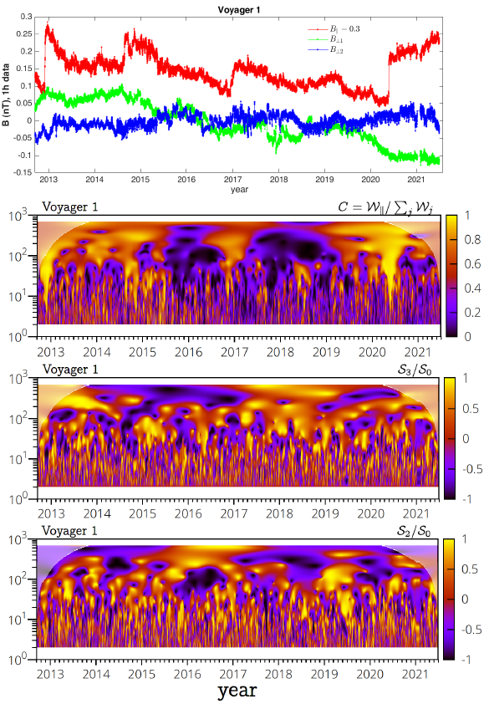
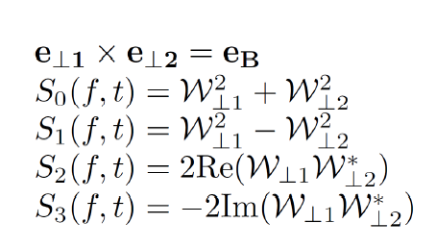

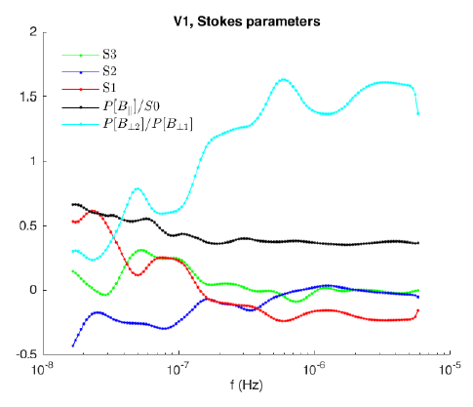
Wave polarization at V1 (Stokes parameters)
Fraternale et al.
AGU FM 2022
Perp energy.
Linear pol.
Linear pol.
Circular pol. (helicity)
Wavelet coefficients are rotated, at each scale, in the local, field aligned reference system. Below, the time average parameters for all VLISM data.
B2 (BN) is dominant both at V1 and at V2. It is the most intermittent component.

Slide 16
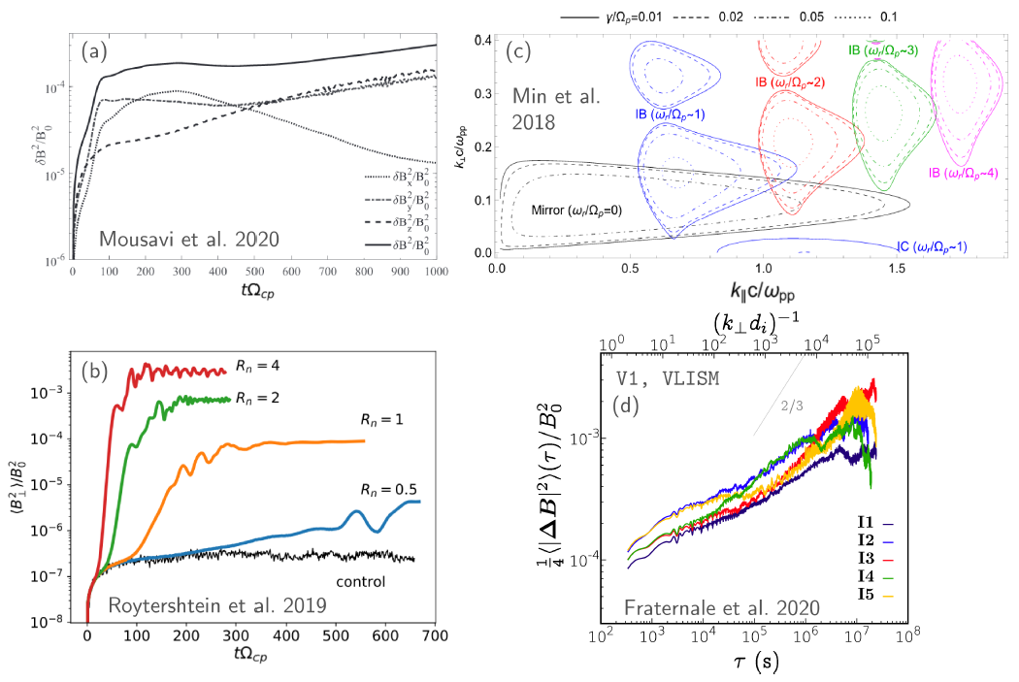
Turbulence in the VLISM: small scales
Kinetic processes: microinstability of PUI distributions
Models predict that the ring-beam distribution is subject to
a number of instabilities such as beam-driven Alfvén ion-cyclotron (AIC), mirror and ion Bernstein (IB), magnetosonic, ion-ion beam-core modes, reviewed by
(Gary, 1991, 1993; Gary et al., 1984).
Hybrid simulations and instability analysis have been presented, e.g., by Florinski et al. (2010); Summerlin et al. (2014); Florinski et al. (2016); Min and Liu (2018); Roytershteyn et al. (2019); Mousavi et al. (2020).
Open point: isotropization of PUI distributions (not achieved in kinetic simulations)
Did Voyager 1 detect signatures of such PUI-related microinstabilities?
Fraternale & Pogorelov 2021

Slide 17
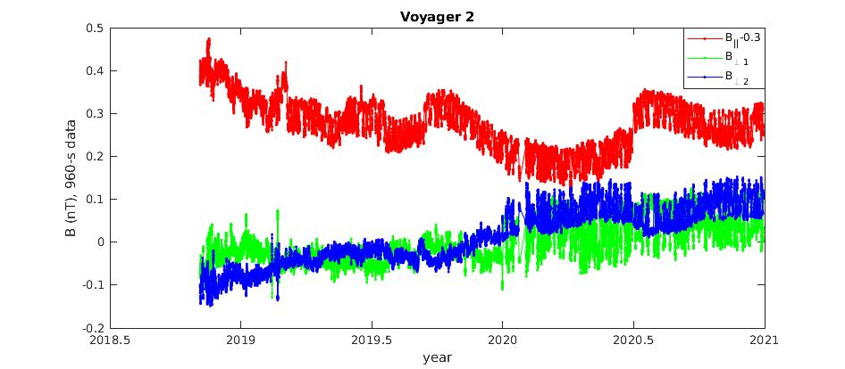
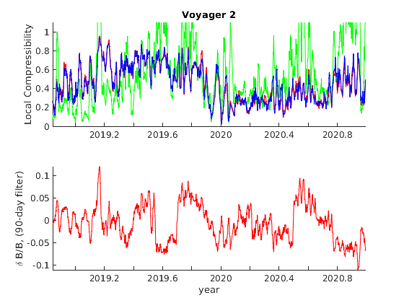
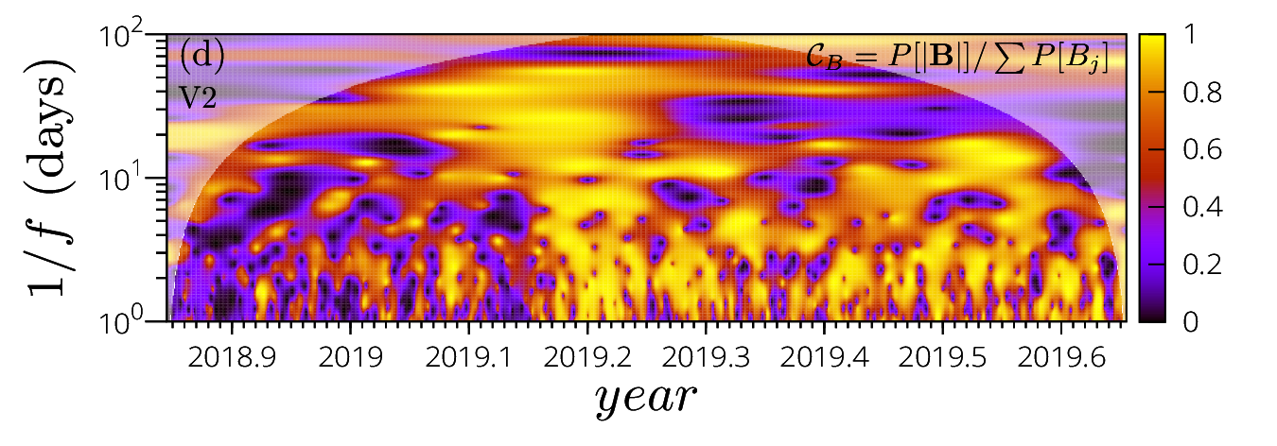
Magnetic field turbulence in the VLISM at V2
Fraternale et al.
AGU FM 2022
2019.398
2019.698
2020.495
What is the nature of the enhanced fluctuations at the 1-day scale, especially beyond 2020?
To date, issues associated with instrumental artifacts or the complex calibration process cannot be excluded. We note that these fluctuations affect intermittency at the intermediate scales discussed by Burlaga 2021, 2022. A rotation of the fluctuations is observed in 2020.0.
Possible physical explanations include the presence of mirror instability associated with temperature anisotropy, or instability of ion beams from shocks or from the HP.

Slide 18
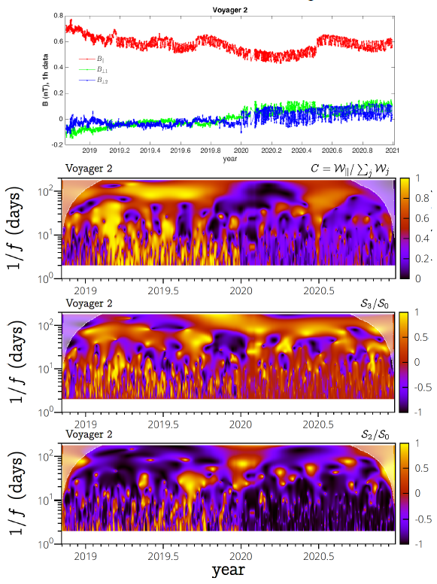
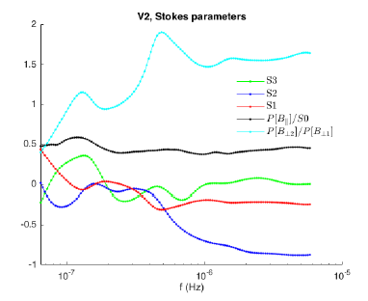
Wave polarization at V2 (Stokes parameters)
Fraternale et al.
AGU FM 2022
Perp energy.
Linear pol.
Linear pol.
Circular pol.
Wavelet coefficients are rotated, at each scale, in the local, field aligned reference system. Below, the time average parameters for all VLISM data.
Linear polarization
is dominant at the small scales (1-day)
Strong correlation between the perpendicular components is found

Slide 19
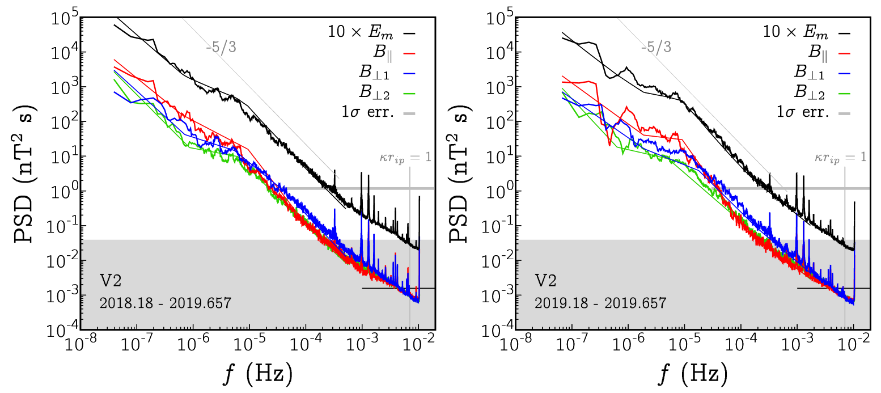
Magnetic field turbulence in the VLISM at V2
2018.84 -2019.0
2019.0 -2019.657
Fraternale et al.
AGU FM 2022
Presence of compressible waves in the range f<10-5 Hz.
A spectral plateau and a break at 10⁻⁵ Hz are present – unlike at Voyager 1.

Slide 20
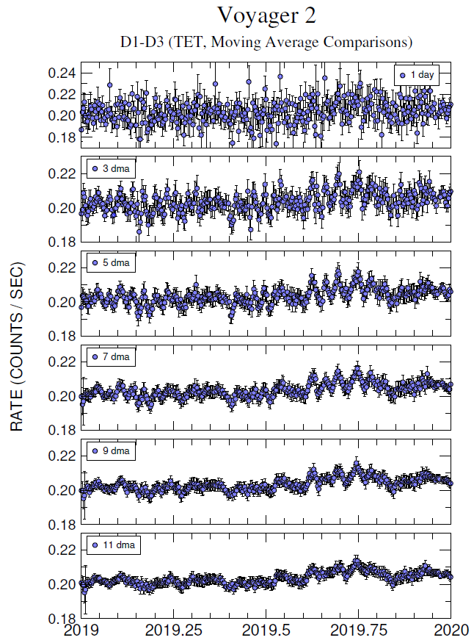
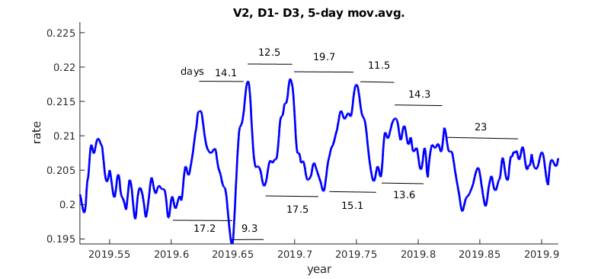
Quasi periodic behavior of electron GCR rates in the VLISM
Analysis of electron GCR count rates (TET Electron Telescope: TAN rate and range rates D1-D2,..,D1-D6) suggests the presence of quasi-periodic fluctuations in the VLISM.
First event observed: an enhancement of fluctuations during ~2019.0-2019.2 and ~ 2019.6-2019.85 in the D1-D3 rate at V2 (5.3-13.2 MeV).
The moving-average analysis reveals a quasi-periodic behavior with the average periodicity of ~14 days.
Courtesy of A. C. Cummings and the CRS team

Slide 21
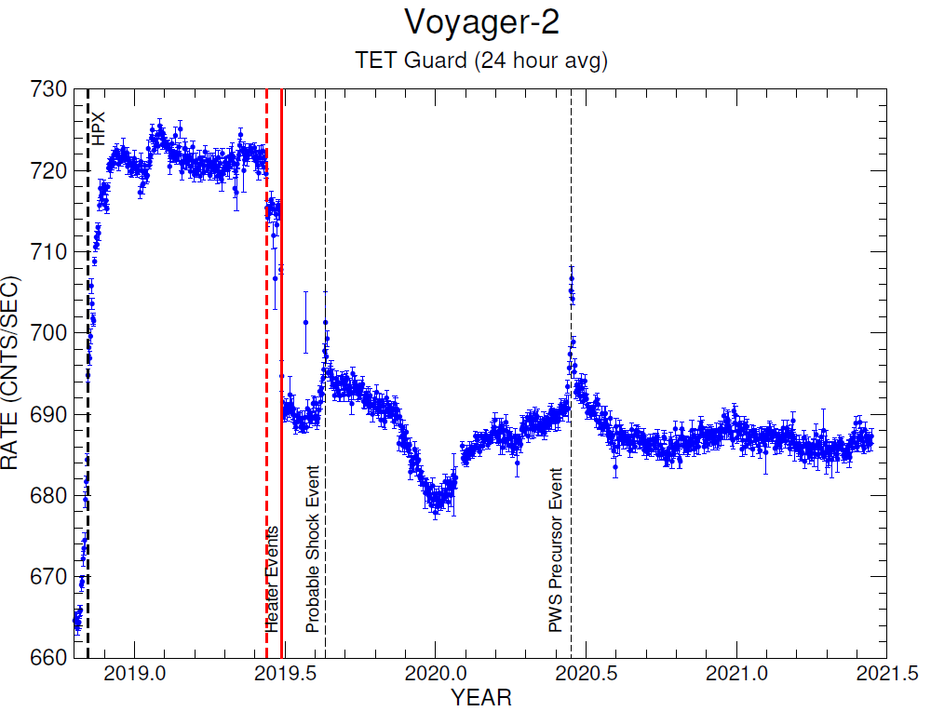
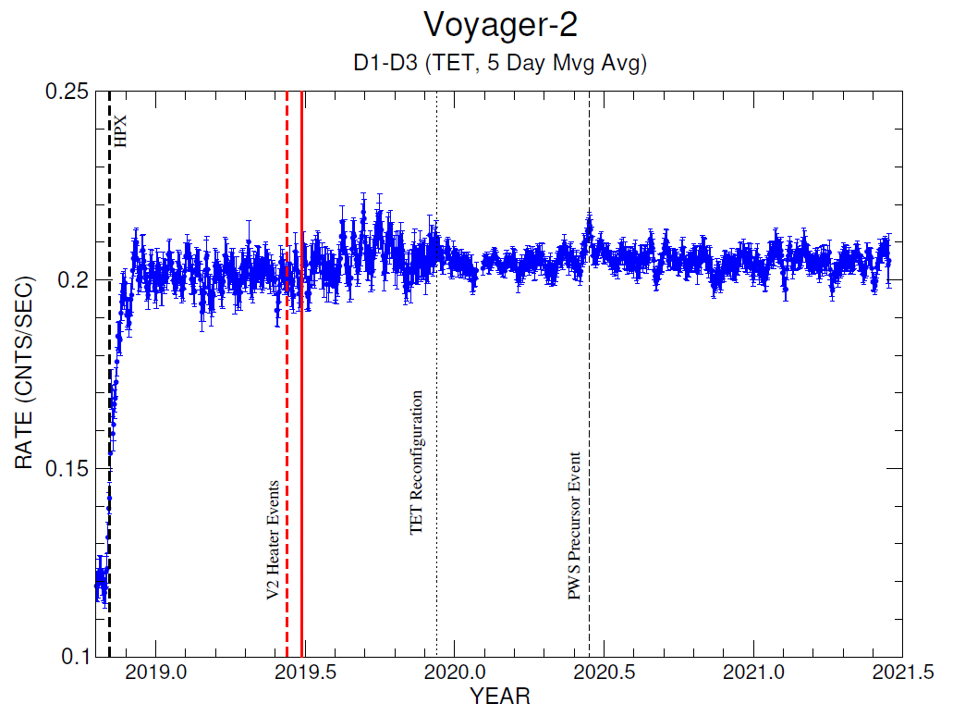
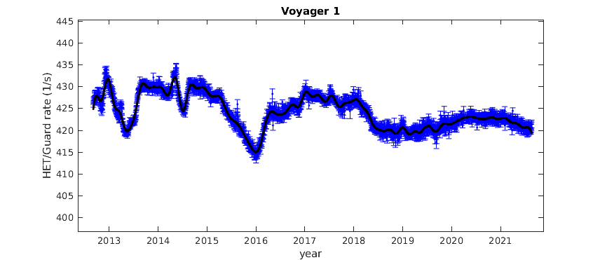
Quasi periodic behavior of electron GCR rates in the VLISM
Heater events:
Courtesy of B. Heikkiala
# At V2: CRS Replacement Heater Turned OFF and Supplemental Heater Turned ON: DOY 160.1/2019
# At V2: CRS Supplemental Heater Turned OFF: DOY 178.05/2019
# At V1: CRS Replacement Heater was turned OFF: DOY 138.95/2022

Slide 22





V1 electron and proton GCR rates in the VLISM
Fraternale, Cummings Pogorelov et al (in preparation)
Shock
Shock
Shock
To discriminate physical oscillations from statistical noise, we look for multiscale correlations/spectral coherence between CR Electron rates (TET/TAN), HET/Guard rates, and B.
Yellow bands show precursor shock-spikes identified by Rankin et al (2021)
$$P_{poisson}=\frac{2}{D<J>}$$
$$D=\frac{∑LT}{T_{tot}}$$
$$LT=\frac{counts}{J}$$

Slide 23

Fraternale, Cummings Pogorelov et al (in preparation)
Shock
Shock
Spectral behavior: Guard rate: f ⁻² spectral index (associated with GCR anisotropy related large scale fluctuations), and peaks associated with quasiperiodic oscillations. Flatter spectra are seen in electron GCR rates.
TAN/Guard spectral coherence is observed on several scales > 10 days

Slide 24

Fraternale, Cummings Pogorelov et al (in preparation)
A waveform with decaying amplitude is observed during 2015. The dominant periodicities are 10, 22, and 40 days.

Slide 25




Slide 26


V2 electron and proton GCR rates in the VLISM
Pois. Noise
estimate
Fraternale, Cummings Pogorelov et al (in preparation)
At V2 in the VLISM near the HP (until 2019.4), we also found a remarkable correlation between CR rates and fluctuations in B suggesting that compressible waves/turbulence may induce the CR oscillations.
The figure shows the normalized CR and B fluctuations from a low-passed signal (left), and the spectrogram (right)

Slide 27

V2 electron and proton GCR rates in the VLISM
Pois. Noise
estimate
Fraternale, Cummings Pogorelov et al (in preparation)
At V2 in the VLISM near the HP (until 2019.4), we also found a remarkable correlation between CR rates and fluctuations in B suggesting that compressible waves/turbulence may induce the CR oscillations.
The figure shows the normalized CR and B fluctuations from a low-passed signal (left), and the spectrogram (right)

Slide 28




Slide 29
Summary
Compressible ‘Turbulence’ observed in the VLISM (OHS) by Voyagers is forced by the motion of the HP, and includes coherent structures e.g. the N-waves possibly associaced with nonlinear steepening of compressible waves, and small scale features. The VLISM is not featureless on scales below the Coulomb collision mean free path.
We have proposed that the OHS turbulence may be described by a coherent cascade scenario with k⁻² spectral slope. The possibility for weak (wave) turbulence cascade should also be considered.
Magnetic turbulence at Voyager 2 shows significant differences from that at V1. In particular, a bulge of energy is seen at intermediate frequencies (10⁻⁶ – 10⁻⁵ Hz) due to enhanced fluctuations of unclear nature. They should be interpreted cautiously to exclude instrumental interferences or other artifacts.
Voyager/CRS obesrves quasi-periodic oscillations of electron and proton GCR count rates
We found a spectral coherence and occasional direct correlations (in the temporal frame), of the proton GCR rates (HET/Guard, dominated by >20 MeV protons) electron GCR rates (>3 MeV) observed by CRS. This may indicate the physical nature of electron and proton GCR fluctuations associated with compressible turbulence.
Further, spectral coherence is found between GCR rates and fluctuations in B in different intervals, in particular close to the HP. The B-GCR direct correlation is not observed at large distances from the HP, but the spectral coherence persists in recent data.

Slide 30





Small-scale turbulence in the VLSIM near a shock wave
From Fig. 8 in Gurnett et al., ApJ 809:121 (2015)
T
Distance from tangent point (T- a) $∼8−20$au, estimated from geometric considerations using a parabolic or spherical shock
${δP}_{m, rms}≈3.7×{ 10}^{−15}$Pa $≈0.2 ΔP_{m,S2}$, $M_{A, turb}=δb_{rms}/V_{A}≈0.03$ (can reach 0.1 for the largest perturbations)
Post-shock oscillations may originate from the interaction with upstream turbulence.
$$M_{f}≈1.2, V_{sh}≈40 km s^{−1}, θ_{Bn}≈65°$$
${r=n}_{2}/n_{1}≈B_{2}/B_{1}≈1.12$ $(n_{1}≈0.0873 cm^{−3})$
$w≈0.044 au \left(t_{V1}=3.3 days\right)$ shock thickness
The instantaneous shock structure can vary significantly!

Slide 31





Quasi periodic behavior of electron GCR rates in the VLISM
Uncertainty level
While spectral peaks above the 95% confidence level are found using a white noise for reference, using the Poisson noise model the confidence level drops below 80% (not good).
How to deal with this? We look at the CR proton rates from the HET telescope. In particular, we compare the Guard rate (IG1) of HET (proton dominated, E > 20 MeV) and the TAN rate (electrons, E>3 MeV)
$$P_{poisson}=\frac{2}{D<J>}$$
$$D=\frac{∑LT}{T_{tot}}$$
$$LT=\frac{counts}{J}$$

Slide 32


Quasi periodic behavior of electron GCR rates in the VLISM
T=11.6 days
T=14.4 days

