Slide 1
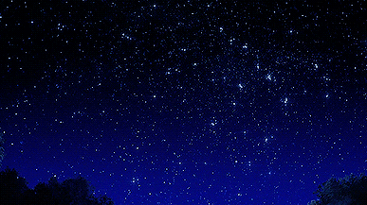
Cosmic ray diffusion
in anisotropic MHD turbulence
Siyao Xu, NASA Hubble Fellow
Institute for Advanced Study

Slide 2
MHD Turbulence
Star formation
Cosmic rays
Diffusion
& Acceleration
Driving
Ionization,
pressure
Acceleration
Notes:
CRs, turbulence, and star formation are connected to each other. Here we will focus on the relation between CRs and turbulence. It of course is affected by SF and also has important implications on star formation.

Slide 3
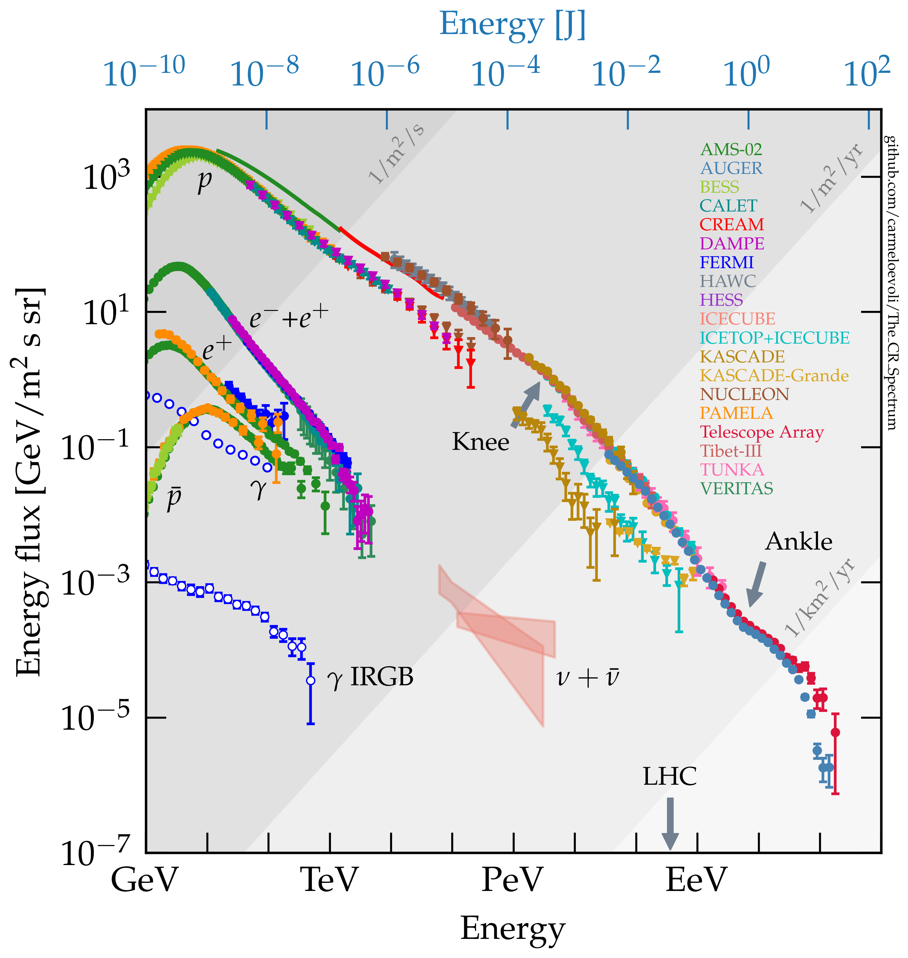
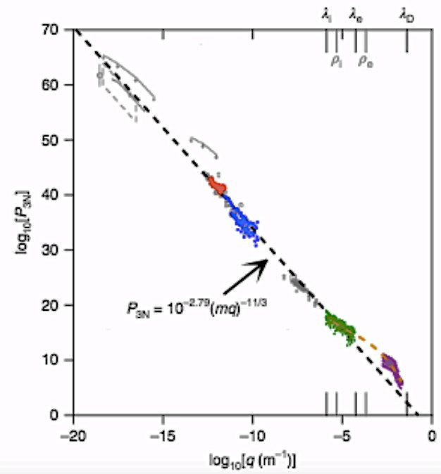
CRs and interstellar turbulence
Cosmic ray energy spectrum
Big Power Law of interstellar turbulence
50 m – 10¹⁷ m
Evoli 2020
10⁹ eV - 10²⁰ eV
Armstrong et al. 1995;
Chepurnov & Lazarian 2010;
Lee & Lee 2019
Kolmogorov
Notes:
Both CRs and turbulence have remarkable big power-laws. CR energies span over many orders of magnitude, with both Galactic and extragalactic origin. The Big power law of turbulence is measured in both the warm ISM and in the very local ISM by Voyager. It spans over 10 orders of magnitudes in length scales, showing the decreasing turbulent fluctuations with decreasing length scales, as a result of turbulent energy cascade from large to small scales.
Interstellar density fluctuations.
Not only interstellar magnetic fields are important for CRs.
Interstellar density fluctuations are also very important, which I will show later.
The interaction between the two is the big question we try to understand.
The interstellar turbulence only accounts for the diffusion of Galactic CRs
It’s not really correct to call them “two” big power laws
The data represent published results of the LEAP, Proton, Akeno, AGASA, Fly’s Eye, Haverah Park, and Yakutsk experiments.

Slide 4
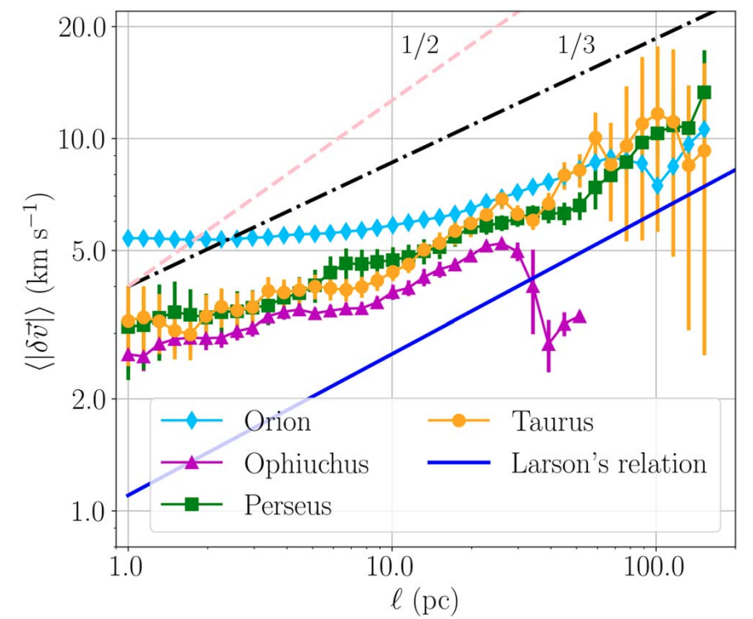
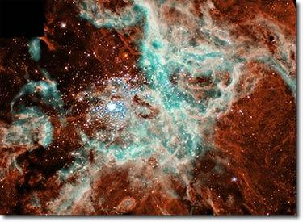
Turbulent motions of stars
Turbulent motions of young stars
Star formation in turbulent interstellar medium
Ha, Li, Xu et al. 2021; Ha, Li, Kounkel, Xu et al. 2022
Notes:
Not only turbulence plays an important role in star formation, we found that stars in star-forming regions have turbulent motions, inherited from the turbulent motions of gas that they form from.

Slide 5
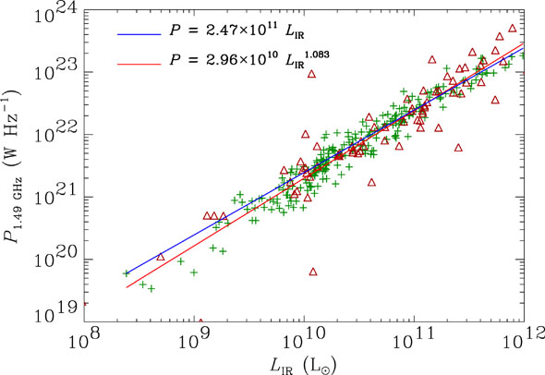
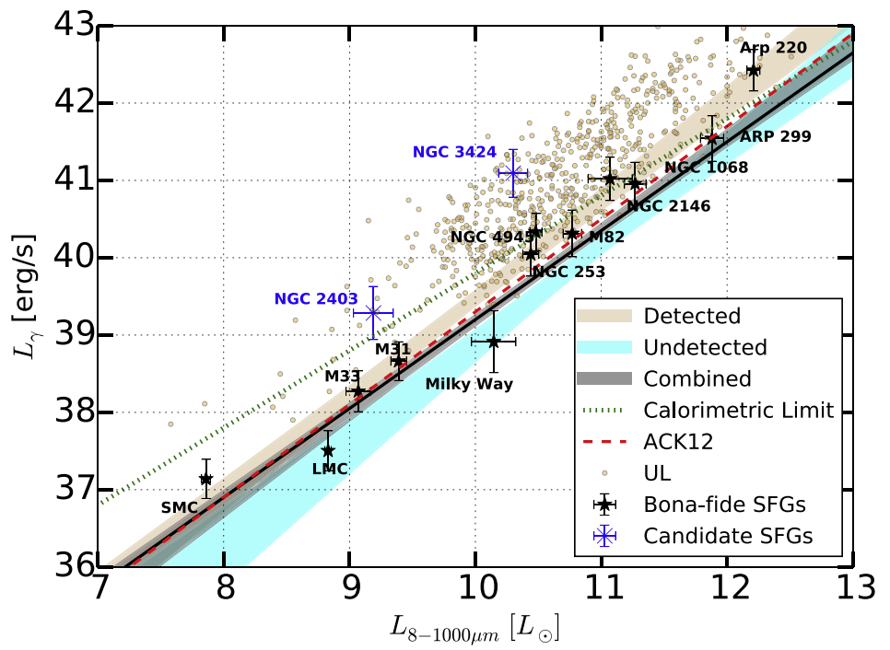
Strong correlation between CR diffusion and star formation
Gamma-ray vs. IR luminosities
for the star forming galaxies
Radio-infrared flux correlation
Dwek & Barker 2002
Ajello et al. 2020, Griffin et al. 2016
Notes:
CRs and star formation are known to be closely related to each other. Their close correlation can be clearly seen from the radio-IR flux correlation of star-forming galaxies left and gamma-ray-IR luminosities of star-forming galaxies right. the infrared emission arises from dust heated by the stars, and the radio emission is synchrotron radiation from relativistic electrons
the gamma-ray emission is generated by the interaction of high-energy CRs with the interstellar gas.
https://ned.ipac.caltech.edu/level5/March03/Dwek/paper.pdf
as both quantities are related to star formation activity
Using roughly 10 yr of γ-ray data taken by the Fermi Large Area Telescope, in this study we constrain the γ-ray properties of star-forming galaxies. We report the detection of 11 bona fide γ-ray-emitting galaxies and 2 candidates.
Cold phase
Star-forming galaxies produce gamma-rays primarily via pion production, resulting from inelastic collisions between cosmic-ray protons and the interstellar medium
The dense ISM and high star formation rates of luminous and ultra-luminous infrared galaxies (LIRGs and ULIRGs) imply that they should be strong gamma-ray emitters
Gamma-ray emission provides a sensitive probe of the cosmicray content of star-forming galaxies.
if the cosmic-ray escape time is much longer than tpp, then one expects a one-to-one linear relation between the gamma-ray luminosity and the star formation rate, as measured by the far-infrared luminosity or GHz radio continuum (RC) luminosity

Slide 6
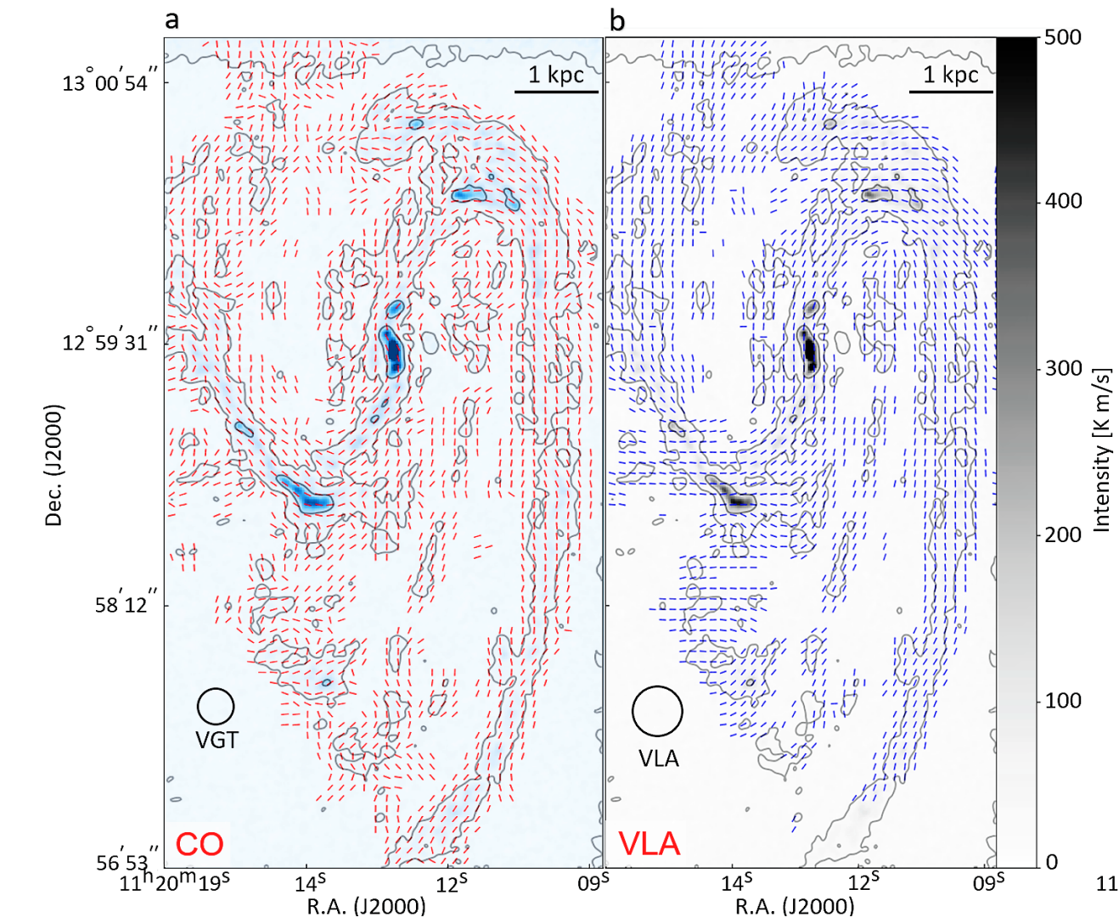
Magnetic fields traced by Gradient technique (MHD turbulence anisotropy) in CO and synchrotron emission
Liu, Hu, Lazarian, Xu, & Soida 2023

Slide 7
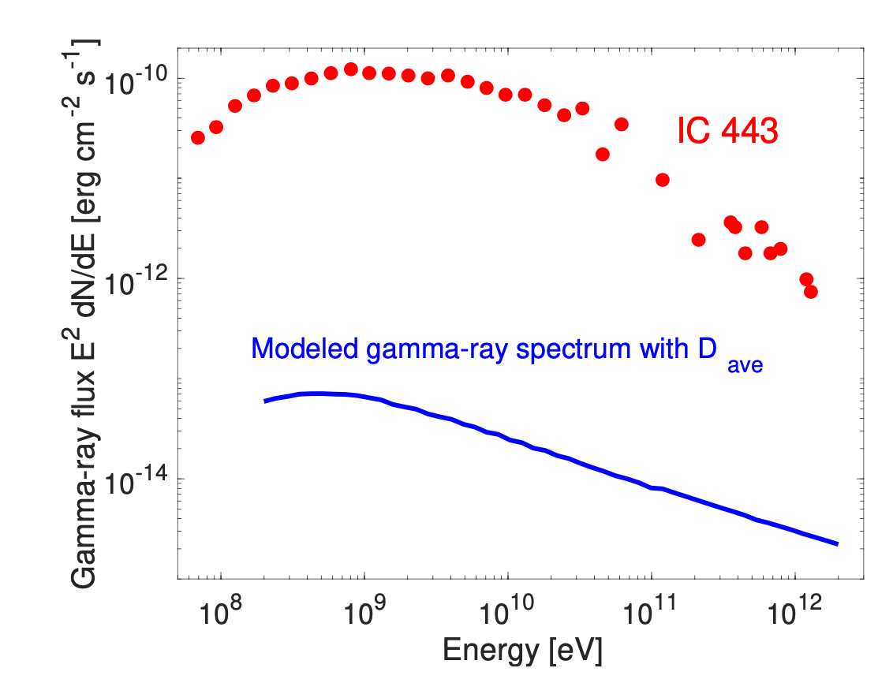
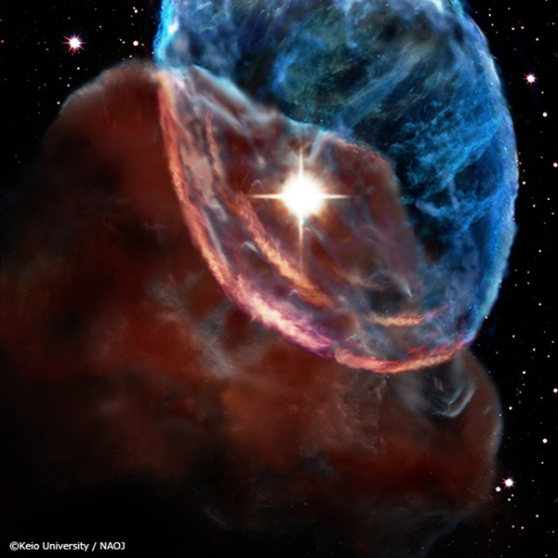
Suppressed diffusion of CRs in star-forming regions
Supernova shock – cloud interaction
Ackermann et al. 2013
Average Galactic diffusion coefficient
cannot explain gamma-ray observations

Slide 8
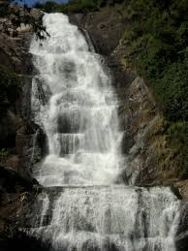
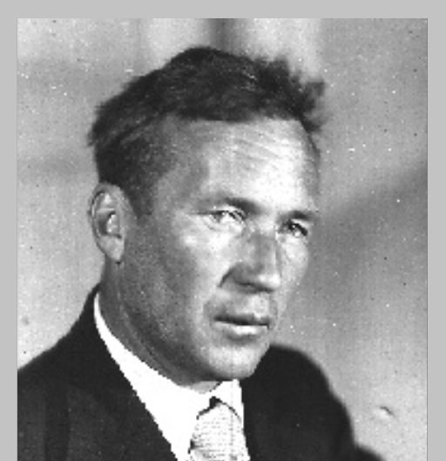
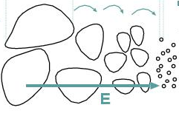
Kolmogorov turbulent energy spectrum
Energy injection
Energy dissipation
E(k)_{1D} ~ k^{-5/3}
Andrey Kolmogorov
(1903-1987)
ε=
L
l₀
Large scale
Small scale

Slide 9
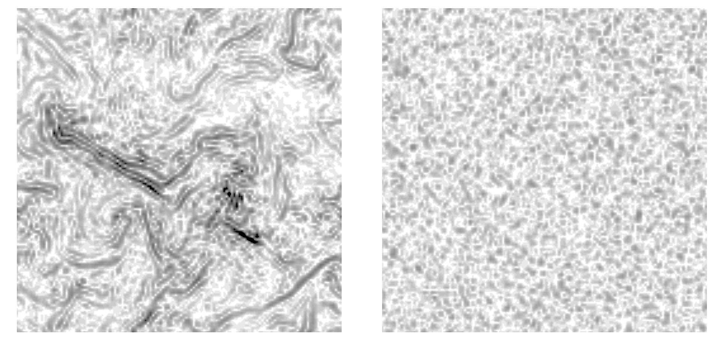
MHD turbulence is not an ensemble of waves
MHD turbulence
Waves
Maron & Goldreich 2001
Notes:
The left panels display magnitudes of the curls of upward- and downward- propagating shear Alfve􏰦 n and slow waves in a (x, y) slice at z \ 0 taken from simulation F5.

Slide 10
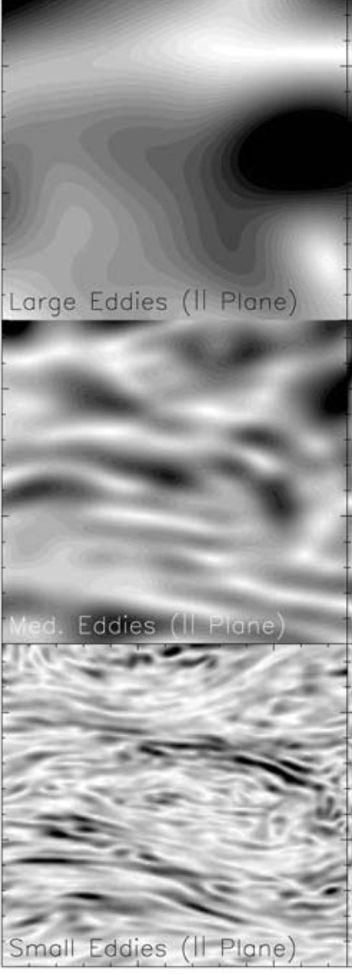
Anisotropic MHD turbulence
Energy injection
Energy dissipation
MHD turbulence
E(k)_{1D} ~ k^{-5/3}
Goldreich & Sridhar 1995;
Lazarian & Vishniac 1999;
Cho & Vishniac 2000;
Cho & Lazarian 2002
Scale-dependent anisotropy
L
l₀
Cho & Lazarian 2003
Large scale
Small scale

Slide 11
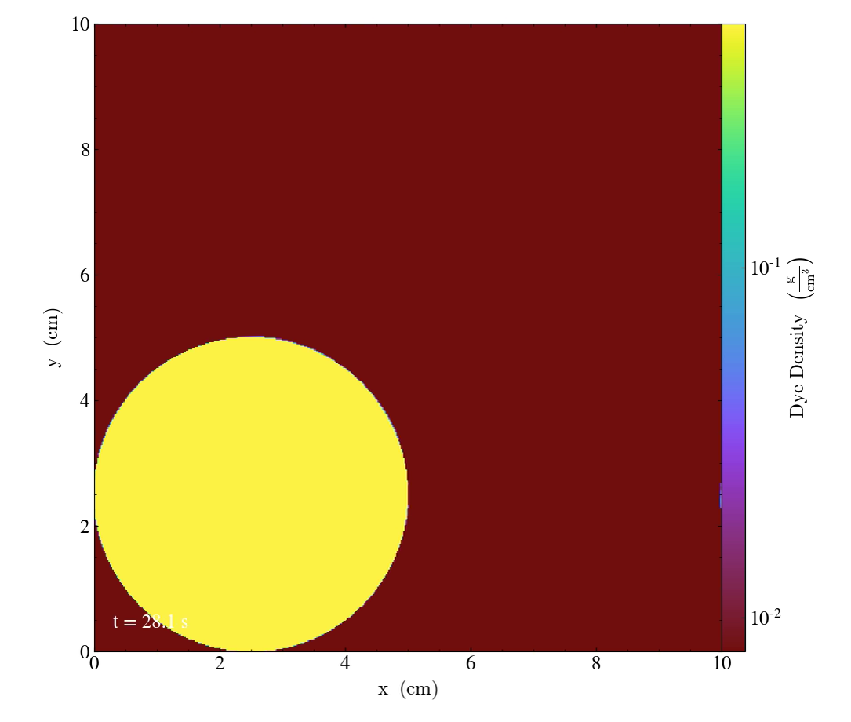

Anisotropic MHD turbulence
Xu et al. 2019
Notes:
Yellow color

Slide 12
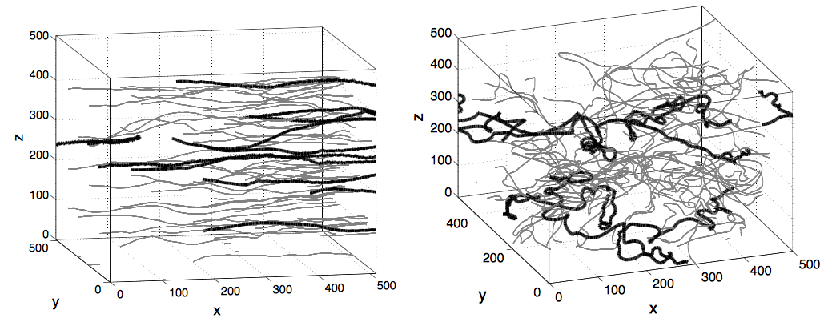
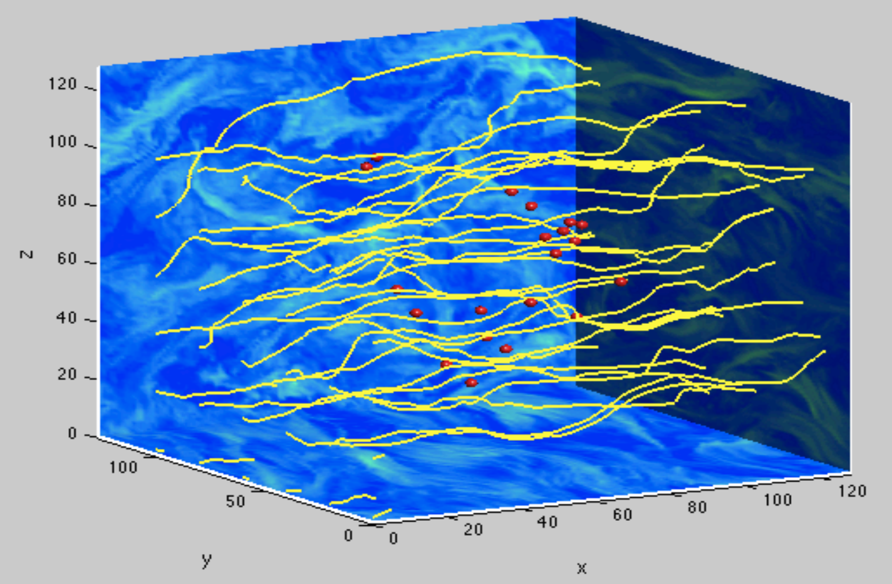
Diffusion of CRs depends on MHD turbulence
M_{A} < 1
Turbulence Alfven Mach number
M_{A} = V_{L} / V_{A}, V_{A} = B / $\sqrt{4πρ}$
M_{A} > 1
Xu & Yan 2013
Notes:
We can further quantify the strength of magnetic fluctuation by using physical parameter called Ma. It’s very difficult for turbulence to perturb magnetic fields, fluctuation is small. Turbulent energy overwhelms the magnetic energy….magnetic field is highly turbulent and magnetic fluctuation is larger. In simulations, by adjusting the value of Ma, we can control of level of magnetic fluctuation. Correspondingly, the diffusion behaviors of CRs that interact with magnetic fluctuations also varies.
To quantify the dependence….
We need a physical parameter to quantify the property of turbulent magnetic fields ….

Slide 13
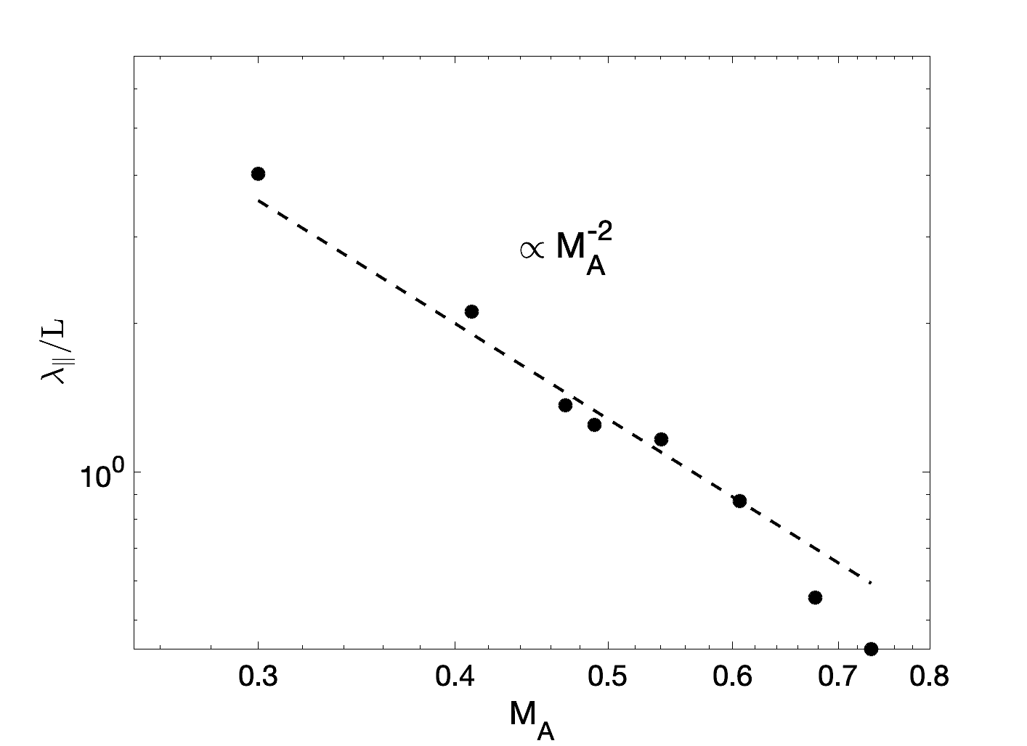
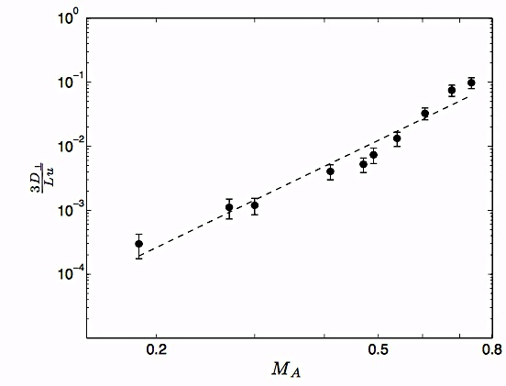

Diffusion of CRs depends on M_{A}
Diffusion parallel to magnetic field
Diffusion perpendicular to magnetic field
Xu & Yan 2013

Slide 14
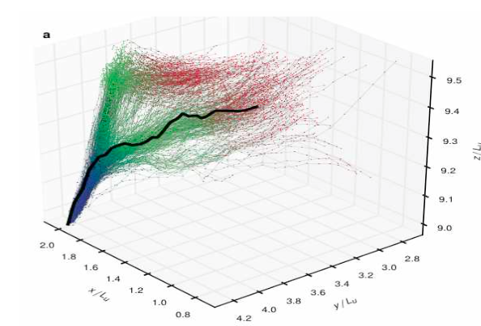
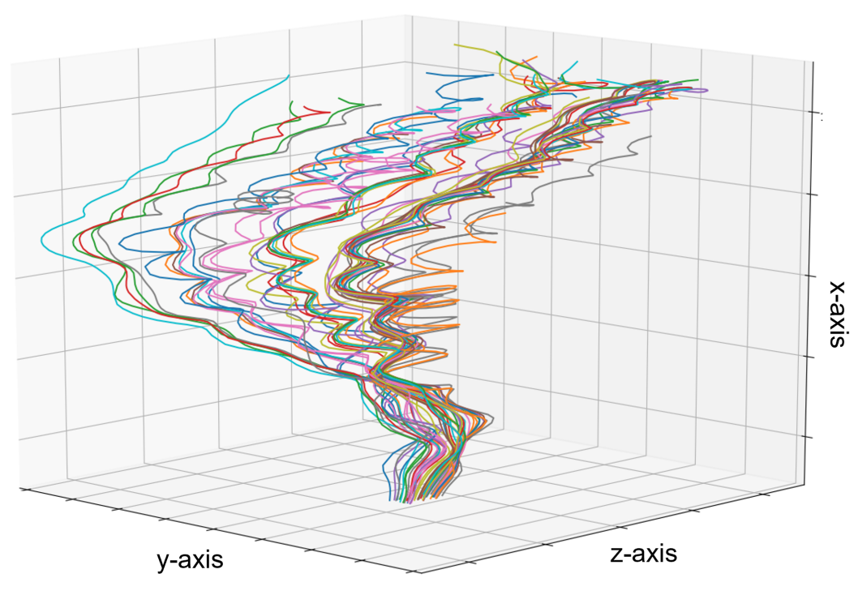
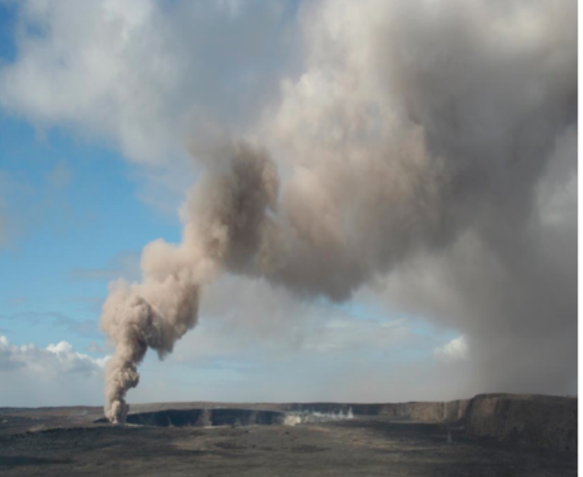
CR perpendicular diffusion
Eyink et al. 2013
Hu et al. 2022
turbulence
magnetic fields
CR particles
CR perpendicular diffusion comes from magnetic field perpendicular diffusion
Notes:
How about in the direction perpendicular to the magnetic field? Turbulent magnetic fields inherit inherit important properties of turbulence. When we observe the spread of smoke particles in turbulent atmosphere, we see a fast growth of the separation between a pair of smoke particles. For turbulent magnetic fields, we also see a similar fast growth of the separation between a pair of field lines. For CR particles in turbulent magnetic fields, we also see a similar fast growth of separation between a pair of CR particles in the direction perp to B. Here the colored lines show the trajectories of CRs. And the mean magnetic field is in vertical direction.
Anisotropic diffusion in anisotropic MHD turbulence
Without a propert model of MHD turbulence, one would not be able to get proper descriptin of Diffusion and proper scaling with MA

Slide 15
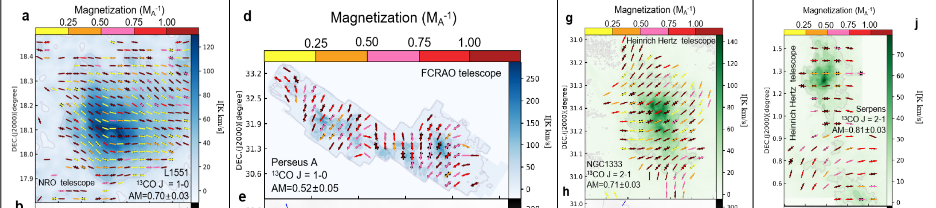
M_{A} dependent CR diffusion coefficients
M_{A} measured by Gradient Technique (MHD turbulence anisotropy)
Self-consistently determine
CR diffusion coefficients in star-forming regions
Hu et al. 2019

Slide 16

Compressible MHD turbulence
Incompressible turbulence
Compressible turbulence
Xu et al. 2019
Suoqing Ji
Notes:
Yellow color

Slide 17
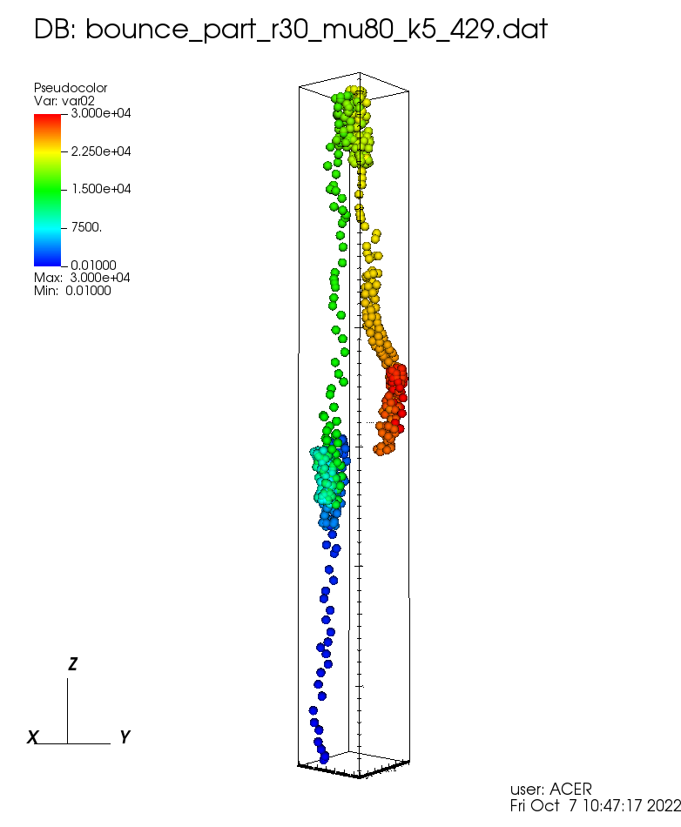
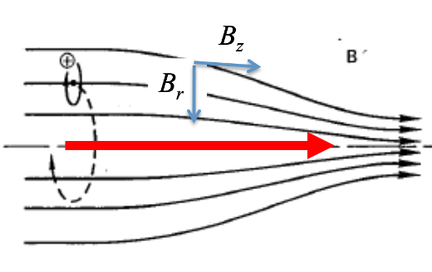
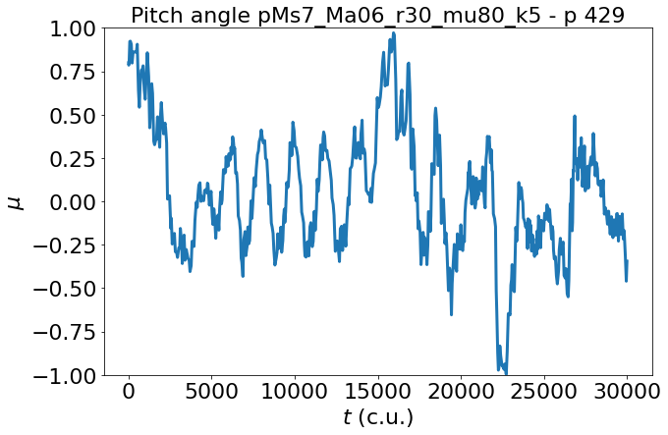
Mirror diffusion of CRs
Mirror trapping
Lazarian & Xu 2021;
dos Santos et al. in prep
Notes:
Magnetic mirror which can reflect particle back to the weak field region.

Slide 18
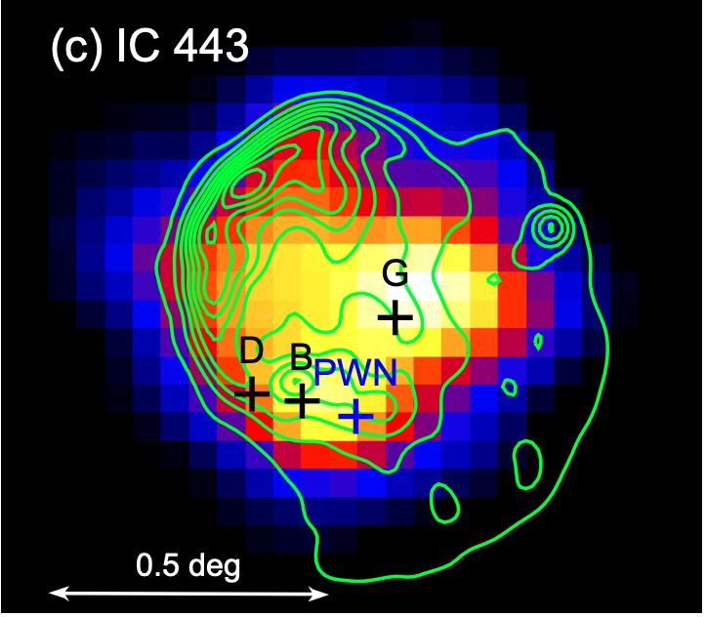
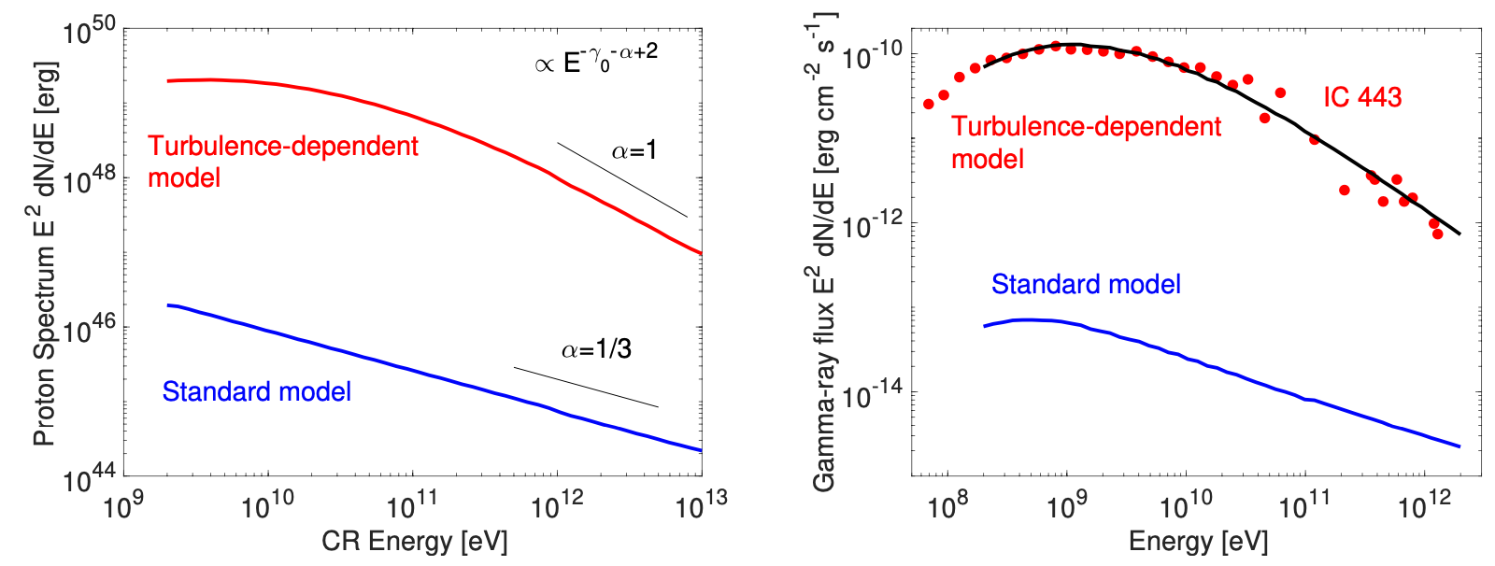
CR diffusion near mid-age supernova remnants
Mirror diffusion near SNRs
Uchiyama & Fermi LAT
Collaboration 2010
CR proton spectrum
Gamma-ray spectrum
Mirror diffusion
Mirror diffusion
Xu 2021
Notes:
Examples on turbulence-dependent diffusion of CR and its applications to gamma-ray observations.
The Runaway CR model considers γ-ray emission from molecular clouds illuminated by runaway CRs that have escaped from their accelerators [21 – 23]. CR particles released by a remnant diffuse into interstellar space with an energy-dependent diffusion coefficient, and collide with massive clouds producing γ-ray photons via π 0 -decay (by CR hadrons) and bremsstrahlung (by CR electrons) channels.
How wrong one could be if ….

Slide 19
Summary
Strong correlation between CRs and star formation
Both CR parallel diffusion and perpendicular diffusion strongly depends on MHD turbulence
Anisotropy of CR diffusion depends on anisotropy of MHD turbulence
By combining with M_{A} measurements with Gradient Technique, we can self-consistently determine CR diffusion coefficients in star-forming regions
Mirror diffusion is important for understanding non-thermal emission in star-forming regions

